Slide 1
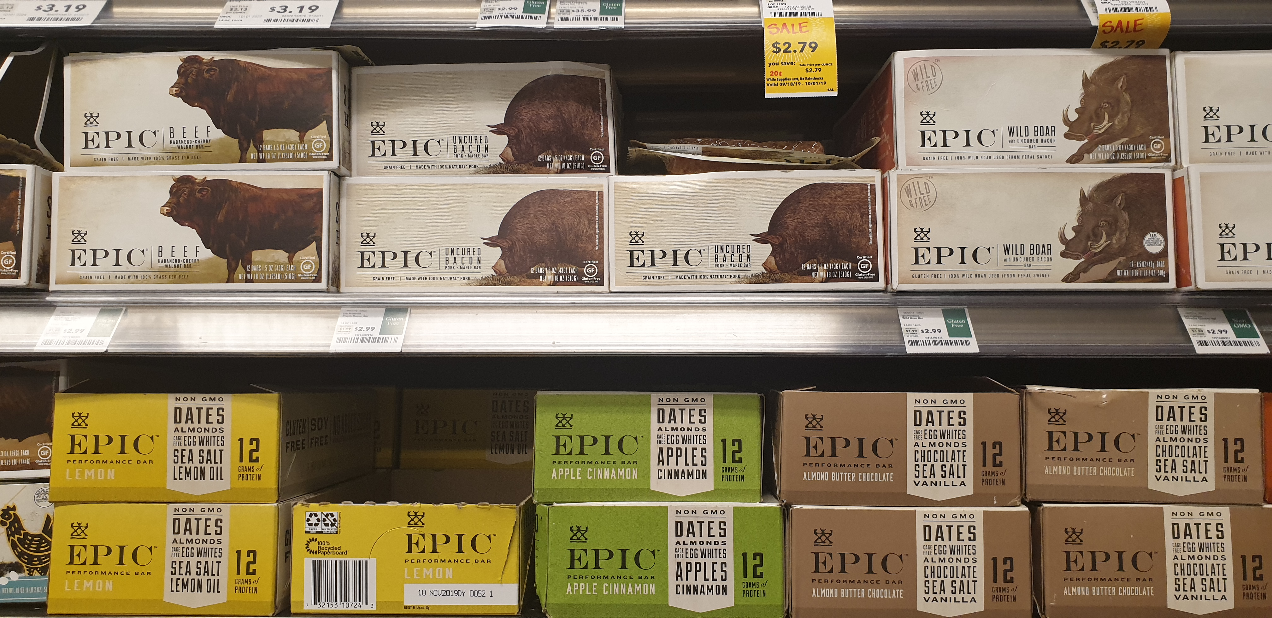
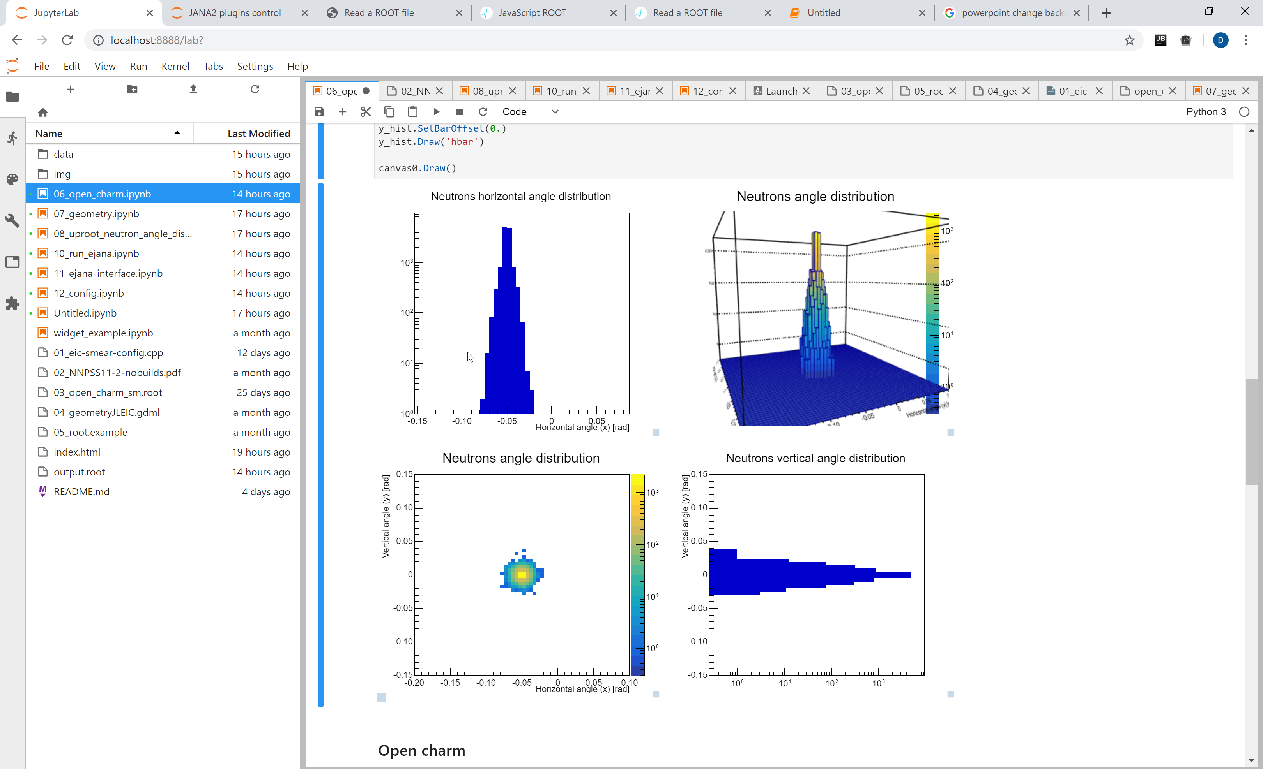
Entry point for EIC software
EPIC NEWS!
Dmitry Romanov

Slide 2
Start the docker
docker @ eicdev/epic
Cloud
Containers
Farms (BNL, Jlab, Argon)
Conda
Workstation Compilation EJPM
Main accent now
The proposed next accent

Slide 3
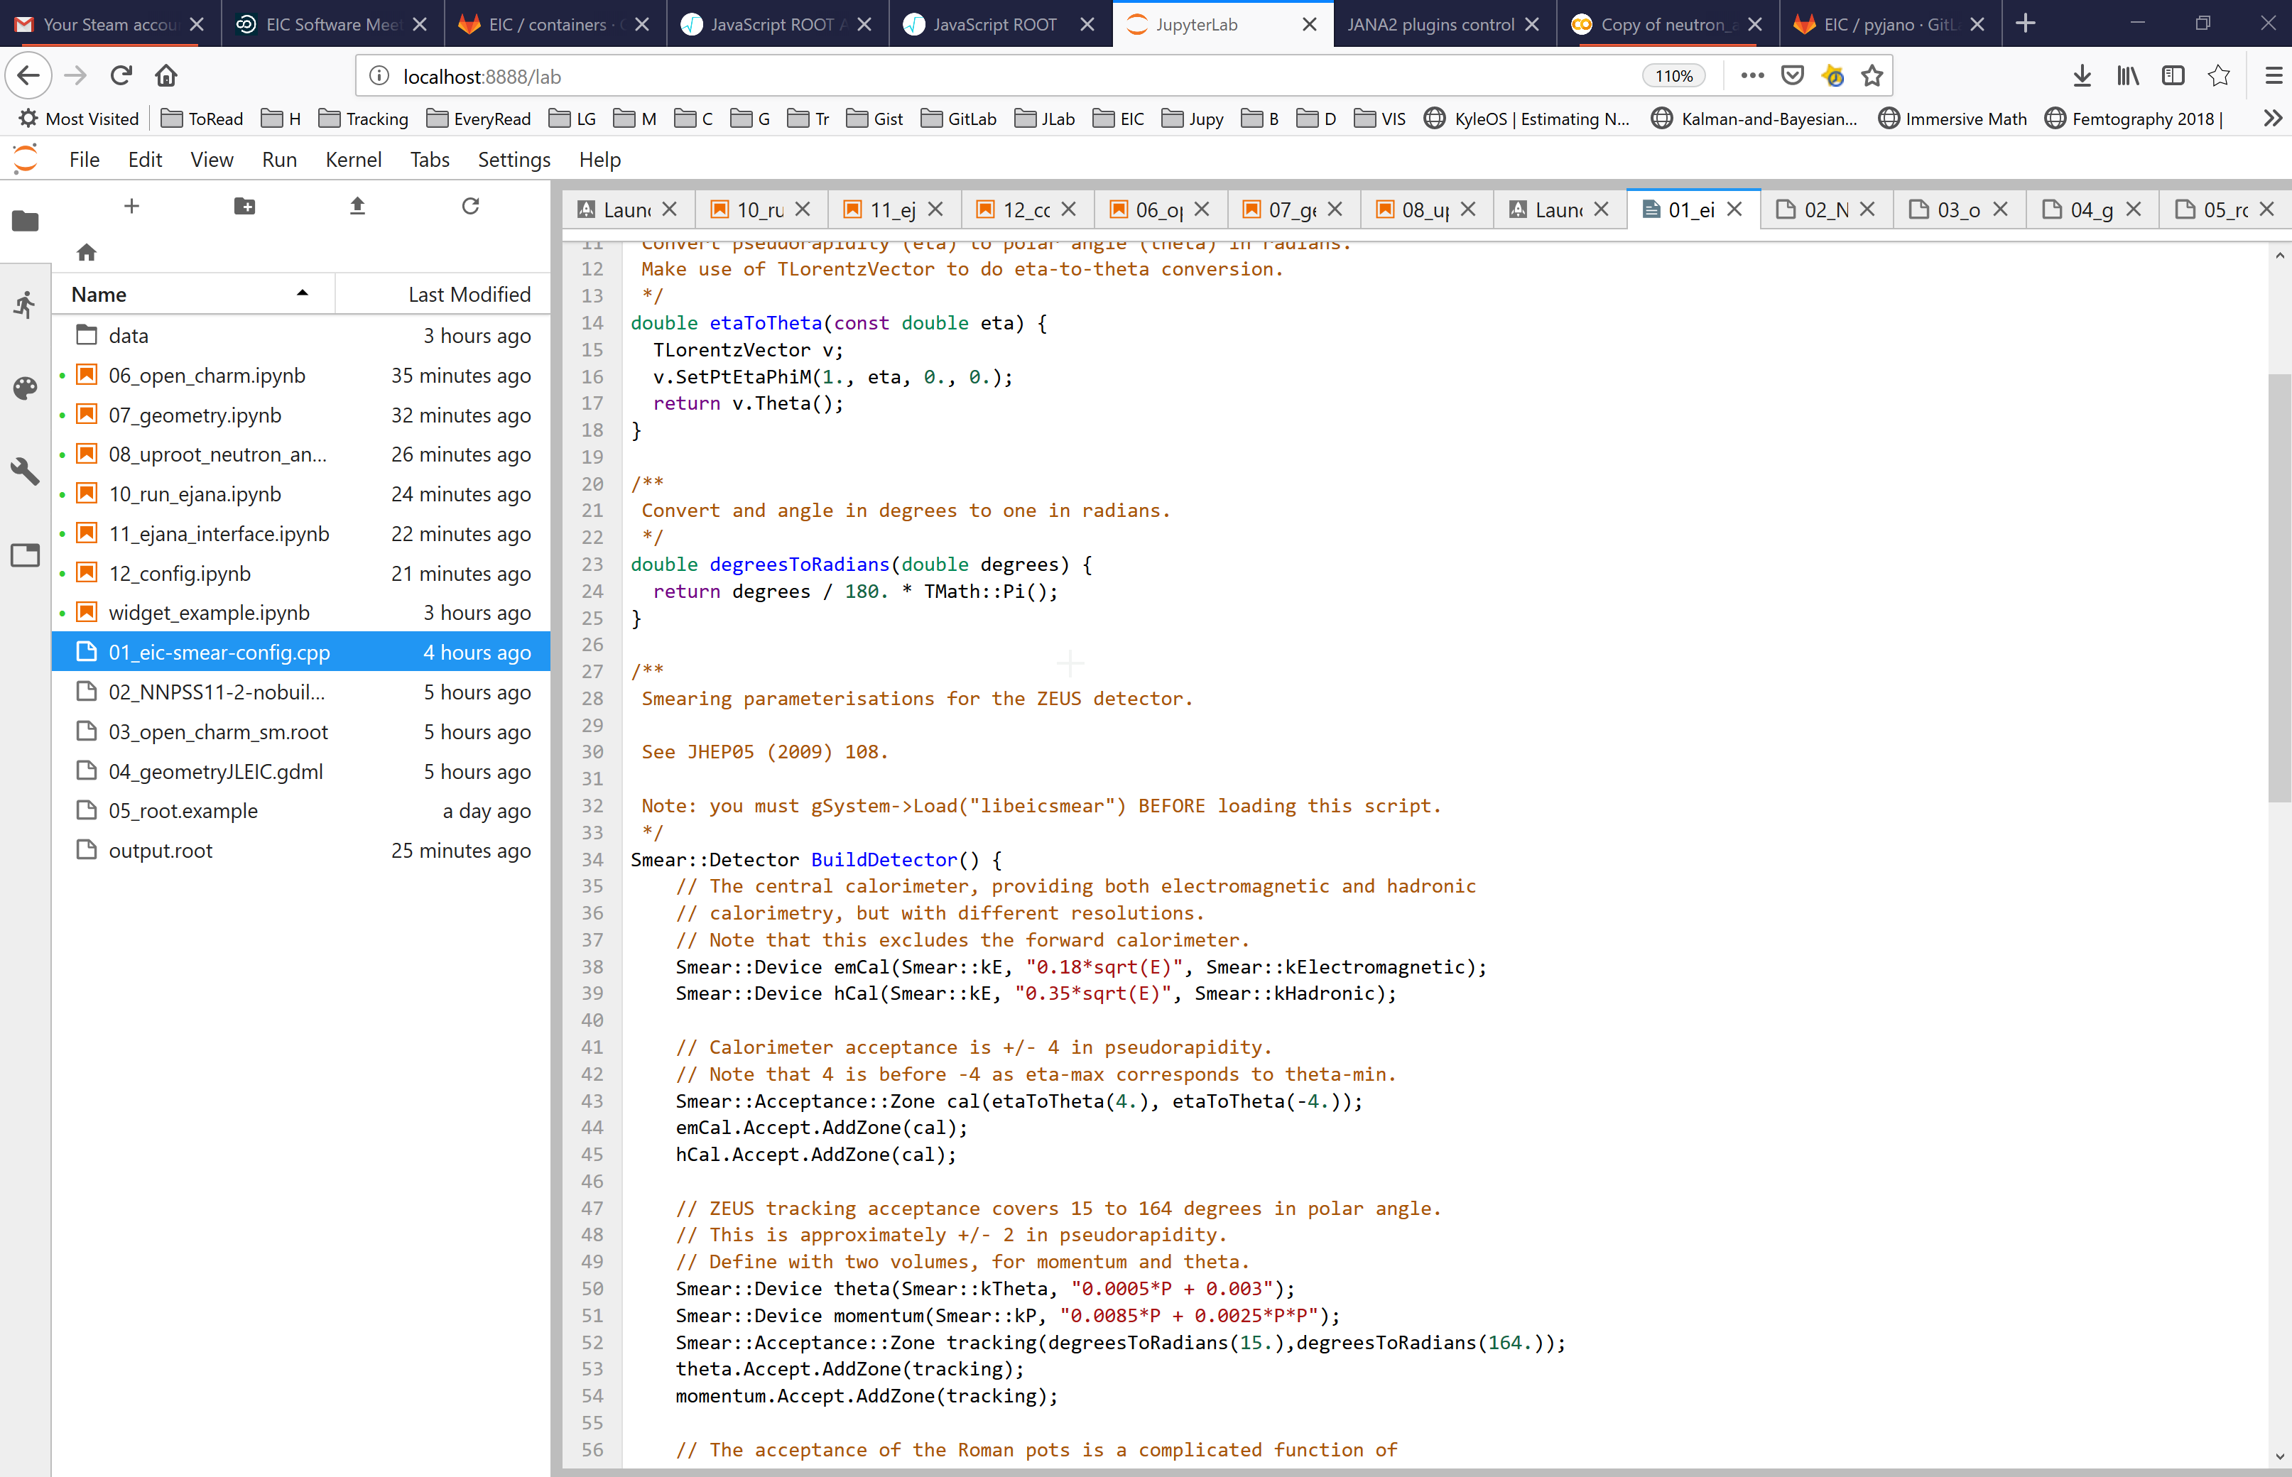
Interact with code

Slide 4
Eve7 root7 event display

Slide 5
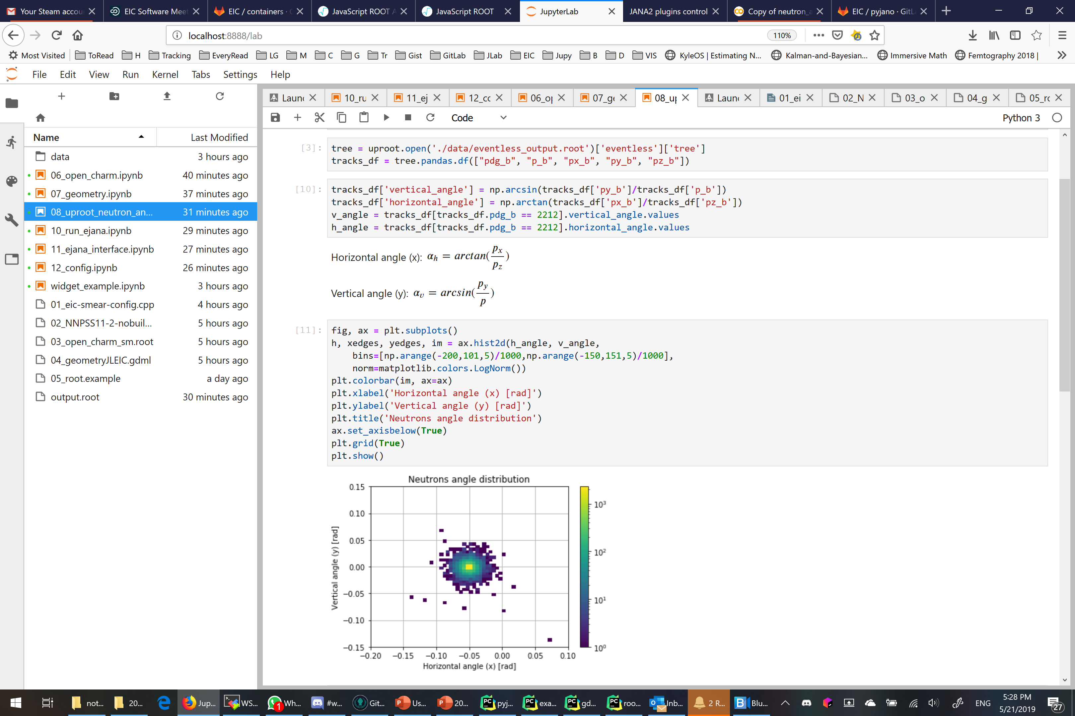
Jupyter notebooks

Slide 6
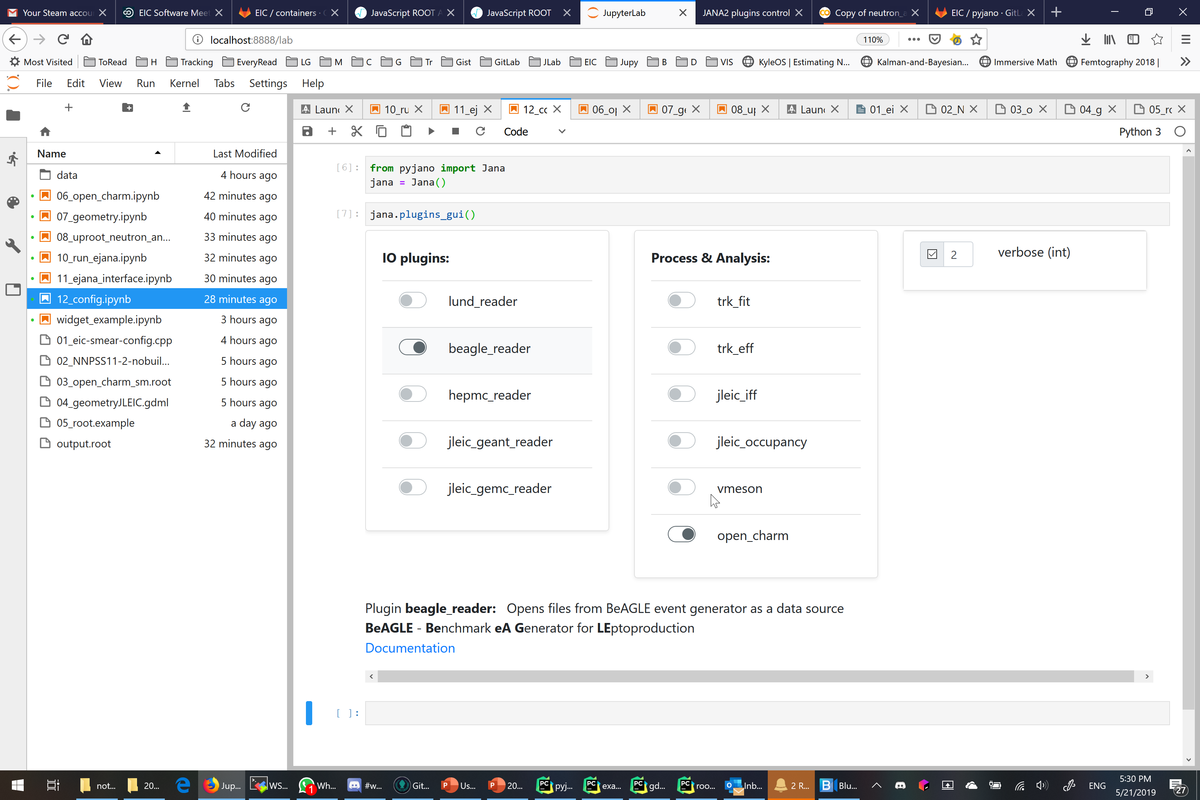
Interactive vidgets

Slide 7
Workflow oriented
OSG, farms
Configuration
Run (sim, recon, analysis)
Introspect results
Tamper with code

Slide 8
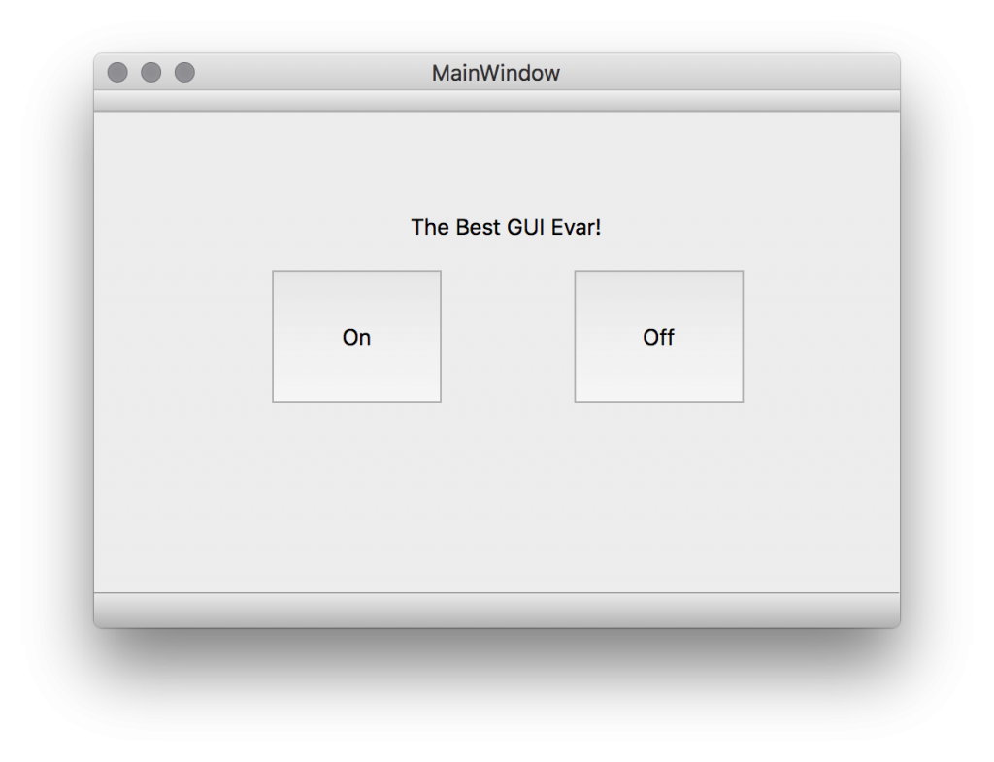
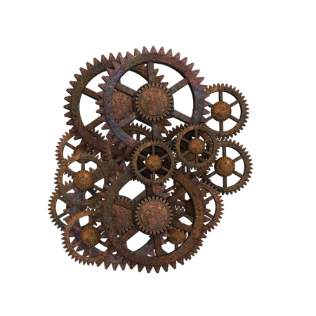
Do we hide complexity?
Jupyter lab, GUI,
Python, scripts, analysis
C++, eJANA, plugins, g4e
JANA, eic-smear, ROOT, Geant4

Slide 9
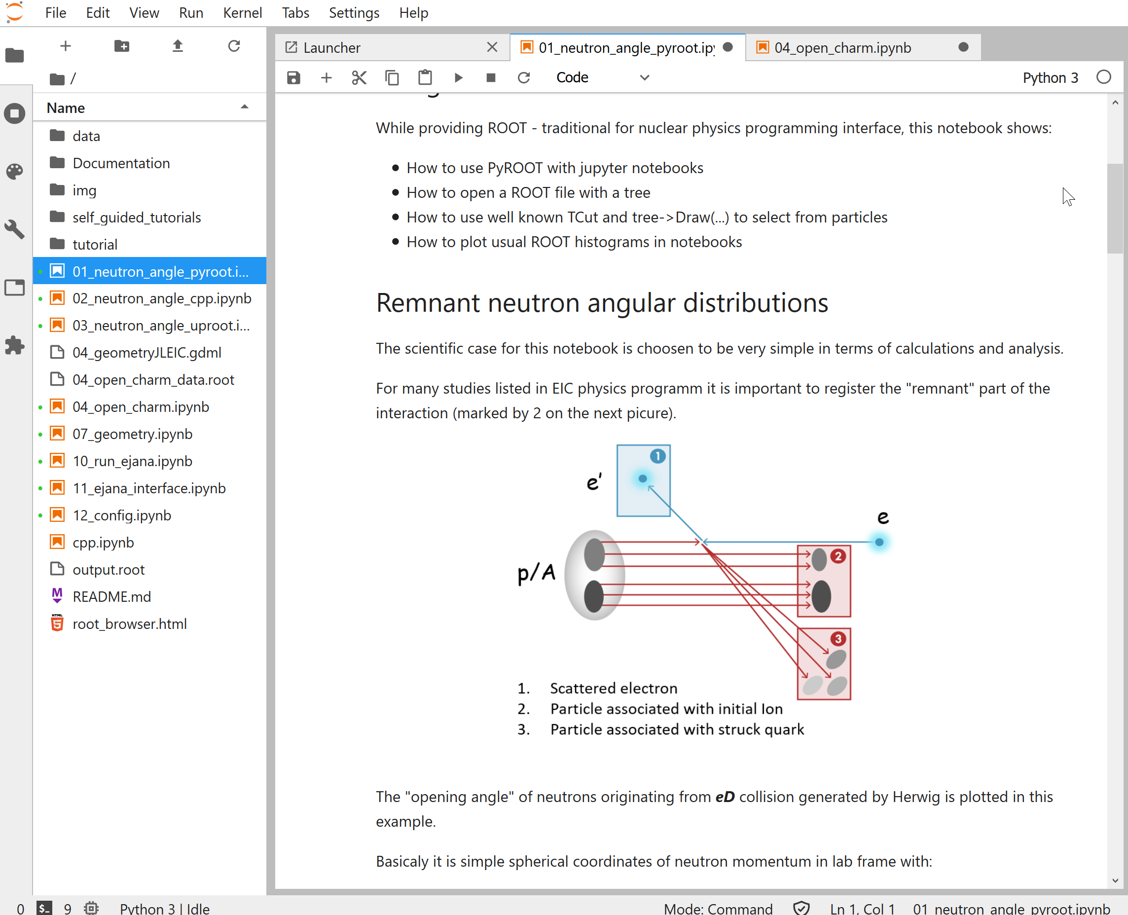
EPIC Goals
Be a common software environment for EIC User Group community
Be a software “entry point” for EICUG in terms of:
documentation,
tutorials,
availability
workflow oriented
Joint effort of JLab and BNL
Be a medium for the Physics Detector Handbook

Slide 10
Where jupyter + data science shines
Very good for final analysis
Root + notebooks, PyROOT, introspecting root files, etc. are supported (for those, who would like good’n’old root analysis)
Modern data science tools, uproot, panas, dusk and plotly are there too
Very good at documentation, common tutorials and examples
Collaborative work, easy publishing (easy to start and distribute on clouds, remote, dockers, etc. Plots in repos)
Latex is supported. (i.e. it is a good medium not only for notebooks, but not interactive notes/articles in general)
Tools for workflow and management

Slide 11
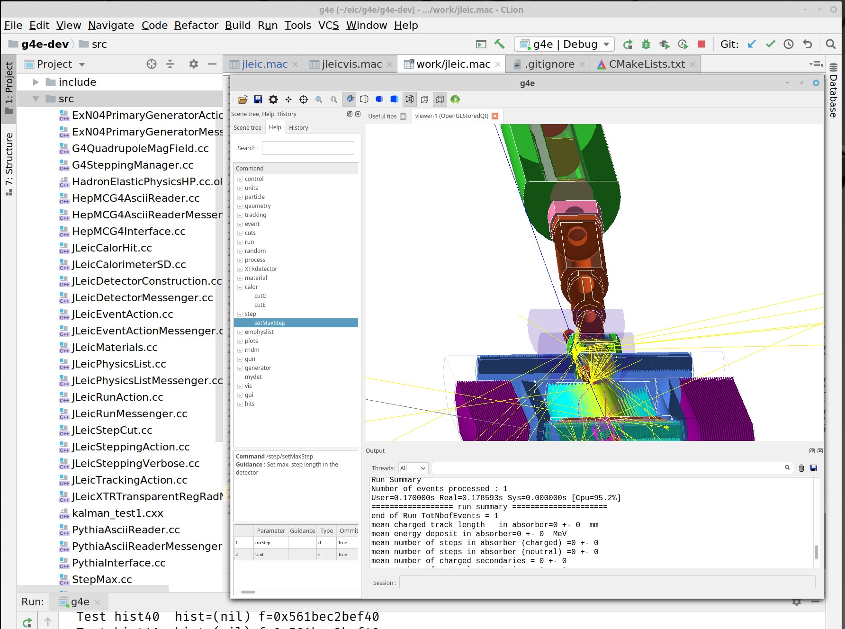
Workflow
VS

Slide 12
“What we’re seeing is that by lowering that barrier and by producing a tool that is very close to the natural workflow, it makes it sort of easy to do the right thing,” © Fernando Perez, - A research scientist at UC Berkeley - One of the founders of the Berkeley Institute for Data Science. - Creator of the original IPython in 2001

Slide 13
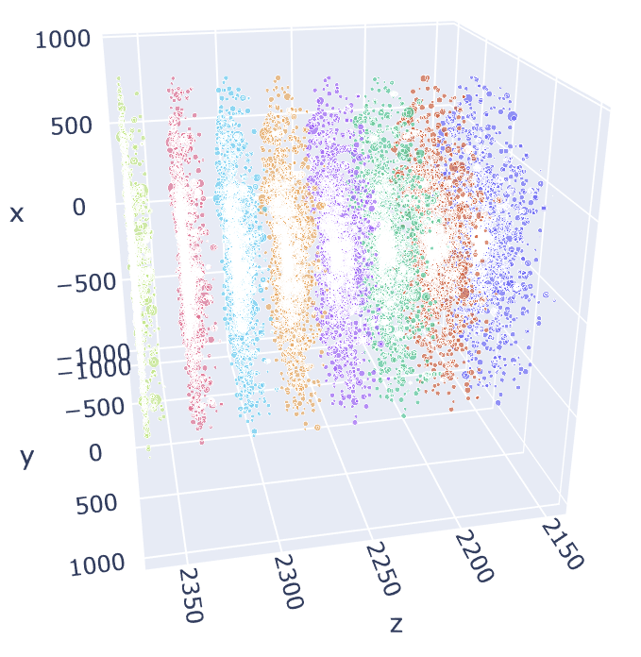
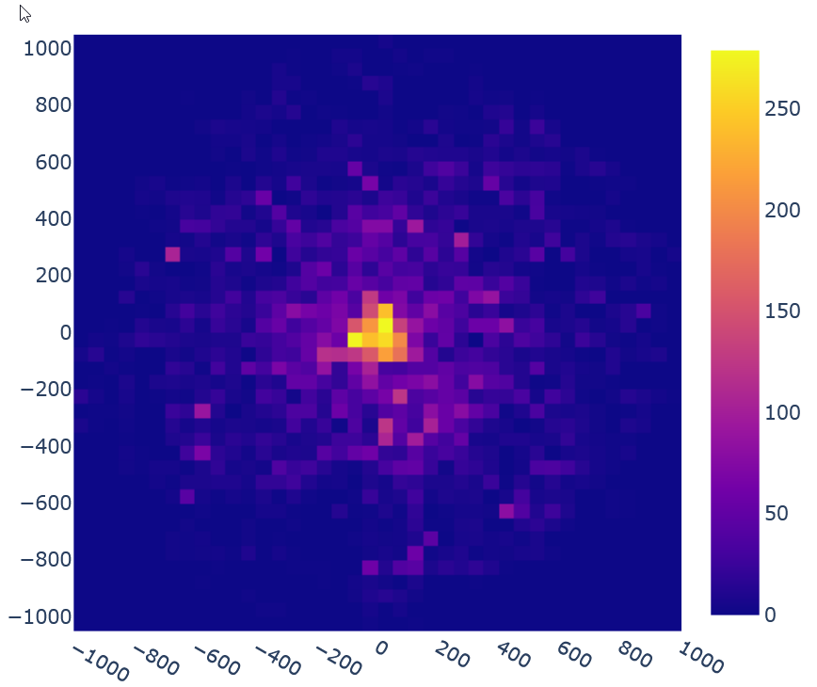
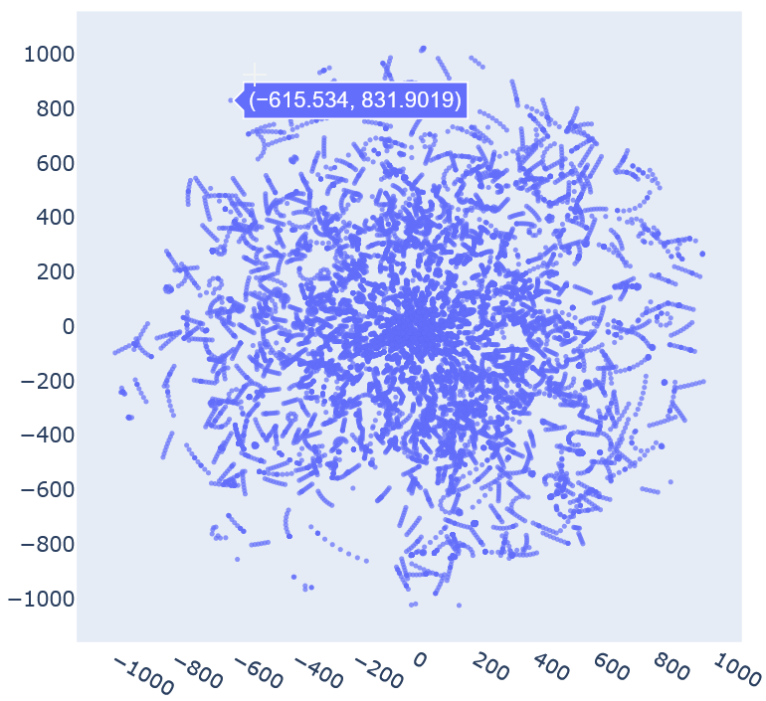
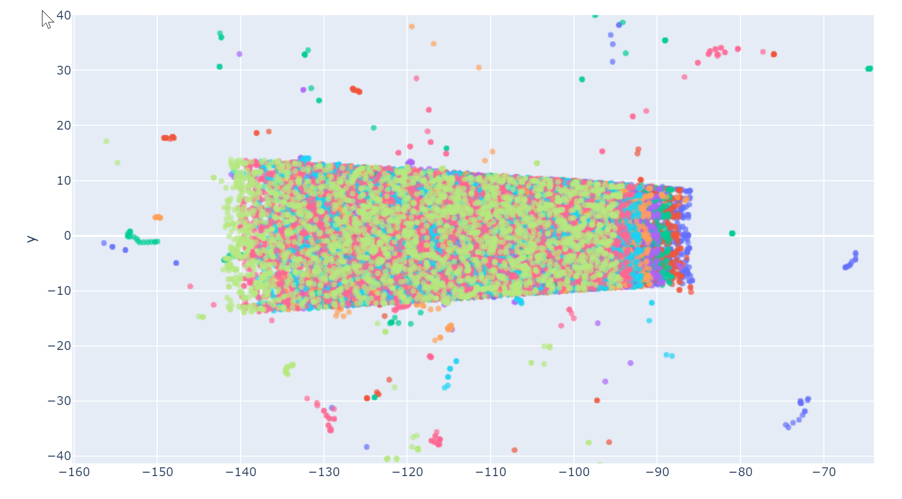
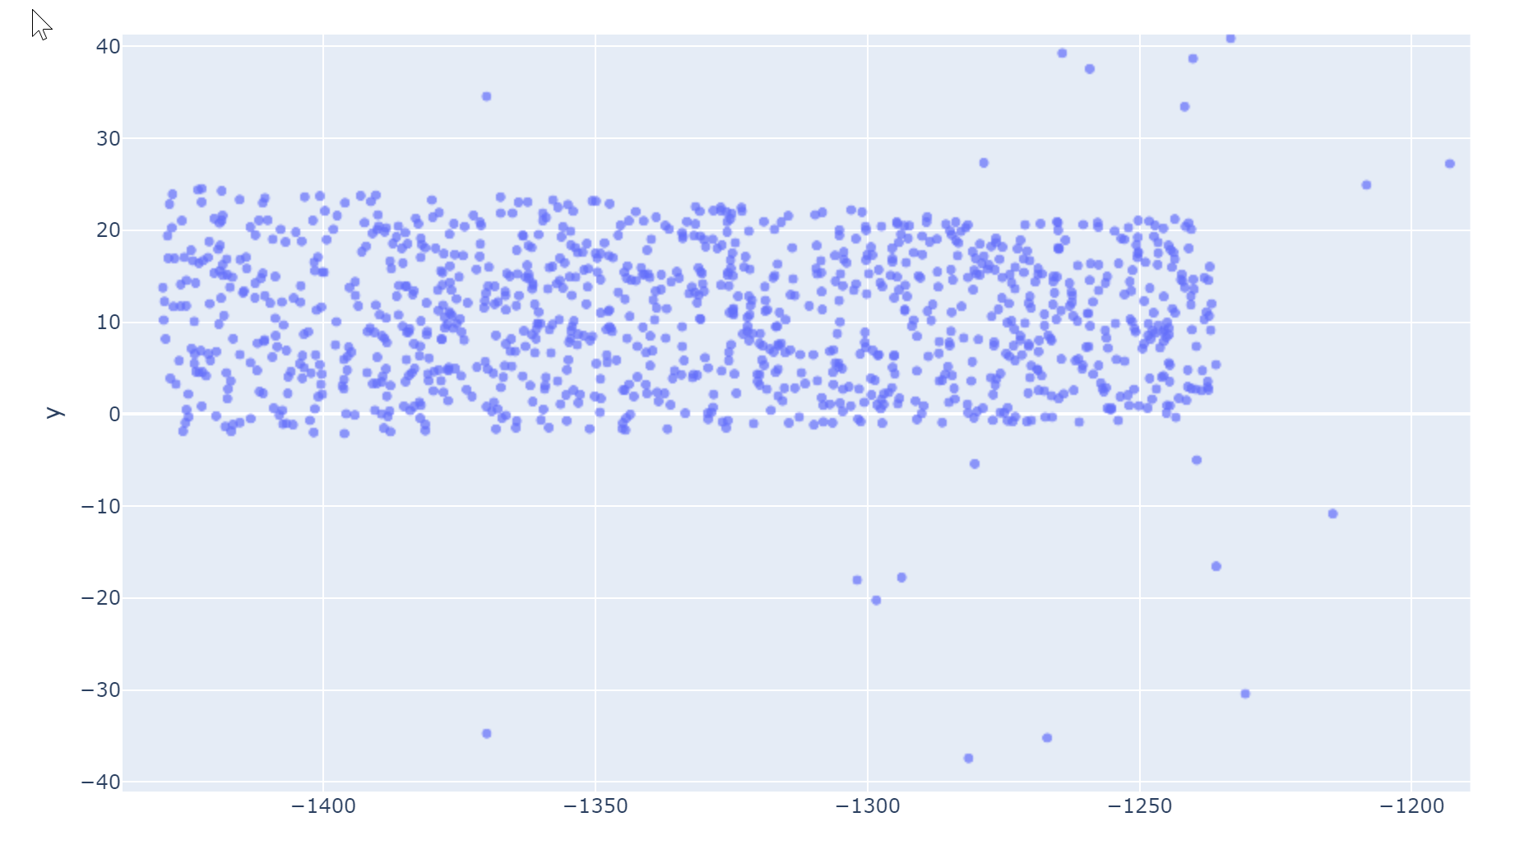
Far forward region study plots examples

Slide 14
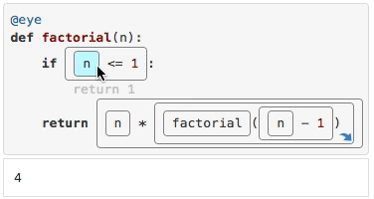
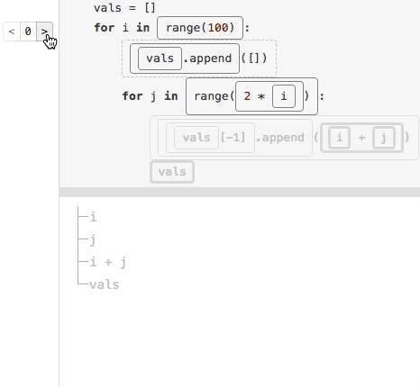
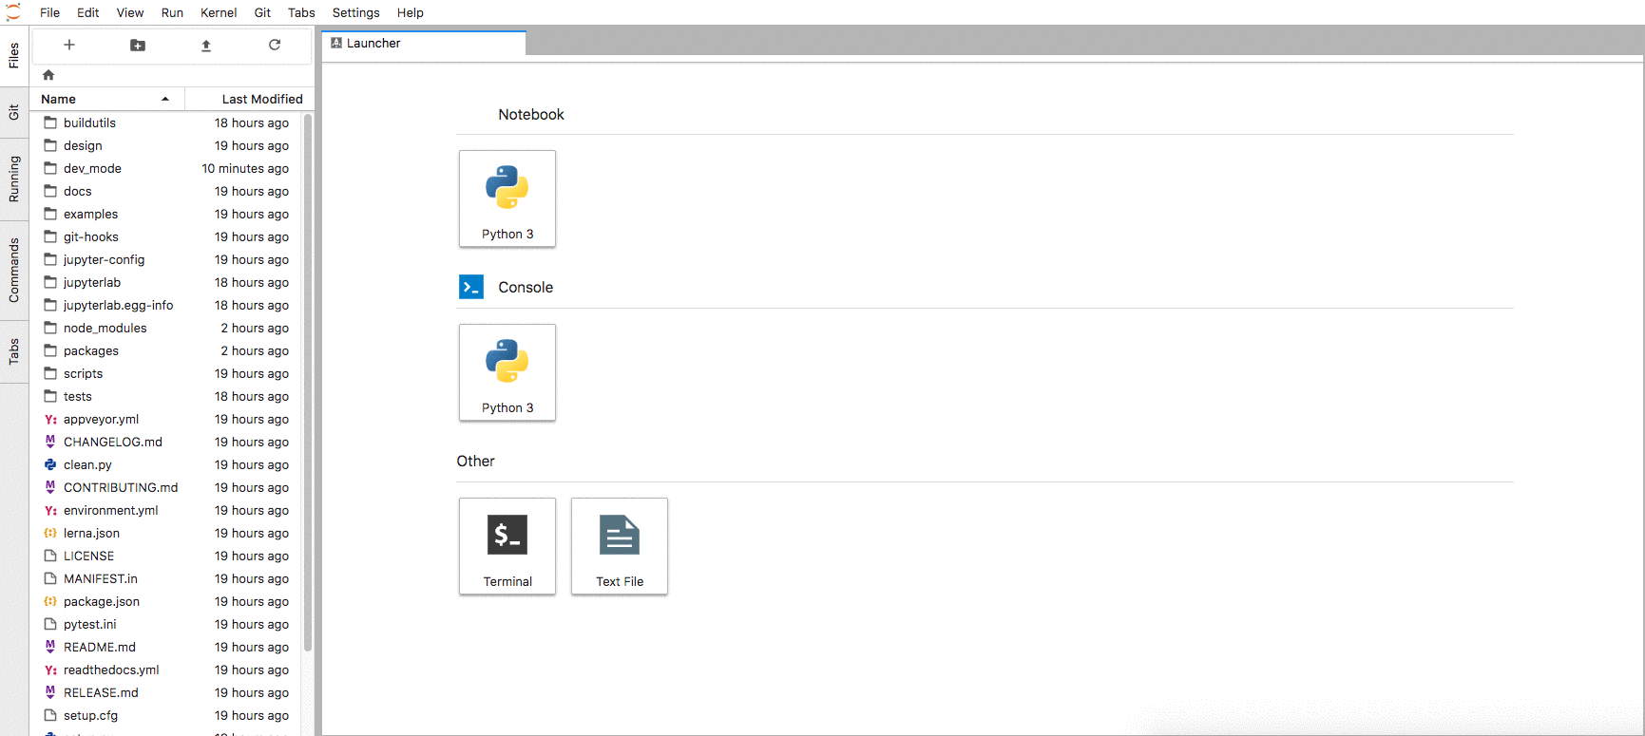
Extending jupyterlab in general
Project management - GUI for git integration
Adoption of the language server protocol
Many debugging tools a being developed

Slide 15
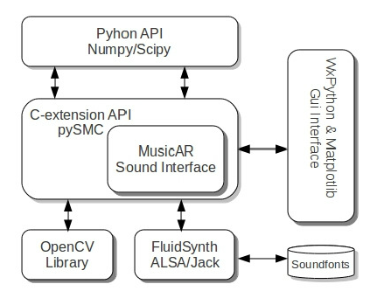
Performance
Many python libraries are speed up with C and others (cython, boos-python, C++, etc)
Cons (as it looks like): Instead of messing with C/C++, users must know python, C and how they interact. (Cython? C++ API, numpy API)

Slide 16
Numba

Slide 17
Numba example
ALSO WORKS WITH CUDA

Slide 18
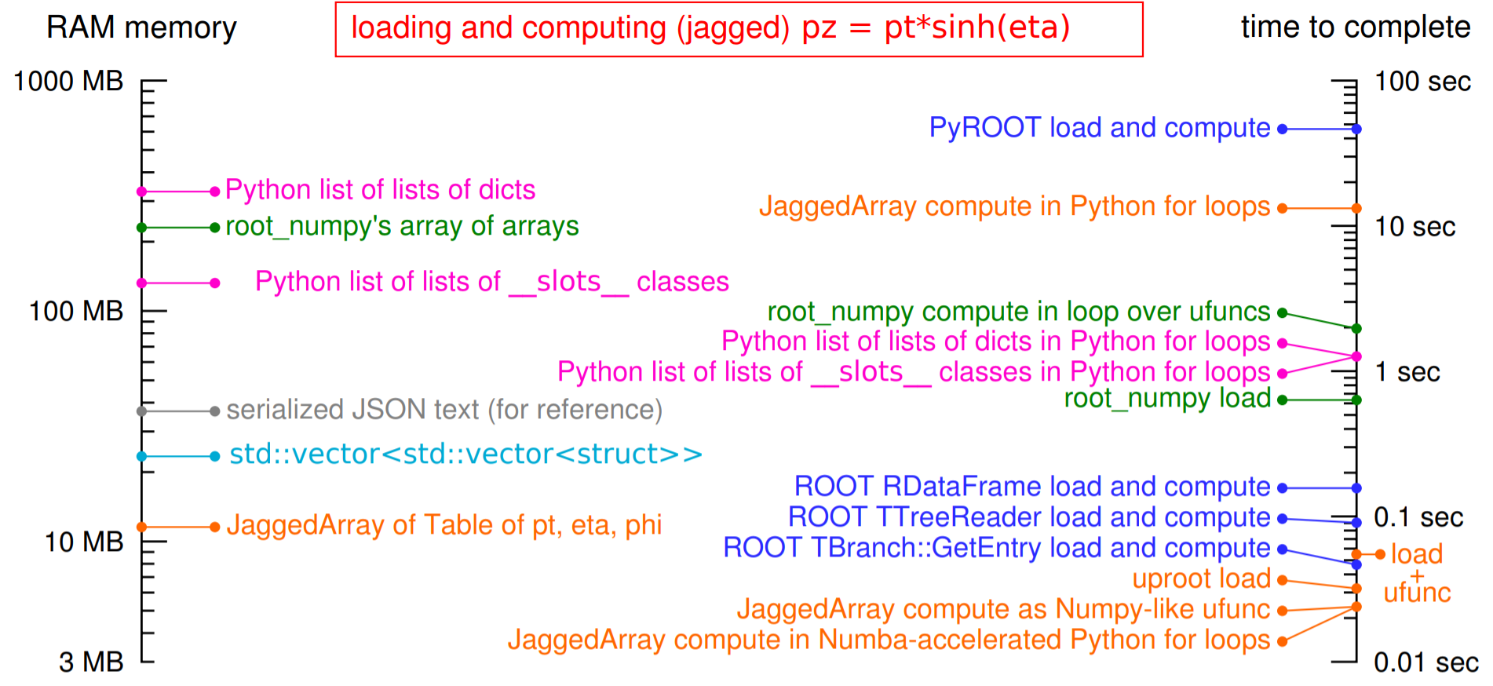
Awkward array performance

Slide 19
But…
Cons (it seems): Python + C/C++ should still be slower than C/C++?
And… there are tons of different data science libraries, they should be slow working together!
Weld! Written in Rust LLVM compiler used to speedup python libraries working together
Many of data science libraries are already highly optimized on a per-function basis, but deliver performance below the limits of modern hardware because they do not exploit parallelism or do not make efficient use of the memory hierarchy Weld provides optimizations across functions in libraries, whereas optimizing these libraries would only make individual function calls faster.

Slide 20
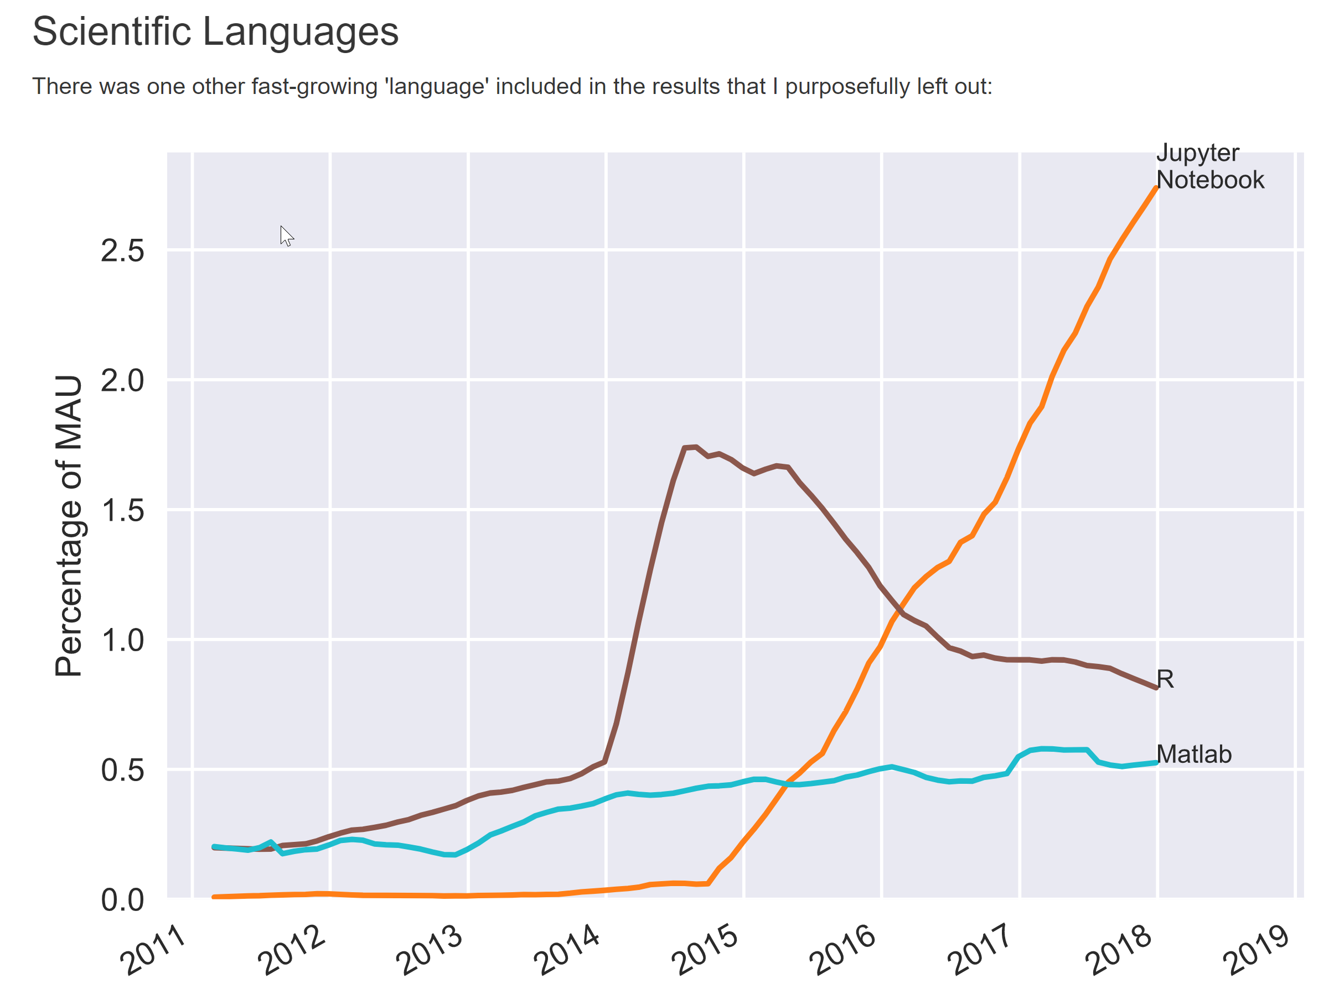
Jupyter+python is the huge world wide effort

Slide 21
Working with Geant
Problems
X11 from a docker
epic-gui docker container with X11 libraries. Works:
Directly
VNC
Through WebGL (so JupyterLab and Geant GUI could be in two tabs of the browser)
Script and code editing - Jupyterlab
Running and evaluating workflow – Jupyterlab directly
Introspecting geometry – Jupyterlab, OpenInventor, Geant GUI

Slide 22
Current work
Add simulation software
Working workflows and tutorials for Geant
Tools for easy docker management
Add projects support
Documentation, tutorials
pip install deic deic workdir /my dir deic run deic run http://github.com/my_project

Slide 23
EPIC Goals
Be a common software environment for EIC User Group community
Be a software “entry point” for EICUG in terms of:
documentation,
tutorials,
availability
workflow oriented
Joint effort of JLab and BNL
Be a medium for the Physics Detector Handbook

Slide 24
Thank you!

Slide 25
Software chain
EIC Containers
Docker for EIC = deic
Use containers as light VM
Entry Point for EIC = EPIC
Workflow driven interactive environment
Configuration
MC sample files
Pythia
Beagle
Herwig
EIC Jana Packet Build
Managaer = ejpm
Unified builder for the software stack
Fast simulation
Full simulation
EIC Smear
g4e Geant4
Reconstruction and analysis
ejana – EIC JANA(2)

Slide 26
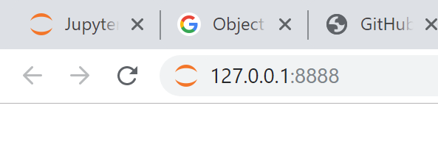
Start the docker
docker run --rm -p 8888:8888 eicdev/epic
…
[I 20:42:19.975 LabApp] The Jupyter Notebook is running at:
[I 20:42:19.975 LabApp] http://127.0.0.1:8888/
[I 20:42:19.975 LabApp] Use Control-C to stop this server

Slide 27
Jupyter lab, Jupyter notebooks, EPW, epic…

Slide 28
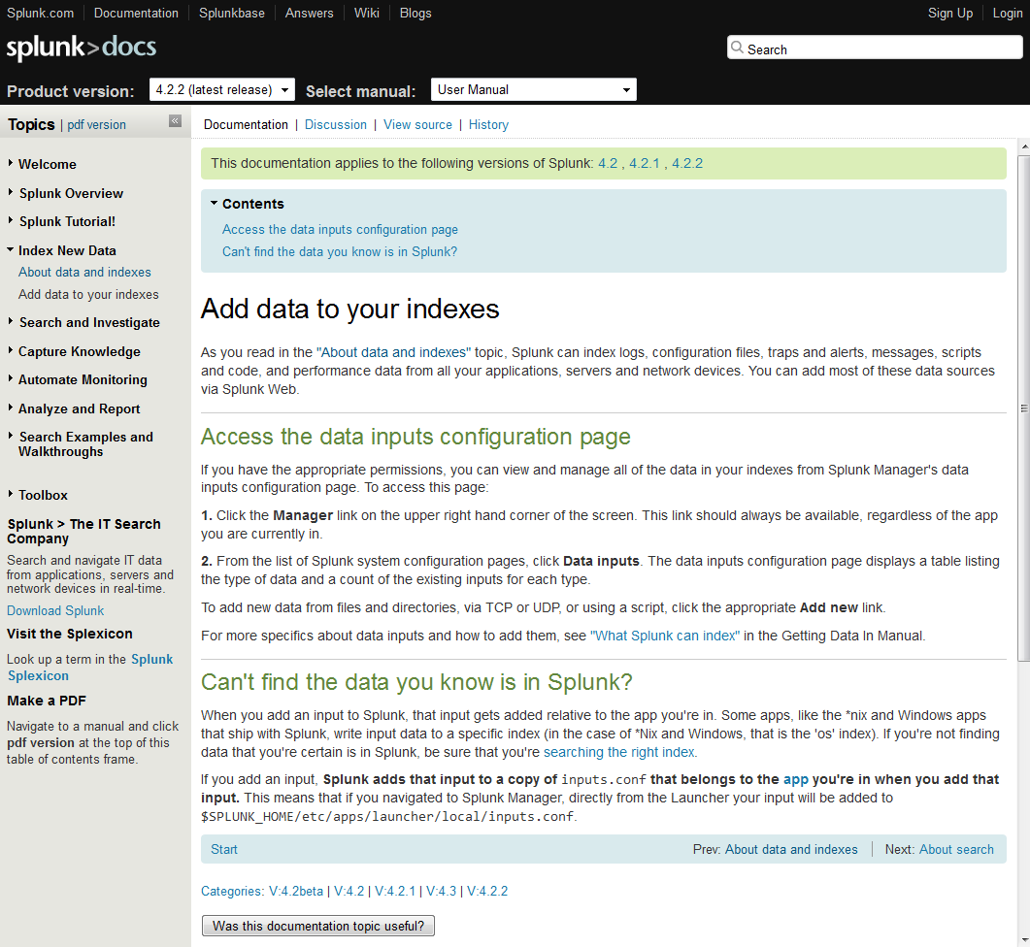
Usually just tools
Users also need workflows
Providing just tools and documentation in form of wikis/sites to it make learning curve steep and prevents users from doing their job effectively
Workflows of how users achieve their tasks must be overthought on each step of software development

Slide 29
Future tutorials
EIC Smear (quick parametrization of a detector) (HowTo create your own EIC detector or tweak existing)
Geant 4 (Right in the JupyterLab)
Jana2 and C++ backend (Write your own analysis, open custom files, etc)
ROOT7 tools (RDataFrame and others) (What if tensorflow was developed by root team? )
Data science tools (HowTo live without root, but with uproot, scy-hep + data science tools)

Slide 30
What software is in the docker container
MC sample files
Pythia
Beagle
Herwig
Fast simulation
Full simulation
EIC Smear
g4e Geant4
Reconstruction and analysis
ejana – EIC JANA(2)

Slide 31
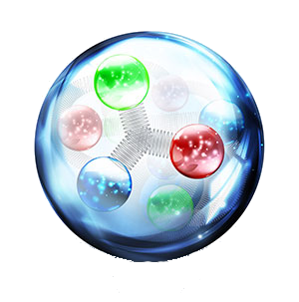
e^{JANA -} Community reference reconstruction
e^{JANA} - stands for EIC JANA
Basic reconstruction
Physics analysis
Users detector codebase integration
Reconstruction
Tracking - Genfit
Vertex finding – Rave
Physical analysis:
ROOT C++ or
Python data science tools (Jupyter, Seaborn, Pandas, etc.
Any existing C++ (or even others) code can be:
- compiled as JANA plugin
- run parallelized in eJANA
- accessed by other plugins
EIC jana

Slide 32
Complexity scaling explained
Failed complexity scaling:
Some complex system
Complex → Simple
Simple → Complex
Will fail most of the times
because of
complexity scaling problem
We try to make complex - simple

Slide 33
Escaping complexity scaling trap
Provide interfaces to internal complexity (and better for everything) (and even better – each step must be replaceable)
Interaction between layers must be clear
Simple
Moderate
Complex
Expert
(And working on modularity… true modularity is the way to make it)

Slide 34
How it relates to a common simulation tools?
What is ready now?
Mid term (1 year)?
Long run?

Slide 35
What is ready now EIC Smear
Working with EIC-Smear through EPIC is what is developed now
Interacting with EIC Smear configuration/detector design (C++ now, Python – coming)
Seamless integration of backend with Jupyter
Workflow run -> configure -> adjust -> run on farm (later is limited now, working on it!)

Slide 36
What is ready now Geant4
Interacting with Geant4 configuration
C++ code (limited) and Python code (better)
Interactive widgets (GUI) for running Geant
Display the geometry (root, GDML, others are possible VRML (X3D), STEP, CADs)
Workflow run -> configure -> adjust -> run on farm (later is limited now, working on it!)

Slide 37
Mid term
Seamless integration between jupyter/jupyterlab and Geant4 related framework
Fully support workflow run -> configure -> adjust -> run on farm
Full featured Documentation and Examples directory for users

Slide 38
Long term
Too many ideas! (Steering from users is needed) General trends:
Python data science tools and Jupyter conquers the scientific world
Classical NP tools are getting bridged with modern Data Science tools
Interacting with code (web-based editors, etc) are getting powerful -> more ways to collaborate and stay with one set of tools
Easier to run jubs on farms, clouds, hyper-mega-giga computing

Slide 39
Target audience
Users from specific collaborations
Detector design groups
General audience (users, who wants to do physics studies)

Slide 40
Geant 4 EIC
The codename g4e – Geant 4 EIC
Beta stage
√s 100 GeV design is implemented
Imports CAD, accelerator group data
Exports final Geometry in various formats
Plain flattened analysis ready ROOT files

Slide 41
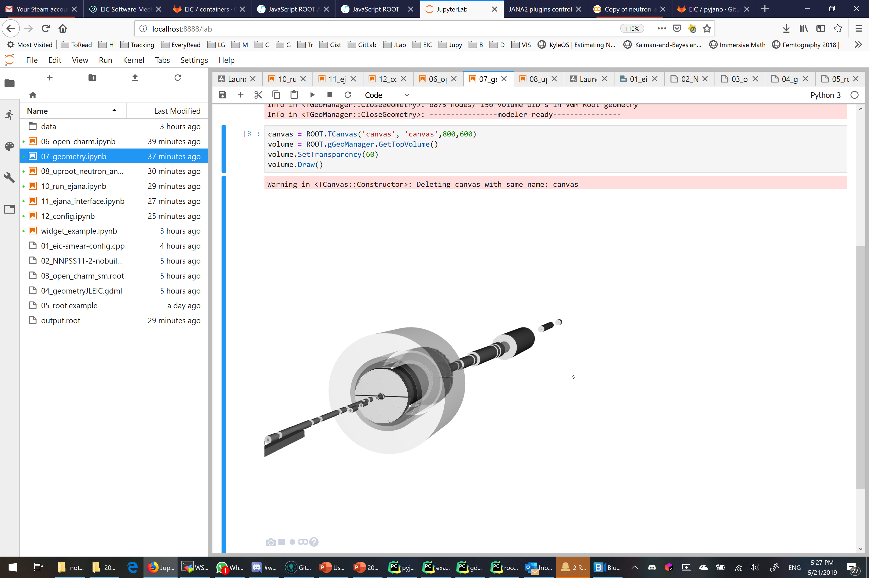
Geometry can be opened right in jupyter notebook

Slide 42
e^{JANA -} Community reference reconstruction
e^{JANA} - stands for EIC JANA
Basic reconstruction
Physics analysis
Users detector codebase integration
Reconstruction
Tracking - Genfit
Vertex finding – Rave
Physical analysis:
ROOT C++ or
Python data science tools (Jupyter, Seaborn, Pandas, etc.
Any existing C++ (or even others) code can be:
- compiled as JANA plugin
- run parallelized in eJANA
- accessed by other plugins
EIC jana

Slide 43
Status
JANA2 – C++ framework for NP data processing - beta
e^{JANA} – EIC community reference reconstruction - beta
g4e – Geant 4 EIC – beta
ejpm – Packet manager builder - beta
deic – Docker helper for EIC users - in project
Eic-smear – Integrated into ejpm, (full integration into ejana in progress) - beta (June)
pyjano – Python JANA Orchestrator – alpha
eic-jupyterlab – GUI for users entry point – prototype-> alpha
Future announces? Follow EIC User Group meeting

Slide 44
Software strategy
We cannot write everything and do all physics analysis by just our team
Thus we will provide tools, documentation and support to users, to help users to grow and direct the software.
Thus ease of user experience is one of our priorities

