Slide 1



Experiments at J-PARC with the new HypTPC detector
Kiyoshi Tanida
(Advanced Science Research Center,
Japan Atomic Energy Agency)
Reimei Symposium on
“Synergies in Hadron Physics
between J-PARC and JLab”
5 Nov. 2019

Slide 2
Contents
Introduction to J-PARC
Hyperon Spectrometer & HypTPC
Planned experiments using HypTPC
  E42 (H dibaryon)
  E45 (N*/Y* spectroscopy)
  E72 (Search for new narrow Λ* resonance)

Slide 3
Part I.
Introduction of J-PARC

Slide 4
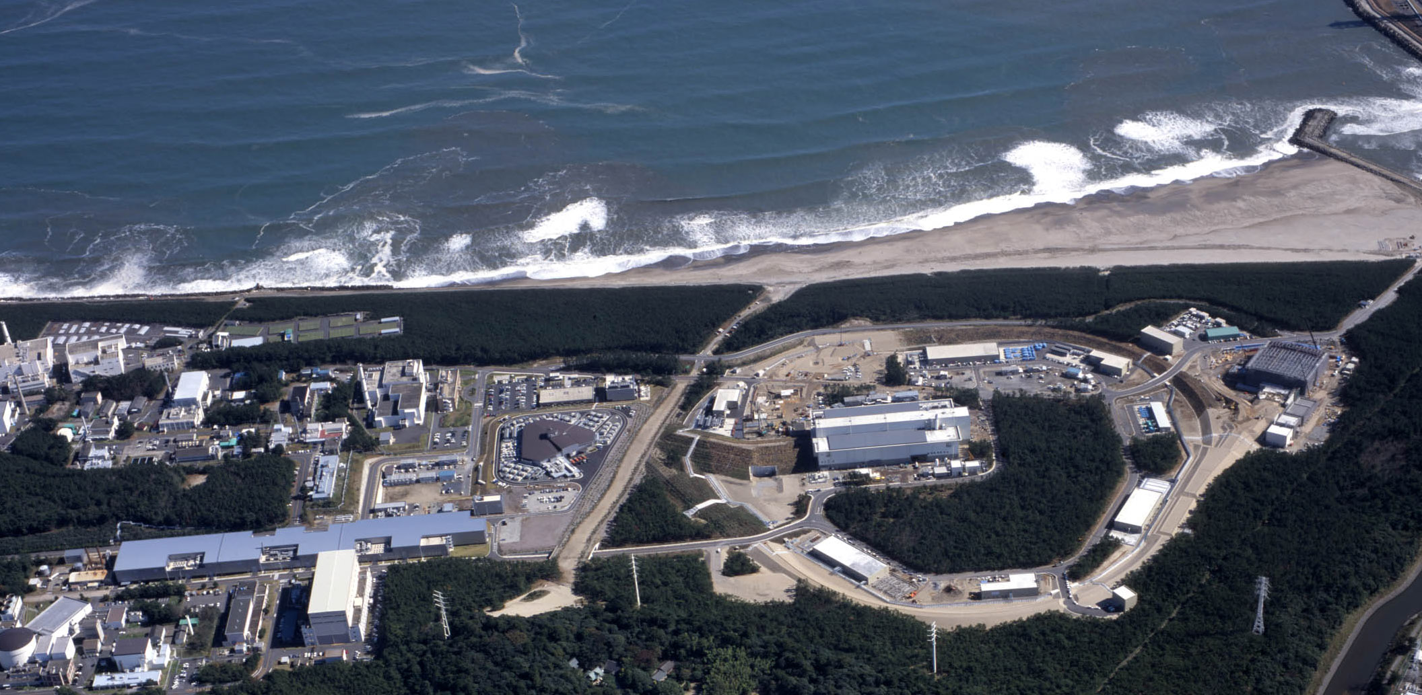
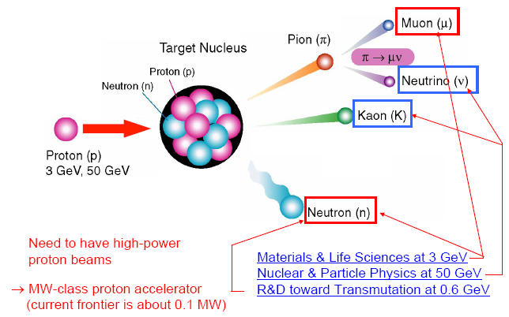
J-PARC
(Japan Proton Accelerator Research Complex)
Tokai, Japan
Material and Biological Science Facility
50 GeV Synchrotron (15 μA)
3 GeV Synchrotron (333 μA)
400 MeV Linac (350m)
Neutrino Facility
World-highest beam intensity

Slide 5
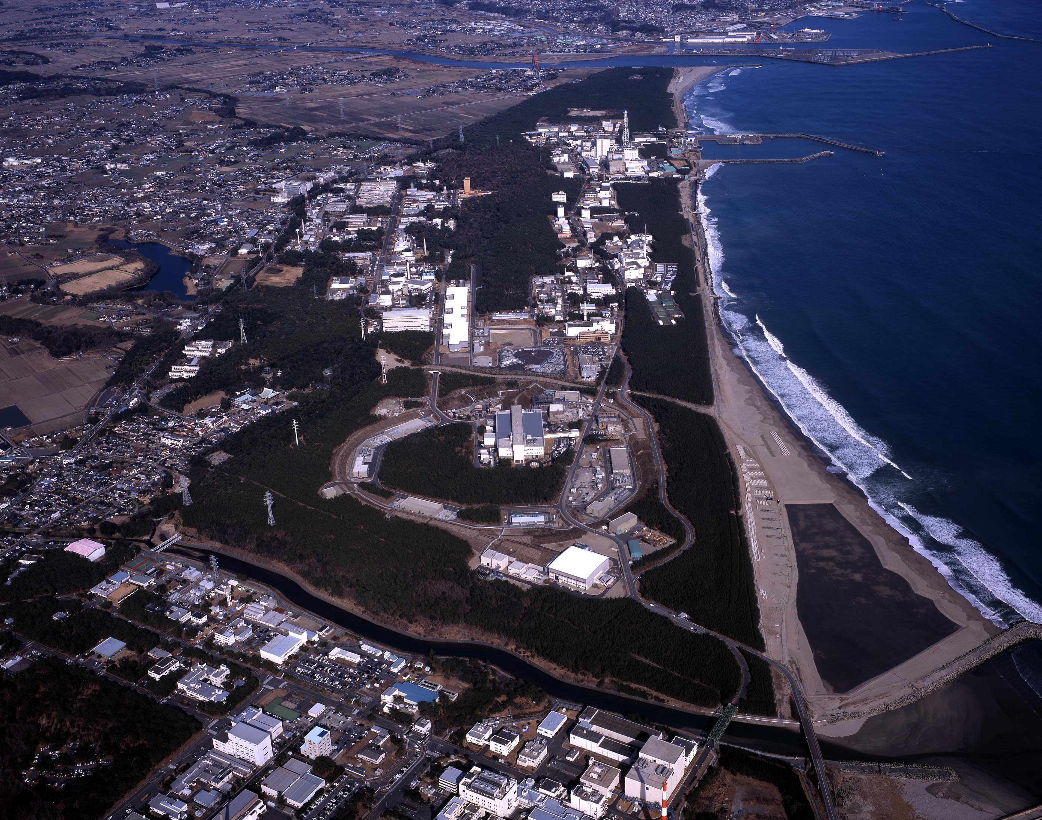
Nuclear & Hadron Physics in J-PARC

Slide 6
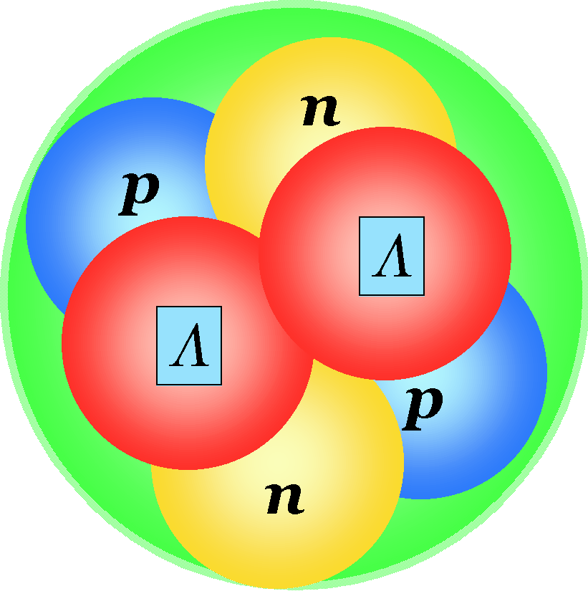

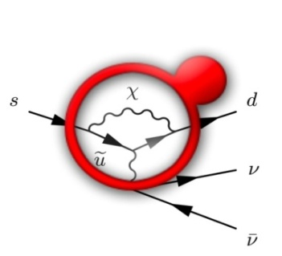
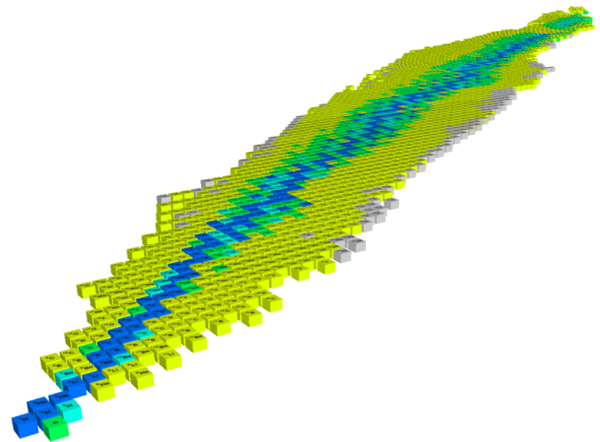
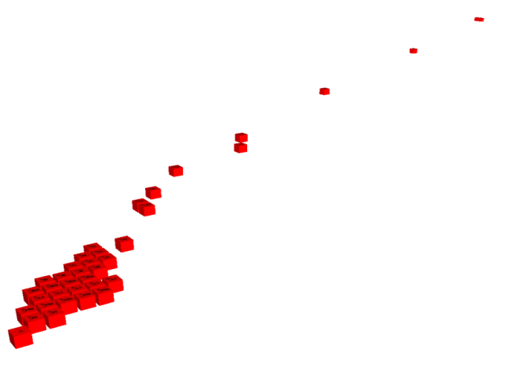


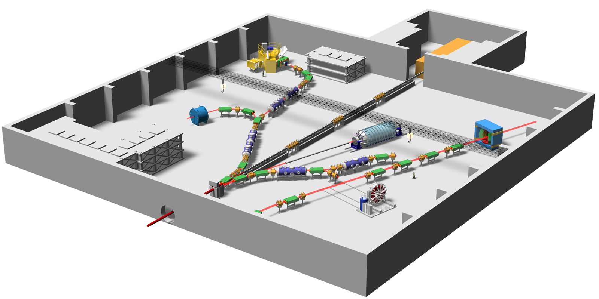
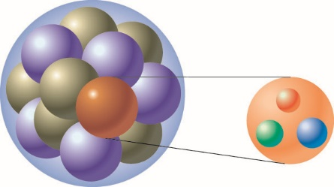
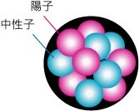
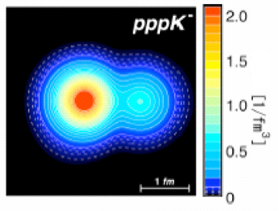
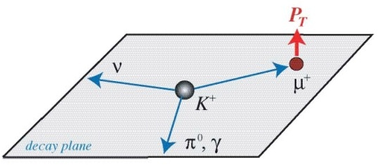

Experiments at a glance (not all)
Nuclear & Hadron Physics at J-PARC
K⁰ → π⁰ νν
d
_{L}
High Density Nuclear Matter, Nucelar Force
s
u
Hypernuclei
d
u
Strangeness
_{ΛΛ}He
Pentaquark Θ⁺
Origin of Mass
⁶
Confinement
ΛΛ, Ξ Hypernuclei
Z
Quark
-2
Λ, Σ Hypernuclei
-1
Λ,Ξ
N
0
SKS
Free quarks
Bound quarks
K1.8
Why are bound quarks heavier？
Mass without Mass Puzzle
K1.8BR
KL
K1.1
K-meson
High-p
Implantation of
Kaon and the
nuclear shrinkage
High Density Nuclear Matter,
Nucelar Force
K1.1BR
COMET
Beam line
Ｋ⁻
Proton Beam
μ-e conversion
T-Viola
tion
→
Ｘray
e⁻
Kaonic atom
Kaonic nucleus
Notes:
6
On the other hand, the hadron experimental hall looks like this.
● Proton beam comes here and various kaon beam lines are prepared, where K=1.8 means kaons with momentum of 1.8 GeV/c.
● At SKS, hypernuclear spectroscopy will be performed for a variety of nuclei. ● In particular, searches for double hypernucleus and pentaquark are the highlights in here.
● In this beamline, kaon implantation is planned. When kaon is implanted inside the nucleus, there is a possibility that high density matter is created. ● Kaonic atom and kaonic nucleus will be studied.
● This beam line is the neutral kaon line to study CP violation, and ● this line is for T-violation experiment.
● Finally, this line, which is not yet completed, is dedicated to the study of chiral symmetry, namely, the mass generation mechanism of bound quarks.
6

Slide 7
Part II.
Hyperon Spectrometer & HypTPC

Slide 8
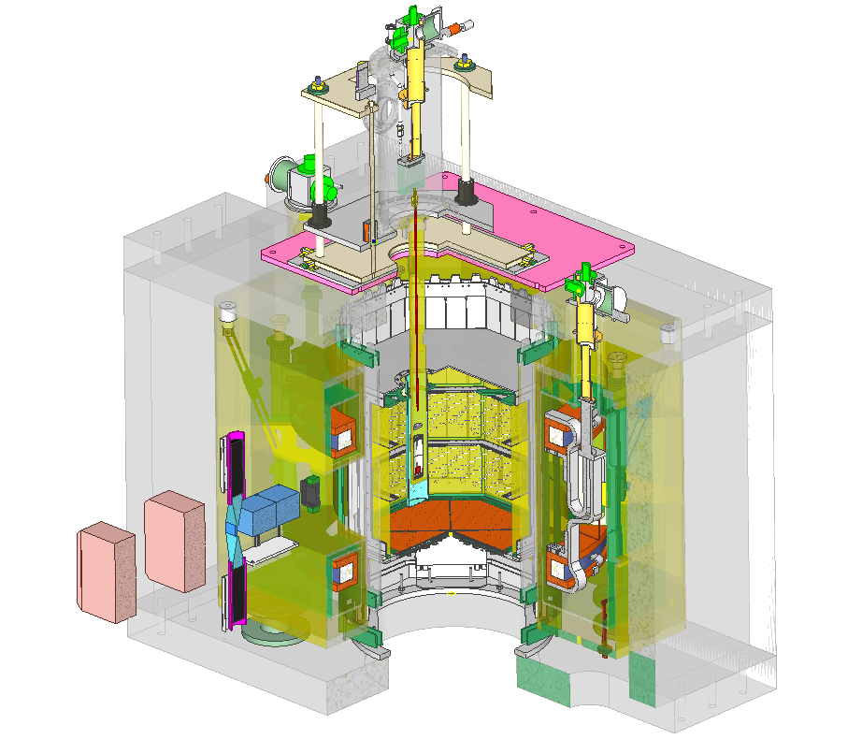
Overview of Hyperon Spectrometer
TPC Hodoscope
Target
Helmholtz magnet
(B=1.0 T)
HypTPC

Slide 9
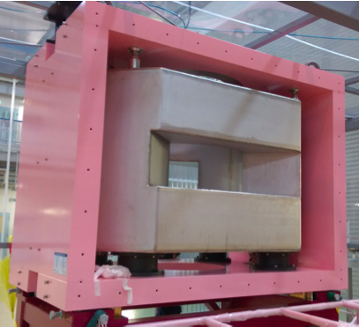
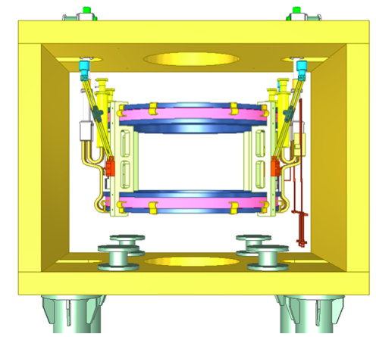
The Superconducting magnet
Helmholz type, design maximum field : 1.5 T
Conduction cooling with 2 GM cryocoolers
Coil diameter : 1.0m
Field uniformity : Br/By<1% in the TPC volume
to achieve the good momentum resolution

Slide 10
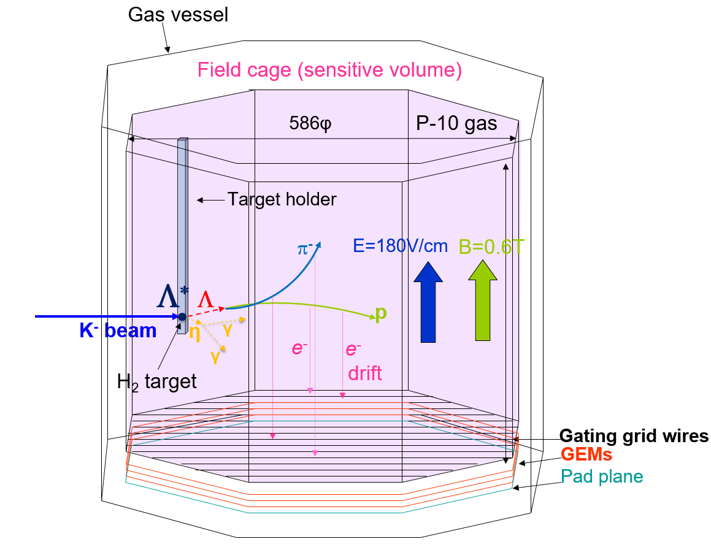
HypTPC
High rate capability
  GEM (100μm+50μm+50μm)
  Gating grid
Target inside the drift volume through the target holder
  Large acceptance
Drift field parallel to B-field
  Good position resolution

Slide 11
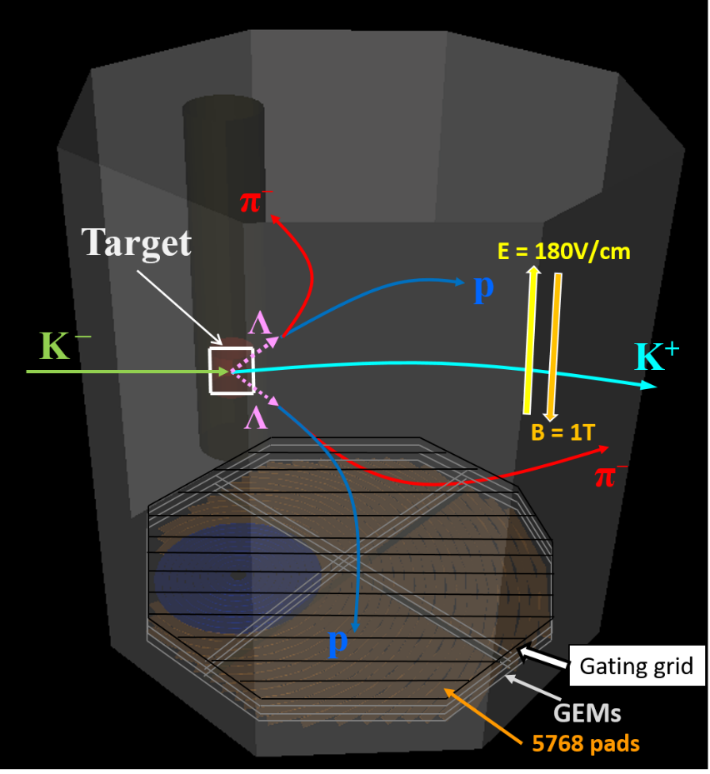
More on HypTPC
〇Octagonal prism field cage
〇5768 readout pads
- Inner(10 rows): 2.1-2.7×9 mm²
- Outer(22 rows): 2.3-2.4×12.5 mm²
〇 Gating grid: φ50 μm, 1mm space
〇 Gas: P-10 (v_{max} ~ 5.3 cm /s)
〇 Gain ~ 10⁴
〇 Position resolution < 300 μm
〇 Δp/p = 1-3% for π and p
Gating Grid
Triple GEM
Readout 5768 pads
Readout circuit
11

Slide 12
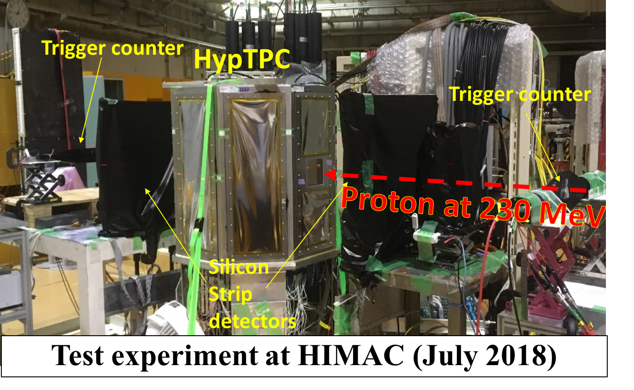
Test experiment at HIMAC

Slide 13
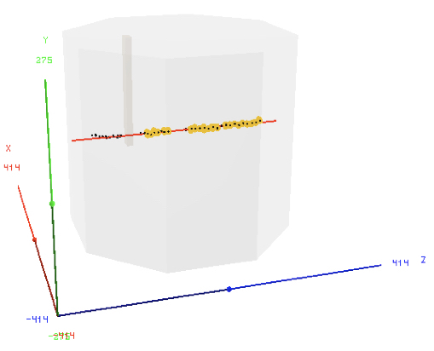

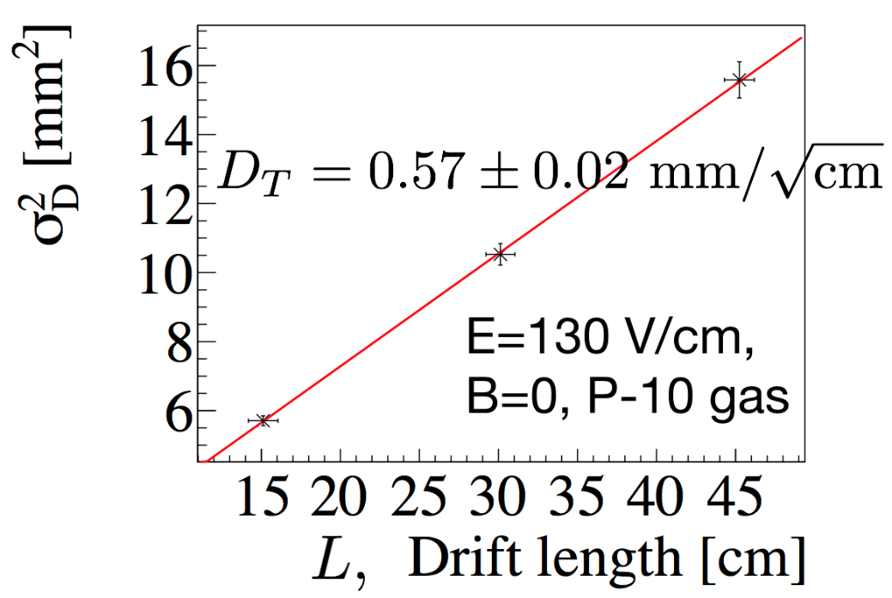
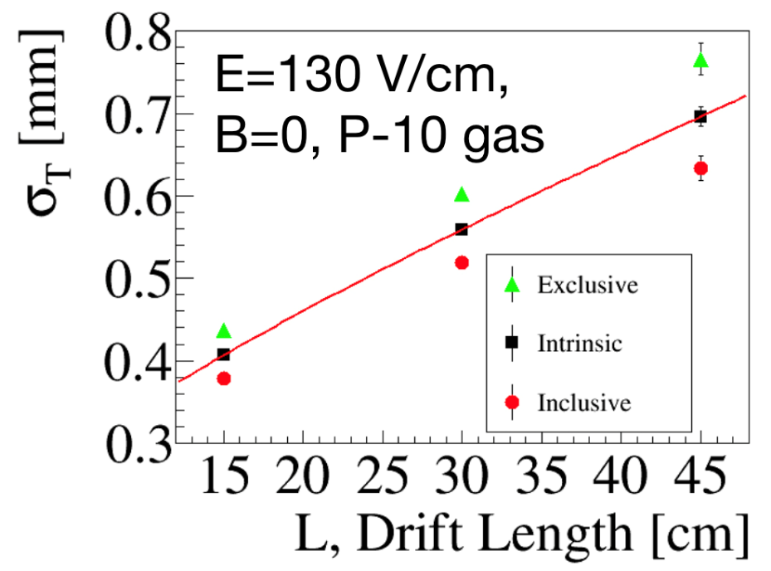
Test Results
Good resolution
obtained w/o magnetic field
<Transverse Diffusion>
<Position Resolution>
Expected to have 200-250 μm resolution under the B field of 1 T

Slide 14
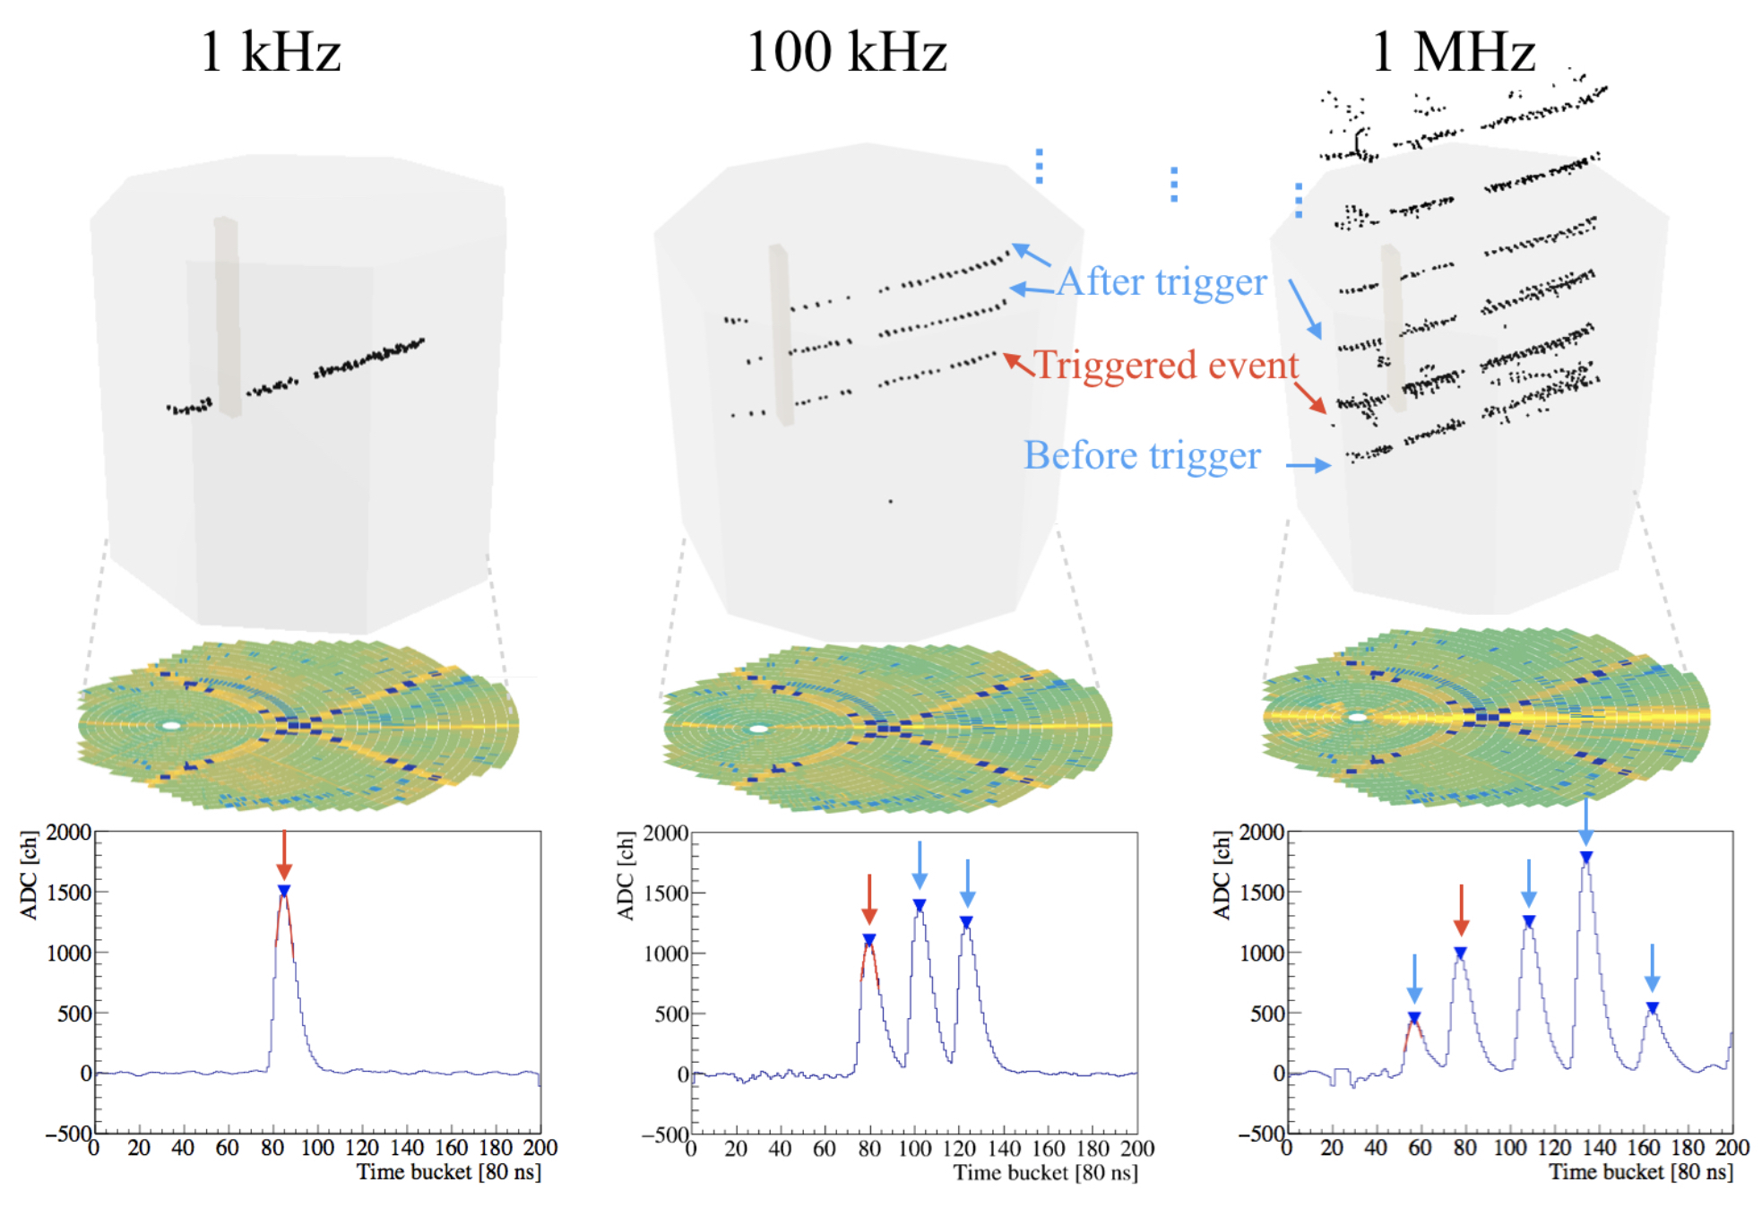
High rate capability

Slide 15
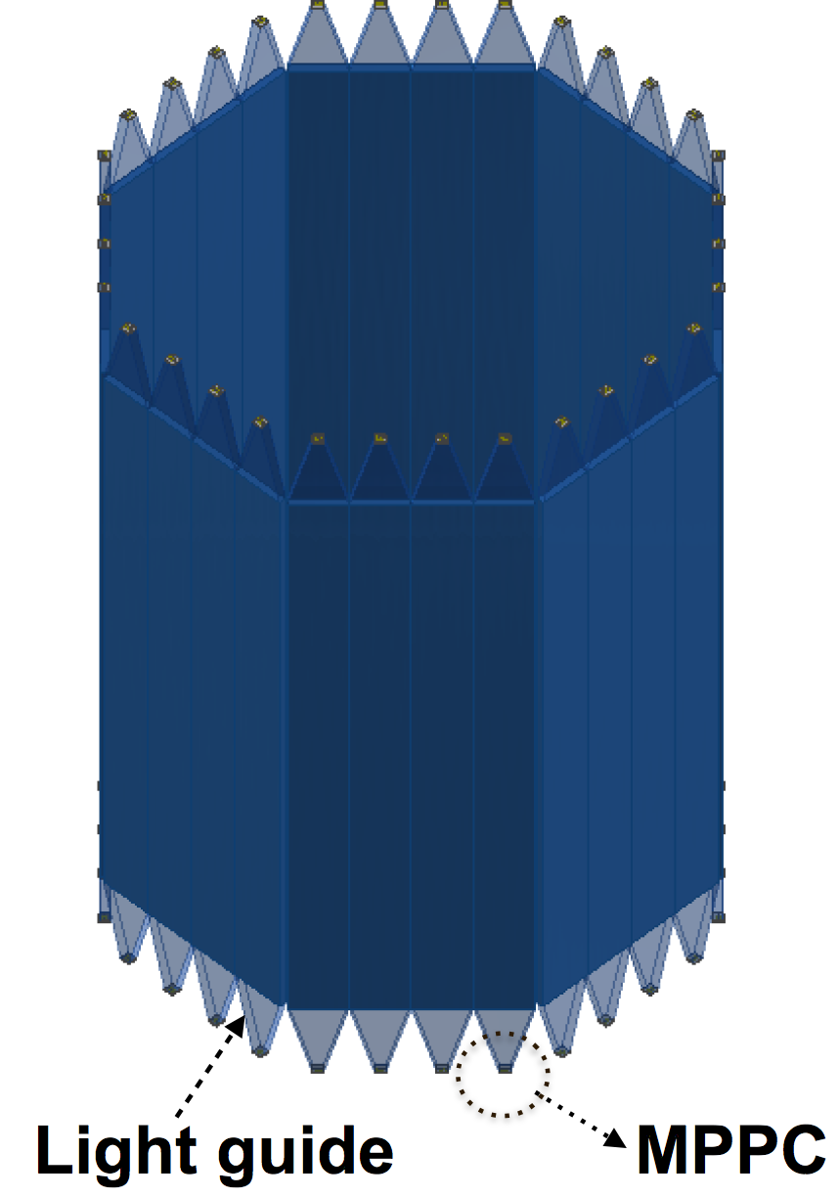
TPC Hodoscope
Used for trigger/TOF
32 segments of plastic scintillator array surrounding HypTPC.
Plastic scintillator of
80cm x 7cm x 1cm
MPPCs on both ends
  PMTs not used due to the strong magnetic field.

Slide 16
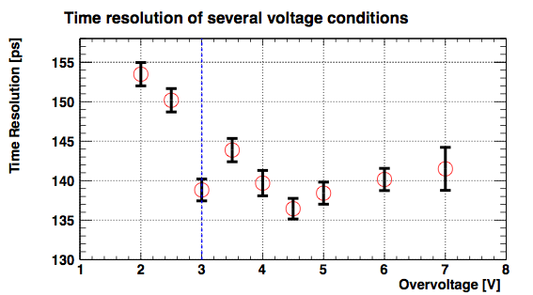
TOF resolution
Achieved ~140 ps resolution with a real size bar.

Slide 17
PID capability
By dE/dx in TPC & TOF with the Hodoscope
  π-p separation up to 0.9 GeV/c
  K-π separation up to 0.5 GeV/c
PID: dE/dx(TPC) vs p/q
PID: TOF(β) vs p/q
Simulation
Simulation
σ_{T} = 150 ps assumption

Slide 18
Part III.
Planned experiments using HypTPC

Slide 19
J-PARC E42 experiment
~Search for H dibaryon~

Slide 20
H dibaryon
Flavor-singlet (00) state (strangeness -2, isospin 0,
or ¹S₀ state in ΛΛ-ΞＮ-ΣΣ system)
Color-magnetic force is not
repulsive, but attractive
u
u
s
s
d
d
6 quark state may exist
→ H dibaryon
but not found so far
A resonant state just above ΛΛ threshold?
⇒ Still an open and important question
u
s
s
d
d
u
All 6 quarks
in s-state

Slide 21
Lattice QCD calculation for H dinaryon
Physical π mass
Physical π mass
P.E. Shanahan, A.W. Thomas, and R.D. Young, PRL 107 (2011).
Calculation at
almost physics point
K. Sasaki for the HAL Collab.,
Reimei 2016, Inha (2016).
Exist around
ΞN threshold？
Preliminary
Preliminary

Slide 22
Lattice QCD vs ALICE data

Slide 23
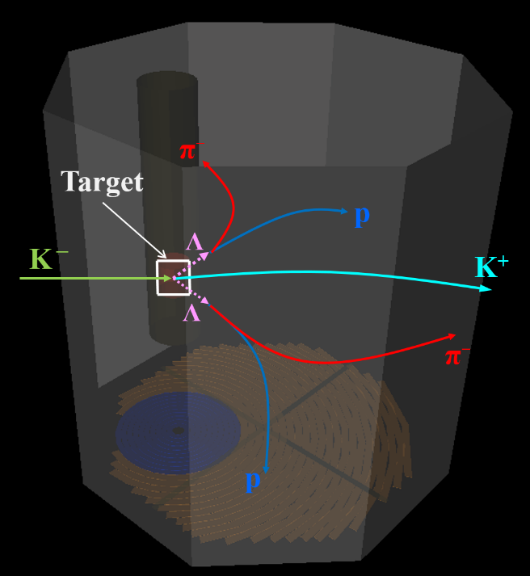
J-PARC E42 experiment
H-dibaryon search by using (K⁻, K⁺) reaction with diamond target.
KEK E522
J-PARC E42
Simulation
σ_{ΔM} ~ 1 MeV
1.5×10⁴ ΛΛ events
σ_{ΔM} ~ 5 MeV
90 ΛΛ evens
HypTPC
KURAMA
K⁻ beam
K⁺
K1.8 Beam line spectrometer
Hyperon
Spectrometer

Slide 24
J-PARC E45 experiment
~Baryon spectroscopy by using p(π, 2π) reaction~

Slide 25
Missing resonances
A lot of states are predicted by QM, but not observed
Measured by using mainly πN → πN, γN → πN reactions

Slide 26
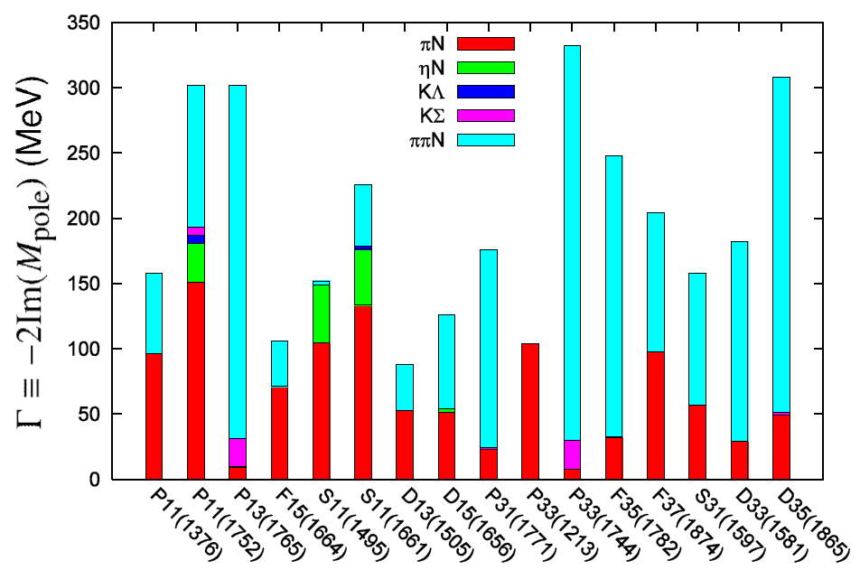
Importance of ππN
(Width of N* resonances)
Over half of the decay branchig fraction goes into 2π channel.
Kamano, Nakamura, Lee, Sato, 2012

Slide 27
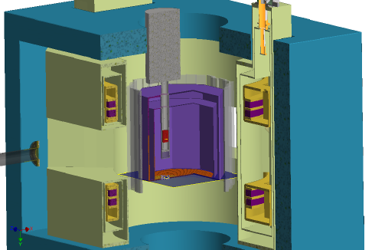
E45 setup
Measure (π,2π) in large acceptance TPC in dipole magnetic field
π⁻p→π⁺π⁻n, π⁰π⁻p 2 charged particles + 1 neutral particle
π⁺p→π⁰π⁺p, π⁺π⁺n →missing mass technique
πN→KY (2-body reaction)
π⁻p→K⁰Λ,
π⁺p→K⁺Σ⁺ (I=3/2, Δ*)
π⁺⁻ beam on liquid-H target
(p= 0.73 – 2.0 GeV/c
W=1.5-2.15 GeV)
x100 more statistics
than ever
Trigger with hodoscope
LH target
π beam
Hyp-TPC

Slide 28
PWA on (π,2π) reaction
Model independent PWA – impossible
  Not a complete experiment: spin observables are not measured.
  Double partial-wave expansion is necessary, but very difficult.
Need theory help for model dependent analysis
  Models used for (γ,2π) analysis@JLAB may be interesting
  Global analysis with one-pion and two-pion reactions

Slide 29
J-PARC E72 experiment
~Search for new Λ* by using K⁻p→Λη reaction~

Slide 30


Dalitz plot: $Λ_{c}^{+}→pK^{−}π^{+}$[PRL117.011801]
Κ∗(896)
Δ(1232)
What’s this?
Λ(1520)

Slide 31
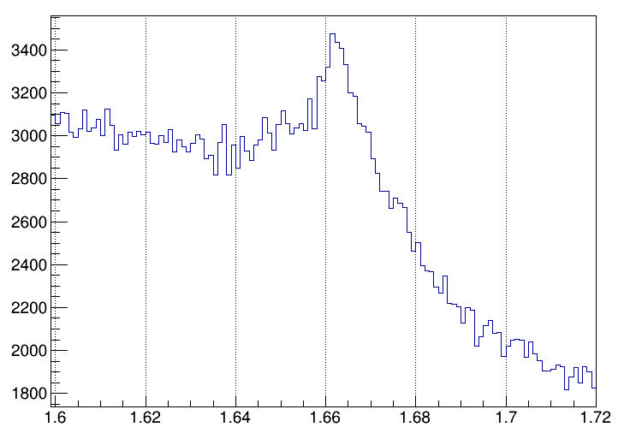
* $M\left(pK^{−}\right)$
■ 1D projection -- $M\left(pK^{−}\right)$
What’s this?
m～1663 MeV
Γ～10 MeV?
Counts / 1$MeV/c^{2}$
$$M\left(pK^{−}\right) [GeV/c^{2}]$$

Slide 32
What’s this?
The peak position is ~1663 MeV, near the Λη threshold (1663.5 MeV)
Width is ~10 MeV, significantly narrower than Λ, Σ resonances in this region
  Λ(1670): 25-50 MeV
  Σ(1660): 40-200 MeV
  Σ(1670): 40-80 MeV
  Λ(1690): ~60 MeV
No such narrow states are theoretically predicted in this region – exotic?

Slide 33
An idea
2 independent groups claim there is a new narrow Λ* resonance at this energy with J=3/2
  Kamano et al. [PRC90.065204, PRC92.025205]
  J^{P}=3/2⁺ (P₀₃), M=1671+2-8 MeV, Γ=10+22-4 MeV
  Liu & Xie [PRC85.038201, PRC86.055202]
  J^{P}=3/2⁻ (D₀₃), M=1668.5±0.5 MeV, Γ=1.5±0.5 MeV
The reason is the same
  From K⁻p → Λη measurement near the threshold by Crystal Ball collaboration at BNL [PRC64.055205]
  Model independent

Slide 34
Differential cross sections (1)

Slide 35
Differential cross sections (2)
Flat near the threshold
  Expected for J=1/2 (S-wave)
Concave-up around p_{K}=734 MeV/c (√s=1669 MeV)
Flat again for p_{K} > 750 MeV/c
(√s=1677 MeV)
Concave shape requires J=3/2 amplitude
→ reason for a narrow resonance; model independent

Slide 36
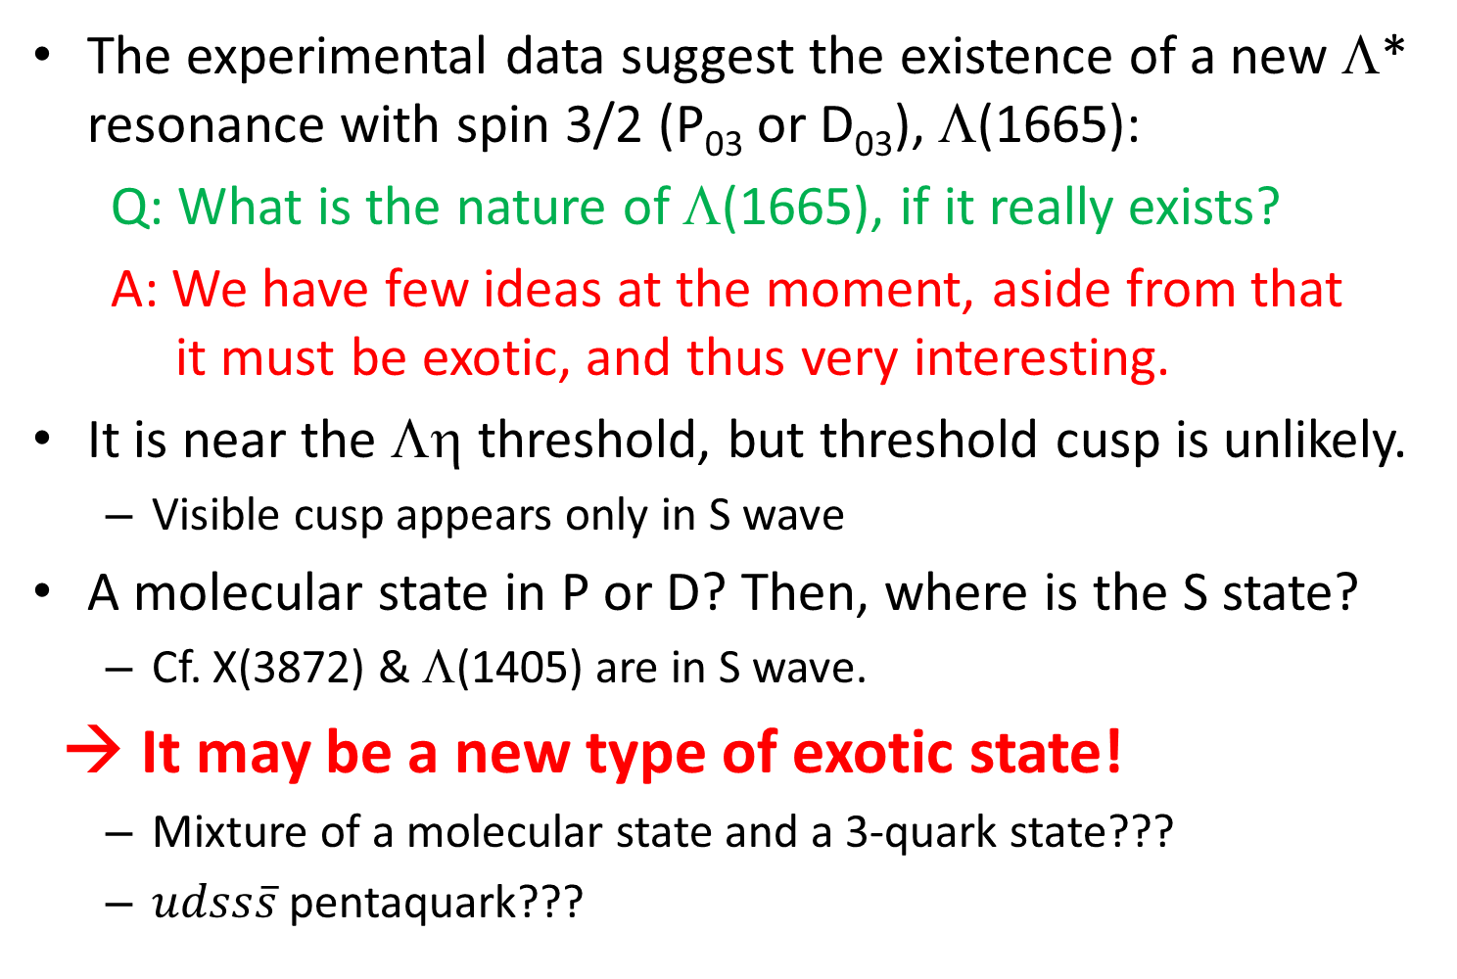
What can it be?
The experimental data suggest the existence of a new Λ* resonance with spin 3/2 (P₀₃ or D₀₃), Λ(1665):
Q: What is the nature of Λ(1665), if it really exists?
A: We have few ideas at the moment, aside from that
it must be exotic, and thus very interesting.
It is near the Λη threshold, but threshold cusp is unlikely.
  Visible cusp appears only in S wave
A molecular state in P or D? Then, where is the S state?
  Cf. X(3872) & Λ(1405) are in S wave.
→ It may be a new type of exotic state!
  Mixture of a molecular state and a 3-quark state???
  $udss\overline{s}$ pentaquark???

Slide 37
J-PARC E72
Repeat the Kp → Λη experiment again with a large acceptance detector, i.e., TPC (HypTPC)
  Confirm angular distribution & the new resonance
  Determine parity by Λ polarization measurement
Principle
  K beam momentum: 720-770 MeV/c
  Momentum resolution: 1 MeV/c or better
  → Can identify narrow resonance of Γ=1.5 MeV
  Detect Λ → pπ⁻, identify η by missing mass
Also take other reactions as well.
  K⁻p → K⁻p, K⁰n, π±Σ∓, Λπ⁺π⁻, …

Slide 38
Identify parity
Angular distribution is the same for 3/2⁺ (P wave)
and 3/2⁻ (D wave)
  Again, we need polarization of the final Λ
Crystal-Ball data is very poor for polarization
  Support for new resonance is not obtained

Slide 39
Polarization – Parity in CB data
No new
resonance
New resonance
in 3/2⁺ (P₀₃)
Model calc. by
Kamano et al.
[PRC92.025205]
Crystal ball data is average of 722-750 MeV/c
& 750-770 MeV/c, not for each momentum.
⬄ Meanwhile, calculations are done on the points.

Slide 40
Calculation by Liu & Xie
[PRC86.055202]
New resonance in 3/2⁻ (D₀₃)
No new resonance
733 MeV/c
734 MeV/c
735 MeV/c

Slide 41
Identify parity
Angular distribution is the same for 3/2⁺ (P wave)
and 3/2⁻ (D wave)
  Again, we need polarization of the final Λ
Crystal-Ball data is very poor for polarization
  Support for new resonance is not obtained
How we can distinguish P&D?
  P wave – no node, D wave – node
We need δp~0.05 for each momentum/angle bin
→ Large statistics needed
x16: δP 0.2 → 0.05
x10: binning 2 → 20
→ Need ~3 weeks of beamtime.

Slide 42
Possible run plan
E42: Earliest possible case is near the end of JFY2020 (Mar. 2021)
No beam in JFY2021 due to power supply upgrade.
JFY2022: E42 or E72
E45 may be JFY2023 or even later (?)
Limiting factors:
  Operational budget
  Overhead for switching (K1.8 → K1.8BR & vice versa)

Slide 43
Summary
We are developing a powerful multi-purpose
time-projection-chamber, HypTPC.
  Internal target – 4π acceptance
  High-rate capability, good momentum resolution
  Will open new possibilities of hadron physics at J-PARC.
Three experiments are proposed to J-PARC
  E42: Search for H-dibaryon by using (K⁻, K⁺) reaction
  E45: Baryon spectroscopy by using p(π, 2π) reaction
  E72: Search for new Λ* resonance via p(K⁻, Λ)η
  More are coming.

Slide 44
Backup

