Slide 1
Meeting the Challenge of DVCS data on the Nucleon
Xiangdong Ji
Strong QCD from Hadron Structure Experiments in the Jlab 12 GeV Era, Nov. 6-9, Jlab

Slide 2

Special Session honoring the outstanding achievements and
the inspiring leadership of
Dr. V. D. Burkert

Slide 3
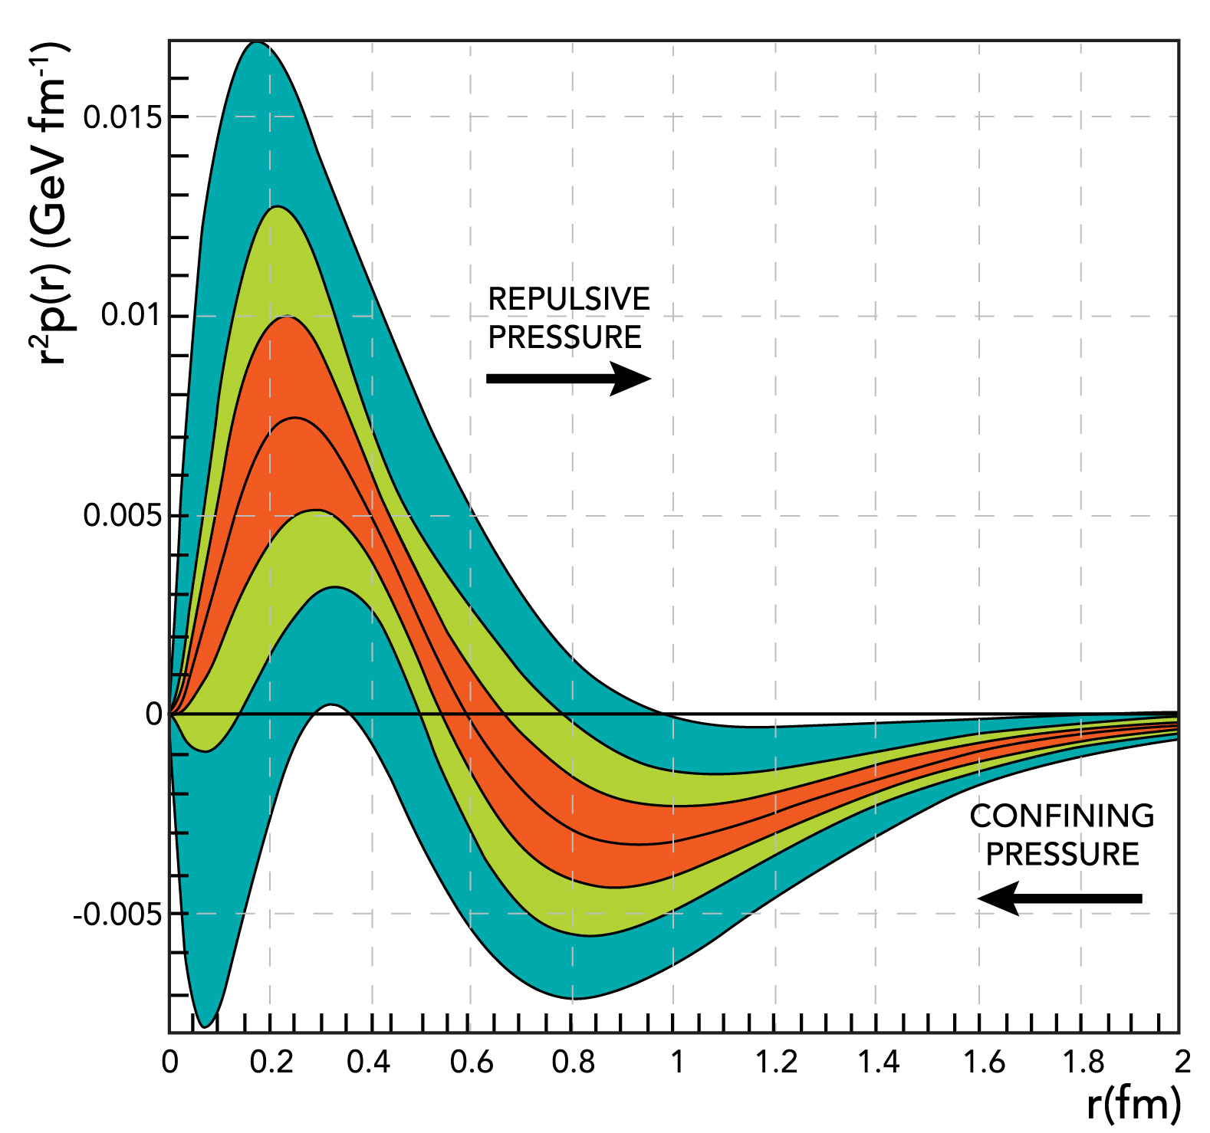
The pressure distribution inside the proton
V. D. Burkert, L. Elouadrhiri & F. X. Girod
Nature vol 557, p. 396–399 (2018)
Congratulations！

Slide 5
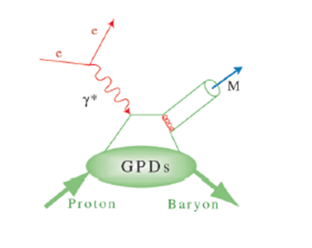
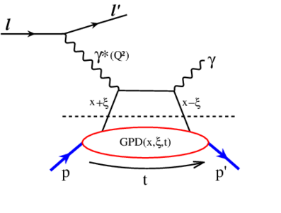
Deeply virtual Compton scattering

Slide 7
Factorization proof:
Factorization for hard exclusive electroproduction of mesons in QCD,
J. C. Collins, L. Frankfurt, and M. Strikman ,Phys. Rev. D56 (1997) 2982-3006

Slide 8
Early DVCS experiments

Slide 9
The Hall-B first DVCS experiment

Slide 10
Hall-B DVCS papers under Voker’s leadership (6 PRL+1 Nature)

Slide 11
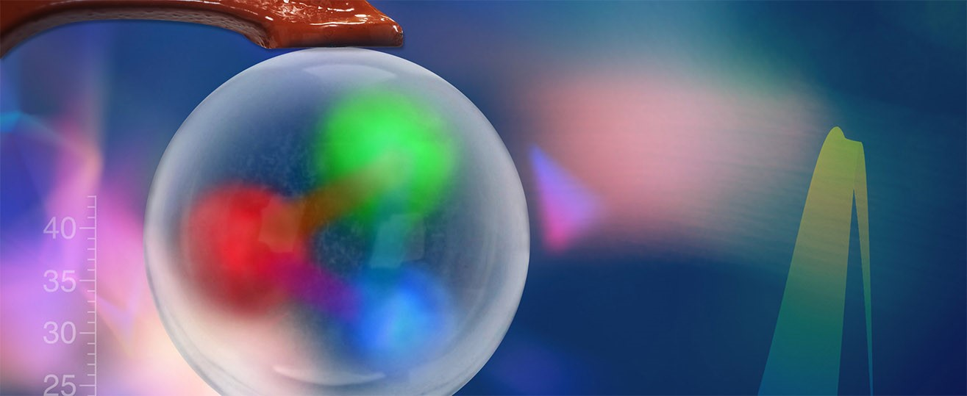
QUARKS FEEL THE PRESSURE IN THE PROTON

Slide 12
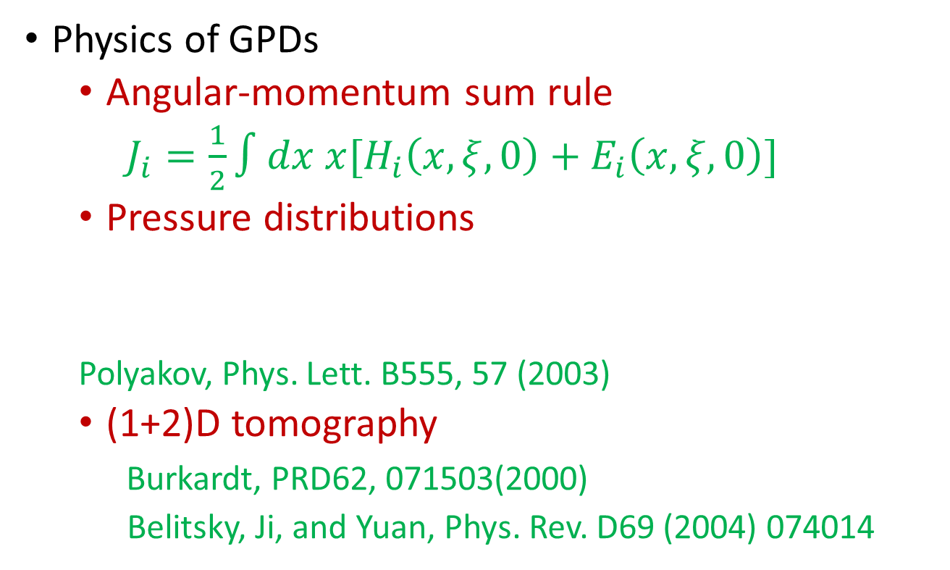
DVCS(DVMP): probe of GPD
Physics of GPDs
  Angular-momentum sum rule
  $J_{i}=\frac{1}{2}∫dx x[H_{i}\left(x,ξ,0\right)+E_{i}\left(x, ξ,0\right)]$
  Pressure distributions
  Polyakov, Phys. Lett. B555, 57 (2003)
  (1+2)D tomography
  Burkardt, PRD62, 071503(2000)
  Belitsky, Ji, and Yuan, Phys. Rev. D69 (2004) 074014

Slide 13
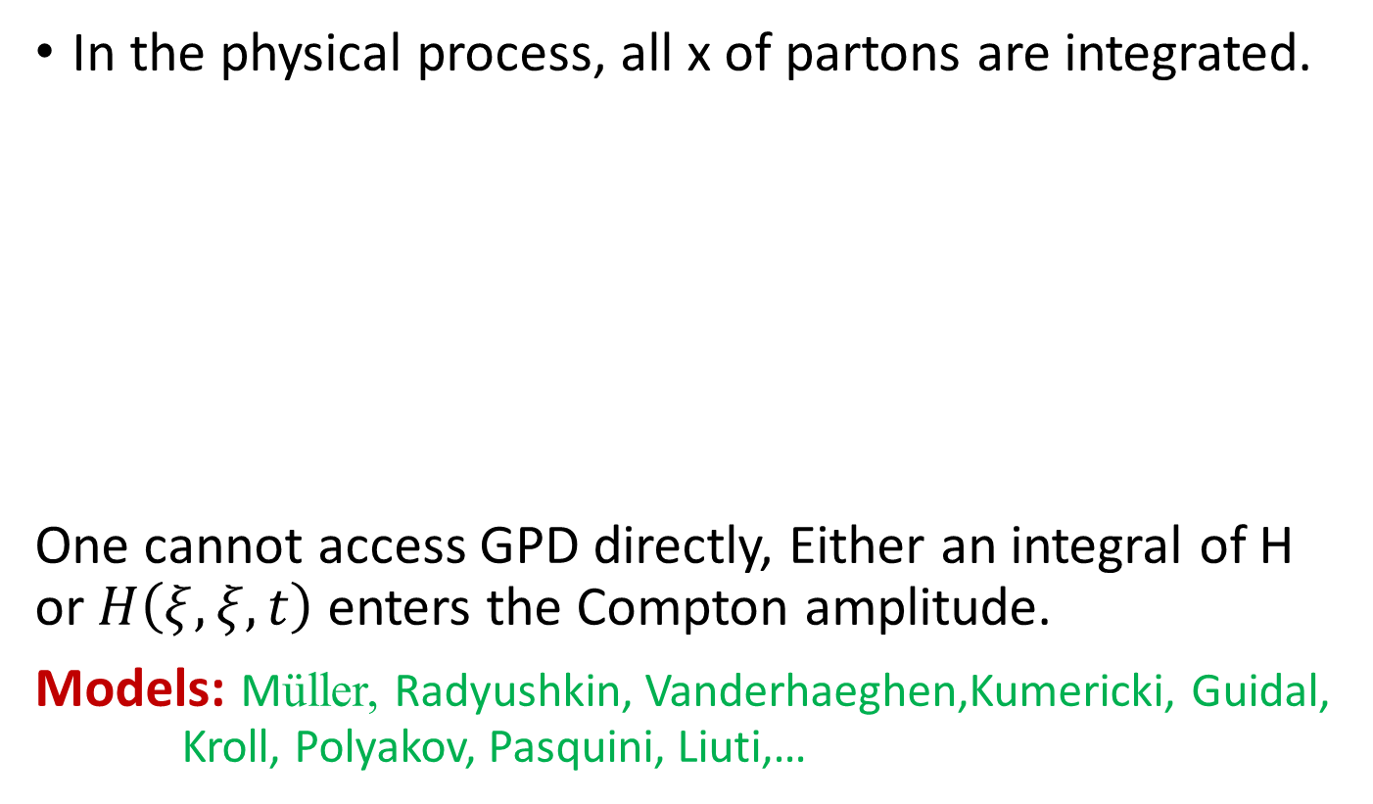
DVCS (DVMP): data analysis
In the physical process, all x of partons are integrated.
One cannot access GPD directly, Either an integral of H or $H\left(ξ, ξ, t\right)$ enters the Compton amplitude.
Models: Müller, Radyushkin, Vanderhaeghen,Kumericki, Guidal, Kroll, Polyakov, Pasquini, Liuti,…

Slide 14
M. Mazouz, Phys.Rev.Lett. 99 (2007) 242501
How do we understand or interpret the DVCS (DVMP) data in a model independent way?
Go back to the fundamental theory of QCD!

Slide 15
Large momentum effective theory
(LaMET)

Slide 16
A recipe for directly calculating parton physics from lattice QCD
X. Ji, Sci. China-PMA 57, 1407 (2014).
A few related talks in this workshop: J. Qiu, H. W. Lin, A. Radyushkin

Slide 17
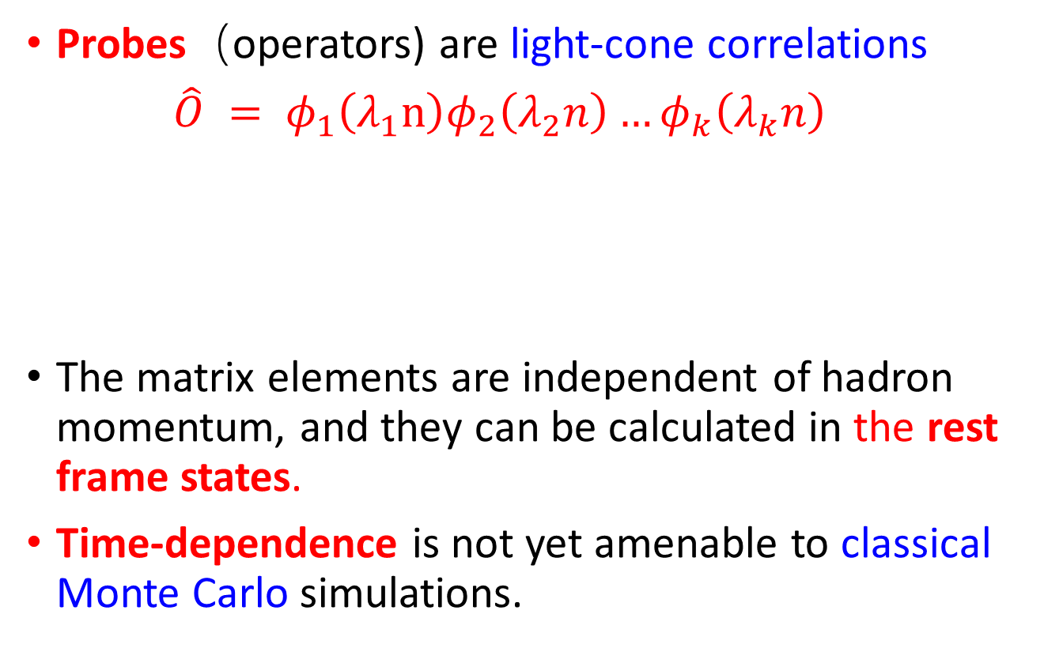
“Heisenberg picture”
Drell, Yan, Chang, Ma, Brodsky, Lepage, Efremov, Radyushin, Mueller, Collins, Soper, Sterman…
Probes（operators) are light-cone correlations
$\hat{O} = φ_{1}\left(λ_{1}n\right)φ_{2}\left(λ_{2}n\right)…φ_{k}\left(λ_{k}n\right)$
The matrix elements are independent of hadron momentum, and they can be calculated in the rest frame states.
Time-dependence is not yet amenable to classical Monte Carlo simulations.
^{n}
^{p}

Slide 18
Light-front quantization
Traditionally, light-cone correlations
have been studied in light-front
quantization, a Hamiltonian approach.
However, due to breaking of rotational symmetries on the light-cone, renormalization of Hamiltonian becomes complicated.
It is a challenge to show that the weak coupling expansion actually converges for infra-red QCD.
Brodsky, Pauli and Pinsky, Phys. Rept. 301, 299–486 (1998)
Wilson et. al. Phys. Rev. D49 (1994)

Slide 19

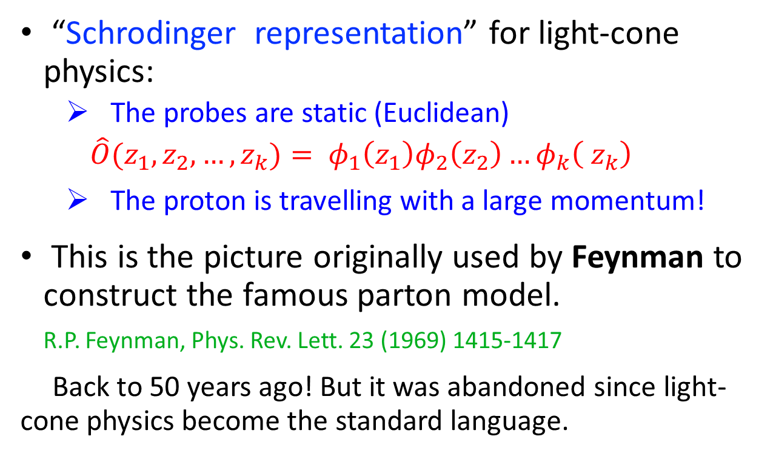
Alternative picture
“Schrodinger representation” for light-cone physics:
  The probes are static (Euclidean)
  $$\hat{O}(z_{1},z_{2}, …,z_{k})= φ_{1}\left(z_{1}\right)φ_{2}\left(z_{2}\right)…φ_{k}\left( z_{k}\right)$$
  The proton is travelling with a large momentum!
This is the picture originally used by Feynman to construct the famous parton model.
R.P. Feynman, Phys. Rev. Lett. 23 (1969) 1415-1417
Back to 50 years ago! But it was abandoned since light-cone physics become the standard language.

Slide 20
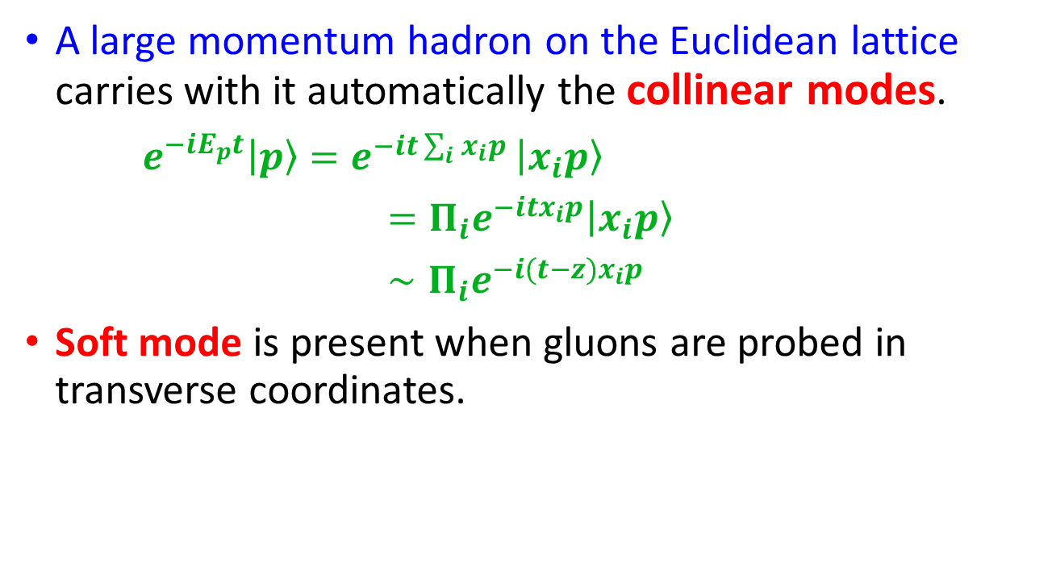
Large-momentum hadron on lattice
A large momentum hadron on the Euclidean lattice carries with it automatically the collinear modes.
$e^{−iE_{p}t}\left|p\right\rangle =e^{−it\sum_{i}{x_{i}p }}\left|x_{i}p\right\rangle$
$={Π_{i}e}^{−itx_{i}p}\left|x_{i}p\right\rangle$
$∼{Π_{i}e}^{−i(t−z)x_{i}p}$
Soft mode is present when gluons are probed in transverse coordinates.
P

Slide 21
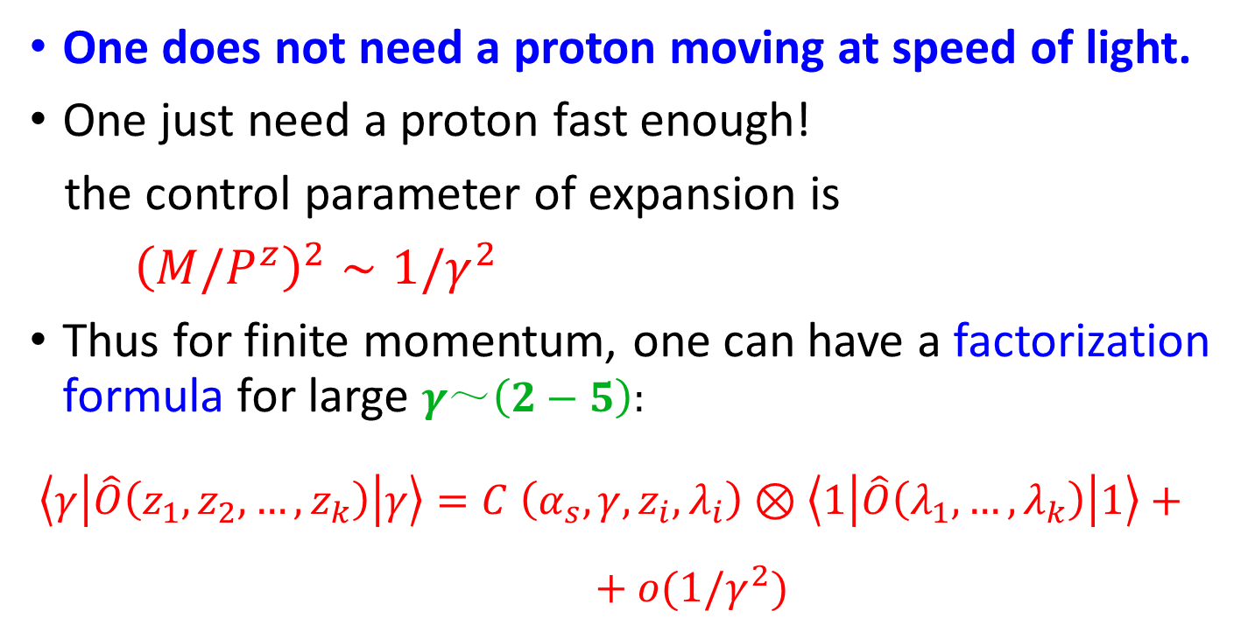
LaMET expansion
One does not need a proton moving at speed of light.
One just need a proton fast enough!
the control parameter of expansion is
${\left(M/P^{z}\right)}^{2}∼1/γ^{2}$
Thus for finite momentum, one can have a factorization formula for large $γ～\left(2−5\right):$
$\left\langle γ\left|\hat{O}\left(z_{1},z_{2}, …,z_{k}\right)\right|γ\right\rangle =C \left(α_{s},γ,z_{i},λ_{i}\right)⊗\left\langle 1\left|\hat{O}\left(λ_{1},…,λ_{k}\right)\right|1\right\rangle + + o(1/γ^{2})$

Slide 22
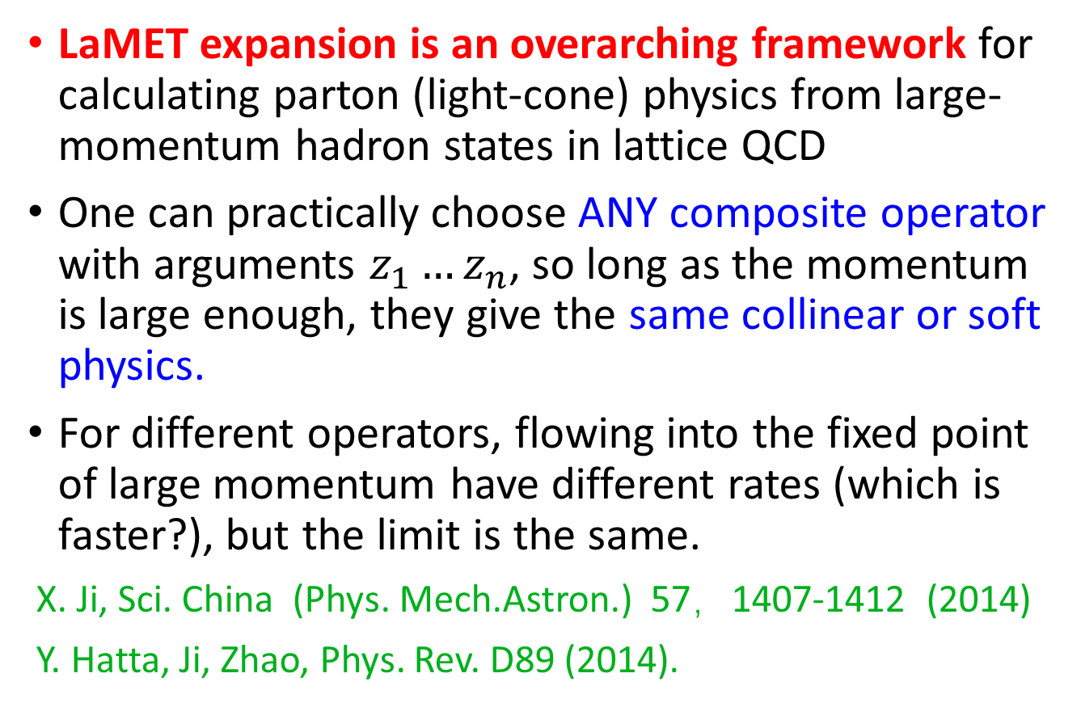
Universality
LaMET expansion is an overarching framework for calculating parton (light-cone) physics from large-momentum hadron states in lattice QCD
One can practically choose ANY composite operator with arguments $z_{1}…z_{n}$, so long as the momentum is large enough, they give the same collinear or soft physics.
For different operators, flowing into the fixed point of large momentum have different rates (which is faster?), but the limit is the same.
X. Ji, Sci. China (Phys. Mech.Astron.) 57，1407-1412 (2014)
Y. Hatta, Ji, Zhao, Phys. Rev. D89 (2014).

Slide 23
Application 1: Gluon total helicity ΔG
In QCD factorization, one can show that the gluon polarization is a matrix element of non-local light-cone correlation.
A. Manohar,Phys. Rev. Lett. 66 (1991) 2684
No one knows how to calculate this for nearly 30 years!

Slide 24
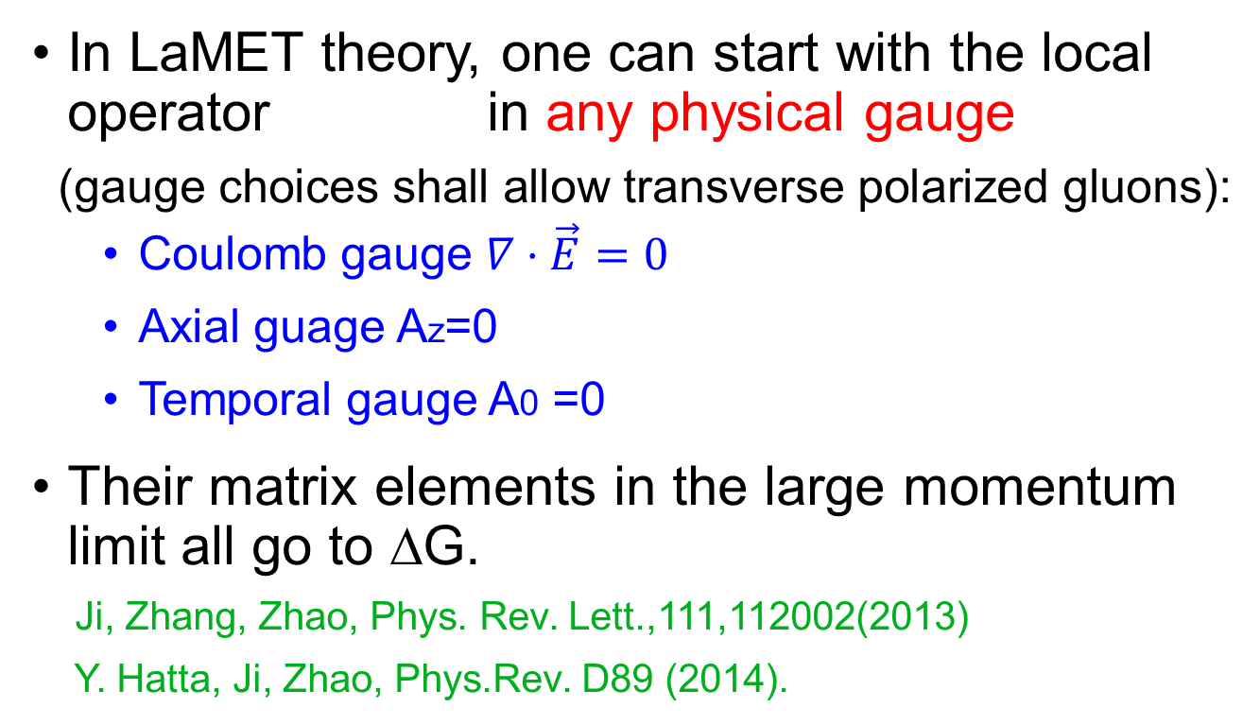
LaMET calculations
In LaMET theory, one can start with the local operator in any physical gauge
(gauge choices shall allow transverse polarized gluons):
  Coulomb gauge $∇⋅\vec{E}=0$
  Axial guage Az=0
  Temporal gauge A0 =0
Their matrix elements in the large momentum limit all go to ΔG.
Ji, Zhang, Zhao, Phys. Rev. Lett.,111,112002(2013)
Y. Hatta, Ji, Zhao, Phys.Rev. D89 (2014).

Slide 25
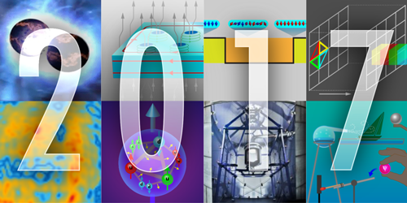
First calculation (Y. Yang et al, PRL(2017), χQCD)
Gluons Provide Half of the Proton’s Spin
The gluons that bind quarks together in nucleons provide a considerable chunk of the proton’s total spin. That was the conclusion reached by Yi-Bo Yang from the University of Kentucky, Lexington, and colleagues (see Viewpoint: Spinning Gluons in the Proton). By running state-of-the-art computer simulations of quark-gluon dynamics on a so-called spacetime lattice, the researchers found that 50% of the proton’s spin comes from its gluons. The result is in agreement with recent experiments and shows how such lattice simulations can now accurately predict an increasing number of particle properties. The simulations also indicate that, despite being substantial, the gluon spin contribution is too small to play a major part in “screening” the quark spin contribution—which according to experiments is only 30%—through a quantum effect called the axial anomaly. The remaining 20% of the proton spin is thought to come from the orbital angular momentum of quarks and gluons.
Need more controlled calculations

Slide 26
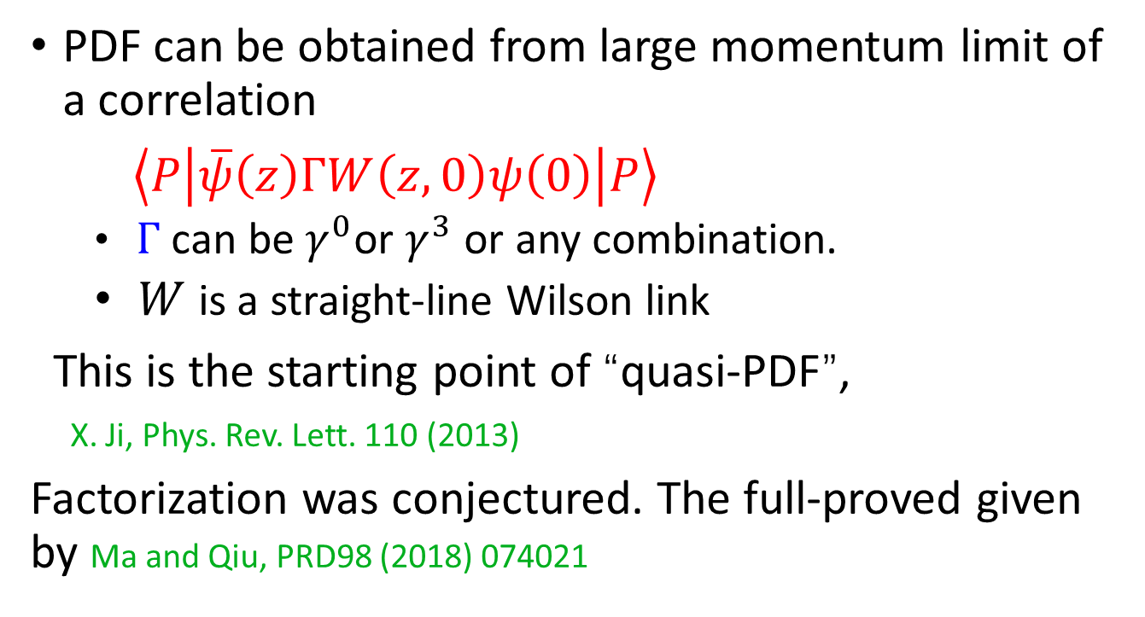
Application 2: PDFs:
PDF can be obtained from large momentum limit of a correlation
$\left\langle P\left|\overline{ψ}\left(z\right)ΓW\left(z,0\right)ψ\left(0\right)\right|P\right\rangle$
  $Γ$ can be $γ^{0}$or $γ^{3}$ or any combination.
  $W$ is a straight-line Wilson link
This is the starting point of “quasi-PDF”,
X. Ji, Phys. Rev. Lett. 110 (2013)
Factorization was conjectured. The full-proved given by Ma and Qiu, PRD98 (2018) 074021

Slide 27
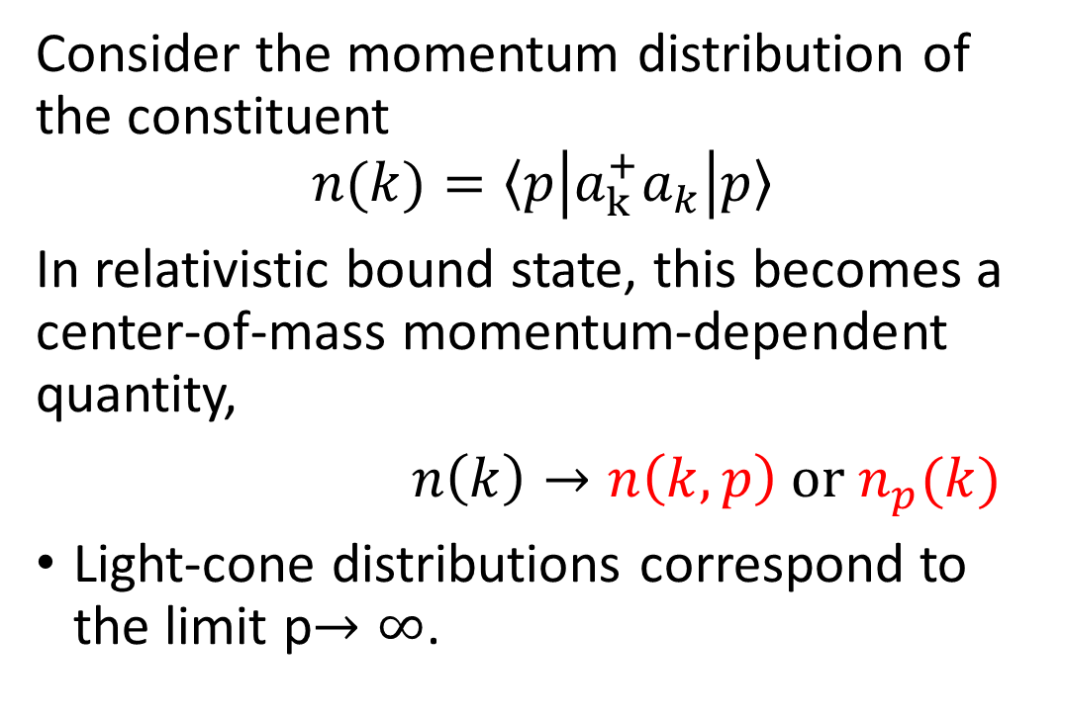
“Quasi”-PDF is really a physical PDF!
Consider the momentum distribution of the constituent
$$n(k)=〈p\left|a_{k}^{+}a_{k}\right|p〉$$
In relativistic bound state, this becomes a center-of-mass momentum-dependent quantity,
$n\left(k\right)→n\left(k,p\right) or n_{p}(k)$
Light-cone distributions correspond to the limit p$→∞$.

Slide 28
State-of-the-art calculations
ETMC PRL121(2018) 112001; LP3 PRL121(2018) 242003
All analysis shall have controlled approximations
  One-loop matching and scale setting, renormalization
  Excited states, higher twist corrections
Different methods of analyzing the same date is possible, but no fundamental difference expected
  “Pseudo-PDF” : A. Radyushkin, PRD96 (2017) 034025
  Coordinate space approach, related to quasi-PDF by Fourier transf.
  One-loop factorization given by
  Ji，Zhang, Zhao, NPB924(2017) 366, Izubuchi et al. PRD98 (2018）

Slide 29
Isovector helicity distribution, from LP3 Collaboration （H.W.Lin et al, PRL, 2019)

Slide 30
Comparison with data

Slide 31
ETMC recent result
C. Alexandrou et al, Phys.Rev.Lett. 121 (2018) no.11, 112001

Slide 32
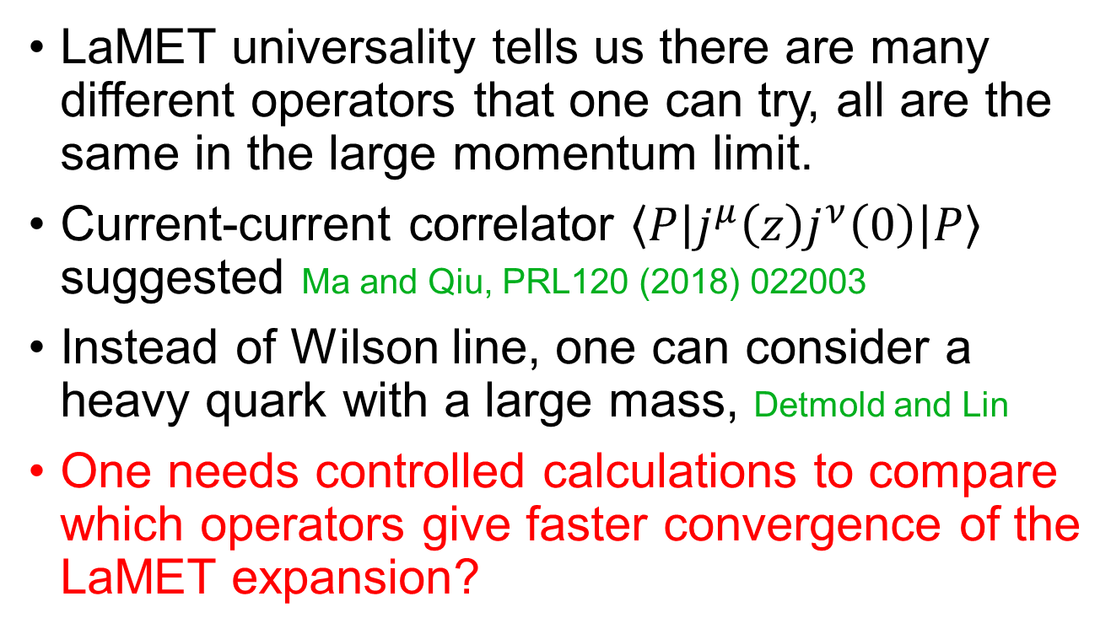
Alternative Euclidean operators
LaMET universality tells us there are many different operators that one can try, all are the same in the large momentum limit.
Current-current correlator $\left\langle P\left|j^{μ}\left(z\right)j^{ν}\left(0\right)\right|P\right\rangle$ suggested Ma and Qiu, PRL120 (2018) 022003
Instead of Wilson line, one can consider a heavy quark with a large mass, Detmold and Lin
One needs controlled calculations to compare which operators give faster convergence of the LaMET expansion?

Slide 33
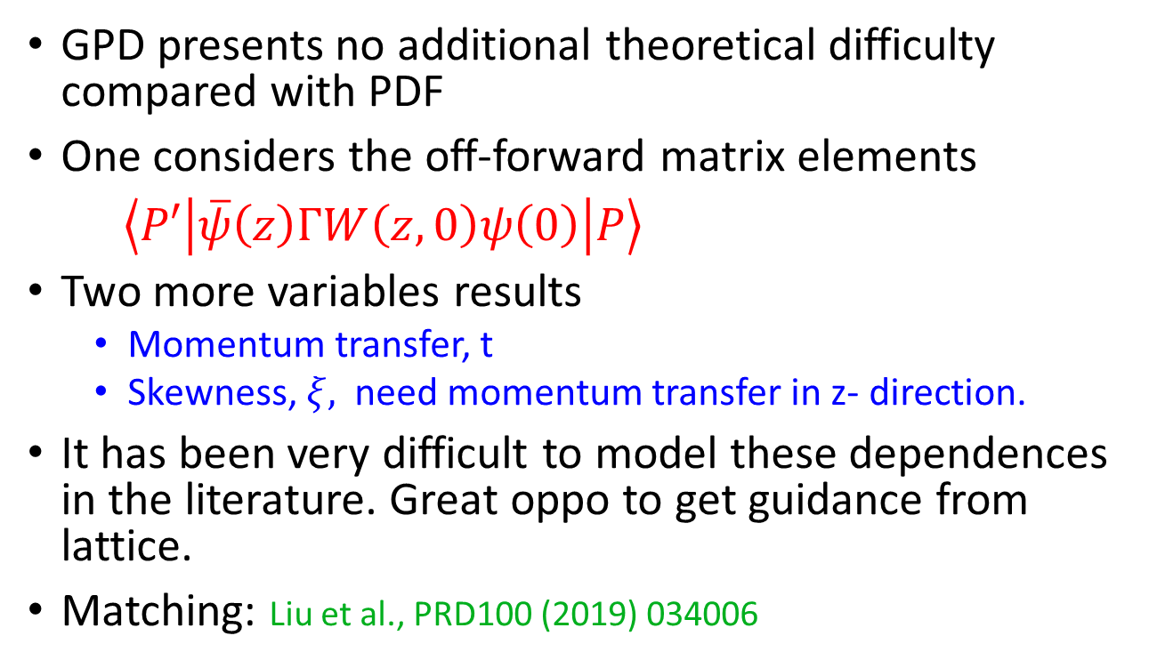
Application 3: Generalized parton distributions (GPD)
GPD presents no additional theoretical difficulty compared with PDF
One considers the off-forward matrix elements
$\left\langle P′\left|\overline{ψ}\left(z\right)ΓW\left(z,0\right)ψ\left(0\right)\right|P\right\rangle$
Two more variables results
  Momentum transfer, t
  Skewness, $ξ,$need momentum transfer in z- direction.
It has been very difficult to model these dependences in the literature. Great oppo to get guidance from lattice.
Matching: Liu et al., PRD100 (2019) 034006

Slide 34
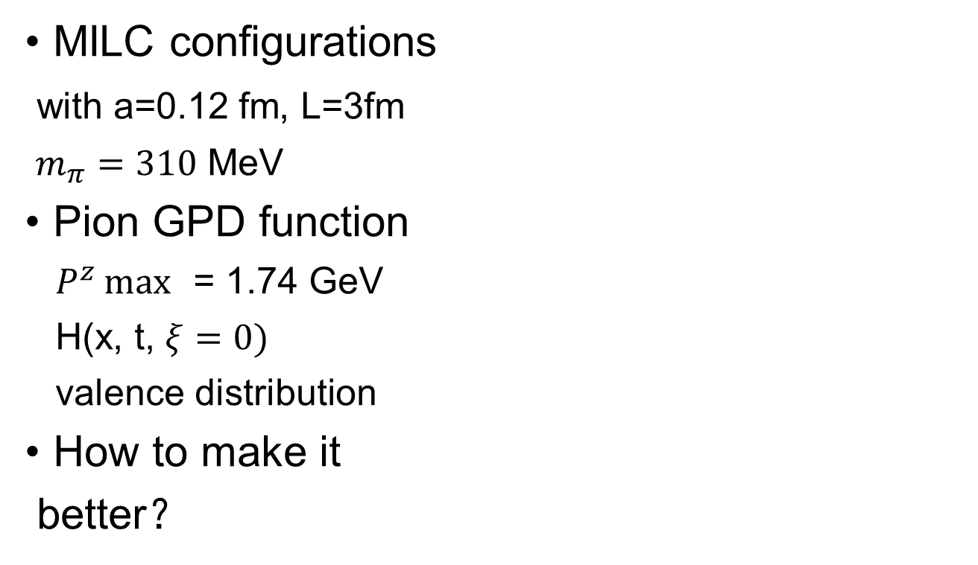
Exploratory study 1: Chen, Lin, Zhang, 1094.1237
MILC configurations
with a=0.12 fm, L=3fm
$m_{π}=310$ MeV
Pion GPD function
$P^{z}\max{ }$= 1.74 GeV
H(x, t, $ξ=0)$
valence distribution
How to make it
better？

Slide 35
Exploratory study 2: ETMC, Xiv:1910.13229

Slide 36
GPD Femtography
GPD computation through LaMET will be critically important for the Jefferson Lab 12 GeV program.

Slide 37
Application 4: TMD-PDFs
A very important nucleon observable, many phenomenology related to spin physics (Sivers effect etc).
TMD collaborations supported by DOE （Qiu, Detmold)
Lattice calculations started from A. Schafer et al., much progress; no x dependence has yet been studied.
Yoon et al. PRD96,094508 (2017)
A number of LaMET formulations:
Ji et al., PRD91,074009 (2015); PRD99,114006(2019)
Ebert, Stewart, Zhao, PRD99,034505 (2019), JHEP09,037(2019); arXiv:1910.08569
Collins-Soper kernel can be calculated!

Slide 38
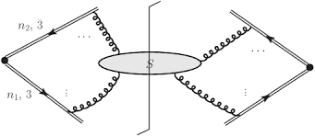
Soft factor
Soft factor involves two light-cone directions, difficult to calculate on lattice.
In a new LaMET formulation
Soft factor can be calculated as
a form factor of a pair of color-anticolor sources.
Ji, Liu & Liu, arXiv:1910.11415
Two lattice groups:
MIT on Collins-Soper evolution kernel
LPC group on soft function (LSC)

Slide 39

Target TMDPDFs Ebert, Stewart, Zhao
Dim. reg. and MS-bar scheme, just like the standard PDF.
Rapidity (light-cone) divergence: extra regulator, there are many version in the literature. One that is consistent up to three-loop is “exponential regulator” Li & Zhu, PRL (2017)
The “physical TMD-PDFs” are regulator-indept.
$$σ_{DY}∼f^{TMD}f^{TMD}$$

Slide 40
Lattice q-TMDPDF
q-TMDPDF without subtraction JI, Yuan, et al. Ebert et al
With subtraction Ji, Liu, Liu, to appear

Slide 41
All-order matching formula
Ji, Liu, Liu, to appear
To all orders in perturbation
RG equation for matching coefficient

Slide 42
Wigner function
Wigner function can be calculated with similar approach as TMD-PDFs and GPDs
They may be probe in certain processes in EIC. Y. Hatta, B. Xiao, F. Yuan PRL (2016）

Slide 43
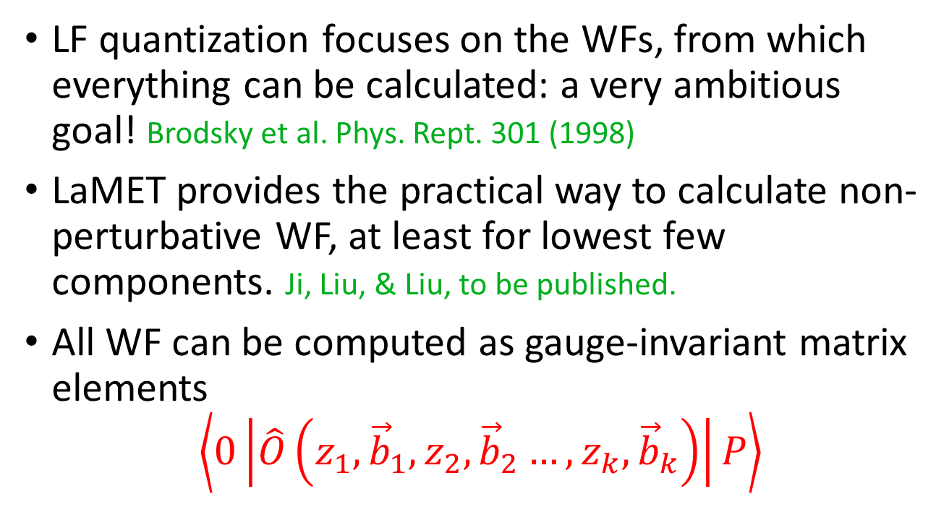
App. 5： Light-Front Wave-Functions
LF quantization focuses on the WFs, from which everything can be calculated: a very ambitious goal! Brodsky et al. Phys. Rept. 301 (1998)
LaMET provides the practical way to calculate non-perturbative WF, at least for lowest few components. Ji, Liu, & Liu, to be published.
All WF can be computed as gauge-invariant matrix elements
$$\left\langle 0\left|\hat{O}\left(z_{1},{\vec{b}}_{1},z_{2}, {\vec{b}}_{2}…,z_{k},{\vec{b}}_{k}\right)\right|P\right\rangle$$

Slide 44
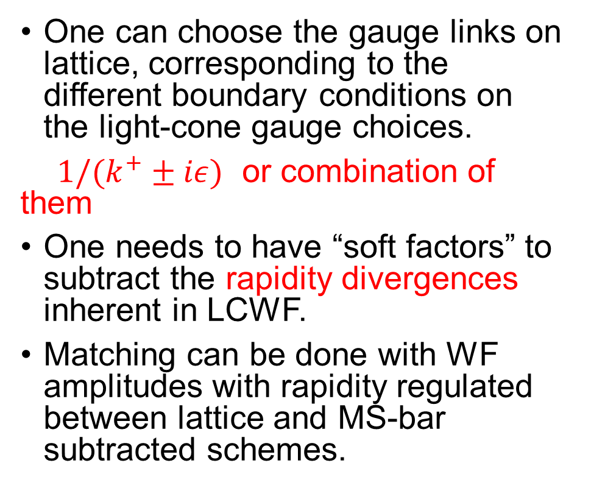
Additional comments about LCWF
One can choose the gauge links on lattice, corresponding to the different boundary conditions on the light-cone gauge choices.
$1/(k^{+}±iε)$ or combination of them
One needs to have “soft factors” to subtract the rapidity divergences inherent in LCWF.
Matching can be done with WF amplitudes with rapidity regulated between lattice and MS-bar subtracted schemes.

Slide 45
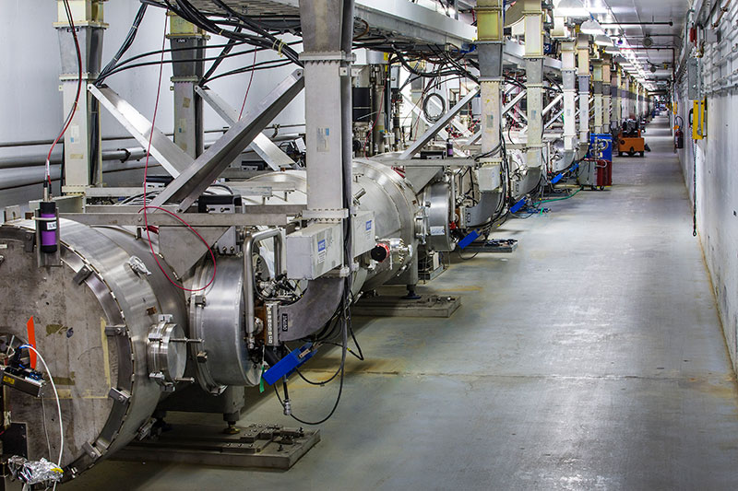
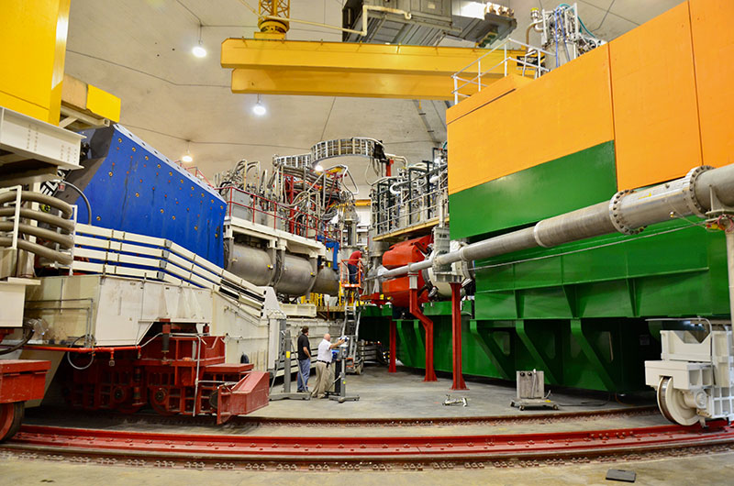
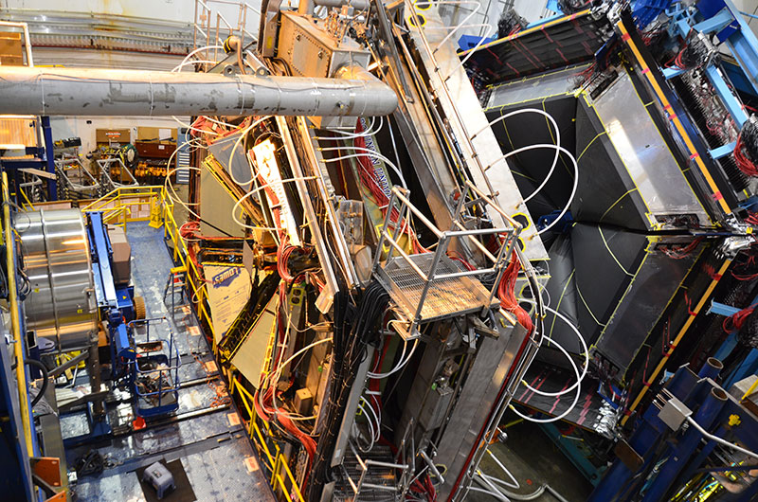
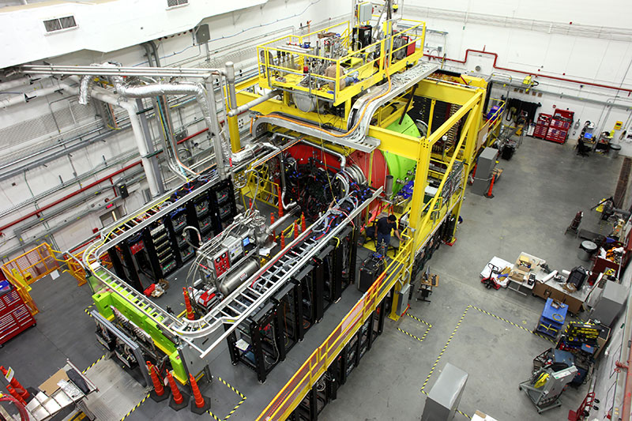
Jlab 12 GeV: now the best DVCS facility in the world!

Slide 49
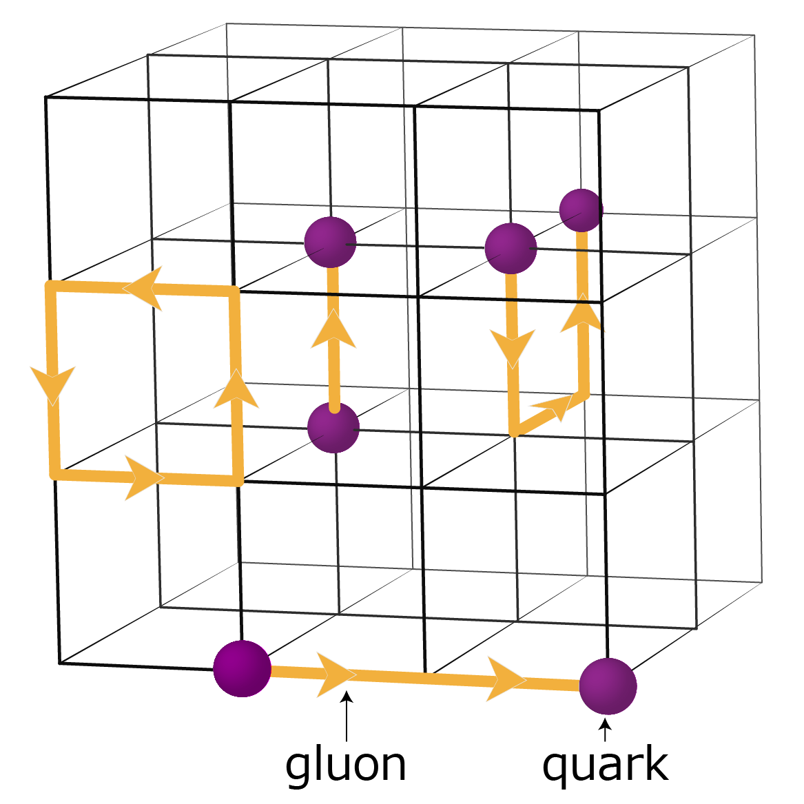
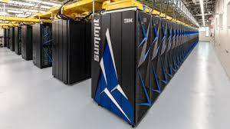
Testing the limits of our understanding:
Femtography from
Numerical Quantum Field Theory

Slide 50
There is lots of work to do
DVCS experiments, more precise data, more analysis work.
There need be matching lattice efforts for GPDs.
More Nature and Science to come!

Slide 51

Thank you, Volker,
for the outstanding scientific achievements and
the inspiring leadership!

