Slide 1
sQCD 2019 … Theory Summary
Craig Roberts … http://inp.nju.edu.cn/

Slide 2
sQCD2019 … Theory Coverage
Outsider perspective
Nuclear Structure
Draayer ... Paving the way to Understand Nuclear Structure from Strong QCD
Encouraging “us” to look beyond our own problems and attempt to expose some simpler order in the spectrum of hadrons
Successes/Advances/Potential for lQCD
Distribution functions
Qiu ... New horizons for the strong QCD theory in the 12 GeV era at JLab
Lin, H.-W. ... Parton Distributions in Meson and Baryons from Lattice QCD
Radyushkin ... Novel Concepts for Evaluation of the Parton Distributions from QCD
N* spectroscopy
Doering ... Advances in the Coupled Channel Approaches for N* Parameter Extraction
Briceno ... Ab initio QCD Descriptions of the Hadron Spectrum and Elastic/Transition Electromagnetic Form Factors

Slide 3
Theory Coverage
Imaging
Vanderhaeghen … N and N* Structure in 3D
Liuti ... Mapping the Energy-Momentum Tensor: From Nucleons to Stars
TMD Status
Radici ... Relating TMD Phenomenology to QCD
Physics Analysis
Szczepaniak ... Amplitude Analyses of Meson Photo-/Electroproduction Data with Electromagnetic Probes.
Hiller-Blin ... Resonant Contributions into Inclusive Electron Scattering from the Data on gamma_vpN* Electrocouplings
Quark Models
Kim, H.-C. ... Hadron Spectra and the Electromagnetic Elastic/Transition Form Factors from Quark Models

Slide 4
Theory Coverage
1D PDF Update
Andres ... Parton Distributions from the Global Analyses of Experiments with Electromagentic Probes
Strong QCD via Theory and Phenomenology of Schwinger Functions
Roberts ... Connecting Strong QCD with Hadron Structure Experiments
Segovia ... Strong QCD from the Resonance Electrocouplings Within Continuum QCD Approaches
Rodriguez-Quintero ... GPD Modeling with Continuum QCD
Mezrag ... Modeling of Baryon and Meson DAs, and their Relevance for DVMP
Open Table
2.5 hour discussion of a set of 5 × 2 = 10 questions.
From the QCD Lagrangian to Hadron Structure and Interactions: a 50-year Experience
Brodsky

Slide 5
Theory Coverage
Outsider perspective
Nuclear Structure
Draayer ... Paving the way to Understand Nuclear Structure from Strong QCD
Encouraging “us” to look beyond our own problems and attempt to expose some simpler order in the spectrum of hadrons

Slide 6
Theory Coverage
Symplectic Shell Model

Slide 7
Theory Coverage
Are nucleons deformed?
How can we see that, if they are?
HPC is invaluable, but it is even more powerful if one can find and exploit simplicity in complexity

Slide 8
Theory Coverage
Successes/Advances/Potential for lQCD
Distribution functions
Qiu ... New horizons for the strong QCD theory in the 12 GeV era at JLab
Lin, H.-W. ... Parton Distributions in Meson and Baryons from Lattice QCD
Radyushkin ... Novel Concepts for Evaluation of the Parton Distributions from QCD
N* spectroscopy
Doering ... Advances in the Coupled Channel Approaches for N* Parameter Extraction
Briceno ... Ab initio QCD Descriptions of the Hadron Spectrum and Elastic/Transition Electromagnetic Form Factors

Slide 12
Theory Coverage
Imaging
Vanderhaeghen
… N and N* Structure in 3D

Slide 13
Theory Coverage
Imaging
Nucleon and its excited states are deformed
Deformation is measurable in transition form factors

Slide 14
Theory Coverage
Imaging
DVCS provides the means to access GPDs

Slide 15
Theory Coverage
Imaging
Liuti ... Mapping the Energy-Momentum Tensor: From Nucleons to Stars
GPDs are the key to interpret the mechanical properties of strongly interacting systems

Slide 16
Theory Coverage
Imaging
Liuti ... Mapping the Energy-Momentum Tensor: From Nucleons to Stars

Slide 17
Theory Coverage
TMD Status
Radici ... Relating TMD Phenomenology to QCD
Comprehensive overview of existing data and modern phenomenological analysis and intepretation

Slide 18
Theory Coverage

Slide 19
Theory Coverage
1D PDF Update
Andres ... Parton Distributions from the Global Analyses of Experiments with Electromagentic Probes
JAM19 … J.J. Ethier, W. Melnitchouk, N. Sato, and Yiyu Zhou
1st simultaneous analysis of unpolarized PDFs and FFs … producing information on strange quark PDF
Notes:
SIA = single inclusive annihilation

Slide 20
Theory Coverage
1D PDF Update
Andres ... Parton Distributions from the Global Analyses of Experiments with Electromagentic Probes
JAM19 … J.J. Ethier, W. Melnitchouk, N. Sato, and Yiyu Zhou
1st simultaneous analysis of unpolarized PDFs and FFs … producing information on strange quark PDF
SIDIS instrumental

Slide 21
Theory Coverage
Physics Analysis
Szczepaniak ... Amplitude Analyses of Meson Photo-/Electroproduction Data with Electromagnetic Probes.
Hiller-Blin ... Resonant Contributions into Inclusive Electron Scattering from the Data on gamma_vpN* Electrocouplings

Slide 22
Theory Coverage
Physics Analysis
Szczepaniak ... Amplitude Analyses of Meson Photo-/Electroproduction Data with Electromagnetic Probes.
Overview of wide-ranging JPAC effort
Extensive international collaboration

Slide 23
Theory Coverage
Physics Analysis
Szczepaniak ... Amplitude Analyses of Meson Photo-/Electroproduction Data with Electromagnetic Probes.
Overview of wide-ranging JPAC effort
Extensive international collaboration
Many highlights
E.g. π₁ exotic

Slide 24
Theory Coverage
Physics Analysis
Szczepaniak ... Amplitude Analyses of Meson Photo-/Electroproduction Data with Electromagnetic Probes.
Overview of wide-ranging JPAC effort
Extensive international collaboration
Many highlights
E.g. π₁ exotic
Coupled-channel amplitude analysis that enforces unitarity and analyticity of the S-matrix.
A single exotic π₁ resonant pole
No evidence for a second exotic state.

Slide 25
Theory Coverage
Physics Analysis
Hiller-Blin

Slide 26
Theory Coverage
Physics Analysis … Hiller-Blin
Unpolarized inclusive cross sections have a very intricate Q² and x-dependence in the resonance region.
Best understood by studying the electro-production of each of the separate N* and Delta resonances and combining the information about their electro-couplings.
Understanding the transition of structure functions between low and high x at non-vanishing Q² is crucial for a sound determination of integrated observables such as the muonic hydrogen Lamb shift.
Proposed combined parametrization of the structure functions for low and high energies
Obeys dispersion relations
Recovers proper threshold and resonance-region behaviour at low energies, and the Regge limit at high energies.
Works well at low Q²
Going to higher Q² is currently work in progress.

Slide 27
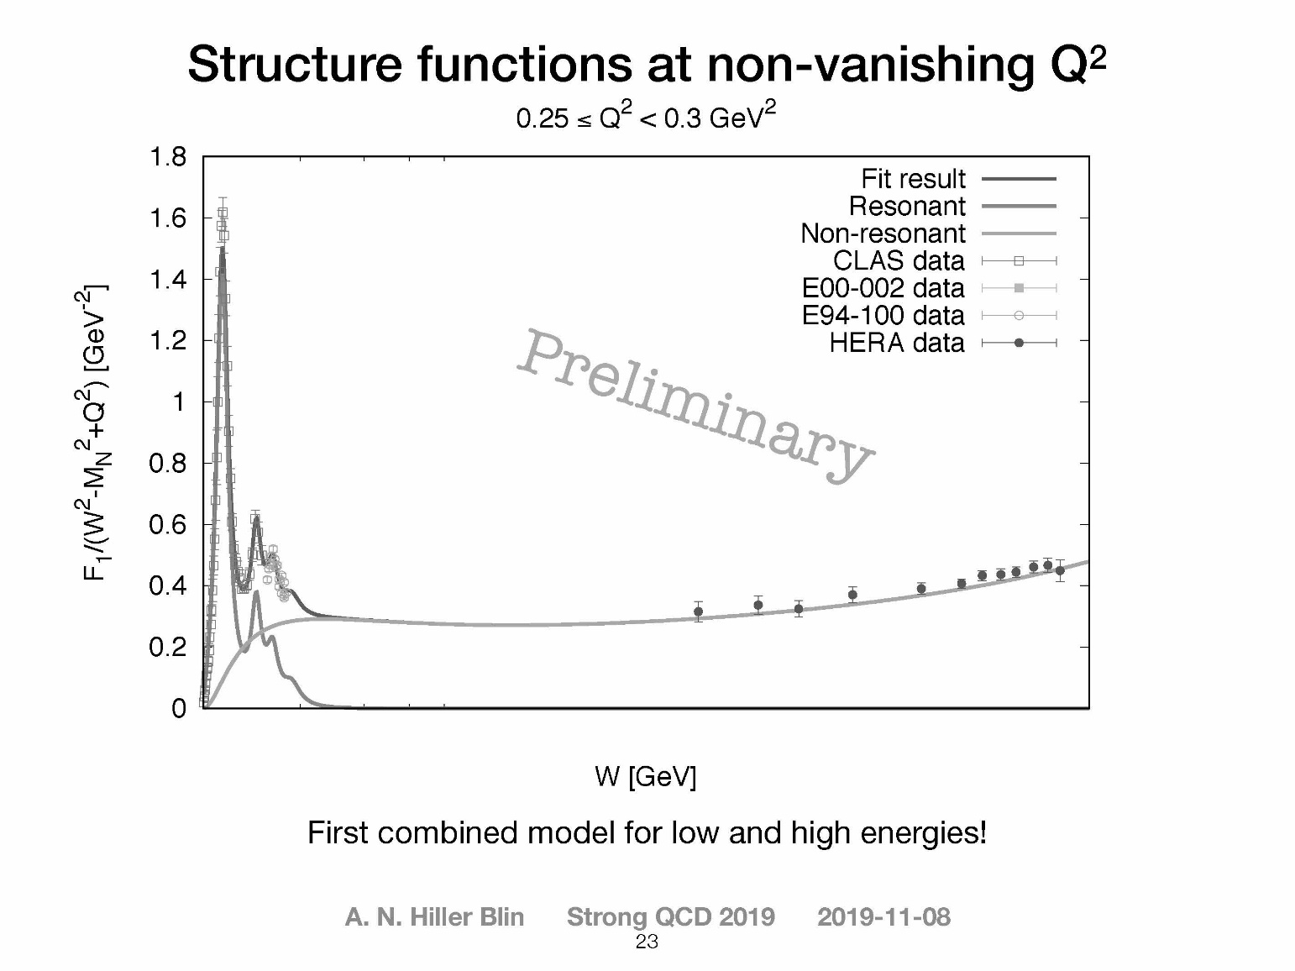
Theory Coverage
Physics Analysis … Hiller-Blin
Unpolarized inclusive cross sections have a very intricate Q² and x-dependence in the resonance region.
Best understood by studying the electro-production of each of the separate N* and Delta resonances and thus using the information about their electro-couplings.
Understanding the transition of structure functions between low and high x at non-vanishing Q² is crucial for a sound determination of integrated observables such as the muonic hydrogen Lamb shift.
Proposed combined parametrization of the structure functions for low and high energies
Obeys dispersion relations
Recovers proper threshold and resonance-region behaviour at low energies, and the Regge limit at high energies.
Works well at low Q²
Going to higher Q² is currently work in progress.

Slide 28
Theory Coverage
Chiral Quark Soliton Model
Kim, Hyun-Chul ... Hadron Spectra and the Electromagnetic Elastic/Transition Form Factors from Quark Models
Illustration of a wide range of applications
em form factors of baryon decuplet

Slide 29
Theory Coverage
Chiral Quark Soliton Model
Kim, Hyun-Chul ... Hadron Spectra and the Electromagnetic Elastic/Transition Form Factors from Quark Models
Illustration of a wide range of applications
em form factors of baryon decuplet
Multipole patterns in transverse plane
(“conversation” with Draayer)

Slide 30
Theory Coverage
Chiral Quark Soliton Model
Kim, Hyun-Chul ... Hadron Spectra and the Electromagnetic Elastic/Transition Form Factors from Quark Models
Illustration of a wide range of applications
em form factors of baryon decuplet
Multipole patterns in transverse plane
(“conversation” with Draayer)
Gravitational form factors of nucleon
and pion

Slide 31
Theory Coverage
Chiral Quark Soliton Model
Kim, Hyun-Chul ... Hadron Spectra and the Electromagnetic Elastic/Transition Form Factors from Quark Models
Illustration of a wide range of applications
em form factors of baryon decuplet
Multipole patterns in transverse plane
(“conversation” with Draayer)
Gravitational form factors of nucleon
and pion
Opportunities & Plans for improvement

Slide 32
Theory Coverage
Strong QCD via Continuum Theory and Phenomenology of Schwinger Functions
Roberts ... Connecting Strong QCD with Hadron Structure Experiments
Segovia ... Strong QCD from the Resonance Electrocouplings Within Continuum QCD Approaches
Rodriguez-Quintero ... GPD Modeling with Continuum QCD
Mezrag ... Modeling of Baryon and Meson DAs, and their Relevance for DVMP

Slide 33
Theory Coverage
Theory & Phenomenology of Schwinger Functions
Rodriguez-Quintero & Mezrag
20-year of study of QCD’s gauge and matter sectors have provided a picture of emergent mass

Slide 34
Theory Coverage
Theory & Phenomenology of Schwinger Functions
Rodriguez-Quintero & Mezrag
20-year of study of QCD’s gauge and matter sectors have provided a picture of emergent mass
Enabling a unified explanation of sQCD phenomena

Slide 35
Theory Coverage
Theory & Phenomenology of Schwinger Functions
Rodriguez-Quintero & Mezrag
20-year of study of QCD’s gauge and matter sectors have provided a picture of emergent mass
Enabling a unified explanation of sQCD phenomena
Predictions for others in many sectors

Slide 36
Theory Coverage
Feedback and cross-fertlisation
Continuum & lattice QCD

Slide 37
Theory Coverage
Open Table … Friday evening, until late
2.5 hour discussion of a set of 5 × 2 = 10 questions.
Moderator Dr. V.I. Mokeev
Panelists = V.D. Burkert, A. Deshpande, S. Kuhn, D.G. Richards, M. Vanderhaegen
Wide-ranging open discussion of 10 questions at the heart of strong QCD
Conversation between experiment and theory

Slide 38
Theory Coverage
What can be learned about strong QCD from the combined investigation of the ground and excited state nucleons? How can the results on N* structure affect the exploration of the ground state nucleon structure, and vice versa?
How can future experiments with electromagnetic probes improve our knowledge on the pressure distribution within the nucleon? How could these results be used for the exploration of the strong QCD dynamics that underlie the pressure part of the energy-momentum tensor?
What is the scope of effort needed in the phenomenological analysis of experimental data in order to extract the transition N→N* GPDs?
How can we use the constraints from the results on the g_{v}pN* electrocouplings for the extraction of the transition N→N* GPDs from the data? How will the transition GPDs extend our knowledge on strong QCD?

Slide 39
Theory Coverage
What can we (still) learn from measuring collinear structure functions (polarized and unpolarized) of hadrons at JLab with 12 GeV and at the EIC, and how can we maximize the information we can extract from such measurements?
The inclusive (and SIDIS) kinematic coverage can be extended towards large xB in the resonance region by employing the g_{v}pN* electrocoupling data. How can we use these results in the exploration of the parton distributions with a traceable connection to QCD?
What are the prospects for the evaluation of the meson and baryon spectra, elastic and transition electromagnetic form factors, and the parton structure functions from the first principles of QCD in the approach to the exascale era, and what are the computational and theoretical challenges?

Slide 40
Theory Coverage
What is the needed interplay between experiment, phenomenology, theory in order to shed light on the connection between hadron mass generation and dynamical chiral symmetry breaking? How can the data on the g_{v}pN* electrocouplings of chiral-partner resonances be used for the exploration of this connection?
What should be done in the development of the phenomenological data analyses to be prepared for the extraction of QCD-interpretable quantities from the future data with the US EIC.
How can we gain insight into hadron mass generation and the mass and pressure distributions within nucleons and nuclei from future EIC studies of the nucleon glue component? Can the saturation regime manifest itself in the particular behavior of the mass and pressure distributions at small x_{B}?

Slide 41
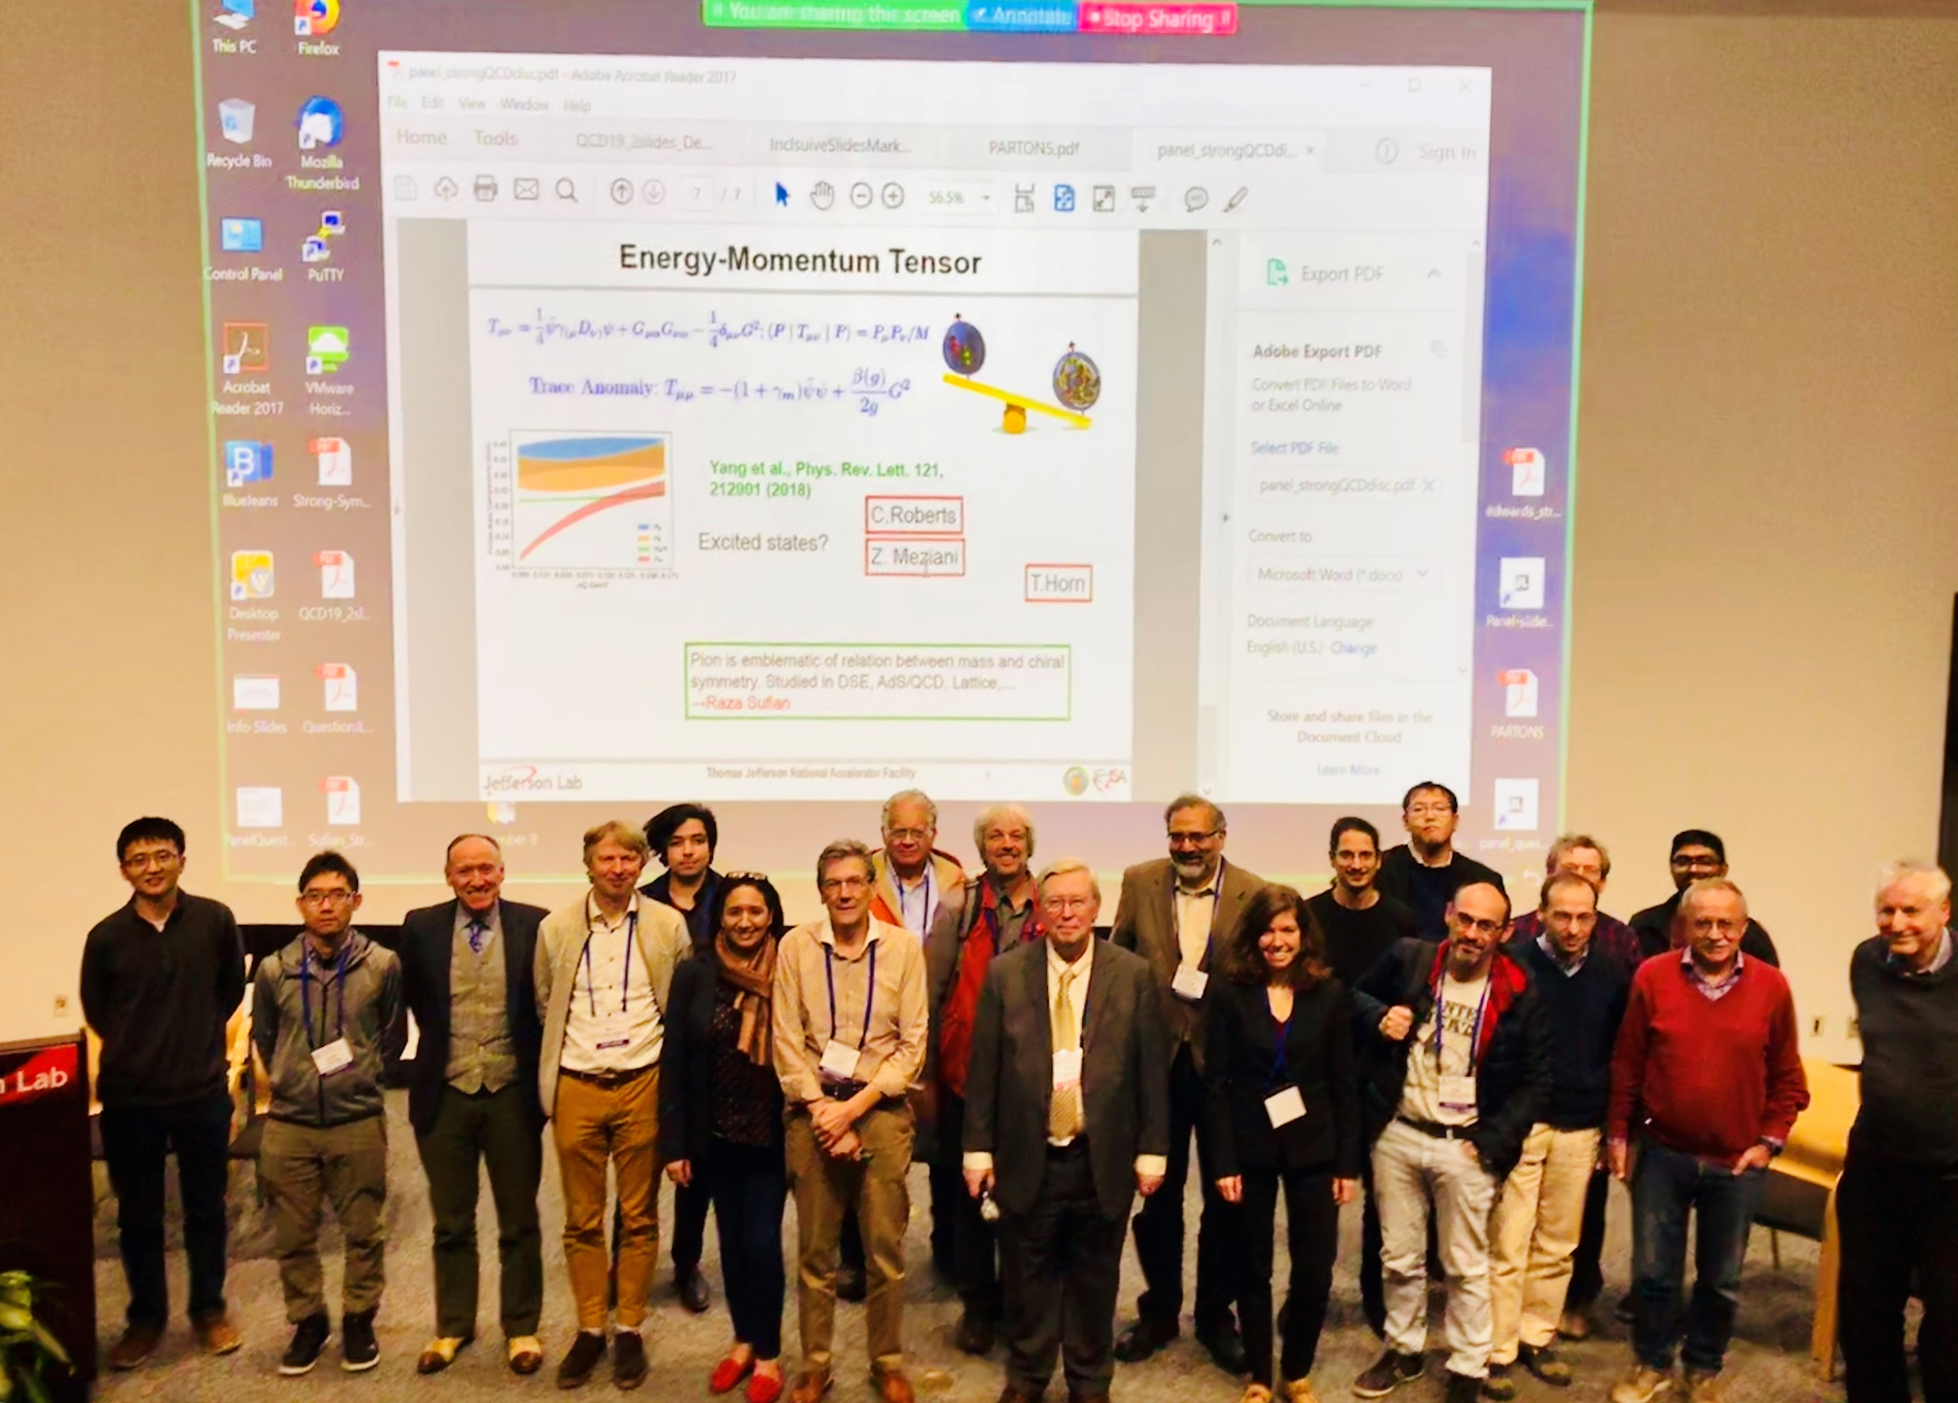
The End of The Beginning
Marathon!
20 runners made it to the finish line
All Still Smiling

Slide 42
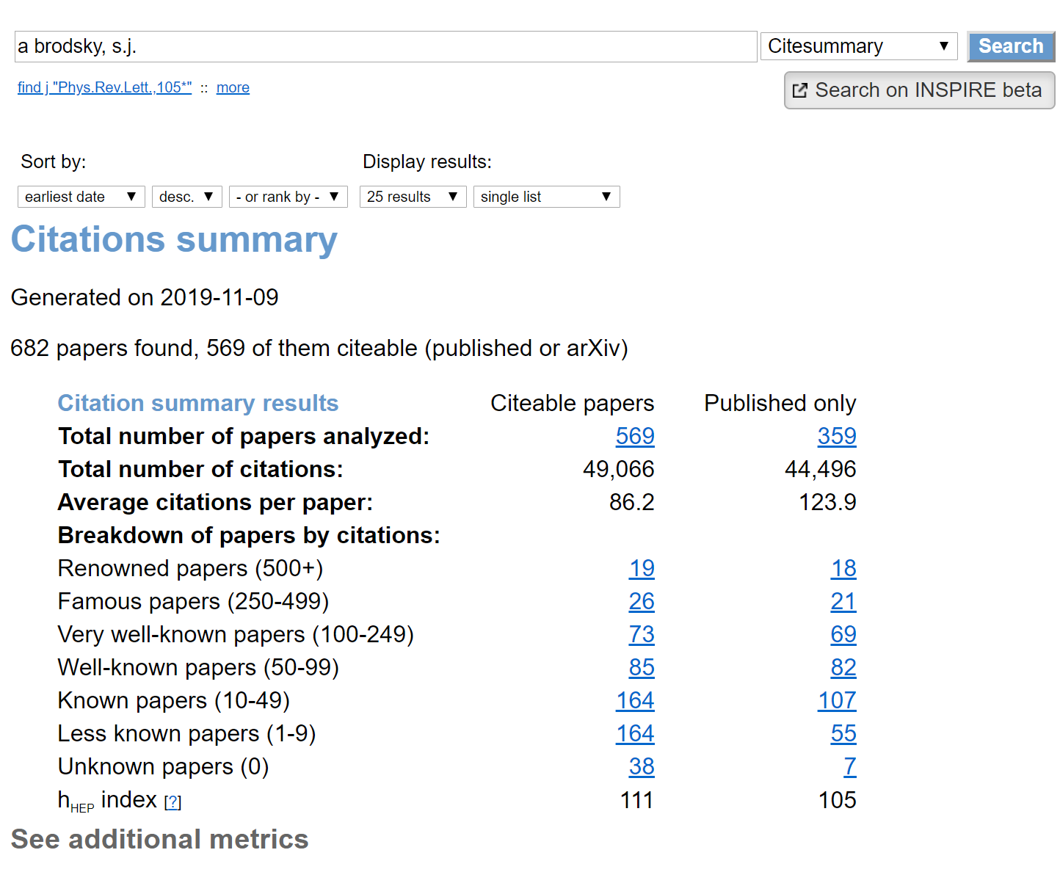
Theory Coverage
Dinner Presentation: >50 years with QCD
Enormous, Positive & Indelible Impact
on QCD Experiment and Theory

Slide 43
sQCD2019 … Outlook
Last workshop … The Nature of Hadron Mass and Quark-Gluon Confinement from JLab Experiments in the 12-GeV Era: 1-4 July 2018, Asia Pacific Centre for Theoretical Physics, Pohang, South Korea
Remarkable progress in the intervening 16 months
Obvious enthusiasm to continue shown by entire community
Inspiration found in many areas, especially, perhaps, in:
Commencement of JLab12 era
Physics Beyond Colliders initiative at CERN
Prospects for constructing EIC
No single approach/experiment can solve this problem alone
Success being delivered by amalgam of Experiment … Phenomenology …Theory
Continue to exploit the synergies we have found and to develop more, including practitioners from other fields, e.g. imaging.

