Slide 1
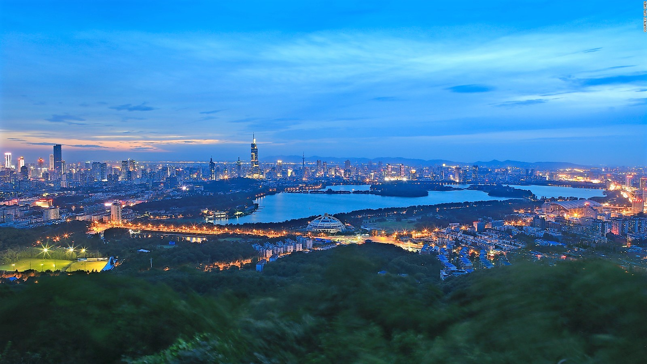
sQCD 2021
Experiment and Theory for Strong QCD
Craig Roberts … http://inp.nju.edu.cn/

Slide 2
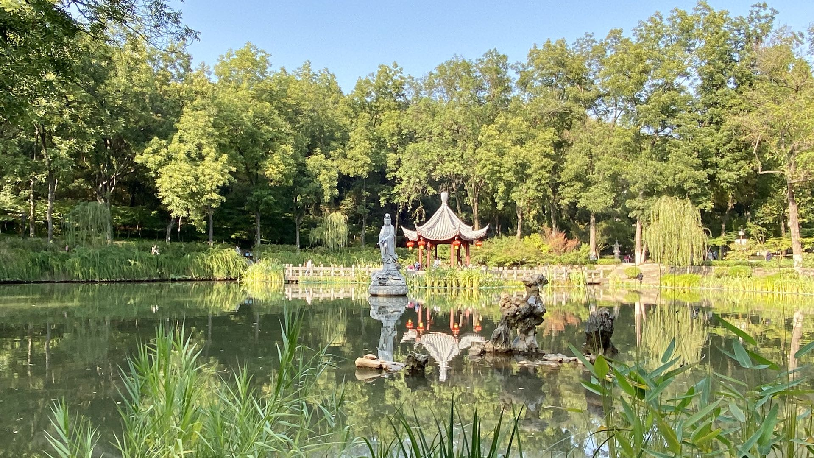
Qixia Mountain Buddhist Temple

Slide 3
sQCD 2021
This series has been hosted in
France (1st),
South Korea (2nd)
and USA (3rd)
May be appropriate for the next workshop to be in Asia once again.
INP therefore proposes that the 4th meeting in this series be held in April or May 2021 NJU INP
Nanjing, China.
Averages … 17C overnight … 25C during the day … < 10% precipitation chance

Slide 4
INP
Now … INP is “under construction”
Recruiting researchers with broad ranging interests and expertise in a wide variety of areas with focus on strong QCD
Intended that the INP will contribute to motivating experiments at the world's leading facilities and be actively involved in collaborations with scientists from around the world.
INP will
Have an active Visitor Programme, aimed at attracting and encouraging scientific exchange between institutes both nationally and internationally.
Host regular international workshops/conferences
Act to preserve and strengthen the international collaborative character of basic research.

Slide 5
Nanjing (Southern Capital)
Old Capital of Imperial China, on the banks of the Yangtze River
Approximately 300km WNW of Shanghai
From Shanghai … Nanjing can be reached via high-speed train in 1h40m.
Comfortable international airport, with direct out- and in-bound flights connecting it to many of the world's major hubs.
Compact city of 8.3-million people, with excellent public transport network
Substantial international expatriate community
Rated the most livable city in China by natives and foreigners alike.
Old Campus of NJU is located in the Gulou district.
Bustling with activity, day and night, particularly along the Shanghai Road,
Gulou is popular, e.g. with both Chinese and international students.
Home to numerous institutes of higher learning. In fact, the ratio of university students to total population is the highest in China.

Slide 6
NJU
Experience with hosting international meetings. Most recently … "9th Workshop on Hadron physics in China and Opportunities Worldwide",
24-29 July 2017, <https://indico.ihep.ac.cn//event/6610/overview>
Held in the Science and Technology Building (STB) at NJU
Fifth floor of which is now "owned" - almost exclusively - by the INP <https://goo.gl/maps/TzfMar8cPczzx5rg6>.
The STB has an excellent auditorium on the ground floor and ample space for refreshment breaks and breakout discussions.
Accommodation, 5-star Golden Eagle Summit hotel
1km away from the STB, i.e. 15 minutes walk
(good options for those on lower budgets … far cheaper and better than GRC quality)
Negotiated rate = $80/night.
Large, clean rooms … with a view
Excellent breakfast (included in the overnight rate)
Well-maintained swimming pool

Slide 7
NJU
Transportation
Air … many airlines operate direct flights into Nanjing International Airport.
Europeans, Lufthansa has a direct flight from Frankfurt.
US examples, one can use a code-share flight to reach Nanjing (one stop in Beijing) from Washington DC, from Chicago, etc.
Ground …
Taxi from Nanjing International Airport to the Golden Eagle is less-than $30.
Alternatively, with one change, at Nanjing South Railway Station, the subway will take a person to the exact location of the Golden Eagle for just $1.20.
Guides
Naturally, INP members would act as guides (meet-and-greet, etc.) for those people in need.
Safety
Perhaps, worth adding here that, unlike many western cities, Nanjing is extremely safe: a person can venture anywhere with complete confidence.
Moreover, Chinese people are extremely helpful and hospitable, so getting around without a knowledge of the language can fairly effectively be overcome.

Slide 8
We think we can serve this community well
& Hope to welcome you to Nanjing

