Slide 1
K⁻pp resonance experimental mass and width
↓
Study of Kaonic nuclei at J-PARC
Yudai Ichikawa (JAEA)
2019/11/5
Strong QCD from Hadron Structure Experiments Workshop (Reimei Workshop)

Slide 2
Contents
K⁻pp
  Introduction of K⁻pp bound system
  J-PARC E27
  J-PARC E15
Search for double kaonic nuclei at J-PARC
Study of Kaonic nuclei via ¹²C(K⁻, p) reaction
  J-PARC E05 byproduct
  Plan to measure as byproduct of J-PARC E42
Summary

Slide 3
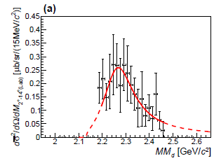
K⁻pp at J-PARC
E27: d(π⁺, K⁺pp)
E15:³He(K⁻, Λp)

Slide 4
Λ(1405)
Λ(1405) is assigned as an excited three quark baryon (u, d, s) with I = 0 and J^{P} = (1/2)⁻ in the constituent quark model.
However, the observed mass is smaller about 80 MeV than the theoretical prediction.
KN bound state(?) two pole state(?)
Many body system called as Kaonic nuclei is expected.
Ex: K⁻pp, K⁻K⁻pp, etc…
―

Slide 5
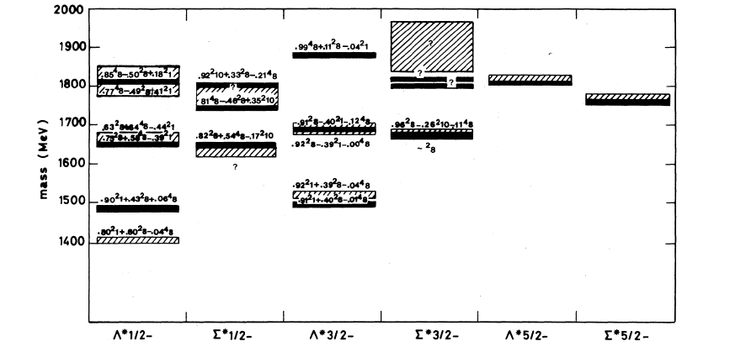
Λ(1405)
Experiment (/////) vs Quark model (―)
Larger difference with LS partner Λ(1520)
Λ(1405)
Large difference between Exp(//////) and QM(―)
Λ(1405) should not be the simple three quark state

Slide 6
K⁻pp bound state
p
K⁻
p
It is expected to be the simplest kaonic nuclei.
Total charge:+1, I = ½, J^{P} = 0⁻.
The bound state was expected due to the KN strong interaction, which is strongly attractive in I = 0.
It has a rich information such as the KN strong interaction in sub-threshold region and behavior of Λ(1405) in many body system.
It makes high density (?)
―
―

Slide 7
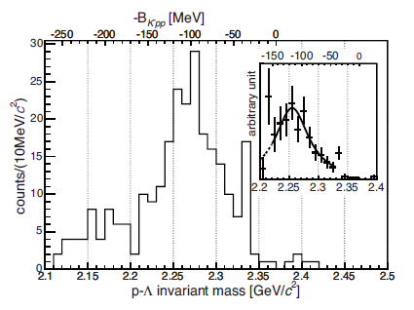
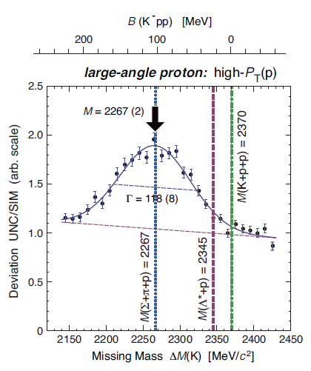
Past experiments for the K⁻pp before J-PARC
FINUDA experiment
  Stopped K⁻ absorption on ^{6,7}Li and ¹²C.
  Invariant mass of back-to-back Λp pairs.
  BE: 115 (stat.) (syst.)MeV,
  Γ: 67 (stat.) (syst.)MeV
DISTO experiment
  pp→K⁺Λp reaction at T_{p}=2.85GeV.
  K⁺ missing mass and Λp invariant mass.
  BE: 103 ±3(stat.) ±5(syst.)MeV,
  Γ: 118 ±8(stat.) ±10(syst.)MeV
M. Agnello et al., PRL 94, 212303 (2005).
+6
−5
+3
−4
+14
−11
+2
−3
T. Yamazaki et al., PRL 104, 132502 (2010).

Slide 8
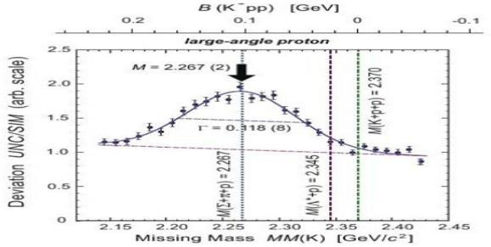
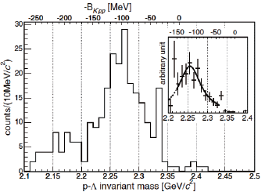
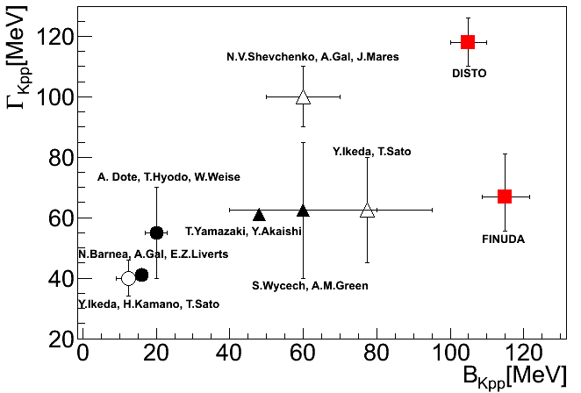
Comparison BE and Γ of the K⁻pp
―
Theoretical values of BE and Γ strongly depend on the KN interaction and calculation method.
Theoretical values can’t reproduce the experimental ones.
Experimental values are not consistent with each other.
→ Further experiment is necessary.
[K⁻pp: Exp vs Theory before J-PARC Exp]
DISTO
K⁻+p+p=2.37GeV
FINUDA
K⁻+p+p=2.37GeV
T.Yamazaki et al., PRL 104, 132502 (2010)
M.Agnello et al., PRL 94, 212303 (2005)
Calculation | K^{bar}-N interaction | Calculation method
● | Chiral | Variational
○ | Chiral | Faddeev
▲ | Phenomenological | Variational
△ | Phenomenological | Faddeev
■: Experiment

Slide 9
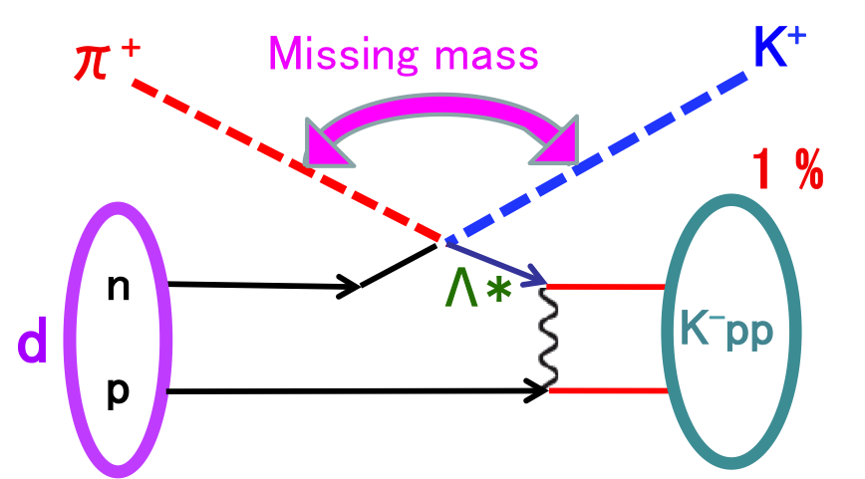
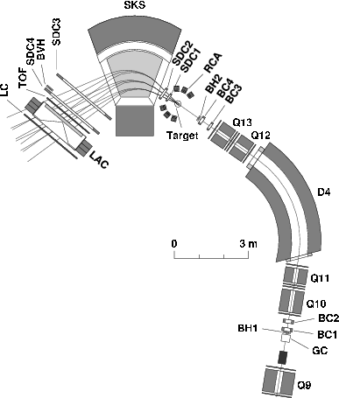
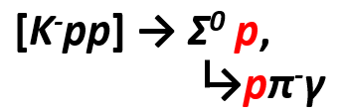
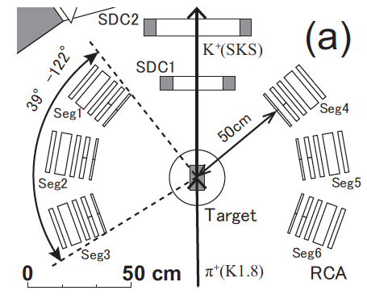
E27: K⁻pp search via the d(π⁺, K⁺)
π⁺
K⁺
SKS Spectrometer
K⁺
π⁺
[Range counter array (RCA)]
K⁺
p
p
K1.8 ビームライン
スペクトロメータ
K1.8 beam line
spectrometer
π⁺
p_{π} = 1.69 GeV/c
p_{π} = 1.69 GeV/c

Slide 10
E27 coincidence result
Broad enhancement ~2.28 GeV/c² has been observed in the Σ⁰p spectrum.
  Mass: (BE: )
  Width:
  dσ/dΩ_{``K}‐_{pp’’→Σ}0_{p} =
<2proton coincidence analysis>
π⁺d→K⁺X, X→Σ⁰p
Y. Ichikawa et al., PTEP 2015, 021D01(2015).

Slide 11
E15: K⁻pp search via the ³He(K⁻, n)

Slide 12
E15 results
Acceptance
Correction
350 <
q
< 650 MeV/c

Slide 13
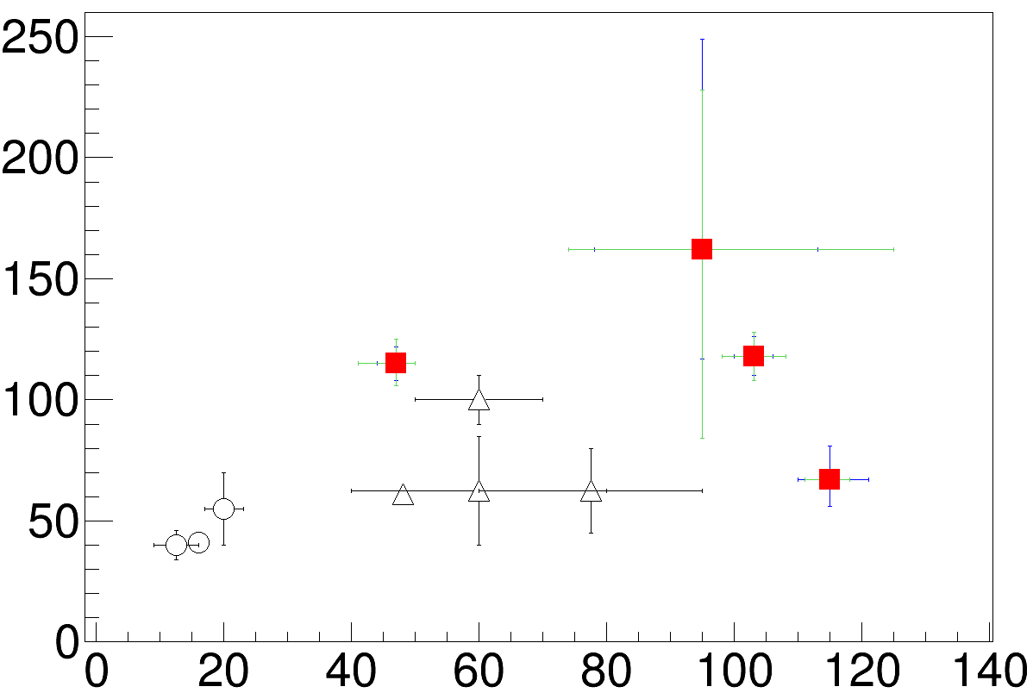
K⁻pp
J-PARC E15: ³He(K⁻, Λp)n
J-PARC E27: d(π⁺, K⁺)Σ⁰p
Y. Ichikawa et al., PTEP 2015, 021D01(2015).
p
K⁻
p
DISTO: p(p, K⁺)Λp
K⁻+p+p=2.37GeV
△= Phenomenological
◯= Chiral
■= Exp.
T.Yamazaki et al., PRL 104, 132502 (2010)
Γ [MeV]
FINUDA: stopped K⁻
M.Agnello et al., PRL 94, 212303 (2005)
Binding Energy [MeV]

Slide 14
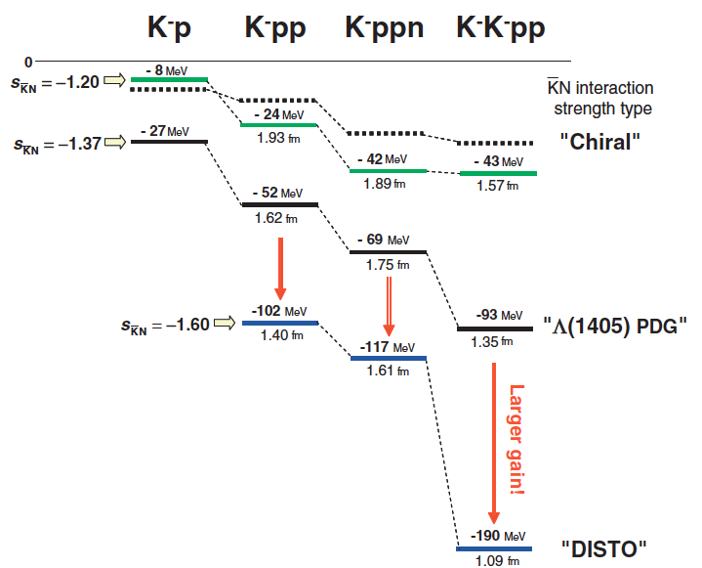

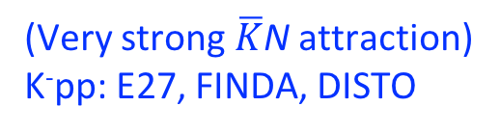
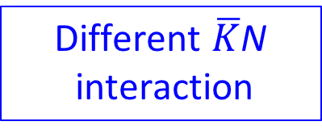
Theoretical calculation for K-nucl
S. Maeda, Y. Akaishi and T. Yamazaki
Proc. Jpn. Acad., Ser.B 89 (2013)
Different $\overline{K}$N
interaction
（Chiral）
K⁻p pole ~ 1420 MeV
Binding energy [MeV]
（Phenomenological）
Λ(1405): K⁻p bound state
K⁻pp: E15 a
BE ~ 100MeV
(J-PARC E27, FINUDA, DISTO)
Binding energies depends on
the $\overline{K}$N interaction systematically!
(Very strong $\overline{K}$N attraction)
K⁻pp: E27, FINDA, DISTO
To confirm the Kaonic nuclei, not only the K⁻pp but also
the other system such as K⁻K⁻pp is important!!

Slide 15
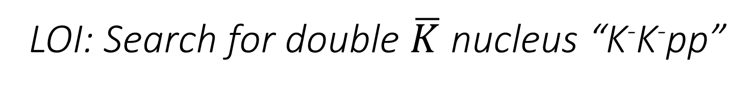
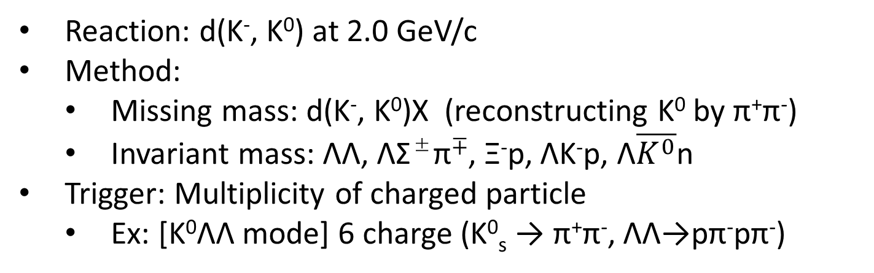
LOI: Search for double $\overline{K}$ nucleus “K⁻K⁻pp”
Reaction: d(K⁻, K⁰) at 2.0 GeV/c
Method:
  Missing mass: d(K⁻, K⁰)X (reconstructing K⁰ by π⁺π⁻)
  Invariant mass: ΛΛ, ΛΣ±π∓, Ξ⁻p, ΛK⁻p, Λ$\overline{K^{0}}$n
Trigger: Multiplicity of charged particle
  Ex: [K⁰ΛΛ mode] 6 charge (K⁰_{s} → π⁺π⁻, ΛΛ→pπ⁻pπ⁻)
Expected spectrum
Simulation

Slide 16
Study of Kaonic nuclei via the ¹²C(K⁻, p) reaction

Slide 17
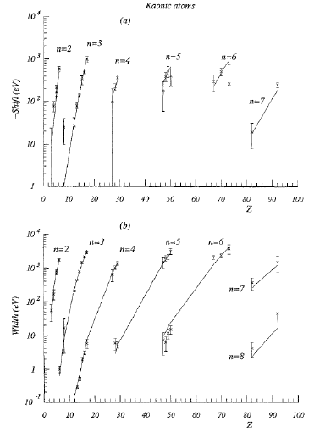



Introduction: $\overline{K}$-A interaction
An important tool is kaonic atoms.
  Simple tρ approach
  Chiral motivated model
  DD(Density dependent) potential
  Fourier-Bessel method
  IHW K^{bar}N interaction+phenomenological multi-nucleon absorption
Re(V₀) ~ －80 MeV
Re(V₀) ≦ －60 MeV
Re(V₀) = －(150-200) MeV
Re(V₀) ~ －(170) MeV
Re(V₀) ~ －(170) MeV

Slide 18
Introduction: $\overline{K}$-A interaction
An important tool is kaonic atoms.
  Simple tρ approach
  DD(Density dependent) potential
  Fourier-Bessel method
  IHW K^{bar}N interaction+phenomenological multi-nucleon absorption
  Chiral motivated model
The depth of K^{bar}-nucleus potential strongly depends on the model setting. It is not conclusive whether K^{bar}-nucleus potential is “deep” or “shallow”!! Both type of potential can reproduce the kaonic atoms data.
↓
To solve this problem,
a new experimental constraint is necessary!
Re(V₀) ~ －80 MeV
Re(V₀) = －(150-200) MeV
Re(V₀) ~ －(170) MeV
Re(V₀) ~ －(170) MeV
Re(V₀) ≦ －60 MeV

Slide 19
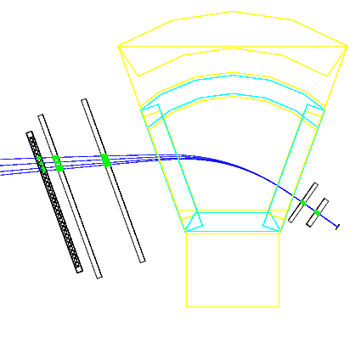
¹²C(K⁻, p) in E05 pilot run
Goal of this measurement
  Compare the real inclusive spectrum with
  DWIA calculation by varying (V₀, W₀) parameters.
  = Search for the Kaonic nuclei.
Proton orbits at 0゜ in ¹²C(K⁻, p) reaction at 1.8 GeV/c
SKS
BE 200MeV
BE 100MeV
BE 0MeV
Elastic

Slide 20
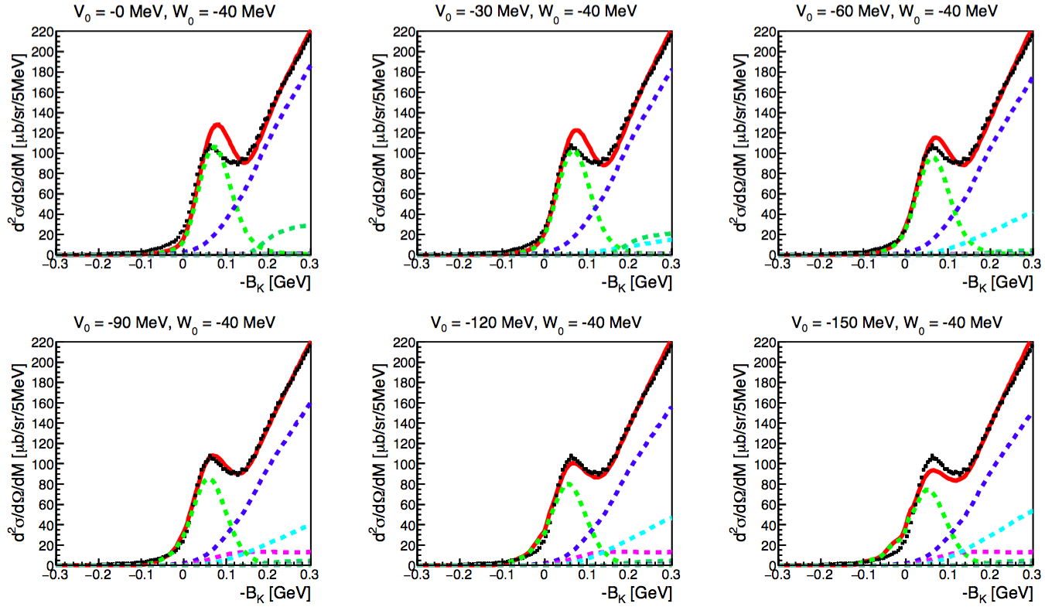
¹²C(K⁻, p) Fitting by varying (V₀, W₀) parameters
(Re)V₀: Changed, (Im)W₀: Fixed to -40 MeV
Good agreement: V₀ ~ -90 MeV
BG
DWIA Calculation by J. Yamagata-Sekihara

Slide 21
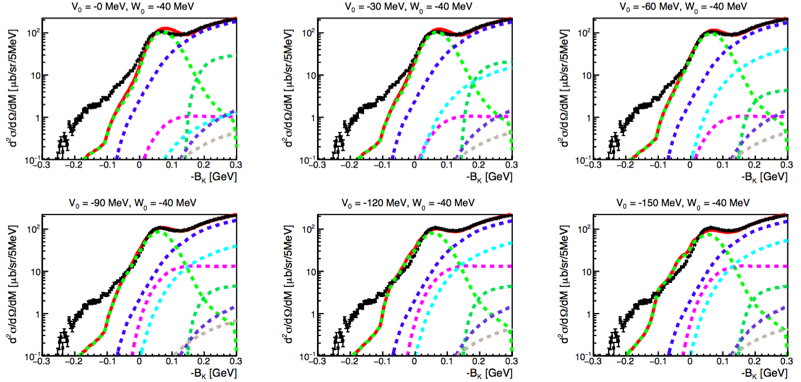
DWIA Calculation by J. Yamagata-Sekihara

Slide 22
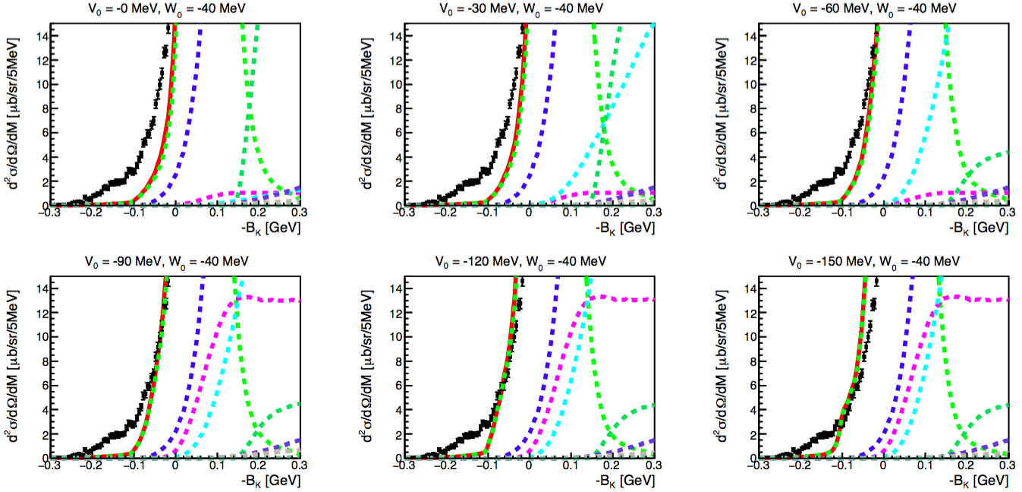
DWIA Calculation by J. Yamagata-Sekihara

Slide 23
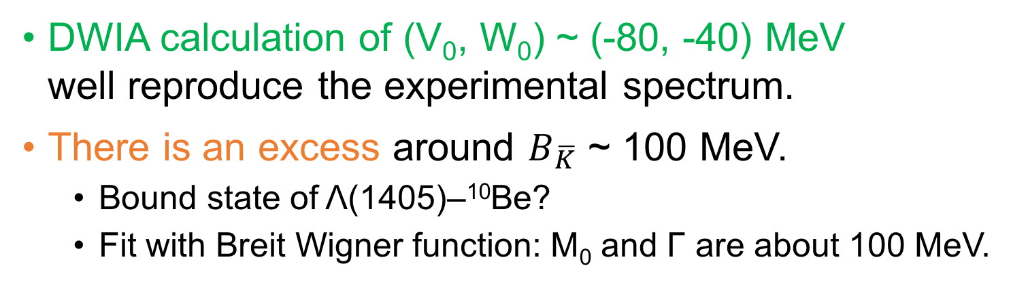
Fitting result of ¹²C(K⁻, p) spectrum
DWIA calculation of (V₀, W₀) ~ (-80, -40) MeV
well reproduce the experimental spectrum.
There is an excess around $B_{\overline{K}}$ ~ 100 MeV.
  Bound state of Λ(1405)–¹⁰Be?
  Fit with Breit Wigner function: M₀ and Γ are about 100 MeV.
DWIA Calculation by J. Yamagata-Sekihara
Preliminary
Preliminary
Zoom
(3.5°< θ <4.5°)

Slide 24
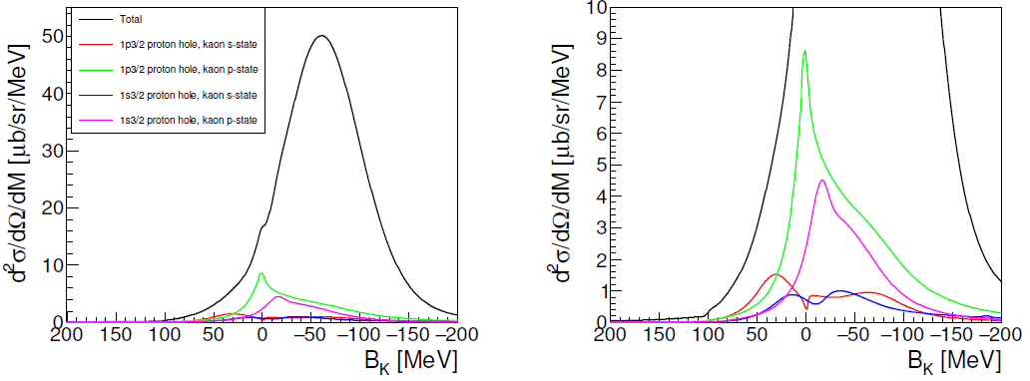
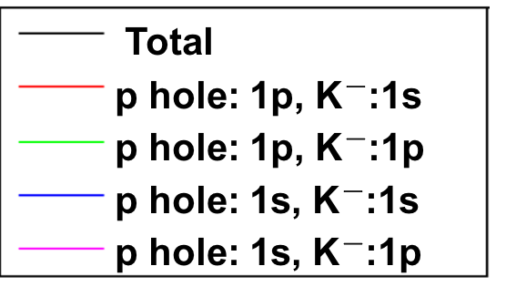
Sub component of
DWIA calculation
(V₀, W₀) = (-80, -40) MeV
Zoom
Zoom
There is 1s bound state
at B_{K} ~ 32 MeV
DWIA Calculation by J. Yamagata-Sekihara
Preliminary
Preliminary
DWIA cal.
DWIA Calculation by J. Yamagata-Sekihara
Zoom
(3.5°< θ <4.5°)

Slide 25
Kaonic nuclei
Λ* nuclei

Slide 26
Fitting result of ¹²C(K⁻, p) spectrum
DWIA calculation of (V₀, W₀) ~ (-80, -40) MeV
well reproduce the experimental spectrum.
There is an excess around $B_{\overline{K}}$ ~ 100 MeV.
  Bound state of Λ(1405)–¹⁰Be?
  Fit with Breit Wigner function: M₀ and Γ are about 100 MeV.
DWIA Calculation by J. Yamagata-Sekihara
Preliminary
Preliminary
Zoom
(3.5°< θ <4.5°)

Slide 27
Fitting result of ¹²C(K⁻, p) spectrum
DWIA calculation of (V₀, W₀) ~ (-80, -40) MeV
well reproduce the experimental spectrum.
There is an excess around $B_{\overline{K}}$ ~ 100 MeV.
  Bound state of Λ(1405)–¹⁰Be?
  Fit with Breit Wigner function: M₀ and Γ are about 100 MeV.
DWIA Calculation by J. Yamagata-Sekihara
Preliminary
Preliminary
BW: Bound state of Λ*-¹⁰Be ?
Preliminary
Zoom
(3.5°< θ <4.5°)

Slide 28
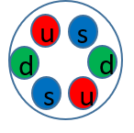
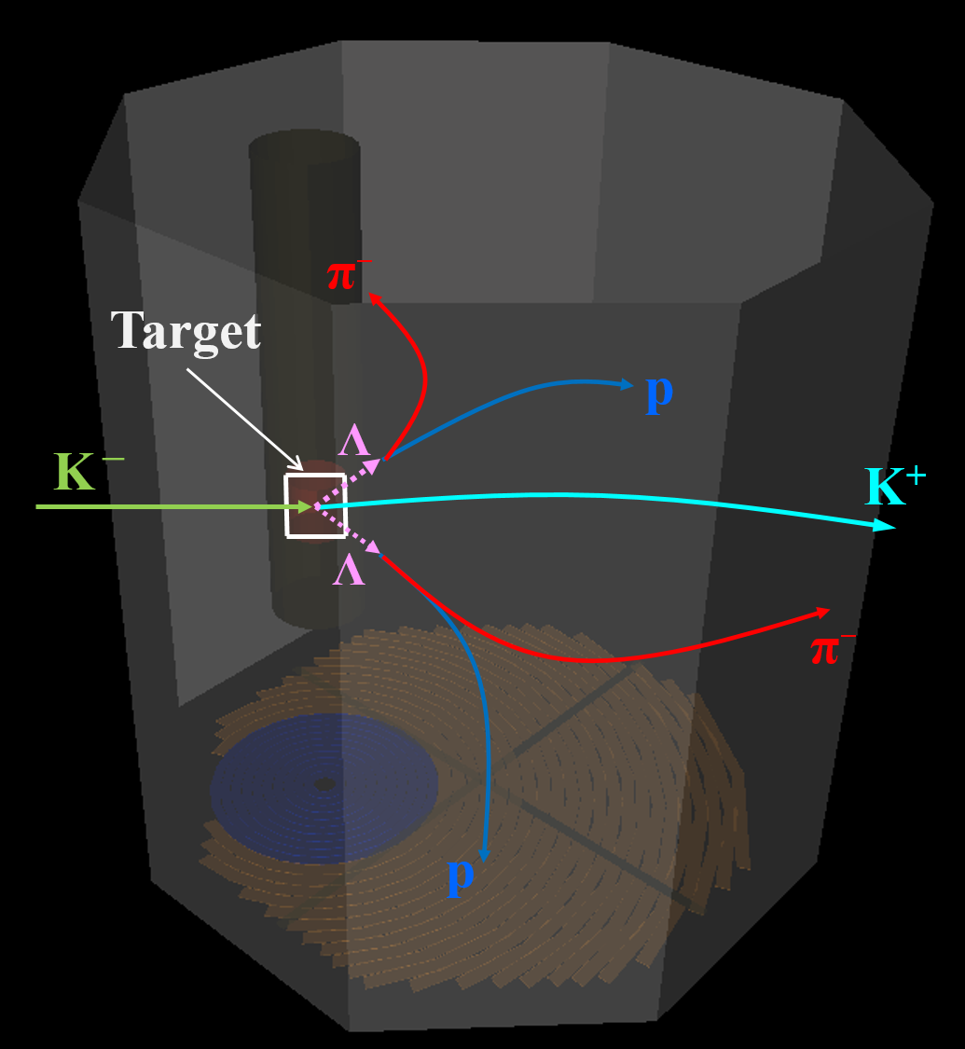
Beyond E05 = E42 (H-dibaryon Search)
Search for the H-dibaryon (uuddss quarks) by using (K⁻, K⁺) reaction with diamond target at J-PARC.
KEK E522
H-dibaryon
J-PARC E42
σ_{ΔM} ~ 5 MeV
90 ΛΛ evens
σ_{ΔM} ~ 1 MeV
1.5×10⁴ ΛΛ events
Simulation
HypTPC
KURAMA
K⁻ beam
K⁺
K1.8 Beam line spectrometer
Hyperon
Spectrometer

Slide 29
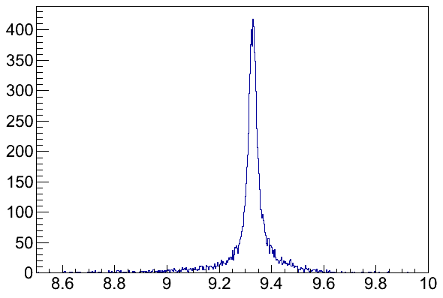
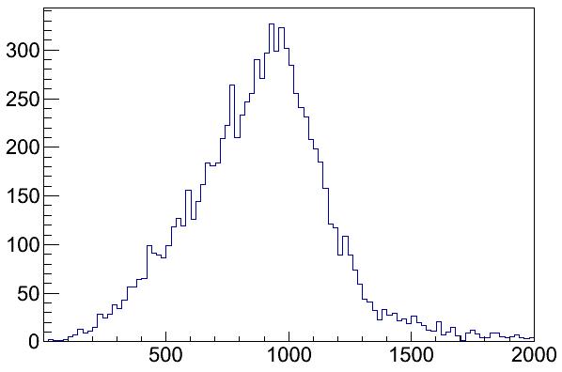
Measured by KURAMA
Measured by Hyp-TPC (measure p π⁻)
K⁻ + ¹²C → p + ¹¹_{K}B (¹⁰_{Λ*}Be), ¹¹_{K}B (¹⁰_{Λ*}Be), → Λ + ¹⁰Be.
Check the missing mass and momentum of ¹²C(K⁻, pΛ)X spectrum. We select the missing mass of X to be M_{X} = ¹⁰Be and missing momentum p_{X} > p_{Fermi-motion} to reduce two nucleon absorption background.
* Δp/p_{beam} = 0.18%(FWHM), Δp/p_{beam} =1.2 %(FWHM) [ref. J.K. Ahn Doctor thesis]
* EM process is not included. At least 5 pad hits is required.
* B.E =132.5 MeV, Γ = 183 MeV is used for ¹¹_{K}B.
Missing mass of ¹²C(K⁻, pΛ)X
Missing momentum of ¹²C(K⁻, pΛ)X
Very Preliminary
Very Preliminary
Missing mass for ¹⁰Be [GeV/c²]
Missing momentum for ¹⁰Be [GeV/c²]

Slide 30
Summary
K⁻pp
  J-PARC E15, E27 observed the structure which can be interpreted as K⁻pp bound state.
  E27, FINUDA, DISTO (BE ~ 100 MeV) πΣN pole?
  E15 (BE ~ 50 MeV) consistent with phenomenological assumption.
  Systematic study of Kaonic nuclei (few body system) is important.
  New LOI to serch for K⁻K⁻pp has been submitted to J-PARC.
¹²C(K⁻, p) analysis (E05 byproduct)
  (V₀, W₀) = (-80, -40) MeV well reproduced the obtained spectrum.
    This potential contains the BE ~ 30 MeV Kaonic bound sate.
  We also found the excess around BE ~ 100 MeV (Λ* bound state?)
  We plan to measure the exclusive spectrum as E42 byproduct.

Slide 31
Back up

Slide 32
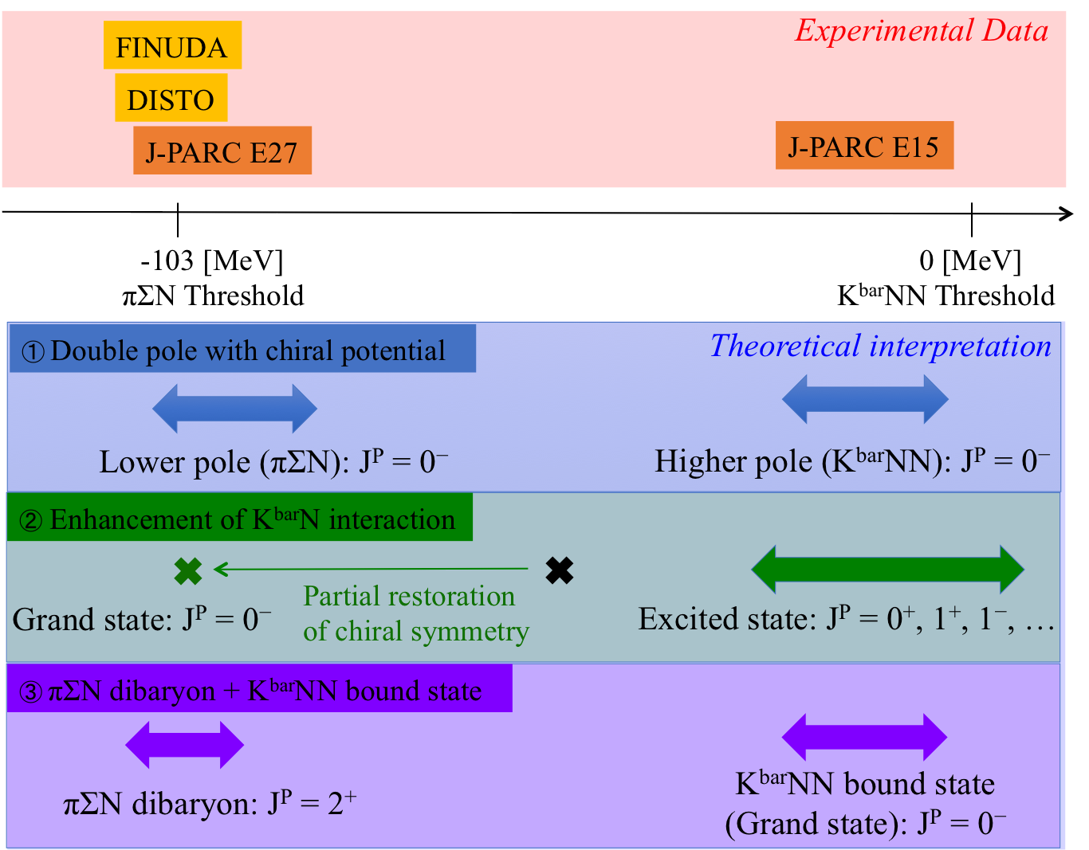
3 scenarios for Experiment
E27: d(π⁺, K⁺pp)
Y. Ichikawa et al., PTEP 2015, 021D01(2015).
E15:
³He(K⁻, Λp)
3 scenarios to
understand the
Experimental results
Determination of
J^{P} is important

Slide 34
K⁻K⁻pp simulation

Slide 35
K⁻K⁻pp simulation (trigger)

Slide 36
JAM simulation for K⁻K⁻pp experiment

Slide 37
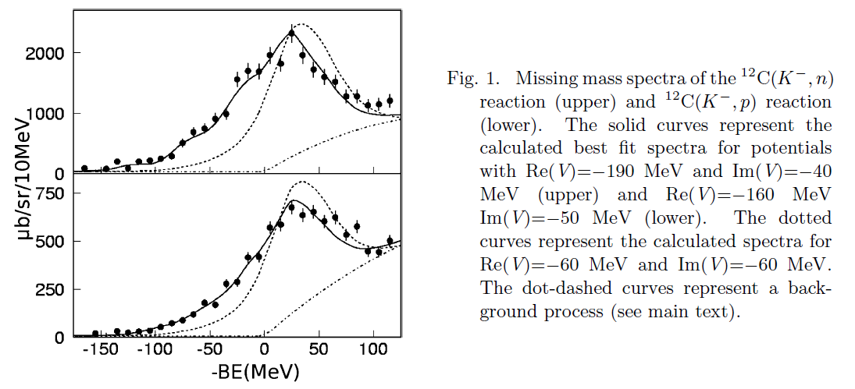
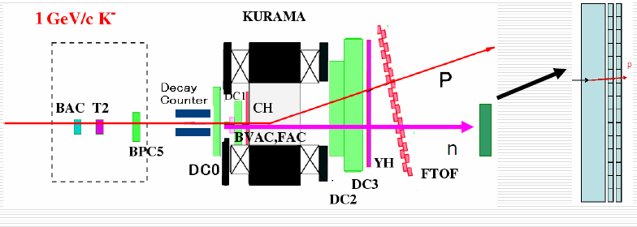
KEK E548 [¹²C(K⁻, N) spectrum]
T. Kishimoto et al., PTP 118, 1 (2007).
¹²C(K⁻, n)
¹²C(K⁻, n), ¹²C(K⁻, p) at 1GeV/c
  K⁻ beam: 10⁴/spill
  KEK-PS K2 beamline + KURAMA
  MM resolution ~ 10 MeV (σ)
  θ_{sc} < 4.1° was chosen
V_{opt} was studied comparing DWIA
  C(K⁻, n): V_{opt} = (V₀: -190, W₀: -40) MeV
  C(K⁻, p): V_{opt} = (V₀: -160, W₀: -50) MeV
¹²C(K⁻, p)
(dotted line: Vopt = (-60, -60) MeV)

Slide 38
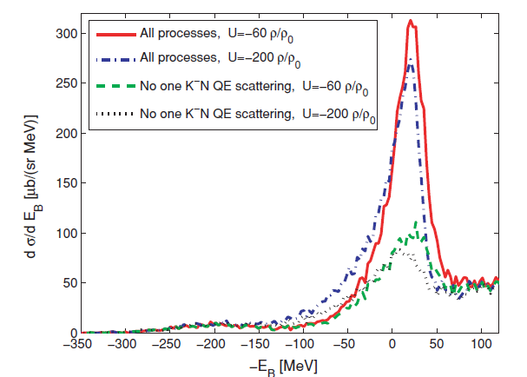
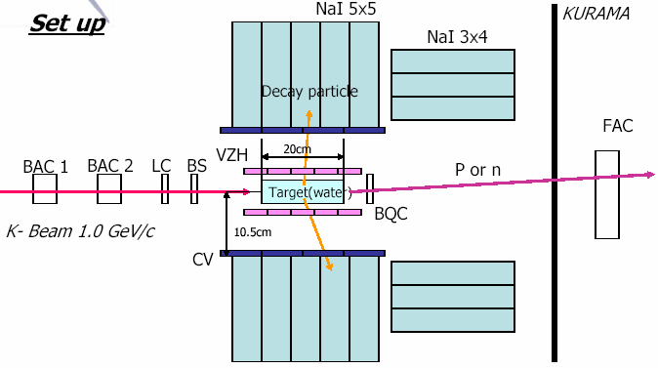
Discussion for KEK E548
V. K. Magas et al., pointed out a serious drawback in this experimental setup.
  In E548, at lest one charged particle detected by their decay counter was required (semi-inclusive spectrum).
Semi-inclusive spectra doesn’t have enough sensitivity !!
V. K. Magas et al., PRC 81, 024609 (2010).

Slide 40
Σ nuclei
Λ nuclei

Slide 41
Bound
⁶_{Λ}H
QF Σ
QF ΣN → ΛN

Slide 44
Two dimensional χ² plot

Slide 45
Background study

Slide 46
Background study

