Slide 1

Studying QCD with the
Electron-Ion Collider
Introduction
Physics Case
- Femtography
- Mass
- Spin
- Dense gluon states
- Hot, dense matter
- New avenues
Accelerator concepts
EICUG
Path Forward

Slide 2
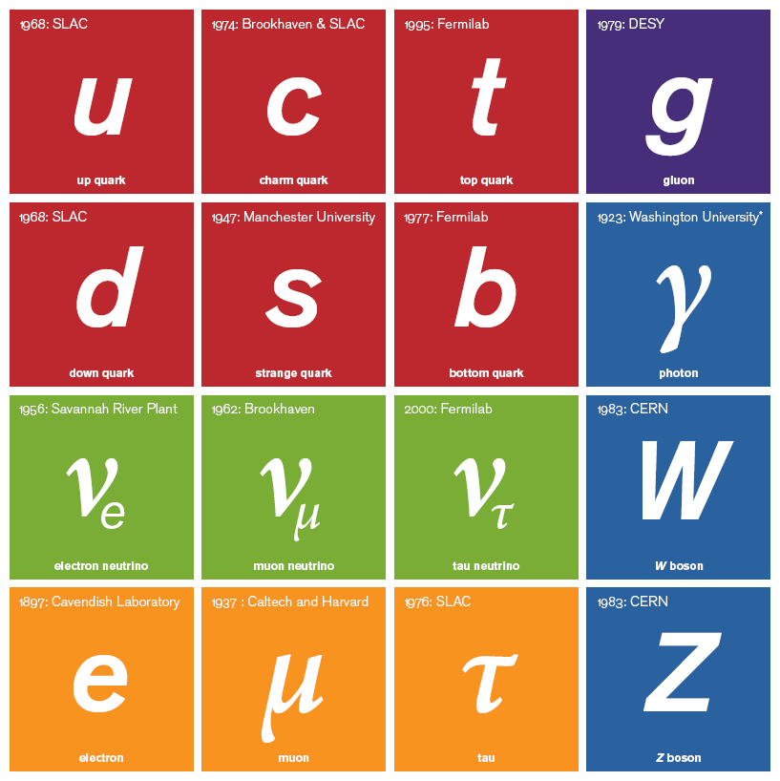

2012: CERN
2012: CERN
Fundamental Building Blocks of Matter 2018
The Standard Model of Physics
2012: CERN
2012: CERN
18 Physics Nobel Prizes
since 1950
H
H boson
H boson
+
Einstein
gravity
2015: Gravitational
waves

Slide 3



2012: CERN
Not directly useful for understanding the
visible matter in the universe
Not detectable
Not
Detectable
H
Unstable
Absorption length ≈ 10 light-years
Unstable
H boson
H boson
Unstable

Slide 4
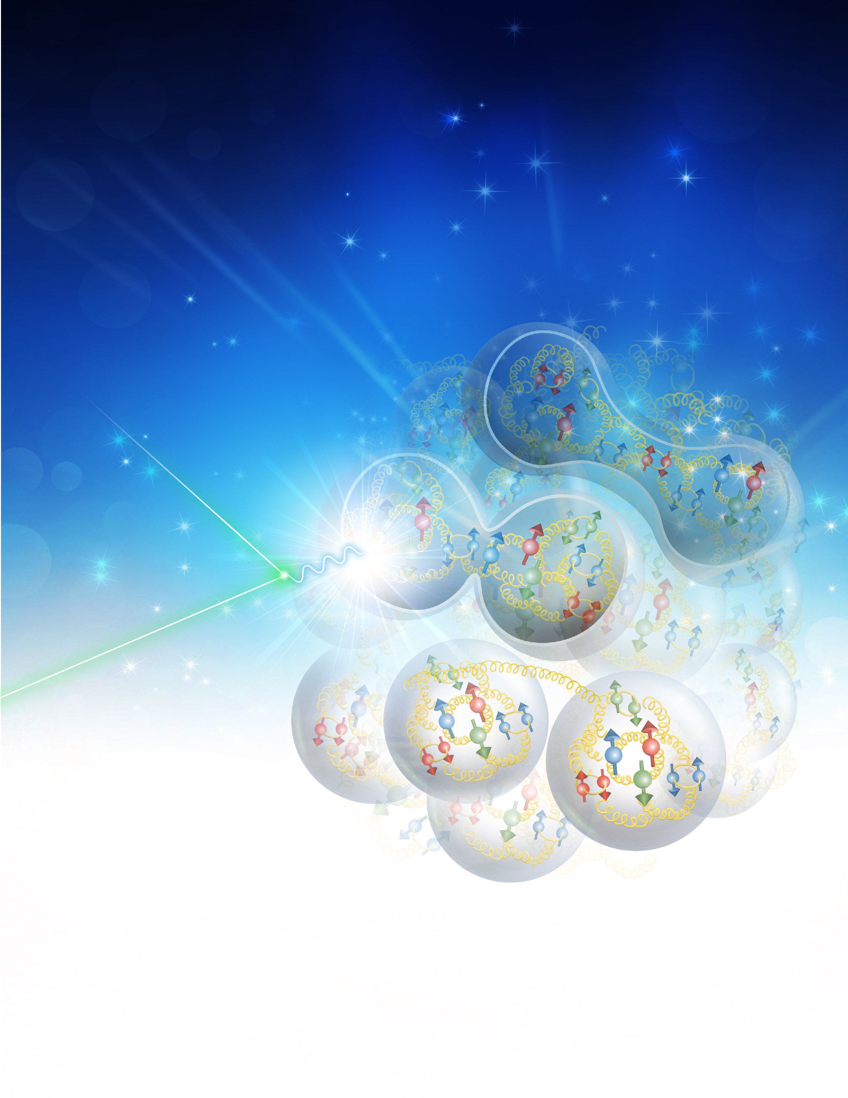


Understanding
The Nucleus
Reality: experiments deal with hadrons
How do we relate the successful hadronic
description of the nucleus to the fundamental
quarks and gluons?
How does the nucleon with its structure and
properties emerge from quarks and gluons of
QCD?
What role does QCD play in the structure and
properties of nuclei?

Slide 5
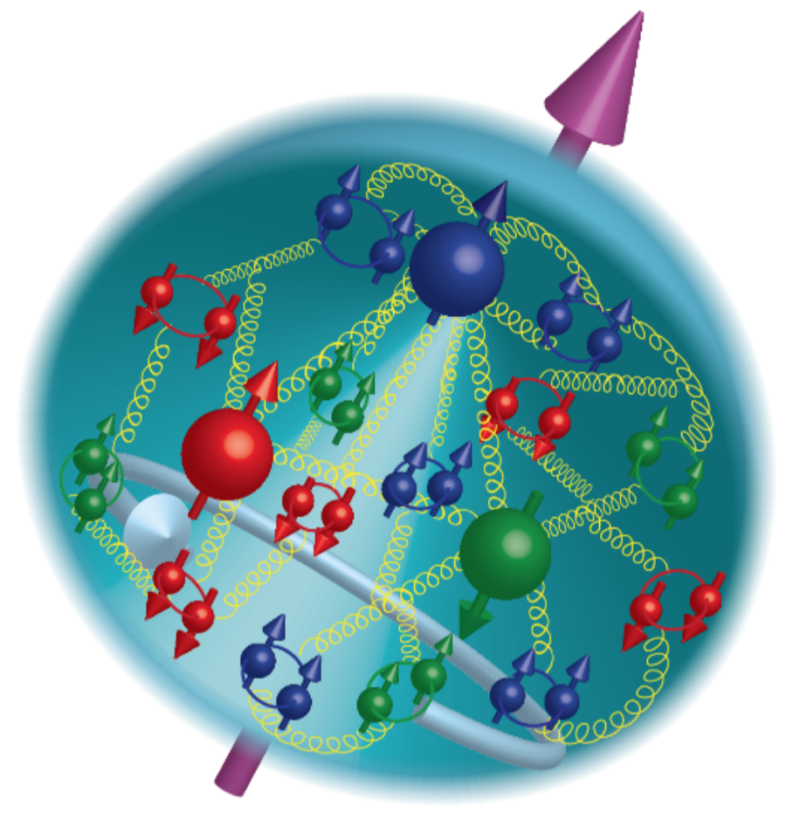
21st Century View of the
Fundamental Structure of the Proton
Elastic electron scattering determines charge and magnetism of nucleon
Approx. sphere with <r> ≈ 0.85 Fermi
The proton contains quarks,
as well as dynamically
generated
quark-antiquark pairs
and gluons.
The proton spin
and mass have large
contributions from
the quark-gluon
dynamics.
1961

Slide 6
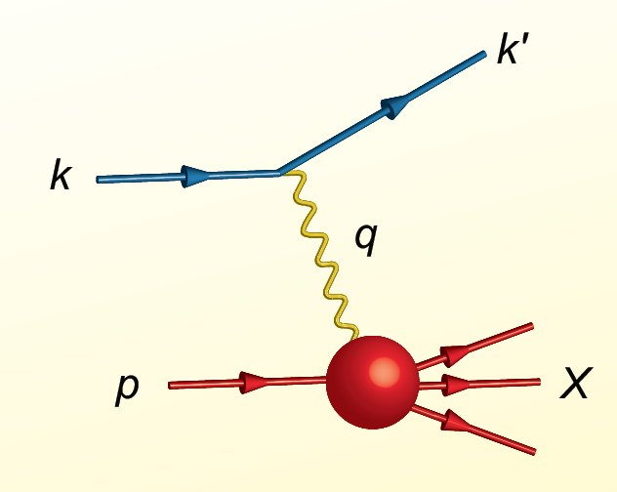
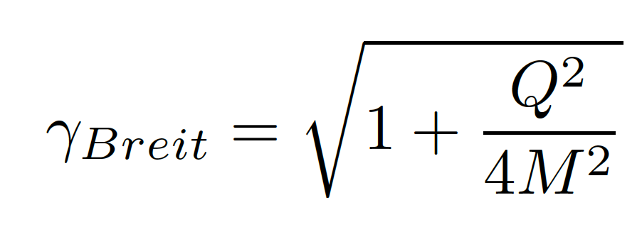
Proton Viewed in High Energy Electron Scattering: 1 Longitudinal Dimension
Viewed from boosted frame,
length contracted by
Internal motion of the proton’s constituents is slowed down by time dilation – the instantaneous charge distribution of the proton is seen.
In boosted frame x is understood as the longitudinal momentum fraction
valence quarks: 0.1 < x < 1
sea quarks: x < 0.1
Lorentz Invariants
E²_{CM} = (p+k)²
Q² = -(k-k’)²
x = Q²/(2p•q)
J. Bjorken, SLAC-PUB-0571
March 1969

Slide 7


Visualization
The camera is a device to capture an image on a desired medium, e.g. CCD or film.
Movie cameras capture a series of individual images in time to give the illusion of having captured motion.
Essential elements of any camera are
- the focus which uses a lens to gather light from
a selected image
- the shutter which is a door that opens for a definite
time to allow selected light to reach the medium.

Slide 8

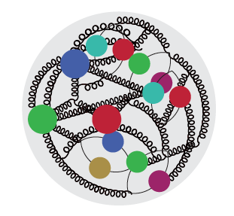
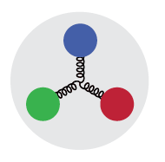
High Energy Electron Scattering
Snapshots where 0 < x < 1 is the shutter exposure time
x ≈ 10⁻⁴
Probe non-linear dynamics
short exposure time
x ≈ 10⁻²
Probe rad. dominated
medium exposure time
x ≈ 0.3
Probe valence quarks
long exposure time

Slide 9
Quark Structure of Proton from High-Energy Lepton Scattering
2004
e-p cross section ≈ σ_{Mott} •F₂(x,Q²)
Snap shots of the charged structure of the proton taken in the boosted frame
1/Q spatial resolution
x exposure time
QCD prescribes evolution with Q² which
connects quarks and gluons
1990

Slide 10
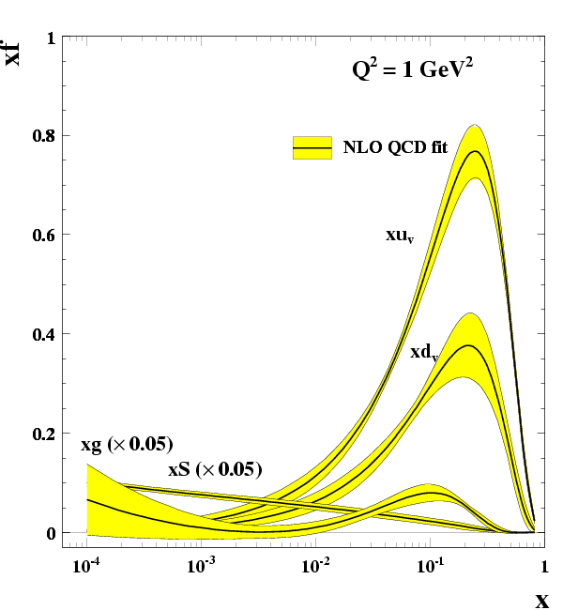
What about the
Nucleus?
R. Yoshida
C. Gwenlan

Slide 11
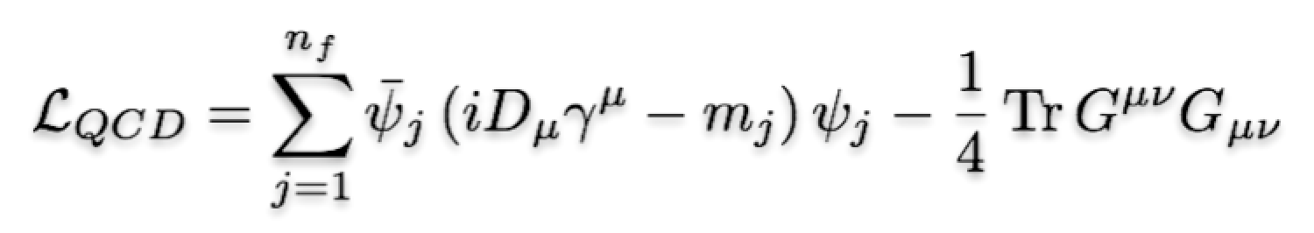
EIC: 21st Century QCD Laboratory
To explore the fundamental structure and dynamics of the matter in the visible world
Interactions arise through fundamental symmetry principles
Properties of the visible universe emerge through complex structure of the QCD vacuum
The proton is a highly relativistic system described by QCD, a fully relativistic quantum field theory.
Lattice QCD is an increasingly powerful means to carry out ab initio QCD calculations of hadron structure.
The goal of the EIC is to provide us with an understanding of the internal structure of the proton and more complex atomic nuclei that is comparable to our knowledge of the electronic structure of atoms themselves, which lies at the heart of modern technologies.

Slide 12
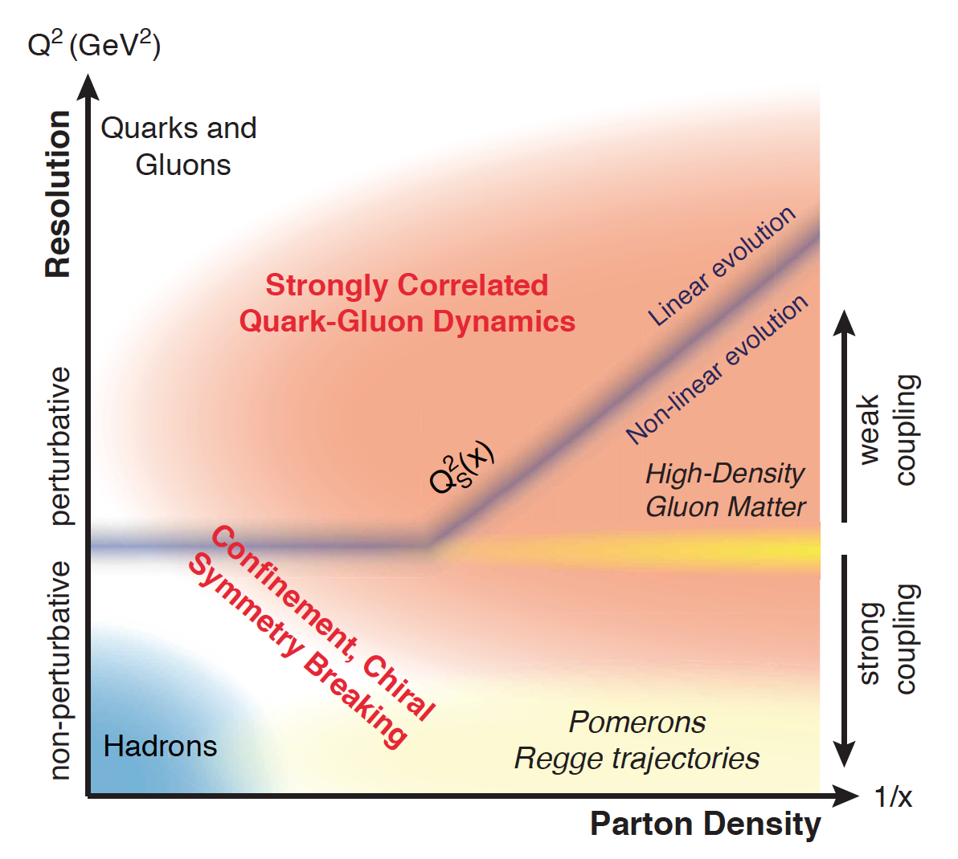
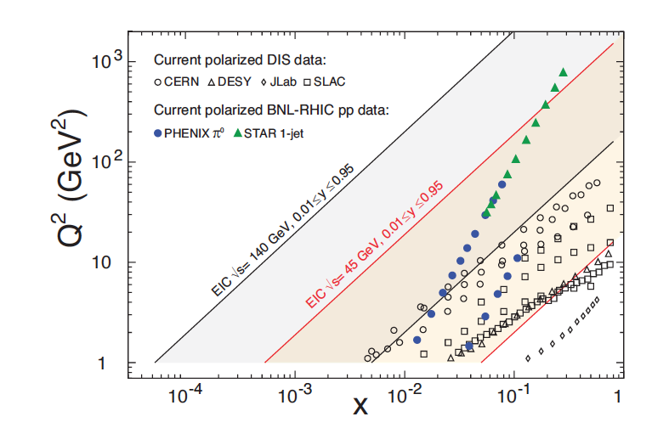
QCD Exploration
EIC will allow us to explore the QCD
landscape over a wide range in x
and Q².
Study high-density gluon matter
Different coupling regimes
Nuclei are terra incognita
Study modifications of gluons in
nuclear environment complementing
heavy ion programs at RHIC and LHC

Slide 13
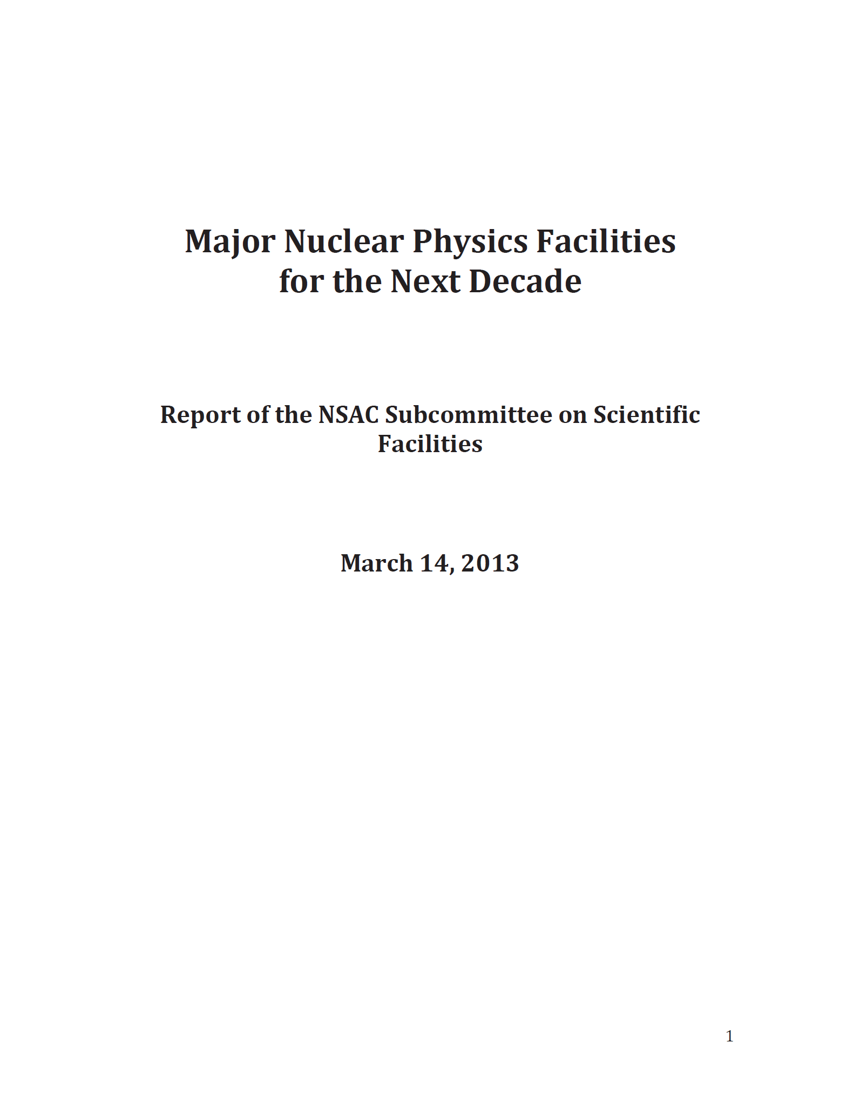
U.S. Electron-Ion Collider Planning 2007-18
2007 NSAC Long-Range Plan
“An Electron-Ion Collider (EIC) with polarized beams has been embraced by the U.S. nuclear science community as embodying the vision for reaching the next QCD frontier”
2013 Electron Ion Collider White Paper
(Writing committee convened by Jefferson Lab and BNL)
2013 NSAC Subcommittee on Future Facilities
Identified EIC as absolutely central to the nuclear science program of the next decade
2015 NSAC Long Range Plan
“We recommend a high-energy high-luminosity polarized EIC as the highest priority for new facility construction following the completion of FRIB.”
2018 National Academy of Sciences – Assessment of U.S. Based Electron-Ion Collider Science
“…the committee finds a compelling scientific case for such a facility. The science questions that an EIC will answer are central to completing an understanding of atoms as well as being integral to the agenda of nuclear physics today.”

Slide 14

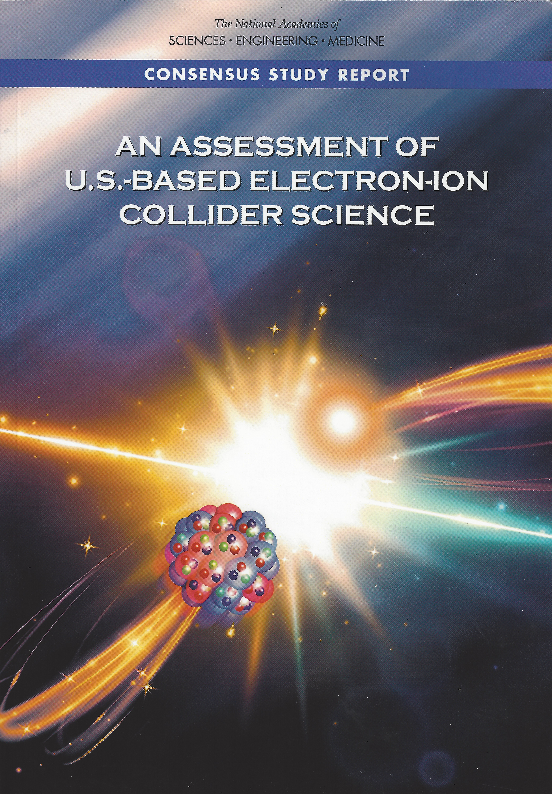
EIC Physics Case
EIC science is compelling,
timely and fundamental
Developed by US QCD community
over two decades
Developed by NAS committee with
broad science perspective

Slide 15
Findings of the NAS committee
Finding 1: An EIC can uniquely address three profound questions about nucleons—neutrons and protons—and how they are assembled to form the nuclei of atoms:
  How does the mass of the nucleon arise?
  How does the spin of the nucleon arise?
  What are the emergent properties of dense systems of gluons?
Finding 2: These three high-priority science questions can be answered by an EIC with highly polarized beams of electrons and ions, with sufficiently high luminosity and sufficient, and variable, center-of-mass energy.
Finding 3: An EIC would be a unique facility in the world and would maintain U.S. leadership in nuclear physics.
Finding 4: An EIC would maintain U.S. leadership in the accelerator science and technology of colliders and help to maintain scientific leadership more broadly.
Finding 5: Taking advantage of existing accelerator infrastructure and accelerator expertise would make development of an EIC cost effective and would potentially reduce risk.
Finding 6: The current accelerator R&D program supported by DOE is crucial to addressing outstanding design challenges.

Slide 16
Findings of the NAS Committee (II)
Finding 7: To realize fully the scientific opportunities an EIC would enable,
a theory program will be required to predict and interpret the experimental
results within the context of QCD, and furthermore, to glean the
fundamental insights into QCD that an EIC can reveal.
Finding 8: The U.S. nuclear science community has been thorough and thoughtful in its planning for the future, taking into account both science priorities and budgetary realities. Its 2015 Long Range Plan identifies the construction of a high-luminosity polarized EIC as the highest priority for new facility construction following the completion of the Facility for Rare Isotope Beams (FRIB) at Michigan State University.
Finding 9: The broader impacts of building an EIC in the United States are significant in related fields of science, including in particular the accelerator science and technology of colliders and workforce development.

Slide 17
Proton Viewed in High Energy Electron Scattering: 1 Longitudinal Dimension

Slide 18

Proton Tomography: 2 New Dimensions Transverse to Longitudinal Momentum
Structure mapped in terms of
b_{T} = transverse position
k_{T} = transverse momentum
Nuclei!
Goal:
Unprecedented
21st Century Imaging
of Hadronic Matter
Direction of longitudinal
momentum normal to
plane of slide
Valence Quarks: JLab 12 GeV
Sea Quarks and Gluons: EIC

Slide 19
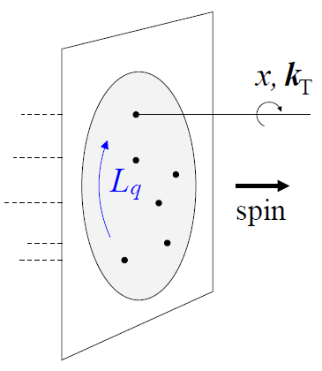


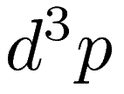
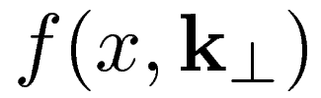
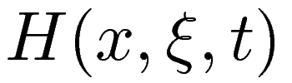
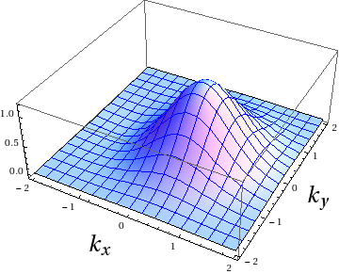
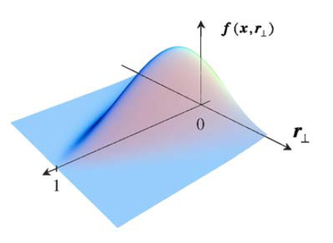
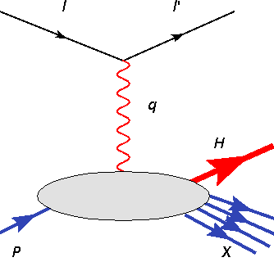
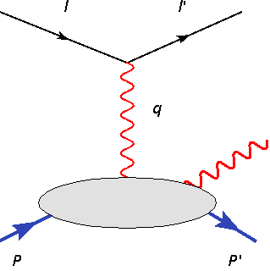
3D Partonic Picture
Theorists have developed a powerful formalism for studying the 3D partonic picture of the nucleon and the nucleus. It is encoded in Generalized Parton Distributions and Transverse Momentum Dependent Distributions
Wigner distribution
Transverse
Momentum
Dependent
distributions
Generalized
Parton
Distributions
Orbital motion
accessible!
SIDIS
DES

Slide 20
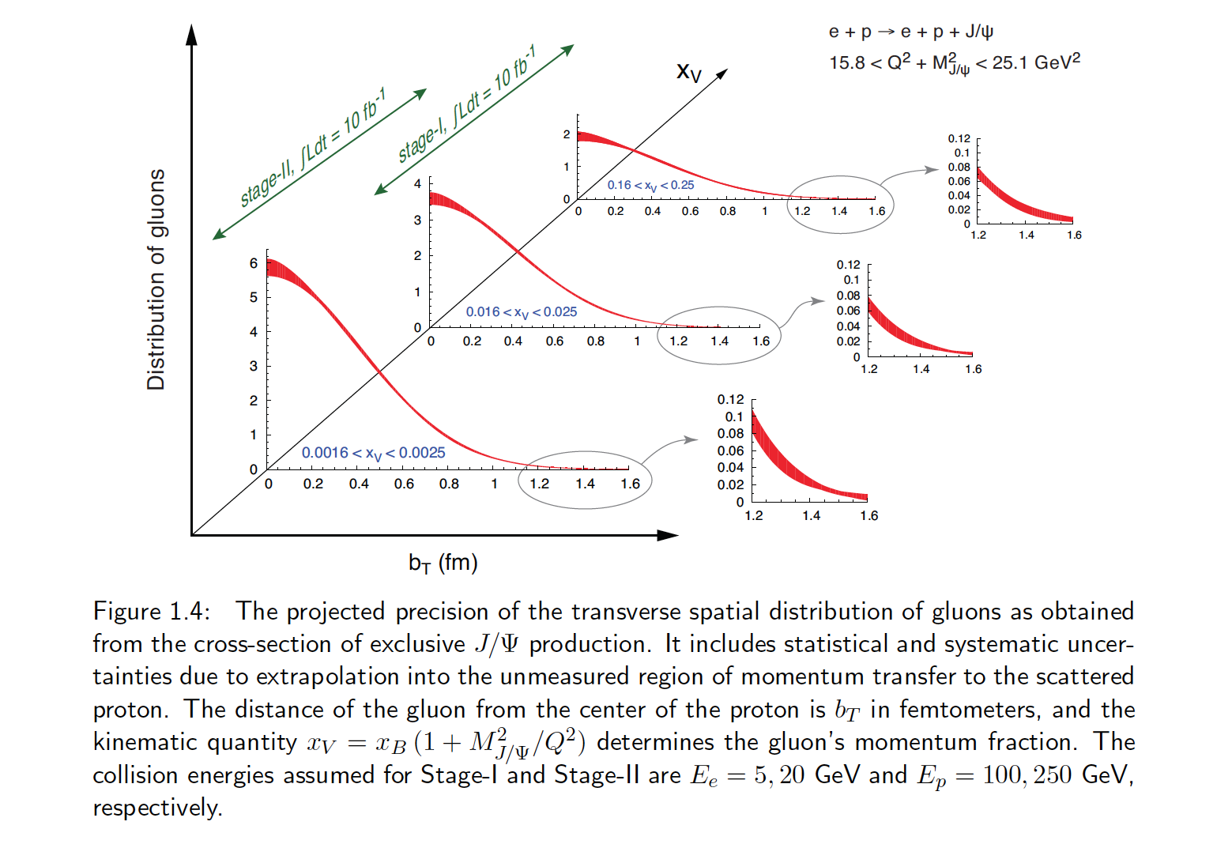
Transverse Spatial Distribution of Gluons
How are gluons spatially distributed in a proton or a nucleus?
Is the distribution smooth?
How does it differ from the charge distribution?
First ever tomographic images of ocean of gluons within matter !

Slide 21
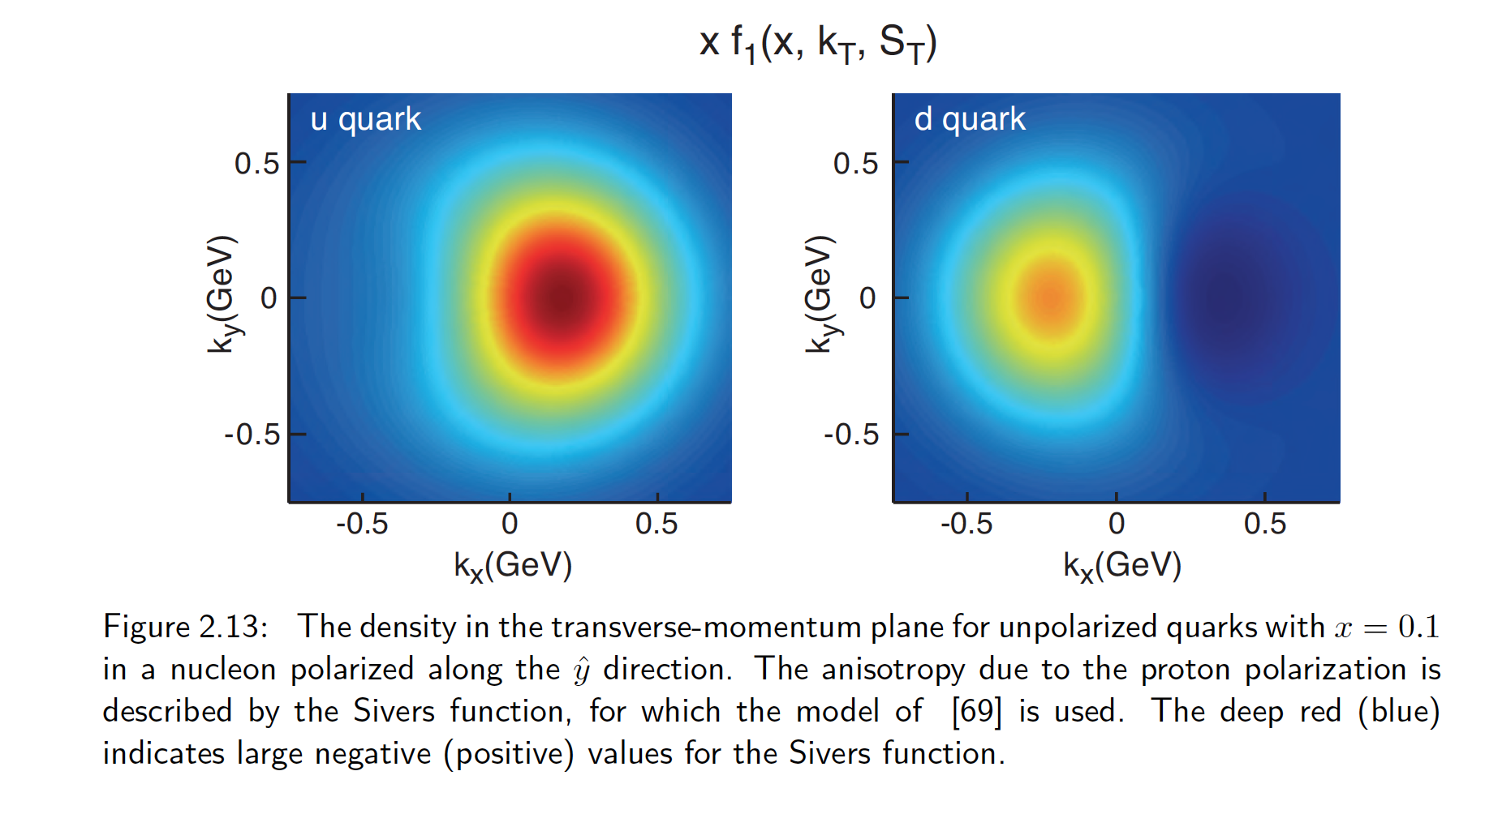
Transverse Momentum Distributions
Spin and the ability to look at transverse momentum together give a powerful new window into QCD
TMDs directly related to orbital motion
For example, we can explore for the first time interference in quantum phases due to color force – impossible with purely longitudinal experiments

Slide 22
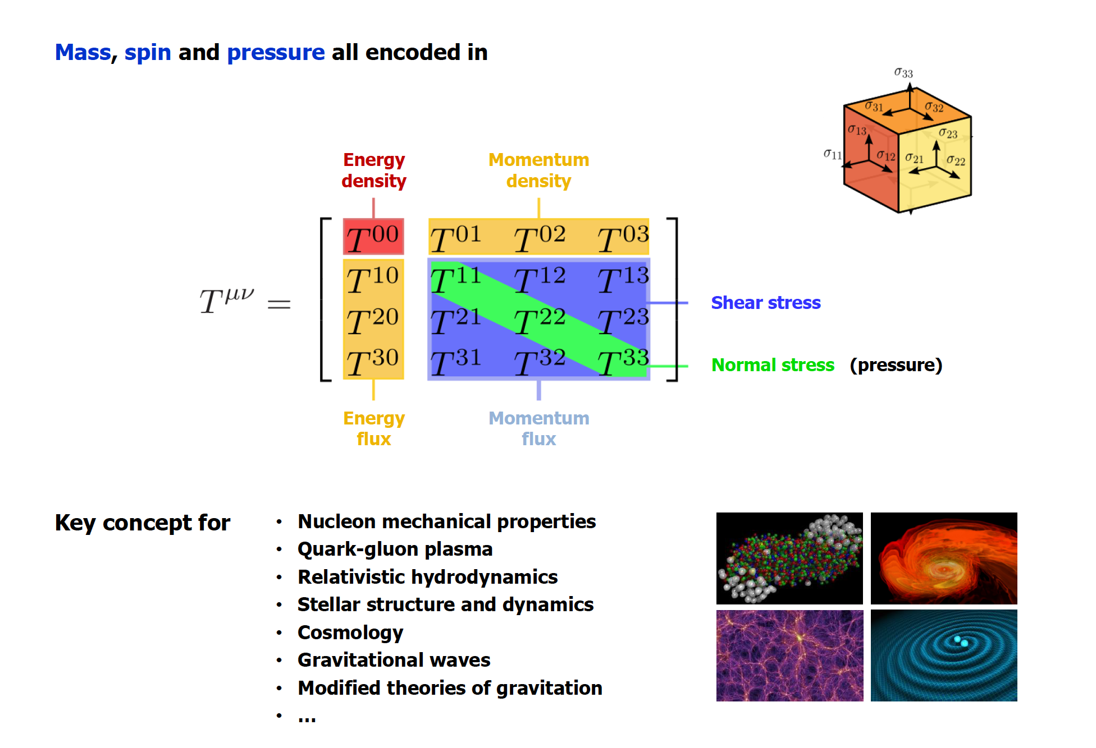
Energy Momentum Tensor (EMT)
C. Lorcé

Slide 23
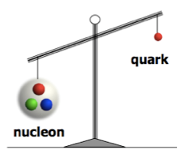
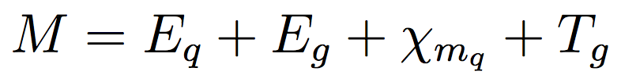
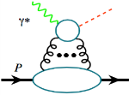




Mass of the Nucleon
“The mass is the result of the equilibrium reached through dynamical processes.” X. Ji
“… The vast majority of the nucleon’s mass is due to quantum fluctuations of quark-antiquark pairs, the gluons, and the energy associated with quarks moving around at close to the speed of light. …” The 2015 Long Range Plan for Nuclear Science
Chiral
Symmetry
Breaking
Quantum
Fluctuations
Relativistic Motion
X. Ji, PRL 74 1071 (1995)
Quark Energy
Gluon Energy
Quark Mass
Trace Anomaly
Criticisms: not scale-invariant, decompositions: Lorentz invariant vs. rest frame
Great interest at workshops: Temple U., March 2016; ECT, April 2017
Community wide consensus on how to determine the different contributions not
yet reached
Lattice QCD providing estimates
Trace anomaly:
Upsilon production
near threshold
J/Ψ, Υ, …
~30%
~40%
~10%
~ 25%
arXiv: 1710.09011

Slide 24
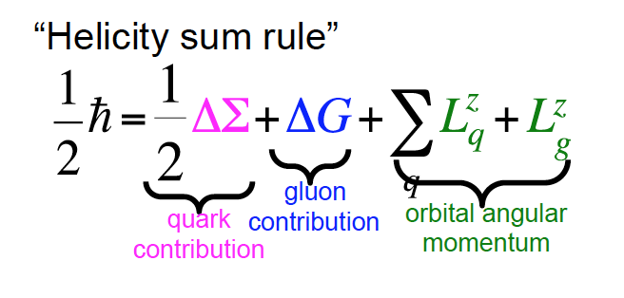
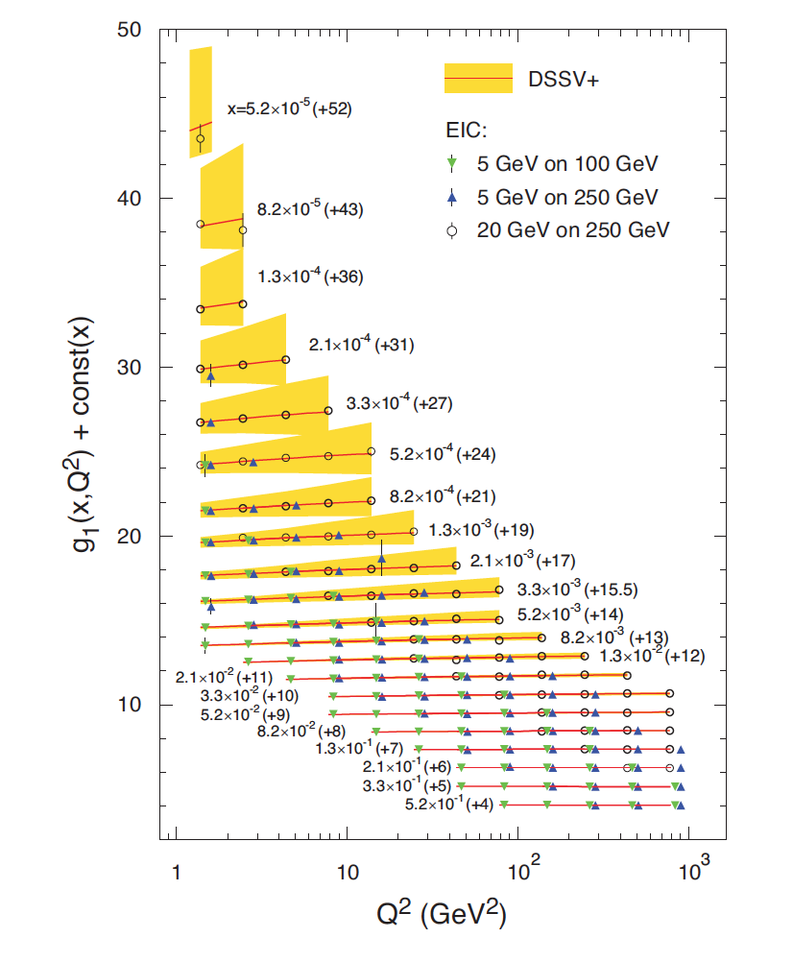
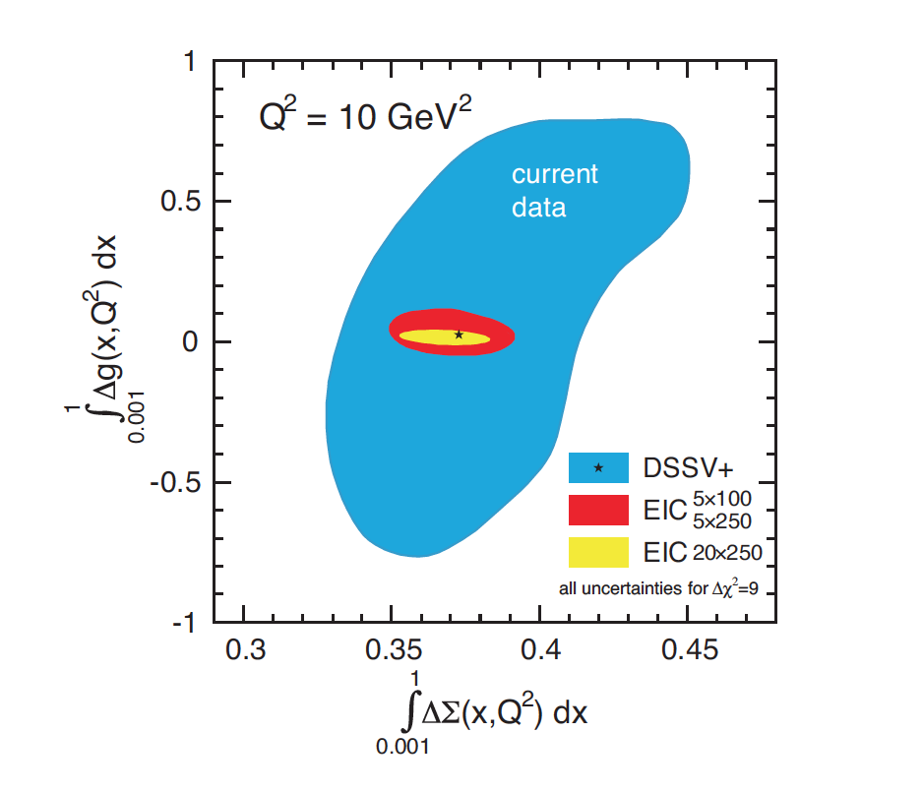
Spin of the Nucleon
EIC projected measurements:
Precise determination of polarized PDFs of
quark sea and gluons ➔ precision ΔG and ΔΣ
➔ Determination of Σ L_{q}+L_{g}

Slide 25
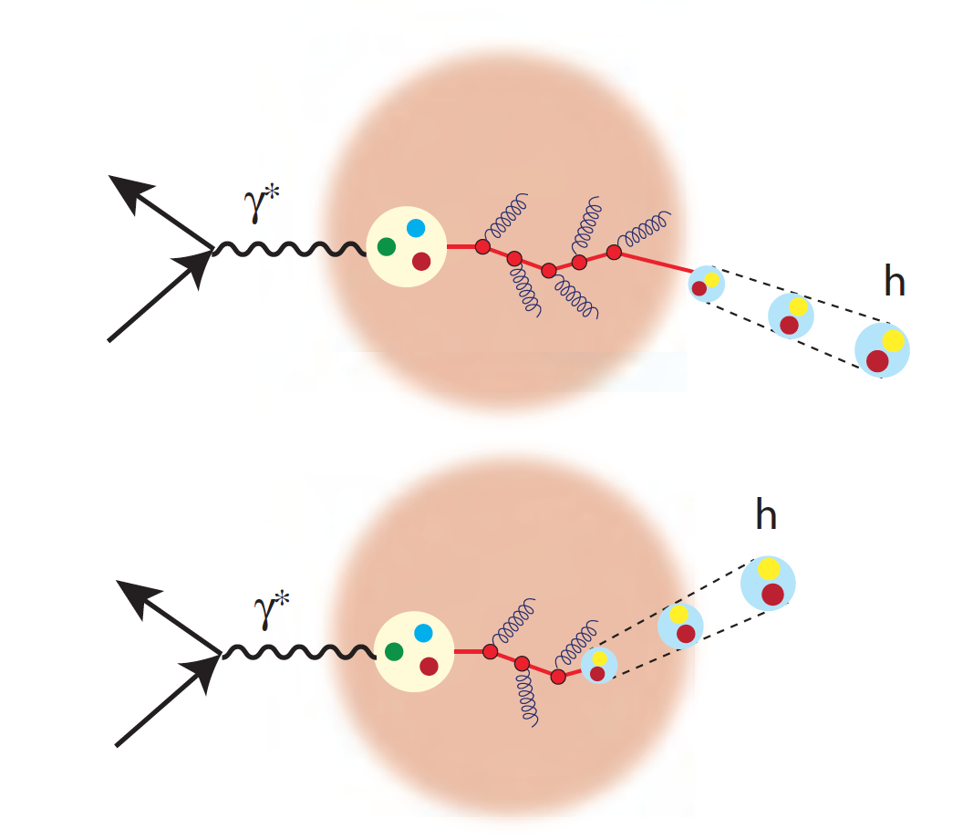
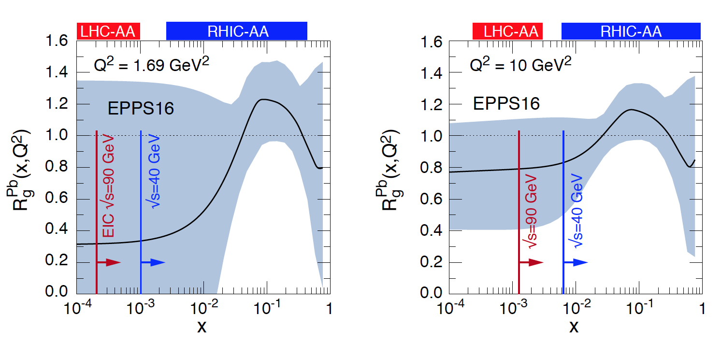
QCD Dynamics in Nuclei
Hadronization: the process that
connects QCD with experiment
Nuclear PDFs
Color neutralization and propagation
Diffraction: no net color exchange
Jets
1/x
Hadronization

Slide 26
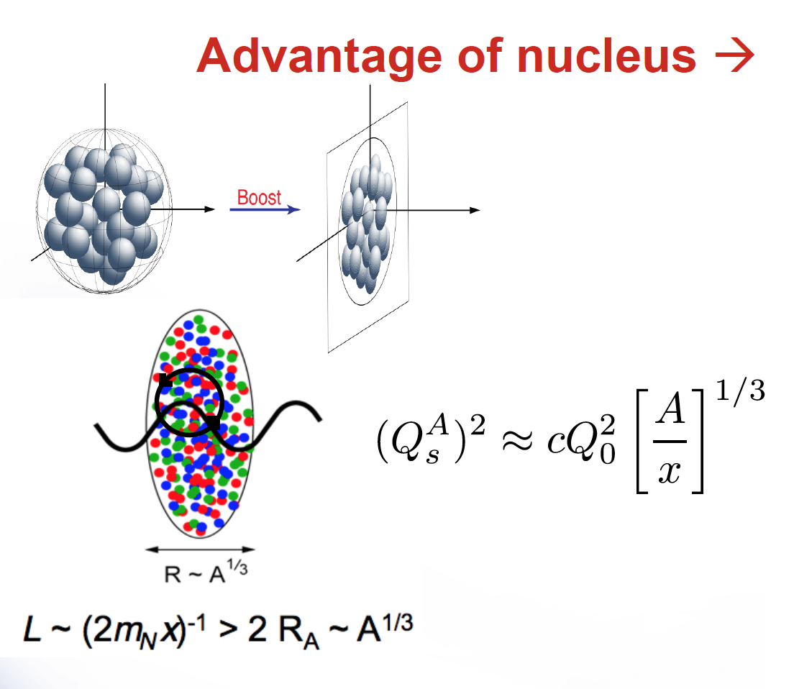
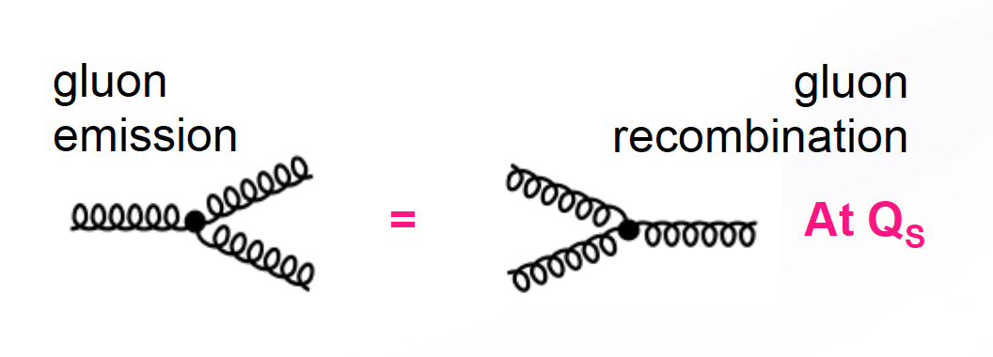
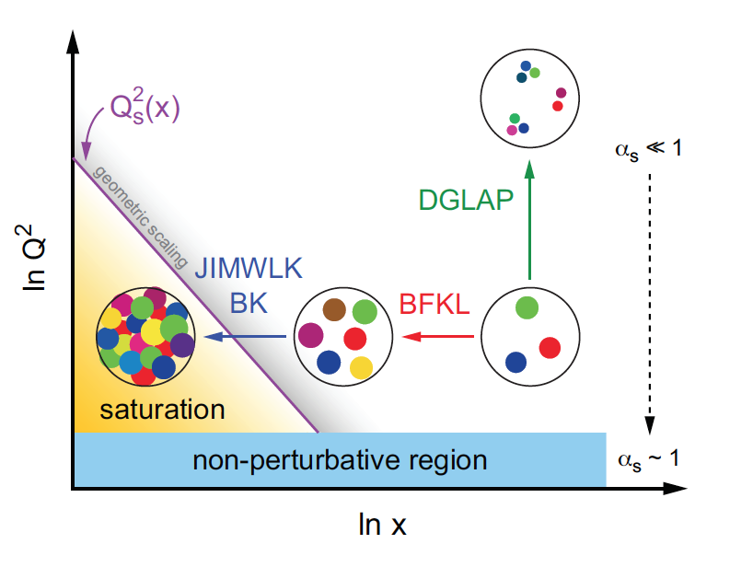
What tames the low-x rise of the gluons?
New evolution equations at low x and moderate Q²
Saturation scale Q_{s}(x) where gluon emission and recombination become comparable
First observation of gluon recombination effects in nuclei
Is this a universal property?
What is the new effective theory in this regime?

Slide 27

Understanding the QGP
ep and eA collisions at high energy offer huge
possibilities to clarify aspects of pp, pA and AA
collisions:
Initial conditions for macroscopic descriptions
Nature of collectivity
Thermalization
Extraction of parameters of the medium
Distinguish “genuine” QGP effects
Elena Ferreiro

Slide 28
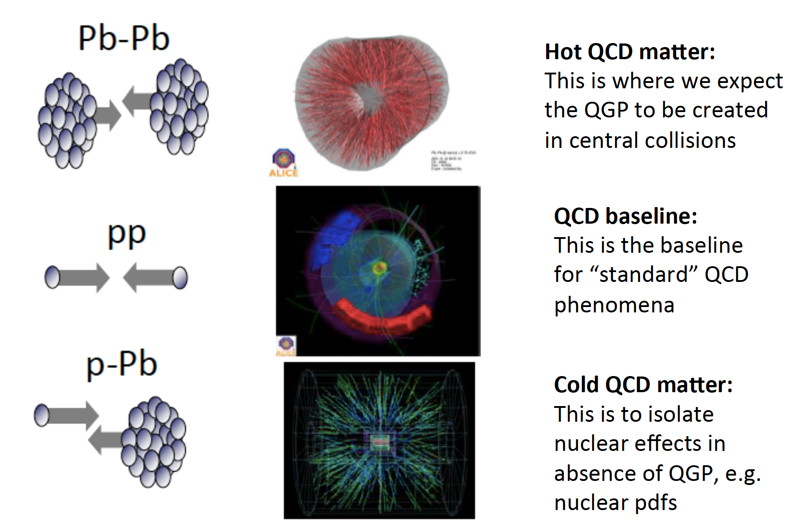
Old paradigm: understanding before 2012

Slide 29
New paradigm: small systems
Totally unexpected!
- the discovery of correlations (ridge) in small systems pA and pp
- smooth continuation of heavy ion phenomena to small systems
- small systems as pA and pp show QGP-like features
Two possible explanations
- initial state: quantum correlations, e.g. CGC
- final-state: interactions leading to flow -> hydrodynamics
The old paradigm that we study hot and dense matter properties in AA collisions and cold nuclear matter in pA and use pp as a comparison appears no longer sensible.
Is the physics underlying soft, collective phenomena the same in all high-energy reactions: e⁺e⁻ to central AA?
ep and eA becomes essential to study this: EIC.
Electroproduction allows initial hadronic state smaller than a proton!

Slide 30

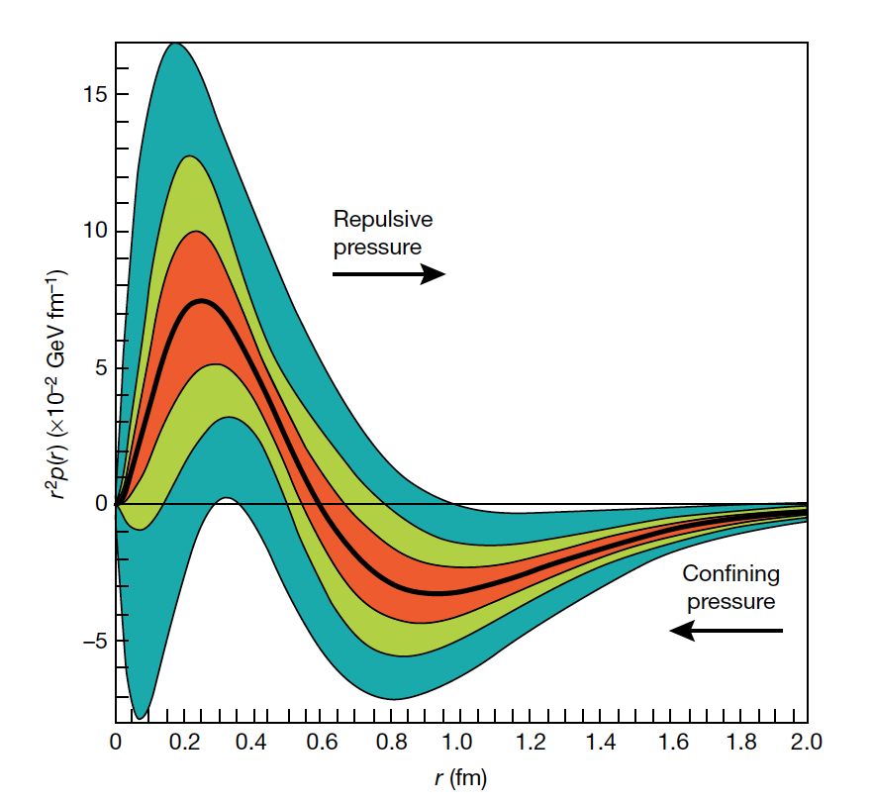
New Avenues
(personal selection)
Pressure in the Proton
- First determination using DVCS data
- Interior pressure in proton is > pressure
inside a neutron star! Who knew that!
- Lattice calculation motivates determination
of gluon GPDs at EIC
Exotic Gluons (i.e. gluons not associated with individual nucleons)
- Inclusive DIS on transversely polarized nucleus with J≥1
- Lattice calculations hint at non-zero effects
Quark-gluon nature of short-range NN interaction
- Extract gluon transition GPD from NN pairs with high relative
momenta
- Estimates indicate that EIC will provide precision data out to
relative transverse NN momentum of at least 3 GeV
Nature, 557, May 17, 2018

Slide 31
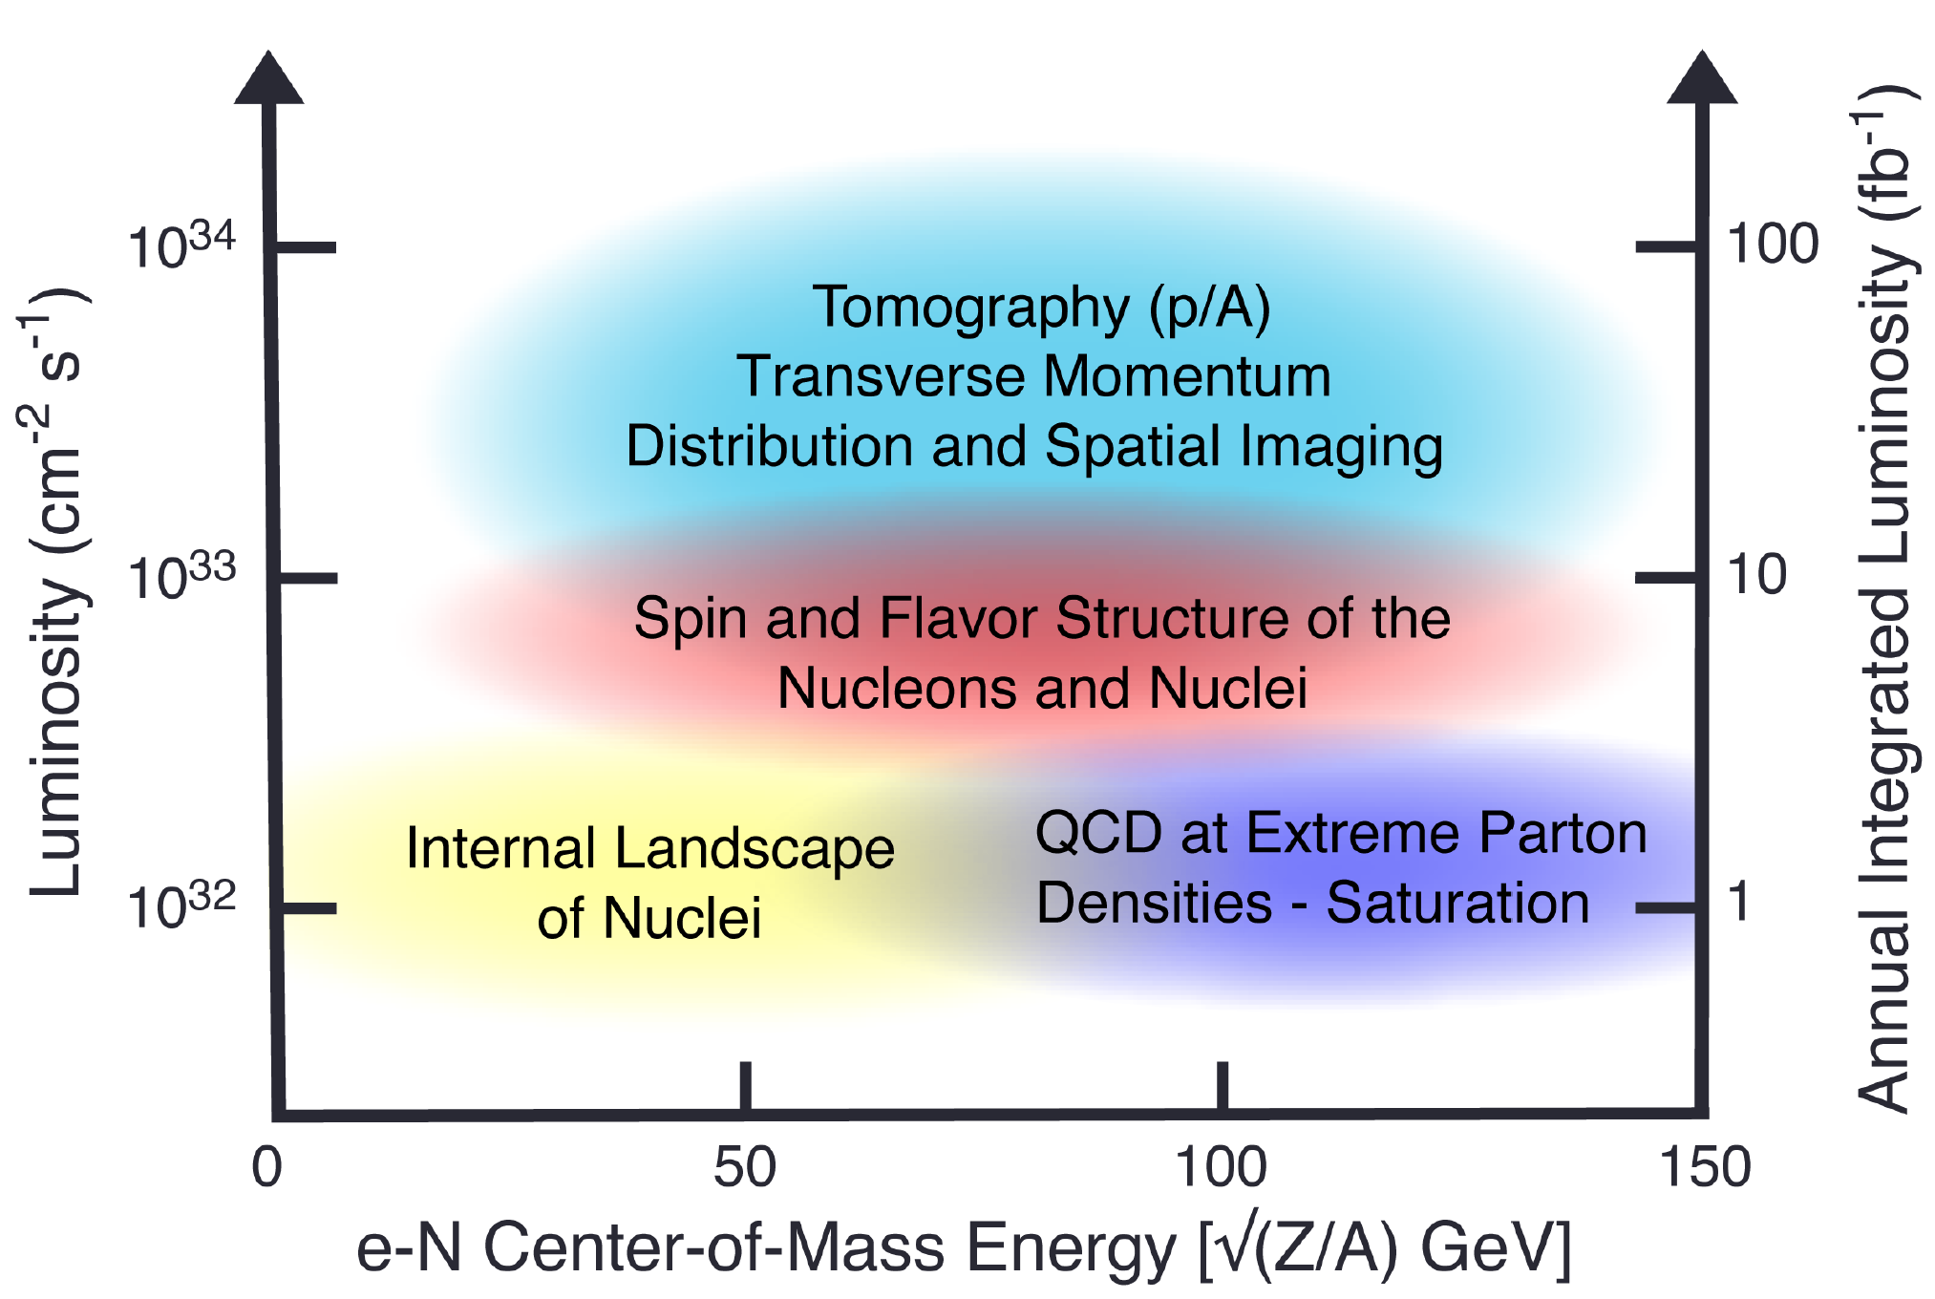
Collider Specifications from Science

Slide 32
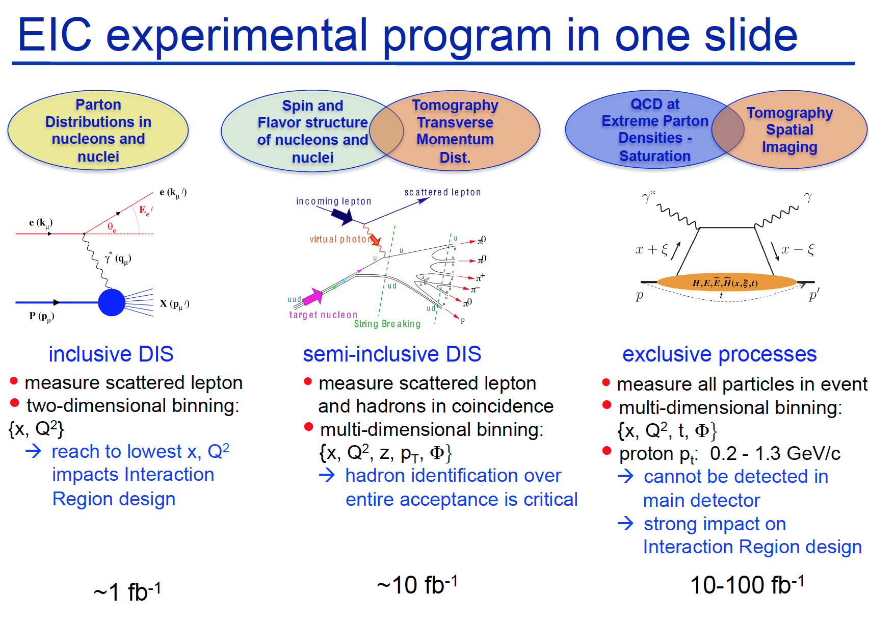
A. Kiselev

Slide 33



NAS Report on EIC Requirements
The EIC is designed to meet the requirements set forth in NSAC Long Range Plan, which was emphasized by the NAS report:
Highly polarized (~70%) electron and nucleon beams
Ion beams from deuterons to the heaviest nuclei (uranium or lead)
Variable center of mass energies from ~20 - ~100 GeV, upgradable to ~140 GeV
High collision luminosity ~10³³ – 10³⁴ cm⁻²s⁻¹
Possibilities of having more than one interaction region

Slide 34
There are two proposals:
JLEIC to be constructed at Jefferson Lab
eRHIC to be constructed at Brookhaven National Lab
Both design benefit from existing Nuclear Physics infrastructure and are based on the same accelerator principles:
Electron Storage Rings with frequent injection of fresh polarized beams
Hadron storage rings with strong cooling or alternatively frequent injections
Detailed study by DOE of accelerator design, cost and siting
in progress

Slide 35

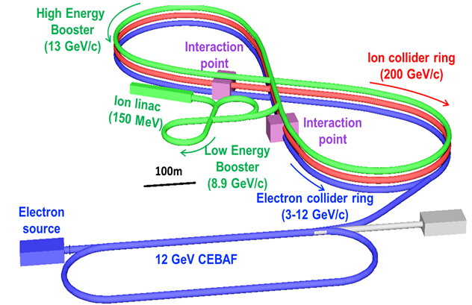
Layouts of
Accelerator
Concepts
eRHIC
JLEIC

Slide 36


eicug.org
Annual EICUG meeting:
2017 Trieste, Italy
2018 Washington, DC
2019 Paris, France
2020 Miami
Formed in 2016
967 members from 194
institutions in 30 countries
EICUG Steering Committee: B. Surrow (Chair), R. Milner (Vice-Chair),
C. Aidala, J. Arrington, D. Boer, R. Ent, Y. Goto, M. Radici, E. Sichtermann, T. Ullrich
Monthly newletter
Recent survey of user groups
EICUG launching 12-18 month study to quantify physics measurements and study detector concepts
Expect to naturally evolve into proto-collaboration formation

Slide 37
Physics and Detector Conceptual Development Study
Initiated by the EICUG Steering Committee.
Purpose
  Advance state of documented physics studies and detector concepts in preparation for the EIC.
  Provide basis for further development of concepts for experimental equipment best suited for science needs, including complementarity of two detectors
  Input towards future Technical Design Reports (TDRs)
Approach
  Two WG: Physics requirement and Detector concepts - 4 conveners each
  Several sub-groups each, ~2 conveners/sub-group
  Time limited effort: ~1 year
Meetings
  December 12-13, 2019, MIT: Kick-off organizational meeting
  Workshops
    March 19-21, 2020, Temple U., Philadelphia
    May 22-24, 2020, U. of Pavia, Pavia, Italy
    September 17-19, 2020, CUA, Washington D.C.
    November 19-21, 2020, UCB/LBNL, Berkeley, CA
It is essential, EIC activities in DOE seem to proceed fast. Let’s get going !!!

Slide 38
Summary
Over two decades, the U.S. nuclear physics community has developed the scientific and technical case for a new 21st century instrument, the Electron-Ion Collider, to push the frontiers of human understanding of the fundamental structure of matter.
The U.S. National Academy of Sciences judges the physics case to be
“compelling, fundamental and timely.”
This compelling EIC physics case continues to sprout vigorous new branches.
FRIB, together with EIC, will probe the visible matter in the universe well into the 21st century.
The parameters of the EIC accelerator are well defined and will drive innovations in accelerator technology well beyond state of the art.
- Accelerator R&D a high priority
- Expertise and scientific thrusts of current flagship NP facilities BNL and Jefferson Lab
are well aligned with EIC.
Realization of EIC will demand that DOE NP, BNL and JLab lead the U.S. to the frontiers of collider technology.
There is substantial interest worldwide in EIC and clear opportunities for foreign investment in U.S. nuclear physics.
- Accelerator R&D - Detector R&D - Theory/Lattice
We await the launch of EIC on the DOE Critical Decision Management process but proceed with further study of the physics and detectors to be ready.

