Slide 1
Connecting Strong QCD with Hadron Structure Experiments
Craig Roberts … http://inp.nju.edu.cn/
Notes:
35+5 … Relating Experimental Studies of Hadron Structure to Strong QCD Within the Unified Continuum QCD Framwork

Slide 2
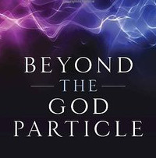
Prologue
LHC has NOT found the “God Particle” … the Higgs boson is NOT the origin of mass
Higgs-boson only produces a little bit of mass
Higgs-generated light-quark mass-scales explain neither the proton’s mass
nor the pion’s (near-) masslessness
Strong interaction sector of the Standard Model,
i.e. QCD, is the key to understanding the
origin, existence and properties
of the vast bulk of all known matter

Slide 3
2013: Englert & Higgs
The most important chapter of the Standard Model is the least understood.
Quantum Chromodynamics (QCD) is that part of the Standard Model which is supposed to describe all of nuclear physics
Matter = quarks
Gauge bosons = gluons
Yet, fifty years after the discovery of quarks, we are only just beginning to understand how QCD moulds the basic bricks for nuclei: pions, neutrons, protons, etc.
This Is Strong QCD

Slide 4
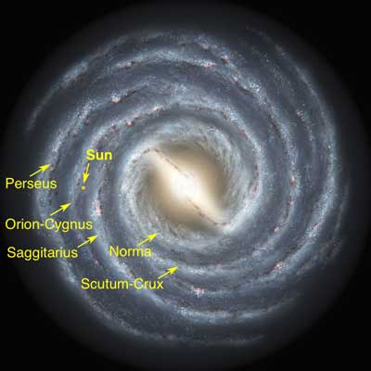
Emergent Phenomena in the Standard Model
Existence of our Universe depends critically on the following empirical facts:
Proton is massive
i.e. the mass-scale for strong interactions is vastly different to that of electromagnetism
Proton is absolutely stable
Despite being a composite object
constituted from three valence quarks
Pion is unnaturally light (not massless, but lepton-like mass)
Despite being a strongly interacting composite object built from a valence-quark and valence antiquark
Emergence: low-level rules producing high-level phenomena, with enormous apparent complexity

Slide 6
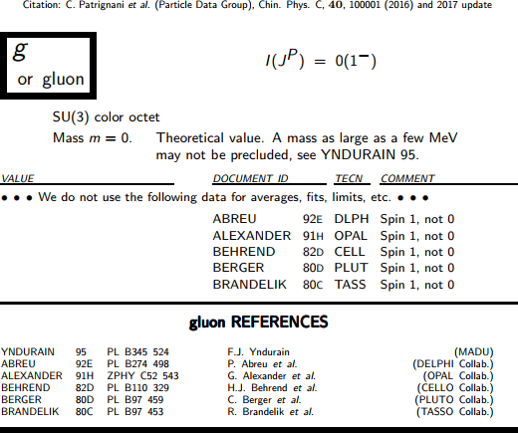
IR Behaviour of QCD
Gluons are supposed to be massless
This is true in perturbation theory
Not preserved non-perturbatively!
No symmetry in Nature protects four-transverse gluon modes …
$qμ Πμν\left(q\right)≡0$
≠

Slide 7
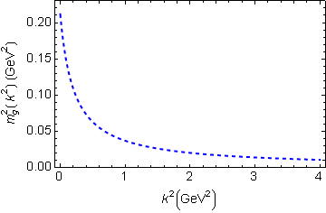
IR Behaviour of QCD
Running gluon mass
Gluons are cannibals – a particle species whose members become massive by eating each other!
μ_{g} ≈ ½ m_{p}
Expression of trace anomaly:
Massless glue becomes massive
Power-law suppressed in ultraviolet, so invisible in perturbation theory
Dynamical mass generation in continuum quantum chromodynamics
J.M. Cornwall, Phys. Rev. D 26 (1981) 1453
The Gluon Mass Generation Mechanism: A Concise Primer
A.C. Aguilar, D. Binosi, J. Papavassiliou, Front. Phys. 11 (2016) 111203
Combining DSE, lQCD and pQCD analyses of QCD’s gauge sector

Slide 8
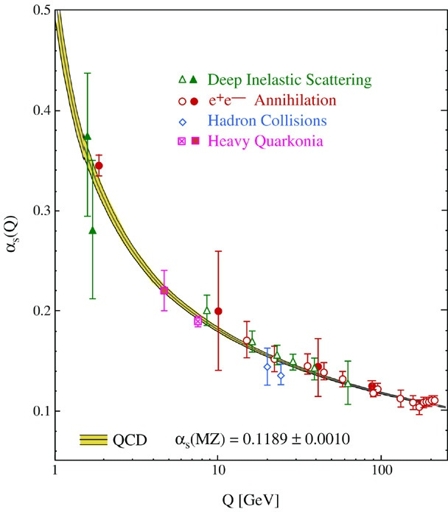
QCD’s Running Coupling
This is where we live
⇐
What’s happening
out here?!

Slide 9
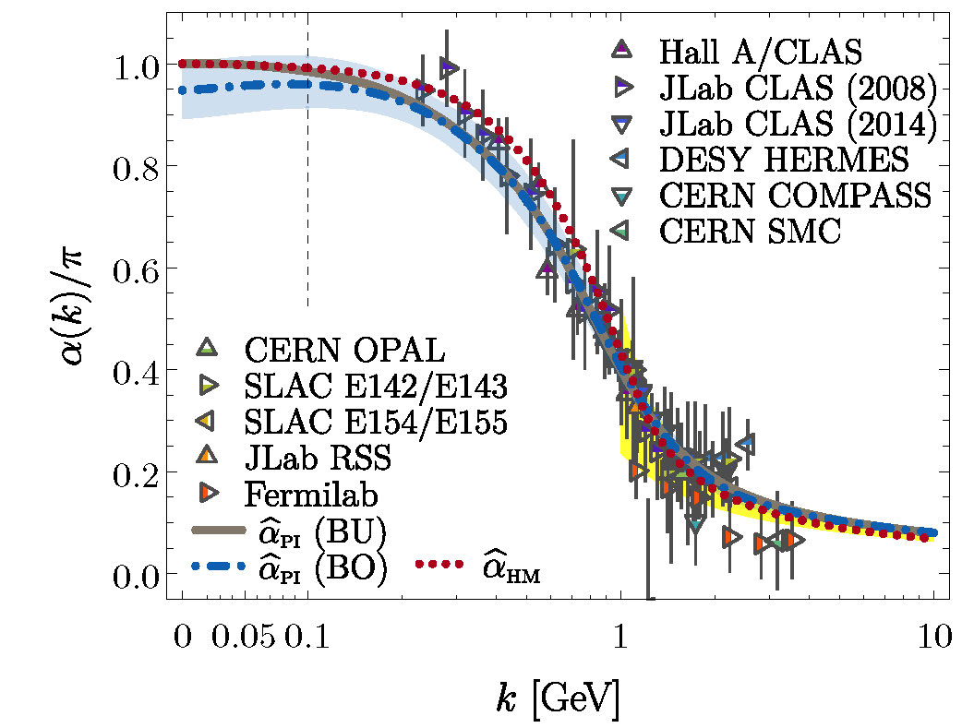
Process-independent effective-charge in QCD
The QCD Running Coupling,
A. Deur, S. J. Brodsky and G. F. de Teramond, Prog. Part. Nucl. Phys. 90 (2016) 1-74
Process independent strong running coupling
Daniele Binosi et al., arXiv:1612.04835 [nucl-th], Phys. Rev. D 96 (2017) 054026/1-7
Process-independent effective coupling. From QCD Green functions to phenomenology,
Jose Rodríguez-Quintero et al., arXiv:1801.10164 [nucl-th]. Few Body Syst. 59 (2018) 121/1-9
Modern continuum & lattice methods for analysing gauge sector enable
“Gell-Mann – Low”
running charge to be defined in QCD
Combined continuum and lattice analysis of QCD’s gauge sector yields a parameter-free prediction
N.B. Qualitative change in α̂_{PI}(k) at k ≈ ½ m_{p}
Data = process dependent effective charge [Grunberg:1982fw]:
α_{g1}, defined via Bjorken Sum Rule

Slide 10
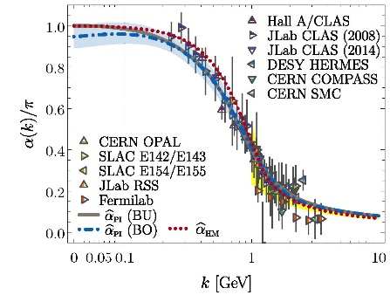
Process-independent effective-charge in QCD
Process independent strong running coupling
Binosi, Mezrag, Papavassiliou, Roberts, Rodriguez-Quintero
arXiv:1612.04835 [nucl-th], Phys. Rev. D 96 (2017) 054026/1-7
The QCD Running Coupling,
A. Deur, S. J. Brodsky and G. F. de Teramond,
Prog. Part. Nucl. Phys. 90 (2016) 1-74
Process-independent effective coupling. From QCD Green functions to phenomenology,
Jose Rodríguez-Quintero et al., arXiv:1801.10164 [nucl-th]. Few Body Syst. 59 (2018) 121/1-9
α̂_{PI} is a new & unique type of effective charge
completely determined by the gauge-boson
two-point function.
α̂_{PI} is
process-independent
unifies a vast array of observables
α̂_{PI} possesses an infrared saturation point
Nonperturbative analysis demonstrating absence of a Landau pole in QCD
QCD is IR finite, owing to dynamical generation of gluon mass-scale
Asymptotic freedom ⇒ QCD is well-defined at UV momenta
QCD is therefore unique amongst known 4D quantum field theories
Potentially, defined & internally consistent at all momenta

Slide 11
What is Confinement?
Confinement is dynamical!

Slide 12
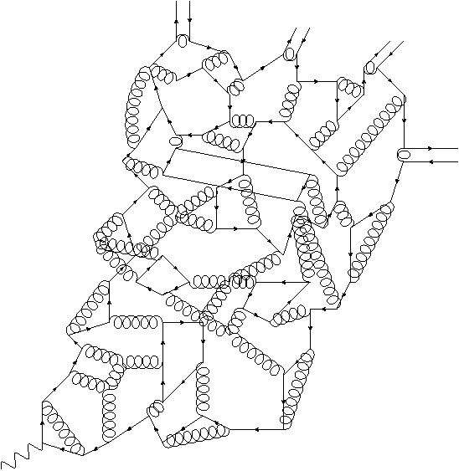
Quark Fragmentation
Fragmentation Functions ⇔ Confinement
meson
meson
meson
A quark begins to propagate
But after each “step” of length σ ≈ 1/m_{g}, on average, an interaction occurs, so that the quark loses its identity, sharing it with other partons
Finally, a cloud of partons is produced, which coalesces into colour-singlet final states
meson
σ
Confinement is a dynamical phenomenon!

Slide 13
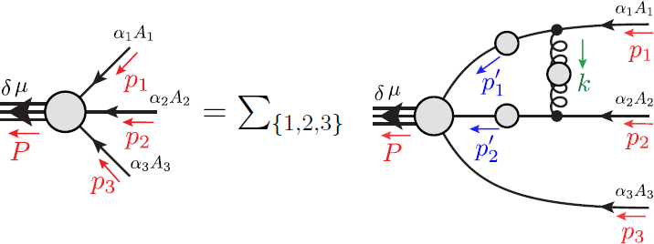
Faddeev Equation for Baryons
Nucleon mass from a covariant three-quark Faddeev equation
G. Eichmann et al., Phys. Rev. Lett. 104 (2010) 201601

Slide 14
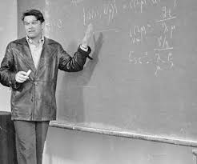
Faddeev Equation
Faddeev equation was introduced almost sixty years ago
Faddeev:1960su: Faddeev, L. D., Scattering theory for a three particle system, Sov. Phys. JETP 12 (1961) pp. 1014-1019
Treats the quantum mechanical problem of three-bodies interacting via pairwise potentials
reducing scattering problem to a sum of three terms
each of which describes a solvable scattering problem in distinct two-body subsystems
The Faddeev formulation of that three-body problem has a unique solution.
Faddeev equation … mentioned more than 47,000 times in scientific literature
L. D. Faddeev
1934-2017

Slide 15
Faddeev Equation
Analogous approach to the three-valence-quark (baryon) bound-state problem in quantum chromodynamics (QCD) was 1st explained in
R.T. Cahill et al., Austral. J. Phys. 42 (1989) 129-145
In this case, owing to
dynamical mass generation, expressed most simply in QCD's one-body Schwinger functions in the gauge and matter sectors
and importance of symmetries
a Poincaré-covariant quantum field theory generalisation of the Faddeev equation is required
Baryons as relativistic three-quark bound states, Gernot Eichmann, Helios Sanchis-Alepuz, Richard Williams, Reinhard Alkofer, Christian S. Fischer, Prog. Part. Nucl. Phys. 91 (2016) 1-100, arXiv:1606.09602 [hep-ph]

Slide 16
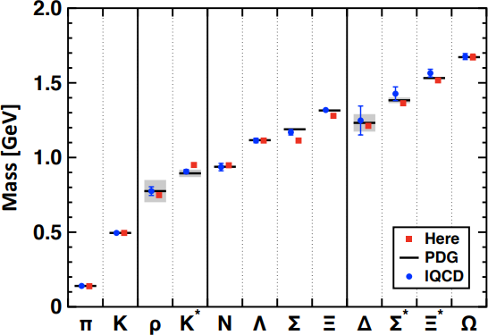
Baryon spectrum
Spectrum of light- and heavy-baryons, Si-Xue Qin, C. D. Roberts and S.M. Schmidt, arXiv:1902.00026 [nucl-th], Few Body Syst. 60 (2019) 26/1-18
(Contribution to a Special Issue dedicated to Ludwig Faddeev.)
Symmetry-preserving truncation of the strong-interaction bound-state equations = gap- and Faddeev-equations
Calculate spectrum of
ground-state J=1/2⁺ , 3/2⁺ (qq′q′′) -baryons, q,q′,q′′∈{u,d,s,c,b} ,
their first positive-parity excitations
parity partners.
Using two parameters (RL), description of the known spectrum of 39 such states is obtained
with a mean-absolute-relative-difference between calculation and experiment of 3.6(2.7)%.
The framework is subsequently used to predict the masses of 90 states not yet seen empirically.

Slide 17
Baryon Spectrum
Comparison with known J=1/2⁺ states
To explain spectra of ground-state flavour-nonsinglet mesons and ground-state octet and decuplet baryons with 2.5% mean-absolute-relative-difference theory-experiment:
Enough to employ a single mass-scale in the RL kernel that is fixed to reproduce the empirical value of the pion's leptonic decay constant.
Ignoring small isospin-breaking effects ($<_{\sim }5\%$),
Spectrum of all these bound-states can be understood as constituted from
Dynamically-dressed-quarks bound by the iterated exchange of gluons,
Gluons themselves are dressed; hence characterised by a running mass-scale, large at infrared momenta

Slide 18
Baryon Spectrum
Example: Predictions for J=3/2⁺ states
Poincaré-covariant Faddeev equation produces spectrum that is just as rich as constituent-quark models
Three-body degrees-of-freedom are fully-dressed quarks
Hence, there is a sense in which these dressed-quarks, whose properties can be and are calculated in QCD, serve as Nature's embodiment of the constituent-quarks used so effectively in bringing order to hadron physics
Difference = full Poincaré-covariance
Hence, wave functions and currents can be used for form factors to arbitrarily large Q².

Slide 19
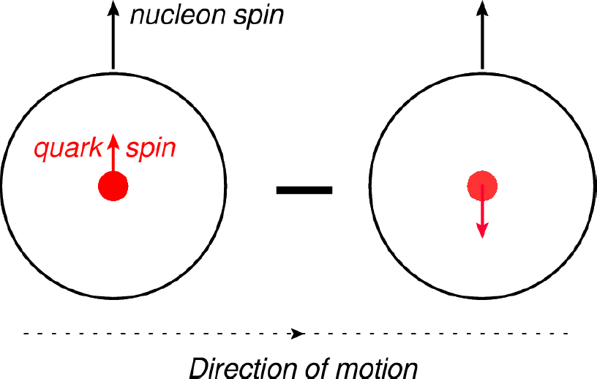
Proton’s Tensor Charge

Slide 20
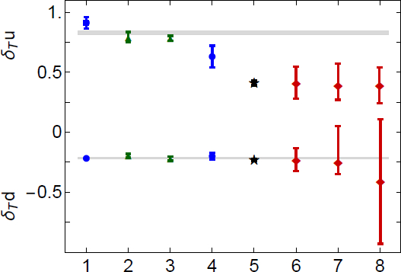
Proton’s Tensor Charges
Proton tensor charges from a Poincaré-covariant Faddeev equation, Qing-Wu Wang, S.-X. Qin, C.D. Roberts and S. M. Schmidt, arXiv:1806.01287 [nucl-th], Phys. Rev. D 98 (2018) 054019/1-10
Faddeev equation predictions
δ_{T}d: Theory and Phenomenology agree
δ_{T}d ≡ 0 in models that suppress axial-vector diquark correlations
δ_{T}u: Increasing tension between theory and phenomenology
Theory average
Realistic Interaction
lQCD
Contact interaction
SoLID precision
phenomenology

Slide 21
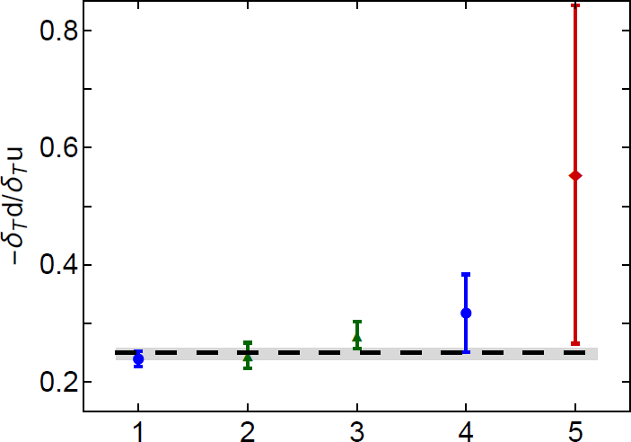
Proton’s Tensor Charges
Proton tensor charges from a Poincaré-covariant Faddeev equation, Qing-Wu Wang, S.-X. Qin, C.D. Roberts and S. M. Schmidt, arXiv:1806.01287 [nucl-th], Phys. Rev. D 98 (2018) 054019/1-10
Scale-invariant ratio
– δ_{T}d/δ_{T}u
Phenomenology [Ye:2016prn] produces ratio that is roughly twice as large
phenomenology
DSE Realistic
lQCD
DSE Contact

Slide 22
Structure of Baryons - diquark correlations
Baryon Structure and QCD
R.T. Cahill, C. D. Roberts, J. Praschifka
Austral. J. Phys. 42 (1989) 129-145

Slide 23
Structure of Baryons
Poincaré covariant Faddeev equation sums all possible exchanges and interactions that can take place between three dressed-quarks
Direct solution of Faddeev equation using rainbow-ladder truncation is now possible, but numerical challenges remain
Prediction: owing to DCSB in QCD, strong diquark correlations exist within baryons

Slide 24
Structure of Baryons
Poincaré covariant Faddeev equation sums all possible exchanges and interactions that can take place between three dressed-quarks
Direct solution of Faddeev equation using rainbow-ladder truncation is now possible, but numerical challenges remain
Prediction: owing to DCSB in QCD, strong diquark correlations exist within baryons
proton and neutron … both scalar and axial-vector diquarks are present
For many/most applications, diquark approximation to quark+quark scattering kernel is used
Confinement and DCSB are readily expressed
Diquark correlations are not pointlike
Typically, r₀₊ ~ r_{π} & r₁₊ ~ r_{ρ} (actually 10% larger)
They have soft form factors

Slide 25
Diquarks within Baryons
Masses of ground-state mesons and baryons, including those with heavy quarks, Pei-Lin Yin, Chen Chen, Gastão Krein, Craig D. Roberts, Jorge Segovia and Shu-Sheng Xu, arXiv:1903.00160, Phys. Rev. D 100 (2019) 034008/1-19
Exploit fact that mass of any given hadron is an integrated (long-wavelength) quantity and thus not very sensitive to details of the system's wave function.
Leads one to contact interaction, which provides largely algebraic approach
Symmetries are crucial and must be preserved in formulating the bound-state equations
Confinement is readily expressed
Consequently, one can use a vector-vector contact interaction to obtain both
sound predictions for the ground-state spectrum of SU(N_{f} = 5) mesons and baryons,
and reliable insights into aspects of their structure.
Framework's simplicity enables insights into features of these systems that are obscured in approaches that rely heavily on computer resources.

Slide 26
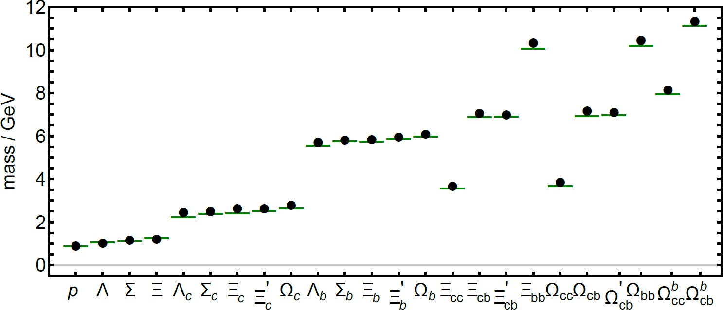
Diquarks within Baryons
Masses of ground-state mesons and baryons, including those with heavy quarks, Pei-Lin Yin, Chen Chen, Gastão Krein, Craig D. Roberts, Jorge Segovia and Shu-Sheng Xu, arXiv:1903.00160, Phys. Rev. D 100 (2019) 034008/1-19
Comparison between computed masses of ground-state flavour-SU(5) J^{P} = 1/2⁺ baryons and either experiment (first 9) or lQCD (last 11)
Contact interaction = (black) circles; and reference values = (green) bars.

Slide 27
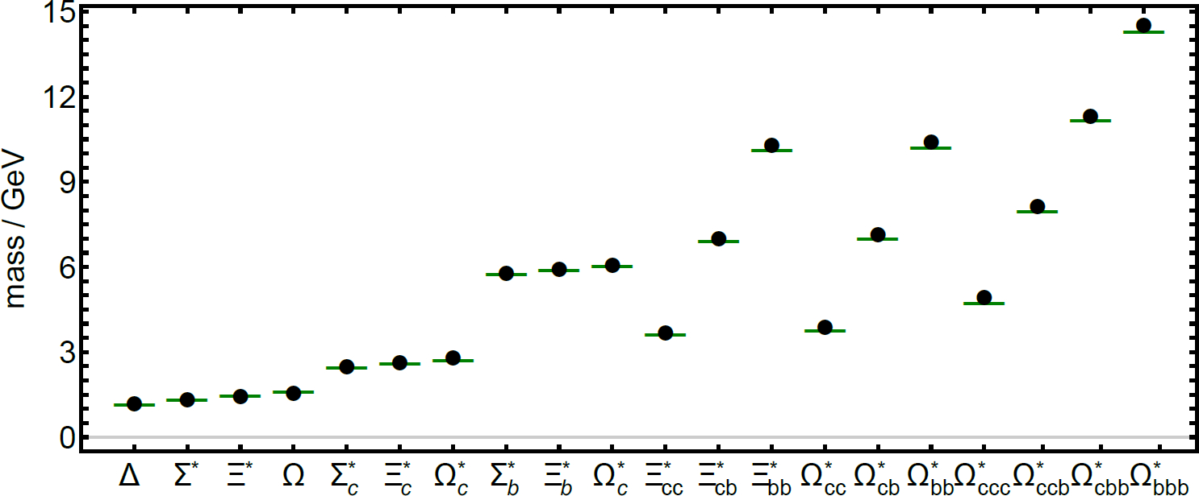
Diquarks within Baryons
Masses of ground-state mesons and baryons, including those with heavy quarks, Pei-Lin Yin, Chen Chen, Gastão Krein, Craig D. Roberts, Jorge Segovia and Shu-Sheng Xu, arXiv:1903.00160, Phys. Rev. D 100 (2019) 034008/1-19
Comparison between computed masses of ground-state flavour-SU(5) J^{P} = 3/2⁺ baryons and either experiment (first 15) or lQCD (last 9)
Contact interaction = (black) circles; and reference values = (green) bars.

Slide 28
Diquarks within Baryons
The lightest allowed diquark correlation typically defines the most important component of a baryon’s Faddeev amplitude, e.g.
scalar [uc] diquark leads in Ξ_{cc}
scalar [ub] is dominant in Ξ_{bb}
Remains true even if an axial-vector diquark is the lightest channel available, e.g.
{uu} is dominant in the Σ_{c}

Slide 29
Diquarks within Baryons
Dominance of lightest diquark correlation can be overcome in flavour channels for which the spin-flavour structure of the bound-state and quark-exchange character of kernel lead dynamically to a preference for mixed-flavour correlations, e.g.
[us]c combination in Ξ_{c} cannot reproduce itself,
its strength is fed into [uc]s - [sc]u correlation.
Eventual outcome depends on the mass-scales of kernel participants and how they affect rearrangement processes in the Faddeev kernel, e.g.
compare Ξ_{b} with Ξ_{cb}

Slide 30
Diquarks within Baryons
Masses of ground-state mesons and baryons, including those with heavy quarks, Pei-Lin Yin, Chen Chen, Gastão Krein, Craig D. Roberts, Jorge Segovia and Shu-Sheng Xu, arXiv:1903.00160, Phys. Rev. D 100 (2019) 034008/1-19
Results … add to the argument against treatments of three-body problem which assume baryons can be described as effectively two-body in nature, e.g.
as being built from a constituent-quark and static/frozen constituent-diquark.
Results … verify that diquark correlations in QCD are essentially dynamical
their breakup and reformation play a crucial role in defining baryon structure.
True for light-quark baryons
lQCD confirms that spectrum possesses richness that cannot be explained by a two-body model
Consequences extend to baryons involving one or more heavy quarks, challenging both
treatment of singly-heavy baryons (qq’Q, q, q’ ∈ {u, d, s}, Q ∈ {c, b}) as two-body light-diquark+heavy-quark (qq’ +Q) bound-states
and analyses of doubly-heavy baryons (qQQ’) which assume such systems can be considered as two-body light-quark+heavy-diquark bound-states, q + QQ’
Observations have implications for few-body studies of hybrid hadrons and tetra- and penta-quark systems

Slide 31
MARATHON EXPERIMENT
Uses deep inelastic scattering off the mirror nuclei ³H and ³He to determine the ratio of the neutron to proton inelastic structure functions, F2n /F2p, and the ratio of the down to up quark distributions in the nucleon, d/u, at medium and large Bjorken x.
Ratio is clean probe of the proton’s valence-quark structure
Aims to solve a question that has stood for 40 years
Preliminary MARATHON data appear at right

Slide 32
MARATHON EXPERIMENT
Data appear quantitatively consistent with new reanalyses of existing data on a wide variety of nuclei:
Flavor dependence of the nucleon valence structure from nuclear deep inelastic scattering data, E.P. Segarra et al. arXiv:1908.02223 [nucl-th]
Red dot at x=1 is scalar-diquark-only nucleon
Such a nucleon has ZERO valence d-quarks
Vertical purple band at x=1 is the q+qq Faddeev equation prediction:
Nucleon spin structure at very high-x, C.D. Roberts, R. J. Holt & S.M. Schmidt, Phys.Lett. B 727 (2013) – arXiv:1308.1236 [nucl-th]
Upper = 1⁺ qq is 35% of proton
Lower = 1⁺ qq is 20% of proton
These experimental results could be a new, significant step forward in our understanding of strong-QCD and the nucleon’s wave function
Scalar diquark models = no hard d-quark
“no valence d-quark”

Slide 33
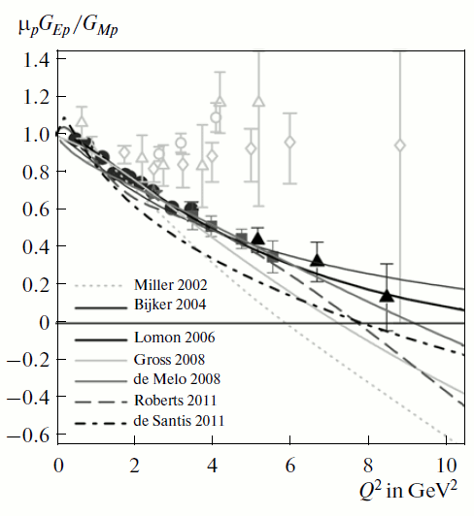
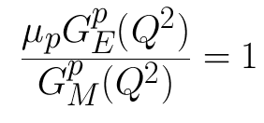
Adjusting to a modern picture of hadron structure
Particle physics paradigm
Particle physics paradigm

Slide 34
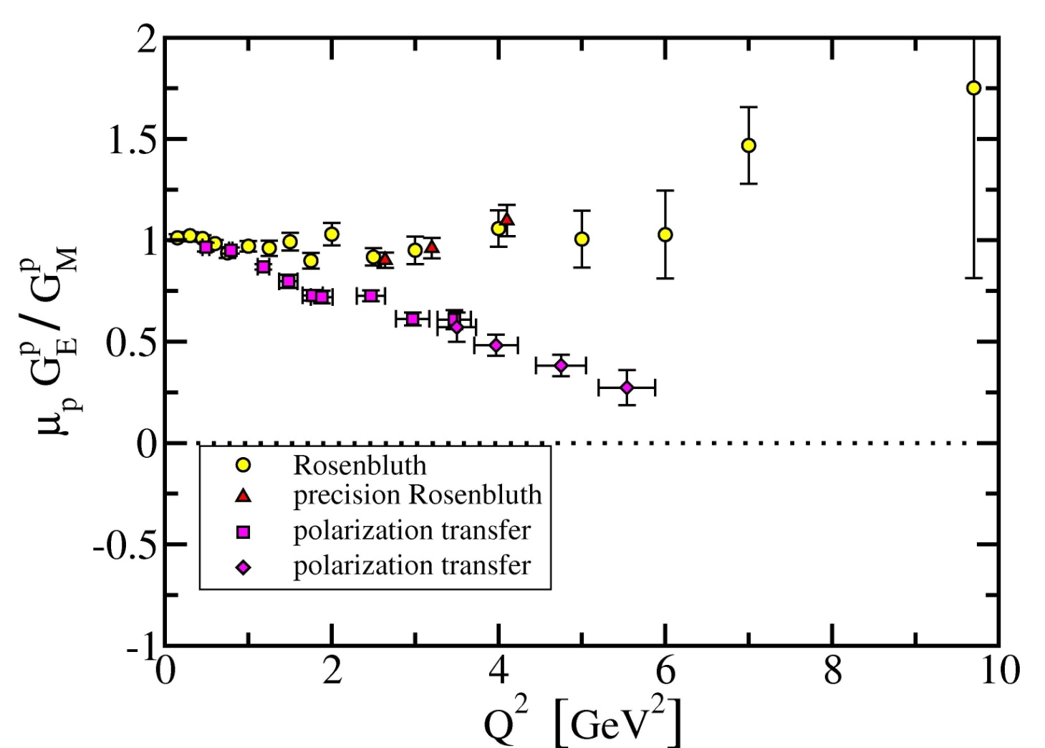
Zero in the Electric Form Factor of J ≠ 1 Hadrons
Data before 1999
Looks like the structure of the proton is simple
The properties of JLab (high luminosity) enabled a new technique to be employed.
First data released in 1999 and paint a VERY DIFFERENT PICTURE
M. K. Jones et al., Phys. Rev. Lett. 84, 1398 (2000)
O. Gayou et al., Phys. Rev. Lett. 88, 092301 (2002)
V. Punjabi et al., Phys. Rev. C 71, 055202 (2005)
A. J. R. Puckett et al., Phys. Rev. Lett. 104, 242301 (2010)
A. J. R. Puckett et al., Phys. Rev. C 85, 045203 (2012)

Slide 35
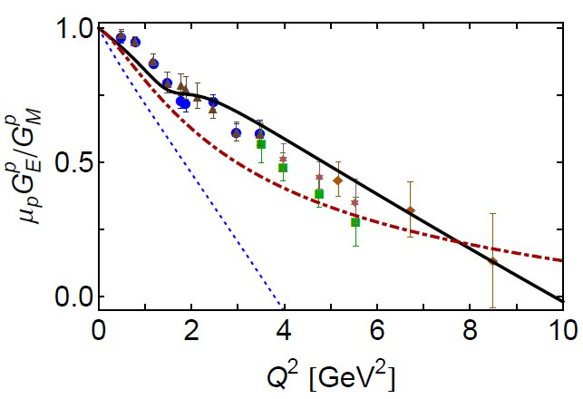
Nucleon and Δ elastic and transition form factors, Jorge Segovia et al., arXiv:1408.2919 [nucl-th], Few Body Syst. 55 (2014) pp. 1185-1222
Zero in the Electric Form Factor of J ≠ 1 Hadrons
DSE: quark+diquark
Solid: M(p²) result
Dashed: M constant
Dot-dashed = 2004 parametrisation of data
Numerous calculations exhibit a zero in $G_{E}^{p}$
Can this be readily understood?
$${ Q}^{2}=9.5GeV^{2}$$

Slide 36
Vector Meson Elastic Form Factors
Elastic electromagnetic form factors of vector mesons,
Yin-zhen Xu et al., in preparation
Vector-meson electric form factor, $G_{E}^{V}$,
Sum of three terms
One term is negative-definite = $F_{2}^{V}$
Hence $G_{E}^{V}$ may possess a zero
Remove $F_{2}^{V}$, then $G_{E}^{V}$positive-definite
This feature establishes its role as a proxy for the proton’s electric form factor.
$G_{E}^{p}=F_{1}^{p}− \frac{Q^{2}}{4M^{2}}F_{2}^{p}$ … can be zero, depending on impact of nonperturbative dynamics on $F_{2}^{p}$
Point/simple vector meson: $G_{E}^{V}$is zero at $Q^{2}\text{≈} 6 m_{V}^{2}$
Linear extrapolation of existing JLab data yields a zero in $G_{E}^{p}$ at $Q^{2}=9.8 m_{p}^{2}=8.7 GeV^{2}$
Negative definite

Slide 37
Vector Meson Elastic Form Factors
Elastic electromagnetic form factors of vector mesons,
Yin-zhen Xu et al., in preparation
Merit of using vector meson studies to locate & explain zero in electric form factor of J ≠ 1 hadron
Relative simplicity of 2-body continuum bound-state problem as compared to the analogous 3-body problem
Nevertheless, using QCD-derived kernels, not trivial.
Use brute-force numerical techniques. Consequently:
Owing to moving singularities in the complex- k² domain sampled by the bound-state equations, for each vector meson ∃ maximum value of Q² beyond which evaluation of form factors is not possible with conventional algorithms.

Slide 38
Vector Meson Elastic Form Factors
Elastic electromagnetic form factors of vector mesons,
Yin-zhen Xu et al., in preparation
Use Schlessinger Point Method (SPM: 1966 & 1968) to extrapolate from domain accessible directly
Based on Padé approximant.
Able to accurately reconstruct a function in the complex plane within a radius of convergence specified by that one of the function’s branch points which lies nearest to the real domain from which the sample points are drawn.
Owing to the procedure’s discrete nature, reconstruction can also provide a reasonable continuation on a larger domain along with an estimate of the associated error.
Very well tested
L. Schlessinger and C. Schwartz, Phys. Rev. Lett. 16, 1173 (1966).
L. Schlessinger, Phys. Rev. 167, 1411 (1968).
R. A. Tripolt, I. Haritan, J. Wambach and N. Moiseyev, Phys. Lett. B 774, 411 (2017).
C. Chen et al., Phys. Rev. D 99, 034013 (2019).
D. Binosi et al., Phys. Lett. B 790, 257 (2019).
D. Binosi and R.-A. Tripolt, (arXiv:1904.08172 [hep-ph]), Spectral functions of confined particles.

Slide 39
Vector Meson Elastic Electric Form Factor
In three panels at right, plot $G_{E}^{V}$as functions of ${x=Q}^{2}/m_{V}^{2}$
for V = ud̅ , u_{s}d̅_{s} , u_{c}d̅_{c}
Analysis predicts a zero in each case
Importantly, as the current-mass of the system’s valence- quarks is increased, the x-location of the zero,${ x}_{z}$, moves toward $x=0$
Shift is initially slow; but the pace increases as one leaves the domain upon which emergent mass is dominant and enters into that for which explicit (Higgs-connected) mass generation overwhelms effects deriving from strong-QCD dynamics.

Slide 40
Vector Meson Elastic Electric Form Factor
Linear extrapolation of existing JLab data yields a zero in $G_{E}^{p}$ at $Q^{2}=9.8 m_{p}^{2}=8.7 GeV^{2}$
Focusing on ρ-meson, made from same valence-quarks as proton
Replace $m_{V}^{2}$ by $m_{p}^{2}$, then
$$x=10.6\left(3\right) \text{⇒}{ Q}^{2}=9.4\left(3\right)GeV^{2}$$
This is an estimate for the location of zero in proton’s elastic form factor.
Quark+diquark Faddeev-equation solution predicts zero at
$${ Q}^{2}=9.5GeV^{2}$$
No symmetry protects $G_{E}^{p}$. Can be negative and very likely exhibits zero at/near this location because dressed-quarks have large anomalous magnetic moments that run slowly to zero
Qnce again, existence of zero is consequence of strong-QCD dynamics, expressed in emergent (running) mass function for light quarks.

Slide 41
Vector Meson Dominance
Existence of a zero in $G_{E}^{V}(x)$ ⇒ validity domain for single-pole VMD model is circumscribed.
Notwithstanding this, $G_{E}^{V}(x)$ is the best case for VMD:
must agree with the computed result in some neighbourhood of x = −1
and, by charge conservation, also in the vicinity of x = 0.
Findings …
VMD approximation is fair on a reasonable domain for light-quark systems
However, VMD is poor for states in which the Higgs-mechanism of mass generation is dominant; hence, likely yields erroneous estimates for off-shell properties of c̅c states & more massive systems.
J/Ψ: VMD fails beyond 4% virtuality
± 20%
VMD discrepancy ratio

Slide 42
Emergent Mass Expressed Observably in Diverse Array of Quantities, including Parton Distribution Amplitudes & Functions
E.g., Presentations
Tuesday 5th November
16:20 - Jen-Chieh Peng: Drell-Yan
Wednesday 6th November
14:40 – Jorge Segovia: Resonance Electrocouplings
Thursday 7th November
11:20 - Haiyan Gao: Transversity
Friday 8th November
10:50 – Tanja Horn: Meson and Baryon Structure
15:00 - Jose Rodríguez-Quintero: GPDs
16:20 - Cédric Mezrag: PDAs and DVCS
Contemporary theory predicts signature consequence of mass emergence:
The gluon content of
Nature's only near-pure
Nambu-Goldstone mode,
the pion,
is far greater
than that in any other hadron
Observably expressed in
$uπ(x;ζ)$
& accentuated in $uK(x;ζ)$/ $uπ(x;ζ)$

Slide 43
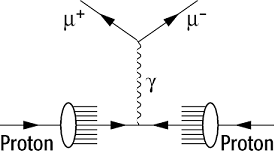
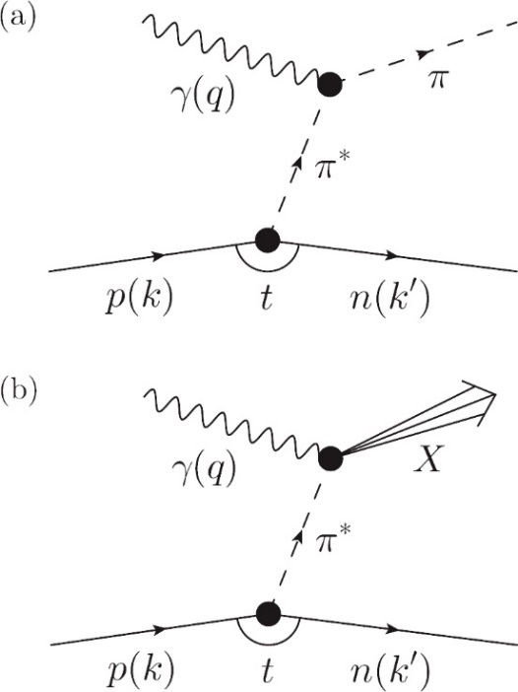
Approved & Planned Experiments
JLab 12 … Tagged Deep Inelastic Scattering
Pion and Kaon PDFs at large x
Sullivan Process …
γ + p → n + X
γ + p → Λ + X
Approved … R. A. Montgomery et al., AIP Conf. Proc. 1819 (2017) 030004
Letter of Intent: A New QCD facility at the M2 beam line of the CERN SPS (COMPASS++/AMBER), B. Adams, arXiv:1808.00848 [hep-ex]
Pion and Kaon Structure at the EIC,
A. C. Aguilar et al., arXiv:1907.08218 [nucl-ex],
Eur. Phys. J. A 55 (2019) 190/1-15
5 key experiments:
pion and kaon PDFs;
pion and kaon GPDs;
open charm production;
pion form factor to 35 GeV²;
pion and kaon fragmentation functions
Pion
& Kaon
Pion and kaon PDFs
via Drell-Yan reaction

Slide 44
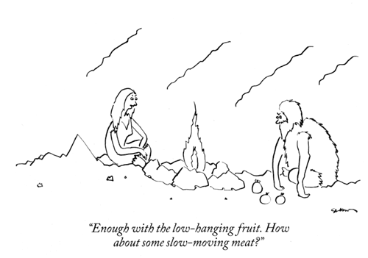
Ground States are Easy.
Ground States are Easy. Equally, Ground States are Insufficient

Slide 45
Ground States are Easy. Equally, Ground States are Insufficient
Strong-QCD theory makes an array of predictions relating to the emergence of mass
Calculations connect these features with observables for nucleon ground-states.
Outcome = indication that ideas are viable.
However, ground state is just one member of a set of Hamiltonian eigenvectors with infinitely many elements
Many, many Hamiltonians produce effectively identical ground states, but their excitation spectra are vastly different.
And spectra alone are not enough.
Many, many Hamiltonians produce effectively equivalent spectra
Structural properties
– the Q² dependence of elastic and transition form factors
possess the greatest discriminating power –
This means using realistic wave functions & currents … computed by whatever reliable means are available

Slide 46
Ground States are Easy. Equally, Ground States are Insufficient
Results on N* structure and those for ground state nucleons & mesons cannot be divorced.
To validate any explanation, one must expose & study the properties of all systems that can be produced by the theory & insist that the approach provide a truly unifying explanation
True for meson & baryon & hybrid & exotic sectors.
Any claim to understand QCD must explain all these things simultaneously, e.g.
How is emergent mass expressed in different bound-states?
Are any differences readily understood?
Are correlations an essential feature of all n ≥ 3 valence-parton systems?
A focus on ground-states alone is like
throwing out the baby and keeping the bathwater

Slide 47
Ground States are Easy. Equally, Ground States are Insufficient
Haven’t solved QCD unless one understands the Roper Resonance
Perspective on this provided in “Roper resonance: Toward a solution to the fifty-year puzzle, Volker D. Burkert and Craig D. Roberts, arXiv:1710.02549 [nucl-ex], Rev. Mod. Phys. 91 (2019) 011003/1-18”
Δ(1232) also has a radial excitation. Is this the Δ(1600)?
The same level-inversion in Δ spectrum as in nucleon spectrum, viz. P= + below P= -
CLAS & Roper experience established …
It is only possible to decide nature of Δ(1600) once one has predictions for transition form factors and experiments to test them.
Poincaré-covariance demands that proton has intrinsic deformation, but quantum mechanics says such deformation is not observable for J=1/2 systems
Deformation can be observed in proton → Δ(1232) & Δ(1600) transitions.
Type of deformation expressed in transition form factors
Prediction: Δ(1232) electric quadrupole moment ≈ twice that of the Δ(1600)
Same is true of the transition quadrupole moment ⇐ Measurable.

Slide 48
Baryons … J=3/2⁺
Poincaré-covariant analysis of heavy-quark baryons, Si-Xue Qin et al., arXiv:1801.09697 [nucl-th], Phys.Rev. D 97 (2018) 114017/1-13
Analysed internal structure of the ground and first positive-parity excited states of qqq, QQQ
Each system has a complicated angular momentum structure, e.g.
Ground states
primarily S-wave
but each possesses P-, D- and F-wave components
P-wave fraction is large in the u and s-quark states;
First positive-parity excitation
large D-wave component,
grows with increasing current-quark mass
but state also exhibits features consistent with a radial excitation.

Slide 49
Transition form factors: γ∗ + p → Δ(1600)
Top panel: Magnetic dipole γ∗ + p → Δ(1600) form factor compared with contemporary data.
Middle panel: Electric quadrupole transition form factor.
Bottom panel: Coulomb quadrupole transition form factor.
In all panels:
solid (black) curve, complete Faddeev result;
long-dashed (blue) curve, result obtained when Δ(1600) is reduced to S-wave state;
dashed (blue) curve, both the proton and Δ(1600) are reduced to S-wave states;
dotted (green) curve, obtained by enhancing proton's axial-vector diquark content;
Other curves = quark model results

Slide 50
Transition form factors: γ∗ + p → Δ(1600)
Marked sensitivity to L ≠ 0 components
G_{E}* changes sign with all components included
Recall D-wave component of 1st J = 3/2⁺ positive-parity excitation is larger than in ground-state
Dashed green curve … enhance 1⁺ diquark to mimic meson-baryon final-state-interactions … move low-x results in correct direction
Also … significant sensitivity to model details
⇒ highlights sensitivity to baryon wave function

Slide 51
Ground States are Easy. Equally, Ground States are Insufficient
Crucial to study the complete spectrum of states and expose the internal structure of characterising members of each level
Answer many questions, e.g.
Is relativity important in hadron structure?
If so: When? How? & What to make of seemingly good predictions from nonrel. models?
Are there correlations in baryons and other hadrons? If so, what sort of correlations and in which channels?
Chart emergent distributions of
energy,
momentum
mass
within QCD bound states; and how they are influenced by the environment.
Etc.
Namely, deliver the complete solution to QCD’s Equations of Motion = Collection of Colour-Singlet Schwinger Functions

Slide 52
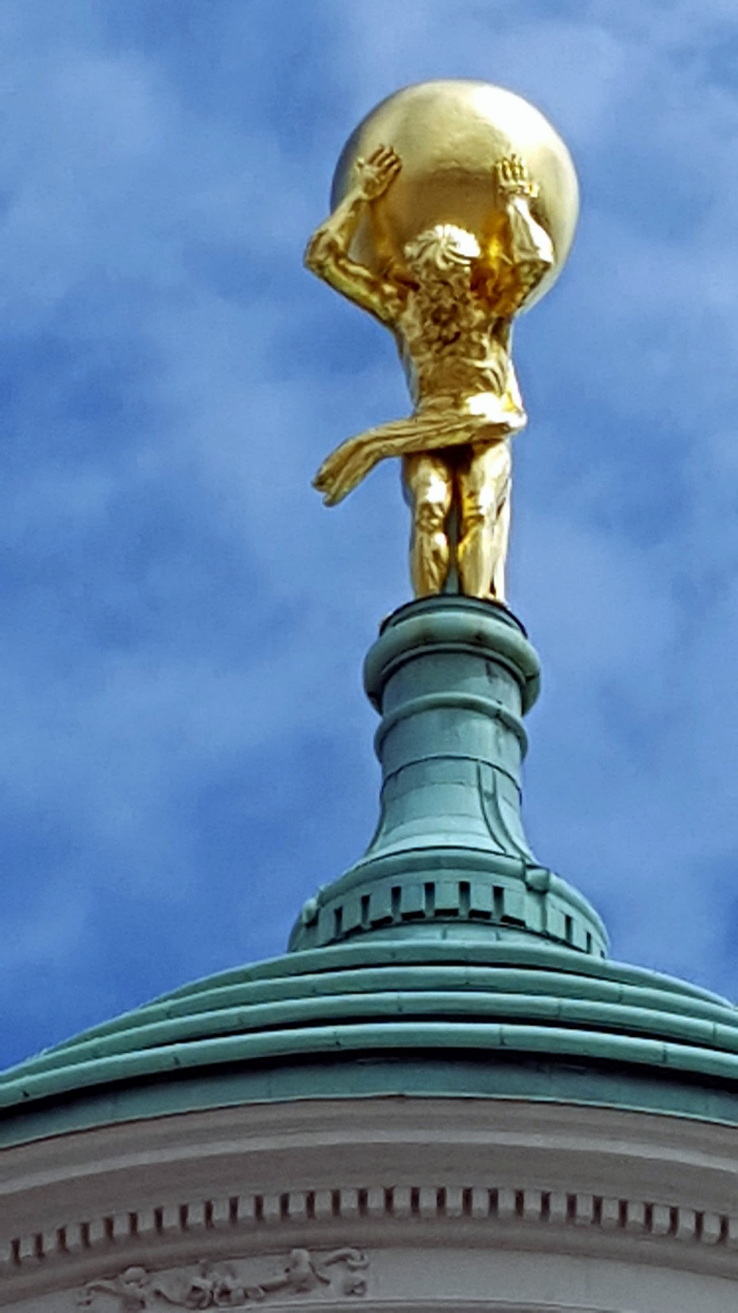
Epilogue:
QCD – Our Weight on Its Shoulders

Slide 53
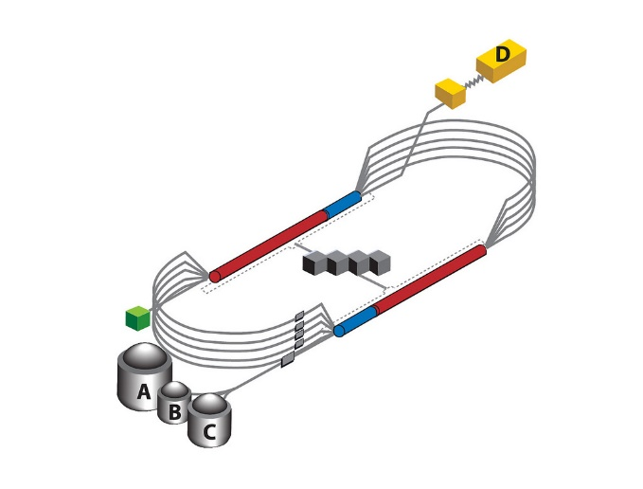
Epilogue
Challenge: Explain the Origin & Distribution of the Bulk of Visible Mass
Current Paradigm: Quantum Chromodynamics
QCD is plausibly a mathematically well-defined quantum field theory,
The only one we’ve ever produced
Consequently, it potentially defines a new paradigm for developing Beyond-SM theories
Challenge is to reveal the content of strong-QCD
Progress and Insights
being delivered by amalgam of
Experiment … Phenomenology …Theory
No single approach/experiment
can solve this problem alone
Continued exploitation of synergies essential
to capitalise on new opportunities provided
by existing & planned facilities

Slide 54
Selected Contributors: 2017 – Now
Students, Postdocs, Profs.
Thankyou!
M. N. Ferreira (UNICAMP, São Paulo)
E. V. Souza (UNICAMP, São Paulo)
Zhao-Qian YAO (Nanjing U.)
Yin-Zhen XU (Nanjing U.)
Marco BEDOLLA (Genova, U Michoácan)
Chen CHEN (Giessen, UNESP - São Paulo, USTC & IIT);
Muyang CHEN (NKU, PKU)
Zhu-Fang CUI (Nanjing U.) ;
Minghui DING (ECT*, ANL, Nankai U.) ;
Jacopo Ferretti (Yale)
Fei GAO (Heidelberg, Valencia, Peking U.) ;
Bo-Lin LI (Nanjing U.)
Ya LU (Nanjing U.)
Cédric MEZRAG (INFN-Roma, ANL, IRFU-Saclay) ;
Khépani RAYA (Nankai U., U Michoácan);
A. Cristina Aguilar (UNICAMP, São Paulo)
Adnan Bashir (U Michoácan);
Daniele Binosi (ECT*)
Volker Burkert (JLab)
Lei Chang (Nankai U. )
Xiao-Yun Chen (Jinling Inst. Tech., Nanjing)
Feliciano C. De Soto Borrero (UPO);
Tanja Horn (Catholic U. America)
Gastão Krein (UNESP – São Paulo)
Yu-Xin Liu (PKU);
Joannis Papavassiliou (U.Valencia)
Jia-Lun Ping (Nanjing Normal U.)
Si-Xue Qin (Chongqing U.);
Jose Rodriguez Quintero (U. Huelva) ;
Elena Santopinto (Genova)
Jorge Segovia (U. Pablo de Olavide = UPO);
Sebastian Schmidt (IAS-FZJ & JARA);
Shaolong Wan (USTC) ;
Qing-Wu Wang (Sichuan U)
Shu-Sheng XU (NJUPT, Nanjing U.)
Pei-Lin Yin (NJUPT)
Hong-Shi Zong (Nanjing U)
… and many more …
Notes:
25+5 … Bonn Nstar 2019

Slide 55
Thankyou!

