Slide 1
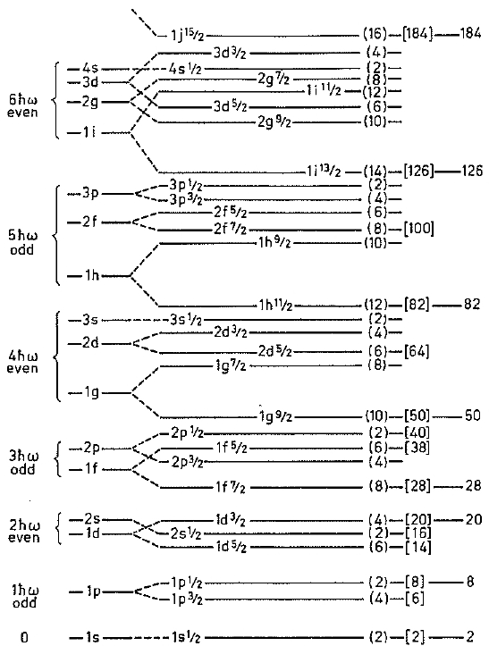
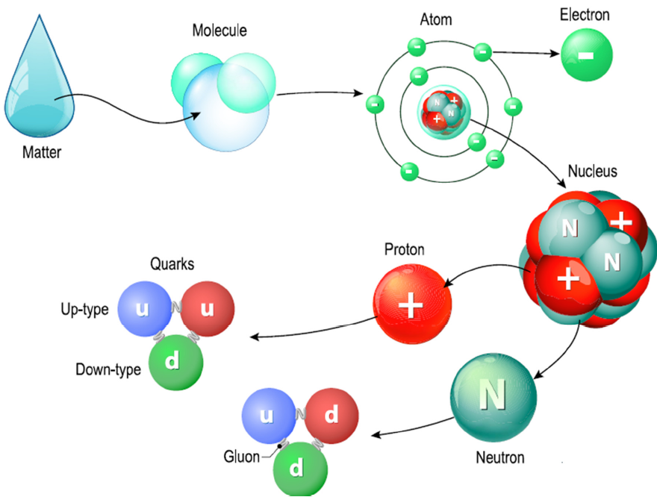
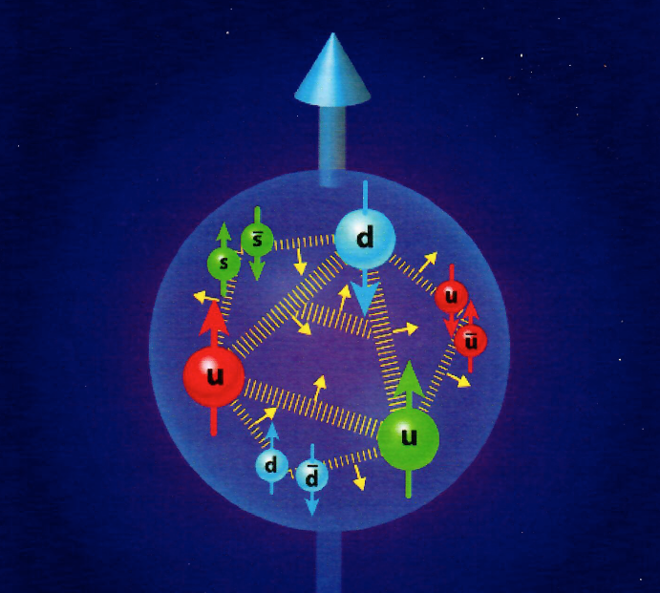
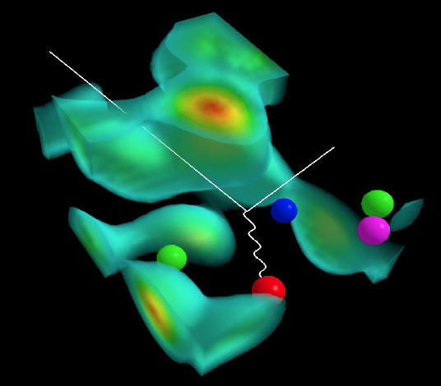
Paving the way to understanding
Nuclear Structure from Strong QCD
Legacy Shell Models ...
21st Century
Cross Over
... Femto-Science World
²⁰Ne
82
- QCD - Quantum
Chromo
Dynamics
50
Two forces – strong color force and the electromagnetic force – are responsible for holding the fundamental pieces – quarks & gluons plus electrons together ...
28
20
8
2
Where LSM, HPC & QCD meet!
PIs: Jerry P. Draayer, Kristina D. Launey, Tomas Dytrych; Post-Doc Alexis Mercenne
Graduate Students: Robert Baker, Alison C. Dreyfuss, David S. Kekejian & Grigor Sargsyan
__________________________________________________
U.S. NSF & DOE plus LSU & SURA Sponsored Research
Notes:
1

Slide 2
General Background
No-Core
Shell Model
Collective Model
*
*
No-Core Shell Model (NCSM)
(Vary, Navratil, & Barrett, ~2000 to present)
Symplectic Shell Model (Sp-NCSM)
(Rowe & Rosensteel, ~1980s to present)
...
Typical Vertical Symplectic Excitation
(Multiple 1p-1h / )
Reorganize
Shell-Model
Space
Cluster & Collective (Natural Subspaces)
-------------
–
+2hω
Sp(3,R)
A Raising
(L = 0 & 2)
Symmetry
Adapted Basis
(Special Features)
Canonical & unitary
Organized by shapes
Quadratic in x’s & p’s
Band-heads ➔ np-nh
Spurious free bands
Captures collectivity
No effective charges
Algebraic framework
Deformation natural
Field theory linkage
–
+2hω
1p-1h
–
+2hω
SU(3)
–
2p-2h
0hω
–
+2hω
Sp(3,R)
B Lowering
(L = 0 & 2)
...
np-nh
–
+nhω
–
-2hω
*Realistic interaction (local or not; NN, NNN, …)
In principle, exact solutions, up to N_{max} cutoff
Successful descriptions to date through ¹⁶O
*Simple logical algebraic underpinning
Elliott SU(3) if no symplectic modes
Sp(3,R) add monopole & quadrupole

Slide 3





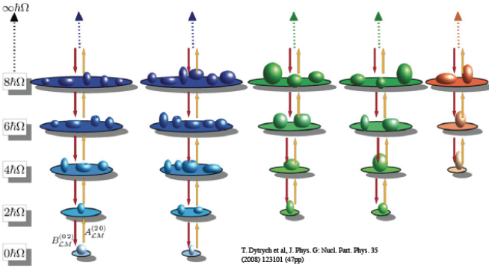
General Background
Symplectic Symmetry / Algebra
Realized by 21 generators of the Sp(3,R) symplectic algebra – all distinct quadratic forms in coordinates (q_{i}) and momenta (p_{i})
Spherical Oblate Prolate
Quadrupole Moment
“Tensor” (6)
Kinetic Energy
“Tensor” (6)
Orbital Angular
Operator (3)
Deformation Flow
“Circulation / Vorticity” (6)
Every configuration is labeled by the SU(3) (lambda, mu) quantum numbers of the Elliott Model (1958), which in turn defines the shape of the so-called “band head” configuration.)
David Kekejian – Graduate Student (JPD#20) from Armenian

Slide 4
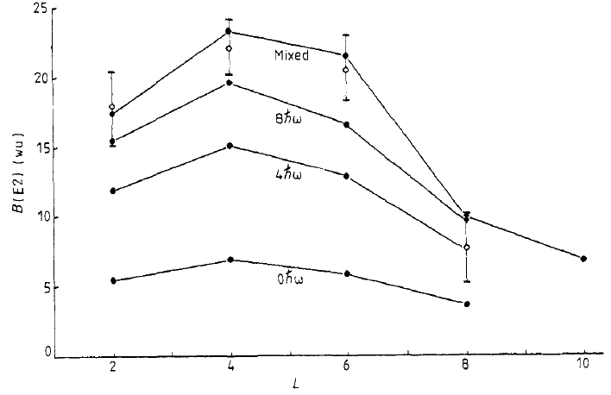
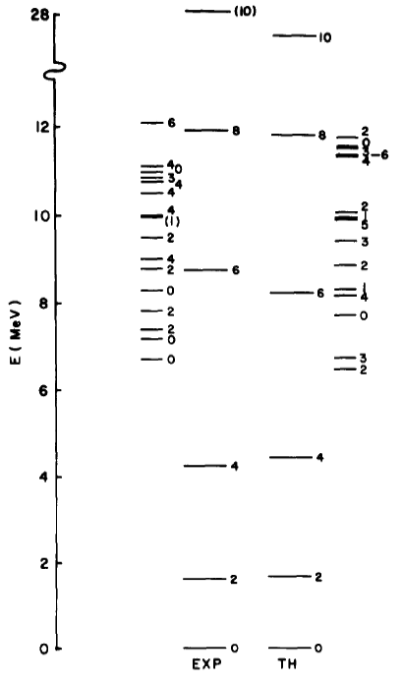
General Background
Simple (Early Shell Model) Picture
²⁰Ne
G. Rosensteel and D.J. Rowe – 1977
J.P. Draayer, K.J. Weeks, G. Rosensteel – 1984

Slide 5
General Background
‘Symmetry Adapted’ NCSM Campaign
Timeline: 5 (2002-06)
+ 5 (2007-2011)
+ 5 (2012-16)
Goal –
Reproduce and predict properties of heavy as well as light nuclei, starting with and building upon QCD/EFT informed and inspired interactions …
Plan –
Exploit existing capabilities to evaluate probability of success and level of effort required to develop a full-blown symmetry adapted NCSM
Develop a symmetry adapted no-core shell model code that capitalizes on exact and approximate (partial) symmetries of nuclei (SA-NCSM)
Study the emergence of collective phenomena, tracking their evolution to and from fundamental (ab initio) features of the interaction
Exploit existing NCSM technology to prove efficacy of method, revealing (or not) any inherent limitations
Explore need (or not) for renormalization, winnowing space to physically relevant and tractable subspaces
Evaluate extensibility of theory and its characteristics vis-à-vis current/emerging computational resources
Apply the theory to study of extreme processes known to be important to understanding nuclei and nuclear systems
Develop a user friendly desktop version of code for simple applications as well as educational and training purposes
Extend theory to include coupling to the continuum, and apply to the result to the study of nuclear reactions

Slide 6
High Performance Computing Era*
Ab Inito No-Core HPC
Shell Models
NCSM
Coupled Cluster Theory
Monte Carlo Methods
.........
DOE
NERSC-X (Berkeley)
Summit (Oak Ridge)
Aurora (Argonne)
... upgrades ...
HPC Era …
NSF
Frontera
Stampede
Blue Waters (NCSA)
... upgrades ...
(TACC)
Collective Models
NCSM
Sp-NCSM
SA-NCSM
.........
Sp(3,R)
SU(3)
*21st Century
– Ab Initio –
Nuclear Physics

Slide 7
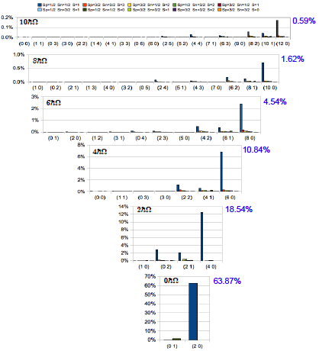
Ab Inito No-Core HPC
First Results for ⁶Li with N_{max} = 10
… Proof of Principle …
> 99% of Physics
In < 1% of the
“reorganized” space
JISP16* bare interaction in Nmax = 10 space with
ħω = 20 MeV
… Team Work …
Many “helps” along the way … e.g., James Vary making his NCSM available to us, Mark Caprio (ND) visiting LSU on a sabbatical, along with quality input from Anna Hayes of LANL, various collaborators from Bulgaria, China, Mexico, and so on. Also to NSF for a PetaApps award, and DOE for an EPSCoR grant, plus SURA for release time and financial assistance with postdoc team!
Simplicity
within
Complexity
*Bonn, Argonne, Idaho,
N3LO (optimized), etc.
... yield similar results ...
Typically
60% - 90%
Leading Sp-IR

Slide 8
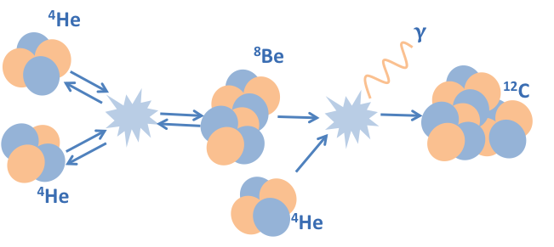
Hoyle State Example
Pushing NC-Shell / Cluster Connection
Creation of ¹²C in hot stars
… The elusive Hoyle state …

Slide 9

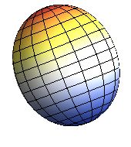
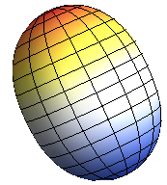
Hoyle State Example
Three Slice Scenario (legacy / modern)
0p-0h
¹²C
2p-2h
(0 4) Bandhead (Oblate)
(6 2) Bandhead (Triaxial)
Main contribution to ground state rotational band (0_{g.s.}⁺, 2₁⁺, 4₁⁺)
Main contribution to the 0₃⁺
4p-4h
(12 0) Bandhead (More Prolate)
Main contribution
to Hoyle state (0₂⁺)
‘Back to the Future’
– déjà vu –
Engeland & Ellis ‘67s

Slide 10
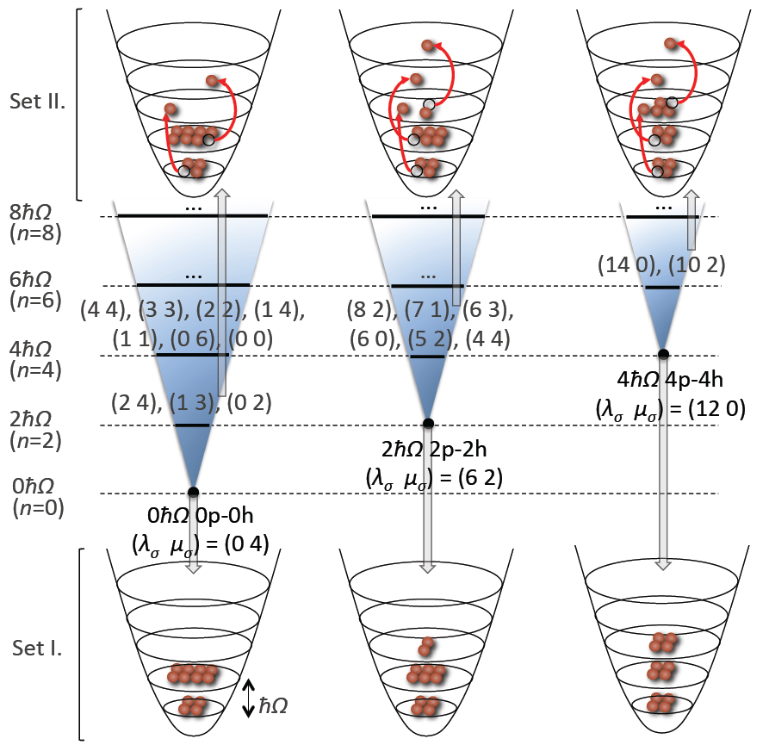
Hoyle State Example
Choose Three Slices (NCSpM View)
0p-0h
¹²C
2p-2h
(0 4) Bandhead (Oblate)
(6 2) Bandhead (Prolate)
4p-4h
(12 0) Bandhead (More Prolate)
Intertwining
Shell & Alpha
Cluster Picture

Slide 11
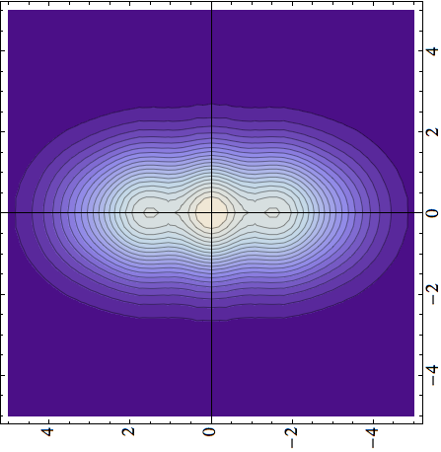
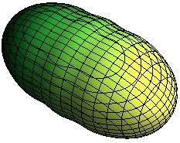
Hoyle State Example
¹²C: Systematics (Function of N_{max})
2⁺
0⁺
4p4h
Hoyle state
0⁺
NCSM
2p2h
2⁺
0p0h
Full
Plus
NCSpM
NCSpM

Slide 12
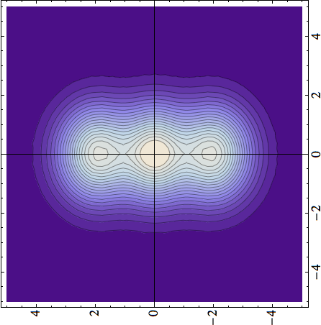

Formation of Clusters!
Hoyle State Example
*Now with mixing
at the band-head
level turn on ... !
Density [fm^{–3}]
z [fm]
x [fm]
x [fm]
x [fm]
Hoyle state
Hoyle state
0⁺
0⁺
4⁺
2⁺
model space (major shells)
Standard ab initio NCSM
*(NCSpM & Band Mixing)

Slide 13

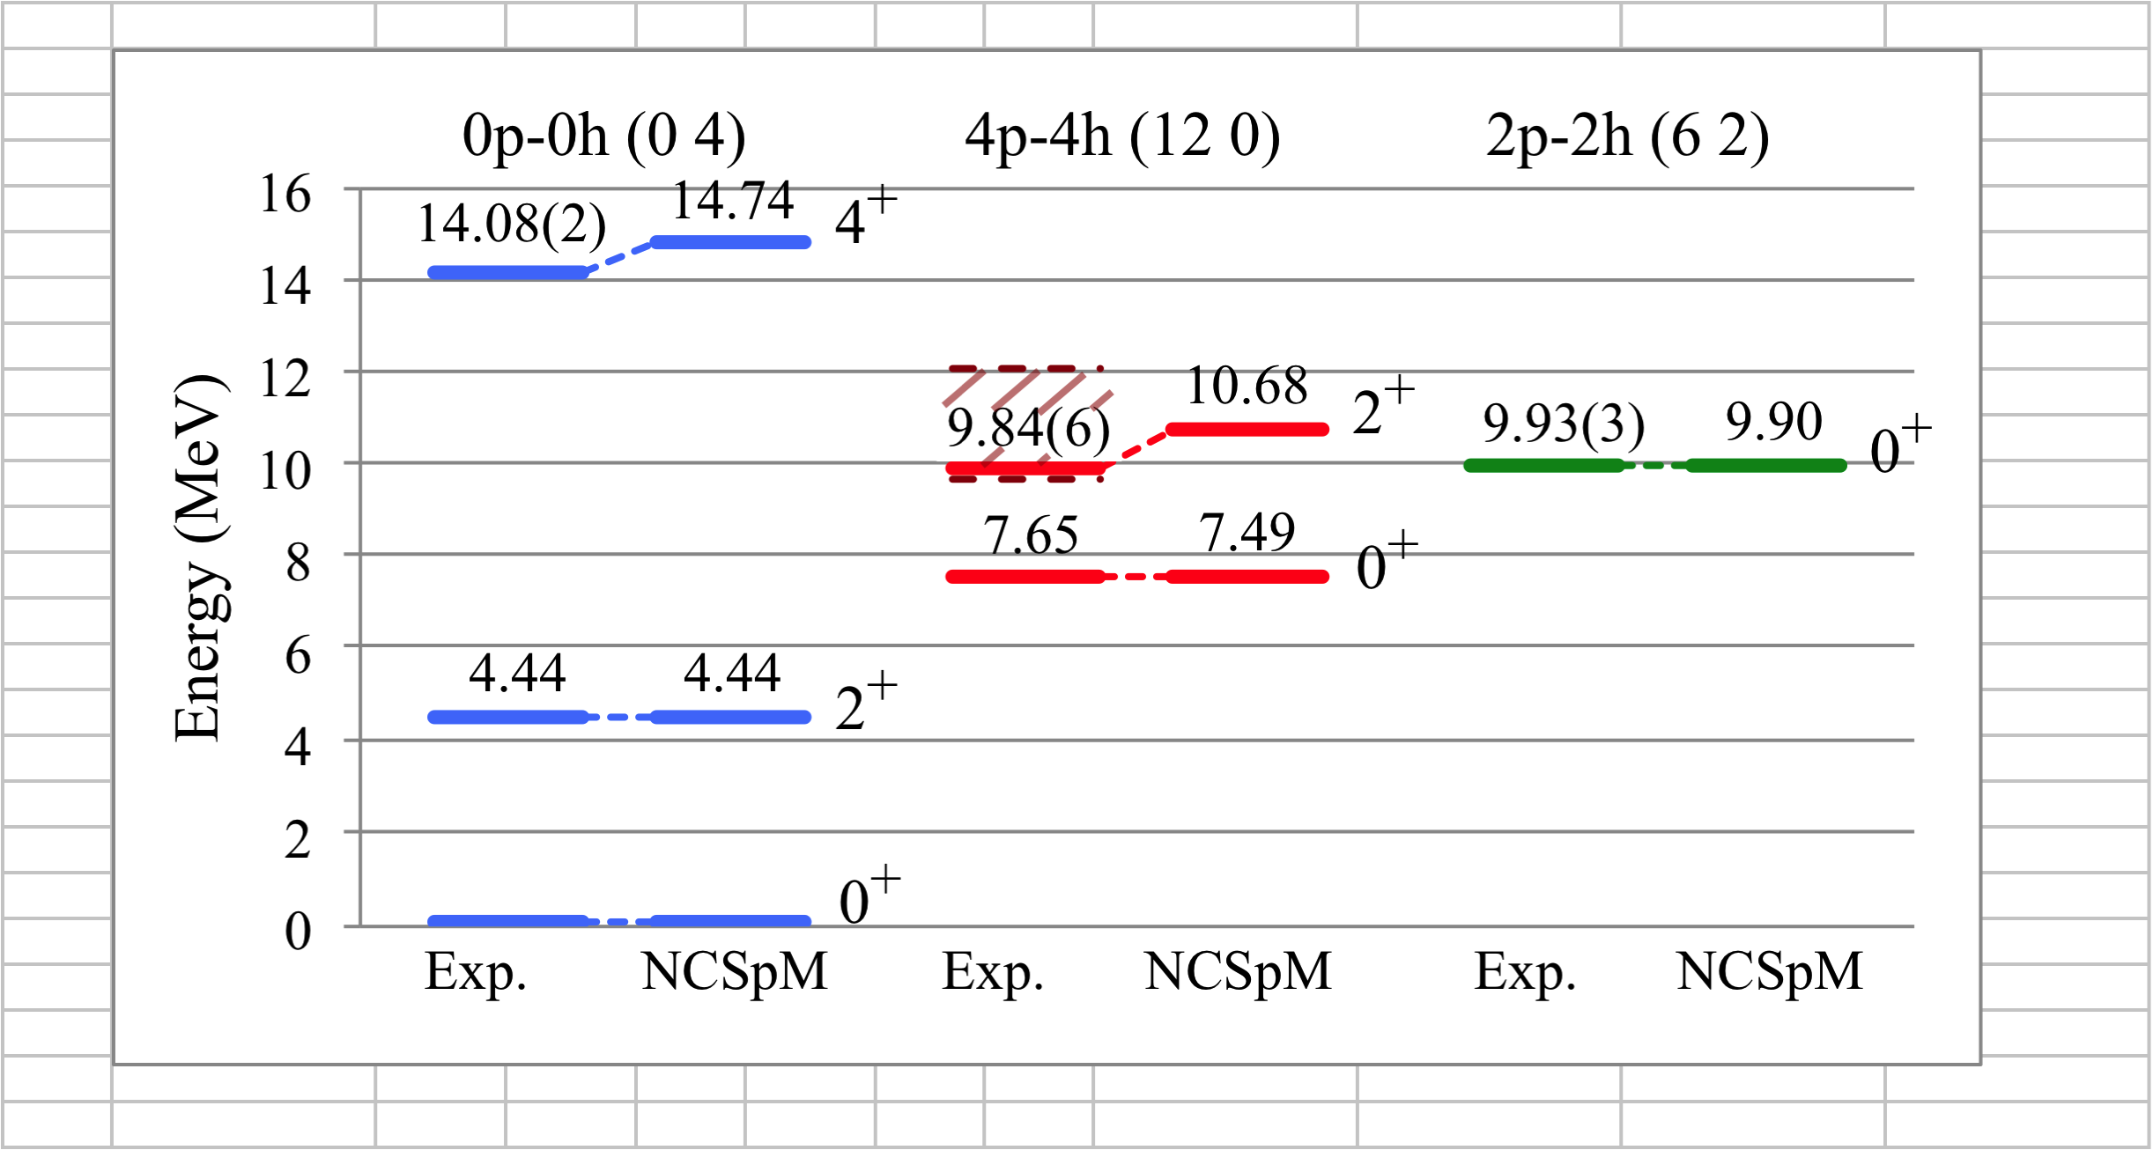
Hoyle State Example
¹²C Observables – Negative Parity
1p-1h (3 3)
“No B(E3)”
... Yet ...
~9.60
63.0 W.u.
3⁻
Energy (MeV)
 |  | NCSpM | Exp
Matter r_{rms}, fm | Ground state | 2.44 | 2.43(2)
 | Hoyle state | 2.93 | N/A
Q, e fm² | 2₁⁺ | +6.62 | +6(3)
 | 2₂⁺ | –20.61 | N/A
4.65 W.u.
5.12 W.u.

Slide 14
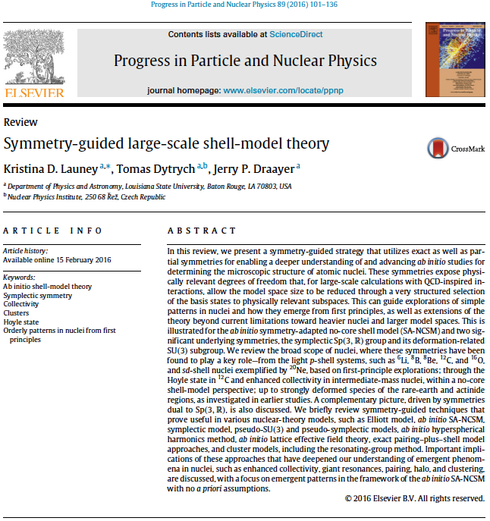
Clustering Examples
Review Article – PPNP 89 (2016) 101-136
... Also ...
– Kristina Launey –
"State of the Art in Nuclear Cluster Physics”
(SOTANCP3) Yokohama, Japan
May 26-30, 2014
&
– Kristina Launey –
"State of the Art in Nuclear Cluster
Physics”
(SOTANCP4)
Galveston, Texas, USA
May 13-18, 2018

Slide 15
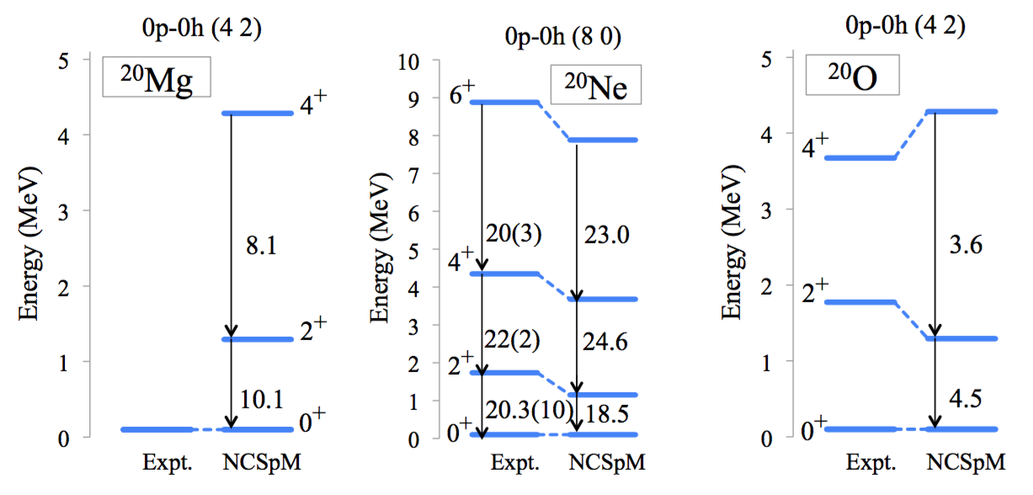
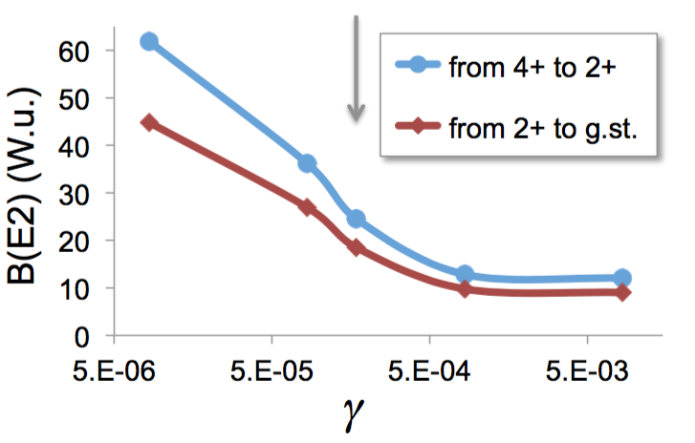
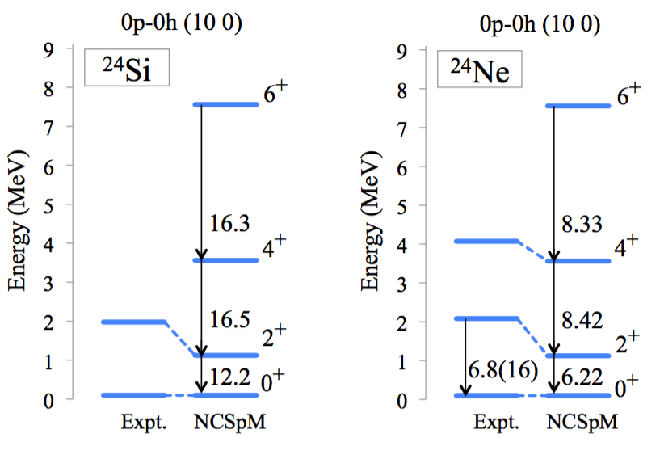
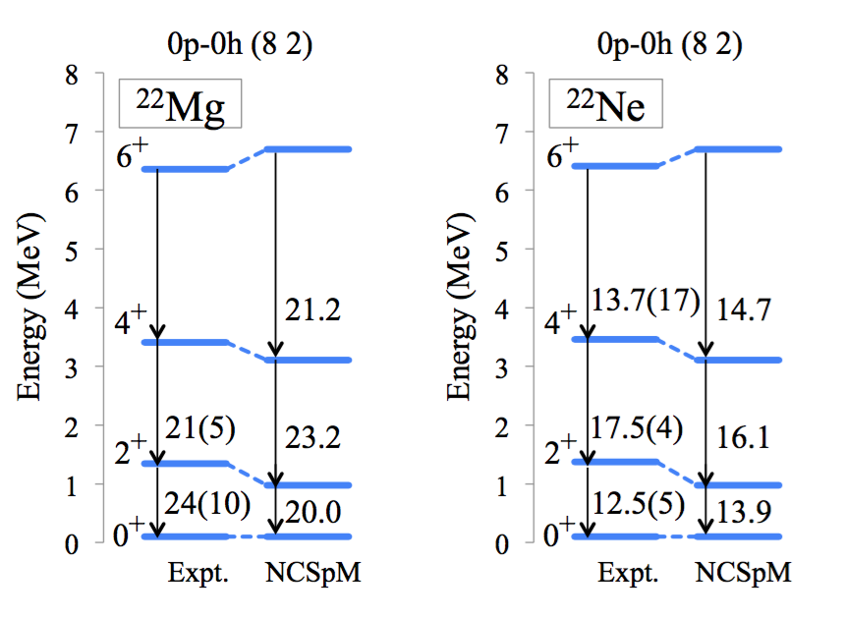
Medium Mass Nuclei (Gregory Tobin / REU)
sd-Shell Examples
Ne-20: grey arrow is gamma used

Slide 16
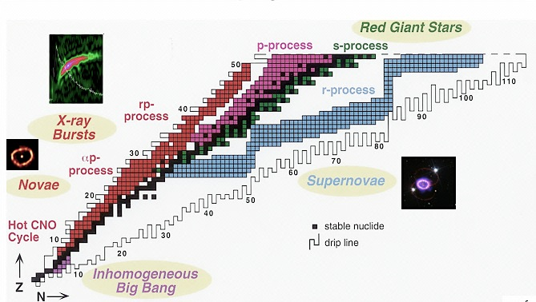
Further sd-shell Results (Robert Baker / GS)
sd-Shell Examples
²⁴Si
Selected (pre-thesis) Examples
(Now onto Beta Decay)
²²Mg
³²Ne
²⁰Ne
… nuclei… elements… stars…
¹⁹Ne
²⁴Ne
Ab initio description (converged selected spaces) (NNLO_{opt}, ħΩ=15 MeV, 13 HO shells)

Slide 17
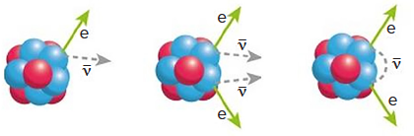
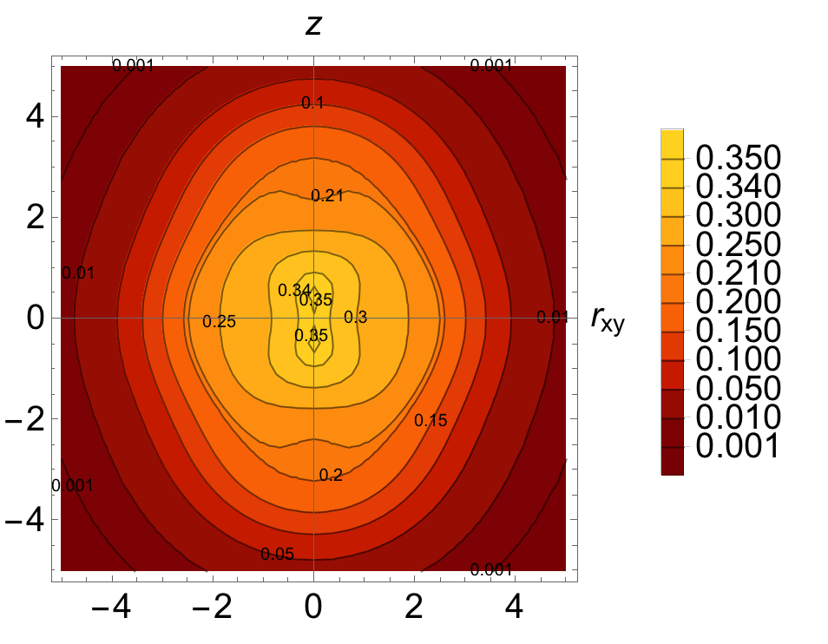
Plus fp-shell Results (Grigor Sargsyan / GS)
fp-Shell Examples
⁴⁸Ca
⁴⁸Sc
⁴⁸Ti
⁴⁸Ca
⁴⁸Ti
Neutrinoless ββ decay
8 shells, N2LOopt
0⁺
SA-NCSM (selected): .................... 966,152
Complete model space: ....... 3,162,511,819 2⁺
SA-NCSM (selected): ................ 3,055,554
Complete model space: ... 14,522,234,982
8 shells, N2LOopt
0⁺
SA-NCSM (selected): ....................... 602,493
Complete model space: ..... 24,694,678,414
2⁺
SA-NCSM (selected): ..................... 1,178,834
Complete model space: .... 113,920,316,658
⁴⁸Ti, Q(2⁺) [e fm²]
--------------------------
Experiment ..................... -17.7
8 shells ............................ -19.3
(no effective charges)

Slide 18
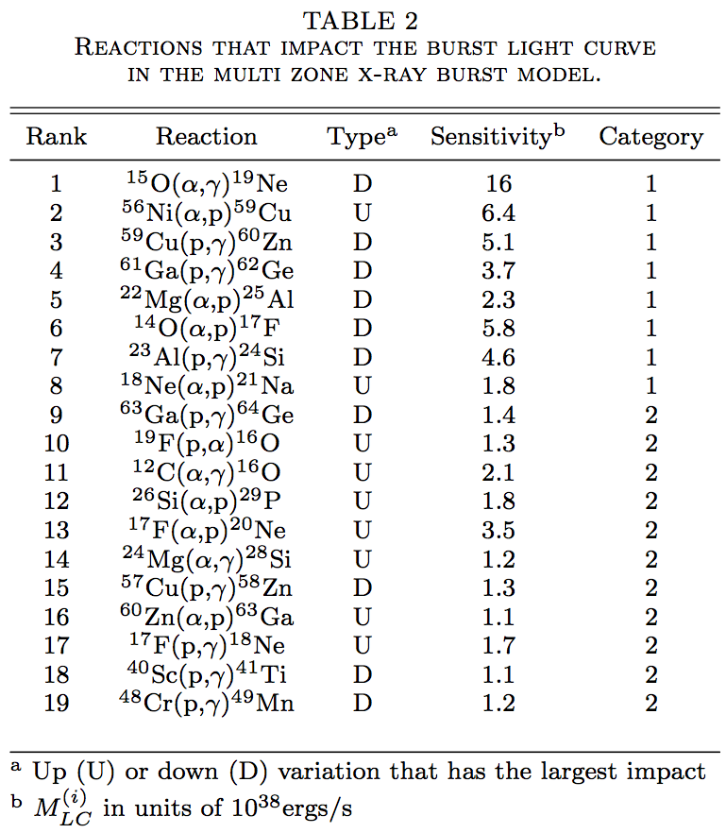
Reaction Theory (Alexis Mercenne / PDoc)
Reaction Theory
Nucleosynthesis: Type I X-Ray Burst
Simulations for XRB are sensitive to certain reaction rates
²³Al(p,γ)²⁴Si
improve rate precision to improve simulations
Ab initio wave functions
Widths
Phase
Shifts
Cross sections
Reaction rates
Reaction network simulation
Abundances

Slide 19
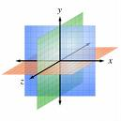
Scattering Theory (Alexis Mercenne / PDoc)
Reaction Theory
SA-NCSM + RGM
[(λ₁μ₁)
x
(λ_{ρ}0)
x
(λ₂μ₂)]
(λ,μ)
Deformation
N₁
N₂
Relative motion
L
Rotations
z
Deformation is the only relevant information
All calculations prior to R-matrix use the SA
basis/deformation, that is the SU(3) symmetry
and corresponding Wigner-Eckart theorem:
  Norm and Hamiltonian Kernel
  CM treatment
  Inversion of the Norm Kernel
Dependence on orbital momentum (and partial
waves) needed to compute cross section, which
is introduced at the last step
M
Spatial Orientation
y
x

Slide 20


Members of the LSU Nuclear Theory Group
LSU NT Team
Alison C. Dreyfuss
Thesis Defense – 2019/10/25
(Headed to NNSA / LLNL - Regular Staff Appointment)
David Kekejian

Slide 21
Exemplary Output - LSU Nuclear Theory Team
LSU NT Team

Slide 22
Exemplary Output - LSU Nuclear Theory Team
LSU NT Team

Slide 23
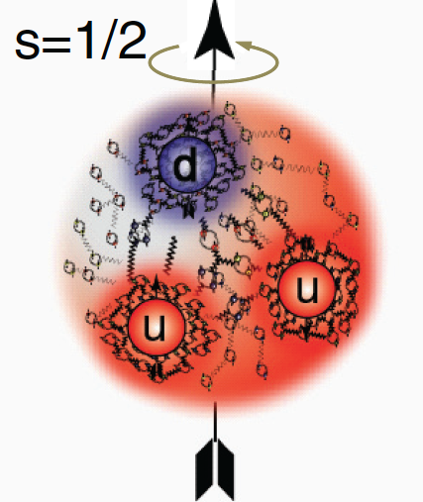
General Observations
Future Considerations / Tasks
SA-NCSM -> Deformation -> DSA-NCSM
Canonical & Unitary Transformation
Algebraic Structure Unchanged
L -> L(deformed) + S(circulation)
Task #1:
“Many-particle Nilsson Model”
Jefferson Lab 12GeV Era
Excited States of the Nucleon
Electric Charge vs Magnetic Distribution
Total Spin -> Angular Momentum plus Quark Spin
Task #2:
“Femtography of Nucleon”
“Normal Concept” versus “Pseudo Concept”
L + S = J = L + S
–
–
–
~
~
Task #3:
“Collusion within & among Nucleons”

Slide 24
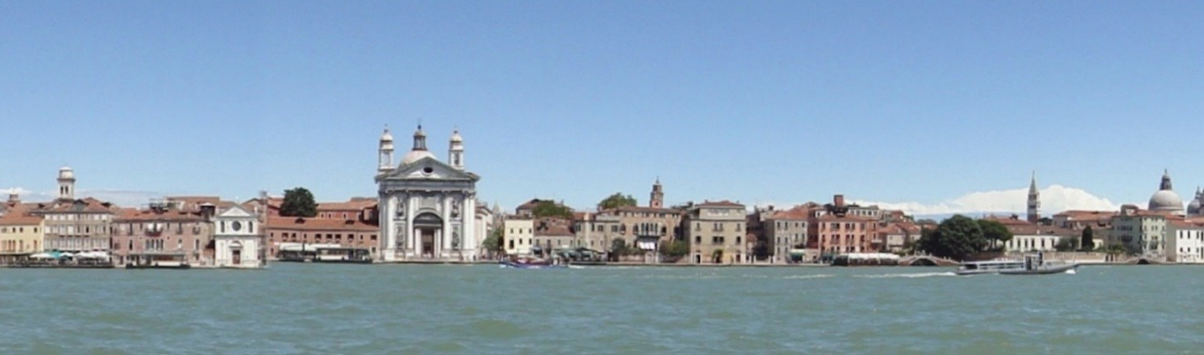
Discovering Simplicity within Complexity
...
... GRAZIE ...
... “Are Nucleons Deformed?” ...
Notes:
24

