Slide 1
Today 7 years ago
On November 6, 2012, Charles Darwin received 4,000 write-in votes from voters in Athens-Clarke County, Georgia, protesting the reelection of an anti-science fundamentalist, Paul Broun, who ran unopposed in the general election as a U.S. Representative. Broun sat on the Science, Space and Technology Committee. Yet, on 27 Sep 2012, he called evolution and the Big Bang Theory, “lies straight from the pit of hell”.
Notes:
My presentation about strong QCD relies completely on the correctness of the BB Theory.

Slide 2
Exploring Strong QCD in the JLab Experiments of the 12 GeV Era
Volker D. Burkert
Jefferson Laboratory
Workshop on Strong QCD from Hadron Structure Experiments
Notes:
For this first session the organizers asked me to address what we learn about sQCD from experiments in the 12 GeV era. Most experiment will have some connection to sQCD, so I will select experiments that may have some connection to one of these basic questions....

Slide 3








JLab @ 12 GeV Project
Add new hall
CHL-2
Enhance equipment in existing halls

Slide 4

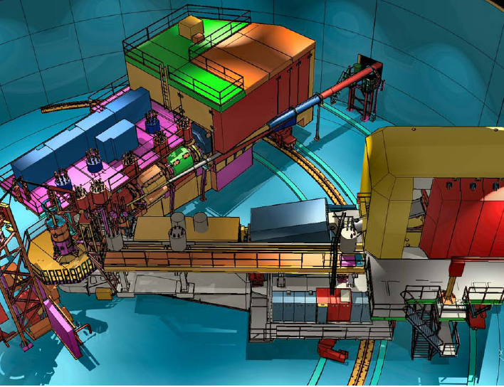
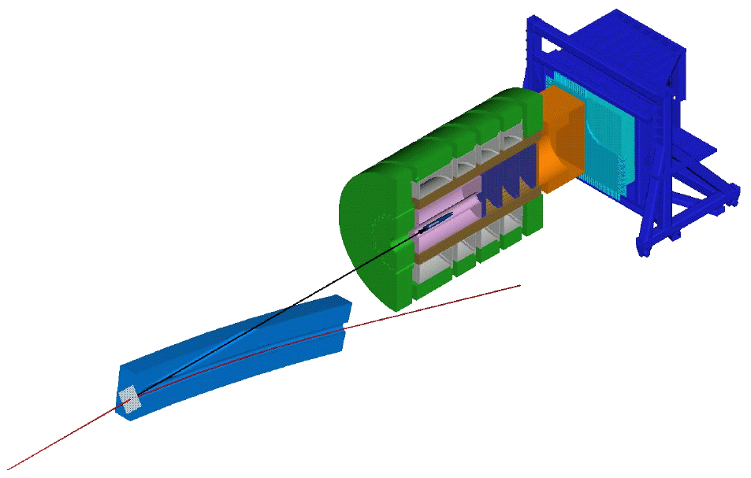
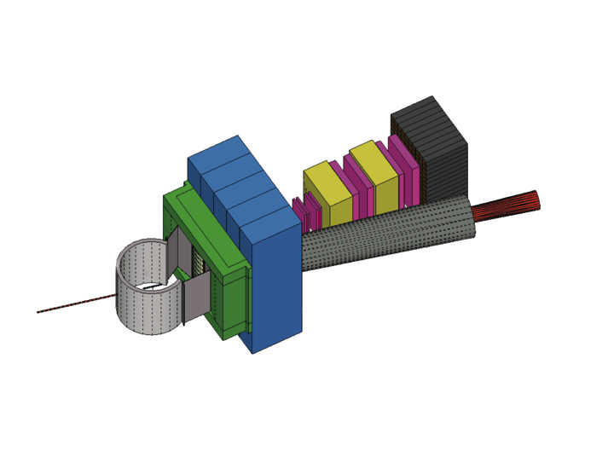
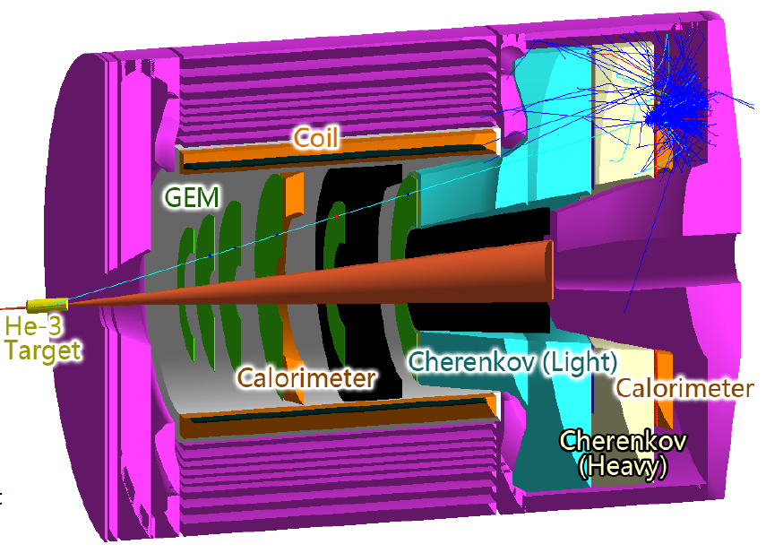
JLab @ 12 GeV Equipment
Hall B
Hall C
Hall D
SHMS
CLAS12
GlueX
SBS-Hall A
Hadron calorimeter
Tracker
MOLLER – Hall A
SOLID - Hall A
Scattering chamber
CH2 analyzer
Beam line Pb shield

Slide 5
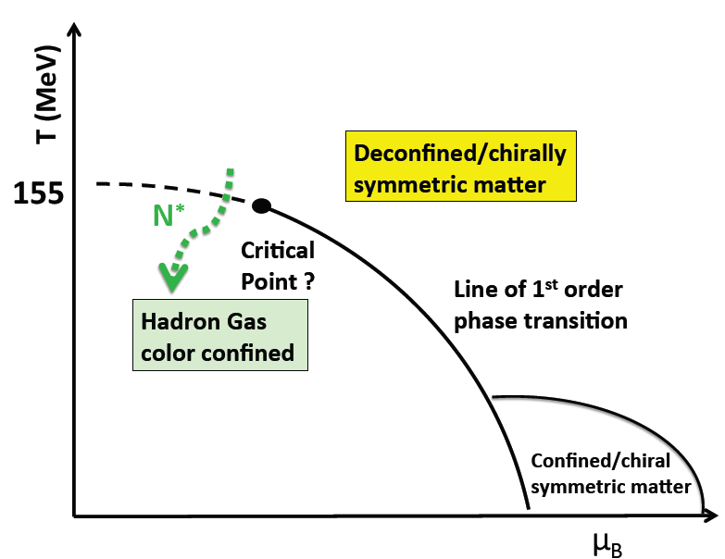
Strong QCD is born ~ 1μsec after the Big Bang
Time after the Big Bang
hot QCD
T ~ 10² s: nuclei
T ~ 10⁻⁶ s: Nucleons
T~ 10⁻⁹ s: QGP
strong QCD
chiral symmetry is broken
light quarks acquire mass dynamically
color confinement becomes manifest
T ~ 10⁻⁶ s: Transition from the QGP to Nucleons
With Jlab6 and JLAB12 we explore these events in (relative) isolation
Notes:
On the internet one finds these colorful posters of the history of the universe from the Big Bang to our times.
There are some marked events that have been of particular significance during the evolution. The quark-gluon plasma, the forming of nucleons, light nuclei, …
The transition from the QGP to hadrons happened just 1 musec after the BB.
As is indicated in this generic QCD phase diagram, where the temperature is plotted vs the baryon chemical potential, this transition is not a 1st order phase transition but a higher order cross over, where excited baryon states occurred in moderating the transition. => STRONG QCD IS BORN IN THIS TRANSITION

Slide 6
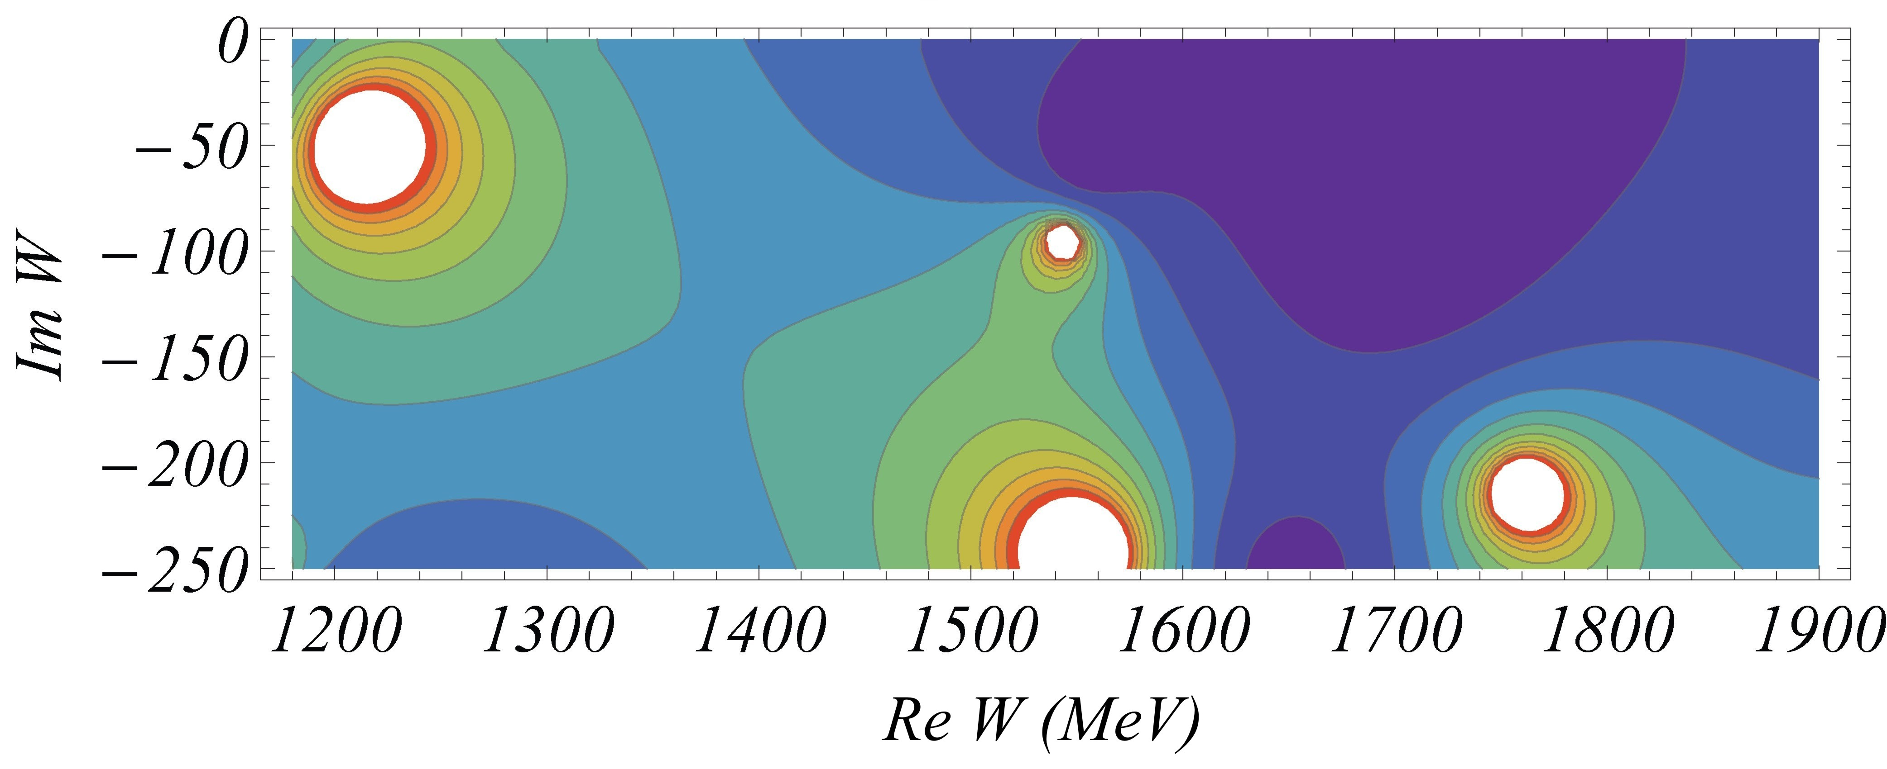
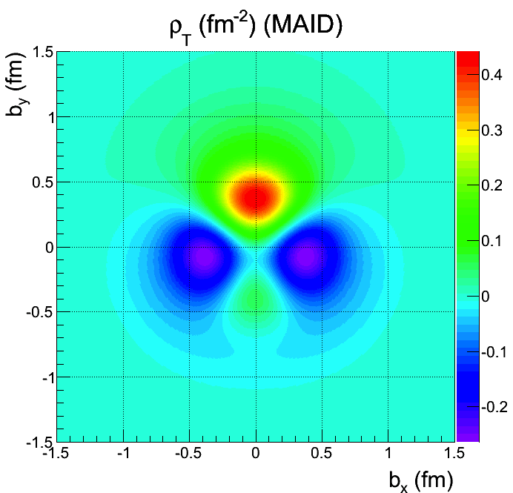
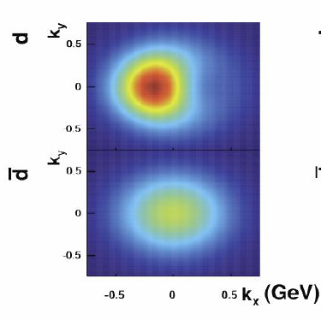
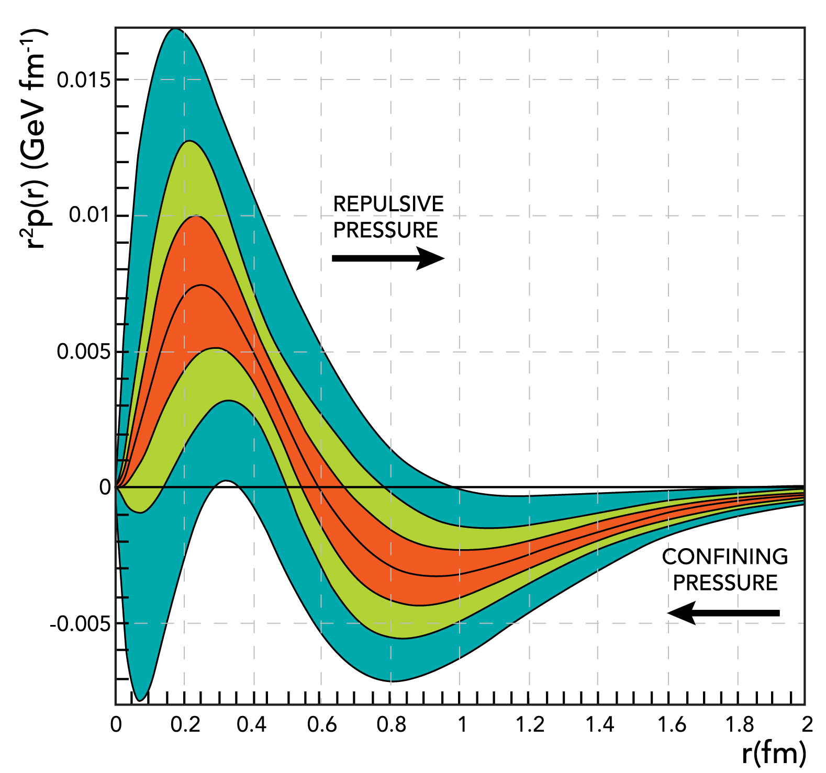
Probing baryons to learn about strong QCD
Energy spectrum - Search for new states ➪ QGP to hadron transition, symmetries underlying hadronic matter
Structure functions ➪ Parton and spin distributions (1D)
Form factors ➪ Effective degrees of freedom versus distance (2D)
Deeply exclusive/semi-inclusive processes & GPD/TMD ➪ 3D imaging of nucleon
Moments of GPDs ➪ Forces on quarks, confinement
Notes:
What are the tools we bring to bear to study all these phenomena? Mapping out the nucleon excitation spectrum gives information about underlying symmetries and effective degrees of freedom. Structure function extract parton distribution functions and spin distribution function (1D). Form factor measurements map effective degrees of freedom vs distance scale and are the basis for 2D imaging. Finally the most complex measurements get access to GPD and TMDs allowing for the 3D imaging of Euclidean and in momentum space. And a new tool in our arsenal goes beyond this and probes how everything is held together.

Slide 7
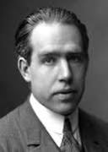
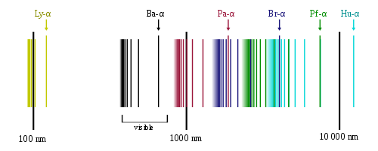
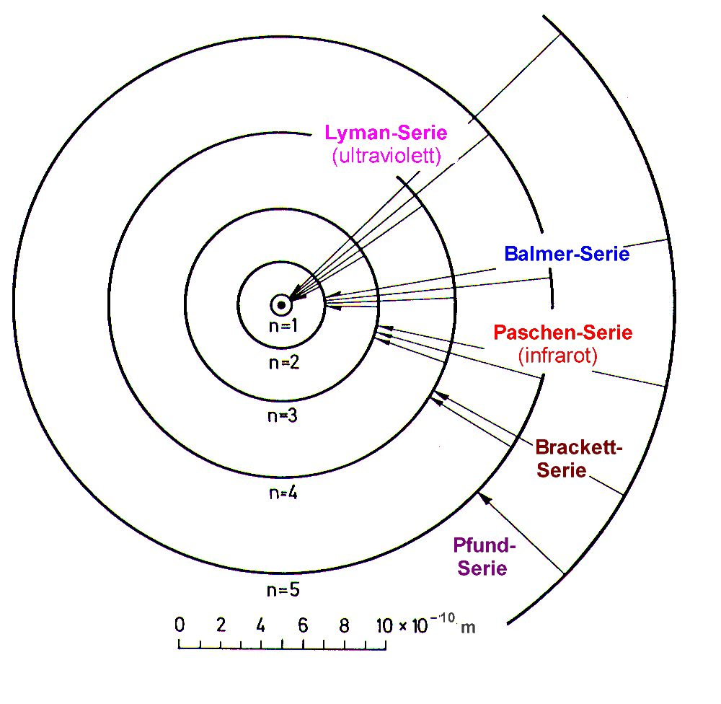
From the H spectrum to the N* spectrum
Analogy QCD & QED => path to discoveries ?
Spectral series of hydrogen
Understanding the hydrogen atom required understanding its
spectrum of sharp energy levels
-> From the Bohr model to QED
-> Lamb shift, …
Understanding the proton requires mapping out its full energy spectrum of broad energy levels
-> From the Quark model to QCD
-> Accuracy of predictions should be commensurate with experiments, i.e. O(few MeV), to allow for surprises.
Niels Bohr, model of the hydrogen atom, 1913.
Notes:
The explanation of the hydrogen emission spectrum with its sharp energy levels began with the Bohr model and finally led to QED. The proton excitation spectrum is created by the strong interaction of quarks and gluons and gives rise to broad energy levels. A full understanding will have to come through high precision data in various reaction channels and a multi-channel analysis, to establish the N* spectrum, and the full application of strong QCD.

Slide 8

Establishing the N* spectrum – Precision & Polarization are essential
Hyperon photoproduction γp→K⁺Λ→K⁺pπ⁻
Fit by BnGa group
A.V. Anisovich et al, EPJ A48, 15 (2012)
γ->Λ Polarization transfer
M. Mc Cracken et al.(CLAS), Phys.RevC81,025201,2010
D. Bradford et al. (CLAS), Phys.Rev. C75, 035205, 2007
Notes:
This shows an example of very precise K-Lambda cross section and polarization data published by the CLAS collaboration.
The Bonn-Gatchina group found strong evidence for the N(1900)3/2+. An excellent fit is achieved in both cross section and polarization observables.
Several new states and states with low * rating were needed to fit the data with acceptable chi^2.

Slide 9
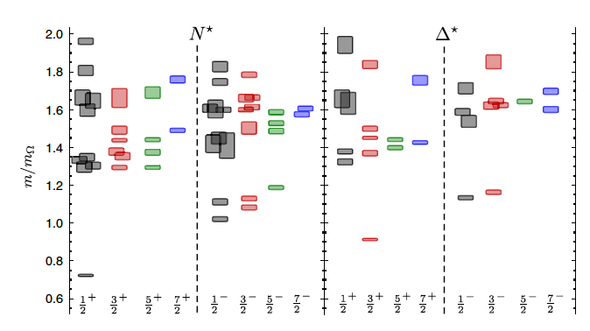
Do new states correlate with predicted LQCD states?
R. Edwards et al., Phys.Rev. D84 (2011) 074508
m_{Ω} = 1672 MeV
m_{π}=396MeV
N(2060)5/2⁻
N(2120)3/2⁻
N(1875)3/2⁻
N(1895)1/2⁻
N(1900)3/2⁺
N(2100)1/2⁺
N(1880)1/2⁺
N(1675)5/2⁻
N(1700)3/2⁻
N(1520)3/2⁻
N(1650)1/2⁻
N(1535)1/2⁻
Lowest J⁺ states 500 -700 MeV high
Lowest J⁻ states 200-300 MeV high
Ignoring the mass scale, the new states correlate with unoccupied J^{P} levels in the LQCD spectrum.
For quantitative comparisons projections at or near the physical pion mass are needed.
11/4/19
8
Notes:
For calibrating the mass scale we can look at the well known negative parity states that are projected from the LQCD in this green ellipse.
They are about 200-300 MeV higher than the physical states
The positive parity states are 500-700 MeV higher that the physical states
If I am allowed to ignore the mass scale, the new states fit into the spectral pattern of LQCD states

Slide 10

Impact of new excited baryons
not included
Sandeep Chatterjee et al;
PRC 96, 054907 (2017)
PDG 2016 with *, **
Hot QCD
HRG-model
Strong QCD
N(1875)
PDG 2018 with
***, ****
We do not describe the transition near the cross over temperature. Additional N* and Δ* states and hyperons will affect behavior.
Notes:
Do these new states make any impact? We have learned from studies in the heavy ion sector that the number of excited baryons in PDG is insufficient to account for the transition near the cross over temperature of 155MeV as predicted by the hot LQCD calculations. The physical processes underlying the behavior is not known.
Hadron gas models built from only PDG 2012 baryons of all flavors do not explain quantitatively the behavior predicted from hot QCD simulations. More excited baryons were needed….. The 2016 PDG which had a number of newly discovered *** and **** states included already, does better than 2012. In 2018 there are a significant number of *** and **** states that hadn't been included in 2016. .... shown in green. So, maybe time to redo the computation.... I like to think of this transition as quarks gluons starting to interact, generating high energy resonances, quarks become dynamically more massive, constituent-like, until nucleons freeze out, and pion cloud finally closes it up.

Slide 11

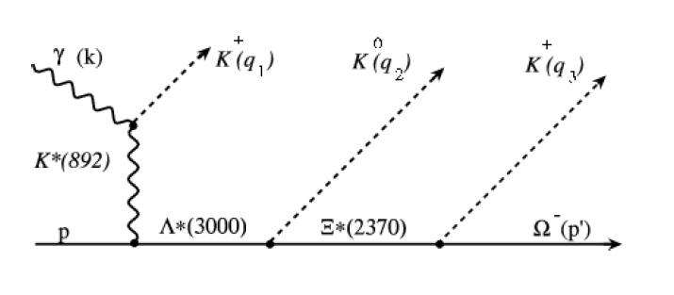
Search for strange baryons
Λ
Proposed K_{long} facility in Hall D to study hyperons K_{L}p interactions.
Experiments at JLab at GlueX and at CLAS12 search for excited hyperon states of Ξ^{0,-} (S=-2) & Ω^{-`}(S=-3)
Multi-strange baryons difficult to produce with photon beams.
Expected statistics for some final states and 100 days data taking.
A fertile ground for LQCD calculations.

Slide 12
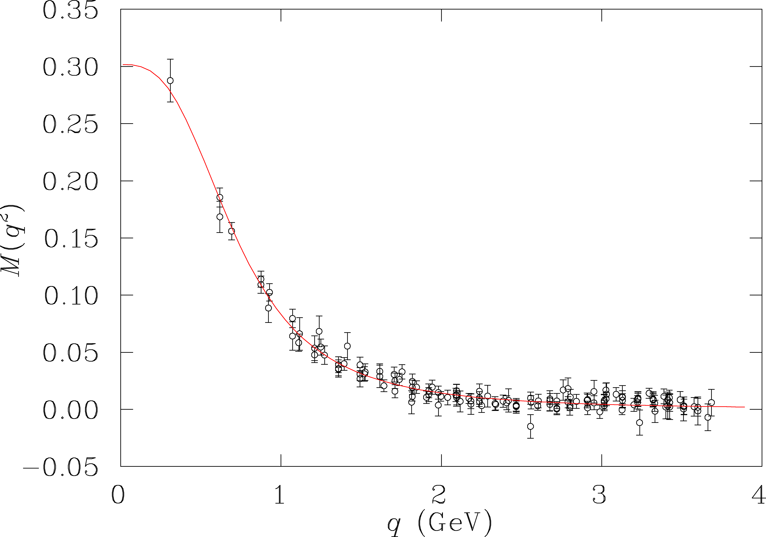
Generating mass as the universe cools
T>10¹⁴K
Dynamical generation of mass modeled on the Lattice and in DSE on single quarks.
Bhagwat, M. S., et al., Phys. Rev. C 68, 015203
Bowman, P. O., et al.,Phys. Rev. D 71, 054507
de-confined
DSE (sQCD)
Lattice QCD (chiral extr.)
quark mass (GeV)
T<10¹⁰K
confinement
Study this in measurements that are sensitive to the running quark mass.
Notes:
The dynamical generation of mass at lower energy has been modeled in LQCD as well as in DSE. The calculation is for a single quark, while in the early universe it is a soup of non-interacting elementary quarks and gluons that at lower temperature coalesce to form hadrons at full mass. To test this behavior, we can employ models with a running qurak mass and study the nucleon at high enough Q2 to probe the quark core. This can be done in elastic scattering and in resonance transitions.

Slide 13
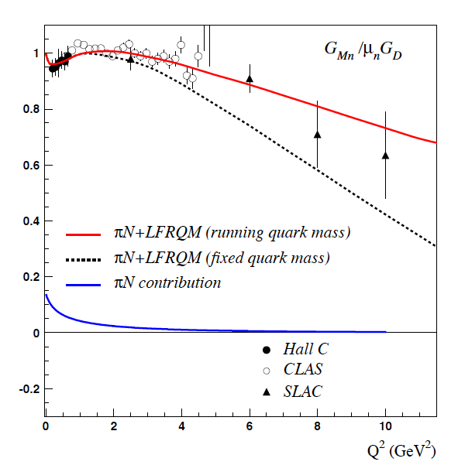

Structure of e.m. FF of proton and neutron
Magnetic proton FF
Magnetic neutron FF
Encode charge and current densities in the light cone frame.
Small (~10%) non-quark πN contributions at small Q^{2.}
Strong sensitivity to the running quark mass function.
Measurements up to higher Q² planned or completed.
11 GeV projection
The quark mass function should be universal and apply also to N* transitions.
Notes:
Elastic EM formfactors encode the charge and current densities in the light cone frame. They are also sensitive to the running quark mass. The effect is large in a LF RQM with/without running mass for proton magnetic FF. Effect is also large for neutron magnetic FF but less significant due to experiment errors. Measurements at 12 GeV, with projected error bars shown here, will test these predictions.

Slide 14
Structure of excited baryons
  charge transition densities
  effective degrees of freedom
  running quark mass
  => reveal nature of N* states
[56,2⁺]
N(1680)5/2⁺
2
L_{3q}
[70,1⁻]
N(1675)5/2⁻
N(1520)3/2⁻
N(1535)1/2⁻
Δ(1620)1/2⁻
e’
π, η, ππ, K
e
γ_{v}
1
N*,△*
Q
N
N, Y
A_{1/2}, A_{3/2}, S_{1/2}
F₁*, F₂*, F₃*
[56,0⁺]
Δ(1232)3/2⁺
N(940)1/2⁺
N(1440)1/2⁺
N(1710)1/2⁺
[56,0⁺]
0
[70,0⁺]
0
1
N [ħω]
2
http://pdg.lbl.gov/2019/reviews/rpp2018-rev-n-delta-resonances.pdf
Notes:
To access the internal structure of excited states requires measurement of structural observables such as transition form factors as a function of Q2.
These quantities may then be used to obtain information on the
- transition charge densities,
- the running quark mass, and
- effective degrees of freedom at varying distance scales, i.e. revealing nature of the state
In the following I discuss what we learn from a few excited states where we have detailed experimental results.

Slide 15
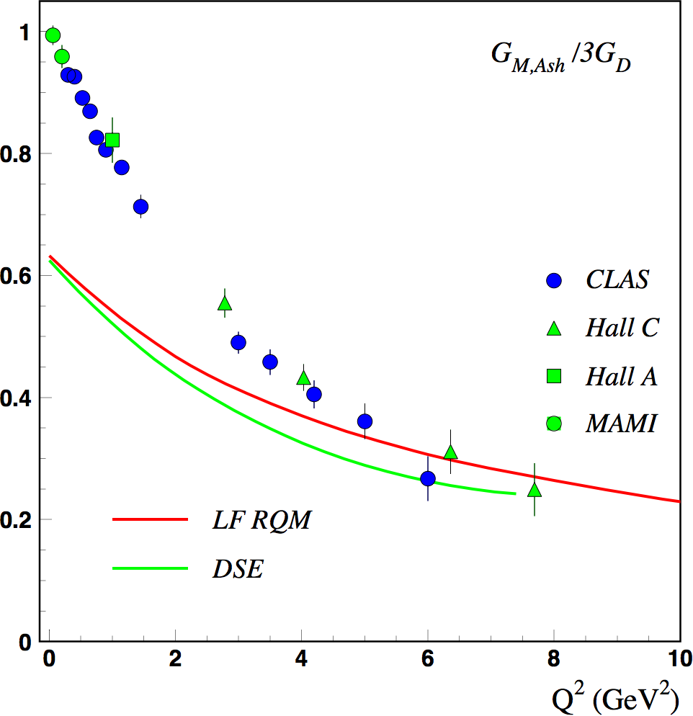
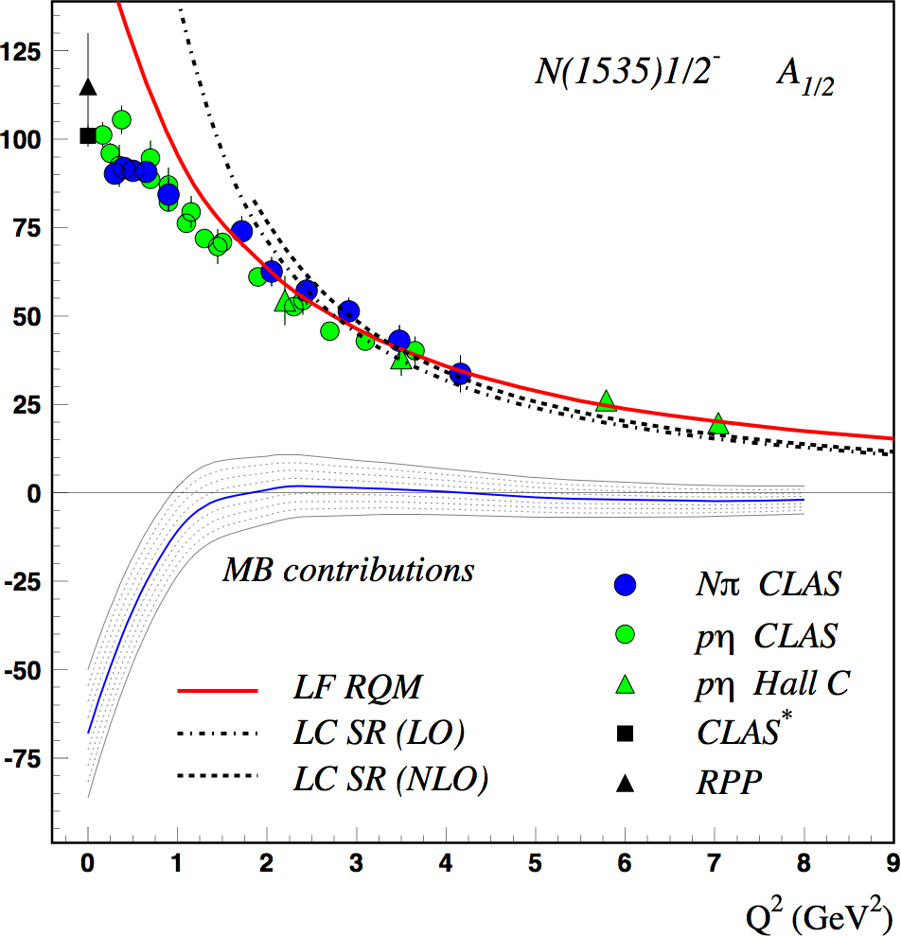
Transition amplitudes of prominent resonances
DSE: J. Segovia, C.D. Roberts et al., PRC94 (2016) 042201
LC SR: I. Anikin, V. Braun, N. Offen, PRD92 (2015) 014018
LF RQM: I. Aznauryan, V.B. arXiv:1603.06692 (2016)
Δ(1232)3/2⁺
MB contributions
Roper N(1440)1/2⁺ is the first radial excitation of the nucleon’s quark core complemented by an external meson-baryon cloud.
N(1535)1/2⁻ is the first orbital excitation of the nucleon’s quark core complemented by an external meson-baryon cloud.
Dressed quark-core behavior accessible at Q² > 2-4 GeV². MB terms more prominent than in elastic FF.
Notes:
The Delta(1232) proceeds dominantly through a quark spin flip. The comparison with LF RQM and DSE shows that above 3-4 GeV2 the dressed quark core dominates, while at low Q^2 non-quark contributions are significant. accounting The leading amplitude for the Roper resonance and for the N(1535)1/1- state are well described at Q2>2 GeV2 by the RQM with running quark mass and by the DSE approach and the LC SR approach, which has traceable links to first principle QCD. Below Q2=2GeV2 non-quark contributions are significant. In all 3 cases we conclude that at high Q2 the quark core behave like the nucleon ground state spin-flip state for the Delta, the first radial excitation for the Roper, and the first orbital excitation for the N(1535). In order to study the quark core in strong QCD we need to go to high enough Q2, e.g. Q2 > 2-4 GeV2.

Slide 16
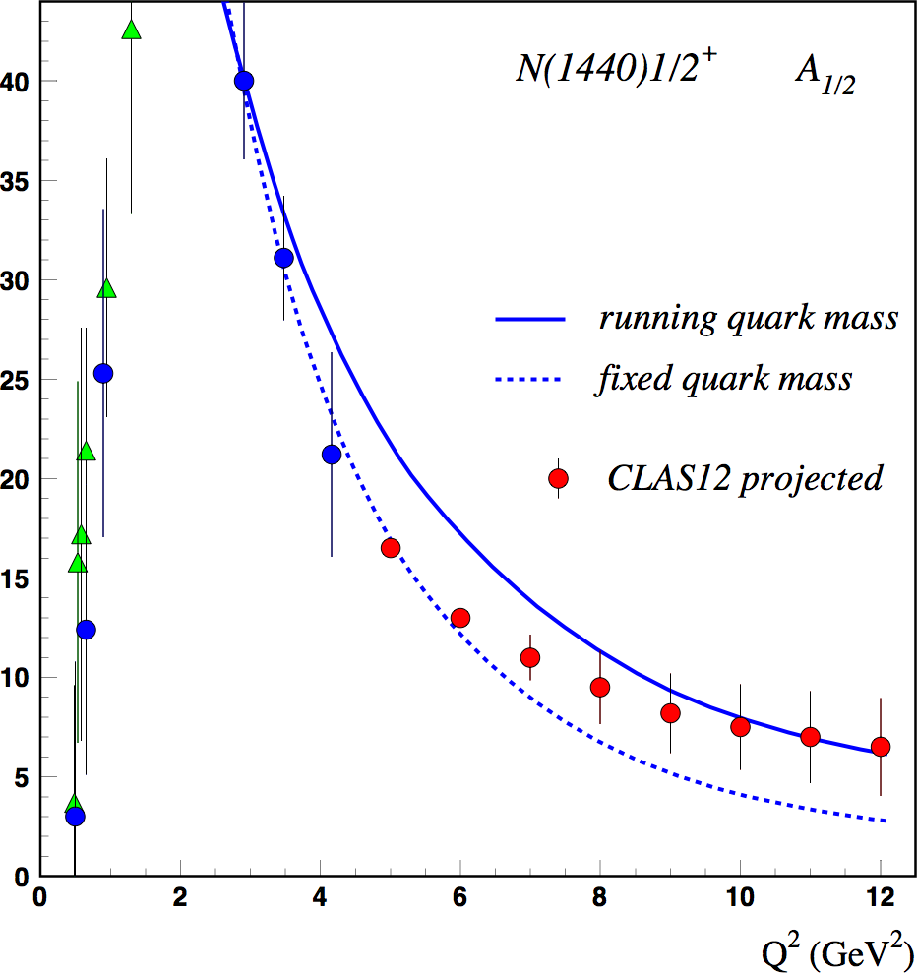
Probing the running quark mass at JLab12
Roper resonance
Running quark mass
6 GeV`
11 GeV
accessible
at 6 GeV
LQCD
DSE
LF RQM
accessible
at 11 GeV
quark mass (GeV)
Probe the transition from the interaction on dressed quarks to elementary quarks.
Notes:
Now that we have established that above 2-3 GeV2 in Q2 the Roper resonance is dominated by the dressed quark core, we can test the running quark mass function at high enough Q2. The calculation in the LF RQM is shown here with running and with fixed quark masses. The right graphs shows the approximate mass range covered in single quark momentum transfer for the two energies.

Slide 17
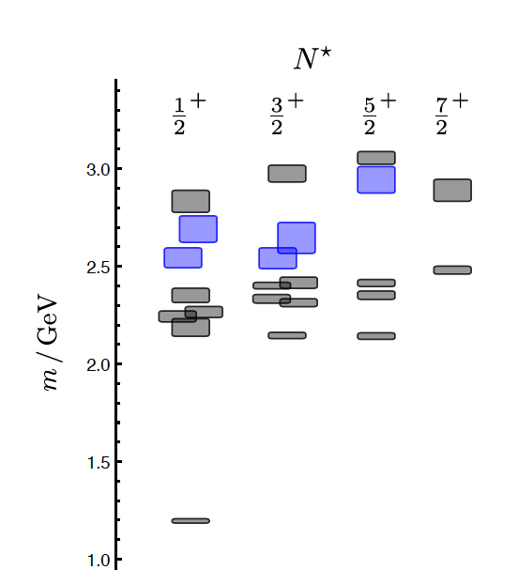
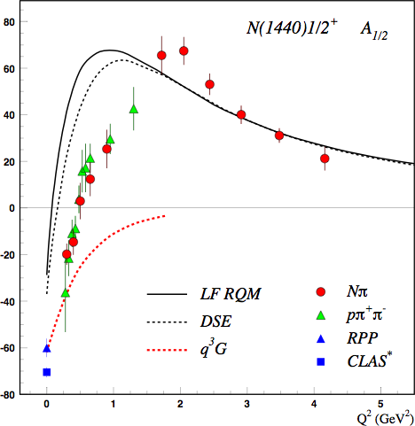
Search for Hybrid Nucleons N^{G}
Is glue manifest in the valence structure of excited nucleons?
J.J. Dudek and R.G. Edwards, PRD 85 (2012) 054016
q³G: Z.p. Li, V.B., Z.j. Li, Phys. Rev. D46 (1992) 70
LQCD
clustered
in mass
1.3GeV
‘hybrid’ states
q³
N
q³G baryons have same J^{P} values as q³ baryons, but are more extended objects
May measure Q² dependence to separate - Program at CLAS12
Calculations for electrocouplings of hybrid states are needed
Notes:
Is strong QCD manifest in the valence structure of excited nucleons? Lattice calculations show hybrid baryons states ~2.2GeV ½+ and 3/2+ spin-parity.
How do we identify them as hybrid states? One possibility is to look at the transition form factors where one expects a different Q2 behavior. The sensitivity is demonstrated for the Roper resonance, which was considered as a possible lowest hybrid state with ½+ JP parity. The dashed red line shows the predictions for the lowest hybrid state. Obviously, the Roper is not a hybrid state.

Slide 18
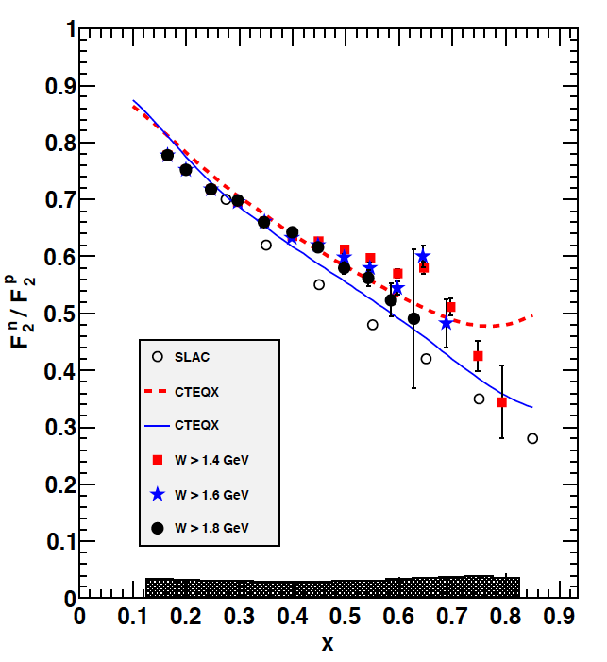
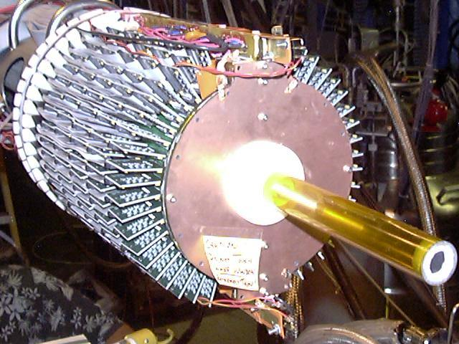
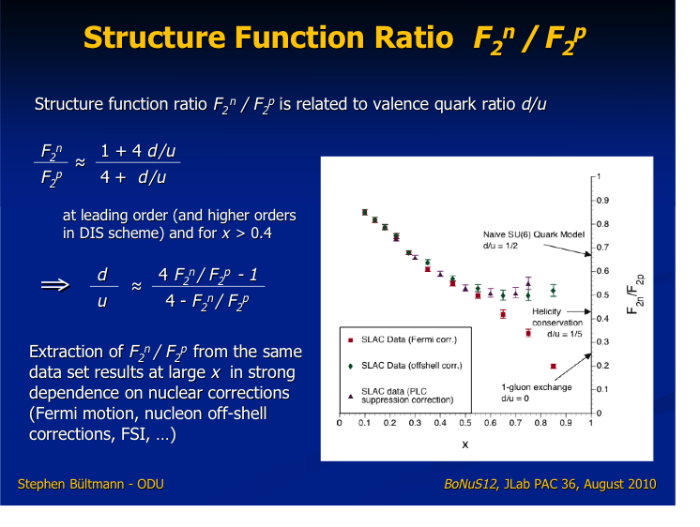
Neutron structure F₂^{n}/F₂^{p} and d/u-ratio
Measure F₂^{n}/F₂^{p} to determine d(x)/u(x)
1) Measure cross section ratio ³H/³He of mirror nuclei (MARATHON, completed).
2) Detect low momentum protons to tag nearly unbound neutrons in deuterium (BoNuS12 in 2020)
e⁻
e⁻D→e⁻p_{s}X
n
Phys.Rev.Lett. 108 (2012) 199902
e⁻
p
p_{s}
>70MeV/c
Radial TPC
track low energy protons in 5 Tesla
mag. field
Parton distribution functions are governed by sQCD. Recent progress in theory (X. Ji) may enable computing d(x)/u(x) in LQCD.
Projected results for d(x)/u(x) for 12 GeV experiments.
11/4/19
17
Notes:
The neutron F2 structure function is usually measured through the ratio F2n/F2p. Two approaches are being used at 12 GeV. One is to measure the ratio tritium/He-3 (Hall A), the second one tags the neutron by measuring the spectator proton to very low momentum using a gas target and a low density tracking detector. The ratio of d-quark to u-quark distribution functions is shown here from a 5 GeV experiment. Experiments at 11 GeV extend this range up to 0.85. Projected results for both experiments are shown here. Recent progress in LQCD should allow computing the d/u ratio.

Slide 19
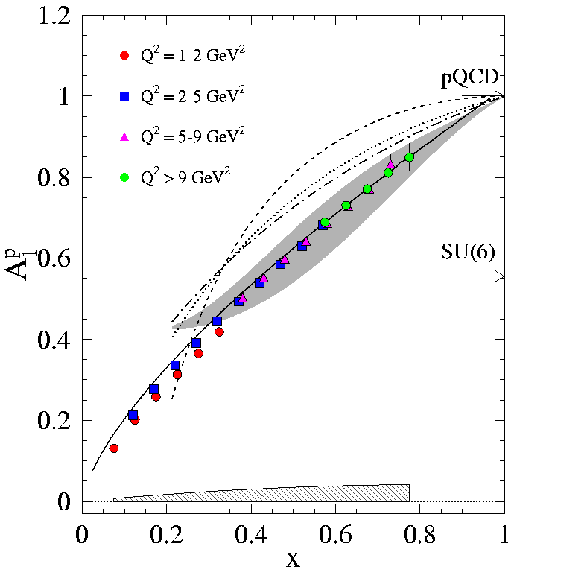
Polarized PDFs on p, d,³He at 11GeV
Beam-Target double spin asymmetry
Two experiments to measure polarized PDFs in the range x ≤ 0.8 on p/d and on neutrons.
A polarized target adapted to CLAS12 can achieve high-precision results on helicity asymmetries on A₁^{p} and A₁^{d} by employing longitudinally polarized NH₃ and ND₃ targets.
Similar coverage is projected with the use of a polarized He-3 target in Hall A.
A₁^{n}
X
With the expected precision a serious effort should be launched to compute A₁(x)

Slide 20
Moments of Spin Structure Functions
Inclusive polarized DIS data obtained at JLab@6GeV have permitted evaluation of the moments at low and intermediate Q².
At 12 GeV the moments will be measured up to Q² = 6 GeV² with much improved statistical precision.
With both proton and neutron measured, the Bjorken sum can be evaluated, which relates to the integral.
What projections from LQCD or sQCD are expected?

Slide 21
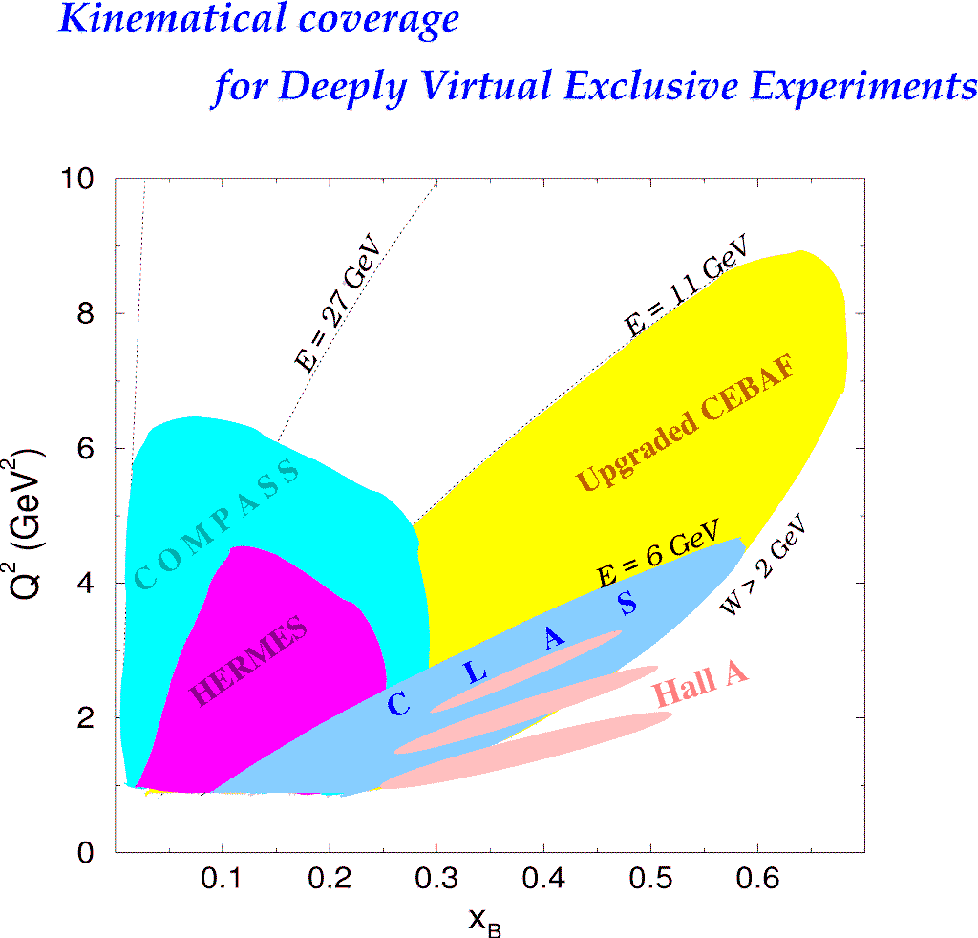
Kinematic coverage for Imaging @ 11GeV
A flagship program of structure studies in deeply exclusive and semi-inclusive processes.
H1, ZEUS
H1, ZEUS
27 GeV
11 GeV
Precision measurements
in the high x_{B} domain
of exclusive processes
requires high luminosity.
200 GeV
11 GeV
JLab Upgrade
JLab @ 11 GeV
COMPASS
W = 2 GeV
HERMES
The 12 GeV Upgrade is well matched to studies in the valence quark regime.
0.7
Notes:
Coming to the nucleon imaging program. The kinematics range that can be covered in exclusive processes with high precision data is shown with this yellow area. This will be the only accelerator where the valence quark regime can be fully covered with high precision data. Other existing machines, even at much higher energies can not cover this regime due to the much lower luminosities.

Slide 22
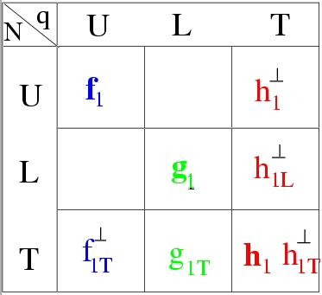
Transverse Momentum Structure of Nucleon – TMDs
(Quantum phase-space quark distribution in the nucleon)
Wigner Function
Integrate over
spatial dimensions
Quark spin polarization
Transverse Momentum-dependent Distributions (TMD)
Nucleon polarization
3D imaging of the nucleon in momentum space
JLab has planned a complete SIDIS program with π/K to access quark TMDs

Slide 23
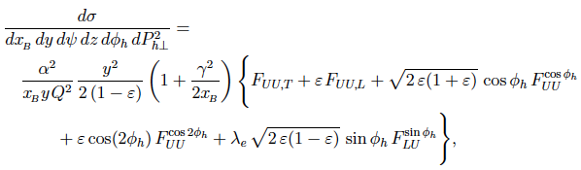
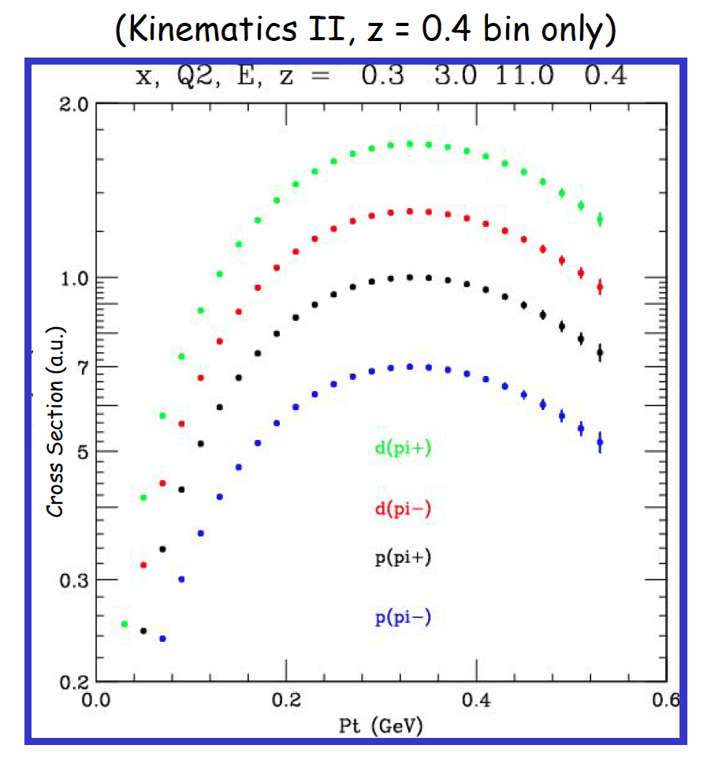
SIDIS for π on unpolarized target
CLAS12 projected, 4 <Q²< 5 GeV²
Hall C
High precision
Large kinematic reach
Notes:
… the graphs shows the projected uncertainties of the x and Pt dependences of the asymmetry for different pion and kaon flavors.

Slide 24
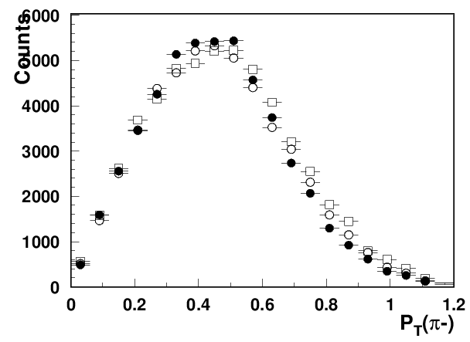
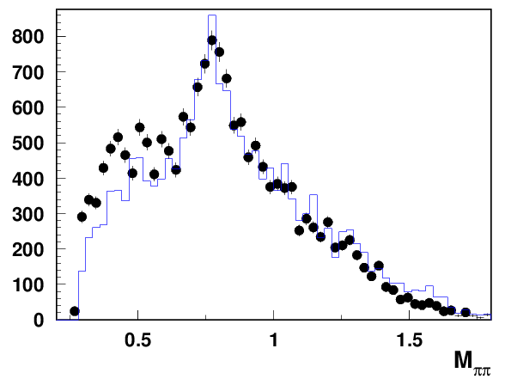
SIDIS in 2-pion production
ep→e’π⁺π⁻X
ep→e’π⁺π⁻X
Provides more direct insight into hadronic correlations.
The comparison with Monte Carlo simulations indicates that there is a significant fraction of pions from VM decays.
Precision data point to a fruitful field for sQCD/LQCD applications, especially for moments of observables.
CLAS12
preliminary
data
MC
ρ⁰(770)

Slide 25
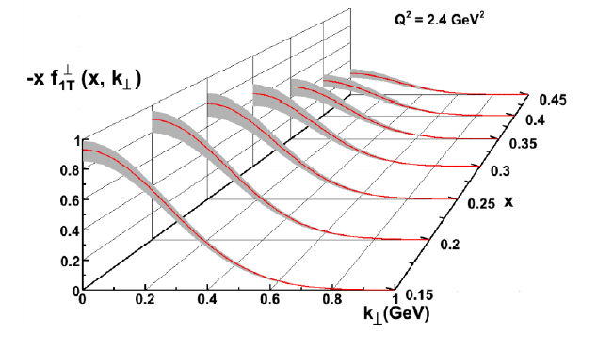
Momentum Tomography with Sivers function
δk_{x}
Sivers function for d-quarks extracted from model simulations with a transverse polarized ³He target.
d-quark momentum tomography for Sivers function. The d-quark momentum density shows a distortion and shift in k_{x}. A non-zero δk_{x} value requires a non-zero orbital angular momentum.
Computable within sQCD/LQCD ?
Notes:
TMDs are the basis for 3D tomography in momentum space. This graph shows the Sivers function extracted from model simulation using projections of an upcoming experiment in Hall A. The graph on the left shows the Kt distribution of the Sivers TMD function for different xB values for d-quarks. The 2D projection shows d-quark tomography of the Sivers function. The transverse polarization results in a distortion and shift transverse to the polarization axis. Any non-zero shift in Kx requires a non-zero orbital angular momentum of the d-quarks.

Slide 26
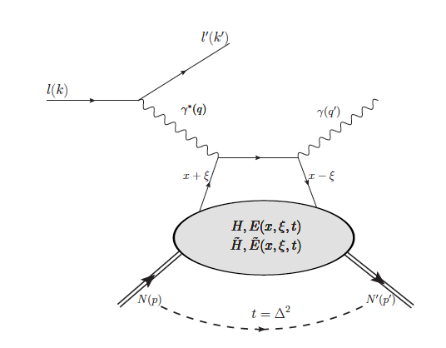

Generalized Parton Distributions
(Quantum phase-space quark distribution in the nucleon)
Polarized DVCS probes GPDs. JLab @ 12GeV has broad DVCS program with polarized beams and polarized targets.
X. Ji, Phys.Rev.D55, 7114 (1997)
Integrate over transverse momentum space
hard scattering
x_{B}
factorization
ξ $≈$
soft part
2 - x_{B}
~
~
p
GPDs H E H, E
p
Probe 3D structure 2D – euclidean space and 1D - momentum space.
GPD H of special Importance as it gives access to the gravitational properties.
D. Müller et al., F. Phys. 42,1994
X. Ji, PRL 78, 610, 1997
A. Radyushkin, PLB 380, 1996
M. V. Polyakov, Physics Letters B 555 (2003) 57
I.V. Anikin and O.V. Teryaev, Phys.Rev.D76, 056007 (2007)
M. Diehl and D.Y. Ivanov, Eur. Phys. J. C52, 919, (2007)
Notes:
Generalized parton distributions are related to the Wigner function through an integration over the transverse momentum space, which results in a 3D structure of 2D transverse space dimensions and 1D in longitudinal momentum space. GPDs are probed in polarized DVCS measurements with polarized beam, long. polarized target, and transversely polarized target. In current experiments the x-dependence can only be accessed at specific kinematics x=$±$xi. The more directly accessible quantities are the Compton form factors, that I show in the next slide for the special GPD H, which is related to the gravitational form factor D(t).

Slide 27
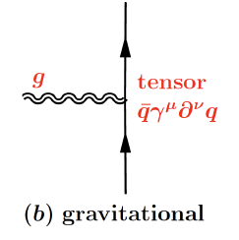
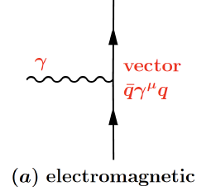
Mapping DVCS to Gravity
The 2-γ field couples to the EMT the same way gravity does.
Graviton
p
World
G p => p
CLAS data
G
CLAS12
J=2
p
2-photon
p
γ
J=2
γγp => p
γ_{v}
p
11/4/19
DVCS makes mechanical properties accessible to experiment
26
Notes:
In what way is the DVCS process related to the gravitational interaction? The analogy is show in these cartoons. The top one showing the gravitational tensor-coupling of gravitons with spin = 2. The bottom one shows the DVCS process where two photons with each spin=1, i.e. total spin = 2, couple to the proton.
Considering the fact, that "Any mass-less spin-2 field gives rise to a force indistinguishable from gravitation" the analogy is clear. With the em coupling many orders stronger than gravitation, DVCS can substitute for gravitation and makes the measurement of gravitational FF feasible. The gravitational FF D(t) come in through a dispersion relation that connects the Real part of the Compton FF, defined as integral over the GPDs, with the Imaginary parts. The real and imaginary parts of CFF H are independently accessible in DVCS experiments. From D(t) we can extract mechanical properties as forces and pressure distributions.

Slide 28
So how do we get insight into sQCD?
Strong QCD was born in the transition from free quarks and gluons to bound hadrons. The structure of all hadrons is related to sQCD. Precise measurements can give the incentive to do the calculations.
The N* spectrum: High precision data and multi-channel analyses enabled discovery of new N* states that fit by J^{P} values into the LQCD spectrum. Predicting the nucleon spectrum precisely is the challenge to sQCD.
Nucleon and transition form factors: Approaches with traceable links to QCD have been successful in interpreting nucleon ground state and N* transitions FF, where dressed quarks are the active degrees of freedom. In the 12 GeV era new measurements provide insights into the running quark mass and di-quarks as active dof.
Spin structure functions and moments: With the expected high precision of the 12 GeV measurements, they will be a fruitful testing ground for modeling sQCD.
Nuclear 3D imaging: GPD-related Compton form factors and TMD related observables of protons and neutrons, should provide multi-dimensional insight into sQCD.
Mechanical properties of particles: Mapping the normal and shear stress inside nucleons may relate to properties of confinement and is a novel testing ground of sQCD. Calculations within LQCD have been done- need higher precision.
Advanced model approaches: LF RQM, LC SR, hQCD, EFT.. continue to provide insights when sQCD has not been solved.
Meson-baryon effects may be crucial in addressing the confinement challenge. Calculations based on EFT may provide new insight.

Slide 29
Additional slides

Slide 30
Probing the properties of the proton
The structure of strongly interacting particles can be probed by means of the other fundamental forces: electromagnetic, weak, and gravity.
strong QCD
Electro-magnetism
Vector
Tensor
Gravity
Q_{p} μ_{p}
M_{p} J_{p} D_{p}
PCAC
g_{A}, g_{P}
D_{p} is the last unknown global property of the proton.
(M. Polyakov, P. Schweitzer)
Weak interaction
Notes:
When we probe the proton we probing strongly interacting matter. The best way is to use a probe whose interaction strength is much smaller than strong interaction, and there are 3 of them. With em interaction we couple to charge and magnetic moment. Weak interaction couples to axial and pseudoscalar form factors and finally gravity couples to mass, angular momentum and the D-term.

Slide 31
DVCS from RG-A
Kinematic reach E=10.6GeV
Beam-Spin Asymmetries
Q² (GeV²)
x_{B}
5% of expected RG-A data t/Q² < 0.25
Notes:
With the expected DVCS data from Hall A and from CLAS12 the kinematic reach and the precision will be significantly extended, making the extraction of the gravitational form factor more accurate and with less systematics. This graph show preliminary beam spina symmetries from a subset of DVCS data taking with CLAS12.

Slide 32
The N/Δ Spectrum up to 2.2 GeV 2018 (PDG)
The N/Δ Spectrum up to 2.2 GeV 2010 (PDG)
new/upgraded
****
***
2.4
N
Δ
2.2
2.0
Mass (GeV)
1.8
1.6
1.4
1.2
1/2⁺
3/2⁺
5/2⁺
7/2⁺
9/2⁺
1/2⁻
3/2⁻
5/2⁻
7/2⁻
9/2⁻
1/2⁺
3/2⁺
5/2⁺
7/2⁺
1/2⁻
3/2⁻
5/2⁻
7/2⁻
J^{P}
11/5/19
31
Notes:
This graph illustrates how our knowledge of the N* spectrum has changed in the past decade due to new precision data especially from JLab
and ELSA and the analysis effort by the BnGa group. How do they fit into the known spectrum? We see some possible spin multiplet pattern to emerge.
The expected mass degeneration of the
parity doublet of 7/2+ and 7/2- Delta states is not confirmed. Their masses differ by 250 MeV.

