Slide 1
Photoproduction Reactions and
Non-Strange Baryon Spectroscopy
Eugene Pasyuk
JLab

Slide 2
Outline
The beginning of the baryon spectroscopy
Milestones in evolution of the experimental data
Renaissance of photoproduction
CLAS contribution
Impact of the photoproduction experiments on baryon spectroscopy
Summary

Slide 3
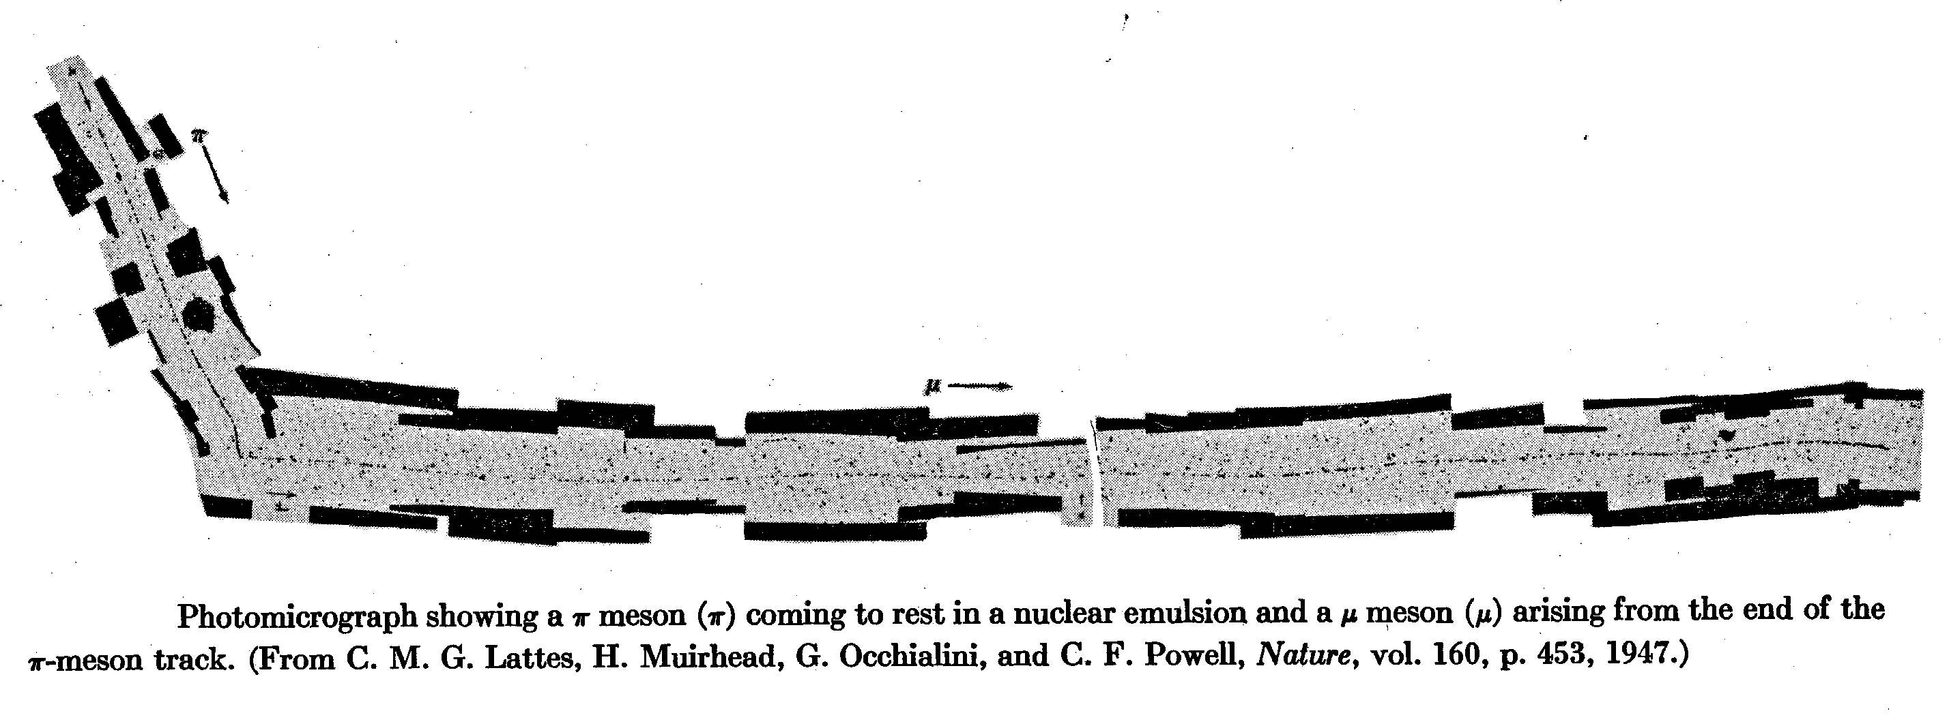
1947: Discovery of pion

Slide 4
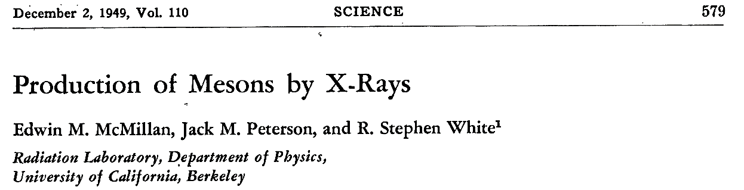
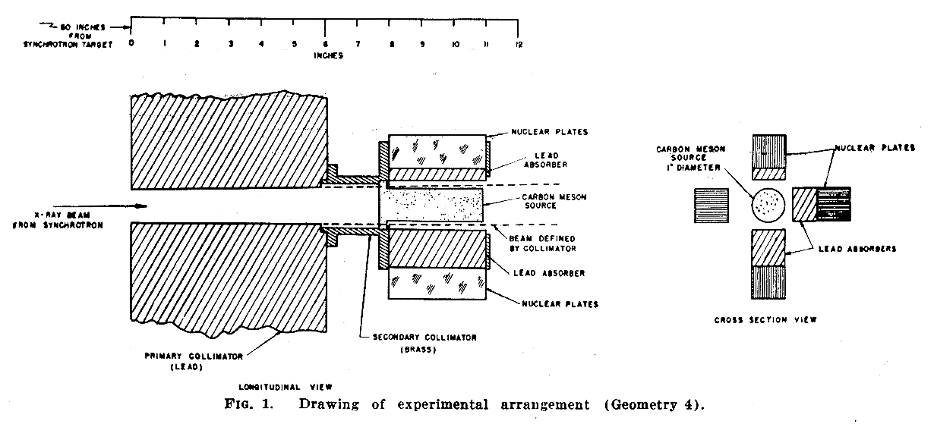
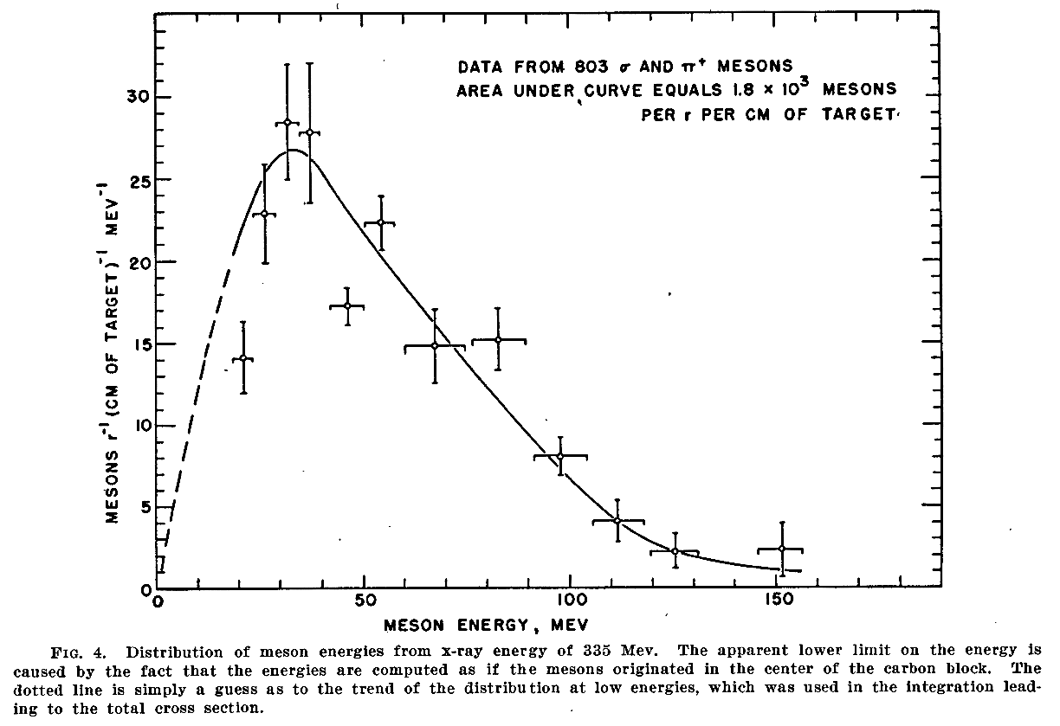
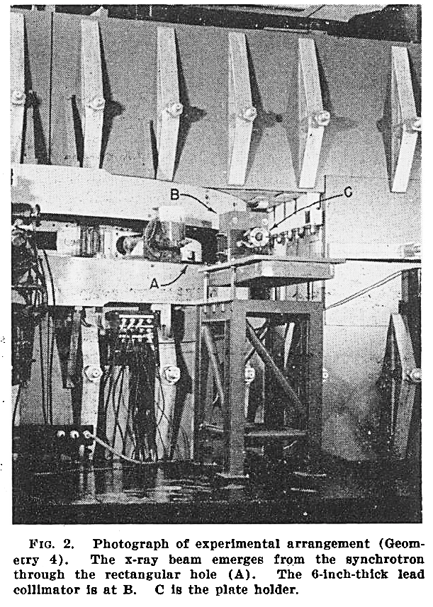
1949: First pion photoproduction experiment

Slide 5
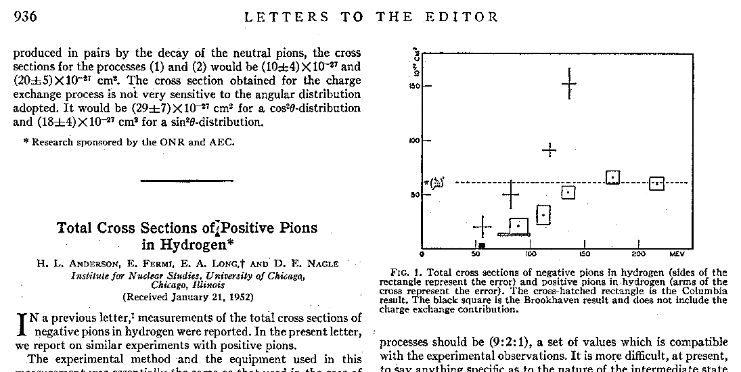
1952: Discovery of Δ resonance
Physical Review 85, 936 (1952)
This milestone marks the beginning of baryon resonance era

Slide 6
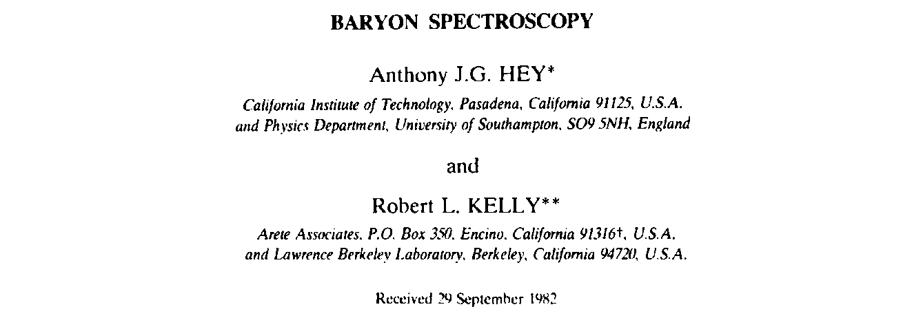
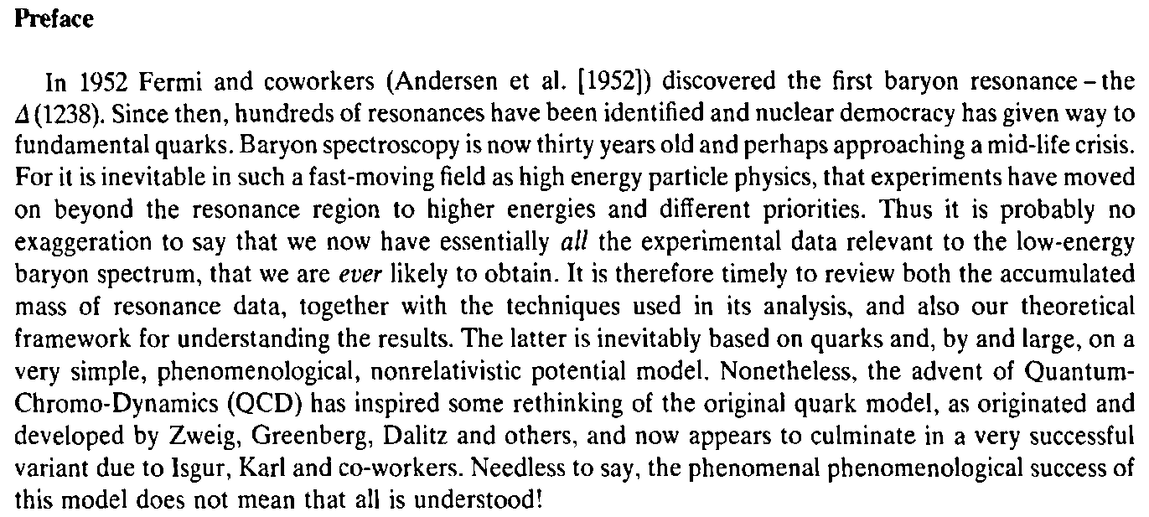
1983: Baryon spectroscopy is 30 years old

Slide 7
Evolution of experimental data

Slide 8
Evolution of experimental data
2010

Slide 9
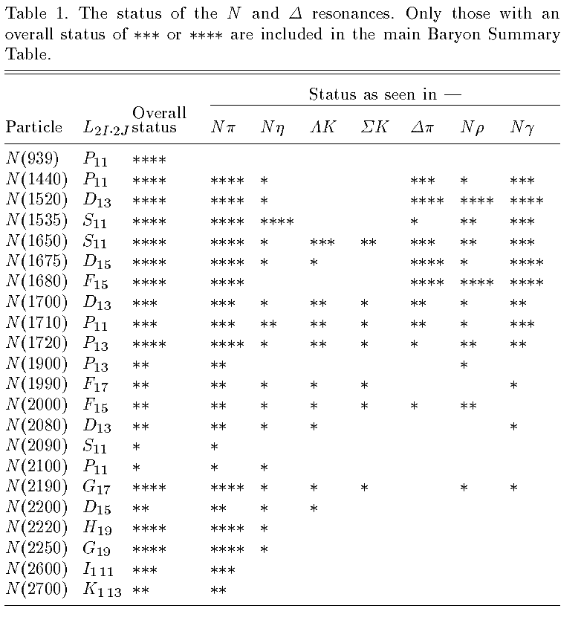
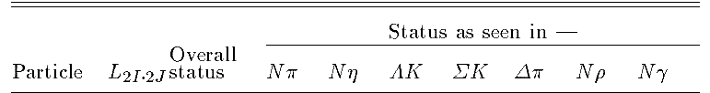
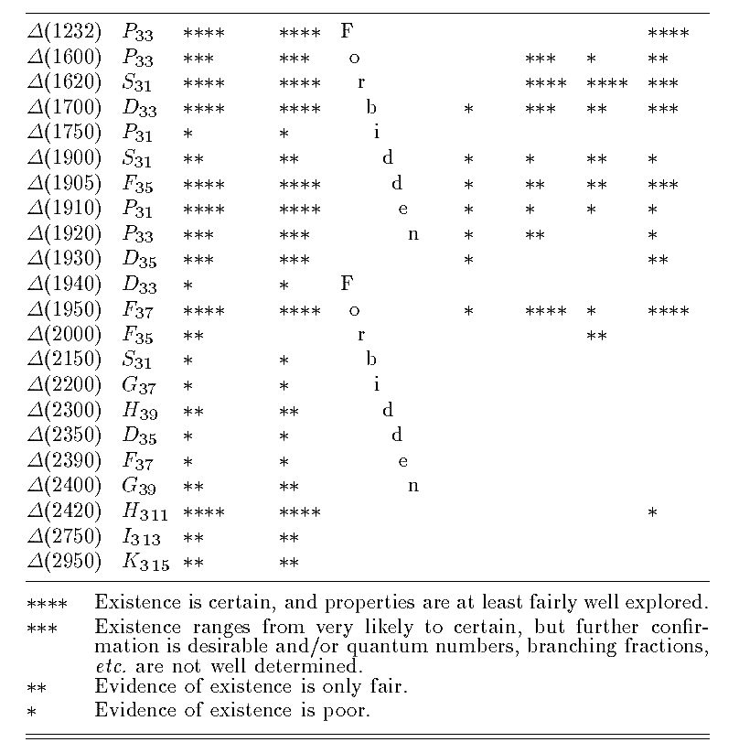
1996: known nucleon resonances
22 N* + 22 Δ

Slide 10
Experimental facilities
MAMI
  DAPHNE
  TAPS
  Crystal Ball/TAPS
ESRF
  GRAAL
ELSA
  SAPHIR
  Crystal Barrel/TAPS
  BGO-OD
Spring-8
  LEPS
  LEPS2
    BGO Egg
    Solenoid spectrometer
ELPH
  NKS2
  FOREST
CEBAF
  CLAS

Slide 11

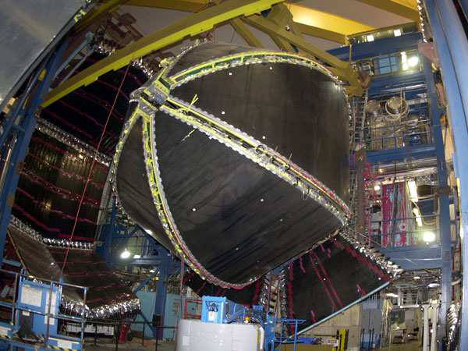
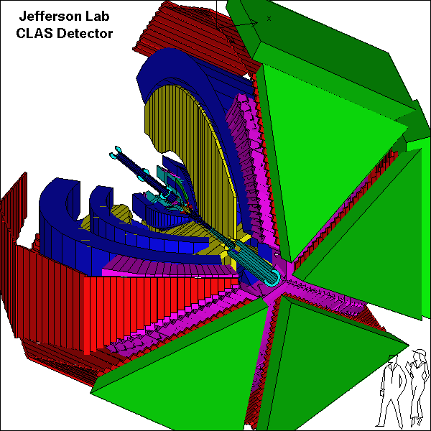
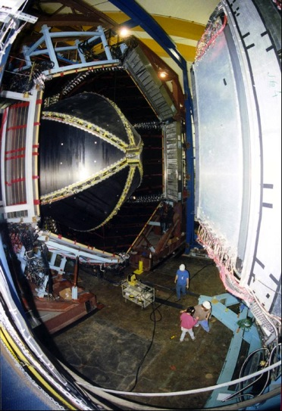
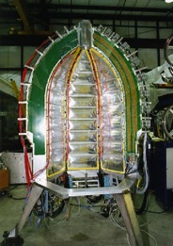

CEBAF Large Acceptance Spectrometer 1997-2012
Torus magnet
6 superconducting coils
Electromagnetic calorimeters
Lead/scintillator, 1296 photomultipliers
target + start counter
Drift chambers
35,000 cells
Time-of-flight counters
plastic scintillators, 684 photomultipliers
Gas Cherenkov counters
e/π separation, 256 PMTs

Slide 12
CLAS photoproduction measurement
 | σ | Σ | T | P | E | F | G | H | T_{x} | T_{z} | L_{x} | L_{z} | O_{x} | O_{z} | C_{x} | C_{z}
Proton target
pπ⁰ | ✓ | ✓ | ✓ | ✓ | ✓ | ✓ | ✓ | ✓
nπ⁺ | ✓ | ✓ | ✓ | ✓ | ✓ | ✓ | ✓ | ✓
pη | ✓ | ✓ | ✓ | ✓ | ✓ | ✓ | ✓ | ✓
pη’ | ✓ | ✓ | ✓ | ✓ | ✓ | ✓ | ✓ | ✓
pω | ✓ | ✓ | ✓ | ✓ | ✓ | ✓ | ✓ | ✓ | SDME
pπ⁺π⁻ | ✓ | 64 more beam-target asymmetries
K⁺Λ | ✓ | ✓ | ✓ | ✓ | ✓ | ✓ | ✓ | ✓ | ✓ | ✓ | ✓ | ✓ | ✓ | ✓ | ✓ | ✓
K⁺Σ⁰ | ✓ | ✓ | ✓ | ✓ | ✓ | ✓ | ✓ | ✓ | ✓ | ✓ | ✓ | ✓ | ✓ | ✓ | ✓ | ✓
K^{0*}Σ⁺ | ✓
K⁰Σ⁺ | ✓ | ✓ | ✓ | ✓ | ✓ | ✓ | ✓ | ✓
“Neutron” target
pπ⁻ | ✓ | ✓ |  |  | ✓ |  | ✓
nπ⁺π⁻ | ✓ | ✓ |  |  | ✓ |  | ✓ | 4 more beam-target asymmetries
K⁺Σ⁻ | ✓ | ✓ |  |  | ✓ |  | ✓
K⁰Λ | ✓ | ✓ | ✓ | ✓ | ✓ |  |  |  |  |  |  |  | ✓ | ✓ | ✓ | ✓
K⁰Σ⁰ | ✓ | ✓ | ✓ | ✓ |  |  |  |  |  |  |  |  | ✓ | ✓ | ✓ | ✓
✓ - published ✓ - analysis complete ✓ - acquired

Slide 13
Data summary (CLAS vs world)
reaction | Cross section | polarization
γp→pπ⁰ | 1200 (21002) | 700 (1341)
γp→nπ⁺ | 618 (7731) | 1286 (4539)
γn→pπ⁻ | 9127 (11411) | 266 (805)
γp→pη | 1202 (12293) | 270 (821)
γp→pη’ | 635 (989) | 62 (76)
γp→pω | 1470 (3015) | 5257 (5925)
γp→K⁺Λ | 3971 (6338) | 3590 (4070)
γp→K⁺Σ⁰ | 3633 (6204) | 1341 (1467)
γn→K⁺Σ⁻ | 285 (354) | 0 (36)
CLAS share is significant
However quality of the data is even more important than quantity

Slide 14
Bump?
SAPHIR data (1998) triggered discussion of “missing” resonances.
D₁₃(1890)?, P₁₁(1840)? D₁₃(1900)?... lots of other interpretations
CLAS got into the game
First CLAS measurements (g1c): dσ/dΩ, P, Cx, Cz
Confirmed bump around 1.9 GeV

Slide 15
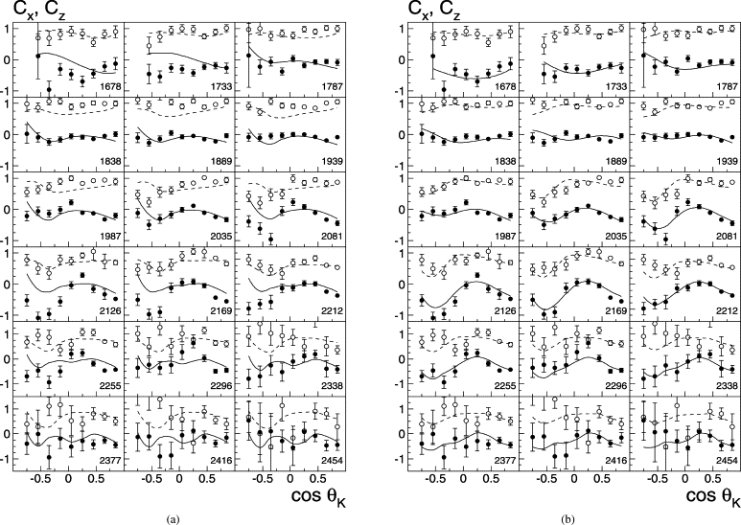
Polarization transfer C_{x} and C_{z}
without N(1900) 3/2⁺
with N(1900) 3/2⁺
Fits: BnGa-Model, V. A. Nikonov et al., Phys. Lett. B 662, 245 (2008)

Slide 16
Cross sections and P
A.V. Anisovich et al. EPJ. A (2011) 47: 27
N(1880) | 1/2+
N(1895) | 1/2-
N(1900) | 3/2+

Slide 17
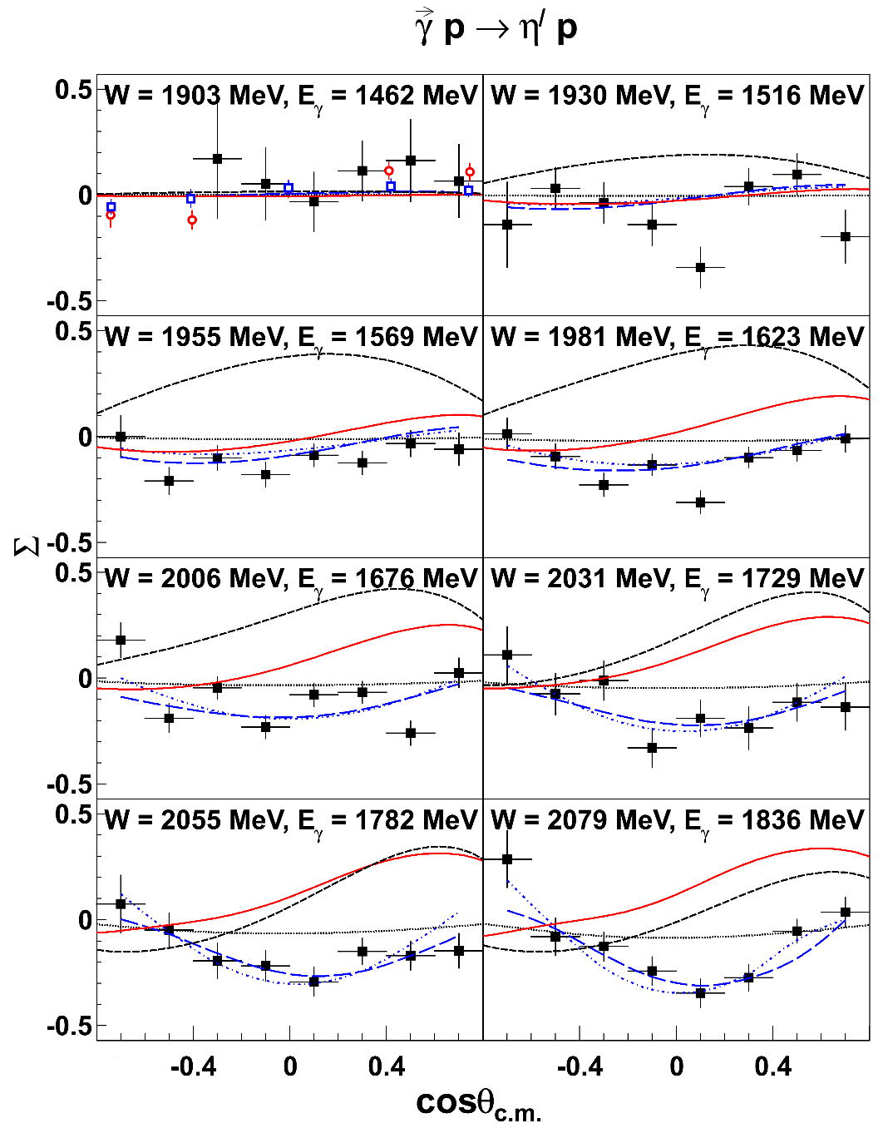
Latest η' photoproduction results
■ CLAS P. Collins et al., Phys Lett B 771, 213 (2017) - 62 points distributed over 8 W bins
○ GRAAL, 1.461 GeV
❐ GRAAL, 1.480 GeV
Asymmetry is small
SAID (black dotted line), ETA-MAID (red solid line), and NH (black dashed line) don’t work so well.
New fits with BnGa model work well
  N(1900)3/2+ is important!
  Statistically significant η' branches for N(1895)1/2⁻, N(1900)3/2⁺, N(2100)1/2⁺, and N(2120)3/2⁻
courtesy of B.G. Ritchie, ASU
Notes:
Similarly, with eta-prime, we greatly extend the energy and angle coverage of Σ measurements above the near-threshold measurements made by GRAAL.
We’ll come back to the curves momentarily.

Slide 18
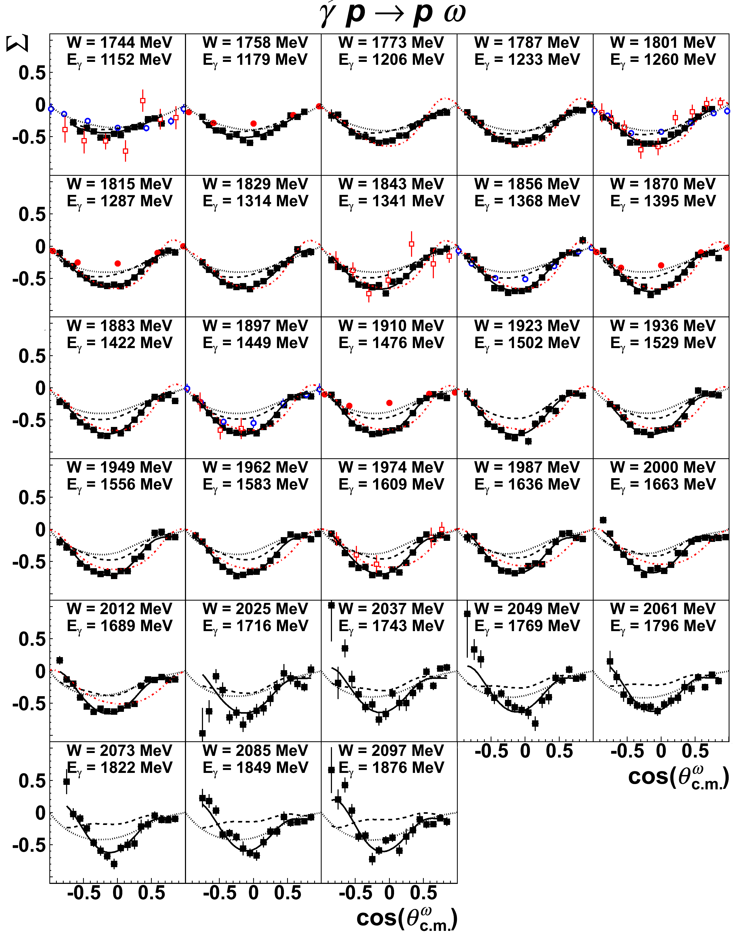
Latest ω photoproduction results
CLAS P. Collins et al., PLB 773, 112 (2017)
- 547 data points distributed over 28 W bins
○ GRAAL (2006)
● GRAAL (2015)
❐ CB-ELSA/TAPS (2015)
BnGa fit with (black solid line) and without (black dashed line) incorporating these new data
Close to threshold the process is dominated by 3/2⁺ and 5/2⁺ partial waves associated with N(1720)3/2⁺ and N(1680)5/2⁺
courtesy of B.G. Ritchie, ASU
Notes:
The omega has a relatively large cross section, so we wound up with some very nice data there, too.
The two sets of GRAAL data disagreed with each other, and our data suggest the earlier measurements are likely correct, while we agree within uncertainties with the CB-ELSA/TAPS data.
Again, we’ve vastly increased W coverage with this new CLAS data.

Slide 19
γd → π⁻p(p)
Need measurements for both proton and neutron targets to disentangle different isospin contributions
(neutron measurements sorely lacking)
D. Ho et al. (CLAS Collaboration),, Phys. Rev. Lett. 118, 242002 (2017).
CLAS “g13” experiment: γd → π⁻p(p)
8400 bins g13 triples world data base!
Eγ : [0.445 – 2.510 GeV]
cos θ_{π}^{cm}: [-0.72 – 0.92]
FSI corrections applied to extract γn from γd
This first determination of neutron couplings at the pole positions significantly improves the world data
amplitudes [GeV^{-1/2}]
Resonance | Coupling | SAID Fits Modulus, phase | PDG 2016 BW
N(1440)1/2⁺ | A_{1/2}(n) | 0.065±0.005, 5º±3º | 0.040±0.010
N(1535)1/2⁻ | A_{1/2}(n) | -0.055±0.005, 5º±2º | -0.075±0.020
N(1650)1/2⁻ | A_{1/2}(n) | 0.014±0.002, -30º±10º | -0.050±0.020
N(1720)3/2⁺ | A_{1/2}(n) | -0.016±0.006, 10º±5º | -0.080±0.050
N(1720)3/2⁺ | A_{3/2}(n) | 0.017±0.005, 90º±10º | -0.140±0.065
P.T. Mattione et al. (CLAS Collaboration), Phys. Rev. C 96, 035204 (2017)

Slide 20
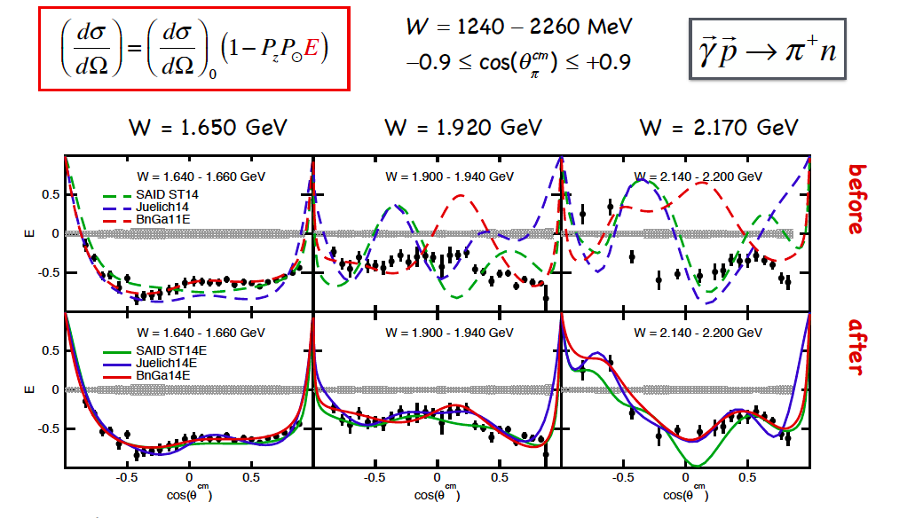
E asymmetry for γp → nπ⁺
S. Strauch, et al., PLB 750 (2015) 53.

Slide 21
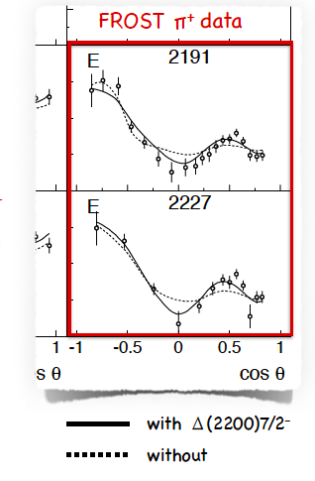
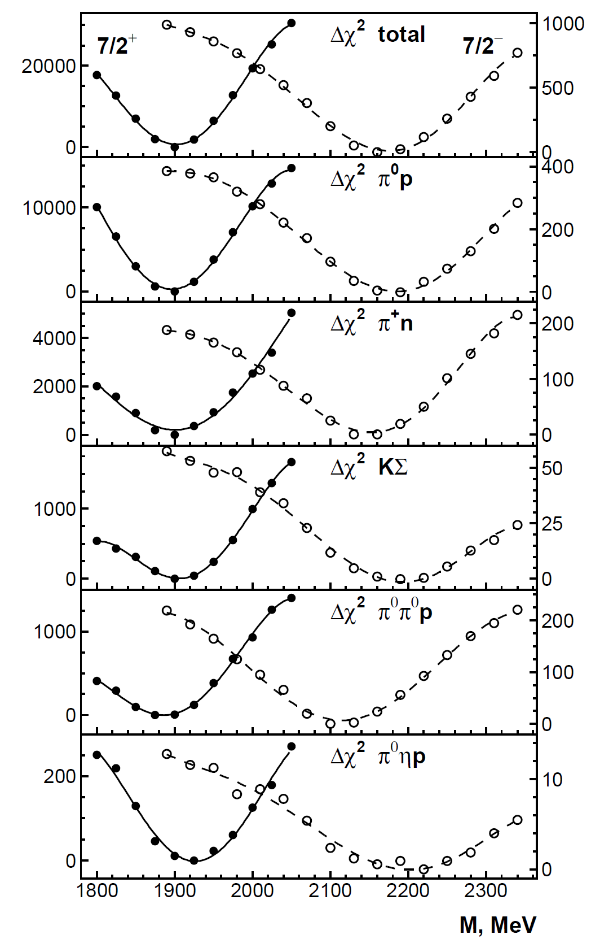
Δ(2200)7/2⁻
Parity partner of Δ(1950)7/2⁺
was poorly known
Δ(1950)7/2⁺ ****
Δ(2200)7/2⁻ *

Slide 22
Pre-Summary I
N* PDG 2018 vs 1996

Slide 23
Pre-Summary II
Δ* PDG 2018 vs 1996

Slide 24
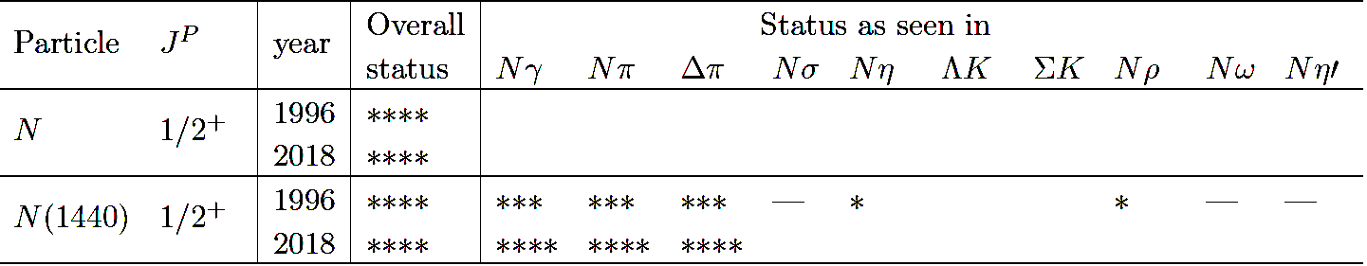
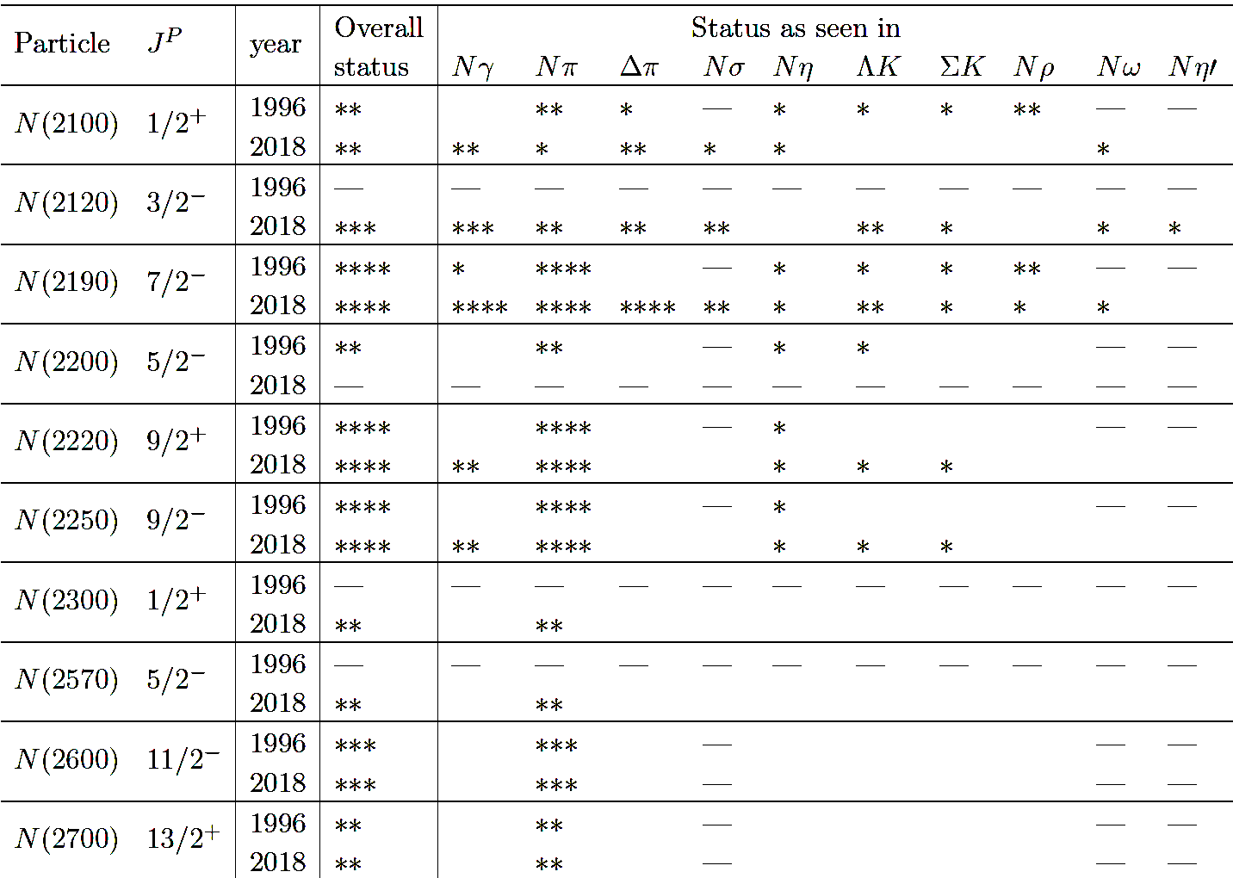
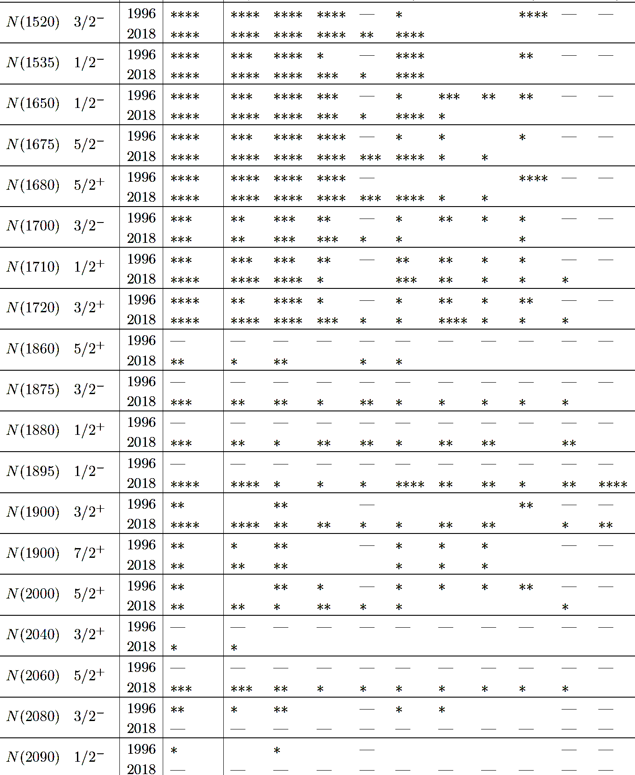
Pre-Summary III
N* PDG 2018 vs 1996
Only 3 states remained untouched, One of them is nucleon itself
9 new states added
3 taken out
3 new decay modes added
More changes for the final state where either meson or baryon have I=0
N* 22+9-3=28

Slide 25
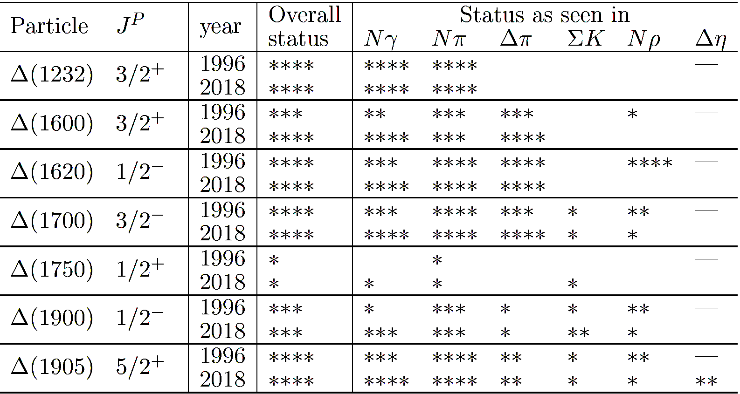
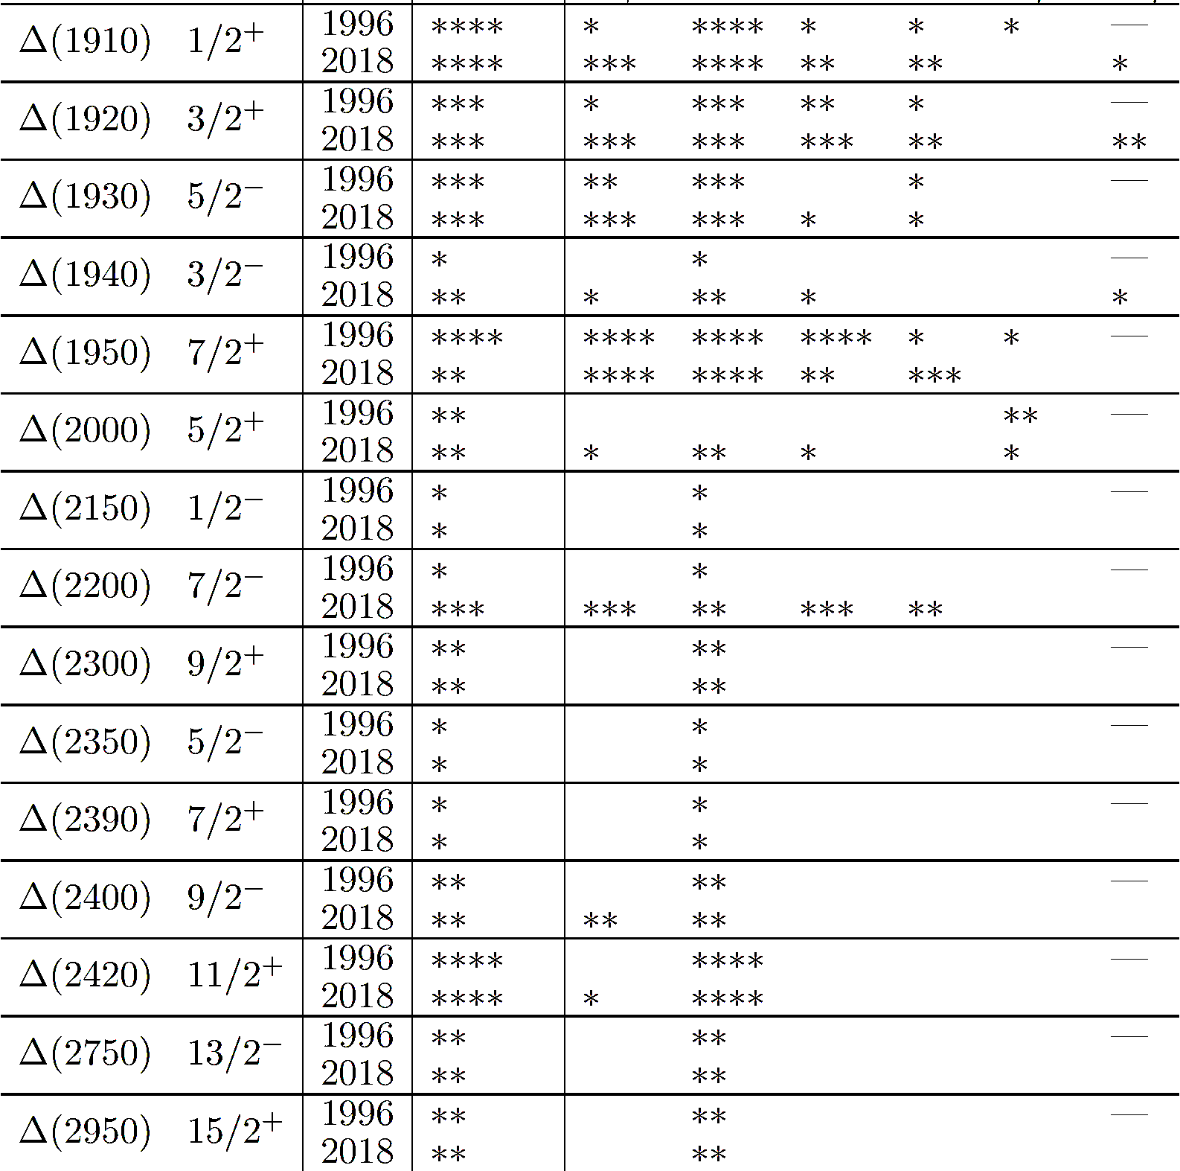
Pre-Summary IV
Δ PDG 2018 vs 1996
No new Δ states have been added but quite a few of them has changed their status.
One new decay mode added

Slide 26
Summary
“…it is probably no exaggeration to say that we now have essentially all the experimental data relevant to the low-energy baryon spectrum, that we are ever likely to obtain” (1983)
There is significant progress in N* spectrum over the last two decades mainly through the photoproduction experiments
It is still on the raise and there are no signs of slowing down
CLAS photoproduction experiments played major role in it
More interesting data are on the way for strange and non-strange meson production both on proton and deuteron targets
… it is no exaggeration to say that non-strange baryon spectroscopy is quite healthy today. Several “missing” resonances have been found. New photoproduction data keep coming and there are no signs of a decline any time soon. (2019)

