Slide 1
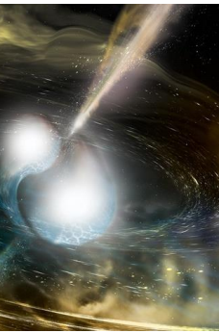
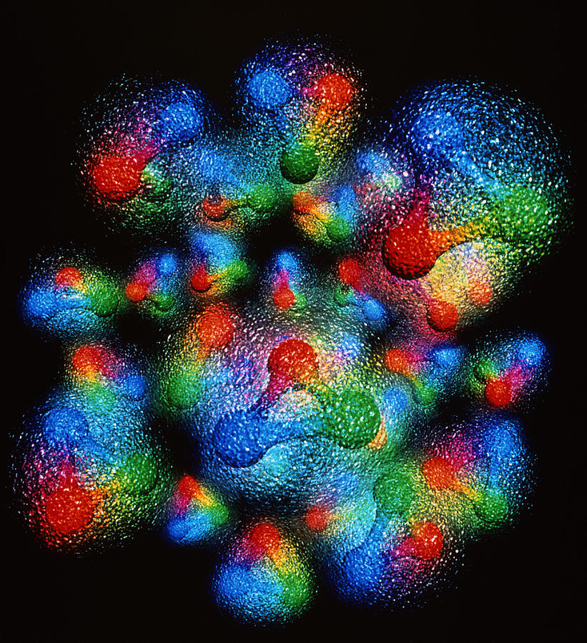
Nuclear femtography as a bridge from the nucleon to neutron stars
Strong QCD
Jefferson Lab
November 6-8, 2019
SIMONETTA LIUTI
UNIVERSITY OF VIRGINIA

Slide 2
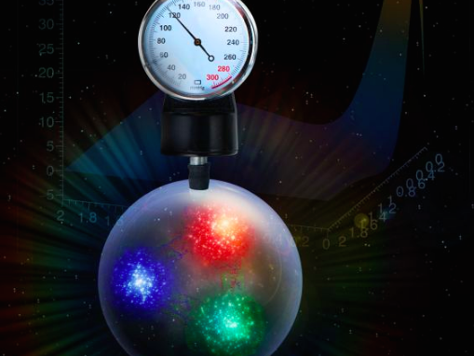
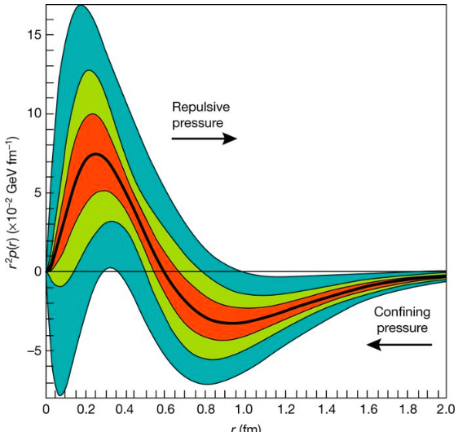
Burkert, Elouadrhiri, Girod, Nature 557, 396 (2018)
“The average peak pressure near the center is about 10³⁵ pascals, which exceeds the pressure estimated for the most densely packed known objects in the Universe, neutron stars”

Slide 3
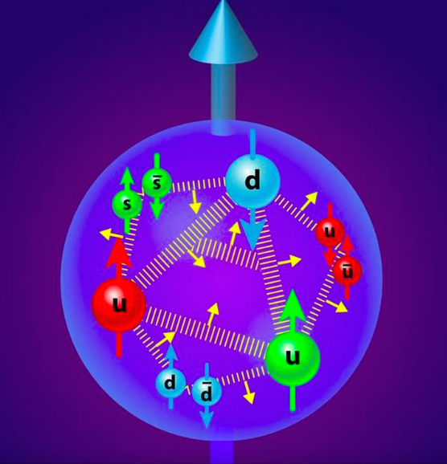
How is the pressure distribution extracted from data?
(How does the proton/neutron get its mass and spin?)

Slide 4
Evaluating the mechanical properties of the proton
Invariance of L_{QCD} under translations and rotations
Energy Momentum Tensor
from translation inv.
.
Angular Momentum Tensor
from rotation inv.
Notes:
The vast majority of the
nucleon’s mass is due to quantum fluctuations of quarkantiquark
pairs, the gluons, and the energy associated
with quarks moving around at close to the speed of light.
mass of the three valence
quarks in the nucleon comprises only a small fraction
of the nucleon’s total mass. The vast majority of the
nucleon’s mass is due to quantum fluctuations of quarkantiquark
pairs, the gluons, and the energy associated
with quarks moving around at close to the speed of light
The lagrangian looks simple and most importantly it is a “known” expression

Slide 5
The QCD Energy Momentum Tensor
Momentum density
Mass
T⁰⁰ | T⁰¹ | T⁰² | T⁰³
T¹⁰ | T¹¹ | T¹² | T¹³
T²⁰ | T²¹ | T²² | T²³
T³⁰ | T³¹ | T³² | T³³
Shear stress
Momentum density
Pressure
Angular Momentum density

Slide 6
S=1/2
QCD EMT matrix element between proton states (X. Ji, 1997)
q,g
forward
off-forward
q and g not separately conserved

Slide 7
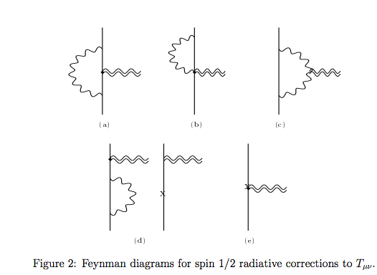
Direct calculation of EMT form factors
Donoghue et al. PLB529 (2002),
A. Freese , QCD Evolution 2019

Slide 8
EMT matrix elements from Generalized Parton Distributions Moments
q’
q
Local Operator Ô
μ
ν
H,E, …
p
p’
p
p’
Large momentum transfer Q²>>M² ➔ “deep”
Large Invariant Mass W²>>M² ➔ equivalent to an “inelastic” process

Slide 9
Deeply Virtual Compton Scattering
e’
-(k-k’)²=Q²
q’
k’
k
p
k’
e
q’
k
q
p’
μ
ν
H,E, …
p
p’
Notes:
DVCS is a coincidence experiment

Slide 10
2nd Mellin moments
From OPE
From EMT
D-term

Slide 11
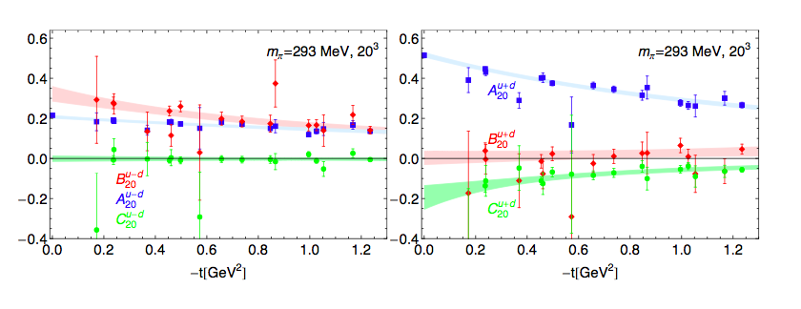
Physical interpretation of EMT form factors
u-d
u+d
Ph. Haegler, JoP: 295 (2011) 012009

Slide 12
C (D-term) is related to pressure
Static approximation
Landau&Lifshitz, Vol.7
M. Polyakov, hep-ph/0210165
M. Polyakov, P. Schweitzer, arXiv:1805.06596
C is a measure of the Elastic Free Energy in the proton

Slide 13
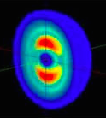

Energy Momentum Tensor in a spin 1 system
PRD86(2012)
7 conserved form factors!

Slide 14
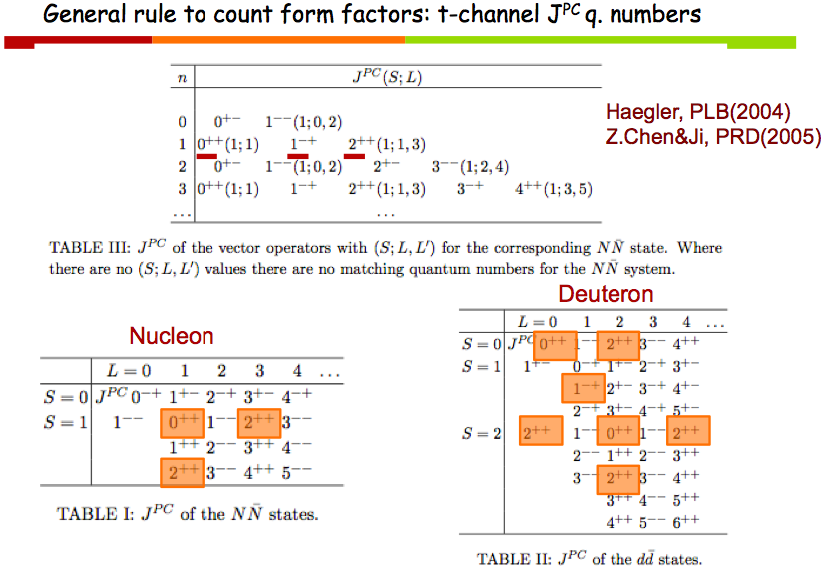
S.L., Talk at INT U. Washington, 2012

Slide 15
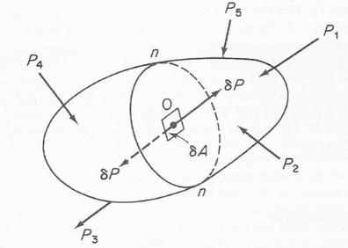
Taneja et al., PRD86(2012)
From OPE
From EMT
Momentum
Angular Momentum
Double flip
D-term dependent on polarization
Quadrupole
ξ-odd
Connected to b₁ SR
Connecting with observables: work in progress with Brandon Kriesten, Abha Rajan Swadhin Taneja

Slide 16
GPDs are the key to interpret the mechanical properties of strongly interacting systems

Slide 17
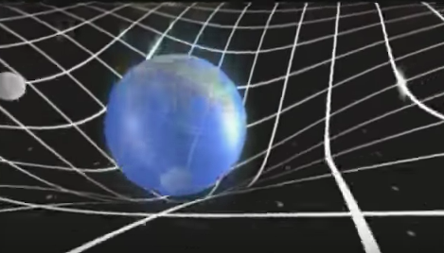
EMT: source of the gravitational field
action
Ricci scalar ➔curvature
Flat space
Matter and energy in the universe
Space-time geometry
Ricci tensor
Einstein’s Eqs.

Slide 18




Using the metric, g_{μν}, one can calculate:
the curvature tensor R_{µν}
the Einstein tensor G_{µν}
the stress energy tensor for a perfect fluid: T_{µν}
energy density
TOV Equations
matter distribution
pressure
$$\frac{dp(r)}{dr}$$
$$−\frac{G}{r}$$
=
$\left(ε\left(r\right)+p(r)\right)\left(m\left(r\right)+4πr^{3}p(r)\right){\left(r−2 G m(r)\right)}^{−1}$
$$\frac{dm(r)}{dr}$$
= 4$πr^{2}ε(r)$
EoS
p(r)-ε(r) relation
Knowing the EoS one can solve TOV to find the mass-radius relation

Slide 19
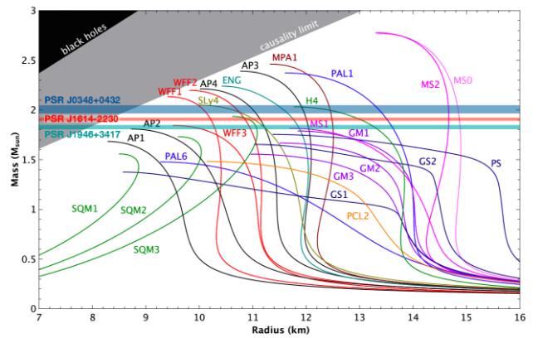
11/3/19
19
Constraints from Pulsar Masses
J. Antoniadis et al., Science 340, 6131 (2013)
P. B. Demorest et al., Nature 467 (2010)
Özel and Freire, http://xtreme.as.arizona.edu/NeutronStars
Constraints require the EoS to be stiff ➔ consistent with predictions for ordinary nuclear matter composed of mostly neutrons and few protons including three body interactions

Slide 20
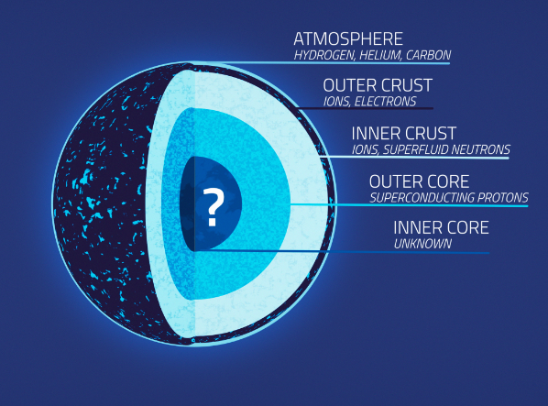
What governs the EoS of neutron stars?
ρ>0.3-0.5 ρ_{o}
ρ>0.5-2 ρ_{o}
ρ>2ρ_{o}
https://svs.gsfc.nasa.gov/20267

Slide 21
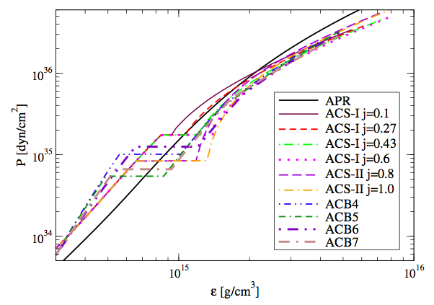
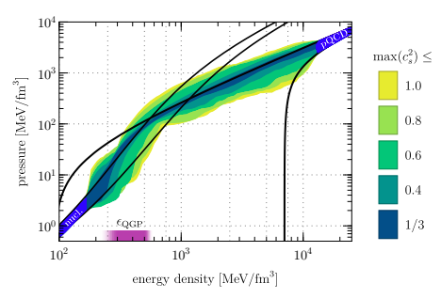
Pascalidhis et al., arXiv:1712.00451
Annala, E., Gorda, T., Kurkela, A., Nattila, J.,
& Vuorinen, A. arXiv:1903.09121
QM phase
baryon matter phase
“ …the existence of quark-matter cores inside very massive NSs should be considered the standard scenario, not an exotic alternative. QM is altogether absent in NS cores only under very specific conditions,…”

Slide 22

We propose a new, model independent way of evaluating the EoS in the quark matter phase by inferring it directly from the matrix elements of the QCD Energy Momentum Tensor (EMT) between nucleon states $→$ GPDs
Model independent means relating measurement to measurement
This allows us to introduce spatial coordinates/distance in a novel way

Slide 23

Based on
arXiv:1812.01479

Slide 24
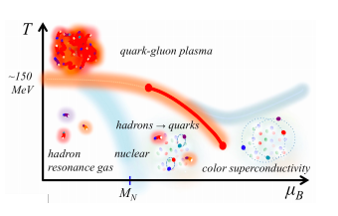
Densities and distance scales
Annala, E., Gorda, T., Kurkela, A., Nattila, J.,
& Vuorinen, A. arXiv:1903.09121
nucleons
quark and gluon structure
deconfinement
0.5 fm
2fm
1fm
G. Baym et al. arXiv:1707.04966

Slide 25
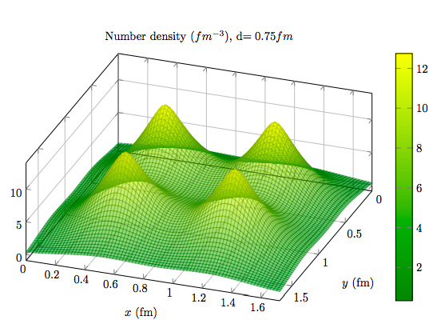
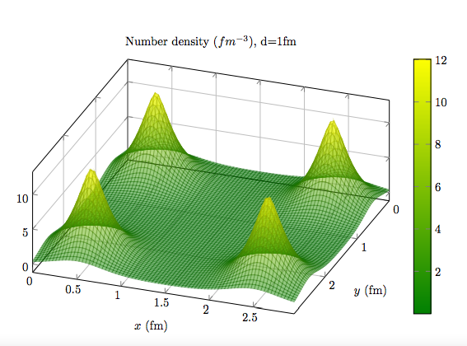
d= 0.75 fm
Nuclear Spatial Density
d= 2 fm
b’
b-b’

Slide 26
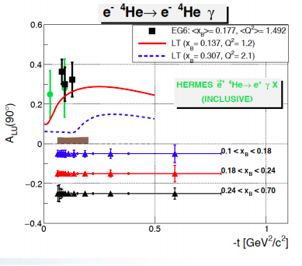
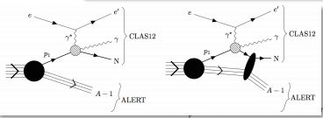
ALERT Proposal at Jefferson Lab: Nuclear Exclusive and Semi-inclusive Measurements with A New CLAS12 Low Energy Recoil Tracker
W. Armstrong. M. Hattawy, …
S=0

Slide 27
Nucleon Gravitomagnetic Form Factors

Slide 28
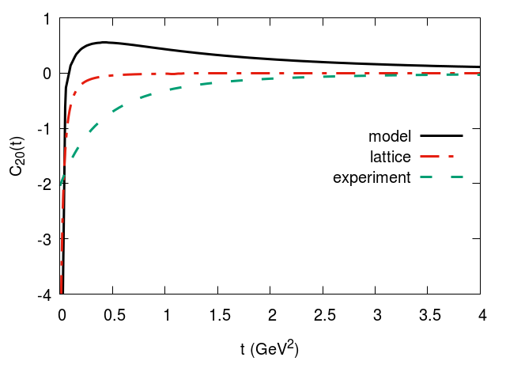
C₂₀
Ph. Haegler, JoP: 295 (2011) 012009
u-d
u+d
Jlab Hall B
experimental range
Lattice
Burkert, Elouadrhiri, Girod, Nature (2018)

Slide 29
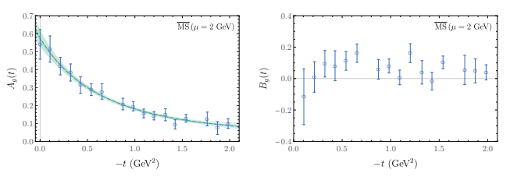
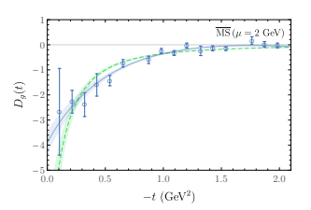
Gluons
m_{π}=450 MeV
Detmold, Shanahan, Phys.Rev. D99 (2019)

Slide 30
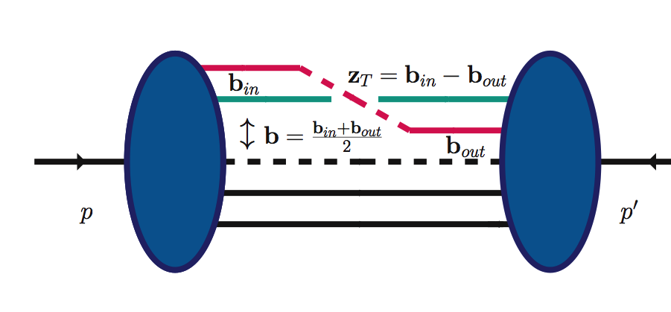
Two distinct distance scales
z⁻
zº
z⁺
Ioffe time
z³
11/3/19
Ioffe time
z⁻,z_{T}
z
partons location
p-p’=Δ

Slide 31
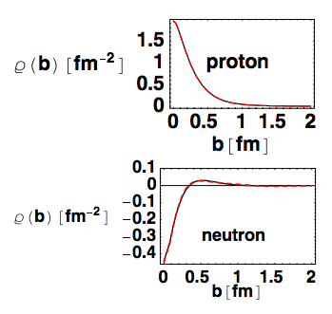
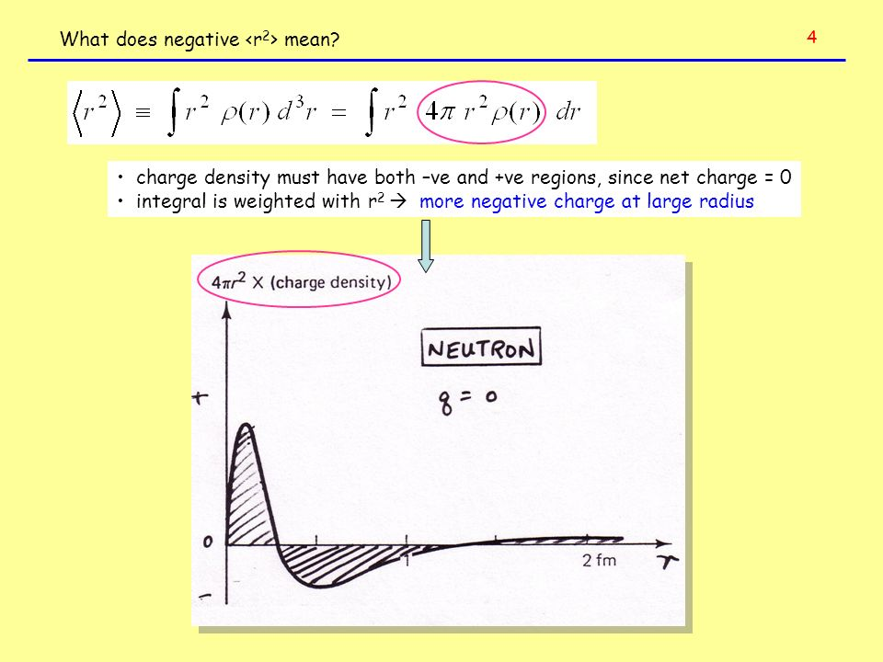
Using we can map out faithfully the spatial quark distributions in the transverse plane
(no modeling/approximation)
G. Miller(2007)
Neutron “textbook” density

Slide 32
Including all polarization configurations:

Slide 33
number/mass density
1st Mellin M.
2nd Mellin M.
Energy density
Pressure

Slide 34
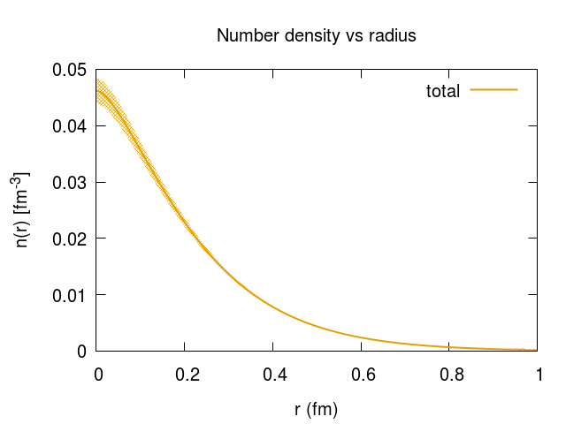
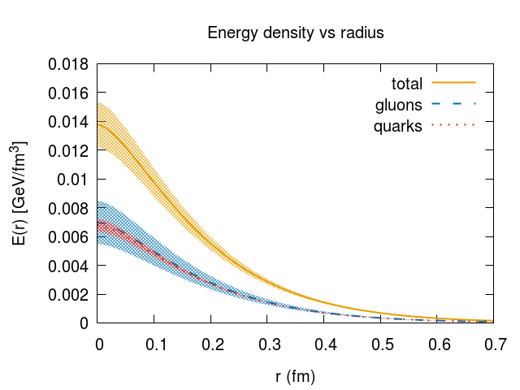
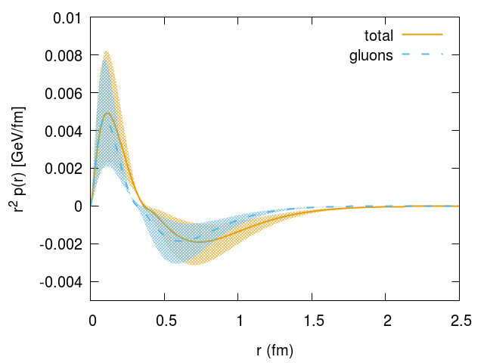
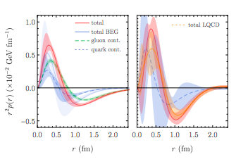
A₂₀
A₁₀
fm
fm
pressure
C₂₀
pressure
Detmold, Shahanan, Phys.Rev.Lett. 122 (2019)

Slide 35
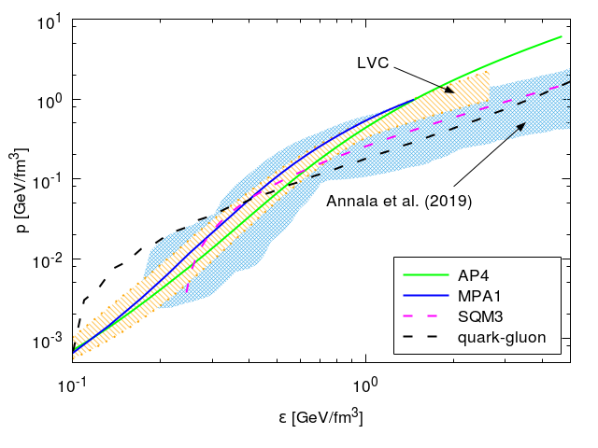
Rajan, Gorda, SL, Yagi, arXiv:1812.01479
GW170817
QCD EMT
MIT bag model: strange quark matter

Slide 36
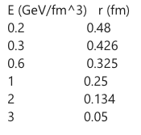
r (fm)
0.5
0.42
0.25
0.13

Slide 37
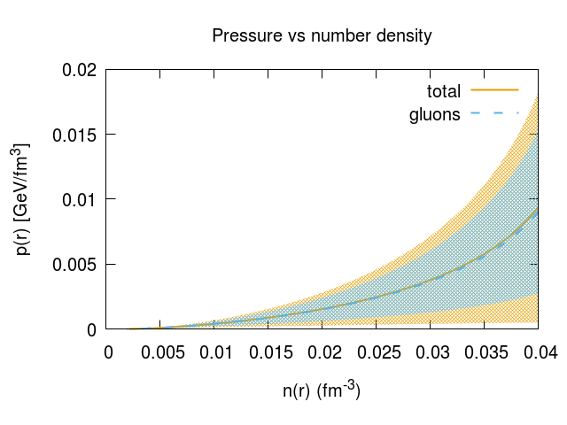
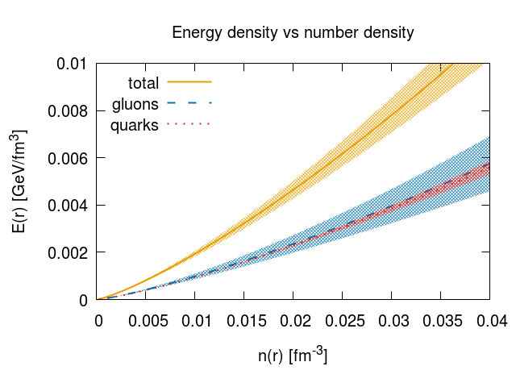

Slide 38
Rajan, Gorda, SL, Yagi, arXiv:1812.01479
QCD EMT
J0348+0432 pulsar mass
strange quark matter
“stitching” at transition pressure 0.15 GeV/fm³

Slide 39
Jefferson Lab’s measurement on the pressure inside the nucleon/hadronic matter needs to be corroborated by an independent set of measurements
Neutron stars mergers/multimessenger astronomy provide an independent constraint

Slide 40
WHAT’S NEXT…
Key question: how to extract accurate information on the mechanical properties of the nucleon from data

Slide 42

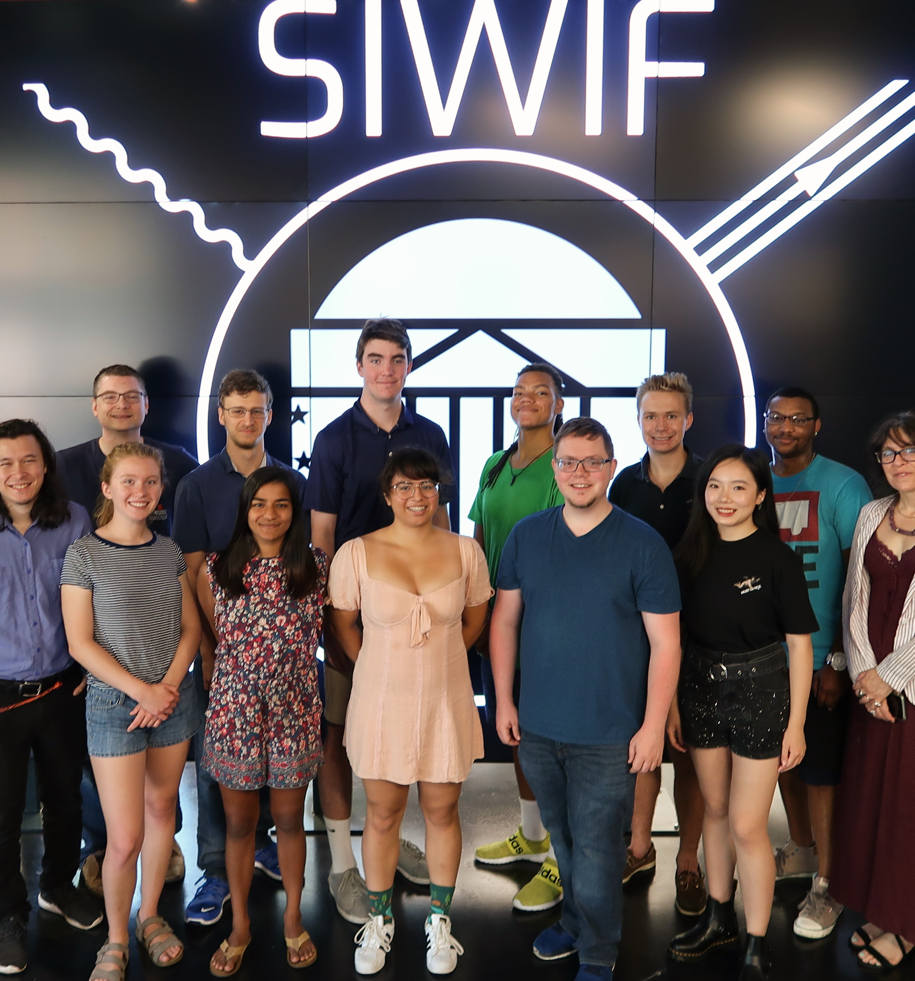
A truly interdisciplinary effort
3D Structure of the proton
Data Science
Quantum Information
Education
Outreach

Slide 43
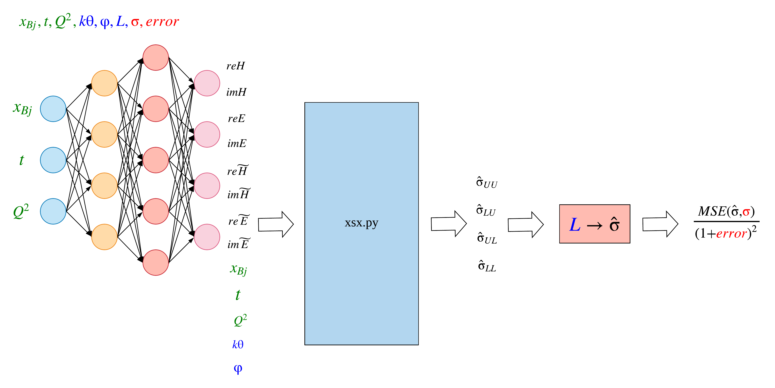
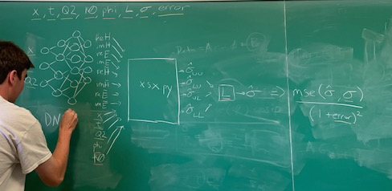
Femtography Imaging with Neural Networks (FINN)
Strategy:
A fully connected neural network maps input kinematic data to a vector of eight form factors (see diagram).
Use a code developed by our Data Analysis Team to evaluate the cross sections and in terms of the CFFs.
Jake Grigsby
We translate the x-sec. code into TensorFlow
➔Automatically differentiable
➔At variance with other efforts we can train CFF extraction network with backpropagation and variants of stochastic gradient descent.
Notes:
Beyond showing actual fits to data
Uncertainty knowledge
In order to train this function, we use a program developed by the Data Analysis Team to take the form factor predictions and calculate cross sections, which can then be compared against experimental measurements.

Slide 44
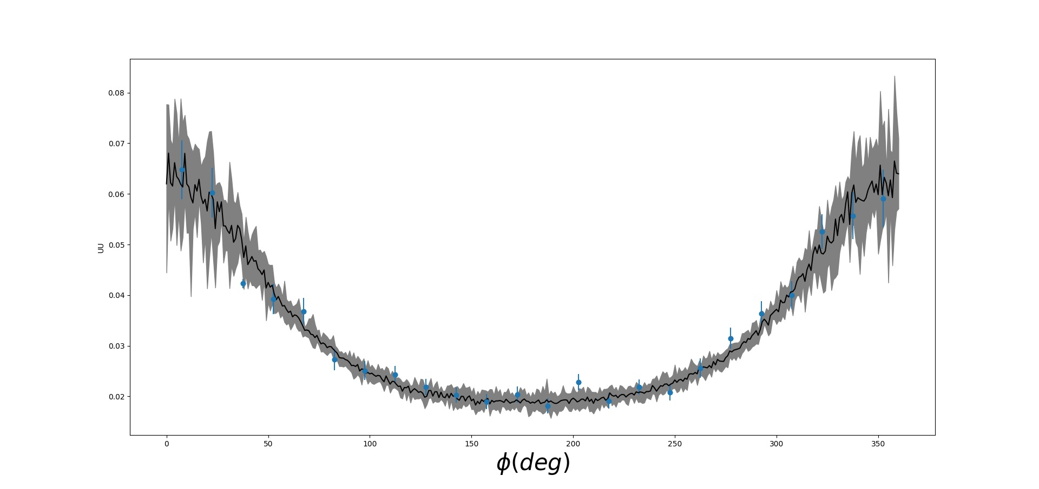
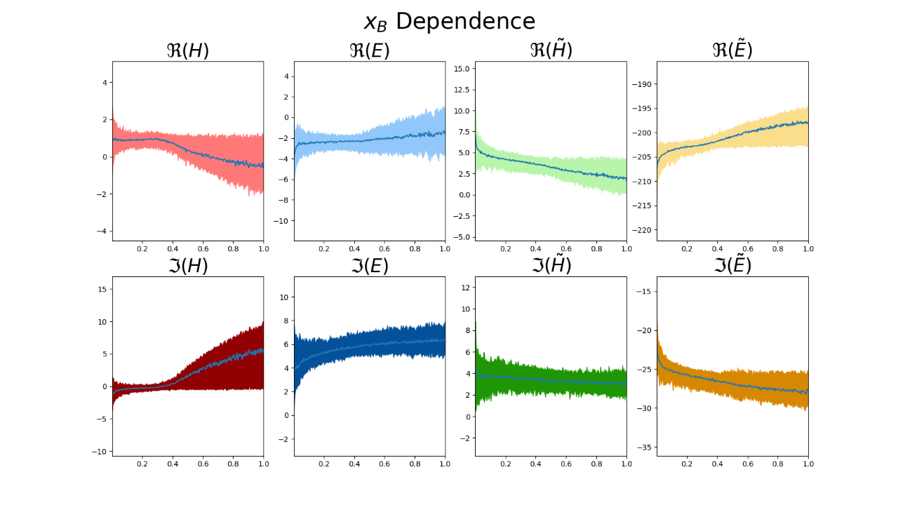
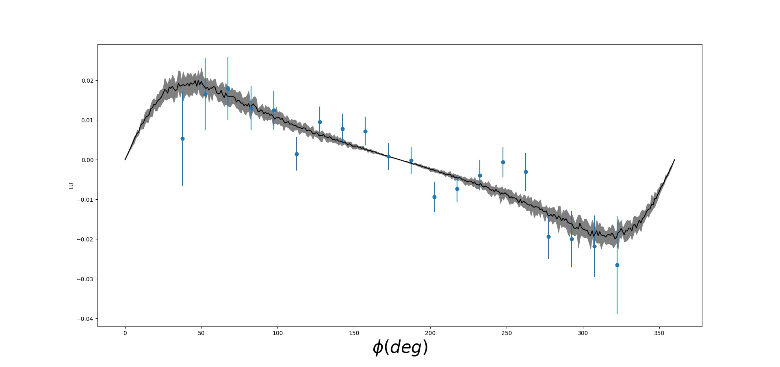
Compton Form factors
Q²
Preliminary
x_{Bj}
Notes:
Physics is pushing Machine Learning to understand systematic errors

Slide 45
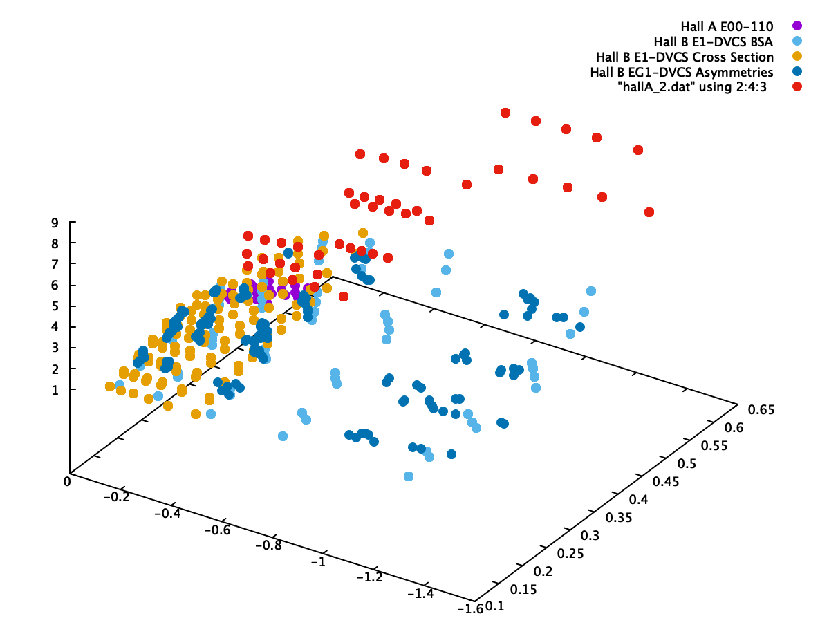
Jlab DVCS data

Slide 46
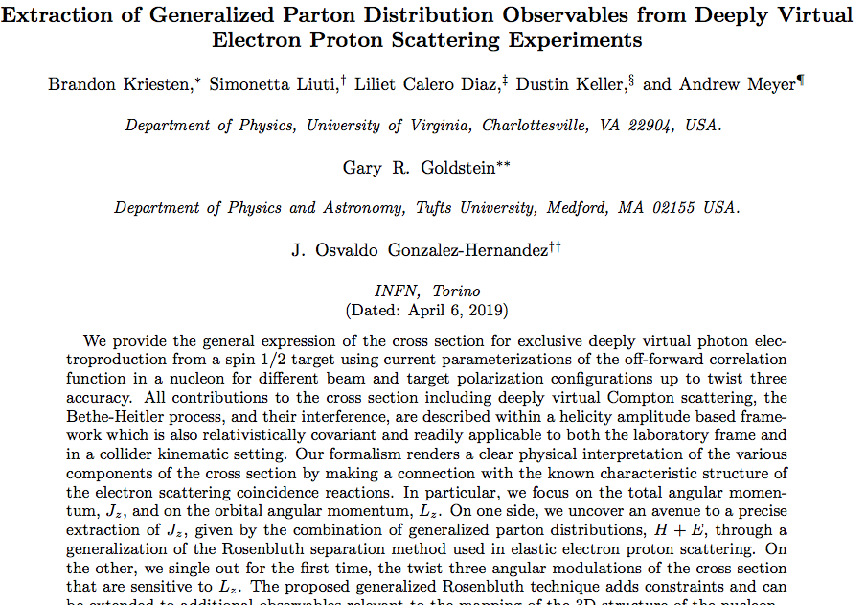
Introducing the complete formalism where all kinematical dependences and approximations are under control
arXiv:1903.05742
Brandon Kriesten, talk Tuesday

Slide 47
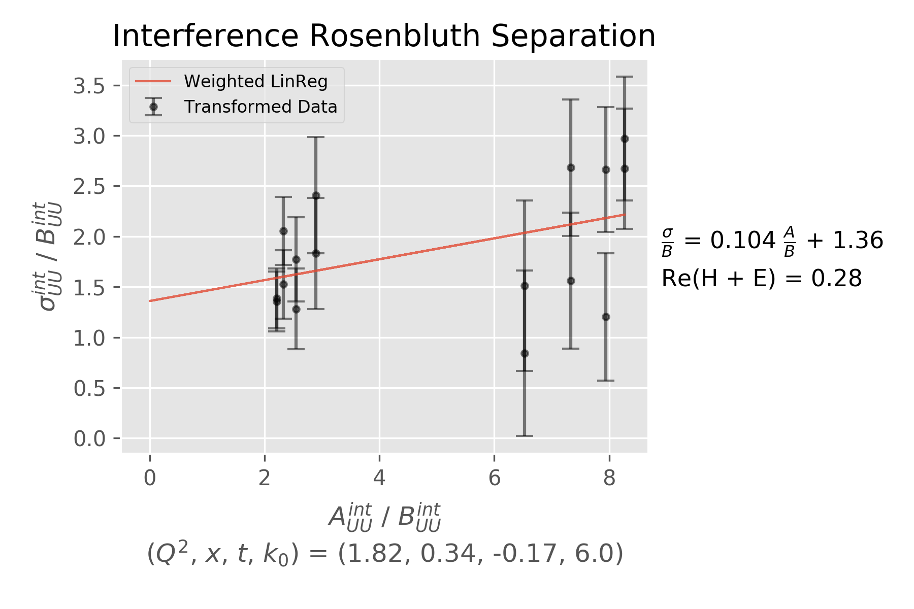
G
G_{E}²+𝛕 G_{M}²
G_{M}²
G_{M} G_{A}

Slide 48
Conclusions and Outlook
The EoS of dense matter in QCD can be obtained from first principles, using ab initio calculations for both quark and gluon d.o.f.
Gluons are found to dominate the EoS providing a trend in the high density regime which is consistent with the constraint from LIGO.
We can connect the pressure and energy density in neutron stars with collider observables: the GPDs.
The proposed line of research opens up a new framework for understanding the properties of hybrid stars. In the future we hope to set more stringent constraints on the nature of the hadron to quark matter transition at zero temperature.
These effects are observable!
Notes:
However, in the definition of these distributions, care must be applied to ensure manifest gauge invariance. In general, this can be accomplished by connecting any non- local correlation function with a Wilson-line gauge link. Specifying a Wilson-line gauge link requires selecting a path along which the vector potential is evaluated. The choice of path raises the immediate issue of how the quantities defined using Wigner distributions (TMDs, OAM, . . .) depend on that choice.

Slide 49
…To observe, evaluate and interpret
Wigner distributions at the subatomic level
requires stepping up data analyses from the standard methods ➔ developing new numerical/analytic/quantum computing methods
Center for Nuclear Femtography Project

Slide 50
