Slide 1


Bridging a Gap Between Space-like and
Time-like EM Transition Form Factors
Philip Cole
Lamar University
Nov. 6, 2019
PHY-1615146

Slide 2
The focus of this talk within the scope (b) of this workshop
  The successful start of the new
  12-GeV era of experiments in the four halls at Jefferson Lab in the U.S.
  as well as the
  European facilities ELSA, MAMI, and GSI, and
  Asian facilities BES, SPring-8, and JPARC.
  (b) exploring the dynamics and impact of hadron mass generation with nucleon elastic, and parton distribution amplitudes, N->N* transitions, and meson elastic/transition form factors.
  … to expose emergent phenomena via quasi-particle formation.

Slide 3
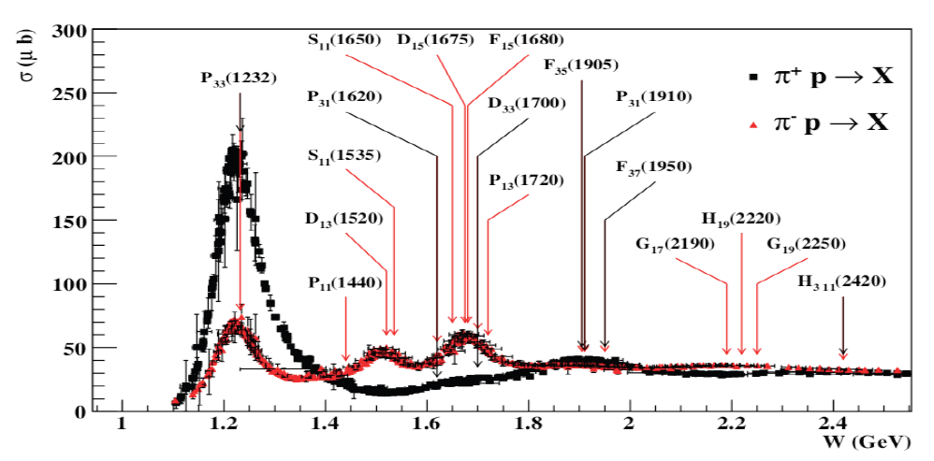
Baryon resonances (N*s and Δ*s)
σ (mb)
N*s are broadly overlapping
Hard to disentangle without polarization observables
Notes:
Delta++/Delta0 cross section ratio is 3. Mention CR-coefs + Qual Prob.

Slide 4
Volker Burkert NSTAR 2019

Slide 5
Coupled-channels are an absolute must
πN
ππN
γN → N* → ηN
KΛ KΣ
The same N* resonance must be found in different reaction channels in a consistent way!
T
πΝ→πΝ
T
ηΝ→πΝ
T
γΝ→πΝ
T
ρΝ→πΝ
T
σΝ→πΝ
T
ΚΛ→πΝ
T
ΚΣ→πΝ
T
πΝ→ηΝ
T
ηΝ→ηΝ
T
γΝ−>ηΝ
T
ρΝ→ηΝ
T
σΝ→ηΝ
T
ΚΛ→ηΝ
T
ΚΣ→ηΝ
T
πΝ→γΝ
T
ηΝ→γΝ
T
γΝ→γΝ
T
ρΝ→γΝ
T
σΝ→γΝ
T
ΚΛ→γΝ
T
ΚΣ−>γΝ
T=
T
πΝ→ρΝ
T
ηΝ→ρΝ
T
γΝ→ρΝ
T
ρΝ→ρΝ
T
σΝ→ρΝ
T
ΚΛ→ρΝ
T
ΚΣ→ρΝ
T
πΝ→σΝ
T
ηΝ→σΝ
T
γΝ→σΝ
T
ρΝ→σΝ
T
σΝ→σΝ
T
ΚΛ→σΝ
T
ΚΣ→σΝ
T
πΝ→ΚΛ
T
ηΝ→ΚΛ
T
γΝ→ΚΛ
T
ρΝ→ΚΛ
T
σΝ→ΚΛ
T
ΚΛ→ΚΛ
T
ΚΣ→ΚΛ
T
πΝ→ΚΣ
T
ηΝ→ΚΣ
T
γΝ→ΚΣ
T
ρΝ→ΚΣ
T
σΝ→ΚΣ
T
ΚΛ→ΚΣ
T
ΚΣ→ΚΣ

Slide 6
Space-Like, of course, is not the whole story for electromagnetic form factors for baryon resonances
Where are we now in bridging the
time-like and space-like divide?
  Photon/electron beams
  Pion beams
  Electron/positron collisions

Slide 7
We seek to understand the kinematical regimes in q²
between the space-like and time-like regions
  q² = 0 [anchor point] photon-beam (unpolarized & linearly- and circularly polarized experiments (ELSA, JLab, LEPS, & MAMI)
  q² > 0 [time-like] meson-beam experiments (GSI and J-PARC) proton-antiproton beam experiments (FAIR)
  e⁻e⁺ → J/ψ → BN* (BES III)
  q² < 0 [space-like] electron-beam experiments (JLab)

Slide 8
Electromagnetic Form Factors
Space-like (SL)
  Form Factors (FF) are real
  The FFs encode information on the the charge distribution on the nucleon
Time-Like (TL)
  Form Factors are complex
    G_{E} (q²) = |G_{E} (q²)|e^{iΦΕ} and G_{M} (q²) = |G_{M} (q²)|e^{iΦΜ}
    ΔΦ = Φ_{M} – Φ_{E} (relative phase between G_{M} and G_{E})
    This phase affects the polarization in the final state even when the initial state is unpolarized. See Nature Phys. 631 (2019).
  The FFs can be related to the time evolution of the EM charges within the nucleon

Slide 9
The Puzzle of the Proton
ECT* Workshops (May 2017 + Sept. 2019) are a start
The special topic session (NSTAR 2017 and NSTAR 2019) is a start
GSI Workshop on Electromagnetic Structure of Strange Baryons (Oct. 2018) is a start
The workshop on Baryon Production at BESIII (Sept. 2019) is a start.
The US-Japan Collaboration (JPARC/JLab) White Paper is a start + the Reimei Symposium on “Synergies in Hadron Physics between J-PARC and JLab”
Baryon production in the time-like and space-like regimes is key towards unraveling the
Conundrum of the Proton

Slide 10
Bridging a Gap Between Space-like and
Time-like EM Transition Form Factors
A (partial) report on the

Slide 11
Our Research Vision
  At the BES III Workshop (Sept 14-16, 2019)
This workshop included the following topics:
  State of the art of nucleon form factor from theory and experiment*
  The production of baryon pair in electromagnetic and hadronic processes*
  Polarization in hyperon production or decay and the interpretations.
  Prospect of hyperon physics in the future super tau-charm factory
  *primarily TL

Slide 12
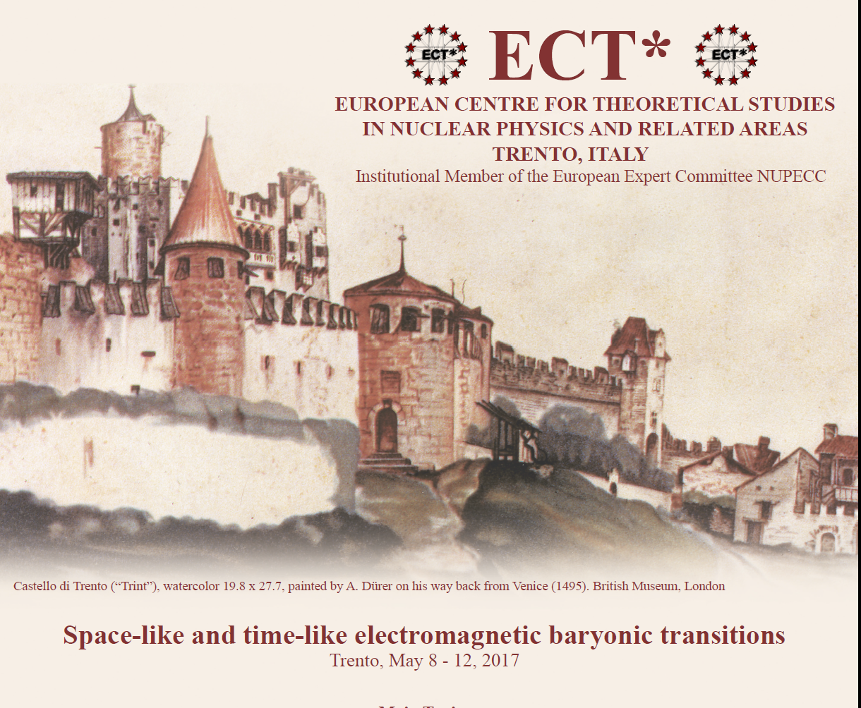
And with a few words on
The ECT* Workshop:
Space-like and time-like electromagnetic baryonic transitions
May 8-12, 2017
The SL/TL ECT* Organizers:
  Philip Cole,
  Béatrice Ramstein,
  Andrey Sarantsev

Slide 13
Our Research Vision
At the ECT* Workshop we sought to
bring together a representative sample of
experimental, phenomenological, and theory groups,
who are working on the nucleon resonance problem.
    Discuss the direction on the study of understanding the underlying structure of nucleons in terms of the time-like and space-like electromagnetic baryonic form factors and transitions;
    Delineate the spectrum of excited baryon states;
    Describe and detail how quarks are confined and acquire mass through the mechanism of dynamical chiral symmetry breaking.

Slide 14
Following topics were covered at the 2017 ECT* Workshop
  Electromagnetic baryon excitations through meson electroproduction
  Theoretical approaches for baryon transition form factors in the space-like region
  Baryon spectroscopy from photoproduction and meson beam experiments
  Amplitude analysis and extraction of baryonic resonances properties
  Electromagnetic transitions through dilepton production
  Unified description of space-like and time-like baryon electromagnetic transitions
  Vector mesons in medium
  Prospects for future experimental studies

Slide 15
Not to be confused, of course, with

Slide 16
Bridging a Gap Between Space-like and
Time-like EM Transition Form Factors
More on this soon…..

Slide 17
Karin Schönning BES III (2019)

Slide 18
Karin Schönning BES III (2019)

Slide 19
Karin Schönning BES III (2019)

Slide 20
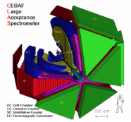
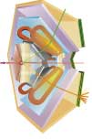
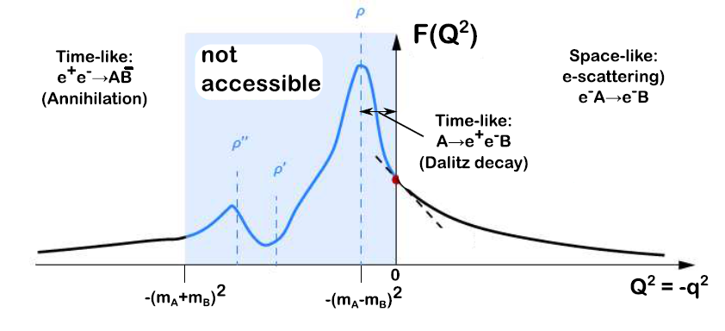
Electromagnetic baryonic transitions in time-like and space-like regions: towards a global picture?
Time-Like electromagnetic form factors
Space-Like electromagnetic form factors
preliminary studies with HADES/GSI
Precise data from JLab/CLAS up to -q²=4 GeV²
F(q²)
n
Inverse pion electroproduction
e⁺
q² <0 fixed
π ⁻
R
γ*
p
γ*
R
e⁻
p
e⁻⁻
e⁻
F(q²)
π⁻
q² =(M _{ee} )²> 0
variable
p
e⁻⁻
Theoretical tools: Dispersion Relations, Dyson-Schwinger, Vector Dominance, Constituent Quarks ?
Béatrice Ramstein ECT* 2017

Slide 21
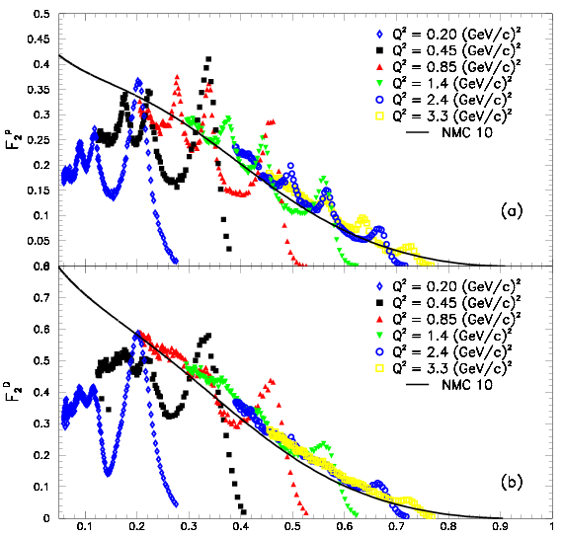
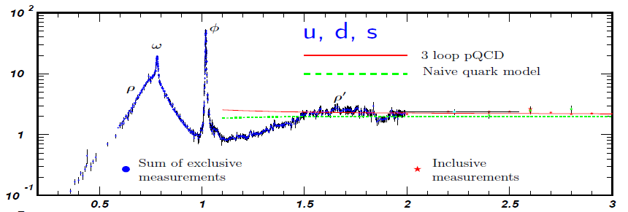
Change in Degrees of Freedom
As function of q²
Spacelike: F₂-Structure Funct.
JLAB
Data
Timelike: e⁺e⁻ → hadrons
p
Im Π_{em}(M) / M²
M [GeV]
d
● Q² _{dual} ~ 2.5-3 GeV²
● depends on channel?
ξ ≈ x
average → Quark-Hadron Duality
lower onset-Q² in nuclei?
Ralf Rapp ECT* 2017

Slide 22
Xiaorong Zhou
BES III Workshop

Slide 23
Simone Pacetti @ the BES III Sept. Workshop http://cicpi.ustc.edu.cn/indico/conferenceProgram.py?confId=2140
Excellent presentation on connecting TL and SL FFs through dispersion relations

Slide 24
Bridging a Gap Between Space-like and
Time-like EM Transition Form Factors
More on this now…..

Slide 25
Simone Pacetti BES III (2019)
Simone Pacetti
BES III Workshop

Slide 26
Simone Pacetti
BES III Workshop

Slide 27
Simone Pacetti
BES III Workshop

Slide 28
PANDA?
Simone Pacetti
BES III Workshop

Slide 29
BingSong Zou
BES III Workshop

Slide 30
SL and TL Magnetic FFs – BES III
Xiaorong Zhou
BES III Workshop

Slide 31
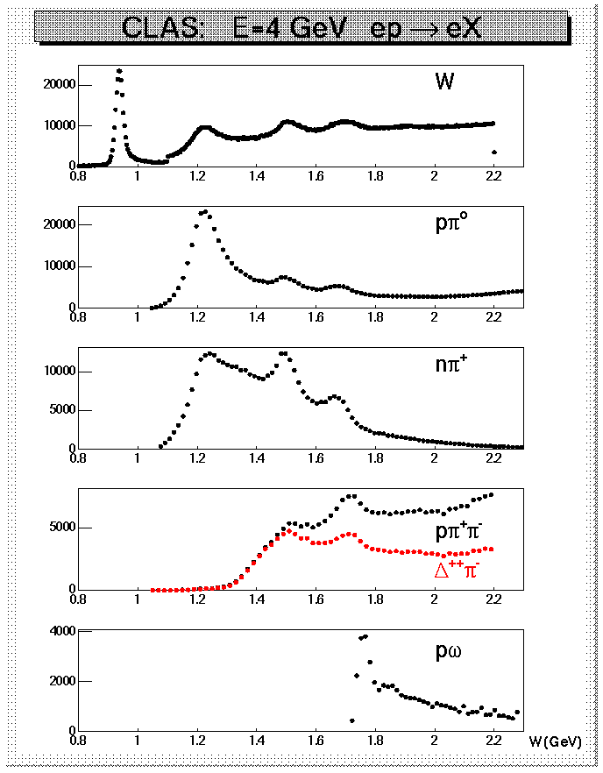
Why Nπ/Nππ electroproduction channels are important
CLAS data on meson electroproduction at Q² < 4.0 GeV²
  Nπ/Nππ channels are the two major contributors in N* excitation region;
  these two channels combined are sensitive to almost all excited proton states;
  they are strongly coupled by πN→ππN final state interaction;
  may substantially affect exclusive channels having smaller cross sections, such as ηp,KΛ, and KΣ.
Therefore knowledge on Νπ/Νππ electroproduction mechanisms is key for the entire N* Program

Slide 32
Multiple Meson Final States
─
─
Q: What about BN* → BBMM (+ c.c.)?
A: BESIII can sample this phase space for charged and neutral final-state particles.
Complementary features to CLAS

Slide 33
Some History (ten years ago)

Slide 34




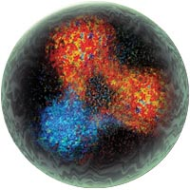
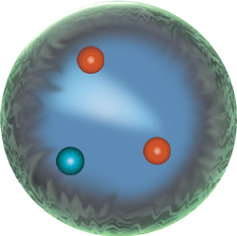
A new
& theoretical/experimental collaborative effort on baryon resonance extraction*
*through a proposed NSF PIRE project
*through an overarching funding mechanism
Philip Cole
Idaho State University
April 22, 2009.

Slide 35
List of Participants – PIRE: Nucleon Resonance Studies (Pre-Proposal)
PI/CoPIs:
  Philip L. Cole (PI and Program Manager, Associate Professor of Physics)
  Department of Physics, Idaho State University, Pocatello, ID 83209
  Ralf W. Gothe (First CoPI and Deputy Program Manager, Professor of Physics)
  Steffen Strauch (CoPI, Associate Professor of Physics)
  Department of Physics and Astronomy, University of South Carolina, Columbia, SC 29208
  Kyungseon Joo (CoPI, Associate Professor of Physics)
  Department of Physics, University of Connecticut, Storrs, CT 06269
Senior Personnel:
  Volker D. Burkert (Hall B Leader)
  Latifa Elouadrhiri (Assistant Project Manager for the 12 GeV Upgrade – Hall B)
  Victor I. Mokeev (Hall B Staff Scientist II)
  Thomas Jefferson National Accelerator Facility, Physics Division, Newport News, VA 23606
  Tsung-Shung Harry Lee (Senior Physicist and Director of Excited Baryon Analysis Center – JLab)
  Physics Division. Argonne National Laboratory. Argonne, IL 60439
  Debra M. Easterly¹ (Director of Research Development & Compliance, NSF ADVANCE Grant Project Director for ISU)
  Angela V. Petit² (Assistant Professor of English)
  ¹Office of Research, ²Department of English, Idaho State University, Pocatello, ID 83209
  Kevin Kelley¹ (Professor of Physics)
  Scott Galer² (Associate Professor of Chinese and Chair of Foreign Languages and Literatures)
  ¹Department of Physics, ²Department of Foreign Languages and Literatures, Brigham Young University – Idaho, Rexburg, ID 83460
Foreign Collaborators:
  Qiang Zhao (Chief Chinese Liaison, Professor of Physics and Group Leader of the Theory Division)
  Bing-Song Zou (Deputy Chinese Liaison, Professor of Physics and Director of the Theory Division)
  Theory Division, Institute of High Energy Physics, Chinese Academy of Sciences, Beijing 100049, P.R. China
  Cong-Feng Qiao (Executive Dean and Professor of Physics)
  College of Physical Sciences, Graduate School of the Chinese Academy of Sciences Beijing 100049, P.R. China
  Xue-Qian Li (Professor of Physics)
  Physics Department, Nankai University, Tianjin 300071, P.R. China
  Bi-Tao Hu (Vice Dean and Professor of Physics)
  The School of Nuclear Science and Technology, Lanzhou University, Lanzhou 730000, P.R. China
  Inna Aznauryan (Leading Staff Scientist)
  Yerevan Physics Institute – Yerevan State University, Yerevan, Armenia, 375036

Slide 36
Issues (1)
BES and CLAS datasets
They have very different contributions to the production background.
  electron-positron collider
  electron beam onto fixed target
They separately have unique N* signatures
  BES: J/ψ → BN* → BBM (e.g. NNπ, NNη)
  CLAS: N* → BM/BMM (e.g. Nπ/Nππ)
─
─
─
─

Slide 37
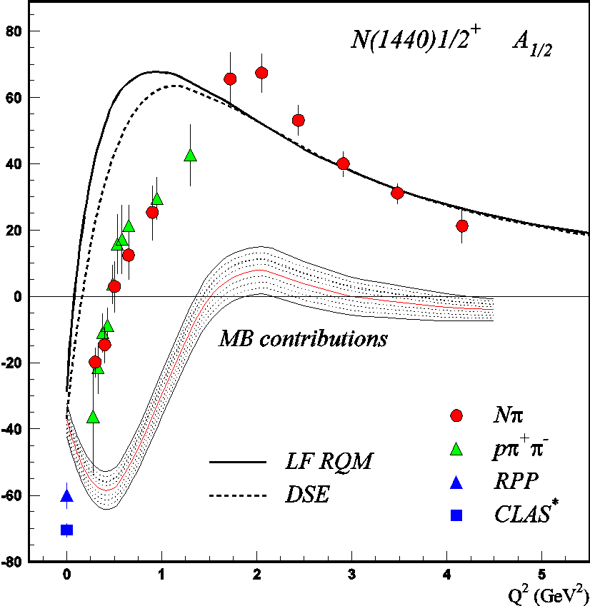
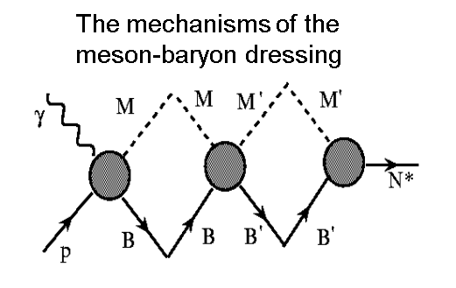
V. D. Burkert, Baryons 2016
DSE describe successfully the nucleon elastic and the transition
N→Δ(1232)3/2⁺, N→N(1535)1/2⁻ form factors with the same dressed
quark mass function (J.Segovia, et al., PRL 115, 171801 (2015)).

Slide 38
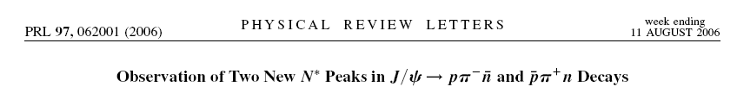
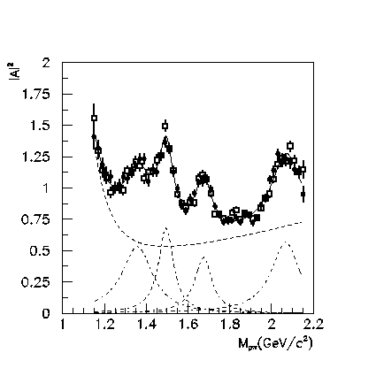
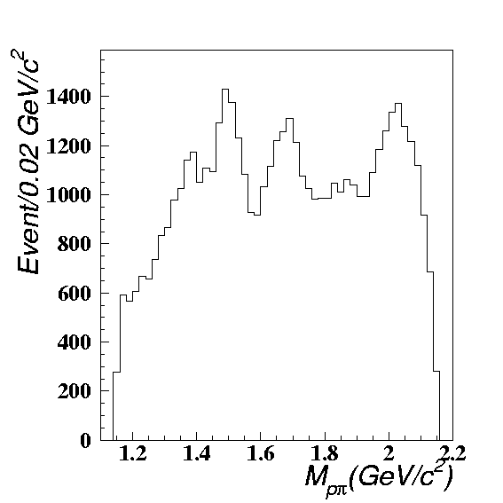
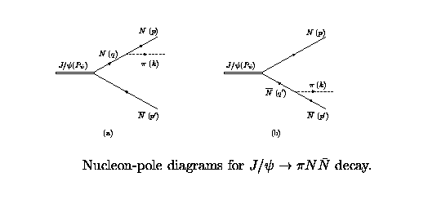
N*(1520)
N*(1535)
N*(1650)
N*(1675)
N*(1680)
Ν∗(1440)
Ν∗(2065)
N*(1440)
?
Off-shell nucleon contribution
BingSong Zou MENU 07
Notes:
39

Slide 39
Issues (2)
BES tells where to dig and CLAS has the steam shovel
BES at BEPC has collected high statistics data on J/ψ production. Its decay into baryon-antibaryon channels offers a unique and complementary way of probing nucleon resonances (N*).
CLAS at JLab has access to N* form factors at high Q², which is advantageous for the study of structure of nucleon resonances,
The low-background BES results will be able to provide guidance for the search for less-dominant excited states at JLab.
Several N* states have been seen at BES in the mass region of 2 GeV. M. Ablikim et al., (BES Collaboration), Phys. Rev. Lett. 97, 062001 (2006).
With the precision electron and photon beams afforded by JLab, not only would the existence of these new N* states be confirmed, but it would further allow for their properties to be precisely mapped out at various distances or Q².
Coordination of efforts between BES and CLAS is timely

Slide 40
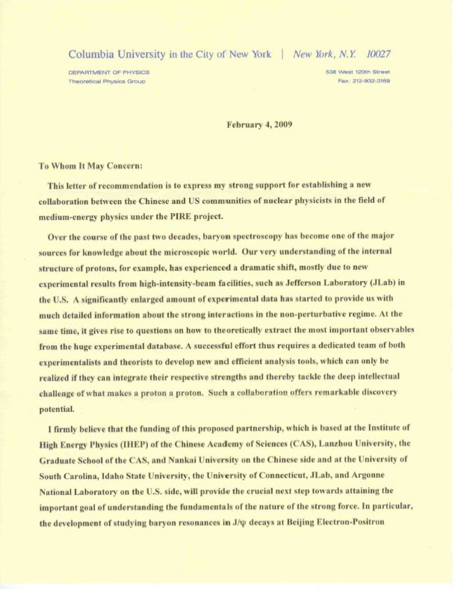
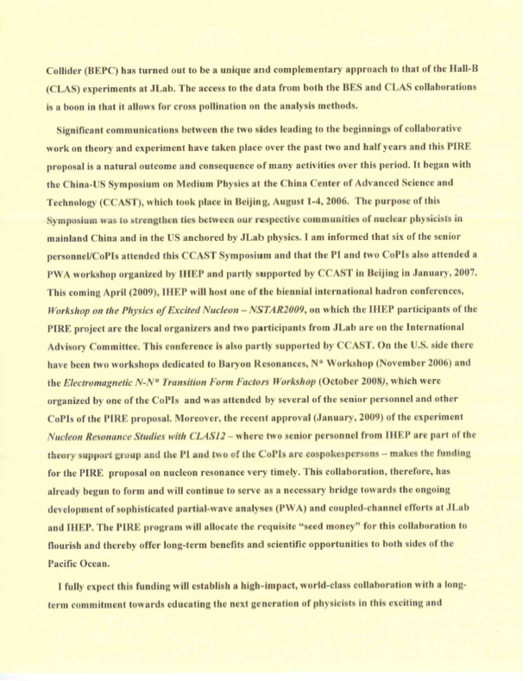
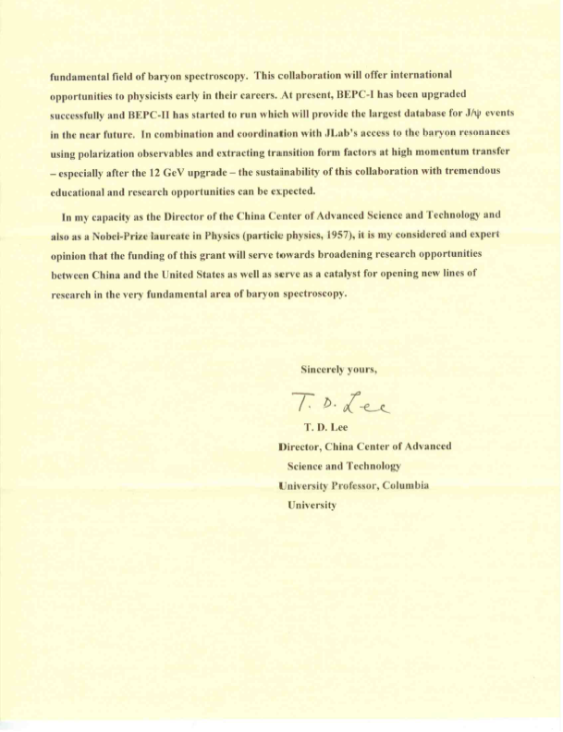
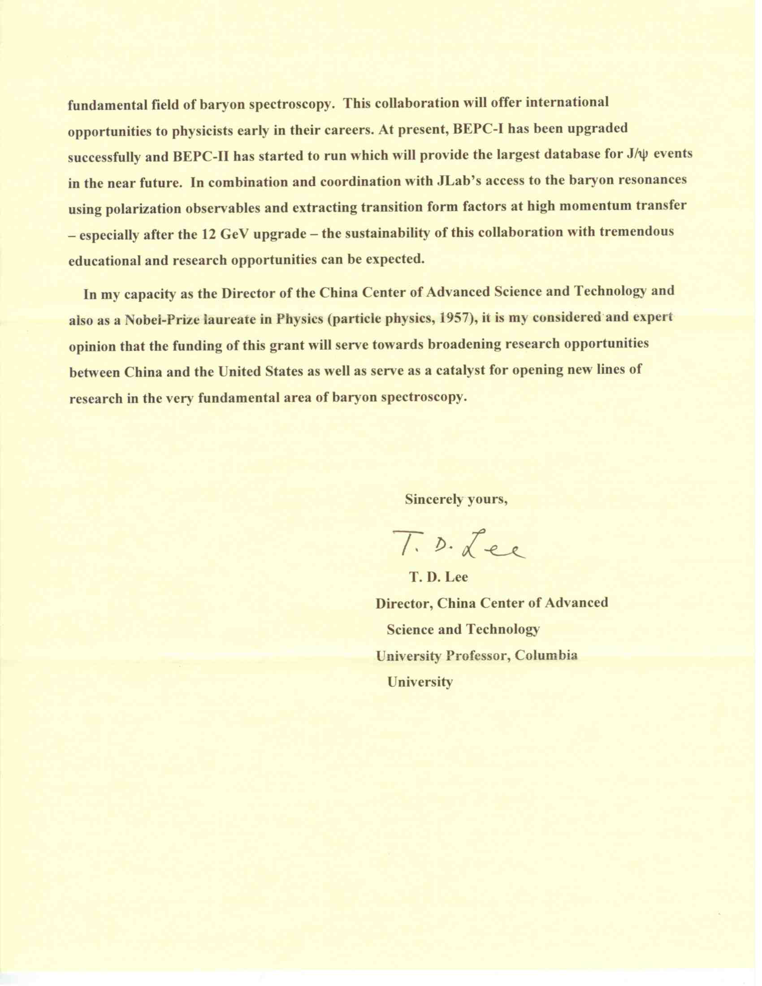
Letter of Recommendation from Prof. T.D. Lee*
* Nobel Prize in 1957, parity violation in the weak decay.

Slide 41
Some History (more recent)

Slide 42
LOI: NSF PIRE Submitted: Sept 8, 2016

Slide 44
Experimental/Theory/Phenomenology for q² < 0, q² = 0, q² > 0 (space-like/photon/time-like)

Slide 45
Experimental/Theory/Phenomenology for q² < 0, q² = 0, q² > 0 (space-like/photon/time-like)

Slide 46
Another Try…..

Slide 47
LOI “Crossing the boundaries to explore baryon resonances” was submitted Oct. 5, 2017 to the steering committee of the H2020 European Integrating Initiative in Hadron Physics.

Slide 48
Physics Opportunities with Meson Beams
William J. Briscoe (GW), Michael Döring (GW), Helmut Haberzettl (GW), D. Mark Manley (KSU), Megumi Naruki (Kyoto Univ.), Igor I. Strakovsky (GW), Eric S. Swanson (Univ. of Pittsburgh)
(Submitted on 26 Mar 2015)
Over the past two decades, meson photo- and electro-production data of unprecedented quality and quantity have been measured at electromagnetic facilities worldwide. By contrast, the meson-beam data for the same hadronic final states are mostly outdated and largely of poor quality, or even nonexistent, and thus provide inadequate input to help interpret, analyze, and exploit the full potential of the new electromagnetic data. To reap the full benefit of the high-precision electromagnetic data, new high-statistics data from measurements with meson beams, with good angle and energy coverage for a wide range of reactions, are critically needed to advance our knowledge in baryon and meson spectroscopy and other related areas of hadron physics. To address this situation, a state of-the-art meson-beam facility needs to be constructed. The present paper summarizes unresolved issues in hadron physics and outlines the vast opportunities and advances that only become possible with such a facility.
Bill Briscoe ECT* 2017

Slide 49
Bill Briscoe ECT* 2017

Slide 50
White Paper

Slide 51
Discussion Focus and Ultimate Goals
Establish the nucleon excitation spectrum and reaction models with emphasis on the high-mass region and gluonic excitations;
Measure space-like and time-like baryonic transition form factors, and thereby quantify the role of the active degrees of freedom in the nucleon excitation spectrum;
Pin down the dressed-quark mass as a function of quark momentum, which will critically deepen our understanding of mass generation dynamics and emergence of quark-gluon confinement.
Provide the analysis tools to enable comparisons of future lattice QCD simulations with experimental results.
White Paper

Slide 52
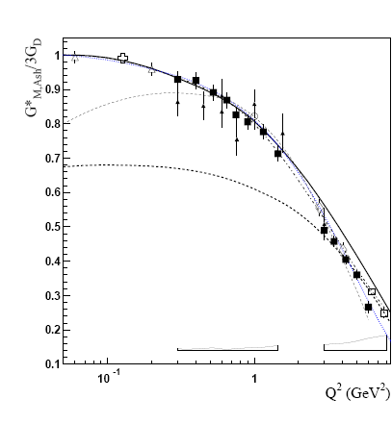

Electromagnetic structure of baryons
Dalitz decays
Δ₃₃ (J=3/2) → N (J=1/2)γ
space-like
N*→Ne+e-
e+e-→NN^{(*)}
e-N→e-N*
„pion cloud”
„quark core”
N
I. G. Aznauryan and V. D. Burkert,
Prog. Part. Nucl. Phys. 67, 1 (2012)
R→ Nγ* : em. Transition Form Factors
R (J≥3/2) : (3) G_{M} (q²), G_{E} (q²) , G_{C} (q²)
R (J=1/2) : (2) G_{M/E} (q² ), G_{C} (q² )
.. or covariant eTFF
for example for J=1/2
„QED”
M. I. Krivoruchenko, et. al
Annals Phys. 296, 299 (2002)
Piotr Salabura ECT* 2017

Slide 53
Electromagnetic baryonic transitions in time-like and space-like regions: towards a global picture?
Time-Like electromagnetic form factors
Space-Like electromagnetic form factors
preliminary studies with HADES/GSI
Precise data from JLab/CLAS up to -q²=4 GeV²
F(q²)
n
Inverse pion electroproduction
e⁺
q² <0 fixed
π ⁻
R
γ*
p
γ*
R
e⁻
p
e⁻⁻
e⁻
F(q²)
π⁻
q² =(M _{ee} )²> 0
variable
p
e⁻⁻
Theoretical tools: Dispersion Relations, Dyson-Schwinger, Vector Dominance, Constituent Quarks ?
Béatrice Ramstein ECT* 2017

Slide 54
Message to take home.
Why N*s are important. (quoted from Nathan Isgur^{1,2})
  The first is that nucleons are the stuff of which our world is made.
  My second reason is that they are the simplest system in which the quintessentially nonabelian character of QCD is manifest.
  The third reason is that history has taught us that, while relatively simple, baryons are sufficiently complex to reveal physics hidden from us in the mesons”
¹Workshop on Excited Nucleons and Hadronic Structure (2000).
²Baryon Spectroscopy, E. Klempt and J.-M. Richard, arXiv:0901.2055v1[hep-ph]1 4 Jan 2009
We need to spread the word to lay and expert audiences alike that
excited baryon research is indeed exciting and crucial to science.

Slide 55
Some Questions to Ponder
How to compare Helicity Amplitudes between SL and TL?
Can the data in the SL region afford constraints for those in the TL regime? (e.g. Covariant Spectator Theory, Teresa Peña).
What is the relationship between the density matrix elements for SL → TL? Again do they offer any constraints on the Helicity Amplitudes between the SL and TL regimes?
Will there be scaling in q² > 0 and q² < 0 (i.e. Q² > 0)?
Can we find a consistent ab initio approach for the QCD d.o.f. in determining the SL and TL transition FFs?
What role does the MB Cloud play? (again for SL and TL)? And how to separate? [Through comparing to other models?]
What are the relevant d.o.f. as a function of q² for the SL and TL regimes?

Slide 56
What have we been doing for the past several years?
  Progress is slow.
  What do we need to do? Would do you think?
  How do we ramp up progress?
  Need TL and SL
    BESIII, Hades, Panda, J-PARC
    CLAS, ELSA, MAMI, Spring-8

Slide 57


Slide 58
Additional Slides

