Slide 1
Panel Questions
What can we (still) learn from measuring collinear structure functions (polarized and unpolarized) of hadrons at JLab with 12 GeV and at the EIC, and how can we maximize the information we can extract from such measurements?
The inclusive (and SIDIS) kinematic coverage can be extended towards large x_{B} in the resonance region by employing the γ_{v}pN* electrocoupling data. How can we use these results in the exploration of the parton distributions with a traceable connection to QCD?
Sebastian Kuhn
Old Dominion University
Strong QCD from Hadron Structure Experiments2019

Slide 2
Overview
What can we learn from collinear Structure Functions?
  Helicity-dependent Parton Distribution Functions (including Gluons)
    Fundamental objects – Standard Model
    Limiting distributions for GPDs and TMDs – required as benchmark and “sanity check”
    Becoming amenable to LQCD calculations (pseudo/quasi-PDFs)
    Requires proper accounting for non-perturbative effects (Higher Twist) -> Need wide kinematic coverage at modest Q²!
  Valence Quarks (u, d), gluons and sea at moderate-high x
    Direct predictions for valence quarks by pQCD, CFTh/AdS₅, DSE
    Required for high-precision data from LHC etc. (high-x, low Q² -> lower x, high Q²)
  Sum Rules, tests of χPT
What can we learn from photocouplings for N* excitations?
  Test and understand duality – can we use it to “go higher in x”?
  Ultimate goal: Understand “Final State Interactions” in QCD
  Needed for parametrizations of structure functions ->
  radiative corrections
Practical Application: Hyperfine Structure of (muonic) Hydrogen

Slide 3
Example:
Valence QUarks
e.g., BONuS
A_{1p}
A_{1n}

Slide 4
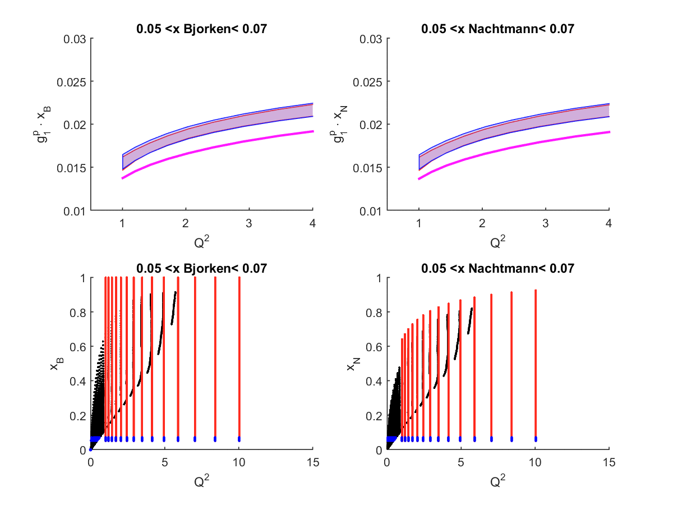
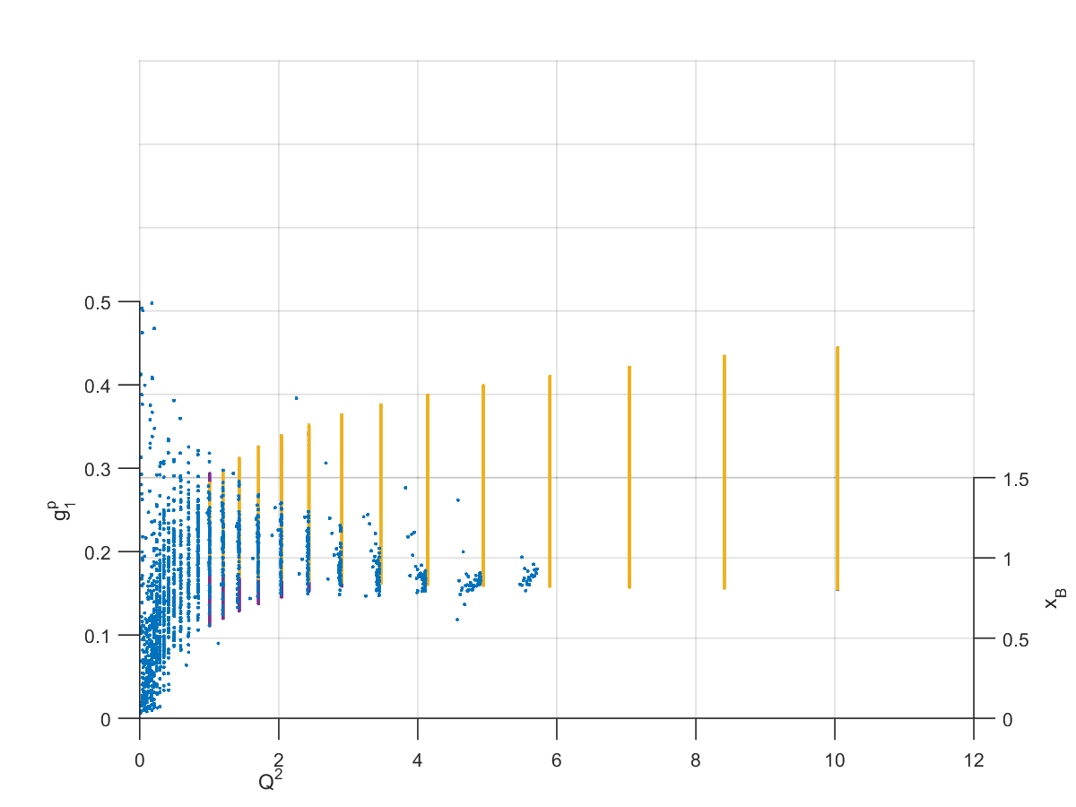
Example: Duality
PHYSICAL REVIEW C 100, 035201 (2019)
F2n
g1p

Slide 5
Energy levels in a Hydrogen-like Atom
Putting it all together – example HFS (courtesy K. Griffioen, W&M):
+…
(21 cm)
Recoil
Measurements of form factors, (generalized) polarizabilities and (spin) structure functions at small Q² are crucial.
Notes:
F2 = Pauli form factor. Point out that these are just moments, but for a more sophisticated model we should directly use the SFs and FFs as input. The +… refers to vacuum polarization effects, weak interaction etc.

Slide 6

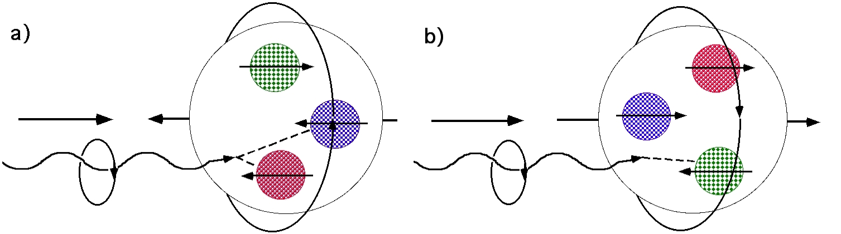
Topics to Explore
A₁(x->1)
p
H
ΔΣ
Duality
Δq, Δq
ΔG
pQCD
OPE, twist >2
GDH,
ChPT
PDFs
LQCD
Resonance
Structure
Orbital Angular Momentum
CFT/AdS₅
Sum
Rules
TMD
Constituent Quark Model
(SU(6))
DVCS
Notes:
Spin structure functions are the most complicated objects that can be calculated rigorously within QCD, at least within an expansion like lattice spacing (LQCD -> moments, pseudo/quasi-PDFs), OPE/twist (1/Q2), ChPT (Q2), pQCD (evalution and HIGH X), or conformal/AdS correspondence. Of particular interest: Connection between Q^2->0 (hadronic dof) and Q^2->∞ (pQCD) => explain valence properties of the nucleon and its excitations through QCD. (Of course, also models like CQM, …) Spin is a more challenging testing ground for any theory!

Slide 7
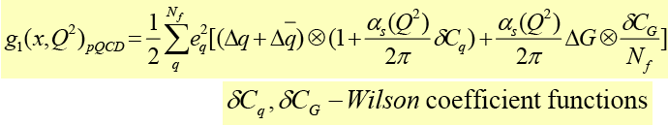
Inclusive lepton scattering
Parton model: DIS can access
g₂^{WW}
At finite Q²: pQCD evolution (q(x,Q²), Δq(x,Q²)
⇒ DGLAP equations) and gluon radiation
⇒ access to gluons.
p
SIDIS: Tag the flavor of the struck quark with the leading FS hadron ⇒ separate q_{i}(x,Q²), Δq_{i}(x,Q²)
H
Jefferson Lab kinematics: ⇒ target mass effects,
higher twist contributions and resonance excitations
Non-zero
Further Q²-dependence (power series in )
Traditional “1-D” Parton Distributions (PDFs)
(integrated over many variables)

Slide 8
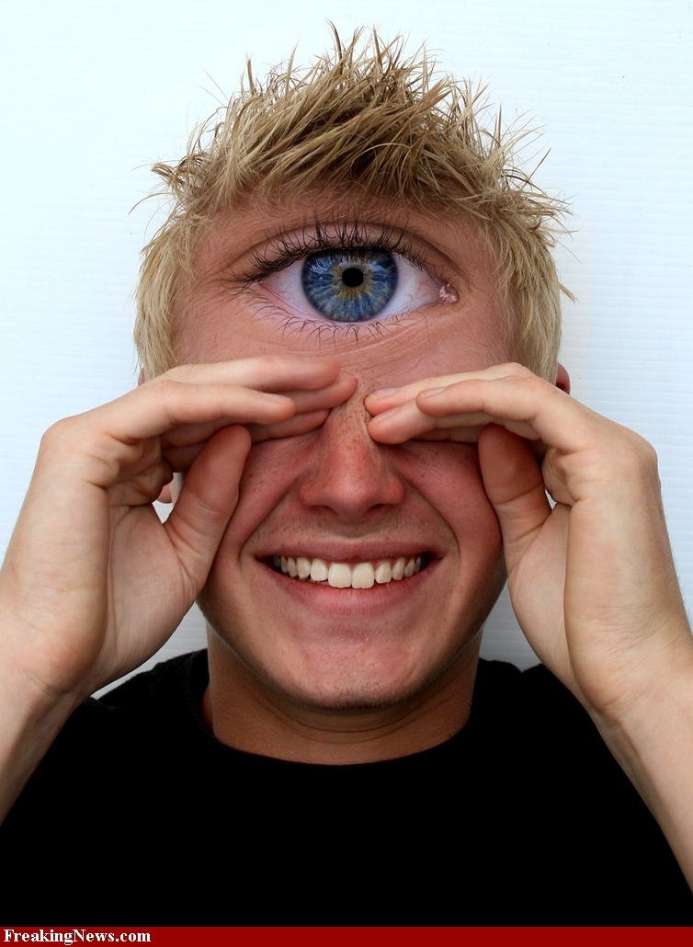
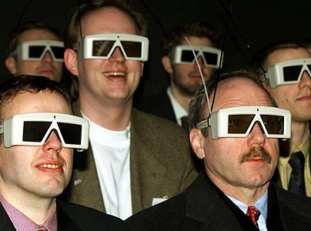
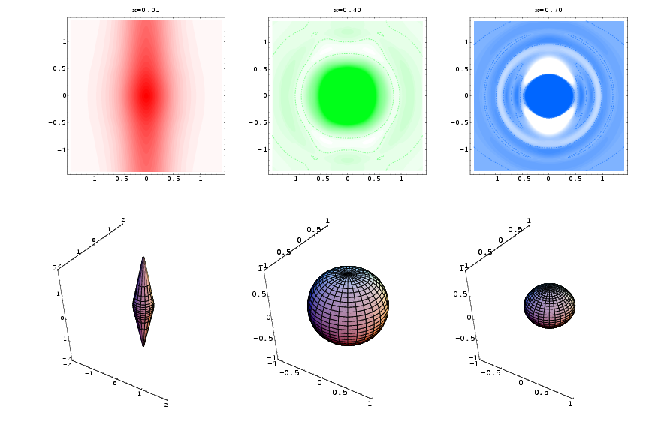
3D Partonic Structure
3-D Picture of parton flavor, spin and momentum (TMDs)
From 1-D to 3-D:
p
S
p
H
Traditional “1-D” Parton Distributions (PDFs) (inclusive, integrated over many variables)
p
3-D parton orbits (GPDs)

Slide 9
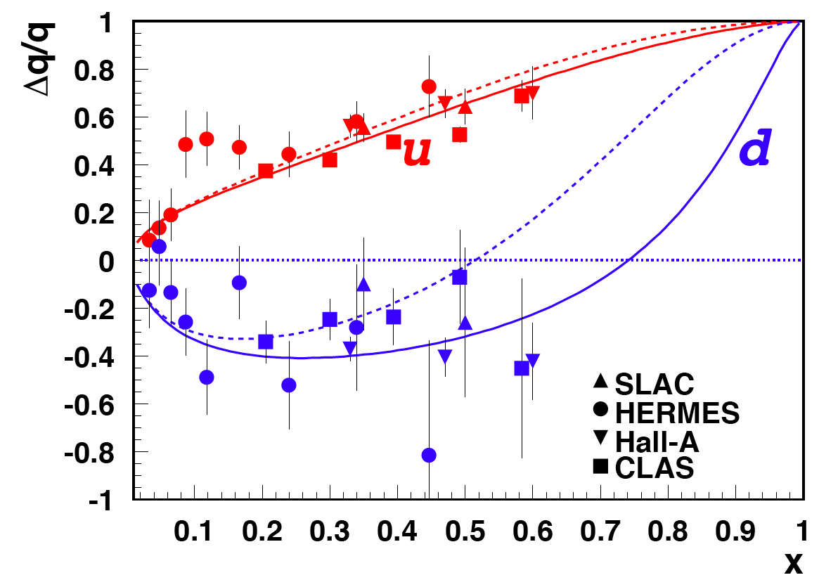
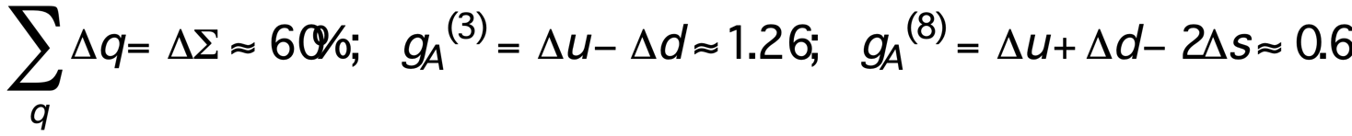
Valence Region and moderate Q²: SFs for x→1
1
Valence quark polarization
-1
SU(6)-symmetric proton wave function in the “naïve” quark model:
In this model: d/u = 1/2, Δu/u = 2/3, Δd/d = -1/3 for all x ⇒
Relativistic Correction: lower component reduces axial charge, adds to orbital angular momentum (p-wave) ⇒
Hyperfine structure effect in QM: S=1 suppressed => d/u = 0, Δu/u = 1, Δd/d = -1/3
for x → 1 => A_{1p} = 1, A_{1n} = 1, A_{1D} = 1
pQCD: helicity conservation (q↑↑p) => d/u -> 2/(9+1) = 1/5, Δu/u -> 1, Δd/d -> 1 for x → 1
Modification due to orbital angular momentum

Slide 10
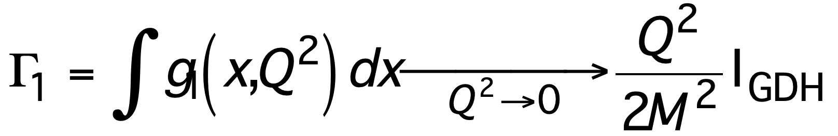
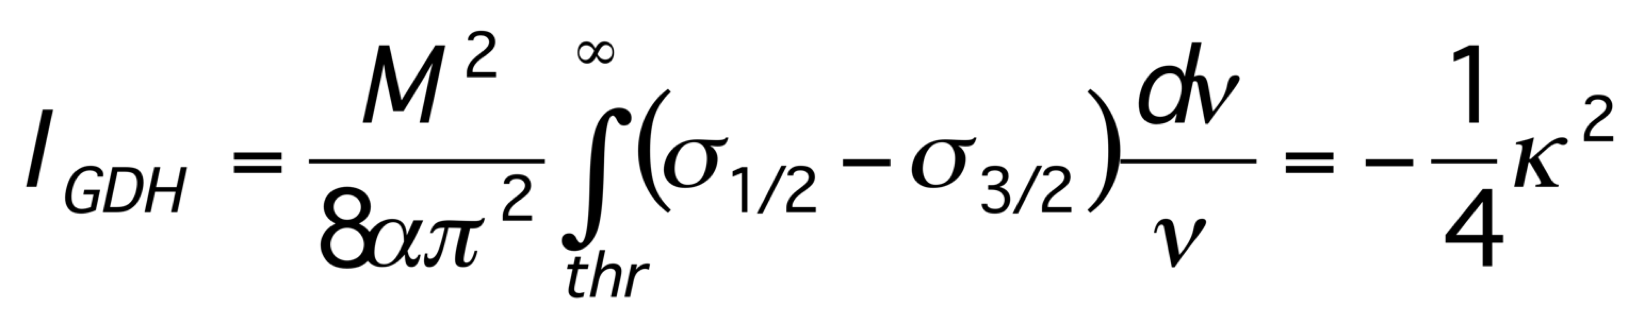
The Limit Q² → 0:
GDH Sum Rule
I_{GDH}
relates the difference of the photo-absorption cross section for helicity 1/2 and 3/2 to the nucleon magnetic moment, i.e. a connection between dynamic and static properties
based on very general principles, as gauge invariance, dispersion relation, low energy theorem
at finite Q² can be related to
the integral of the spin structure
function g₁
strong variation of nucleon spin
properties as a function of Q²
Q²-dependence described by Chiral
Perturbation Theory (χPT) at low Q²
DIS
pQCD
Γ₁
operator product expansion
quark models
Lattice QCD?
ChPT
1
Q² (GeV²)
GDH sum rule
Notes:
Need to add Gamma1

Slide 11
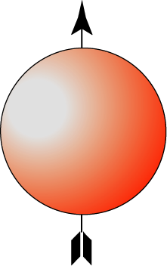
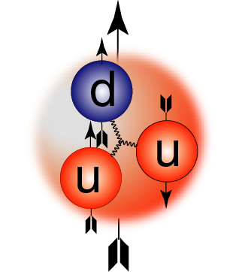
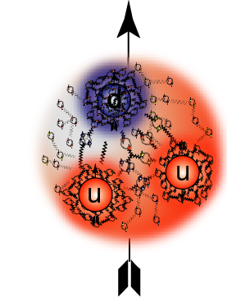
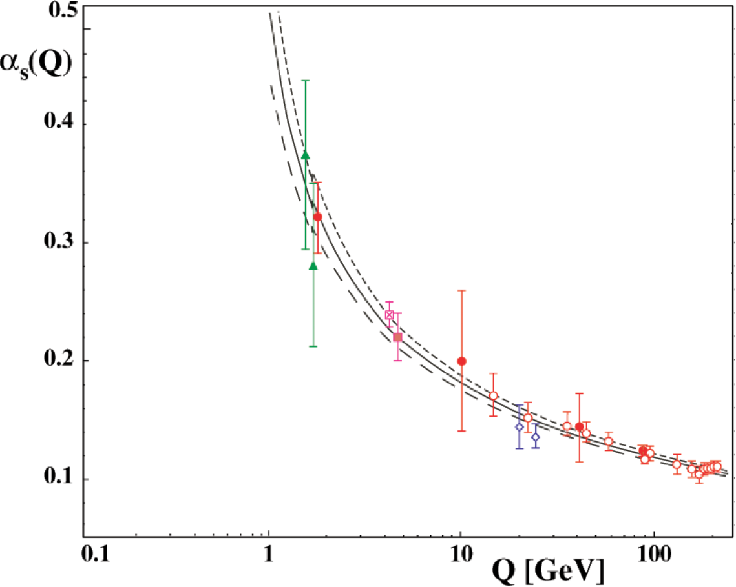
Duality
α_{S}(Q)
Long Distance Physics: hadronic observables
Asymptotically Free
Quarks: regime of pQCD

Slide 12
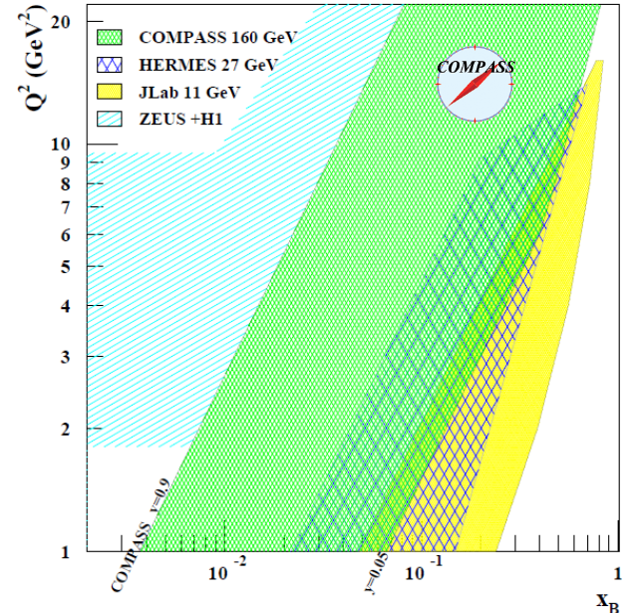
Q²
EIC
Outlook: Completing the Picture
RHIC
JLab
Δu/u and Δd/d at high x ?
Nuclear effects on nucleon structure
Understanding the sea – Δs, u - d, Δu - Δd?
Orbital angular momentum? -> GPDs in 3D
Axial and Tensor charges of the nucleon
Full mapping of all TMD PDFs
in the valence and sea region
Gluon helicity distribution at large x and a small x? What is the integral ΔG?
Test of universality
Test of prediction that time-odd TMDs (e.g., Sivers asymmetry) change sign in Drell-Yan processes
What happens at really small x << 0.01?
x
JLab @ 12 GeV
EIC
JLab, FNAL, RHIC, COMPASS
COMPASS, JLab
EIC
EIC
EIC
JLab + COMPASS (NLO), RHIC, COMPASS SIDIS
RHIC
RHIC, COMPASS, FNAL
RHIC, COMPASS, FNAL, FAIR, JPARC
vs. JLab
EIC

Slide 13
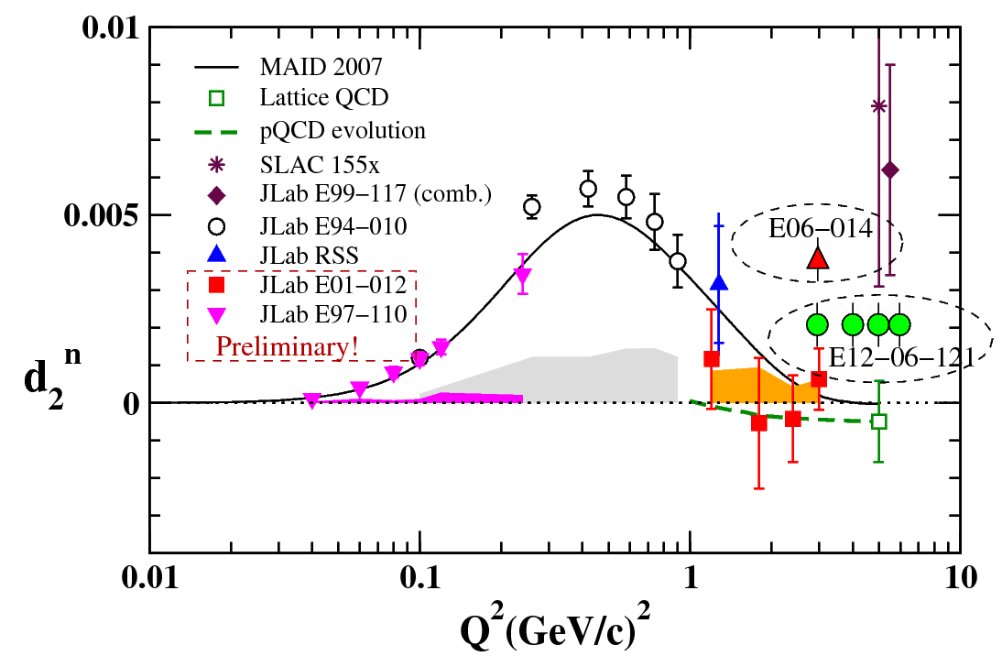
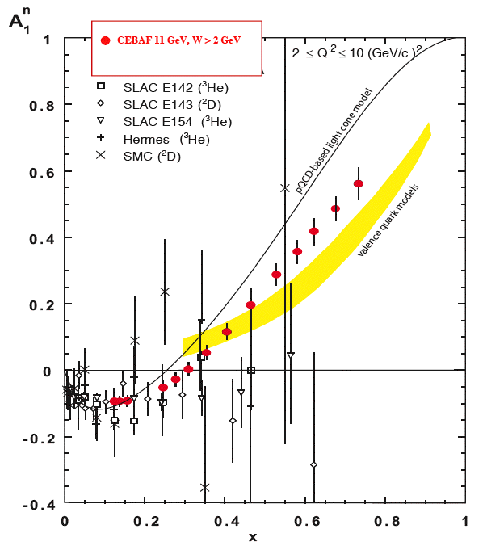
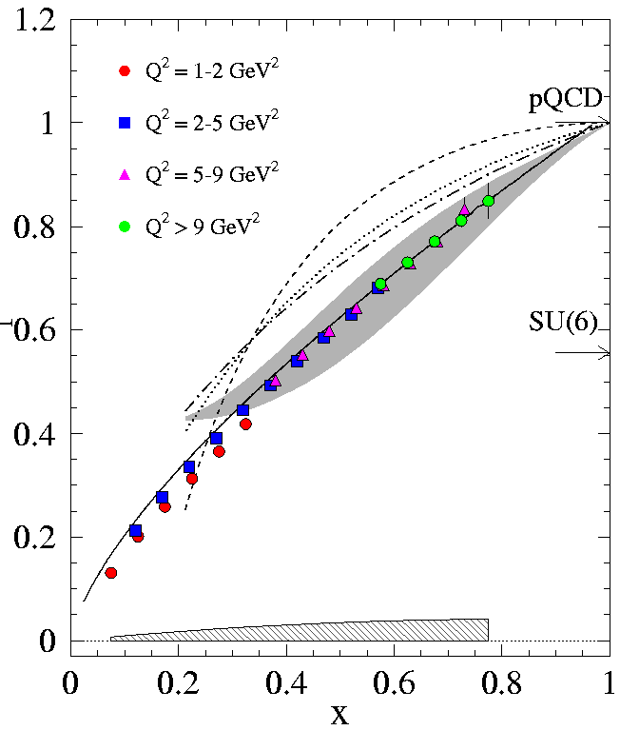
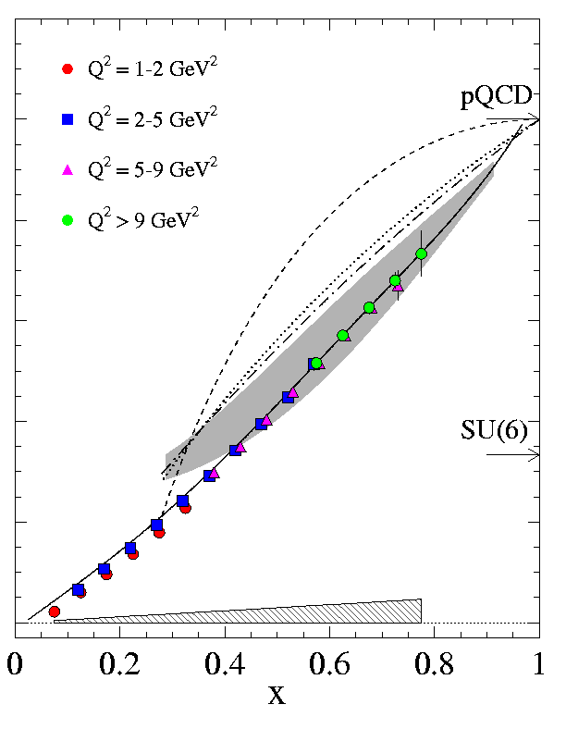
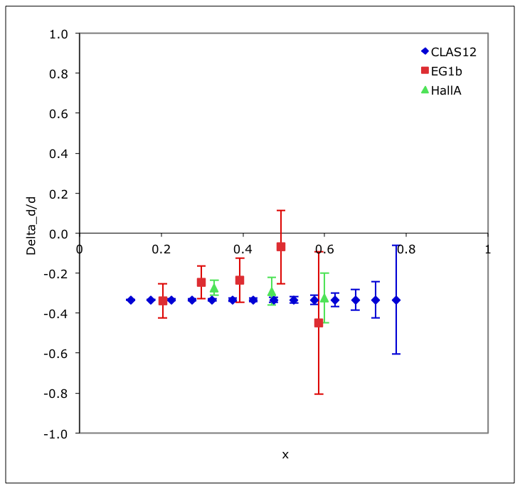
The Future
High precision inclusive SSFs on p, d, n in the region
x > 0.05
³He
Proton
Deuteron

