Slide 1




Summary and Outlook (Experiment)
V.I. Mokeev, Jefferson Lab
*

Slide 2
Outcome of the Experiments with Electromagnetic Probes (Highlights)
Completion of the light (S=C=B=0) meson and baryon spectrum exploration
from exclusive photo-, electro-, and hadro-production data finalizing the
search for ``missing” resonances, new hybrid and multi-quark states.
Considerable extension of the information on the 1D-structure of the ground
state mesons and nucleons in terms of different meson form factors, nucleon
elastic form factors, and PDFs getting insight to the process-independent
QCD running coupling.
A unique information on many facets of strong QCD in generation of the
excited states of nucleon with different structural features from the results
on transition γ_{v}pN* electrocouplings.
Insight into the 3D-structure of the ground nucleons from semi-inclusive-DIS,
DVCS , and DVMP data within the GPD and TMD concepts.
Opportunity to map-out the energy-momentum tensor of the ground nucleons
in terms of mass, angular momentum, and force (pressure) distributions
determinedfrom the DVCS and DVMP data.

Slide 3
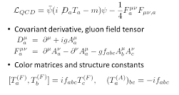
Insight into the Strong QCD from the Synergy between Experiment, Phenomenology, and Theory
Experiment
Theory
Observables from the
Experiments with the
EM Probes:
Differential cross sections
Beam asymmetry
Target asymmetries
Recoil asymmetries
Combinations of 2-fold
and 3-fold asymmetries
QCD Lagrangian:
Strong QCD
underlying
the hadron
generation
α_{s} ~ 1
Phenomenology:
Amplitude analyses
Reaction models
Lattice QCD
Continuum QCD
Light front quark models
AdS/CFT approaches
Quark-Soliton models
Hypercentral quark model
Covariant quark models
……………………………..
Elastic/Transition form factors
PDFs, PDA,TMD-functions
Compton form factors
Projection of GPD to observables

Slide 4
The Workshop Objectives and Highlights
Major objective: Forge the synergistic efforts between experimentalists,
phenomenologists, and theorists in order to gain insight into strong QCD
dynamics underlying the hadron generation from the data of the experiments
with EM probes on the spectra and structure of the ground and excited hadrons.
Status and prospects for the experimental studies
V.D. Burkert, Exploring Strong QCD in the JLab Experiments of the 12 GeV era
Theoretical interpretation
J. Qiu, New Horizons for Strong QCD Theory in the 12 GeV era at Jlab
C.D. Roberts, Relating Experimental Studies of Hadron Structure to Strong QCD Within
the Unified Continuum QCD Framework
Extending the nucleon structure studies in 3D
M. Vandergaedhen, Ground and Excited Nucleon Structure in 3D
Towards understanding of the atomic nuclear structure from QCD
J.P. Draayer, Paving the way to Understand Nuclear Structure from Strong QCD
Preparing to the new era of experiments with the USA EIC
R.G. Milner, Studying QCD with the Electron-Ion Collider

Slide 5
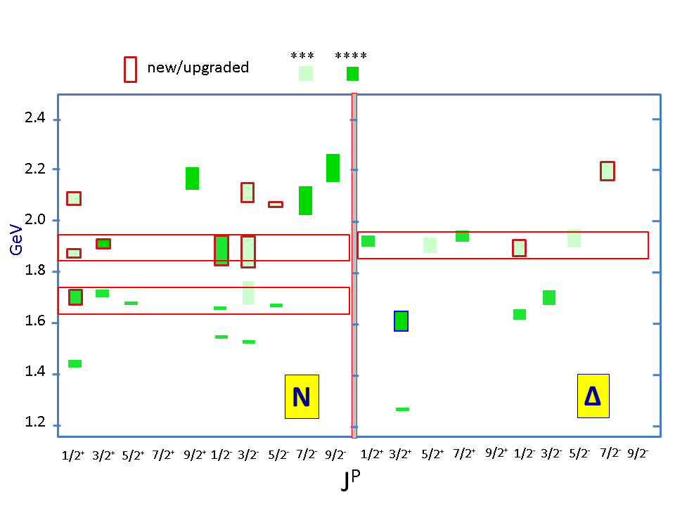
Advances in Exploration of the N*-Spectrum
Several new nucleon resonances (``missing” states) have been discovered
with the decisive impact of the CLAS open strangeness photoproduction
data. A.V. Anisovich et al.,Phys. Lett. B782, 662(2018),
V.D. Burkert, Few Body Syst. 59, 57 (2018).
V.D. Burkert
Nucleon resonances listed in Particle Data Group (PDG) tables
N*/Δ* Spectrum 2019
State N(mass)J^{P} | PDG pre 2016 | PDG 2018*
N(1710)1/2⁺ | *** | ****
N(1880)1/2⁺ |  | ***
N(1895)1/2⁻ |  | ****
N(1900)3/2⁺ | ** | ****
N(1875)3/2⁻ |  | ***
N(2100)1/2⁺ | * | ***
N(2120)3/2⁻ |  | ***
N(2000)5/2⁺ | * | **
N(2060)5/2⁻ |  | ***
Δ(1600)3/2⁺ | *** | ****
Δ(1900)1/2⁻ | ** | ***
Δ(2200)7/2⁻ | * | ***
[70,2+] supermultiplet gets populated.
Confirmation of the essential role of the SU(6) spin-flavor approximate symmetry in the generation of the N* spectrum
Where are the other N* expected from SU(6) spin-flavor symmetry?

Slide 6
A. Thiel

Slide 7
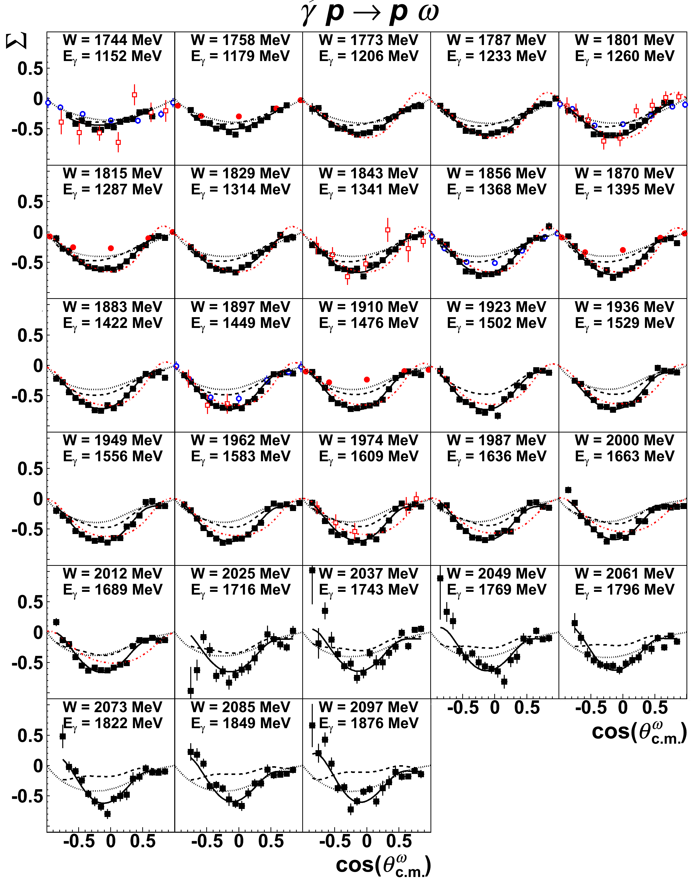
Latest ω photoproduction results
CLAS P. Collins et al., PLB 773, 112 (2017)
- 547 data points distributed over 28 W bins
○ GRAAL (2006)
● GRAAL (2015)
❐ CB-ELSA/TAPS (2015)
E. Pasyuk
BnGa fit with (black solid line) and without (black dashed line) incorporating these new data
Close to threshold the process is dominated by 3/2⁺ and 5/2⁺ partial waves associated with N(1720)3/2⁺ and N(1680)5/2⁺
Implementation of new results from the
less explored exclusive photoproduction
channels into the global multichannel
analyses facilitate further search for new
baryon states shedding light on driving
Symmetry for the N* spectrum
courtesy of B.G. Ritchie, ASU
Notes:
The omega has a relatively large cross section, so we wound up with some very nice data there, too.
The two sets of GRAAL data disagreed with each other, and our data suggest the earlier measurements are likely correct, while we agree within uncertainties with the CB-ELSA/TAPS data.
Again, we’ve vastly increased W coverage with this new CLAS data.

Slide 8
T. Horn
Constraints from the data on pion BS amplitudes are of particular importance in order to shed light on hadron mass generation
C. Aguilar et al., Eur. Phys. J. A55,190 (2019)

Slide 9
C.Andres

Slide 10
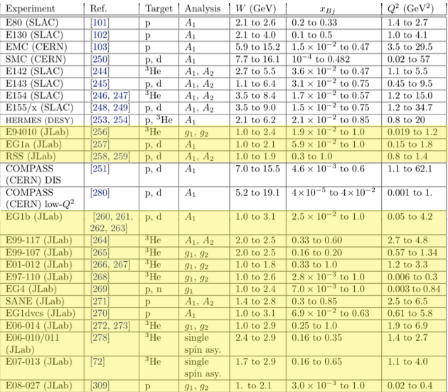
Spin Structure Functions in the last 40 years
S. Kuhn
Nobuo Sato, W. Melnitchouk, S. E. Kuhn, J. J. Ethier, and A. Accardi:”Iterative Monte Carlo analysis of spin-dependent parton distributions”, Phys. Rev. D 93, 074005 (5 April 2016).
A. Deur, Y. Prok, V. Burkert, D. Crabb, F.-X. Girod, K. A. Griffioen, N. Guler, S. E. Kuhn, and N. Kvaltine: “High precision determination of the Q² evolution of the Bjorken sum”, Phys. Rev. C 90, 012009 (July 2014).
Notes:
Change – just show A1p and A1d results (incl eg1dvcs), 3He and JAM fits

Slide 12
A. Radyushkin

Slide 13
A. Hiller Blin
Opportunity for the extraction of parton distributions accounting for the
resonant contributions computed from the experimental results on γ_{v}pN*
electrocouplings

Slide 14
Parton Distributions in the Ground Nucleon from SIDIS
M. Radici

Slide 15
Synergy between Experiments with Electron and Hadron Beams

Slide 16
Ground Nucleon 3D-image in the Momentum Space
M. Radici

Slide 17
Ground States are Easy. Equally, Ground States are Insufficient
C.D. Roberts
Results on N* structure and those for ground state nucleons & mesons cannot be divorced.
To validate any explanation, one must expose & study the properties of all systems that can be produced by the theory & insist that the approach provide a truly unifying explanation
True for meson & baryon & hybrid & exotic sectors.
Any claim to understand QCD must explain all these things simultaneously, e.g.
  How is emergent mass expressed in different bound-states?
  Are any differences readily understood?
  Are correlations an essential feature of all n ≥ 3 valence-parton systems?
A focus on ground-states alone is like
throwing out the baby and keeping the bathwater

Slide 18
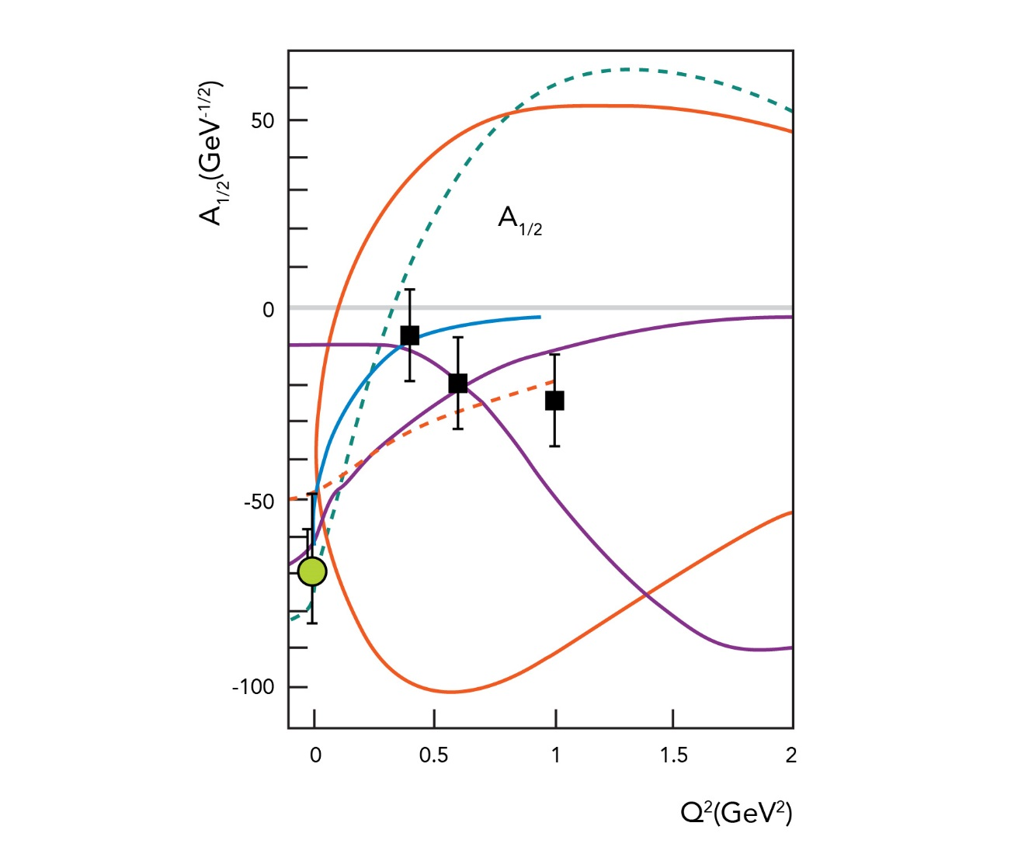
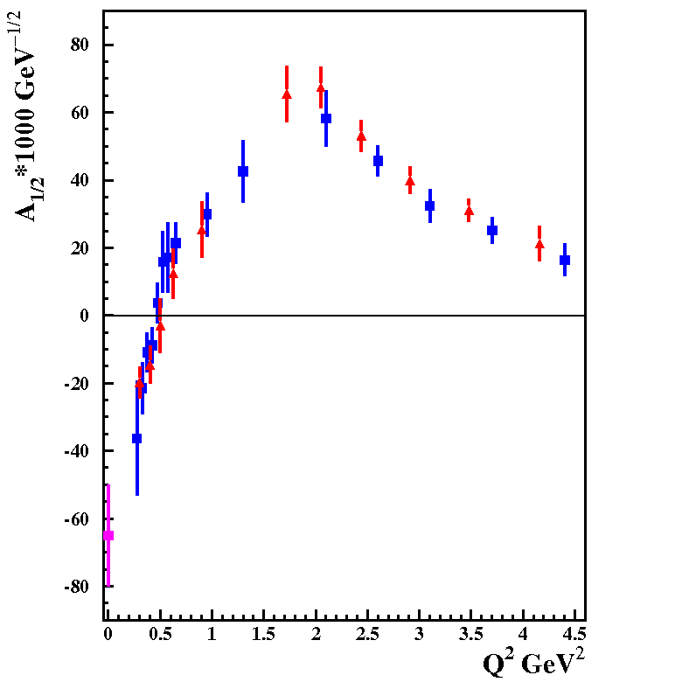
Roper Resonance in 2002 & 2019
R.W. Gothe
2002
2019
Nπ
π⁺π⁻p
Baryons 2002
Strong QCD Workshop 2019

Slide 19
Summary of Results on γ_{v}pN* Electrocouplings from CLAS
Exclusive meson electroproduction channels | Excited proton states | Q²-ranges for extracted γ_{v}pN* electrocouplings, GeV²
π⁰p, π⁺n | Δ(1232)3/2⁺ N(1440)1/2⁺,N(1520)3/2⁻, N(1535)1/2⁻ | 0.16-6.0 0.30-4.16
π⁺n | N(1675)5/2⁻, N(1680)5/2⁺ N(1710)1/2⁺ | 1.6-4.5
ηp | N(1535)1/2⁻ | 0.2-2.9
π⁺π⁻p | N(1440)1/2⁺, N(1520)3/2⁻ Δ(1620)1/2⁻, N(1650)1/2⁻, N(1680)5/2⁺, Δ(1700)3/2⁻, N(1720)3/2⁺, N’(1720)3/2⁺ | 0.25-1.50 0.5-1.5
The website with numerical results and references:
https://userweb.jlab.org/~mokeev/resonance_electrocouplings/

Slide 20
M.Vanderhaeghen

Slide 21
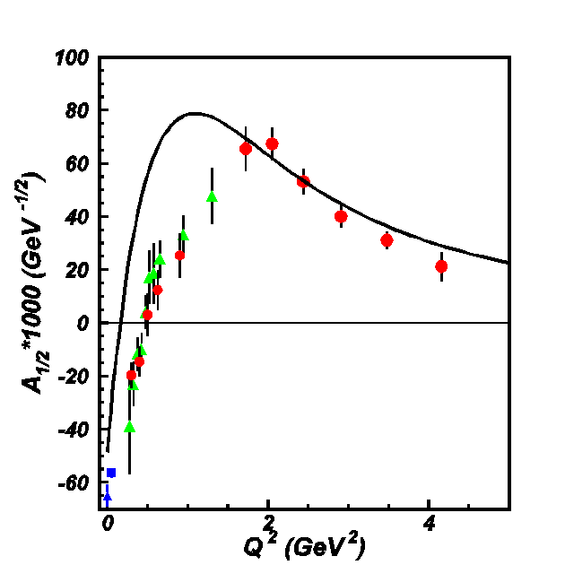


From Resonance Electrocouplings to Hadron Mass Generation
N→Δ(1232)3/2⁺ magnetic from factor
Jones-Scadron convention
J. Segovia,
R.W Gothe
Substantial
contributions
from meson-
baryon cloud
Quark core
dominance
Substantial
contributions
from meson-
baryon cloud
Dyson-Schwinger Equations
(DSE):
J. Segovia et al.,
Phys. Rev. Lett. 115,
171801 (2015).
J. Segovia et al.,
Few Body Syst. 55,
1185 (2014).
quark mass:
frozen
running
Good data description at Q²>2.0 GeV² with the same dressed quark mass function for the ground and different excited nucleon states validate the DSE results on generation of dressed quarks as the relevant degree of freedom in the structure of the ground and excited nucleons.
γ_{v}pN* electrocoupling data offer access to the strong QCD dynamics underlying the hadron mass generation.
Faddeev amplitude of the ground nucleon can be evaluated with the dressed quark mass function and di-quark correlations checked against the data on gvpN* electrocouplings
Notes:
Полученные в экспериментах на детекторе CLAS результаты по амплитудам электровозбуждения низколежаших нуклонных резонансов оказали значительное влияние на развитие теории структуры адронов и впервые обсепечили проверку теоретического описания динамики сильных взаимодействий в непертурбативной области. Впервые дoстигнуто хорошее описание амплитуд электровозбуждения Δ(1232)3/2+ и N(1440)1/2+резонансов при Q²>2.0 GeV² на основе фундаментального лагранжиана КХД в рамках метода уравнений Дайсона-Швингера развитого теоретической группой. Argonne National Lab (ANL). На слайде приведено сравнение данных. CLAS по магнитному переходному форм фактору N→Δ(1232)3/2+ с результатми его описания в рамках DSE подхода. Результаты получены для: а) упрощенной параметеризации qq-взаимодеиствия как контактоного взаимодействия и б) реалистического qq-взаимодеиствия совпадаюшего с результатами полученными из решений уравнений Дайсона-Швингера для глюоннных пропагаторов и одетых кврак-глюонных вершин используя лагранжиан КХД. Контактное взаимодействие, несмотря на модельные упрощения, воспроизводит динамическую генерацию масс легких одетых кварков ~300 МэВ, но при этом масса одетого кварка не зависит от импульса переносимого кварком. В случае реалистичекого qq-взаимодействия, масса одетого кварка зависит от импульса (правый рис слайда). Расчитанные в рамках DSE Q²-эволюция магнитного форм фактора показана на левом рис слайда для двух вариантов qq-взаимодеиствия. Наблюдается значительное и возрастающее с Q² расхождение между результатами эксперимента и DSE для не зависящей от переносимого импульса массы одетого кварка (красная пунктирная линия). В тоже вермя, результаты хорошо описивают данные при Q² > 1.8 GeV² в случае реалистического qq-взаимодеиствия с массой одетого кварка зависящей от импульса. Таким образом, экспериментальные результаты детектора. CLAS по N→Δ магнитному форм фактору впервые подтвердили фундаментальные ожидания теории сильных взаимодеиствий в непертурбативной области о зависимости массы одетого кварка от импульса.

Slide 22
Synergy in the Studies of the Ground and Excited Nucleon Structure
Faddeev amplitude encoded a full information on the ground nucleon structure
GPDs/TMDs can be evaluated from Faddeev amplitudes, plugged into the reaction
models for evaluation of the DVCS,DVMP/SIDIS observables and confronted with
the data
Successful description of the DVCS,DVMP/SIDIS observables with the dressed quark
mass function and di-quark correlation amplitudes checked against the data on γ_{v}pN*
electrocouplings will confirm credible insight into the strong QCD dynamics underlying
the ground nucleon generation. will shed light on emergence of hadron mass and quark-
gluon confinement from QCD.

Slide 23
3D Ground Nucleon Image From GPD
Talks by: L. Elouadrhiri, S. Liuti, M. Vanderhaeghen, A.Kim, M. Ben Ali, C. Mezrag, Z-E. Mezziani (experiment/phenomenology advances)
Studies of unpolarized DVCS/DVMP cross sections and beam, beam-target asymmetries for different orientations of the target-proton spin are needed
Offer access to the GPDs at x=ξ or to the integrals from GPDs
The models are needed in order to gain insight into the GPDs in an entire range of x, ξ, t

Slide 24

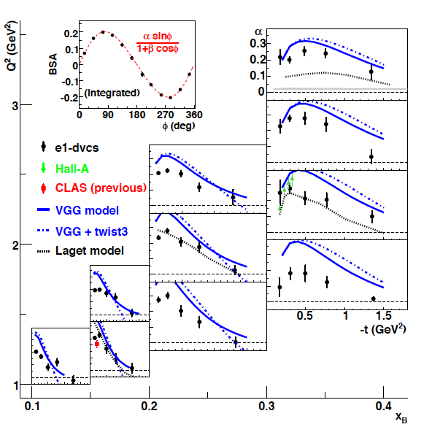

DVCS Beam Spin Asymmetry
F.X. Girod et al. Phys.Rev.Lett. 100 162002 (2008)
Measurements in a large phase space Q², x_{B}, t
small & suppressed
Notes:
Some of the DVCS data taken with CLAS on beam-spin asymmetries in deeply virtual photon production are shown in this graph. They cover a large range in kinematics in Q2, xB (or xi), and momentum transfer t to the proton. The data have high statistical precision as shown in this azimuthal angle dependence, and are fitted with the parameterization to extract the amplitude alpha, which becomes a single marker in one of these kinematical points here.

Slide 25
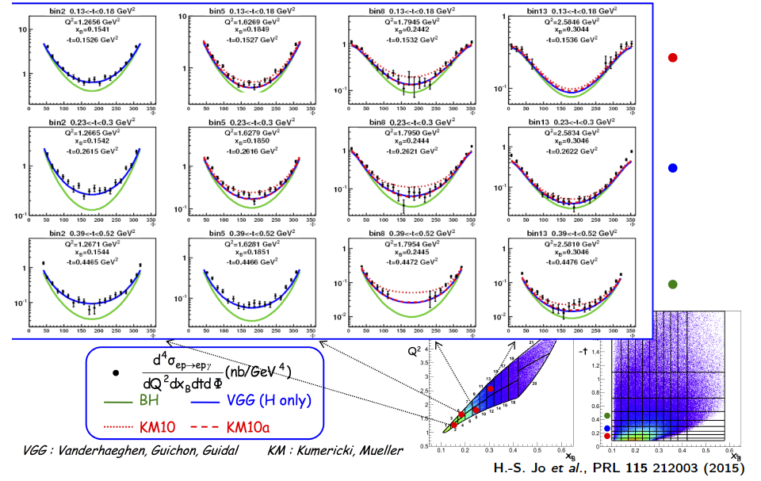
DVCS Unpolarized Cross-Sections

Slide 26
M.Vanderhaeghen
Can the image be computed under connection to
QCD? See the talks by J.Qiu

Slide 30
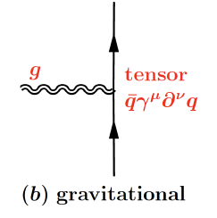
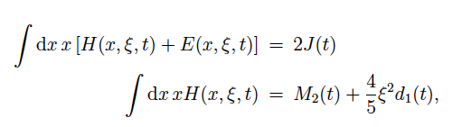
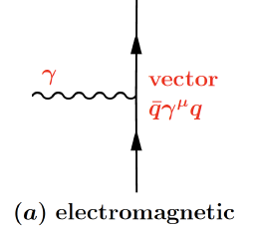
The GPDs and Gravitational Form factors
Nucleon matrix element of the Energy-Momentum Tensor contains three scalar form factors (R. Pagels, 1966) and can be written as (X. Ji, 1997):
M₂(t) : Mass distribution inside the nucleon
J (t) : Angular momentum distribution
d₁(t) : Forces and pressure distribution
Graviton scattering
p
Gp => p
GPDs
GFFs
G
p
DVCS
p
γ
γγp => p
γ
p
X. Ji, Phys. Rev. Lett. 78, 610 (1997)
X. Ji, Phys. Rev. D55, 7114 (1997)

Slide 31
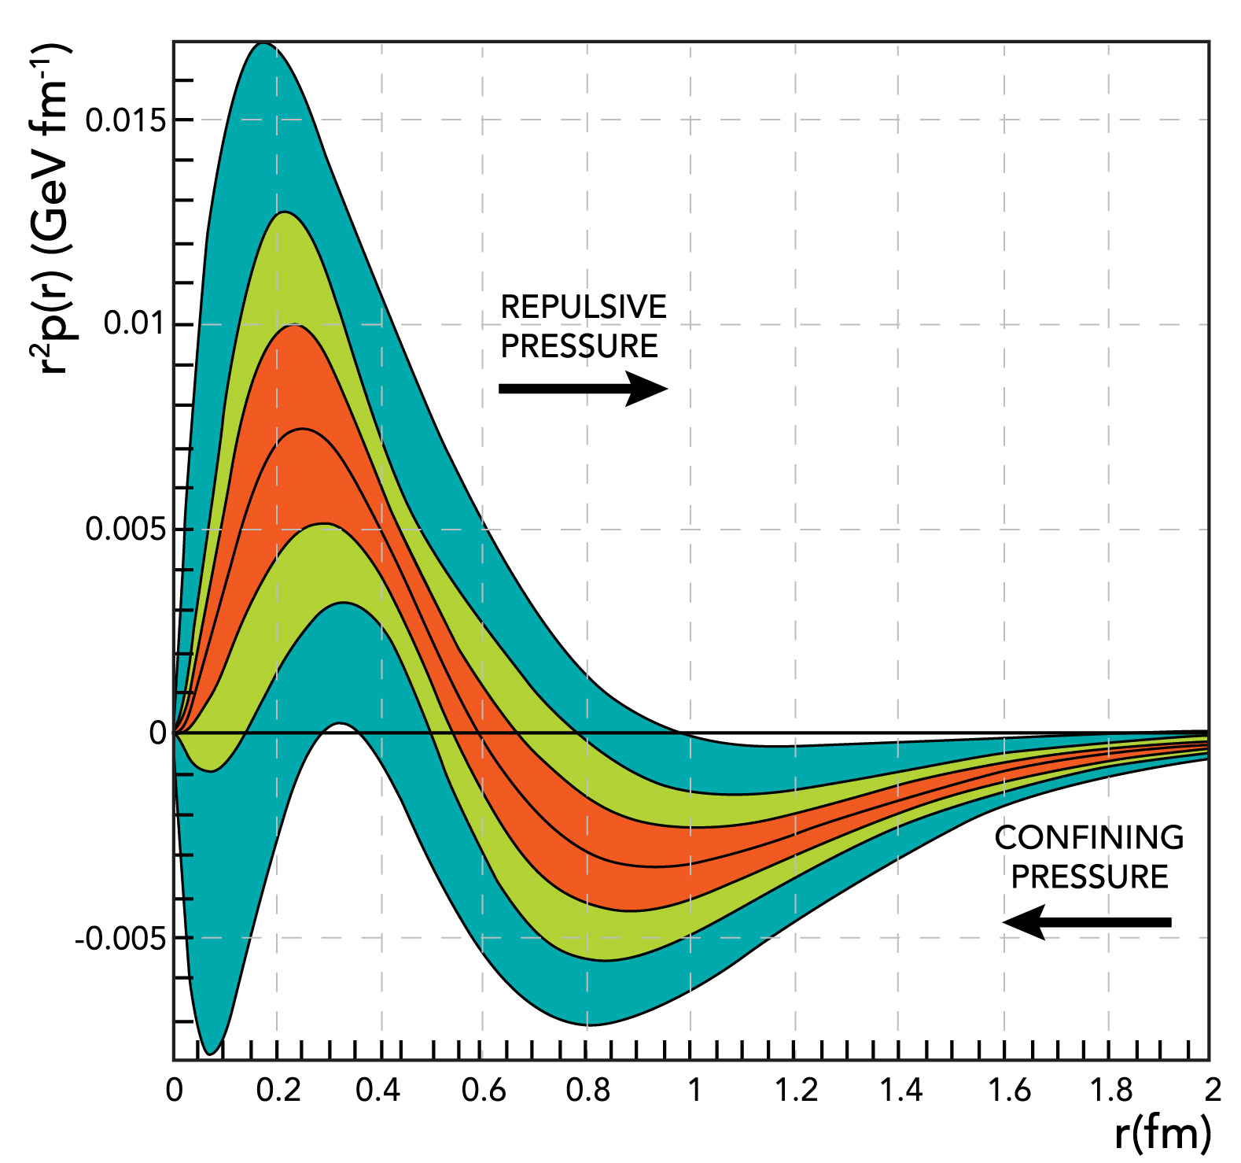

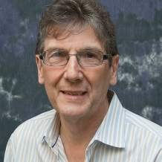
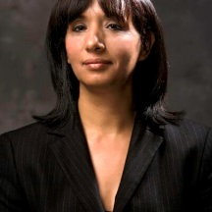
The pressure distribution inside the proton
Repulsive pressure at
r < 0.6 fm <p> 10³⁵ Pa
Confining pressure at
r > 0.6 fm
Nature 557 (2018) no.7705, 396-399
V. Burkert, L. Elouadrhiri, F.X. Girod
This work opens up a new area of research on the fundamental gravitational properties of protons, neutrons and nuclei, which can provide access to their physical radii, the internal shear forces acting on the quarks and their pressure distributions.
How the balance between repulsive and confining pressure comes from QCD?

Slide 32
Synergy in the Studies of the Ground and Excited Nucleon Structure
Different data sets from experiments with electromagnetic probes from the measurements
in the N* and DIS-regions with a focus on exploration of both ground and excited hadron
structure offer an excellent opportunity to gain insight into strong QCD undelying the
hadron generation from quarks and gluons
Synergistic efforts between experimentalists phenomenologists and theorists is needed.
Roadmap forward:
a) publication of the ``Strong QCD from Hadron Structure Experiments” with a goal to
facilitate the new research projects on exploration of strong QCD from the experimental
data on spectra and structure of the ground and excited hadrons;
b) continuation of the Workshops with the planned next Workshop in the first half of 2021
in Nanjing University, China under C.D. Roberts leadership

Slide 33

sQCD 2021
Experiment and Theory for Strong QCD
Craig Roberts … http://inp.nju.edu.cn/

