Slide 1
GRINCH Status Report
SBS G_{M}^{n} / G_{E}^{n} Collaboration Meeting
5-Aug-2019
T. Averett, C. Ayerbe-Gayoso, M. Satnik – W&M
B. Wojtsekhowski – Jlab
G. Niculescu – JMU
A. Amidouch, S. Danagoulian – NC A&T
J. Annand, R. Montgomery - Glasgow
BigBite Spectrometer gas Cherenkov detector
C₄F₈ heavy gas
510 PMT array
NINO front end
VETROC/TDC-based hit clusters
64 ch ADC for calibration

Slide 2
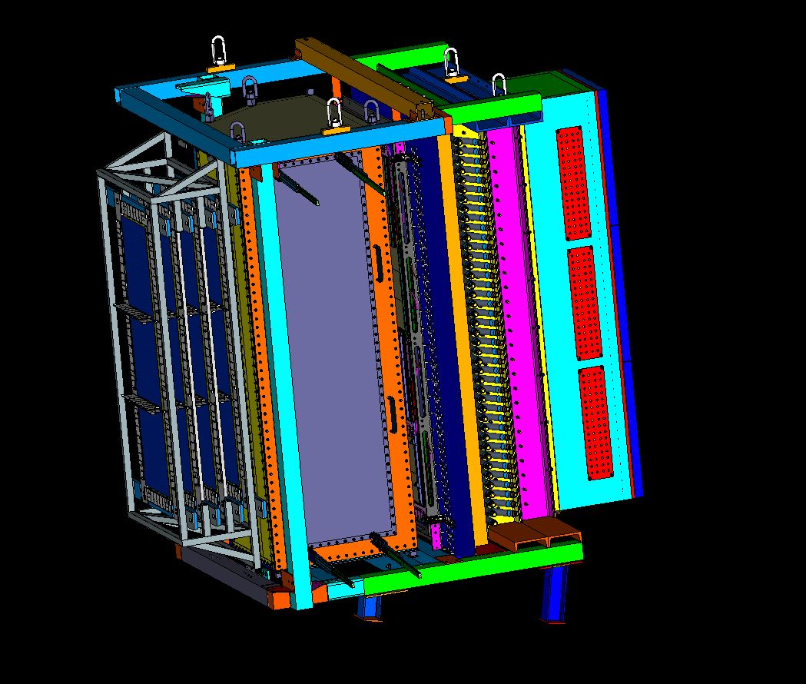
BigBite Detector Stack – 12 GeV
GEM x 4
Cherenkov
PreSh
Shower
GEM
Hodo

Slide 3
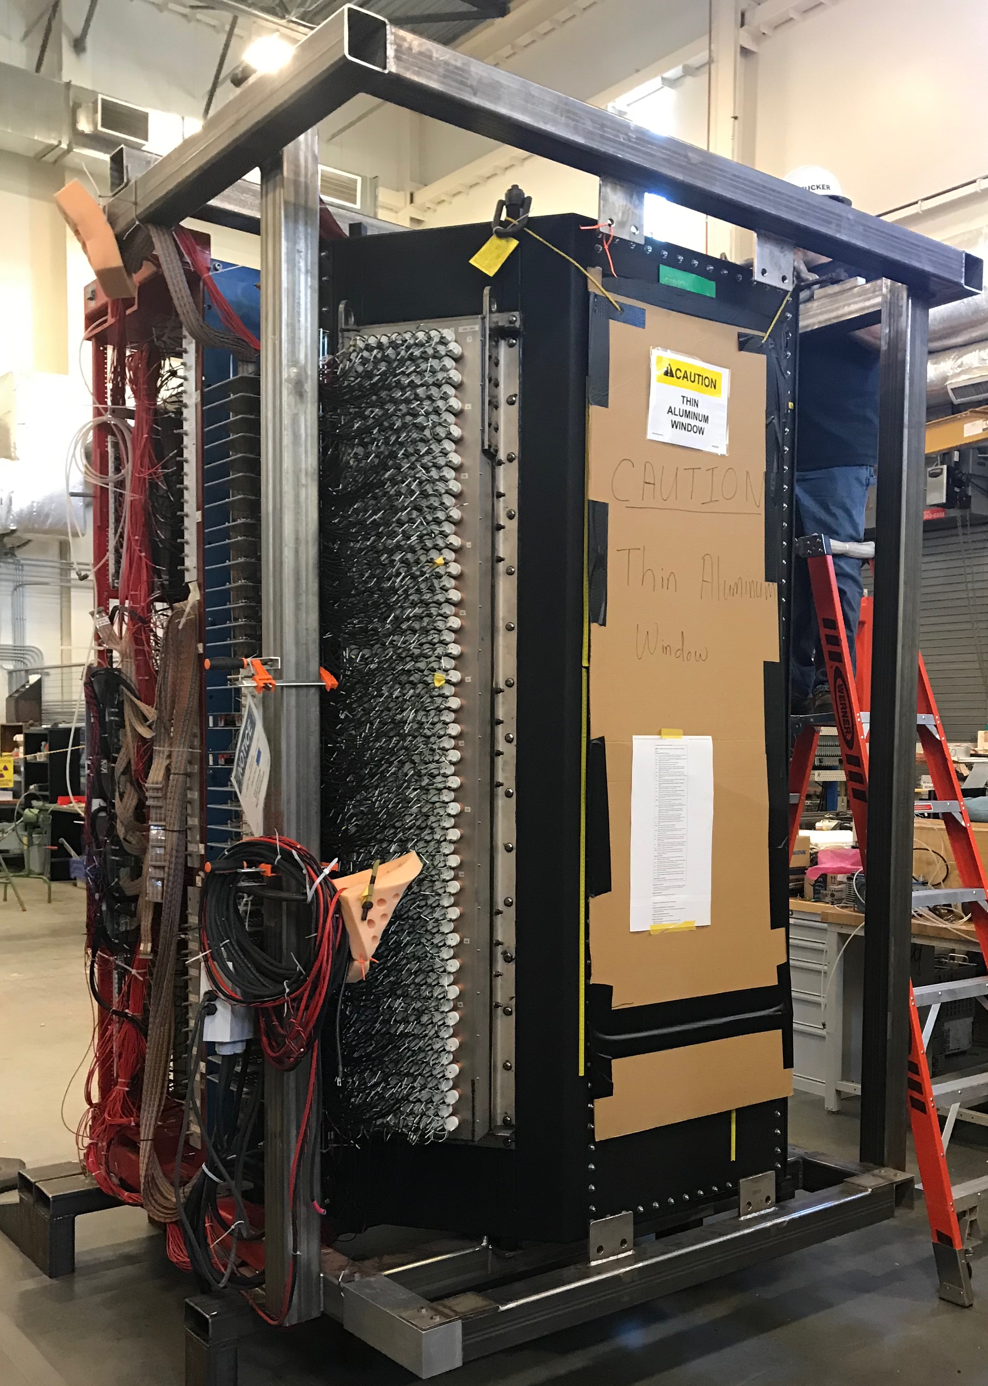
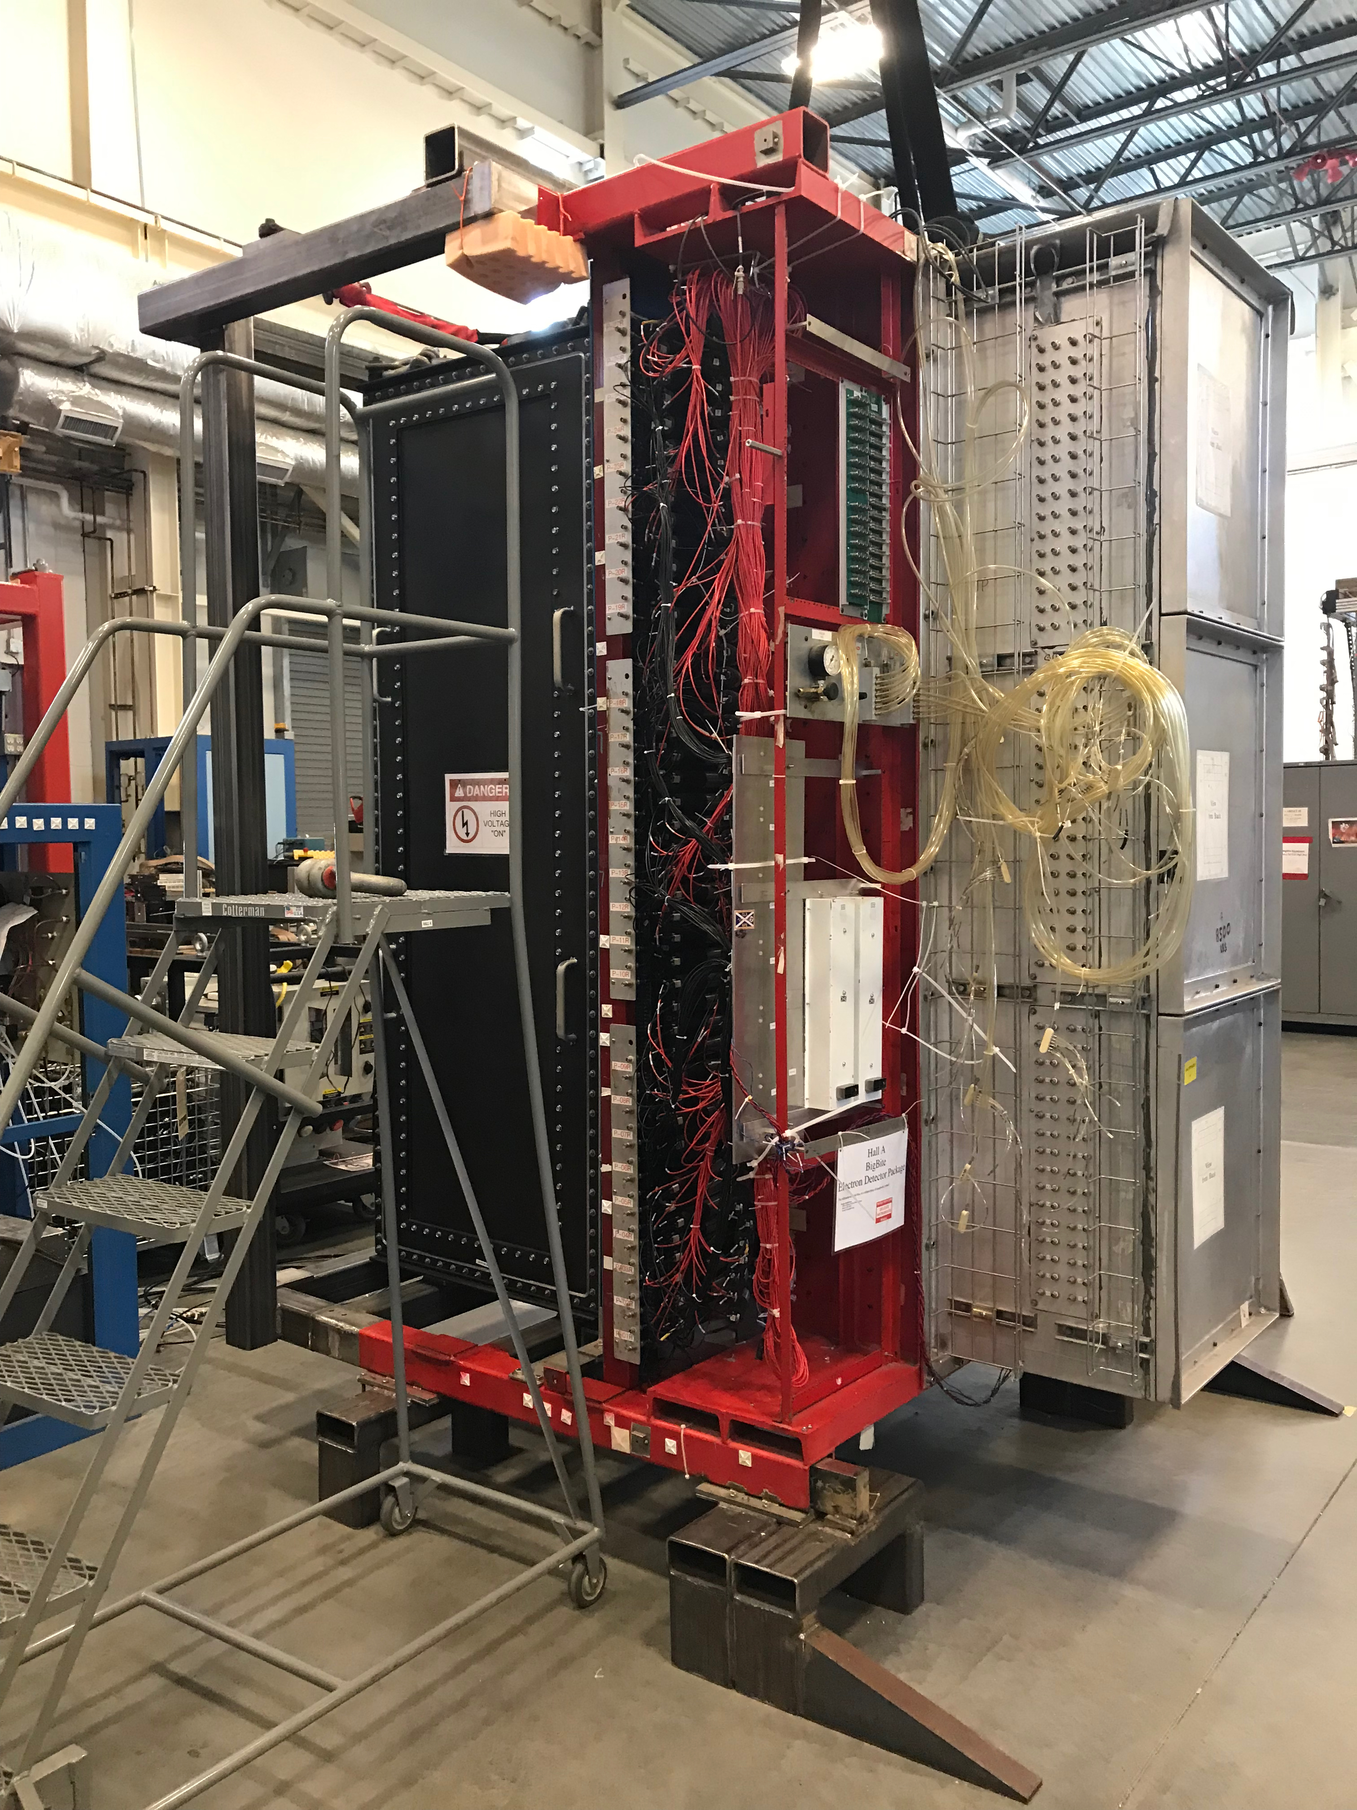
GRINCH/BB in TED

Slide 4
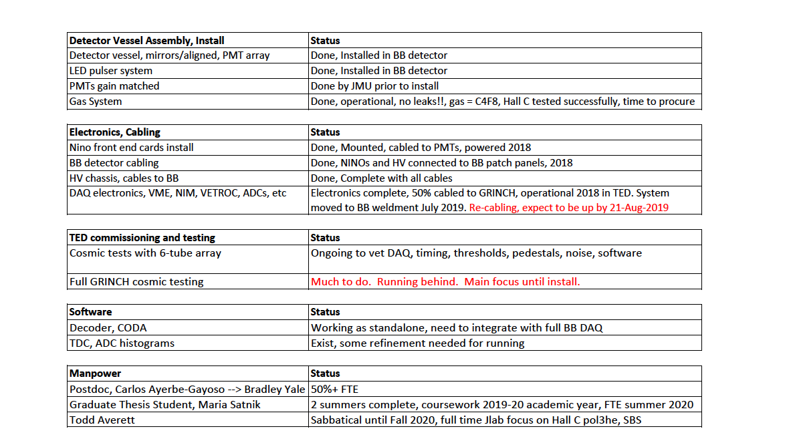

Slide 5
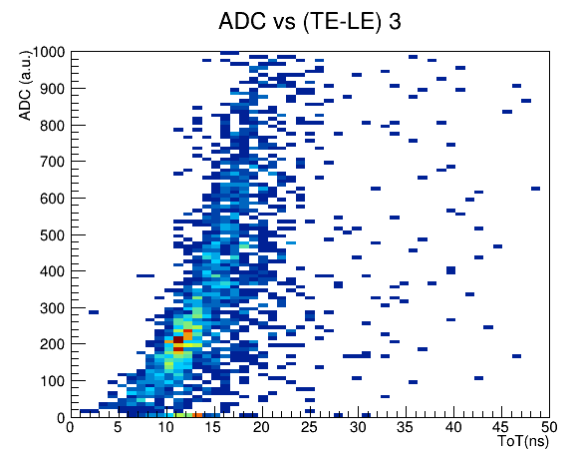
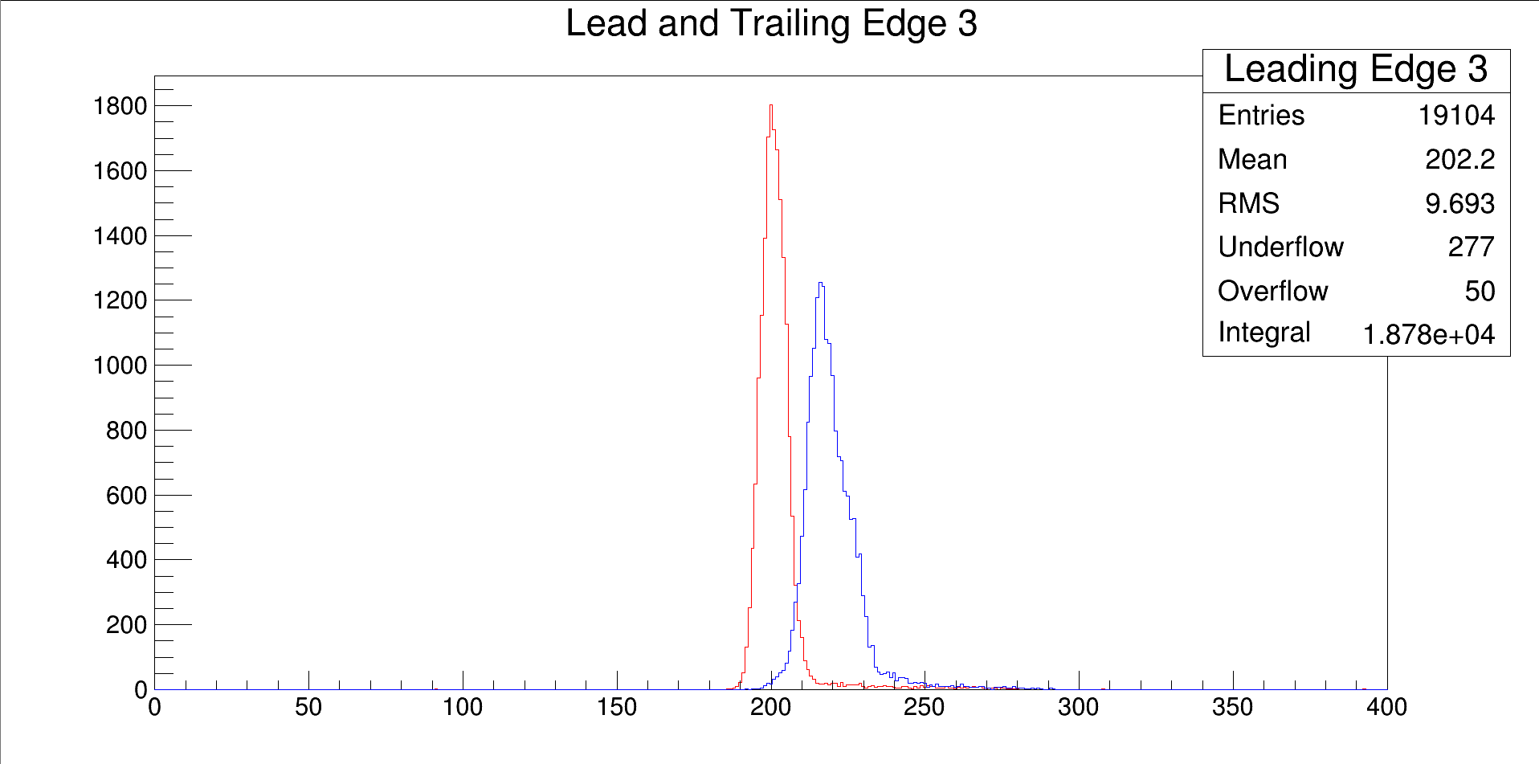
GRINCH/6 PMT Cosmic Data

Slide 6
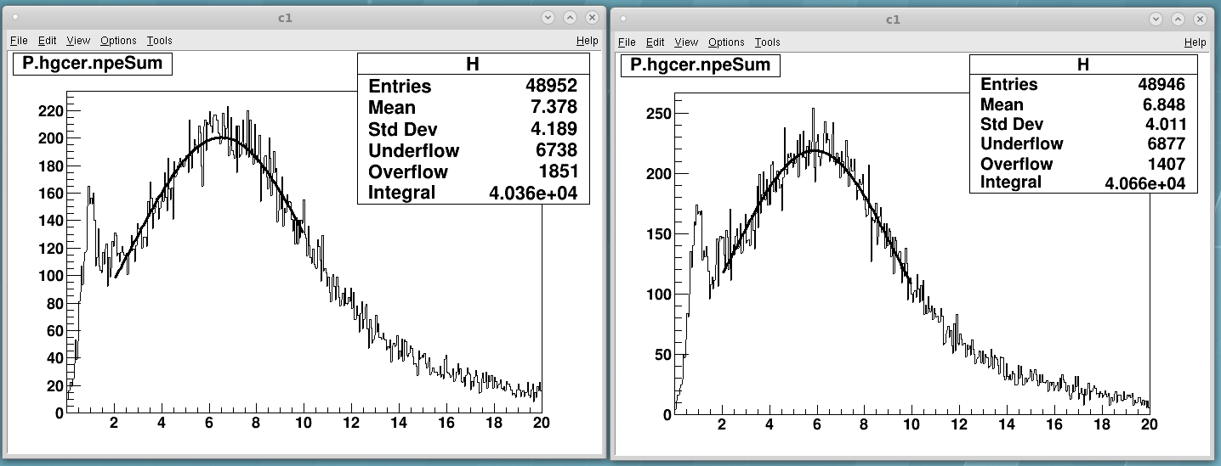
Test of C₄F₈O vs. C₄F₈ in SHMS Jul-2019
B. Sawatzky, Z. Zhao, J. Zhou
Conclusion: Relative photon yield = 0.93 as expected from refractive index measurement at W&M. 0.88 compared to original proposal gas, C₄F₁₀
Thia: We officially request purchasing 100 kg of C₄F₈ at a cost of $7.7k for G_{M}^{n} to include two fills (3 volumes exchanges per fill) and operation (leaking) for 100 days.
Double this to include G_{e}^{n}? Price and availability are good. Could change.

