Slide 1
SBS Engineering Status
Robin Wines
August 2019

Slide 2
Kinematics of SBS
SBS Program is defined by three experiments, each with multiple configurations of equipment. Each configuration has been modeled and the required layout of the Hall has been determined.

Slide 3
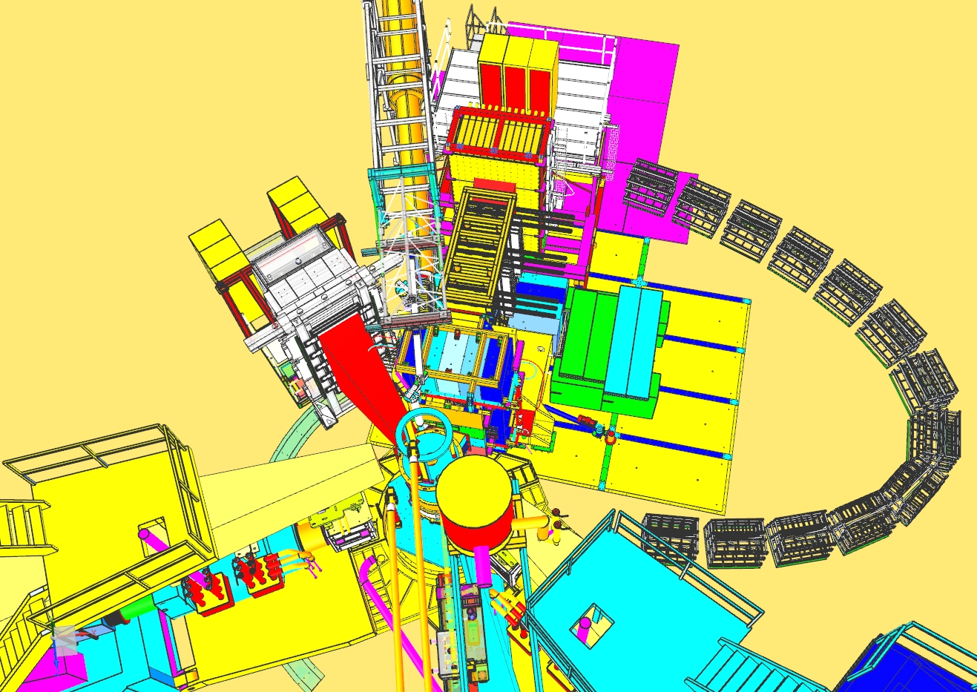
GEp
HCAL
ECAL
Cable Carts
E-HUT
SBS
HRS-L
HRS-R

Slide 4
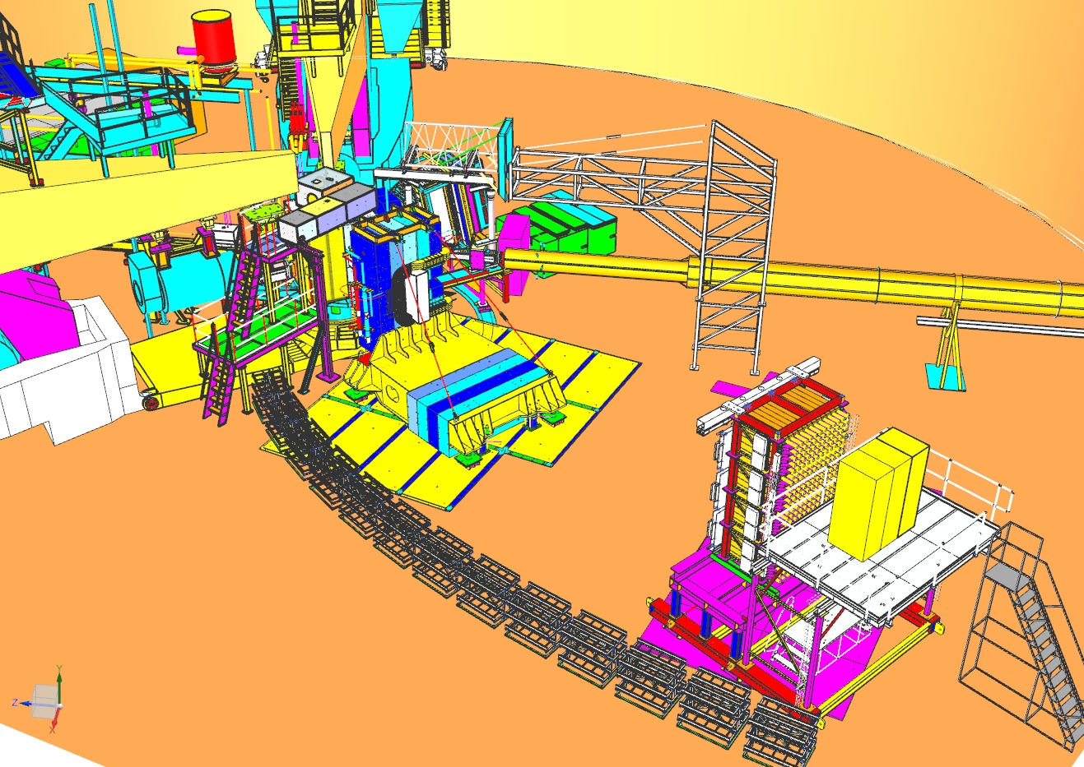
GEn
HRS-L
BB
HRS-R
SBS
CDET
HCAL

Slide 5
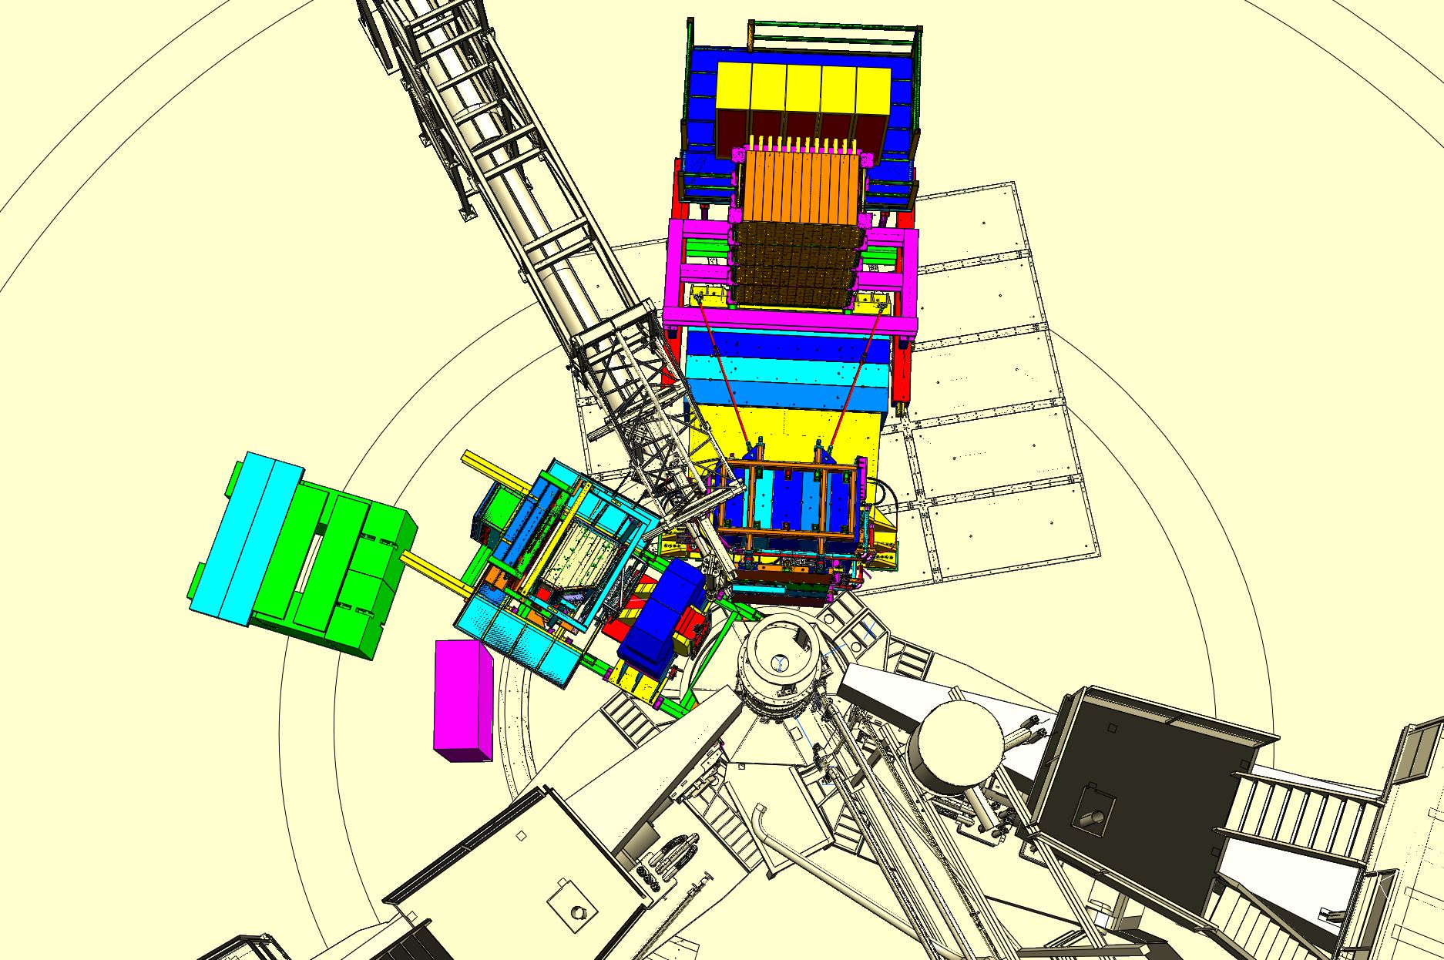
GMn
BB
SBS and HCal
E-HUT

Slide 6
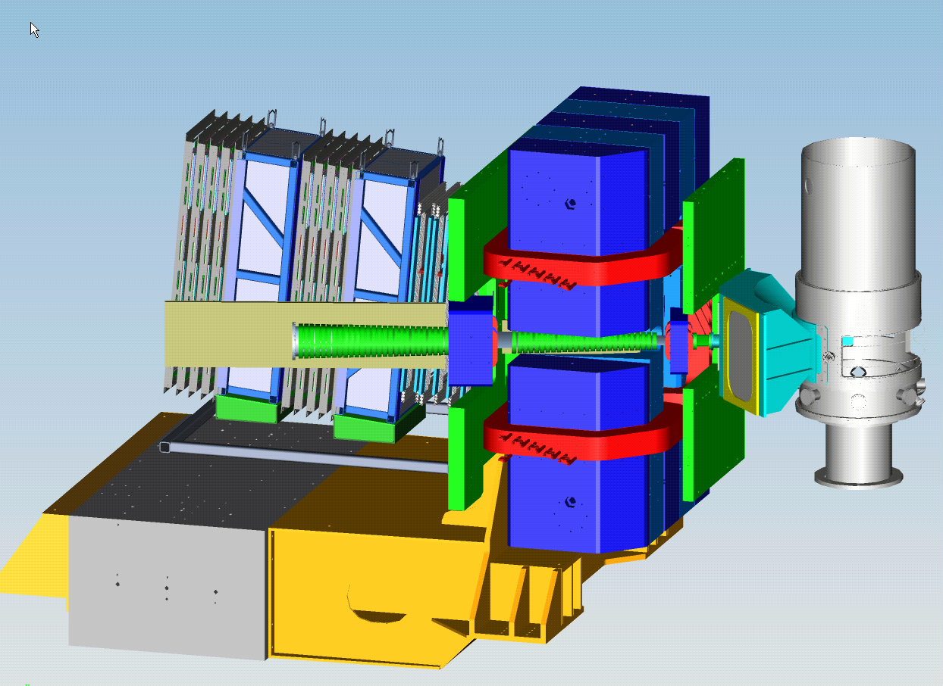
SBS status- main components complete and in storage
Plastic Analyzers-in storage
48D48 Magnet-in storage
Rear Field Clamp-in storage
Front Field Clamp-in storage
GEM frames-parts in storage
Exit Beam Pipe-parts in storage
Scattering Chamber & Vacuum Snout-in storage
Counterweight Support Structure-in storage
Corrector Magnets-in storage

Slide 7
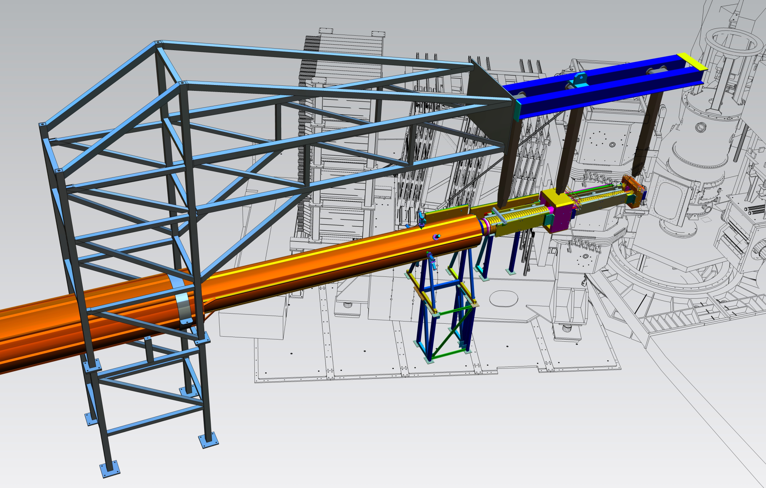
Beamline Support
Vertical supports in fabrication.
Tower extension in storage
Main tower
Corrector
SBS beam line
Corrector
Radiation shielding & supports in storage.
Existing beam line
Kinematics of experiments require 4 beamline configurations. Developed tower & overhead support to accommodate all configurations.
Tower fabricated and in storage.

Slide 8
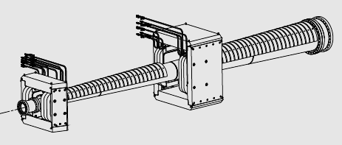
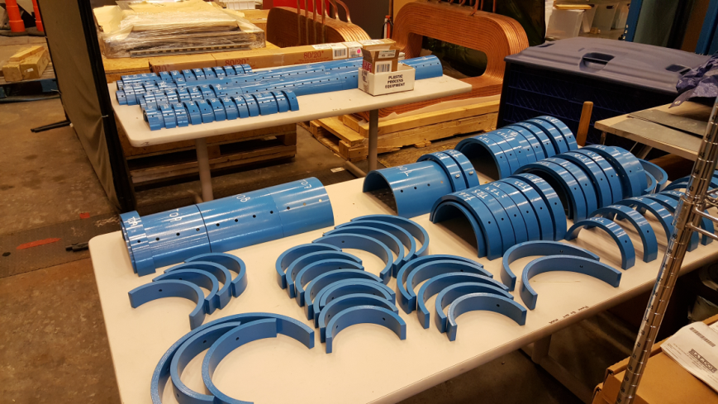
Beamline Shielding
Conical beam pipe, correctors and shielding pieces are in storage.
Assembly drawings complete.
Trial assembly completed, remaining assembly parts being purchased.

Slide 9
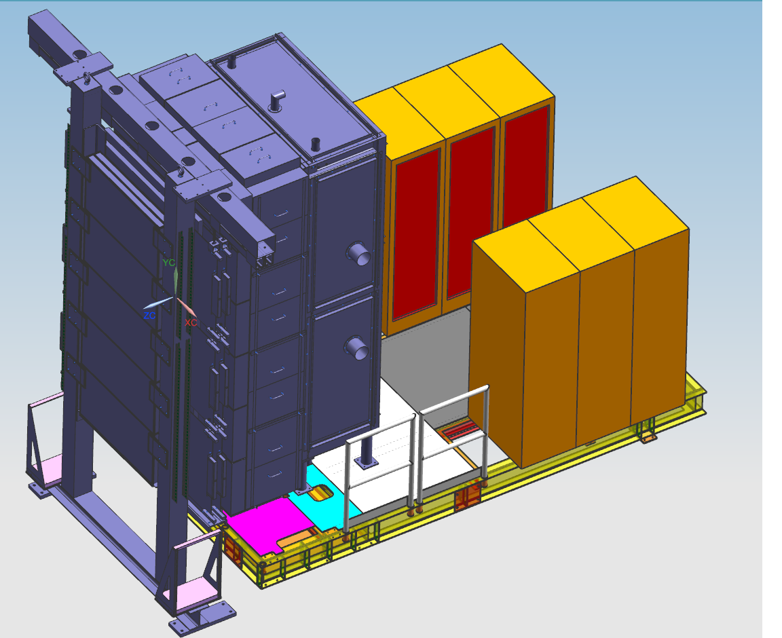
ECAL
Front frame has been delivered.
Design of back frame near completion- needs access doors and support feet.
Modifying existing platform- needs design of support feet and lifting frame

Slide 10
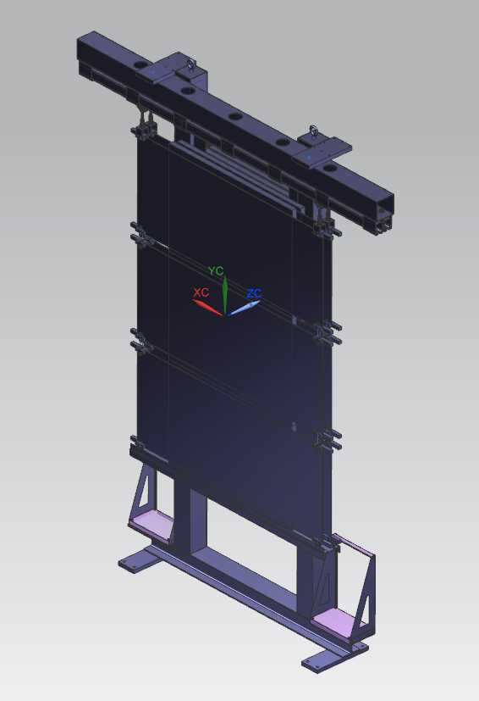
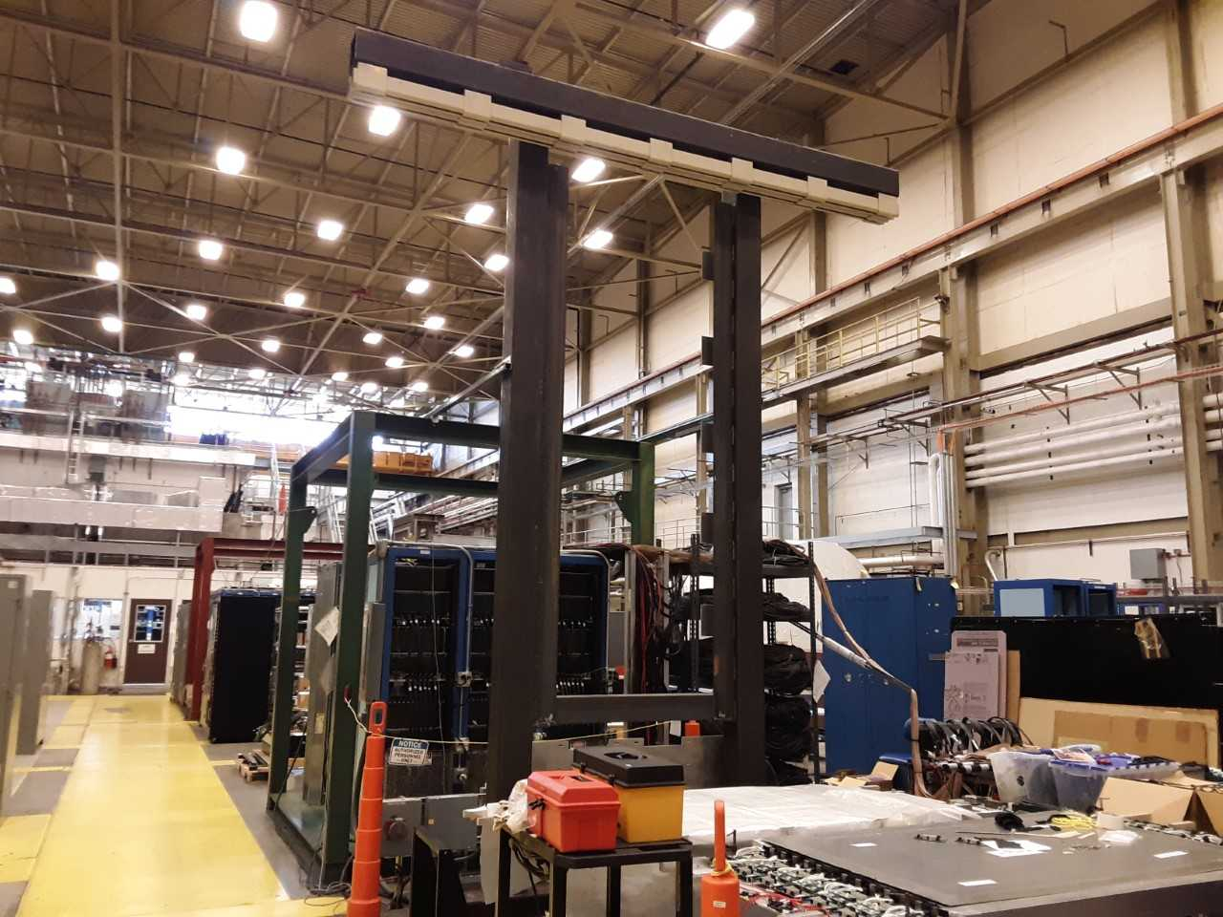
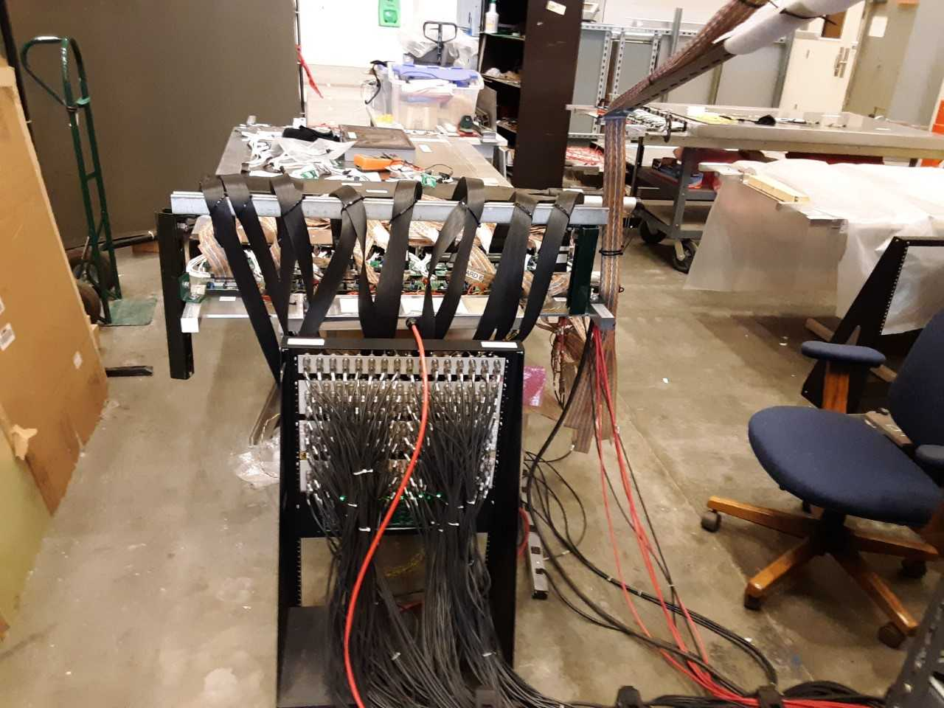
CDET
Have CDet frame
Added hardware design to mount detector modules to frame
Added modifications to the frame for the addition of the post racks that house the cables
Added strain relief bars for the cables
Need to determine if width of frame is sufficient for access of the panels

Slide 11
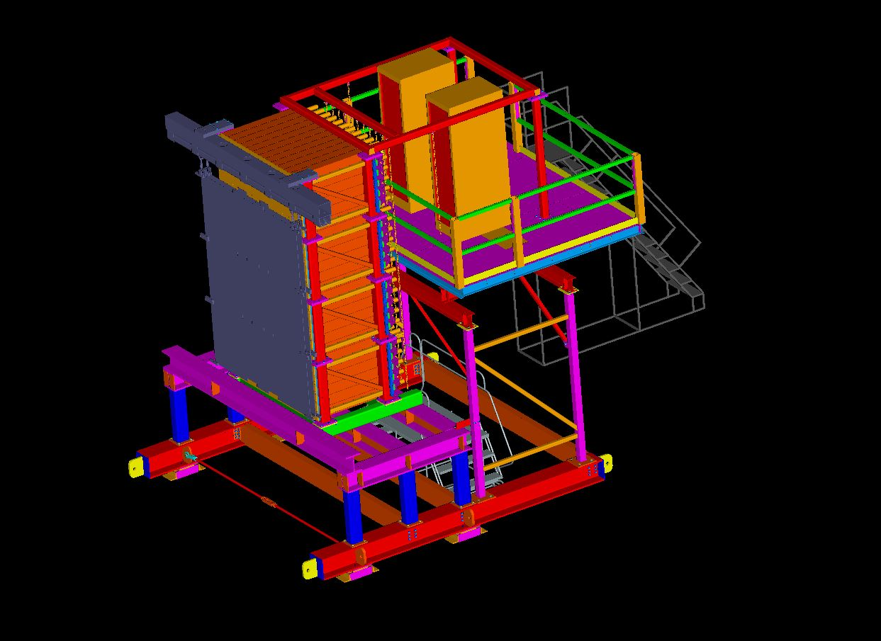
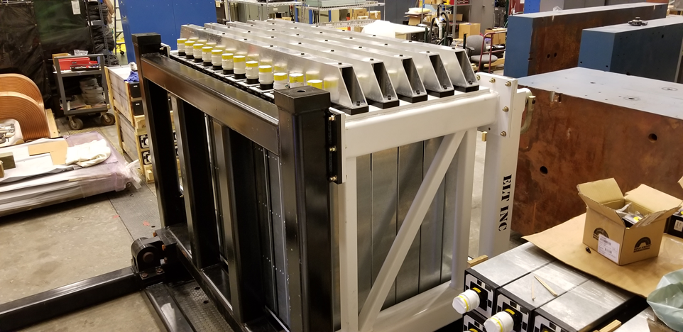
HCAL & CDET Support/ Access Platform
HCAL is being assembled
Access platform in procurement
Support platform in procurement

Slide 12
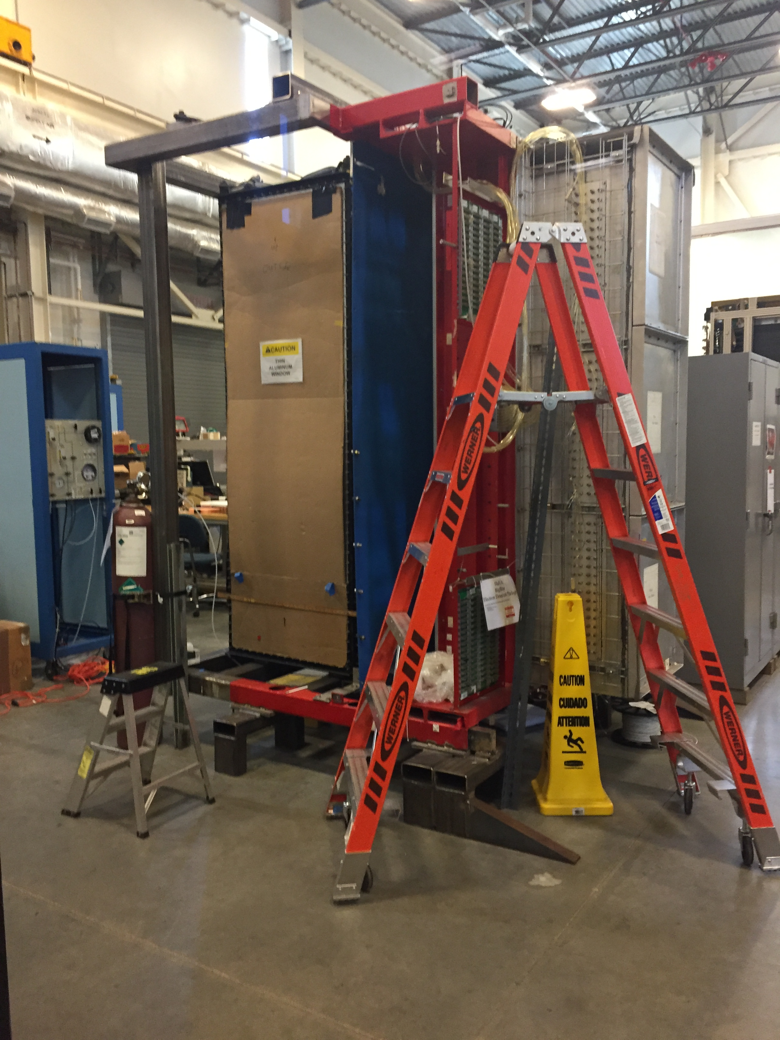
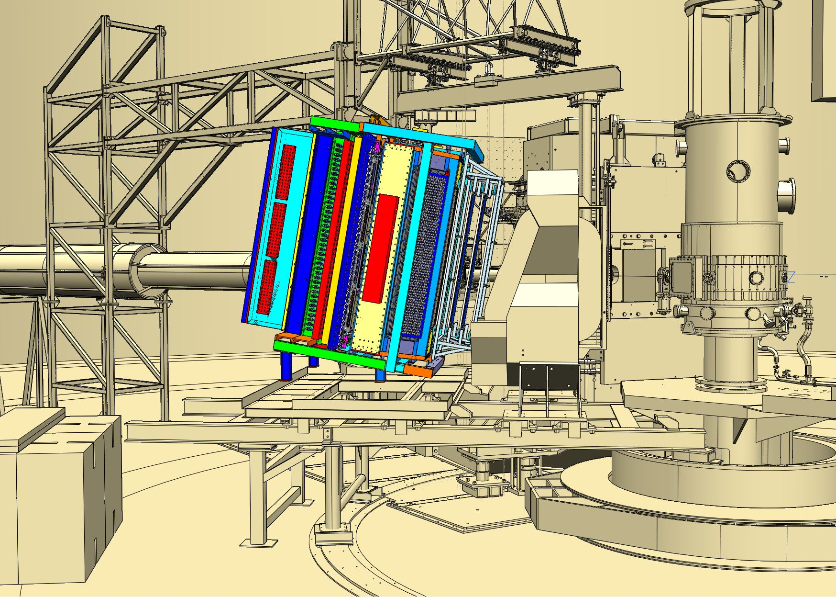
BigBite
BigBite detector frame modifications are defined to include GEMs and GRINCH.
Modifications have been completed.
New BB electronics frame is complete.

Slide 13
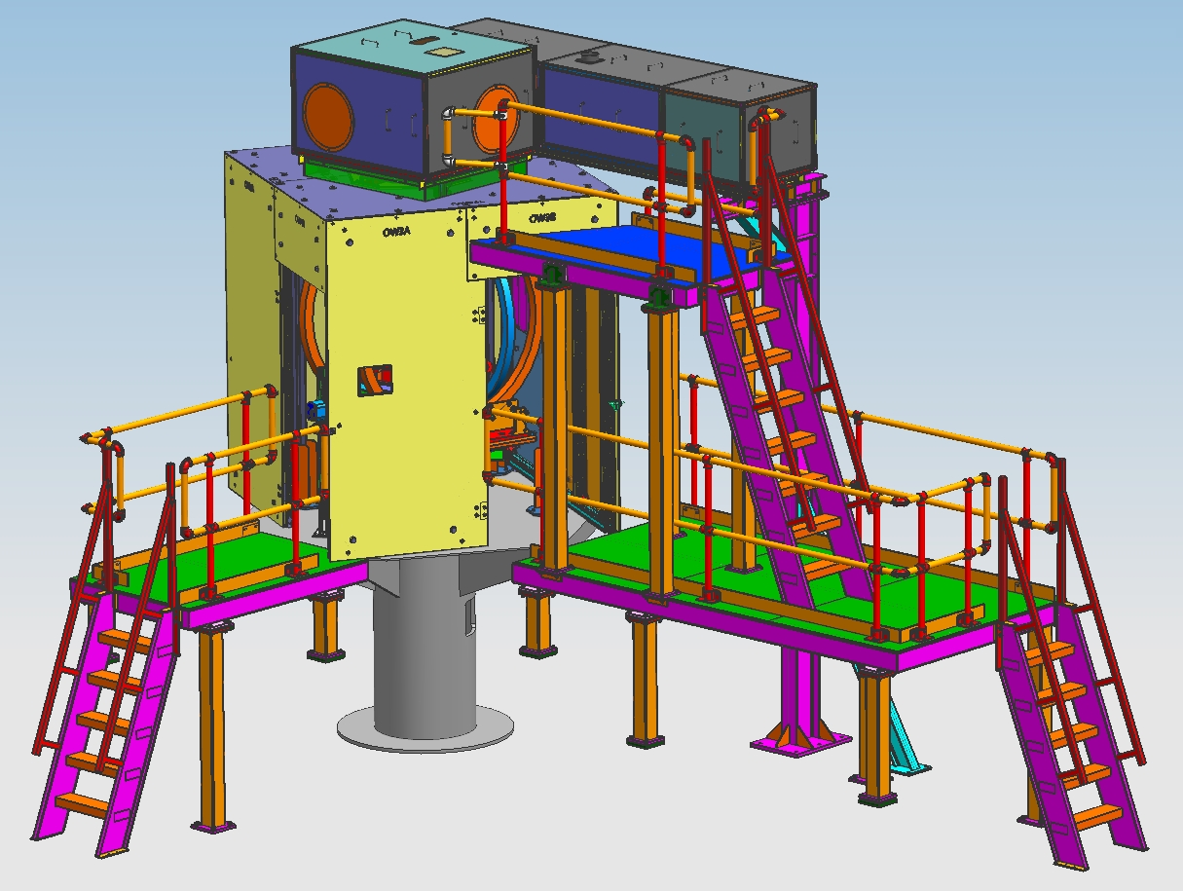
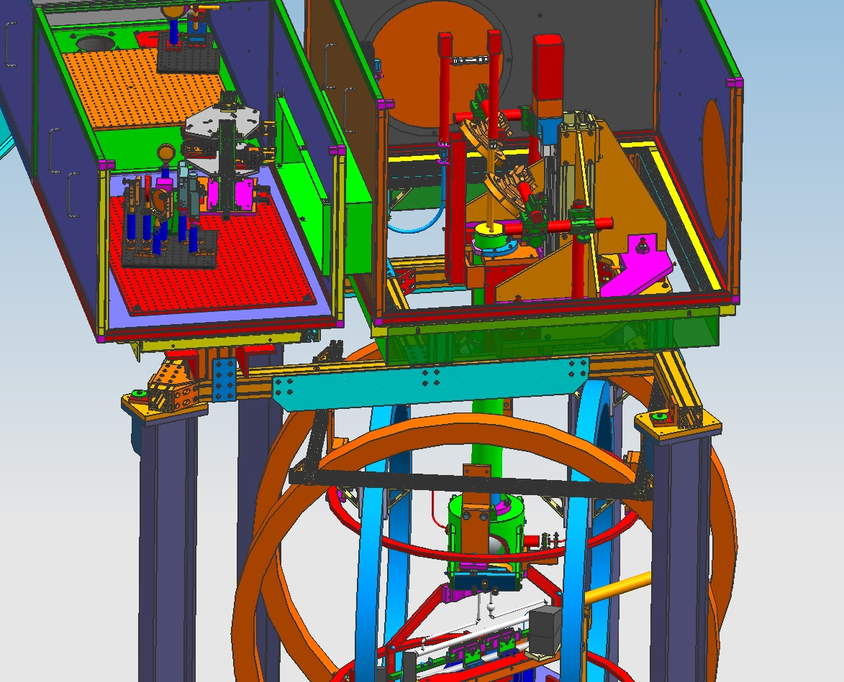
Polarized 3He Target

Slide 14
Polarized 3He Target
Design completed. Continue on drawings and procurements.
  Oven material delivered
  Be window telescoping beampipe delivered
  Be window flange delivered
  Cell glue fixture delivered
  Alignment cartridge delivered
  Telescoping exit beampipe weldment delivered
  Magnetic shielding assembly in storage delivered
  Platform drawings 95% complete.
  Target system drawings 75% complete.

Slide 15
Utilities
Electronics Huts – Main hut to be located on beam left side of Hall. Two GEM electronics huts to be relocated as needed with use of BB, SBS detectors and GEn-RP detectors. All materials in storage.
Power Supplies- SBS dipole power supply in-house. Corrector power supplies in-house.
LCW- Upgrades to LCW system starting September 2019.

Slide 16
SUMMARY
Items remaining :
- Drawings & modifications of Ecal/ CDet support platform
- ECal back frame and assembly drawings
- Complete CDet hardware and frame modifications
- Beamline assembly hardware procurement
- Review of SBS detector frame
- Procuring assembly parts & hardware (beamline flanges, tie
rods, stand-offs, cylinder cart, floor plates)
FY19-FY20 Schedule & Manpower
- With present staff, need 12 calendar weeks to complete

Slide 17
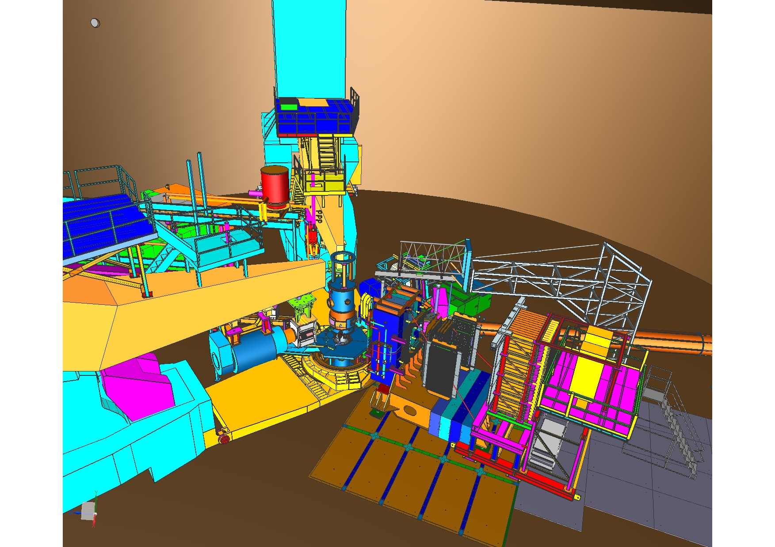
GEn polarimeter Layout
BL
BB
SBS
BR
Polarimeters
HCAL

Slide 18
Kinematics of GEn-RP

