Slide 1
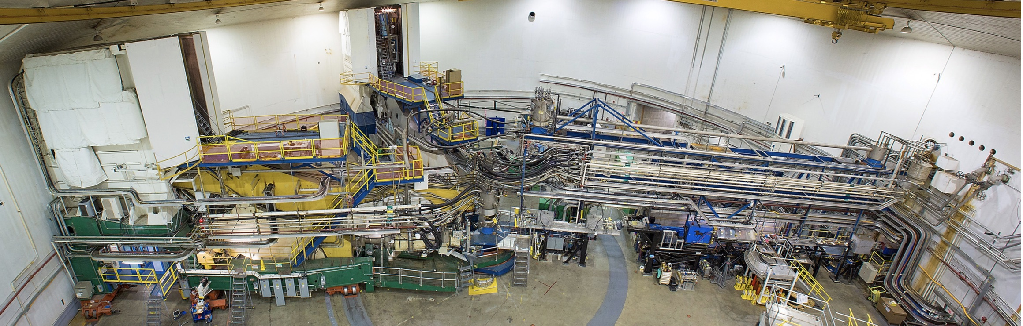
Hall A Update
SBS Collaboration Meeting
Jefferson Lab - August 2019
Thia Keppel

Slide 2
Hall A PROGRAM
2016-2018 – DVCS, G_{M}^{P}
Fall 2018 – Tritium Era
E12-10-103 MARATHON
E12-11-112 Short Range Correlations (high X)
E12-14-011 ³H(e,e′p) ³He(e,e′p) – momentum distribution
E12-17-003 Λnn search
Spring 2019
E12-10-009 APEX dark matter
Now
E12-11-101 PREX2 neutron skin in Lead
Fall 2019
E12-12-004 CREX neutron radius in Calcium
Future – SBS (2020 installation), hypernuclear, MOLLER, SoLID

Slide 3
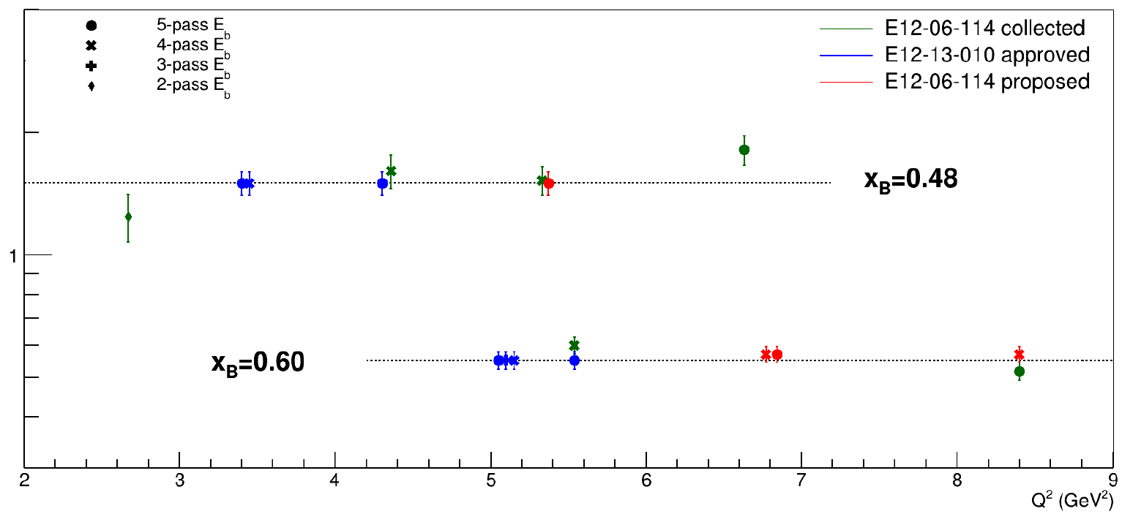
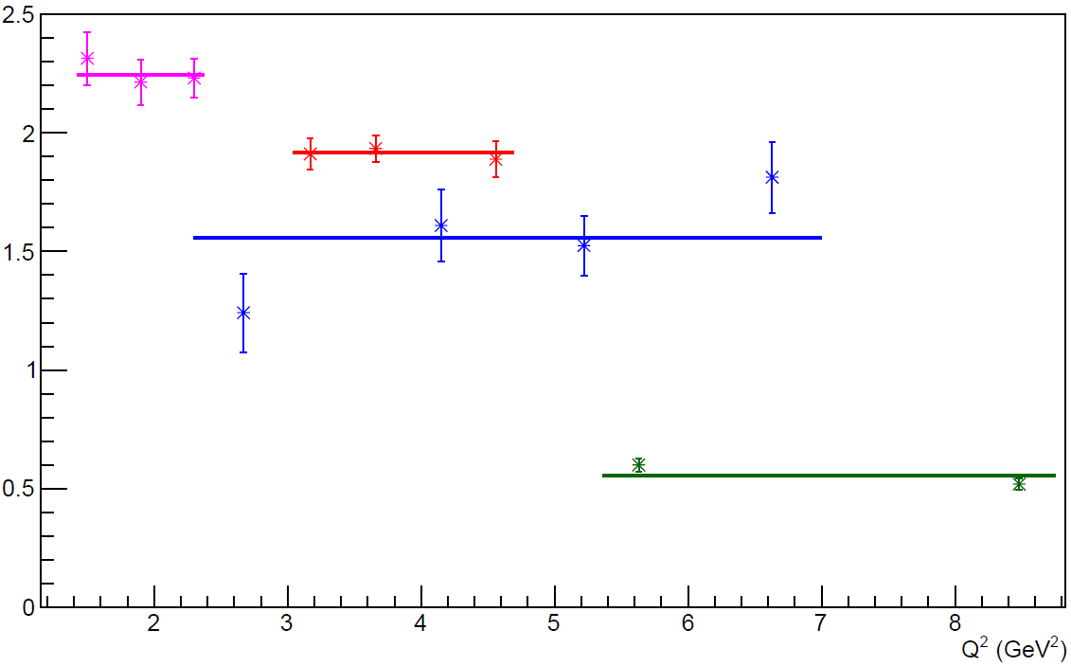
E12-06-114 DVCS/Hall A Experiment at 11 GeV
100 PAC days approved:
- High impact experiment for nucleon 3D imaging program
- High precision scaling tests of the DVCS cross section at fixed x_{B}
- CEBAF12 allows to explore for the first time the high x_{B} region
Jeopardy proposal to PAC47 to complete x_{B}=0.50 and x_{B}=0.60 settings
50% of experiment planned
& completed in 2014-2016
Amplitude of hel-dep x-sec
Analysis status:
Analysis of DVCS cross sections completed for all 9 kinematic settings
(presented at SPIN 2018)
Publication being drafted, expected to be circulated by the end of July’19
π⁰ electroproduction results and publication will follow soon afterwards
Previous
6 GeV
x_{B}=0.36
x_{B}=0.48
x_{B}=0.60
Notes:
Suggested rework
Add bullet on What we are doing
Rolf to find another plot

Slide 4
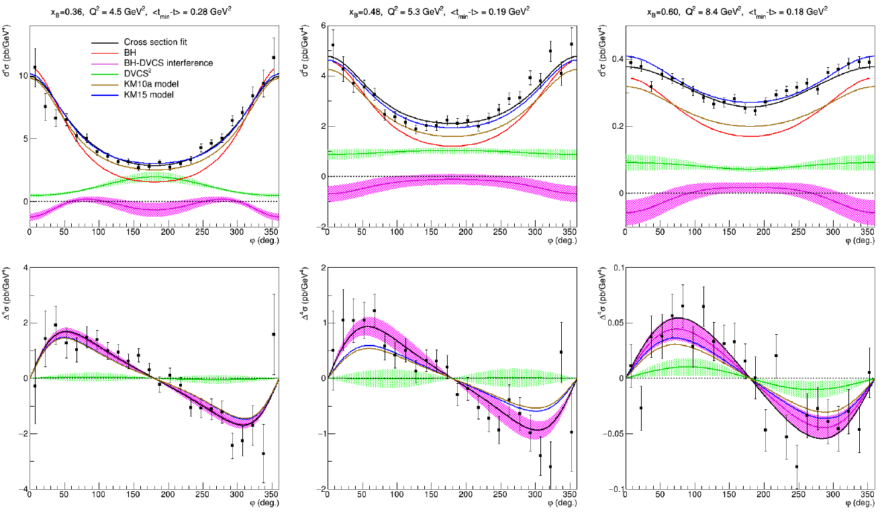
E12-06-114 DVCS/Hall A Experiment at 11 GeV
Sample of cross-section results:
Helicity-independent cross section
BH
Models
DVCS²
Twist-2 Interference
x_{B}=0.36
x_{B}=0.48
x_{B}=0.60
Helicity-dependent cross section

Slide 5
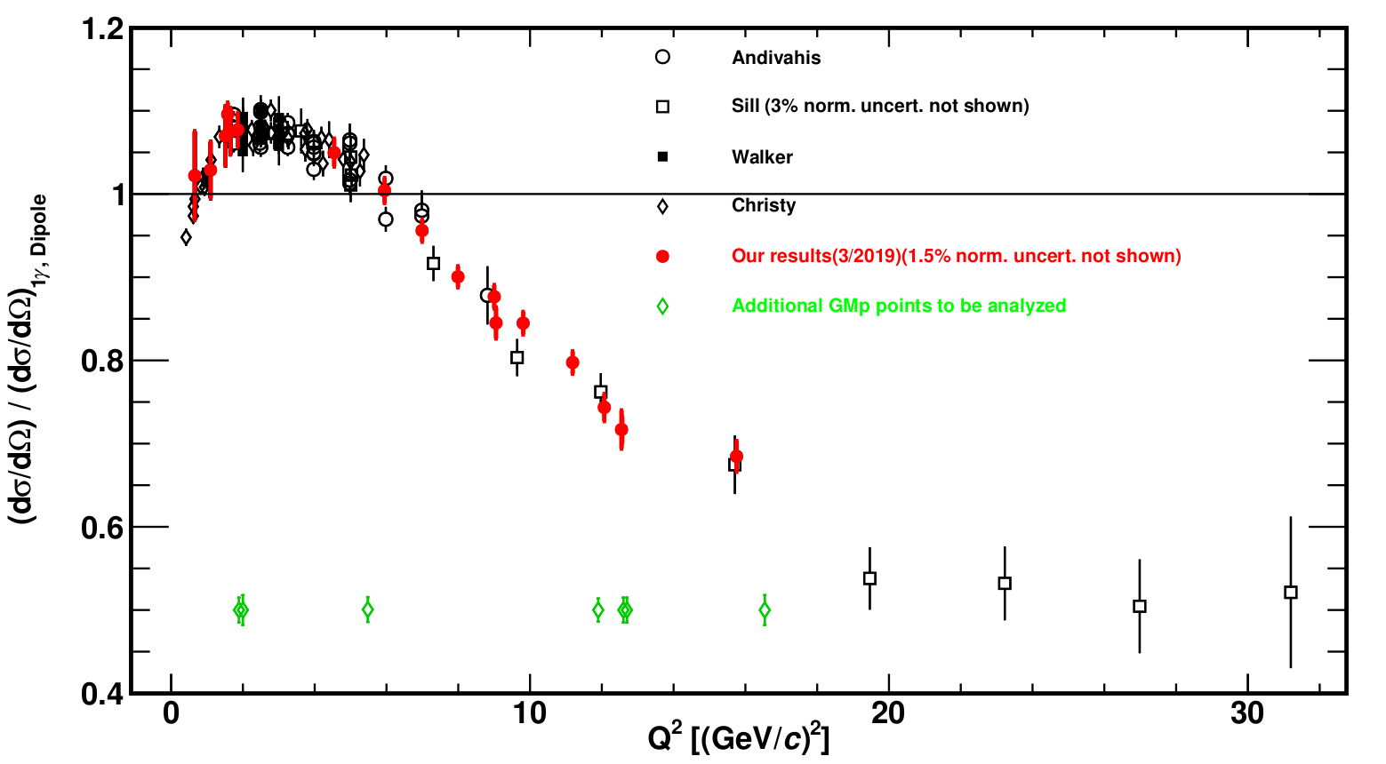
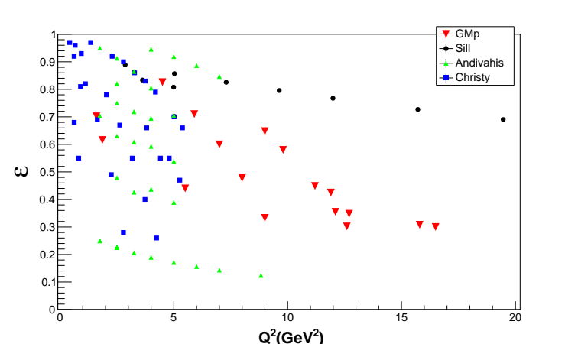
12 GeV Era GMp Experiment: E12-07-108
Precision Measurement of the Proton Elastic Cross-Section at High Q²
Precision e-p elastic cross-section necessary for:
  Baseline cross section for many 12 GeV hadronic physics measurements
  Determination of G_{E}^{p}, G_{M}^{p} and 2-γ effects at high Q² in combination with polarization measurements
Systematic uncertainties on Fall 2016 LHRS data ~1.3% (pt-pt), 1.5% (norm)
RHRS (additional 2% from optics)
Fall 2016 data finalized. First paper to collaboration in July 2019 – running a bit late!
JLab data critical for
Q² > 6 GeV²

Slide 6
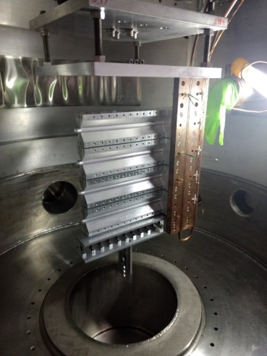
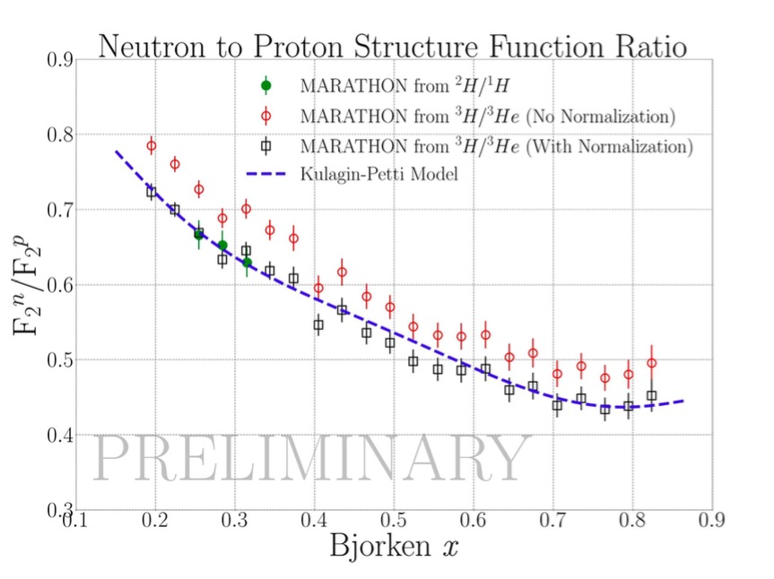
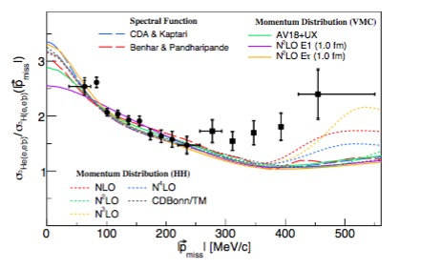
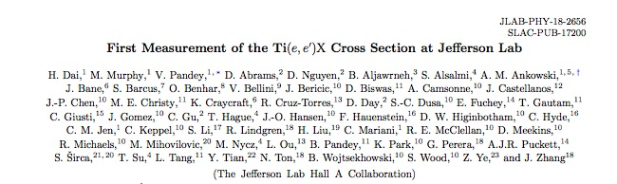
Hall A Tritium (and Argon) RUNNING COMPLETED
First tritium target used for electron scattering in three decades!
MARATHON preliminary results presented at April 2019 APS in Denver
Phys. Rev. C 98 (2018) no.1, 014617
Phys.Rev. C99 (2019) no.5, 054608
Short Range Correlation (e.e’p) publication submitted, arXiv:1902.06358v1

Slide 7
E12-17-003: Searching for The Possible Λnn Resonance
Λp and Λn interaction properties are so far treated as the same, based on negligible CSB found in NN interactions.
Significant CSB in ΛN interactions is confirmed by the isospin pair hypernuclei: ⁴_{Λ}He and ⁴_{Λ}H.
The origin of such CSB is important to understand BB interactions in all flavors within the SU(3) framework.
There are Λp scattering data although very limited. However, Λn data do not exist.
A GSI experiment recently reported possible existence of a (bound) Λnn state.
³H(e,e’K⁺)Λnn reaction at JLab is currently the best method to search and study such a state by measuring its binding energy and natural width. It may provide experimental data on Λn interaction for the first time.
Variety of data were taken from H, T, He, multi-C for purposes of calibration and production
Achieved ~80% of approved production time but gained on additionally needed calibration data. It is sufficient for the experiment at the current level.
Online spectra showed good Λ production
Critical analyses undergoing:
  Optics optimization for both HRS’s (resolution)
  Kin. calibration (precision on absolute MM)
e’
K⁺
e
E12-17-003 ran in Hall A in Nov. 2018

Slide 8
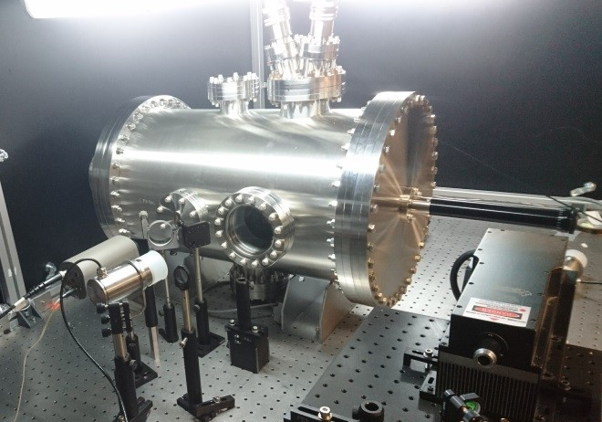
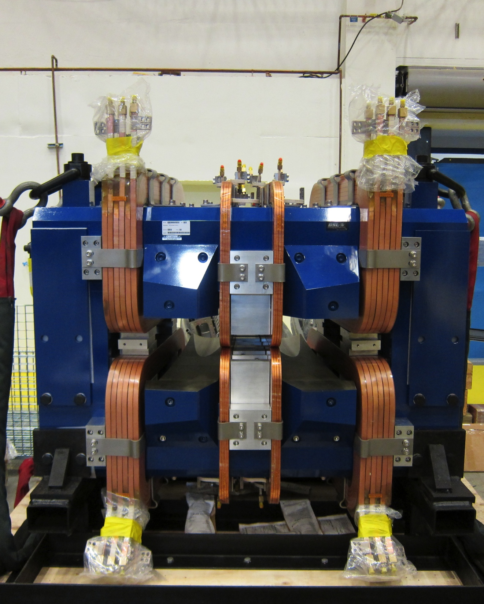
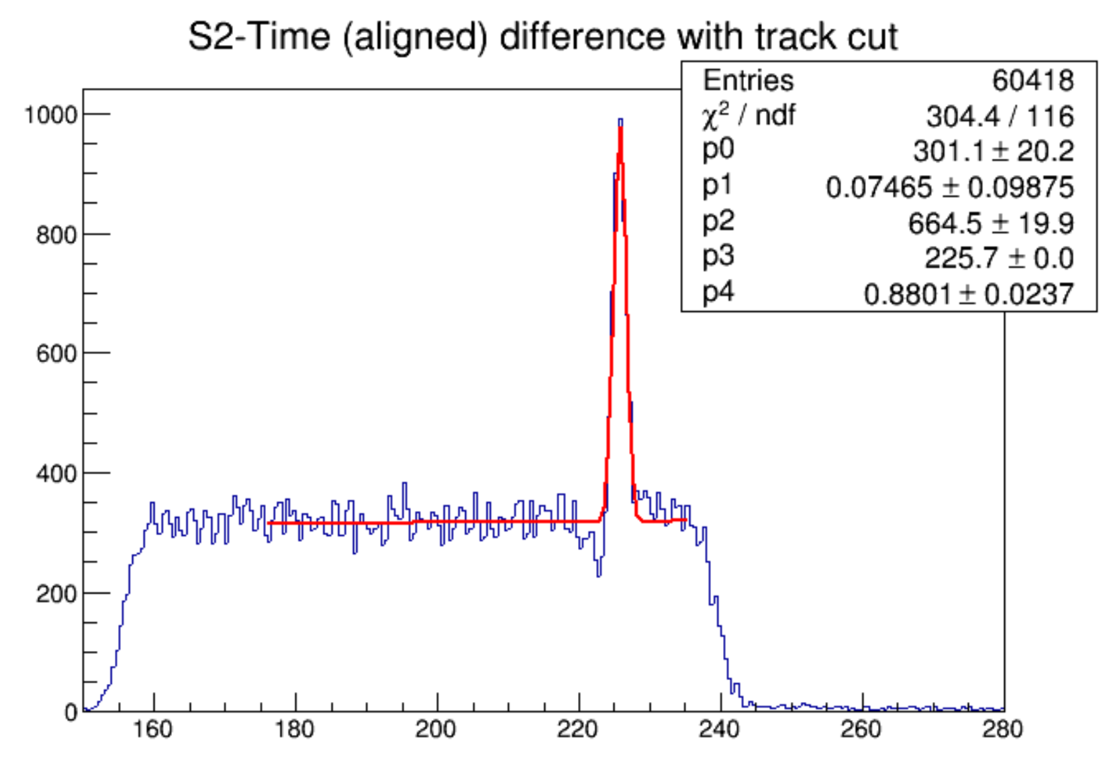
A’ Experiment (APEX) Heavy Photon Search
Obtained Spring 2019
Resolution 0.9 ns

Slide 9
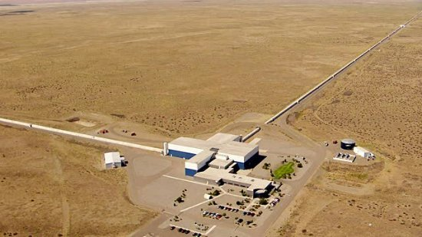
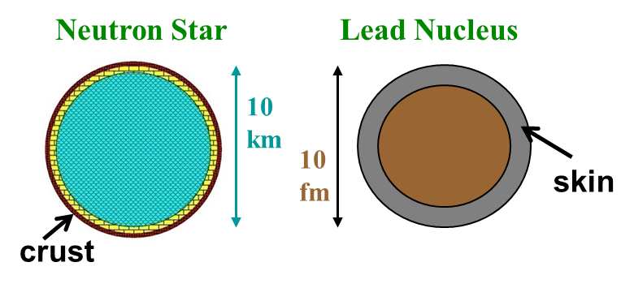
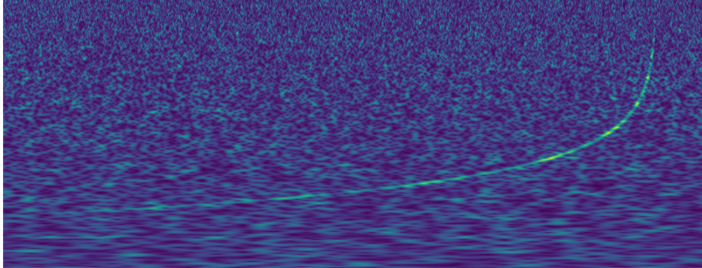
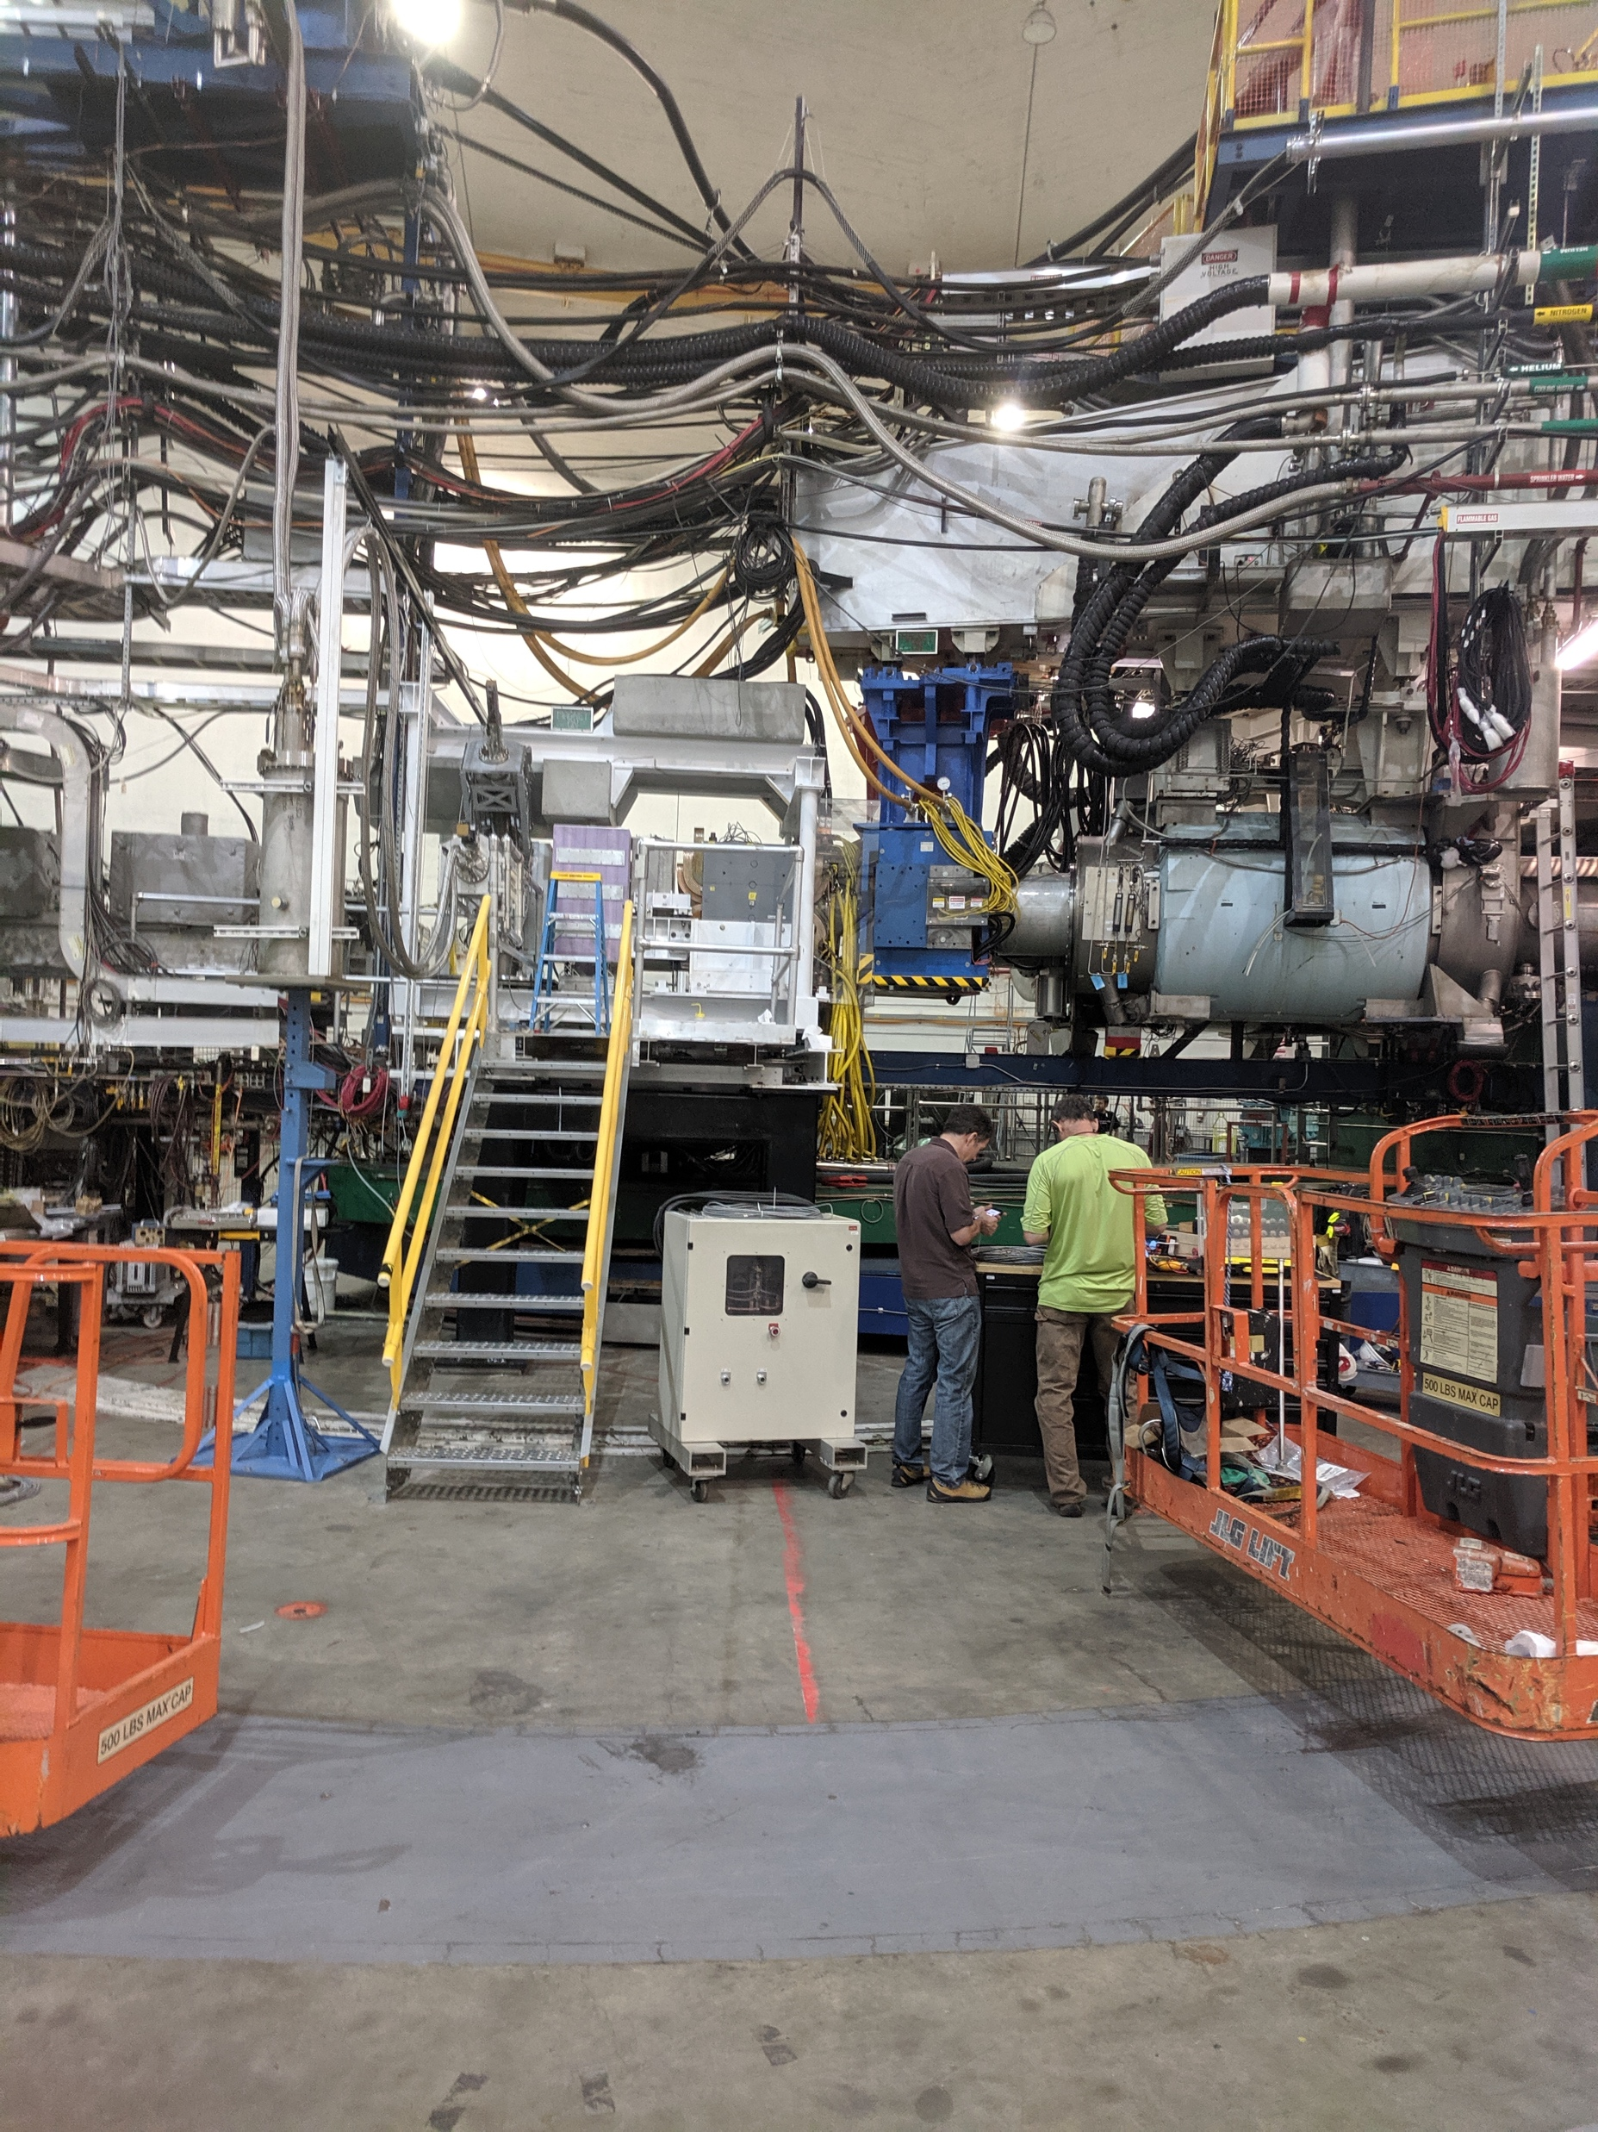
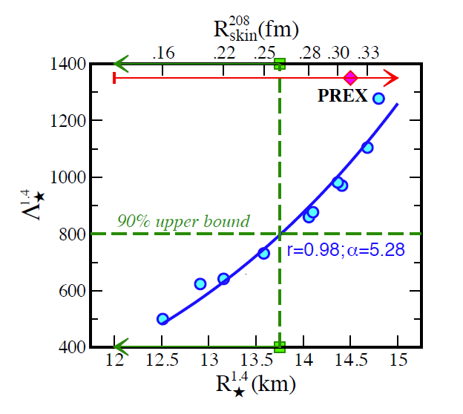
2019 Hall A Summer Run: PREX2/CREX
(LIGO)
(JLab)
Measurement of neutron skin at JLab constrains tidal polarizability of neutron stars
Phys. Rev. Lett. 120, 172702 (2018)
Running in Hall A

Slide 10
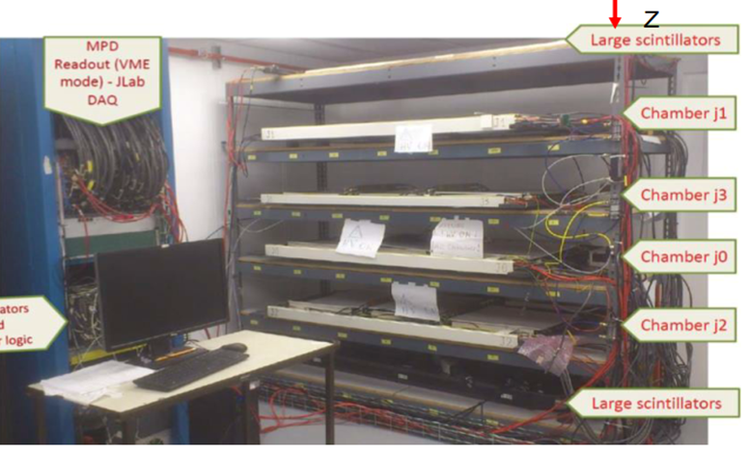
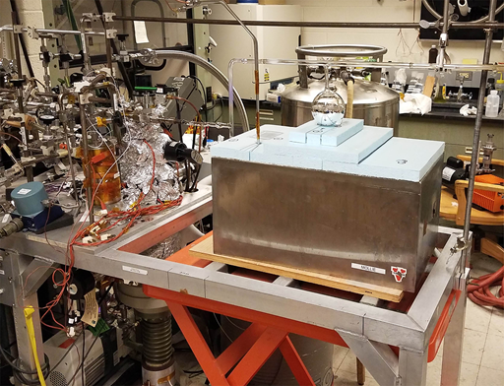
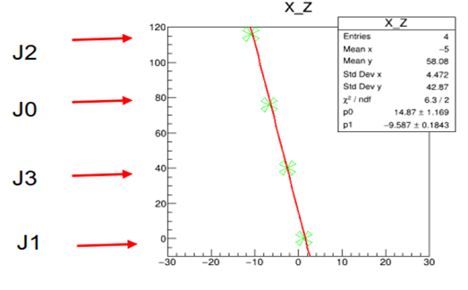
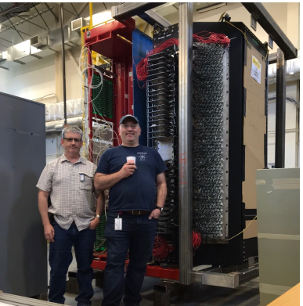
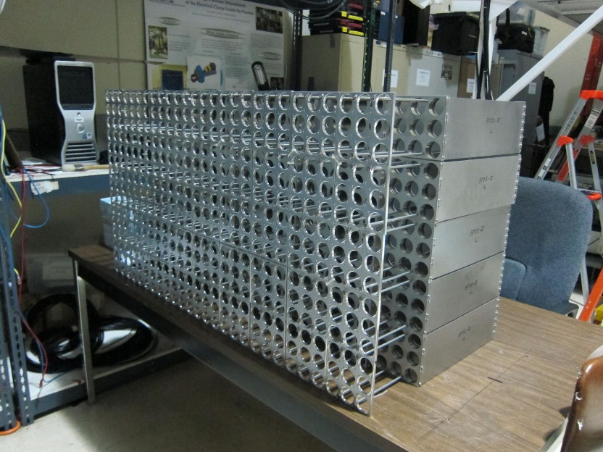
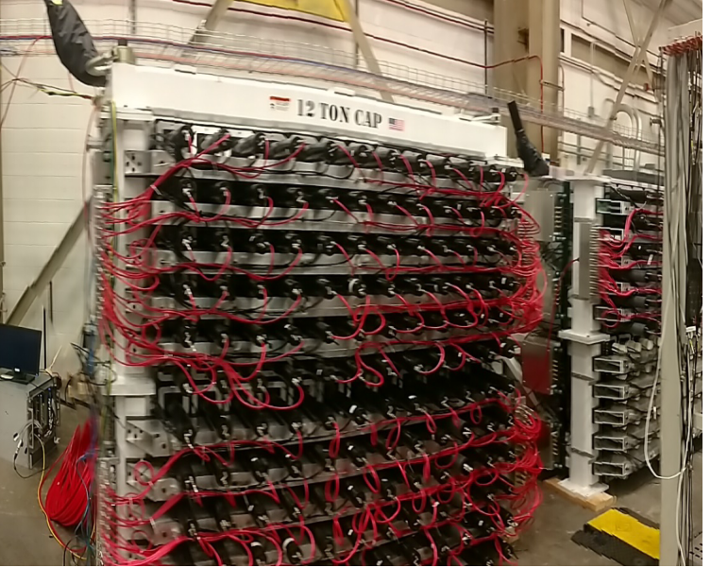
Major SBS Components at JLab, undergoing final testing, PLANning FOR 2020 G_{M}^{n} (G_{e}^{n}-RP) installation
GEM Front Tracker
Polarized 3He: setup of filling a target cell with ~11 atmospheres of gas by chilling the cell to a temperature near that of LHe. The target is inside the closed metal dewar box.
ECAL: Part of the 100 supermodules frames that have been assembled.
HCAL: 4 superframes which each hold 6x12 modules stacked in groups of two.
GRINCH installed in BigBite frame
5-12/2020 JLab Down for CHL2K cold box – SBS installation opportunity!
10

Slide 11
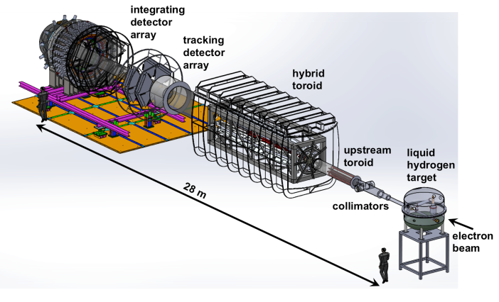
Jlab MOLLER Activities
April 2019 Director’s Review (cost, schedule, technical)
- formed project team
- technical specifications
- ”bottoms up” costing from L2 managers
- define and plan for dependencies
Possible project start FY20
High power target development
Physics Division magnet group costing, looking at design options
Developing common Hall A/C platform for polarimetry
Considering same approach for beam instrumentation
Parity quality beam development
Ferrite raster development

Slide 12
MOLLER High-Level Project Schedule --DRAFT--
Draft a Plan

Slide 13
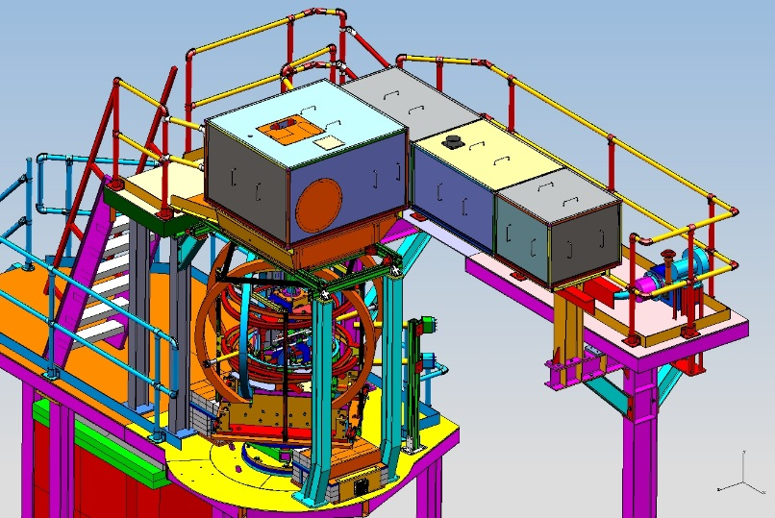
Jlab solid activities
    Engineering and design
      Outer steel arrived from Cornell last week!
    Magnet preparations
      Looking towards static test
      Instrumentation and controls (reduce highest schedule risk)
    Data acquisition
      Also high rate GEM test stand (TDIS+, E. Jastrzembski)
    Slow controls
    Software development
    Polarized ³He target development
    Polarimetry (also for PREX2/CREX,..)
    Regular parity quality beam meetings
    Magnetic field analysis
    Project planning
      Cost updates for Director’s Review end of Summer 2019

Slide 14
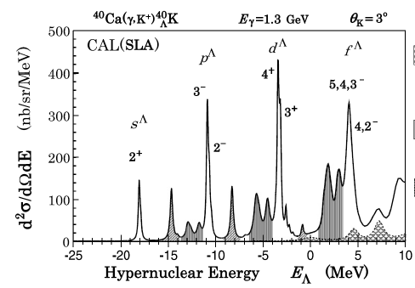
Hypernuclear Spectroscopy
PCSM
Ready by 2021
New PCSM (Pair of Charge Separation Magnets)
Ca target holder design/construction started

Slide 15
2019 Hall A Publications + Students
First Measurement of the Ar(e,e′)X Cross Section at Jefferson Lab
Phys. Rev. C 99, 054608 (2019) (H. Dai et al.)
First Measurement of the Ti(e,e′)X Cross Section at Jefferson Lab
Phys. Rev. C 98, 014617 (2018) (H. Dai et al.)
High-resolution hypernuclear spectroscopy at Jefferson Lab, Hall A
Phys. Rev. C 99, 054309 (2019) (F. Garibaldi et al.)
Measurement of double-polarization asymmetries in the quasi-elastic ³He↑(e↑, e′p) process
Phys. Lett. B 788, 117 (2019) (M. Mihovilovič et al.)
Proton charge radius extraction from e scatt. data using dispersively improved chiral effective field theory
Phys. Rev. C 99, 044303 (2019) (J.M. Alarcón, D.W. Higinbotham, C. Weiss, Z. Ye.)
Density Changes in Low Pressure Gas Targets for Electron Scattering Experiments
Accepted NIM A - 10.1016/j.nima.2019.06.025 (S.N. Santiesteban et al.)
Graduated Students: Dien Nguyen, Scott Barcus, Thir Gautam, William Henry, Caryn Palatchi, Barak Schmookler

Slide 16
Hall A Publication Drafts
Measurement of the single-spin asymmetry A_{y}⁰ in quasi-elastic ³He↑(e,e′n) scattering at 0.4<Q²<1.0 GeV/c²
arXiv:1906.04075 (E. Long et al.)
Probing for high momentum protons in ⁴He via the ⁴He(e,e′p)X reaction
arXiv:1905.00541 (S. Iqbal et al.)
Comparing proton momentum distributions in A=3 nuclei via ³He and ³H(e,e′p) measurements
arXiv:1902.06358 (R. Cruz-Torres et al.)
Dispersive Corrections to the Born Approximation in Elastic eA Scattering in the Intermediate Energy Regime
arXiv:1805.12441 (P. Guèye et al.)
The Double Spin Asym. of Nitrogen in Elastic and Quasi el. Kin. from a Soild Ammonia Dynamically Pol. target
arXiv:1905.12550 (Moshe Friedman, Jessica Campbell, Adam Sarty, Douglas W. Higinbotham, Guy Ron)

Slide 17
SBS GMn, GEn-RP Internal Hall Preparedness Review
This will be the second SBS Internal Hall preparedness review for the GMn, GEn-RP experiments (meeting afternoons).
This review will be as we did before – short, pointed talks on each component focusing on:
- current status
- any remaining needs
- timeline/tasks to readiness
- manpower
- integration considerations
There will be other parts of the collaboration meeting dedicated to reporting on good work done and interesting observations/plans – not for the review
The Hall review is not formal; the only deliverable is a list of notes by/to me for anything that requires (unplanned or additional) attention, resources, manpower
Thank you Steve and Howard!

Slide 18
Thanks! Any questions?

