Slide 1
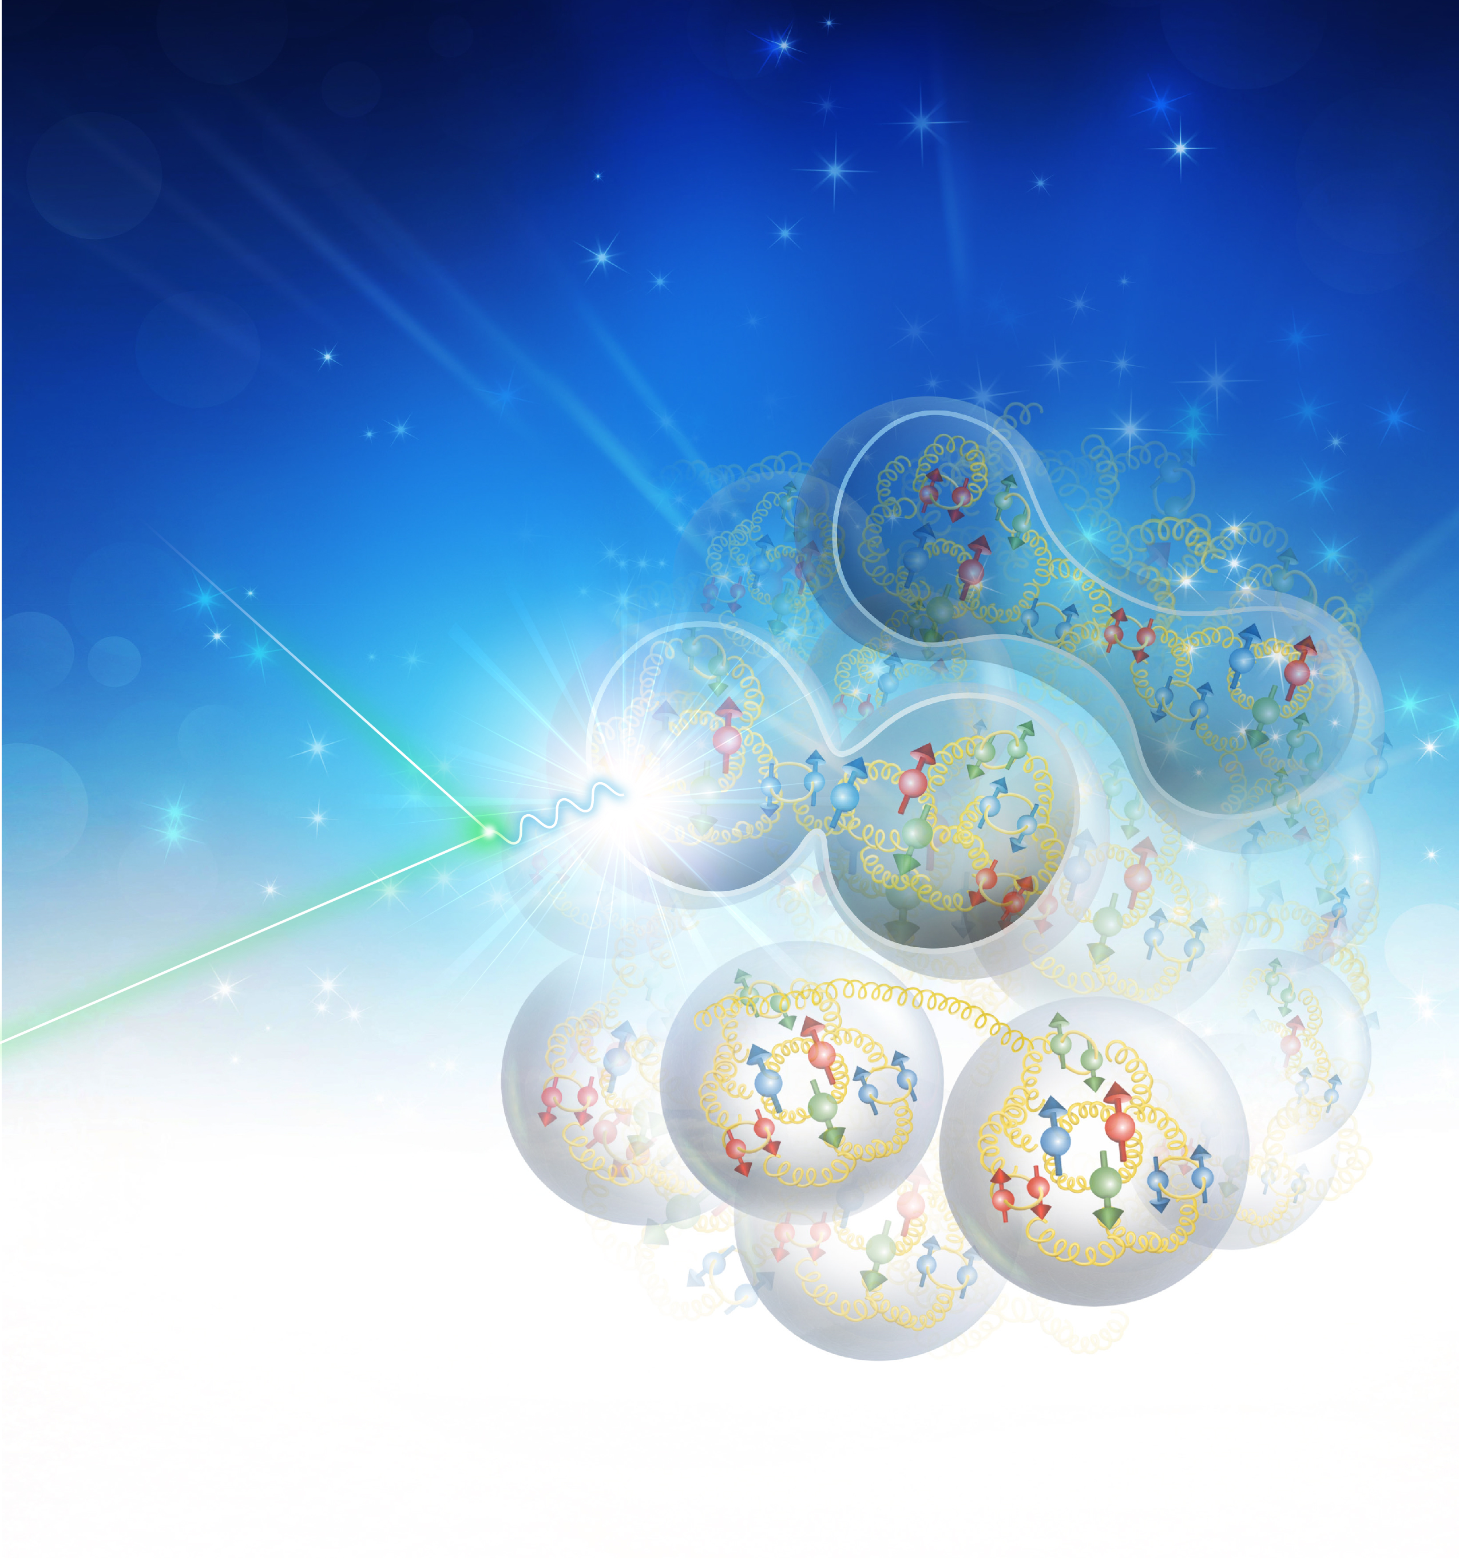
Role of Halls A and C in JLab 12 GeV Program
Rolf Ent

Slide 2
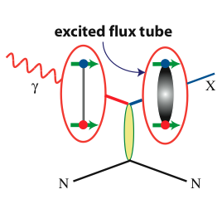
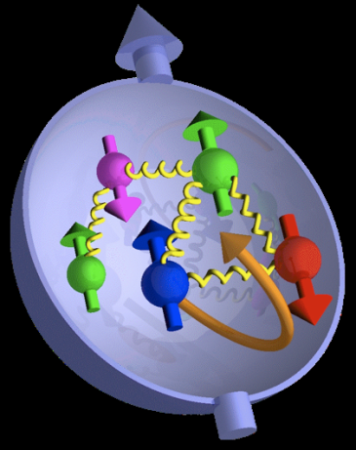

JLab: 21st Century Science Questions
What is the role of gluonic excitations in the spectroscopy of light mesons? Can these excitations elucidate the origin of quark confinement?
excited gluon field
Where is the missing spin in the nucleon? Is there a significant contribution from valence quark orbital angular momentum?
Can we reveal a novel landscape of nucleon substructure through measurements of new multidimensional distribution functions?
What is the relation between short-range N-N correlations, the partonic structure of nuclei, and the nature of the nuclear force?
Can we discover evidence for physics beyond the standard model of particle physics?

Slide 3
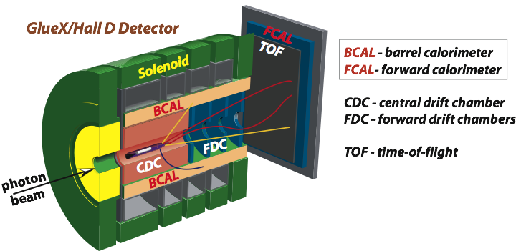
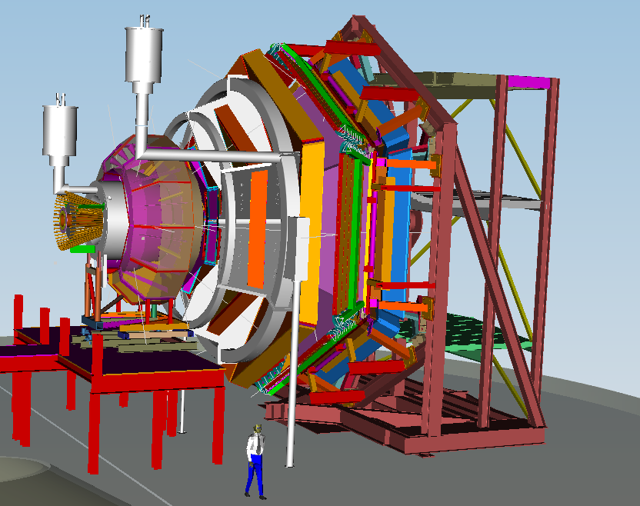
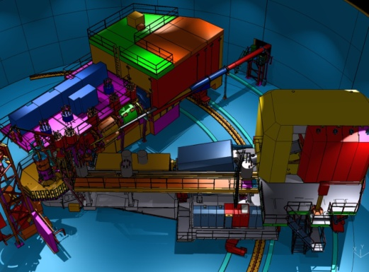

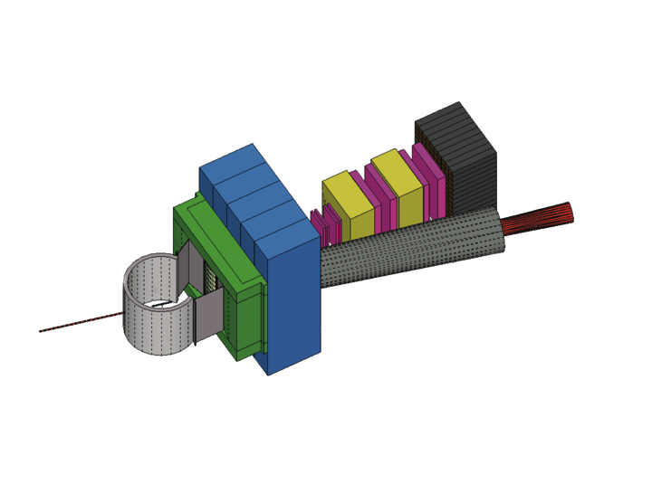

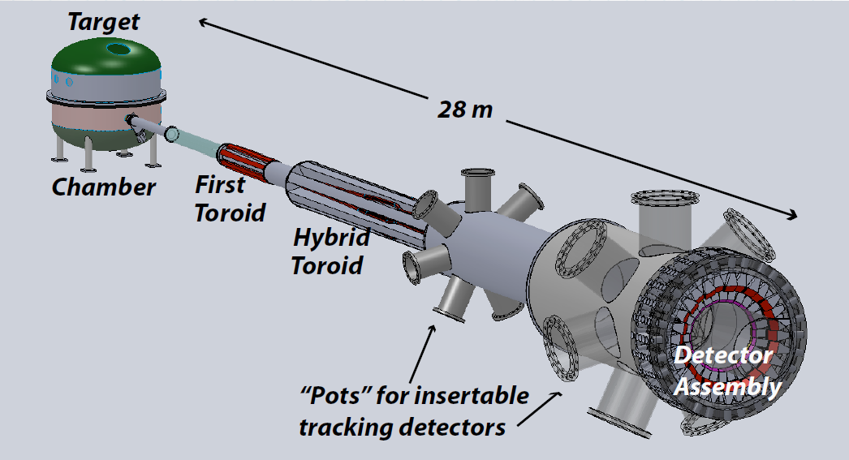
Detector Requirements: Complementarity
Hall D | Hall B | Hall C | Hall A
excellent hermeticity | luminosity 10³⁵ | energy reach | custom installations
polarized photons | hermeticity | precision
E_{γ}~8.5-9 GeV | 11 GeV beamline
10⁸ photons/s | target flexibility
good momentum/angle resolution |  | excellent momentum resolution
high multiplicity reconstruction |  | luminosity up to 10³⁸
particle ID
SBS
SOLID
SOLID
MOLLER

Slide 4
Hall C at 12 GeV: HMS + SHMS + NPS + CPS + LAD
Charged particle detection with momentum up to beam energy z = E_{h}/ν = 1
Small angle capability essential to measure charged particle along momentum transfer θ_{h} // q ± few º
Precision L/T separations
High Luminosity L = 10³⁸
σ = Γ(σ_{Τ} + εσ_{L} + ε cos(2φ)σ_{TT} + [ε(ε+1)/2]^{1/2}cos(φ)σ_{LT})
2006 slide, 2019 changes
Exclusive and Semi-Inclusive Reactions (z > 0.3) at high Q²
Separation of Polarized and Unpolarized Structure
Functions over large range of x and Q²
→Small Cross Sections
→Photon Beams and Photon/Neutral-Pion Detection

Slide 5
Role of Halls A/C in JLAB 3D Imaging Program
1D: Form Factors! – Nucleon, Pion (and Kaon?)
1D: Real Compton Scattering – one of the processes leading to the birth of the 3D formalism, and perhaps still the least understood elementary process.
1D: Structure Functions – Largest x (where “large-x kinematic focusing” enhances need for luminosity and less so of acceptance) – F₂^{p,d}, A₁^{n}/d₂^{n}
Precision Cross Sections required for 3D imaging!
  Separation of longitudinal and transverse cross sections towards understanding of reaction mechanism of DVCS, and charged and neutral light meson (pion, kaon) electro-production – both SIDIS and DES
  Precision cross section ratios, like π⁺/π⁻, K⁺/π⁺
  Precision helicity-dependent cross section ratios (aka spin asymmetries) making use of the Halls A/C versatility – like high-intensity photon beams, longitudinal and transverse polarized target compatibility, e.g., WACS, TCS, photoproduction
  3D Imaging at large x (where again the “large-x kinematic focusing makes systems such as SBS and SoLID well superior).
My analogy is always that Halls A/C should provide the structure of the house, and Hall B the floors/roof, you need both to make your house habitable.

Slide 6
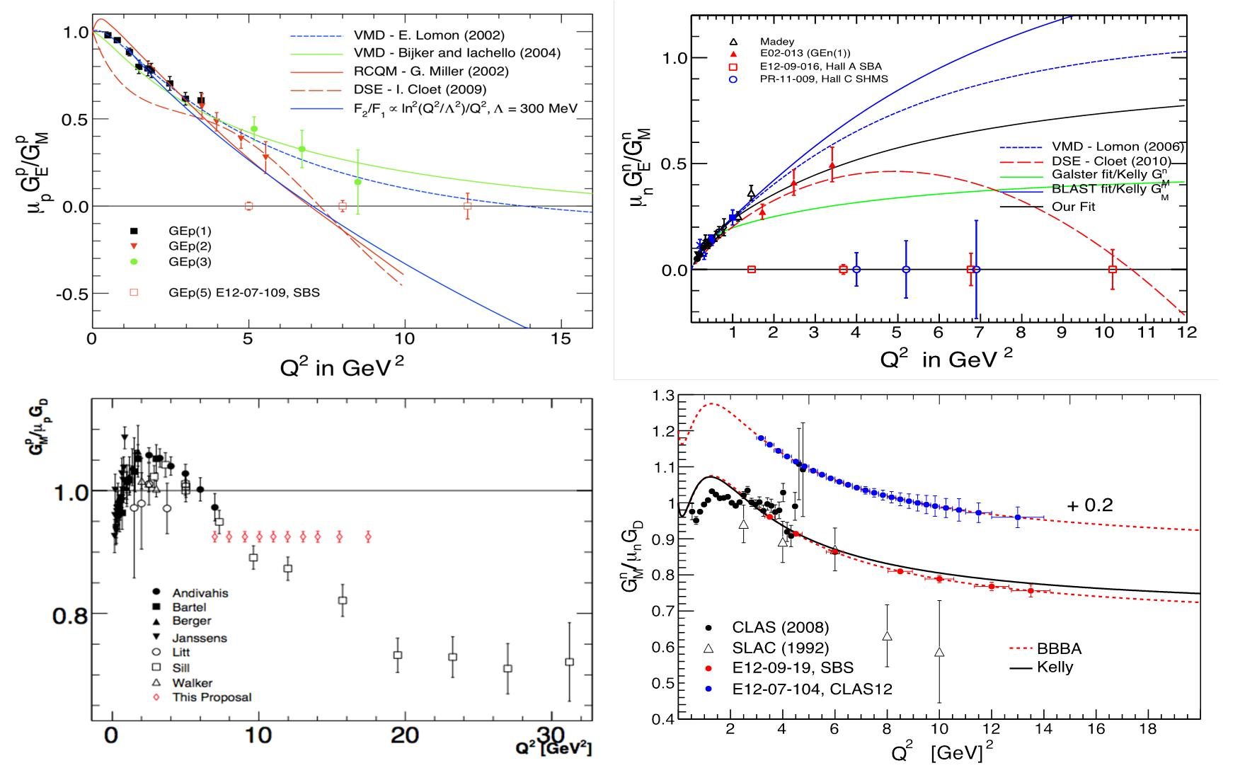
Extending Q² Range oF NUCLEON Form Factors
Physics Reach extended by Super BigBite Spectrometer (SBS) in Hall A:
- Use high luminosity + open geometry + GEM detectors
  - Pushes G_{E}^{p}/G_{M}^{p}, G_{E}^{n}, G_{M}^{n} to high Q² (>10 GeV²)
  - Allows for flavor decomposition to distance scales deep inside the nucleon

Slide 7
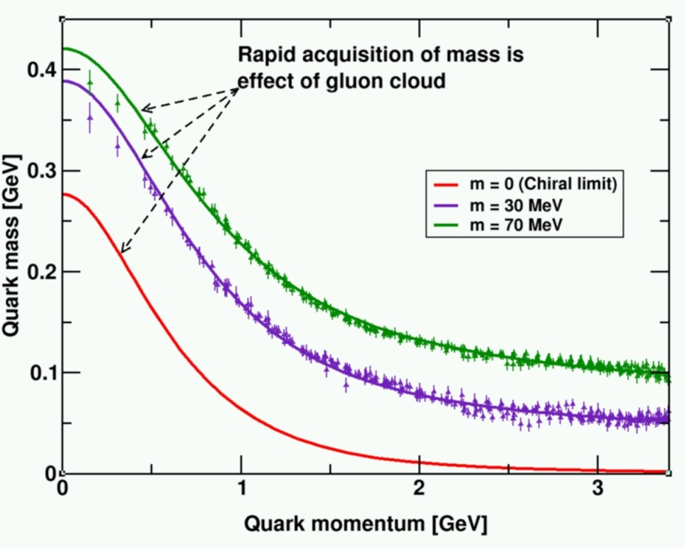
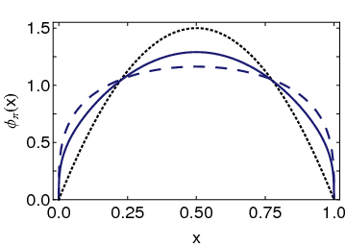
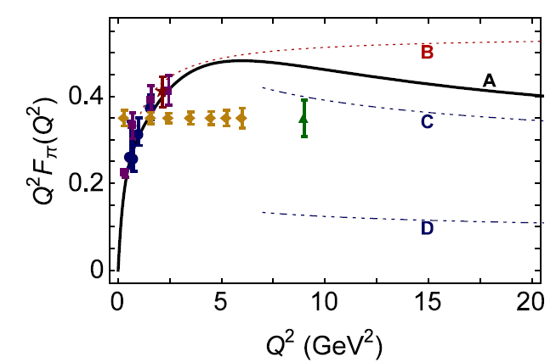
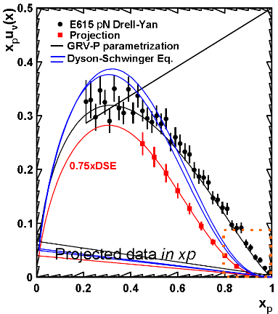
Pion Form Factor and PION Structure Function
Conformal QCD
DSE
RL
Real-world PDAs are squat and fat
Implications if so: two longstanding puzzles could be solved
Magnitude of pion form factor in hard scaling regime
Power of pion parton behavior at large x
Also implications for nucleon and N* form factor interpretation (not shown here).
monopole
Hard QCD obtained with the PDA appropriate to the scale of the experiment
Hard QCD obtained with φ_{π}^{asy}(x)
Pion FF – first quantitative access to hard scattering scaling regime?
Pion SF – (1-x)¹ or (1-x)² dependence at large x?
and kaon

Slide 8
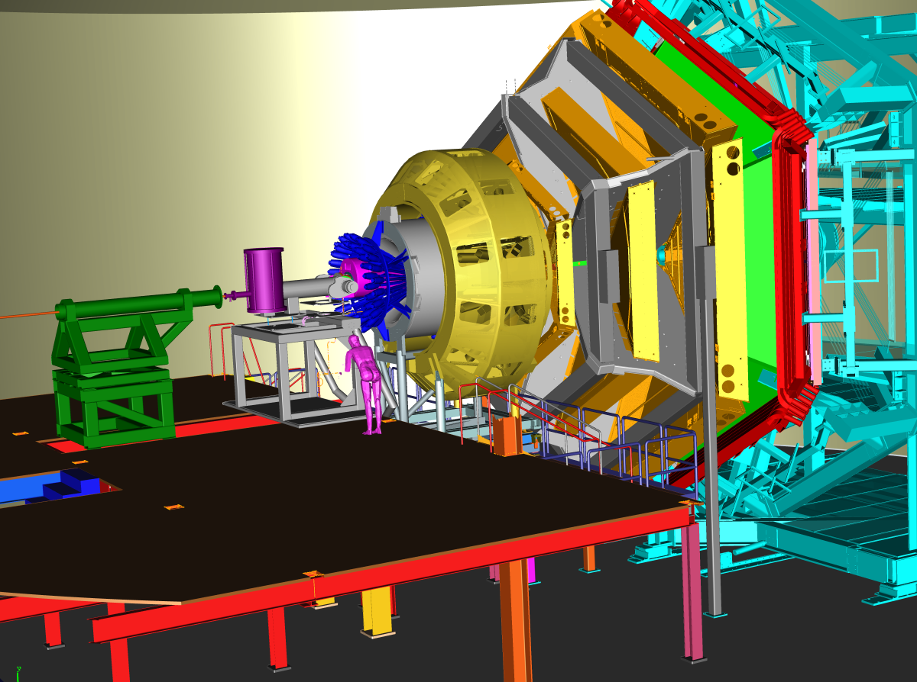

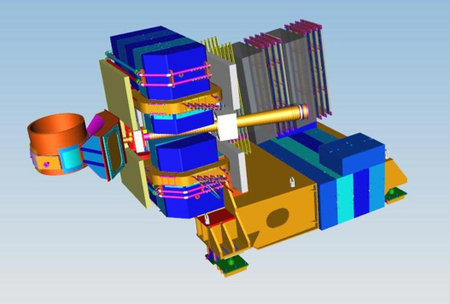
3D Imaging With JLab @ 12 GeV
Generalized Parton Distributions (GPDs) and Transverse Momentum Distributions (TMDs)
CEBAF Large Acceptance Spectrometer (CLAS12) in Hall B: general survey experiments, large acceptance and medium luminosity
SHMS, High Momentum Spectrometer (HMS) and Neutral-Particle Spectrometer (NPS) in Hall C: precision cross sections for L-T studies and ratios, small acceptance and high luminosity
Super Bigbite Spectrometer (SBS) in Hall A : dedicated large-x TMD study,
medium acceptance and high luminosity
Future: Solenoidal Large Intensity Device (SoLID) in Hall A: large acceptance and high luminosity

Slide 9
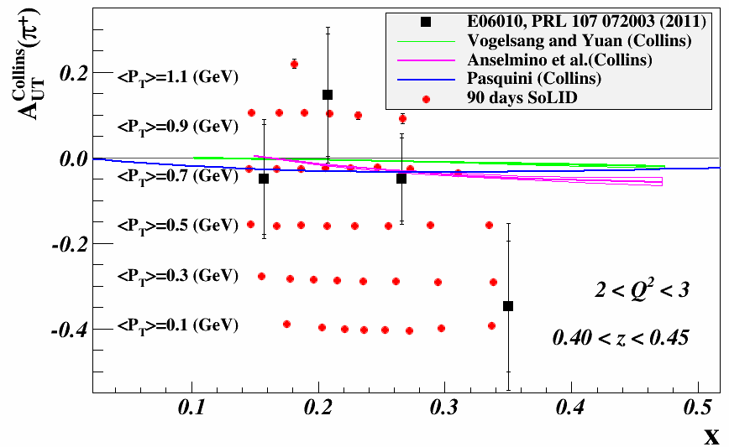
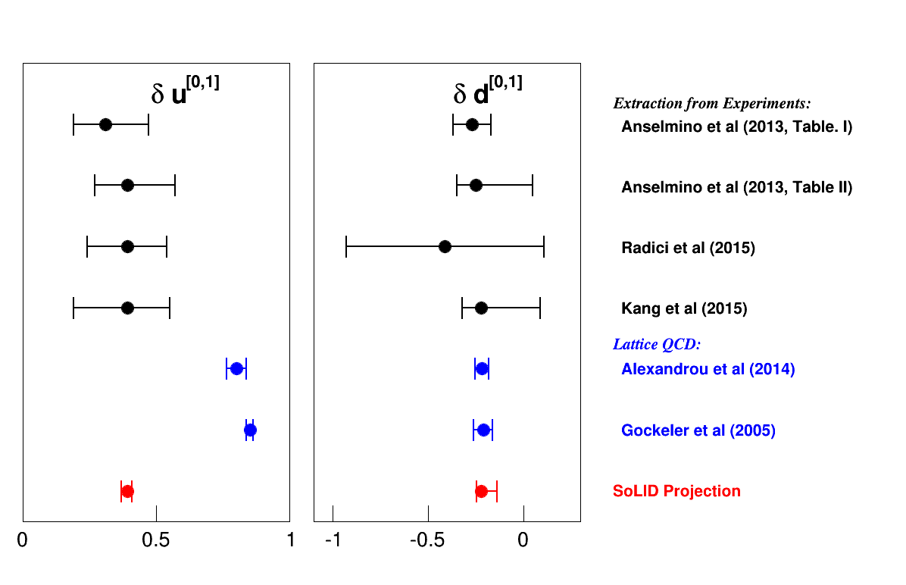
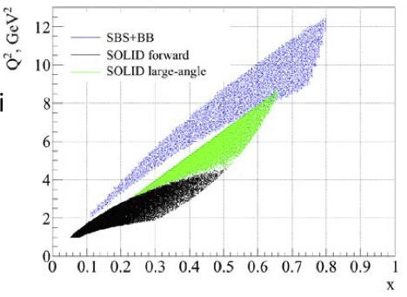
TMD Program in Hall A with SoLID & SBS (match large acceptance devices at high luminosity to anticipated polarized 3He target performance)
Tensor Charges
SoLID projection extraction by A. Prokudin using only statistical errors and based on:
a set of data with a limited range of x values
the assumption of a negligible contribution from sea quarks
assumption on Q² evolution
model dependent assumptions on the shape of underlying TMD distributions
SoLID & SBS: Complementary Kinematics

Slide 10
Role of Halls A/C in JLAB Nuclear Program
Absolute Cross Section measurements and Ratios required for Nuclear Program
  Experiments relying on good energy resolution and determination – Hypernuclei! Also few-body systems (radii, form factor minima, etc.)
  Precision nuclear cross section ratios, over a wide range of nuclei, towards x > 1 and nuclear EMC effect resolution
  Low-scattering probability nuclear reactions making use of the Halls A/C versatility – like momentum distributions at large missing momentum, color transparency for (e,e’π) at highest Q², tagged proton measurements, possibility of tensor-polarized deuterium.
  Nuclear experiments benefitting from parity-quality Jefferson Lab beam (see Fundamental Symmetries slide)

Slide 11

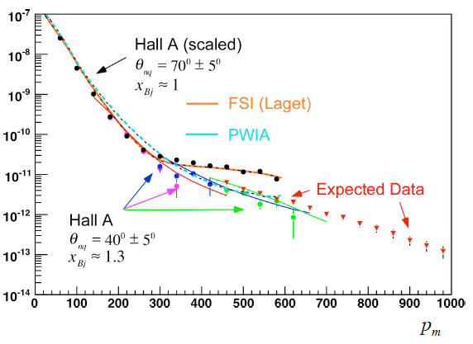
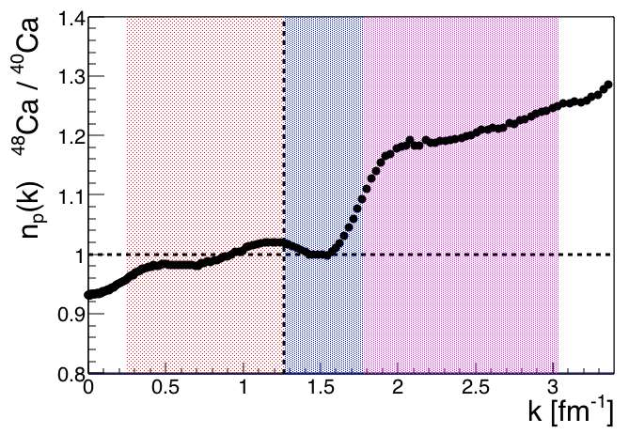
Proton Momenta in the nucleus
p
n
⁴⁸Ca → ⁴⁰Ca (adding 8 neutron to a f 7/2 subshell ) 40% more neutrons
Projected measurements @ 12 GeV of ²H(e,e’p) cross section mapping high proton momenta induced by short-range repulsive NN core
Map ratio of ⁴⁸Ca(e,e’p) and ⁴⁰Ca(e,e’p) cross sections at high proton momenta
Hall A ³H, ³He data in
More correlated pn pairs
D(e,e’p)n cross section [fm²/MeV/sr²]
(Hall C)
No change in # of correlated protons
Proton momentum [MeV/c]
Lonardoni, et al.,
arXiv.1705.04337 [nucl-theory] 2017
Hall C some ²H high-P_{m} data in

Slide 12
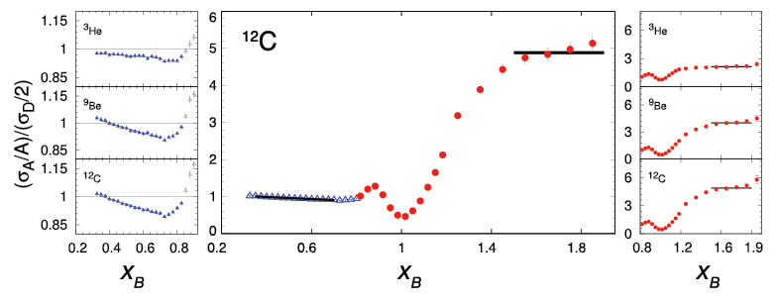
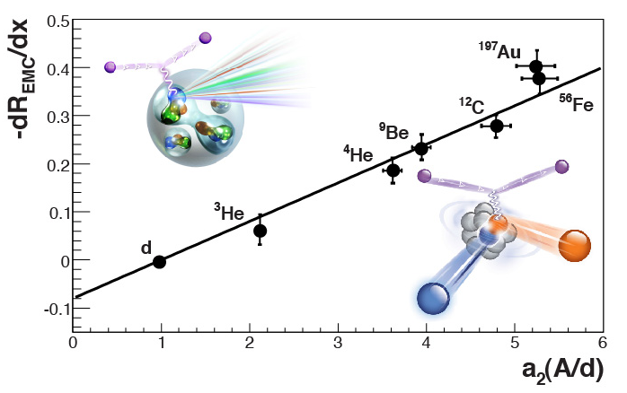
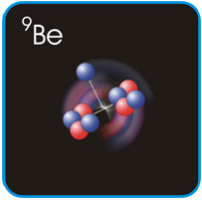
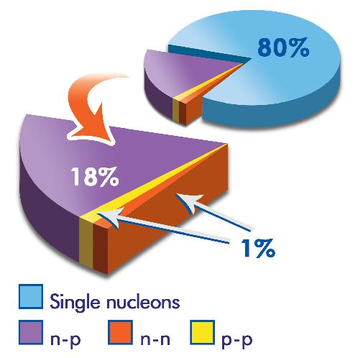
Parton Dynamics and N-N Correlations
EMC effect: quark momentum in nucleus is altered
N-N Correlations: pairing due to tensor force and strong repulsive core
EMC Slopes 0.35 ≤ x_{B} ≤ 0.7
a₂(A/d)
Luminosity, nuclei
N-N correlated pairs x_{B} ≥ 1.4
12 GeV science quest:
isospin dependence: ³H, ³He, ^{6,7}Li, ⁹Be ^{10,11}B, ^{40,48}Ca
initial spin dependence (⁷Li)
“tagged” deep-inelastic scattering off ²H
  with both slow and fast protons
Hall C ⁹Be, ^{10,11}B data in
⁹Be ~
ααn

Slide 13

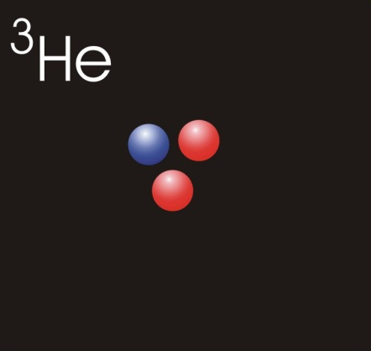


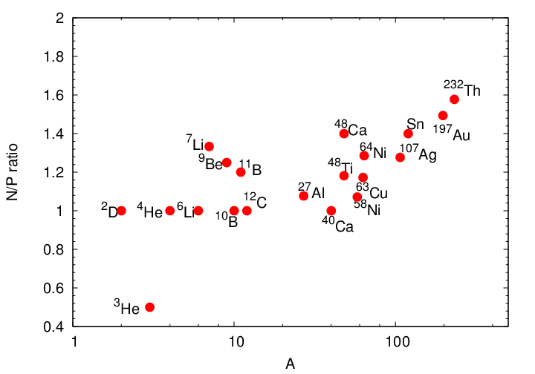
X > 1 and (Precision) Nuclear EMC Effect
x>1 uses wide range of nuclear targets to study impact of cluster structure, separate mass and isospin dependence on SRCs
Additional foil targets (dark blue) added to original proposal. No additional beam time required, no special target issues
All targets measured for SRCs at high-rate kinematics. Select targets run at higher Q² to study Q² dependence or extend kinematic reach
¹H
²H
³He
⁴He
^{6,7}Li
⁹Be
^{10,11}B
¹²C
Targets selected to match 12 GeV EMC experiment
Light nuclei: Reliable calculations of nuclear structure (e.g. clustering)
Heavier nuclei: Cover range of N/Z at ~fixed values of A

Slide 14
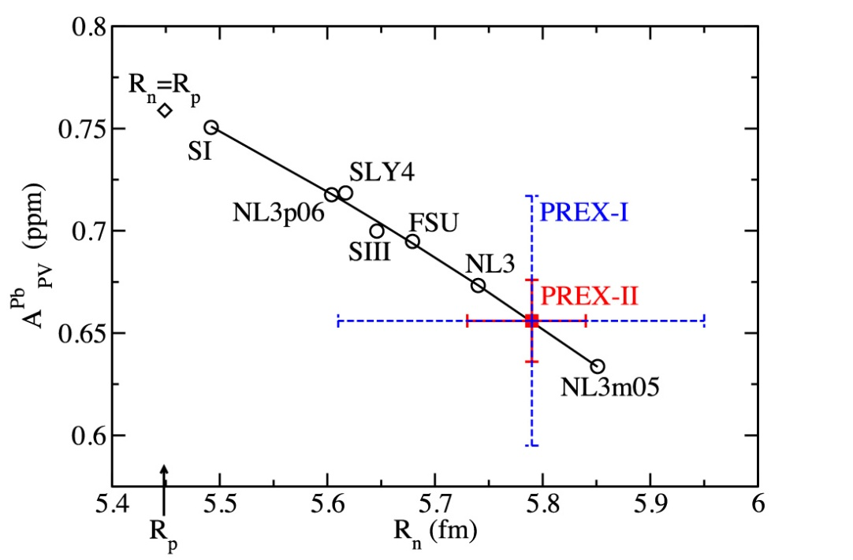
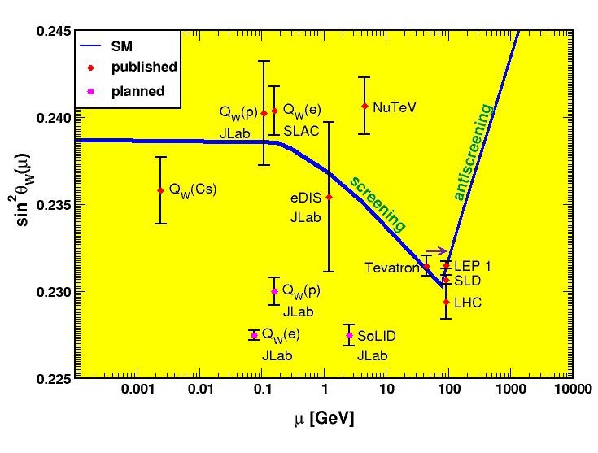

Role of Halls A/C in JLAB fundamental symmetries Program: Parity Violation Experiments
Strangeness Form Factors (complete)
HAPPEX (Hall A)
G0 (Hall C)
PREX neutron skin (present)
first PREX (²⁰⁸Pb) experiment completed
PREX-II and CREX (⁴⁸Ca) ongoing
Qweak (complete)
proton weak charge
lepto-quark couplings
MOLLER (future)
electron weak charge
purely leptonic
SoLID (future)
lepto-quark couplings
lepto-phobic Z’
d/u, higher-twist
Luminosity, polarization

Slide 16
Wide-Angle Compton Scattering
Arguably the least understood of the fundamental reactions in the several-GeV regime
Wide-Angle Compton Scattering cross section behavior nonetheless was a foundation leading to the GPD formalism
Reaction mechanism intrinsically intertwined with basic of hard e-q scattering process (handbag diagram), yet also sensitivity to transverse structure like high-Q² form factors
Perhaps (6-GeV data) factorization valid for s, -t, -u > 2.5 GeV²
12-GeV data for –u > 2.5 and –t up to ~ 10, s up to ~ 20 GeV²
Also polarized now with NPS and CPS

Slide 17
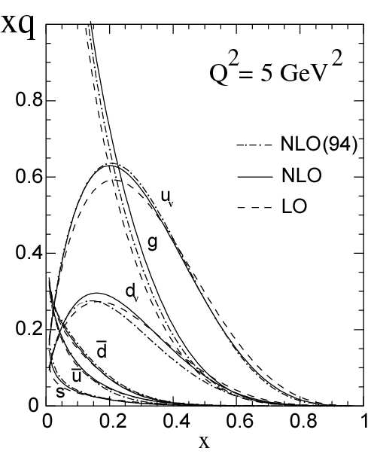
Measuring High-x Structure Functions
REQUIRES:
High beam polarization
High electron current
High target polarization
Large solid angle spectrometers
BONUS
3H/3He
PVDIS
x →1 predictions | F₂^{n}/F₂^{p} | d/u | A₁^{n} | A₁^{p}
SU(6) | 2/3 | 1/2 | 0 | 5/9
Diquark Model/Feynman | 1/4 | 0 | 1 | 1
Quark Model/Isgur | 1/4 | 0 | 1 | 1
Perturbative QCD | 3/7 | 1/5 | 1 | 1
QCD Counting Rules | 3/7 | 1/5 | 1 | 1
12 GeV will access the regime (x > 0.3), where valence quarks dominate

Slide 18
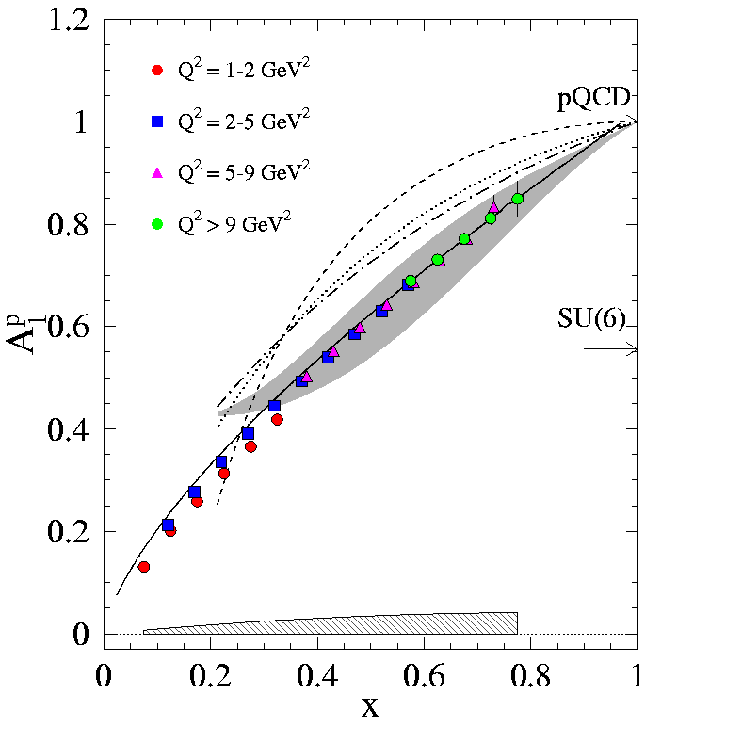
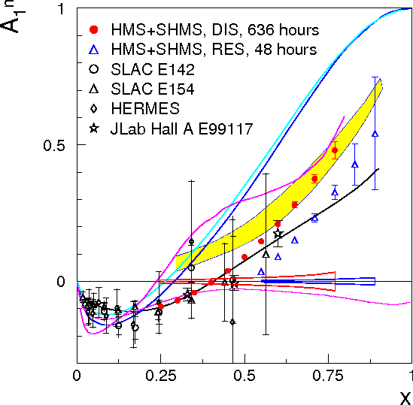
Measuring High-x Structure Functions
REQUIRES:
High beam polarization
High electron current
High target polarization
Large solid angle spectrometers
Hall B: A₁^{p}
(and A₁^{d})
Hall C: A₁^{n}
(from A₁^{3He})
12 GeV will access the regime (x > 0.3), where valence quarks dominate

Slide 19
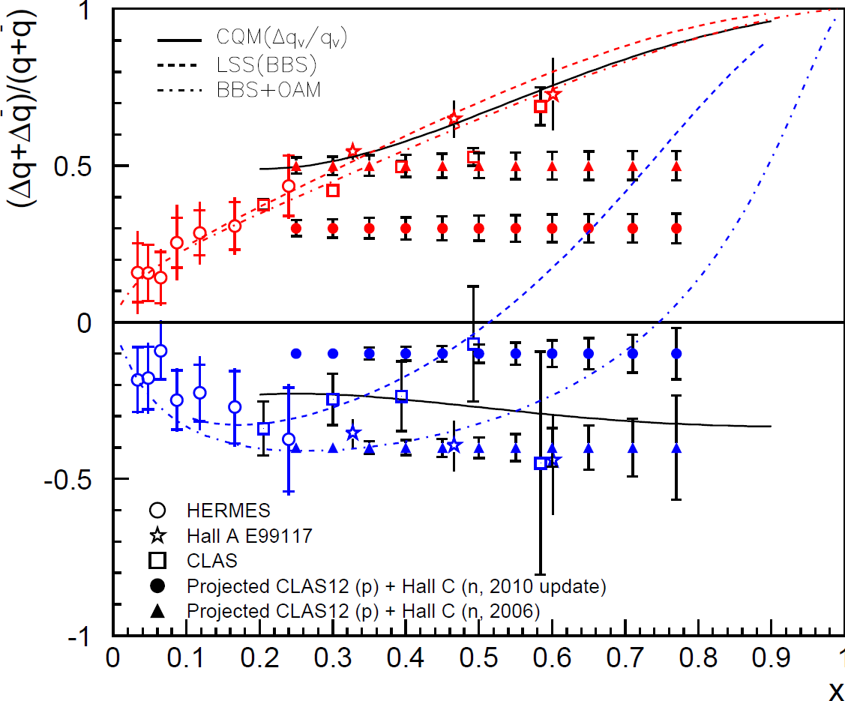
Measuring High-x Structure Functions
REQUIRES:
High beam polarization
High electron current
High target polarization
Large solid angle spectrometers
Combine Hall B A₁^{p} and Hall C A₁^{n} → extract Δu/u and Δd/d (constrained by knowledge of A₁^{n} → requires polarized ³He performance!)
Δu/u
Δd/d
12 GeV will access the regime (x > 0.3), where valence quarks dominate

Slide 20
Towards 3D Imaging
Motivation: in other sciences, imaging the physical systems
under study has been
key to gaining new
understanding.
Structure mapped
in terms of
b_{T} = transverse position
k_{T} = transverse momentum

Slide 21
Exploring the 3D Nucleon Structure
After decades of study of the partonic structure of the nucleon we finally have the experimental and theoretical tools to systematically move beyond a 1D momentum fraction (x_{Bj}) picture of the nucleon.
    High luminosity, large acceptance experiments with polarized beams and targets.
    Theoretical description of the nucleon in terms of a 5D Wigner distribution that can be used to encode both 3D momentum and transverse spatial distributions.
Deep Exclusive Scattering (DES) cross sections give sensitivity to electron-quark scattering off quarks with longitudinal momentum fraction (Bjorken) x at a transverse location b.
Semi-Inclusive Deep Inelastic Scattering (SIDIS) cross sections depend on transverse momentum of hadron, P_{h⊥}, but this arises from both intrinsic transverse momentum (k_{T}) of a parton and transverse momentum (p_{T}) created during the [parton → hadron] fragmentation process.
Nuclear Femtography

Slide 22
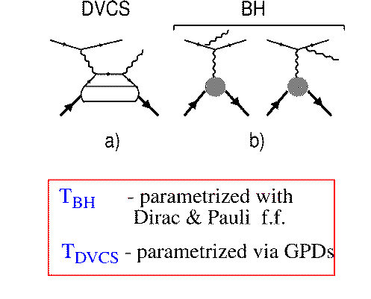
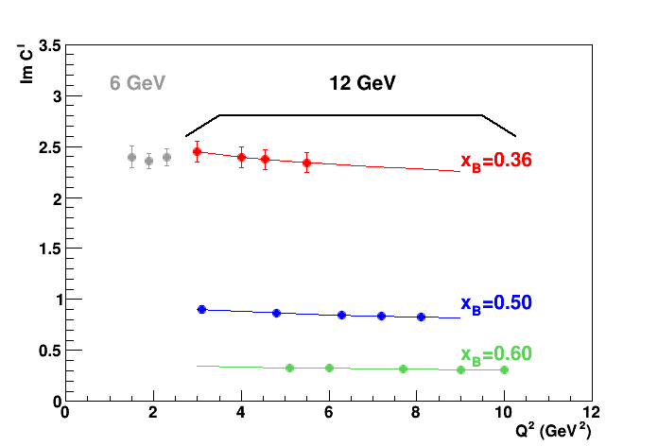
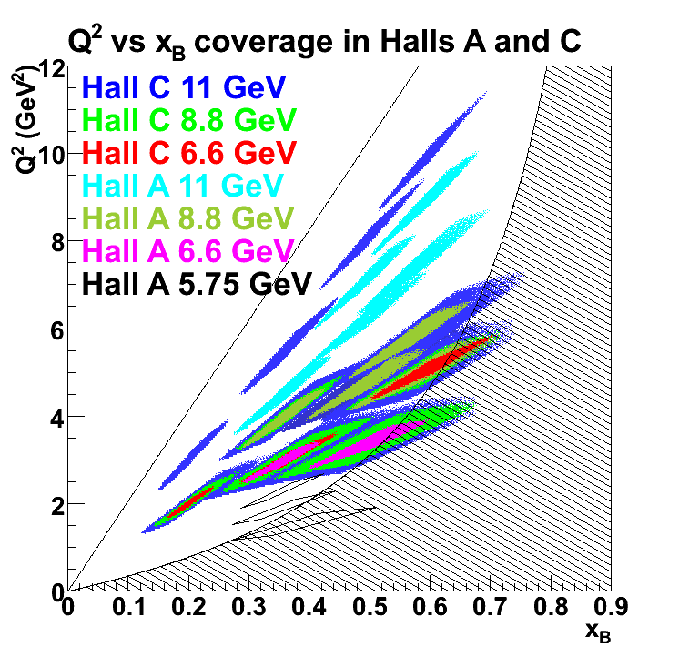
DVCS – Spatial Imaging
DVCS
Simplest process: e + p → e’ + p + γ (DVCS)
e
BH
e
p
p
Im C’
Hall A Jlab 6 GeV data for CFF (over limited Q² range) agree with hard scattering
Measurements in the 12 GeV Halls A and Hall C with NPS combined cover a large kinematic range
E12-13-010 goals:
Confirm scaling of the Compton Form Factor (CFF)
Extraction of the real part of CFFs through Rosenbluth-like separation of DVCS through cross section measurements at multiple beam energies
Halls A & C

Slide 23
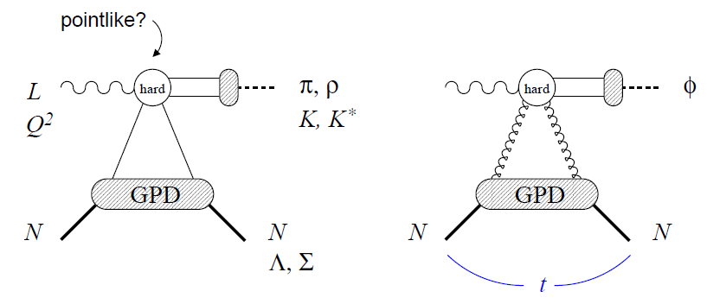
Towards Spin/Flavor Separation
Exclusive Reactions:
Deep Virtual Meson Production (DVMP)
pointlike?
Nucleon structure described by 4 (helicity non-flip) GPDs:
  H, E (unpolarized), , (polarized)
Quantum numbers in DVMP probe individual GPD components selectively
  Vector : ρº/ρ+/K* select H, E
  Pseudoscalar: π,η,K select the polarized GPDs, and
Need good understanding of reaction mechanism
  QCD factorization for mesons
  Can be verified experimentally through L/T separated cross sections

Slide 24
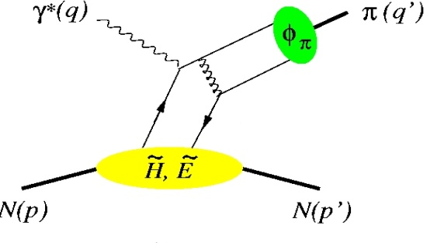
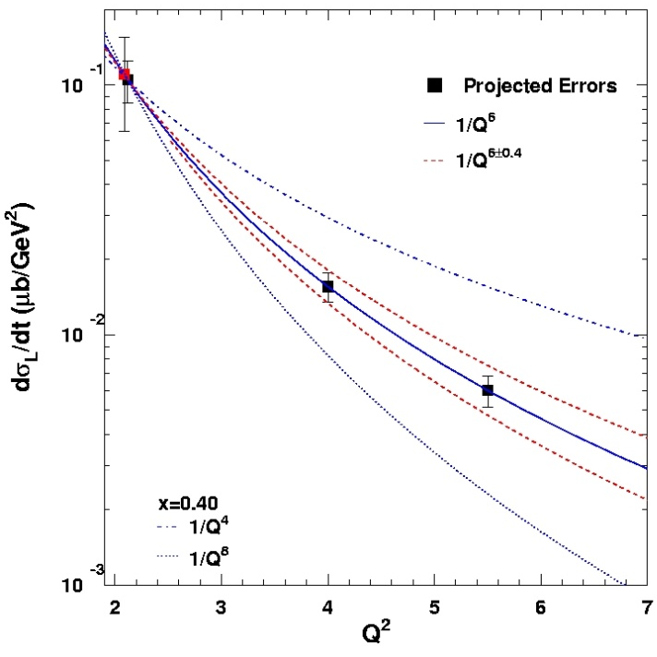
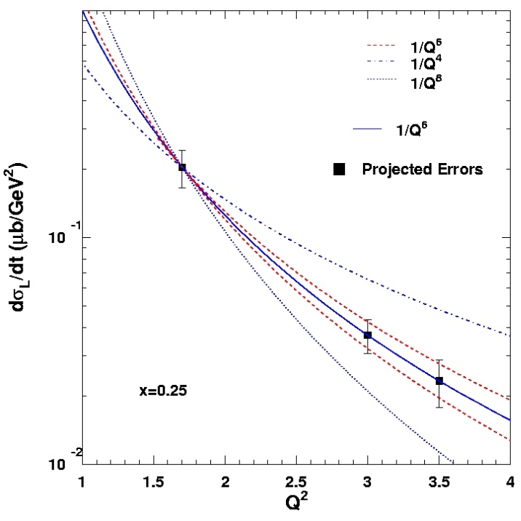
Factorization Tests in π⁺ and K⁺ Electroproduction
σ = Γ(σ_{Τ} + εσ_{L} + ε cos(2φ)σ_{TT} + [ε(ε+1)/2]^{1/2}cos(φ)σ_{LT})
π, K, etc.
p(e,e’π⁺)n
φ
π⁺: up to Q² = 10
K⁺: up to Q² = 6
Hard Scattering
Q⁻⁴
GPD
Q⁻⁶
Fit: 1/Q^{n}
Q⁻⁸
One of the most stringent tests of factorization is the Q² dependence of the π and K electro-production cross section
  σ_{L} scales to leading order as Q⁻⁶
x_{B} = 0.40
p(e,e’K⁺)Λ
Q⁻⁶
Q⁻⁴
Experimental validation of factorization essential for reliable interpretation of results from the JLab GPD program at 12 GeV for meson electro-production
Q⁻⁸
x_{B}=0.25
K and π together provide quasi model-independent study

Slide 25

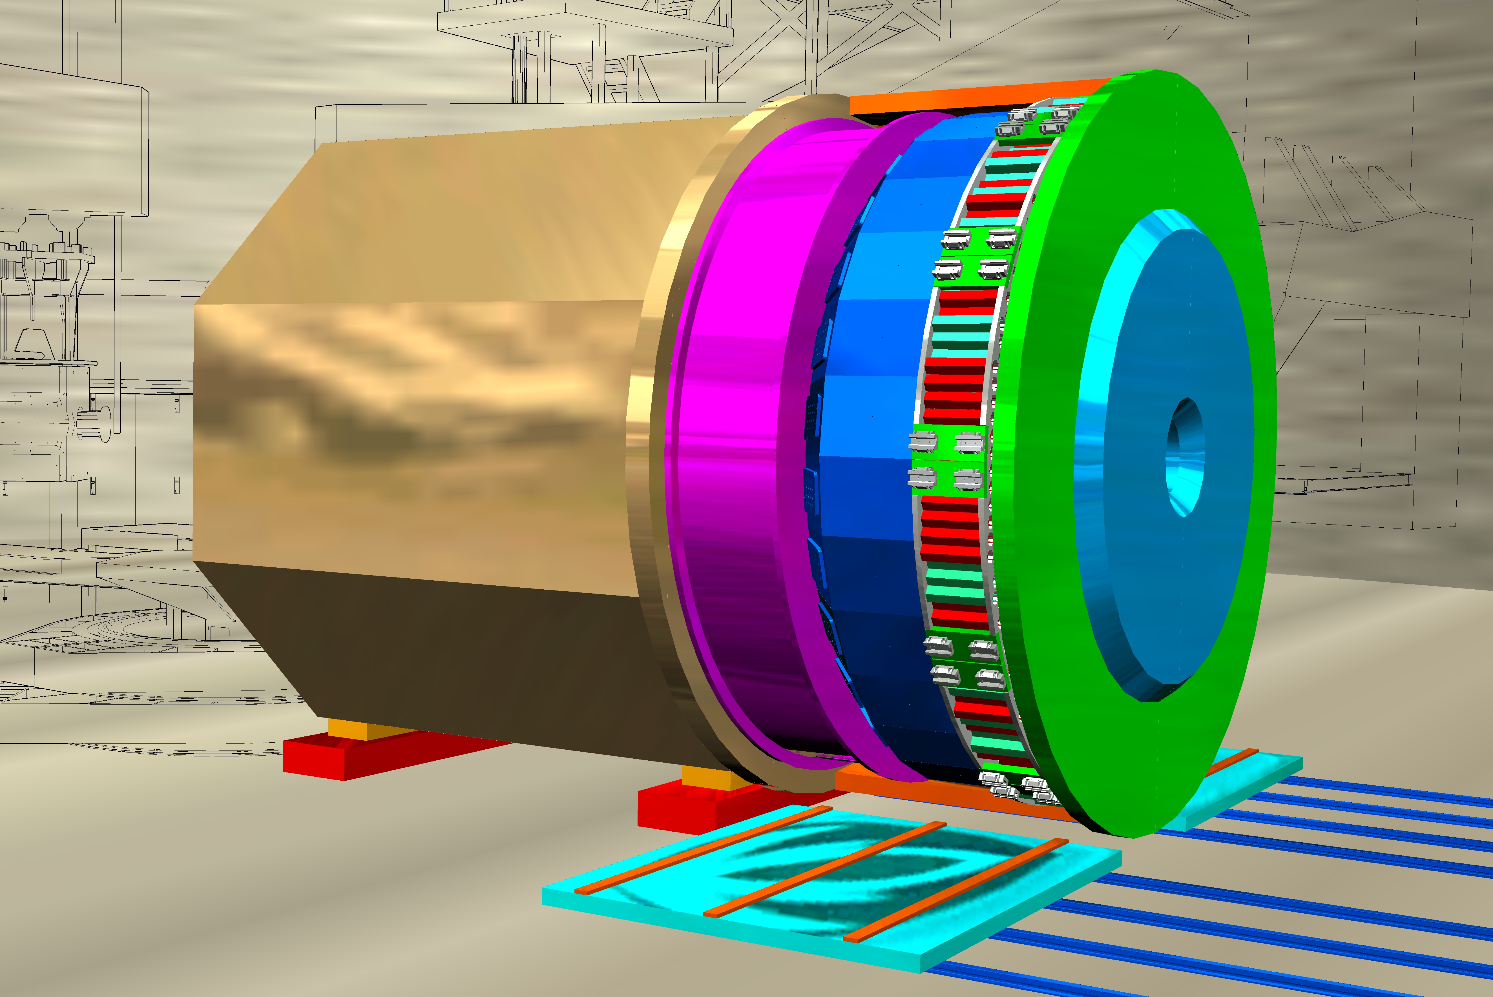
Together Stronger: 3D Momentum Imaging
CLAS12 in Hall B
General survey, medium lumi
SHMS, HMS, NPS in Hall C
L-T studies, precise π⁺/π⁻/π⁰ ratios
SBS in Hall A
High x, High Q², 2-3D
SOLID in Hall A
High lumi and acceptance – 4D

Slide 26
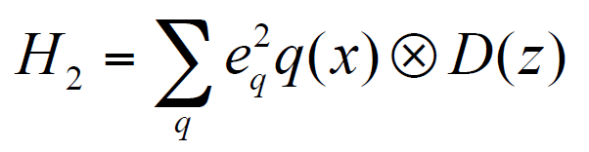
Hall C SIDIS Program – basic (e,e’Π) and (E,e’K) cross sections
Why need for (e,e’π) cross sections?
PAC37 Report: “the cross sections are such basic tests of the understanding of SIDIS at 11 GeV kinematics that they will play a critical role in establishing the entire SIDIS program of studying the partonic structure of the nucleon. In particular they complement the CLAS12 measurements in areas where the precision of spectrometer experiments is essential, being able to separate P_{T} and φ-dependence for small P_{T}.”
Basic precision cross section measurements:
Crucial information to validate theoretical understanding
  Convolution framework requires validation for most
  future SIDIS experiments and their interpretation
  Can constrain Q² dependence & TMD evolution
  Questions on target-mass corrections and ln(1-z) re-summations require precision large-z data
σ
f
Goal: Measure the basic SIDIS cross sections of π⁺, π⁻, π⁰ (and K⁺) production off the proton (and deuteron), including a map of the P_{T} dependence (P_{T} ~ Λ < 0.5 GeV), to validate⁽*⁾ a flavor decomposition and the k_{T} dependence of (unpolarized) up and down quarks
⁽*⁾ Can only be done using spectrometer setup capable of %-type measurements (an essential ingredient of the global SIDIS program!)

Slide 27
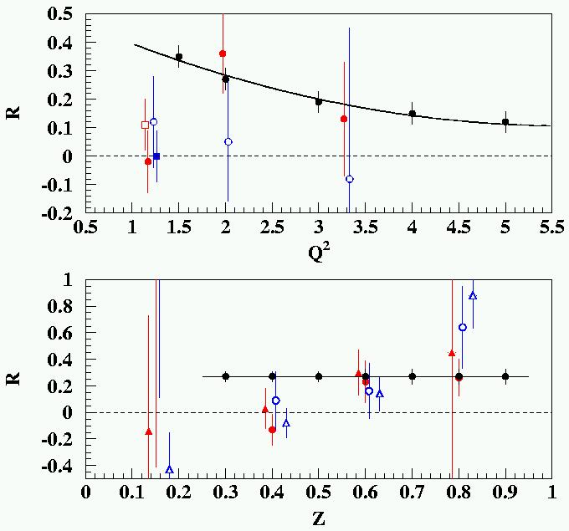
LONGITUDINAL CROSS SECTION: R = σ_{L}/σ_{T} IN SIDIS
R_{DIS} is in the naïve parton model related to the parton’s transverse momentum:
R = 4(M²x² + <k_{T}²>)/(Q² + 2<k_{T}²>).
R_{DIS} → 0 at Q² → ∞ is a consequence of scattering from free spin-½ constituents
Cornell 70’s existing (H and D, π⁺ and π⁻)
JLab 12-GeV projected (H and D, π⁺ and π⁻)
R_{DIS}
Knowledge on R_{SIDIS} is non-existing
R_{SIDIS} may (will!) vary with z, and with p_{T}
(JLab E12-06-104 will scan versus p_{T} too)
Knowledge on R_{SIDIS} needed for any TMD-related asymmetry
Even if one can relate R_{SIDIS} to a flavor- dependent average transverse momentum in a naïve parton model
(W. Melnitchouk et al, in progress), R_{SIDIS} can not easily be integrated
in a global TMD analysis as it is
sensitive to gluon and HT effects.
R_{DIS} (Q² = 2 GeV²)

Slide 28
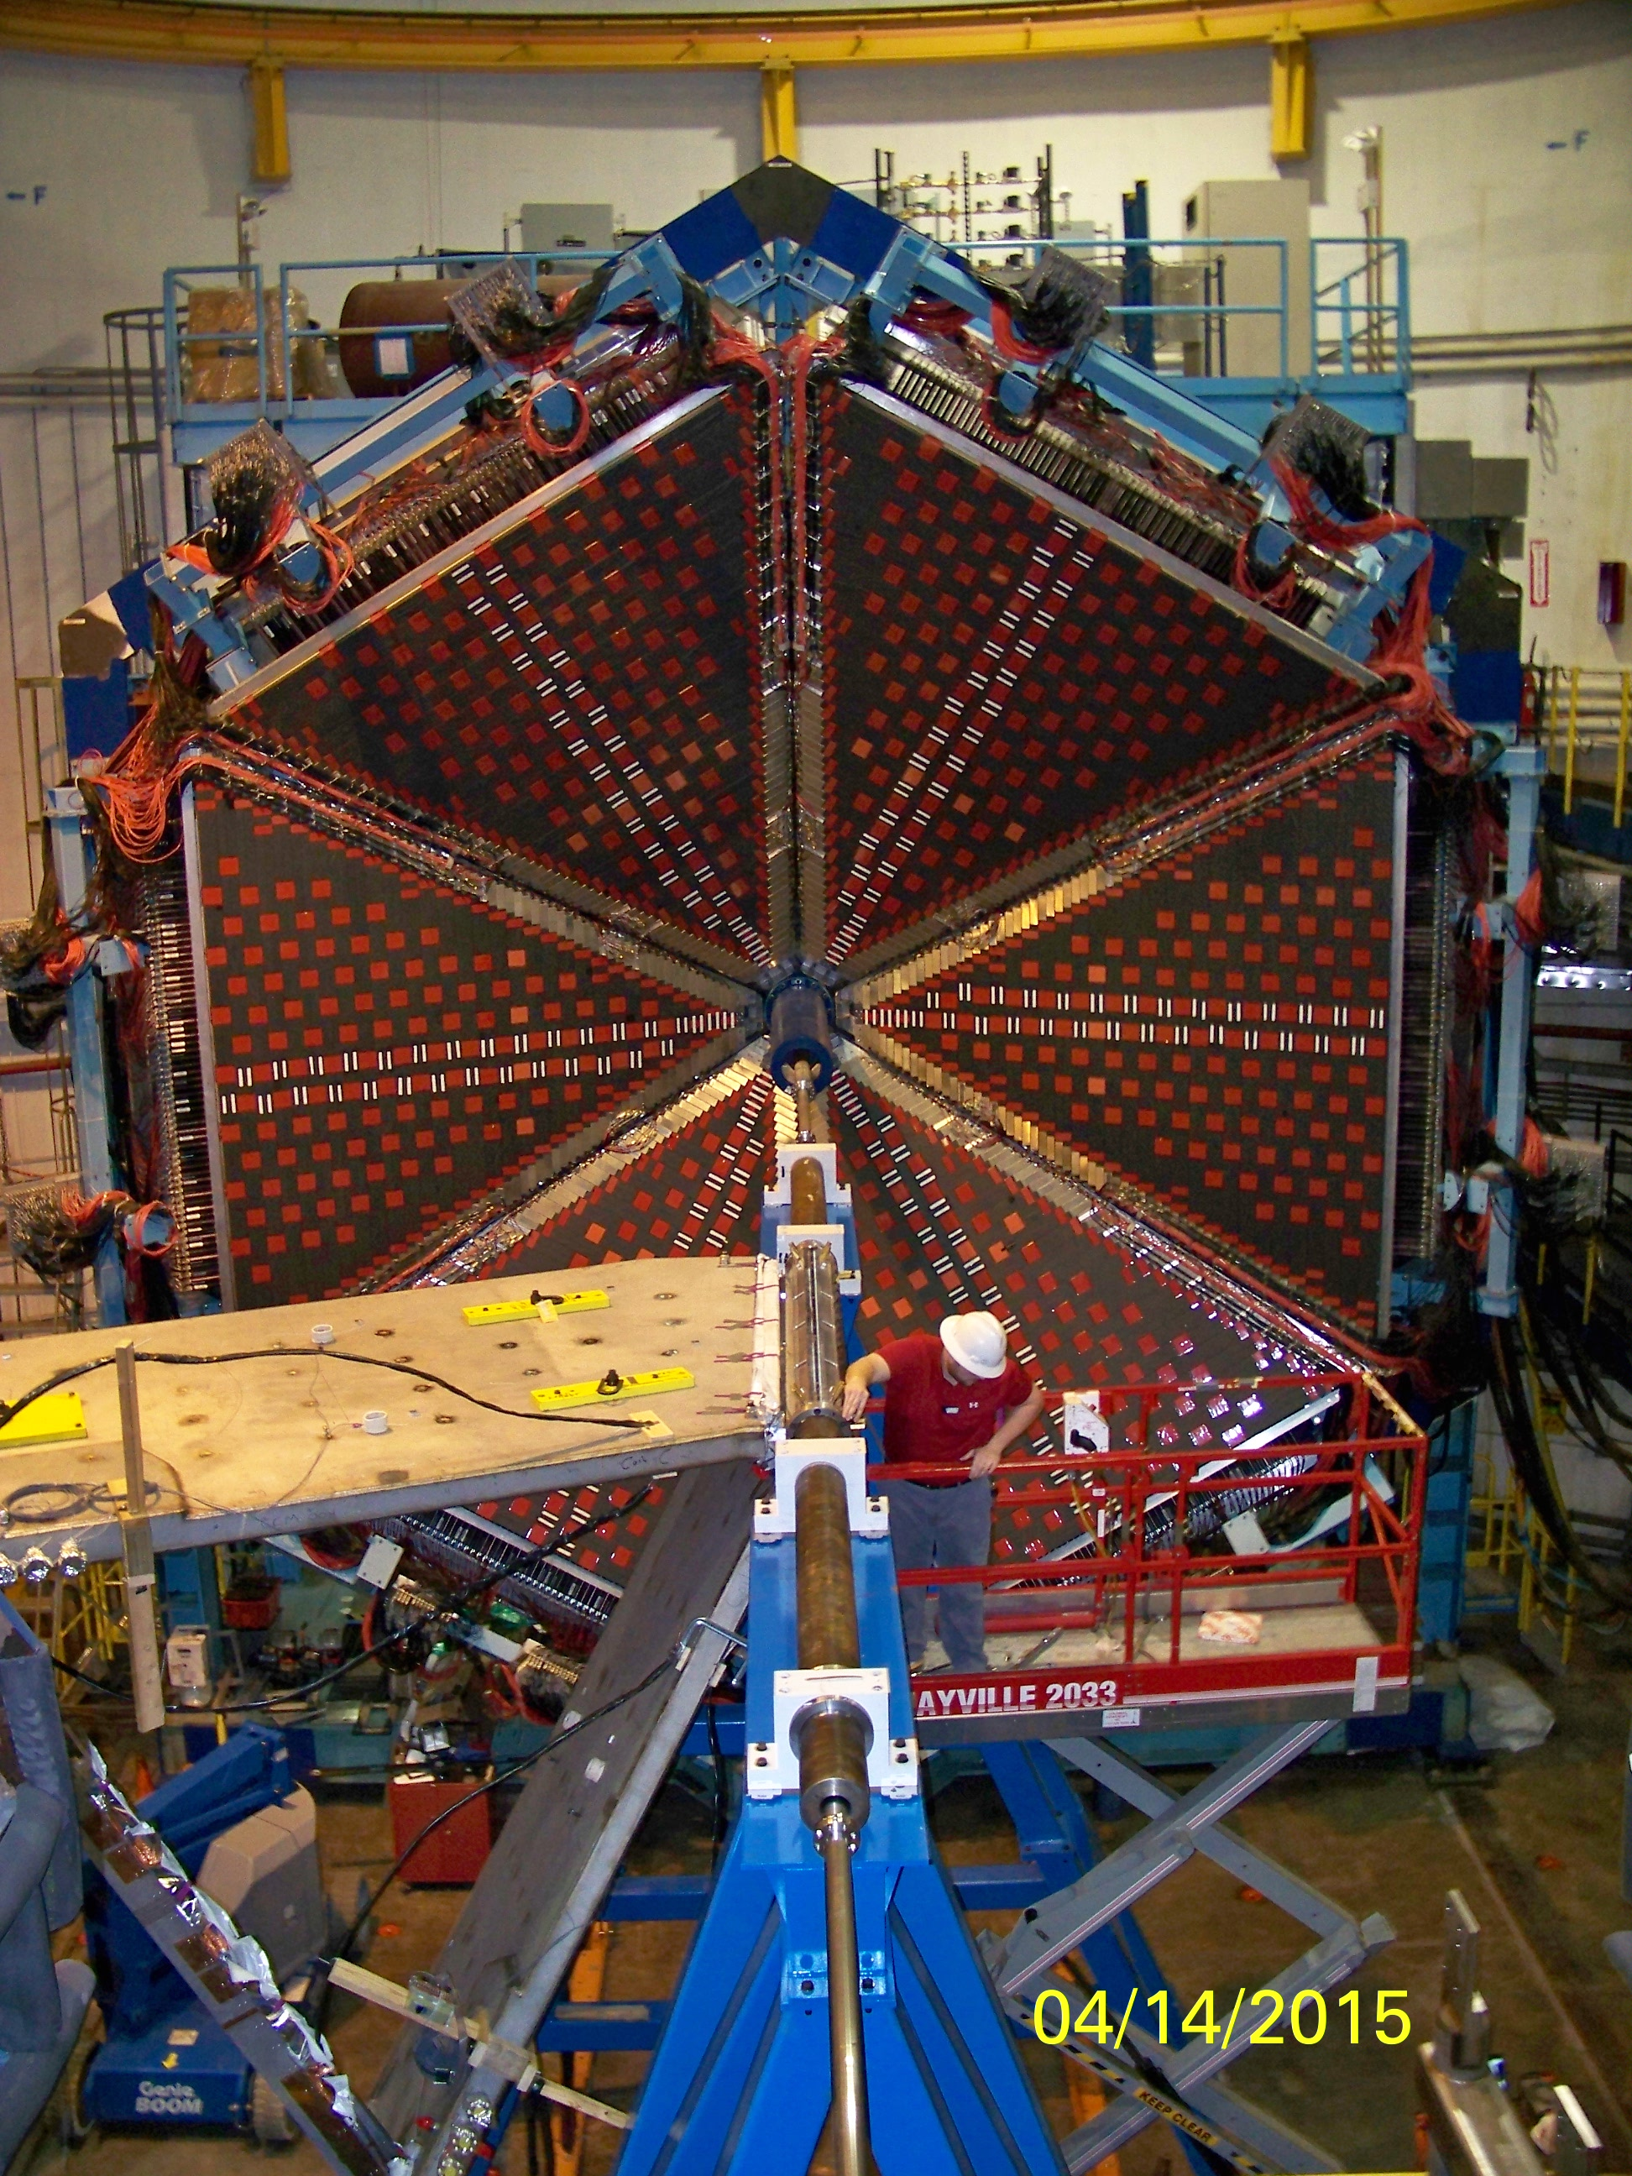
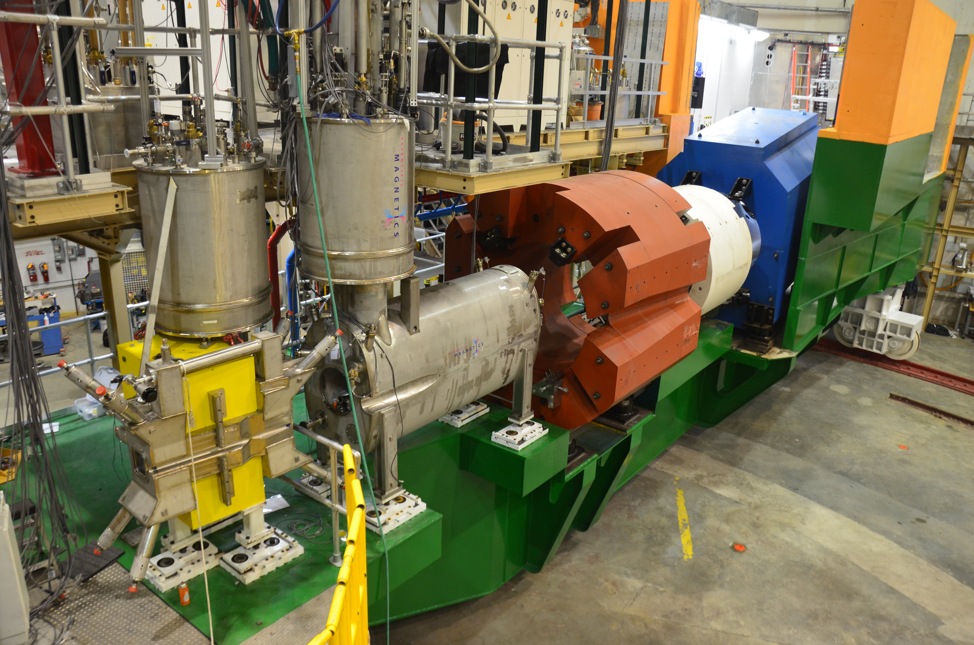
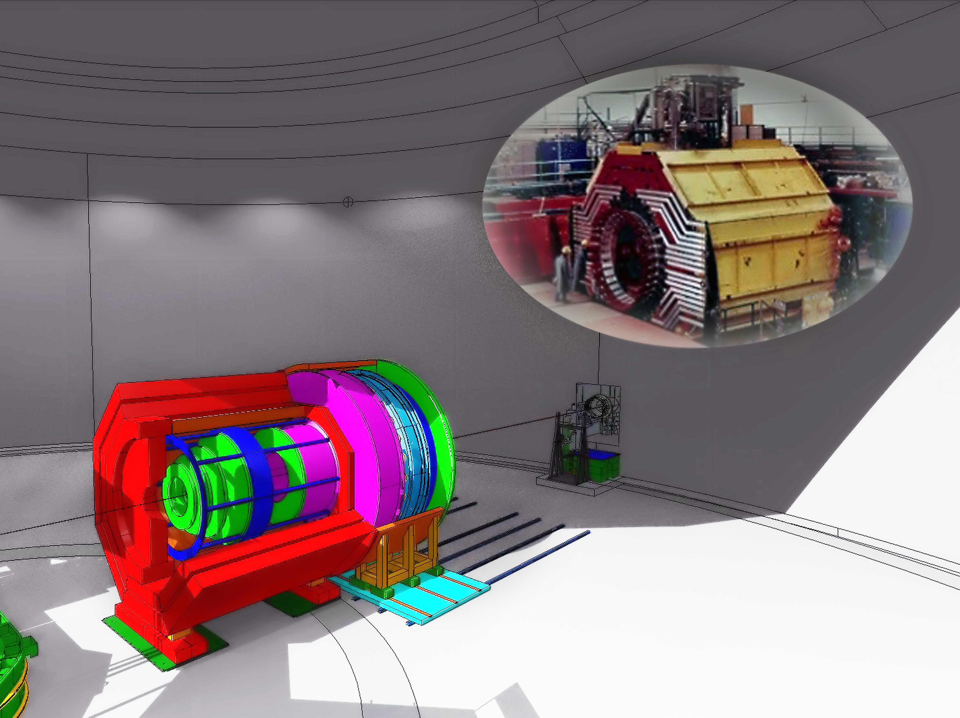
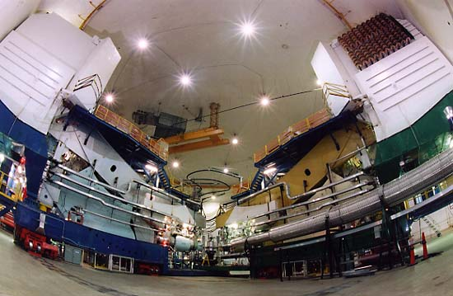
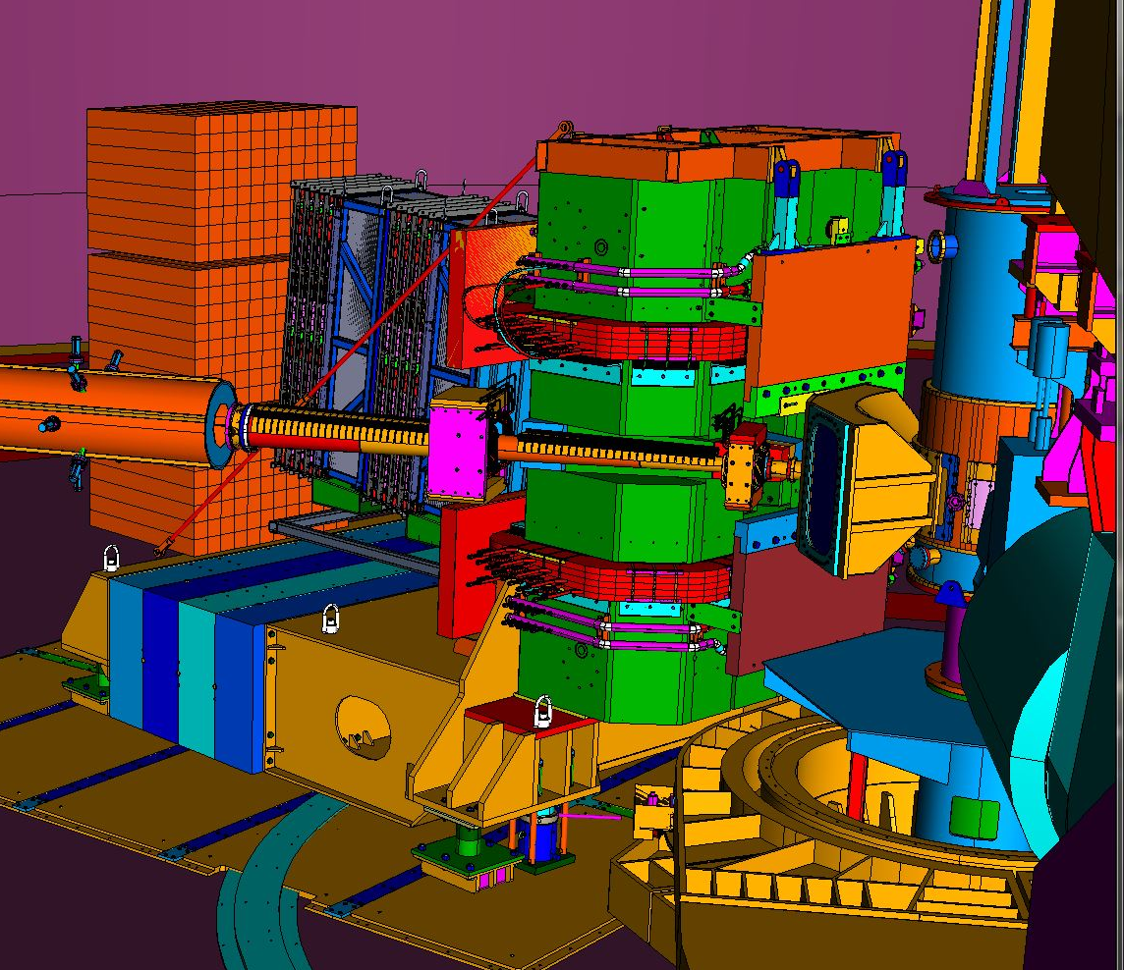
12 GeV (GPD/TMD) Scientific Capabilities
Hall B – understanding nucleon structure via GPDs and TMDs
Hall C – precision determination of valence quark properties in nucleons/nuclei
SIDIS/DES cross-section factorization tests
TMDs and GPDs comprehensive study
Hall A – nucleon form factors, future new experiments (e.g., SBS, MOLLER and SoLID)
Ultimate TMD statistical precision in valence region

