Slide 1

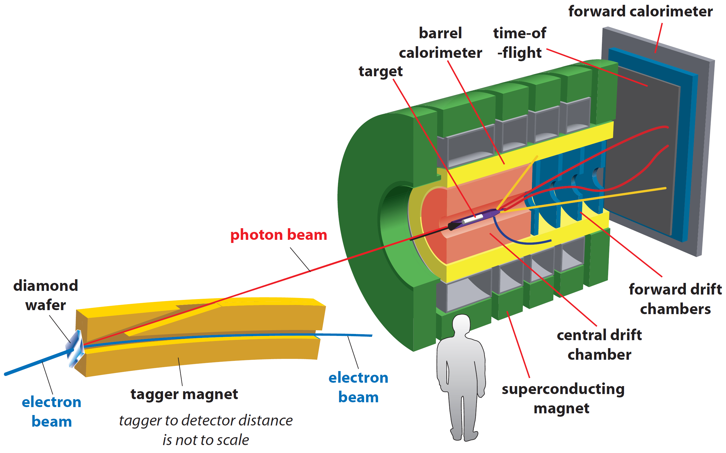
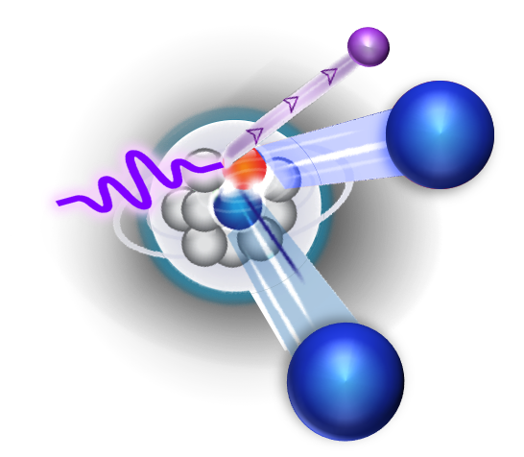
Studying SRC with real photons
PR12-19-003
Spokespersons:
O. Hen (MIT), M. Patsyuk (JINR),
E. Piasetzky (TAU), A. Schmidt (GWU),
A. Somov (JLab), L.B. Weinstein (ODU).
Theory Support:
S. Brodsky, L. Frankfurt, A.B. Larionov, G.A. Miller, M. Sargsian, M. Strikman.
JLab, PAC 47, Jul 29 – Aug 1, 2019

Slide 2
The proposed measurement
Exclusive Proton Reactions | Exclusive Neutron Reactions
γ + p → π⁰ + p | γ + n → π⁻ + p
γ + p → π⁻ + Δ⁺⁺ | γ + n → π⁻ + Δ⁺⁺
γ + p → ρ⁰ + p | γ + n → ρ⁻ + p
γ + p → K⁺ + Λ⁰ | γ + n → K⁰ + Λ⁰
γ + p → K⁺ + Σ⁰ | γ + n → K⁰ + Σ⁰
γ + p → ω + p | x
γ + p → φ + p | x
… | …
beam :
2x10⁷ γ/s⁻¹
Targets: H, D, ⁴He, ¹²C

Slide 3
Nuclear ab-initio calculations
NN interaction cannot be calculated from the ab- initio interactions between quarks and gluon.
Nuclear interactions are described using effective models with
parameters from elastic phase shifts (below pion production).
Relativity ( ) ?
Can we use point-like nucleons with effective interactions for modeling
short–distance structure of atomic nuclei
dense astrophysical systems such as neutron stars ?

Slide 4
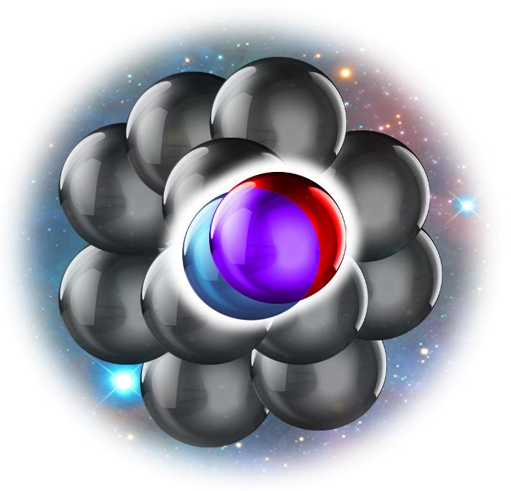
What are SRC ?
Nucleon pairs that are close together in the nucleus
  Momentum space: high relative and lower c.m. momentum, compared to the Fermi momentum (k_{F})
k-space
r-space

Slide 5
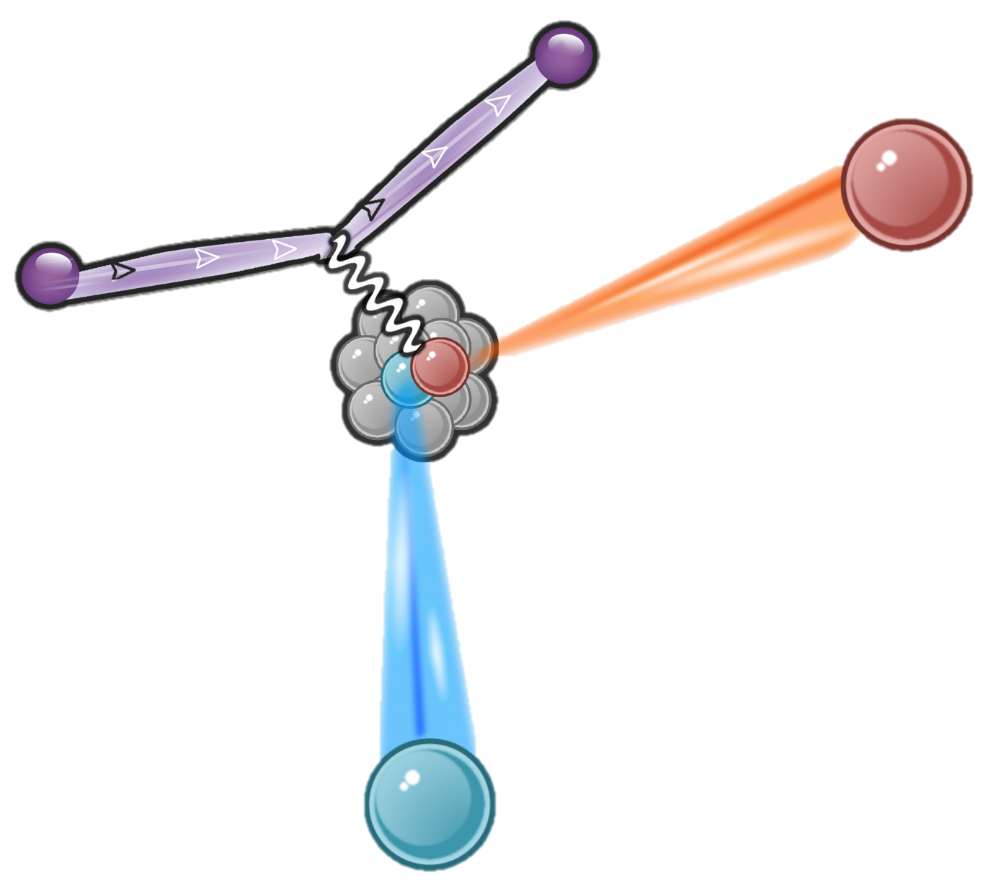
How do we study SRC?
Exclusive Hard scattering in selected kinematics
5

Slide 6
Exclusive Hard electron scattering in selected kinematics
E_{in} >5 GeV
Q²>1.7 (GeV/c)²
anti-parallel kinematics
X_{B}>1.2
(e,e’NN)
P_{miss} > 300 MeV/c
Suppressed
Can be neglected
Dominant contribution
Factorized cross section
SRC-FSI
Can be calculated
6

Slide 7
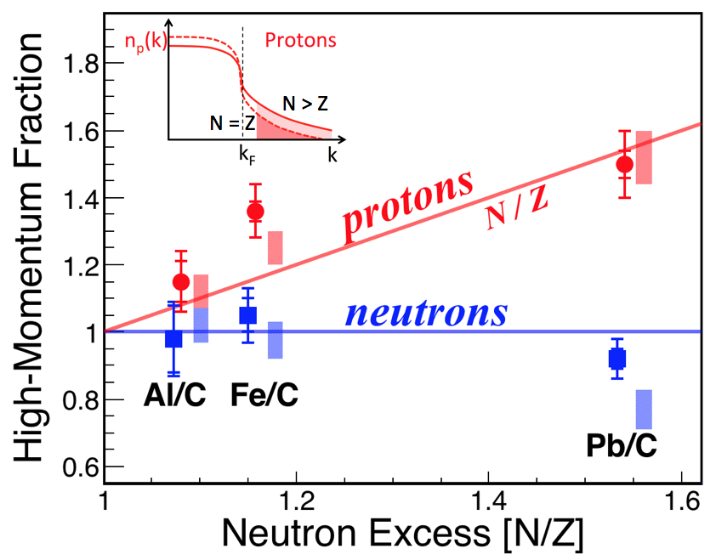
Why do we study SRC?
Nature 2018
Nuclei
2018-19
Data:
Nature 566, 354 (2019),
Nature 560, 617 (2018),
PRL 122, 172502 (2019),
PRL 121, 09201 (2018),
Phys. Lett. B, In-Print (2019),
arXiv: 1902.06358.
Theory:
Phys. Lett. B 791, 242 (2019),
Phys. Lett. B 793, 360 (2019),
Phys. Lett. B 780, 211 (2018),
Phys. Lett. B 785, 304 (2018),
arXiv: 1812.08051,
arXiv: 1907.03658.
Nature 2019
Nucleon
Sub-Structure
Being submitted
NN Interaction

Slide 8
Exclusive Hard scattering in selected kinematics
GCF
8

Slide 9
Off shell eN cross section
De Forest, NP (1983)
Data
Cohen, PRL (2018)
Glauber calc. tested by data
M. Duer, PLB In-Press
Probe of NN interaction at previously unreachable short distances
From ab-initio QMC
R. Cruz-Torres et al.
arXiv:1907.10003
+ Weiss PLB (2019)
+ Weiss PLB (2018)
+ Cruz-Torres PLB (2018)

Slide 10
Nuclear ab-initio calculations
NN interaction cannot be calculated from the ab- initio interactions between quarks and gluons
Nuclear interactions are described using effective models.
Parameters from elastic phase shifts (below pion production).
Relativity ( ) ?
How well do we know the nuclear interaction at high relative momentum, short distances, high nuclear density ?

Slide 11
SRCs Dominated by np pairs
5%
Duer, PRL (2019); Duer, Nature (2018); Hen, Science (2014); Korover, PRL (2014); Subedi, Science (2008); Shneor, PRL (2007); Piasetzky, PRL (2006); Tang, PRL (2003); Review: Hen RMP (2017);

Slide 12
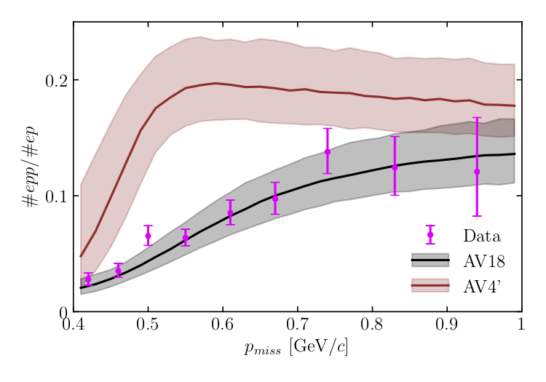
Data
P_{miss} [GeV/c]
12

Slide 13
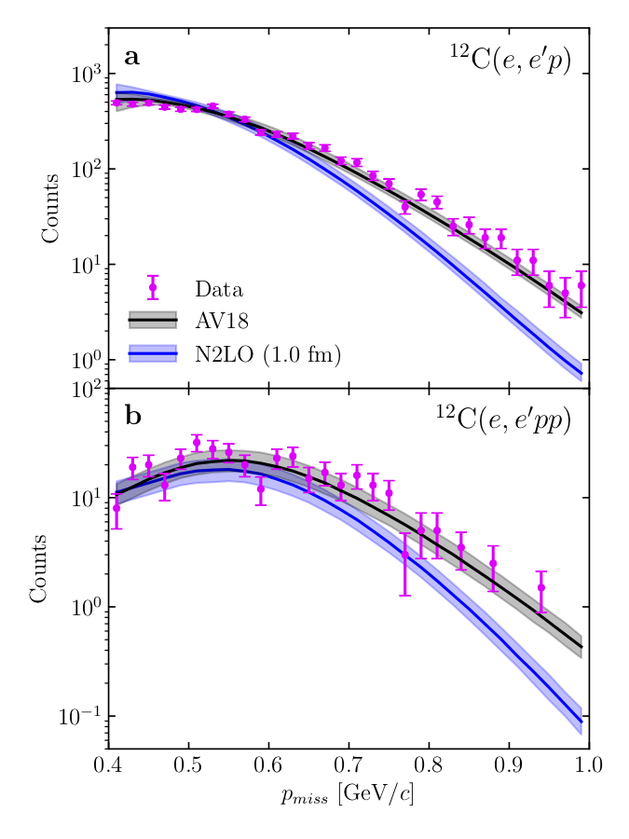
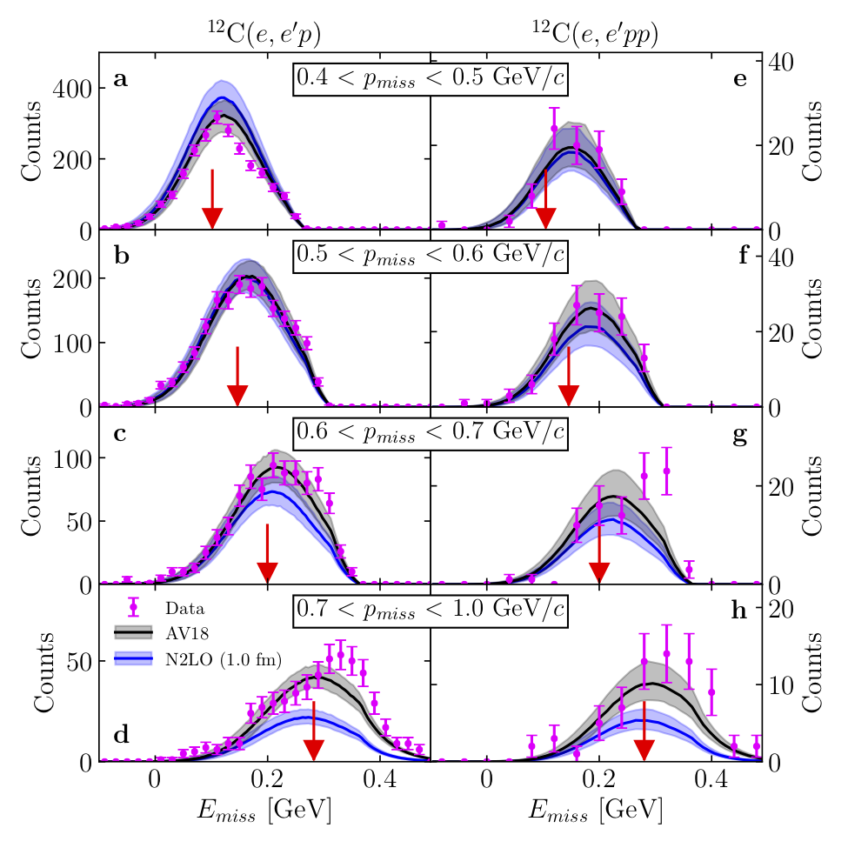
400 – 500 MeV/c
500 – 600 MeV/c
600 – 700 MeV/c
700 – 1000 MeV/c
P_{miss} [GeV/c]
E_{miss} [GeV]
13

Slide 14
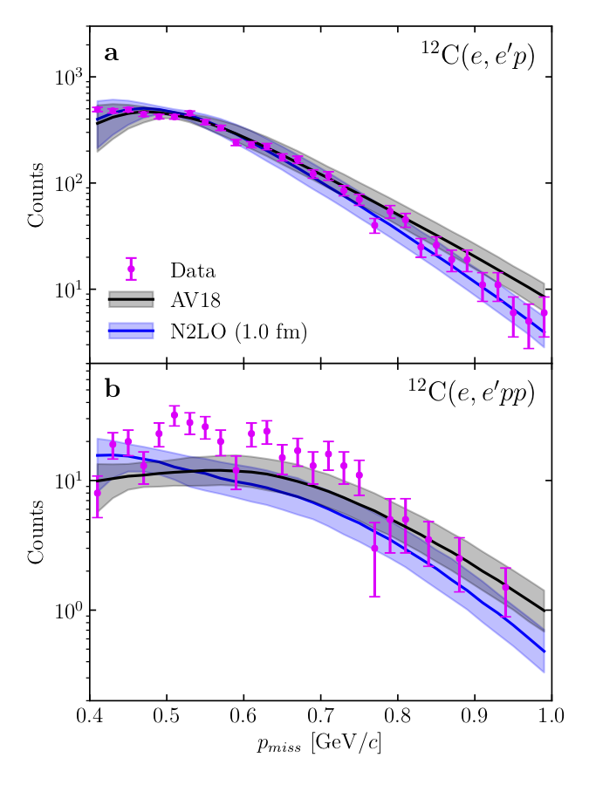
Light-Cone
P_{miss} [GeV/c]
P_{miss} [GeV/c]
Post proposal submission results

Slide 15
Quantitative Revolution in SRC studies
Reaction Theory
[Glauber]
Ab-Initio Many-Body Theory
Generalized Contact Formalism
[GCF]
+
+
Precision SRC studies
Using Exclusive Reactions!
=
Warning!
We need to test our assumptions, especially factorization

Slide 16
Factorization ?
GCF
16

Slide 17
Why real photons ?
$$γ+N→B+M+N_{recoil}+{\left(A−2\right)}^{∗}$$
Outgoing Meson
Incident Photon
Outgoing Baryon
(Recoil Nucleon)
To test the reaction cross-section factorization!

Slide 18
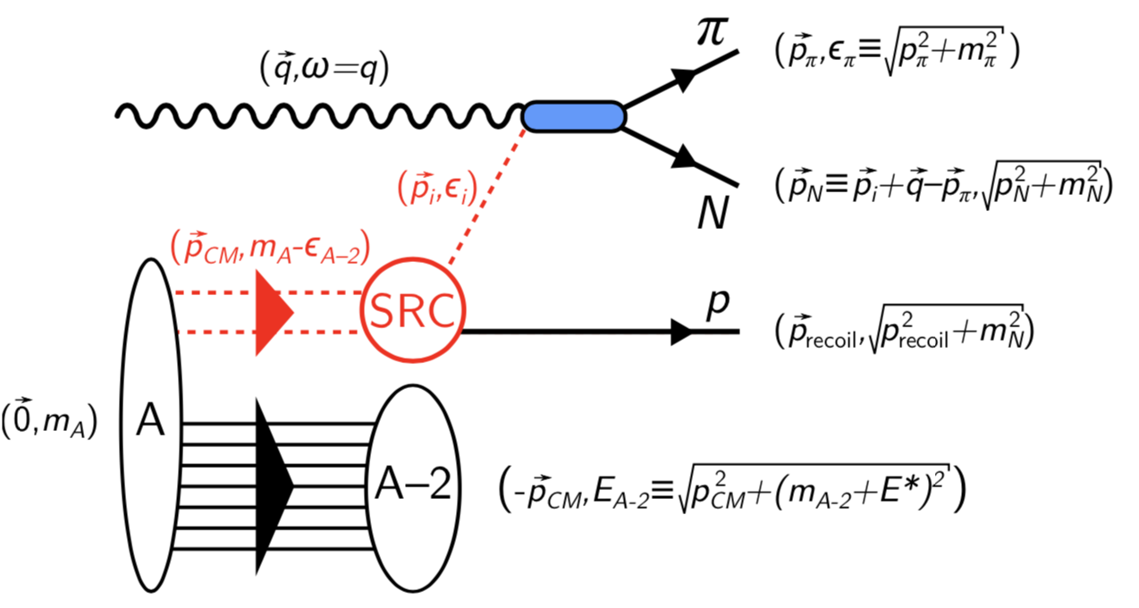
Check the scale separation assumption
18

Slide 19

Electrons vs. Photons
(e,e’NN)
X_{B}>1
(𝛾,NNπ)
$$\frac{dσ}{dt}∝s^{−7}$$

Slide 20
Electrons vs. Photons: FSI
(e,e’NN)
FSI:
Similar to elastic NN scattering off a mean-field nucleon.
The recoil nucleon goes backwards in the lab.
Can not be produced by elastic FSI.
Lead-N
Recoil-N
(𝛾,NNπ)
Recoil-N
Lead-N
Lead-π

Slide 21
Electrons vs. Photons: MEC
Electrons: (e,e’NN)
MEC:
Sensitive to different processes.
(𝛾,NNπ) requires much higher meson virtuality than (e,e’NN) which is suppressed
Photons: (𝛾,NNπ)

Slide 22
Electrons vs. Photons: relativity
(e,e’NN)
Relativistic Effects:
The effective ‘boost’ is very different for forward α>1 (e) and backward α<1 (𝛾)recoil nucleons.
Lead-N
Recoil-N
(𝛾,NNπ)
Recoil-N
Lead-N
Lead-π

Slide 23
Interim summary
(e,e’NN)
(𝛾,NNπ)
For SRC studies (𝛾,NNπ) is not superior to (e,e’NN) but different enough to allow testing the reaction cross-section factorization.

Slide 24
What else real photons are good for ?
Outgoing Meson
Incident Photon
Outgoing Baryon
From the “bread and butter” to the “high risk high gain”:
(Recoil Nucleon)
Probing bound nucleon structure

Slide 25
n
Free Neutron
τ ≈ 15 min
Bound Neutron
τ = ∞
Are the BR of scattering off a bound nucleons same as these of free nucleons ?
Is the partonic-structure of bound nucleons same as that of free nucleons ?

Slide 26
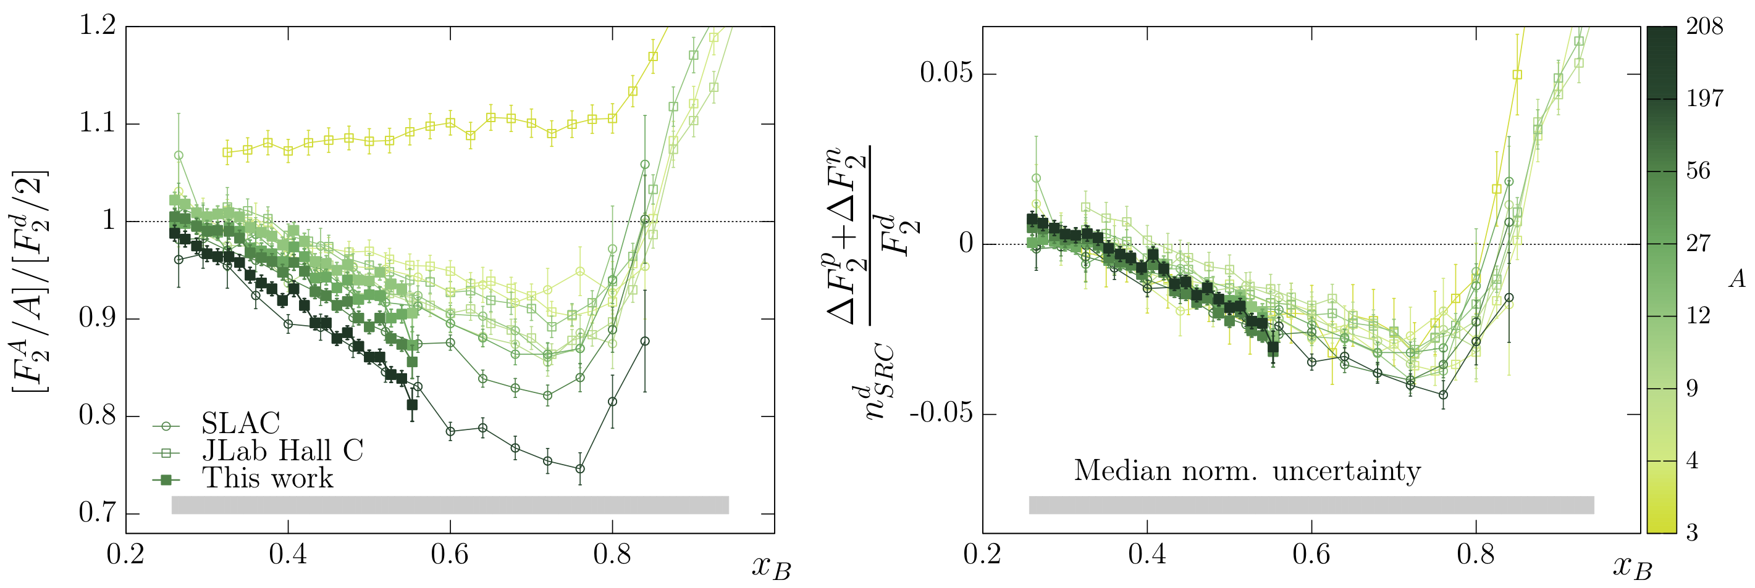
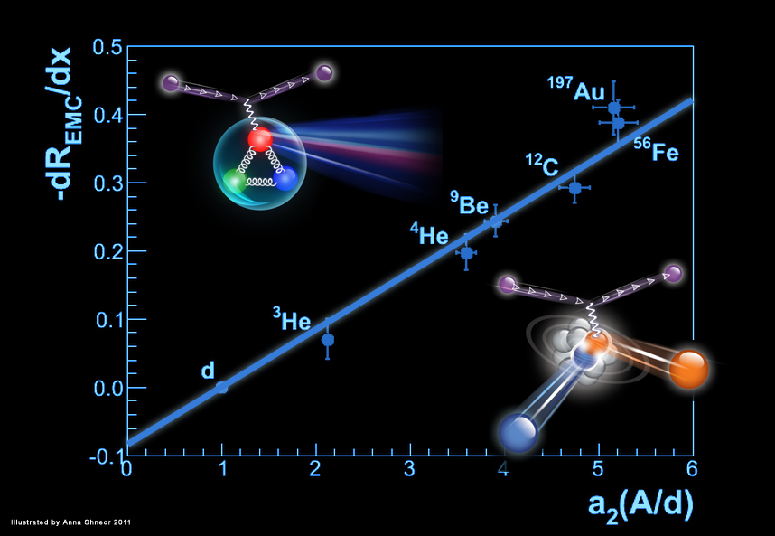
EMC
+
EMC ratios
SRC
Universal function
PRL 106, 052301 (2011); PRC 85 047301 (2012); RMP 89, 04500 (2017); Nature 566 354 (2019)

Slide 27

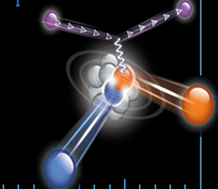
A free proton
A nucleon in a SRC pair

Slide 28
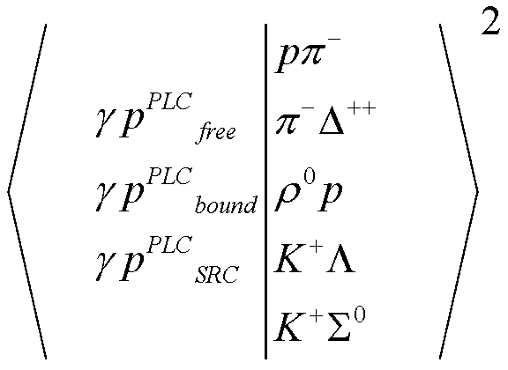
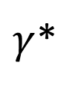

A new method to look for EMC-like physics
c.m. Frame:
$γ$*
$$θ_{c.m.}$$
Nucleon
Compare the BRs for free, QE, and tagged proton
using hard scattering (large s, u, t ):

Slide 29
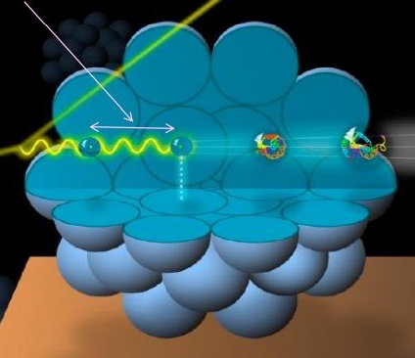
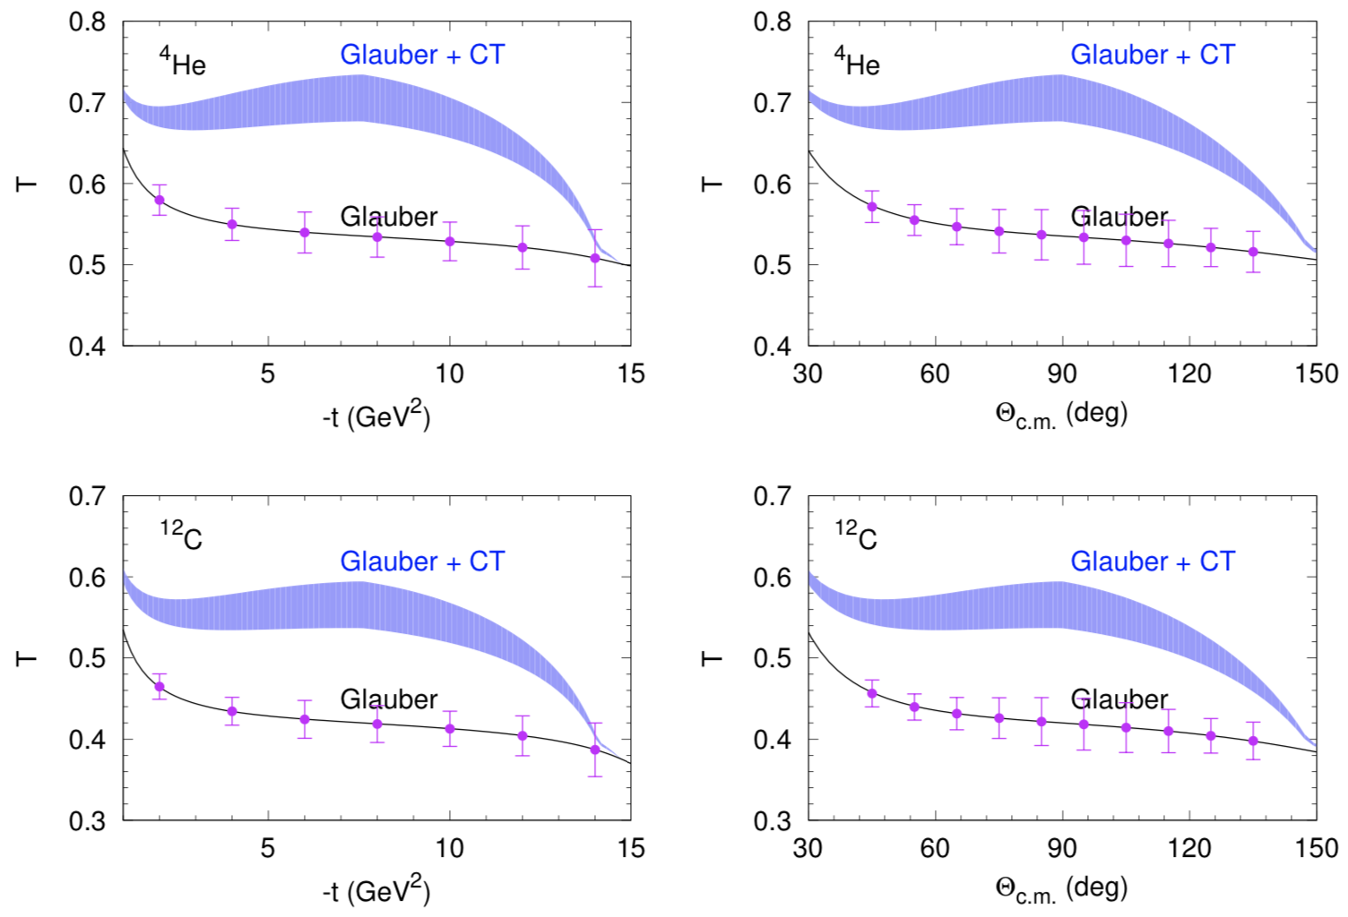
Probing Color Transparency
GlueX advantages:
Higher photon energy
(enhanced freezing).
2. Extends t-range
(3.5 to >10 !).
3. Extended θ_{C.M} coverage.
4. Many reaction channels
(Mesons and Baryons)

Slide 30
Summary
We propose a new photonuclear program for Hall-D.
No changes to the GlueX spectrometer and/or Hall-D beam line.
Physics focus:
  SRC – Testing reaction mechanism
    Use (𝛾,NNπ) to verify exciting (e,e’NN) results
  Probing bound nucleon structure
  Color Transparency
Outgoing Meson
Incident Photon
Outgoing Baryon
(Recoil Nucleon)

Slide 31
Backup
For the PAC also

Slide 33
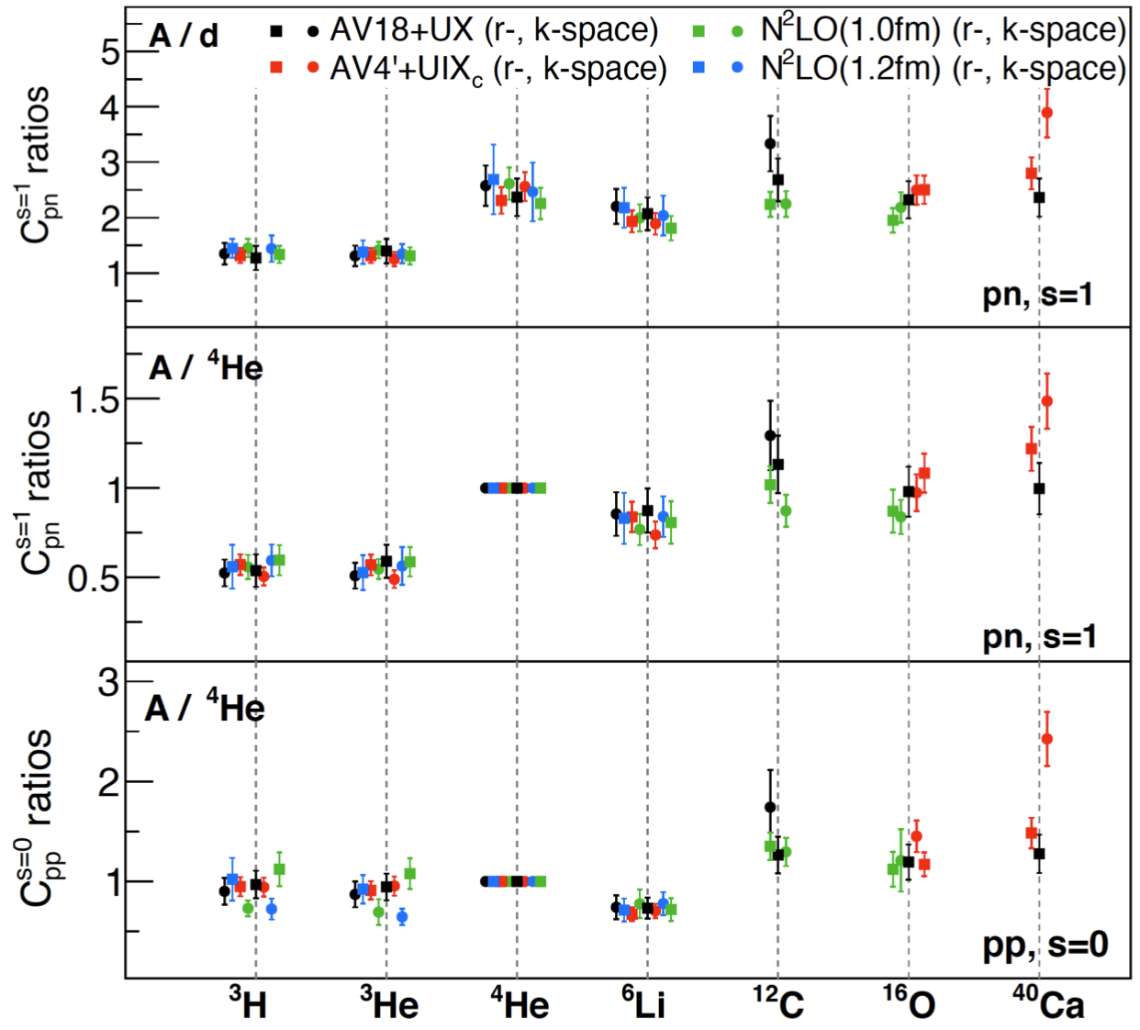
SRCs from Quantum Monte-Carlo:
Scale & Scheme Independence
Momentum–Position Equivalence
Generalized Contact Formalism (GCF) allows extracting SRC properties from ab-initio many-body calculations using various NN interactions
Cruz Torres and Lonardoni et al. (2019)

Slide 34
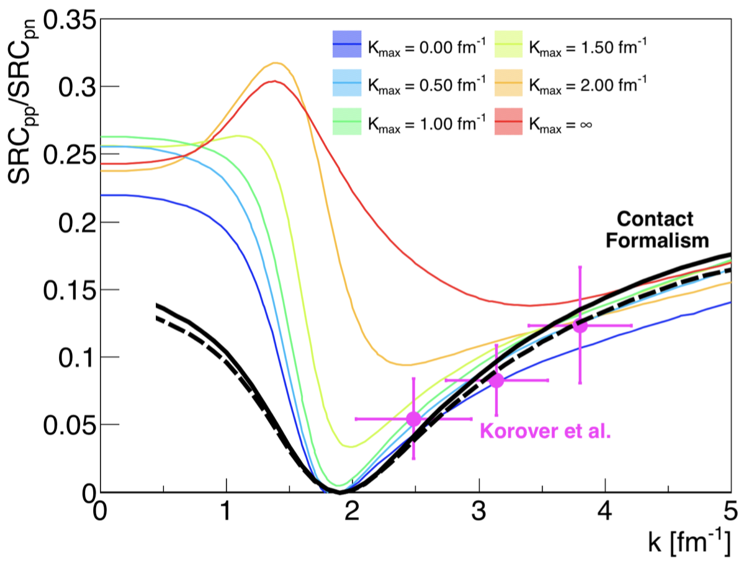
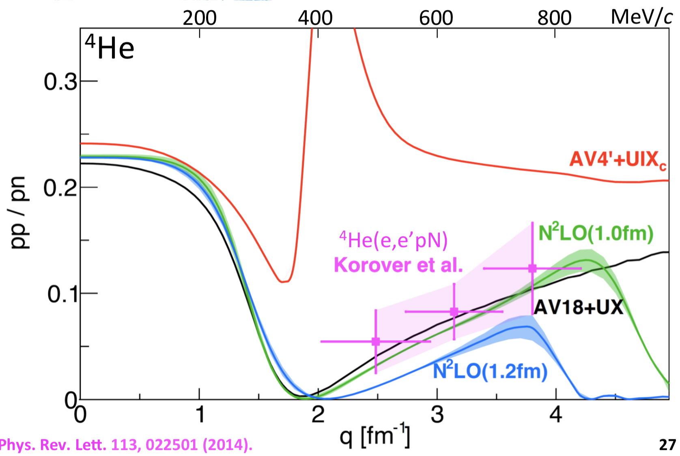
GCF: Relating Ab-Initio Theory & Exclusive Data
N³LO
AV18
Weiss, Phys. Lett. B (2019); Cruz Torres, Phys. Lett B (2018); Weiss Phys. Lett B (2018).

Slide 35
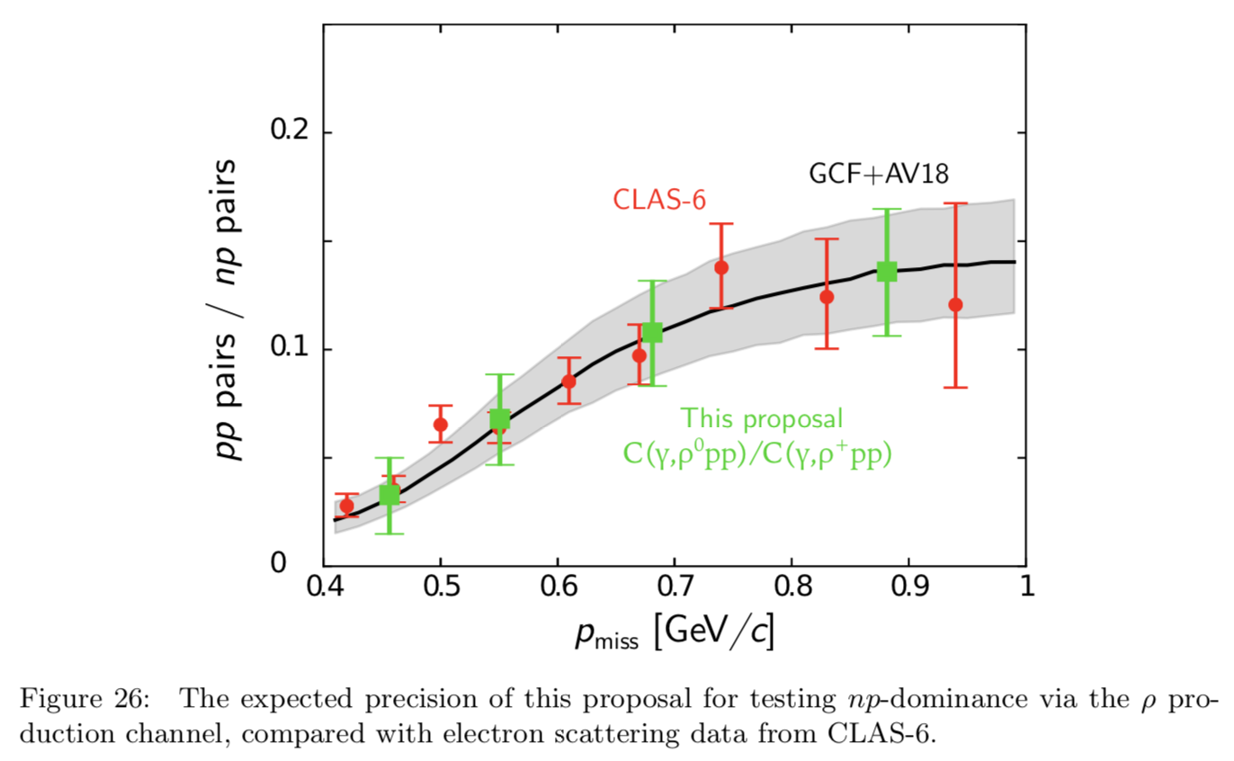
Example of expected accuracy

Slide 36
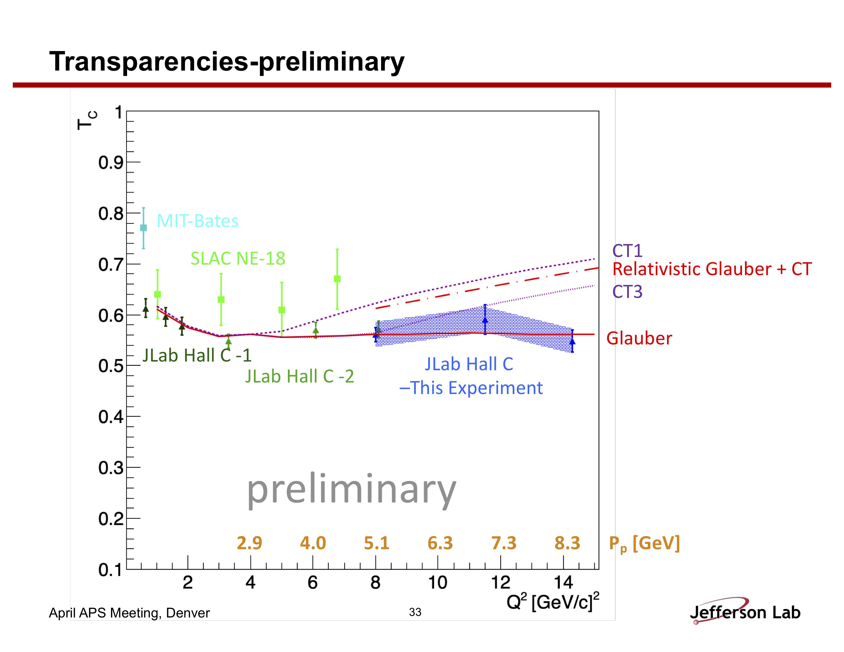
Baryons: (e,e’p)
Hall C preliminary results
H. Szumila-Vance, APS April meeting 2019

Slide 37
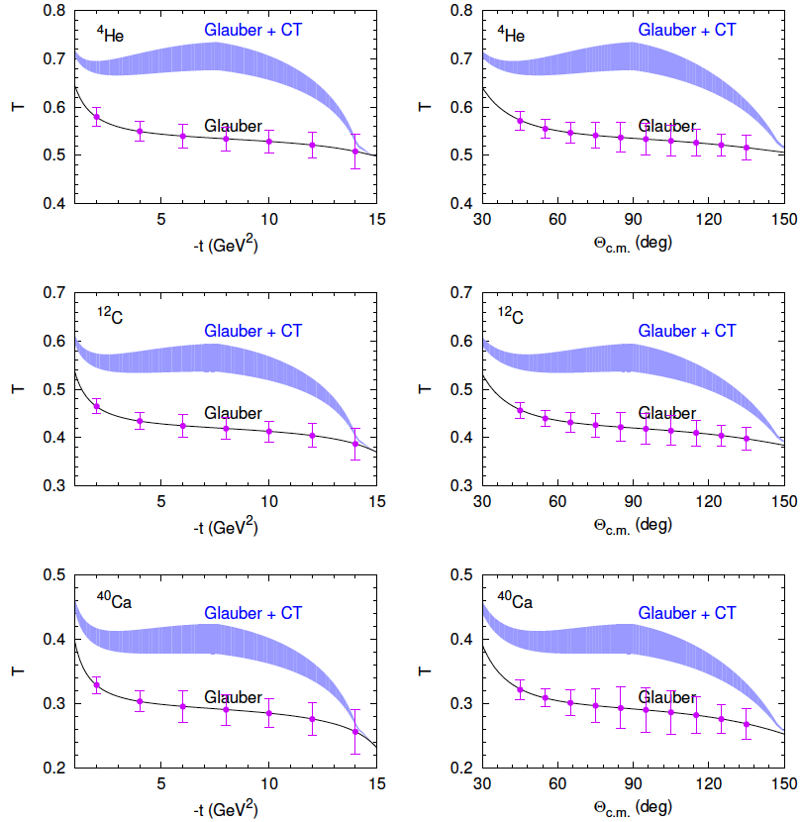
Probing Color Transparency
GlueX advantages:
Extends |t_{max}| from 3.5 to >10 !
Higher photon energy (enhanced freezing)
Study of many baryon-meson final states
Wide c.m. angle coverage.

