Slide 1
Large Acceptance Proton Form Factor Ratio Measurements up to 14.5 GeV² using Recoil Polarization Method
Update on E12-07-109
E.Cisbani, M.Jones, N.Liyanage, L.Pentchev, A.Puckett, B.Wojtsekhowski
Notes:
The experiment will continue the main stream of JLab physics with hadron form factors.

Slide 2
Large Acceptance Proton Form Factor Ratio Measurements up to 12 GeV² using Recoil Polarization Method
Update on E12-07-109
E.Cisbani, M.Jones, N.Liyanage, L.Pentchev, A.Puckett, B.Wojtsekhowski
Notes:
The experiment will continue the main stream of JLab physics with hadron form factors. Selected by PAC41 as a high impact experiment.

Slide 3
Electron-nucleon elastic scattering
Nucleon current, one₋photon approximation, α_{em} = 1/137,
Scientific case
Notes:
Classical formula of the hadron current and FFs

Slide 4
The nucleon electromagnetic form factors
GMp
GMn
SBS
GEp
GEn
Notes:
These data represent the final set before the 12-GeV era
plus new information from the 2016 Hall A GMp experiment.

Slide 5
The proton GEp form factor
Notes:
The latest experiment data on GEp-III were in PRL 2010 and
the final results were published in PRC 2017.
Our goal is an accurate measurement up to 12.5 GeV²

Slide 6
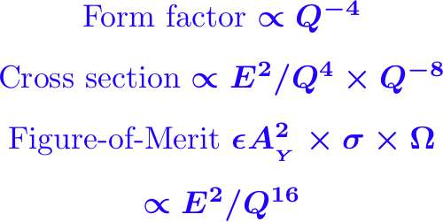
Challenges in this experiment
Need large statistics, max luminosity and solid angle
Max luminosity -> large background
Large solid angle -> small bend -> huge background
A solution is a modern tracking detector based on
Gas Electron Multiplier (Fabio Sauli, 1997)
Notes:
Q² increases from 8.5 to 12.5 GeV² but higher beam energy 11 vs. 6 GeV => a factor of 7 of the FOM loss, but the SBS larger solid angle helps.

Slide 7
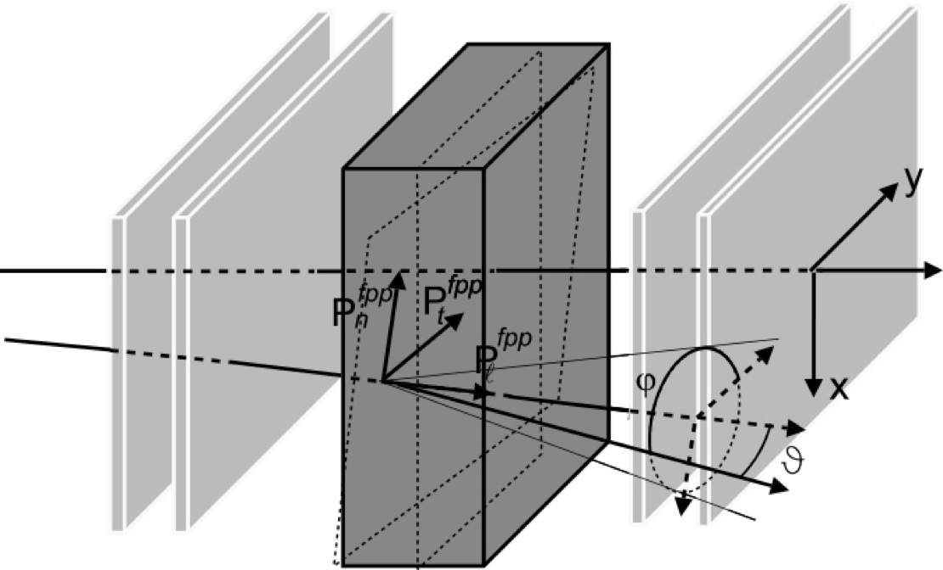
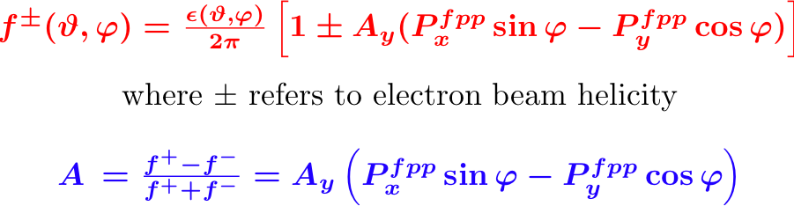
Method: Focal Plane Polarimeter
A_{Y} analyzing power vs.
inverse proton momentum
Track in
Track out
p will be ~ 7 GeV/c
fringe field correction
Notes:
The key element is a Focal Plane Polarimeter and the analyzing power of secondary scattering. Needs a well understood A_{Y}.

Slide 8

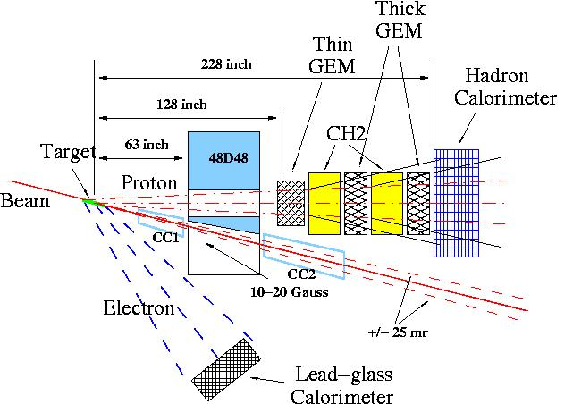
Experiment: Layout and Parameters
Beam: 75 μA, 85% polarization
Target: 30 cm liquid H₂
Electron arm at 29º, covers Q² range from 12.5 to 16 GeV²
Proton arm at angle 17º,
Ω = 35 msr ,
Spin precession angle is ~ 90º
(it is optimum)
Event rate is 10 times higher
than with standard spectrometer
From 58 days of production time
resulting accuracy is
45
PAC32 August 7, 2007
Slide 5
GEP-15 Bogdan Wojtsekhowski, JLab
Notes:
The same layout as 12 years ago, no competitors.
45 days approved in January 2010 by PAC35.

Slide 9
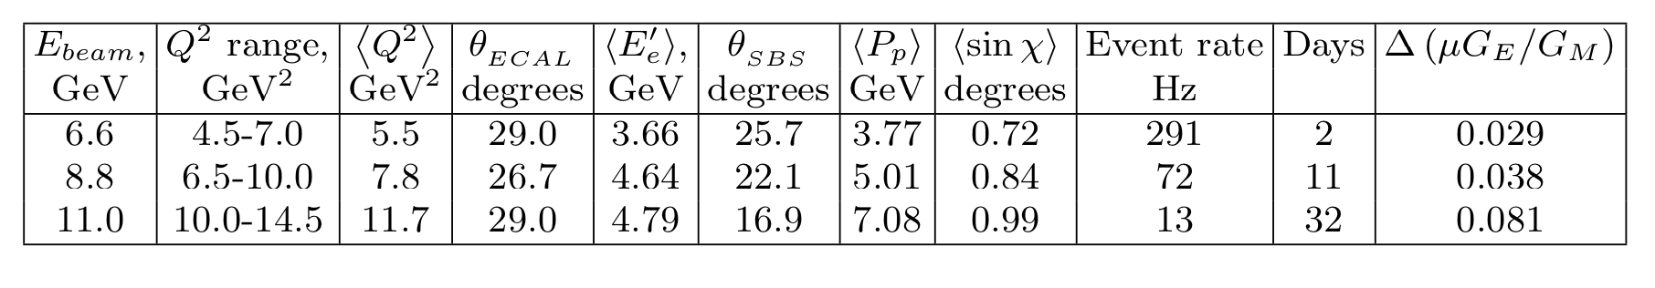
GEp/SBS Q² acceptance, projected accuracy, and beam time request
Total 45 days
Notes:
We updated the data points. As PAC35 recommended, we limited the Q² range by 12.5 GeV² and the total beam time is 45 days. About 20M events per data point.

Slide 10
Proton arm in the model
Notes:
Very briefly on equipment status: Magnet and beam line.

Slide 11
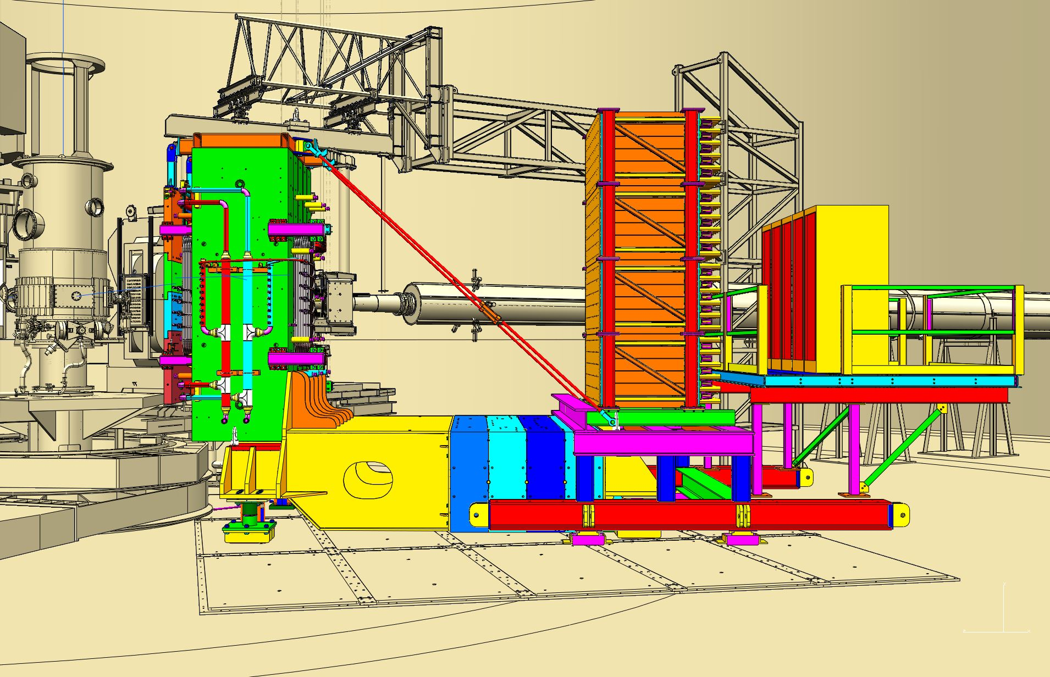
Proton arm calorimeter in the model
Notes:
The hadron calorimeter. Novel feature is sub ns time resolution.

Slide 12
Electron arm calorimeter in the model
1737 lead-glass modules
Elevated temperature of the glass (225-185 C)
provides continuous annealing of radiation damage
Notes:
Electron arm is based on old technology with innovative addition of continuous thermal annealing. Fully tested. Construction is 2/3 completed.

Slide 13
SBS trackers/polarimeters:
Front tracker: INFN/UVa
Notes:
One of the largest sets of the GEM chambers.

Slide 14
SBS trackers/polarimeters:
Rear tracker: UVa/INFN
Notes:
Rear chambers are 60 cm x 200 cm

Slide 15
The proton GEp/GMp form factor ratio
Scientific case
Notes:
Now let us look one more time at the projected physics results and the discriminative power of the high Q² data points for the theory predictions.

Slide 16
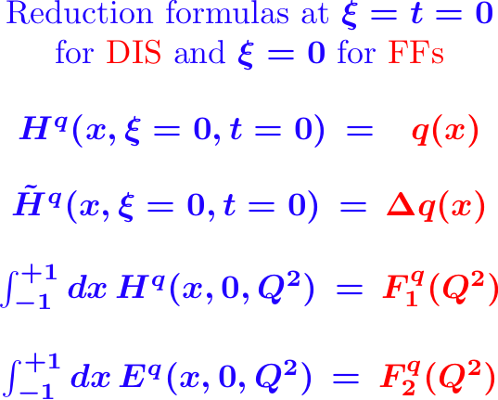
The nucleon structure in terms of GPDs
Scientific case

Slide 17
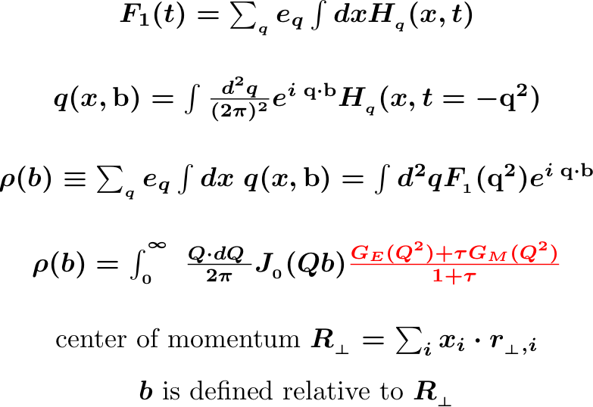
The nucleon structure in terms of GPDs
Muller, Ji, Radyushkin
M.Burkardt
P.Kroll: u/d segregation
G.Miller
Transverse center of the
quarks longitudinal
momentum fractions
Scientific case

Slide 18
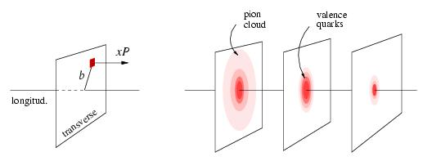
Mapping transverse distribution(s)
two-photon contributions at high Q²
x < 0.1
x ~ 0.3
x ~ 0.8
Scientific case
Notes:
Connections via the GPDs phenomenology. TPE contributions are small. The x=1 point data are from FFs.

Slide 19
Q² dependence of F2/F1
Flavor separated contributions:
The log scaling for the proton
Form Factor ratio at few GeV²
is likely “accidental”.
The lines for individual flavor
are straight!
Scientific case
Notes:
Flavor composition is important way to study FFs

Slide 20
Summary
After 12 years of development the GEp/SBS experiment is on track to be ready for installation in 2022.
Nucleon elastic form factors are important constraints on QCD-based models in the high-t region.
Flavor composition of the nucleon form factors will be used for testing the DSE and lattice QCD predictions.
Notes:
Thank you for your time and attention.

Slide 21
Backup slides

Slide 22
MC simulation

Slide 23
Electron arm: Calorimeter’s temperature, 3x3 group
Heat conductor, 0.25 mm Cu foil
Air pipe
Heat tape, 225 C 185 C 55 C

Slide 24
Proton arm: Calorimeter counter structure

Slide 25
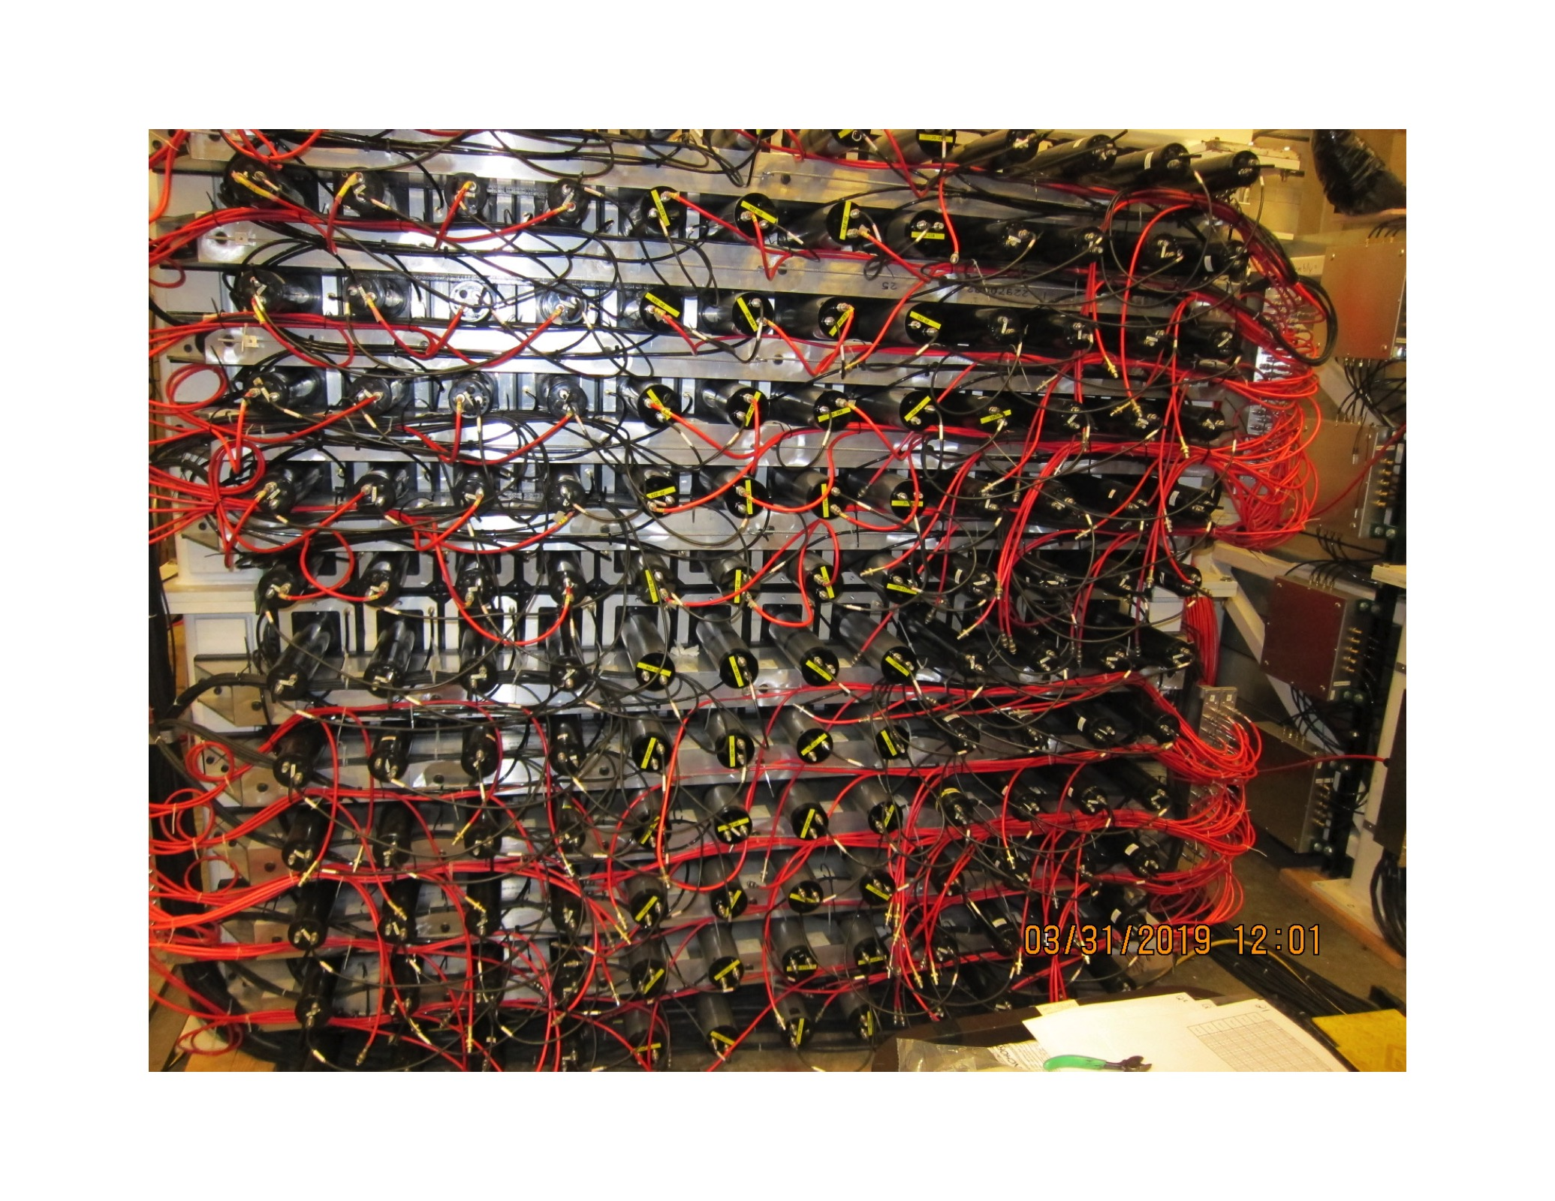
Proton arm: Calorimeter commissioning
HCAL has 288 counters (in 12 x 24 array)

Slide 26
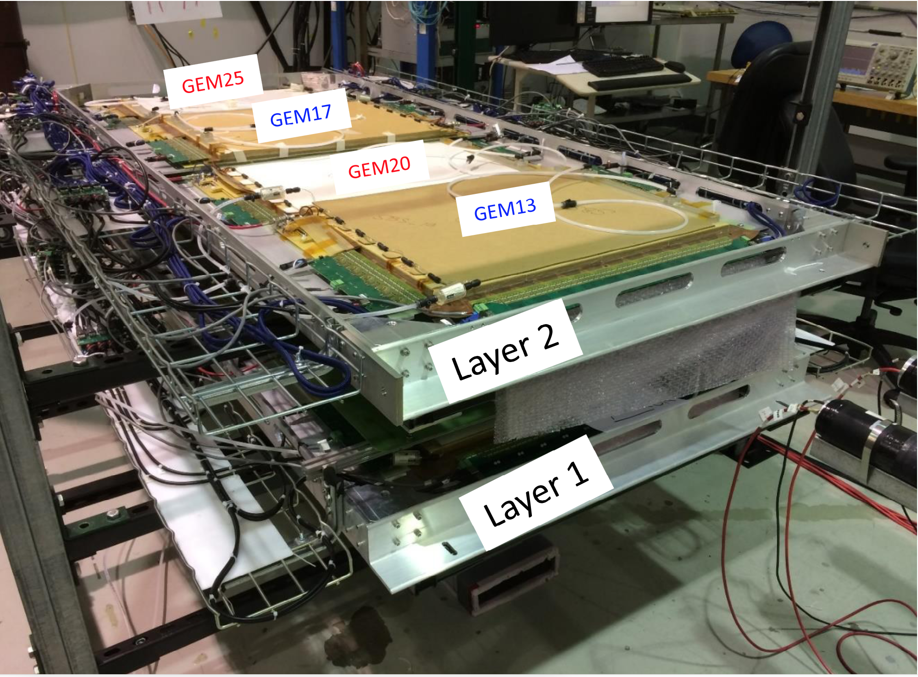
Proton arm: GEM chambers commissioning

