Slide 1
ESR2 PDR: Controls
Considerations for the ESR2 Refrigerator Electrical and Controls Design.
R Norton

Slide 2
Requirements
Electrical power for equipment
Fabrication or purchase of equipment
Controls for the cryogenic plant.
User Interface and Control Room.

Slide 3
Requirements: Electrical Power
Electrical power requirements for equipment
Main Compressors
2x 4160V Starters, 2x 480V Starters
Recovery Compressors
2x 480V Starters (part of compressor)
Air Compressors
480V Air Compressors,
Purifiers
208VAC Power
CBX Vacuum
120VAC for Diffusion Pump, 480V for Rotary
CBX Heaters (A/R)
Likely 208VAC, breakers/control box.
Dewar Heaters
208VAC

Slide 4
Fabrication/Procurement Requirements
Procure:
4160V MCC (2x starters)
2x 480V Main Compressor starters
Purifier Controls (integral with Purifiers)
Fabricate (or procure as required)
Main Compressor Controls 4x (similar to CHL1 C6)
Recovery Compressor Controls (identical to CTF recoveries)
Heater Control Enclosures (as for other cold boxes)
Vacuum Control Enclosure (identical to other DP systems)
Control Enclosure for Warm Gas Management (similar to LCLS)
Control Enclosure for Cold Box system (similar to LCLS)
Racks for Controls Equipment in Control Room (Similar to CTF)

Slide 5
ControlLogix PLC

Slide 6
Controls Considerations
Central ControlLogix PLC
Housed in Control room racks, including power supplies.
2 sub-enclosures, one in Compressor room and one in CBX room.
Digital Inputs: ~11
Digital Outputs: ~8
Temperatures: ~72
Analog Inputs: ~81
Analog Outputs: ~85
Recovery Compressors, Compressors, and Purifier have independent PLCs that communicate with the central system.
A-B Micro800 PLCs for compressors/recovery compressors
ControlLogix PLC for purifier (if same as CTF)
Identical or very similar to existing installations.

Slide 7
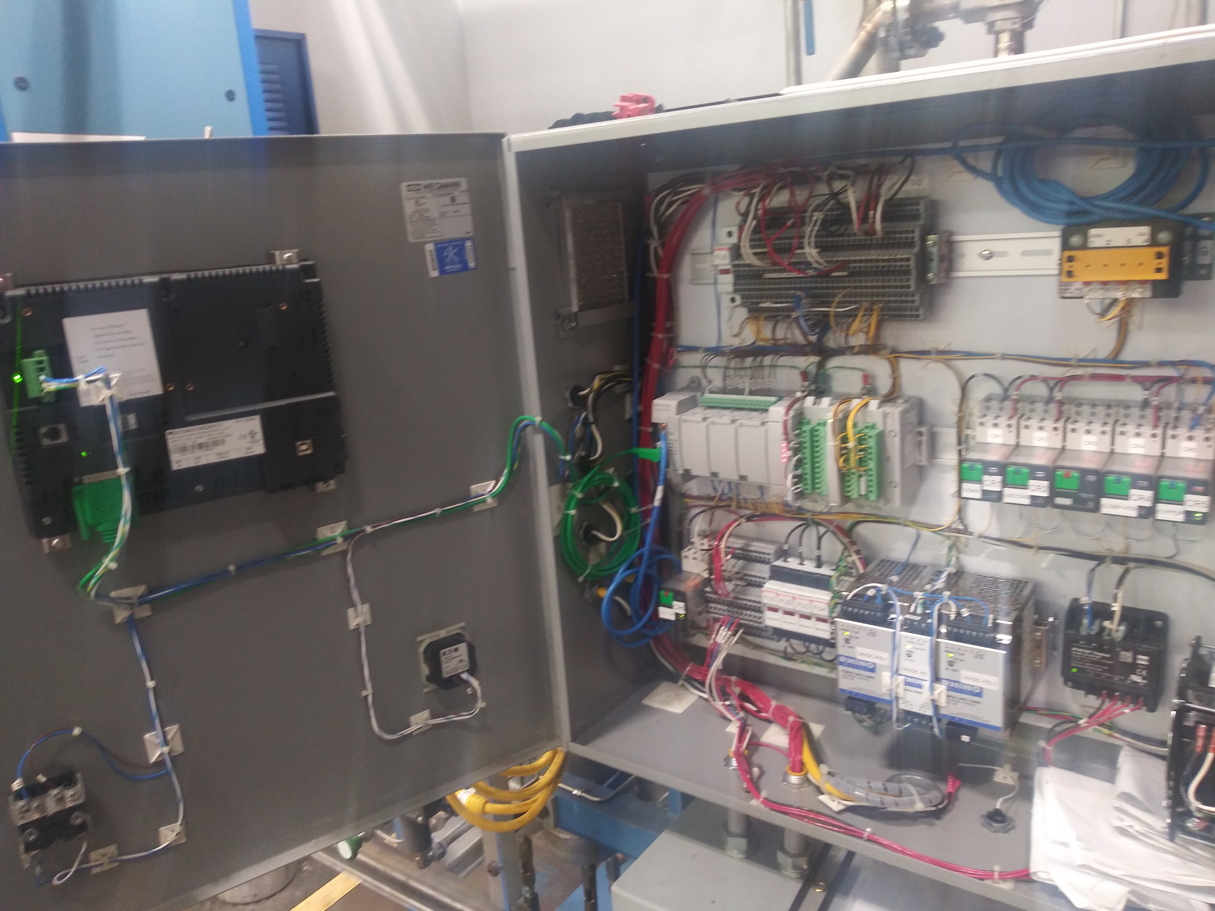
Recovery Compressor Controls

Slide 8
Programming
Compressor, Recovery Compressor, and Purifer systems are nearly identical to existing software.
Warm Gas Management and associated systems are simple enough to use standard PID loops to automate
The Cold Box will require work to establish how turbines are protected, what sequences are required, which valves require specialized automation beyond the turbine inlets, and what the general cold box shutdowns are.

Slide 9
Control Room
The Control Room is 10’ by 21’, in the southeast corner of the cold box room
The central control racks will be located here
Most I/O will go to sub-located panels to minimize cable runs.
2 Computer stations provide a place for an operator to make modifications to the system from EPICS.
A touchpanel should be included in the design to provide control in the event of a problem with the network connections.
The roof of the control room will be capable of some light storage and accessible from the cold box room stairs.

Slide 10
Example: CTF Control room Cabinets

Slide 11
Control Room Layout

Slide 12
Moving Forward
Begin control system drawings
Drawings needed for Compressor controls, gauge panels, local control enclosures.
Begin PLC Programming
Copying existing systems as a base.
Define procurement requirements for electrical equipment
MCCs and Motor Starters
Electrical portion of gear such as purifiers, air compressors, etc…

Slide 13
Power
Fabrication/Procurement
Controls
Control Room

