Slide 1
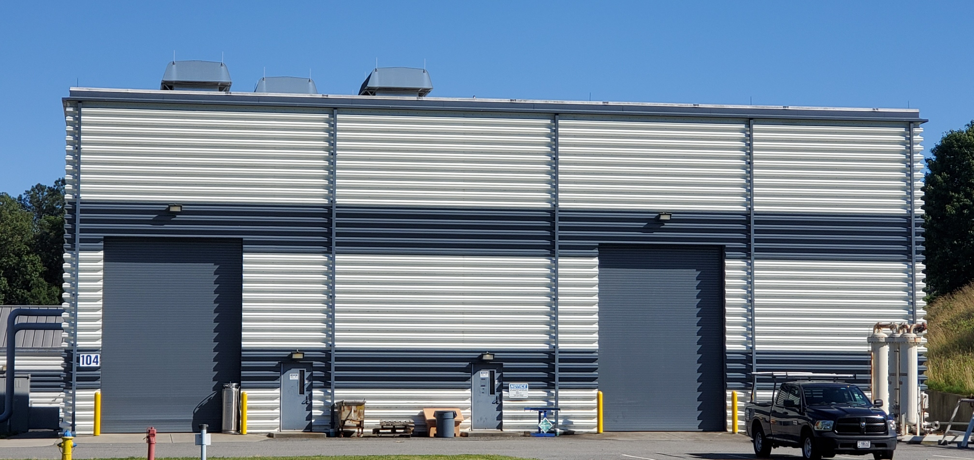
ESR2 Cryoplant Utilities
ESR2 Preliminary Design Review
Corey Butler

Slide 2
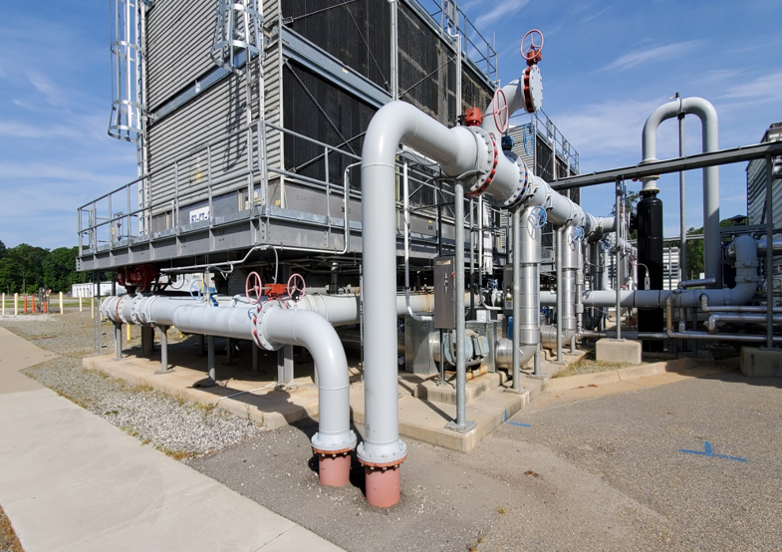
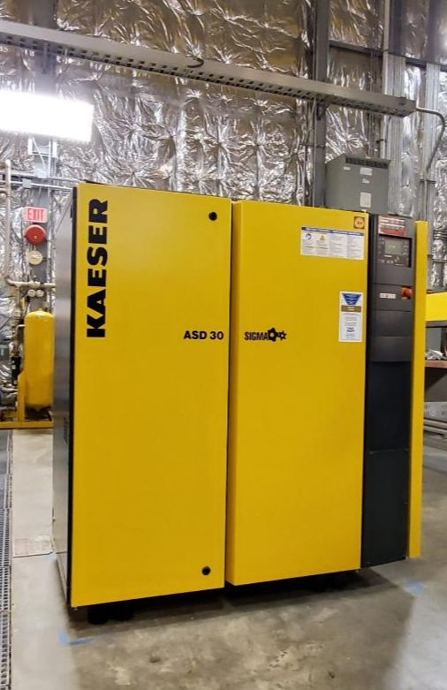
ESR2 Primary Utility Commodities
The two primary utility commodities for ESR2 I will discuss are:
WATER and AIR

Slide 3
ESR2 Primary Utility Commodities
What ESR2 equipment requires cooling water?
1. Two Sullair 1st Stage Comprs – Approx 56 GPM ea
2. Two Sullair 2nd Stage Comprs – Approx 175 GPM ea
3. Two Recovery Comprs – Approx 30 GPM ea
4. Diffusion pump on Main Cold Box – Approx .25 GPM
5. Four turbines in the Main Cold Box System
T1 – Approx 4 GPM
T2 – Approx 3.2 GPM
T3 – Approx .5 GPM
T4 – Approx .7 GPM
CRYO desires that the maximum flow rate not exceed 10 ft/sec. This will minimize erosion of the water piping and provide adequate cooling flow.
Flow values were derived as follows:
Main Stage Compressors: Using INPUT power and considering a 10K Delta T
Turbines: Developed from break cooler numbers supplied by vendor
It is imperative that the equipment listed above be adequately cooled such to protect it and lengthen it’s service. This equipment will generate heat which must be continually displaced by cooling water.

Slide 4
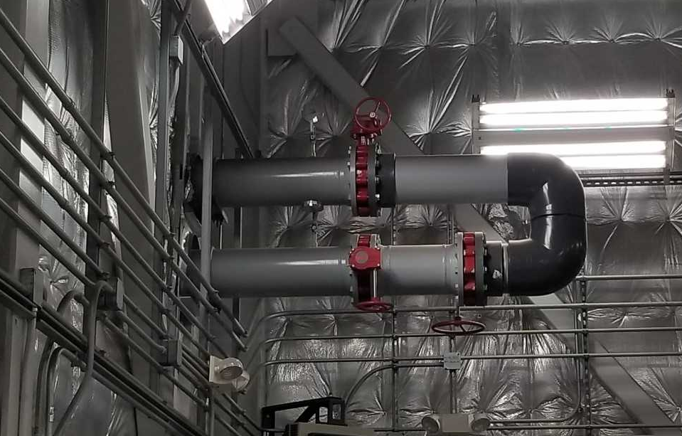
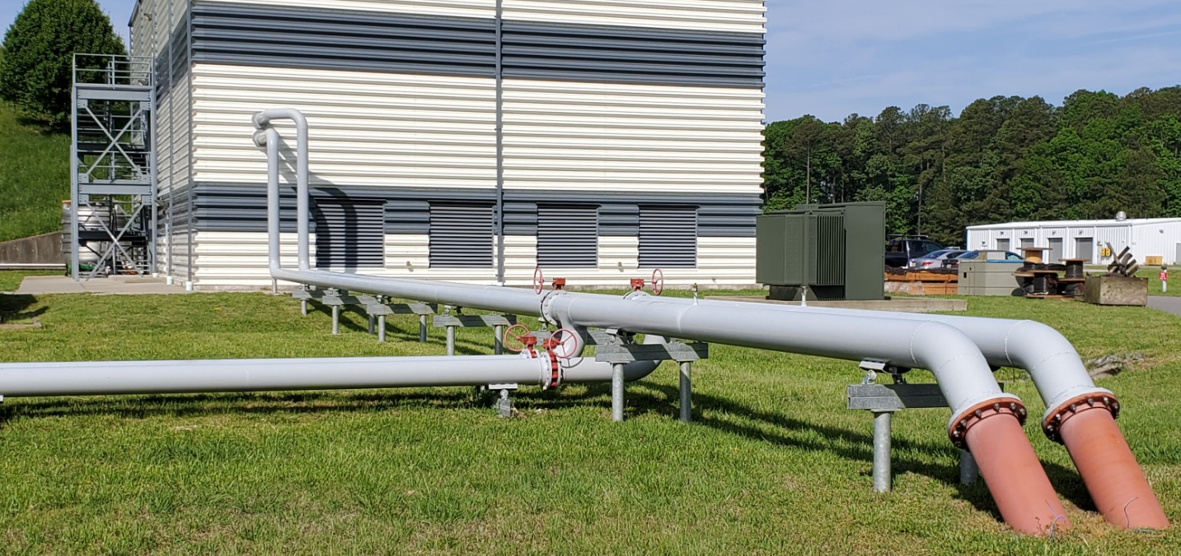
What has facilities management provided for the ESR2 Cooling Water System?
Facilities management has provided Supply and Return Cooling Water Piping with isolation valves that loops inside of bldg at the southeast corner. ESR2 Cooling Water will be supported by the North Access Cooling Tower.
Facilities management has indicated that they will provide labels for the SUPPLY and RETURN piping such that the headers can clearly be identified.

Slide 5
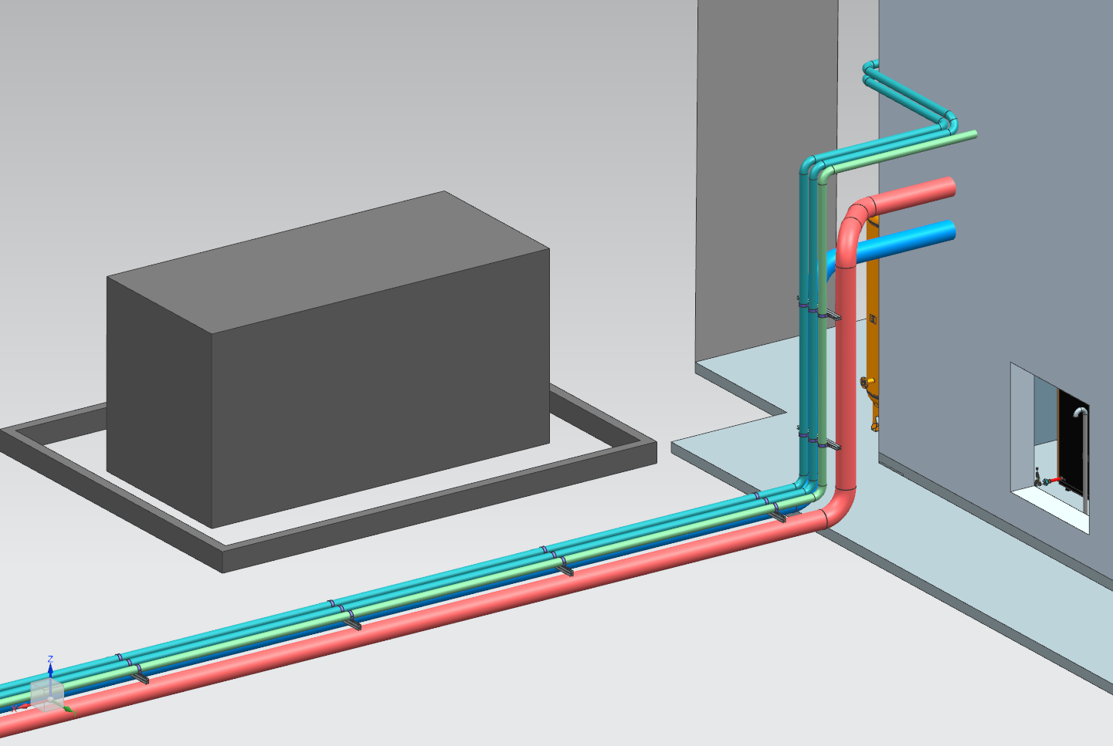
What does CRYO need to do to complete the water system?
Based on a P & I generated by CRYO, the piping will interface with existing valves provided by facilities management and be routed “to” and “from” the necessary equipment in the ESR2 compressor and cold box rooms.
CRYO has developed a conceptual 3D model which illustrates how the piping can be routed to the equipment that requires cooling water. Based on gage pressures observed in field piping by Damon Rath and I, the CWS piping is shown BLUE and the CWR piping is shown RED.

Slide 6
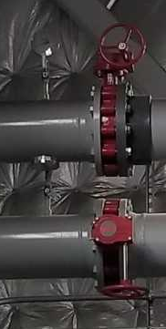
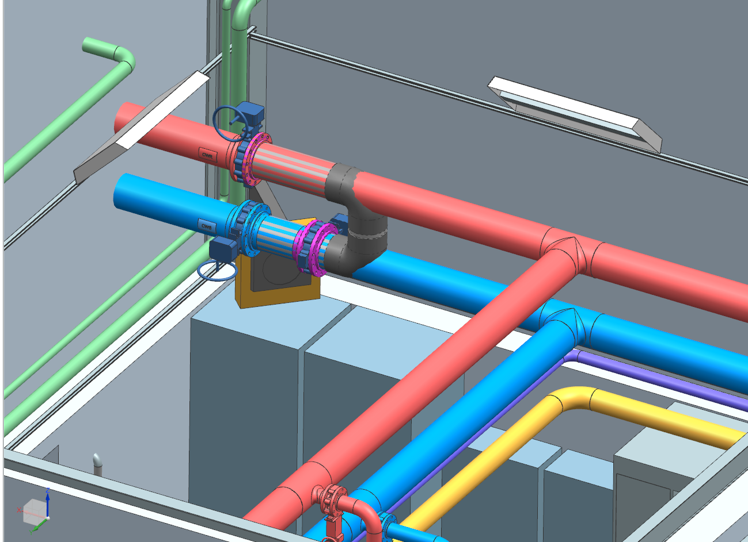
Pictures of conceptual CWS & CWR piping from 3D model
CWR
CWR

Slide 7
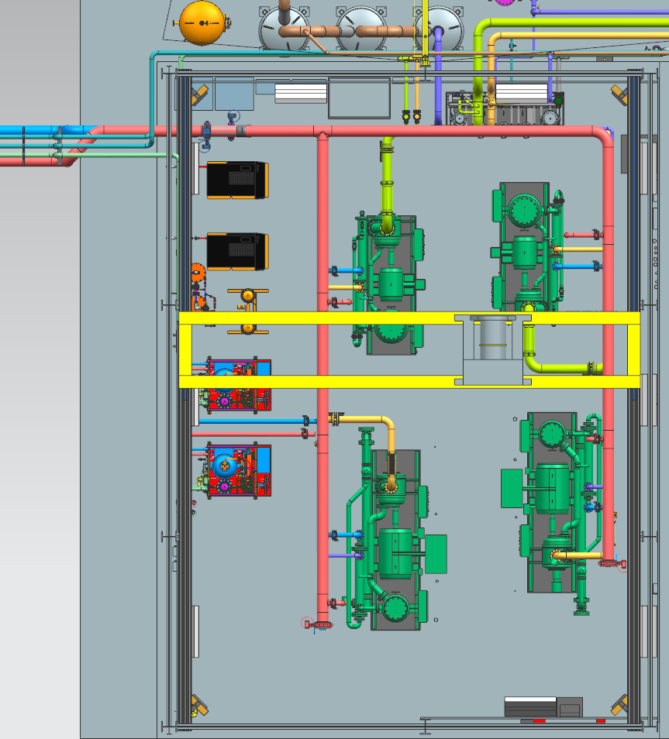
Pictures of conceptual CWS & CWR piping from 3D model

Slide 8
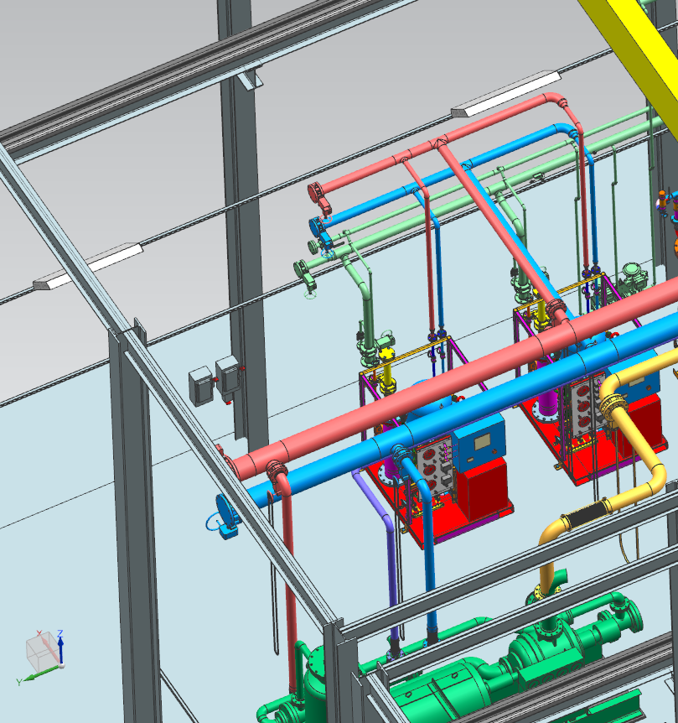
Pictures of conceptual CWS & CWR piping from 3D model

Slide 9
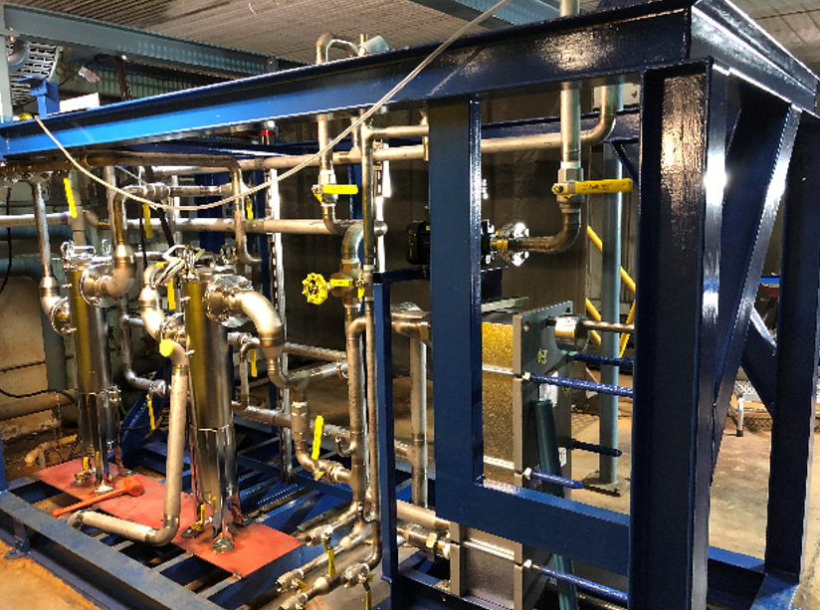
Secondary Turbine Cooling Water Skid
A Secondary Turbine Cooling Water Skid is required to filter water that will be dedicated to the diffusion pump and four turbines located in the cold box room. This will be a closed loop water circuit that can be feed from the main cooling water system if necessary.
This skid will be very similar as to what our JLab fabricators built for the SC1R 2K cold box using JLab drawings. CRYO will design this skid and generate a build to print drawing package. CRYO has designed and fabricated these type skids for CHL1 and CHL2.
Line sizes are not currently shown on the associated P&I for this equipment but they will be added once the engineering analysis is completed. Even though this skid is not shown in this presentation it will look similar to the picture shown below for the SC1R 2K cold box.

Slide 10
What we know about the Instrument Air System
We don’t have any of the equipment needed to support this system.
Majority of the equipment will be vendor supplied.
There will be MANY control valves which will require Instrument Air throughout the various plant systems.
Piping will be fabricated by JLab technicians from build to print drawings.
We have a good conceptual design which illustrates where we envision the Instrument Air equipment should be located and how the piping should be routed. This 3D layout is based off the existing CHL2 Instrument Air system which has a comparable demand. Pictures from the conceptual layout are provided on the following slides.
What big equipment do we THINK we need to procure?
Two Air Compressors Kaeser ASD 30 Series
One 2,200 Gal Air Storage Tank
One Heatless Desiccant Dryer Skid Kaeser KAD 165
Two Oil Mist Eliminators Kaeser OME 500
One Oil/Water Separator Kaeser KCF 50

Slide 11
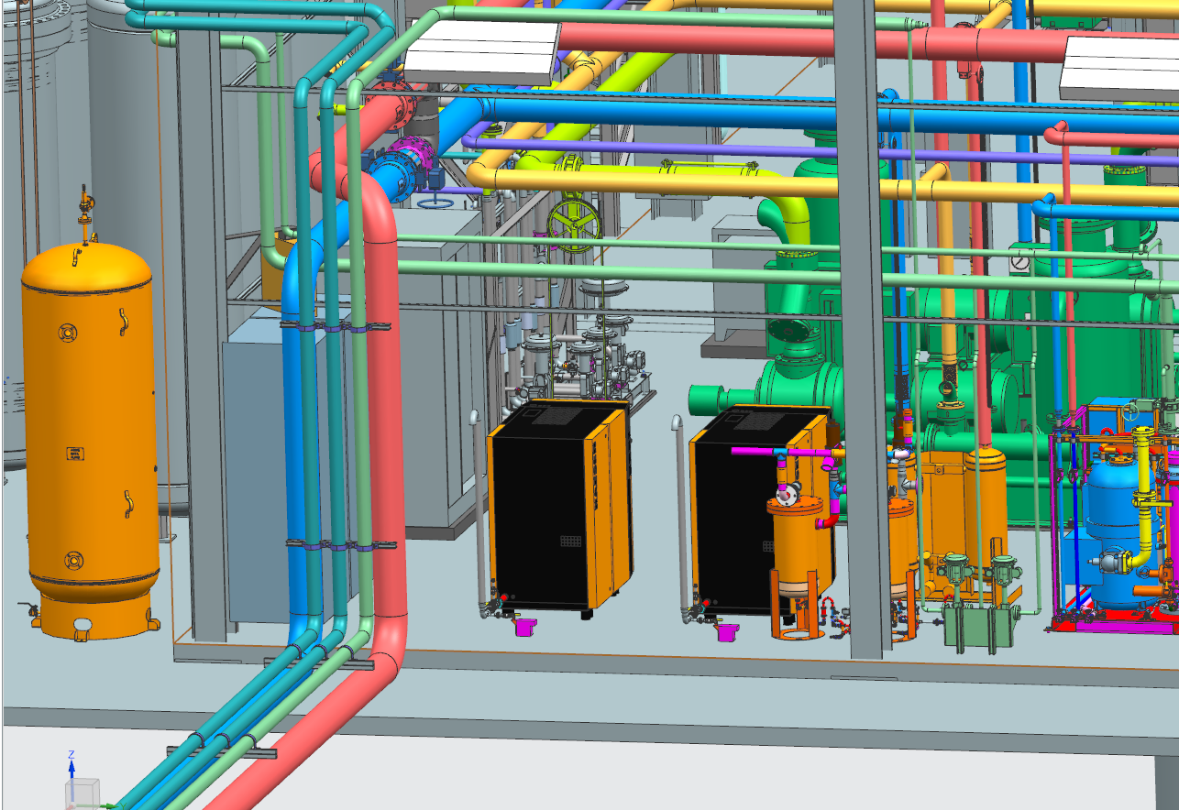
Pictures of conceptual Instrument Air equipment from 3D model

Slide 12
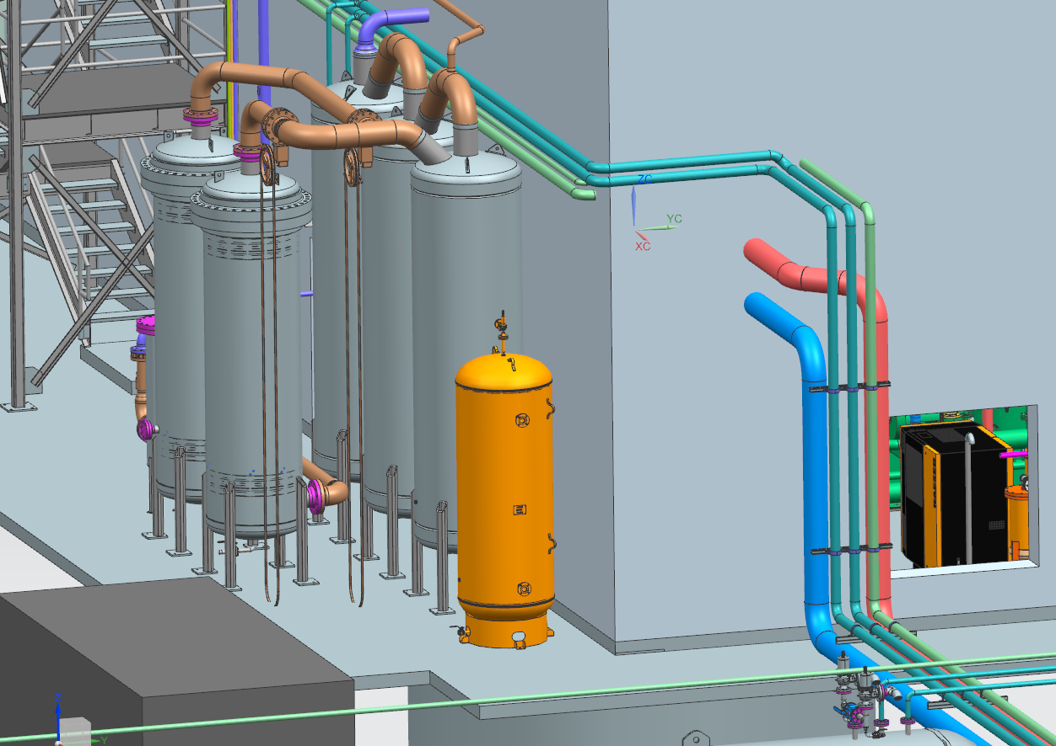
Pictures of conceptual Instrument Air equipment from 3D model

Slide 13
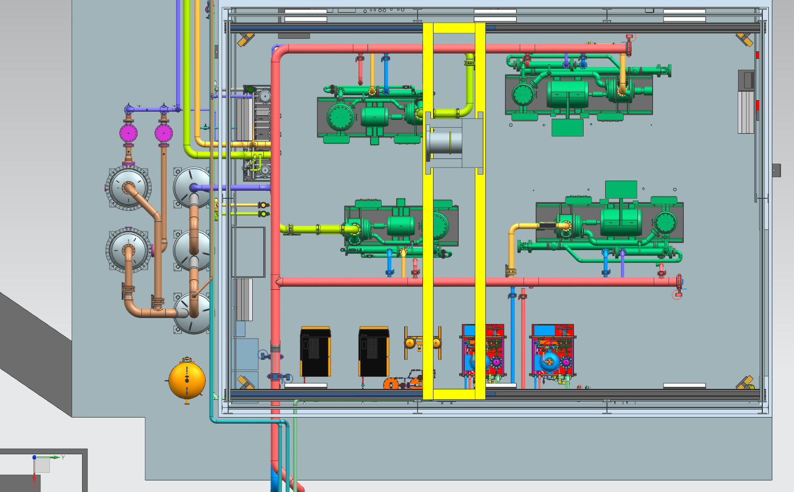
Pictures of conceptual Instrument Air equipment from 3D model

Slide 14
Conclusions:
In this presentation I have shown that CRYO has a good conceptual idea of how the Cooling Water and Instrument Air systems can be installed at ESR2. Note that the piping and equipment shown are conceptual and are subject to change.
All P&Is for the ESR2 Cooling Water and Instrument Air Systems have been made available for the PDR review committee at the link below. https://www.jlab.org/indico/event/331/
All necessary long lead time equipment has been identified. Some equipment will be fabricated by JLab but the majority will be vendor supplied. Line sizes for system piping may not be shown on associated P&Is as the engineering analysis has not been completed. This information will be completed by FDR.

Slide 15
End of the road
THANK YOU

Slide 16
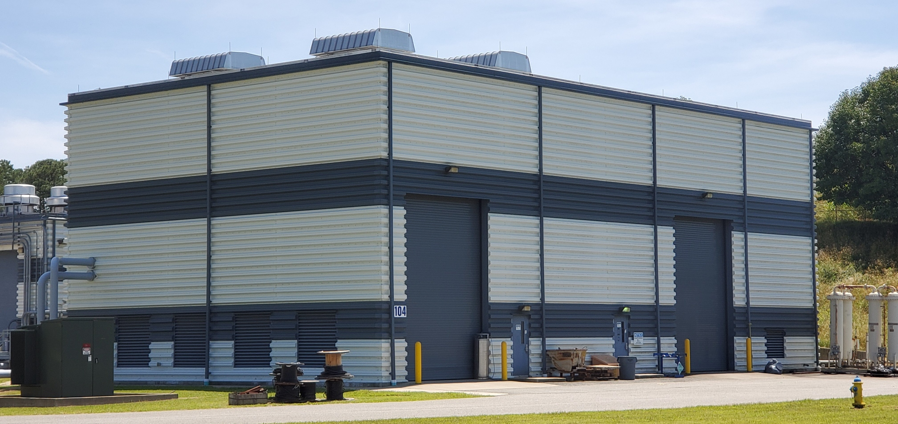
Corey Butler
757-269-7104

