Slide 1
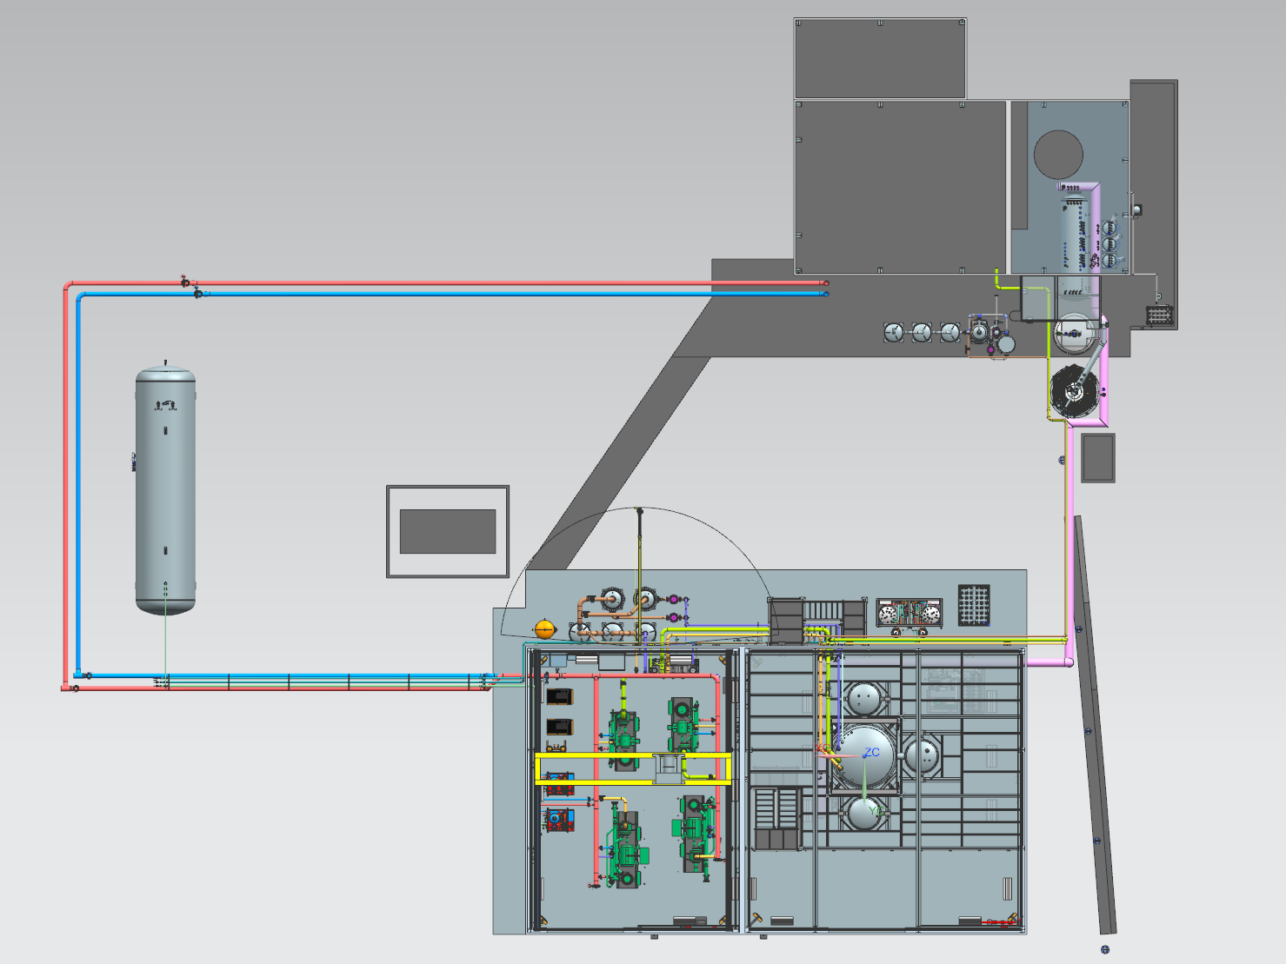
ESR2 Preliminary Design Review
Cryogenic Piping Design
Joe Matalevich

Slide 2
Cryogenic Piping Design – ESR2 PDR
Agenda
  P&I Review
  Cryogenic Transferline Interfaces
  Transferline General Routing
  Next Steps

Slide 3
Cryogenic Piping Design – P&I

Slide 4
Cryogenic Piping Design – P&I

Slide 5
Cryogenic Piping Design – Interface Points
Cold Box
(in ESR2)
Valve Box
(in ESR)
He Dewar
(outside)
Hall Expansion Cans
(in ESR)

Slide 6
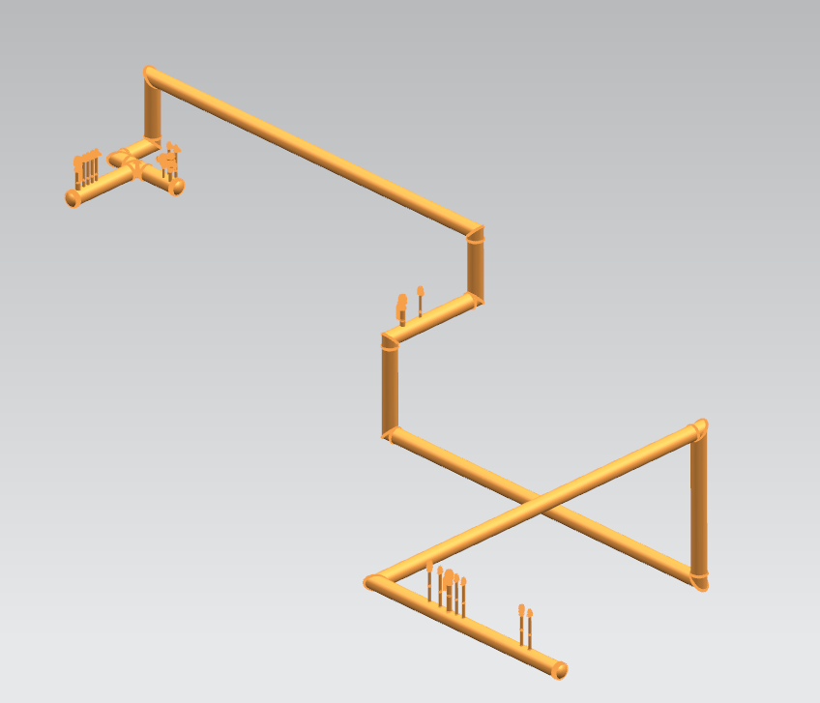
Cryogenic Piping Design – Interface Points
Valve Box
(in ESR)
Hall Expansion Cans
(in ESR)
He Dewar
(outside)
Cold Box
(in ESR2)

Slide 7
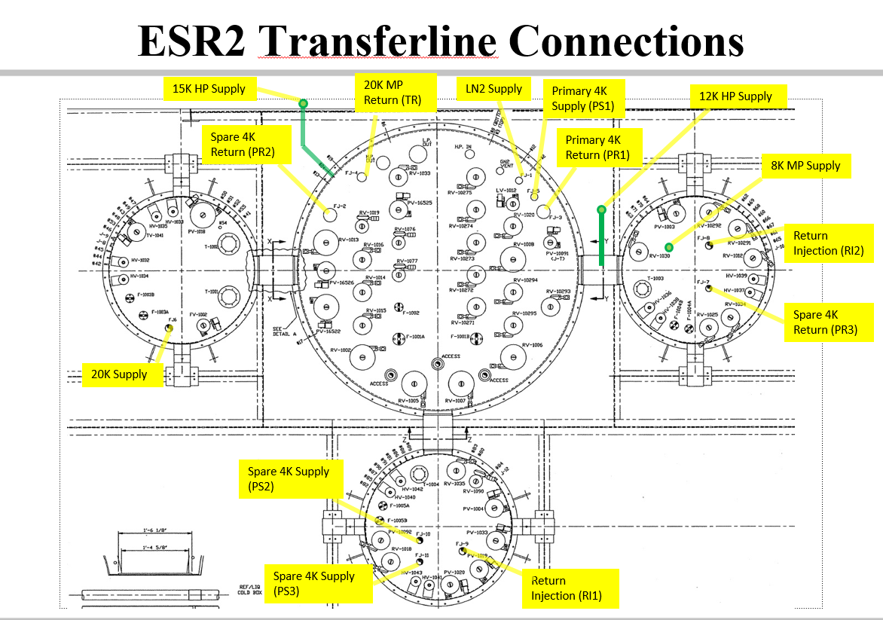
Cryogenic Piping Design – Cold Box Interface
TR
LN2
PS1
PR1
TS1
8 K HP supply

Slide 8
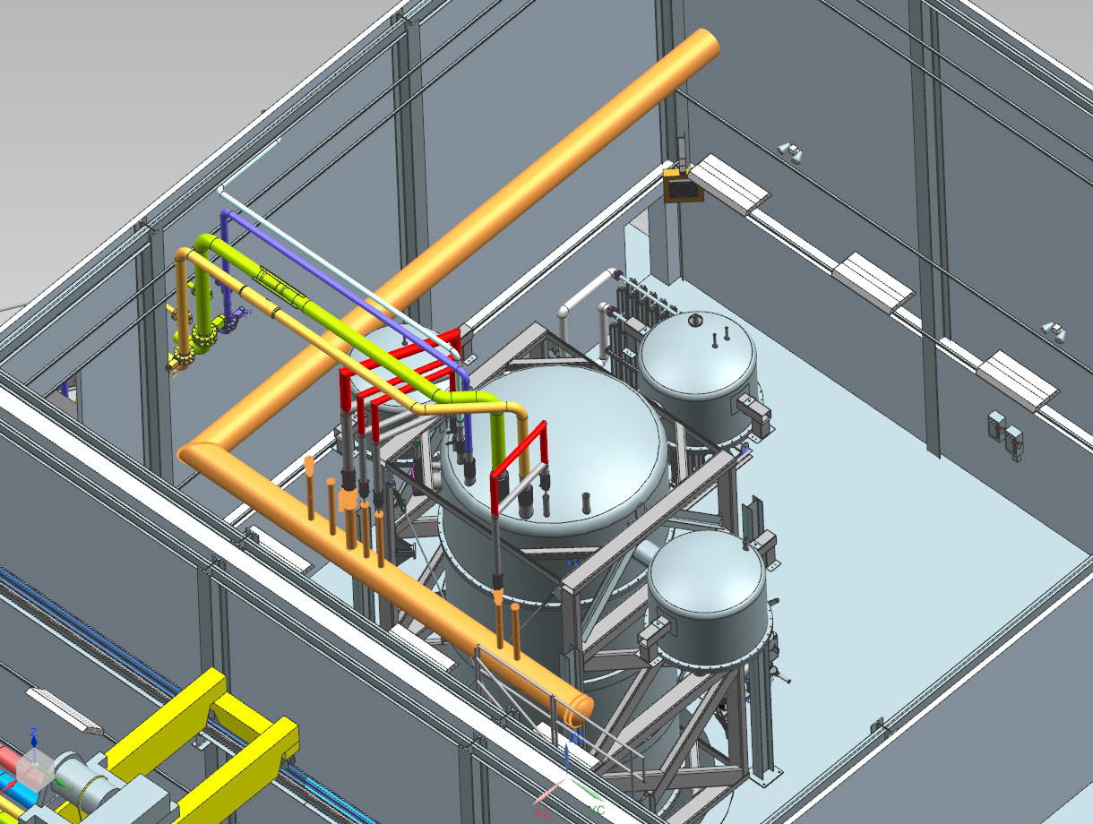
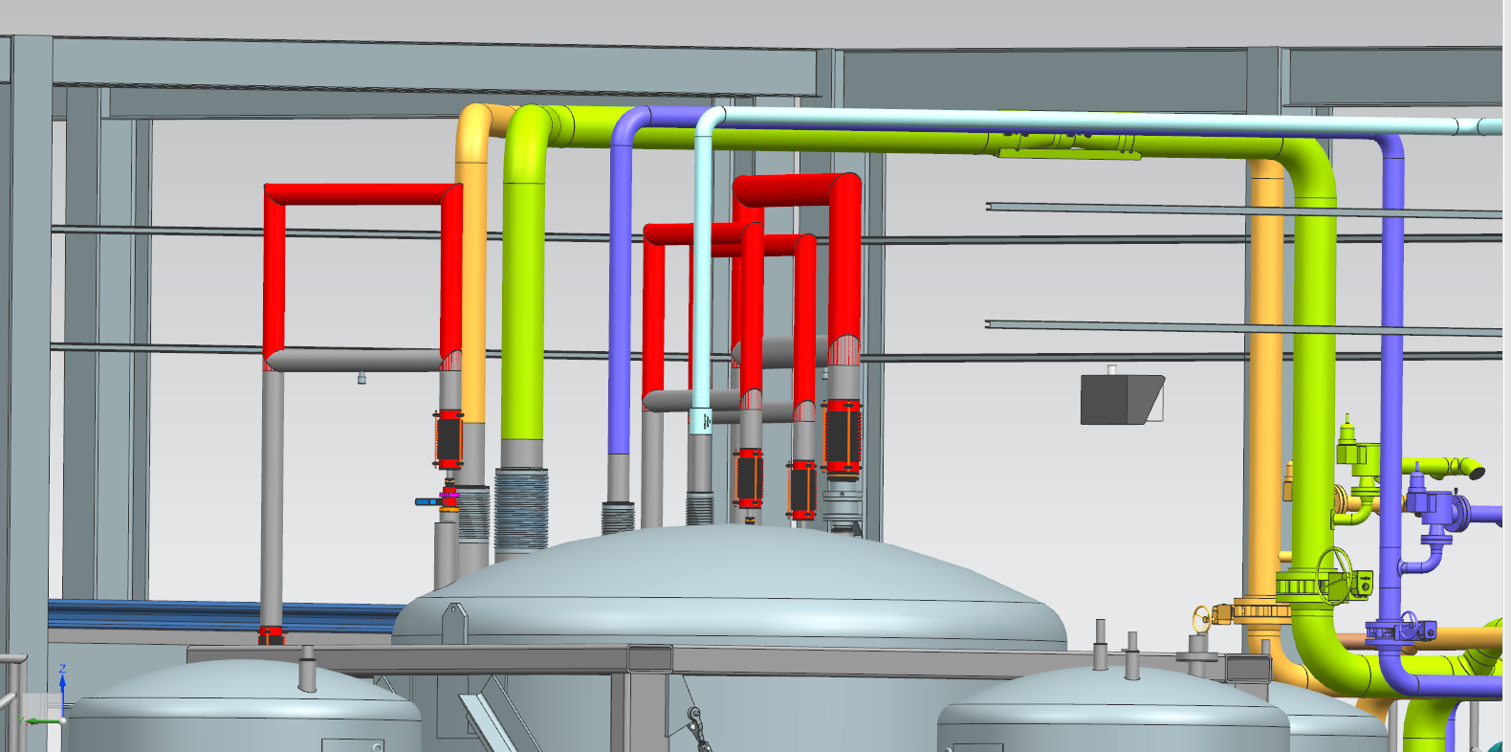
Cryogenic Piping Design – Cold Box Interface
Transferline consists of two straight sections within the ESR 2 building.
Transferline is supported beneath the second level decking.
Section that runs north-south has a series of bayonets to facilitate u-tube connections to the coldbox.
Section that runs east-west exits the building on the west side.

Slide 9
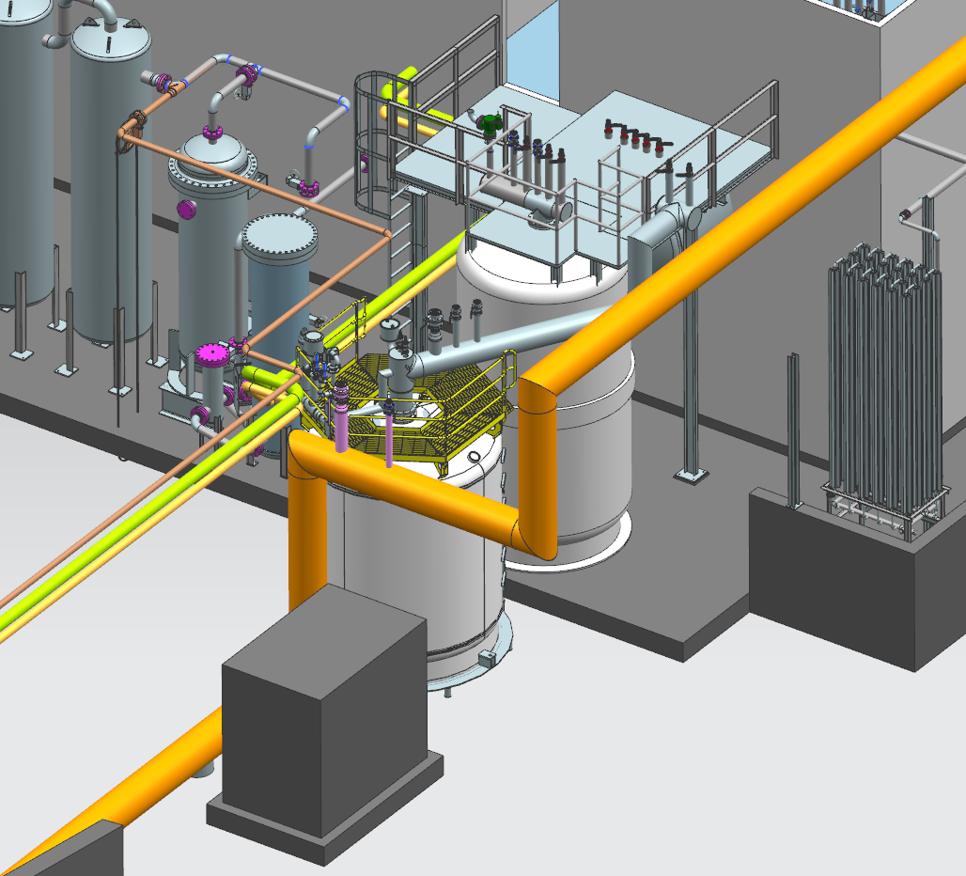
Cryogenic Piping Design – He Dewar Interface
He dewar u-tube connections to transferline are made outside the buildings.
Proximity of transferline routing to dewar location simplifies u-tube design.
Mechanism to assist in u-tube operations to be incorporated into dewar structure.

Slide 10
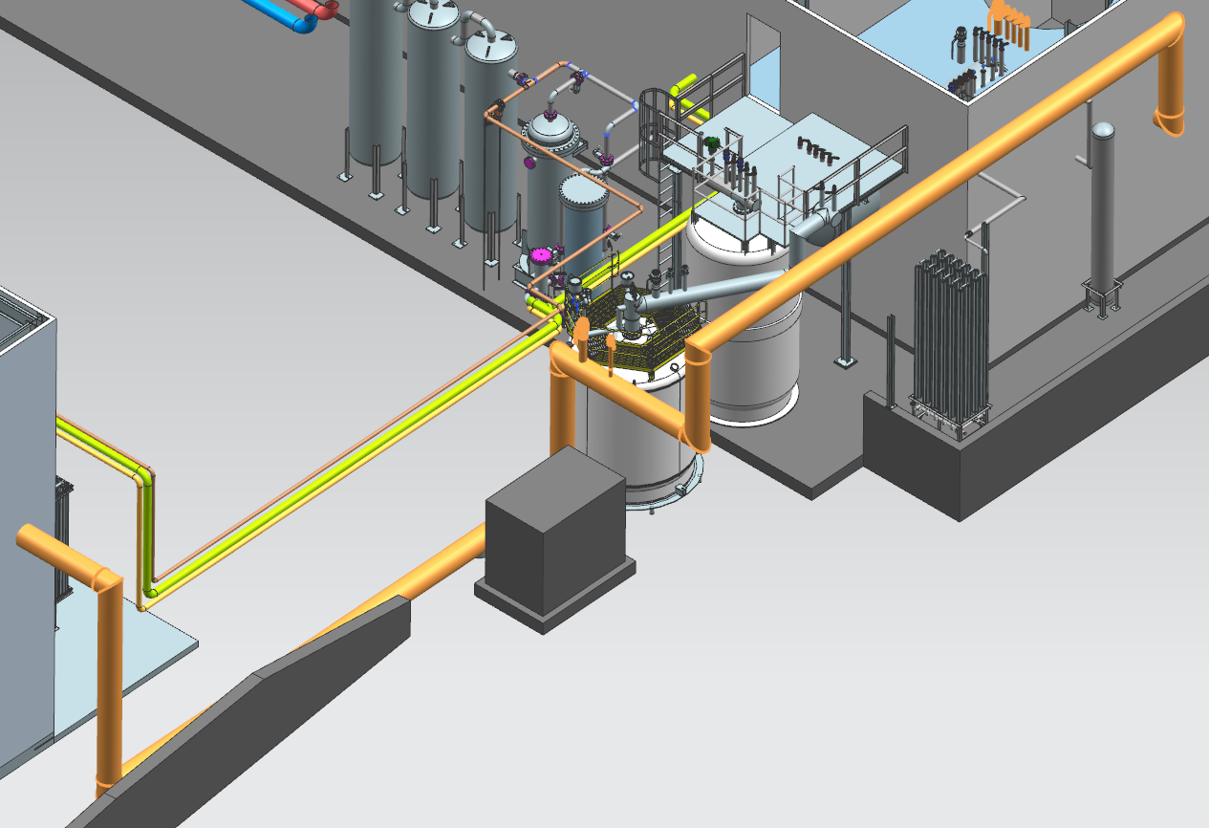
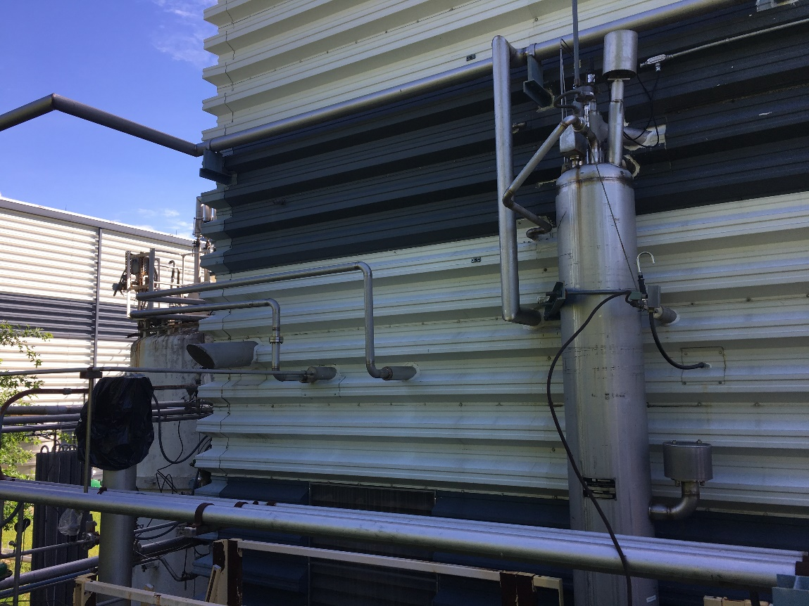
Cryogenic Piping Design – Outside Routing
Long section of transferline will travel over to ESR close to the ground to simplify installation. (considered elevating this section).
Some bends/jogs will be necessary to avoid existing infrastructure. Nothing overly complicated is required.
Entry on the west wall results in a longer run outside, but simplifies the section of transferline within the existing ESR building.
Exact entry location determined by tradeoffs from options inside ESR.

Slide 11
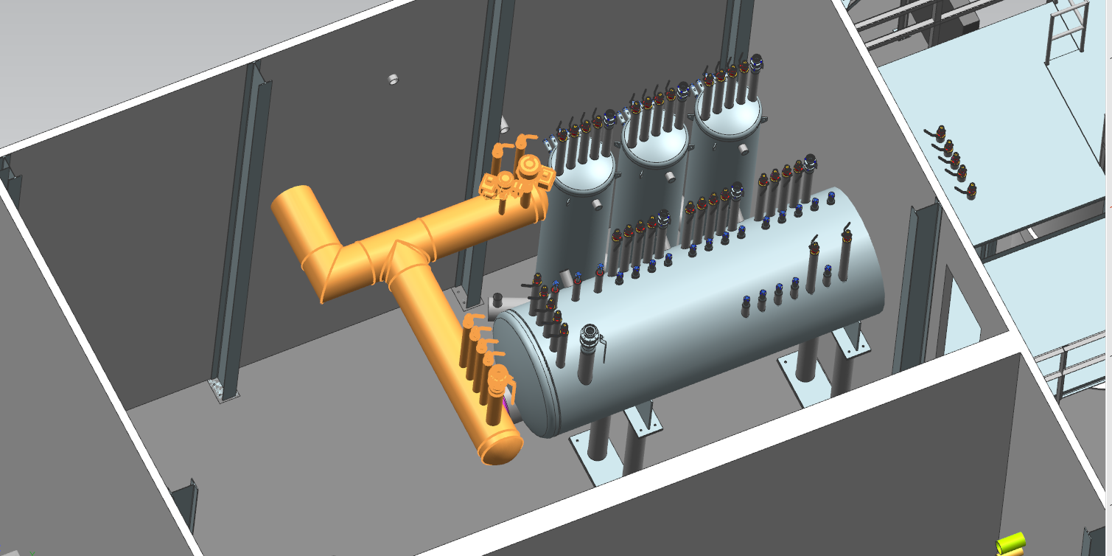
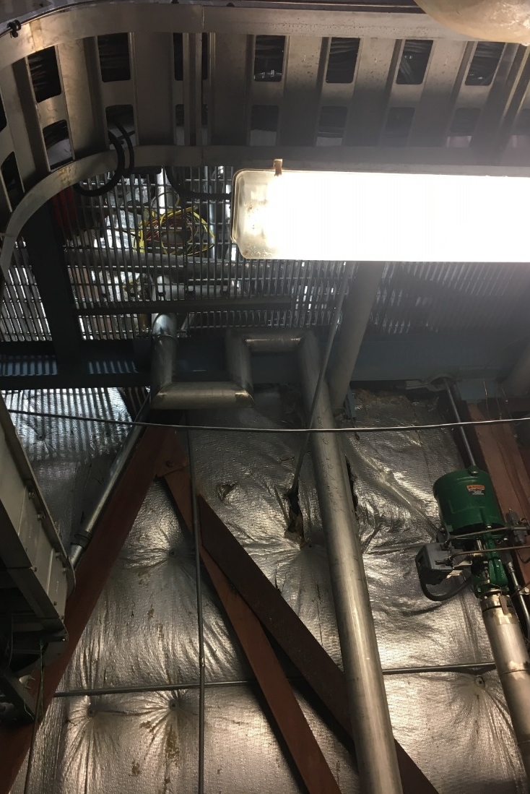
Cryogenic Piping Design – Valve Box and Hall Can Interface
Inside Routing:
Entry through west wall enables relatively short sections for both the hall can and valve box bayonets.
Shortest most direct route interferes with existing piping (ESR Refrigeration Recovery Heat Exchanger). Potential it can be moved or removed. (under evaluation).

Slide 12
Cryogenic Piping Design – Next Steps
Detailed Engineering
    Process calculations finalized
      Operational pressure drop
      Operational heat load
      Pressure relief scenarios
    Piping flexibility analysis
    Transferline support structure analysis
    Transferline internal G10 spider analysis
Design Tasks
    Additional detail (of existing infrastructure) into CAD model
    Define interface to dewar
    Detailed piping design
    Define support structures
      Incorporate flexibility analysis and anchoring scheme
    U-tube designs

Slide 13
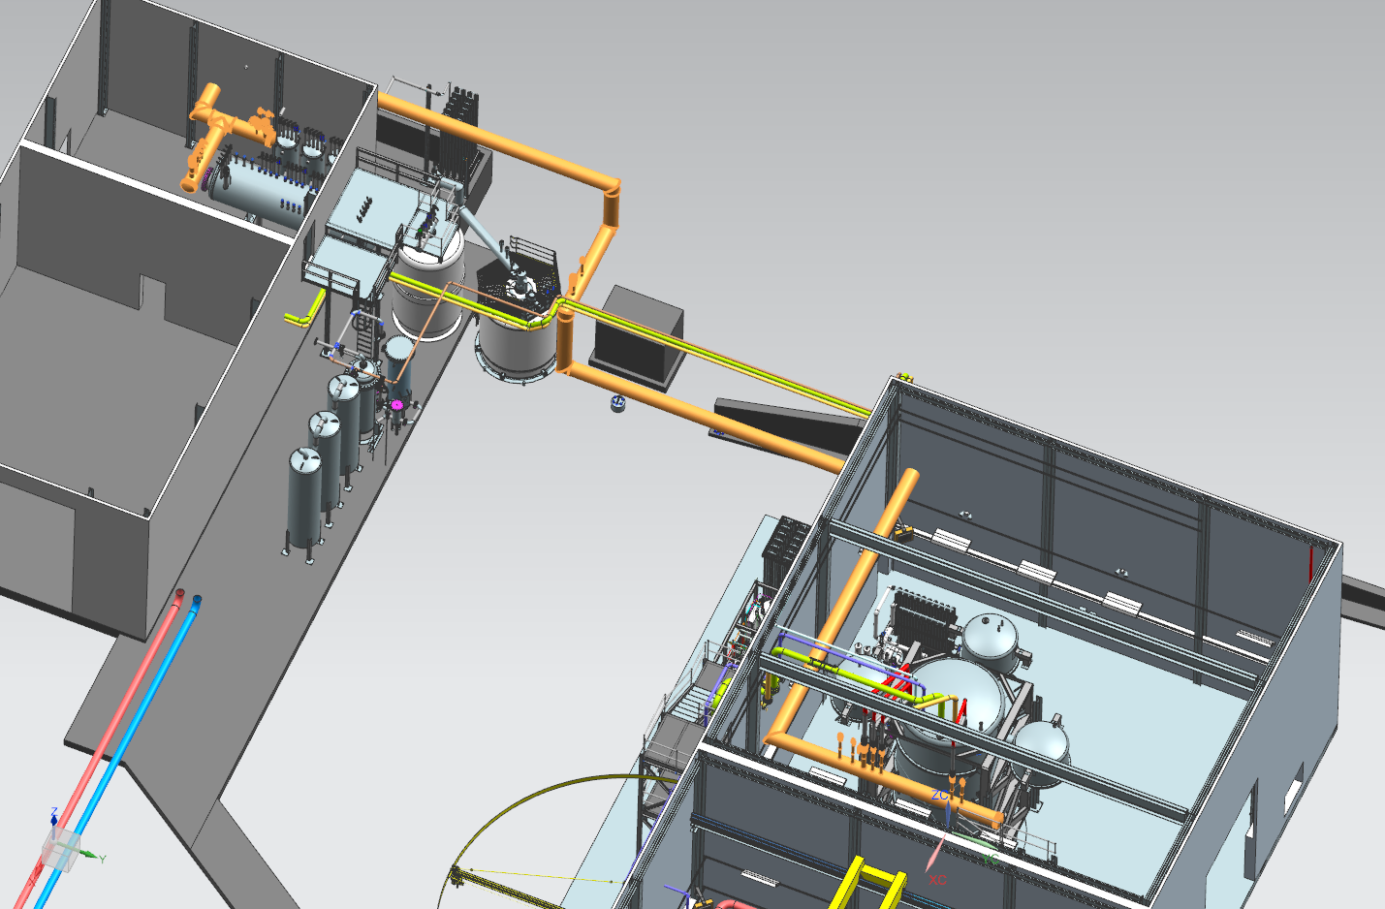
ESR2 Preliminary Design Review – Cryogenic Piping Design

Slide 14
Cryogenic Piping Design
Additional Slides

Slide 15
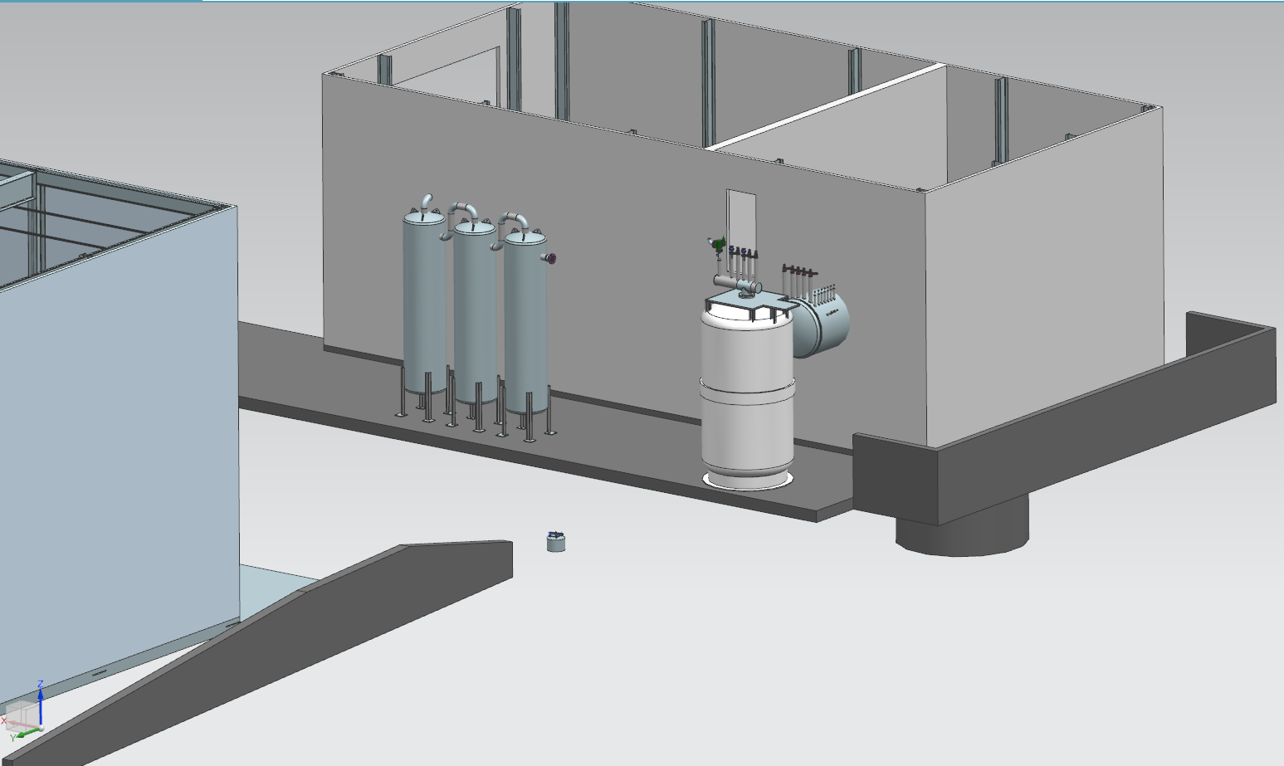
Cryogenic Piping Design
Routing Configurations Considered
West Wall
North Wall at Valve Box Level
North Wall near ground level
B)
A)
C)

Slide 16
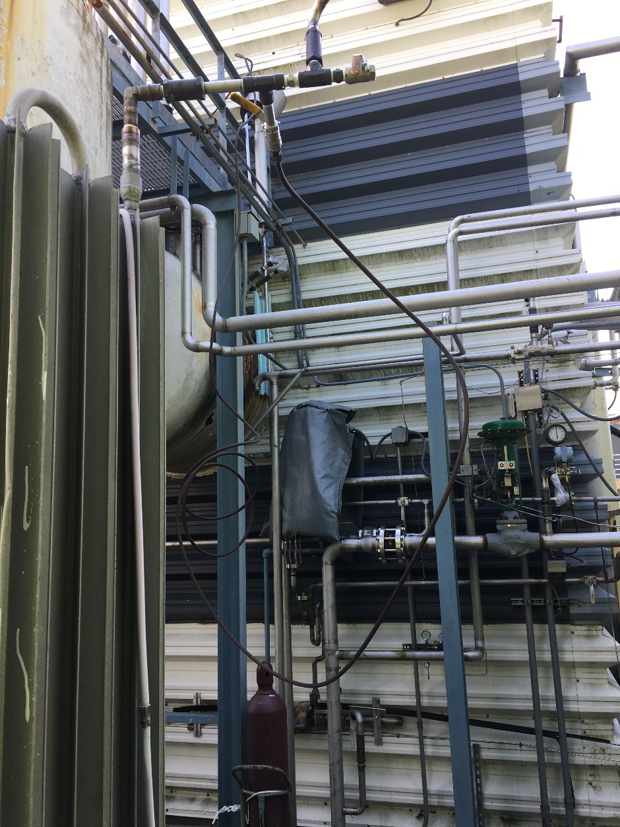
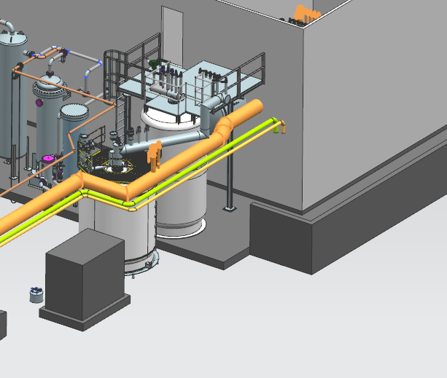
Option B – Enter ESR North Wall at Valve Box Level
Cryogenic Piping Design – Transferline Routing
Outside Routing:
High and in proximity of new dewar to facilitate connection to neck can
Slight jog required to tuck in behind existing dewar
Existing pipes and structure in the area but should be OK.

Slide 17
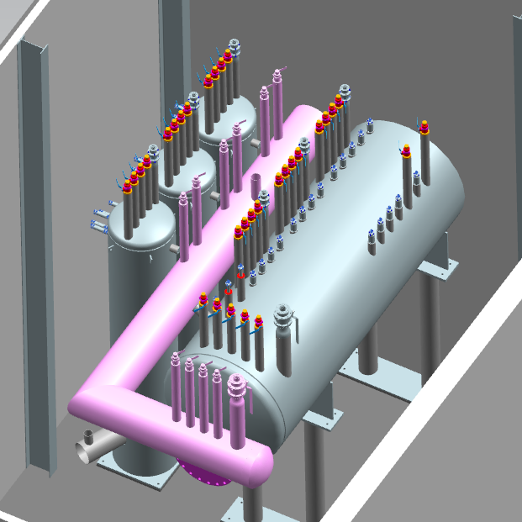
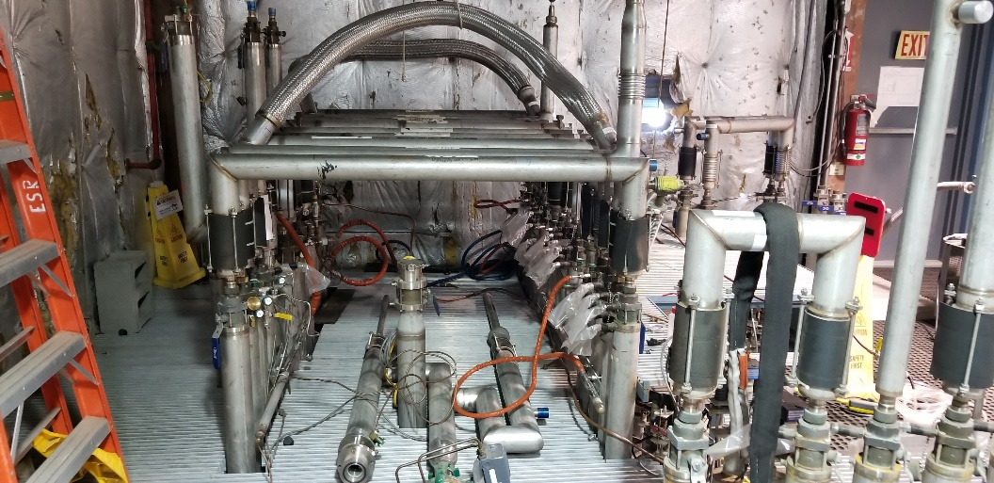
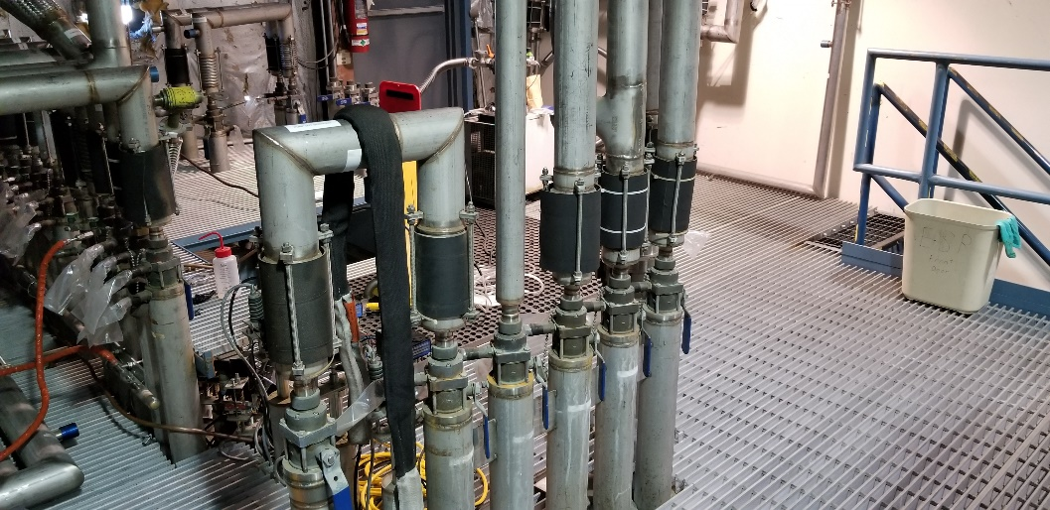
Option B – Enter ESR North Wall at Valve Box Level
Cryogenic Piping Design
Inside Routing:
L-shaped section. Could support either sub-option for connection to hall cans.
Short u-tube connections to valve box located directly across from valve box bayonets.
Several concerns/issues with fabrication and installation.

Slide 18
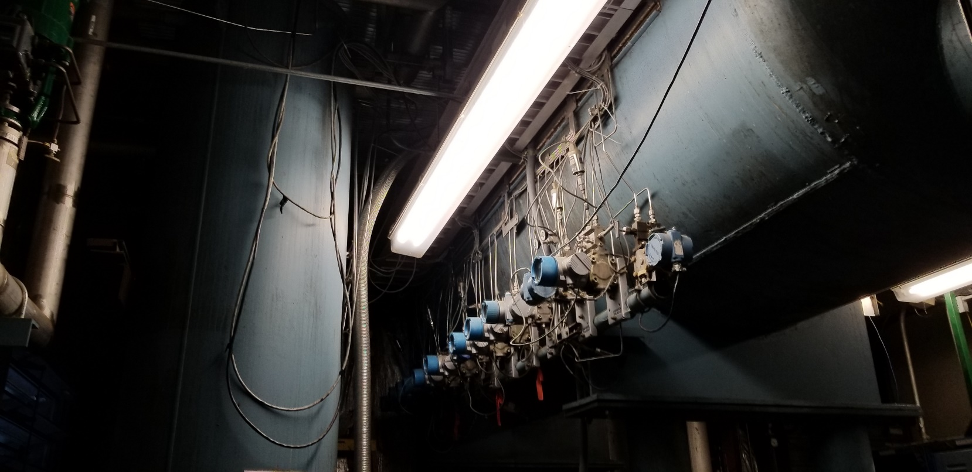
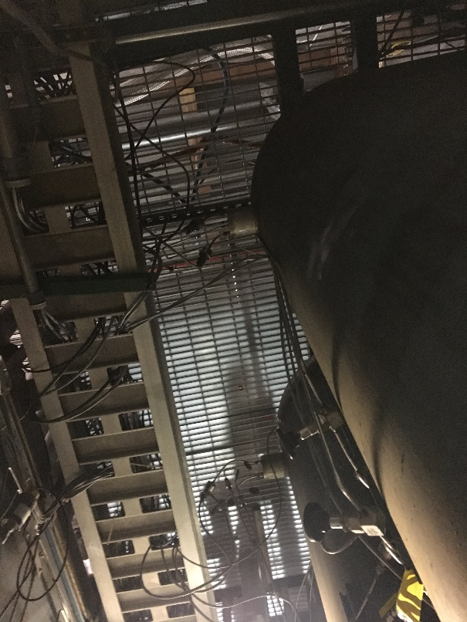
Option B – Enter ESR North Wall at Valve Box Level
Cryogenic Piping Design – Transferline Routing
Inside Routing Concerns / Issues:
The transferline would need to be broken into multiple sections to be able to get it into place.
Temporarily (or permanently) relocating the cable tray would be a non-trivial effort , time-consuming, with a risk for lengthy interruption of operations.
The expansion can pressure tubing would need to be modified or moved.

Slide 19
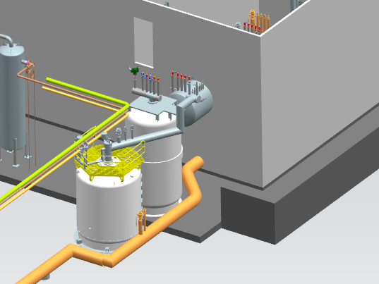
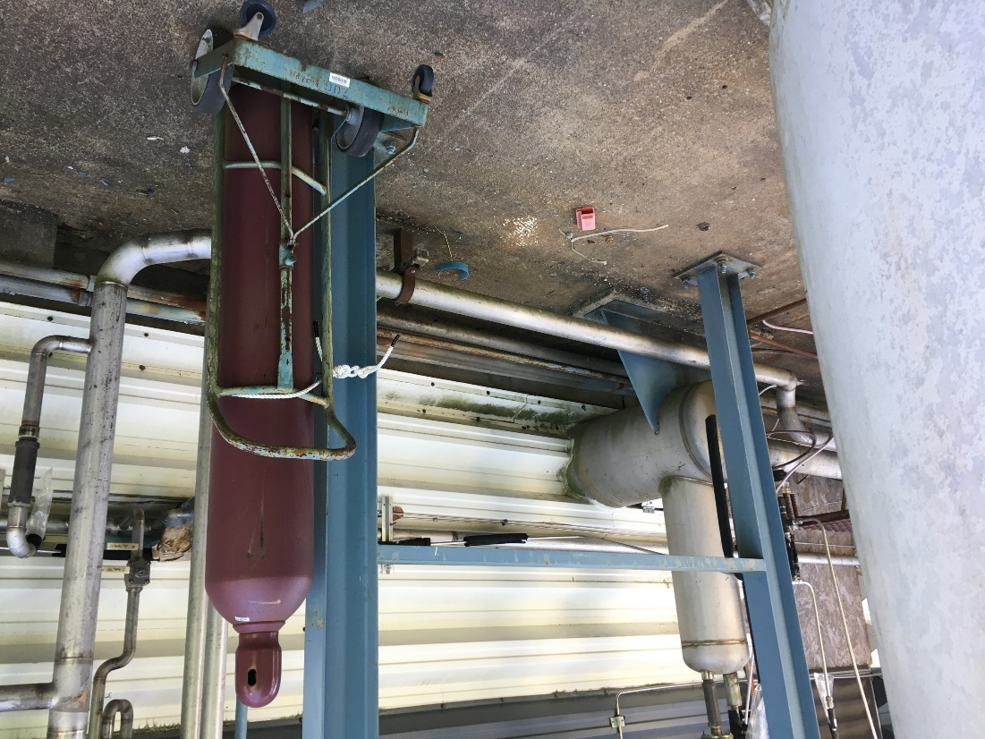
Option C – Enter ESR North Wall at Ground Level
Cryogenic Piping Design – Transferline Routing
Outside Routing:
Transfer line stays low to the ground
Jog (45) required to tuck in behind existing dewar.
Fairly clear; some existing pipes and structure in the area but routing is feasible.

Slide 20
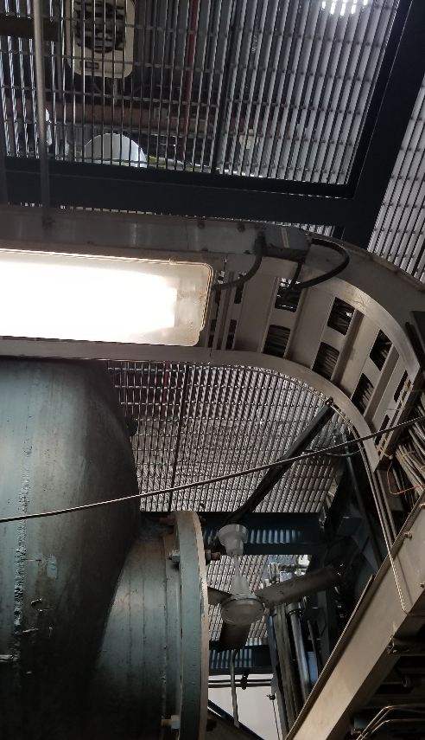
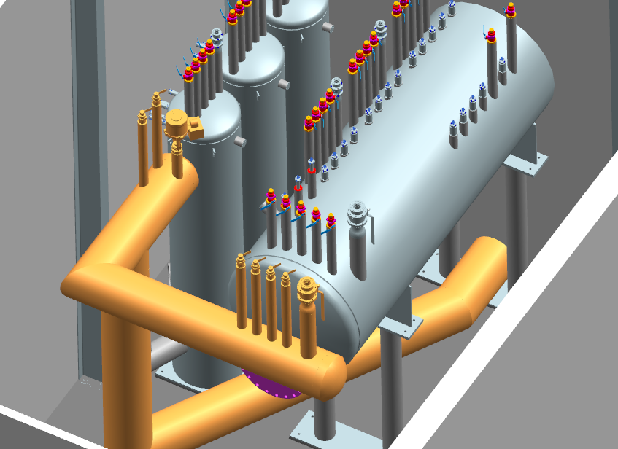
Option C – Enter ESR North Wall at Ground Level
Cryogenic Piping Design – Transferline Routing
Inside Routing:
Small L-shaped section for the valve box and hall can connections. Larger section traverses the floor (mainly unobstructed) and connects to a vertical section.
Would make sense to build an elevated platform over the floor section. Would help with access to some components.
Interference with existing infrastructure is minimal.
Fairly large sections would need to be brought inside. Would require multiple sections and field joints.

Slide 21
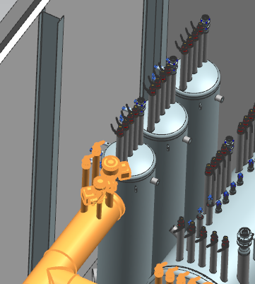
Cryogenic Piping Design – Hall Expansion Can Options
Considered design variants for connection to hall expansion cans.
  One set of bayonets which connect to a flexible u-tube which can reach all 3 cans.
  3 sets of bayonets. Each of which has its own set of short/rigid u-tubes.
Option 1 is current intended design approach. Simpler overall for fabrication and is preferred for u-tube operations.
Option 1 → One set of bayonets
Option 2 → Three sets of bayonets

Slide 22
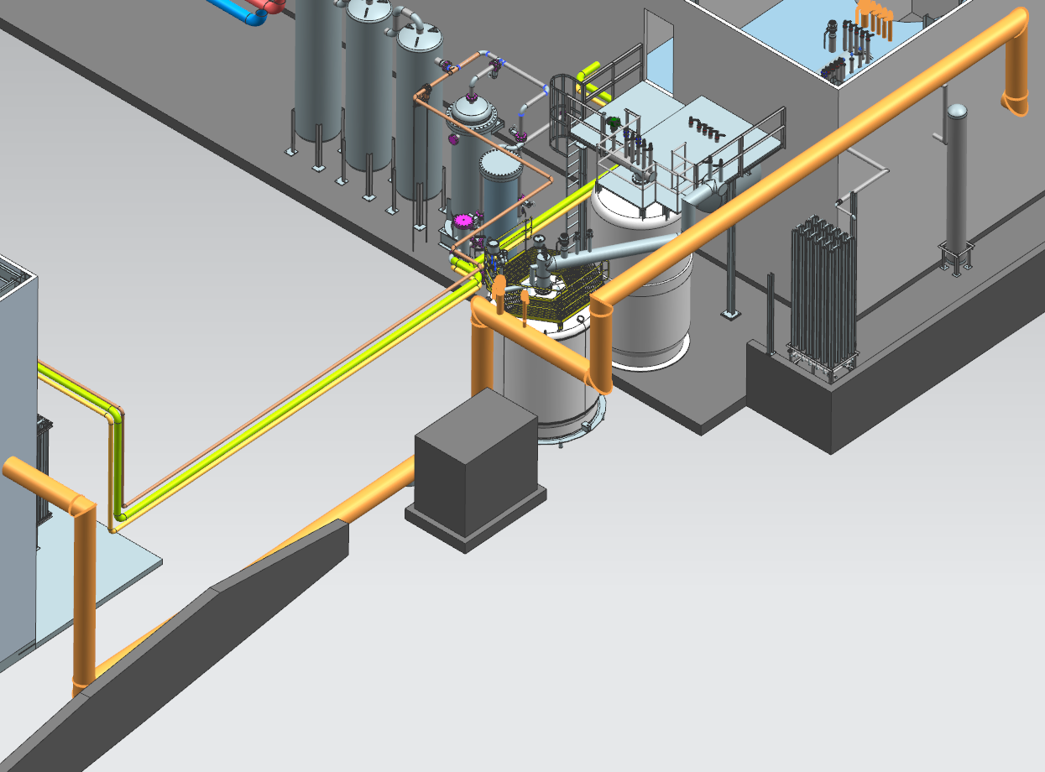
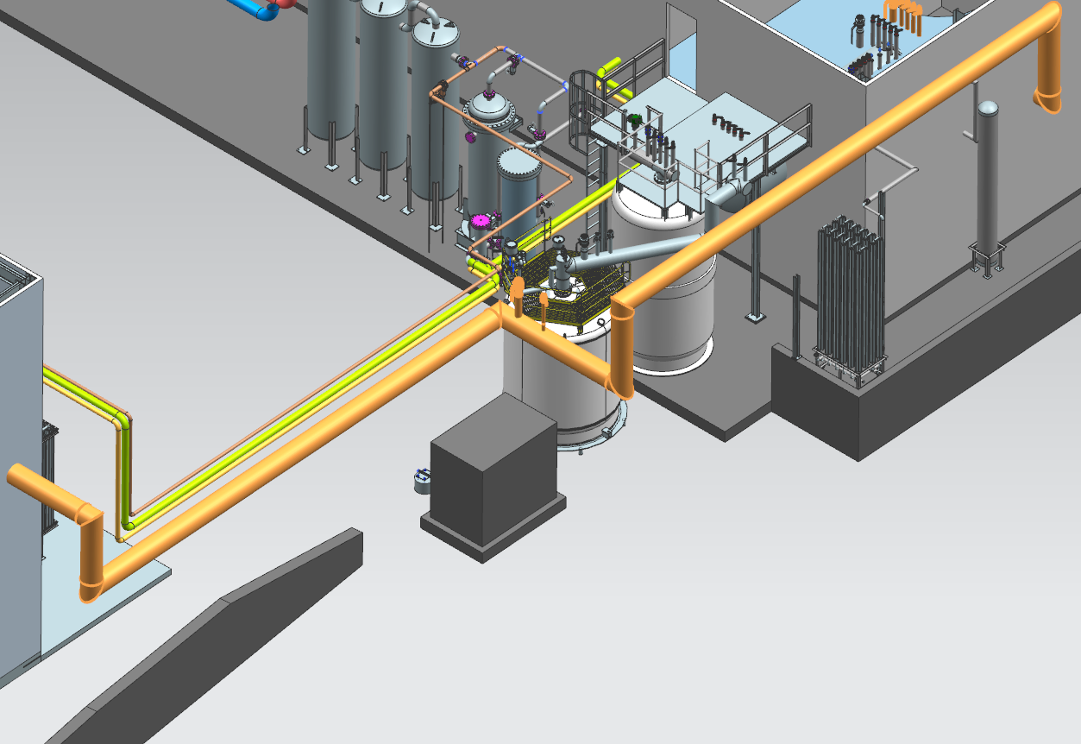
Cryogenic Piping Design – Height of Outside Section
Will evaluate best overall option for height of transferline in long section that runs between buildings.
Currently have it low to the ground for ease of installation.
Low to ground → Easiest install
Elevated → Shorter length

Slide 23
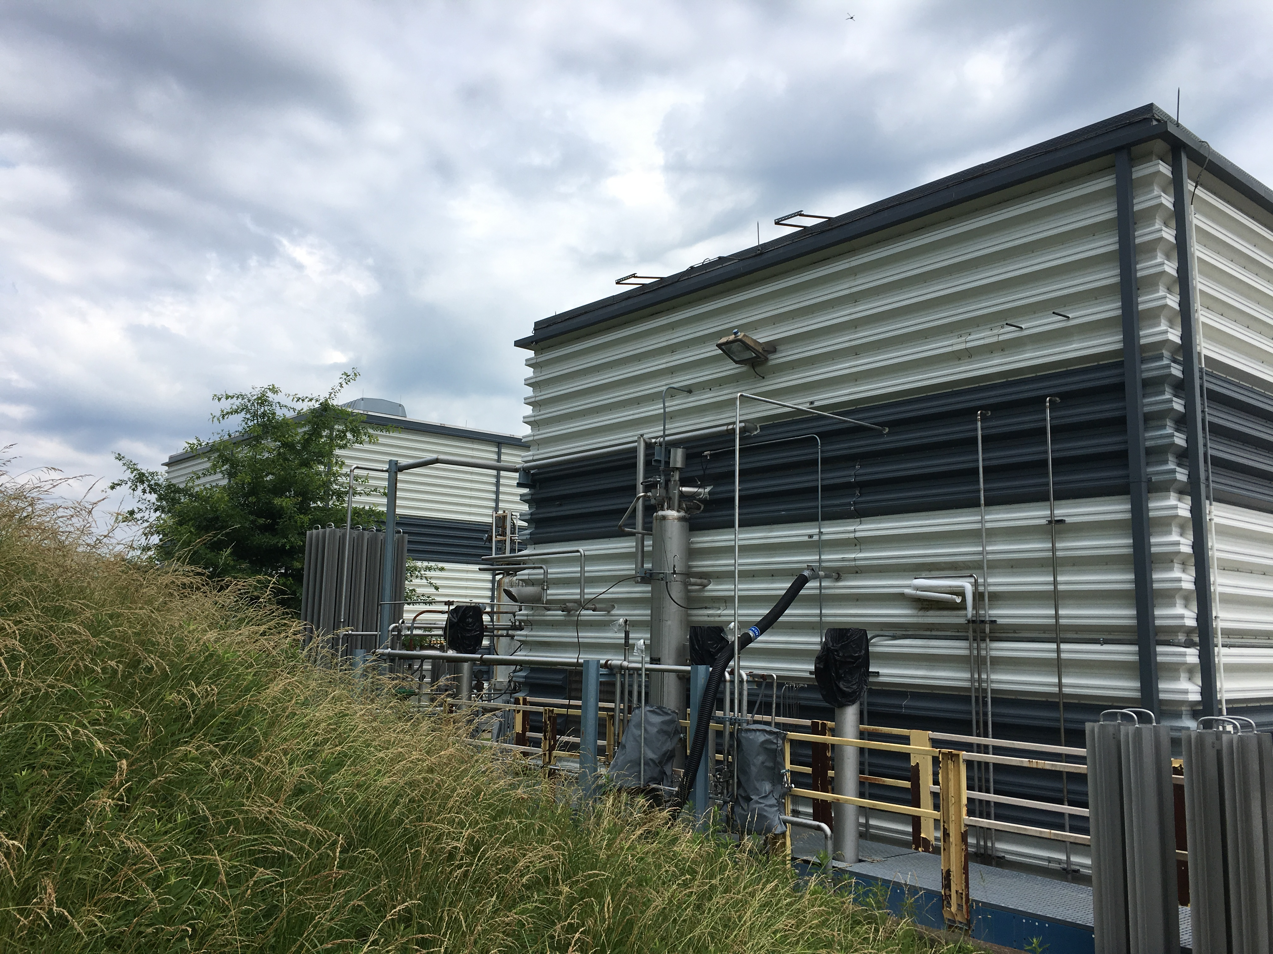
Cryogenic Piping Design – Additional Photos

Slide 24
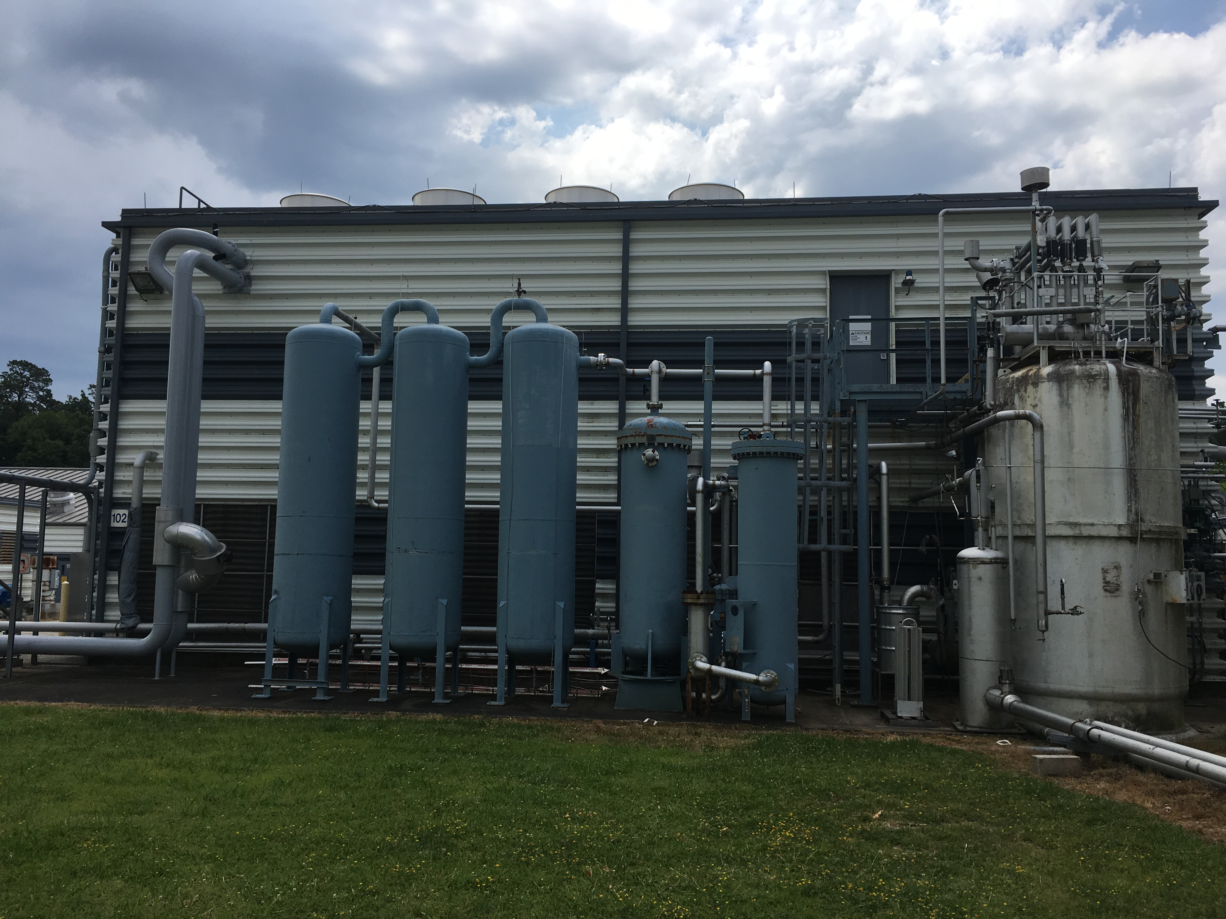
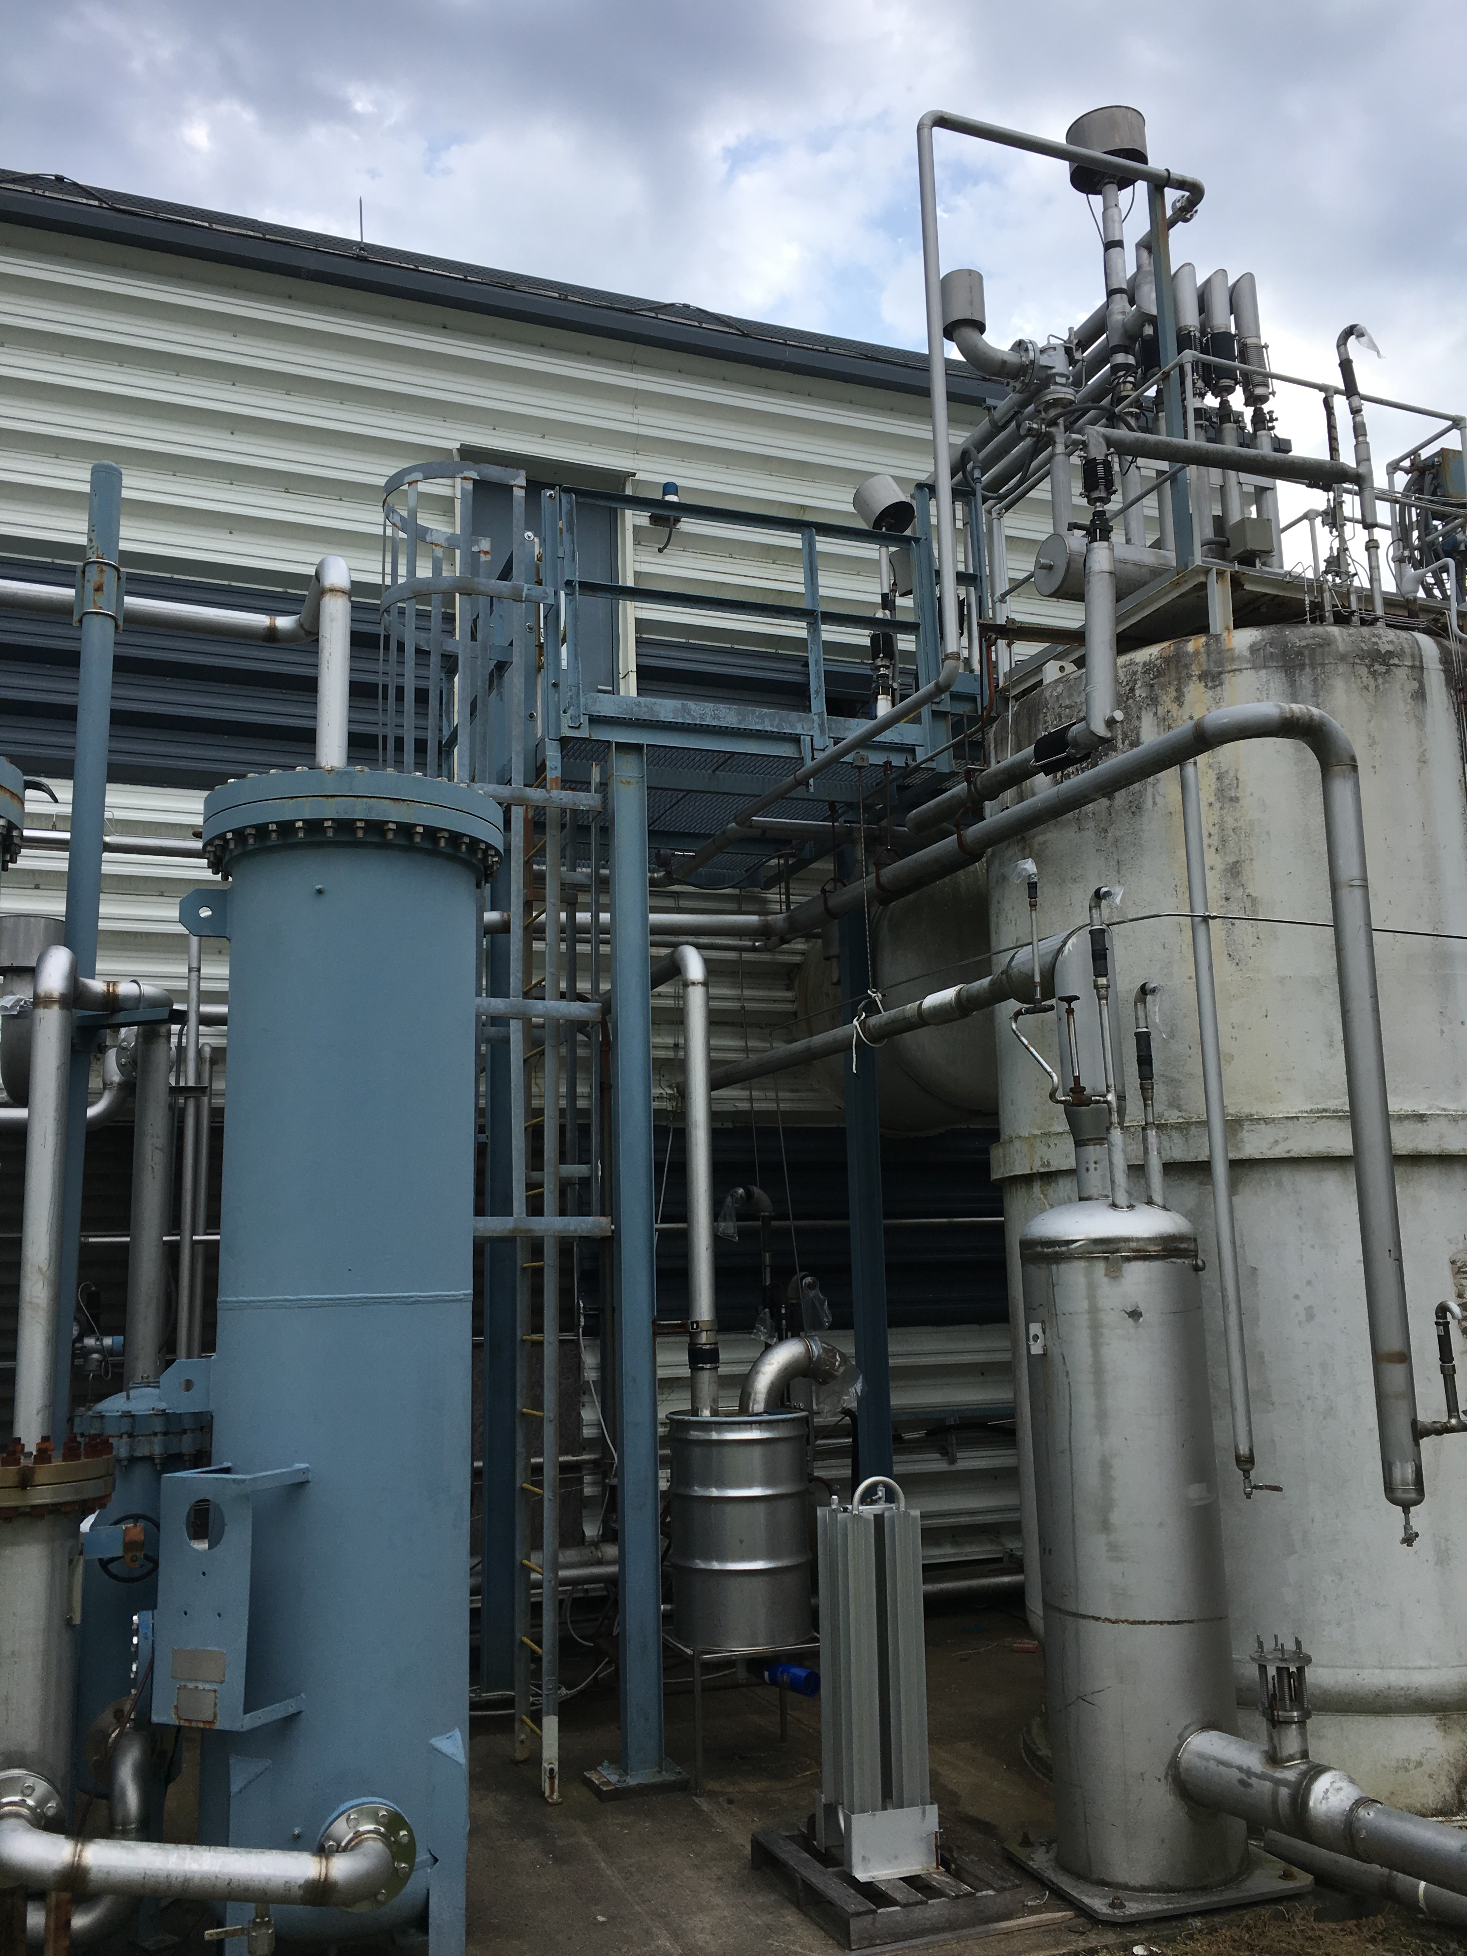
Cryogenic Piping Design – Additional Photos

