Slide 1
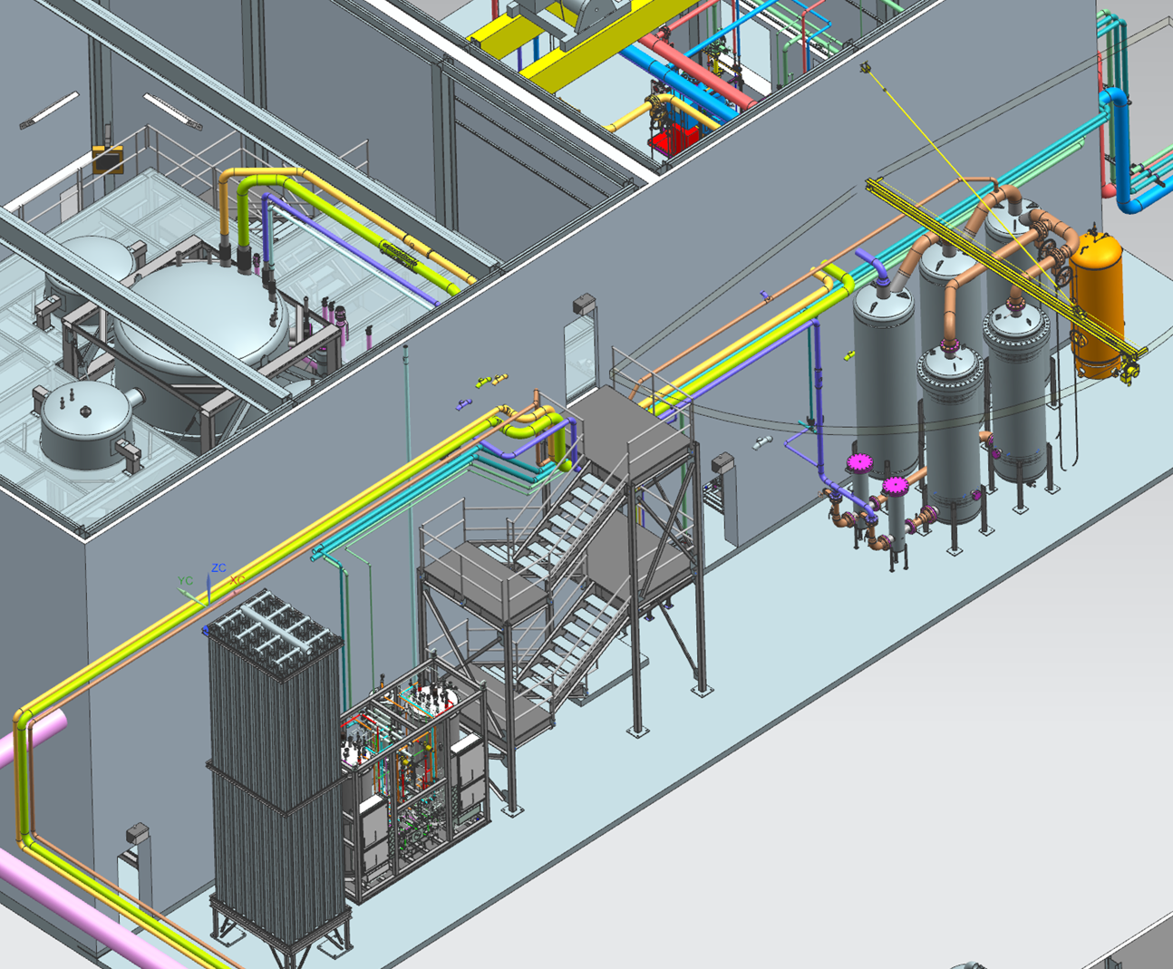
ESR2 Warm Piping Layout
Topics to be Covered:
Existing Layout
Design Considerations
Cold Box Piping
Outdoor Piping
Oil Removal System
Gas Management Skid
Compressor Room
Chris Perry

Slide 2
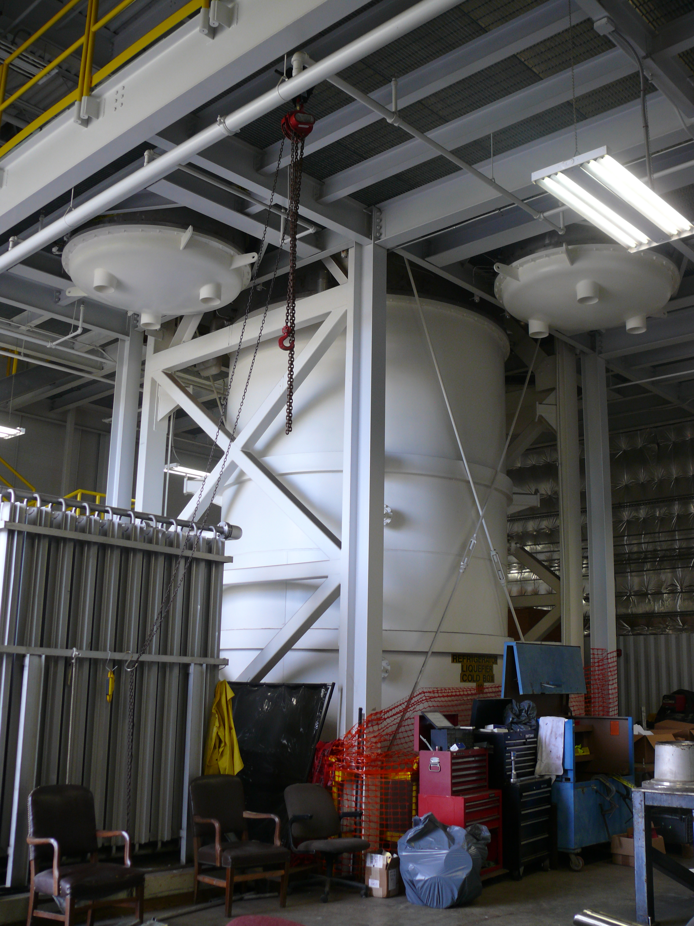
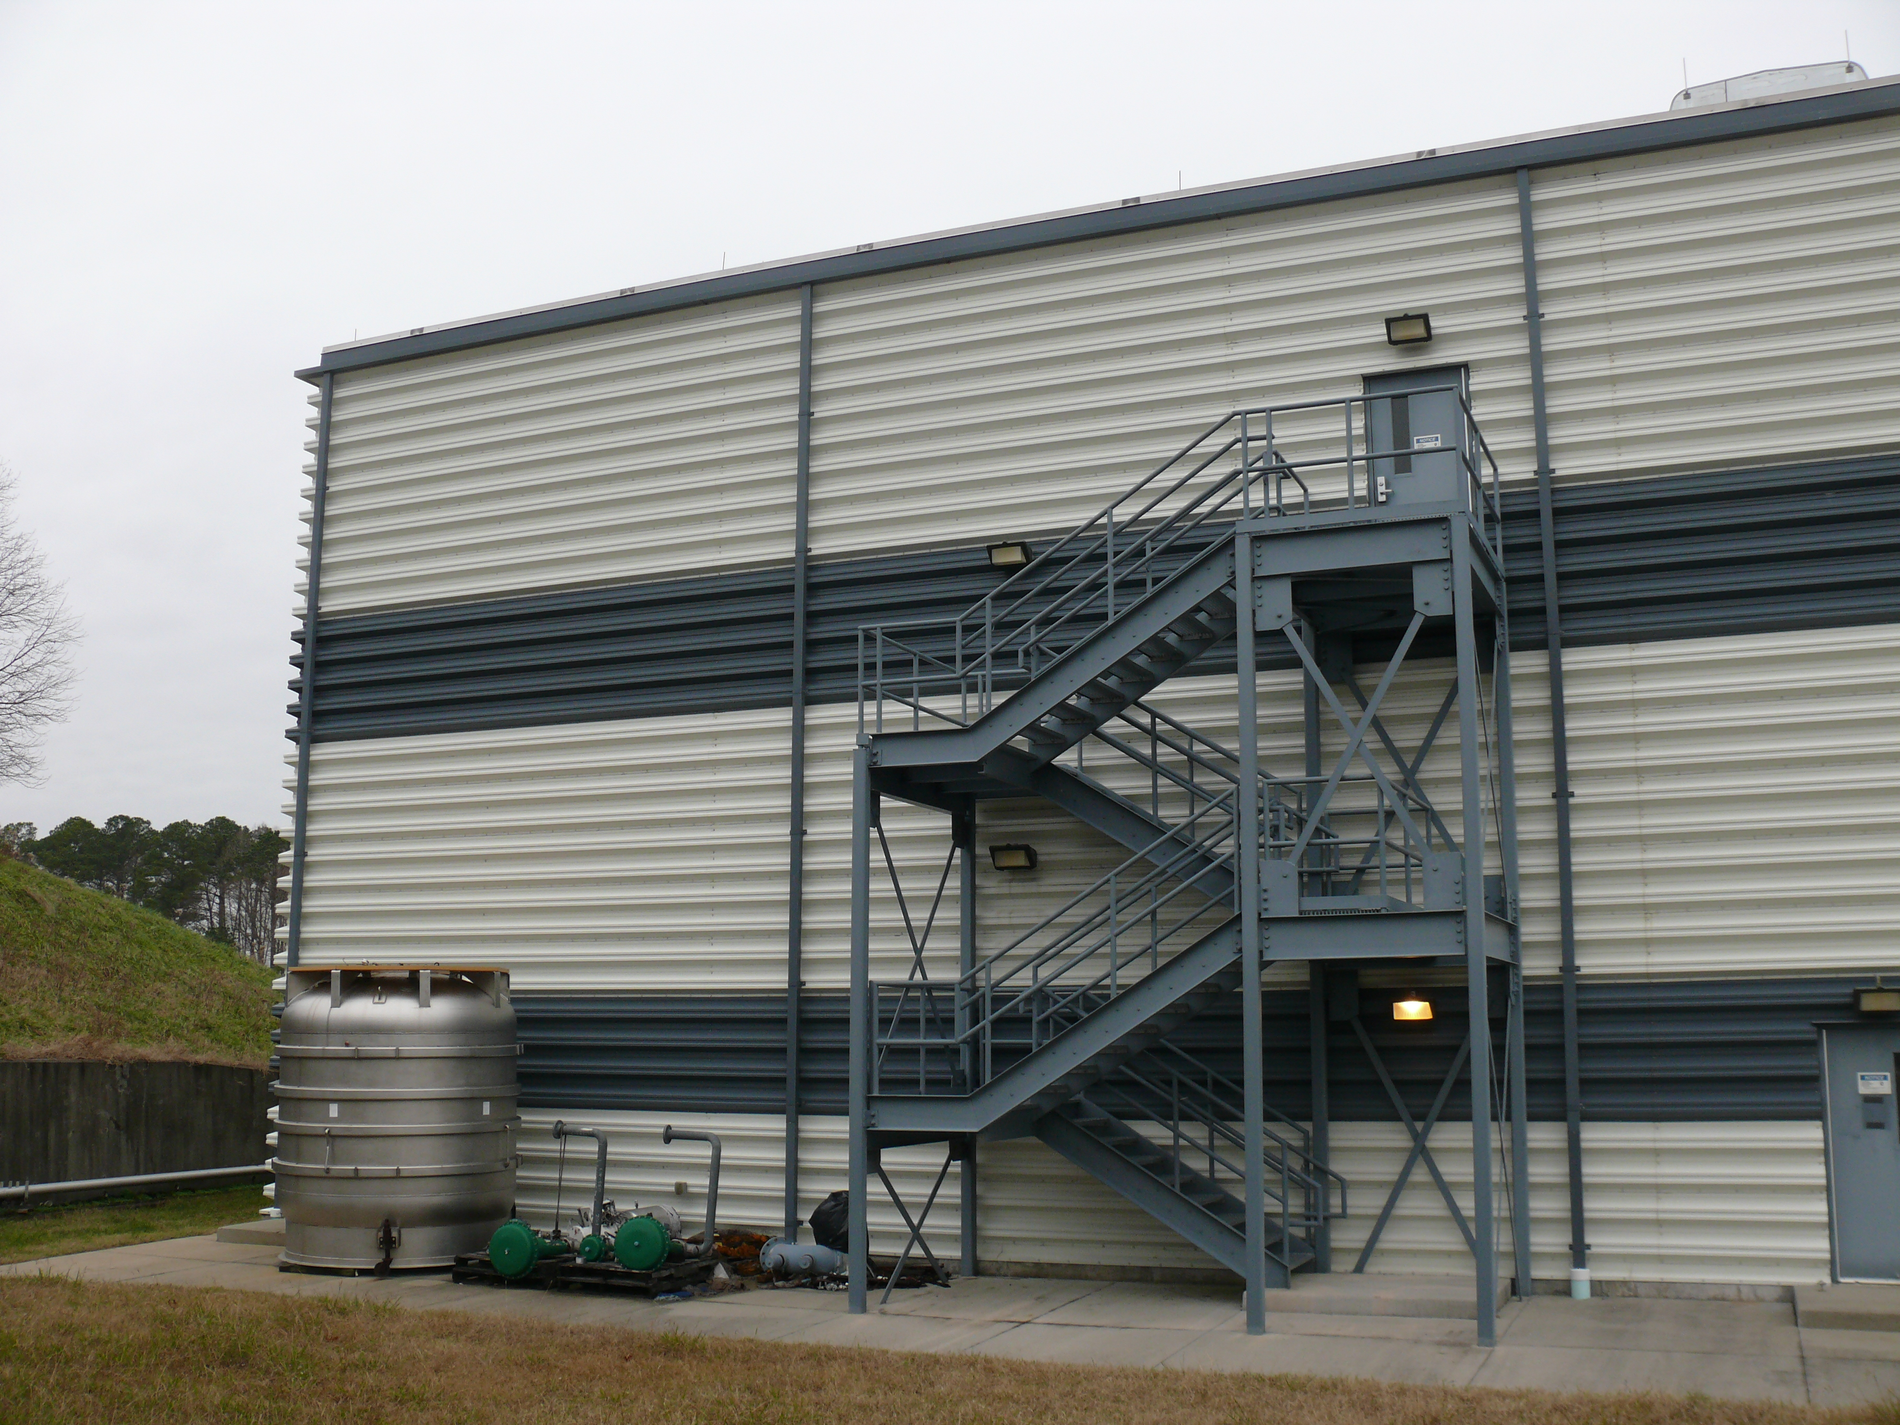
Existing Layout
ESR2 Building built ~ 2008
Position and orientation of cold box is fixed
Position and orientation of the 4 compressor skids are fixed
Outside and inside stairs and grating are in place

Slide 3
Design Considerations
Oil migration
  HP, MP and LP headers in the compressor room will be assumed to have oil accumulating in the bottoms of the piping at all times
  Design piping so that pooling oil will flow downward toward compressors and away from the cold box at all times
    No ‘U bends’ in piping (provide drains if a U bend is necessary)
    Set compressor room reliefs lower than cold box reliefs
    Cold box reliefs set on vertical piping draining toward compressors
Provide cross connect to existing ESR1 compressors
Test data indicate the temperature of the MP and LP headers from the cold box will produce significant condensation of water during normal operation
Outside stairs present a significant obstacle to piping runs

Slide 4
Design Considerations (Cont.)
Maintainability
  Compressor room piping to allow overhead crane access to equipment (compressor motors, housings, etc.) and allow unimpeded access to loading area in front of roll up door.
  Locate as many valves and piping joints as feasible in accessible locations (preferably indoors) for manual actuation, leak checking, and maintenance work.
  Main process relief valves should be located indoors to maintain integrity and reliability of the valve.
  Main process relief valves should be located to promote ease of serviceability.

Slide 5
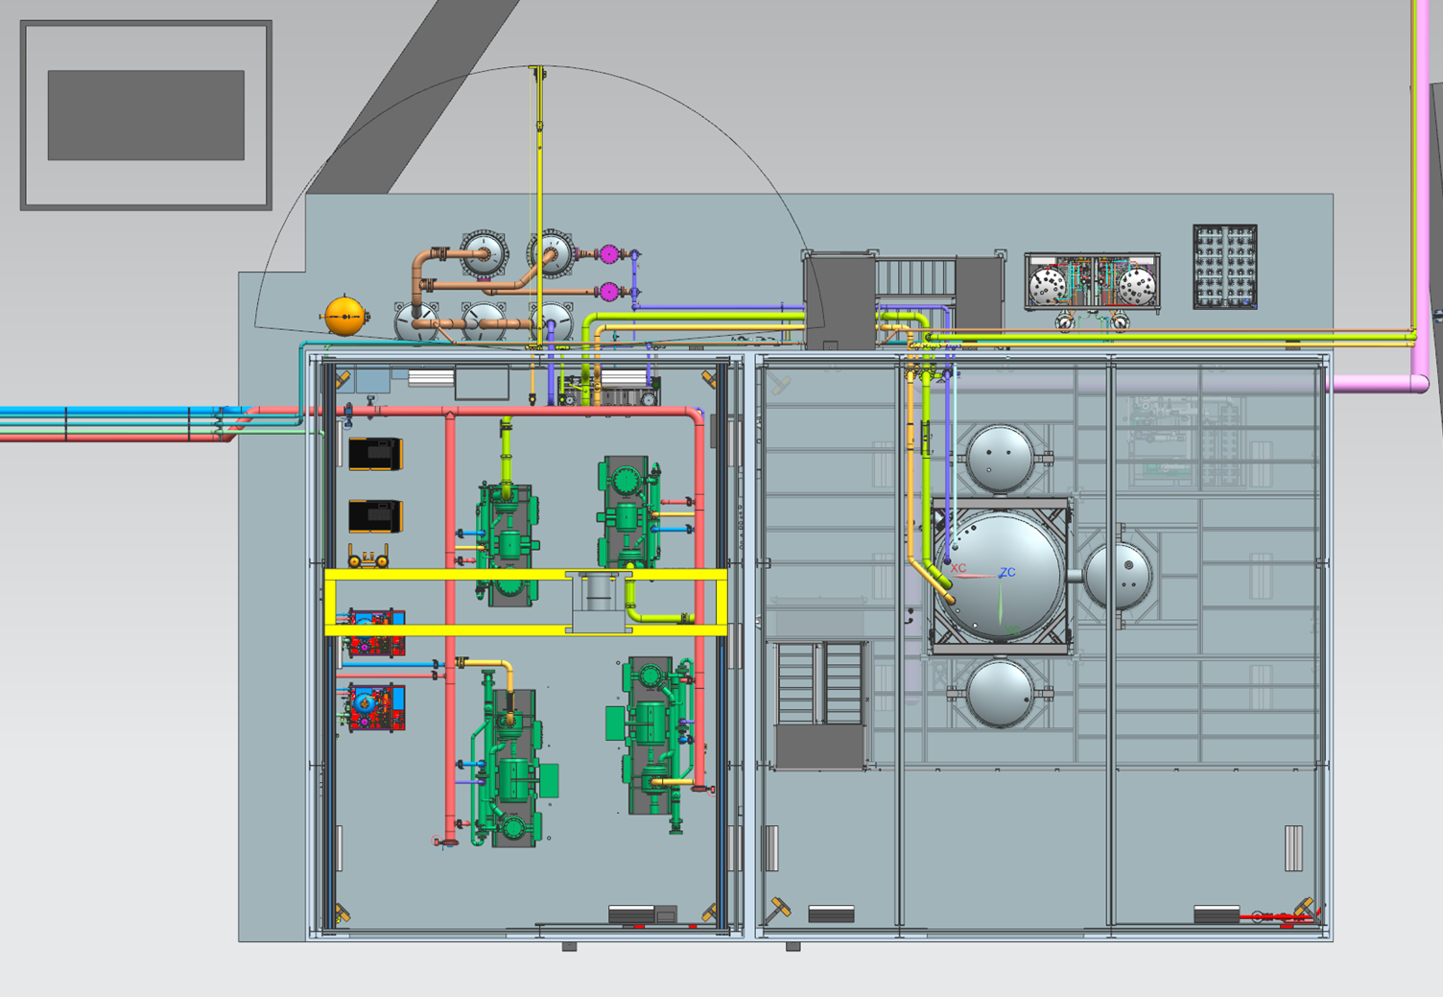
Overall Layout
Cryo and warm gas connections to ESR1
Control Room and storage
Cooling water and gas tank connections
Loading Area
Loading Area

Slide 6
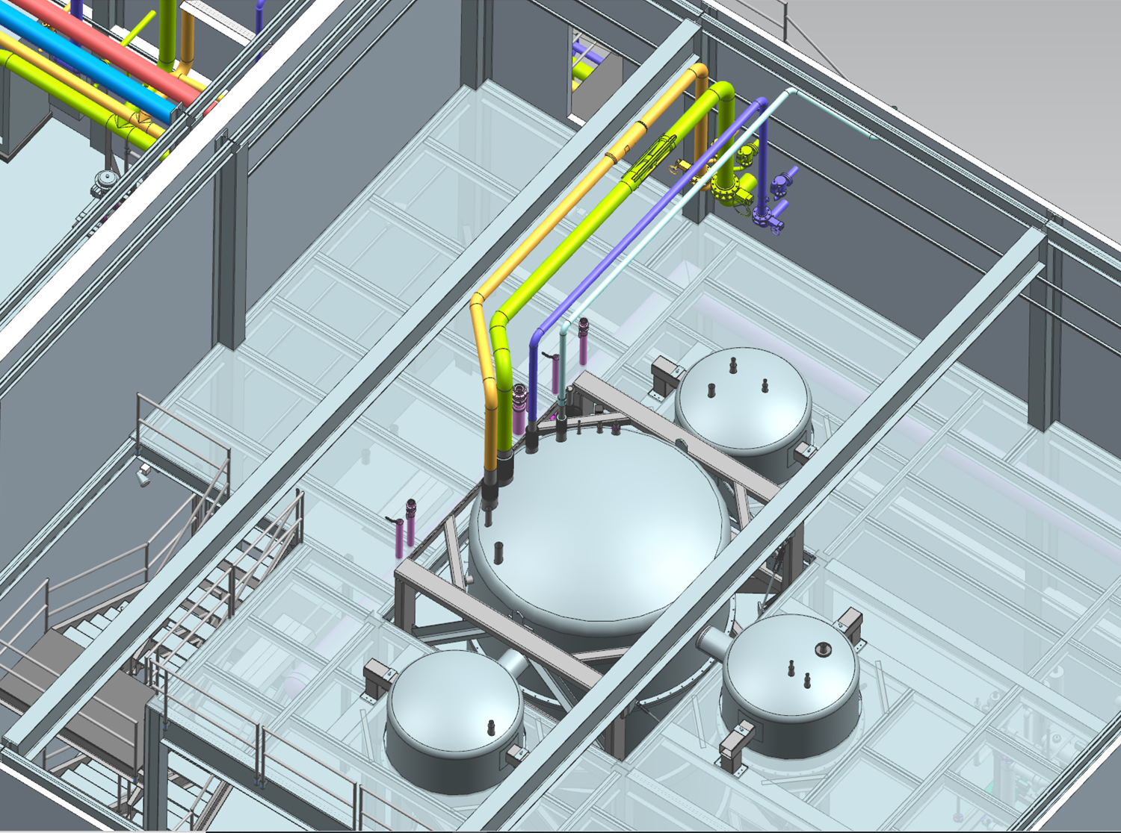
Cold Box Piping
HP, MP, LP header cold box reliefs and isolation valves

Slide 7
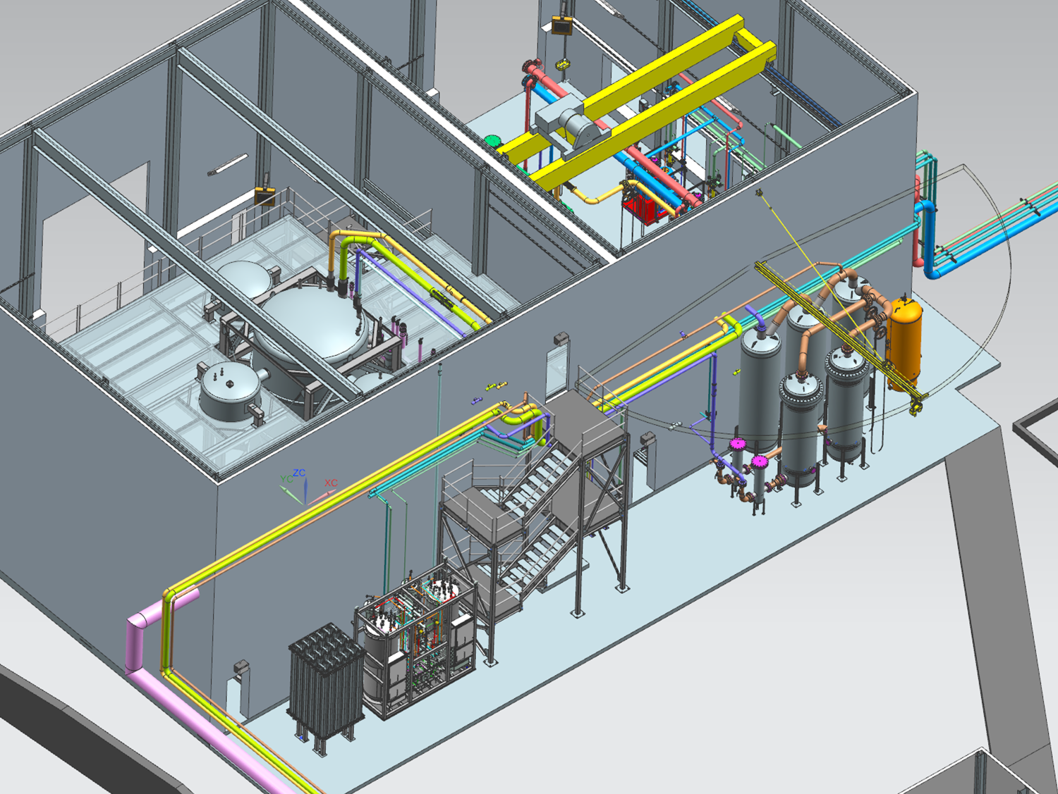
Back Wall

Slide 8
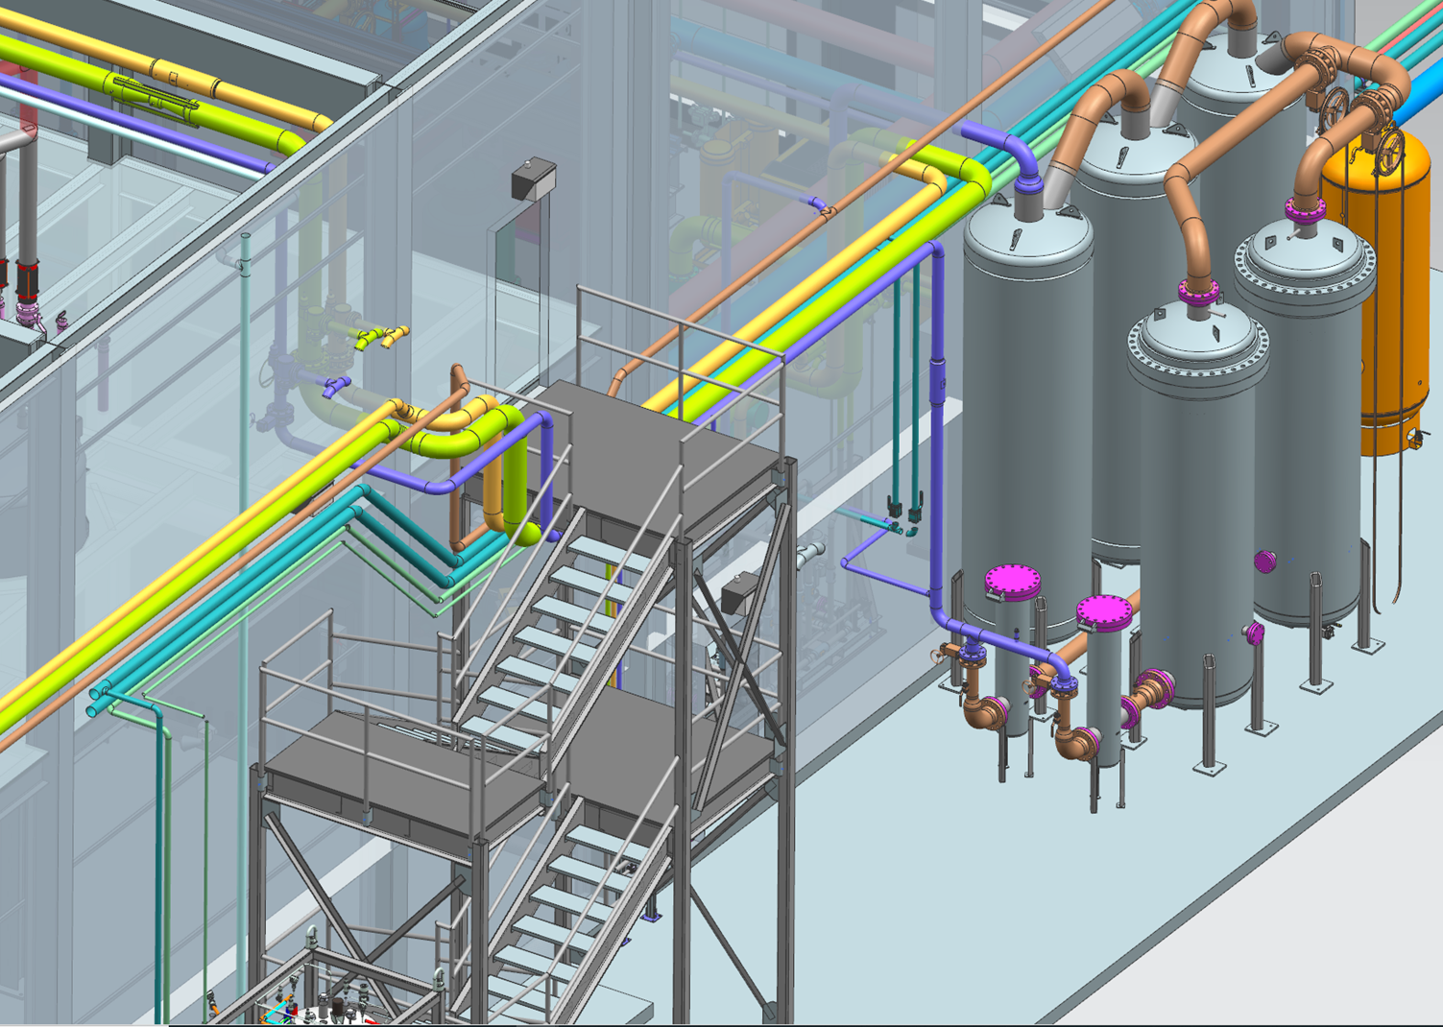
Back Wall (Cont.)

Slide 9
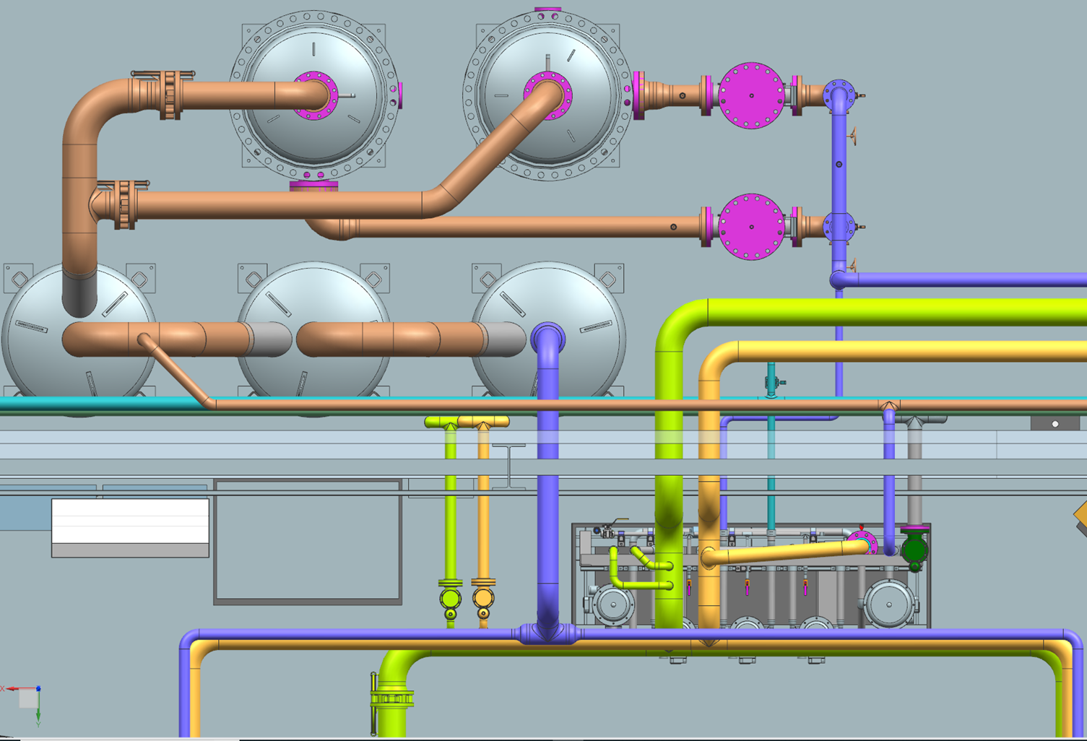
Oil Removal System

Slide 10
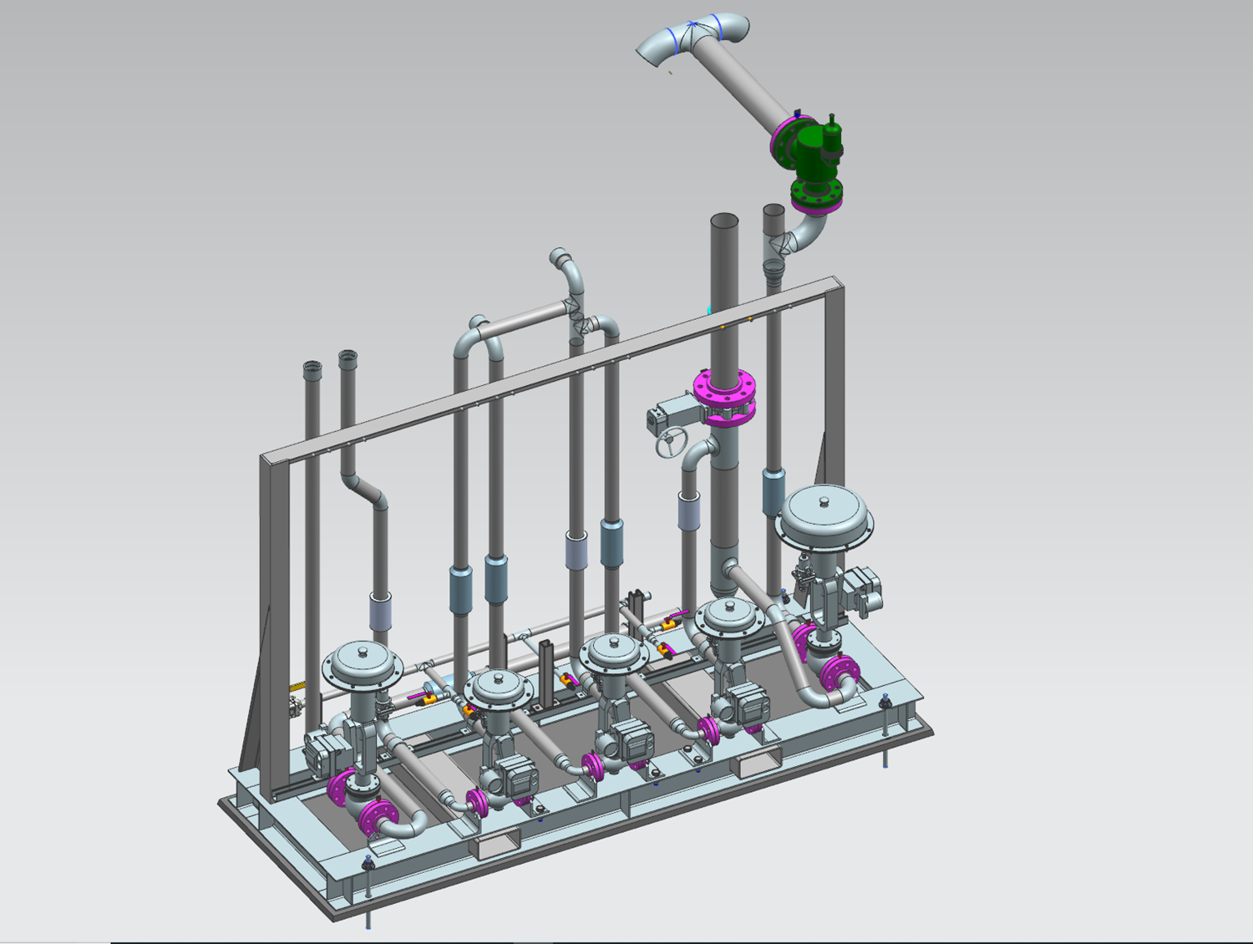
Gas Management Skid

Slide 11
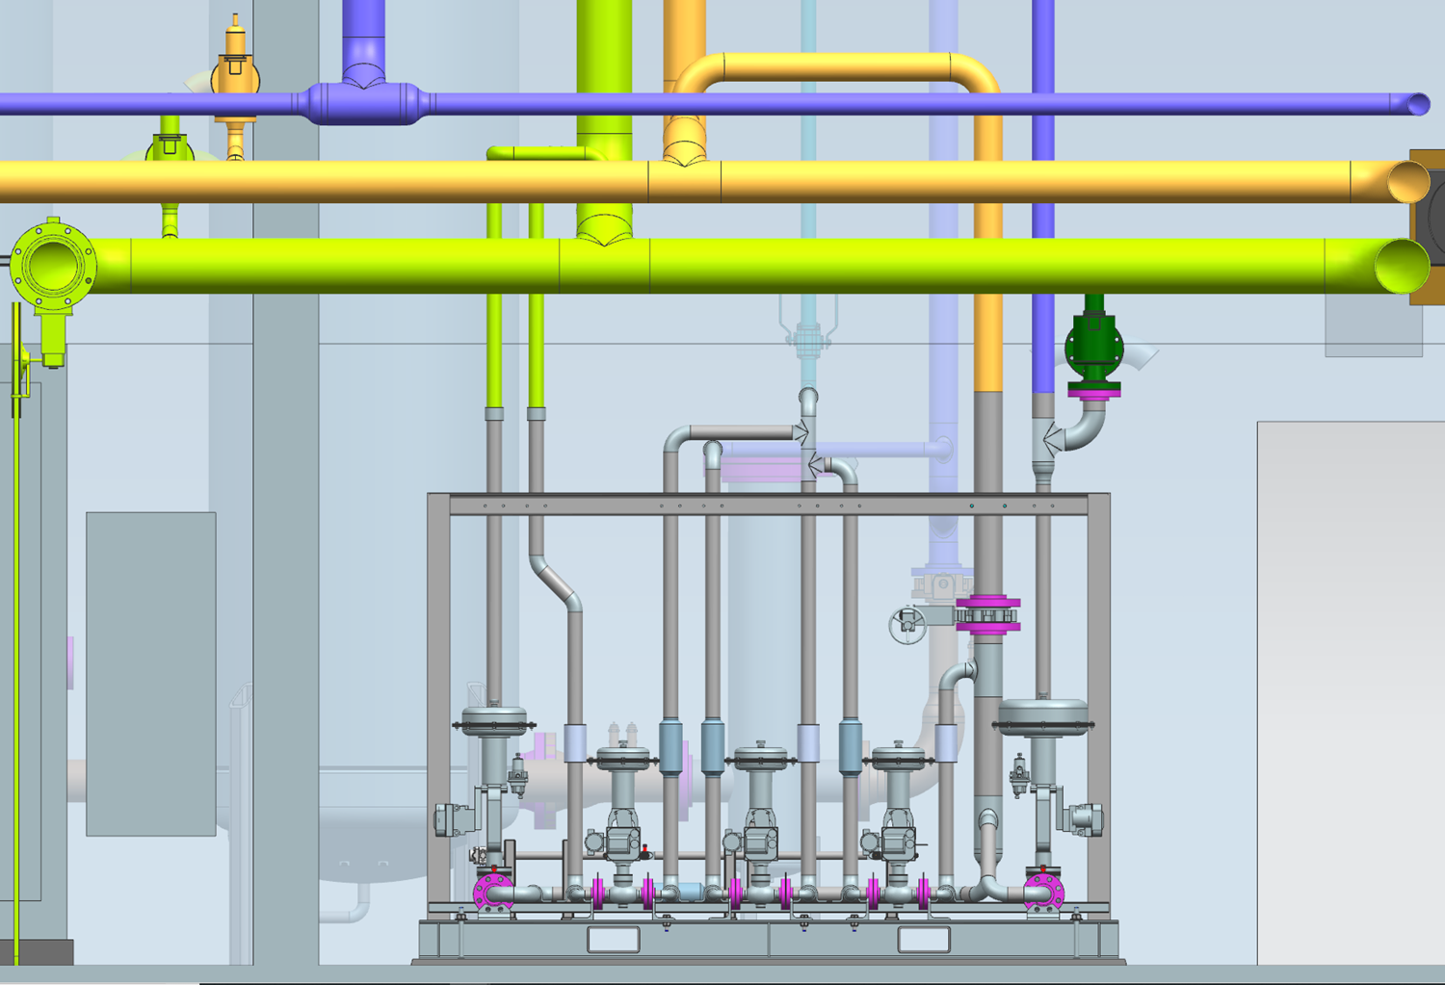
Gas Management Skid

Slide 12
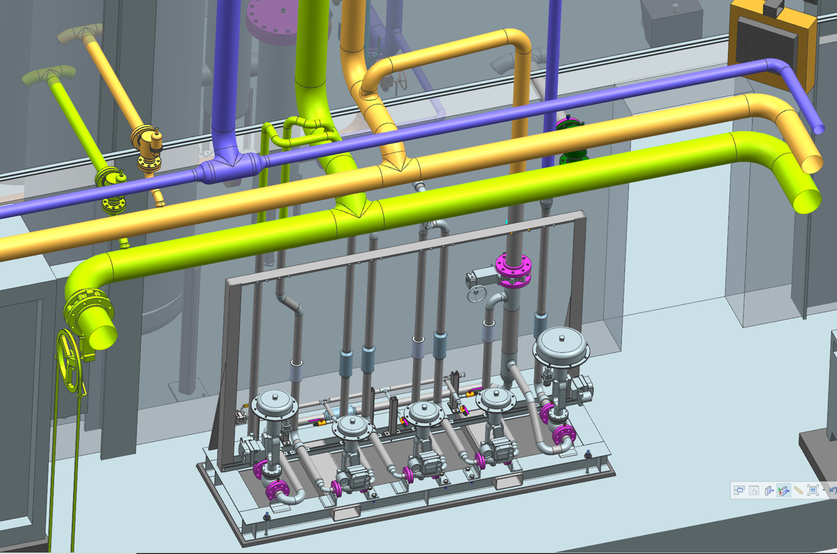
Gas Management Skid

Slide 13
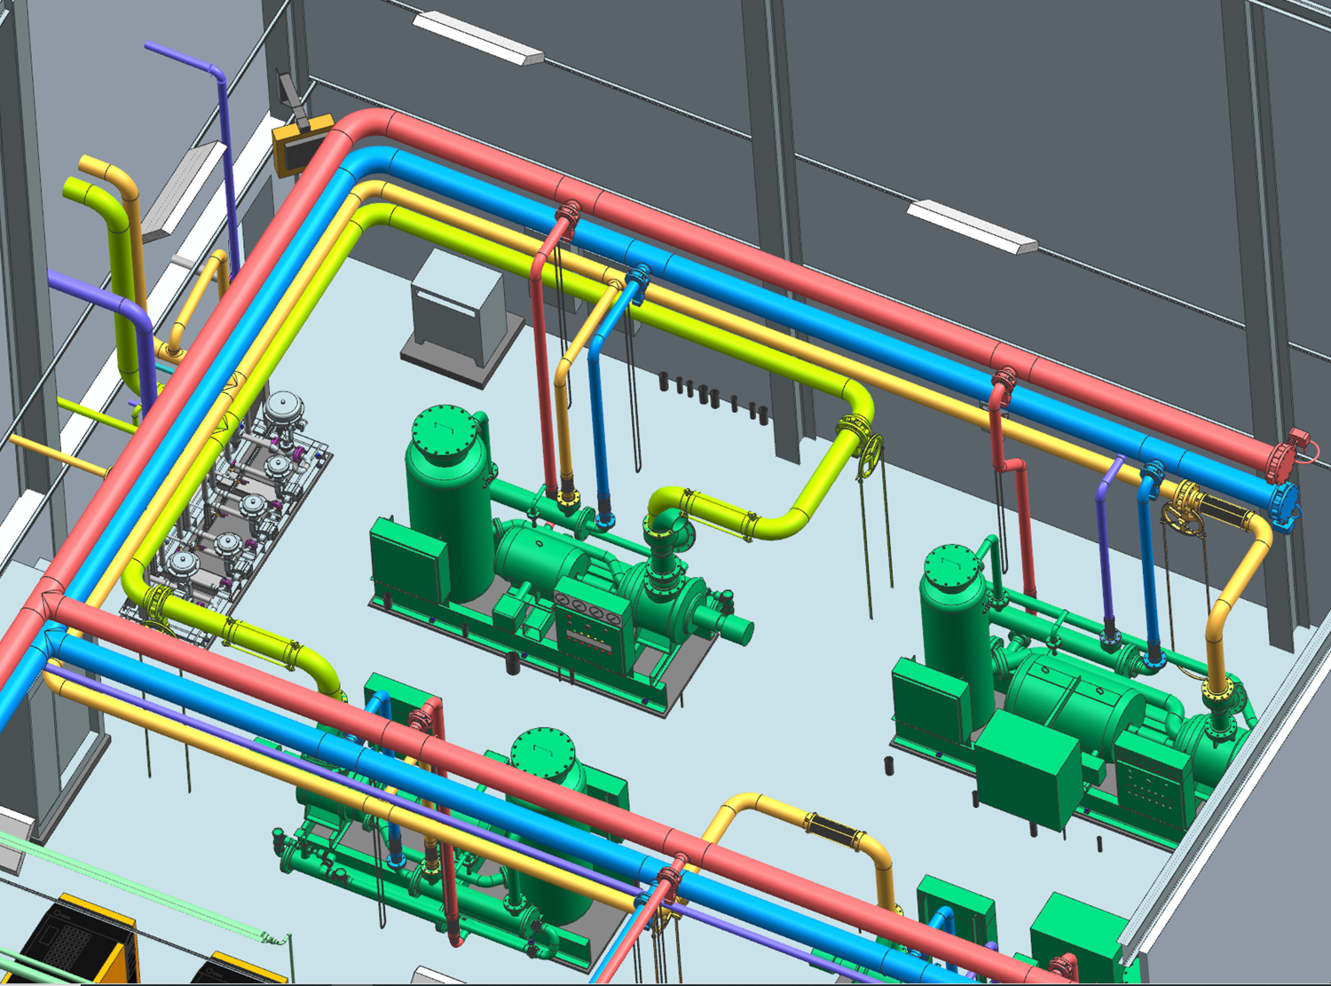
Compressor Room

Slide 14
Questions?
Topics Covered:
Existing Layout
Design Considerations
Cold Box Piping
Outdoor Piping
Oil Removal System
Gas Management Skid
Compressor Room

