Slide 1
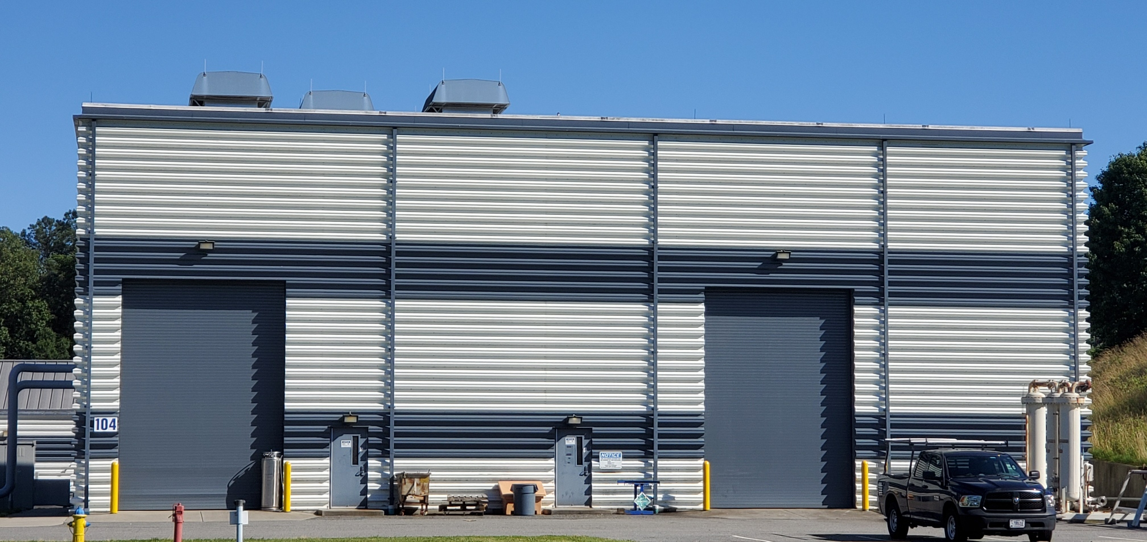
Process Flow Diagrams & Nomenclature
ESR2 Preliminary Design Review
Corey Butler

Slide 2
ESR2 Cryoplant System Numbering
ESR2 will be the 6th cryoplant located on the Jefferson Lab site complex.
A good numbering system is imperative as it is the foundation for the success of this project. I will attempt to show CRYO has a plan to insure integrity for the various systems required to operate the ESR2 cryoplant.
Identification of the systems required for the ESR2 cryoplant to function have been established. An illustration of this is provided on the next slide.
System numbering conforms to the conventional format of what has been used in other Jefferson Lab cryoplants. We are not reinventing the wheel, only designating unique numbers for each system specific to ESR2.
Systems will be categorized by specific numbering groups such that they can be clearly recognized by JLab operators and technicians. Drawings (P&Is, arrangement, assembly and detail) will be developed and grouped accordingly.

Slide 3
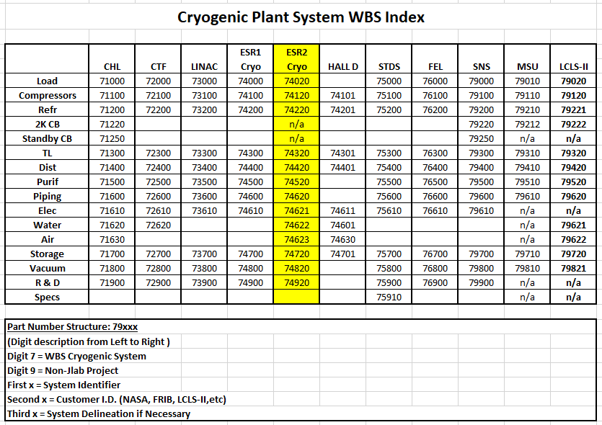
ESR2 cryoplant system numbering

Slide 4
ESR2 System P&I List

Slide 5
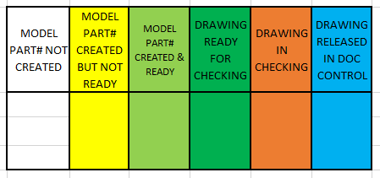
Explanation for color coding in ESR2 Systems P&I list
Color coding has been implemented to the ESR2 P&I list with intent to provide a prompt understanding of drawing status.
Here is a chart indicating what each color means when it is highlighted a specific color.
Drawings designated “DRAWING IN CHECKING” have a percentage assigned to them which provides an integrity percentage pertaining to what is depicted on the document. These documents are currently being reviewed by CRYO engineers.
The more confident the engineers and designers are about the integrity of what is shown on a document, the higher the percentage will be. A value of 100% means the document is complete lacking none of the required system information or components.

Slide 6
ESR2 System P&I Status
ALL P&Is for systems and equipment we plan to use in the ESR2 cryoplant have been created.
JLab is taking ownership of a few SSC P&Is so that we insure components provided with SSC equipment is accounted for. This also reduces the amount of new P&Is that JLab needs to produce. An illustration of this is shown later in this presentation.
Currently the following breakdown of P&Is is:
New dwgs – Qty 15
Vendor dwgs absorbed into JLab – Qty 3
Existing ESR1 dwgs requiring dwg revisions for ESR2 interface – Qty 11
At present there is a total of 29 P&Is.
CRYO engineers plan to leave the existing ESR1 P&Is that will require a dwg revision to accommodate for ESR2 interface in an Open Rev state at this time. These P&Is are planned to be released once the intefaces have been installed in the field piping.
Many, if not all of the released ESR2 P&Is will require future revisions as the flow analysis, stress analysis and pressure calculations are not completed. These P&Is provide a basic layout of what we envision is necessary to operate the ESR2 at this time. Engineers working on these tasks for the various systems. There will likely be some feedback from the PDR which will be incorporated into the various sytems design.

Slide 7
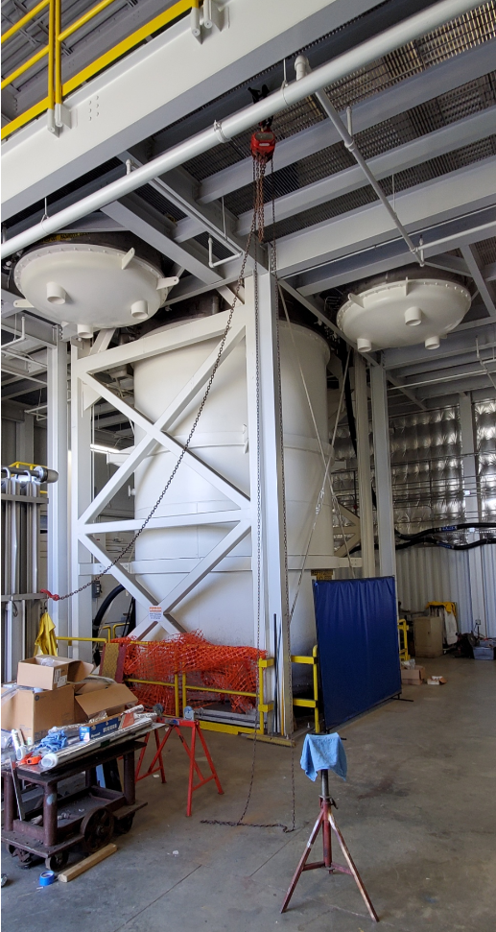
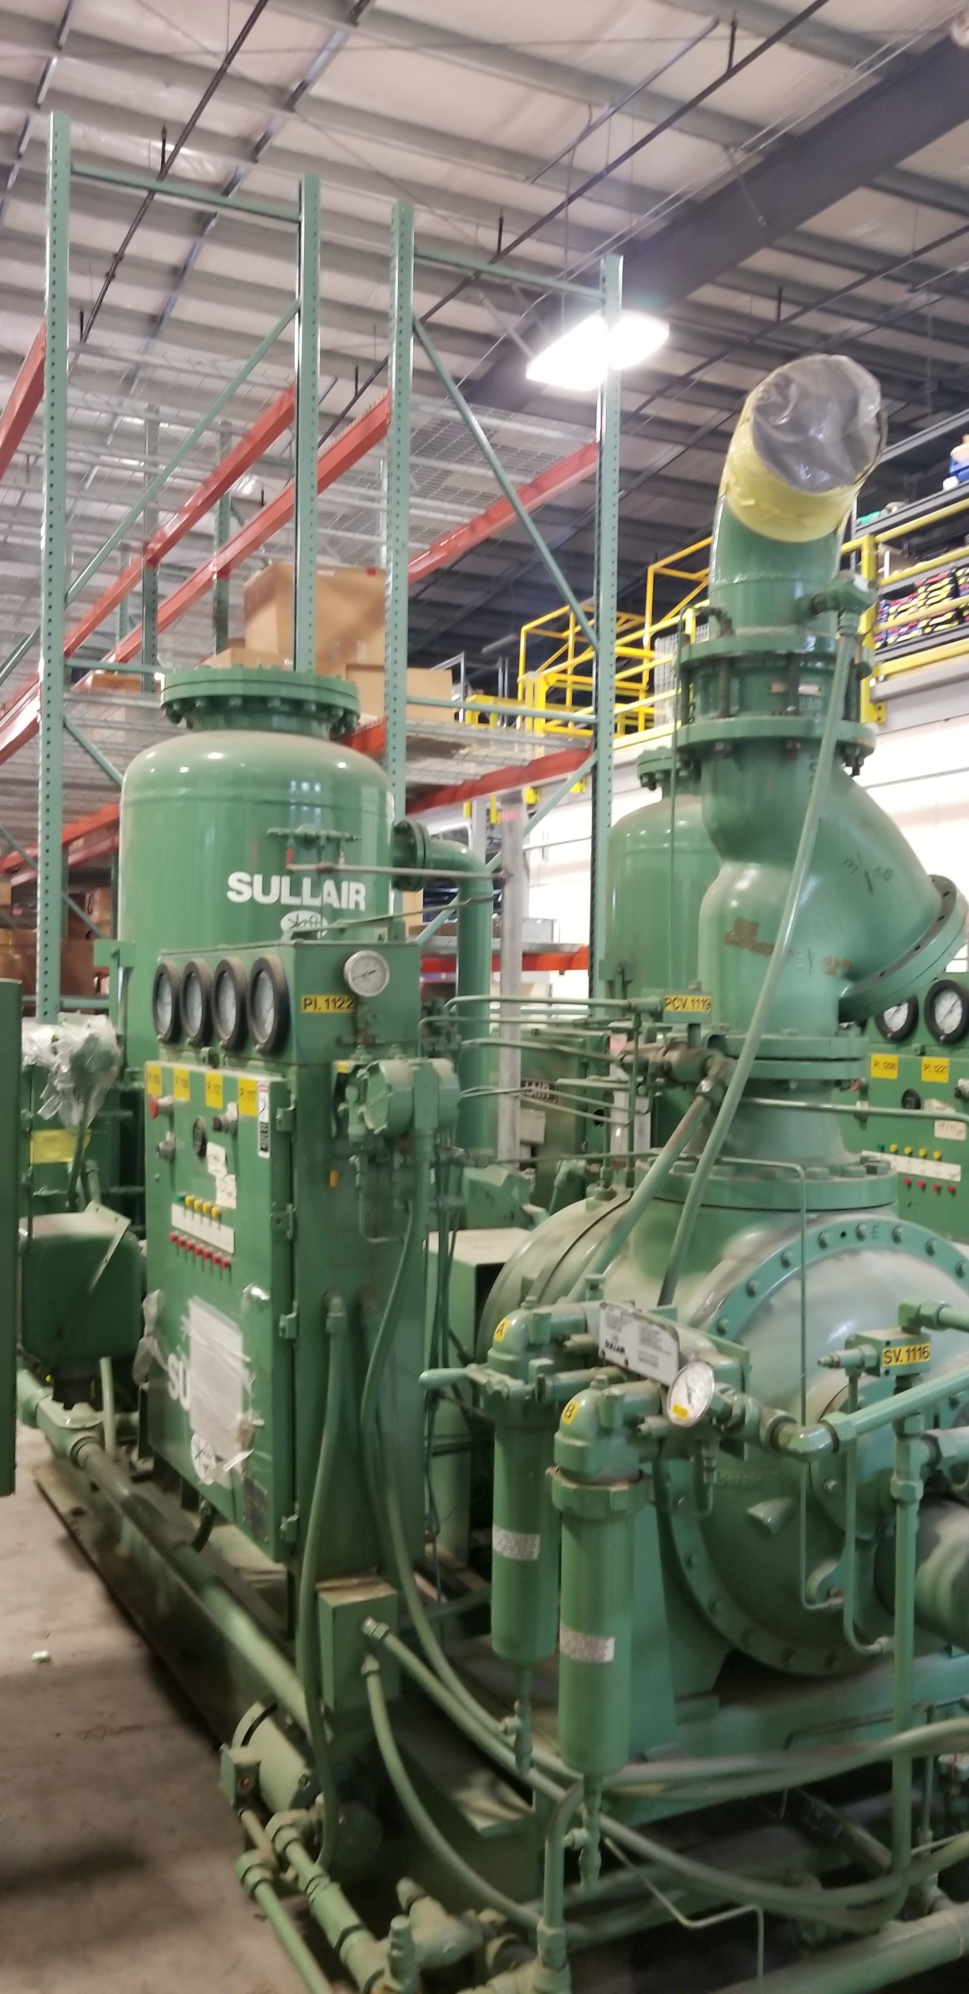
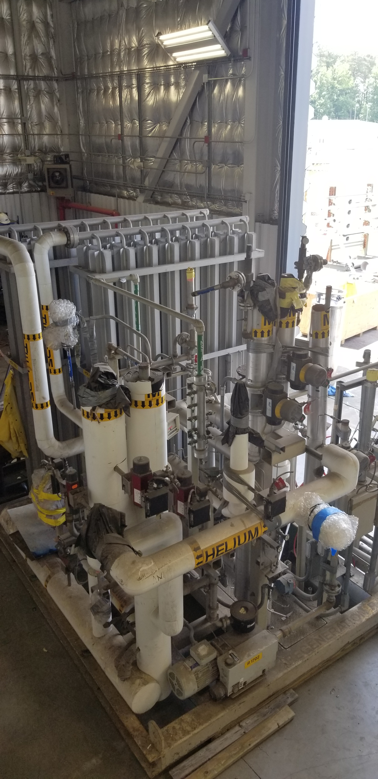
ESR2 equipment – What’s old and being recycled?
Some of the equipment for ES2 is old equipment previously purposed for the SSC project. Those components are:
The Main Cold Box
4 Sullair Main He Compressors (two 1st Stage & two Second Stage machines)
A Regeneration Skid

Slide 8


ESR2 equipment – What’s new?
Here is a list of the major new procurements required for ESR2:
Three main oil coalescers (Oil Removal System) – Vendor Supplied
Two carbon adsorber beds (Oil Removal System) – Vendor Supplied
Gas Management Skid (Compressor System) – JLab Build to Print
Two final filters (Oil Removal System) – Vendor Supplied
Two Recovery Compressors (Recovery System) – JLab Build to Print
He Purifier Skid containing two Purifiers (Recovery System) – Vendor Supplied
One 30,000 Gal He Gas Storage Tank (Storage System) – Vendor Supplied
One 20,000 Gal LN2 Dewar (Storage System) – Vendor Supplied
One 10,000 L LHe Dewar (Storage System) – Vendor Supplied
Air Storage Tank (Air System) – Vendor Supplied
Two Air Compressors Kaeser ASD 30 Series (Air System) – Vendor Supplied
One 2,200 Gal Air Storage Tank (Air System) – Vendor Supplied
One Heatless Desiccant Dryer skid Kaeser KAD 165 (Air System) – Vendor Supplied
Two Oil Mist Eliminators Kaeser OME-500 (Air System) – Vendor Supplied
One Oil/Water Separator Kaeser KCF 50 (Air System) – Vendor Supplied
Secondary Turbine Cooling Water Skid (Water System) – Vendor Supplied
CRYO plans to have all procurement specifications for Vendor Supplied equipment completed and ready for bidding by Feb 1st, 2020.

Slide 9
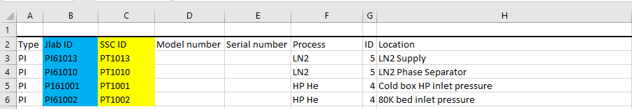
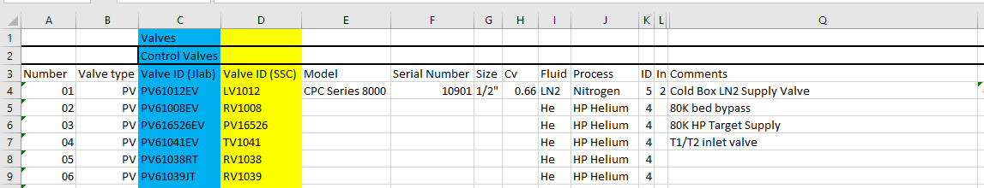

Tag number designations for SSC components
There will be hundreds of components in the various cryoplant systems requiring identification. This information is critical such that the correct items are installed within the piping systems at the locations specified per the P&Is. Tag numbers will be important for plant engineers and technicians such that ESR2 will be able to be operated efficiently.
Forethought has been applied in this area because we needed to account for ESR1 component tag numbers that are currently in use. This is very important as ESR1 and ESR2 will eventually be cross-connected. ESR2 tag numbers cannot conflict with any existing ESR1 tag numbers.
CRYO has developed a plan to insure unique tag numbering for ESR2 components.
For all equipment we will recycle from the SSC project, the original tag number provided with the equipment will be used but a “6” will be placed in front of the tag number. An example of this is displayed below.
Further distinction in the tag number will be required for the various control valves as there are multiple types that could share the same tag number. This issue will exist in all SSC equipment we plan to reuse. Examples of this are PV61002, EV61002 or HV61002 which in the JLab system would all be categorized as PV61002.
To address this issue we plan to label the control valves as follows:

Slide 10
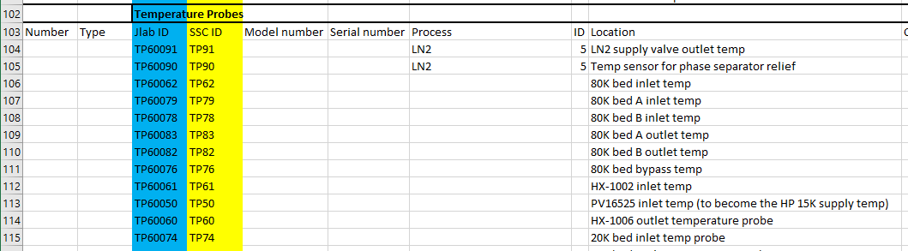
SSC Main Cold Box TP (RTD) tag numbering
We noticed that the SSC Cold Box Temperature RTDs were abnormally numbered with regard as to how the other components in the cold box system were numbered.
In attempt to make the RTD numbering more consistent with all the other tag numbering we added “600” in front of the existing SSC tag number. There were 24 instances where we identified this issue.

Slide 11
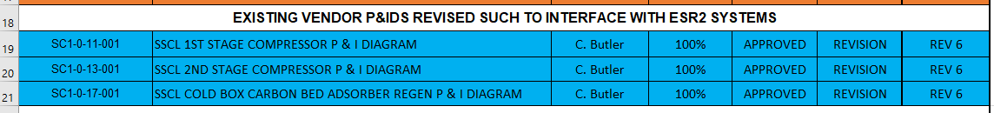

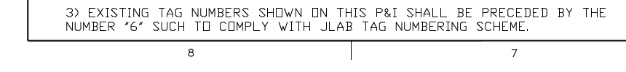
Tag number designations for SSC components
CRYO will maintain a document so that new JLab tag numbers can be cross referenced to the original SSC tag number.
New tags will be made and attached to the SSC components.
As stated earlier in the slides, CRYO will assume responsibility for three SSC P&Is.
This is being done for two reasons:
Reduce design effort redrawing these documents.
Accurate account of components provided with the equipment.
Each of the three SSC P&Is listed in the table above have been revised to include a note which reads.

Slide 12
Sample of SSC P&I JLab will maintain

Slide 13
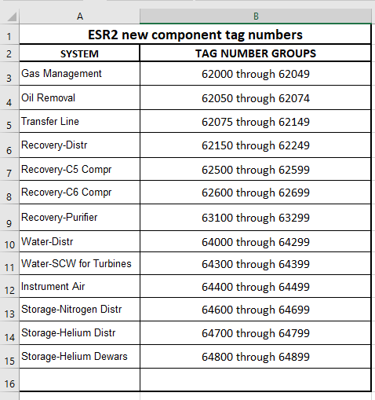
Tag number designations for new ESR2 components
Tag numbers for ESR2 components that JLab will provide in the cryogenic plant design shall begin with digits “62” thru “64”.
These tag numbers have been propagated throughout the new ESR2 P&Is.

Slide 14
Conclusions:
In this presentation I have shown that CRYO has identified all the necessary P&Is required for the fabrication and operation of the ESR2 cryoplant.
All P&Is for the ESR2 cryoplant have been made available for the PDR review committee at the link below. https://www.jlab.org/indico/event/331/
There is clear delineation from ESR2 and ESR1 drawings and components. This has been demonstrated with the identification of unique tag numbering for future instrumentation and piping components.
All necessary long lead time equipment has been identified. Some equipment will be fabricated by JLab but the majority will be vendor supplied. Items such as venturis or control valves have not been confirmed at this time as the piping analysis for various systems are not complete. Venturis, control valves and all other necessary components will be confirmed by FDR.

Slide 15

End of the road
THANK YOU

Slide 16
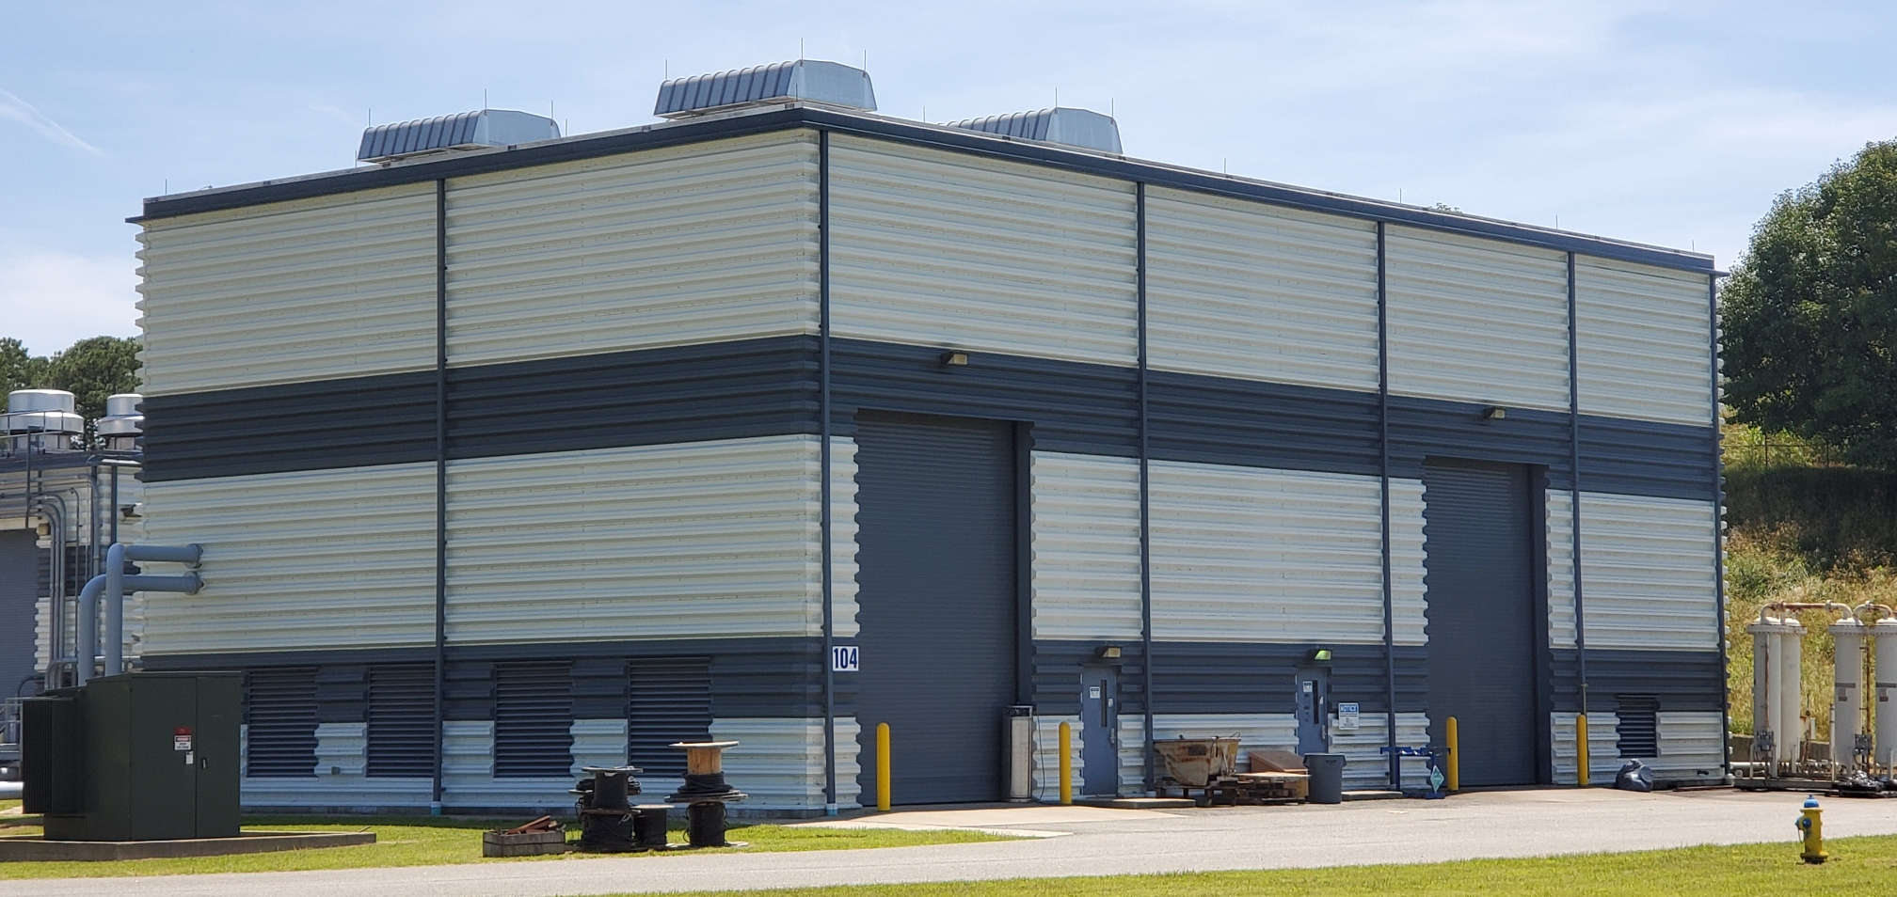
Corey Butler
757-269-7104

