Slide 1
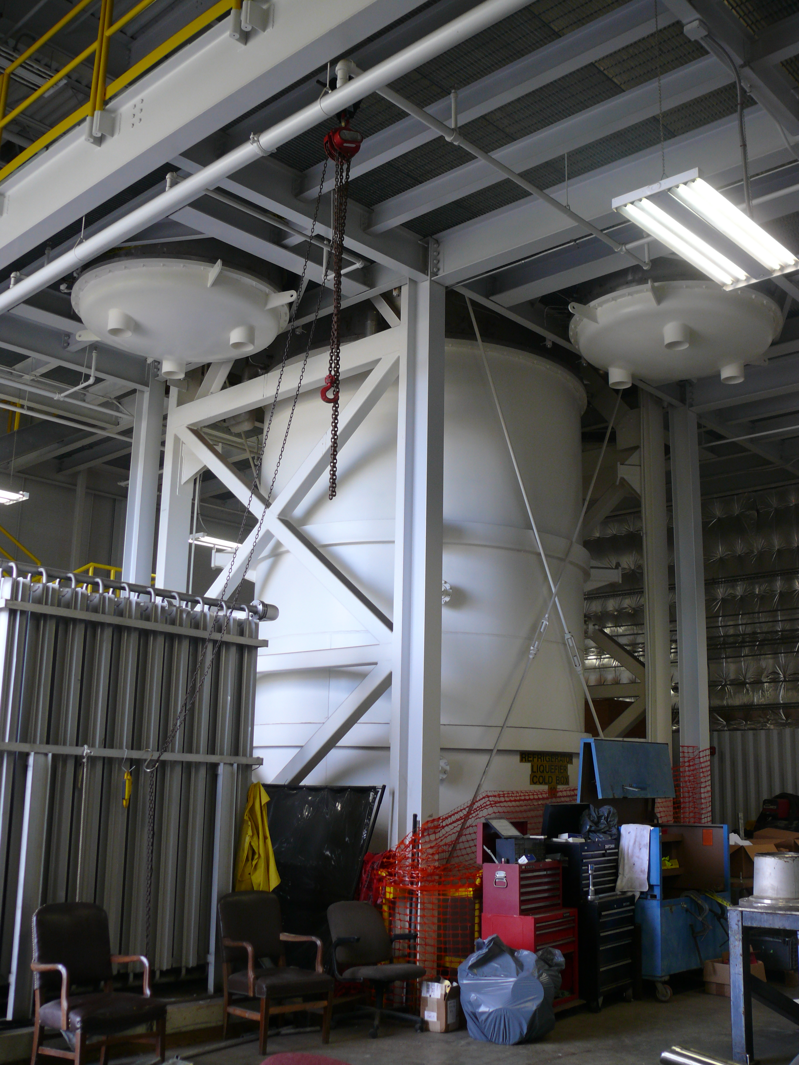
ESR2 4 kW Cold Box Modifications
Topics to be covered:
Cold Box details
Required Modifications
Process Locations
Physical Locations
Chris Perry

Slide 2
Existing Cold Box Configuration
4.0 kW 4.5 K Cold Box
Tested Capacity (At SSC)
  4.5 K Refrigeration: 2.0 kW
  4.5 K Liquefaction: 20 g/s
Compressor System (Sullair)
  Two 186 kW (250 hp) 1st stage
  Two 522 kW (700 hp) 2nd stage
Four turbo-expanders
Eleven heat exchangers grouped into six brazed aluminium cores
Two 80 K beds, One 20 K bed

Slide 3
Existing Cold Box Configuration
Connections:
Three 4.5 K, 3 Atm Primary Supply connections (PS1, PS2, PS3)
Three 4.5 K LP Primary Return connections (PR1, PR2, PR3)
Two Return Injections to LP header
  RI1 (300 K – 4.5 K)
  RI2 (15 K – 4.5 K)
One 20 K Supply from MP header (configurable for 80 K from HP)
One 20 K Return to the MP header
All hard pipe connections, will need to convert some, if not all, to bayonets.

Slide 4
Load requirements
New loads (beyond current ESR loads)
Moeller: 5 kW, 15 K
Potential LSAT 4.5 K supply
Other future high power 15 K (or colder) targets

Slide 5
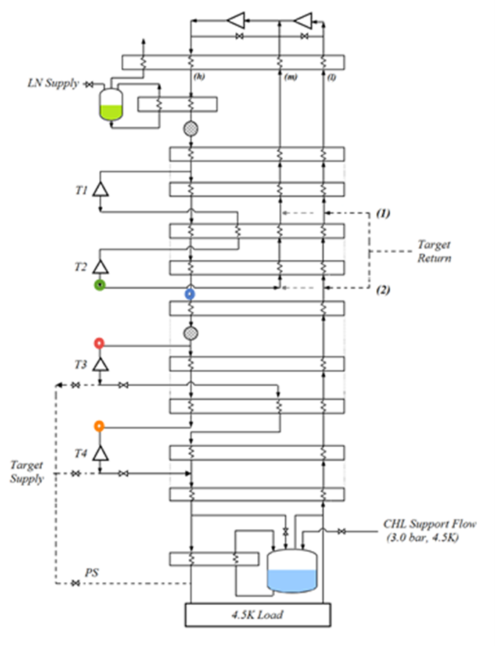
Cold Box Modifications – Process Locations
15 K MP supply, Outlet of T2 (existing)
15 K HP supply
(Modification required)
12 K HP supply, Inlet of T3
(Modification required)
8 K HP supply, inlet of T4
(Modification required)

Slide 6
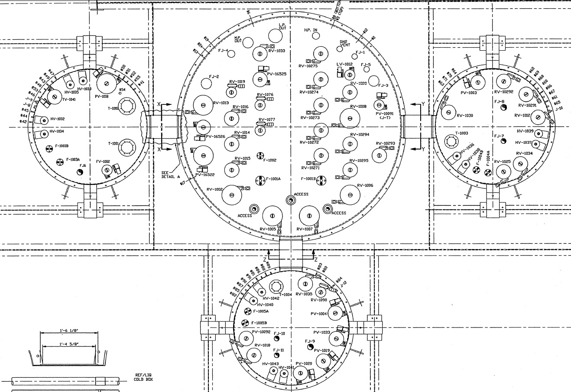
Cold Box Modifications – Physical Locations
15 K HP supply
12 K HP supply
8 K HP supply

Slide 7
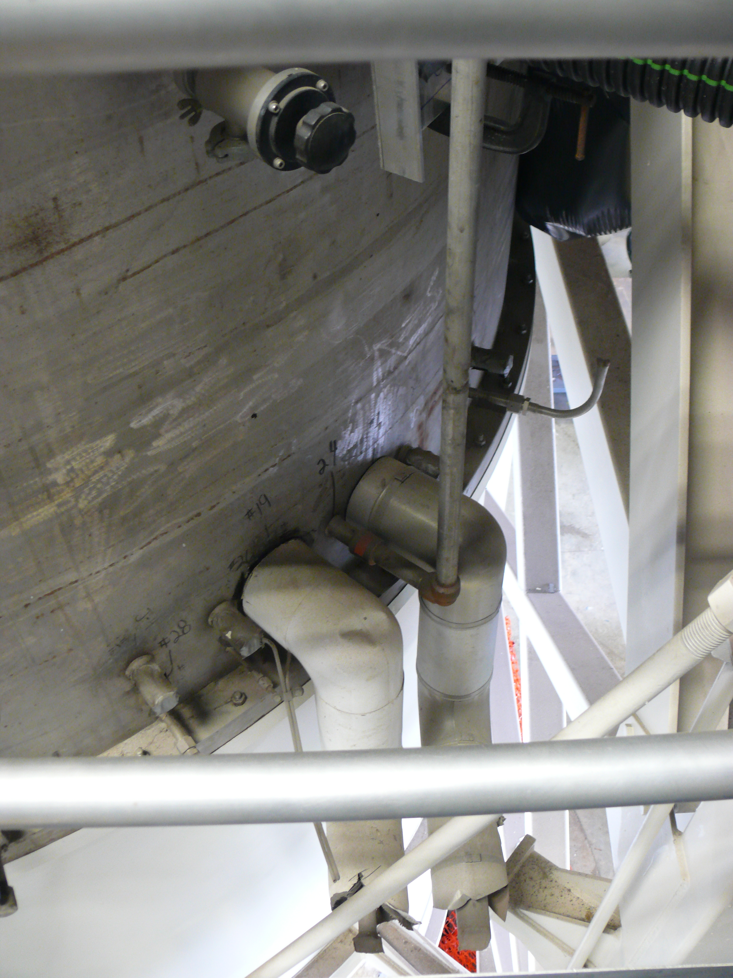
15 K HP Target Supply Modification
Repurpose this 300 K helium connection that feeds into the HP header at the 15 K level, so that it becomes the new 15 K HP supply.
The existing PV16525 will be used in place as the pressure regulator/isolation for this connection.
Minimal work needs to be done on the inside of the VJ.
Connection is close to the main vessel vacuum jacket flange, allowing easier access to work on inside of vacuum shell.
Remove insulation from regen piping
Add Bayonet
Add flex if needed
Cut out hole in shell to accommodate VJ

Slide 8
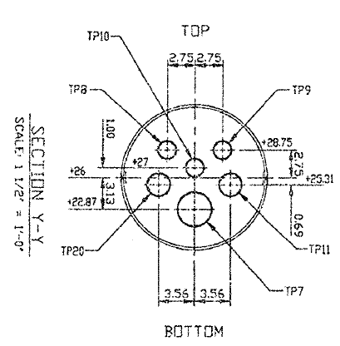
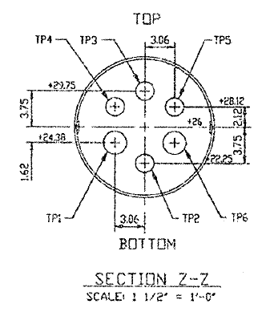
12 K and 8 K HP Modifications
All 3 connections to the turbine pods from the main vessel will need to be built
T3 and T4 tie-ins will include the piping, control valve, and bayonet for target supply
T3 inlet connection
(looking into main vessel)
T4 inlet connection
(looking into main vessel)

Slide 9
ESR2 Cold Box Connections As Installed
Three 4.5K Primary Supply Connections
  PS1: Original Dewar supply, to be left as a spare connection.
  PS2: Primary supply to dewar and load.
  PS3: Spare connection that could be used for LSAT
Three 4.5K Primary Return Connections
  PR1: Primary 4.5K return from Dewar and load
  PR2: Spare, possible to use for LSAT 4.5K return
  PR3: Spare
15K HP Supply: Current Hall 15K targets
12K HP Supply (T3 inlet): Primary Moeller supply
8K HP Supply (T4 inlet): Backup Moeller supply, allow flexibility for future experiments
15K MP Supply (T2 outlet): To be used for future low pressure drop 15K targets
MP Target Return: Returns target flow to the MP header at 20K
RI1: return injection from 4.5K to 300K
RI2: return injection from 4.5K to 15K

Slide 10
Questions?
Topics covered:
Cold Box details
Required Modifications
Process Locations
Physical Locations

