Slide 1
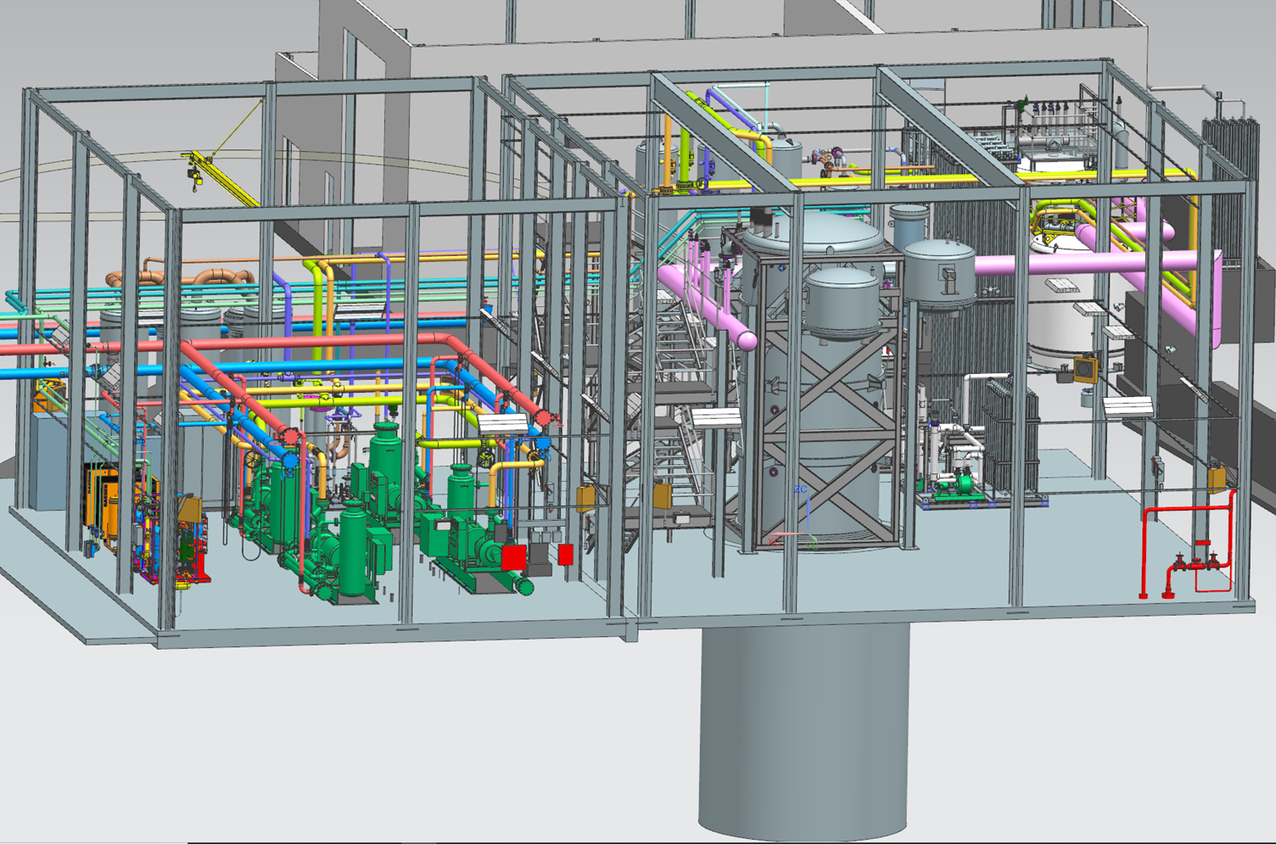
ESR2 Equipment Layout
Topics to be covered:
Equipment List
LHe, LN2 Dewar Location
GHe Tank Location
Building Layout and Walkways
Chris Perry

Slide 2
ESR2 Equipment List
LHe dewar, (Wessington 10kL Dewar)
LN2 dewar, (20,000 Gal, horizontal)
Helium gas tank, (30,000 Gal)
Oil Removal System, (NASA JSC design, ~700 g/s)
  3 oil coalecers
  2 carbon filters
  2 final filters
Recovery system, Jlab compressors, Ability purifiers
  2 recovery compressor skids
  2 purifiers
Instrument Air system, (135 scfm?)
  2 air compressors
  1 dryer
  1 air tank
Cold Box Regen Skid, (existing)
New Vaporizer
Gas Management Skid
(New design)
Turbine cooling water filter skid (TBD)

Slide 3
Dewar and Warm Helium Tank
LHe Dewar located as close to the load as possible to maintain as much subcooling as possible to the Halls and to facilitate u-tube connections with valve box and possibly with old Lhe Dewar.
  Need to talk to Facilities about proximity to Hall A truck ramp
GHe tank has limited options for location
  GHe tank cannot be located overtop of truck ramp.
  Existing walkway, electrical equipment, drainage ditch, and water pipe “corral” further limit possible locations

Slide 4
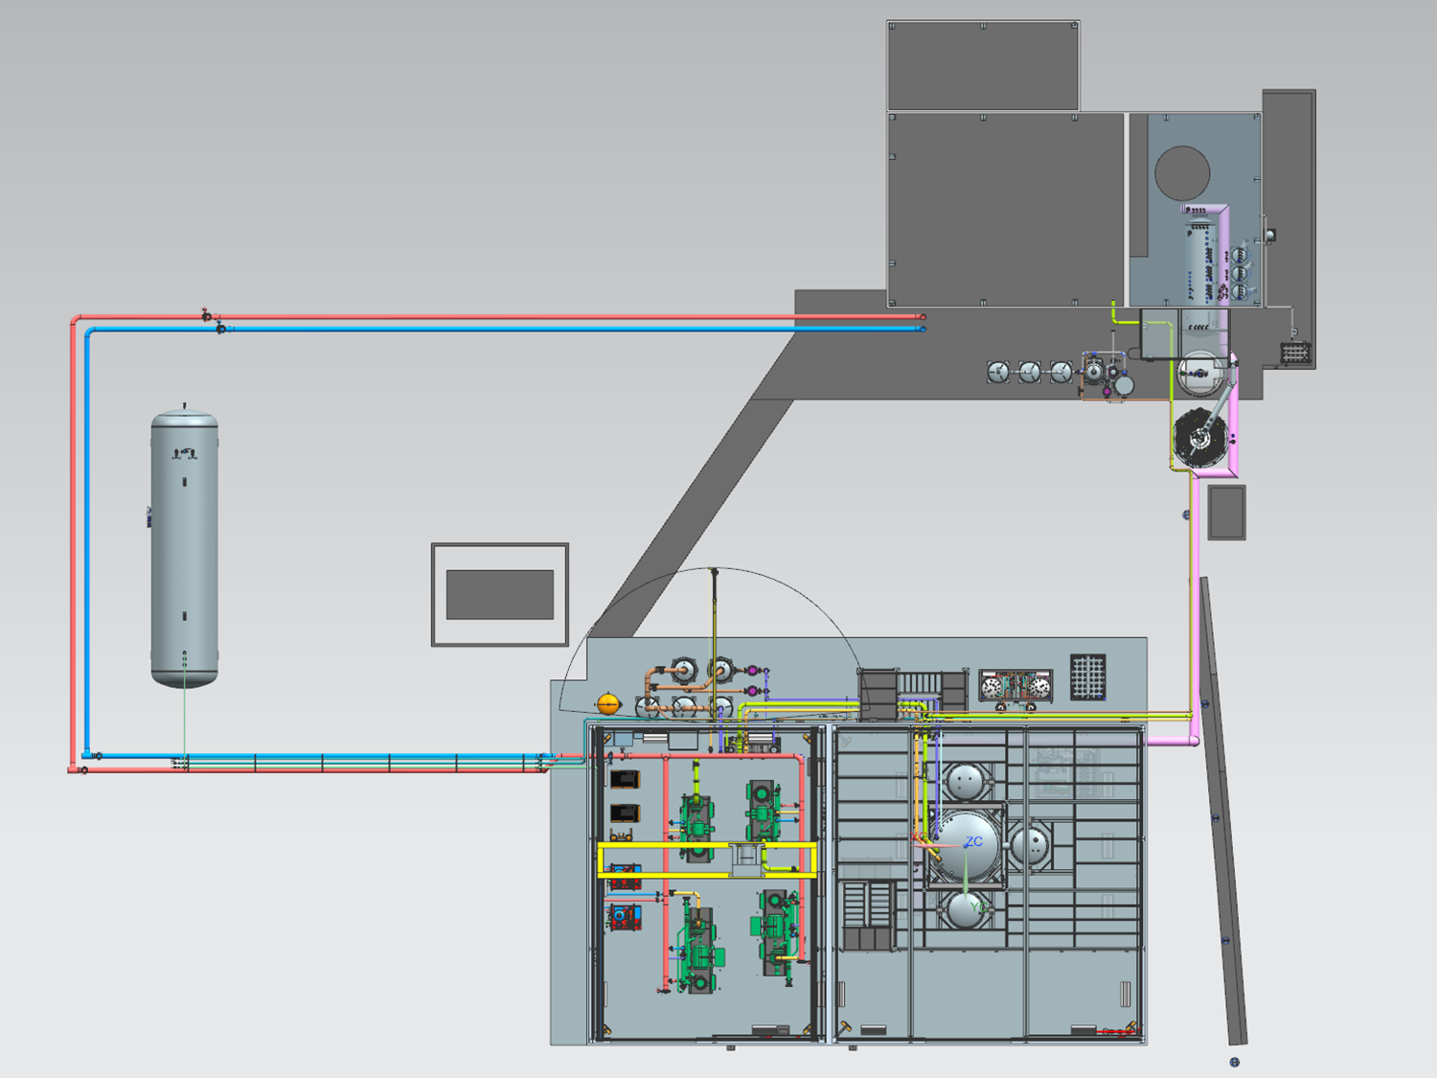
Dewar and Warm Helium Tank
Hall A Truck Ramp (Cant put gas tank over top)
Drainage Ditch
Ghe Tank
Lhe Dewar
Existing cooling water piping

Slide 5
LN2 Dewar Location
Current ESR LN2 supplied from CHL via CHL-ESR TL
LN2 supply has added benefit of providing an 80K shield to the 4K CHL support flow to ESR
ESR2 will still require CHL support flow at times and will require thermal shielding of the 4K flow
New LN2 dewar will require:
  Space
  Fill station
  Truck access
Benefits of location at CHL:
  More room available
  Fill station and truck access exist
  Maintains simplicity of shielding CHL 4K support flow
  Dewar can be configured to support CHL (or rather: New CHL LN2 dewar can be configured to support ESR only)
Analysis has shown that the existing LN2 TL from CHL can support the increased LN2 flow with a small pressure drop.

Slide 6
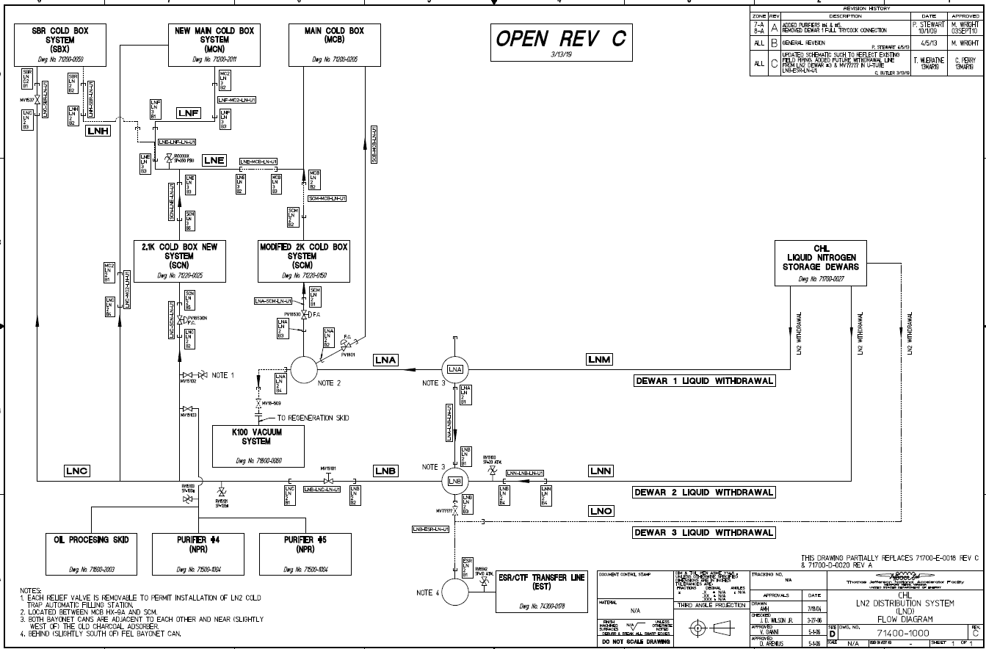
LN2 Dewar Location
Manual valve allows dewar 3 to be exclusive to ESR
Tie-in of new dewar can be accomplished with 3-legged u-tube

Slide 7
LN2 Dewar Location
New LN2 Dewar for ESR “for CHL” located at CHL
Existing CHL LN2 Fill station

Slide 8
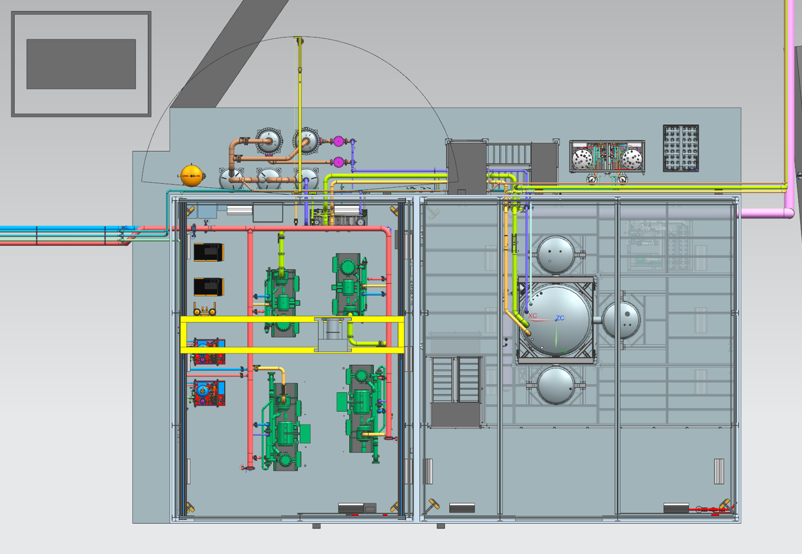
ESR 2 Building layout
Purifiers
Vaporizer
Regen Skid
Control Room
Walkways

Slide 9
ESR2 Building Layout

Slide 10
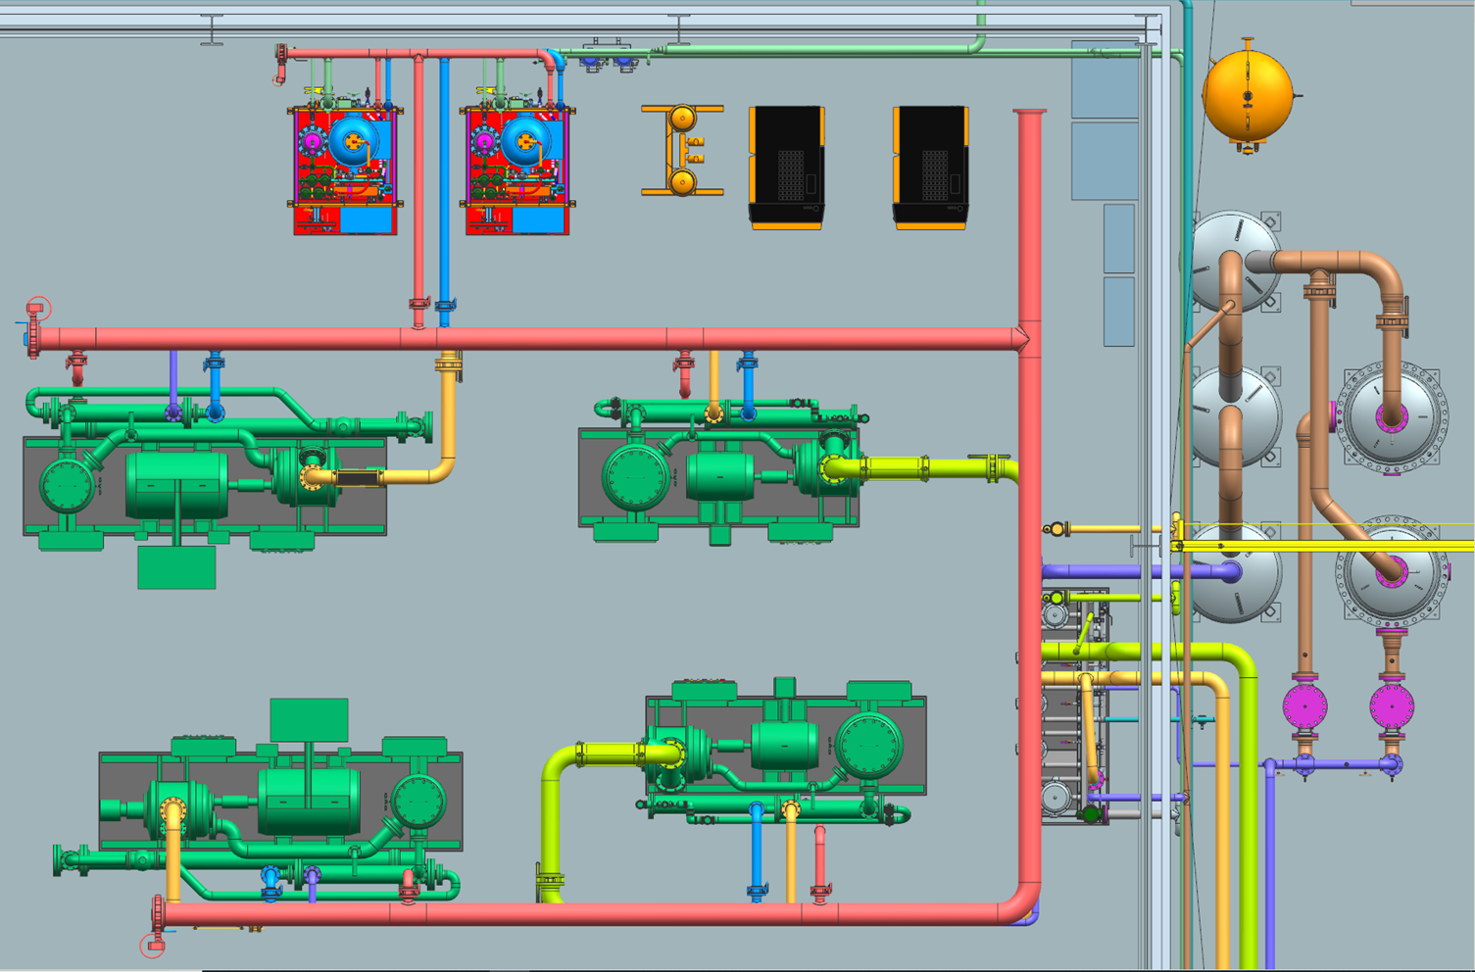
Compressor Room Layout

Slide 11
Questions?
Topics covered:
Equipment List
LHe, LN2 Dewar Location
GHe Tank Location
Building Layout and Walkways

