Slide 1
Welcome
ESR2 Preliminary Design Review
June 19, 2019
Dana Arenius

Slide 2
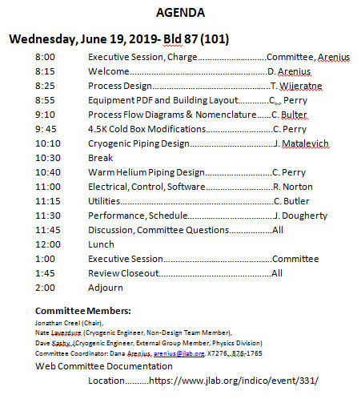
Agenda
https://www.jlab.org/indico/event/331/

Slide 3
Preliminary Engineering Design Review
Function of the review
Sets the “direction” of the detailed engineering which is to follow
Provides baseline design for engineers to follow to meet the function of the design, end user requirements, and cryogenic/laboratory operations/maintenance needs
Includes integrated process, electrical, mechanical, controls, operations, maintenance, project management
Includes national and laboratory engineering standards of engineering inclusive of ASME, NEC, etc.
Answers the question of
Are we on the right track?
Have we missed something or need to look at something different?

Slide 4
Committee Charge Backup Slides

Slide 5
Committee Charge (2)

Slide 6
Committee Report
Provide a short preliminary summary of findings, comments, and/or recommendations at close out.
Final report submittal in two weeks after PDR

