Slide 1
SNS PPU CRYOMODULE FDR
Cryomodule Transportation Preliminary Design
Naeem Huque

Slide 2
Overview
Introduction
SNS Cryomodule Shipping System
Lessons from LCLS-II and SNS
SNS Shipping Tests
Changes for SNS-PPU Cryomodule Shipping
Design Verification for updated PPU Shipping System
Dummy Cryomodule testing
Production Cryomodule road test
Instrumentation
Summary

Slide 3
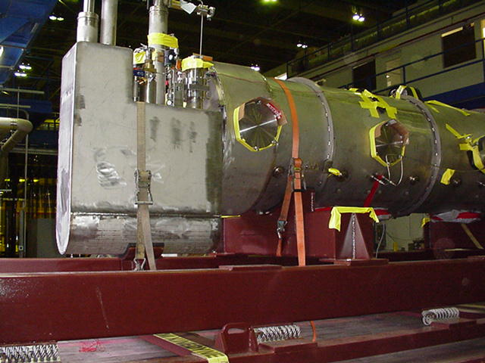
Introduction
Twenty four SNS Cryomodules were shipped ~500 miles from JLab to ORNL
The same shipping system will be used to transport SNS-PPU cryomodules
Small changes to the system will be implemented to take CM design changes into account

Slide 4
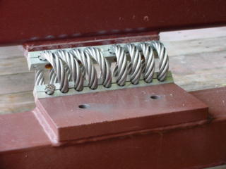
SNS Shipping System
Shipping Fixture consisted of two frames, separated by 12 helical isolator springs (Aeroflex CB1500-15-C2)
1 inch thick rubber between CM and cradles on the inner frame
Cryomodules held on to the frame by ratchetting straps
Shipping assembly was fitted on a trailer with air-ride suspension
SNS CMs were designed to withstand:
Vertical: +/- 4.0g
Beam-Axis: +/- 5.0g
Transverse +/- 1.5g

Slide 5
Shipping Frame Design
The Shipping Frame springs attenuates shocks to the CM
Shocks responses are shown in the table below
Input shocks are taken from those recorded on LCLS-II shipments
Shocks with a maximum duration of 20ms are considered
Predicted shocks are below the spec
Shock Attenuation
Direction | Input Shock | Predicted Response
Lateral | 1.0g | 0.42g
Vertical | 2.5g | 0.85g
Beamline | 1.0g | 0.25g
The resonant frequency of the system should be higher than 2.0 Hz (natural frequency of the Air-Ride suspension)
Frequencies are above 2.0 Hz
Other frequencies to avoid needs to be defined by modal analysis or component testing
Resonant frequencies for components in SNS cryomodules were all above 25 Hz
Spring Resonant Frequencies
Lateral (X) | 8.0 Hz
Vertical (Y) | 6.5 Hz
Beamline (Z) | 4.0 Hz

Slide 6
Lessons from LCLS-II
Conduct shipping road tests prior to starting production shipments
Include shock and vibration spectra separately when creating a shipping specification
Consider sub-component testing of sensitive items (e.g. couplers, tuners, bellows)
Ensure assembly used as testing bed is identical (in sensitive regions at least) to production units
Involve industry at an early stage of shipping scheme development
In addition to paid consultants, some specialized transportation companies may provide advice as part of bidding process
Only employ companies that work with special loads
Variables such as route, speed, road conditions and weather cannot be controlled; a shipping system should be able to handle deviations

Slide 7
Lessons from SNS
Use a commercial sliding curtain roof on the trailer
Custom design used in SNS failed during shipment
Actively monitor beamline vacuum
One of the SNS cryomodules had a beamline leak during shipment, and no data was available about timing
Consider using the same drivers
The same team of drivers was used for all SNS shipments which proved efficient
Have beamline vacuum and trailer location tracked live
Shipping issues during SNS could not be traced back to certain times/events

Slide 8
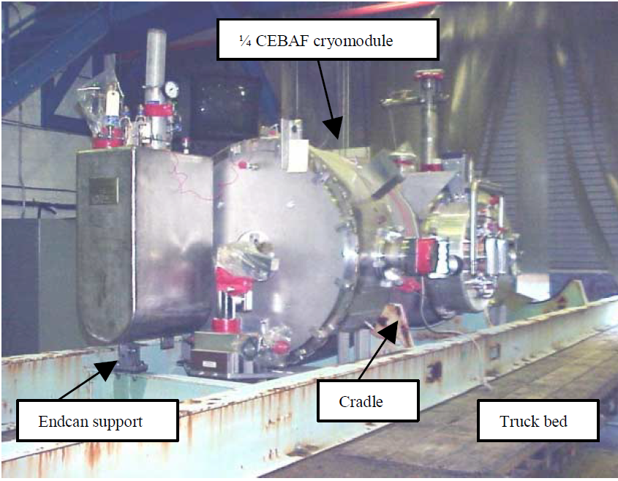
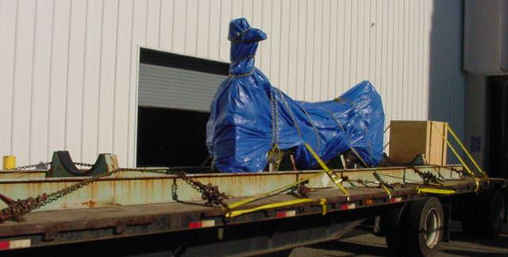
SNS Shipping Tests
A preliminary test was carried out at JLab using a Quarter-Cryomodule (2000)
The QCM was fixed to a rigid frame, with 1 inch of rubber padding on the cradles (no additional springs were used)
Sensors to measure vibration and shocks
QCM was cold tested after the road test
After the test, vacuums and cavity passbands were unchanged
One beamline flange moved 0.3mm (vs. +/- 0.5mm spec)
All shocks were below the SNS design loads
Maximum Shocks (g)
 | Vacuum Vessel | Beamline
Vertical | 2.8 | 0.9
Beam-Axis | 1.9 | 1.3
Transverse | 1.6 | 1.4

Slide 9
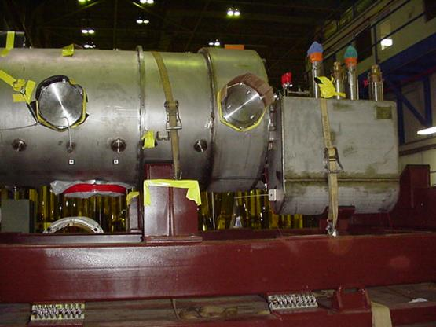
SNS Shipping Tests
The test was repeated with the prototype Medium-Beta cryomodule (2002)
The CM was loaded on to the shipping fixture, and the assembly installed on a trailer fitted with Air-Ride suspension
The load was driven 400 miles around Virginia
Maximum shocks all within design limits
Shipping Fixture deemed successful

Slide 10
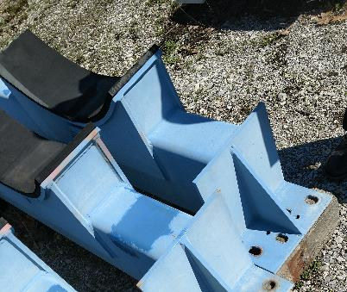
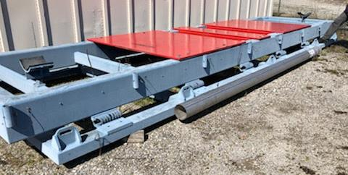
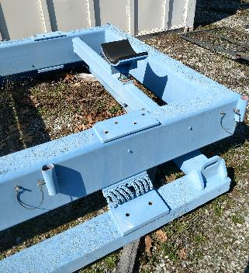
Current SNS Shipping Frame
The original shipping frame is still in use at ORNL
The frame has been refitted for transporting other components (red plates)
Any modifications to the shipping frame will allow the system to be returned to use for other purposes

Slide 11
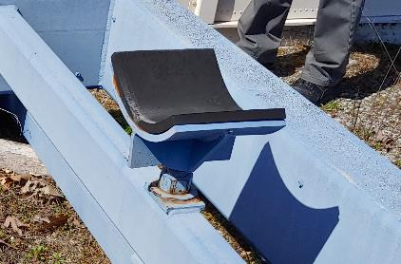
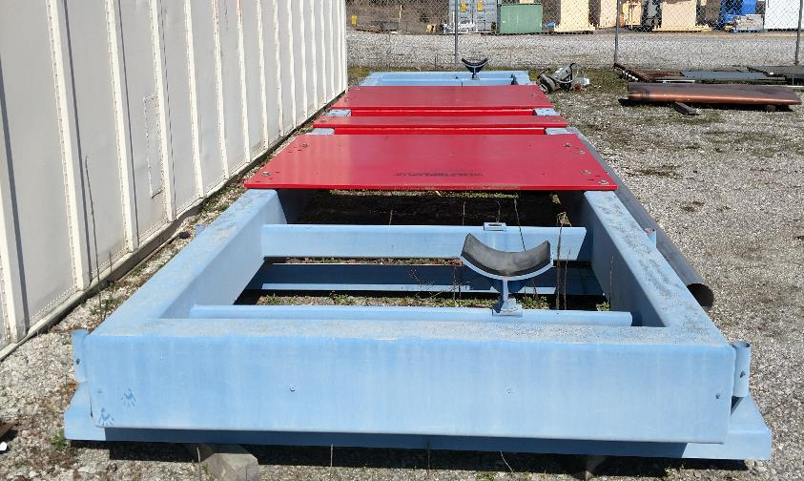
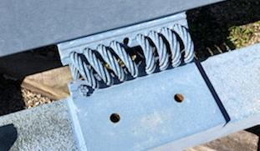
Modifications to Existing Shipping Frame
Required changes:
Isolator Springs will be replaced (bottom image)
1” rubber on saddles will be replaced
All steel surfaces will be stripped and repainted
A permanent housing for instrumentation and batteries will be installed on the frame

Slide 12
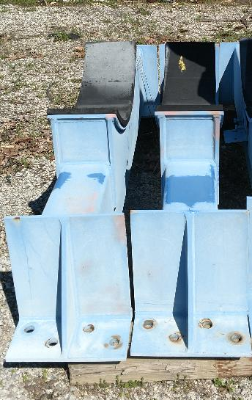
Modifications to Shipping Frame CM Support (Option 1)
The Return Can on PPU CMs is ~10” lower than that in SNS, relative to the vacuum vessel
A structural steel spacer (bottom image) between the saddle cross member (top right image) and the Inner Frame would raise the CM enough to account for the can
The shape of the can support (bottom right image) would need modification to support the flat-bottomed Supply can
Pros
Inexpensive
Minimal engineering and design required
Simple to revert to old system for other CMs
Cons
Raised center of gravity may require changing the springs

Slide 13
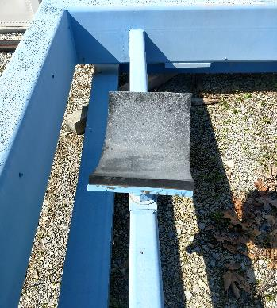
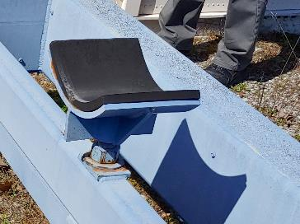
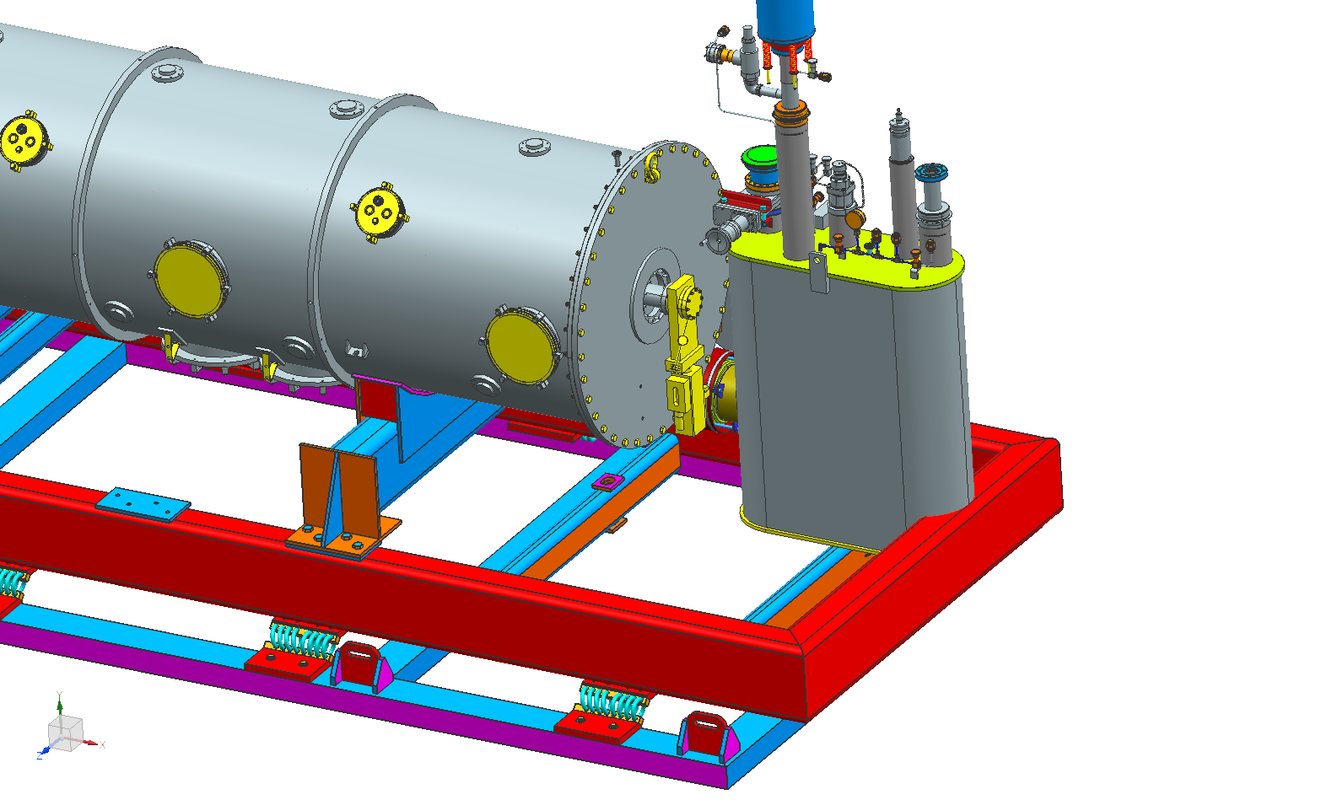
Modifications to Shipping Frame CM Support (Option 2)
The Return Can support cross-member (top right image) may be lowered 5” (bottom image)
The member connection (red box) would be changed from a weld to a bolt connection allowing the system to revert for SNS cryomodules
The main frame cross member will have to be modified
The shape of the can support (bottom right image) would need modification to support the flat-bottomed Supply can
Pros
Shipping configuration almost identical to original SNS shipments
Cons
More expensive than Option 1
More engineering and design required
Reverting to use for SNS cryomodules more labor intensive than with Option 1
Area to be modified
Notes:
The Return End Can is the low end can.

Slide 14
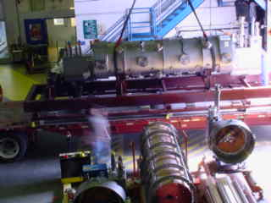
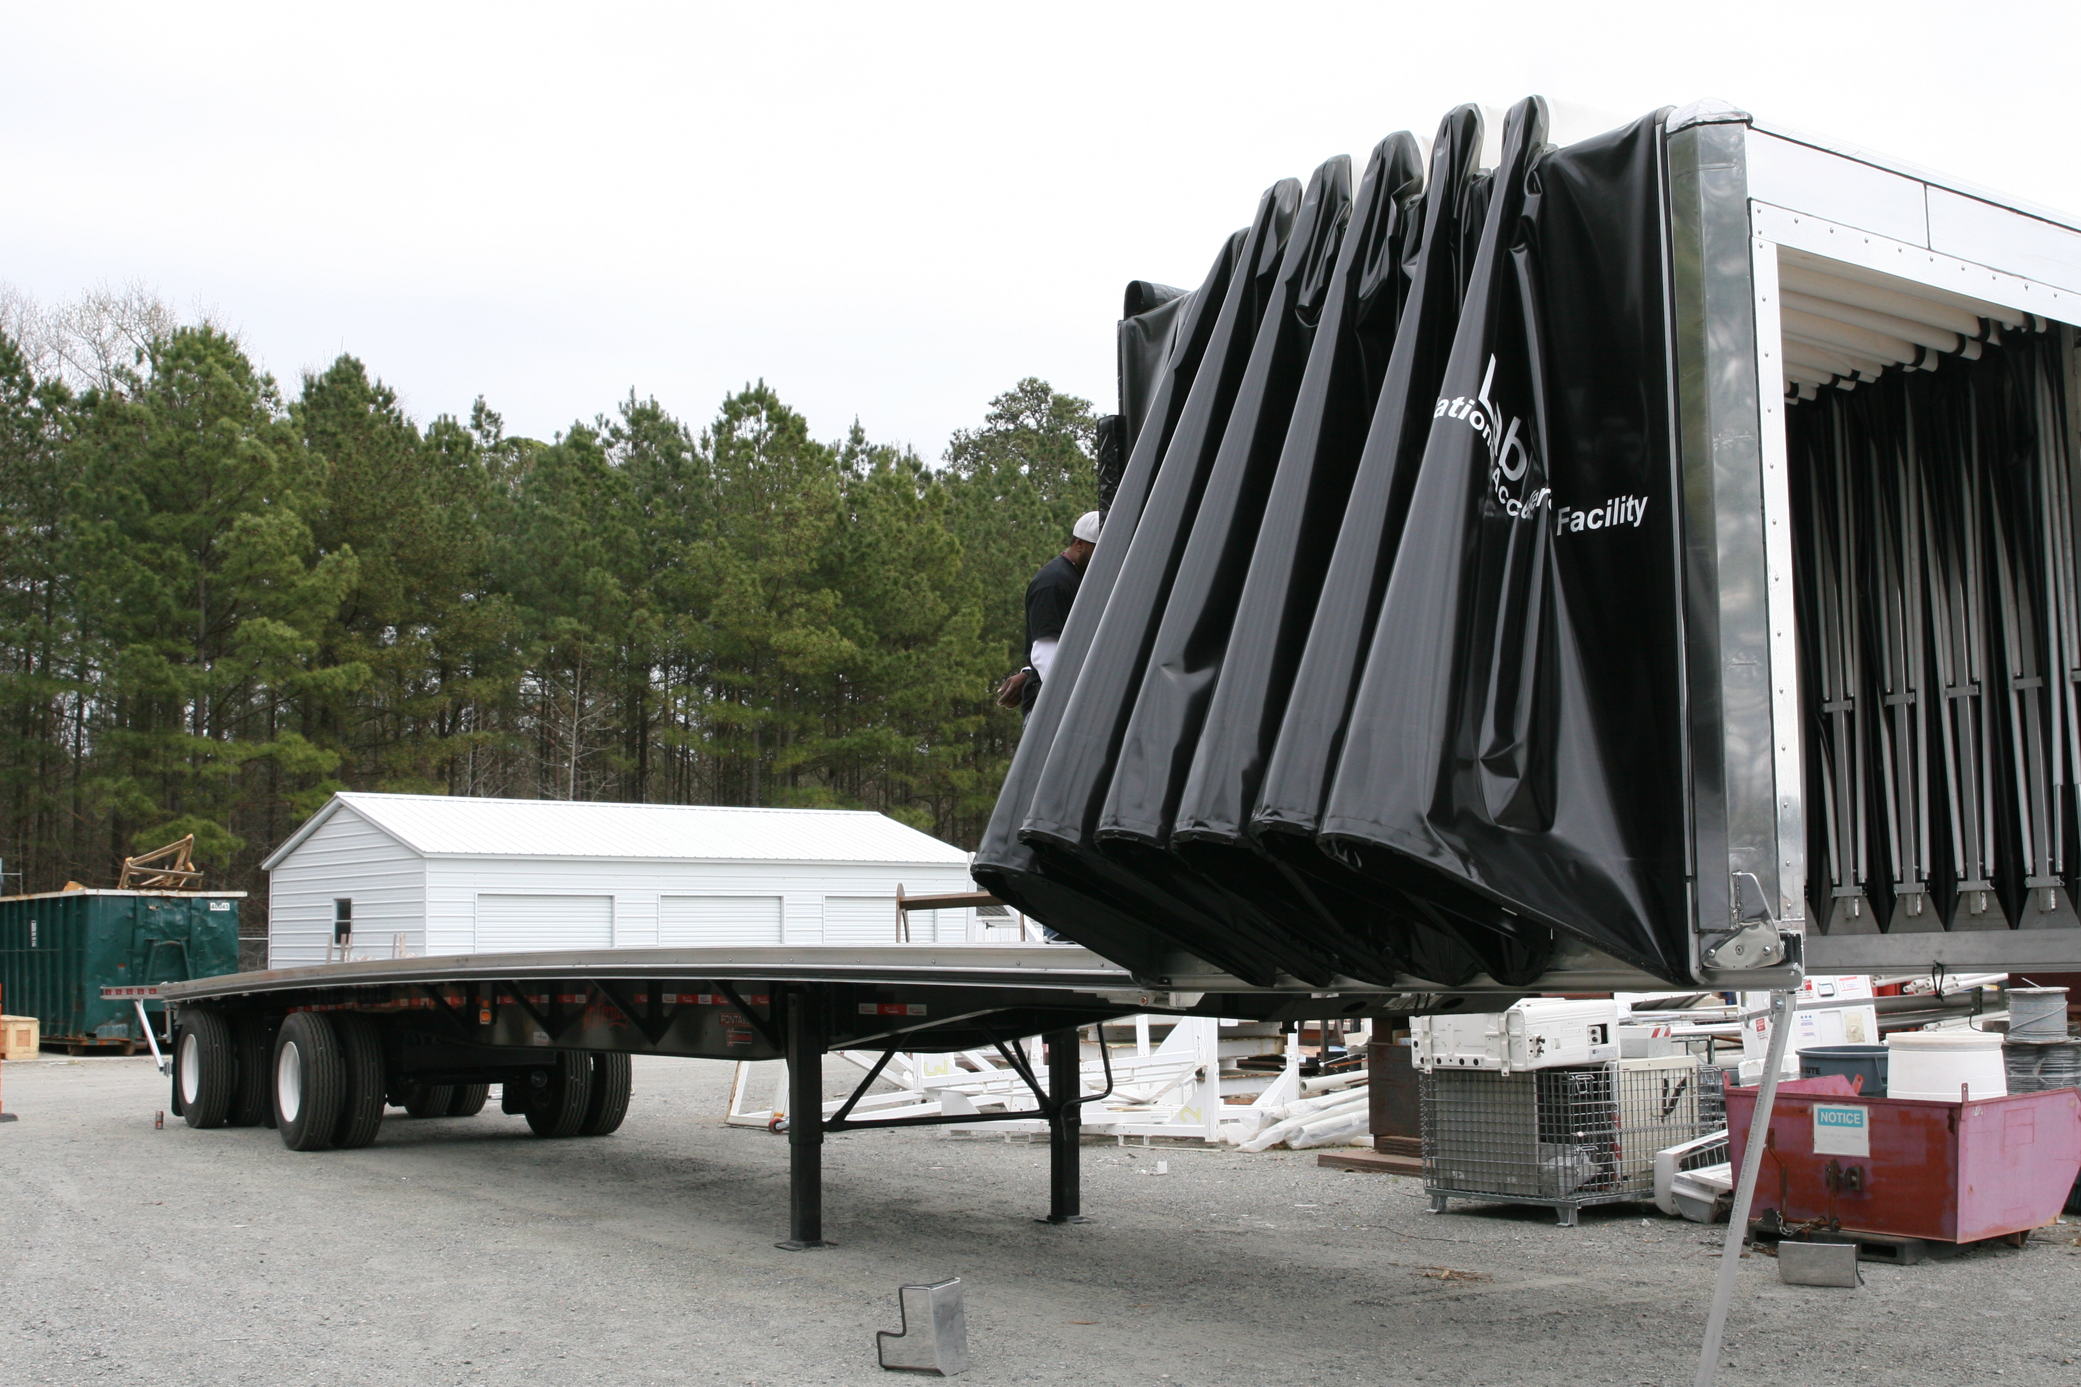
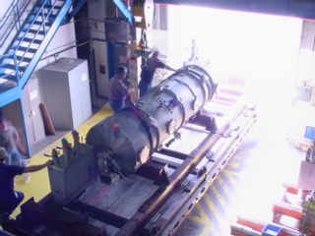
Other Improvements to Shipping System
Trailer choices - considerations
The tractor and trailer require Air-Ride suspension
Conestoga sliding roof will be used instead of tarp
The LCLS-II flatbed trailer may be available
Less cost, same trailer for each trip
Plan to solicit input from industry
DoT rated straps will be used for strapping down the CM and the shipping frame

Slide 15
Shipping System Design Verification
A simulated cryomodule will be used to test the shipping system
A large pipe with a diameter equal to that of the vacuum vessel will be filled with concrete to weight 10,100 lbs and have a comparable center of gravity
Appendages will be attached to the pipe to represent End and Supply Cans and other components
Spring deflections will be measured to ensure that the load is uniform. Remedies if not uniform:
Change springs
Reposition springs
Stiffen inner frame
The simulated cryomodule will be shipped to ORNL from JLab (~500 miles) using the shipping frame and the final trailer configuration
Instrumentation will record shock attenuation of the springs, and the natural frequency of the shipping frame

Slide 16
Production Cryomodule Shipping Test
The first PPU CM produced at JLab will be used for the full scale shipping test
Extra instrumentation and measurement will be applied for the first shipment:
Fiducial points will be installed on the cavity string and gate valves and measured through the access ports
Vibration sensors will be installed on the FPCs to determine whether excessive force or motion is being imparted on the ceramic
Vibration and shock sensors will be installed on the shipping frame and the vacuum vessel
Insulating vacuum space will be pressurized to 1 psig with dry N2
The following will constitute a successful test:
Movement of the cavity string and the gate valves relative to the vacuum vessel and space frame are acceptable
No degradation of the insulating vacuum space pressure (1 psig) and beamline vacuum
No leaks in the cryogenic lines
The CM was not subjected to shocks beyond the design loads
Instrumented components inside the cryomodule did not suffer from excited vibrations from the road
CM passes all electrical and RF checks

Slide 17
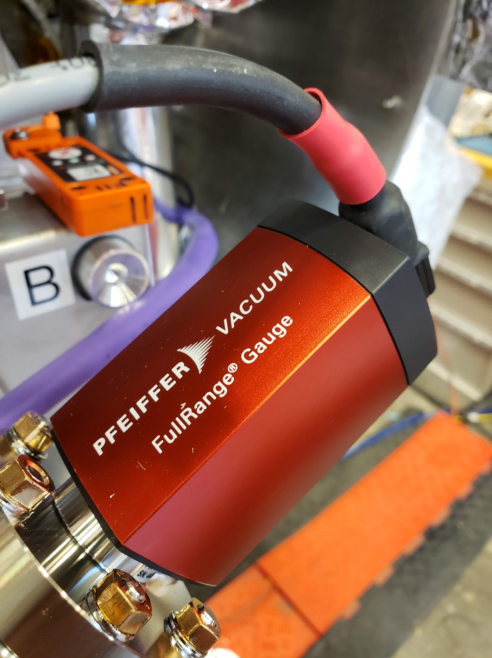
Instrumentation
Shocks on the shipping frame and vacuum vessel will be measured and logged using a Lansmont SAVER9X
Main unit is on the outer shipping frame
Two PCB triaxial accelerometers are attached to the inner frame and vacuum vessel, and logged by the main unit
The embedded GPS system will show the locations of any high shock loads
Vibration and displacement of the cryomodule internal components are measured using Mide Slam Stick X (top image)
The SSX has been successfully used on LCLS-II shipments
Vacuum gauges (bottom image) on the beamline will be transmitted live using a Digi-Connect transmitter
A GPS tracker will transmit the location of the trailer at all times
An external set of batteries installed on the trailer bed will power SSX units and data transmitters; the former will use USB feedthroughs passing through modified access port covers

Slide 18
PDR Comments/Recommendations
PDR Recommendation #10:
Clarify the scope for Jefferson Lab regarding shipping preparation and shipping-related design.
Outcome - CLOSED
A detailed shipping proposal was presented to SNS on March 27 and agreed to
This is the plan that was presented today
PDR Comment #6
Consider local shipping tests on individual components and assemblies prior to shipping the first cryomodule to SNS.
Outcome - CLOSED
SNS plans on conducting shipping tests on the FPC assemblies and results factored into the plan
We will do a local shipping test of the shipping fixture prior the first CM shipping

Slide 19
Summary and Future Work
The Shipping Frame designed for the original SNS project may be modified to transport SNS-PPU CMs from JLab to ORNL
Due to design changes in the PPU CMs, it is recommended that several road tests be carried out with both a simulated CM and an actual CM to verify the shipping frame design
Next Steps:
Determine the best option for shipping frame modification
Modify shipping frame
Design and fabricate dummy cryomodule
Test shipping system using dummy cryomodule
Adjust shipping system accordingly if required in preparation for production cryomodule shipments

Slide 20
Questions?
Naeem Huque
Huque@jlab.org

Slide 21
Back up

Slide 22
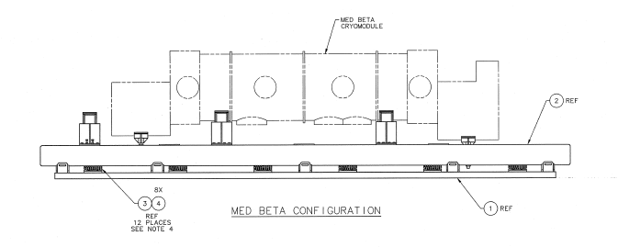
Original MB and HB shipping configurations

