Slide 1
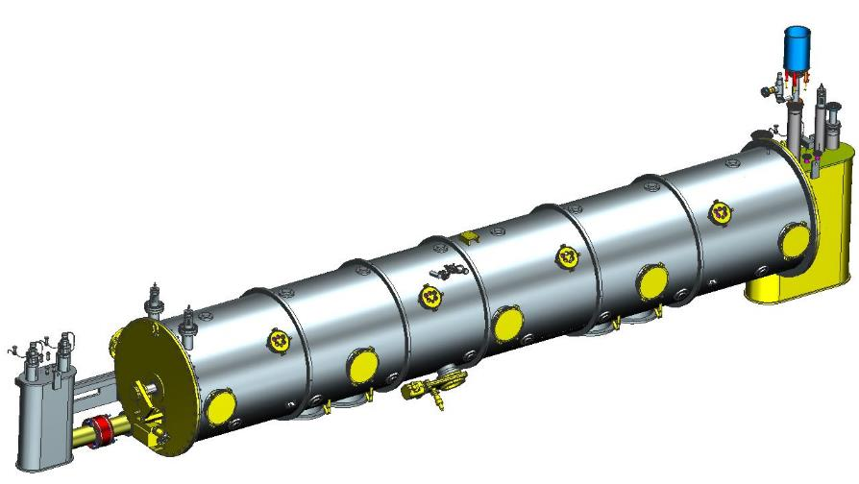
SNS PPU CRYOMODULE FDR
Cost & Schedule: Design, Procurement, Assembly
Tony Reilly

Slide 2
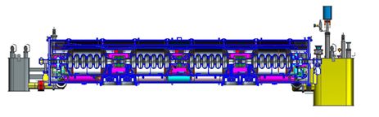
Outline
Introduction
Procurement Plans
Production Plans
Quality Assurance
Staff / Staffing
Cost
  Design, Procurement and Assembly
Schedule Overview
  Design, Procurement and Assembly
Summary
Contributors:
Katherine Wilson
Ed Daly
Phil Kessler
Eden Evans
Kelly Krug
Jim Henry
Mark Wiseman
Kurt Macha

Slide 3
Introduction
Key Points
General JLab scope is to complete the design package, procure all major components (except cavities and couplers) and assemble (7) high-beta cryomodules to support the Spallation Neutron Source (SNS) Proton Power Upgrade Project (PPU)
Project Management Office has implemented a work breakdown structure (WBS) and cost have been estimated for each section
Design is in progress due to be completed June 2019, except tooling (Feb 2020)
The preliminary procurement strategy has been defined
Preliminary production plans have been developed
Quality plans are being derived starting with a draft set of work control documents
A P6 schedule has been developed by the PMO and reviewed with stakeholders
Preliminary SRF Operations technician staffing needs have been identified by work center

Slide 4
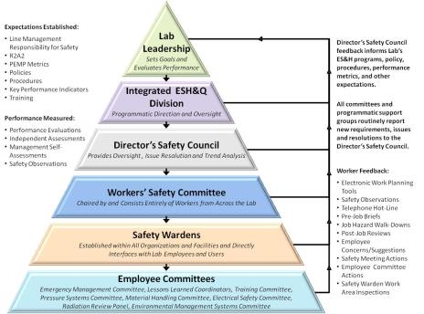
Safety - Requirements
Work Observations are routinely conducted,
ESH professionals, Division Safety Officer, and Accelerator Division staff and management involved
All safe for all observations
ISM – Integrated Safety Management applies for all work.
  Areas include Inventory, Receiving/Inspection, VTA, Assembly and Testing
Example - Shoulder injury experienced by a technician while loosening a bolt on an LCLS-II cavity flange.
  Immediate actions to modify work procedures, larger wrench
  Follow up in depth investigation by Division Safety Officer
  All corrective actions have been completed

Slide 5
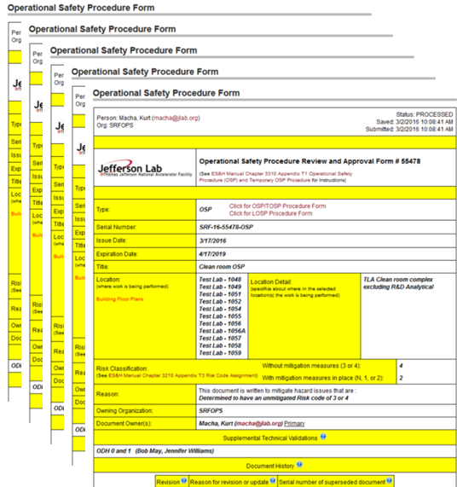
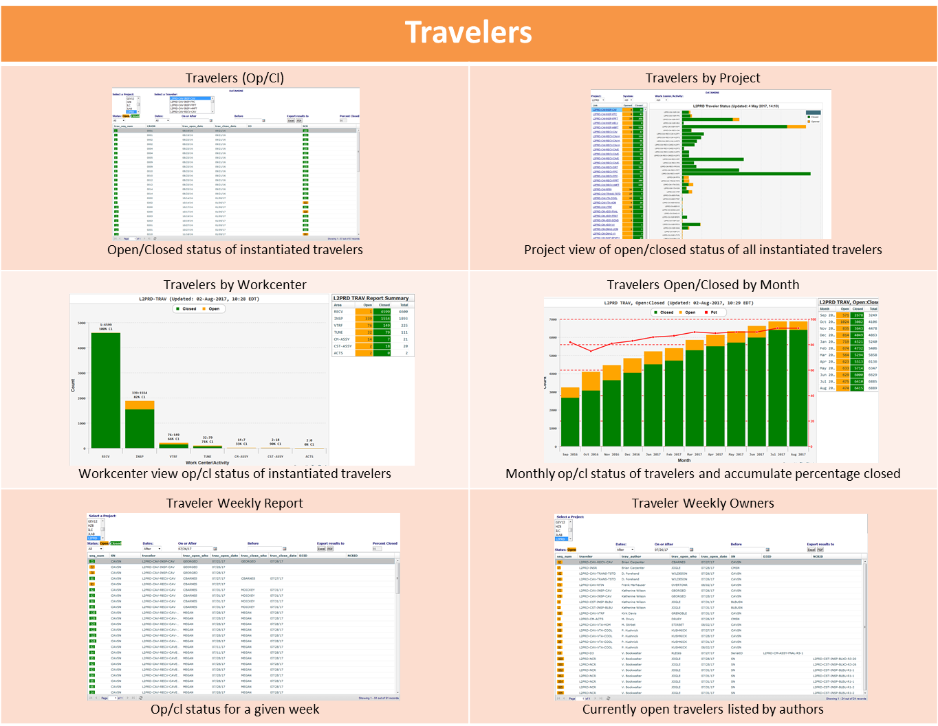
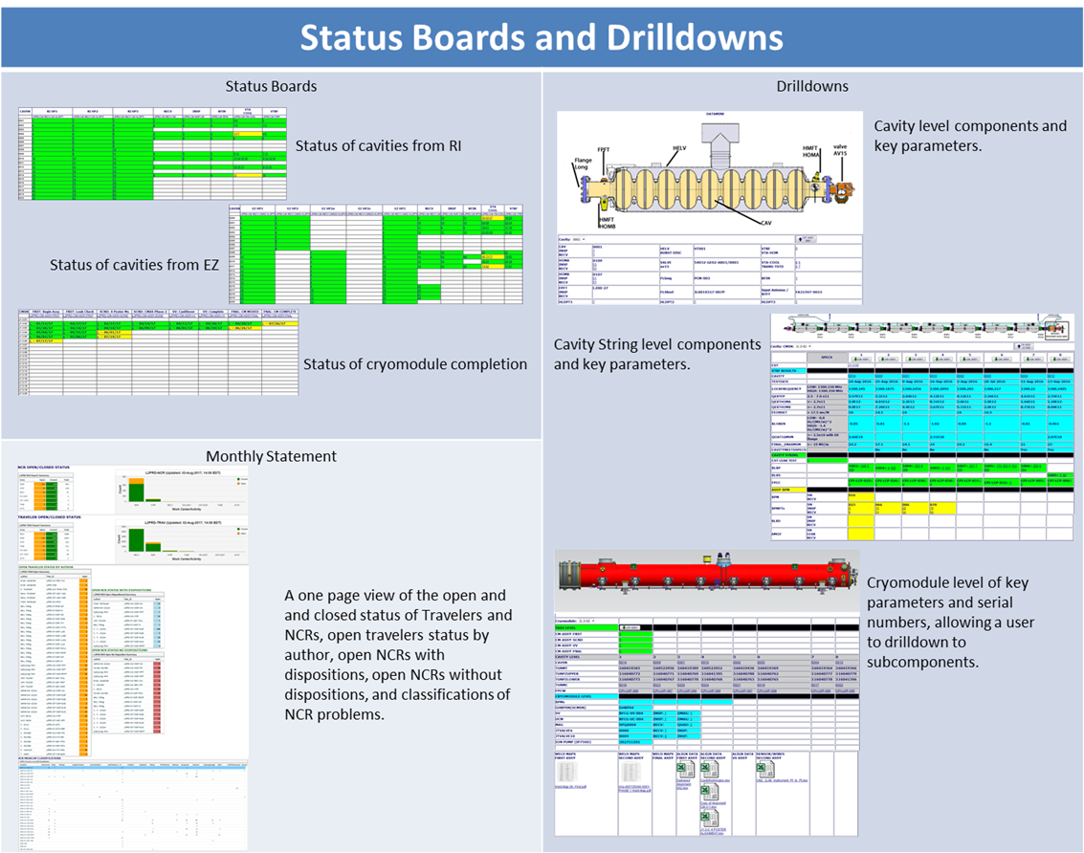
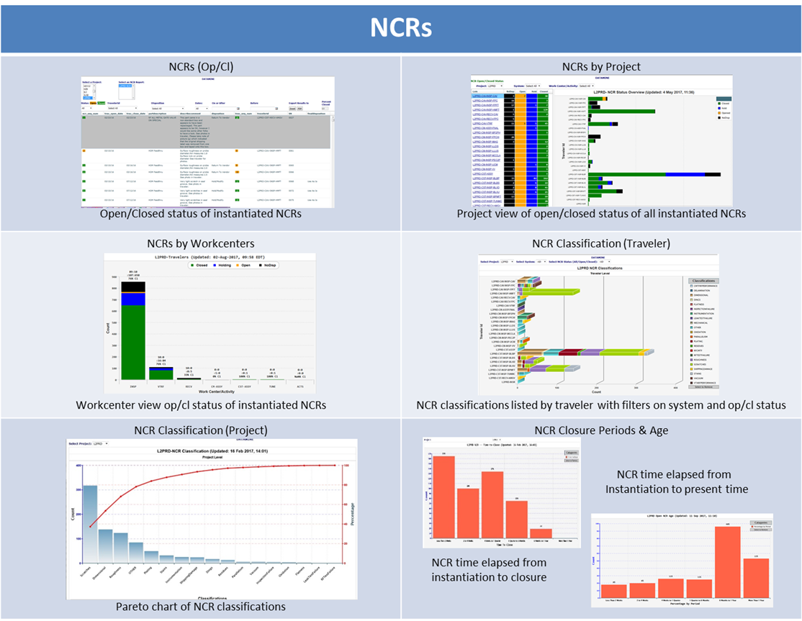
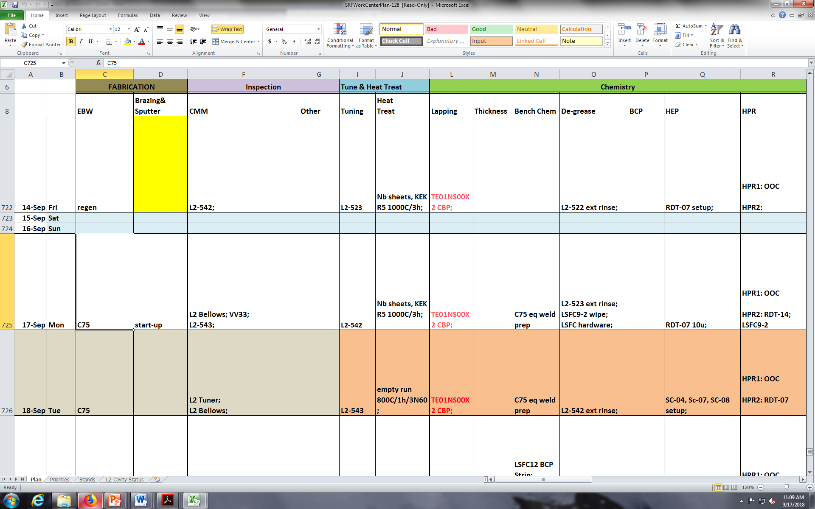
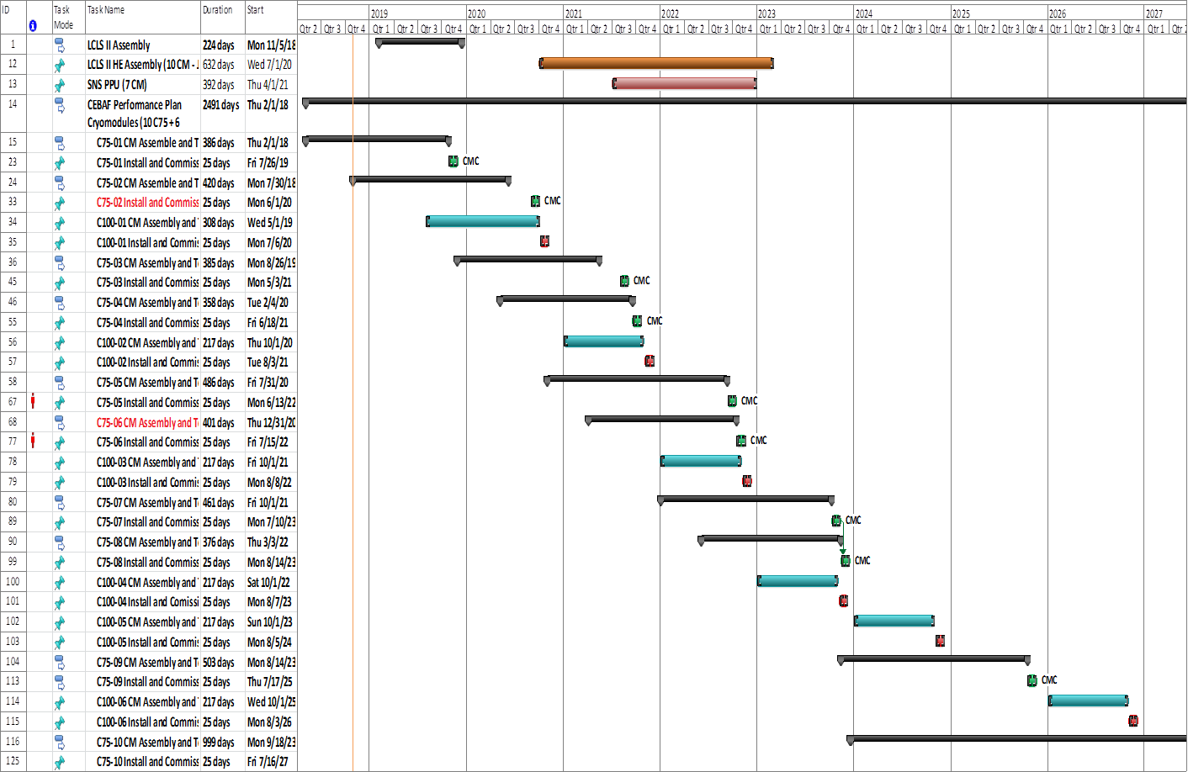
Safety, Quality then Schedule
Safety
All work centers have an Operational Safety Procedure (OSP)
Equipment within work centers exceeding the risk category prescribed by the ES&H manual also has an associated OSP
Cavity vertical and cryomodule test have additional work control documents associated with radiological control (Rad Worker Permits)
Safety
Quality
Schedule
Quality
SRF Quality Manual
Work Controls and Authorization
Travelers and Procedures
Quality Reports
Schedule
Twice Daily work planning meetings
Weekly Planning Sessions
Gantts for in-house projects
P6 from PMO for large scale

Slide 6
Procurement Plans
Key Points
Estimated M&S cost and schedules are based on original SNS experience and more recent MB/HB CM purchases by SNS
SOTR (subcontracting officer’s technical representative) system will be implemented for each procurement
Lessons learned on previous projects guide the strategy used for procurements on PPU
The procurement process will look to obtain domestic vendors
Procurement Plans are required for actions above $1million
JLab Procurement Procedures shall be used for all procurements

Slide 7
Procurement Plan
Material:
  Estimated cost and schedule in P6 based on original SNS experience and more recent MB/HB CM purchases by SNS
  JLab procurement will be reaching out to new/additional vendors for PPU to improve quality and keep costs competitive
Labor:
  JLab uses SOTR (subcontracting officer’s technical representative) system in which a technical expert works with a subcontracting officer for each procurement to ensure any issues (technical/business) are managed efficiently
  The Procurement department (Major Supply Group) is currently assigning subcontracting officers to each PPU procurement to advance planning where possible and to better meet the needs of technical personnel

Slide 8
Procurement Plan
Lessons learned on previous projects guide the strategy used for procurements on PPU
  Best value procurement methods will be used to ensure we get the best possible outcome on the requirements.
  Options in subcontracts will be used to reduce duplication of effort at a later date for spare parts if needed while minimizing cost and unused parts
The procurement process will look to obtain domestic vendors (preferably small/large businesses),
  Potential to avoid customs fees, exchange rate adjustments and international shipping issues
Procurement Plans are required for actions above $1million
JLab Procurement Procedures shall be used for all procurements
Mitch Laney is the primary procurement contact at 757-269-5338 and email at: laney@jlab.org

Slide 9
Production Plans
Key Points
Production rate and schedule are reasonable based on past CM production experience
  Start cavity qualification in August 2020 (July 28), qualify (2) cavities per month (nominal)
  Complete the assembly and ship a cryomodule ~ every 2 months starting Jan 2022 thru Feb 2023
String assembly done in ISO 4 clean room on mobile rail system
Cryomodule assembly will occupy one assembly bay in the CM assembly area on assembly rails
Cryogenic testing will occur in the cryomodule test facility (CMTF)
Preliminary staffing levels are understood and have been integrated with best available information for other projects

Slide 10
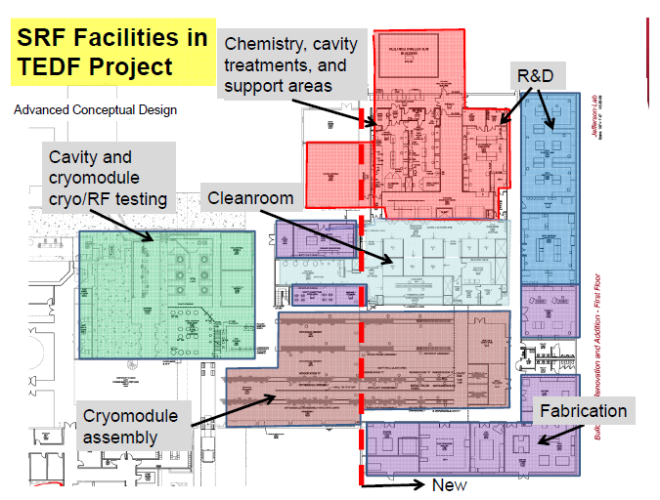
SRF Facilities at JLab
Located in Annex –
Receiving
Inspection
Inventory
Offsite considered for additional storage
Ship

Slide 11
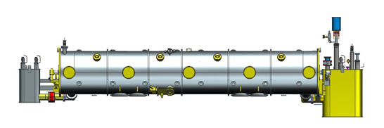
SNS PPU Cryomodule Assembly Flow
Inventory, Inspection
Cavity Qualification
String Assembly
Cold Mass Assembly
Space Frame/Shields
Final Assembly
Cryogenic Check
Prep for Shipment
Pack and Ship

Slide 12
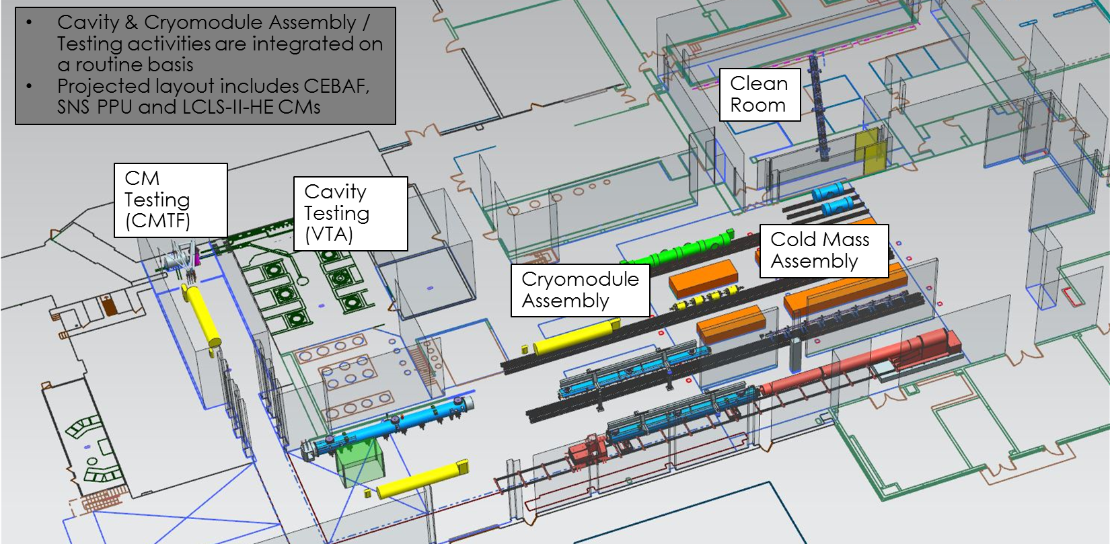
Test Lab – CM Production Area Layout (FY2022)

Slide 13
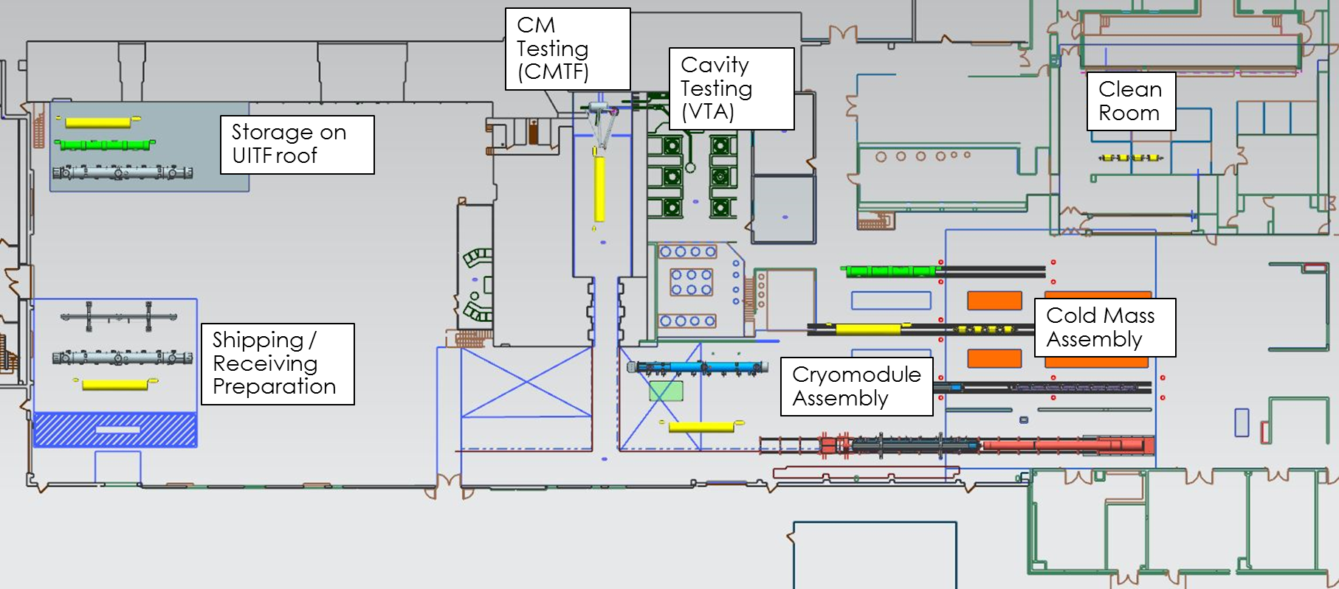
Test Lab – Overall Layout (FY2022)

Slide 14
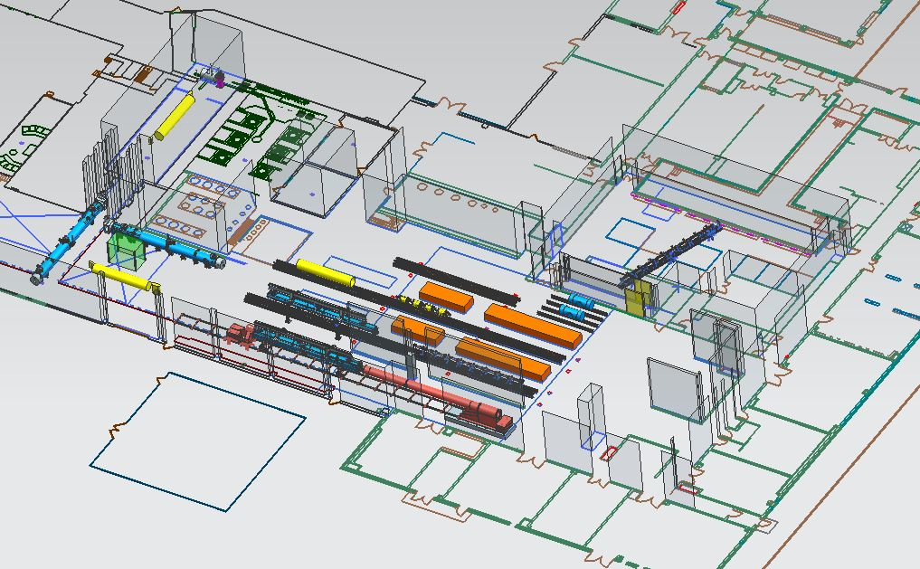
SRF Production Floor Plan
CM Test Facility
(CMTF)
Cavity Vertical Test (VTA)
Cavity Prep
String Assembly
CM Final Assembly
CEBAF CM Assembly
SNS PPU CM Assembly
LCLS II HE CM Assembly

Slide 15

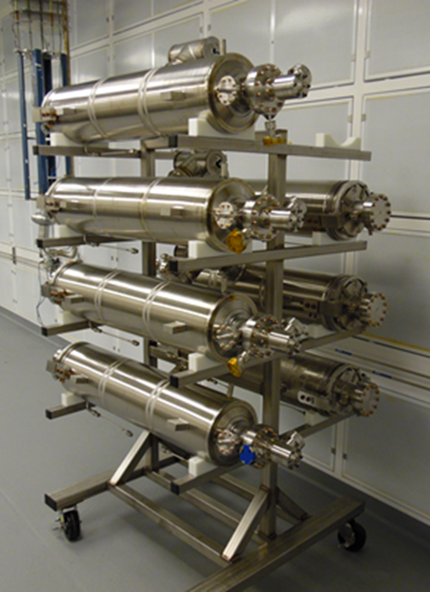
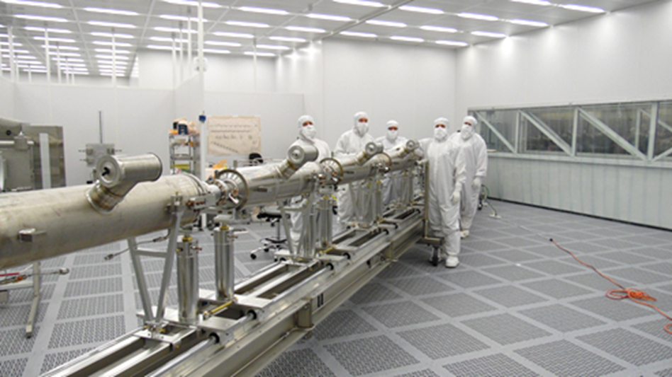
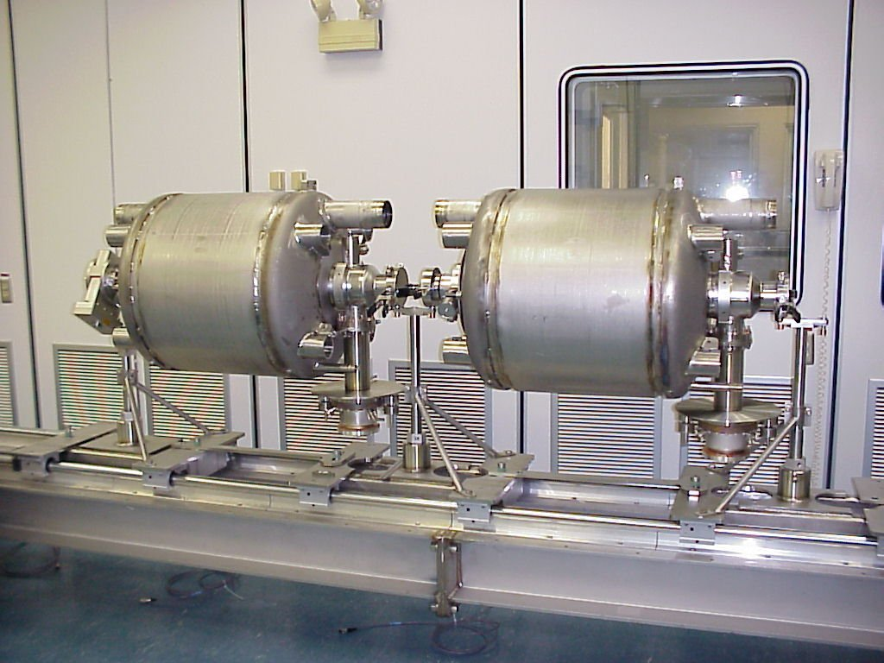
SNS Cavity String Assembly
Cavities will be isolated, left under vacuum and installed on the clean room storage rack
“Lollipop” supports for each cavity subassembly
Lollipops mounted to mobile rail system
Use mobile rail system to “roll-out” string to CM assembly

Slide 16
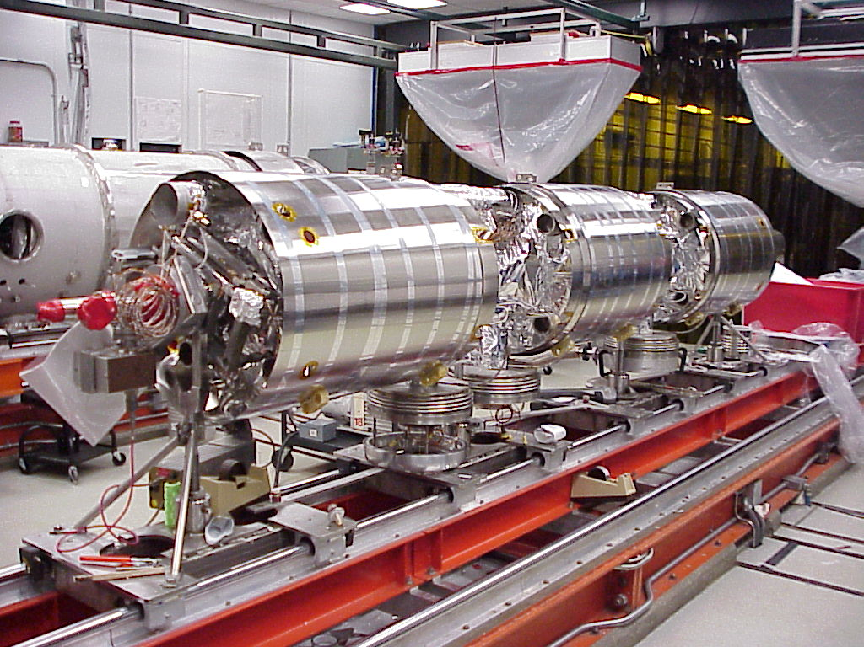
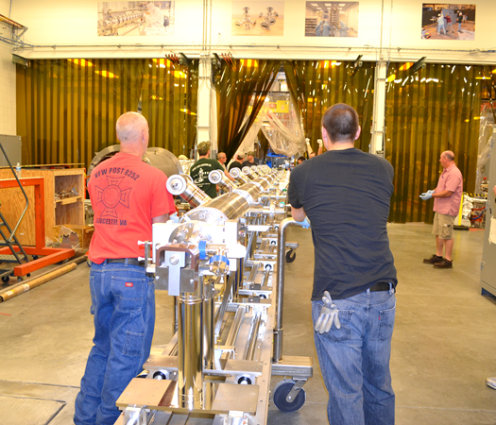
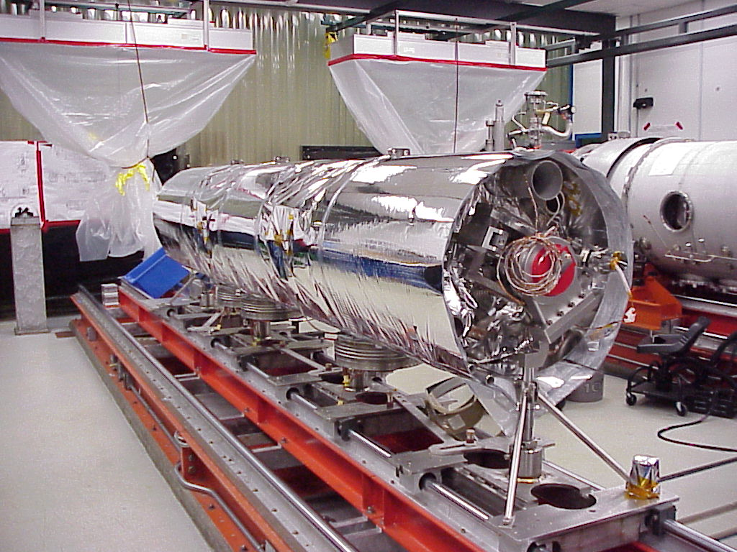
Cryomodule Assembly Plans
Use mobile clean room rail system to transport from clean room onto cryomodule assembly rail system
Use CM assembly rail system for cold mass assembly, space frame and thermal shields

Slide 17
Production Plans – Quality Assurance
Key Points
SRF has a quality management system (QMS)
  Quality Policy is contained in the SRF Quality Manual QA-M-001
  Process elements are based on ISO 9001:2008
  Supplements lab-wide JLab Quality Assurance Plan
SRF Operations is assessing ISO 9001:2015 FY19/20
Document Control (QA-P-001) includes project work control documents such as Travelers
Control of Non-conforming Product (MAI-P-004) describes the NCR processes and control of non-conforming material
Quality Board reviews performance metrics for travelers and NCR monthly
  Reports are issued weekly to project managers, managers and work center leads
Pansophy, Docushare and PRIMeS are primary tools used in QA
A comprehensive suite of reports, dashboards and drill downs are available for up-to-date status of work control documents, work status and performance test data

Slide 18
SRF Quality Manual (SRF QA-M-001)
SRF Quality Manual and related procedures are in Docushare
https://jlabdoc.jlab.org/docushare/dsweb/View/Collection-16729
QA-M-001 SRF Quality Manual
QA-P-001 Document Control
QA-P-002 Records Retention
MR-P-002 Management Review Process
PR-P-005 Inventory Control
PR-P-006 Equipment Change Control
MAI-P-004 Control of Non-Conforming Product

Slide 19
SRF Document Control Process (QA-P-001)
An example of one of the formal processes for the creation, review, approval and filing of process documents.
Centrally stored files for common access to the latest approved document versions.
Revision control is maintained for history and records.

Slide 20
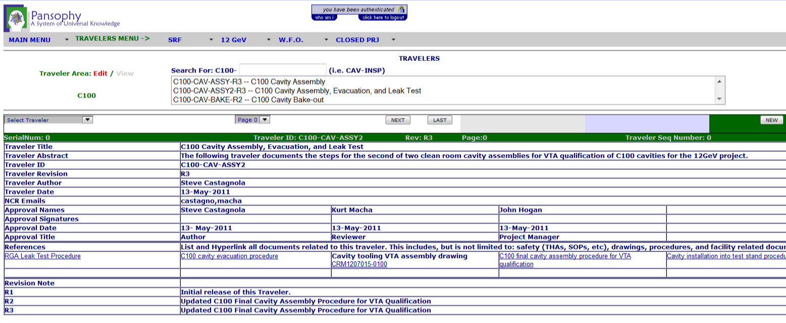
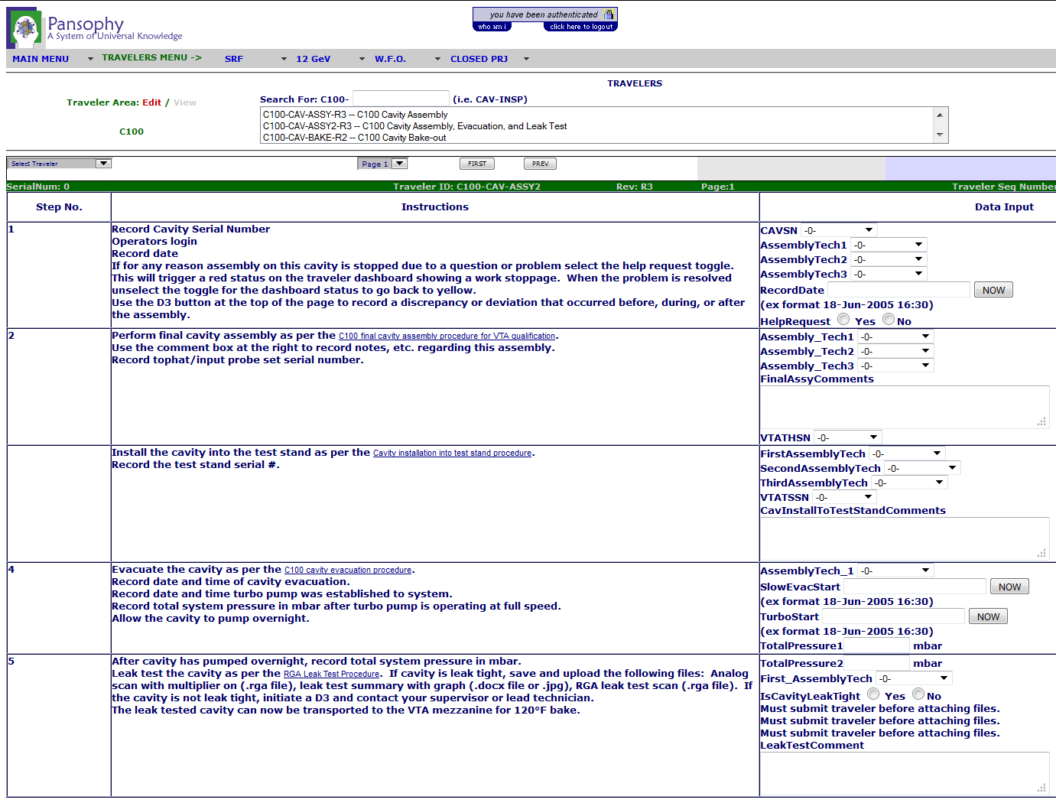
Pansophy Traveler – An Example
Traveler Cover Page:
Descriptions & approvals.
Links to associated procedures.
Revision history.
DATA INPUT –
Process instructions & steps to guide work flow.
Data Input – data entry and comments made by user at prescribed process points.
‘Hooks’ to inventory system – automatic serial number push and I.D.s for individual components and assemblies.

Slide 21
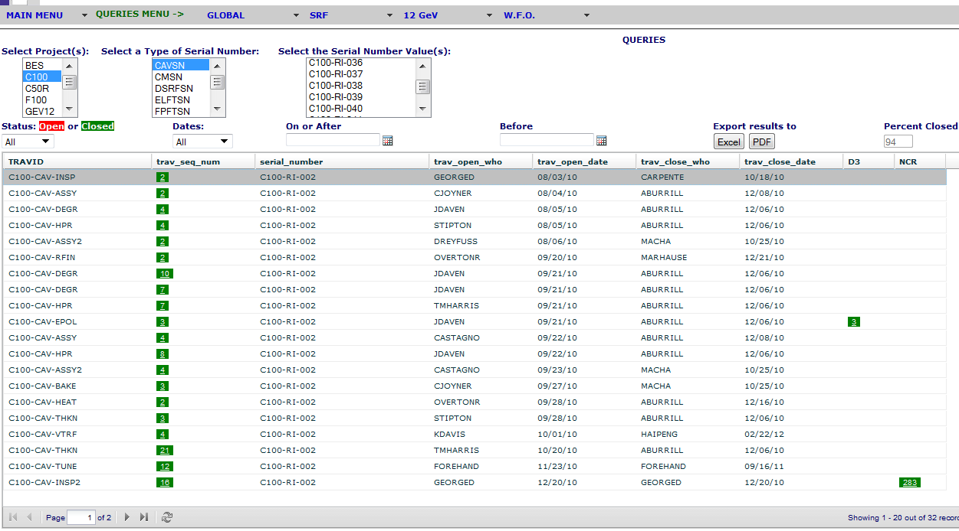
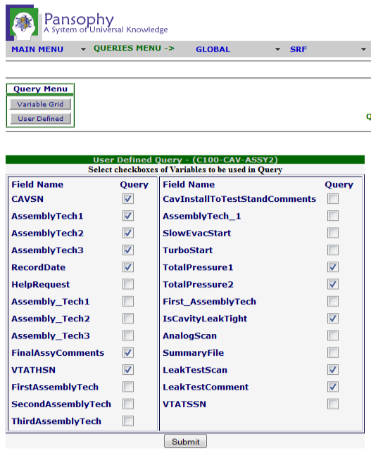
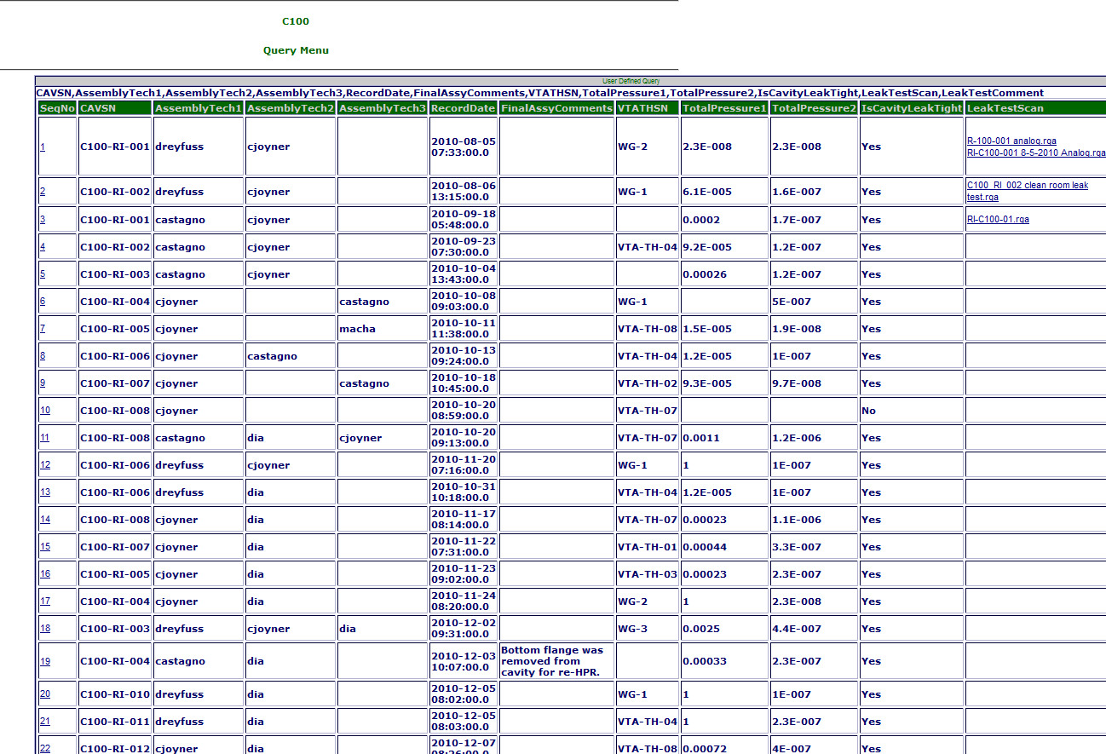
Pansophy Traveler – An Example (cont.)
DATA OUTPUT
Status Board - provides snapshot of work-in-process.
Data Query and Filter Functions for REPORTs on selected parameters.
Export function to MS Excel for other data analyses.
Status Board
Query
Traveler Report

Slide 22
SRF Performance Monitoring Process & Tools
SRF Mission : To provide top-class innovative solutions to SRF acceleration system needs of Jefferson Lab, the DOE complex, and other partner applications.
Production
Daily Production Coordination meetings
Document Control
Use of Pansophy, a Data Management Tool for
Quality Metrics
Periodic SRF Quality Board review of Key Metrics
Data management of Prototype & Production builds
Inventory Management - PRIMES
Continuous Improvement activities
Strategic Planning
SRF R&D/Operations Plans are in support of the Laboratory Agenda from which our Budget, Resource & Capacity Planning are derived
Examples include D3, NCR Non Conformance & Corrective Action Report
Weekly Scheduling meetings to review weeks outlook

Slide 23

Traveler/NCR Reports & Dashboards/Drilldowns

Slide 24
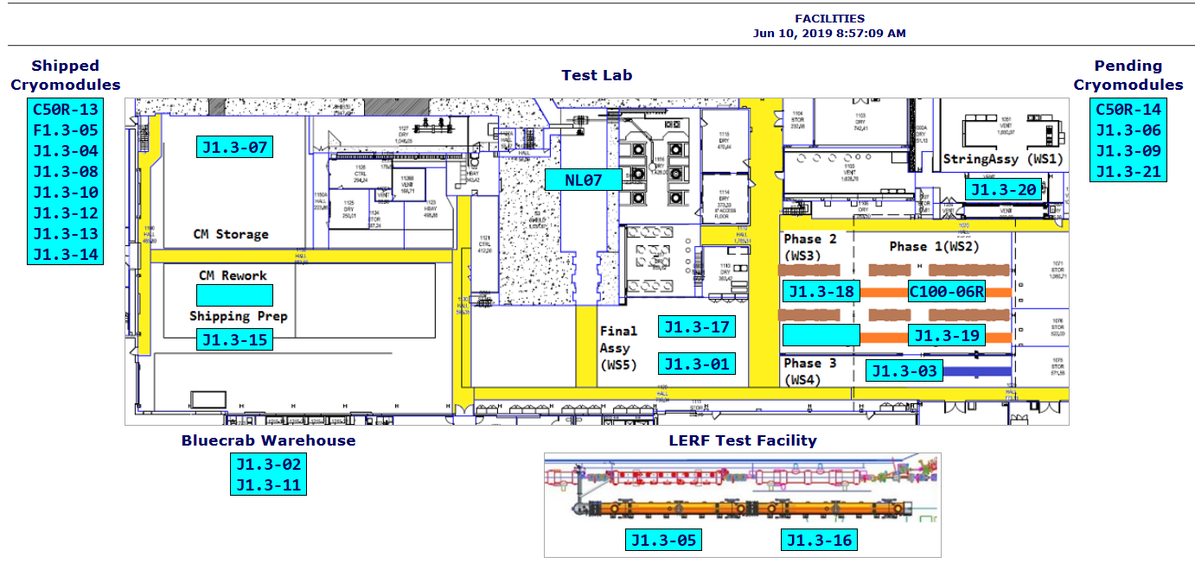
CM Production Area (Current Status)
13 LCLS-II CMs currently onsite or in storage; C100-06R in progress
SNS PPU will occupy one of the assembly lines

Slide 25
Staffing
Key Points
Accelerator Division provides line management to Lab Director, production leadership, project integration across all cryomodule projects and quality assurance at the Division level
Project organization chart demonstrates commitment at the Directorate level with Senior Technical Lead reporting to Lab Director
SRF Operations organization will be staffed to provide the production leadership and resources to successfully complete the SNS PPU Project
  Core staff augmented with term employees
Engineering Division is a key partner and resource contributor
  Design leads, SOTR, Survey&Alignment and assembly techs
EHS&Q provides a QA lead and SME as needed

Slide 26
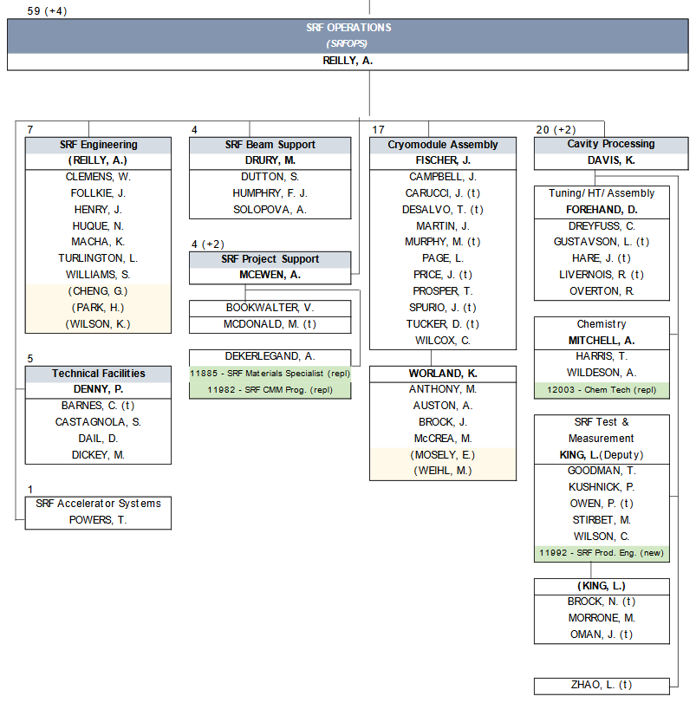
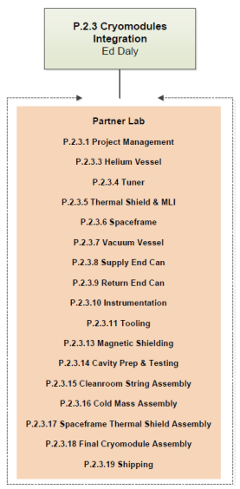
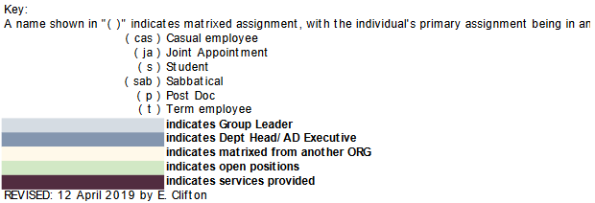
Organization @ JLab – SRF Operations
Accelerator Division provides:
  Production leadership
  Total Staff – 63
Engineering Division provides:
  Design Lead Engineer
  Matrixed Engineers
  Designers
  Survey & Alignment
ESH&QA Division provides:
  ESH & QA Lead
  SMEs

Slide 27
JLAB SNS PPU PROJECT ORGANIZATION CHART

Slide 28
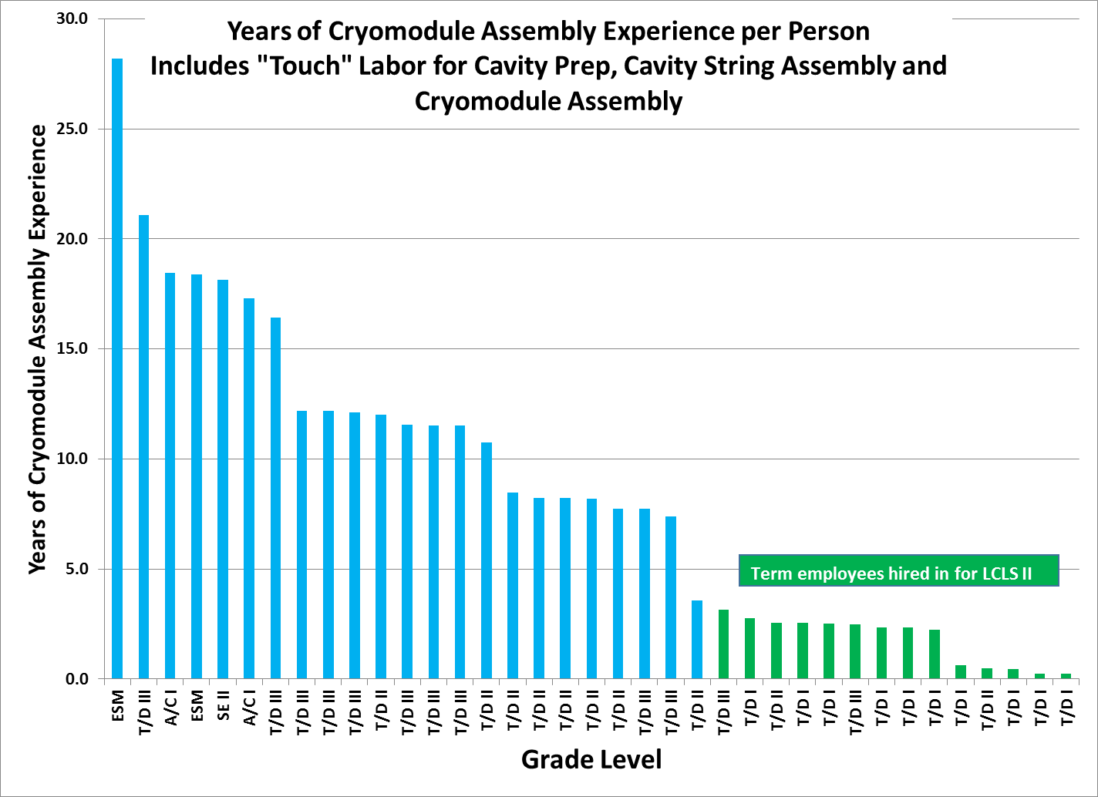
SRF Operations Assembly Experience in Years

Slide 29
Cost
Key Points
Project Management Office (PMO) has developed and implemented a Work Breakdown Structure (WBS)
Cost Account Managers have been assigned
  Design, Procurement, Project Management, Cryomodule Assembly
Cost are estimated for project management, design, procurement and assembly
Total cost (fully burdened) is about $21.185M

Slide 30
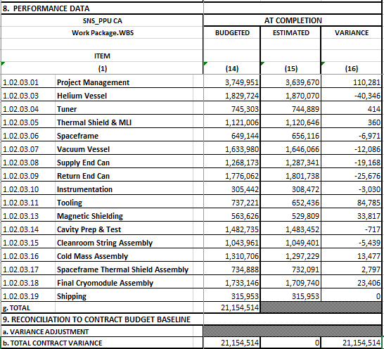
Cost – Jefferson Lab Scope
Rolled up at L4
Control accounts are defined at L5
  24 in total
Currently funded for:
  Project Management
  CM design effort

Slide 31
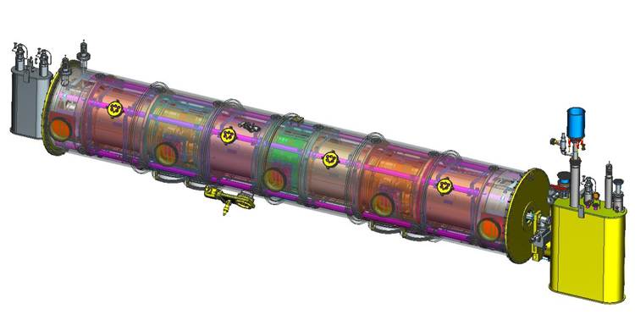
Cost Summary
WBS | WBS Description | BAC (Loaded)
1.02.03.01 | Project Management | $3,788,557
1.02.03.03 thru 18.02 | Design | $1,535,789
1.02.03.03 thru 19 | Procurements | $10,697,421
1.02.03.14 thru 19 | Fabrication | $5,132,746

Slide 32
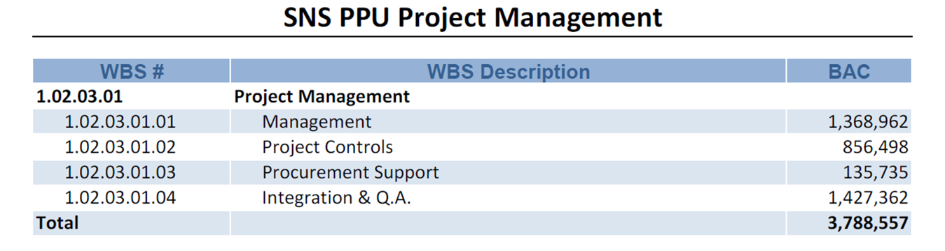
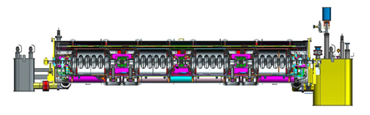
Project Management Cost (Loaded)

Slide 33
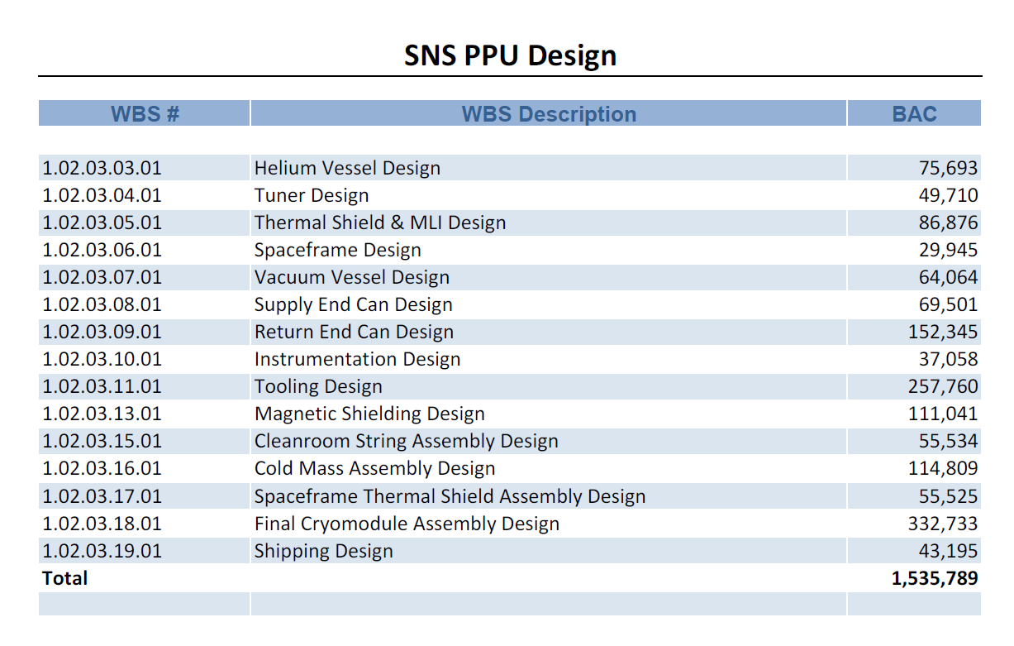
Design Labor Cost (Loaded)

Slide 34
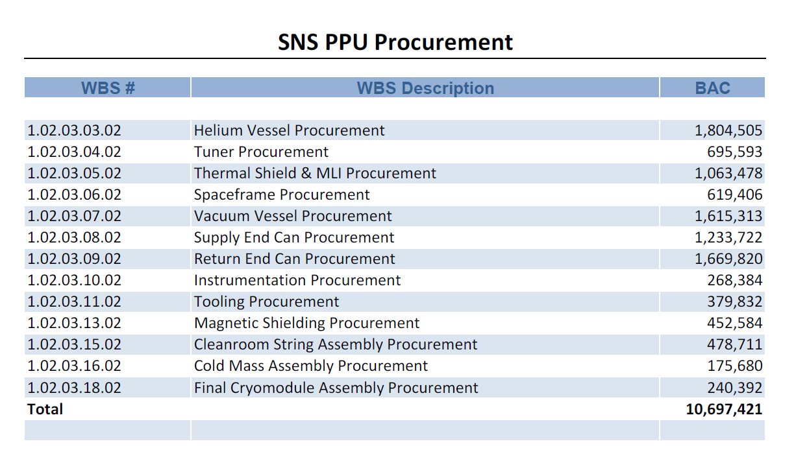
Major M&S Procurement Cost (Loaded)

Slide 35
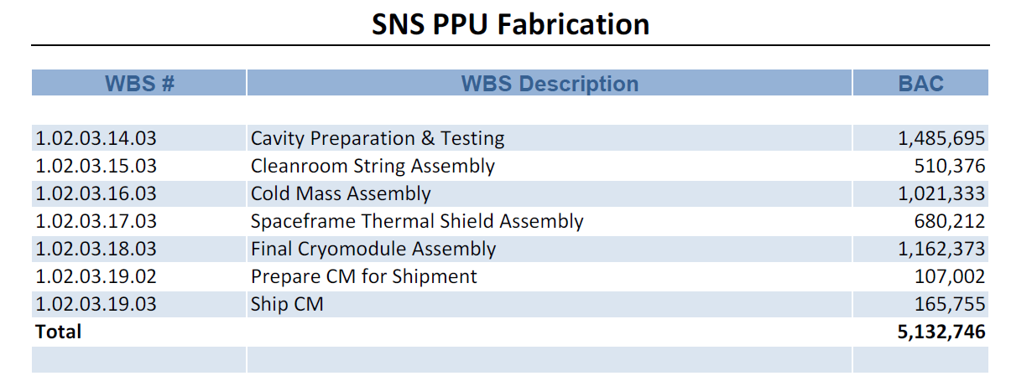
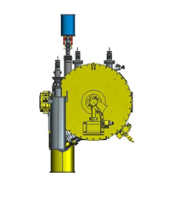
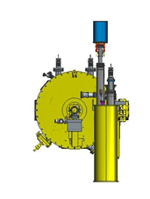
Fabrication (Assembly) Labor Cost (Loaded)

Slide 36
Schedule
Key Points
PMO developed a comprehensive schedule in P6 which includes all project phases
Schedule has been reviewed with stakeholders and made available through “CAM Notebook”
Preliminary work center staffing needs have been extracted from P6 schedule

Slide 37
SNS PPU Schedule Overview from 10JUN2019 P6
Task Name | Duration | Start | Finish
SNS PPU Overview from 10JUN2019 | 922 days | Tue 7/23/19 | Wed 2/1/23
Procurement | 407 days | Tue 7/23/19 | Wed 2/10/21
Cavity Qualification | 383 days | Tue 7/28/20 | Thu 1/13/22
Cavity String Assembly | 283 days | Wed 1/27/21 | Fri 2/25/22
Cold Mass Assembly | 314 days | Wed 3/24/21 | Mon 6/6/22
Space Frame Assembly | 346 days | Wed 5/26/21 | Wed 9/21/22
Final Assembly | 329 days | Fri 8/13/21 | Wed 11/16/22
Cold Shock Test | 300 days | Mon 10/18/21 | Fri 12/9/22
Shipping Preparation | 312 days | Tue 11/9/21 | Wed 1/18/23
Cryomodule Shipping | 300 days | Thu 12/9/21 | Wed 2/1/23

Slide 38
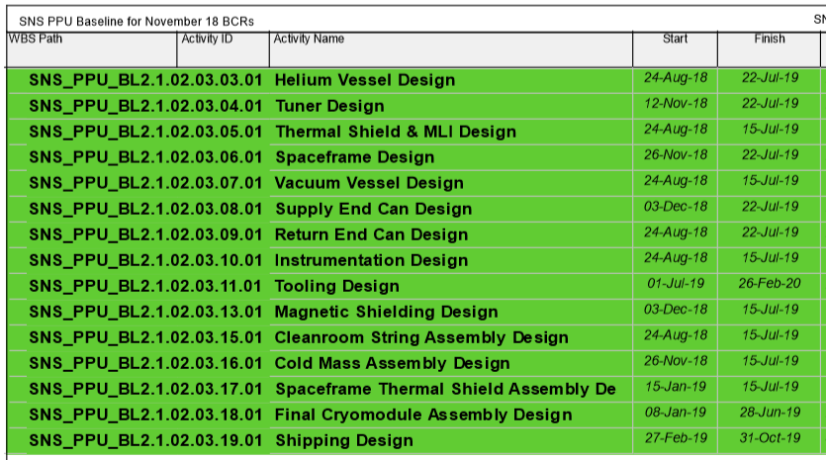
Schedule - Design

Slide 39
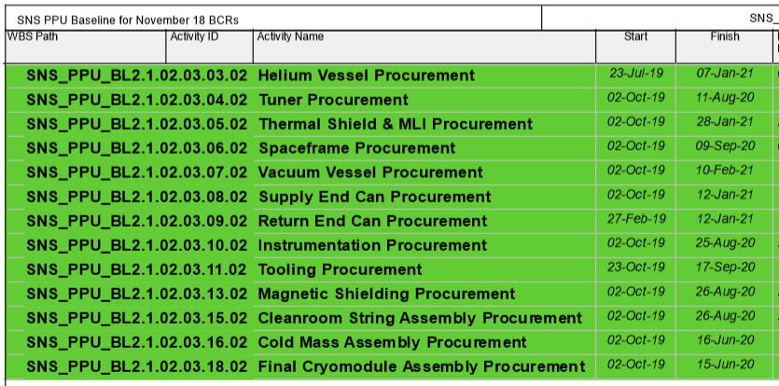
Schedule - Procurement

Slide 40
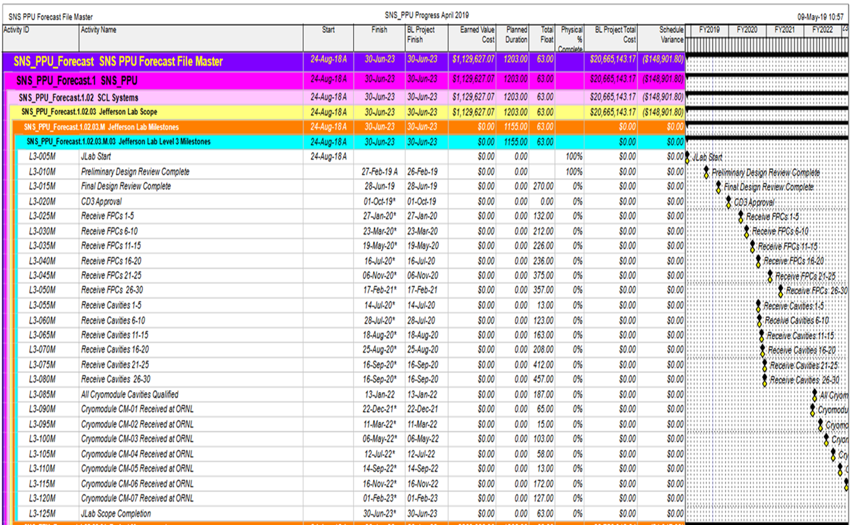
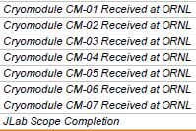
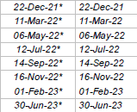
Schedule - Milestones

Slide 41
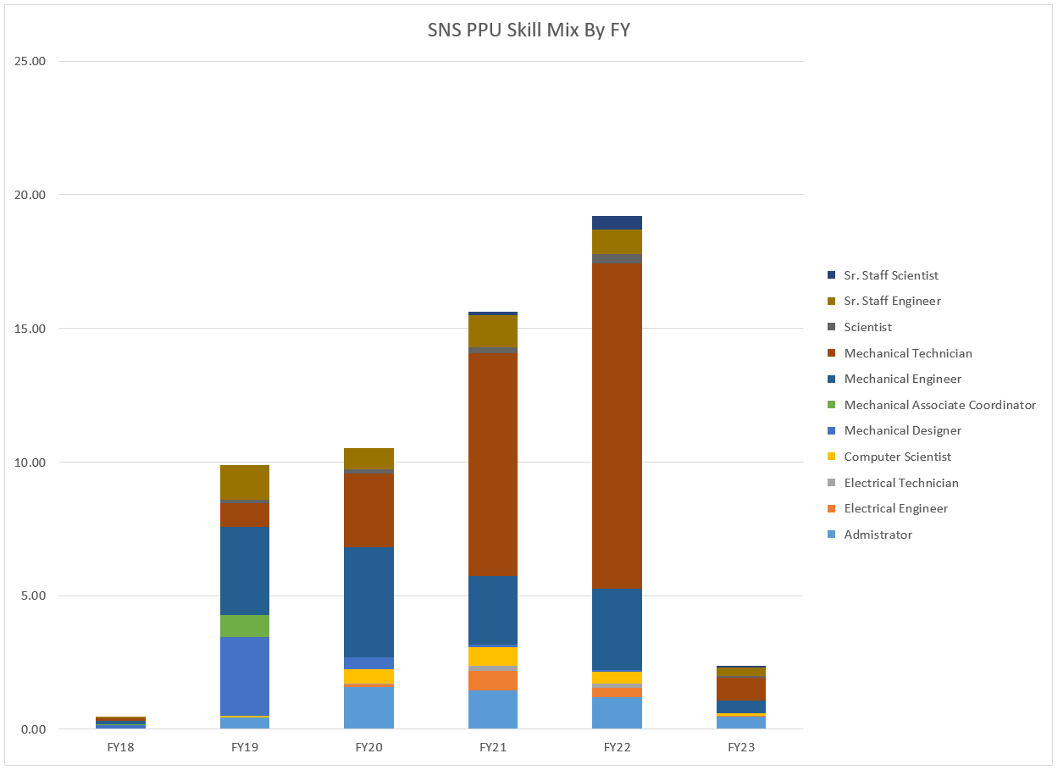
Labor Profile – Peaks at 20 FTE during FY 22
For comparison, LCLS-II (21 CMs, 4 yrs) averages 45 FTEs during full production
CM Assembly
Cavity Qual
Procurement
Design

Slide 42
Summary
JLab Procurement Procedures will be used for all procurements
SOTR (subcontracting officer’s technical representative) system will be implemented for each procurement
The procurement process will look to obtain domestic vendors
Production rate and schedule are reasonable based on past CM production experience
Preliminary staffing levels are understood and have been integrated with best available information for other projects
The SRF Quality Management System will be used for the SNS PPU project (WCD, Metrics, QB, Reports and Dashboards)
Preliminary quality assurance plans and work control documents are being developed
A WBS has been implemented, CAMs have been assigned and cost for each phase have been estimated and loaded into the WBS
A comprehensive schedule has been developed in P6 and has been reviewed and published on the CAM Notebook

Slide 43
Thank You!
Questions?

