Slide 1
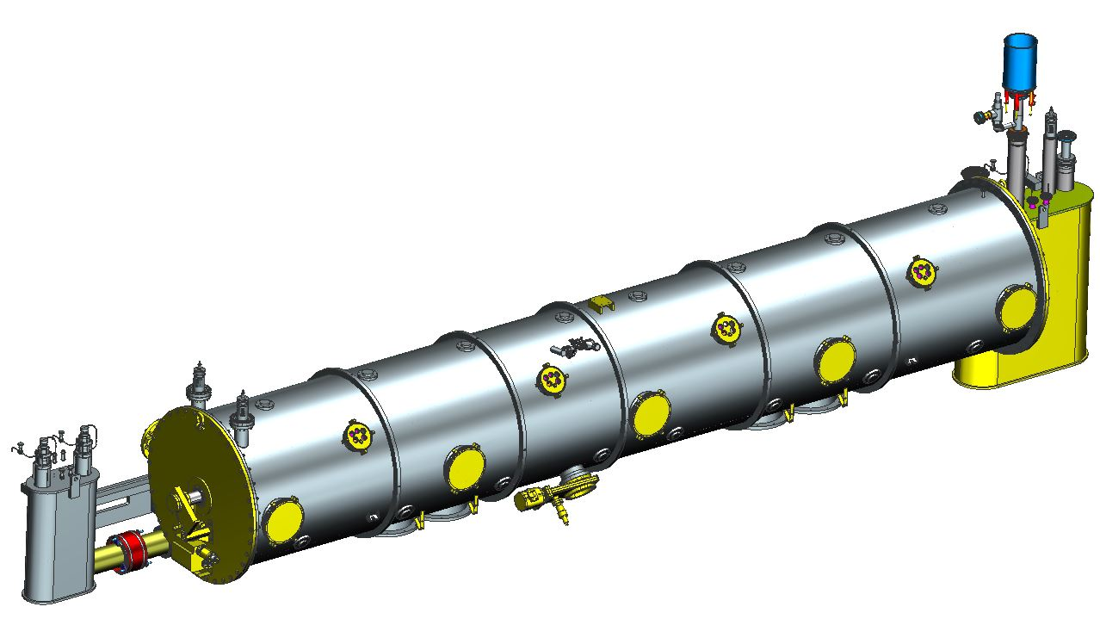
SNS PPU CRYOMODULE FDR
Cryomodule Assembly Plan
This talk will be mostly tooling focused
Other talks cover more in depth assembly processes
Kurt Macha

Slide 2
Outline
Four major workstations
Work station #1 Clean Room Assembly (earlier talk by K. Wilson)
Work station #2
Cold Mass Assembly
Thermal Shield/Space Frame Assembly
Alignment
Insertion of cold mass into the vacuum tank
Work Station #3 Cryomodule Final assembly
End can assembly
Top hat assembly
Work station #4
Test cave thermal cycle and checkout
Tooling is at PDR status, will progress over the next few months toward final design. Will show current status of tooling.
Majority of the assembly plan is based on the original SNS CM build
The end can assembly will be different due to the new CM design.

Slide 3
Recommendations and Comments
R7 | Develop conceptual designs for cleanroom and assembly tooling. | CLOSED | This has been done and will be presented at the FDR. [Clean Room and Cryomodule Assembly talk]
C11 | Consider CAD demonstration of cleanroom-to-spaceframe tooling interfaces. | CLOSED | This has been done and will be presented at the FDR. [Cryomodule assembly talk]

Slide 4
Cryomodule assembly floor layout
Work station #1
Clean room
Assembly
Work station #4
Thermal cycle
testing and checkout
Work Station #3
End Can assembly
to the vacuum vessel
Work Station #2
Vacuum vessel
assembly

Slide 5
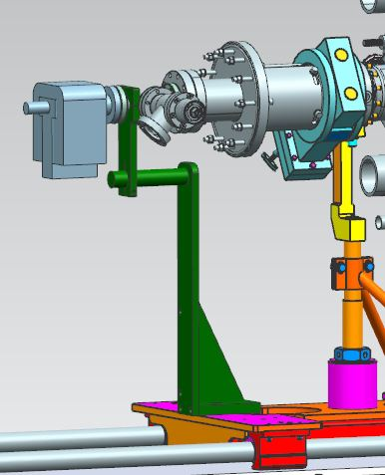
Cavity string transfer from the clean room
Recommendation #7
The cavity string assembly will be transferred from the clean room to a fixed high bay rail for further assembly.
An ion pump will be used to maintain vacuum and monitor pressure through out the assembly process.
The ion pump weight will be supported to the end lollipop carriage.
Ion pump support
Cavity string as transferred
from clean room

Slide 6
Work station #2
Recommendation #7 and Comment #11
Ion pump support
Space frame tooling
Lollipops as used for
first SNS build, ready for
removal at this stage of assembly
Cold mass assembly will be assembled using the same tooling as the original SNS build
The ion pump support from the lollipop will be transferred to the spaceframe for insertion into the vacuum vessel
Alignment using the one arm fixtures (Same process as original build)

Slide 7
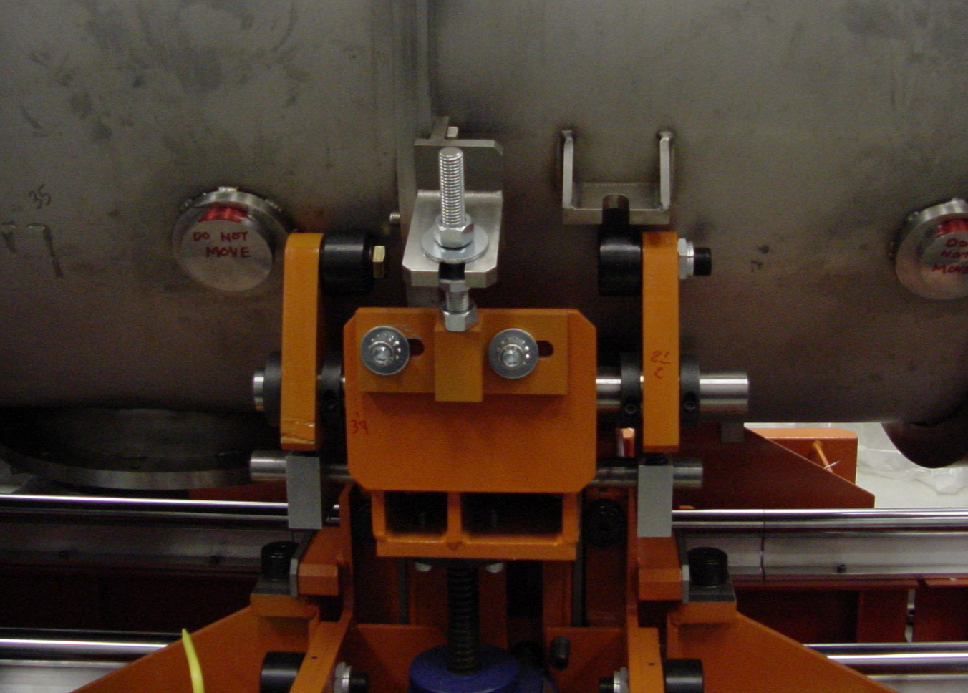
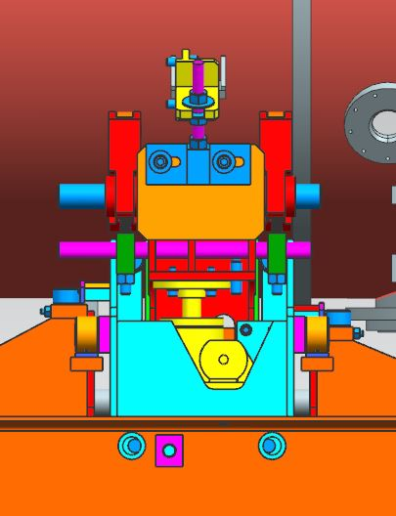
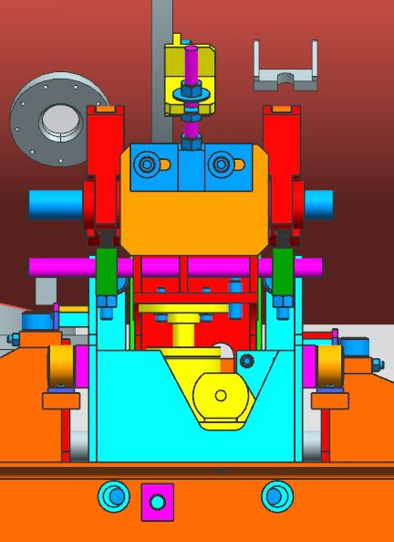
Work station #2
Comment #11
Tooling removed as CM is rolled into vessel
The original vacuum tank support will be used
A minor interference causing a modification for mounting (Left)
Repositioning the support with a new mounting bracket will easily resolve the interference (Right)

Slide 8
Work station #2
Align the spaceframe in the center of the vacuum vessel
Investigating differential screws for fine adjustment (Talked about in earlier talk)
Install and secure all lockdowns
Crane the vacuum vessel assembly to the next work center, install saddles and set the assembly on concrete blocks for proper work height
Center BL Flange
To Vacuum Vessel
Flange

Slide 9
Work Station #3
Recommendation #7
The cryomodule shell sub-assembly will be staged on blocks for appropriate work height.
The end cans will be mounted on tooling that is installed on rail carts for easy maneuverability.
Clear access for top hat assembly

Slide 10
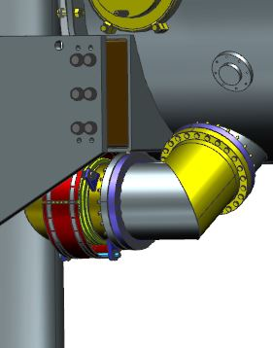
Work station #3
Recommendation #7
The end can rail cart rails are set perpendicular to the vacuum vessel for in and out adjustment. (Use Jig)
Three point adjustment for setting of height and plumb.
Support fixture allows fine swivel adjustment.
We have a draft assembly procedure. Tooling was designed around this plan.
Mounting block
New rail cart
design
Rotatable flanges
Simple jig used to
locate cart in relation
to the shell

Slide 11
Work station #3
Recommendation #7
Same assembly process used for both end cans
Same adjustment
Fixture design used for both End Cans
Existing rail
cart

Slide 12
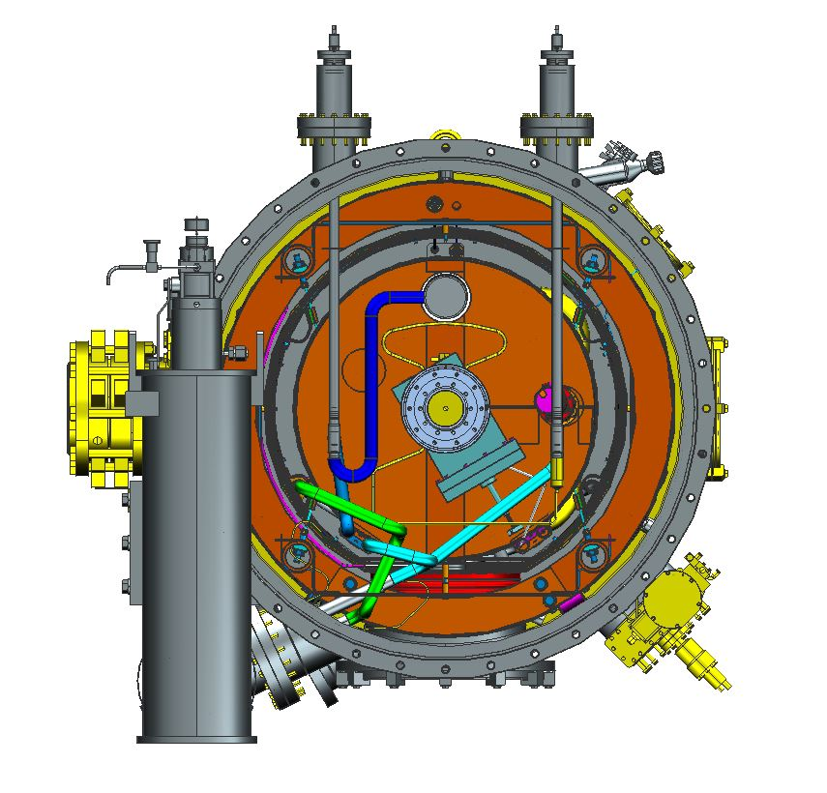
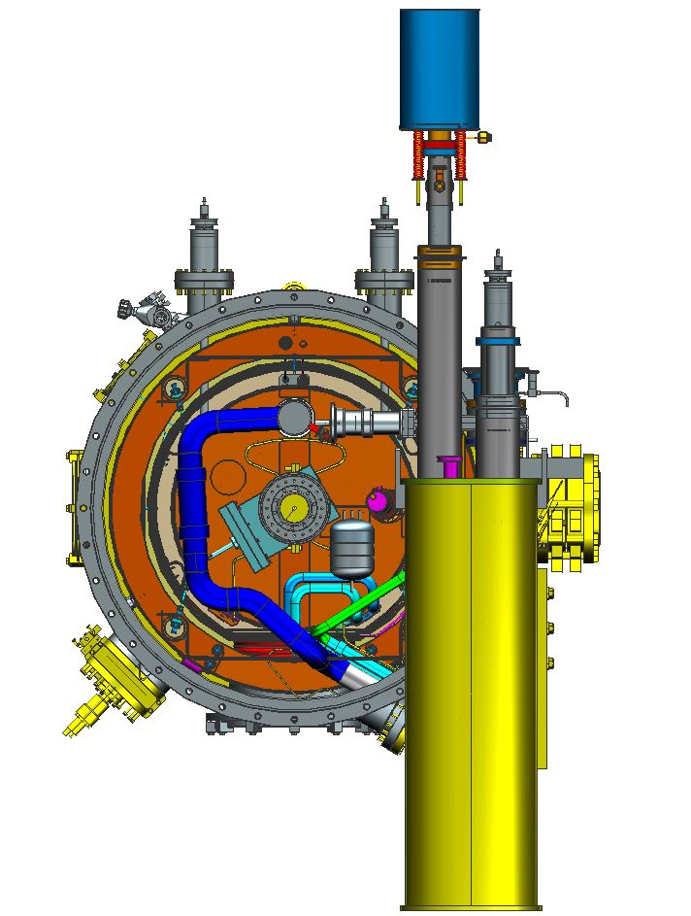
Work station #3
Install 2k, 4k, coupler and shield piping.
Leak test 2k, 4k, coupler and shield piping
Install end cap thermal shield, Mu shielding and MLI.
Install the VV end plates
Close up the top hat areas
Supply
End Can
Return
End Can

Slide 13
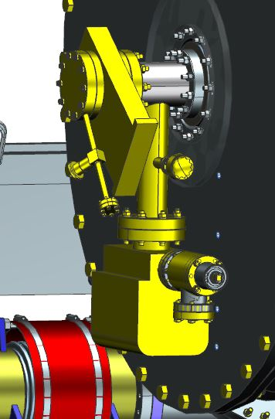
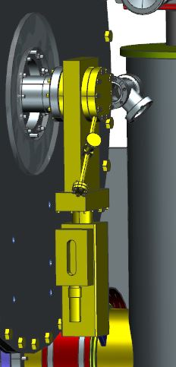
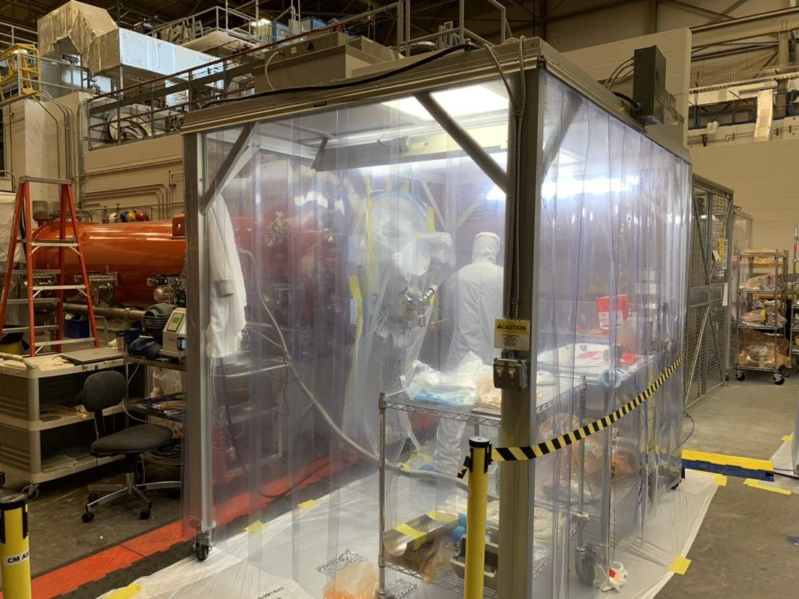
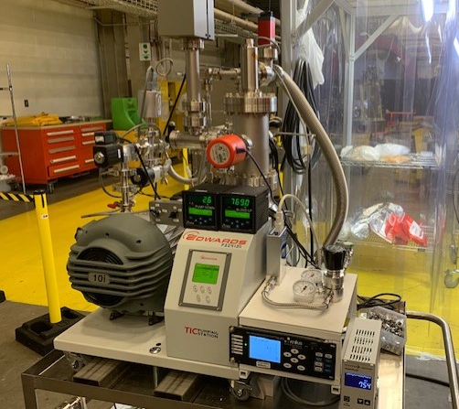
Work station #3 Warm to cold beamline assembly
Install the final beam line sections using portable clean room work spaces
Extra precautions to ensure reduced particulate.
Slow pump and slow backfills will be done using improved equipment and procedures

Slide 14
Work Station #3
Close all vacuum shell ports
Parallel plate reliefs, blank flanges, burst disk, instrumentation ports, pump gate valve and vacuum monitoring manifold.
Pump and leak test vacuum shell
Testing of internal piping
Access port
blank flange
Instrumentation
port
Parallel plate relief
Burst disk
Gauge manifold
Pump out valve

Slide 15
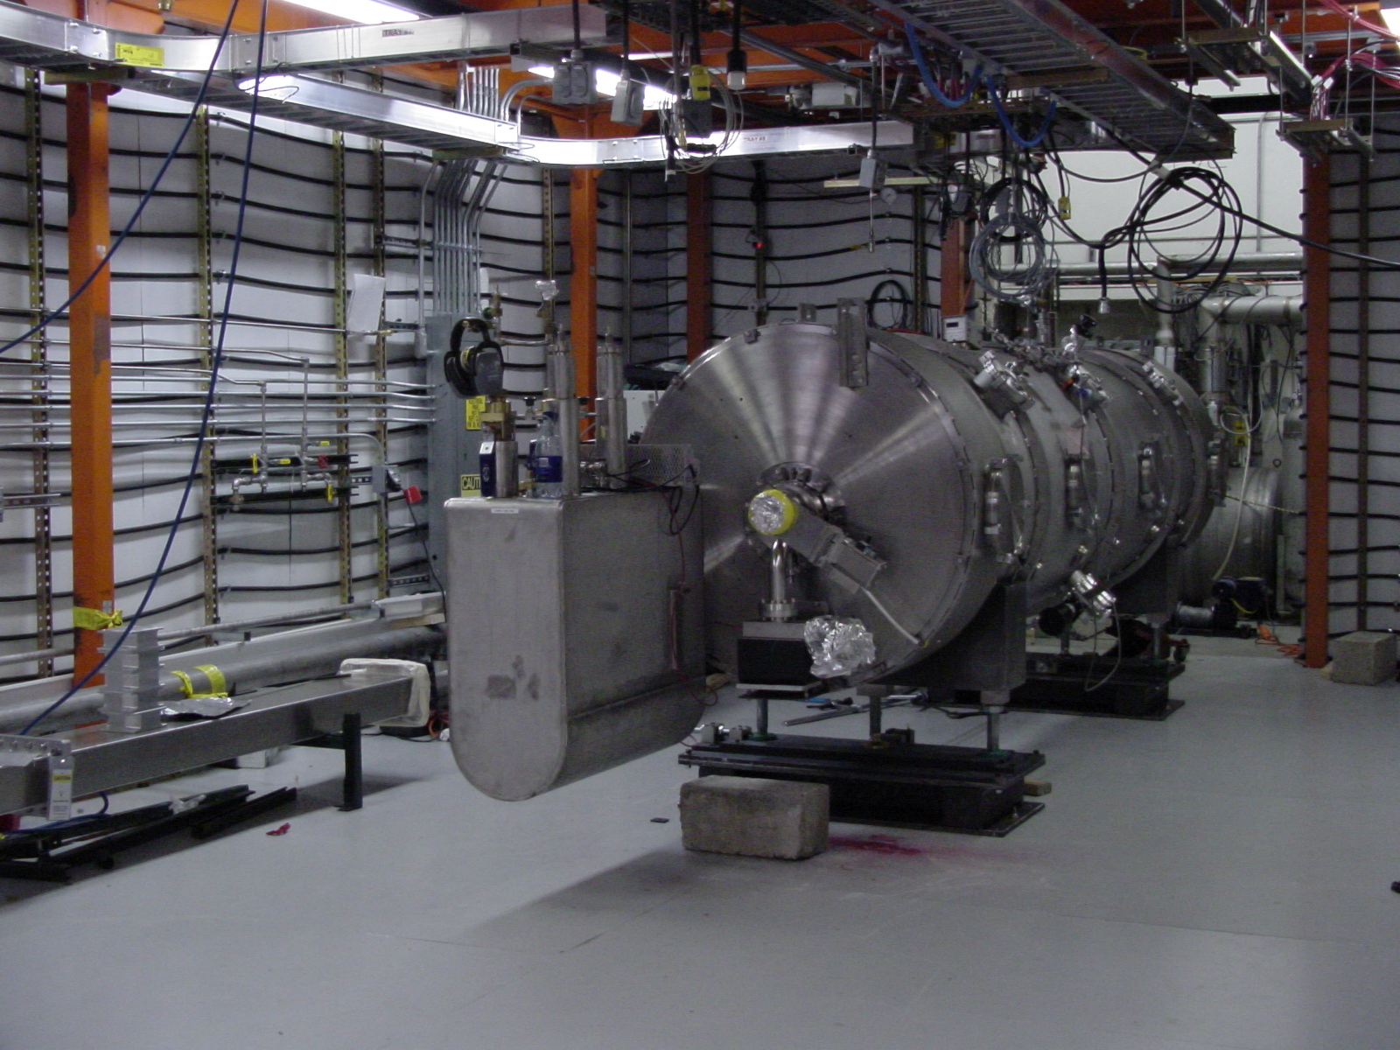
Work station #4
Cryomodule test cave will be used for thermal shock testing
Instrumentation checkout
Existing U-tube pipes will need modification to accommodate the new end can design
Cryomodule rolling carts need modification due to new end can designs.

Slide 16
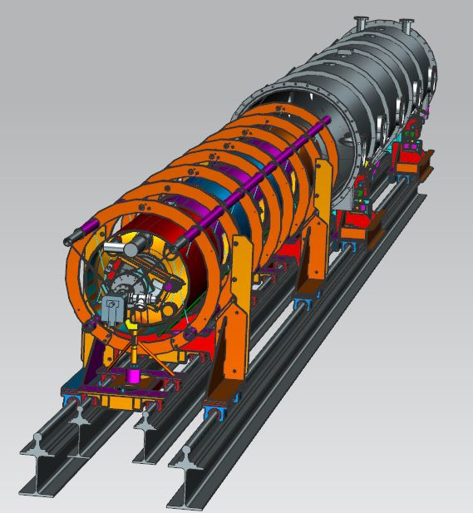
Summary
Kurt Macha
macha@jlab.org
Many of the same assembly processes to the first SNS build
Work station 3 resulting in the most difference due to end can design.
New assembly processes
New tooling for end can assembly
Extra care will be taken to support the temporary Ion pump weight during assembly
Work station 4
Cryomodule rolling cart will require modifications
U-tube modifications

