Slide 1
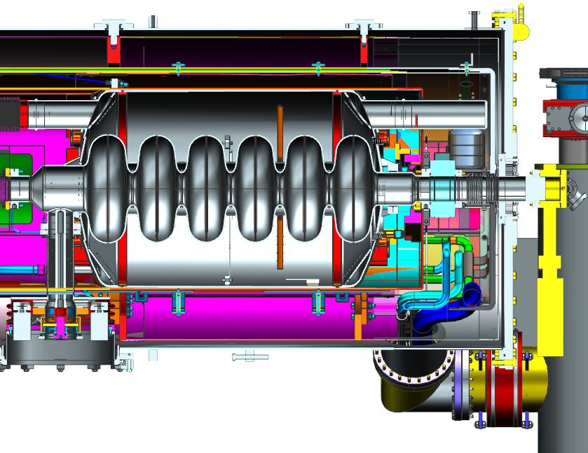
SNS PPU CRYOMODULE FDR
SNS PPU Cryomodule Instrumentation
Peter Owen

Slide 2
Outline
Instrumentation Overview
Changes for PPU
Updates since PDR
Response to Recommendations & Comments Items
SOW & Procurement Plan

Slide 3
Instrumentation Overview
Cernox temperature sensors
Field Probe cable
Heaters
Liquid level probes
Instrumentation port flanges
Vacuum vessel pressure sensors
Helium circuit pressure transducers*
FPC instrumentation*
*Final parts provided by SNS

Slide 4
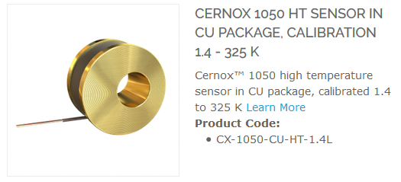
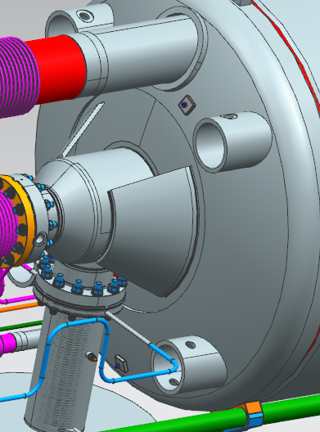
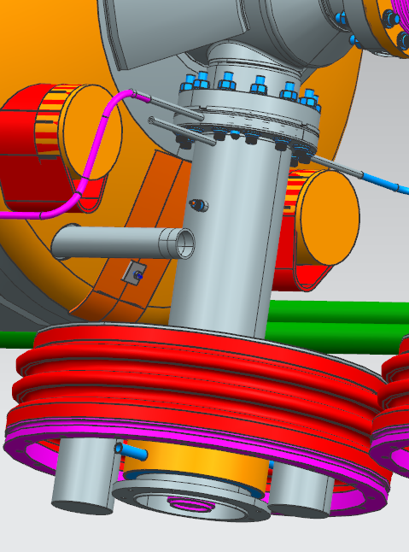
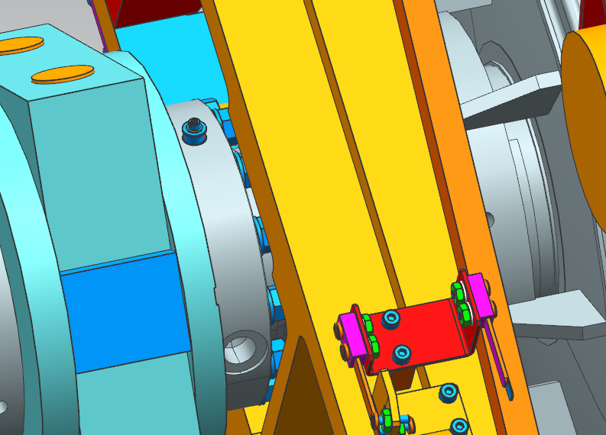
Cernox Temperature Sensors - Cavity
Cernox Temperature Sensors (38 per CM)
CX-1050-CU-HT-1.4L
All mounted external to helium circuits
Cavity, helium vessel & FPC (6 per, 24 total)
Helium Vessel (low and high), FPC Flange, Beam Pipe, FPC 1/3 from end (x2)
Sensors through J2 feedthroughs on instrumentation ports (slide 9)
He Vessel High
FPC flange
Beam Pipe
He Vessel Low
FPC body (x2)

Slide 5
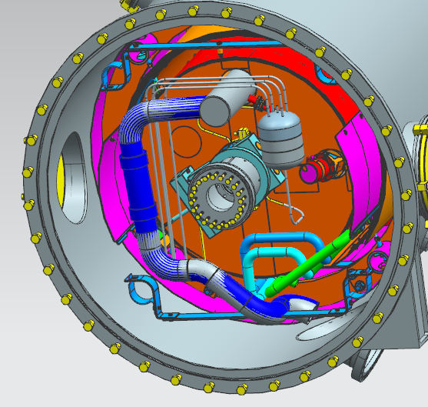
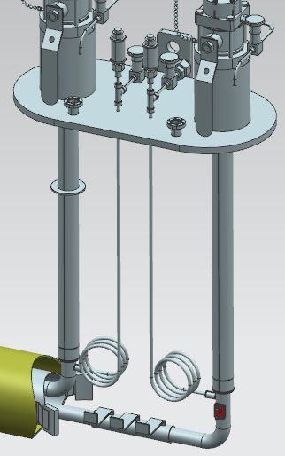
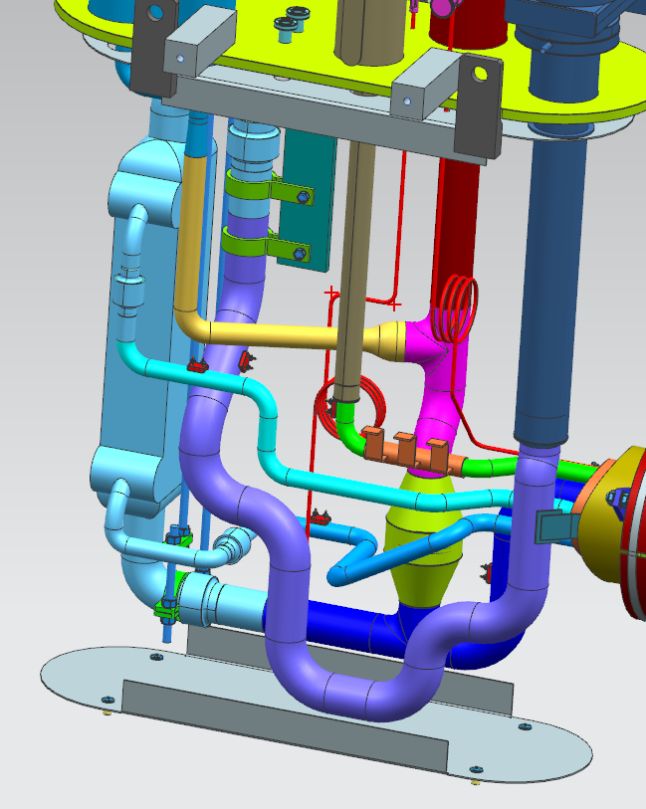
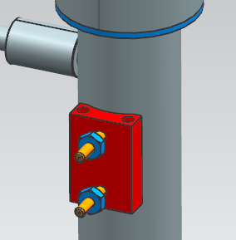
Cernox Temperature Sensors – End Cans
Cernox Temperature Sensors (38 per CM)
Surge Tank (2 total)
Surge tank sensors through J23 feedthroughs on instrumentation port #1 (slide 9)
End Cans (12 total)
Supply End Can (shield inlet) x 2
Return End Can (HX HP inlet & outlet, HX LP inlet & outlet, shield outlet) x2
10 Pin CF feedthroughs on end can top plates
Surge tank
HX LP outlet
(2) 10 pin feedthroughs on CF
(1) 6 pin feedthrough on CF
HX HP inlet
Shield
exit
HX HP outlet
Shield
supply
HX LP inlet

Slide 6
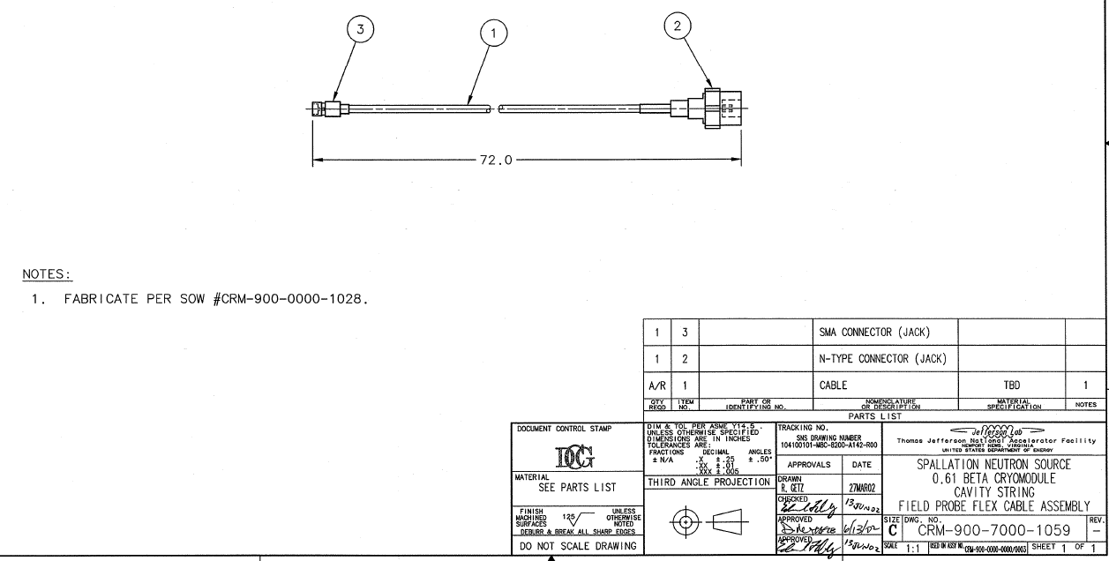
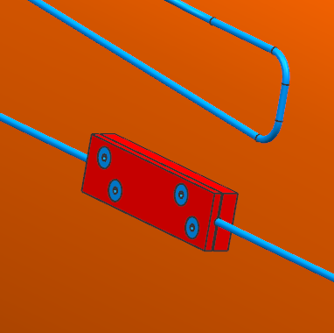
Field Probe Cable
SNS provides the field probe with the cavities
Will use original SNS design for cable
72 inches long, CRM9007000-1059
SOW CRM9007000-1059 exists but need to remove reference to HOM cables
Type N connector at warm end on instrumentation port (J6)
Gore Phaseflex cable
0XN01R010720
FP cable through J6 feedthroughs on instrumentation ports (slide 9)
FP Cable heat sink
on thermal shield

Slide 7
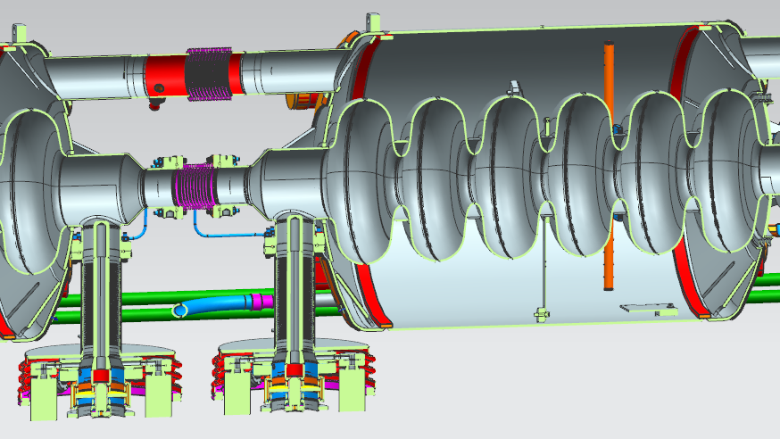
Heaters
One 100 watt heater in each helium vessel
Kapton foil type heater mounted on G10 plate
Two heaters through each 8 pin cryogenic feedthrough
Between cavities 1&2, and 3&4
Through J1 feedthrough on instrumentation ports (slide 9)
8 pin feedthrough for two heaters between cavities
Cavity 1 Heater

Slide 8
Liquid Level Probes
Two liquid level probes in helium vessel #1
Single 8 pin cryogenic feedthrough on helium vessel exit
Single 10 pin feedthrough on top of vacuum vessel near return end flange
Mini CF port for 10 pin feedthrough
8 pin feedthrough in return header
Liquid Level Probes

Slide 9
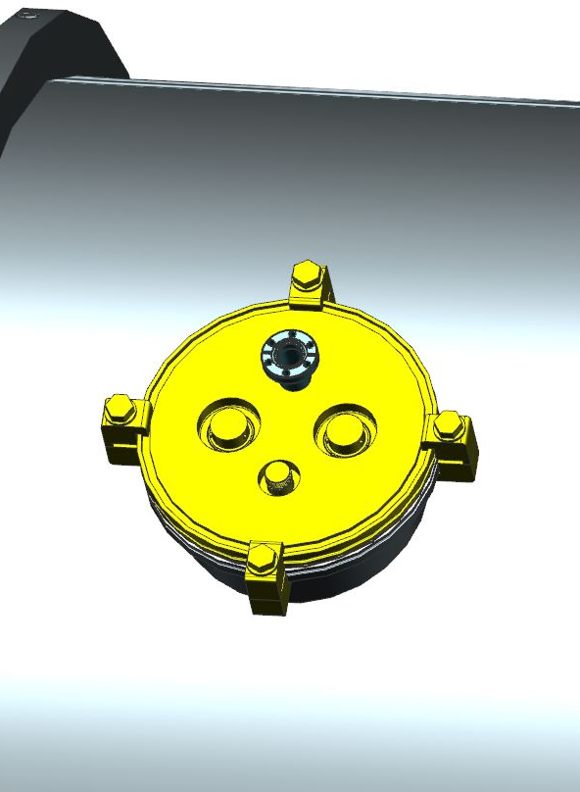
Instrumentation Flange
Port #4
Port #3
Port #2
Port #1
One instrumentation port per cavity/helium vessel
Port 1 only, Surge tank CERNOX diodes, 6 pin feedthrough on mini CF
Ports 2-4 blank flange
J23
Cavity/helium vessel & FPC CERNOX
diodes
19 pin feedthrough
J1
J2
Heater, Tuner motor and limit switches
19 Pin feedthrough
J6
Field Probe (Type N)

Slide 10
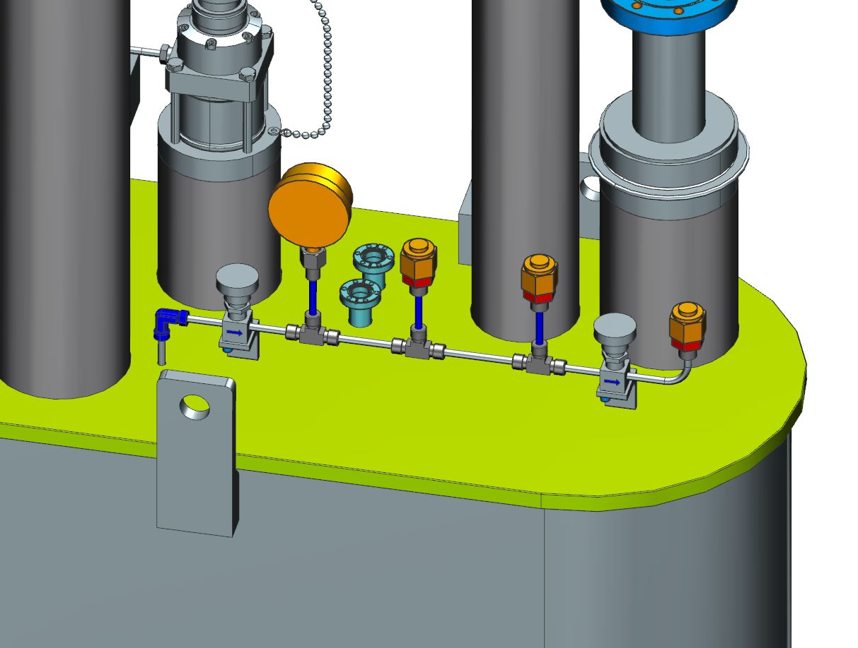
Instrumentation Feedthrough
(1) 6 pin feedthrough on CF
(2) 10 pin feedthroughs on CF
Vacuum Pressure Gages
Port #5
Liquid He Level
J8

Slide 11
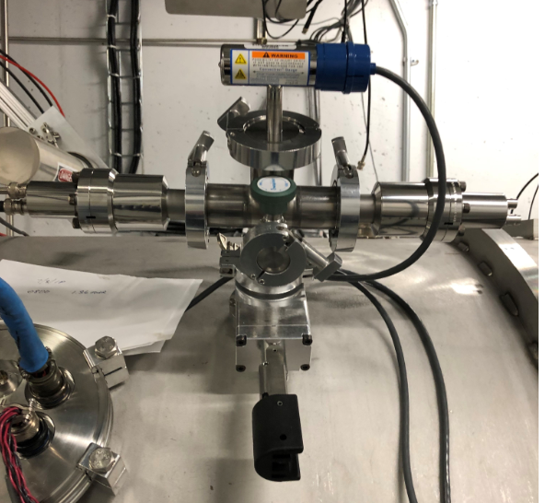
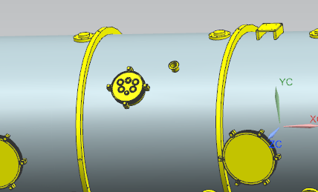
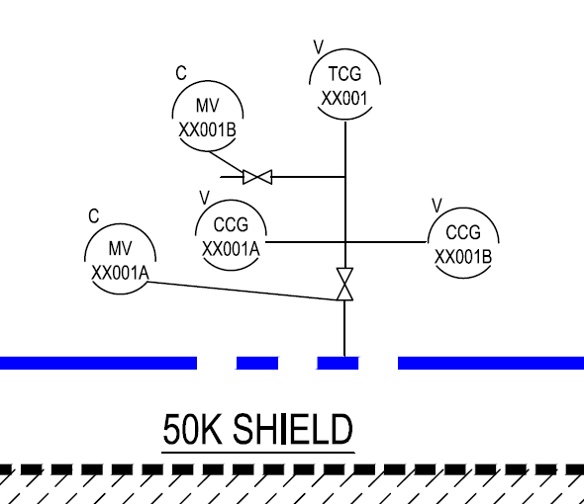
Vacuum Vessel Pressure Sensors
Cold Cathode Gauge (2)
Convectron Gauge (1)
Isolation and pump out valve
Mounted to NW 40 flange on vacuum vessel
All JLAB supplied
Port 5 (NW 40)
Pressure manifold at SNS
Ref. P&ID
R8U-8200-P001r0

Slide 12
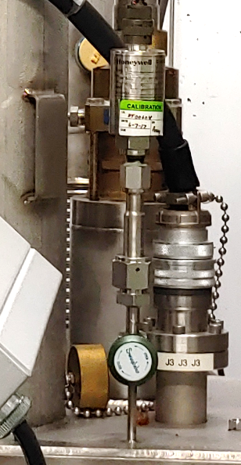
Pressure Transducers
Three on end cans (supplied and installed at SNS)
High and low pressure for primary circuit
Surge tank pressure
30/30 dial gauge and mounts for transducers (Supplied and installed by JLab)
a b c c a d
Typical sub atmospheric pressure transducer manifold
Isolation valve
30/30 dial gauge
Low and high pressure transducer with VCR connectors
Pump out port with VCR
Surge tank Honeywell transducer with VCR adaptor

Slide 13
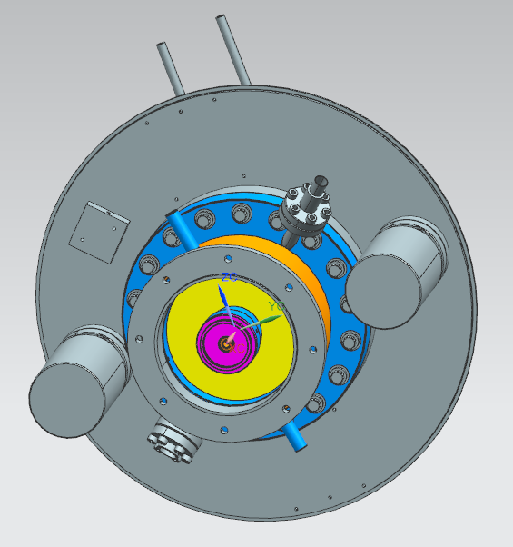
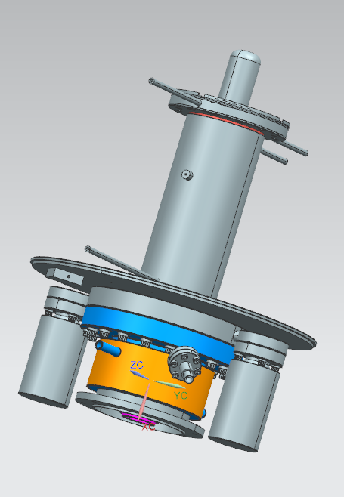
FPC Instrumentation
All supplied by SNS
Additional instrumentation installed at SNS on air side components
Thermocouple (x2) and thermal
switch
Heater assembly (x2)
Electron Probe
Cold Cathode
Gauge (x2)
Thermocouple
on exit cooling tube
Window for Arc Detector

Slide 14
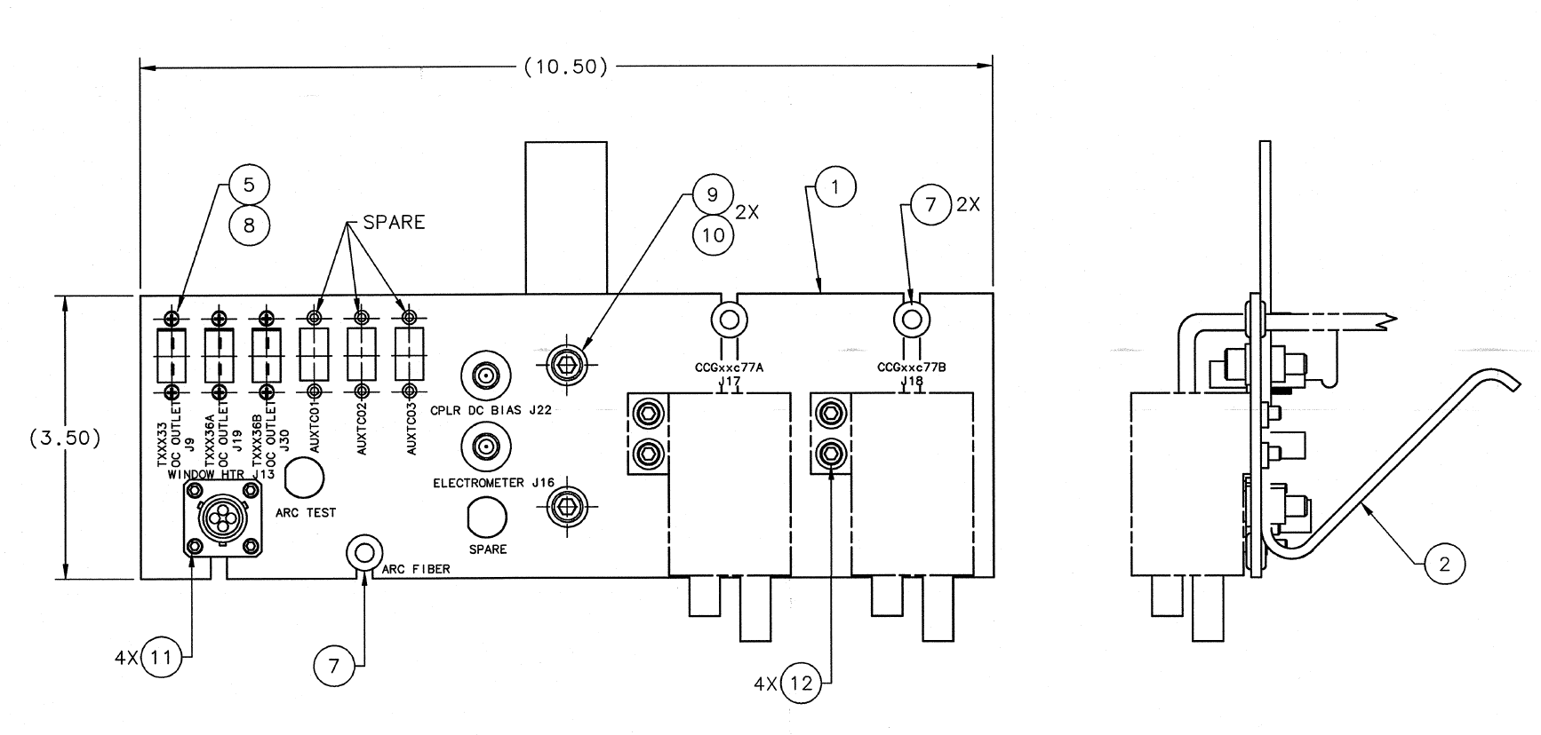
FPC Instrumentation Panel
Support for FPC instrumentation connectors
Plate and connectors - Jlab
Sensors and wire - SNS
CRM-900-1000-000

Slide 15
Changes for PPU
Changes relative to the HB spare module
Will use all Cernox temperature sensors, radiation durability (CX-1050-CU-HT-1.4L)
Added threaded mounts for the temperature sensors on the helium vessel, mechanical mounts for the end can
Eliminated the HOM connections on the four instrumentation ports
Changed one port to a mini-CF connection for the surge tank temperature sensors on Port 1
Ports 2-4 will have a blank flange

Slide 16
Updates since PDR
Researched current vendors and part numbers
Updated drawings with current schematics and part numbers
CM Wiring Diagram
104212000-M8U-8200-A001
End Can Wiring Diagram
104212000-M8U-8200-A002
SNS High Beta Cryomodule Instrumentation & Control Interface Table updated
104210200-M8U-8200-A007
Instrumentation drawings are either signed off, or final checking

Slide 17
Updates since PDR
From the PDR Review in February

Slide 18
SOW and Procurement Plan
Create a SOW for Field Probe Cable (CRM9000000-1028)
Same as previous SOW, remove mention of HOM cables
Test FP cable with cryocycling
Begin writing requisitions for instrumentation when funds are available
Many items sole-source eg. Cernox - Lakeshore

Slide 19
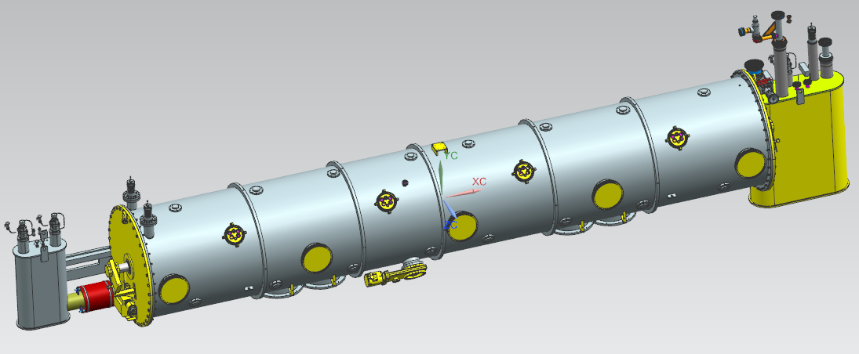
Peter Owen
powen@jlab.org
Instrumentation Overview
Changes for PPU
Updates since PDR
SOW & Procurement Plan

Slide 20
Backup Slides

Slide 21
CERNOX Temperature Sensors – Overview
Location | # CERNOX
Cavity (6 per) | 24
Surge Tank | 2
Supply End Can | 2
Return End Can | 10
Total | 38

