Slide 1
SNS PPU CRYOMODULE FDR
CRYOMODULE FINAL ASSEMBLY
Jim Henry

Slide 2
OUTLINE
This discussion will address the final cryomodule assembly.
The Spaceframe / Thermal Shield Assembly has been installed, aligned, and locked down.
The End Cans have been final aligned and installed.
Design requirements are the same as stated for similar components.

Slide 3
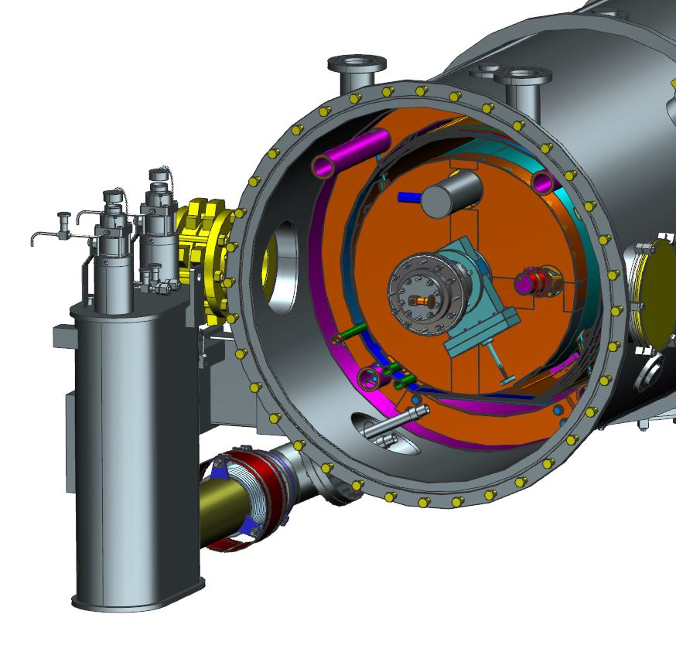
SUPPLY END – INITIAL CONFIGURATION

Slide 4
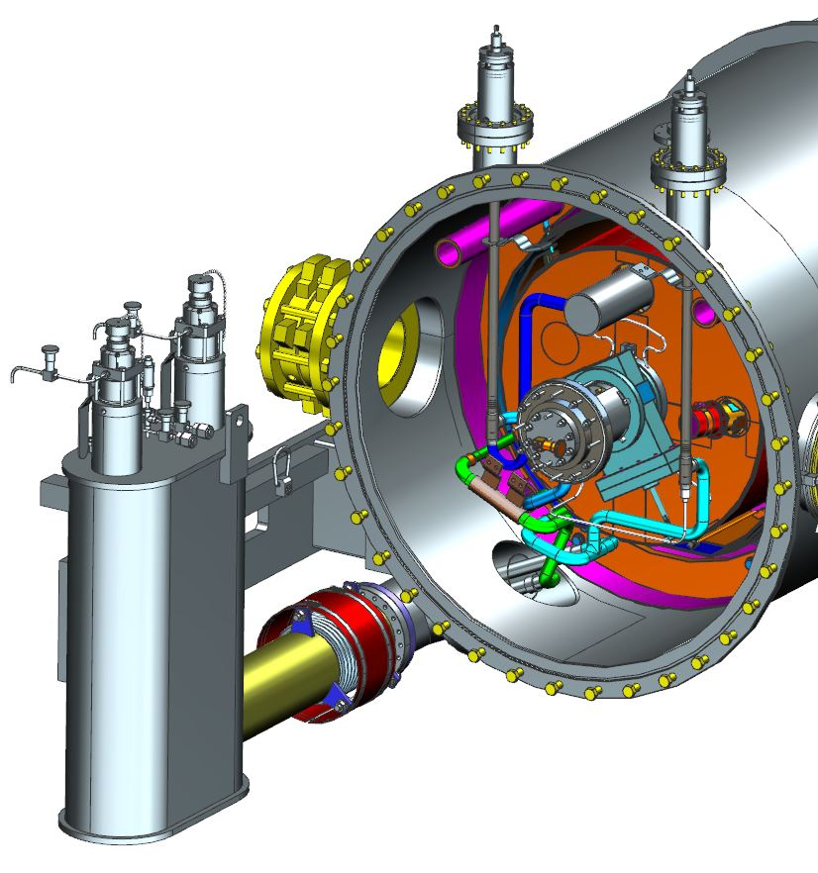
SUPPLY END FINAL ASSEMBLY STEP 1
PRIMARY JT VALVE
FLANGE / COUPLER JT VALVE
PRIMARY LHe SUPPLY
BEAMLINE THERMAL INTERCEPT
SHIELD
SUPPLY
HP He
FROM H/X
HP He
TO H/X

Slide 5
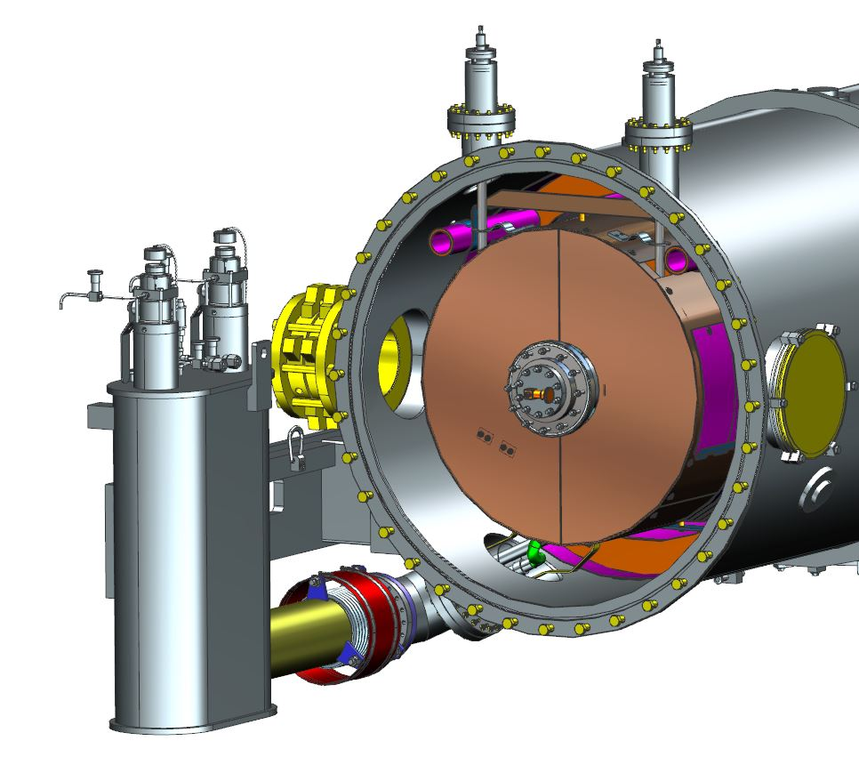
SUPPLY END FINAL ASSEMBLY STEP 2
Thermal shield
extension

Slide 6
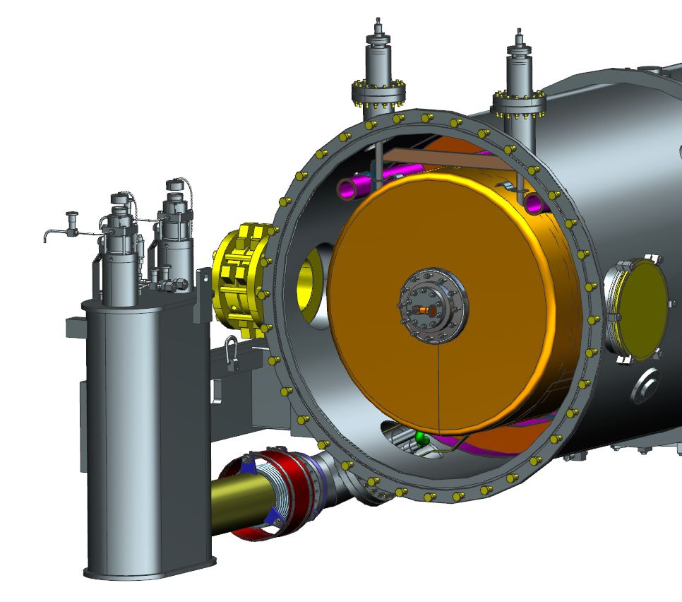
SUPPLY END FINAL ASSEMBLY STEP 3
Outer MLI

Slide 7
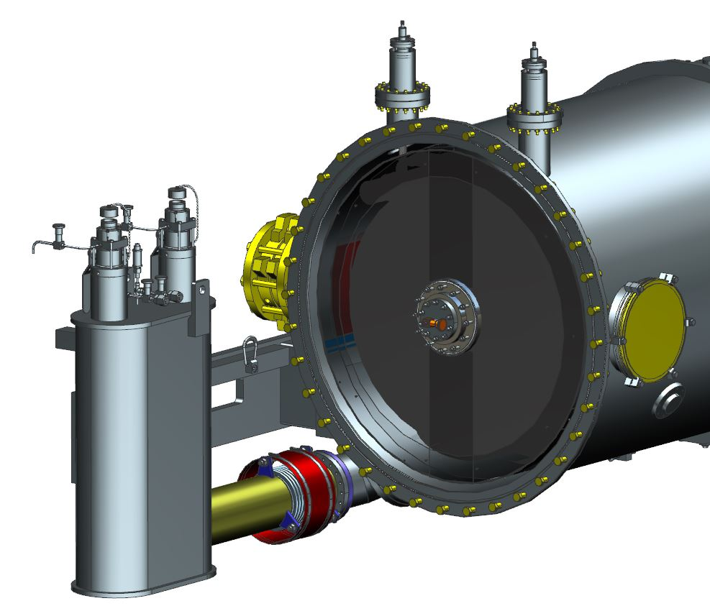
SUPPLY END FINAL ASSEMBLY STEP 4
OUTER MAGNETIC SHIELD EXTENSION

Slide 8
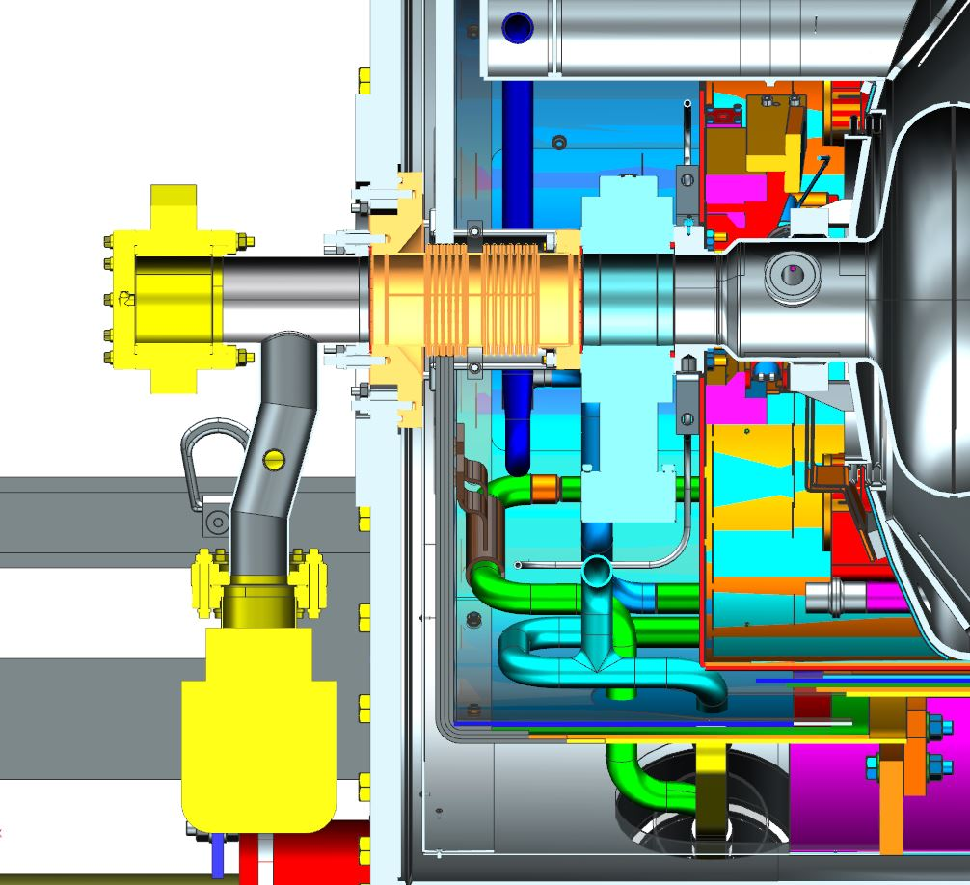
SUPPLY END FINAL ASSEMBLY STEP 5
WARM / COLD BEAMPIPE

Slide 9
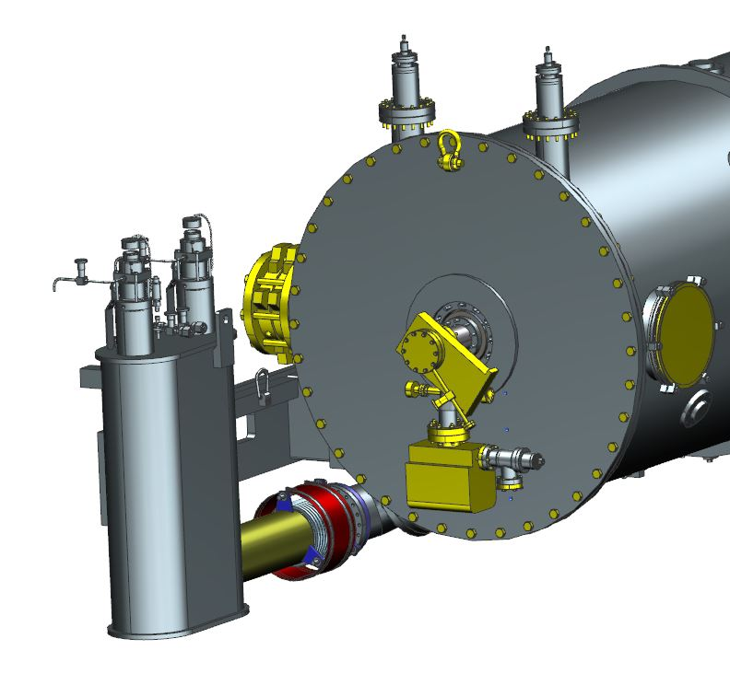
SUPPLY END FINAL ASSEMBLY STEP 5

Slide 10
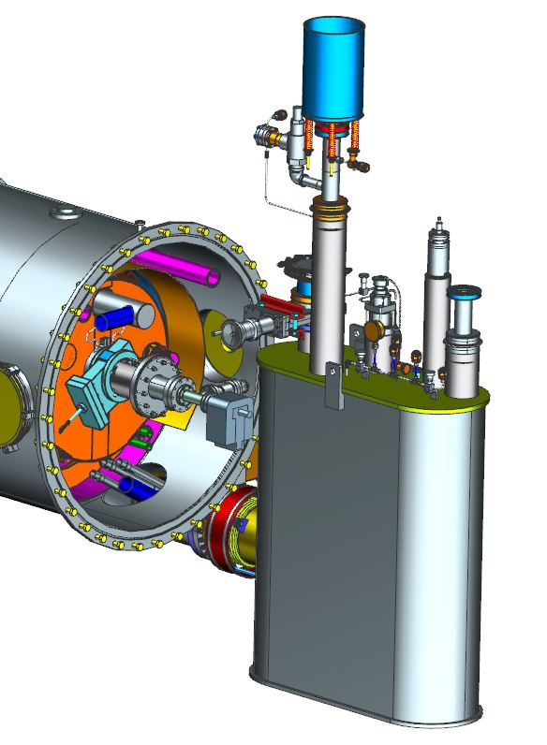
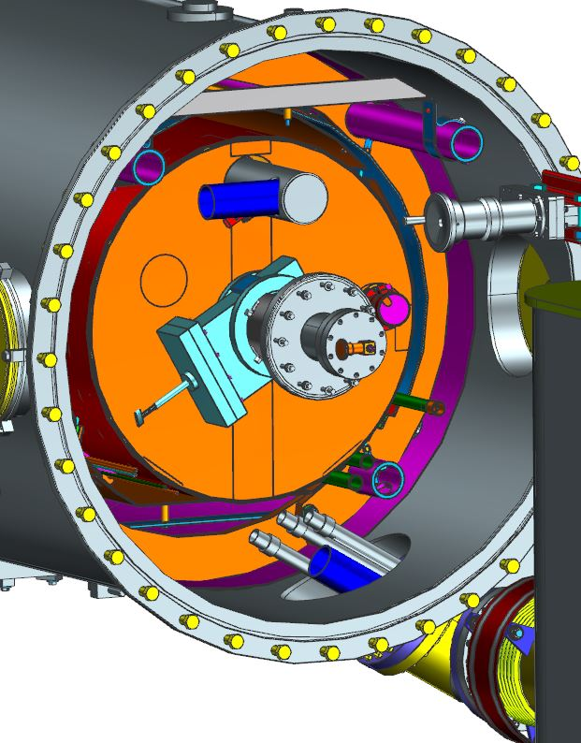
RETURN END – INITIAL CONFIGURATION

Slide 11
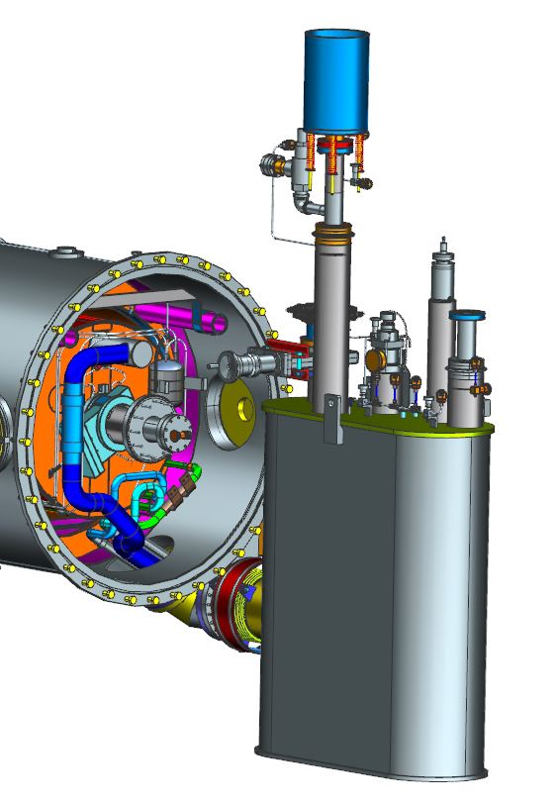
RETURN END FINAL ASSEMBLY STEP 1
BEAMLINE FLANGE
THERMAL INTERCEPT
PRIMARY 2K
RETURN
SURGE TANK
HP He FROM H/X
HP He TO H/X
SHIELD RETURN

Slide 12
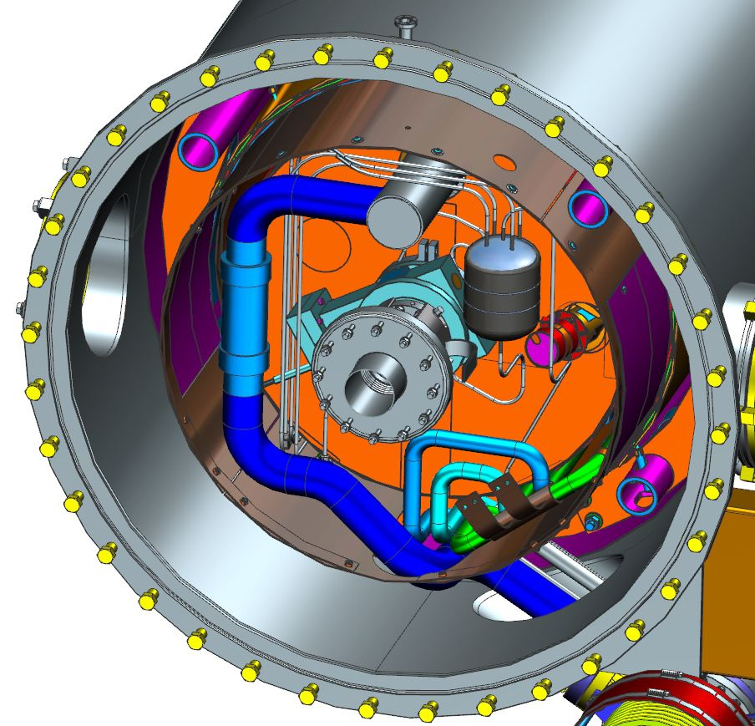
RETURN END FINAL ASSEMBLY STEP 1

Slide 13
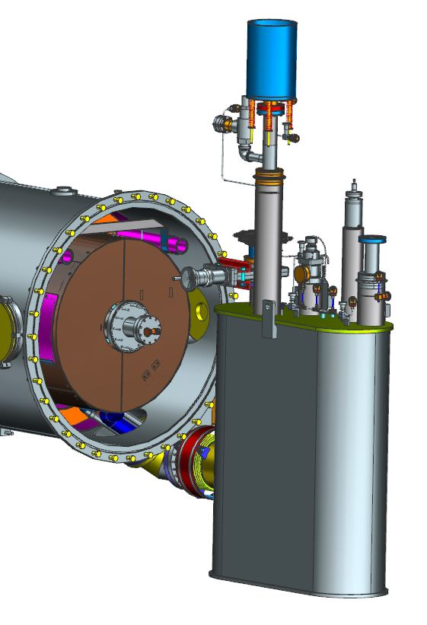
RETURN END FINAL ASSEMBLY STEP 2
THERMAL SHIELD EXTENSION

Slide 14
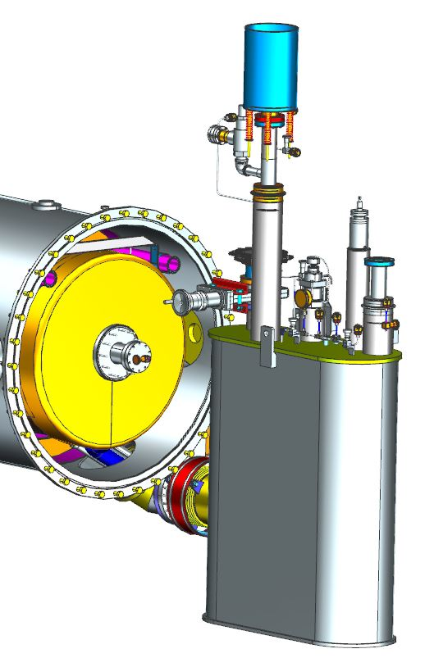
RETURN END FINAL ASSEMBLY STEP 3
OUTER MLI

Slide 15
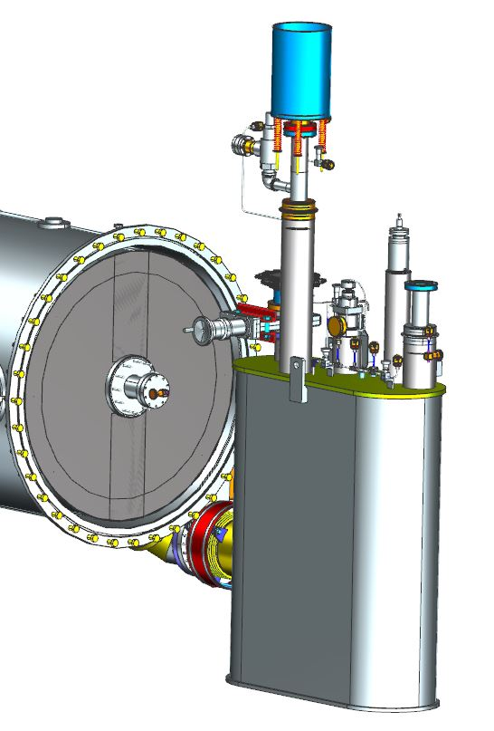
RETURN END FINAL ASSEMBLY STEP 4
OUTER MAGNETIC SHIELD EXTENSION

Slide 16
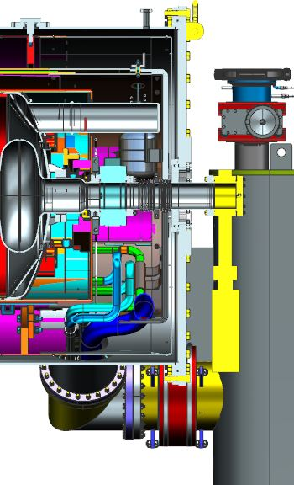
RETURN END FINAL ASSEMBLY STEP 5

Slide 17
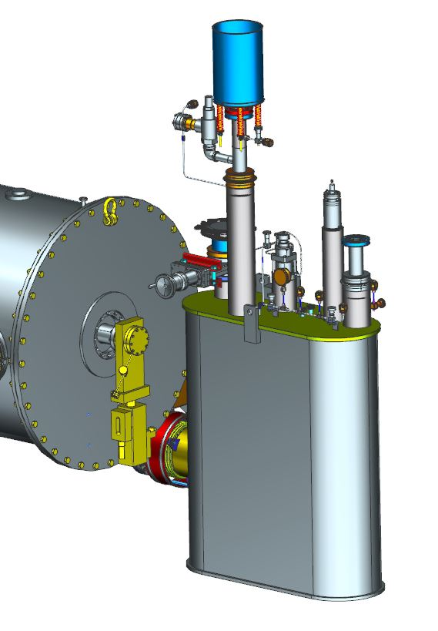
RETURN END FINAL ASSEMBLY STEP 5

Slide 18
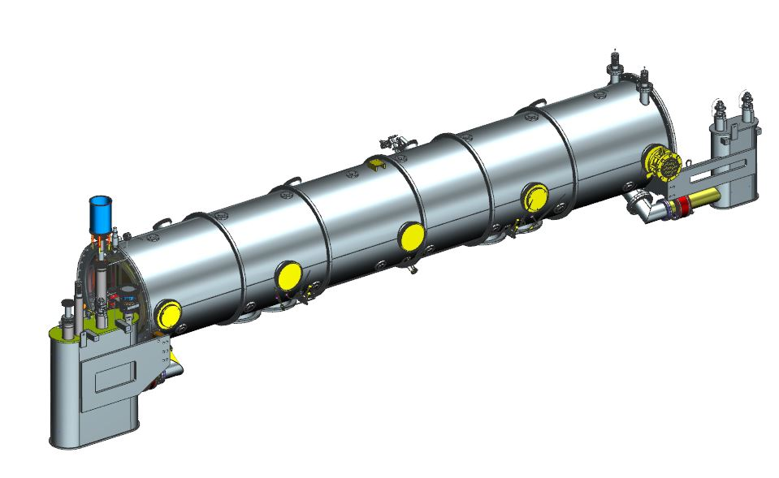
EXTERIOR ASSEMBLY
INSTRUMENTATION PORTS
INSULATING
VACUUM GAGES
ASME BURST
DISC
INSULATING
VACUUM VALVE
COUPLER OUTER
CONDUCTOR
COOLING RETURN
PARALLEL PLATE
VACUUM RELIEF
(X2)

Slide 19
SUMMARY
Thermal Shield Extensions, Magnetic Shield Extensions, MLI, and Warm / Cold Beampipe drawings are in final checking.
Piping detail drawings must be created.
Top assembly drawings must be created.

Slide 20
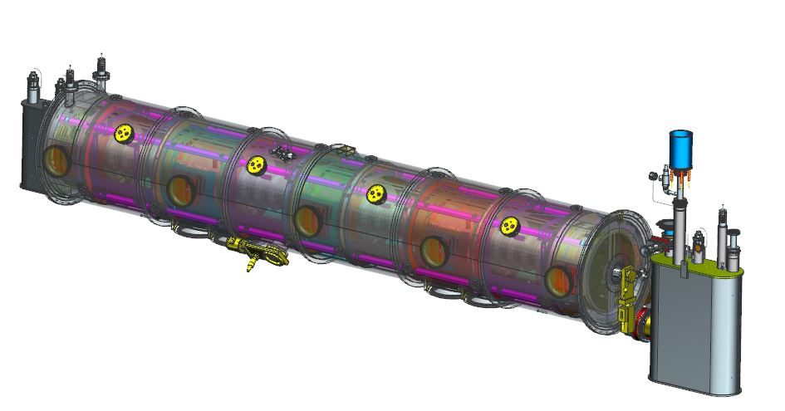
Questions?
Jim Henry
CRYOMODULE FINAL ASSEMBLY
THANK YOU FOR YOUR ATTENTION

