Slide 1
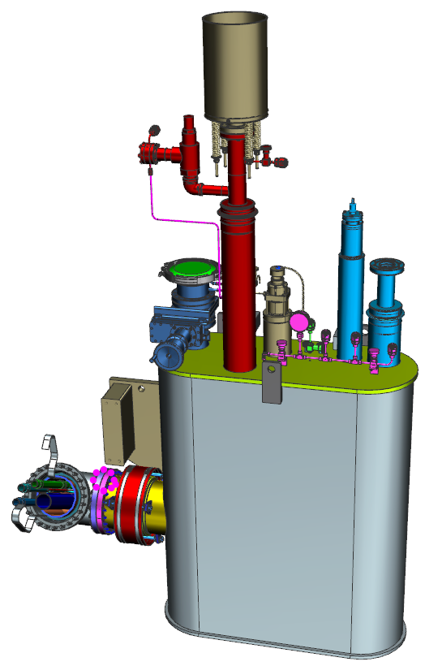
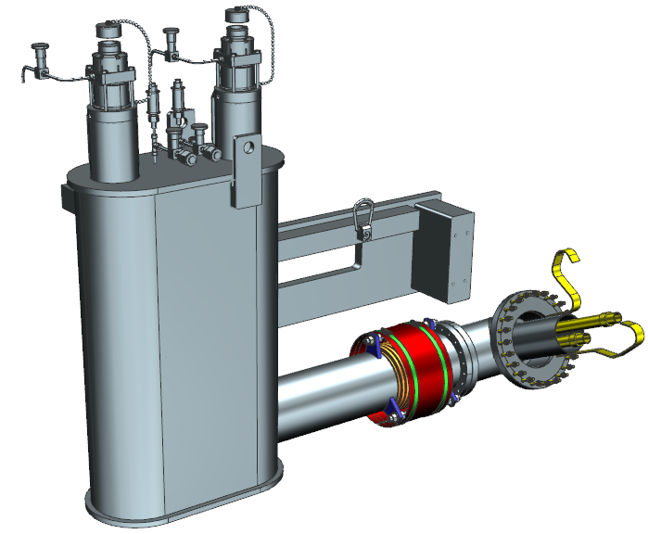
SNS PPU CRYOMODULE FDR
Supply and Return End Cans
Gary Cheng

Slide 2
Outline
Technical Requirements
Design Overview
Interface with Other Designs
Updates since PDR
Response to Recommendations & Comments Items
Engineering
SOW & Procurement Plan
Plans to Finish

Slide 3
Technical Requirements
Design, fabrication and testing of the supply and return end cans must meet ASME BPVC and B31.3 rules. ASME U-stamp is required for both end cans.
Design pressures and temperatures are detailed in the Engineering section of this report.
End cans shall be designed to be able to maintain structural integrity during shipping, while connected to the rest of the cryomodule, from JLAB to ORNL.
End cans, especially the return end can, should have features to facilitate alignment of the interface female bayonets with respect to the male bayonets on the insertion U-tubes.

Slide 4
Design Overview
The end can design is based on that of the SNS HB Spare Cryomodule.
Both end cans adopt obround cross section vacuum shell. The shape and dimensions of the shell are kept consistent with SNS HB Spare Cryomodule End Cans.
On the bridging/interconnect tubes, bellows and companion flanges are added to permit alignment adjustments.
In the return end can, the heat exchanger position and thermal shield geometry are slightly adjusted to increase the clearance between the 50K and 2K objects.
Engineering work is conducted to verify that the cryogenic pipes and welds can withstand thermal and mechanical loads during cool down, pressurization and transportation.

Slide 5
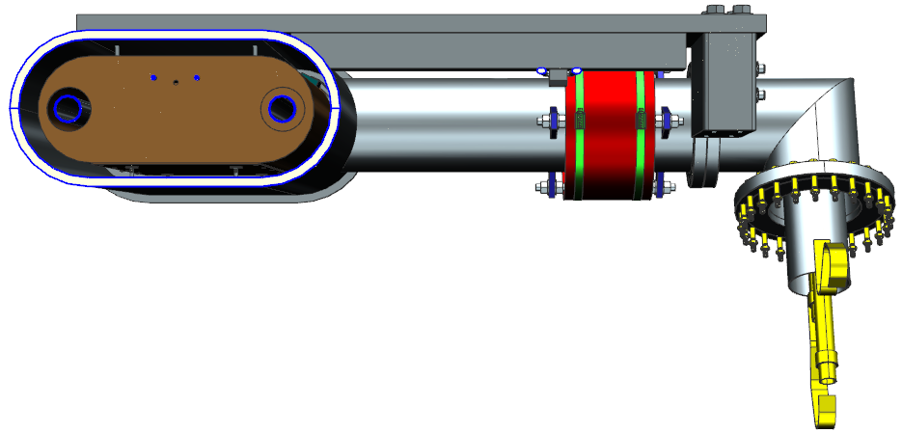
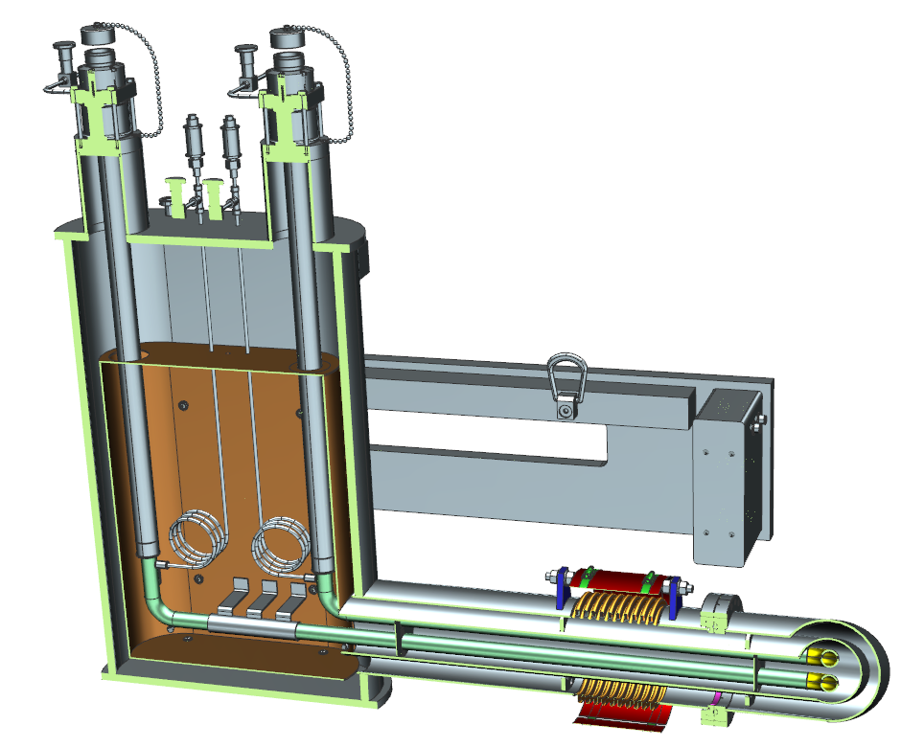
Design Overview – Supply End Can Pictorial View
Obround cross section vacuum shell
Bellows and o-ring sealed flanges for alignment

Slide 6
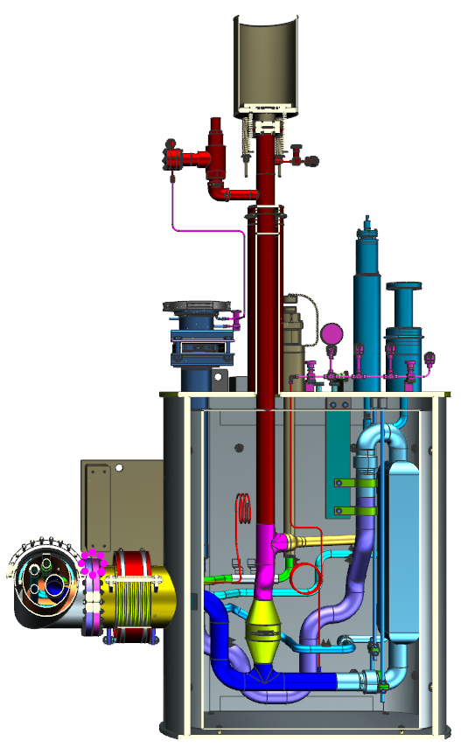
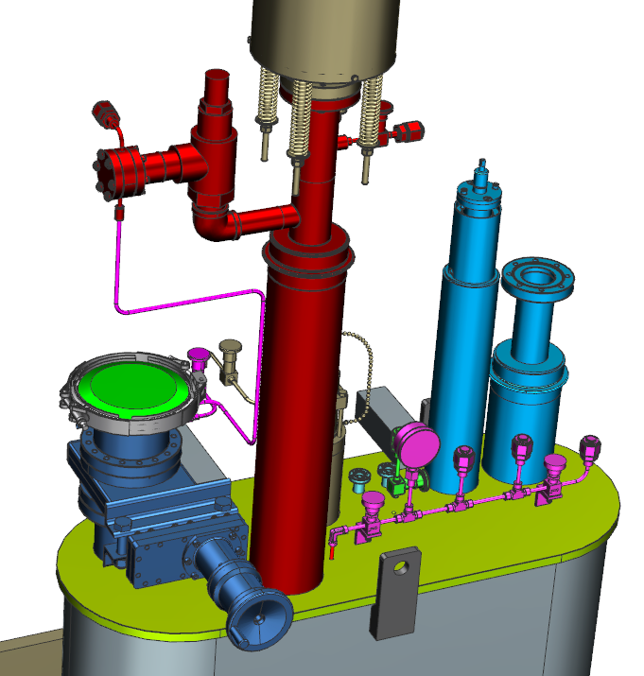
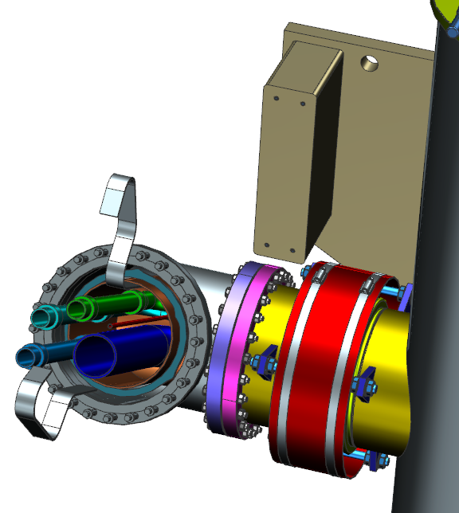
Design Overview – Return End Can Pictorial View
RXSO ASME relief valve
30/30 pressure gauge
Support block with jacking screws

Slide 7
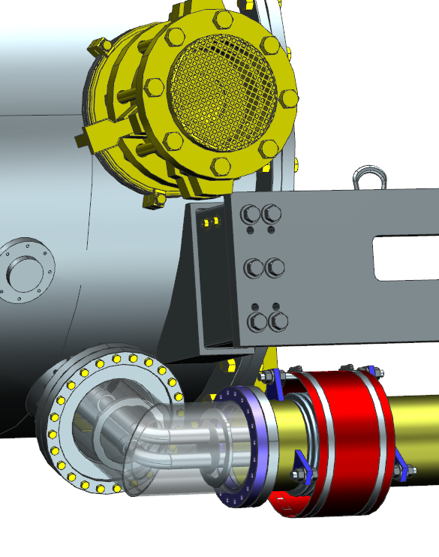
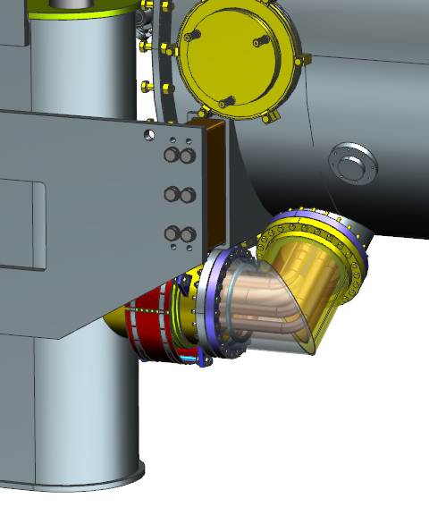
Interface with Other Designs
The end cans connect to the cryomodule’s main body in similar manner, i.e. one welded joint and one flange connection.
Connection cryogenic pipes are hosted inside the bridging tubes.
Supply end can has two connection cryogenic pipes and return end can has 5. Pipes will be marked to ease identification during assembly.

Slide 8
Updates Since PDR
Cryogenic pipe flexibility and shipping load analyses are carried out. More details will be given in the Engineering section.
According to the flexibility analysis, rigid connections between the bridging tube’s thermal shield and obround box’s thermal shield shall be avoided, especially for the REC.
Make sure there is a clearance between the tubular and box shields
Use braided copper wire instead of solid copper straps.
Planned changes in the end cans are now implemented. There are a few changes that were not introduced during the PDR. A list of end can changes are attached as back up slides.
Drawing packages are prepared and being signed off.

Slide 9
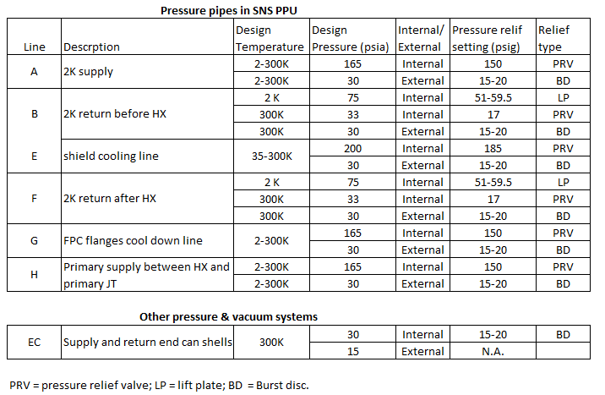
Engineering – Pressure System Requirements
Pressure system design parameters
Code compliance: ASME B31.3, normal fluid service

Slide 10
Engineering – Shipping Loads for Design
Shipping Loads:
Vertical: 4 g
Longitudinal(beam axis): 5g
Transverse: 1.5 g
Accelerations to be applied independently.
Note:
There is no plan to do ASME BPVC design on the SEC and REC vacuum shell. The design was performed by ORNL and a couple of ASME shops have done their own BPVC analyses. New vendor to build SNS PPU end cans will carry out their own BPVC analysis.
The added alignment bellows were analyzed per EJMA rules and found to be safe. Bellows vendor has the freedom to alter some design parameters in their design.

Slide 11
Engineering – Analysis Model
Piping flexibility and shipping loads analysis model
Pipes fix to the 3rd bracket
Pipes can slide w.r.t. the rest 7 brackets
All 8 brackets are mounted to the helium vessels
To simplify the model:
End can vacuum shell sides and bottom omitted.
Shield circuit inside the vacuum vessel omitted.
The majority of 1/4“ lines inside the vacuum vessel not included.

Slide 12
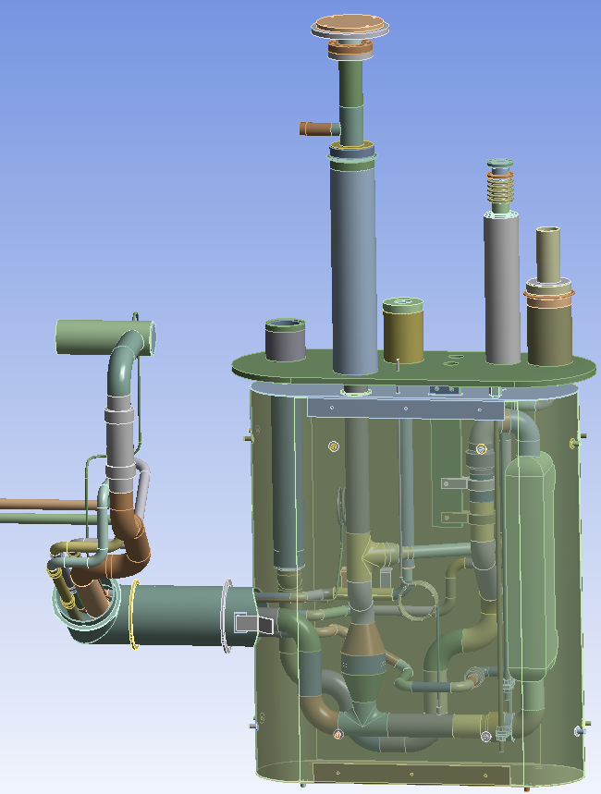
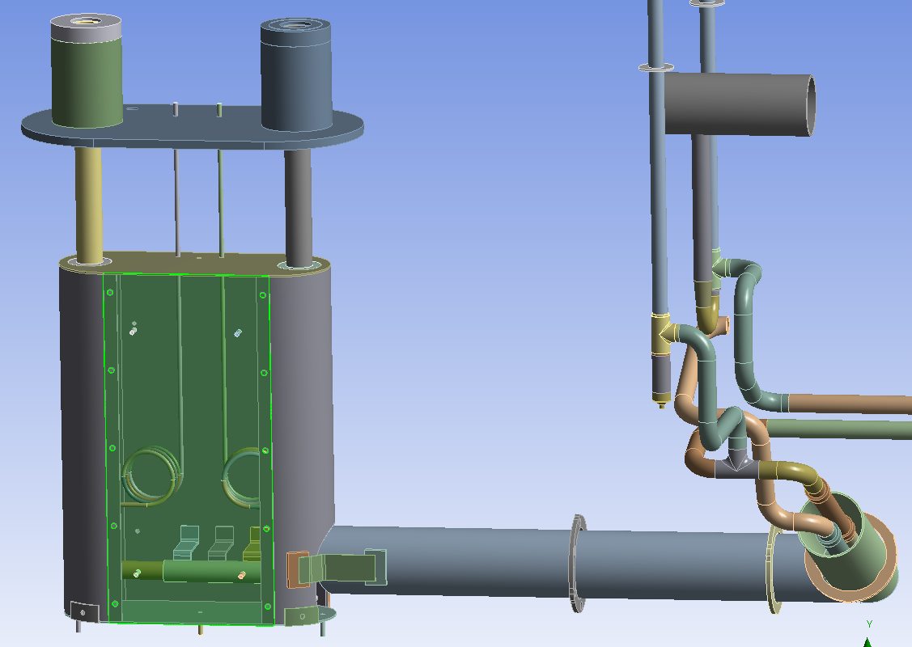
Engineering – Analysis Model Details
Return End Can w/o vacuum shell
Supply End Can w/o vacuum shell

Slide 13
Engineering – Flexibility and Shipping Analyses
Observing ASME B31.3 rules, SNS PPU piping flexibility analysis considers thermal contraction, i.e. the displacement load, and pressure, i.e. the sustained load, respectively. Gravity is always included.
Design pressures take from table shown on an earlier slide
A thermal model is run to determine the temperature profile used to generate thermal contractions.
Shipping analyses include the following cases:
Vertical upward 4g, V +4g
Vertical downward 4g, V -4g
Longitudinal upstream direction 5g, L +5g
Longitudinal downstream direction 5g, L -5g
Transverse front/aisle direction 1.5g, T +1.5g
Transverse back/wall direction 1.5g, T -1.5g

Slide 14
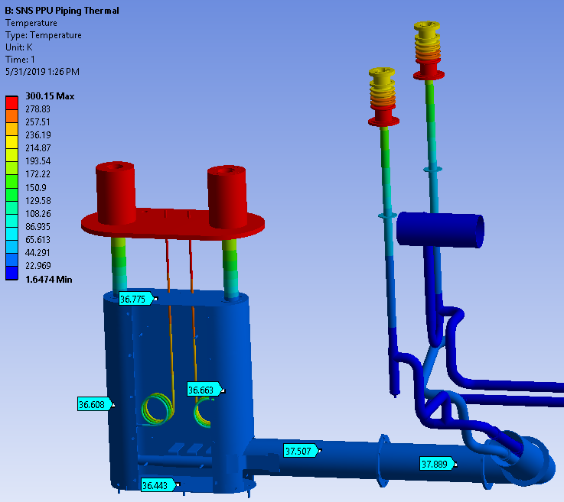
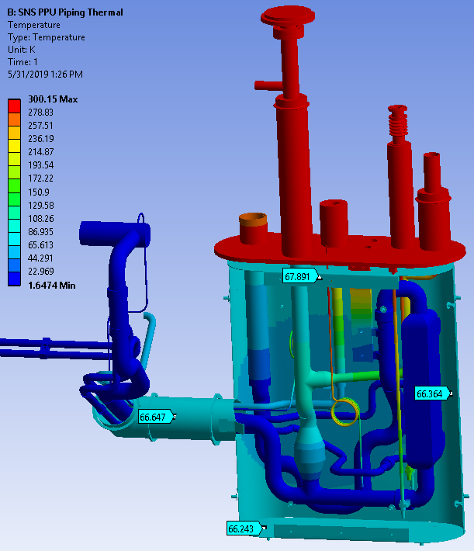
Engineering – End Can Temperatures
SEC temperature profile
REC temperature profile
Note that the cryogenic pipes’ temperatures are preset to nominal values.

Slide 15
Engineering – Supply End Can Thermal Contraction
Note: deformations in movies are exaggerated.

Slide 16
Engineering – Return End Can Thermal Contraction
Note: deformations in movies are exaggerated.

Slide 17
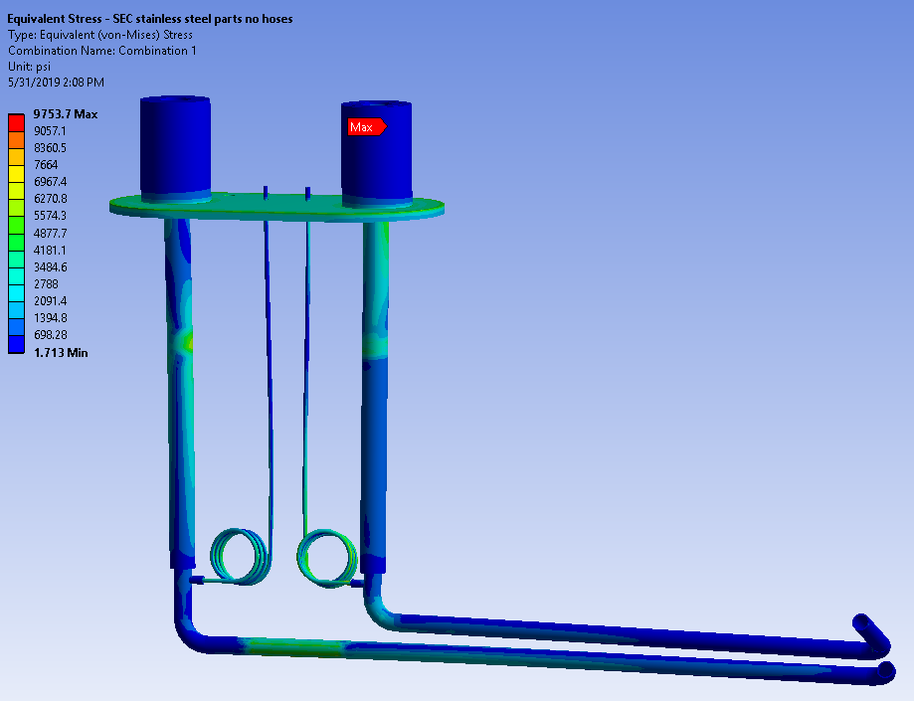
Engineering – Thermal Stress
Thermal stress on stainless steel pipes is of the primary interest.
Allowable displacement stress for 316L stainless steel is S_{a} = 25,050 psi.
Copper thermal shield is found to develop localized high stresses, which are dismissed since local yielding of copper shield will not affect its function.
Other parts are generally under benign thermal stress.

Slide 18
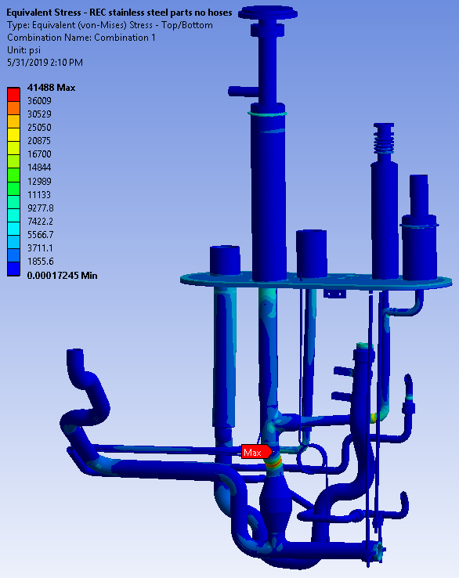
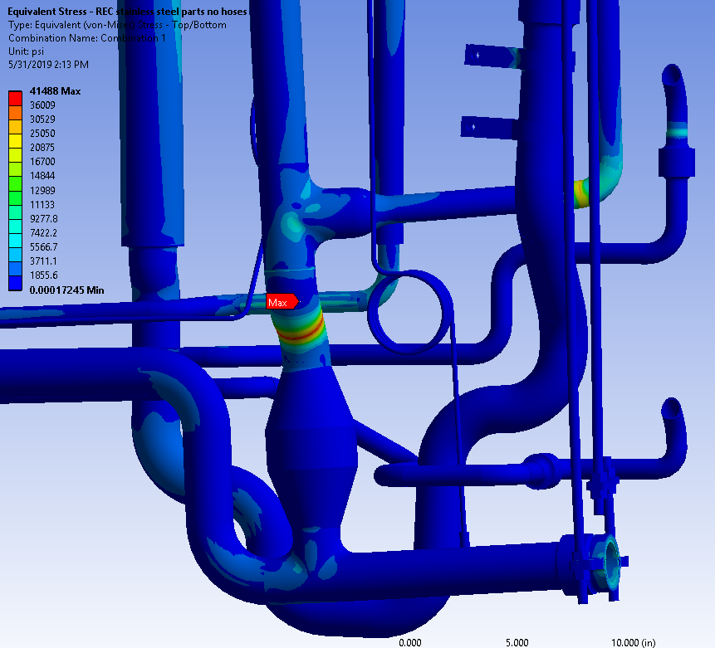
Engineering – Thermal Stress
Localized high stress appears at “Bonded” joints that are not real.
Above the check valve, use of a standard 2” tee plus 2” to 1” reducer, as compared to a 2” to 1” reducing tee, mitigated the stress.

Slide 19
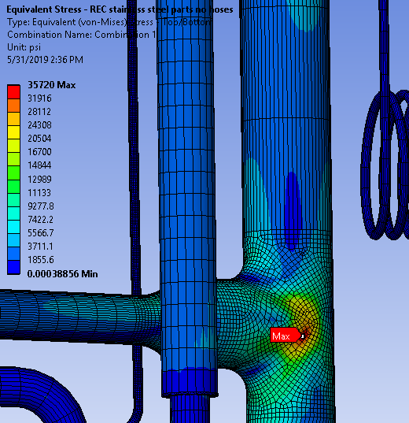
Engineering – Pressure Stress
For convenience, the analysis model applies onto each pipe the corresponding design pressure – this is very conservative since to have all pipes reaching design pressure at the same time is rare.
In the end cans and on the stainless steel parts, high stress appears at a few sharp corners, where finite element analysis typically shows singularity and thus the reported high stress is false.
Wall thickness of cryogenic pipes were checked before, all safe.
The supply end can stainless steel parts have lower than 7,000 psi stress. The allowable is S_{L} = 16,700 psi.

Slide 20
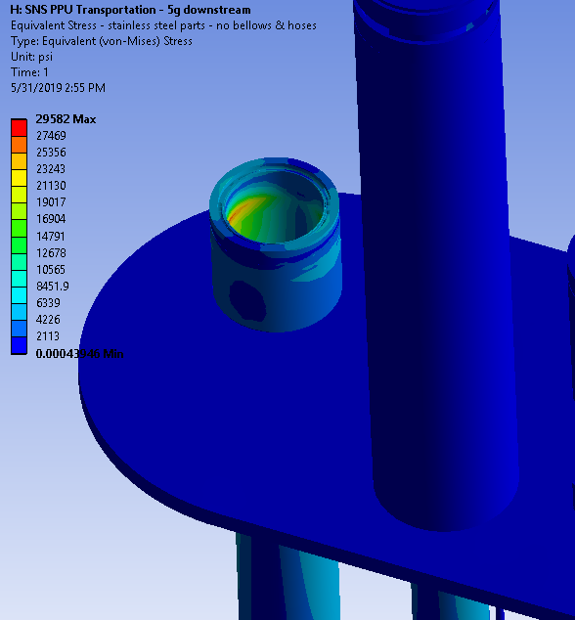
Engineering – Shipping Stress
Stresses induced by shipping loads
Copper’s yield stress is around 10,000 psi. With current conservative shipping loads design specifications, thermal shield may develop local yielding (stresses in red).
On stainless steel parts, there are a couple of high stress zones that are close to the 0.035” fillet weld that had failure during transportation in the past. They will be checked during the weld analysis.

Slide 21
Engineering – Weld Strength Revisit
During the PDR, it was reported that the initial weld calculations, based on assumed loads, show that SEC welds are fine, however, the REC welds could not pass the failure criteria.
With the FEA model of the end cans completed, forces, torques and bending moments can be conveniently retrieved from the model and used for weld strength analysis.
Welds that are near the high stress zones are specifically selected for detailed weld analysis.
3 critical welds on the SEC and 5 on the REC are checked. No issues found.
An example is given in the subsequent slide on the 0.035” fillet weld between the 2K return bayonet flange and inner tube.

Slide 22
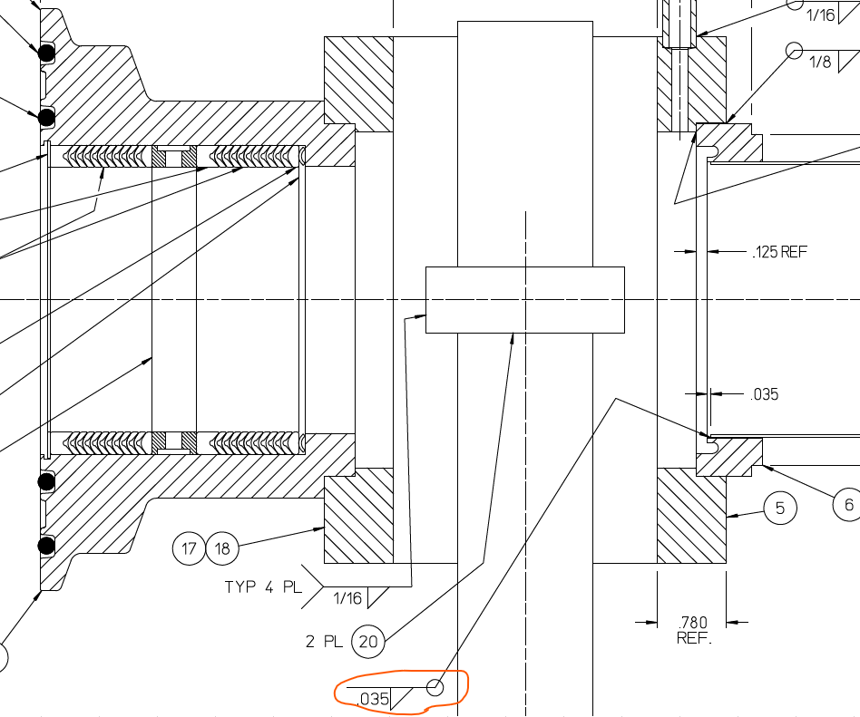
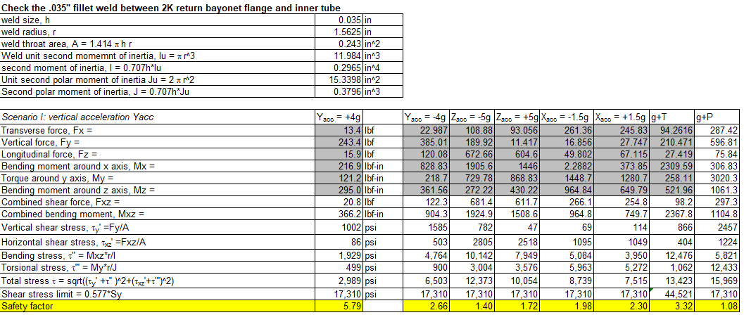
Engineering – Weld Analysis Example
2K return bayonet 0.035” fillet weld that FEA model shows it locates near a high stress zone
Weld calculations show it is safe. Numbers in gray shades are taken from FEA model

Slide 23
SOW and Procurement Plan
Return end can heat exchanger SOW is signed off. A procurement request (PR) has been submitted earlier. Bidding in progress.
A united SOW for the SEC and REC will be written based on ORNL SOWs for the SEC and REC as well as JLAB original SOWs for end cans.
Plan to select one vendor based on best value evaluation.
Will acquire ASME certified parallel plate reliefs from ORNL.
CERNOX diodes and RXSO ASME stamped pressure reliefs will be purchased by JLAB and supply to the vendor.
End can drawing packages, including the instrumentation wiring diagram, relevant JLab & ORNL specifications cited and the SOW will be ready to support SNS PPU End Can procurement schedule.

Slide 24
Plans to Finish
SEC and REC drawing status:
SEC: 18 new drawings created; 20 new drawings started; reuse drawings to be counted; none of the new drawings has gone through either Engineer or Designer check.
REC: 9 legacy drawings to reuse. 43 new drawings passed Engineer check. 17 drafted drawings haven't been checked yet. 15 new drawings to make, most of them are upper level assemblies within the return end can & the overall assembly for the return end can. A total of 80 ~ 90 drawings for REC.
Engineering analysis needs a final report.
Finalize the SOW.
Finalize and approve all drawings.

Slide 25
Questions & comments?
Thank you!

Slide 26
Backups

Slide 27
Back up slides – List of SEC Changes
A bellows is added to the bridging 6” OD tube. A pair of flanges is added too.
The support mount/block inserts into a socket engraved on the vacuum vessel’s SEC mounting pad.
Pipes connecting to the female bayonets are of 3/4” NPS, no more necking down to 1/2“ NPS, no 3/4” to 1/2” reducer.
Added “pig tail” loops to the pressure tap lines to mitigate the risk of having thermoacoustic oscillation (TAO).
Weld unions added to the pressure tap lines to facilitate welding.
Lifting lugs added. A tapped hole on the support link is added so a 3-point lift can be carried out.
Cernox diodes holder added.
Tubular thermal shield inside the bridging tube is coped to allow more clearance to the run pipe. This shield has clearance with the box-shape shield to avoid interaction during cool down.

Slide 28
Back up slides – List of SEC changes (Cont’d)
The two thermal straps connecting the tubular and box thermal shields are re-shaped. They have dual functions, i.e. thermal and structural links.
The threaded tube G-10 standoffs in between the tubular thermal shield and vacuum jacket in the bridging tube are replaced with G-10 spiders for more robust structural support during shipping.
Washers added to all G-10 standoffs to spread the pressure/stress.
At the bottom of the thermal shield, use 4x G-10 standoffs.
Added 4 screws to the support link and block to resist weld shrinkage during final assembly.

Slide 29
Back up slides – List of REC changes
A bellows is added to the bridging 8” OD tube.
The support mount/block also inserts into a socket on the vacuum vessel REC mounting pad.
REC shell and thermal shield are made concentric to each other to increase clearance. Shell geometry intact.
HX moved upstream by 1/2".
Reroute plumbing due to the move of HX and for simplicity.
The top pieces of thermal shield are combined into one.
The female bayonets are switched to JLab traditional design.
Pipes connecting to the female bayonets are of 3/4” NPS, no more necking down to 1/2“ NPS, no 3/4” to 1/2” reducer.
Added “pig tail” loops to the pressure tap lines to mitigate the risk of having TAO.
Added a weld union to a pressure tap line to facilitate welding.
Five Cernox diodes holders are added

Slide 30
Back up slides – List of REC changes (Cont’d)
Lifting lugs added. A tapped hole on the support link is added so a 3-point lift can be carried out.
Added a structural support to the HX to resist beam axis shipping load.
The vertical long bent rod for HX support is replaced with two straight rods and an offset connector. The other rod is relocated for more clearance.
Switch the Circle Seal K5120B-10MP-17 non-ASME PRV with a type RXSO 1 ¼ inlet, 1 ¼ outlet safety relief valve for the 17 PSID low pressure relief. It can be ASME certified. It has a Teflon seat. This PRV’s location is relocated 0.5” in X direction (in/out of paper).
Pressure transducer manifold adopts the typical CEBAF design to have a 30/30 gauge and VCR connections that will need adapters to the Honeywell pressure transducers that SNS PPU will use.
Added 4 sets of G-10 standoffs to each of the two side thermal shields near the leading & trailing edges to resist shipping load.

Slide 31
Back up slides – List of REC changes (Cont’d)
Removed the aluminum weld protection shield. Resized tubular thermal shield to be larger to increase cryogenic pipe spacing.
Use spider supports between the bridging tube and its tubular thermal shield. Two of such supports have 0.25” radial headroom. Consider adding springs for cushion shipping loads.
Use 4x G-10 standoffs at the bottom of the box shape thermal shield.
Added a copper heat intercept ring to the pressure relief stack pipe.
Above the check valve, use a standard 2" tee plus 2" to 1" reducer to mitigate thermal and shipping stress.
The long rods lifting the HX are straight now with a connector plate.
Added 4 screws to the support link and block to resist weld shrinkage during final assembly.

