Slide 1
SNS PPU CRYOMODULE FDR
Magnetic Shields
Gary Cheng

Slide 2
Outline
Technical Requirements
Design Overview
Interface with Other Designs
Updates since PDR
Response to Recommendations & Comments Items
Engineering
SOW & Procurement Plan
Plans to Finish

Slide 3
Technical Requirements
The purpose of magnetic shielding is to attenuate ambient magnetic field hence reduce the heat generated on the superconducting cavity surface.
SNS PPU project does not have new requirements on magnetic shielding, or more broadly magnetic hygiene.
According to a Dec. 2000 FDR report by T. Hiatt, the original SNS cryomodules magnetic shields are said to aim at reducing the 1G background field to < 10 mG, i.e. shielding factor of 100.
Studies by Sun An in 2003 show that the specified shielding factors cannot be met with the original SNS magnetic shield design.
SNS operational experience does not suggest there is a need to improve the magnetic shielding factor. The original SNS cavity Q₀ specification is met and has not changed for SNS PPU.

Slide 4
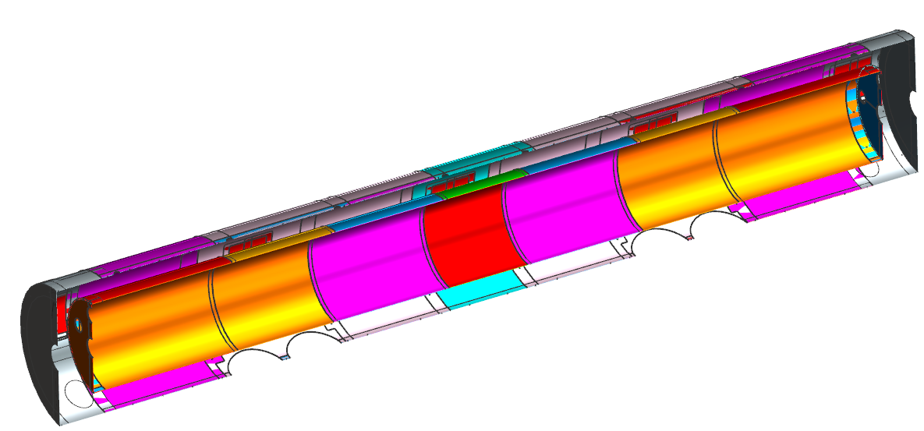
Design Overview
The SNS PPU magnetic shield design is based on the SNS HB Spare CM’s design.
Outer magnetic shield has an OD of 36.83"
The shields are basically two layers of long cylinders with end caps.
Outer magnetic shield extensions at both the upstream and downstream ends
Inner magnetic shield has an OD of 24.24"

Slide 5
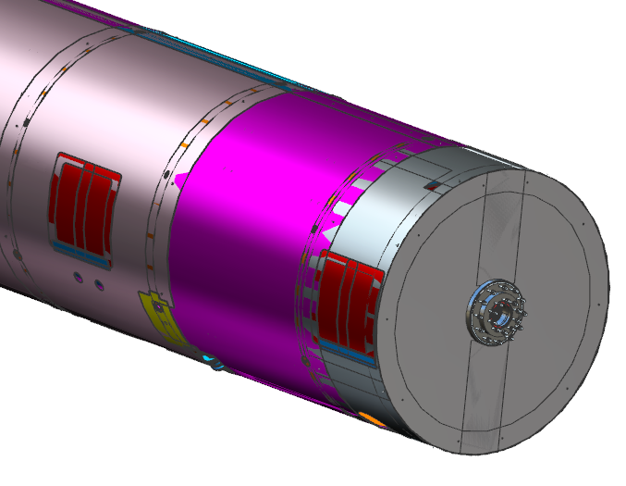
Design Overview – Clam-Shell Design
To ease installation, both the inner and outer magnetic shields are split into two halves with overlaps, i.e. the clam-shell scheme.
Clam-shell design with overlaps
Outer magnetic shield extension will be installed after welding of the end can pipes.

Slide 6
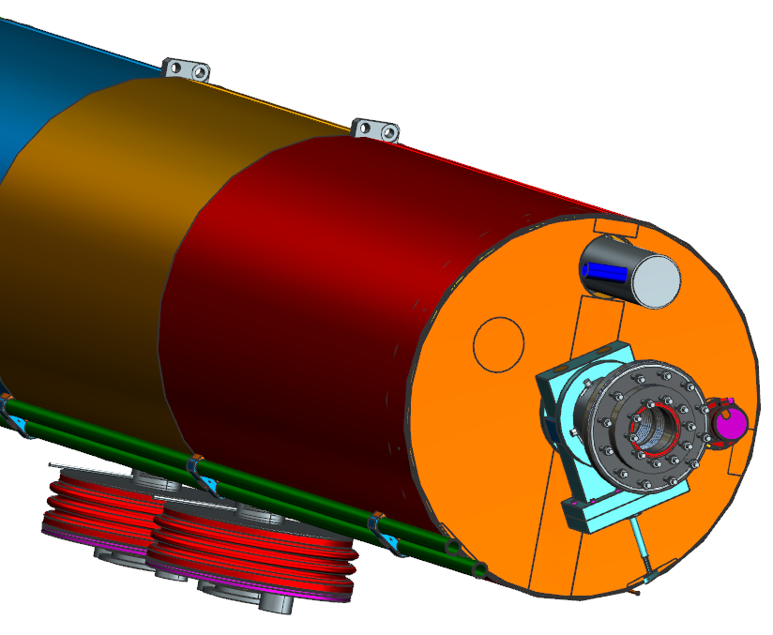
Interface with Other Designs – Inner Magnetic Shield
The inner magnetic shield lays on the helium vessels. It has openings for multiple penetrations, such as the beam line, headers, tuners, Nitronic rod bases, etc.
Nitronic rod base
Helium header
Tuner motor
Beamline

Slide 7
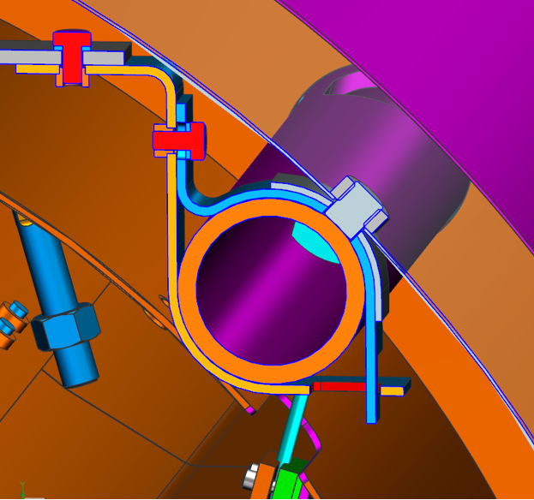
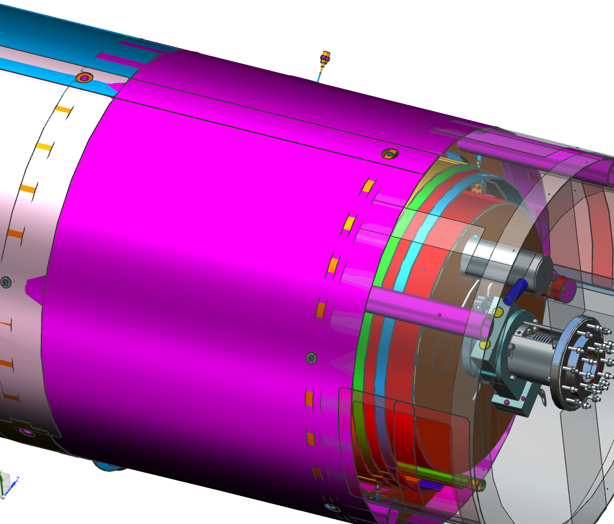
Interface with Other Designs – Outer Magnetic Shield
The outer magnetic shield lays on the spaceframe rings and tubes. There are screws anchoring the outer magnetic shields onto the spaceframe rings. The majority of shields are riveted together. Outer magnetic shield also has many openings for penetrations.
Holes for lockdown studs
Screws anchoring shield to spaceframe rings
Screw anchoring magnetic shield extension to spaceframe tube

Slide 8
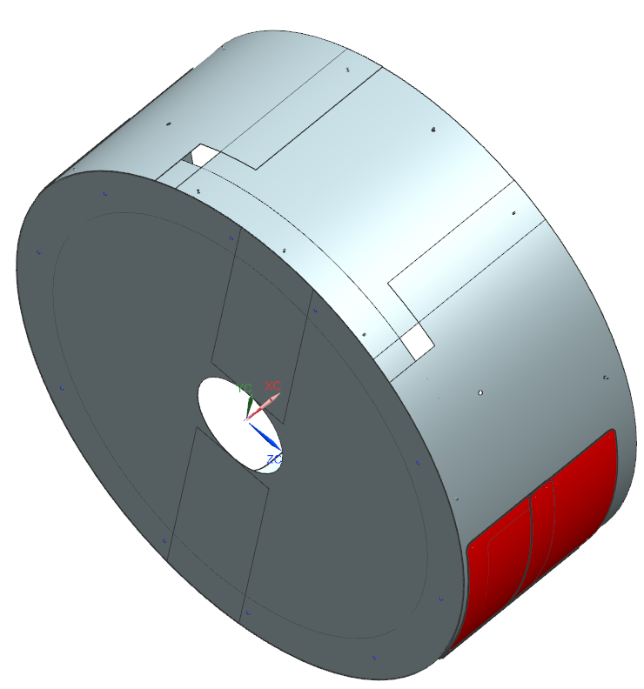
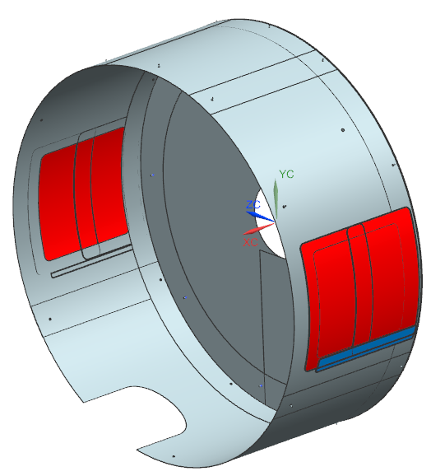
Updates since PDR – Outer Magnetic Shield Extensions
The outer magnetic shield extensions are now finalized. Each extension consists of a cylinder, an angle-ring and an end disc.
Openings for JT valves
Supply end mag shield extension
Return end mag shield extension

Slide 9
Updates since PDR – Response to PDR Comment
PDR Comment #9 - “Determine the advantage, if any, of substituting Cryoperm-10 or similar material for mu-metal on the inner magnetic shield”
Consulted with SNS project staff regarding the need to improve the magnetic shielding. Their response was that the existing design was adequate and they saw no need to improve on the design.
The project decides not to add magnetic shields to shield the big openings created by the FPCs.
JLab will not ask vendor to bid alternative materials, such as Cryoperm 10 and Amumetal 4K, for the inner magnetic shield.

Slide 10
Engineering
It is known that mumetal, once permanently deformed, will suffer degradation in its permeability. Therefore, the SNS PPU magnetic shield engineering design considered measures to reduce the risk of deforming the shield during assembly, such as opening up the door support, better aligning the shield openings for FPCs, etc. The easier it is to install, the less the risk of magnetic shields being compromised.
Mechanical supports to the shield pieces are generally reviewed. It is emphasized on the assembly drawings that all joints between shield pieces shall be taped for added strength even if there are fasteners.
No engineering calculations were carried out on the SNS PPU magnetic shields.

Slide 11
SOW & Procurement Plan
One united Statement of Work (SOW) will be drafted for both the inner and outer magnetic shields, including the outer magnetic shield extensions.
Procurement plan is to have one vendor to build both the inner and outer magnetic shields.

Slide 12
Plans to Finish
Drawing status:
Inner Mag Shield drawings: 8 new drawings created; 16 original drawings to reuse; all new drawings have been through 1st Engineer check and are in 1st Designer Check
Outer Mag Shield and Shield Extension drawings: 28 new drawings created; 12 original drawings to reuse; all new drawings have been through 1st Engineer check and are in 1st Designer Check
Need to finalize all magnetic shield drawings and sign them off.
Finalize the SOW and get it signed off.

Slide 13
Questions & comments?
Thank you!

