Slide 1
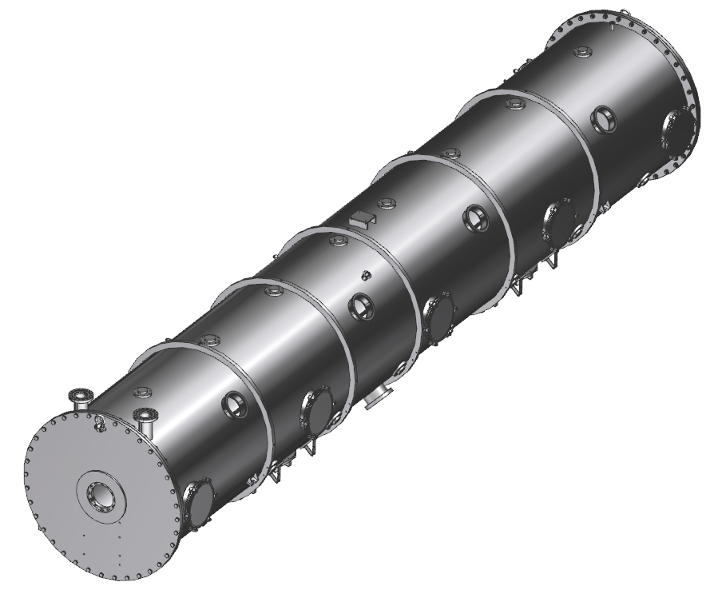
SNS PPU CRYOMODULE FDR
SNS PPU Cryomodule Vacuum Vessel
SNS PPU Cryomodule Vacuum Vessel
Matt Marchlik
Matt Marchlik

Slide 2
Outline
Requirements
Design
Procurement
Response to PDR Recommendations and Comments
Remaining Tasks
Summary

Slide 3
Requirements
Vacuum Vessel will be ASME stamped vessels with a MAWP of 25 PSIG
Design pressures of 30 PSIG internal and 15 PSIA external
Interface with all necessary subsystems

Slide 4
Requirements
Agreement between the labs defined in detail in “SNS PPU Cryomodule Pressure & Vacuum Systems” Power Point slides, by Gary Cheng, dated November 6, 2018
To meet ORNL requirements
The End Can vacuum shell and Vacuum Vessel will be ASME stamped vessels with a MAWP of 25 PSIG
Design pressures of 30 psig internal and 15 psia external
To meet JLab requirements
Vacuum vessels will be designed and built to the intent of the ASME BPVC pressure vessel code
Comply with JLAB’s ES&H Manual Chapter 6151
FPC Vacuum top hats and bellows will be designed to the ASME BPVC but treated as JLab Category II vacuum components
Consistent with the SNS HB Prototype and allows JLab to make the top hat bellows closure weld

Slide 5
Design
The existing SNS drawings will be used for unchanged components
JLab drawings have been created to capture any changes from the original design.
This section primarily highlights any design changes

Slide 6
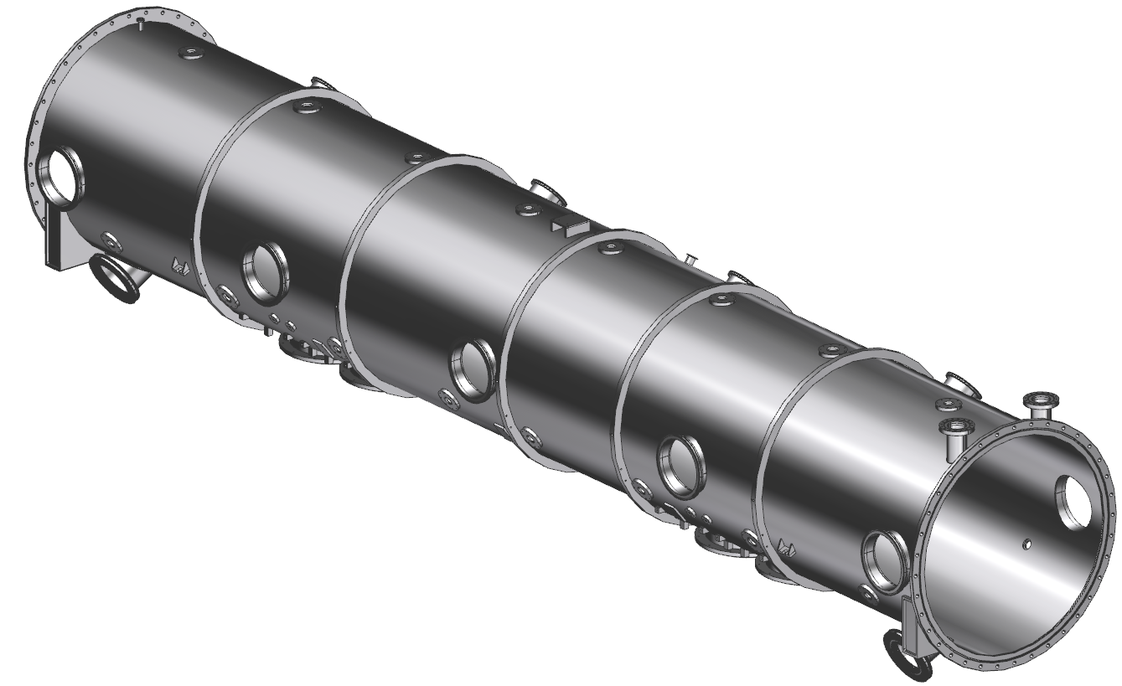
Design - Vacuum Vessel Weldment
Weldment
304 SS
Comprised of the welded bodies that make up the pressure boundary and items welded to the boundary
Only the vendor, a ASME BPVC code shop, may weld to the pressure boundary.

Slide 7
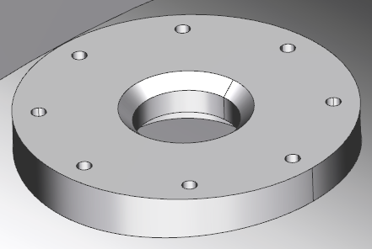
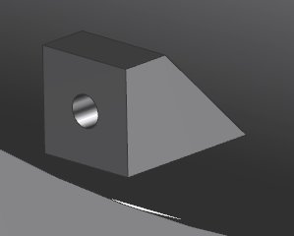
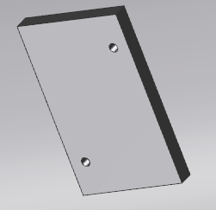
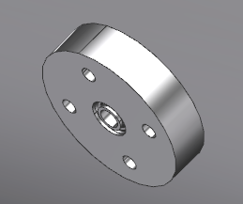
Design - Vacuum Vessel Weldment
Lock Down Weld Pads
x24
Stiffener Rings
x5
JT Valve Port
Return End
Can Mount Pad
Return End
Can Port
FPC Exhaust Manifold Support Weld Pads
Air Side FPC Ext.
Mounts
X4 sets
FPC Exhaust
Manifold Ports
x4
Supply End
Can Mount Pad
Supply End
Can Port
End Flanges

Slide 8
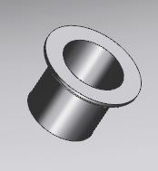
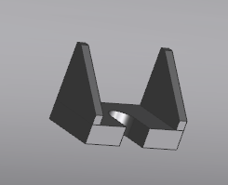
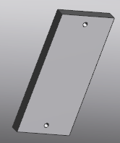
Design - Vacuum Vessel Weldment
Pressure Manifold Port
Instrumentation Ports
x4
Vessel Restraint Brackets
x4
FPC Ports
x4
ISO250-K Ports x10
Interface Panel Weld Pads

Slide 9
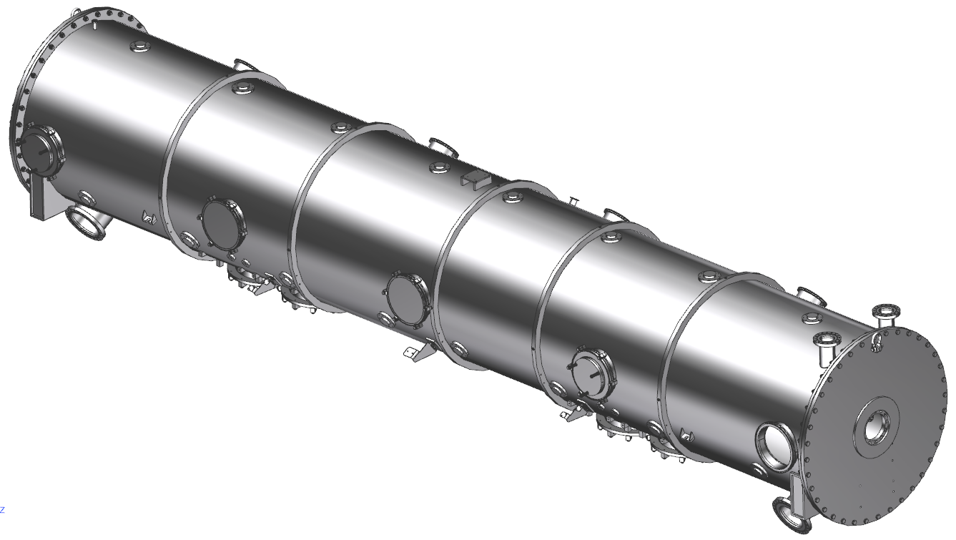
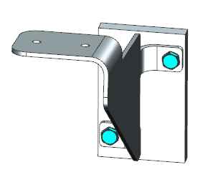
Design - Vacuum Vessel Assembly
Weldment
Tie downs
x24
End flanges x2
Parallel plate PRV
x2
Blanks
x7
FPC Exhaust
Manifold Port Supports
x3
Coupler top hats
x4
Port for burst disk
In CM Assembly

Slide 10
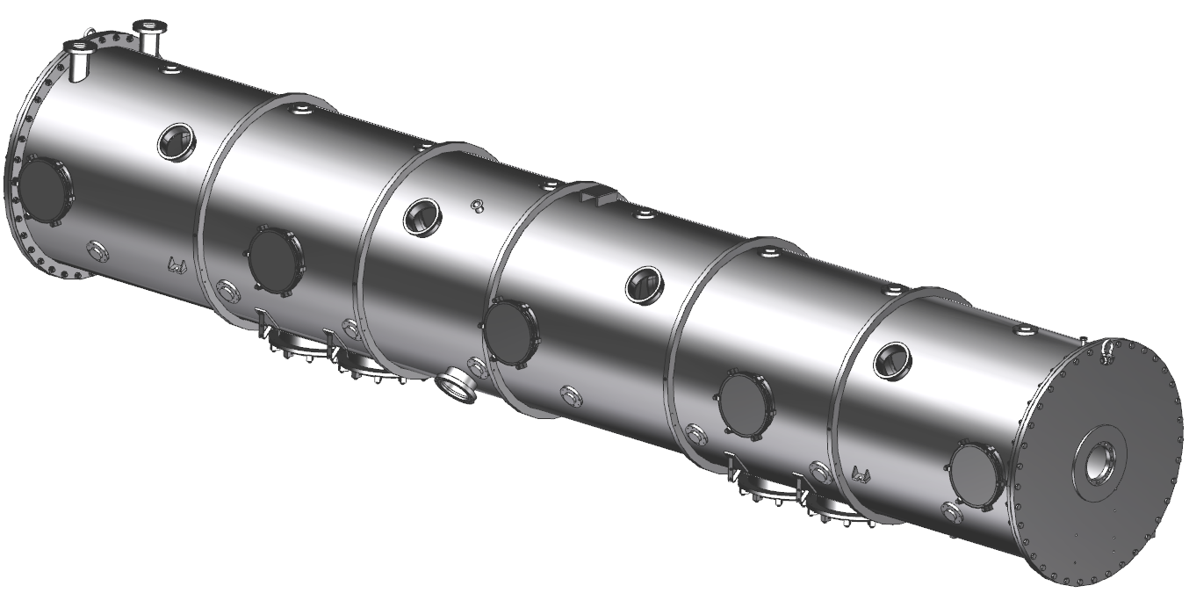
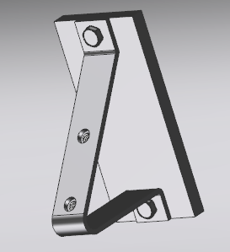
Design - Vacuum Vessel Assembly
Interface Panel
Mounts
X4

Slide 11
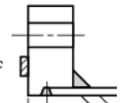
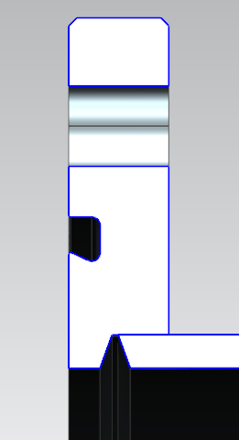
Design – End Flange Weld
The configuration matches sketch (4a) of fig.2-4 of ASME BPVC VIII-I
Radially and longitudinally self-fixturing to assist in arriving at desired tolerances
Internal circumferential weld contraction should have less impact on flange flatness than other configuration
Unchanged since PDR
(4a)
Flange flatness, location and perpendicularity to shell axis is GD&T controlled on the weldment drawing

Slide 12
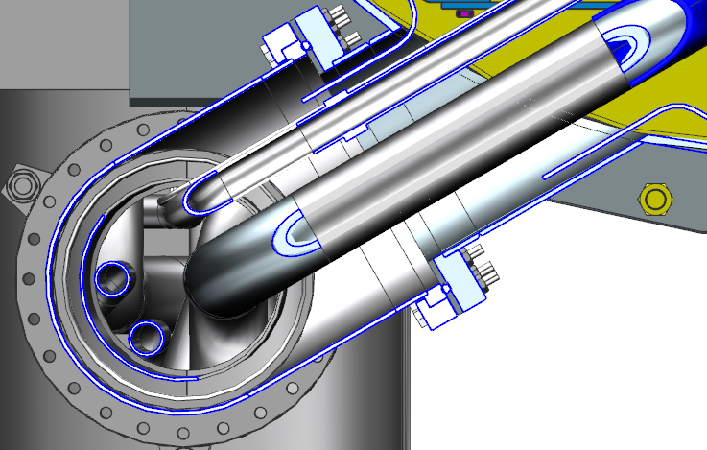
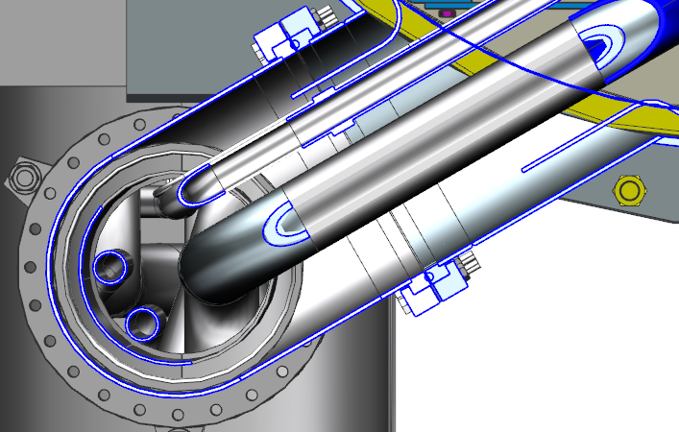
Design – Vessel End Can Ports
Originally, the return end can port of the vacuum vessel had a significantly smaller ID than that of the end can elbow
Original vessel port
6.36 in ID
The vacuum vessel port ID has been opened up to match that of the return end can elbow
More clearance between pipes and walls
SEC has plenty of clearance
Increased vessel port
7.80 in ID

Slide 13
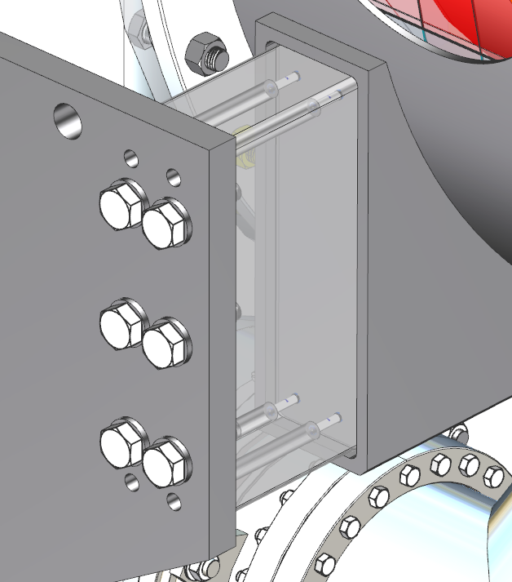
Design – End Can Mounting
Set Screws
End Can Support Arm
Support Mount
Mounting Pad
Set screws have been added since PDR. After alignment, they are inserted to pocket face prior to welding in order to minimize weld contraction
Mounting pads are considered weld pads, do not make up the pressure boundary. Welded by JLAB during assembly

Slide 14
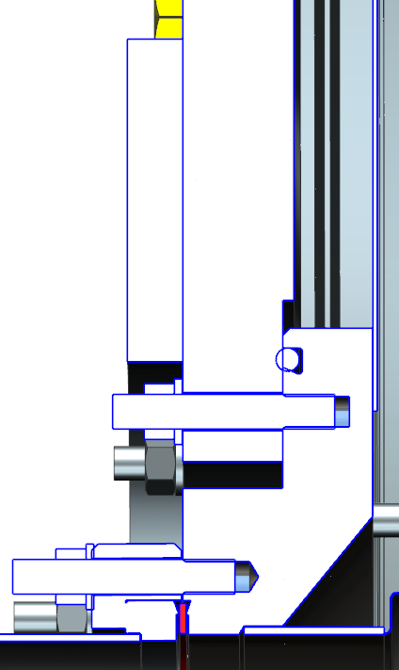
Design – End Flange Reinforcement
Unchanged since PDR
The warm to cold beam line modification outlined by K. Wilson & J. Henry requires the opening in the end flange to increase.
The new opening of 6.1 in and reinforcement was shown to be acceptable per ASME BPVC VIII-I, UG-39
Reinforcement

Slide 15
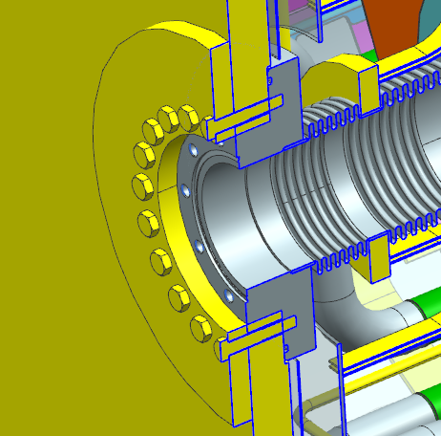
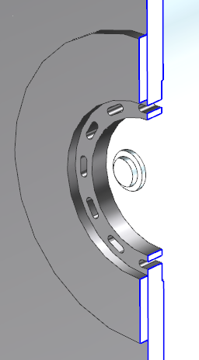
Design – Beamline to Vessel Flange
Unchanged since PDR
There were 20 bolts making up the beamline to vacuum vessel end flange joint
Verified bolt number with calculation per BPVC VIII-I
The number of bolts has been reduced to 12
20 bolts
12 bolts

Slide 16
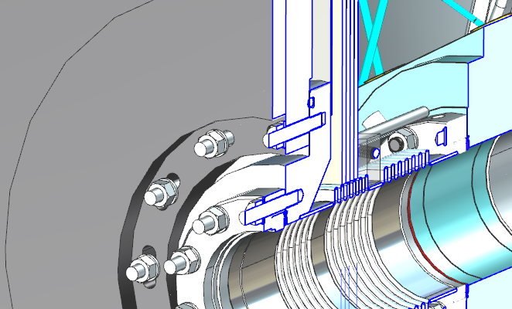
Design – Beamline to Vessel Flange
Slots
+/- 5 degree rotation
Gate Valve
Rotatable CF
At the Clean Room Assembly level, the warm to cold bellows is connected to the gate valve
Rotatable CF flange at the gate valve end is utilized to accomplish the desired bellows clocking
The through holes in the end flange have been slotted to allow +/- 5 degree of misalignment to ensure studs pass through the flange

Slide 17
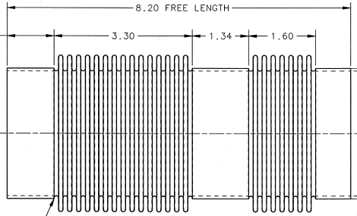
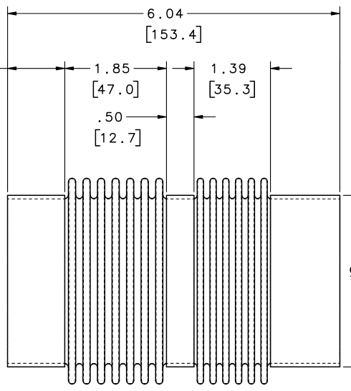
Design – Warm to Cold Transitional Bellows
Original SNS Bellows
CRM9005040-0008
Successfully shipped in the past
Current Bellows
104210300-M8U-8200-A101
Analysis performed for comparison and to verify that the shorter bellows response to shipping is acceptable

Slide 18
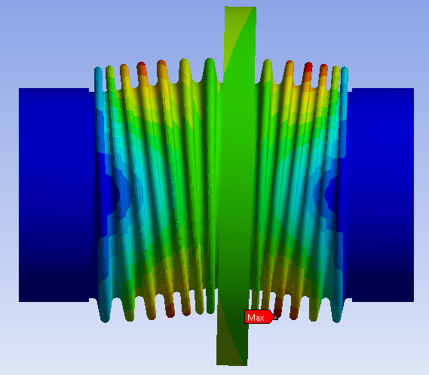
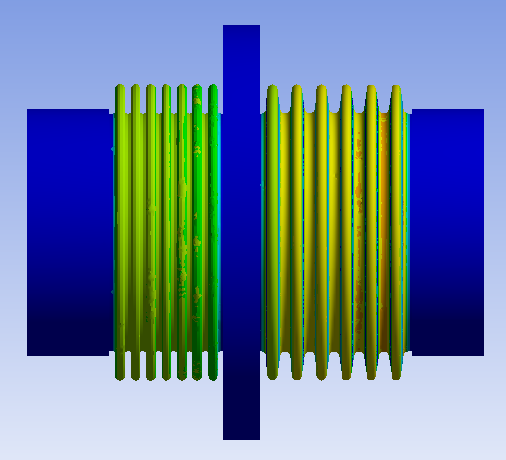
Design – Warm to Cold Transitional Bellows
Transportation Load Analysis
Conservatively eliminated thermal straps
Assumed convolution geometry
4 g vertical load
Max stress = 5 ksi
* Yield = 31 ksi
5 g longitudinal
Max stress = 8 ksi
PDR D&MR Report Recommendation 5: Verify that the dynamic response of the warm to cold transitional joint intercept flange is not detrimental to the bellows during shipping

Slide 19
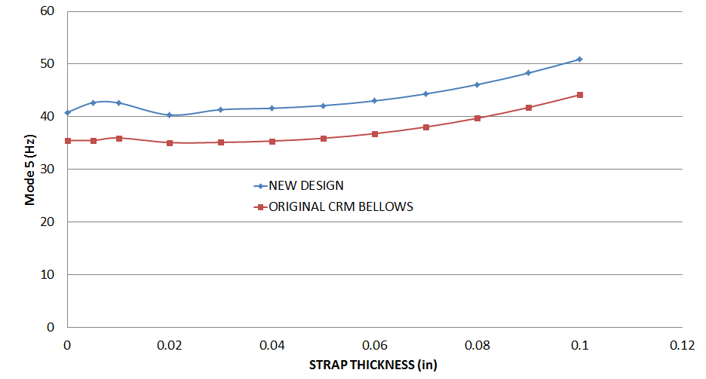
Design – Warm to Cold Transitional Bellows
Modal Analysis
The new bellows are shorter than the original
Mode search range: 0 – 100 Hz
Analyzed with no straps and with straps from .005” - .1”
Compared old design at mode 5 for comparison
Results
Mode 5 (longitudinal oscillation of intercept): only mode found that was not inherent to strap geometry
Original design contains longer bellows, frequency shifted down as expected
Avoids air ride trailer frequency of 1.5 – 2 Hz.
Avoids the shipping frame’s spring rate frequency of 4, 6 and 8 Hz.
Avoids 60 Hz
PDR D&MR Report Recommendation 5: Verify that the dynamic response of the warm to cold transitional joint intercept flange is not detrimental to the bellows during shipping

Slide 20
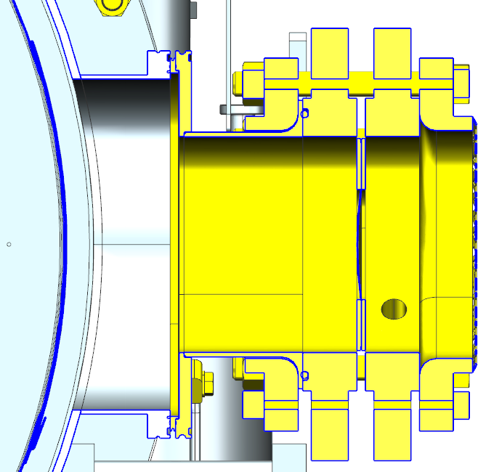
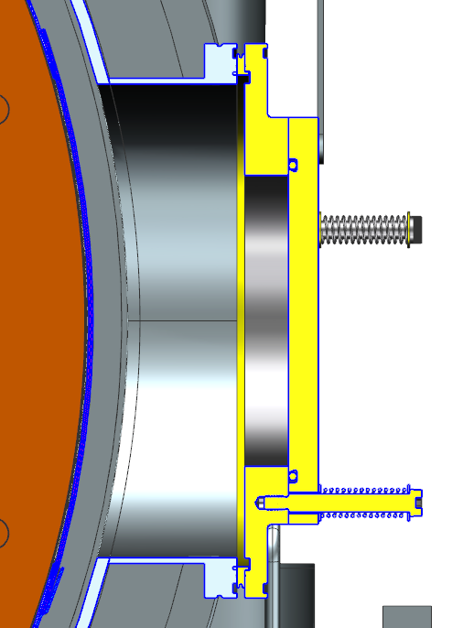
Design – Relief Path
A = $π∗D∗h$
23 in²
Burst Disk
Opening
7 in²
6 in
(28 in²)
The parallel plate relief flanges had a small hole, 3” ID, through the center. This is has been increased to the original 6” ID flange. Reduces chance of obstruction from MLI or other debris
The parallel plate will need to open ~.37” to equal 7in² area of burst disk
The flow area between the outer mag shield and vac vessel is much larger at 23 in²
PDR D&MR Report Comment 10: Verify that the relief valve flow paths between the outer magnetic shielding and the vacuum vessel are adequate

Slide 21
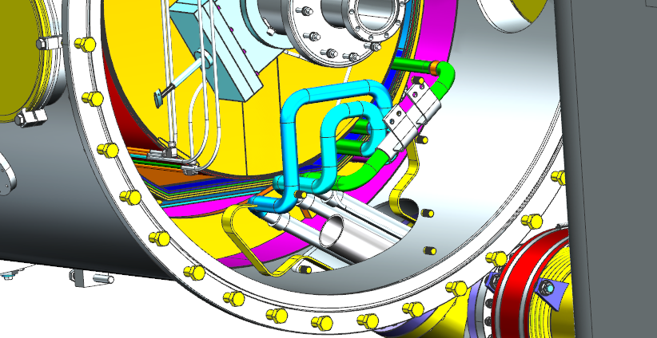
Design – End Can/Vessel Leak Checking
PDR D&MR Report Comment 4: Consider leak testing the end can to vacuum vessel connections prior to making the pipe welds
An end can extension cap inserted over the end can piping was considered
The cold mass assembly is too close to the end can piping to fit any type of cap
The vacuum vessel and end cans will be leak tested individually. Procedural controls will ensure the flanges are protected from damage from the time between initial leak test and installation. The flanges will be examined before making the vacuum vessel to end can connections.
This is deemed an acceptable risk. The probability level of flange damage is considered to be low

Slide 22
Procurement
Vessel weldment along with corresponding flanges will be fabricated by an ASME BPVC “code shop”
SOW (104210800-M8U-8200-A001-SOW) is approved
SOW reflects details found in the existing SNS and JLab SOW
The parallel plate relief valves will be purchased separately, are not considered part of the vacuum vessel assembly
The FPC top hats will be purchased separately
The first and last vessel will arrive with all flanges necessary for leak testing

Slide 23
Summary
Vessel design is in good shape, > 90% complete
Vessel interfaces with other subsystems have been verified
Drawings, quantity of 21, for any design changes have been completed
Drawings have been through preliminary checking. They are in final checking/approval
Necessary calculations for proposed changes are complete. Will be turned into analysis notes and approved
SOW is written and approved
All PDR D&MRR comments and suggestions have been addressed and are considered closed

Slide 24
Backups
PDR response table
End flange calculations
Beamline to Vacuum Bolt Number and Flange Stress Calculation
Warm to cold transition bellows dynamic loading and Modal analysis notes

Slide 25
D&MRR Comment/Recommendation Response
D&MRR Comment/ Recommendation | Description | Response/Status
* Informal/verbal, not in D&MRR | Add weld pads to the vessel for bracket mounts. Eliminates need for weld repair to pressure boundary if fragile brackets are damaged. Slides 9 & 10 | Incorporated weld pads with tapped holes. Brackets now connect to weld pads through use of hardware instead of welding. CLOSED
Recommendation 5 | Verify that the dynamic response of the warm to cold transitional joint intercept flange is not detrimental to the bellows during shipping. Slide 19 | FEA performed. Stresses in the bellows were found to be negligible. Bellows restraint is not required for shipping. CLOSED
Comment 3 | To the extent possible, perform finite element analysis on simplified assembly models of the cryomodule Slide 20 | Modal analysis performed on the warm to cold transitional bellows. Detrimental frequencies avoided. CLOSED
Comment 10 | Verify that the relief valve flow paths between the outer magnetic shielding and the vacuum vessel are adequate Slide 21 | The flow areas are substantially larger than the areas of the valves themselves, adequate flow path is present CLOSED
Comment 4 | Consider leak testing the end can to vacuum vessel connections prior to making the pipe welds Slide 22 | Is not feasible. The risk is deemed an acceptable risk. The probability level of flange damage is considered to be low. CLOSED

Slide 26
Backups
End Flange Calculations

Slide 27
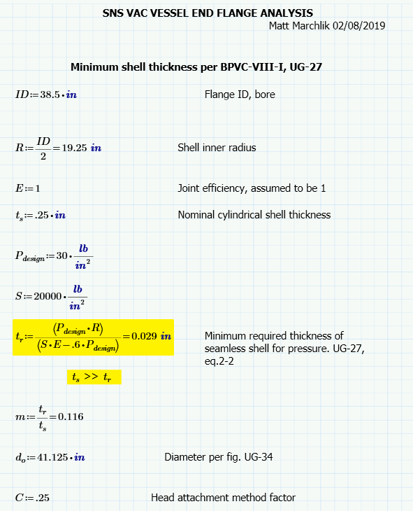
Backups – End Flange Calcs

Slide 28
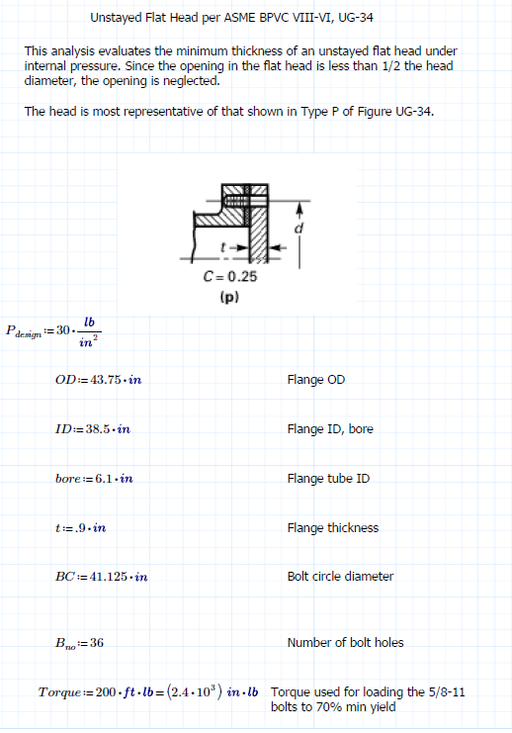
Backups – End Flange Reinforcement/Max Opening Calc

Slide 29
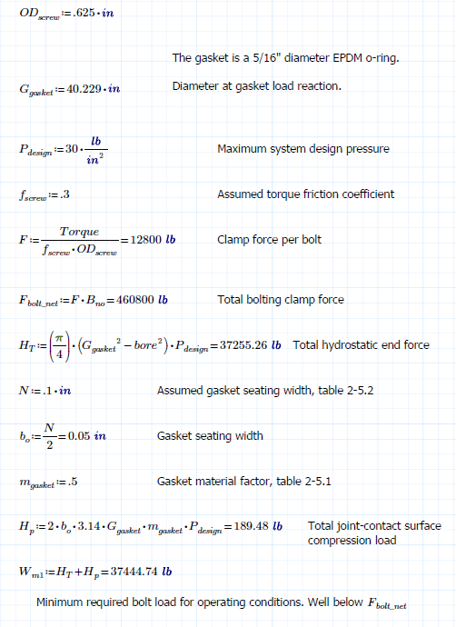
Backups – End Flange Reinforcement/Max Opening Calc

Slide 30
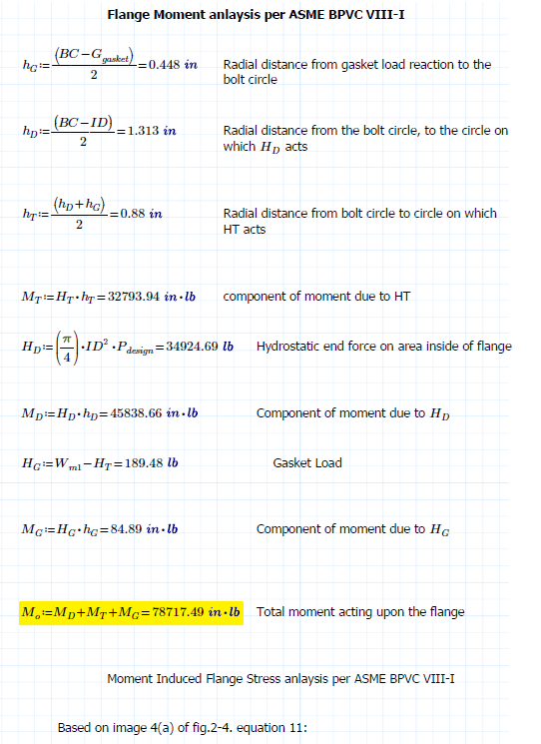
Backups – End Flange Reinforcement/Max Opening Calc

Slide 31
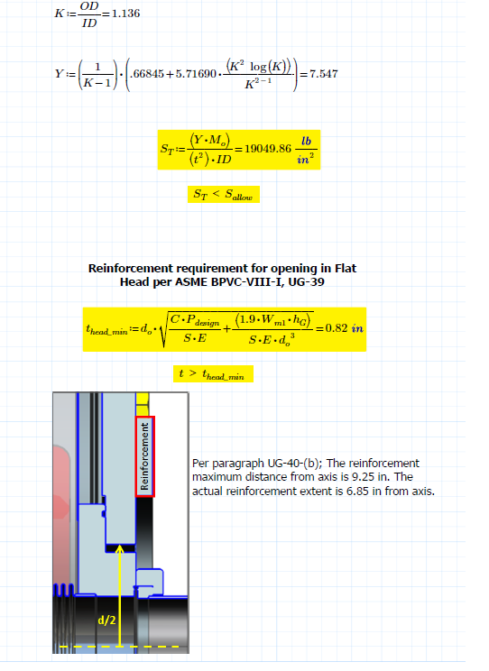
Backups – End Flange Reinforcement/Max Opening Calc

Slide 32
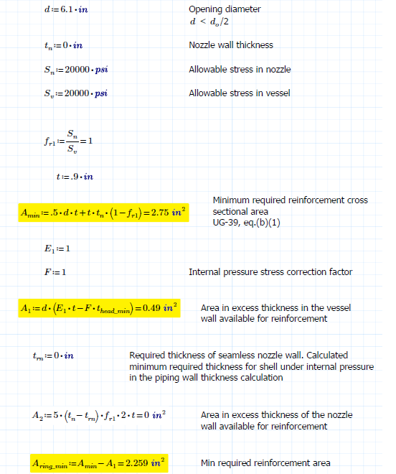
Backups – End Flange Reinforcement/Max Opening Calc

Slide 33
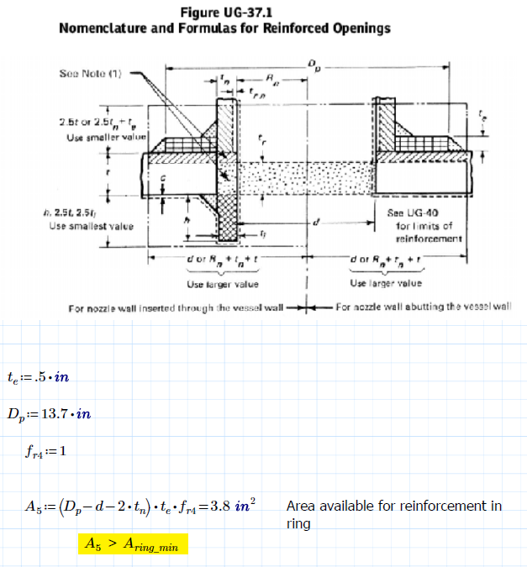
Backups – End Flange Reinforcement/Max Opening Calc

Slide 34
Backups
Beamline to Vacuum Bolt Number and Flange Stress Calculation

Slide 35
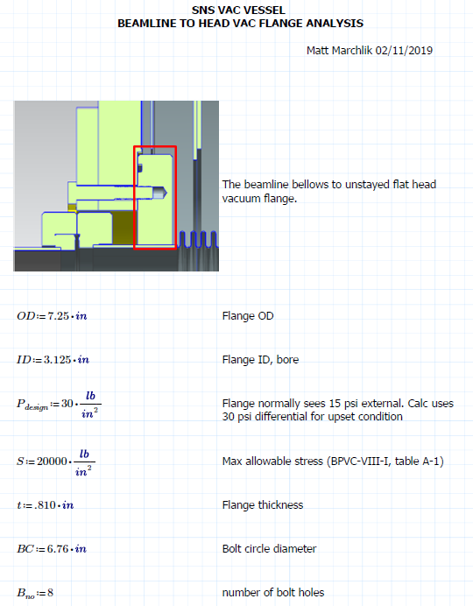
Backups

Slide 36
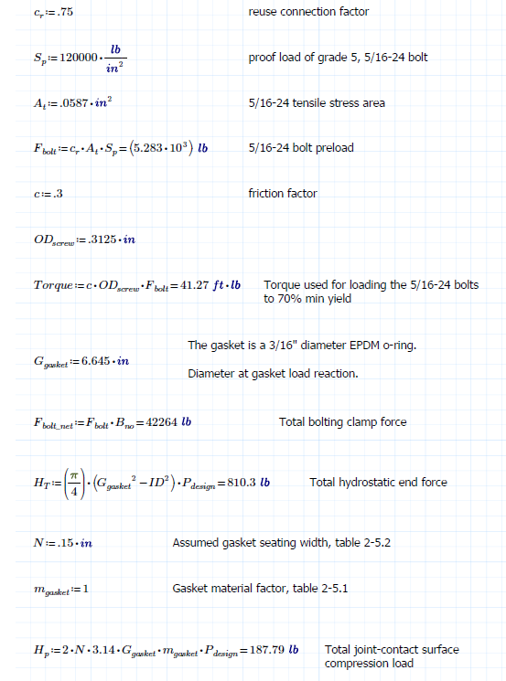
Backups

Slide 37
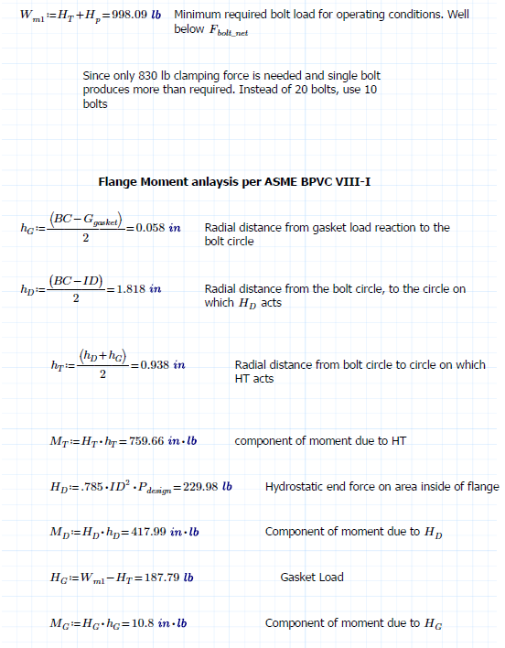
Backups

Slide 38
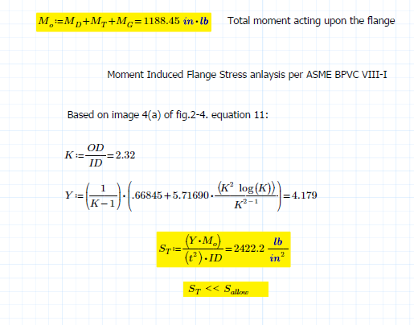
Backups

Slide 39
Backups
Warm to cold transition bellows
dynamic loading and modal analysis notes

Slide 40
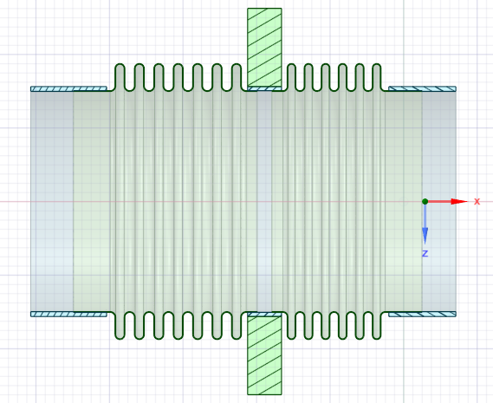
BELLOWS DESIGN
SS BELLOWS
SS CUFFS
Cu INTERCEPT BLOCK

Slide 41
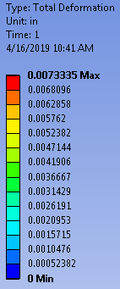
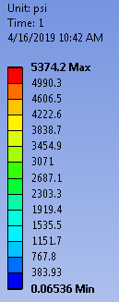
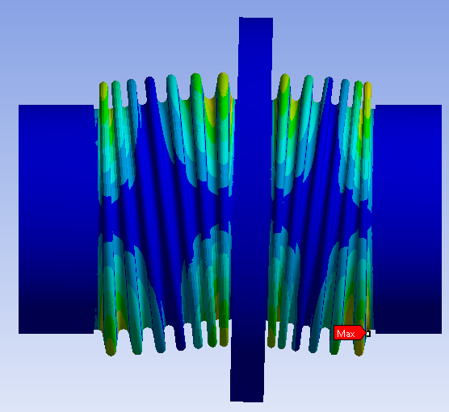
TRANSPORT LOADING
4 g transverse acceleration loading
One analysis of .008” thick bellows
Fixed supports at each cuff end
Thermal straps not included
.008” Thick Bellows
Deflection of .007”
Stress only 5.4 ksi. Allowable is 20 ksi

Slide 42
MODAL ANALYSIS
Modes search range of 0 – 100 Hz
Since the stiffness and behavior of braided thermal straps is very difficult to model in FEA, analyses were performed with varying thermal strap thickness in an attempt to establish a relation of mode shift to strap thickness
The original CRM bellows was analyzed as well for comparison

Slide 43
MODAL ANALYSIS
Only one mode was found in the search range that was not strap geometry dependent
The found mode, named Mode 5, can be described as a longitudinal oscillation of the Cu intercept block

Slide 44
MODAL ANALYSIS
As expected, the thicker bellows drives the mode higher
The original CRM bellows were found to have modes at the lowest frequency due to their longer length that the other two bellows
The graph below shows the mode behavior, with two data sets for bellows thickness and varying strap thickness

Slide 45
ANALYSIS - SUMMARY
The newly designed PPU warm to cold bellows will survive the transport loading according to the analysis results
The modal results show that the new bellows design geometry avoids the air ride frequency of 1.5-2 Hz, the shipping frame’s spring frequency of 4, 6.5 and 8 Hz, and the 60 Hz frequency induced from AC powered equipment

