Slide 1
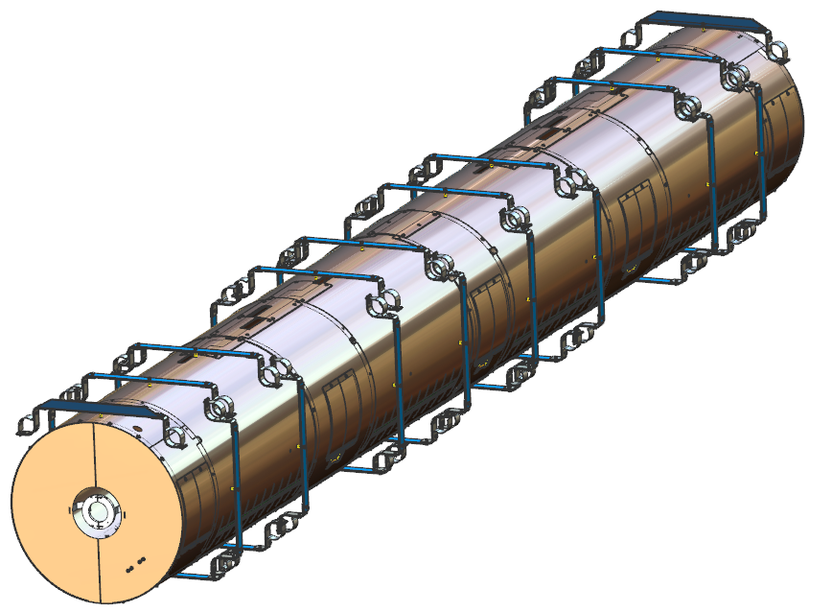
SNS PPU CRYOMODULE PDR
SNS PPU CRYOMODULE PDR
SNS PPU Cryomodule Thermal Shield & MLI
Matt Marchlik
Matt Marchlik

Slide 2
Outline
Requirements
Design
Procurement
Response to PDR Recommendations and Comments
Remaining Tasks
Summary

Slide 3
Requirements
Thermal Shield
Provide 50 K thermal radiation shielding to the cold mass
Allow for thermal contraction from 300 – 50 K
Handle the shipping design loads
(4 vertical, 5 longitudinal, 1.5 transverse)
The shipping design loads and geometry mass has not significantly changed from the original design. The design is assumed to be adequate based on past performance
MLI
Reduce thermal radiation heat load to the cold bodies within the CM

Slide 4
Design
The existing SNS drawings will be used for unchanged components
JLab drawings have been created to capture any changes from the original designs.
This section primarily highlights any design changes

Slide 5
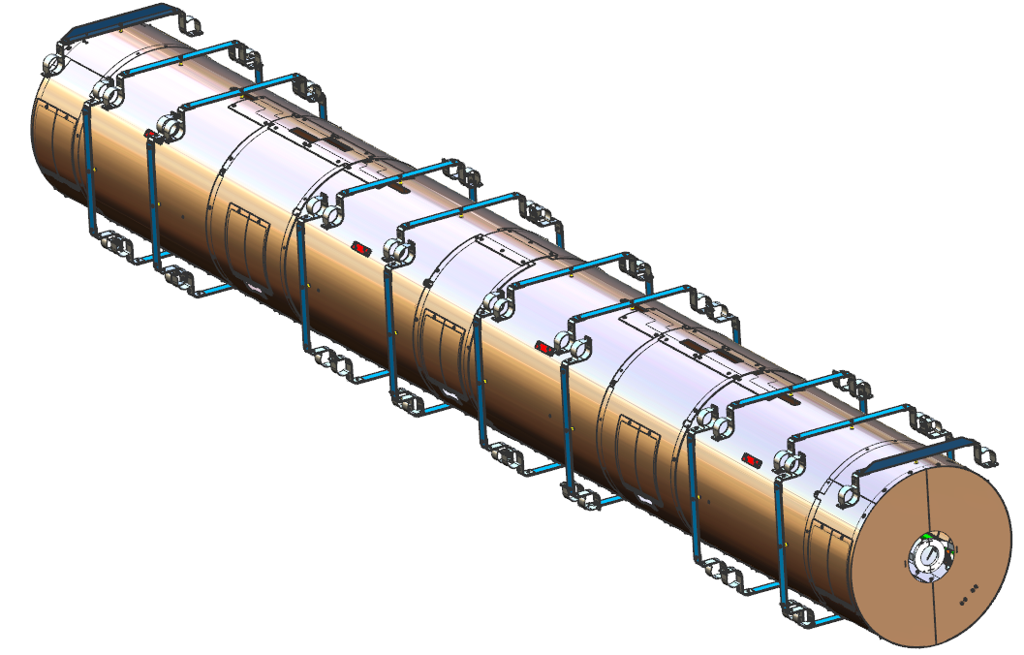
Design – Assembly Overview
Supply End Shield Extension
With support
Shield
segments
Axial nitronic rod patch panels
Tuner access
Panels
Shield to space frame supports
30 K Helium line
Field probe cable
Heat intercept blocks
Return End Shield Extension
With support
Beamline Thermal Intercept
* All shield segments and patch panels are made from (C11000 ETP Cu)

Slide 6
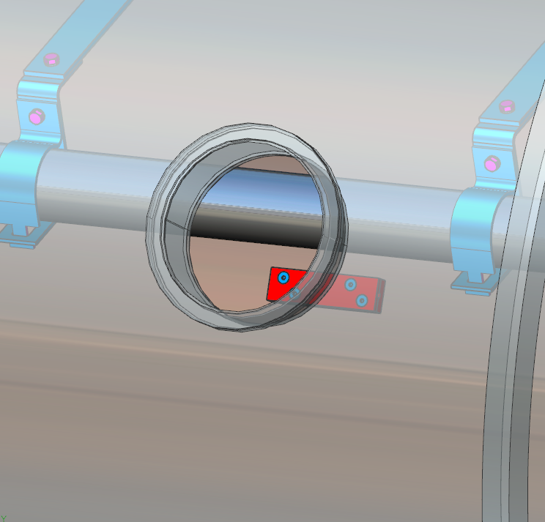
Design – Field Probe Cable Heat Intercept
The field probe cable thermal intercept blocks have been moved to align with instrumentation ports
Allows more access to intercept block in case need for cable replacement arises
Cable length and block design remains unchanged since the PDR

Slide 7
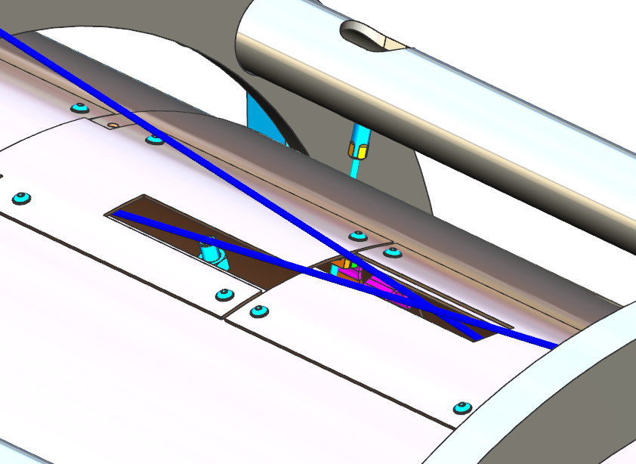
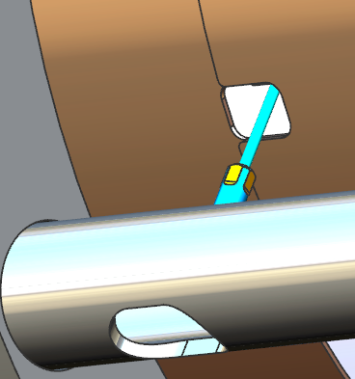
Design – Nitronic Rod Clearance
Axial and transverse rod clearance slots contain plenty of clearance between shield and nitronic rods
Thermal contraction clearance verified

Slide 8
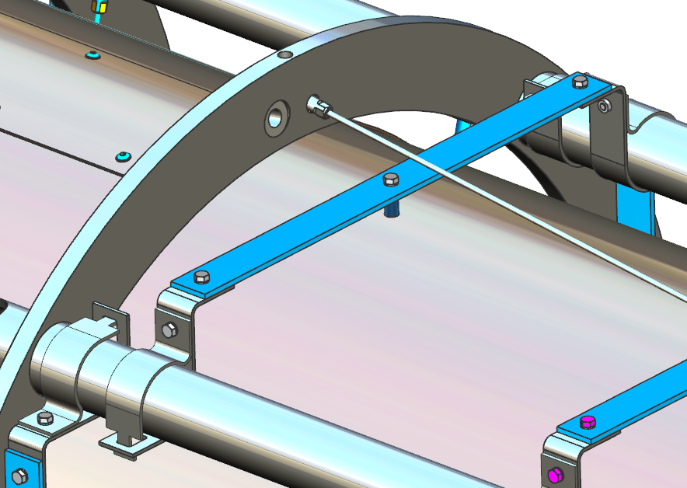
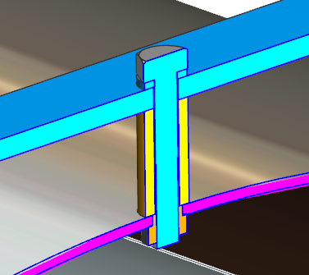
Design – Shield/Space Frame Support
Shield support bands
(G11)
G11 band
Corner support clamps
(304 SS)
Bolt
Washer
Pem nut
G11 Standoff

Slide 9
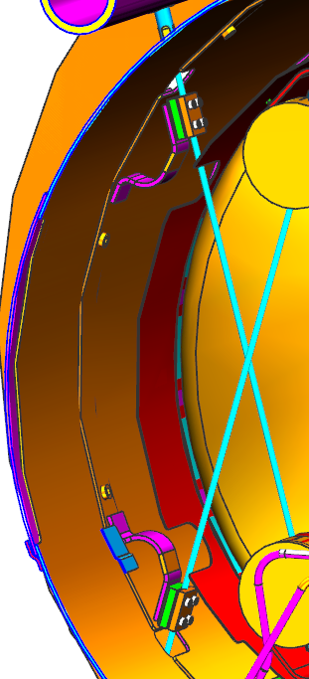
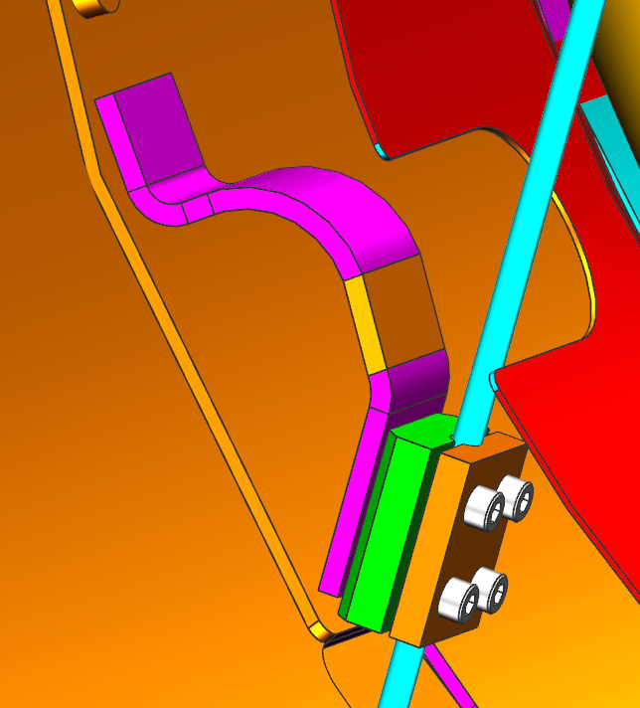
Design – Nitronic Rod Intercepts
Each transverse nitronic rod is heat intercepted inside of the thermal shield
Axial rods are not intercepted in the original design
It is assumed that previous calculations showed that the heat leak through the longer rods is negligible
The original strap was made from solid copper sheet. An equivalent capacity braided copper strap was selected to replace the solid one
TIG braze

Slide 10
Design – Helium Line
7/8 in OD, .045 in wall copper tubing runs along the length of the shield
Tubing is segmented into 4 pieces by bellows assemblies
The tubing segments are torch brazed to the shield segment’s strain relief cut outs
Verified the wall thickness is acceptable per ASME B31.3
Verified that the SS to Cu adapter is acceptable per ASME B16.22

Slide 11
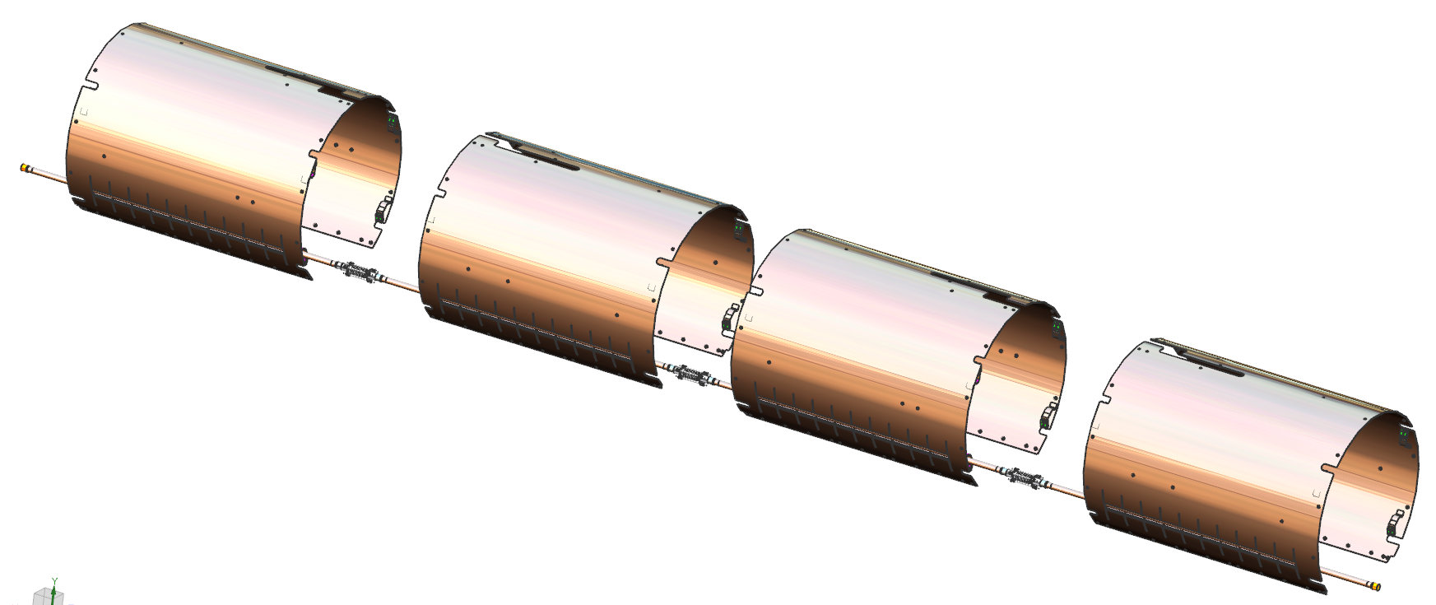
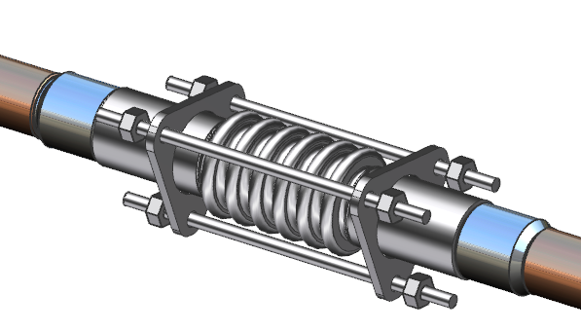
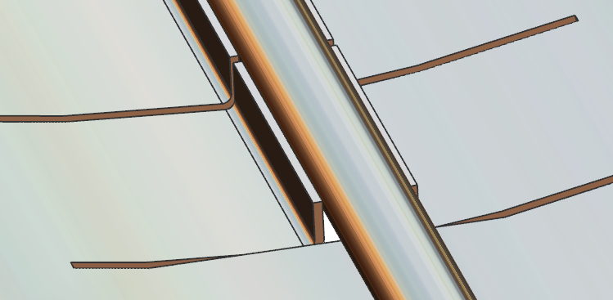
Design – Shield Subassembly
Bellows lock rods prevent over stretch
SS to SS weld
TIG braze
Bellows assemblies integrated between each shield segment
SS to Cu socket braze
Tube brazed to the strain relief fingers of the shield segments

Slide 12
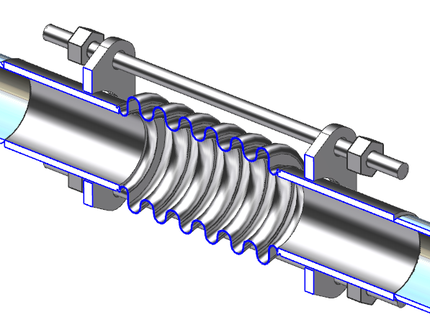
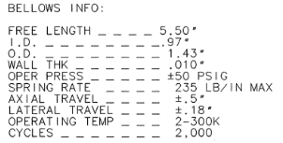
Design – Bellows
DESIGN PRESSURE _ _ _ _ _
200 psig
Design pressure is specified on the drawing and bellows will be pressure tested to 1.1 * design pressure = 220 psig
Note added to dwg: “Bellows squirm shall not be present during the ASME B31.3 pressure/leak test”
The bellows manufacturer shall meet the design requirements
There is only .015” radial clearance between the support rods and bracket through holes. This will minimize the angle that the bellows can be bent and decrease the chance of squirm
Locking nuts are used to limit the axial travel to +/- .5”
Compliance to the requirements will ensure that the bellows will perform under all operating conditions
PDR D&MR Comment 12: Evaluate the thermal shield bellows performance under all potential operating scenarios. Bellows Squirm.

Slide 13
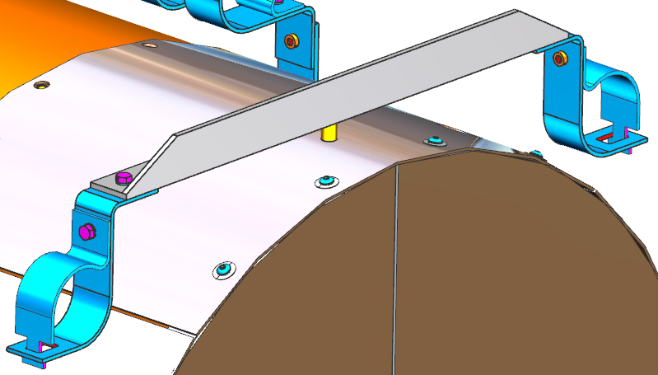
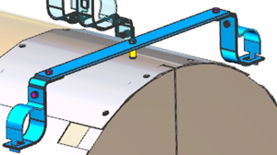
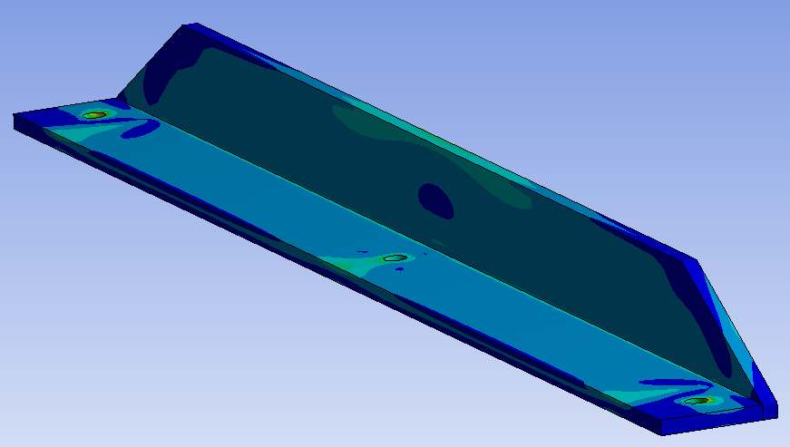
Design – Shield Extensions
PDR
Current design replaces the flat G11 band shield mount with a stiffer G11 angle member
Extension ~ 50 lb
A simple FEA model was evaluated under the 4 g vertical shipping load. Max stress ~ 15 ksi
Very conservative analysis, neglects the support from the main shield body
PDR D&MR Report Comment 3 : Perform FEA on simplified models where appropriate

Slide 14
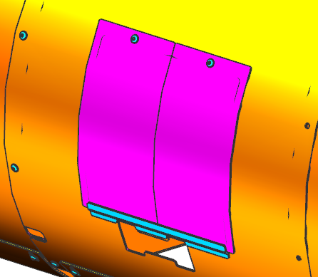
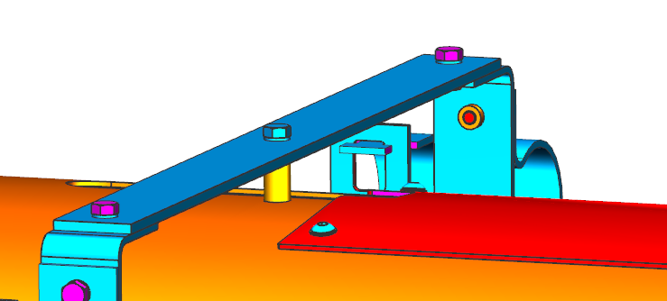
Design – Thermal Contraction
The shield assembly mounts “rigidly”(some flexibility in G11 supports) to the spaceframe.
300 – 50 K thermal contraction is ~.8 in
Hardware will be omitted at two seams of the assembly to allow each segment to contract individually. Done procedurally during assembly.
Some thermal contraction relief provided by twist in the 3/16” thick G11 bands

Slide 15
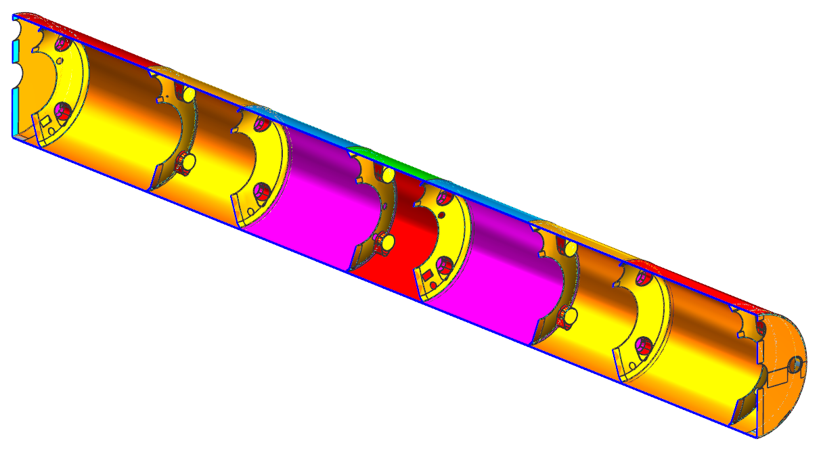
Design – Cold Mass MLI
Nitronic Rod Ends
(1 blanket, 15 layers)
He Vessel Ends
(1 blanket, 15 layers)
Main Blankets
(2 blankets, 7 segments along length, 12 layers ea.)
Ends
(1 blanket, 15 layers)
Original CRM MLI assembly being used
Removed the piezo penetration from ends

Slide 16
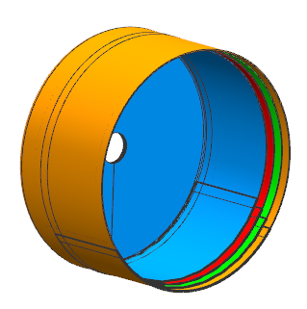
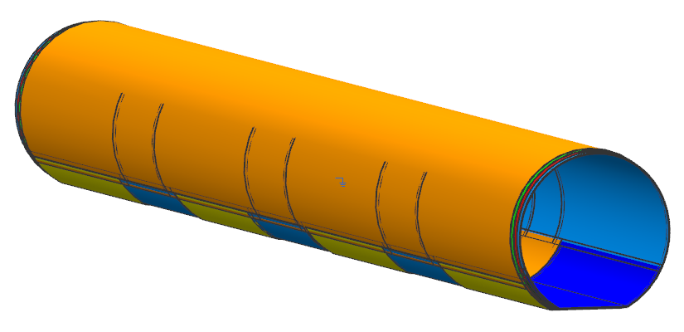
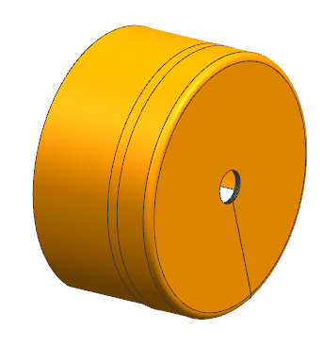
Design – Thermal Shield MLI
Main Blankets
(4 blankets, 15 layers ea.)
Tuner access port slits
Shield Extension End MLI
Shield extension MLI
Bottom segments
Very similar to existing design
Some extension and edge staggering employed
May get first blanket assembly alone for fit/verification in first CM. Possibly have slits added to the design to aid in assembly for remaining blankets.

Slide 17
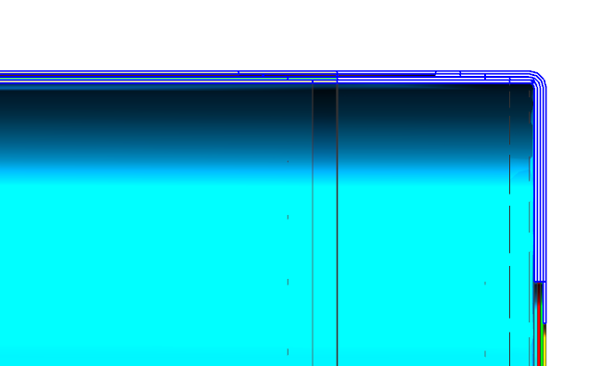
Design – Thermal Shield MLI
Blankets staggered
Shield Extension

Slide 18
Procurement
The entire thermal shield assembly, including extensions, will be procured as a complete assembly.
The Thermal Shield SOW (104211100-M8U-8200-A002-SOW) is complete and has been approved
All of the MLI blankets will be procured together
Each MLI blanket will arrive individually packaged and labeled
The MLI SOW (104211300-M8U-8200-SOW) is complete and has been approved

Slide 19
Summary
Thermal shield and MLI designs are established
Additional slits may be added to the MLI design if the first MLI set installation deems it necessary
Shield and MLI drawings are >90% complete and have been through preliminary checking
Shield and MLI drawings are in final checking
Interfaces with other subsystems have been verified
PDR D&MRR comments/suggestions have been addressed and are considered closed

Slide 20
Backup
Shield cooling line code calcs

Slide 21
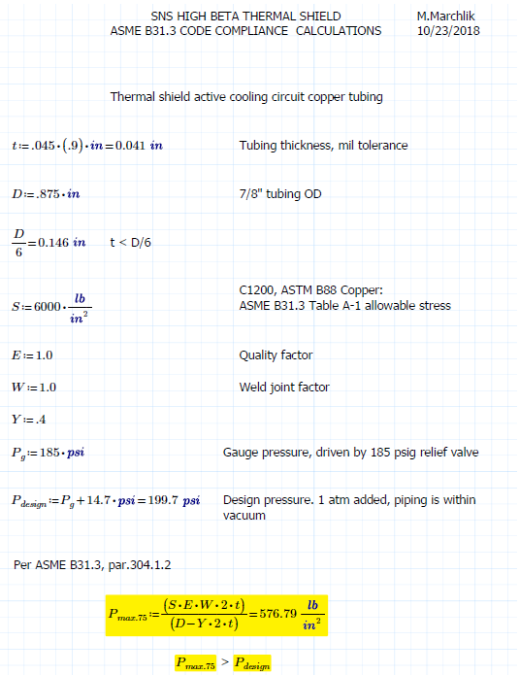
Backup

Slide 22
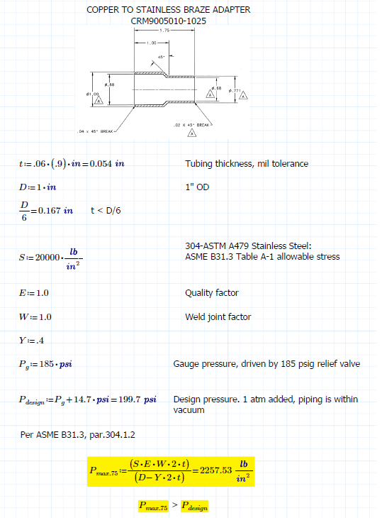
Backup

