Slide 1
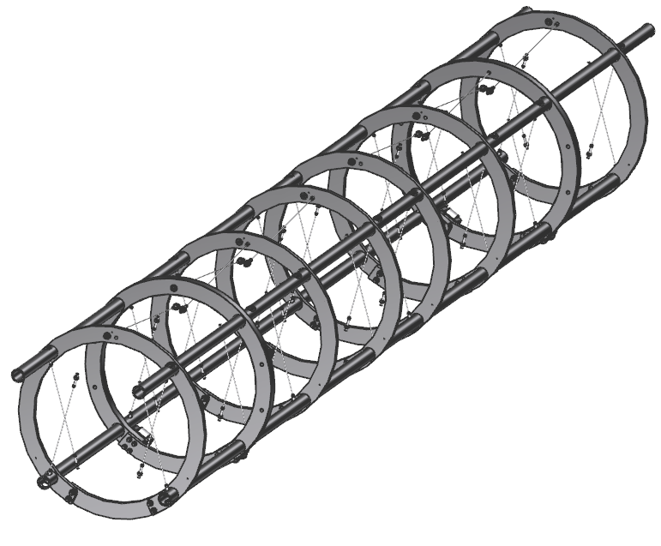
SNS PPU CRYOMODULE PDR
SNS PPU CRYOMODULE PDR
SNS PPU Cryomodule Space Frame
Matt Marchlik
Matt Marchlik

Slide 2
Outline
Requirements
Design
Procurement
Response to PDR Recommendations and Comments
Remaining Tasks
Summary

Slide 3
Requirements
Support the cold mass assembly
Aligns the cold mass
Support the thermal shield
Support the end thermal shield assemblies
Support the outer magnetic shield
Handle the shipping design loads
(4 vertical, 5 longitudinal, 1.5 transverse)

Slide 4
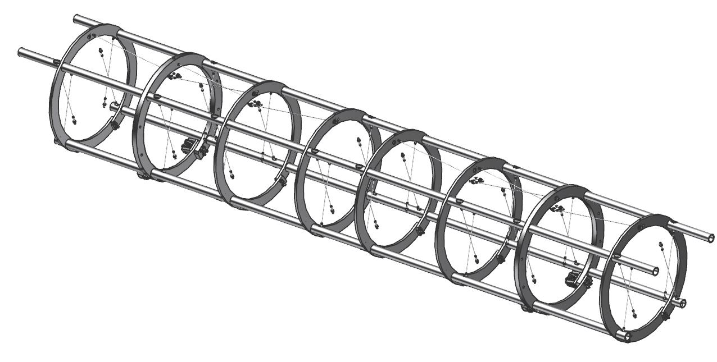
Design – Assembly Overview
Weldment
Axial Nitronic Rods
x8
Transverse Nitronic Rods
x32
Support Ring Connectors
x8
Wheels
x4

Slide 5
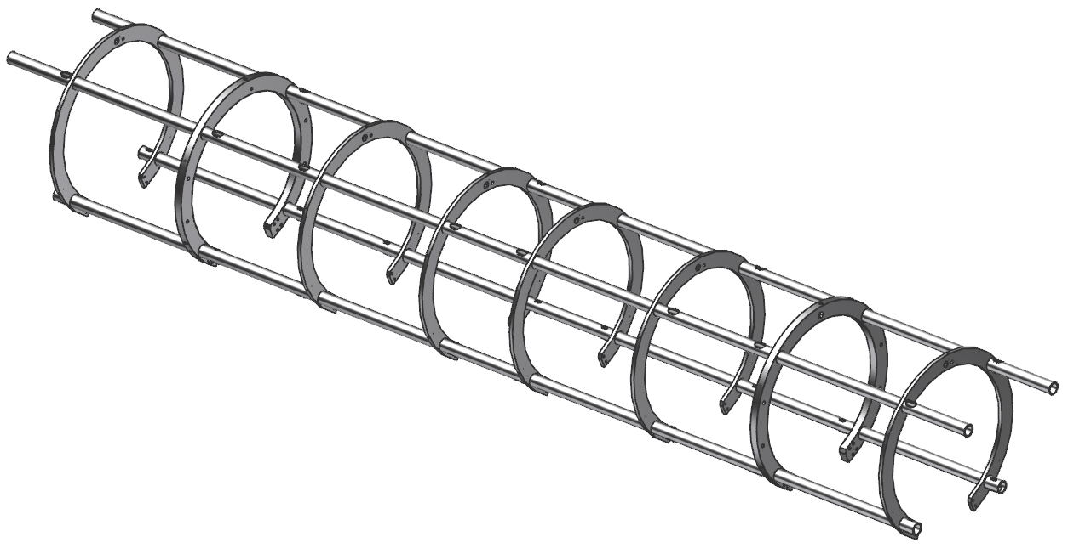
Design – Weldment
Thin support rings
x6
Thick support rings
x2
Support tubes
2.5” OD x .25” wall
Made from 304 SS

Slide 6
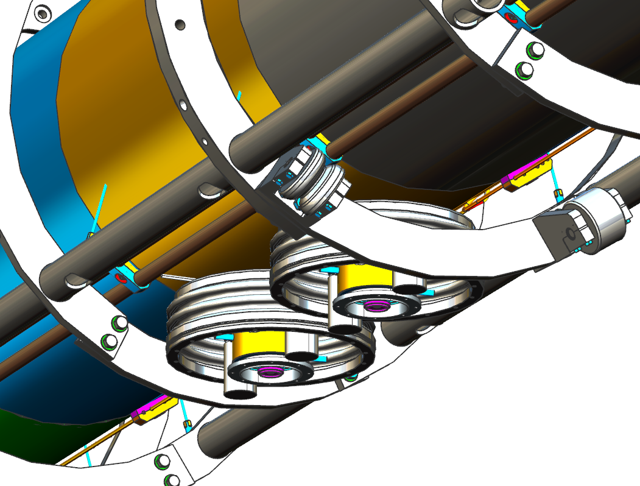
Design – Support Ring Connectors
Support Ring Connectors
Support ring connectors are removed to clear FPCs during the cold mass to spaceframe transfer. Reinstalled after transfer.

Slide 7
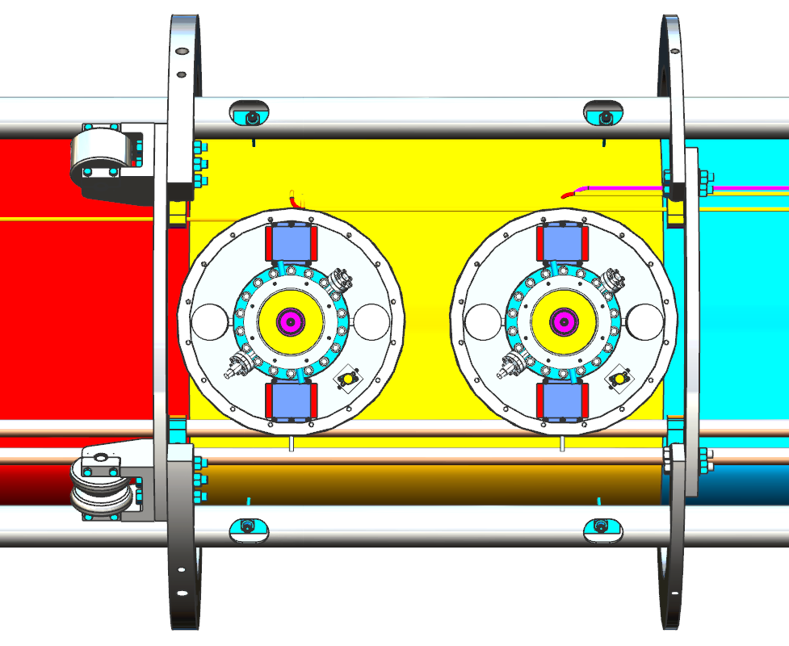
Design – Wheels
2 wheels per thick support ring connector
Wheels oriented in front of support ring connector in direction of insertion into vac vessel. Supply end first into vac vessel
Wheels support the spaceframe in the vac vessel as the assembly is transferred from the assembly rails.
Wheels lose contact after the spaceframe is lifted by the tie downs

Slide 8
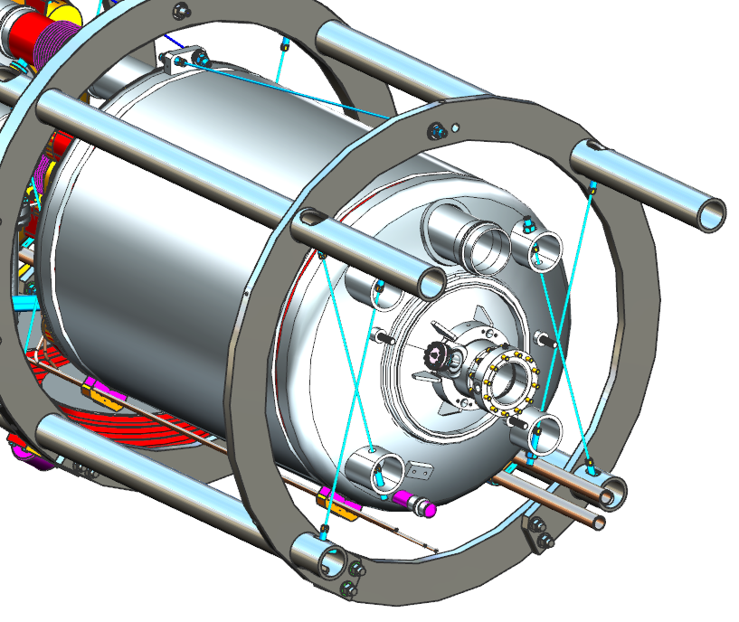
Design – Nitronic Rods
Axial nitronic rods
3,850 lb max preload
29,500 lb/in Stiffness
Nitronic 50 (200 ksi min yield)
2 for each cavity
Transverse nitronic rods
3,300 lb max preload
52,180 lb/in Stiffness
8 for each cavity
The rods are used to align the cavities to beamline
Rods are incrementally tightened to preload while monitoring alignment
Axial rods connect at the FPC ends of the vessels, vessels/cavities contract towards FPC

Slide 9
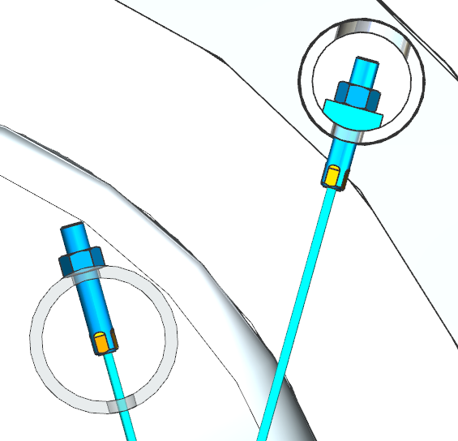
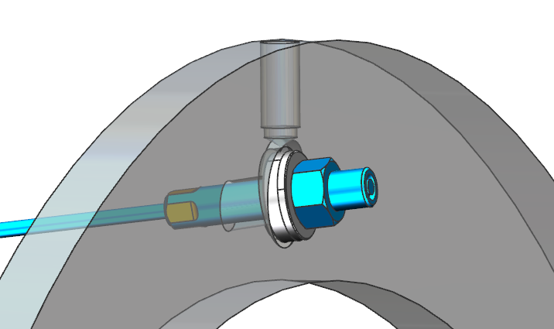
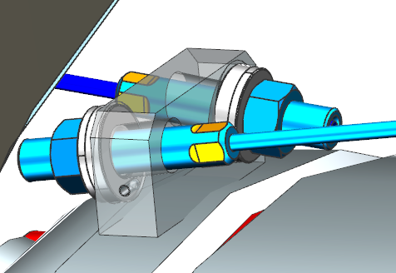
Design – Nitronic Rods Mounts
Transverse Rod Mounts
Axial Rod Mounts

Slide 10
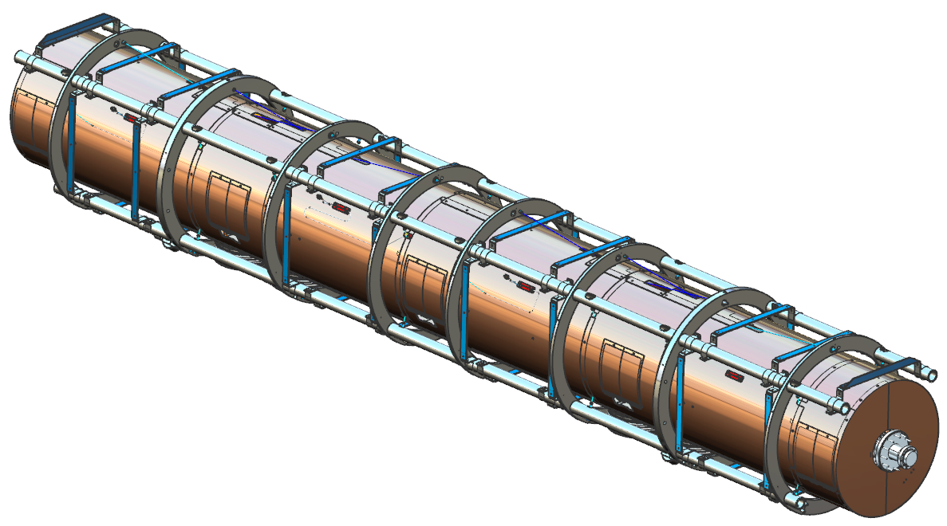
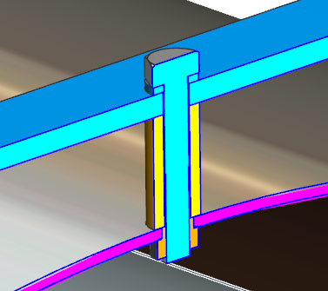
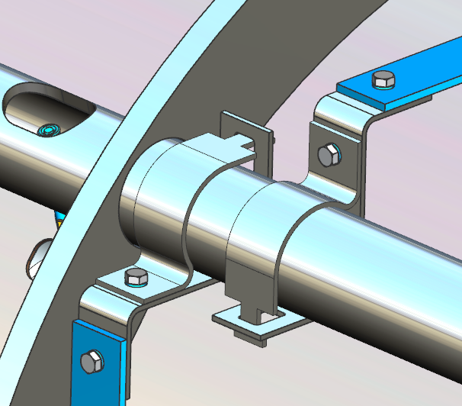
Design – Thermal Shield Support
G10 band
Bolt
Washer
Pem nut
G10 Standoff
SS Clamps onto space frame

Slide 11
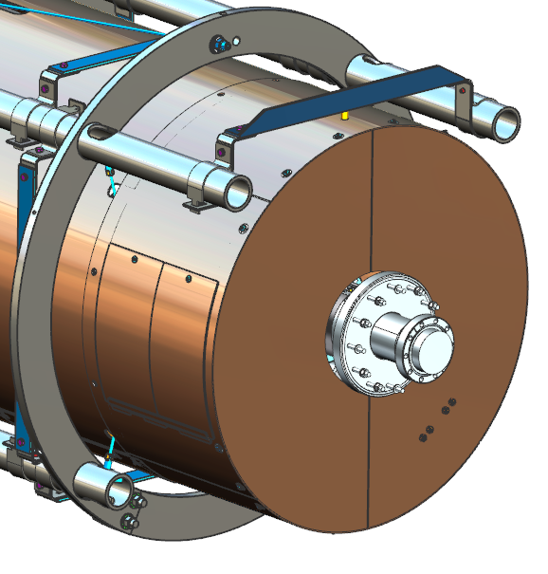
Design – Thermal Shield End Supports
All four of the support tubes were extended in the PDR, now only the top two are extended
Stiffer supports have replaced the flat G10 bands on the shield extension supports that were present in the PDR
The analysis of the support is covered in the Thermal Shield presentation

Slide 12
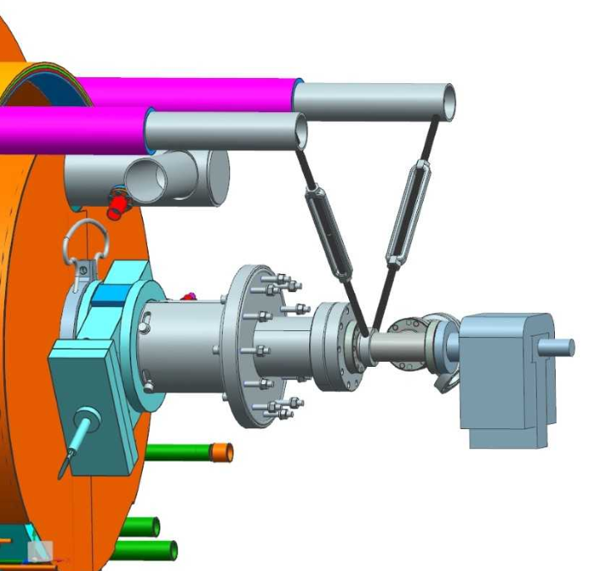
Design – Thermal Shield End Supports
Support Pin Holes
Beamline support tooling is currently being developed to support the temporary ion pump during space frame and vacuum vessel assembly
Holes have been added to the two top space frame support tubes for mounting the beamline support

Slide 13
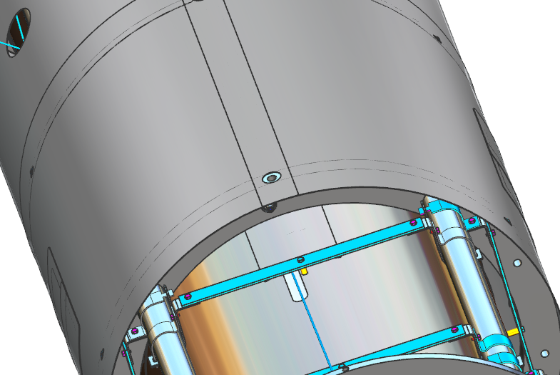
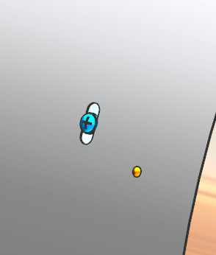
Design – Outer Magnetic Shield Support
The outer magnetic shield assembly rests on the space frame support rings and is secured with ¼-20 hardware.
2/ring

Slide 14
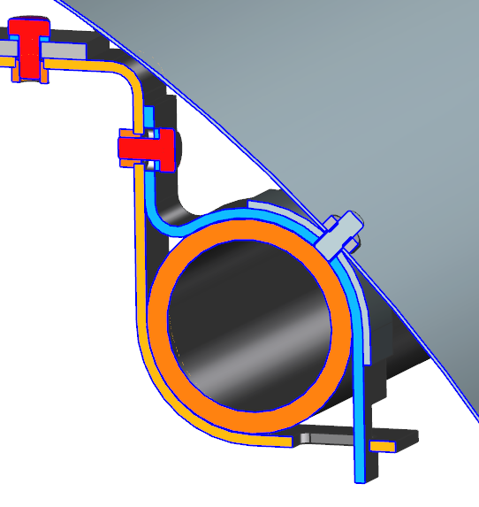
Design – Outer Magnetic Shield Extension Support
Thermal Shield Extension Support
Outer Mag Shield Extension
Nut
Support Tube Clamp
¼-20 Stud
Tack welded to clamp
3/32 strip tack welded to clamp
Four thermal shield extension mount clamps have been modified to support the outer magnetic shield extensions during shipping

Slide 15
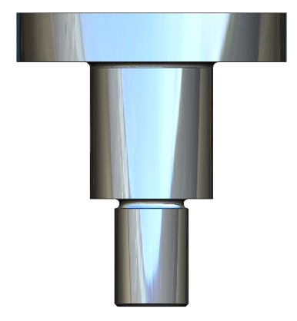
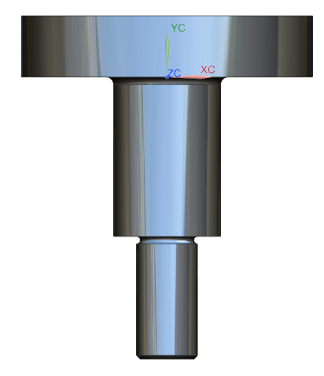
Design – Tie Downs
Tie downs to vessel welds
Thick support ring
Thin support ring
The thick support ring tie downs(3/ring) lifts the space frame through the vacuum vessel and are used for alignment.
The thin ring tie downs (3/ring) are lightly snugged after alignment in order to stabilize the reminder of the space frame and to withstand transport loads
Thick support ring tie down
¾-10
304 SS
Thin support ring tie down
½-13
304 SS

Slide 16
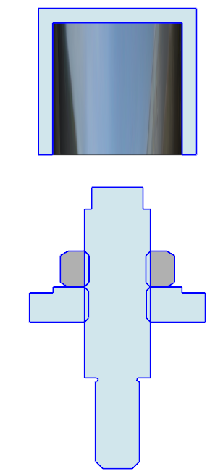
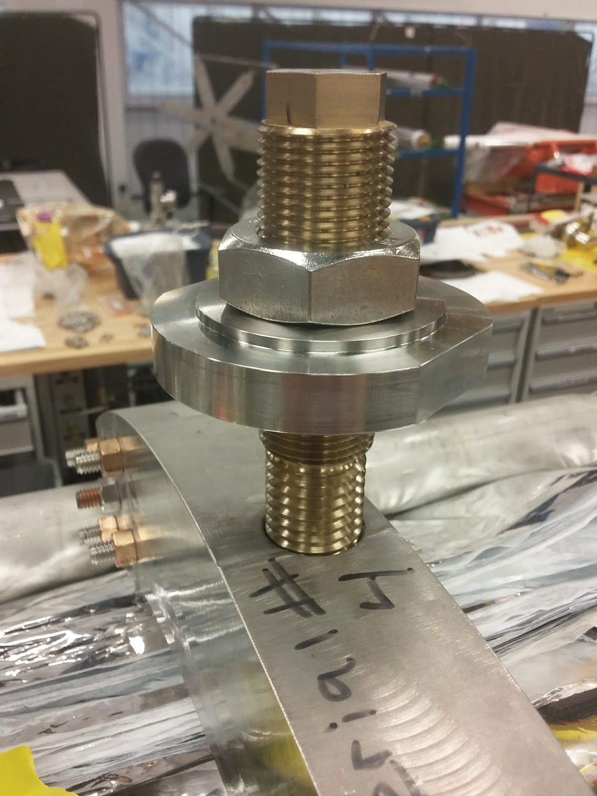
Design – Tie Downs
Vac Cap
Lock Nut
1-1/8 - 12
Weld Disk
Screw
Vac Vessel
3/4 - 10
Potential Tie Down Design Change
May replace the six primary lifting tie downs with a differential screw assembly to increase the adjustment resolution
Equivalent strength as the primary tie down
Prototypes already fabricated, to be tested in one of the C100 CM assemblies in the near future
May have minor impact on vacuum vessel weld pads

Slide 17
Procurement
The space frame assembly will be procured as a complete assembly
The tie downs will be procured along with the space frame since the tie downs thread into the spaceframe support rings
The Spaceframe SOW (104210900-M8U-8200-A001-SOW) is approved

Slide 18
Summary
Space frame design is established
Drawings are >90% complete
Finished preliminary checking
In final checking
Interfaces with other subsystems have been verified
Procurement path understood
May replace the six tie downs with differential screws, pending C100 test

