Slide 1
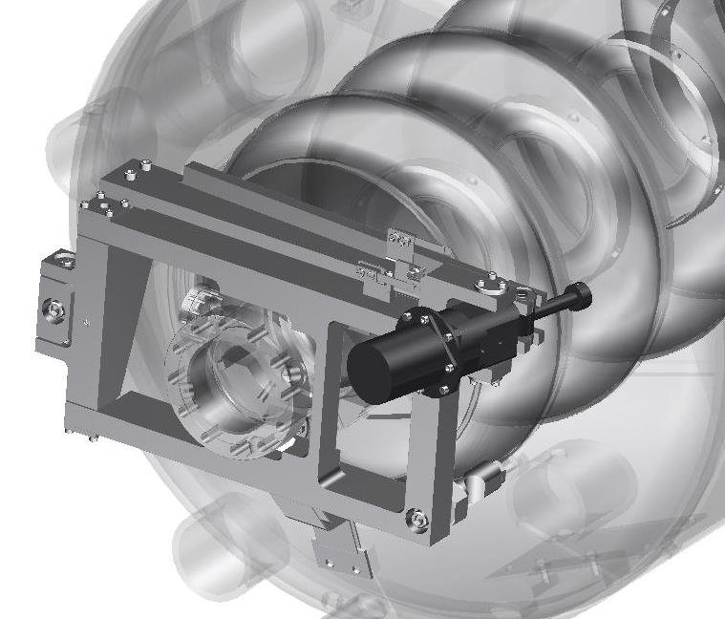
SNS PPU CRYOMODULE FDR
Cavity Tuners
Naeem Huque

Slide 2
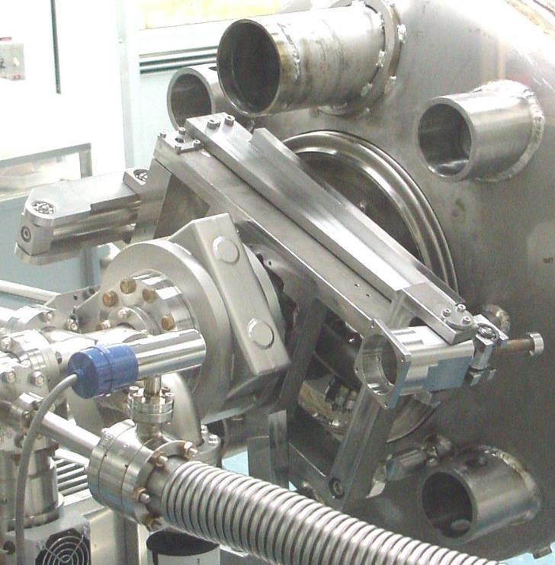
Outline
Introduction
Tuner requirements
Performance
Tuner Components
  Frame
  Motor
  Harmonic Drive
Tuner development and testing
Procurement plan
Summary

Slide 3
Introduction
SNS tuner is based on the DESY/Saclay design
Stainless steel frame
  Attaches to chocks on cavity
  Attaches via flexures and threaded studs to helium vessel head
Cold transmission
  Components in insulating vacuum space
  Stepper motor and harmonic drive rated for UHV, cryogenic and radiation environment
Cavities are only tuned in compression
Original SNS included Piezo actuators, which are not in the PPU design
There have been no changes to the tuner design since the PDR

Slide 4
Cavity Information
Description | Value
Frequency | 805 MHz
Gradient | 16.0 MV/m
Operating Mode | Pulsed, 60 Hz
Bandwidth | 1100 Hz
Microphonics | +/- 100 Hz
Cavity Stiffness | 17,000 lb/in
Frequency Sensitivity | 230 Hz/um

Slide 5
Tuner Requirements
Parameter | Requirement (Actual)
Range | 500 kHz (490 kHz)
Resolution | < 25 Hz (< 3 Hz)
Backlash | < 25 Hz (< 10 Hz)
Cyclic Life | 29,000
Radiation Limit | > 10⁸ rads
Tuning Method | Compression
Load | 8900N
Travel | 1.8 mm (2.0 mm)

Slide 6
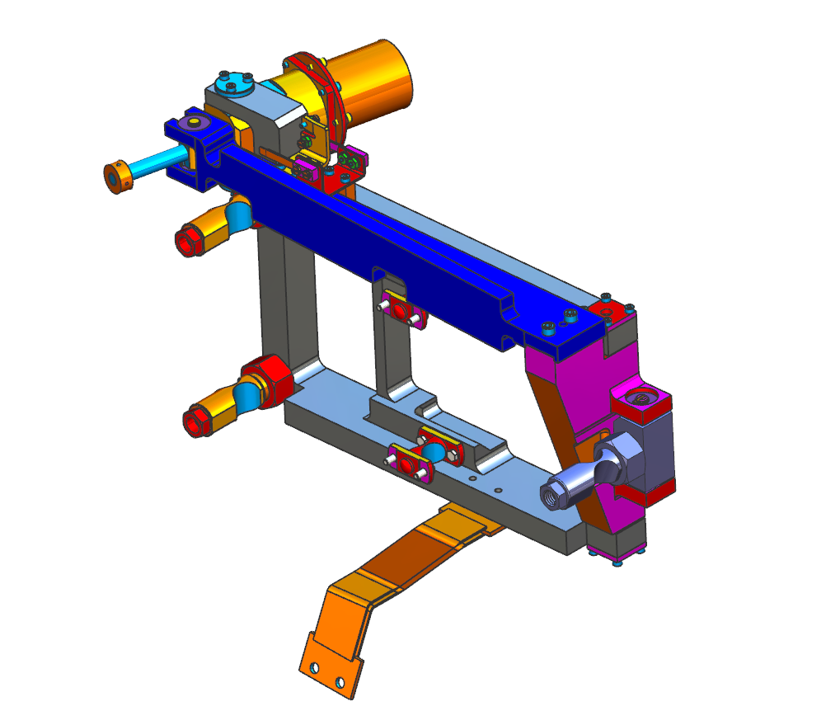
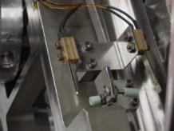
Tuner Operation
Motor: Phytron VSS-52, 52 in.oz
Harmonic Drive: HDC-14-100-2ASP
With 100:1 Reduction
Limit Switches
Dicronited
Beryllium Copper
Drive Screw, M12 x 1.5
316L
Stainless Steel Arm
Flexure Connection to Helium Vessel (3X)
Flexure Connection to Cavity (2X)

Slide 7
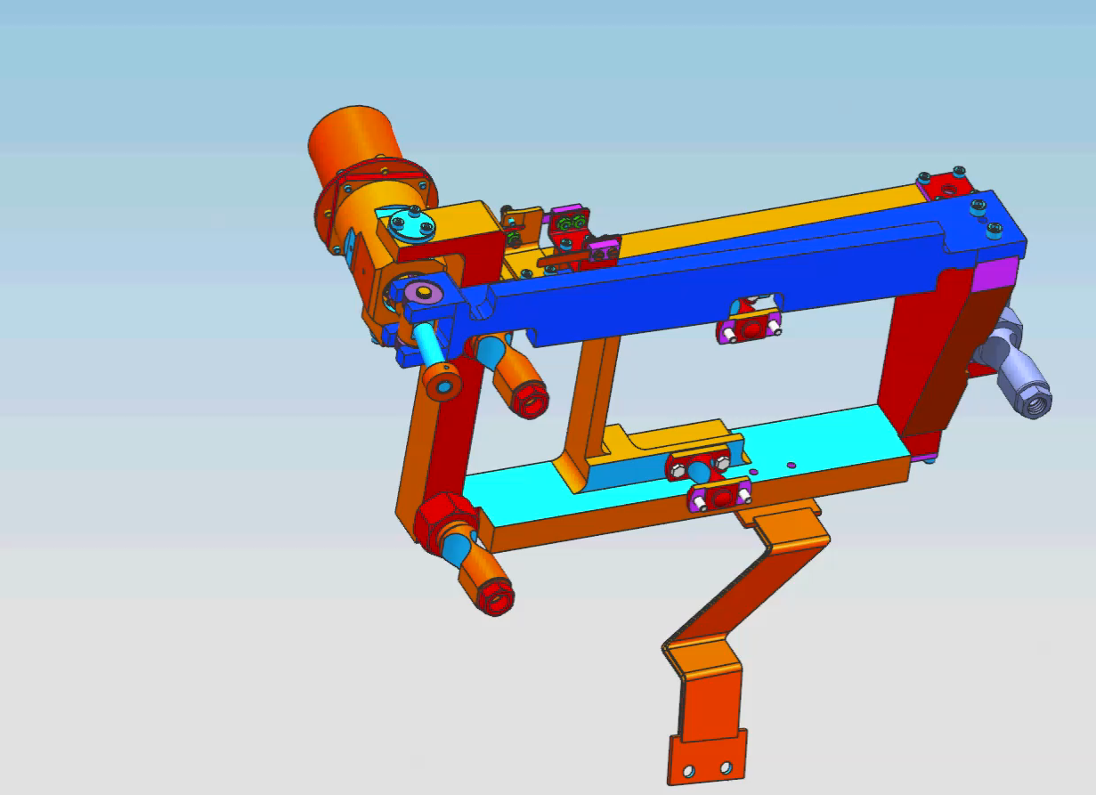
Tuner Operation

Slide 8
Tuner Operation
Course tuning
Fine tuning

Slide 9
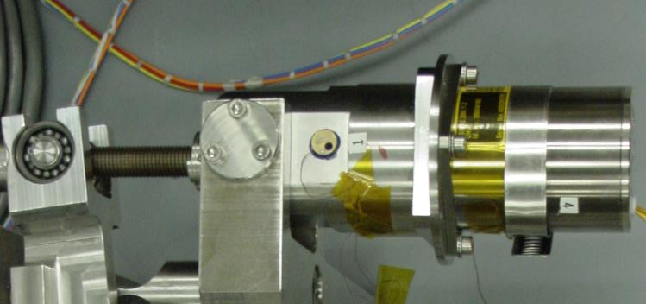
Motor and Harmonic Drive
Phytron will deliver motors identical to SNS models bought in 2002
Phytron VSS.52.200.1.2 models are designed for UHV and cryogenic conditions
QC is conducted at the vendor
  Cold shocks
  Electrical checks
Gear drive is made by Harmonic Drive LLC (gear ratio 100:1)
The motor and gear drive assembly will undergo testing at JLab
Motor Parameters | Value
Current | 1.2 A
Resistance | 3.9 Ω
Max Voltage | 70 V
Holding Torque | 350 mN.m
Detent Torque | 13 mN.m
Max Axial Load | 25 N
Max Radial Load | 70 N
HD Parameters | Value
Gear Ratio | 100:1

Slide 10
PDR Comments/Recommendations
PDR Comment #1:
  The project should assure itself that asking vendors to remake out-of-production components such that they are identical to legacy designs doesn’t create a long-term supply problem, for example, the harmonic drive.
Outcome - CLOSED
  The comment may apply to both the Phytron motor and Harmonic Drive
  The motor is a catalogue item that is still produced
  Harmonic Drive LLC stated that the drive model used in SNS (and to be used in PPU) is a special design and that no updated version is available. Though not a catalogue item, the model will not be discontinued as it is the only type available for cryogenic use
  After further consultation, SNS agreed to the plan presented today.

Slide 11
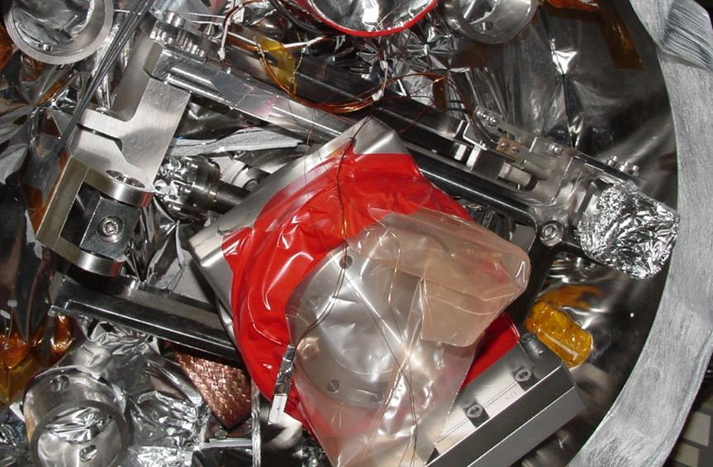
Tuner Installation
Tuners are installed on the cavity string at the same point as the original SNS
Procedures will be updated, but no large changes are predicted
Particular attention will be given to ensuring correct alignment of the motor spindle and harmonic drive, as this affects tuner life

Slide 12
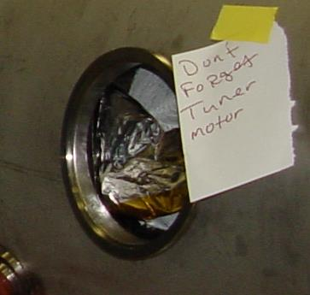
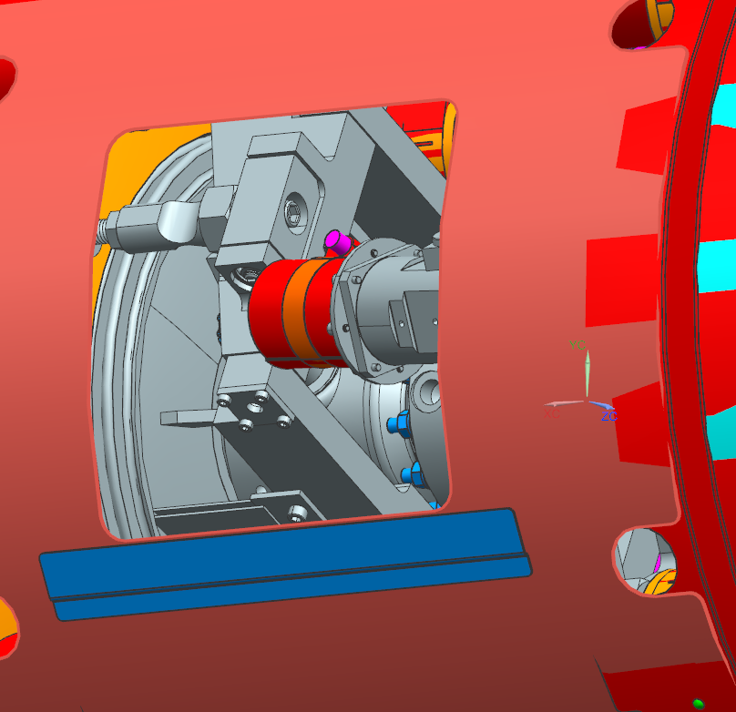
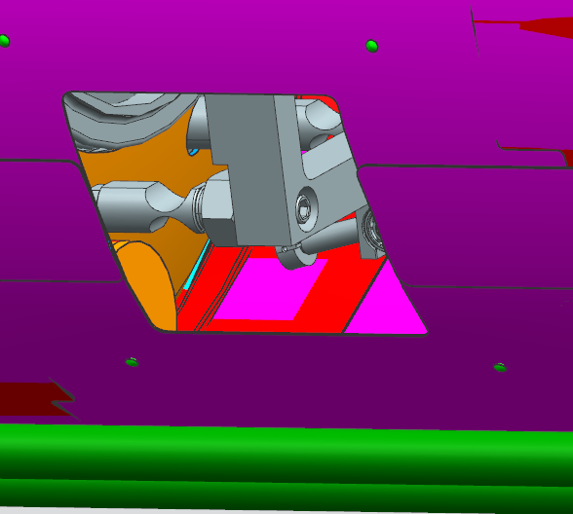
Tuner Installation
Dedicated ports exist on the vacuum vessel to replace any broken tuner components
In the past, the entire tuner assembly has been replaced through the tuner port

Slide 13
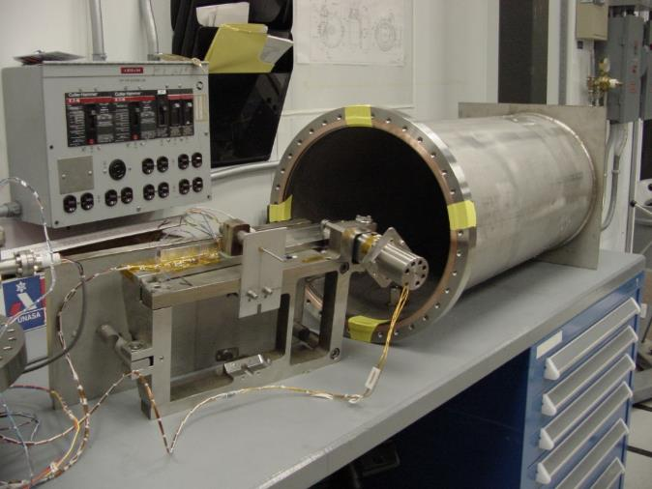
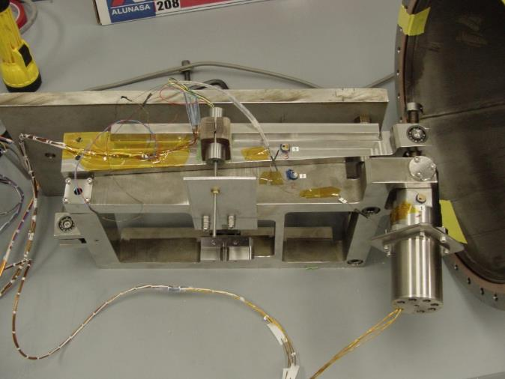
SNS Tuner Development, Testing and Operation
The full tuner assembly was made to undergo an accelerated life test in the JLab VTA
  Stepper motor (attached to frame) was tested for 5 lifetimes
    1,000 cycles at full stroke
    30,000 cycles at 10% full stroke under load
  Tuner/Motor assembly passed the 5 lifetime test
Tuners have been in use at SNS for 15 years

Slide 14
SNS PPU Tuner Testing
The Phytron stepper motor and Harmonic Drive will undergo an accelerated life test
  The set tested will be from the first batch as used in the production cryomodules
The assembly will be run against a spring representing the cavity, in the JLab VTA
The motor assembly will run at 4K in insulating vacuum

Slide 15
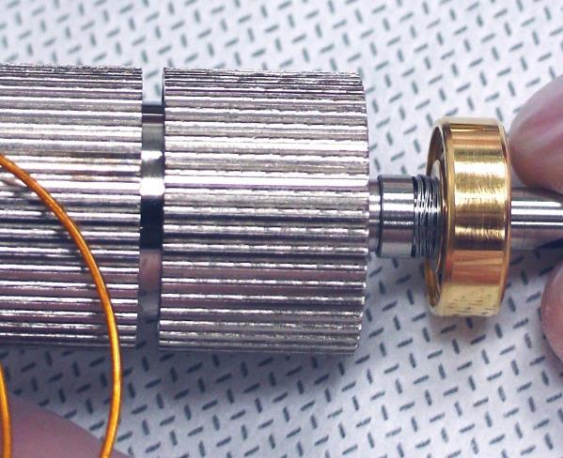
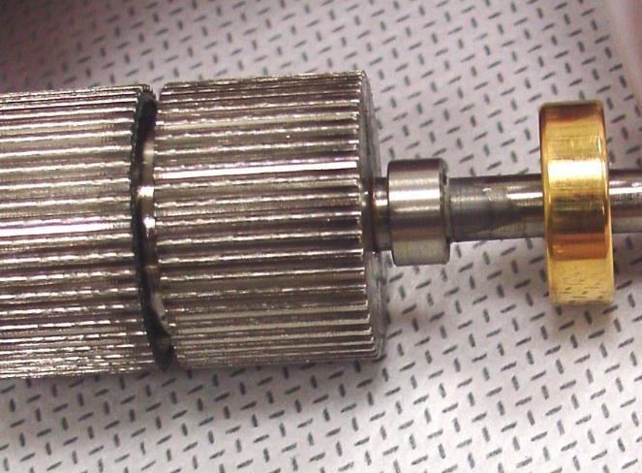
Testing Justification
The Phytron motor tested during the original SNS differed from the first production units delivered
Wave washers were replaced by a single washer, which caused the units to seize up
Even though the model number is the same, other small changes may have been made to the design over the past 18 years
Rotor from accelerated life test motor
Rotor from M-01 Cav. #2 Tuner
Single larger wave washer location(not shown)
Wave washers

Slide 16
Procurement Plan
The stepper motor will be purchased as a sole-source procurement from Phytron Inc.
  Lead time is 16 weeks
  QC will be performed at the vendor
The harmonic drive will be purchased as a sole-source procurement from Harmonic Drive LLC
  Lead time is 36 weeks
  QC will be performed at the vendor
Motors and Harmonic drives will be bought in advance as a long-lead procurement
  One set from the batch will be used for acceptance testing
The tuner frame will be released for competitive bids

Slide 17
Current Status
Ready for Procurement Process
Tuner Frame drawings have been checked and approved
SOWs for the Tuner Frame, Stepper Motor and Harmonic Drive have been completed and approved
Plans after CM FDR
Purchase Reqs will be submitted (NOFUND)
RFQs will be sent to vendors for the motor and gear drive for final pricing
  Awards will be made after CD-3b approval
Accelerated Life Testing plan for the stepper motor and gear drive has been written and approved
  Drawings for the test rig are yet to be completed

Slide 18
Questions?
Naeem Huque
huque@jlab.org
Tuner components
Accelerated life testing
Differences between SNS and SNS-PPU Tuners
Procurement plan
Remaining tasks

Slide 19
Back-up

Slide 20
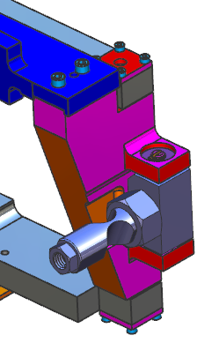
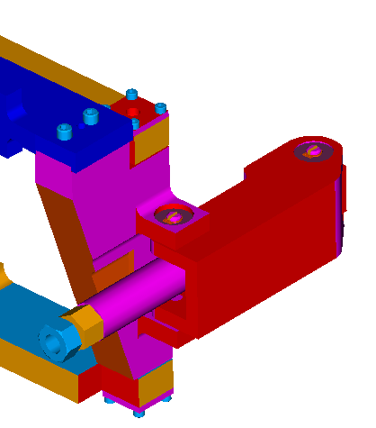
SNS and SNS-PPU Tuner Differences
The PPU tuner (left) design no longer uses a piezo actuator, which was a feature of the original design (right)

Slide 21
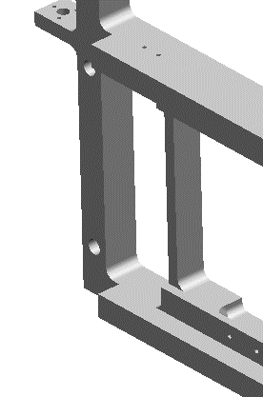
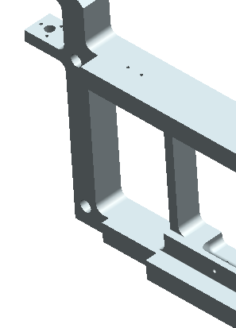
SNS and SNS-PPU Tuner Differences
The PPU tuner (left) no longer has a notch in the frame
The notch was to allow clearance for the HOM feedthrough, which is no longer present

