Slide 1
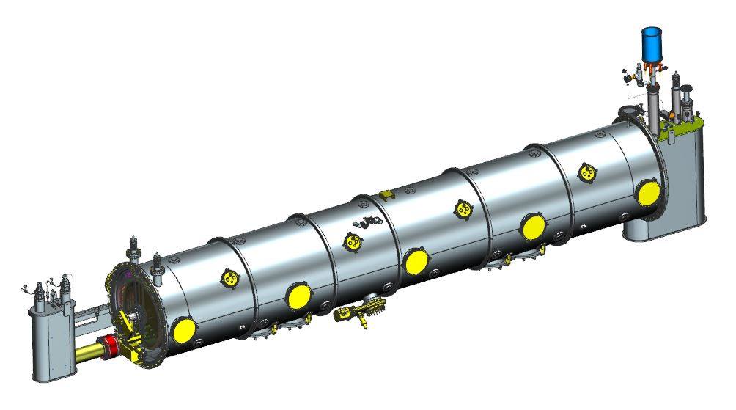
SNS PPU CRYOMODULE FDR
SNS PPU Cryomodule Design Overview
Mark Wiseman

Slide 2
Outline
Design Team
Requirements
  SNS Statement of Work and interface requirements
  Pressure systems
  Other design requirements
Cryomodule Overview
  Cavities and Fundamental Power Couplers
  Clean Room Assembly
  Cold Mass Assembly
  Thermal Shield and Spaceframe Assembly
  Cryomodule Assembly
  Installation Assembly
Response to PDR Recommendations and Comments
Remaining Design Schedule
Summary

Slide 3
SNS PPU CM Design Team
Mark Wiseman ME, Team Lead (Eng. Div.)
Josh Armstrong Designer (Eng. Div.)
  Spaceframe, thermal shield, MLI, instrumentation, ICD
Gary Cheng ME (Eng. Div.)
  End Cans, magnetic shielding
Gary Hays Designer (Eng. Div.)
  Magnetic shielding, vacuum vessel, supply end can
Jim Henry Lead Designer (SRF Dept.)
  Cryomodule assembly
Naeem Huque ME (SRF Dept.)
  Tuner, shipping
Ron Lassiter Designer (Eng. Div.)
  Helium vessel, tuner, clean room and cold mass assembly
Kurt Macha Associate Coordinator (SRF Dept.)
  Assembly planning and tooling
Matt Marchlik ME (Eng. Div.)
  Space frame, thermal shield, MLI, vacuum vessel
Peter Owen ES (SRF Dept.)
  Instrumentation
Bruce Reinhart Designer (Eng. Div.)
  Supply and return end cans
Katherine Wilson ME (Eng. Div.)
  Helium vessel, clean room assembly components
Jeffrey Herger, Earl Skjoldager CAD Interns (Eng. Div)
  Helium vessel, tuner, clean room assembly, end cans
Jeff Campbell, Chris Dreyfus, Kirk Davis, John Fischer, Danny Forehand, Ken Worland, and others
  SRF assembly and tooling design

Slide 4
Design Requirements
SNS PPU Cryomodule Statement of Work - 104110000-SW008-R00
SNS PPU Cryomodule Design Statement of Work - PPU-P02-SW0001-R00
SNS High Beta Cryomodule P&ID - 109100501-R8U-8200-P001
PPU Interface Control Document for 2.3 Cryomodule Integration at Jefferson Lab
SNS PPU Cryomodule Interface Control drawing - 1042101200-M8U-8200-A007^
PPU High Beta Cryomodule Performance Requirements and Minimum Acceptance Criteria - 104210200-M8U-8200-A001-MAC-R0^
Cryomodule Performance Requirements | SNS PPU | Original SNS
Gradient (MV/m) | 16 | 15.8 design / 14.8 avg. operating
Q_{o} (at 2.1K) | 5 x 10⁹ | 5 x 10⁹
FPC Power (kW) | 700 peak (65 avg.) | 550 peak (50 avg.)
Q_{ext} | 8 x 10⁵ | 7 x 10⁵
^Updated or added since PDR

Slide 5
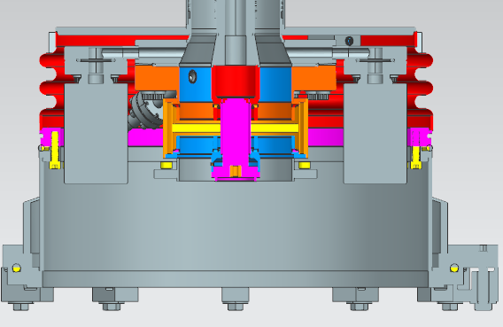
Requirements - Pressure Systems
Agreement between the labs defined in detail in “SNS PPU Cryomodule Pressure & Vacuum Systems” Power Point slides, by Gary Cheng, dated November 6, 2018
  To meet ORNL requirements
    The End Can vacuum shell and Vacuum Vessel will be ASME stamped vessels with a MAWP of 25 PSIG
    Design pressures of 30 PSIG internal and 15 PSIG external
  To meet JLab requirements
    Helium circuits will be designed and built to ASME B31.3 piping code
    Helium vessels will be designed and built to the intent of the ASME BPVC pressure vessel code
    Exclusions as needed due to the use of Nb for the cavities and NbTi for the cavity end dishes
In addition
  FPC Vacuum top hats and bellows will be designed to the ASME BPVC but treated as JLab Class II vacuum systems
    Consistent with the SNS HB Prototype and allows JLab to make the top hat bellows closure weld
FPC Flange to bellows weld
FPC vacuum bellows
Top hat

Slide 6
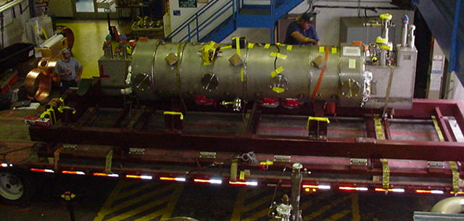
Requirements
All other design requirements have been taken from the original JLab SNS HB design requirements
Other than the pressure systems requirements these are mostly unchanged
  Examples
  Tuner specifications
  Shipping G loads for design (4 vertical, 5 longitudinal, 1.5 transverse)
Designs that have changed from the original design or current SNS design will be highlighted in the individual talks
Data from first MB shipping to SNS, 2002

Slide 7
Cryomodule Overview
Detailed design information in talks
  Helium Vessel K. Wilson
  Tuner N. Huque (M. Wiseman)
  Shipping Plans N. Huque (E. Daly)
  Space Frame M. Marchlik
  Thermal Shield & MLI M. Marchlik
  Magnetic Shields G. Cheng
  Vacuum Vessel M. Marchlik
  End Cans G. Cheng
  Instrumentation P. Owen
  Cryomodule Final Assembly J. Henry
Draft assembly procedures in talks
  Clean Room Assembly K. Wilson
  Cryomodule Assembly K. Macha
Next seven slides are to provide an overview

Slide 8
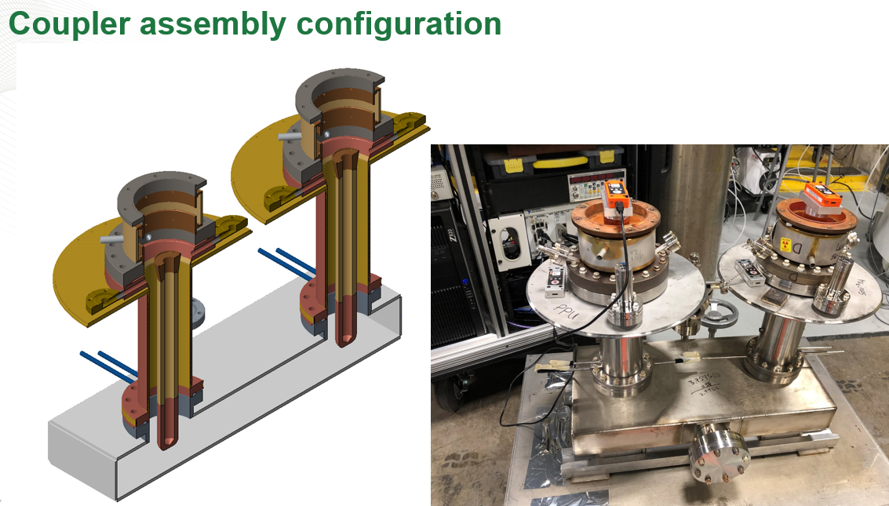
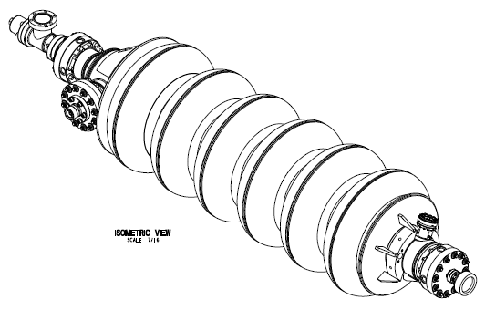
Cavities and FPC’s
805 MHz Cavities, FPC inner conductor with window, and FPC outer conductor are provided by SNS
30 Cavities will arrive from the vendor ready for VTA testing
The FPC inner and outer conductor will be RF vacuum conditioned at SNS and delivered to JLab ready to install in a cavity string
High Beta cavity with flanges assembly from vendor
104211800-M8U-8330-A001
J. Mammosser TTC presentation

Slide 9
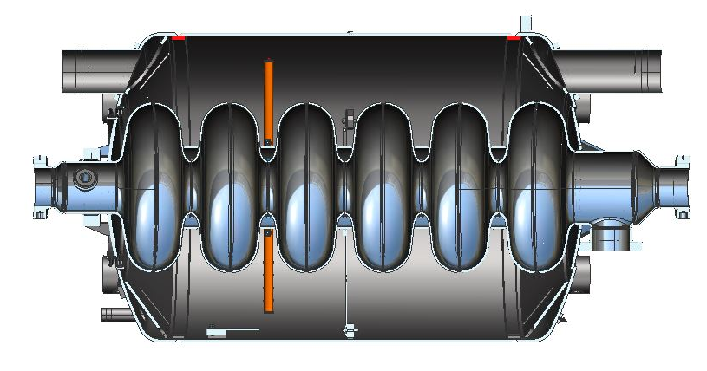
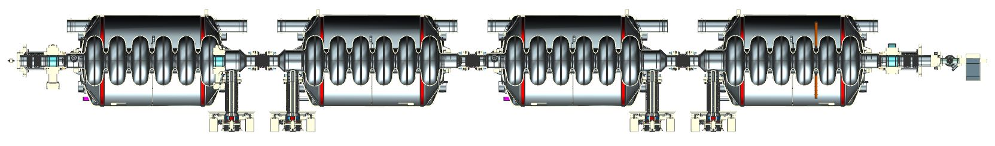
Clean Room Assembly
Cavities are installed in helium vessel at JLab
Four Cavity with helium vessel to a string
  One with liquid level probes
FPC assembly
Field Probes
Beamline bellows between cavities
Metal seal gate valves at ends
Warm to cold transition bellows with restraints
  Temporary vacuum pumping on the return end
1.29 m
Field Probe
Cavity in helium vessel (24” OD)
Gate valve
Warm to cold beam line bellows
Beam line bellows
Warm to cold beam line bellows w Ion pump
FPC assembly

Slide 10
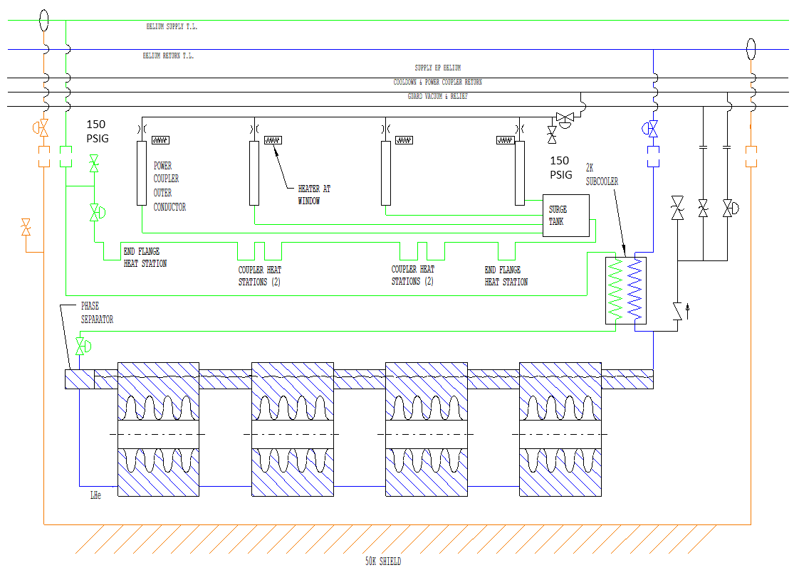
Helium Circuits (P&ID 109100501-R8U 8200 P001)
Simplified Version
Primary Supply
2K Return
FPC circuit control valve
Cool down valve
185 PSIG
17 PSID
Primary JT valve
60 PSIA
Shield Circuit

Slide 11
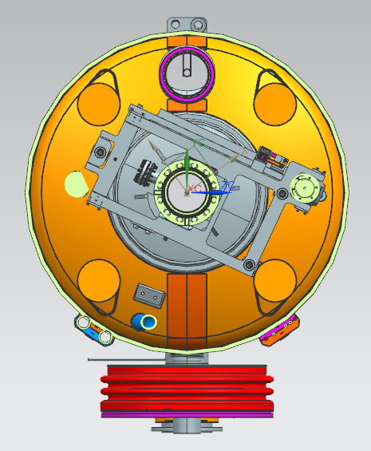
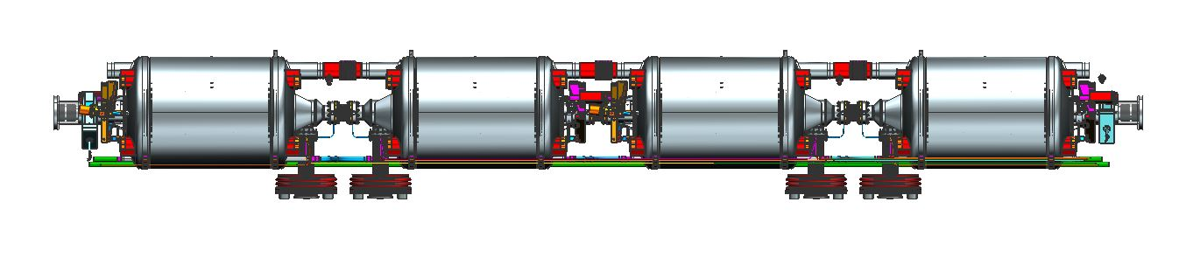
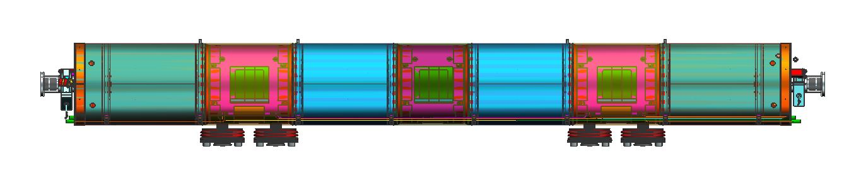
Cold Mass Assembly
2K header bellows and lower liquid level flex hoses between helium vessels
~5k coupler circuit + HX supply and return lines
FPC vacuum vessel bellows
Tuners
MLI (not shown)
Cold magnetic shielding
Tuner
Flex lines
Header bellows
Coupler circuit
FPC vacuum bellows
Magnetic shield
HX supply and return helium lines

Slide 12
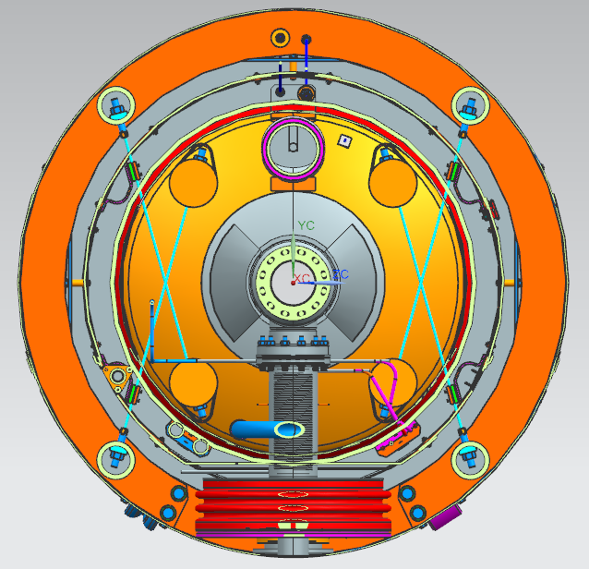
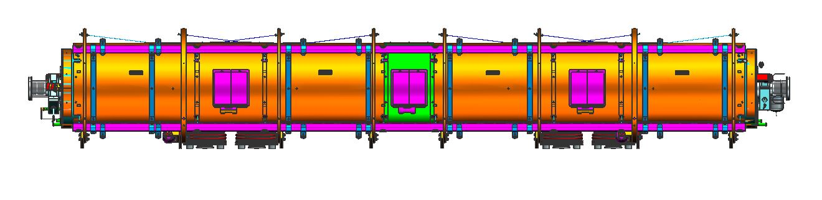
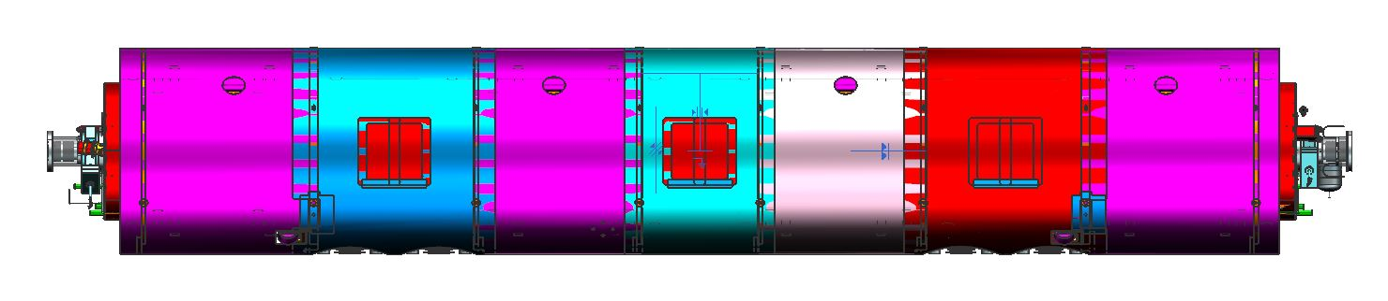
Space Frame and Thermal Shield Assembly
Thermal shield installed in spaceframe
MLI (not shown)
Cavity string aligned in space frame using nitronic rods
Warm magnetic shield around space frame
Spaceframe
Thermal shield
Nitronic rods
Magnetic shield

Slide 13
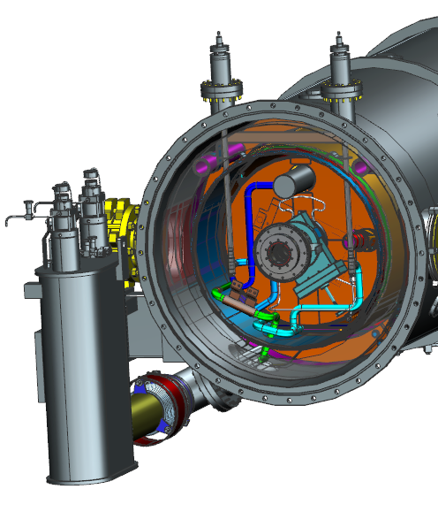
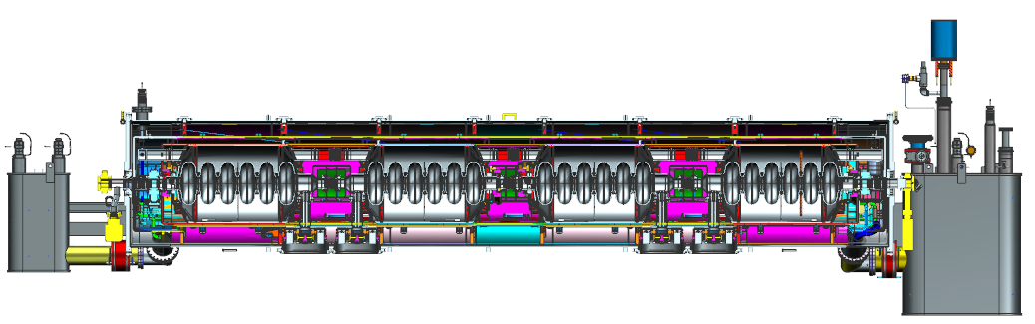
Cryomodule Assembly
Vacuum Vessel
Supply and Return End Cans
Finish helium circuit piping with valves
Add thermal shield, warm magnetic shields and MLI to both ends inside vacuum vessel
Beam pipes with valves and vacuum pump
Exterior coupler tubing (shown on next slide)
Supply end view with internal piping
Supply end can
Return end can
Vacuum vessel (39” shell OD)
Beam line length (6.290 m)
Overall length (7.87 m)

Slide 14
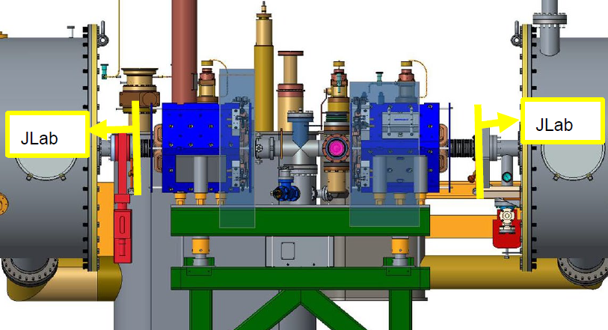
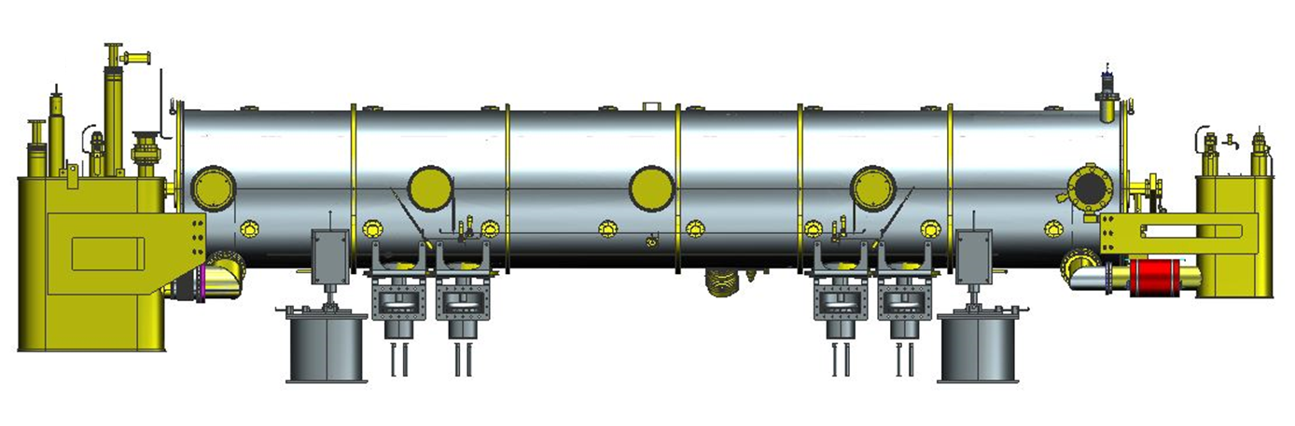

Cryomodule Installation
Cryomodule on stands and saddles in tunnel
Air side FPC couple and waveguide installed
Warm girders between cryomodules
All supplied by SNS
Warm girder between CMs (from ICD)
Saddle
Air side FPC extensions, doorknobs and waveguides
FPC exhaust manifold (installed at JLab)
Stand

Slide 15
Response to PDR Recommendations
# | Recommendations | Status | Response
1 | Keep a running list of changes incorporated in the PPU upgrade cryomodules since the SNS spare design and fabrication. | CLOSED | The list has been generated and is being progressed. Revision C updated just prior to the FDR. [Document in the backing material]
2 | Prior to the Final Design Review, finalize the design decisions and fabrication plans associated with the changes from the SNS spare, including the magnetic shielding, cold-to-warm transition, end can temperature diode specification, field probe cable specification, and shipping analysis. | Due 6/12/2019 | Final designs will be presented at the FDR on 6/10.
3 | Set up regular online coordination meetings between SNS and JLab to track progress, discuss issues, and ensure goals and responsibilities are well understood. | CLOSED | Meetings are held between SNS and JLAB every two weeks to discuss project issues. Additional meetings are scheduled as needed to discuss specific topics.

Slide 16
Response to PDR Recommendations
# | Recommendations | Status | Response
4 | Complete procurement packages for all major sub-systems. | Due 12/31/2019 | The designs will be presented at the FDR on 6/10. The procurement packages and statement of works will be completed on time to support the procurements. A procurement plan is in place and included in the baseline schedule.
5 | Verify, through analysis or simulation, that the dynamic response of the cold-to-warm transition joint thermal intercept flange is not detrimental to the bellows assembly during transportation. | CLOSED | The new warm to cold transition has been compared to the original design by M. Marchlik. The shipping stresses are acceptable and the modal analysis indicates that the fundamental frequencies of the new design is above the old design. [Vacuum Vessel Talk]
6 | Perform flexibility analysis on the end can piping. | CLOSED | This has been done, along with shipping and pressure load analysis by G. Cheng. [End Can Talk]

Slide 17
Response to PDR Recommendations
# | Recommendations | Status | Response
7 | Develop conceptual designs for cleanroom and assembly tooling. | CLOSED | This has been done and will be presented at the FDR. [Clean room and Cryomodule assembly plan talk]
8 | Verify in-tunnel clearance between cryomodules. | CLOSED | The clearance between the cryomodules has been checked and deemed adequate. The Interface Control Drawing has been created with the new design. [ICD in backing material]
9 | Define pre-shipping acceptance criteria at Jefferson Lab and receiving acceptance criteria at SNS. | In Process | The "PPU High Beta Cryomodule Performance Requirements and Minimum acceptance Criteria" for testing at JLAB has been generated and agreed to. [Document in backing material] Receiving acceptance criteria at SNS is being developed.
10 | Clarify the scope for Jefferson Lab regarding shipping preparation and shipping-related design. | CLOSED | Shipping Proposal was presented to SNS on March 27 and agreed to. [Shipping talk and the proposal in backing material]

Slide 18
Response to PDR Comments
# | Comments | Status | Response
1 | The project should assure itself that asking vendors to remake out-of-production components such that they are identical to legacy designs doesn’t create a long-term supply problem, for example, the harmonic drive. | CLOSED | We reviewed the tuner motor and drive options with the vendors and confirmed that the original two options were the only viable solutions. We reviewed the options with SNS and decided to stay with the original design. [Tuner Talk]
2 | The project should leave itself open to potential improvements in technology relative to the original SNS production. | CLOSED | We have reviewed the RF cables options and decided to stay with the original design. We have looked into alternate MLI designs but have decided to use the existing design. We have adopted an updated design for the explosion bonded joints. [Various talks]
3 | To the extent possible, perform finite element analysis on simplified assembly models of the cryomodule and end cans to point out potential trouble spots, especially during transportation. | CLOSED | Reviewed the vibration analysis done by K. Matsumoto (LANL, 2001) for the MB Cryomodule. Lowest mode was 30 Hz lateral motion of Cavity/Helium Vessel. Vibration and stress analysis by M. Marchlik on the warm to cold bellows predicts >40 Hz. Vibration work by SNS on the new FPC predicts modes >70 Hz. All modes above frequencies of concern for shipping. G. Cheng has completed shipping analysis of end cans and piping. [Next slide]

Slide 19
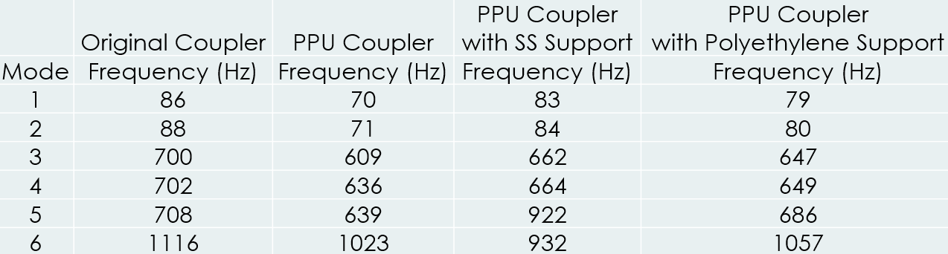
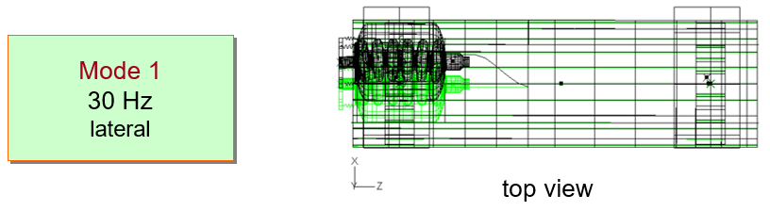
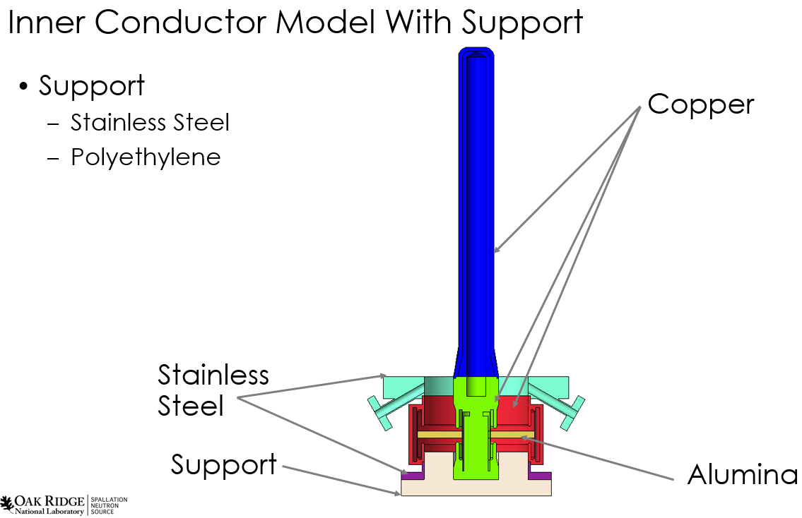
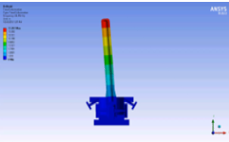
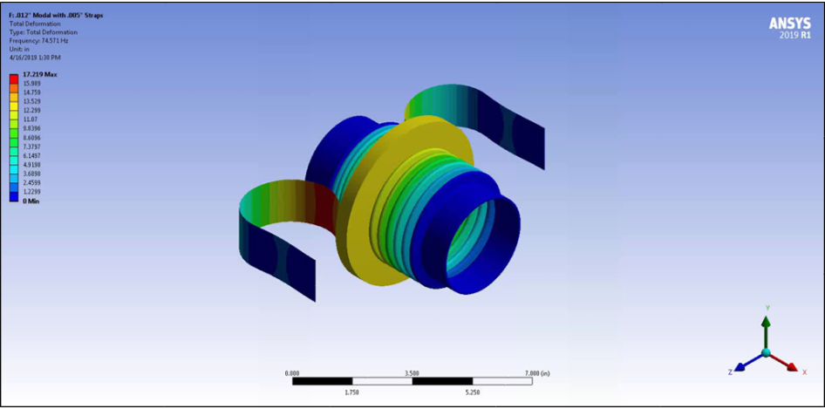
PDR Comment #3
# | PDR Comments | Status | Response
3 | To the extent possible, perform finite element analysis on simplified assembly models of the cryomodule and end cans to point out potential trouble spots, especially during transportation. | CLOSED | Reviewed the vibration analysis done by K. Matsumoto (LANL, 2001) for the MB Cryomodule. Lowest mode was 30 Hz lateral motion of Cavity/Helium Vessel. Vibration and stress analysis by M. Marchlik on the warm to cold bellows predicts >40 Hz. Vibration work by SNS on the new FPC predicts modes >70 Hz. All modes above frequencies of concern for shipping. G. Cheng has completed shipping analysis of end cans and piping.
Medium Beta CM Vibration Study
K. Matsumoto (LANL) (9/28/2001)
SNS PPU FPC Analysis
S. Stewart (SNS) (10/05/2018)
Shipping tests planned
Fundamental frequencies higher than the original design
HB End Can and Piping Analysis in G. Cheng FDR Talk
Warm to Cold Bellows
M. Marchlik FDR talk

Slide 20
Response to PDR Comments
# | Comments | Status | Response
4 | Consider a means of leak checking the bolted connection between the end cans and cryomodule prior to making the internal welded connections. | CLOSED | This was explored and deemed to not be feasible do to geometry constraints. We will plan on leak checking the vacuum vessel and end can assemblies upon receipt and protect the flanges until final assembly. [Vacuum Vessel Talk]
5 | Consider the benefits of using orbital welding where practical. | CLOSED | This will be looked at and decided on prior to production. [Closed for design]
6 | Consider local shipping tests on individual components and assemblies prior to shipping the first cryomodule to SNS. | CLOSED | SNS plans to do shipping tests on the FPC assemblies. A cryomodule shipping proposal was presented to SNS on March 27 and agreed to. A change request has been processed to address any additional charges required for the testing. [Shipping talk]

Slide 21
Response to PDR Comments
# | Comments | Status | Response
7 | If necessary, check with Fermilab on qualification tests performed on explosion bonded Ti/SS transition joints used on LCLS-II cryomodules. | CLOSED | K. Wilson contacted FANL and received the information from on the qualification tests on explosion bonded joints. We also talked to High Energy Metals (vendor) about design improvements. Information from both sources is being used in the design. [Helium vessel talk]
8 | Consider the necessity and the extent to which fasteners should be secured using thread locking compound, safety wires, etc. | CLOSED | We think it is worth considering locking compound, etc. on critical bolted connections, primarily for shipping considerations. We will review the potential radiation considerations and confirm the plan with SNS prior to production. This will be done with procedures and no design changes planed. [Closed for design]
9 | Determine the advantage, if any, of substituting Cryoperm-10 or similar material for mu-metal on the inner magnetic shield. | CLOSED | Consulted with SNS project staff regarding the need to improve the magnetic shielding. Their response was that the existing design was adequate and they saw no need to improve on the design. [Magnetic shielding talk]

Slide 22
Response to PDR Comments
# | Comments | Status | Response
10 | Estimate whether adequate flow areas exist at the parallel plate and burst disk relief locations. | CLOSED | M. Marchlik reviewed the flow areas through the shields and near the reliefs and confirmed the areas to be greater than the relief area. [Vacuum vessel talk]
11 | Consider CAD demonstration of cleanroom-to-spaceframe tooling interfaces. | CLOSED | This has been done and will be presented at the FDR. [Cryomodule assembly plan talk]
12 | Evaluate the thermal shield bellows performance under all potential operating scenarios. | CLOSED | We checked the performance of the bellows and have modified the bellows specification accordingly. [Thermal shield talk]
13 | Additional diagnostics might be useful in the cryomodule, e.g. temperature sensors, vibration sensors, diodes, etc., to better understand any outstanding performance issues. | CLOSED | Consulted with SNS project staff regarding additional instrumentation for outstanding performance issues. There were no specific concerns to be addressed. Instrumentation needed for shipping was included in the shipping test proposal. [Shipping talk and proposal in backing material]

Slide 23
Remaining Design Schedule
SNS PPU Cryomodule design
  Respond to action items from this review
  Remaining design task to be highlighted in individual talks
  Finish and sign the remaining drawings in time to support the procurement activities
Tooling designs
  Preliminary tooling designs presented today
  Preliminary shipping fixture design options presented today
  Finalize the designs, conduct FDRs of the designs, and finish the designs in time to support production activities
Engineers will transition to SOTR’s for the procurement process

Slide 24
Summary
The SNS PPU Cryomodule designs are ~complete
Preparation for procurement has begun
Remaining work will be highlighted in individual talks
Thank you!
Questions?

Slide 25
Backing Material

Slide 26
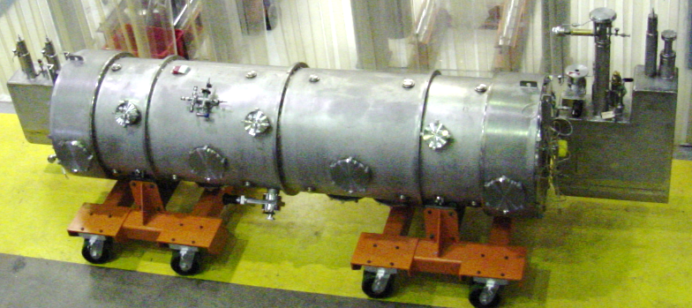
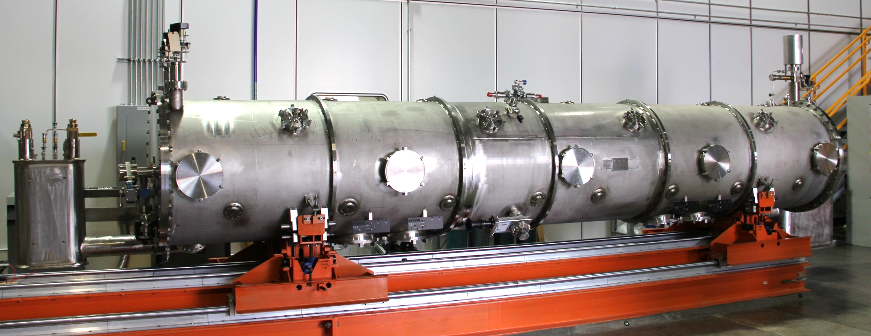
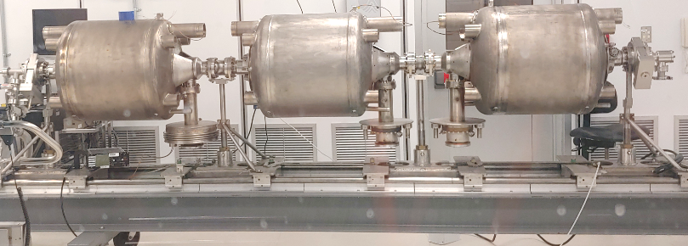
Brief History
Original JLAB SNS Design ~1999-2004
  Complete design and fabrication of 24 cryomodules
  One Medium Beta Prototype
  11 Medium Beta Cryomodules
  12 High Beta Cryomodules
  First ~13 cryomodules tested at JLab, remainder tested at SNS
SNS Designs
  HB Prototype (Spare) ~2012
    ASME Vacuum Vessel and End Cans
    Modified helium vessels, warm to cold beam pipes, cryogenic piping at vessel ends
  MB Spare (currently under assembly)
    Incorporated PPU cavity and coupler changes
SNS Proton Power Upgrade 2018-2023
  7 HB Cryomodules
  Combine the old and new designs
    Update the design drawings
  Procure parts
  Assembly at JLab
  Final RF test at SNS
Original MB ready for testing
SNS HB prototype on rails
JLab SNS PPU CAD model
SNS MB spare cavity string in cleanroom

