Slide 1
SNS PPU CRYOMODULE FDR
Clean Room Assembly
Katherine Wilson and Kurt Macha

Slide 2
Outline
Assembly plan overview (including cavity test)
Design/engineering of components (not included elsewhere)
Current status and updates since PDR
SOW & procurement plan
Plans to finish

Slide 3
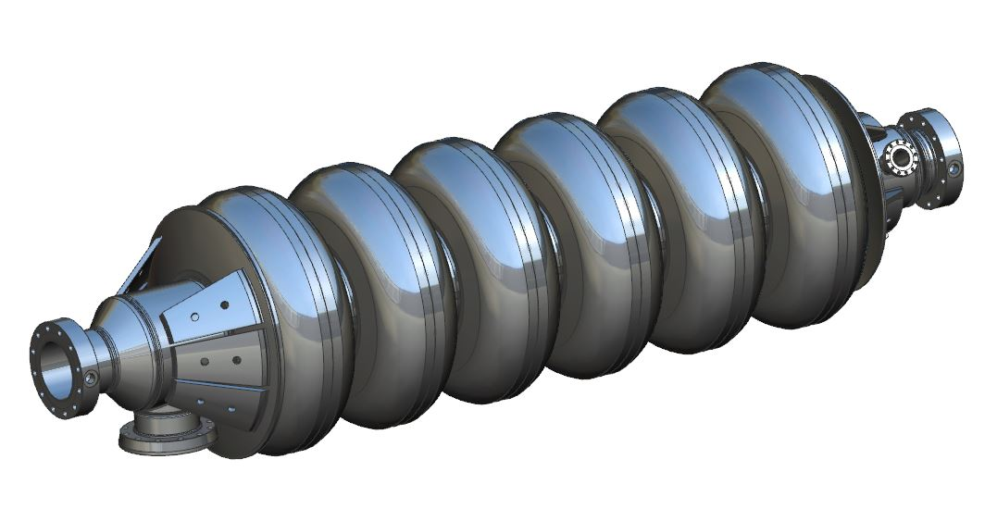
Cavities
Cavities arrive bare, under vacuum, with testing hardware
Tested at JLab
Helium tanks welded on (discussed in separate talk)

Slide 4
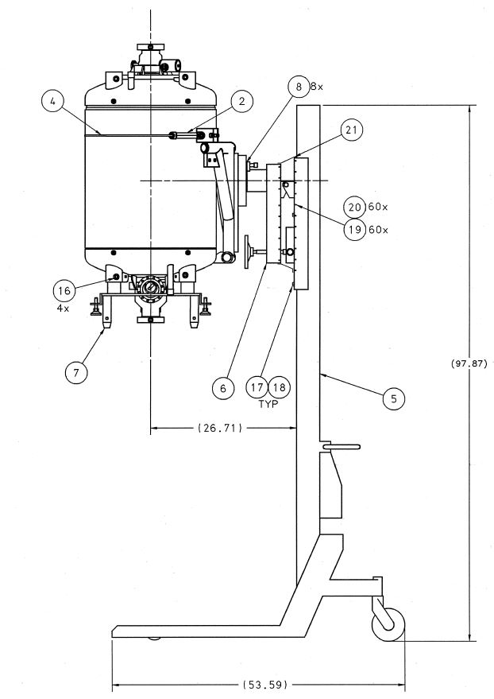
Cavity Handling Tooling
Adapter plate for mounting in test stand for VTA qualification
BackTech with support frame attached to helium vessel to be used for transport of cavity assemblies
Same tooling will be used for cavity mounting onto VTA test stands for qualification

Slide 5
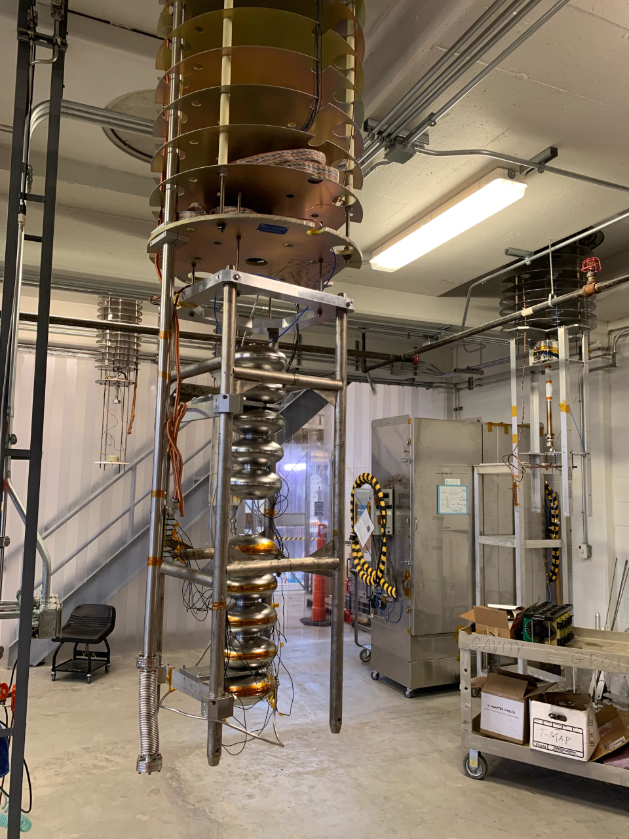
Cavity VTA Testing
Bare cavity caged and ready for hanging in test stand for VTA qualification

Slide 6
Fundamental Power Couplers
Delivered from SNS to JLab tested and under vacuum on a manifold
SNS will provide cleanroom carts for moving and shipping equipment (manifolds, shipping carts, inner conductor shipping restraints)
Delivery will be in time for string assembly
At JLab:
Clean outside of assembly for entry into clean room
Leak check
Inspect seal surfaces for scratches

Slide 7
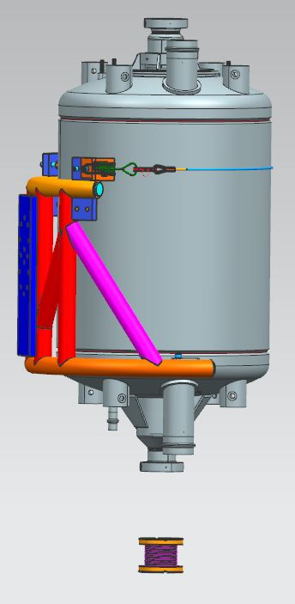
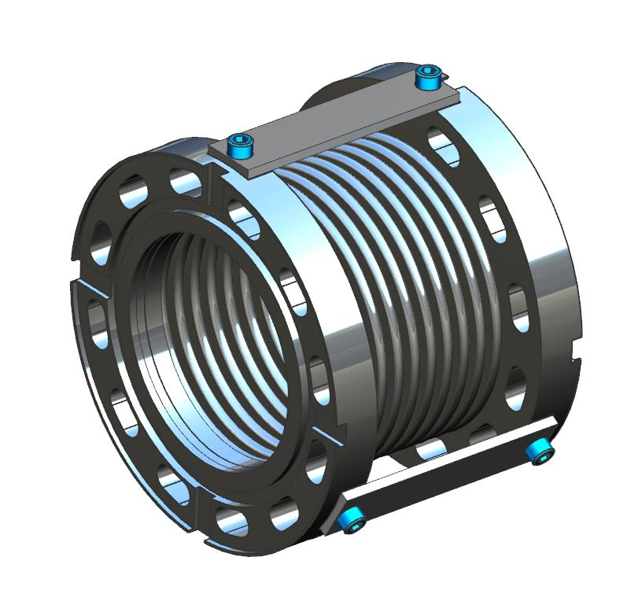
Beamline Bellows Design and Installation
Beamline bellows will be installed with cavity supported vertically on BackTech
Design changes – flats & bolt holes added for restraints, clearance of lip on flange increased for ease of installation

Slide 8
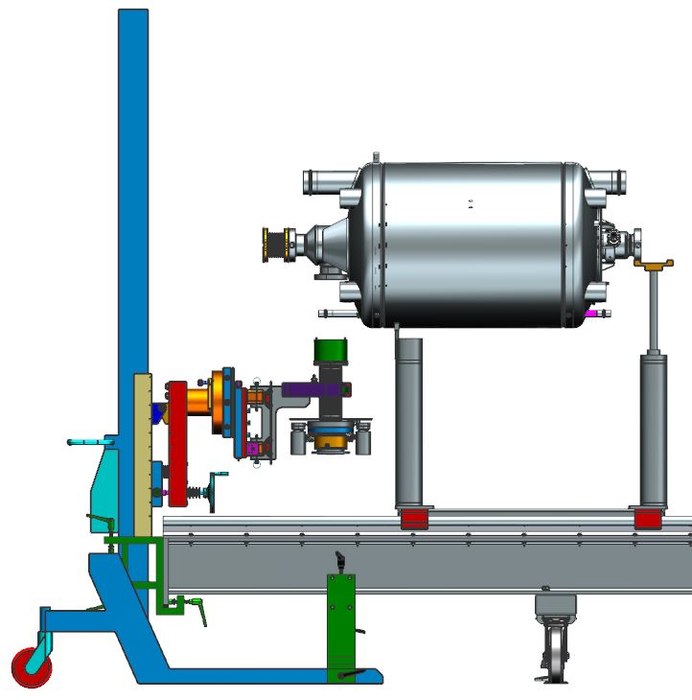
FPC Installation
Dedicated rail with lollipops for cavity/coupler assembly to ensure stability during assembly
BackTech lift tooling (likely secured to rail for stability) to be used for coupler alignment and installation
Covers with alignment features to be used for coupler alignment to cavity port
Seal surfaces on flanges get final visual inspection

Slide 9
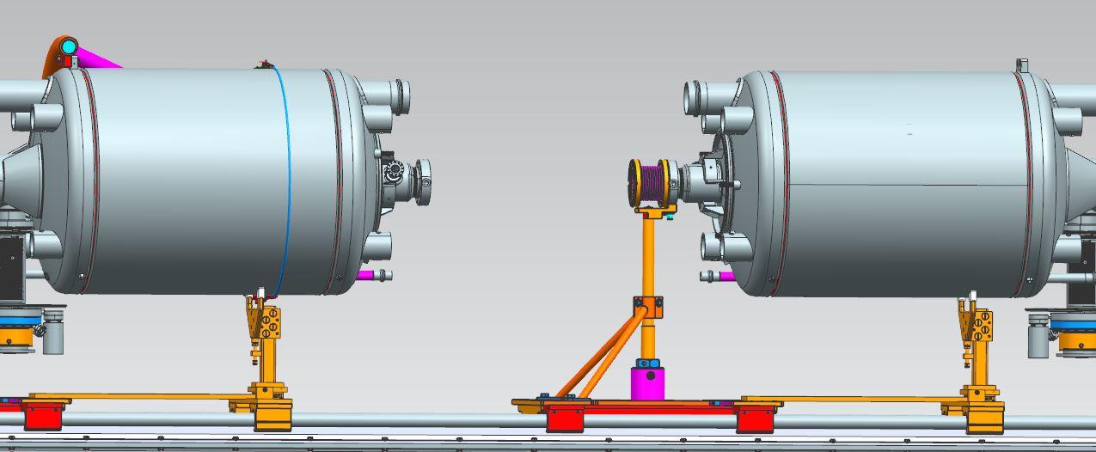
Move Cavity onto Lollipops on Assembly Rail
Roll fixed by V-block and counterbored hole on cavity flange
Reference beamline flange with dial indicators
Adjust tooling for beamline flange alignment
Tooling removed after beamline assembled

Slide 10
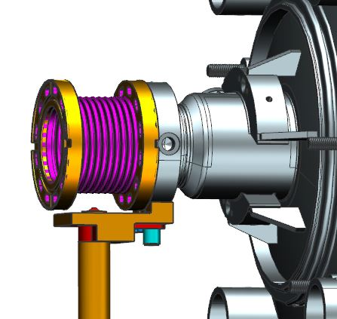
Cavity/Bellows Support During Assembly
Split support at the top of the lollipop
Allows removal of half the V-stand assembly to allow free assembly access
Bellows restraints (not shown) remain during installation

Slide 11
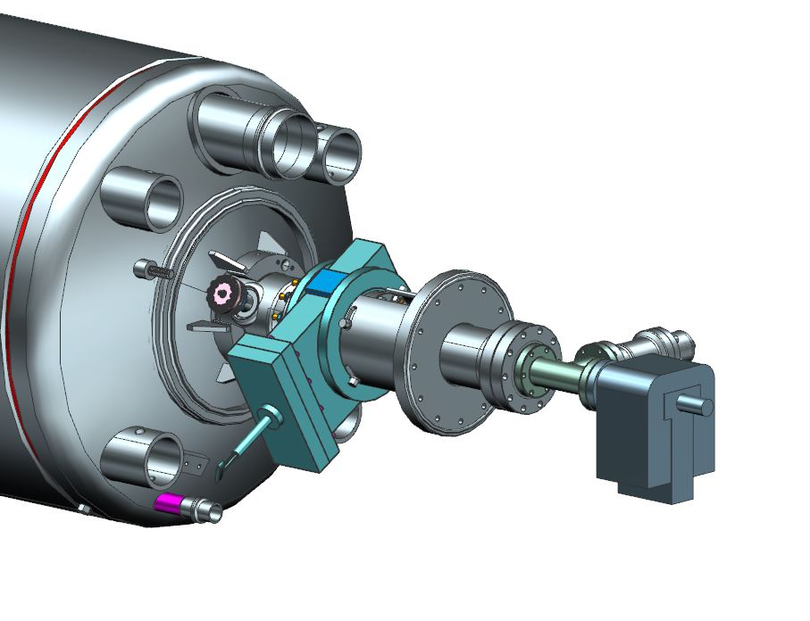
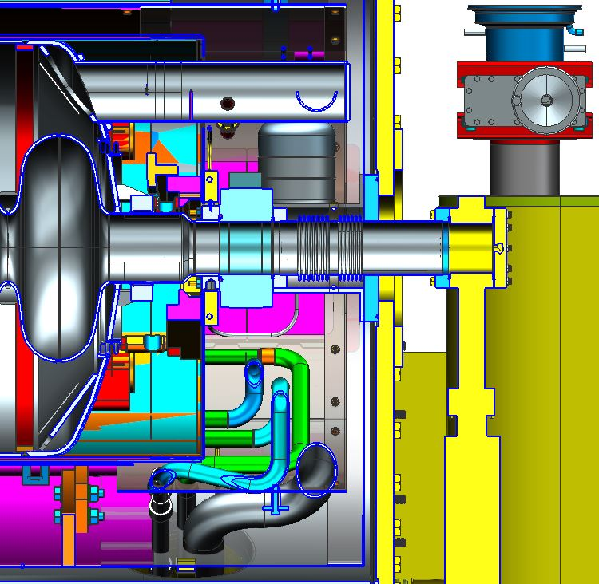
Return Warm-to-Cold Design
Return end has bellows/spool assembly with large mid-point flange that will attach to vacuum vessel head
Temporary tee and pump which will be removed after VV assy
Pump temporarily supported by clean room rail

Slide 12
Return Warm-to-Cold Beampipe Assembly
Support tooling allows for warm to cold beam section to be fully assembled into a sub-assembly
Valve position will be set to the cavity beamline flange
Bellows section will be mounted and positioned to valve
Ion pump manifold will be mounted to complete the sub-assembly
Full assembly will be brought to the cavity flange for final flange assembly
Tooling will be removed and the Ion pump load will be supported

Slide 13
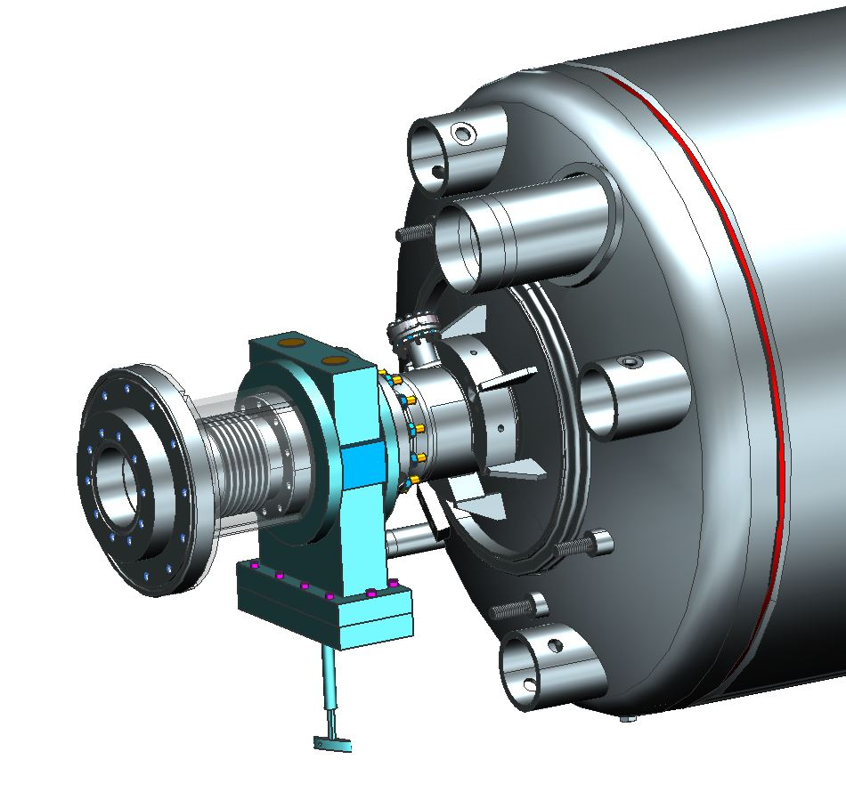
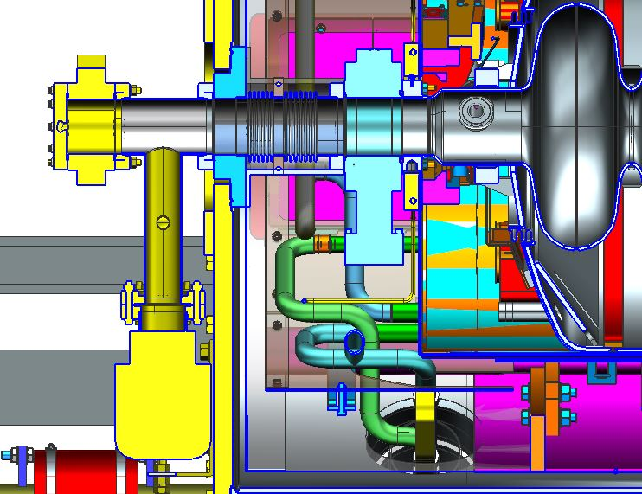
Supply Warm-to-Cold Design
Supply end of CM has a bellows outboard of the beamline gate valve
Restraint bolted at both ends prevents motion of bellows
Blanked-off flange will eventually bolt to vacuum vessel head and pump drop

Slide 14
Supply Warm-to-Cold Beamline Assembly
Supply warm to cold beam tube assembly will be assembled similar to the return end. Mostly the same tooling will be used at both ends.
Restraints on both W2C bellows protect and restrain the bellows; removed through tuner ports during CM assembly

Slide 15
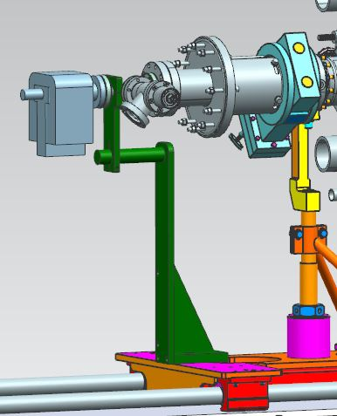
Assembly
A support for the pump will be added when the pump assembly lollipop is removed
Rolling lollipops allow components to be assembled with minimal particulate generation
Entire rail can roll out of clean room when assembly is complete

Slide 16
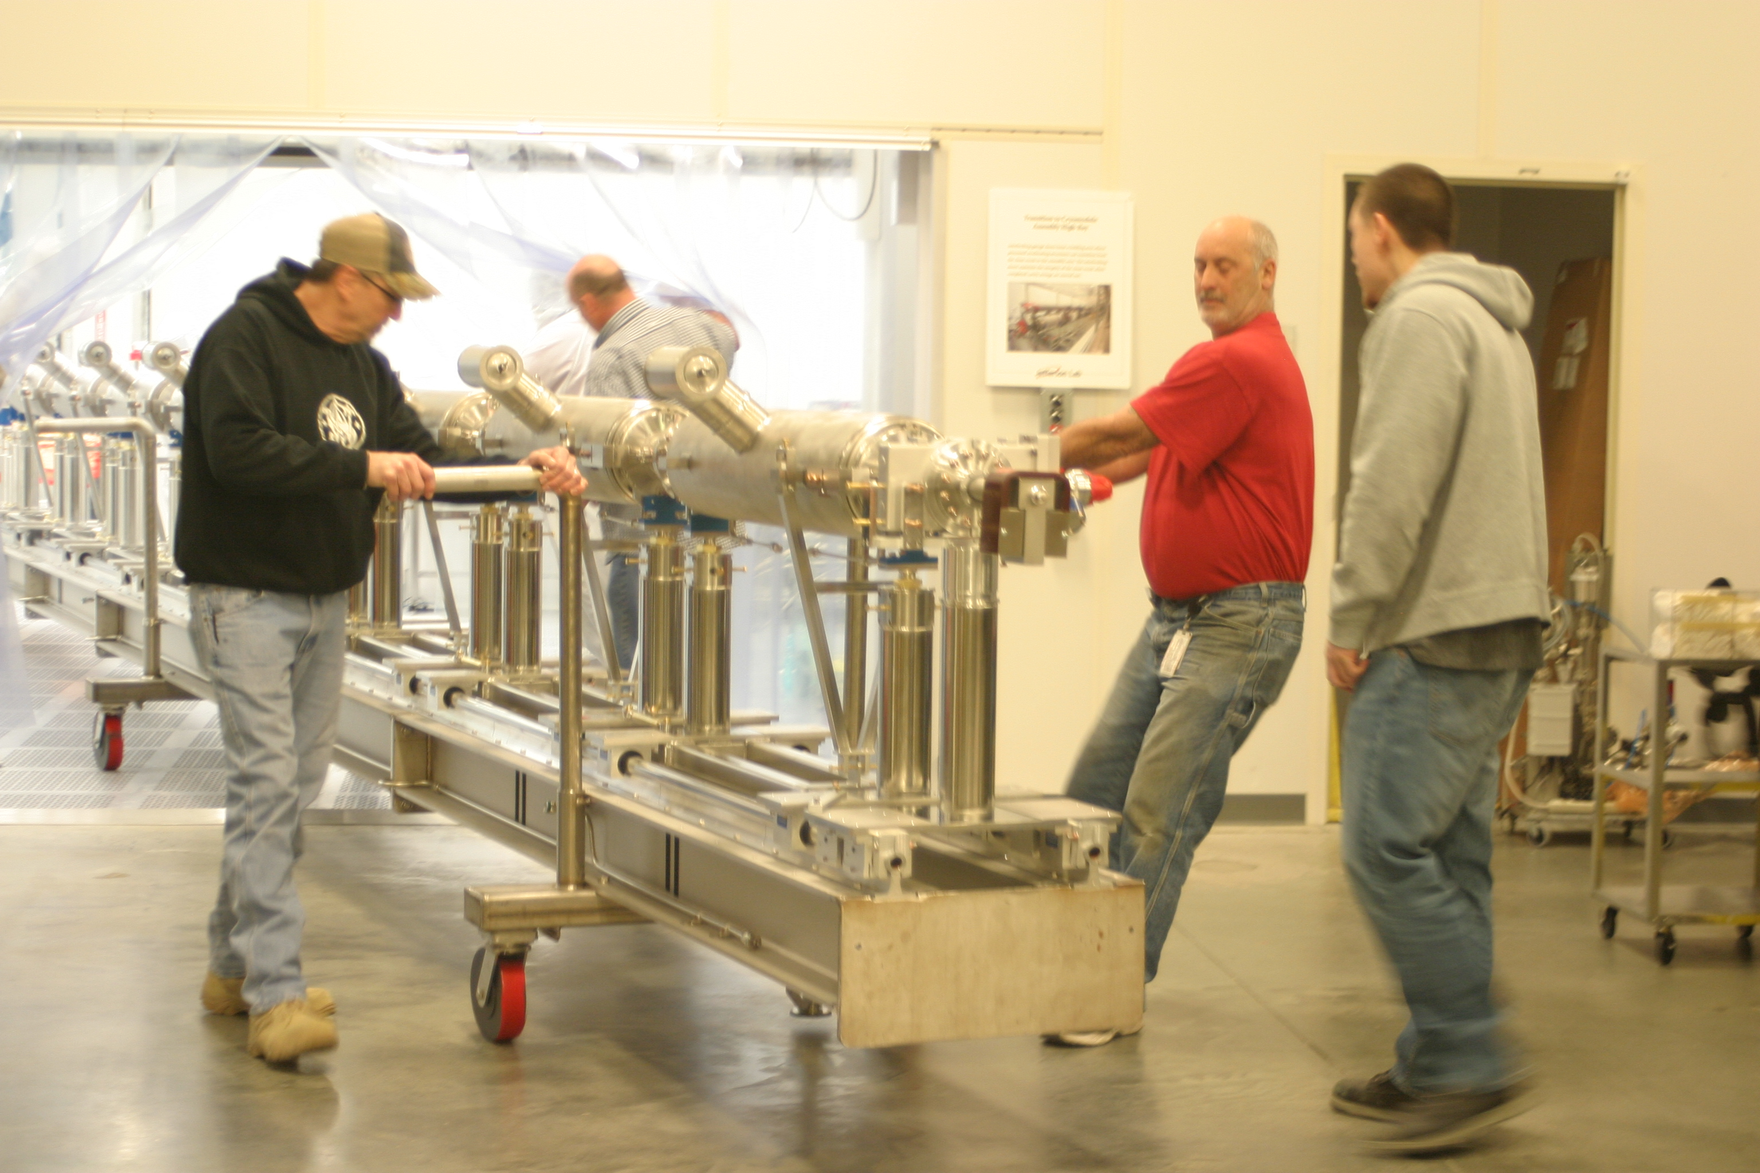
Roll Out of Cleanroom

Slide 17
Tooling Status
Tooling design is ready for PDR
Remaining work:
Tooling concepts complete
Details still to be finalized
Drawings to be completed
Procedures & travelers still to be developed
Recommendation 7 from PDR: Develop conceptual designs for cleanroom and assembly tooling.
Status: complete.

Slide 18
Cavity String Assembly Status
Drawings for cavity string assembly and components are 90% complete
Cavity String Procurements
Beamline bellows
Warm-to-cold bellows (supply and return)
Gate valves
Consumables incl pump assembly
Work status:
Drawings generally complete; some updates remaining
SOWs to be developed as needed
Procurement plan has been discussed
Budgetary quotes are in process
On track for procurement

Slide 19
Conclusions
Tooling has been redesigned to accommodate updated assembly practices for reducing field emission
Tooling is at PDR stage; FDR for tooling components to occur later as drawings are finalized
Beamline components (beamline bellows, warm-to-cold-bellows, valves, miscellaneous/consumables) at FDR stage and ready to start procurement soon
Procurement planning has begun to allow for on-schedule award

Slide 20
SLIDES FROM PDR THAT WILL NOT BE USED IN FDR

Slide 21
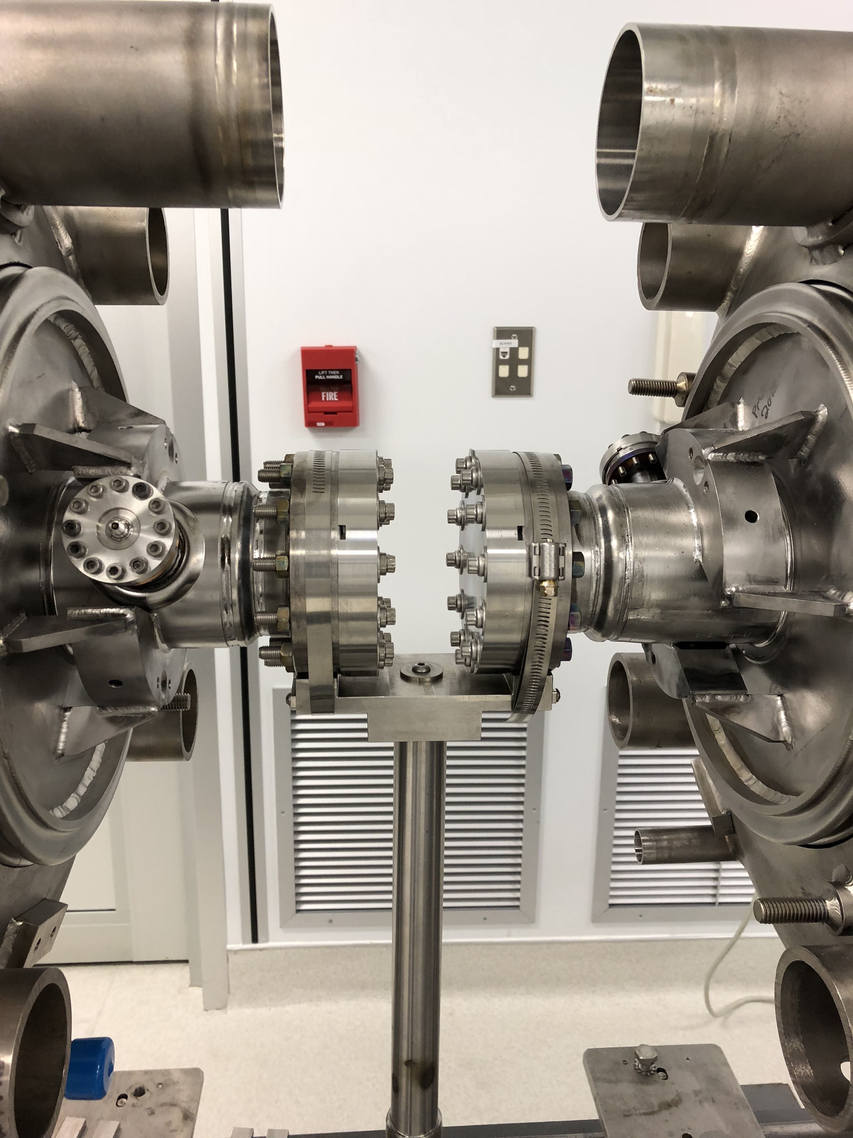
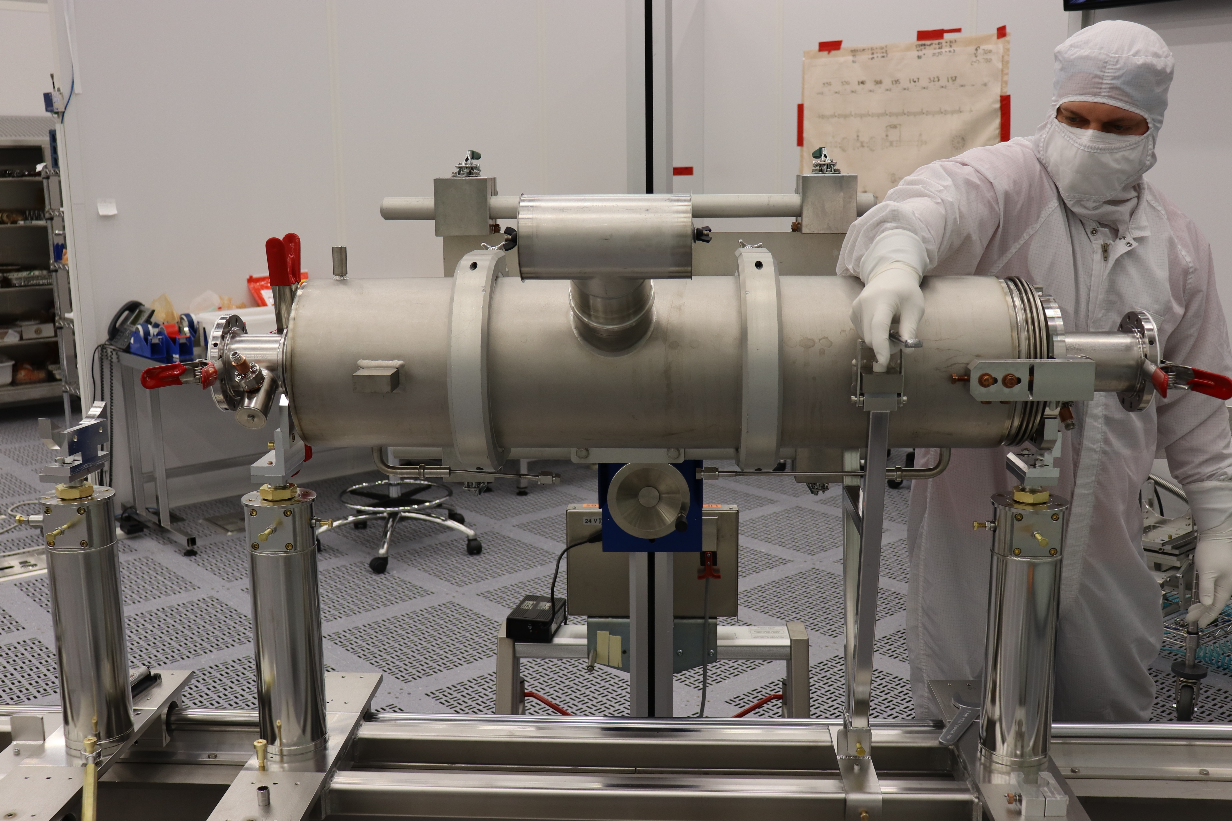
Move Cavity onto Lollipops
Original lollipops supported two cavities
Possible design change:
Considering lollipop that supports one cavity discretely (design to be developed)

Slide 22
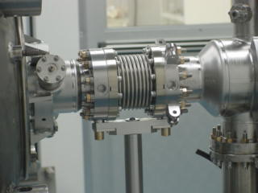
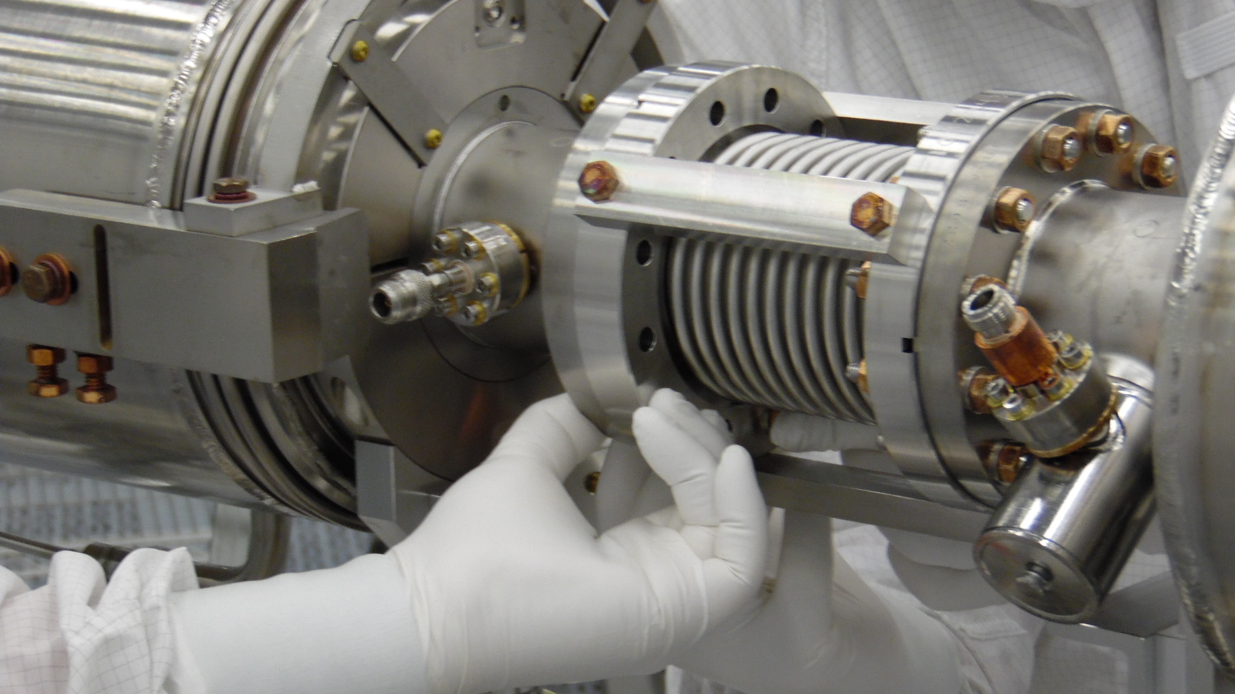
Install Beamline Bellows
Original design located each cavity and requires bellows compression to install
Possible design change:
JLab prefers installing relaxed bellows on one cavity and then moving second cavity into place
Cleaner assembly

Slide 23
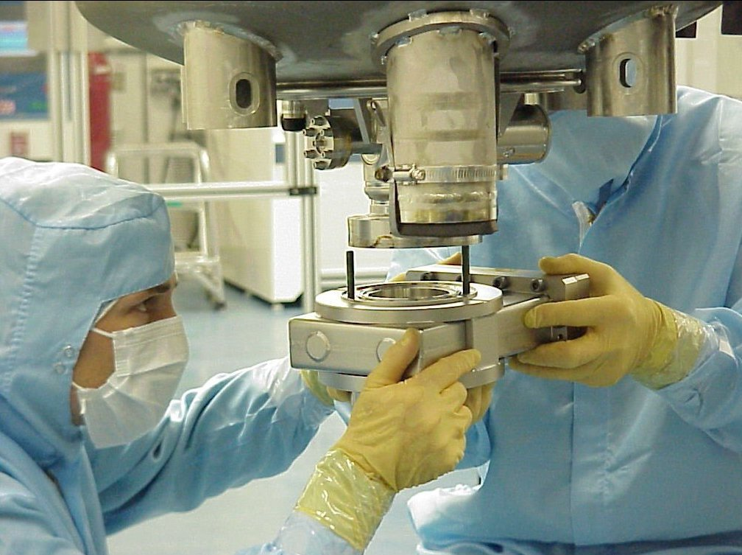
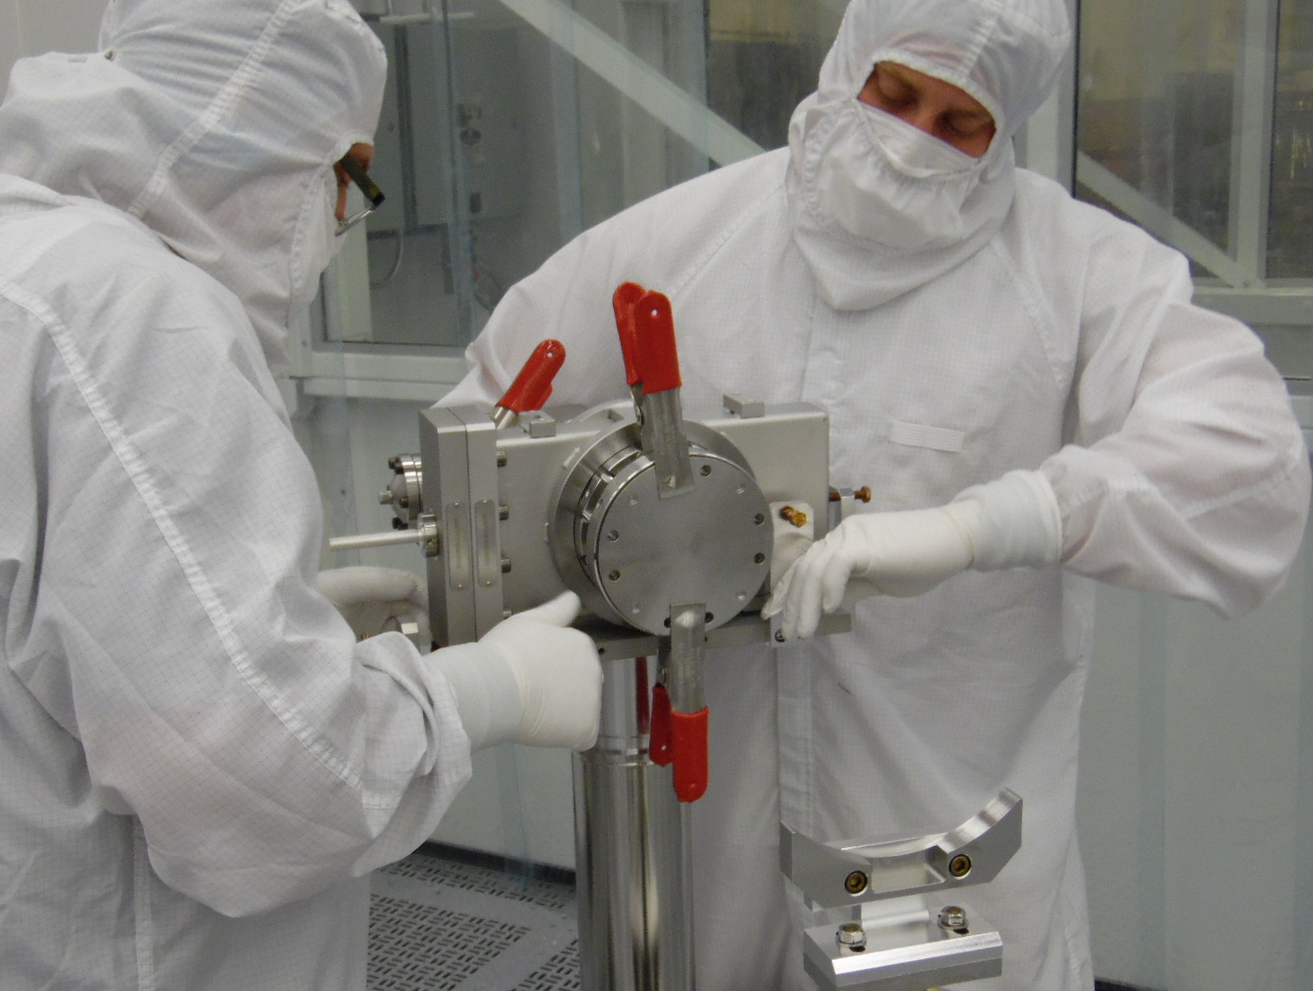
Valve Installation
Cavity moved into class 10 CR and dried after HPR
On original SNS, oriented vertically for valve installation
Possible design change:
Cleaner installation if valve and cavity are both horizontal

Slide 24
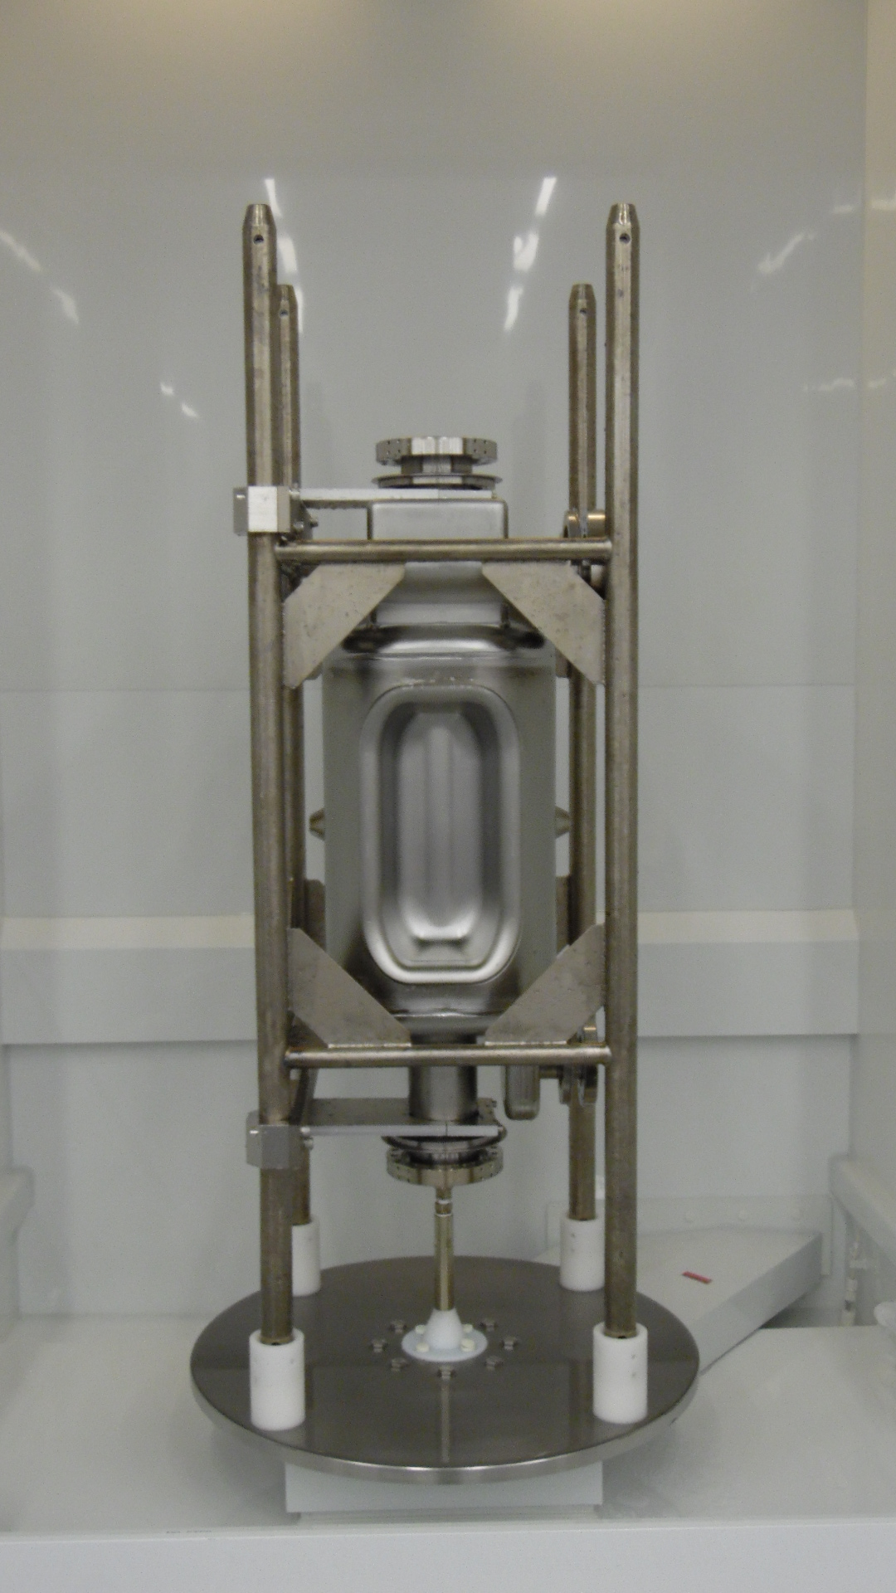
High Pressure Rinse
New nozzle and HPR procedure being developed
Cleaning effectiveness varies with size of cavity
Procedure/tooling development based on successful HPR of similar-sized cavities
Photo: HK Park

Slide 25
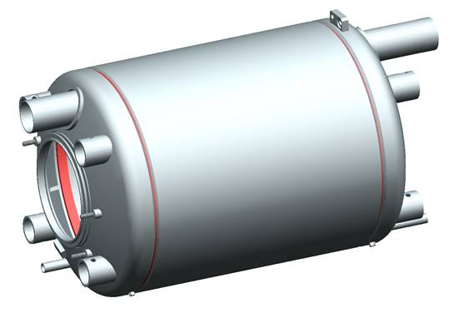
Preparation for String Assembly
4 cavities, 1 with liquid level
Cavities will be cleaned/HPRed/dried
4 FPCs
Will arrive w/ inner & outer conductors assembled from SNS ready for installation
Spares available
Beamline bellows, gate valves, smaller components
Tooling
Based on original SNS designs but still under development

Slide 26
JLab Inventory Program
All major components are serialized and tracked individually
Kits are prepared for each stage of assembly

Slide 27
Slow Pump Down and Leak Check
Pump installed on return end of string
Cavities/bellows locked in place to prevent collapse during pump down
Slow pump down to prevent migration of particles which can act as field emitters and limit cavity performance
DESY recommended < 200 mTorr differential pressure, so JLab pumps at 1 torr/minute to maintain non-turbulent gas flow
JLab typically leak checks strings to 1 or 2 E-10 torr L/sec

Slide 28
Improved Cleanroom Tooling and Procedures
New larger ISO class 4 cleanroom w/ floor return
Improved ultrapure water (UPW) system
Increased knowledge of clean handling/assembly
Techniques supported by recommended tooling changes:
Sliding cavities together rather than compressing bellows
Vertical joints (parallel to airflow)

Slide 29
Clean Room Tooling
Required
Improvements to the helium vessel welding procedures and tooling
Warm to cold beam line bellows restraint and temporary ion pump supports
Proposed new tooling to improve clean assembly
Beam line gate valve horizontal installation
FPC assembly for possible horizontal installation to cavity flange
Cavity beam line flange to beam line bellows improved assembly

Slide 30
Back-up slides

