Slide 1
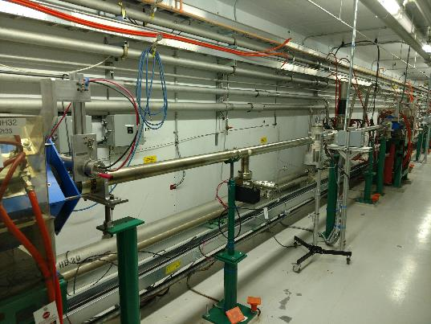
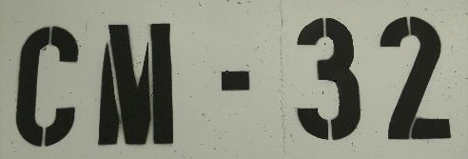
SNS PPU CRYOMODULE FDR
Introduction
Ed Daly
SNS PPU STL

Slide 2
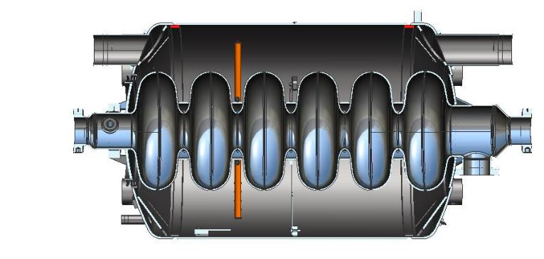
Outline
Welcome
Safety
Reviewers & Guests
Connectivity
Charge
Agenda
Questions

Slide 3
Safety Orientation (D. Arenius)
Tornado: “Toto, I don’t think we are in Kansas anymore” does not apply here… we do get them
Loud siren, many pagers go off at the same time
Walk, Take stairway next to elevator, muster in hallways in front of 1st floor elevator running north and east OR in 1st floor auditorium next to elevator room F113, wait for the “all clear” message
Fire: Fire Alarm Bell/Horn, pull station in hallway
Walk, Take stairs, (not elevator) to first floor, three stair locations at end of main hallways, easiest is stairway door to the right of the elevator. When entering the 1st floor, go through glass doors on left and then immediately right through building exit doors. Muster in north parking lot until all clear is given.
Defibrillator: First floor, near elevator
Hurricane: Season started on 1-June
Restrooms: Across the hall from meeting room

Slide 4
Review Committee Members & Participants
Review Committee
Tom Nicol (Chair) - FNAL
John Hogan – JLab
ORNL / SNS PPU Participants
Mark Champion – SNS PPU Project Manager
Sang-Ho Kim – SNS PPU Technical Director
Matt Howell - L2 Manager, SCL Systems
Stephen Stewart – Mechanical Engineer

Slide 5
Connectivity
Wireless
SDefpma8a22ty
SSID: jlab_guest
Uses WPA2-PDK security
BlueJeans Conference Call Information:
Phone Dial-in
+1.888.240.2560 (US Toll Free)
(Global Numbers)
Meeting ID: 406 978 482
Room System
199.48.152.152 or bjn.vc

Slide 6
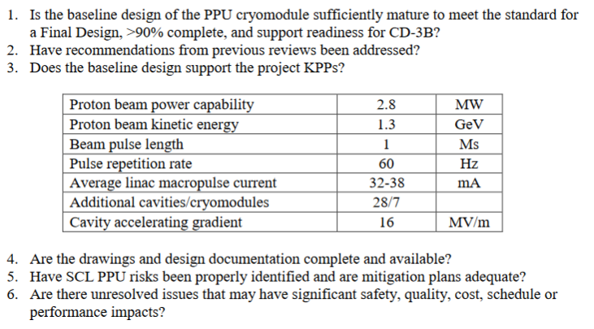
Review Charge

Slide 7
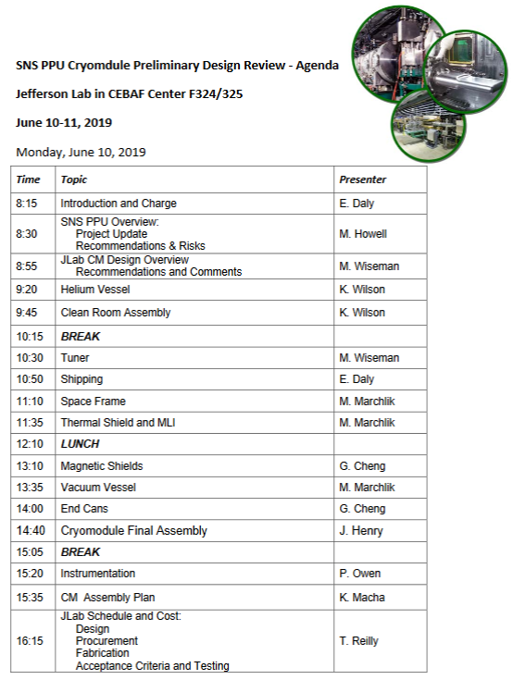
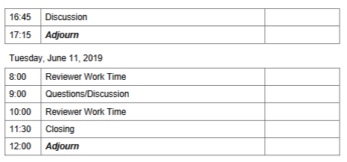
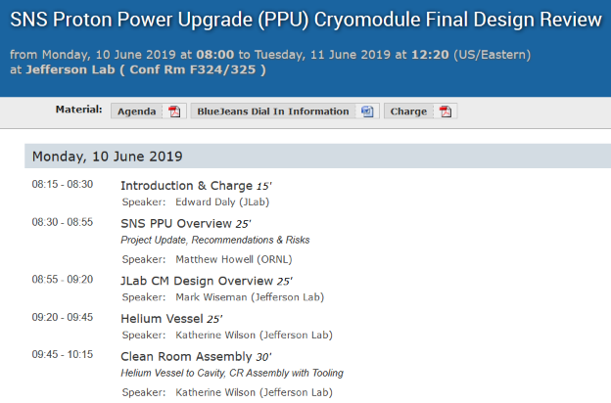
Agenda
https://www.jlab.org/indico/event/326/
Test Lab Tour (Proposed) -
Tuesday Morning, 8.30 AM

Slide 8
Questions?

Slide 9
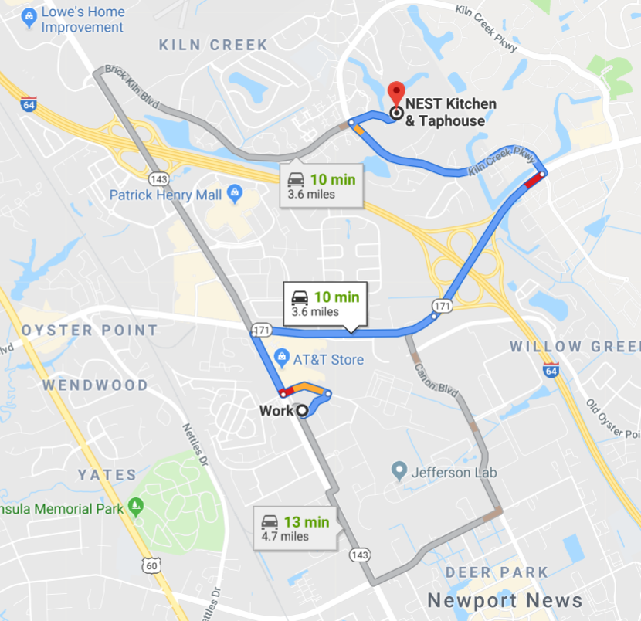
No-Host Dinner
No-host dinner on Monday evening at the Nest in Kiln Creek (https://www.breakfasttobeer.com/ ).
We'll plan for dinner at 6.30 pm.
Please RSVP
to Christine today.

