Slide 1
SNS PPU CRYOMODULE FDR
SNS PPU Helium Vessel Design and Assembly
Katherine Wilson

Slide 2
Outline
Technical Requirements
Design Overview
Engineering
Interface with Other Designs
Current status and updates since PDR
SOW & Procurement Plan
Plans to Finish

Slide 3
Pressure Systems Requirements
Pressure boundary defined by SNS is vacuum vessel; however, JLab requires “Every reasonable effort shall be made to design and construct pressure vessels in full compliance with the Code [or]…to the greatest extent that is reasonably possible.”
Design requirements developed by Gary Cheng and agreed to by SNS specify the design pressure as 5 atm/75 psia internal @ 2K, 2.2 atm/33 psia internal and 45 psia external @ 300K
10CFR851 provides a limited exemption to BPVC
When national consensus codes are not applicable (because of pressure range, vessel geometry, use of special materials, etc.), contractors must implement measures to provide equivalent protection

Slide 4
Other Design Requirements
Temperature range: 2-300 K
Shipping loads
4 g vertical
5 g longitudinal/axial/beam axis
1.5 g transverse
Tuner requirement: 490 kHz/2.0 mm and 29,000 cycles
Grade 2 titanium (bellows grade 1 titanium)
Similar CTE to niobium
Requires Ti-to-SS transitions

Slide 5
Bellows
Stroke: ± 0.31 in
Pressure: 75 psi internal/45 psi external
Infinite fatigue life
Active length 1.25 in
Operating temp: 2-300 K
Cold shocked / leak checked
Wall thickness, number of convolutions to be set by manufacturer BPVC calculations
Internal pressure test to 75 psi on qualification part (by manufacturer)

Slide 6
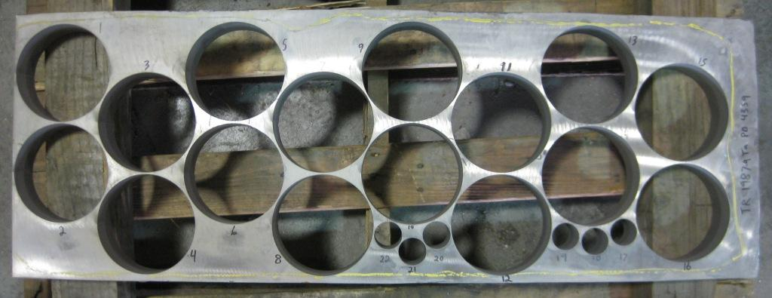
Explosion Bonded Joints
Transition Gr 2 Ti to 316L SS
Updated design! Based on R&D by national labs and used in similar applications
Thicker at the explosion joint for more bonding area
Longer for less heat during welding
Change in location of plate cut-outs to reduce leaks
Proven design and vendor
Will be thermal shocked and leak checked by vendor
Extras to be procured for weld process development

Slide 7
Helium Vessel Procurement
Procured as three separate components (probe end head assembly with backing strap, FPC end head assembly with backing strap, shell)
Subcontractor to procure explosion-bonded joints as directed source and QC
Subcontractor to procure bellows and QC (pressure test on qualification part)
Backing straps will be supplied unattached and tacked in place at JLab for ease of assembly
QC at vendor:
Cold shock & leak check
RT of all pressure-boundary welds
Visual inspection of welds by certified inspector
CMTFs, tracking of materials, serial numbers
Assembled to cavity at Jefferson Lab

Slide 8
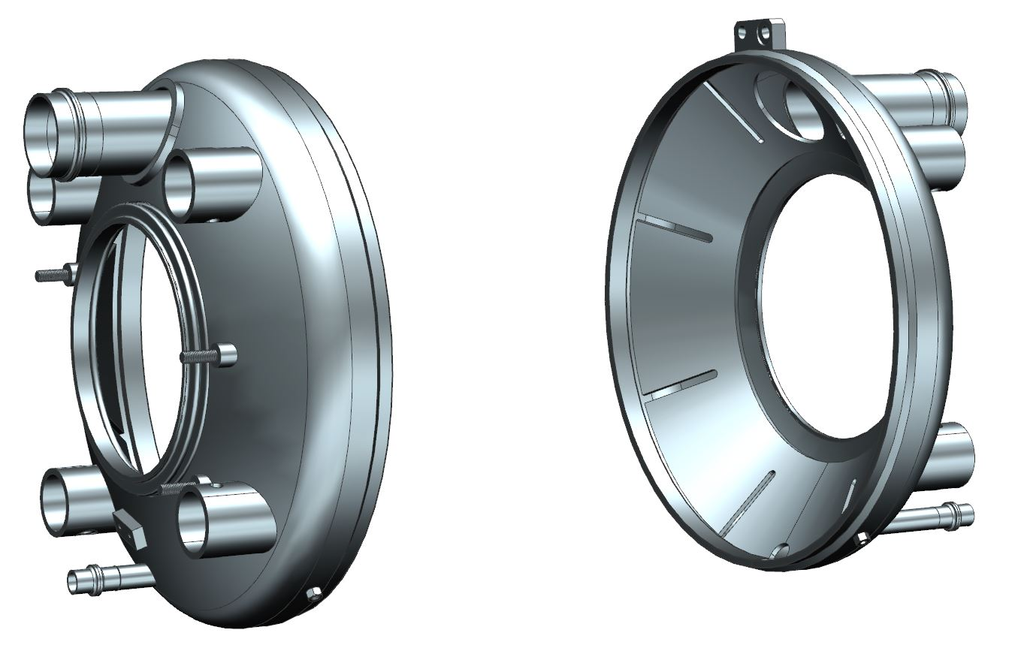
Heads
Nitronic rod attachments
Bellows
Explosion-bonded joints
Backing straps
Stiffener

Slide 9
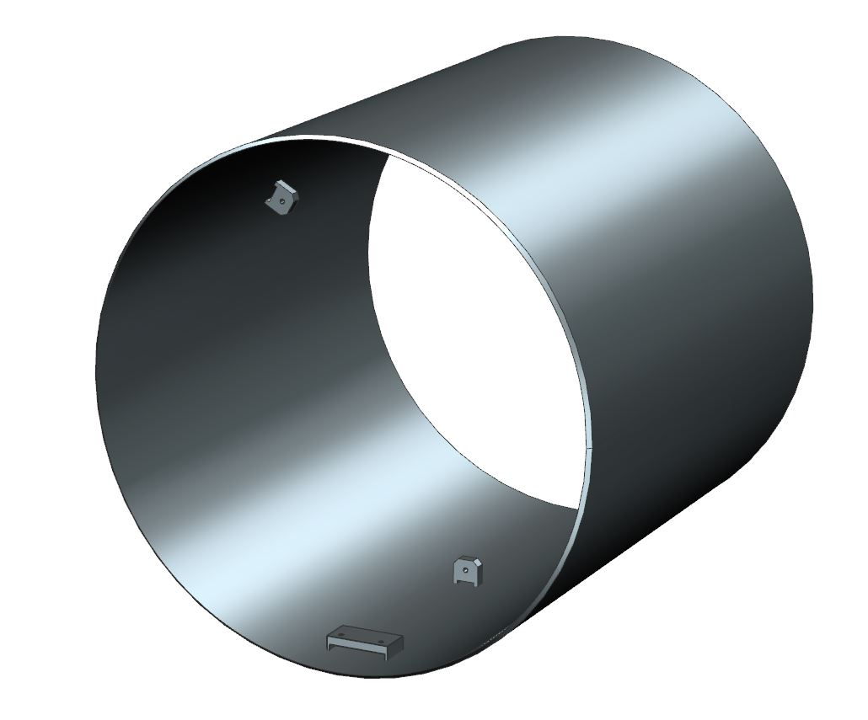
Shell
Shell trimmed to fit cavity at JLab prior to welding
Cavity spider attachments x3
BPVC-compliant seam weld
Heater mount

Slide 10
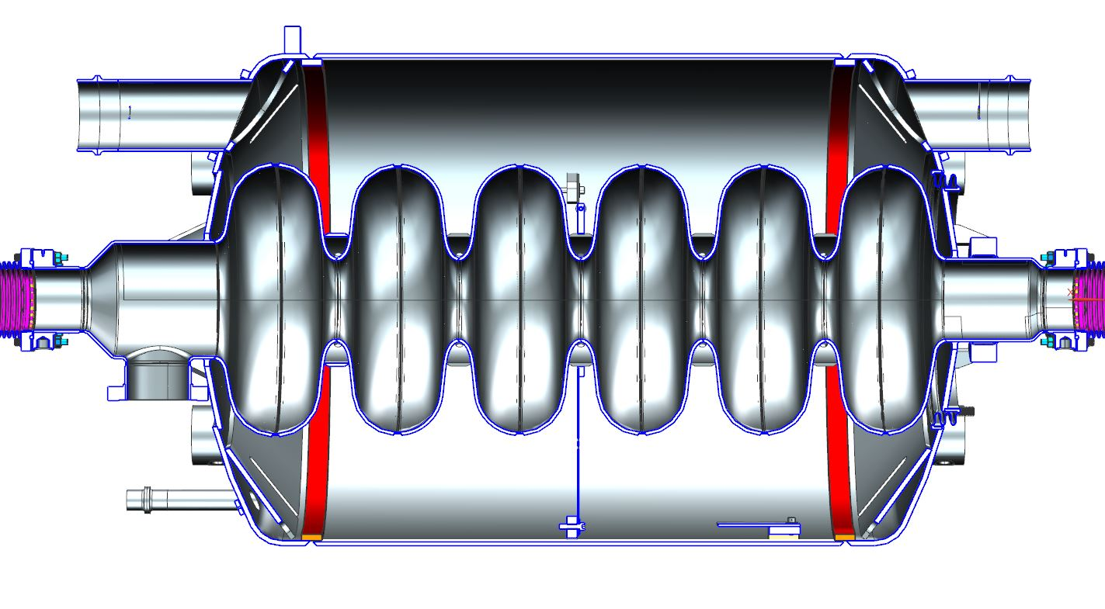
Pressure Vessel Assembly
Heads and shell welded to each other and cavity at JLab
Heads and shell welded with BPVC-compliant double bevel butt welds with backing straps
Non-BPVC-compliant fillet weld between head and cavity qualified by calculations and experience
Head welded to cavity at bellows

Slide 11
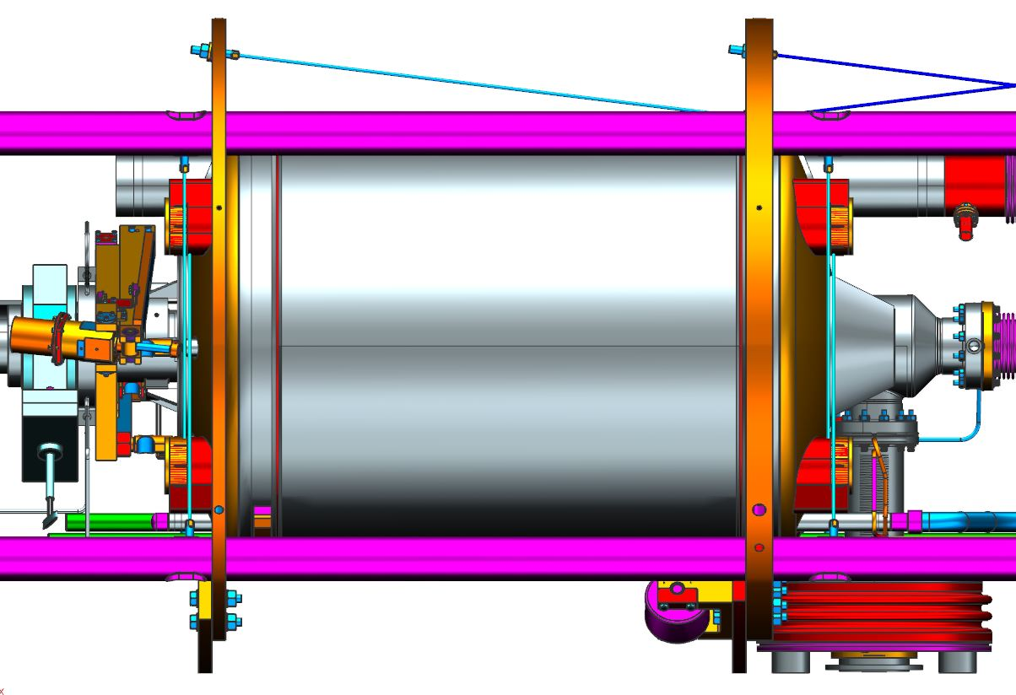
Nitronic Rod Attachment Locations
Welds were confirmed to have a comfortable factor of safety for nitronic rod pre-loads
Shipping loads were analyzed in detail during original SNS and this analysis was not repeated

Slide 12
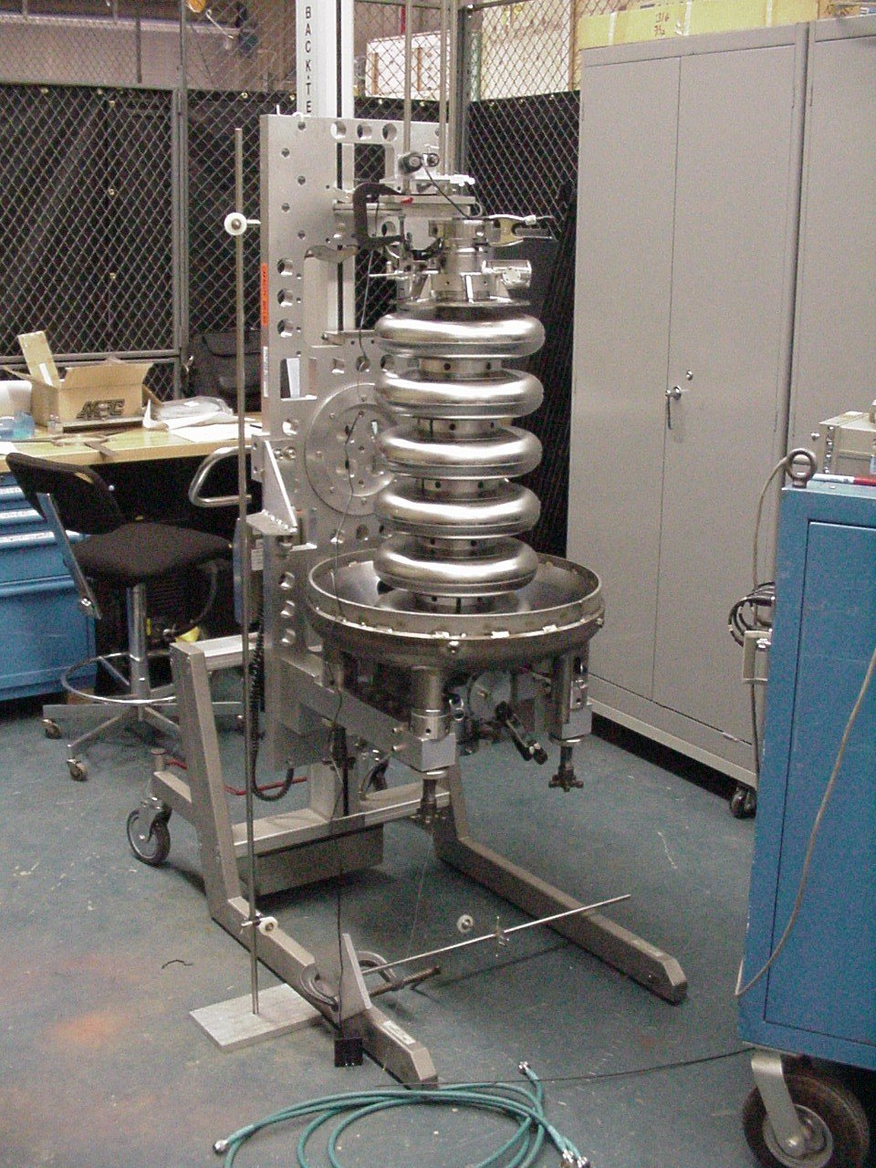
Assembly Plan
Process development required to avoid detuning the cavity
Legacy helium vessel components available from SNS will be used for practice
First few cavities will be tested bare and dressed to confirm process
Cavity will be measured and shell trimmed to fit
Cavity, two heads, shell will be welded. Small amount of adjustability is available.
Welding procedures will be developed and tooling verified before production

Slide 13
Assembly Procedure
JLab plans to adapt horizontal set-up and welding
Each head assembly will arrive welded together (dished head, inlet & outlet pipes, stiffener).
Cavity support blocks that attach to spider are welded inside HV to match cavity dimensions
Two options:
Pre-weld FPC end head to shell – reduces detuning of cavity due to weld shrinkage
Weld both heads to shell at the same time – reduces the number of weld set-ups
Cavity is installed horizontally into shell/FPC end head assy
Instrumentation is attached and wiring is fed out
“Spider” is attached
FPC end dish welded to cavity NbTi
Probe end dish installed and welded to shell and cavity
Details of procedures being developed

Slide 14
Procurement Strategy
Helium vessels needed before cavities, summer 2020
Lead time ~ 30 weeks
Weld process will be developed on qualification parts in parallel
Build to print
Bellows and explosion-bonded joints purchased by HV vendor
Explosion-bonded joints to be a directed source
CMTRs and traceability requested
Certified welders and inspectors
Vendor to perform QC (cold shock, leak check, etc)

Slide 15
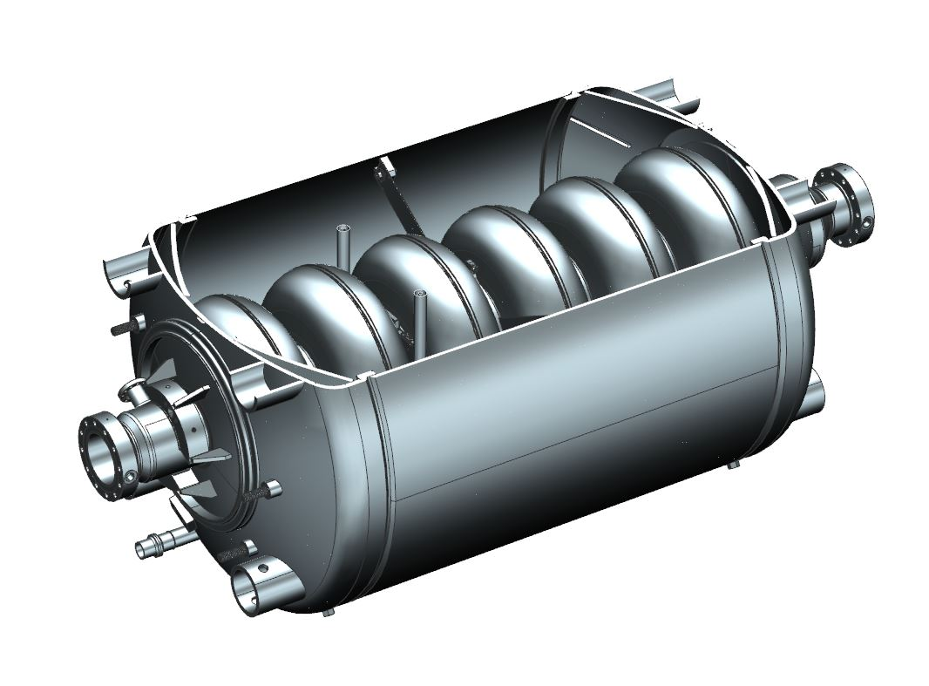
Current Status
Drawings are 90% complete; need to be finalized
SOW is complete and signed
Procurement plan has been discussed with JLab procurement department
No-fund purchase req allows procurement to solicit budgetary quotes for schedule efficiency
On track for procurement to support project schedule

Slide 16
BACKUP SLIDES

Slide 17
Applicable Codes and Specifications
Requirements
“SNS PPU Cryomodule Pressure & Vacuum Systems” Power Point slides, by Gary Cheng, 6 Nov 2018
JLab EHSQ manual 6151 “Pressure and Vacuum Systems Safety Program”
10CFR851, DoE “Worker Safety and Health Program”
Reference
Spallation Neutron Source Statement of Work PPU Cryomodule 104110000-SW0008-R00
Helium Vessel w/o Liquid Level Probes and Helium Vessel with Liquid Level Probes, 104110102-M8U-8200-A008 and –A009

Slide 18
Pressure Systems Requirements
Pressure boundary defined by SNS is vacuum vessel; however, JLab requires “Every reasonable effort shall be made to design and construct pressure vessels in full compliance with the Code [or]…to the greatest extent that is reasonably possible.”
Design requirements developed by Gary Cheng and agreed to by SNS specify the design pressure as 5 atm/75 psia internal @ 2K, 2.2 atm/33 psia internal and 45 psia external @ 300K
10CFR851 provides a limited exemption to BPVC
When national consensus codes are not applicable (because of pressure range, vessel geometry, use of special materials, etc.), contractors must implement measures to provide equivalent protection…. Measures must include the following:
Design drawings, sketches, and calculations….
Qualified personnel must be used to perform examinations and inspections of materials, in-process fabrications, nondestructive tests, and acceptance test.
Documentation, traceability, and accountability must be maintained for each unique pressure vessel or system…

Slide 19
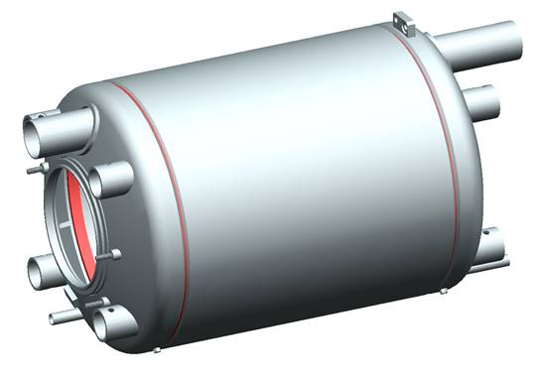
Design
Helium vessel consists of shell and torispherical heads
Anticipate that HV will arrive from vendor in 3 pieces: backing straps already tacked to heads, explosion-bonded joints attached, bellows attached to one head
Shell will be trimmed to fit
Instrumentation covered in instrumentation talk (M. Wiseman)

Slide 20
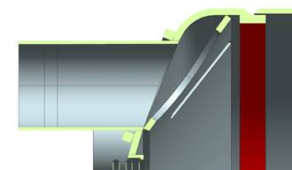
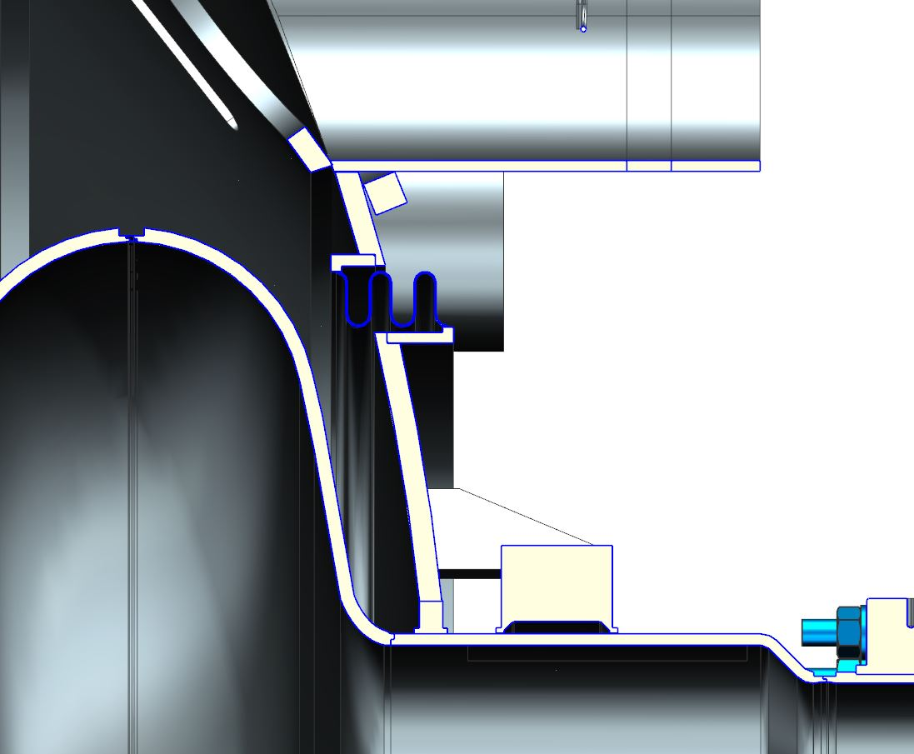
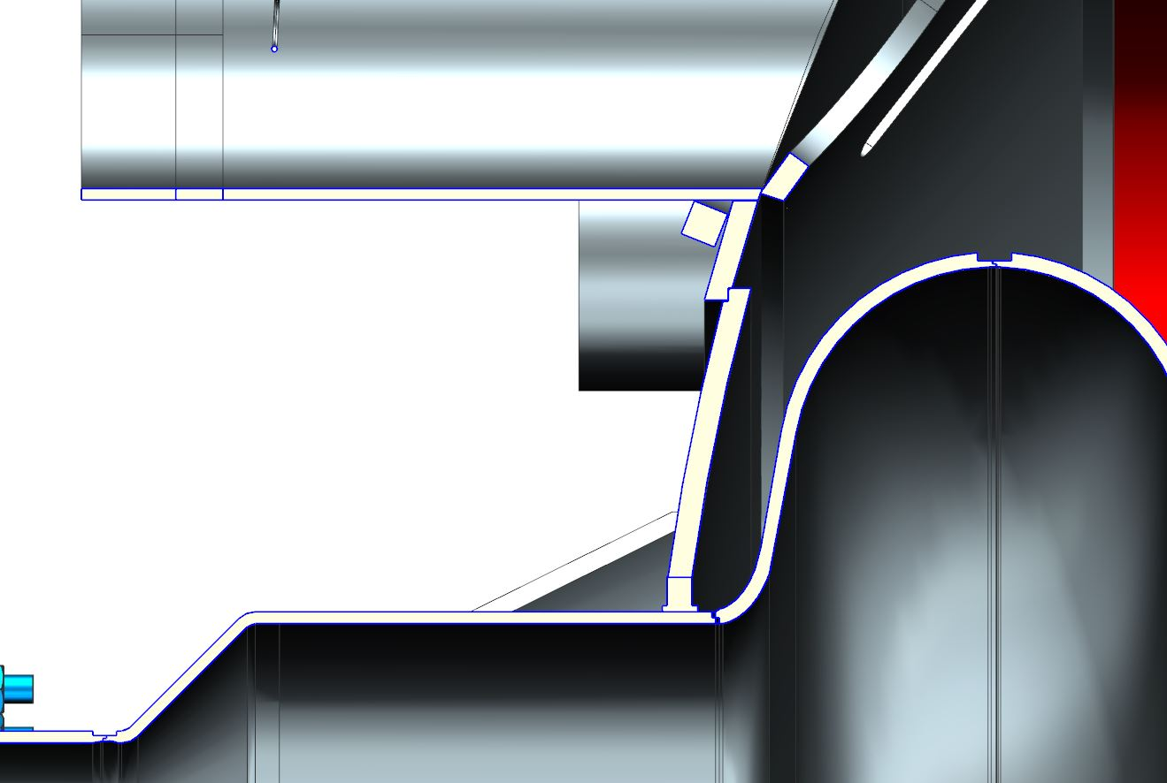
Welds
Shell-to-head weld modified to add backing straps per welders’ request; allows for better purging
Shell-to-head weld is now code-compliant double bevel butt joint
Head-to-bellows welds verified
Head-to-cavity weld increased size; design unchanged

Slide 21
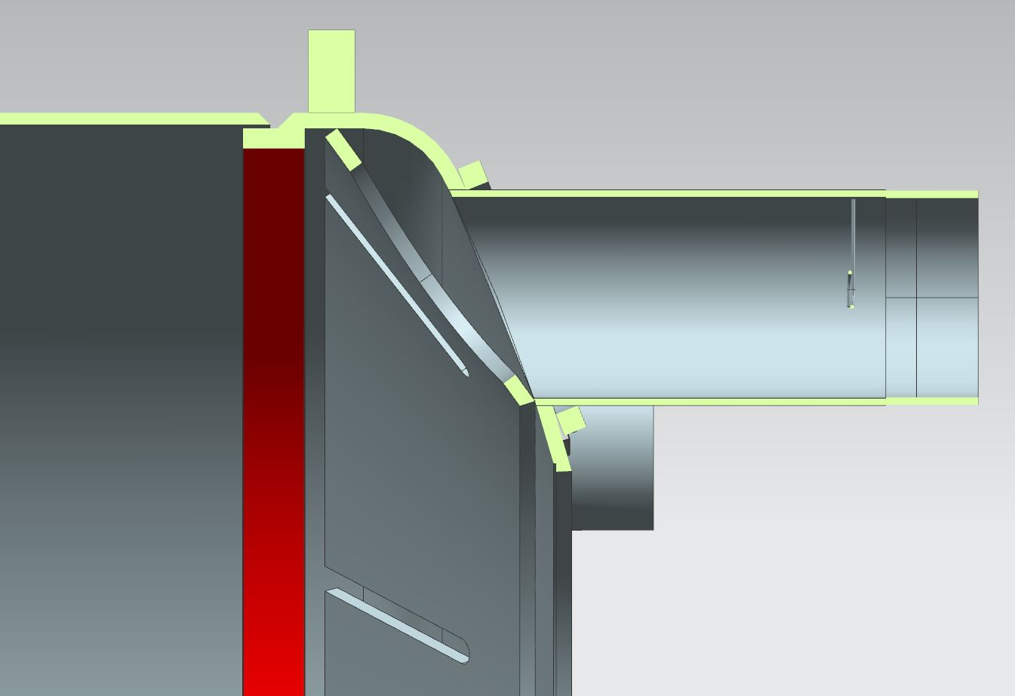
Helium Vessel Stiffener
Original design: fillet welds between head and shell; stiffener was welded to the sliding ring
Modified design: fillet welds changed to double bevel butt welds for BPVC compliance; stiffener completely within head
Original SNS Design
Current PPU Design
Modified SNS Design

