Slide 1
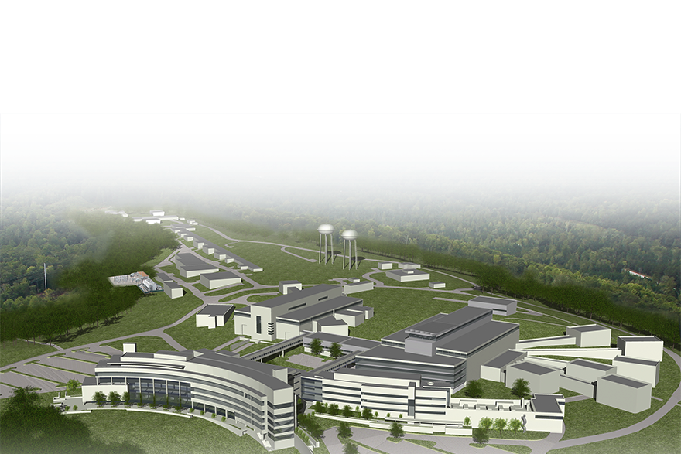
SNS PPU CRYOMODULE FDR
Overview
SNS-PPU upgrades the existing accelerator structure
SNS-STS constructs a second target station with an initial suite of 8 beam lines
Matt Howell
A1 – PPU Project Overview

Slide 2
Outline
PPU Overview
Scope of PPU SCL
SCL Performance
WBS Team
Division of responsibilities
Response to recommendations
Cost, Schedule and Labor
Risk
Summary

Slide 3
SNS Upgrade Plans
Today
Future
First Target Station
24 instrument positions
19 instruments built
First Target Station
24 instrument positions
21 instruments built
After STS Upgrade
Second Target Station
22 instrument positions
8 initial instruments
1.4 MW
2 MW
0.8 MW
Accelerator today
After PPU Upgrade

Slide 4
PPU Project Progress
OPA CD-1 review
CD-1 approved
OPA CD-3A review
CD-3A approved
OPA CD-3B review
Initial target gas injection
CD-2 preparation
Address target recommendations
CD-3A preparation
CD-3B preparation
May
2017
July
Sept
Nov
Jan
2018
Mar
May
July
Sept
Nov
Jan
2019
Mar
May
$36M line item FY18 approved
SCL partner selected (JLab)
$60M line item FY19 approved
PPU CD-path tailored to available resources + ready technologies
  CD-3A: $10.5M for superconducting RF cavities
  CD-3B: ~$52M for superconducting cryomodules, supporting RF and klystron gallery buildout

Slide 5
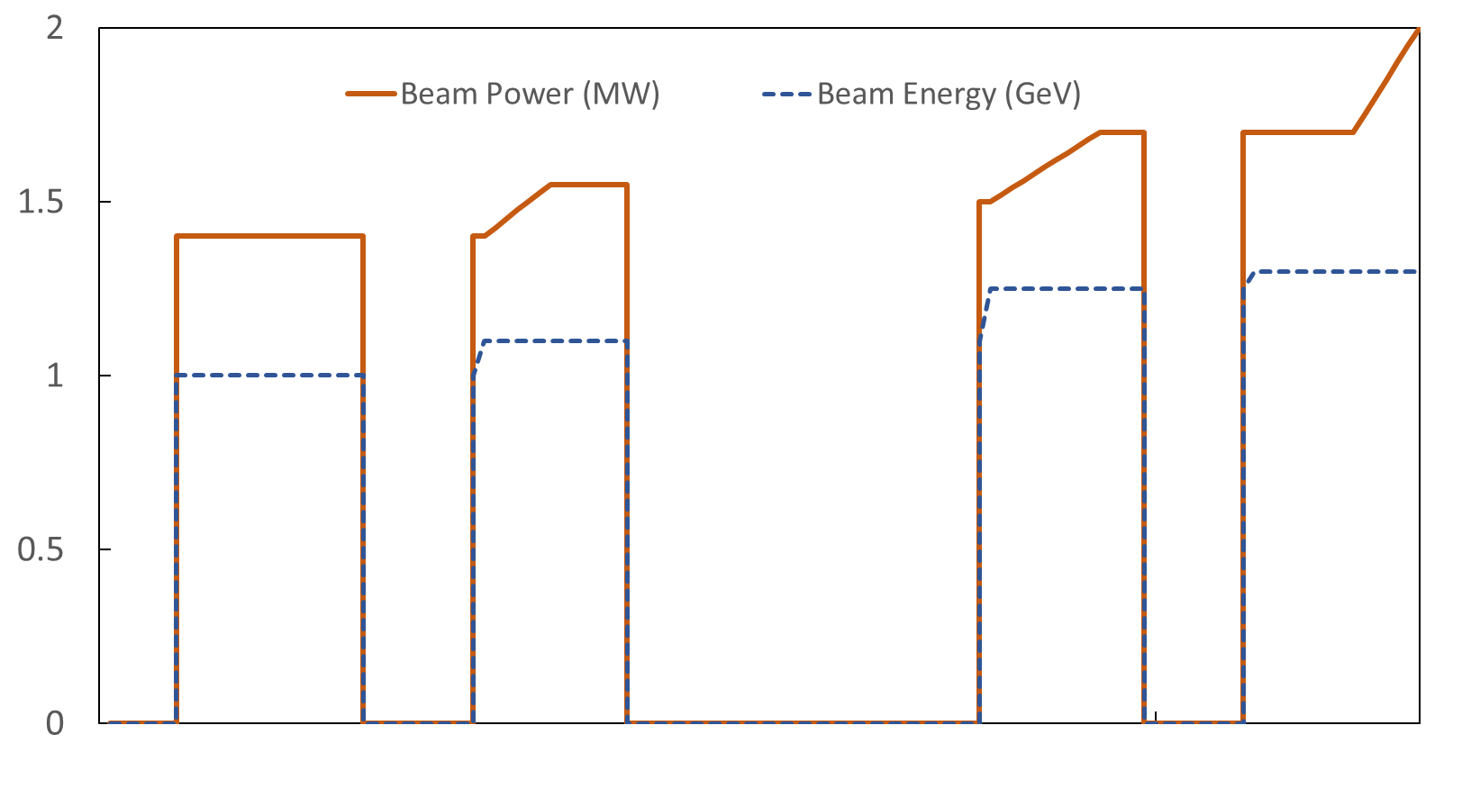
PPU Early Power Ramp Up Proposal
Provides higher beam power to users sooner
CD-3B is needed to meet this schedule
Early Finish
2.0 MW
1.7 MW
1.3 GeV
Beam power (MW)
Beam energy (GeV)
PPU Test Target 1
PPU Test Target 2
3 PPU CM
RF
Ring
RTBT Stub
Target
PPU
Target 1
PPU
Target 2
2 PPU CM + RF
2 PPU CM + RF
Jan.
2022
Jan.
2023
Jan.
2024

Slide 6
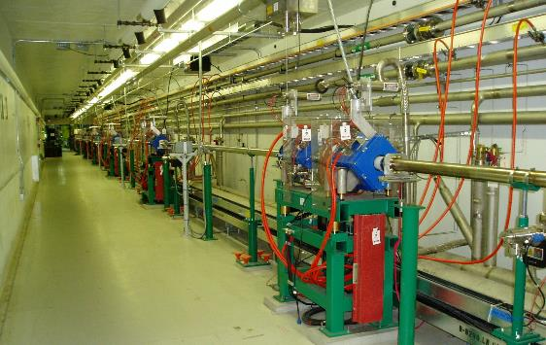
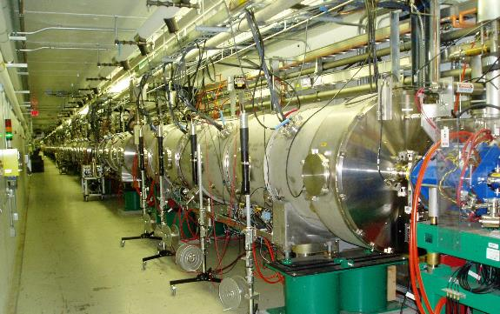
Scope – PPU SCL
Increase beam energy from ~1.0 GeV to 1.3 GeV
Procure, fabricate, test, install, and commission seven new high beta cryomodules
Nine empty slots
  Warm sections and magnets are already in place

Slide 7
SCL Performance - SCL Parameters
Key Parameters | Present | PPU
Proton beam power capability (MW) | 1.4 | 2.8
Linac output energy (GeV) | 1.0 | 1.3
Beam pulse length (ms) | 1 | 1
Pulse repetition rate (Hz) | 60 | 60
Average linac macro-pulse current (mA) | 27 | 38
Additional cavities/cryomodules |  | 28/7
Cavity accelerating gradient (MV/m) | 14.8* | 16
* Average accelerating gradient of high beta cavities as of July 2018

Slide 8
SCL Performance - PPU Energy
SCL Performance | PPU
Beam Output Energy of MB Cavities (MeV) | 450
Beam Output Energy of Existing HB Cavities (MeV) | 960
Beam Output Energy of PPU Cavities (MeV) | 1,300
Three PPU cavities in reserve providing margin (currently one cavity for energy reserve)
Spare MB and HB cryomodules will be available to allow for repairs while maintaining energy
Plasma processing and repair of 11b increases performance of MB cavities
For PPU, a large fraction of existing HB cavities will be reduced in gradient due to RF power limitation

Slide 9
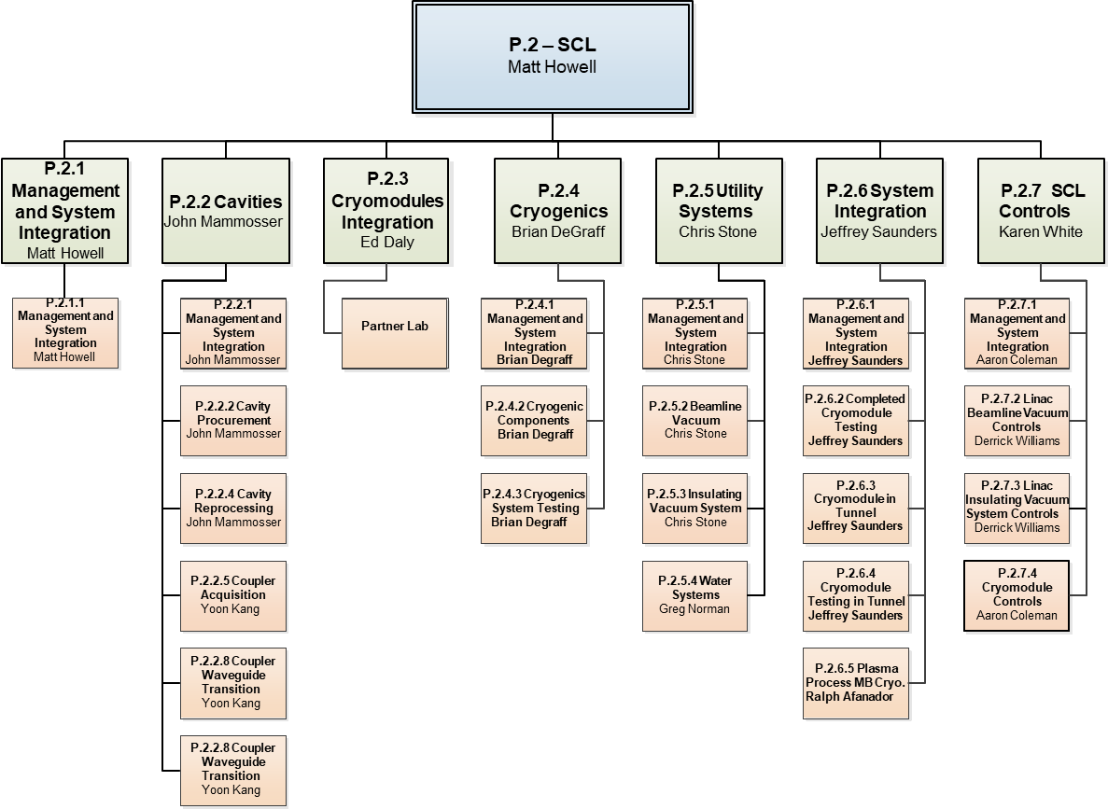
WBS Team

Slide 10
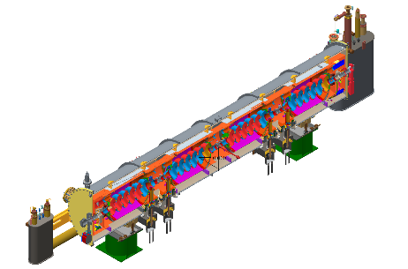
Division of responsibilities
  Partner laboratory contribution to cryomodule
    Procure all major CM components from industry
    Assemble cryomodules at their facility
      Cavity strings will be assembled from cavities qualified in P.2.2
    Conduct shipping test
    Ship completed cryomodules to SNS
  SNS contribution to cryomodule
    Provide on site oversight of cryomodule assembly
    Deliver a reference documentation package developed during HB spare
    Provide quality assurance
    Test all cryomodules in SNS RF test facility
      SNS has unique testing facility for 805 MHz cryomodules

Slide 11
Responses to Recommendations
All items in action tracking from CD-1 and CD-3A IPR are closed
Action Item # | Recommendation/ Comments | Status | Response
IPR1 R1 | Complete the choice of a partner laboratory for cryomodule production, sign the agreement to perform the work, and establish a working relationship with the partner laboratory as early as possible. | Closed | The partner laboratory has been selected. Jefferson Laboratory engineering has coordinated drawing and documentation efforts with PPU mechanical engineering.
CD-3A IPR
  Proceed to CD-3A
Link to CD-3B Indico site
https://conference.sns.gov/event/161/overview

Slide 12
Cost: SCL Systems Budget at Completion

Slide 13
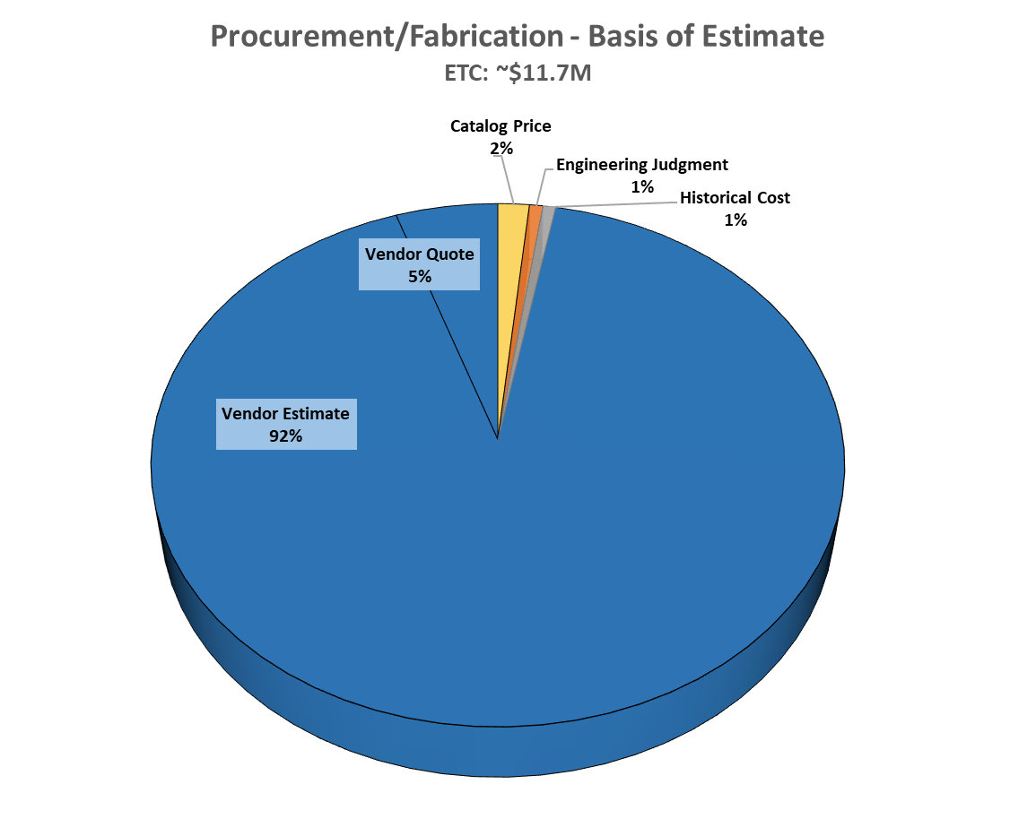
Cost: SCL Systems – CD-3B LLP Basis of Estimate
Large fraction of estimate is from vendors

Slide 14
Cost: SCL Systems – Post CD-3 Basis of Estimate
Remaining procurements based on vendor quotes and estimates

Slide 15
Cost: SCL Cost Estimate by Year
With the LLPs, the peak PPU SCL spending is in 2020

Slide 16
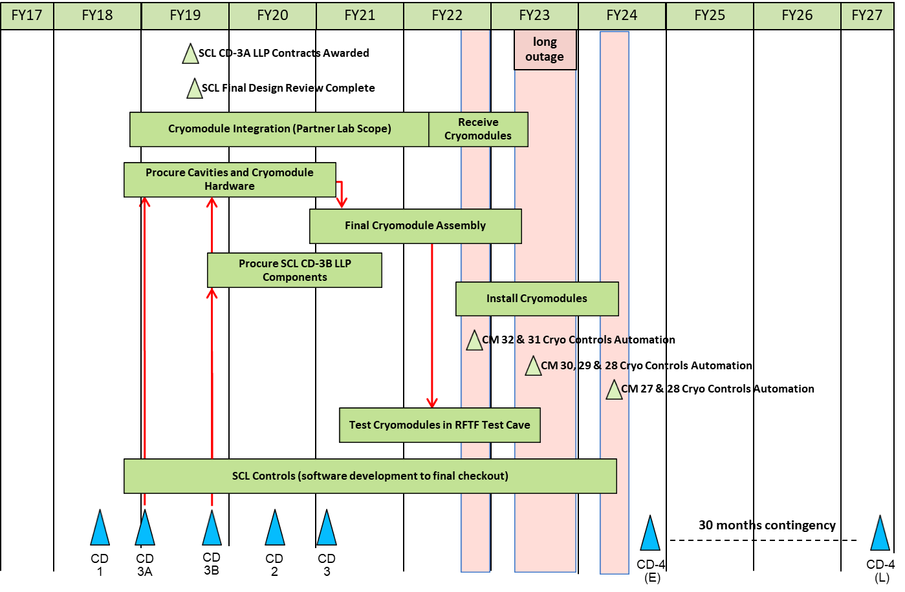
Summary Schedule: SCL

Slide 17
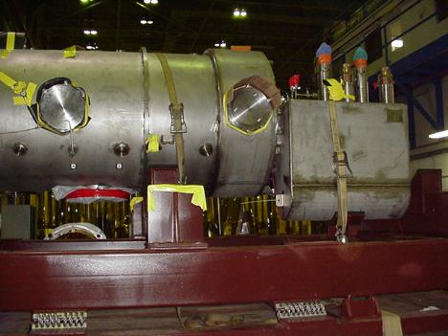
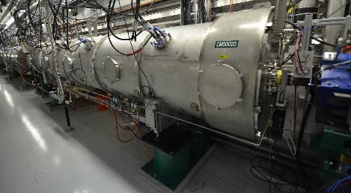
Summary Schedule
CMs | Activity | Date
CM-01 | Delivery | Dec 2021
CM-02 | Delivery | Mar 2022
CM-03 | Delivery | May 2022
CM-04 | Delivery | July 2022
CM-05 | Delivery | Sep 2022
CM-06 | Delivery | Nov 2022
CM-07 | Delivery | Feb 2023
CM-31&32 | Installed | Jun 2022
CM-28,29&30 | Installed | Dec 2022
CM-25&27 | Installed | Dec 2023
Cryomodule on shipping fixture
Installed cryomodule in Linac

Slide 18
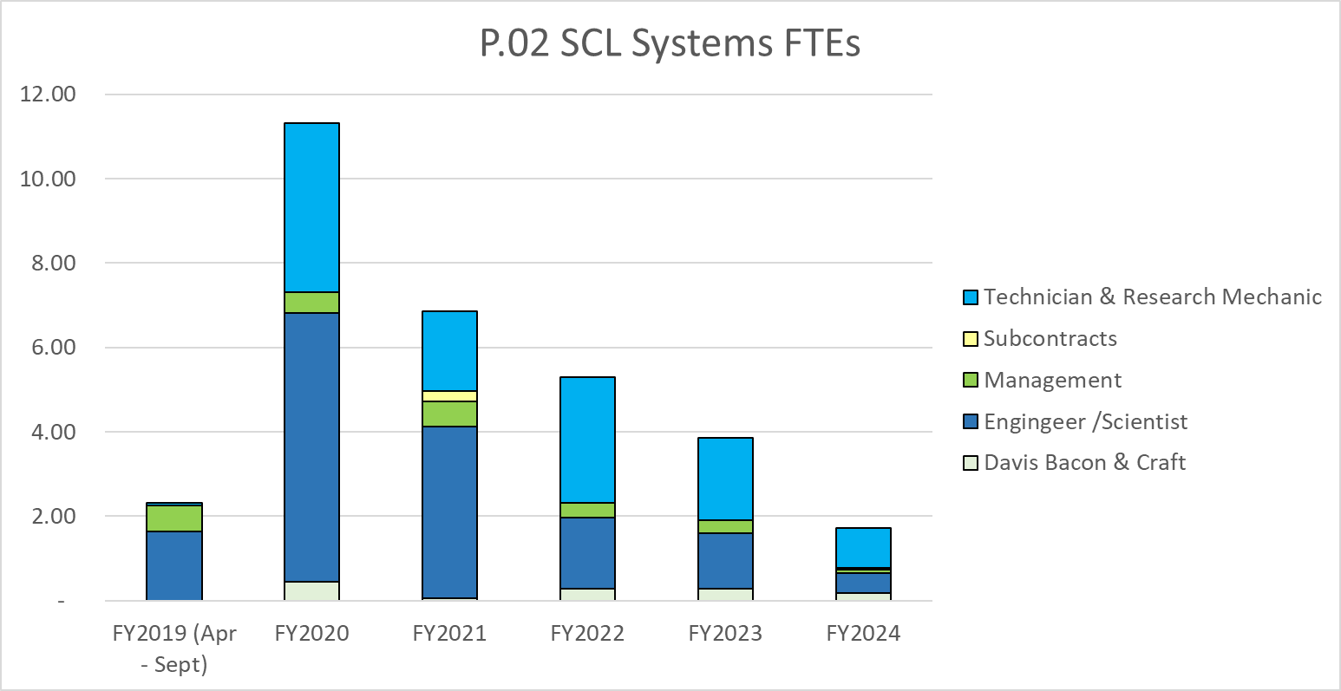
Labor Profile: SCL Systems
Internal labor only not including subcontracted labor or partner laboratory

Slide 19
Risk Register
32 Risks Identified (open threats)
  8 risks have been retired
  Pre-Mitigated Ranking: 14 Medium, 18 Low
  Post-Mitigated Ranking: 2 Medium, 30 Low
High Risks
  No High Risks
Key risk categories analyzed
  Performance of cryomodules in similar projects
  Adequately managing and functioning with our partner laboratory
  Overcoming technical issues previously experienced at SNS

Slide 20
Risk Register
Risk ID | Status | L3 WBS | Risk Title | Expiration Date | Pre -Mitigation Rank | Post Mitigation Rank
T-P.2-022 | Open | P.02.04 | Cryogenic Sequence Development | 8/15/2022 | 12 | 12
T-P.2-014 | Open | P.02.03 | First 2 Cryomodule Delivery Is Late | 10/19/2021 | 12 | 2
T-P.2-015 | Open | P.02.03 | Tuner Delivery | 8/23/2021 | 12 | 1
T-P.2-028 | Open | P.02.06 | Installation of Cryomodules | 6/24/2022 | 9 | 3
T-P.2-025 | Open | P.02.05 | Vacuum Components Delivery Is Late | 8/15/2022 | 9 | 1
T-P.2-010 | Open | P.02.02 | Production Cavity Performance | 4/1/2021 | 6 | 6
T-P.2-033 | Open | P.02.02 | Coupler Outer Conductor Copper Plating Failure | 2/1/2020 | 6 | 4
T-P.2-020 | Open | P.02.03 | Partner Laboratory Priorities | 3/8/2022 | 6 | 3
T-P.2-045 | Open | P.02.02 | Outer conductor delivery is late | 2/1/2020 | 6 | 2
T-P.2-016 | Open | P.02.03 | Final 2 Cryomodule Delivery Is Late | 6/16/2022 | 6 | 2
T-P.2-017 | Open | P.02.03 | Second delivery of 2 Cryomodules Is Late | 12/2/2021 | 6 | 2
T-P.2-002 | Open | P.02.01 | Can't Repair Cavity 11b | 9/30/2020 | 6 | 1
T-P.2-003 | Open | P.02.03 | Helium Vessel Delivery Is Late | 3/25/2020 | 6 | 1
T-P.2-004 | Open | P.02.03 | Integration of Helium Vessel & Cavity | 5/28/2021 | 6 | 1

Slide 21
Summary
The division of responsibilities is well understood
The partnership between SNS and Jefferson Laboratory is working well
The design effort is on schedule is well coordinated with the SNS scope
The risks have been identified and entered into the risk registry
We are ready to proceed to procurement of PPU Cryomodule components!

