Slide 1

Jefferson Lab Report
Bob McKeown
JLab Satellite Meeting
2019 APS April Meeting

Slide 2
Outline
Recent Highlights
12 GeV Program, PAC
Future Projects
EIC
Summary

Slide 3
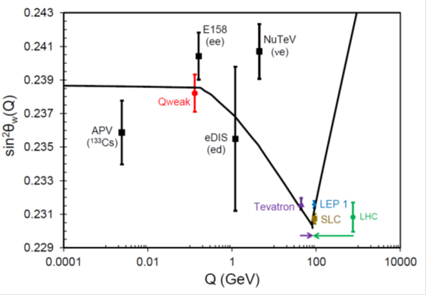
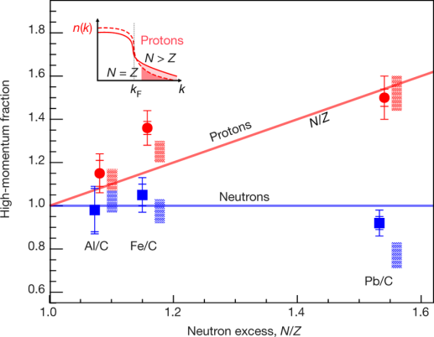
Results Published in Nature
Final Qweak results:
Nature 557, 207–211 (2018)
An accurate calculation of the nucleon axial charge with lattice QCD:
Nature 558, 91-94 (2018)
The weak charge of the proton – “Qweak”, represents the (tiny) difference of the charge of the proton and it’s mirror image
The pressure distribution in the proton:
Nature 557 (2018) no.7705, 396-399
Ultrafast Nucleons in Asymmetric Nuclei:
Nature 560 (2018) no.7720, 617-621
Analysis of 6 GeV CLAS DVCS data on the proton.
Modified Structure of Protons and Neutrons in Correlated Pairs (accepted)
Annual NP 2021 Budget Presentation

Slide 4
Jefferson Lab User Growth
“Other Users” include US National Labs and Industry

Slide 5
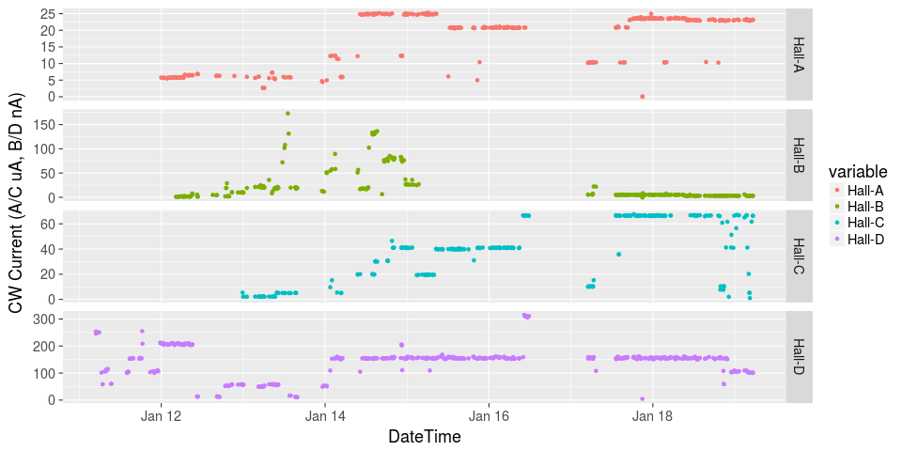
Initiated Four Hall Operation!
μA
A up!
nA
Installation
B up!
Beam Current
Pass Change
μA
C up!
D up!
nA

Slide 6
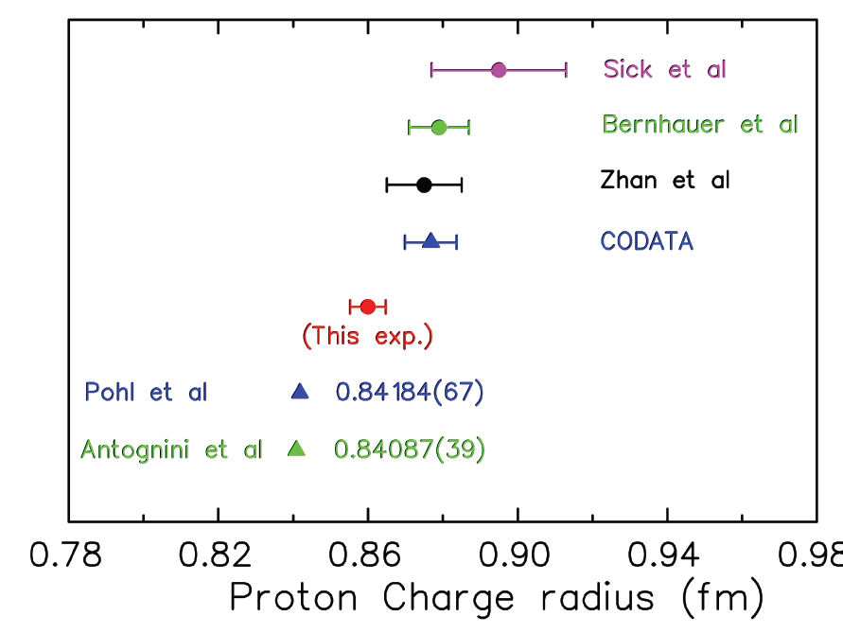


Solving the Proton Radius Puzzle
Elastic e-p
scattering
Atomic H
Muonic H
PRad: new experiment to
address proton radius @ JLab
NSF MRI: H₂ gas target
DOE GEM tracking detectors
Successful run in summer 2016!

Slide 7
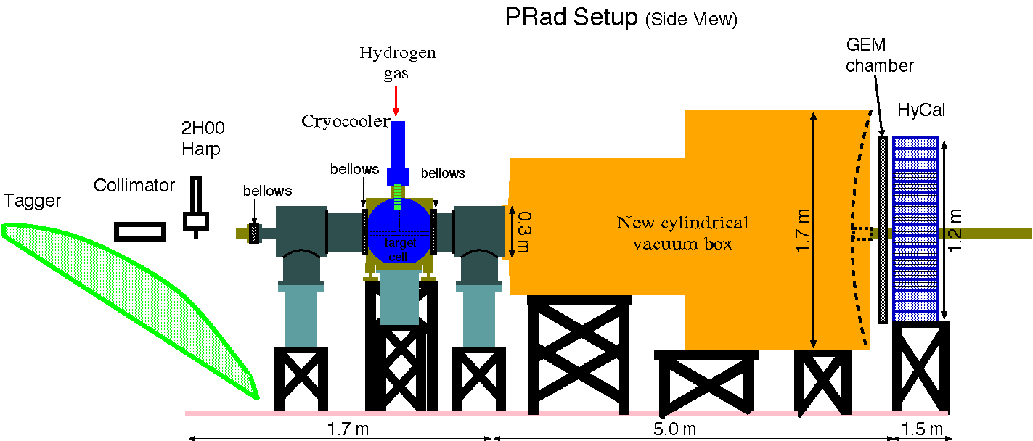
Prad: First completed experiment in 12 GeV era
e - beam

Slide 8
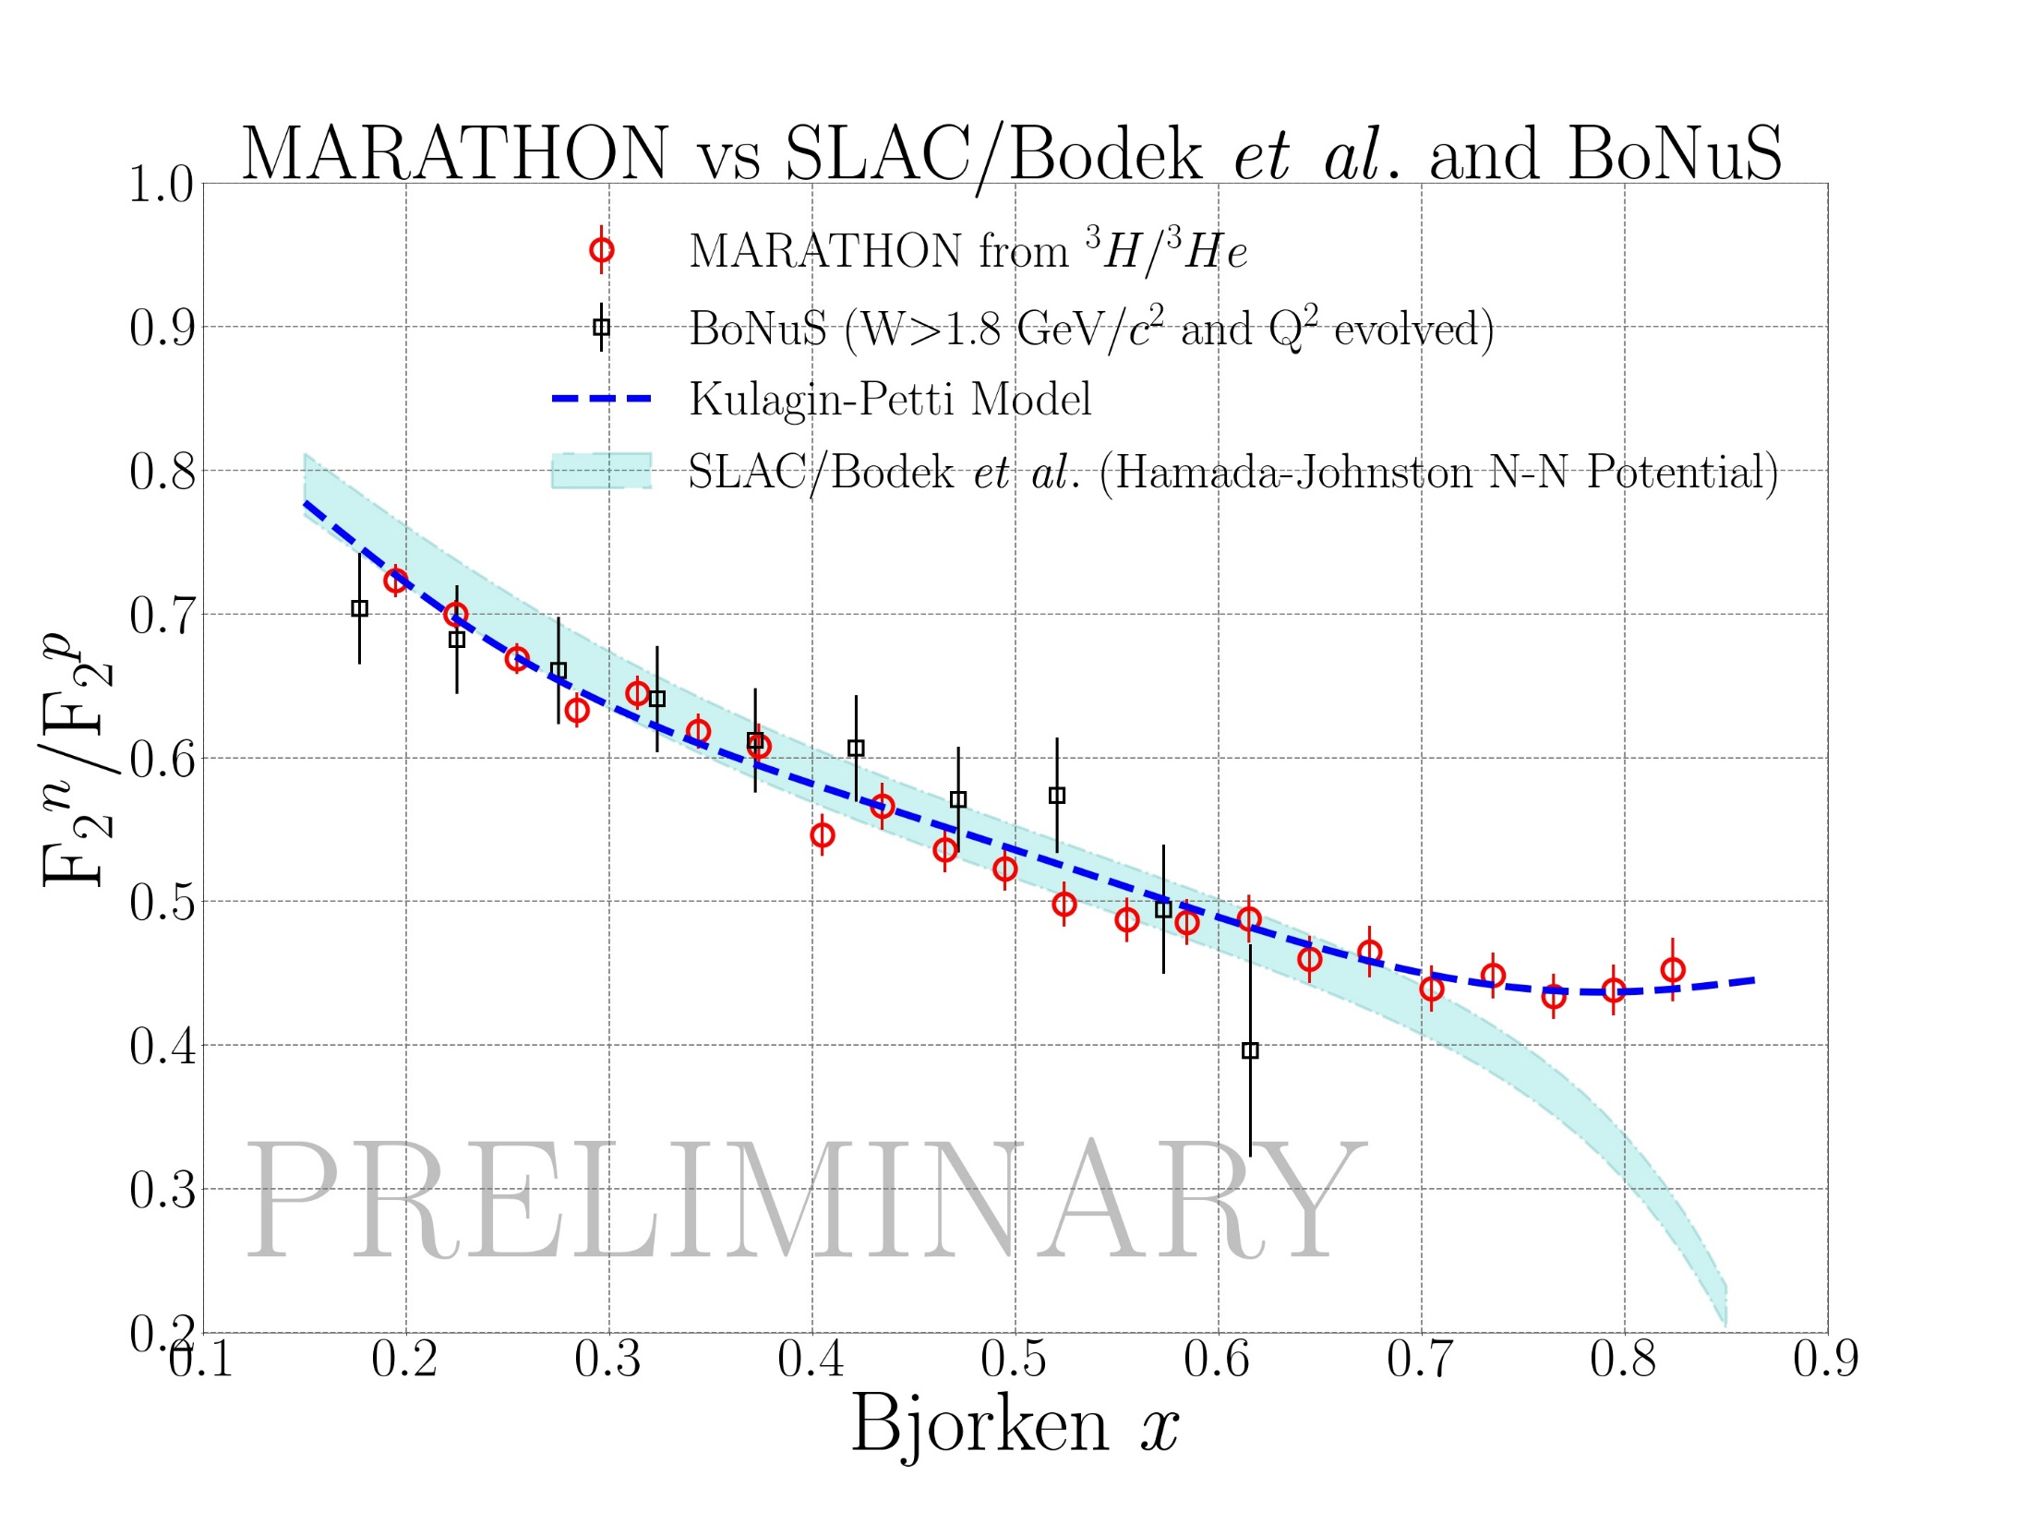
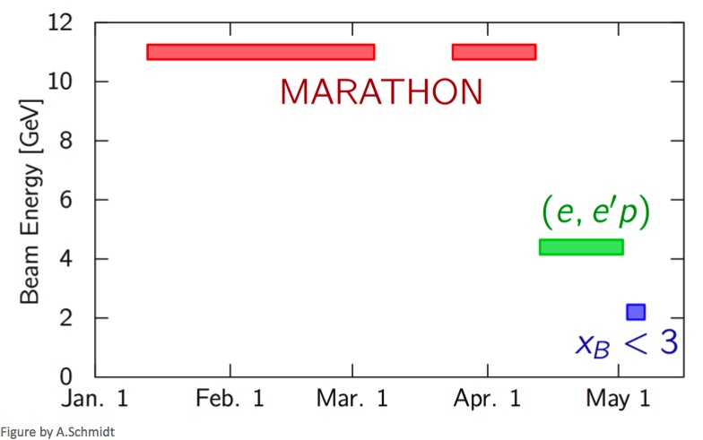
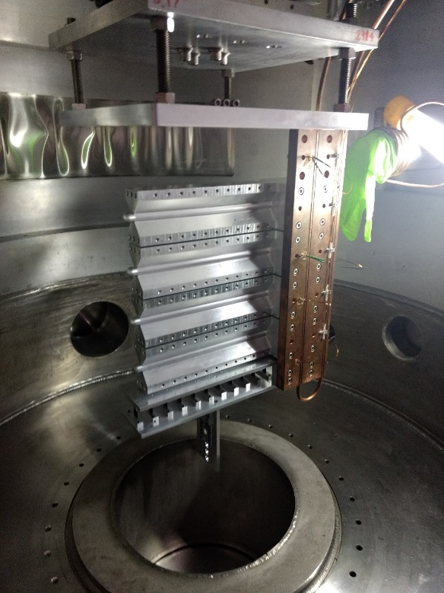
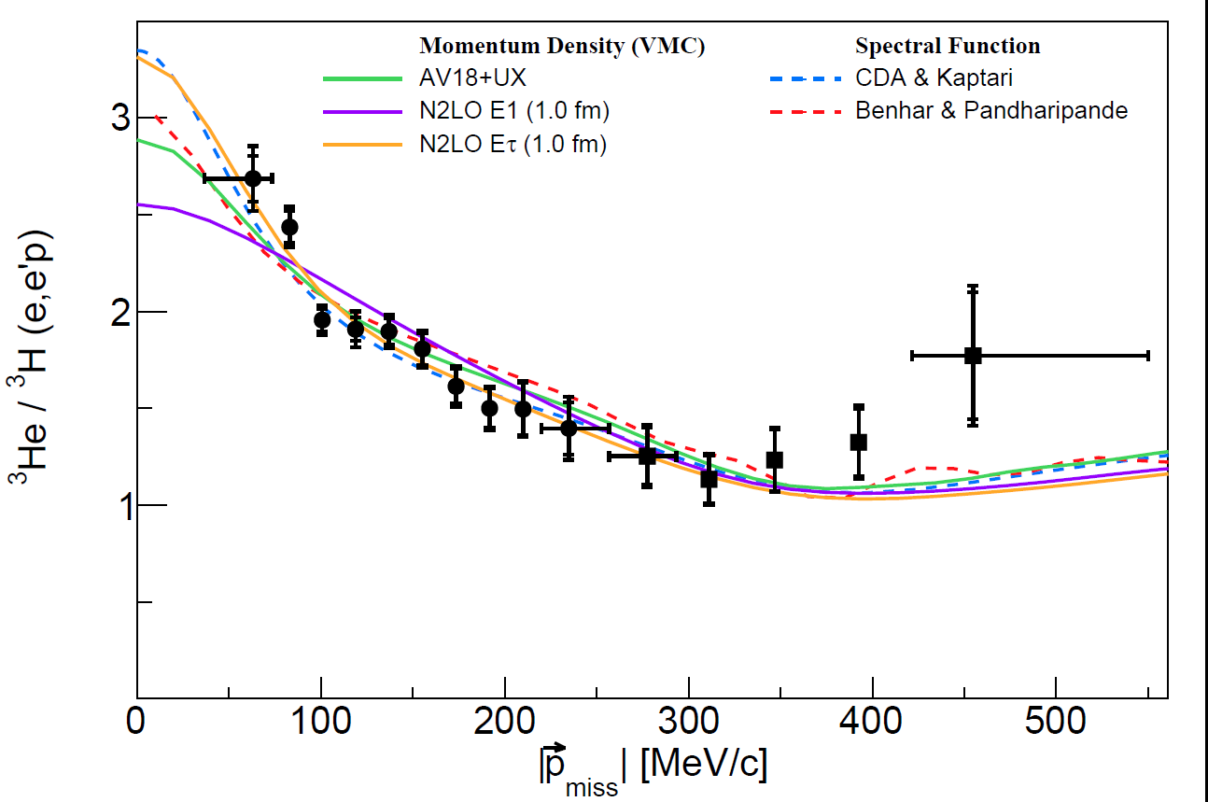
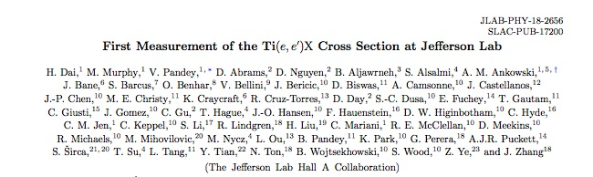
Hall A
Ran tritium family of experiments in 2018 – all 4 complete!
Successful run of APEX
Continue to publication results of previous 12 GeV experiments
Published in Phys. Rev. C98 (2018) no.1, 014617

Slide 9
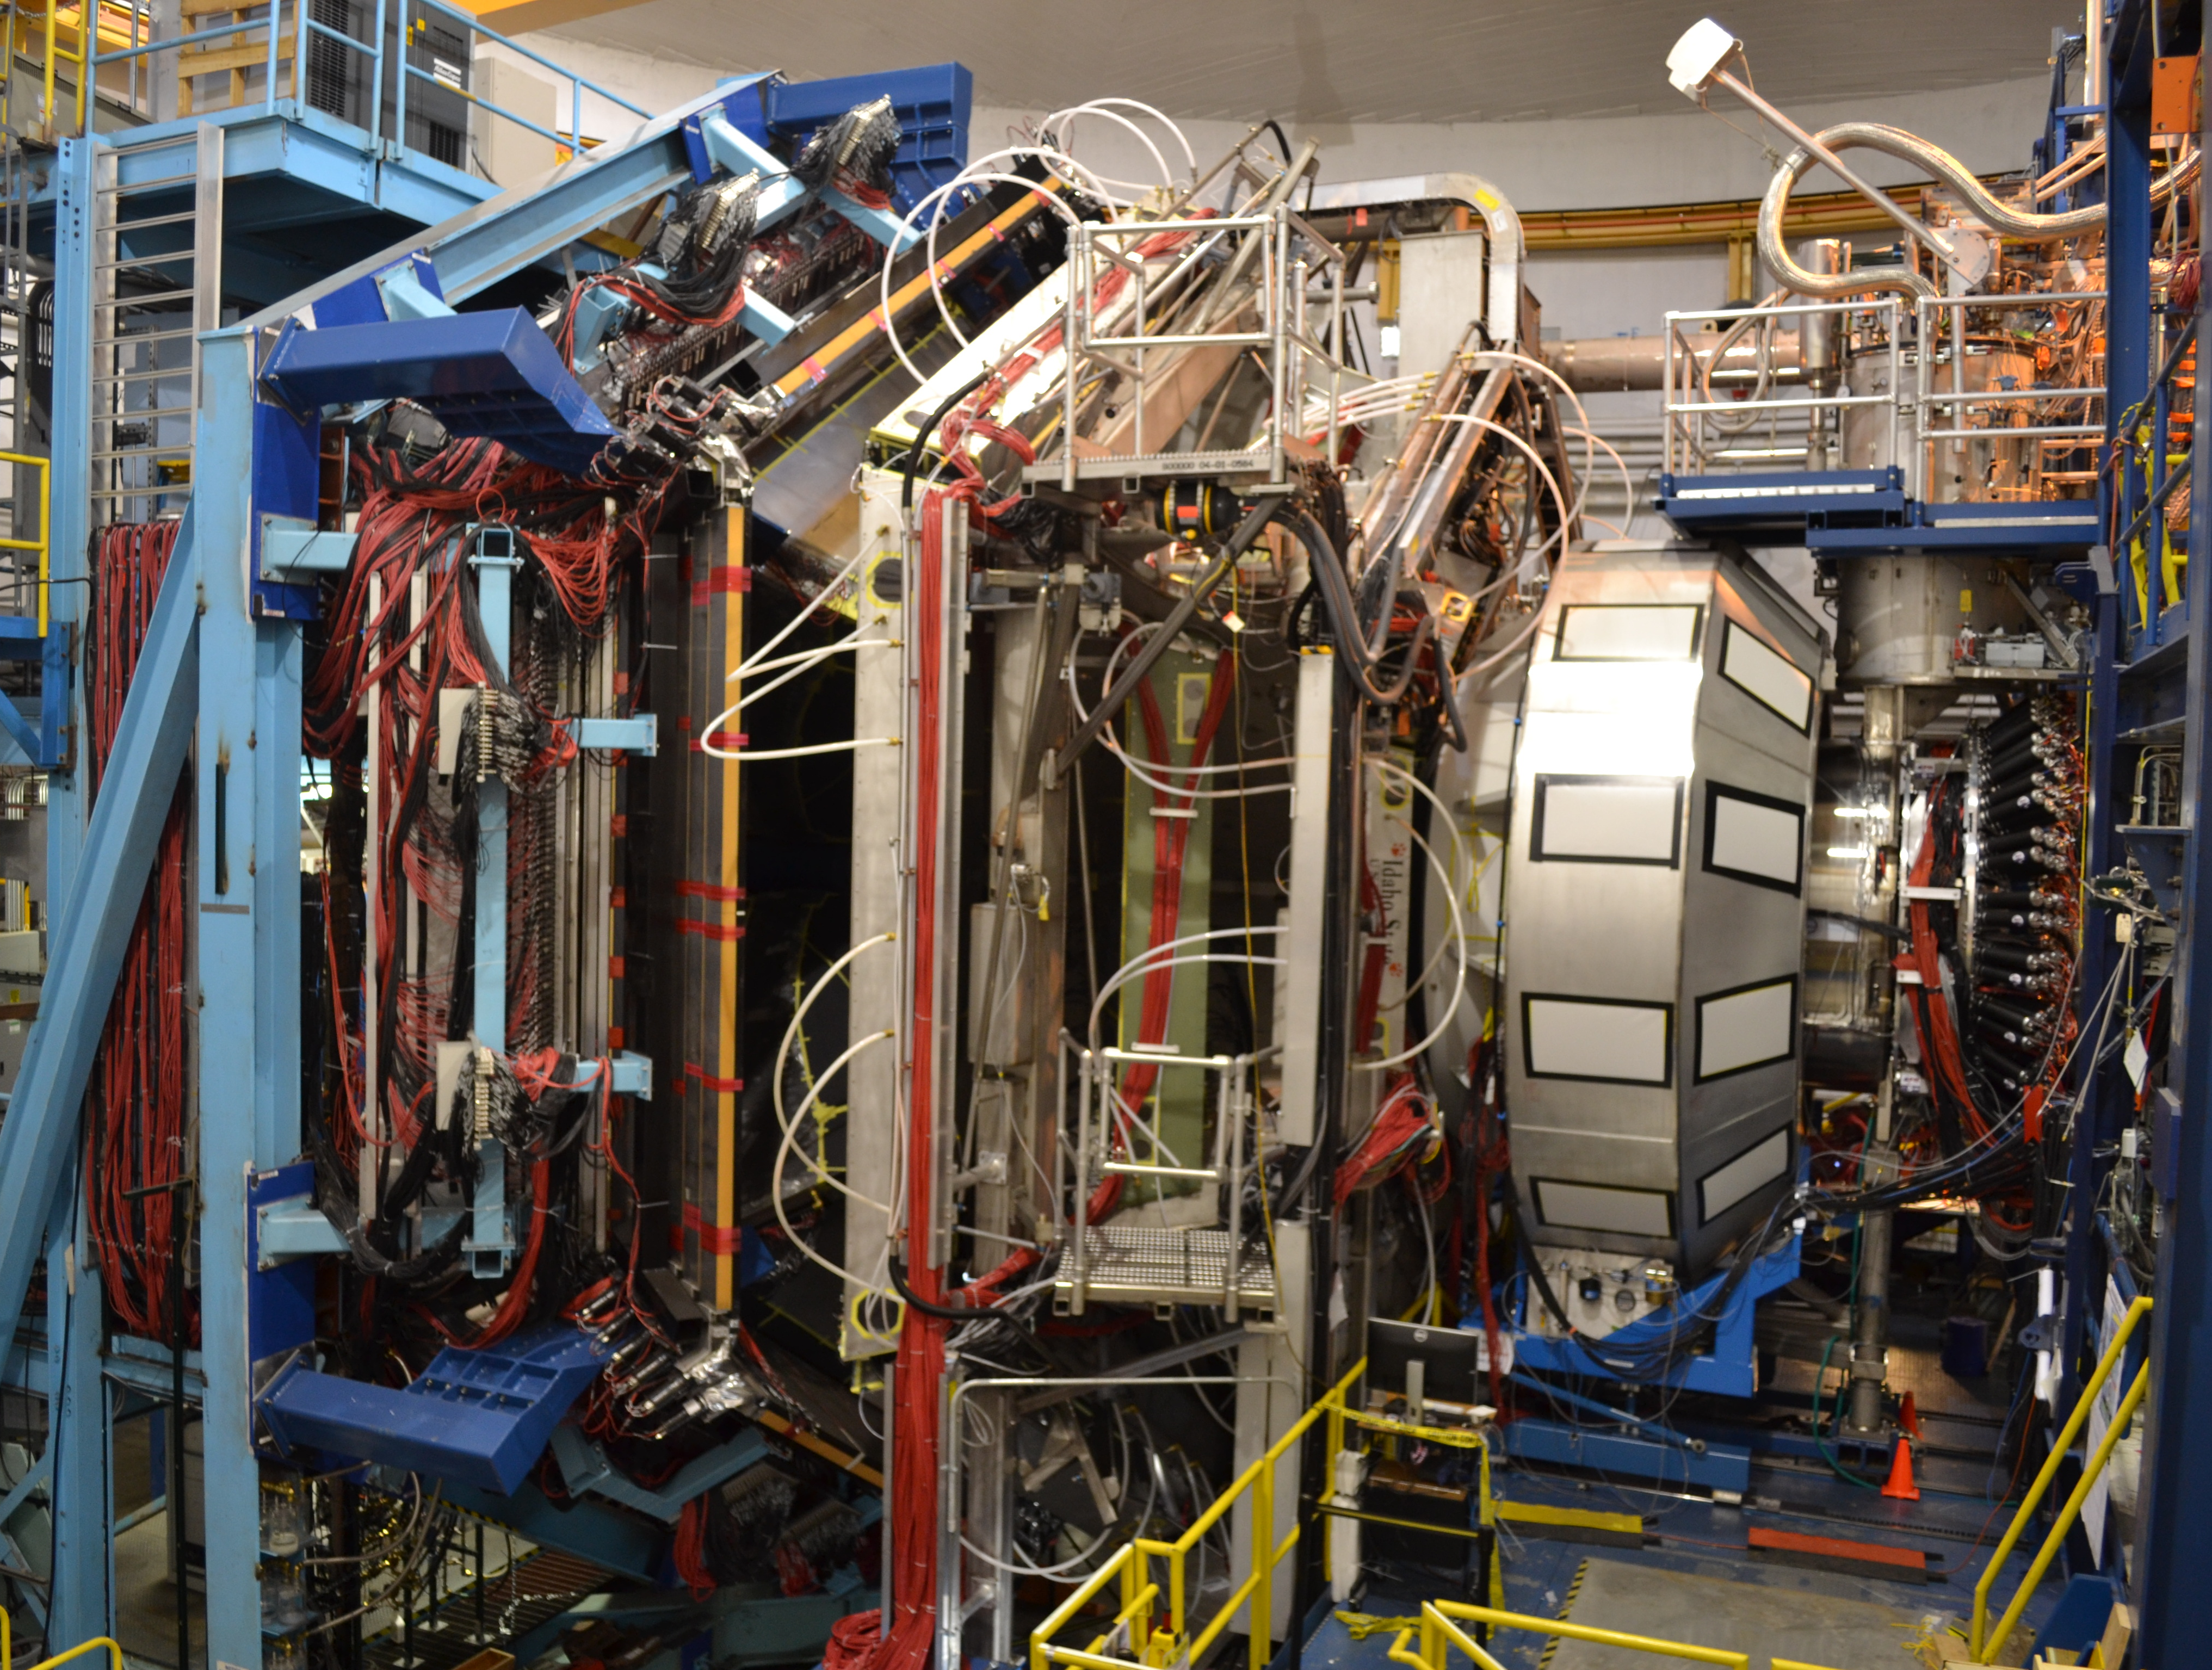

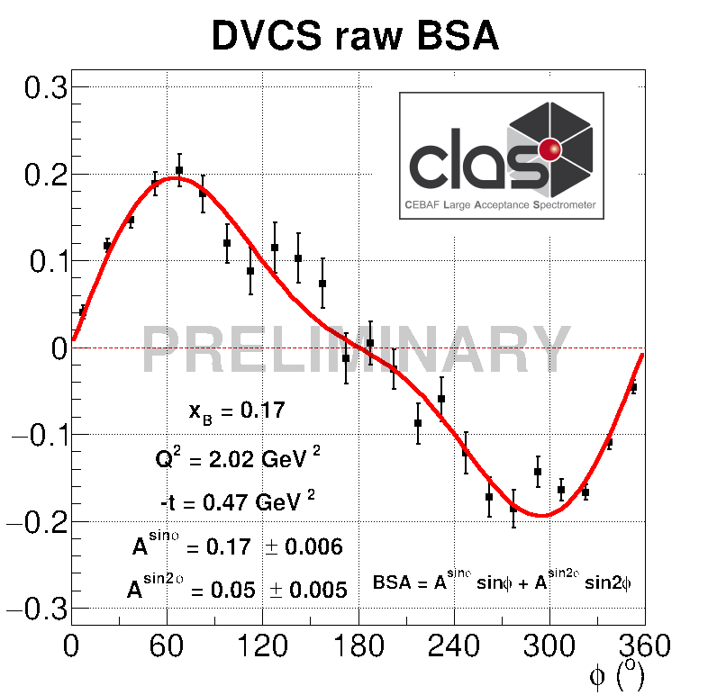
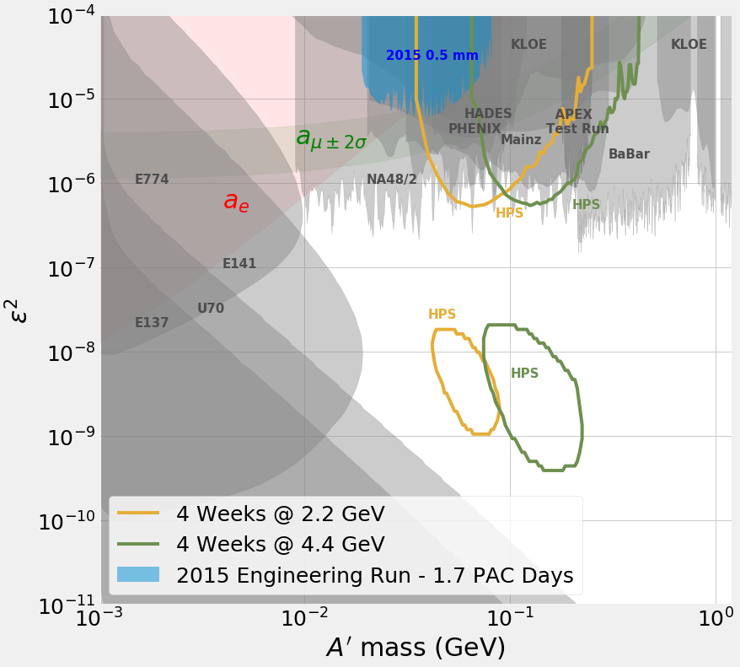
Hall B : Toward High Impact Science
Heavy Photon Search (HPS)
1 mm gap between Si
tracker detectors for
passage of electron beam
￼
2015 Engineering Run
1.7 PAC days @ 1.05 GeV
2 GeV data taken in 2016,
under analysis
NP-HEP Collaboration
Notes:
PEMP Mid-year

Slide 10
Hall C – New Results
}
Theory (1994)
Preliminary

Slide 11
Hall D: Exotic Mesons on the Way
JPAC: Phys. Rev. Lett. 122, 042002 (2019).
COMPASS: Phys. Lett. B 740, 303 (2015).
γ + p → p η’ π⁰
GlueX-I is complete
25% of data analyzed
3 papers in preparation
Successful run of Primex-η
Next is GlueX-II (with DIRC)
Notes:
PEMP Mid-year

Slide 12

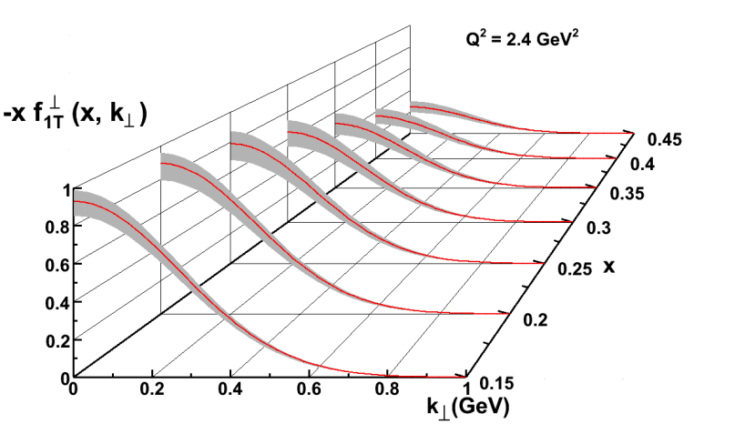
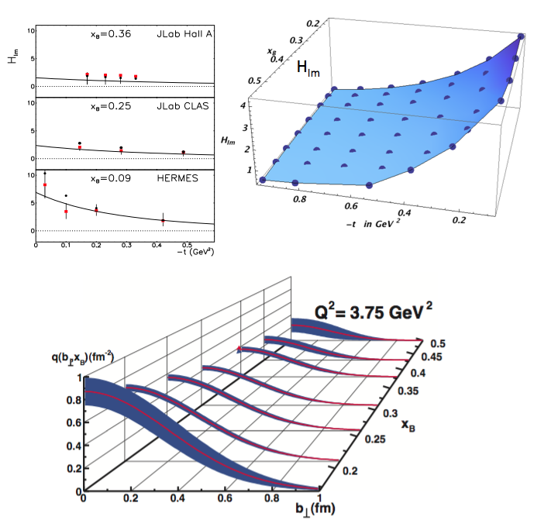
Nuclear Femtography
5D
Transverse Momentum Distribution (TMD)
– Confined motion in a nucleon (semi-inclusive DIS)
Generalized Parton Distribution (GPD)
– Spatial imaging (exclusive DVCS)
Requires
– High luminosity
– Polarized beams and targets
– Sophisticated detector systems
3D
Center for Nuclear Femtography
Proposal to Commonwealth of Virginia
  Initial request of $0.5M for pilot study awarded; funding of ~$2M/year envisioned
Consortium of Virginia universities
Theoretical physics, experimental physics, computation, data science, statistics – interdisciplinary effort
Benefit to 12 GeV program and future EIC studies
Symposium on Imaging and Visualization in Science’ , UVa, Dec. 10-11, 2018.
Major new capability
with JLab @ 12 GeV

Slide 13
Approved experiments (thru march 17)
Topic | Hall A | Hall B | Hall C | Hall D | Other | Total
Hadron spectra as probes of QCD | 0 | 2 | 1 | 3 | 0 | 6
Transverse structure of the hadrons | 6 | 3 | 3 | 1 | 0 | 13
longitudinal structure of the hadrons | 2 | 3 | 7 | 0 | 0 | 12
3D structure of the hadrons | 5 | 9 | 6 | 0 | 0 | 20
Hadrons and cold nuclear matter | 8 | 5 | 7 | 0 | 1 | 21
Low-energy tests of the Standard Model and Fundamental Symmetries | 3 | 1 | 0 | 1 | 2 | 7
Total | 24 | 23 | 24 | 5 | 3 | 79
Total Experiments Completed | 6.9 | 5.4 | 4.8 | 1.2 | 0 | 18.3
Total Experiments Remaining | 17.1 | 17.6 | 19.2 | 3.8 | 3.0 | 60.7

Slide 14
Approved Experiments – PAC Days (thru March 17)
Topic | Hall A | Hall B | Hall C | Hall D | Other | Total
Hadron spectra as probes of QCD | 0 | 219 | 11 | 540 | 0 | 770
Transverse structure of the hadrons | 150.5 | 85 | 110 | 25 | 0 | 370.5
longitudinal structure of the hadrons | 65 | 230 | 211 | 0 | 0 | 506
3D structure of the hadrons | 409 | 872 | 197 | 0 | 0 | 1478
Hadrons and cold nuclear matter | 220 | 275 | 205 | 0 | 14 | 714
Low-energy tests of the Standard Model and Fundamental Symmetries | 547 | 180 | 0 | 79 | 60 | 866
Total Days | 1392 | 1861 | 734 | 644 | 74 | 4704.5
Total Days - (includes MOLLER) | 917.5 | 1861 | 734 | 644 | 28 | 4184.5
Total Approved Run Group Days (includes MIE) | 1392 | 1026 | 691 | 444 | 74 | 3626.5
Total Approved Run Group Days (includes MOLLER) | 917.5 | 1026 | 691 | 444 | 28 | 3106.5
Total Days Completed | 173.5 | 145 | 111.5 | 132 | 0 | 562
Total Days Remaining | 744 | 881 | 579.5 | 312 | 28 | 2545
A Decade of Experiments!

Slide 15
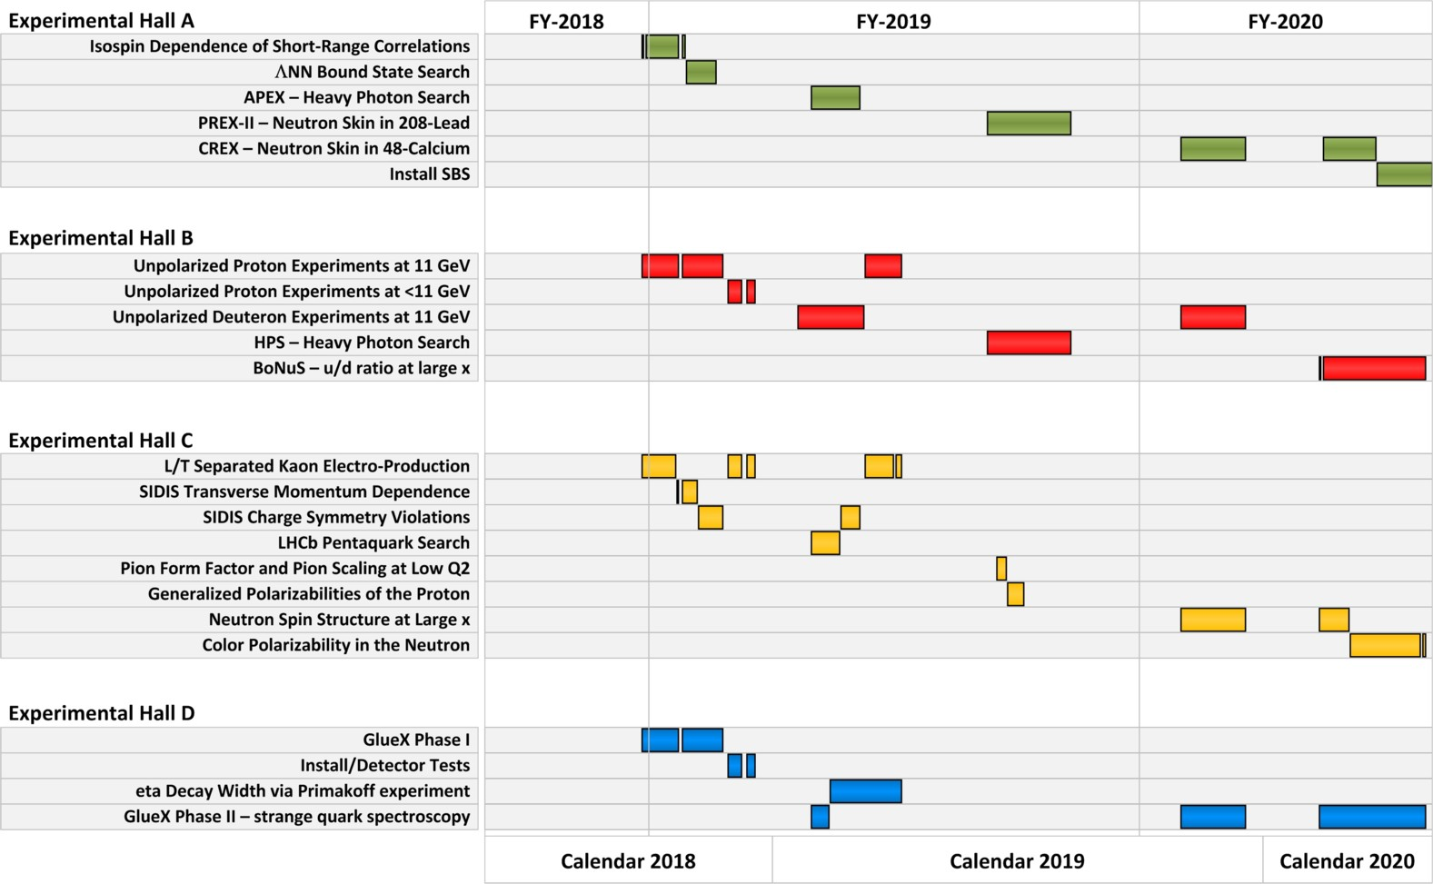
Published FY19-20 Schedule

Slide 16
PAC47
July 29th - August 2, 2019
Proposals are due June 10
New members: Markus Diehl, Barbara Erasmus,
Matthias Grosse Perdekamp
Will initiate Jeopardy process...

Slide 17
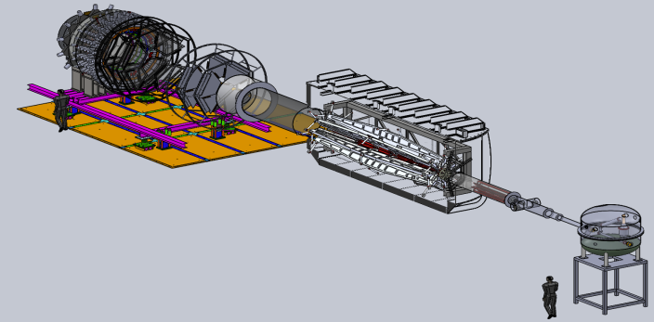

Future Projects
MOLLER experiment
(Possible MIE – FY20-24)
– Precision Standard Model Test
– DOE science review (Sept. 2014) – strong endorsement
– Director’s Cost, Schedule and Technical review held Dec. 2016
– CD-0 approved, Dec. 2016
– FY20 start in Pres. budget
– Director’s Review April 24-26, 2019
SoLID
– Large acceptance, high lumi
– SIDIS and PVDIS
– CLEO Solenoid 
– International collaboration
– Director’s review (Feb. 2015)
 new pre-CDR complete
– Director’s review in CY19
– Awaiting science review from ONP

Slide 18
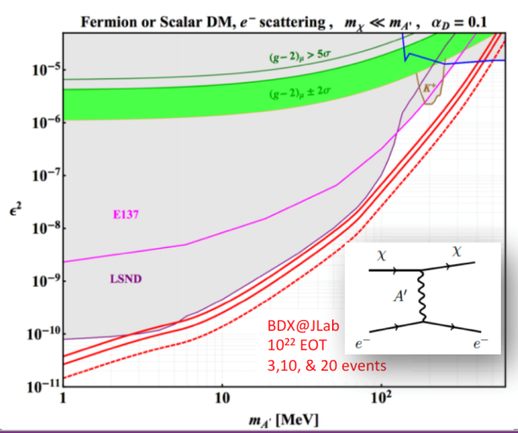
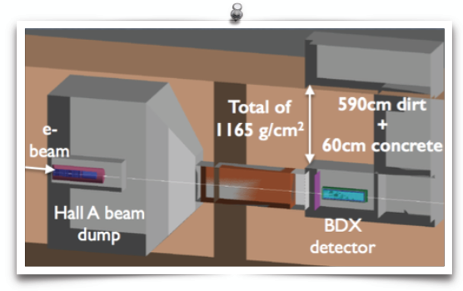

Beam Dump eXperiment (BDX)
BDX @ JLab:
New underground (~8m) hall downstream of a high intensity dump
BDX significantly exceeds the space covered by other experiments ➔potential to lead to a new discovery
  Proposal for design study submitted to HEP

Slide 19

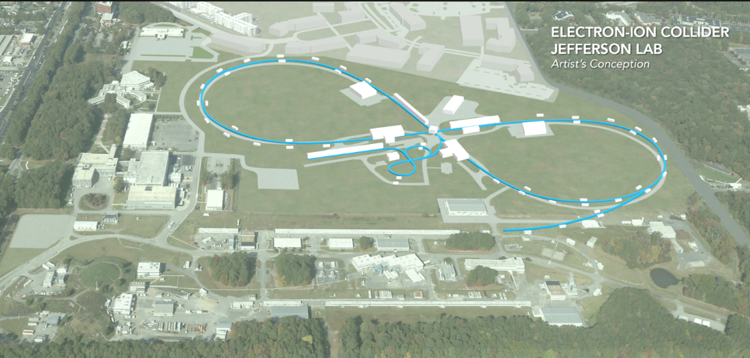
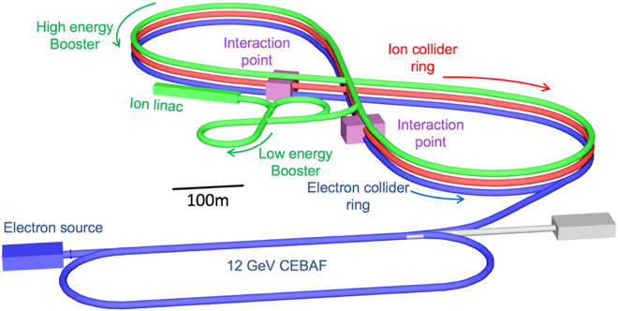
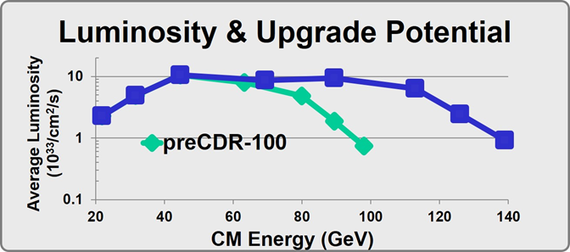
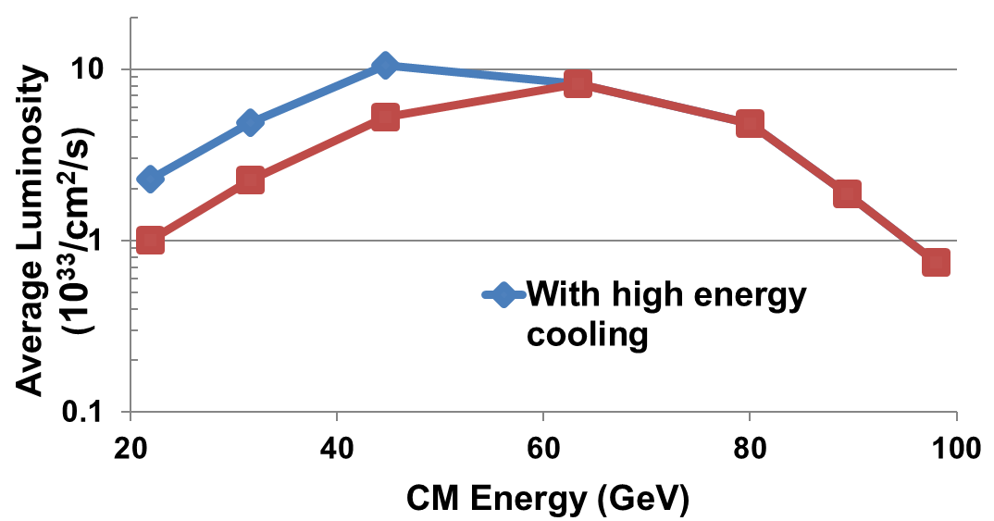

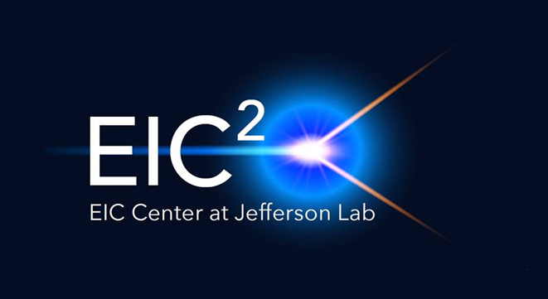
Electron Ion Collider at Jefferson Lab
JLab EIC Figure 8 Concept
    High Polarization (including deuterons)
    High Luminosity
    Energy Range: √s : 20 to 100-140 GeV (magnet technology choice)
    Low technical risk for white paper goals
    Flexible timeframe for construction
    consistent w/running 12 GeV CEBAF
    High performance, low-risk
    Cost effective operations
    Fulfills White Paper, NAS Requirements
100 fb⁻¹/yr
PreCDR complete
E_{CM} 65100GeV
in progress
Notes:
Update bullets; Add ICR; Add EIC Center?

Slide 20
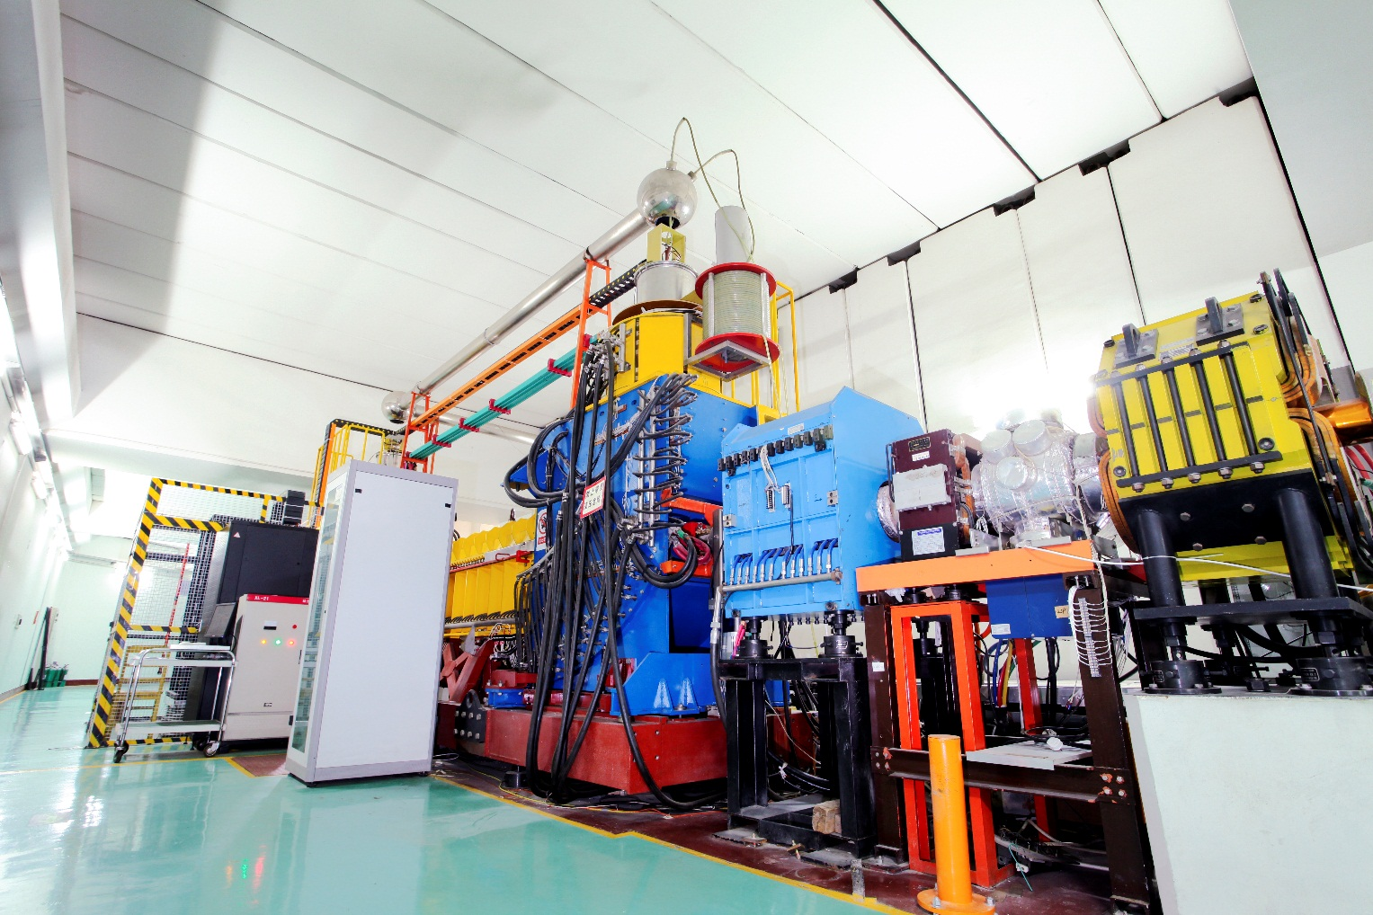
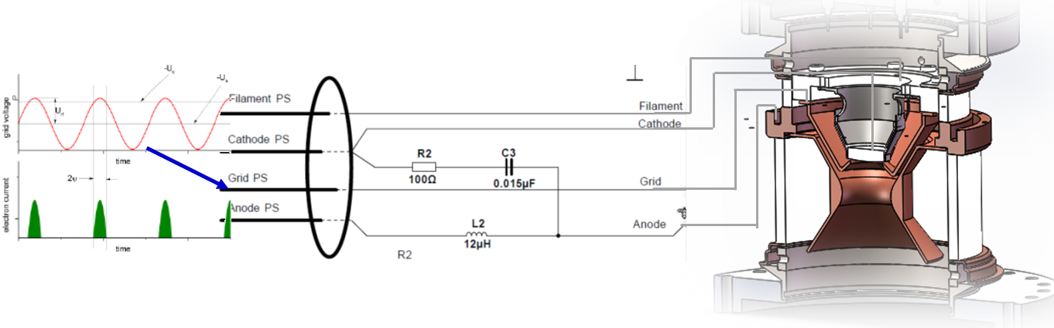
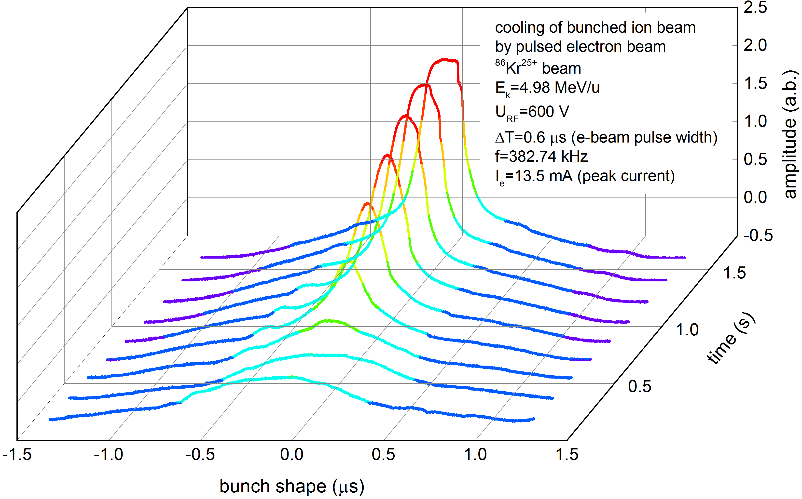
Demonstration of Cooling of Ions by a Bunched e-Beam
A DC electron cooler at Institute of Modern Physics, China
4/2016, 1st experimental demonstration
Follow-up experiment on 4/2017, 12/2018
First reported at JLEIC Meeting Fall 2016 (Oct. 5, 2016)
First publication in Procs. of COOL17 Workshop (18-22 Sept. 2017)
Pulsed e-beam by switching on/off the grid electrode
Longitudinal cooling (reduction of bunch length)
Ion | ⁸⁶Kr²⁵⁺
Energy (i/e) | 5 MeV/u & 2.7 KeV
Ion bunches | 2
RF voltage | 600 V
Stored ions | ~10⁸
Anode voltage | 400 V, 600 V, 800 V
Pulse width | 300 ns to 1200 ns
Transverse cooling

Slide 21


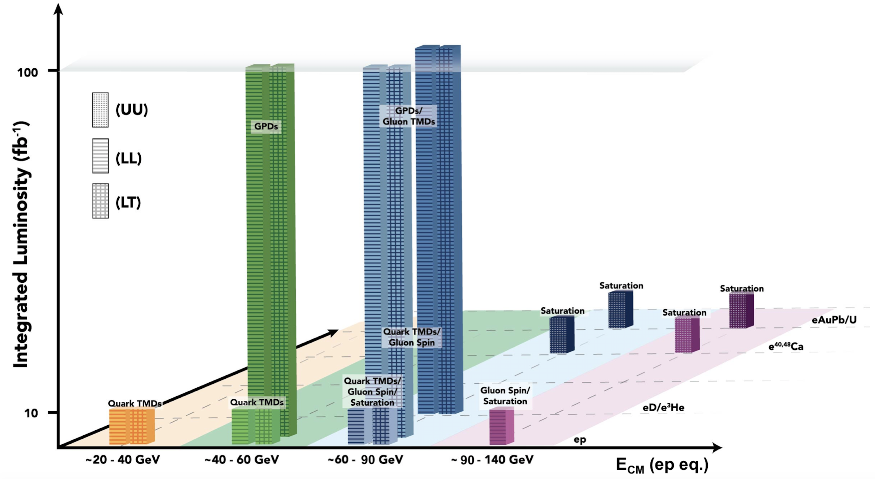
EIC White Paper Science Goals
Note: Total of ~710 fb⁻¹
  10³⁴ cm⁻²s⁻¹  6 fb⁻¹/week,
  ( >100 fb⁻¹ /year)
  10³³ cm⁻²s⁻¹  0.6 fb⁻¹/week,
  ( >10 fb⁻¹ /year)

Slide 22
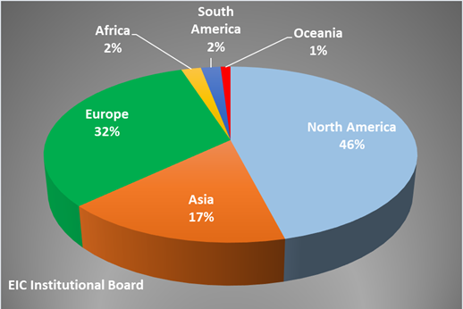
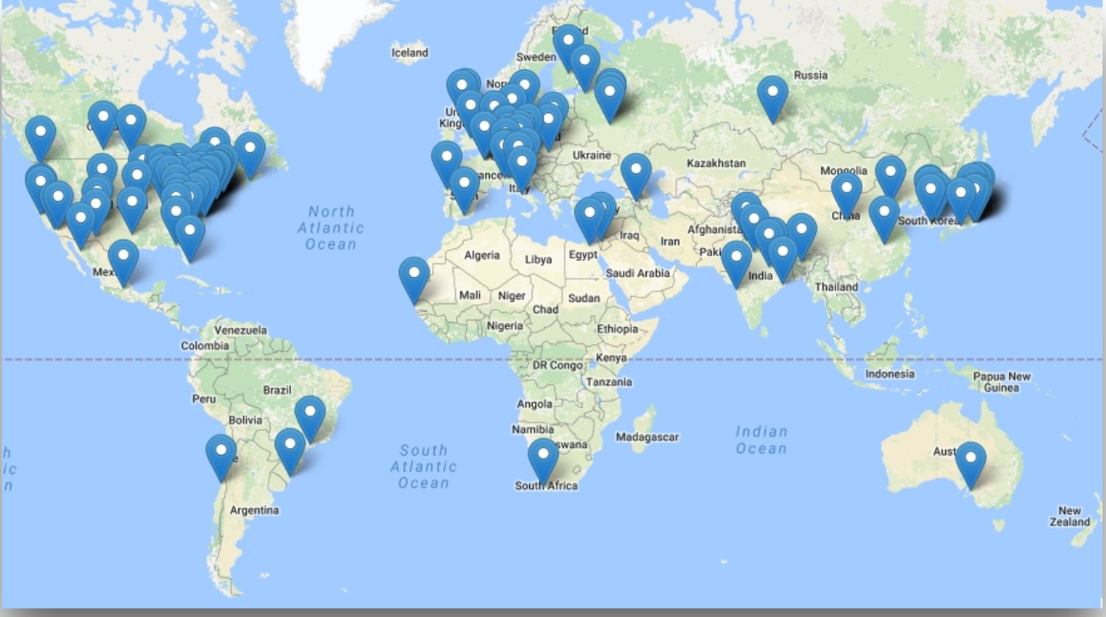
EIC Users Group and International Interest
Formed in 2016; currently:
  864 members
  184 institutions
  30 countries

Slide 23
Breaking news
FY 20 President’s Budget Request:
Other Project Costs (OPC) funding to support high priority, critically needed accelerator R&D to retire high risk technical
challenges for the proposed U.S.-based EIC. Subsequent to the FY 2018 National Academy of Science Report confirming
the importance of a domestic EIC to sustain U.S. world leadership in nuclear science and accelerator R&D core
competencies. Critical Decision-0, Approve Mission Need, is planned for FY 2019.

Slide 24
Summary
12 GeV science program at JLab is underway
  4 Hall operation is now routine
  A broad program of 79 approved experiments with many opportunities for discovery is planned
  Initial science results are already being reported
Future Equipment projects
  MOLLER: CD0 – hope for FY20 start
  SoLID: Prepare for DOE science review
  NSF mid-scale?
EIC status continues to develop
- FY20 DOE budget language
- JLEIC design continues

