Slide 1
Publications and Presentations Committee May 2019
Gabriel Charles
Rouven Essig
Norman Graf
Rafayel Paremuzyan
A.C.

Slide 2
PPC Responsibilities
Get talks and publicize speaking opportunities
Maintain talk and conference publication data-base
Get speakers and allocate speaking opportunities
Review and approve
Abstracts
Talk slides
Conference proceedings
Instrumentation papers
Manage the paper writing process for results papers
Maintain a page of “officially-approved” plots

Slide 3
I'm giving an HPS-talk: what should I do?
Contributed or invited talks:
Abstract submitted to PPC for approval 2 weeks before deadline
Slides submitted to PPC for approval 2 weeks before talk – PPC will circulate to the collaboration and collect comments
Final slides submitted to PPC for posting on the PPC website
Conference proceedings submitted to PPC for approval 2 weeks before deadline – PPC will circulate to the collaboration and collect comments
Seminars or colloquia:
No approval needed
Final slides submitted to PPC for posting

Slide 4
The rules – papers and results
Physics Results:
“Officially approved plots” archived on the password-controlled PPC page: if you use plots from that page (or from already published papers), there is no need for approval.
Key transparencies with new results need approval
EC and PPC (and Analysis Committee) approval
2/3 vote of collaboration
Physics Publications:
Analysis note
Made available to collaboration
Needs approval by PPC and EC (and Analysis Committee)
Writing team formed by PPC (and EC)
2 weeks for collaboration comments
Review team (writing team plus 3 more) writes 2nd draft
2 more weeks for comments (minor only)
Needs approval by PPC, EC and 2/3 of collaboration

Slide 5
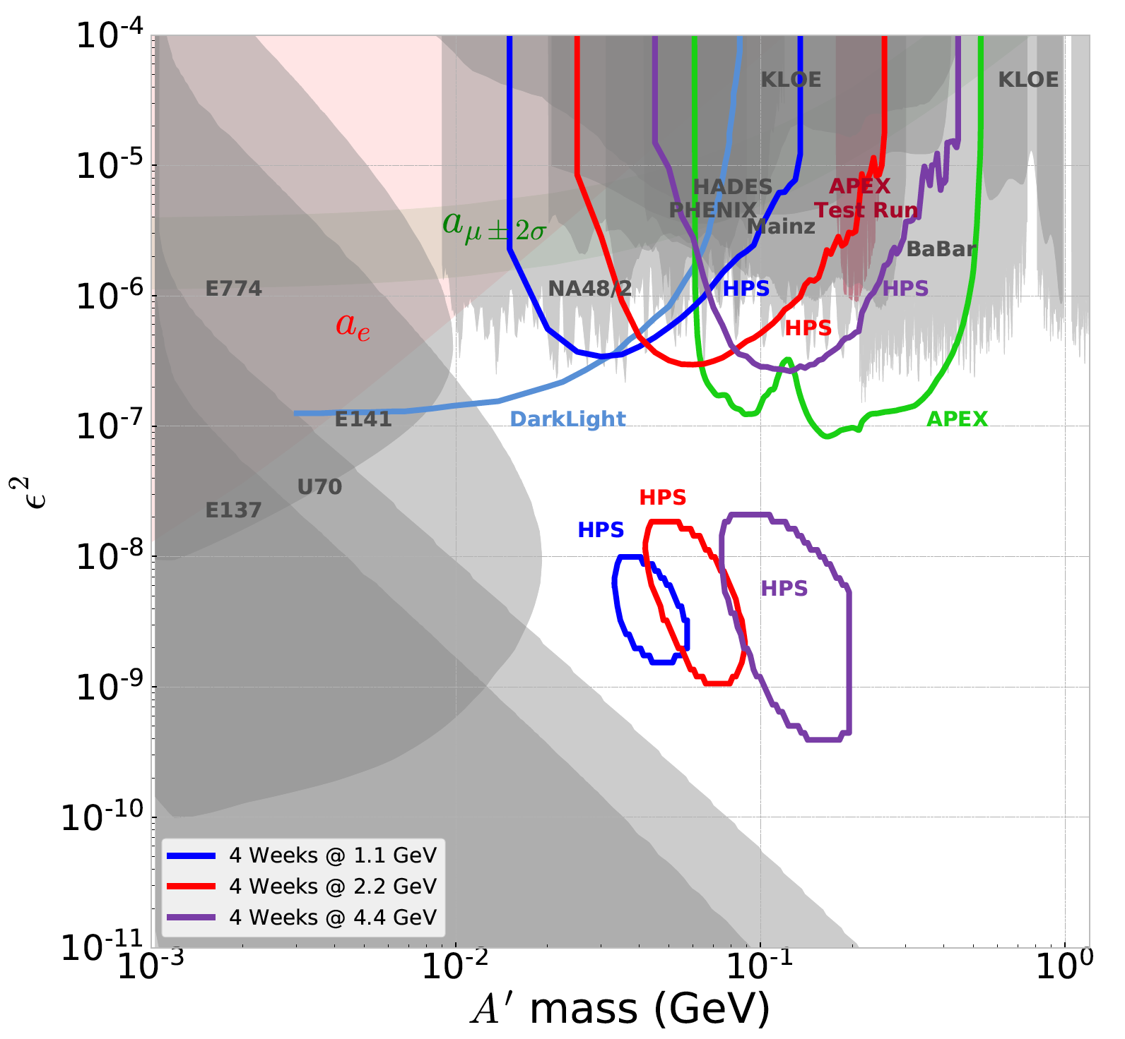
Officially-approved plots page
PPC should maintain a web-page of “officially approved” plots – from approved analysis notes and published papers.
Currently: 2015 vertex analysis and 2015 bump-hunt analysis relevant plots are uploaded.
A.C. takes care of updating the page with approved plots from published papers / approved notes
Detector experts: please send to Norman key plots / figures from your subsystem to be uploaded to the page

Slide 6
HPS Talks: December 2018 to May 2019
Conference | Speaker | Date
ML-at-SLAC | Matthew Solt | Feb. 19
APS April meeting (Denver, CO) | Matthew Solt | April 13-16
Forthcoming conferences with already-planned HPS contributions:
Menu 2019 (Maurik Holtrop)
DPF 2019 (Cameron Bravo)
CHEP 2019 – abstract was sent by Norman (thanks!). Contact PPC if you are interested in giving the talk.

