Slide 1
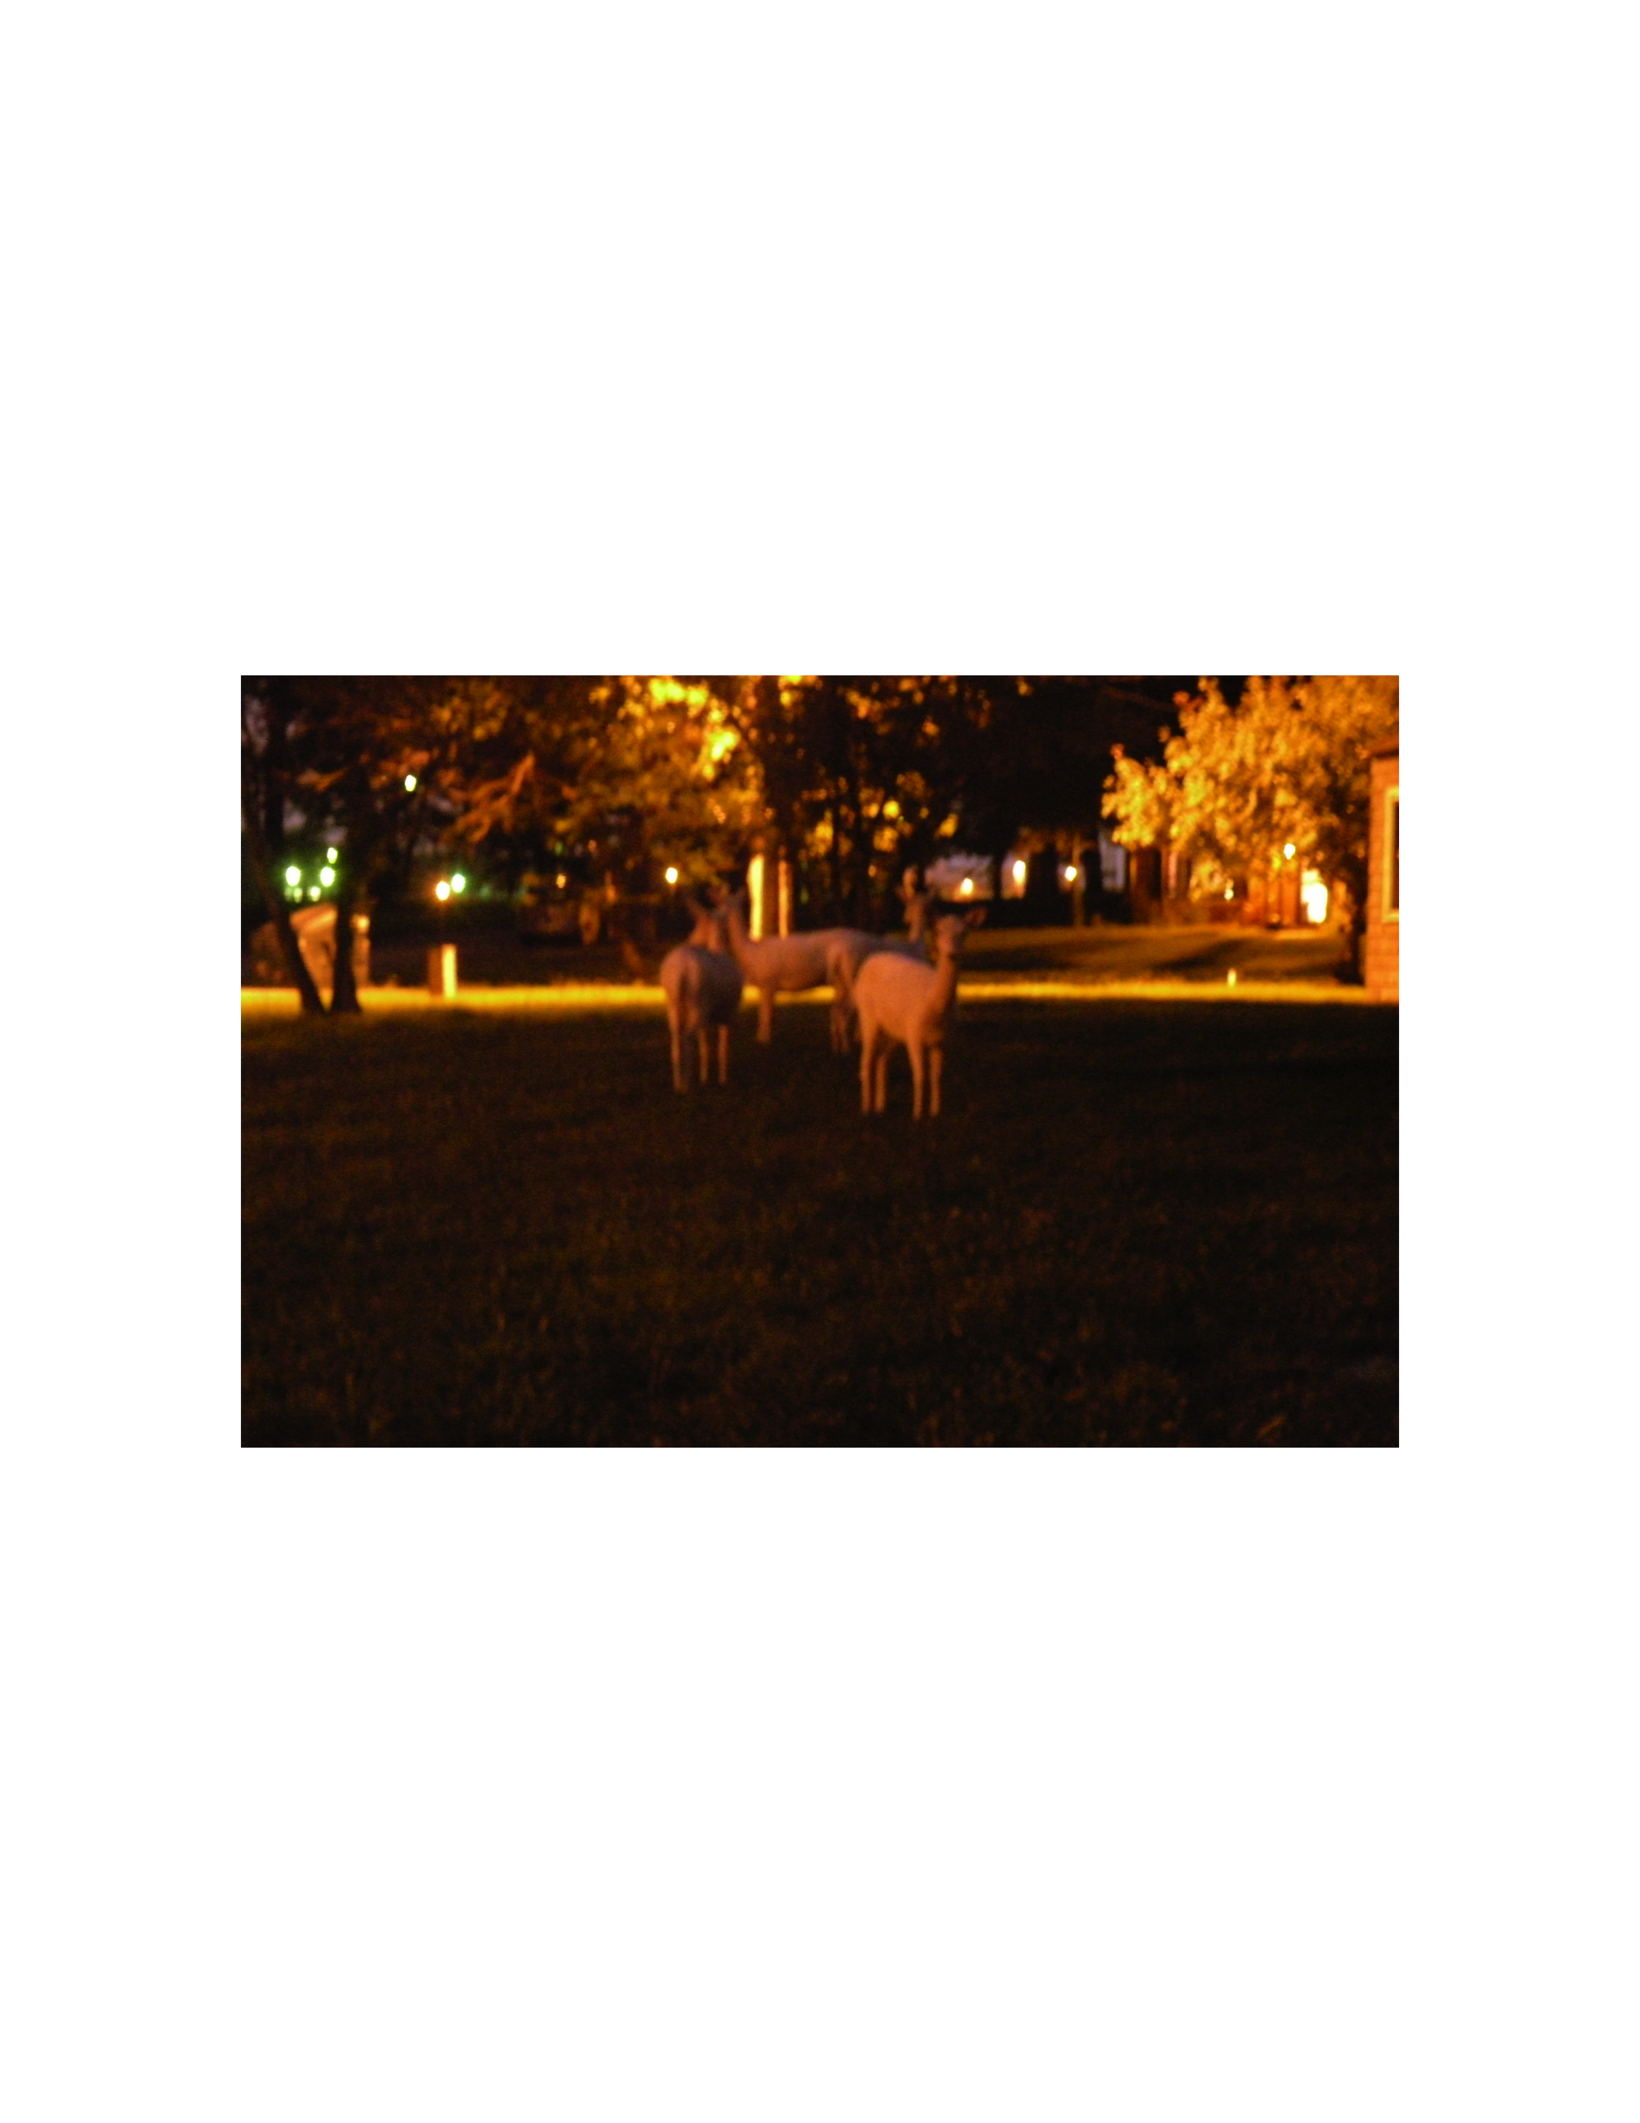

Nuclear femtography as a bridge from the nucleon to neutron stars
QCD Evolution 2019
Argonne National Lab, May 13-17, 2019
Simonetta Liuti
University of Virginia
ANL, Summer 2009

Slide 2
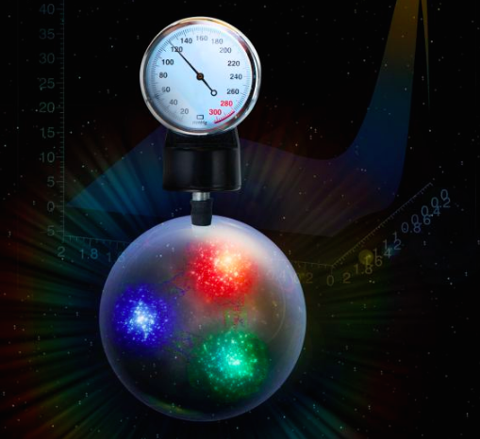
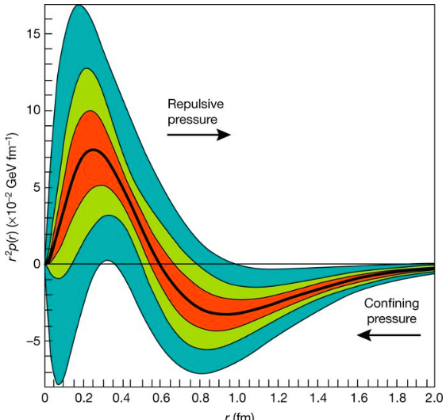
Burkert, Elouadrhiri, Girod, Nature 557, 396 (2018)
“The average peak pressure near the center is about 10³⁵ pascals, which exceeds the pressure estimated for the most densely packed known objects in the Universe, neutron stars”

Slide 3
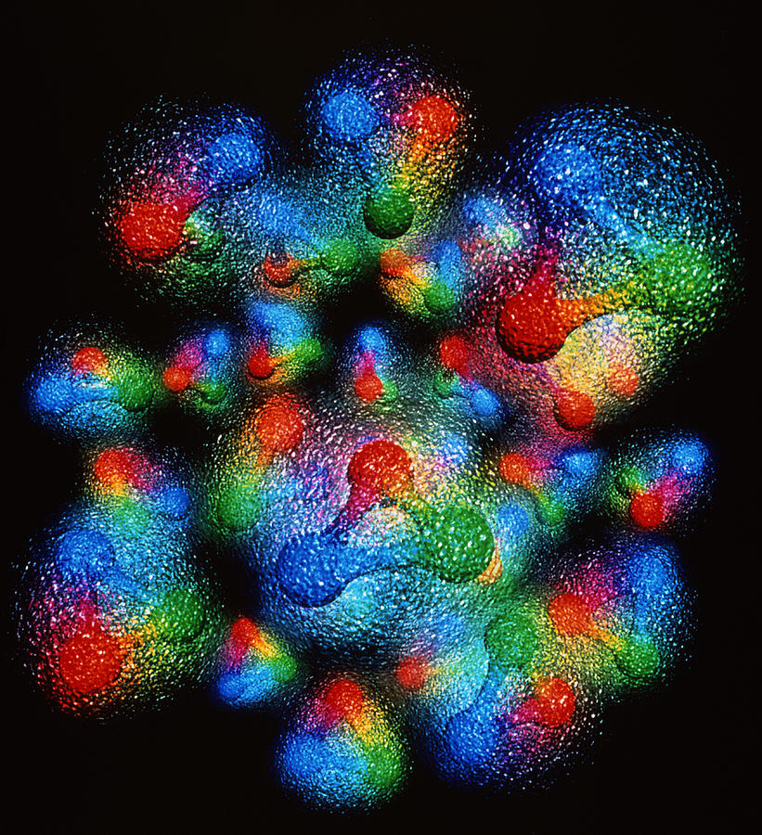
How is the pressure radial distribution extracted from data?
(How does the proton/neutron get its mass and spin?)
Invariance of L_{QCD} under translations and rotations
Energy Momentum Tensor
from translation inv.
.
Angular Momentum Tensor
from rotation inv.
Notes:
The vast majority of the
nucleon’s mass is due to quantum fluctuations of quarkantiquark
pairs, the gluons, and the energy associated
with quarks moving around at close to the speed of light.
mass of the three valence
quarks in the nucleon comprises only a small fraction
of the nucleon’s total mass. The vast majority of the
nucleon’s mass is due to quantum fluctuations of quarkantiquark
pairs, the gluons, and the energy associated
with quarks moving around at close to the speed of light
The lagrangian looks simple and most importantly it is a “known” expression

Slide 4
S=1/2
Parametrization of QCD EMT matrix element between proton states (X. Ji, 1997)
q,g
forward
off-forward
q and g not separately conserved

Slide 5
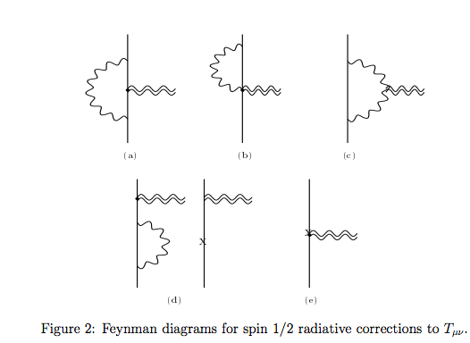
Direct calculation of EMT form factors
Donoghue et al. PLB529 (2002)

Slide 6
GPDs and EMT matrix elements
q’
q
Local Operator Ô
μ
ν
p
p’
p
p’
Q²>>M² ➔ “deep”
W²>>M² ➔ equivalent to an “inelastic” process but not directly accessible

Slide 7
2nd Mellin moments
From OPE
From EMT
Nucleon
D-term

Slide 8
Physical interpretation of EMT form factors

Slide 9
C (D-term) is related to pressure
Static approximation
Landau&Lifshitz, Vol.7
M. Polyakov, hep-ph/0210165
M. Polyakov, P. Schweitzer, arXiv:1805.06596
C is a measure of the Elastic Free Energy in the proton

Slide 10

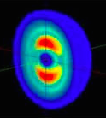
Energy Momentum Tensor in a spin 1 system
PRD86(2012)
7 conserved form factors!
S=1

Slide 11
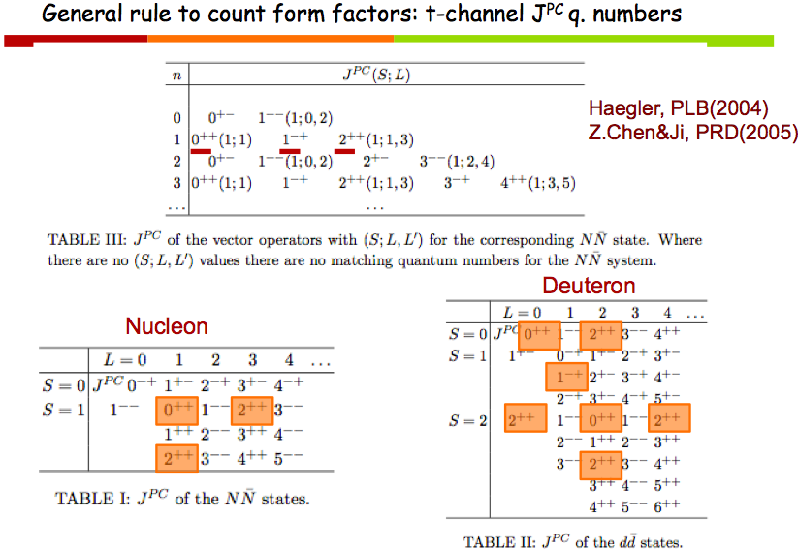
S.L., Talk at INT U. Washington, 2012

Slide 12
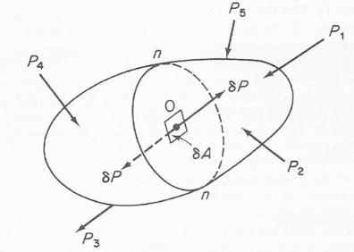
Taneja et al., PRD86(2012)
Deuteron
From OPE
From EMT
Momentum
Angular Momentum
Double flip
D-term dependent on polarization
Quadrupole
ξ-odd
Connected to b₁ SR
Connecting with observables: work in progress with Brandon Kriesten and Adam Freese

Slide 13
GPDs are the key to interpret the mechanical properties of the proton

Slide 14
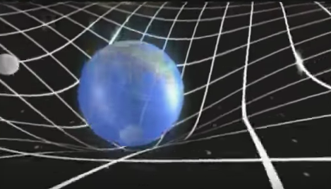
EMT and the source of the gravitational field
action
Ricci scalar ➔curvature
Flat space
Matter and energy in the universe
Spacetime geometry
Ricci tensor
Einstein’s Eqs.

Slide 15
Using the metric, g_{μν}, one can calculate:
the curvature tensor R_{µν}
the Einstein tensor G_{µν}
the stress energy tensor for a perfect fluid T_{µν}
energy density
matter density
pressure
TOV Equations
Knowing the EoS
EoS
p(r)-ε(r) relation
One can solve TOV to find the mass radius relation

Slide 16
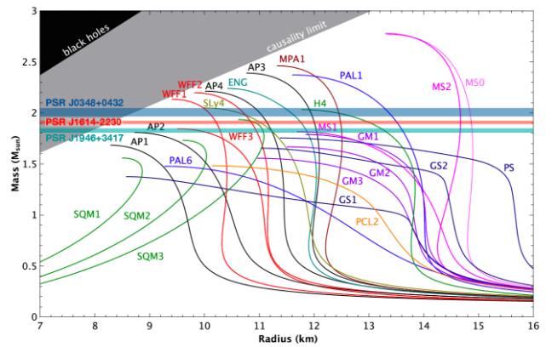
5/16/19
16
Constraints from Pulsar Masses
J. Antoniadis et al., Science 340, 6131 (2013)
P. B. Demorest et al., Nature 467 (2010)
Özel and Freire, http://xtreme.as.arizona.edu/NeutronStars
Constraints require the EoS to be stiff ➔ consistent with predictions for ordinary nuclear matter composed of mostly neutrons and few protons including three body interactions

Slide 17
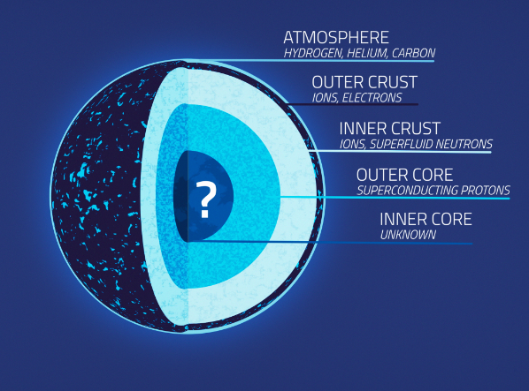
What governs the EoS of neutron stars?
ρ>0.3-0.5 ρ_{o}
ρ>0.5-2 ρ_{o}
ρ>2ρ_{o}
https://svs.gsfc.nasa.gov/20267
Due to their extreme compactness, the central density of neutron stars exceeds the nuclear saturation density, ρ_{o}= 0.16 fm⁻³

Slide 18
Most observed neutron star masses are > 1.3M
Gravitational collapse is countered by pressure originating from nuclear forces
TOV equations inject the mechanical/microscopic properties of NS matter into the stars macroscopic properties

Slide 19
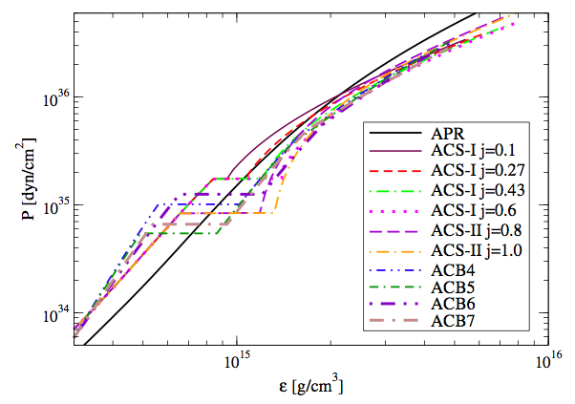
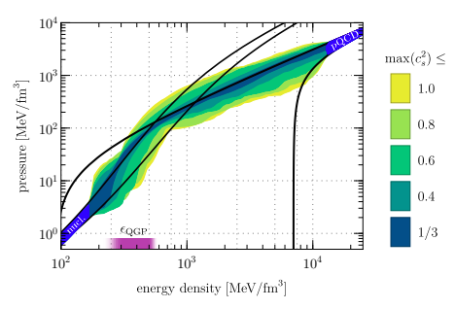
Pascalidhis et al., arXiv:1712.00451
Annala, E., Gorda, T., Kurkela, A., Nattila, J.,
& Vuorinen, A. arXiv:1903.09121
QM phase
baryon matter phase
“ …the existence of quark-matter cores inside very massive NSs should be considered the standard scenario, not an exotic alternative. QM is altogether absent in NS cores only under very specific conditions,…”

Slide 20
We propose a new, model independent way of evaluating the EoS in the quark matter phase by inferring it directly from the matrix elements of the QCD Energy Momentum Tensor (EMT) between nucleon states.
Model independent means relating measurement to measurement
The ingredients of our calculation are GPDs
This allows us to introduce spatial coordinates/distance in the picture in a novel way

Slide 21

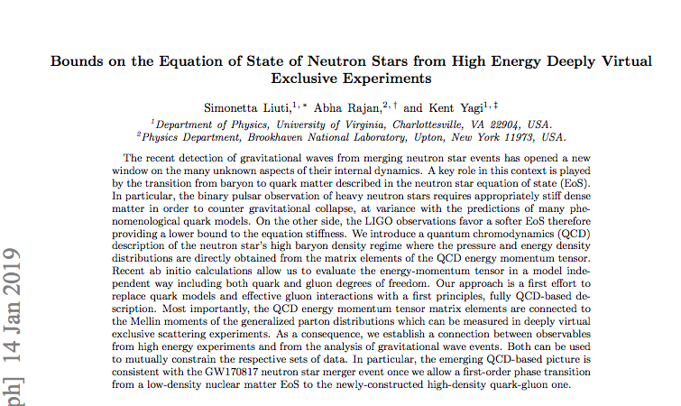
Based on
arXiv:1812.01479

Slide 22
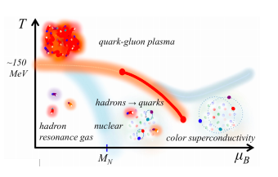
Densities and distance scales
Annala, E., Gorda, T., Kurkela, A., Nattila, J.,
& Vuorinen, A. arXiv:1903.09121
nucleons
quark and gluon structure
deconfinement
0.5 fm
2fm
1fm
G. Baym et al. arXiv:1707.04966

Slide 23
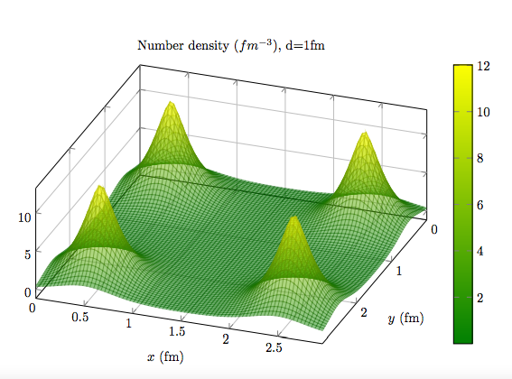
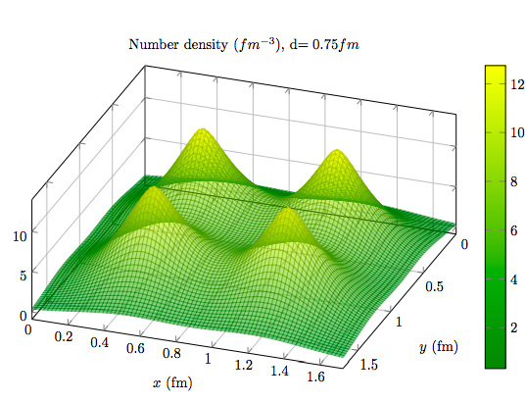
b’
b-b’
d= 2 fm
d= 0.75 fm

Slide 24
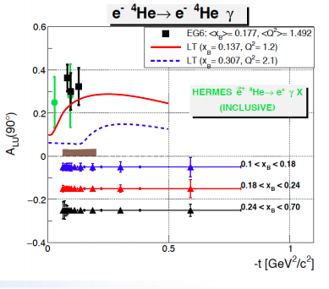
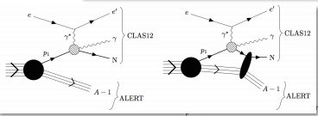
ALERT Proposal at Jefferson Lab: Nuclear Exclusive and Semi-inclusive Measurements with A New CLAS12 Low Energy Recoil Tracker
W. Armstrong et al.
S=0

Slide 25
Nucleon Gravitomagnetic Form Factors

Slide 26
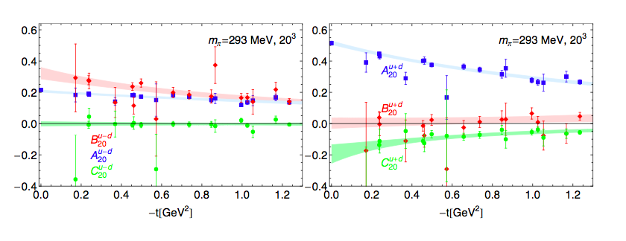
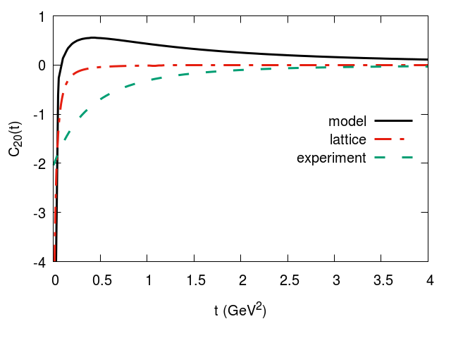
C₂₀
Ph. Haegler, JoP: 295 (2011) 012009
u-d
u+d
Jlab Hall B, Burkert Elouadrhiri, Girod, Nature (2018)
experimental range
Lattice

Slide 27
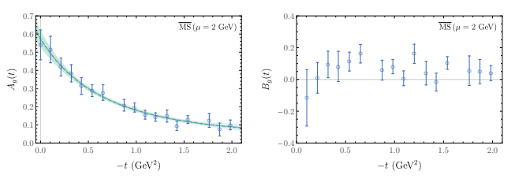
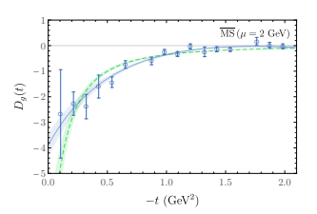
Gluons
m_{π}=450 MeV
Detmold, Shanahan, Phys.Rev. D99 (2019)

Slide 28
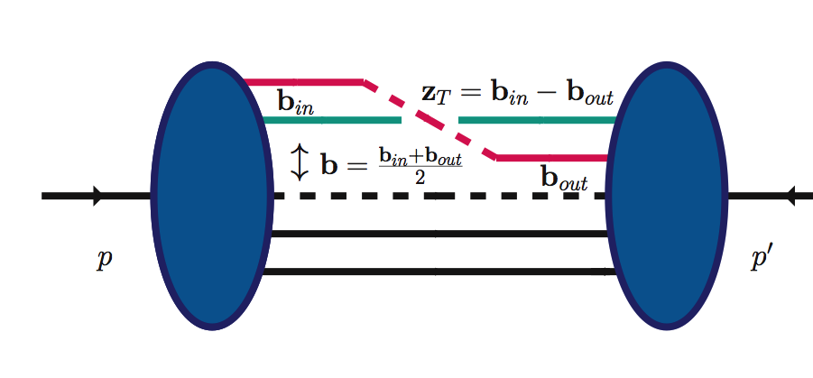
Two distinct distance scales
z⁻
zº
z⁺
Ioffe time
z³
5/16/19
Ioffe time
z⁻,z_{T}
z
partons location
p-p’=Δ

Slide 29
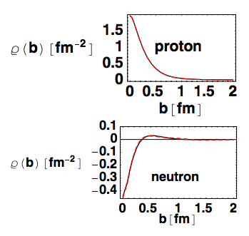
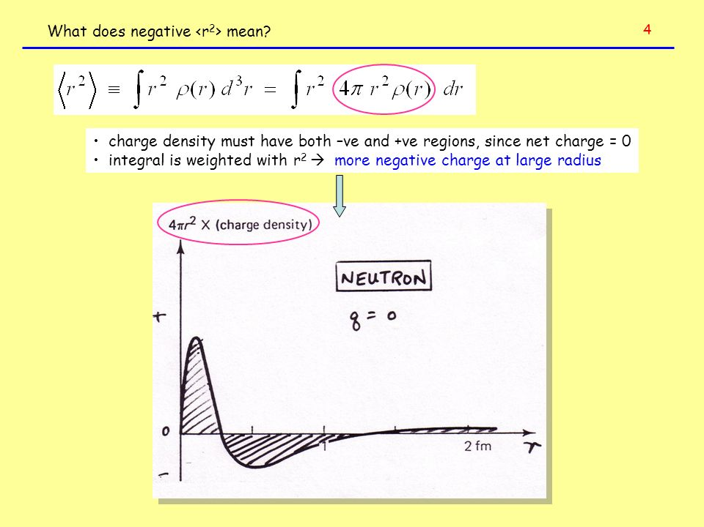
We can map out faithfully the spatial quark distributions in the transverse plane
(no modeling/approximation)
Soper (1977), Burkardt (2001)
Already a surprise: re-evaluation of nucleon charge distribution
Neutron “textbook” density
G. Miller(2007)

Slide 30
Including all polarization configurations:

Slide 31
number/mass density
1st Mellin M.
2nd Mellin M.
Energy density
Pressure
From transverse distance to z₃ using Lorentz invariance
Radyushkin and Orginos, arXiv:1706.05373

Slide 32
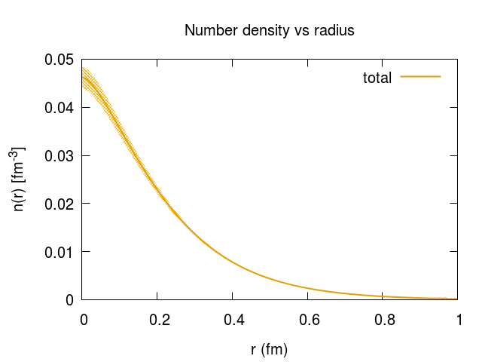
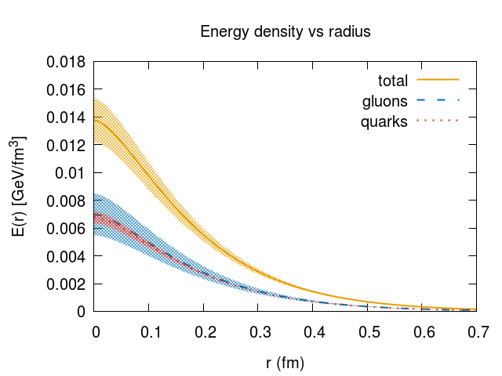
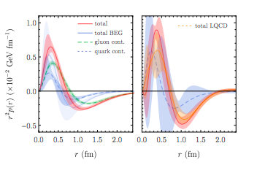
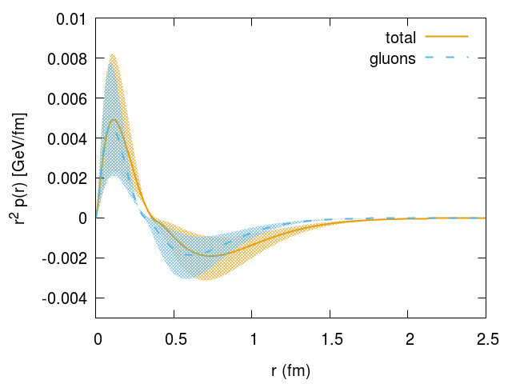
A₁₀
A₂₀
fm
fm
pressure
C₂₀
pressure
Detmold, Shahanan, Phys.Rev.Lett. 122 (2019)
SL, Rajan, Yagi, arXiv:1812.01479

Slide 33
GW170817
QCD EMT
MIT bag model: strange quark matter
SL, Rajan, Yagi, arXiv:1812.01479

Slide 34
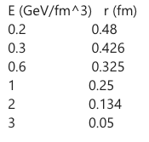
r (fm)
0.5
0.42
0.25
0.13

Slide 35
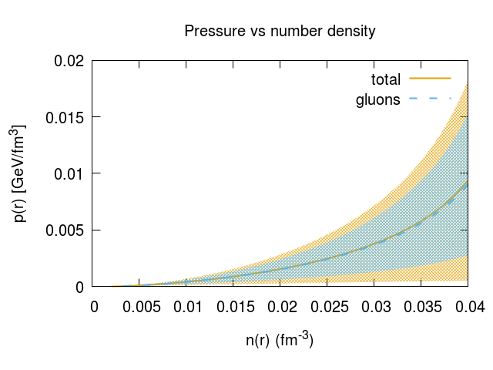
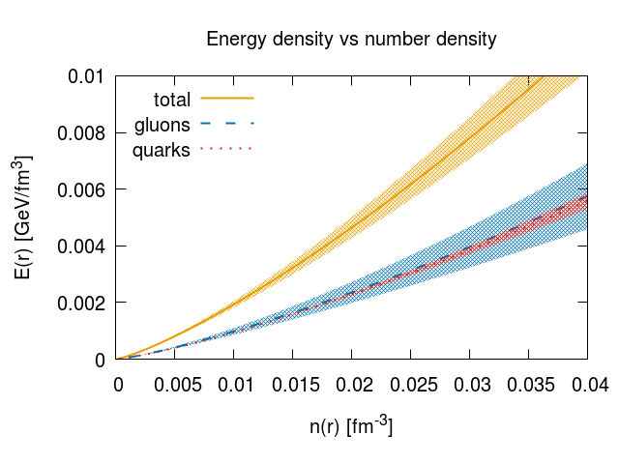

Slide 36
QCD EMT
J0348+0432 pulsar mass
strange quark matter
“stitching” at transition pressure 0.15 GeV/fm³
SL, Rajan, Yagi, arXiv:1812.01479

Slide 37
Jefferson Lab’s measurement on the pressure inside the nucleon/hadronic matter needs to be corroborated by an independent set of measurements
Neutron stars mergers/multimessenger astronomy provide an independent constraint

Slide 38
WHAT’S NEXT…
Key question: how to extract accurate information on the mechanical properties of the nucleon from data

Slide 39
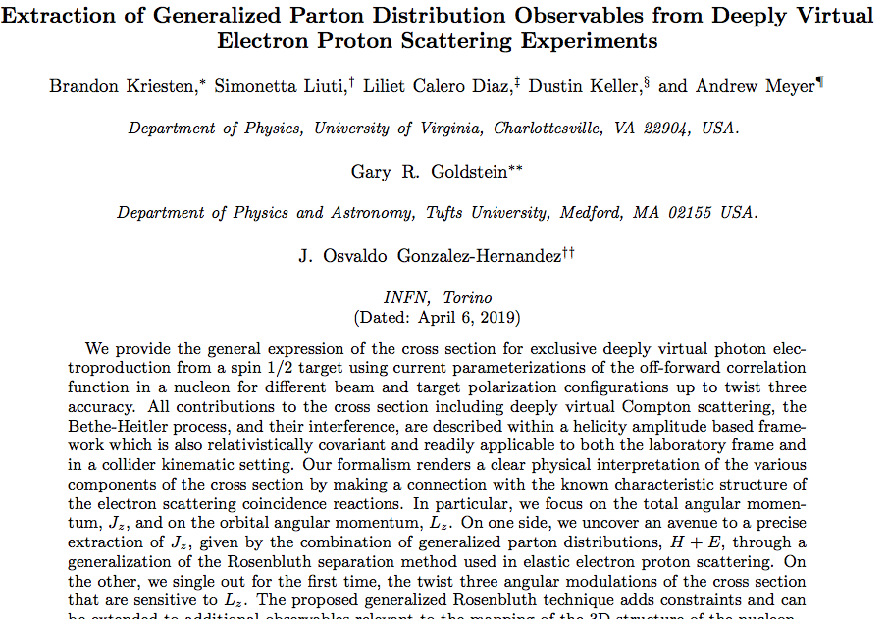
B. Kriesten’s talk
arXiv:1903.05742

Slide 40

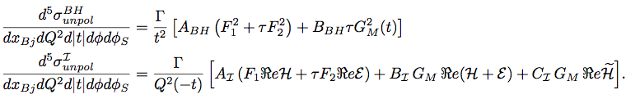
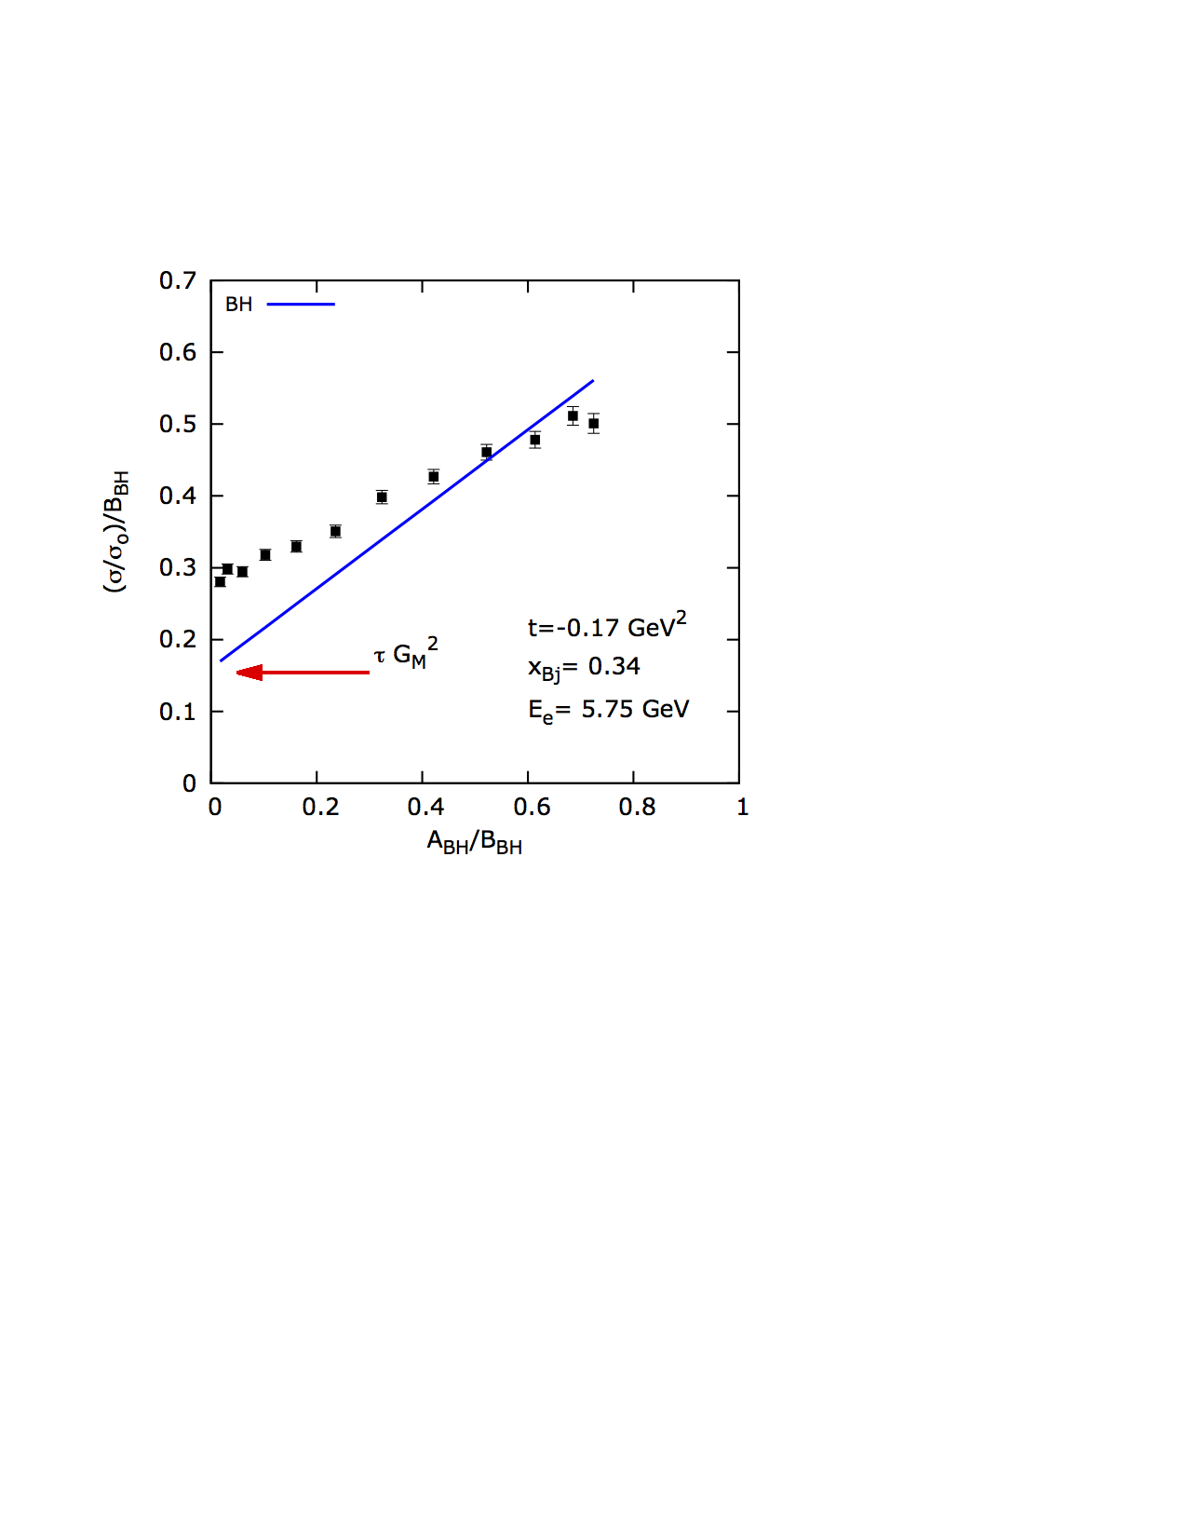
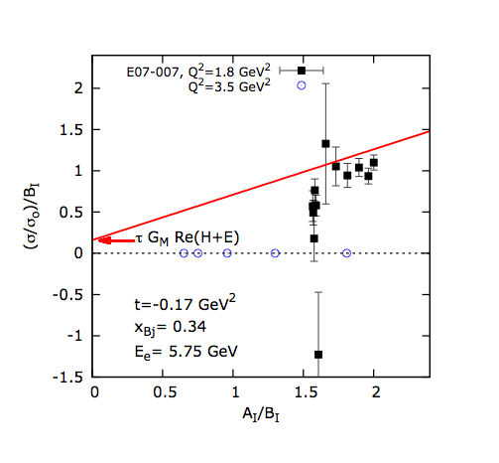
New formalism for deeply virtual exclusive processes
No harmonics, please…..this is just a coincidence experiment
(write the cross section a la Donnelly…)
2) This formalism has not been developed in previous work for GPDs
BH
DVCS

Slide 41
Conclusions and Outlook
The EoS of dense matter in QCD can be obtained from first principles, using ab initio calculations for both quark and gluon d.o.f.
Gluons are found to dominate the EoS providing a trend in the high density regime which is consistent with the constraint from LIGO.
We can connect the pressure and energy density in neutron stars with collider observables: the GPDs.
The proposed line of research opens up a new framework for understanding the properties of hybrid stars. In the future we hope to set more stringent constraints on the nature of the hadron to quark matter transition at zero temperature.
These effects are observable!
Notes:
However, in the definition of these distributions, care must be applied to ensure manifest gauge invariance. In general, this can be accomplished by connecting any non- local correlation function with a Wilson-line gauge link. Specifying a Wilson-line gauge link requires selecting a path along which the vector potential is evaluated. The choice of path raises the immediate issue of how the quantities defined using Wigner distributions (TMDs, OAM, . . .) depend on that choice.

Slide 42
…To observe, evaluate and interpret
Wigner distributions at the subatomic level
requires stepping up data analyses from the standard methods ➔ developing new numerical/analytic/quantum computing methods
Center for Nuclear Femtography at Jefferson Lab

Slide 43

After the
Summer Institute on Wigner Imaging and Femtography, SIWIF@UVA: May-August 2019
Organizers
P. Alonzi, M. Burkardt, D. Keller, S. Liuti, O. Pfister, P. Reinke

