Slide 1
Measurement of ³He Elastic Electromagnetic Form Factor Diffractive Minima Using Polarization Observables
Scott Barcus, Douglas Higinbotham, and Shujie Li
with help and support with Brad Sawatzky

Slide 2
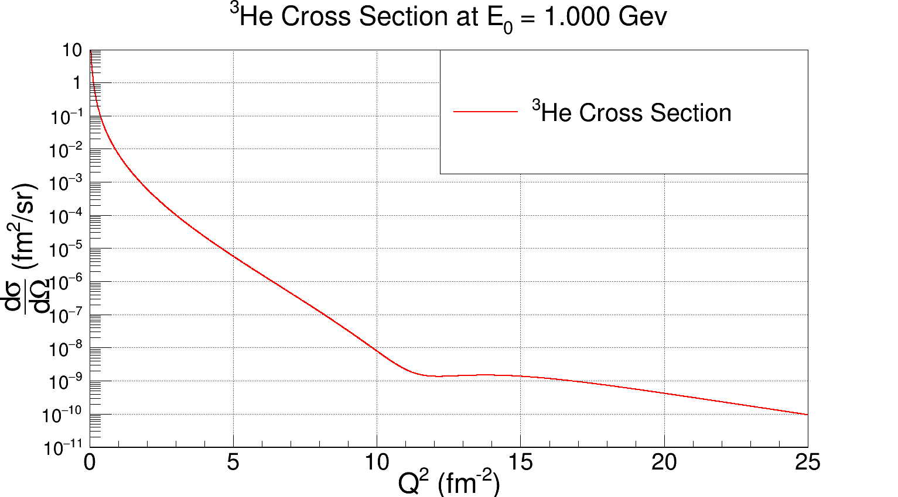
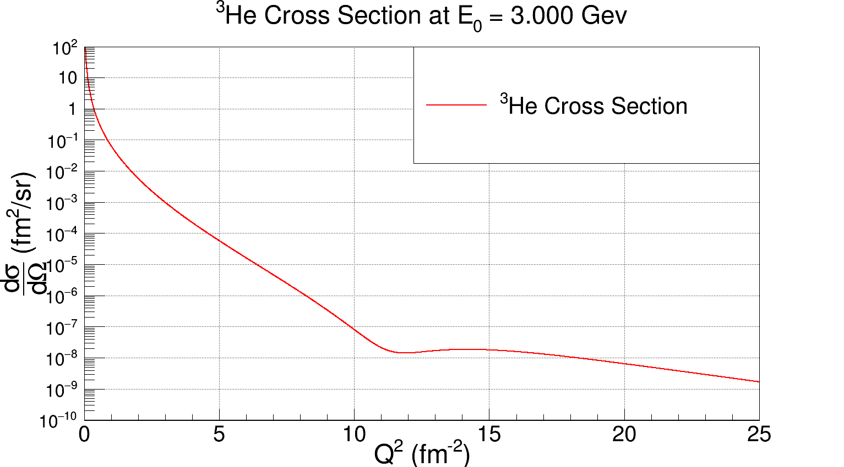

Slide 3
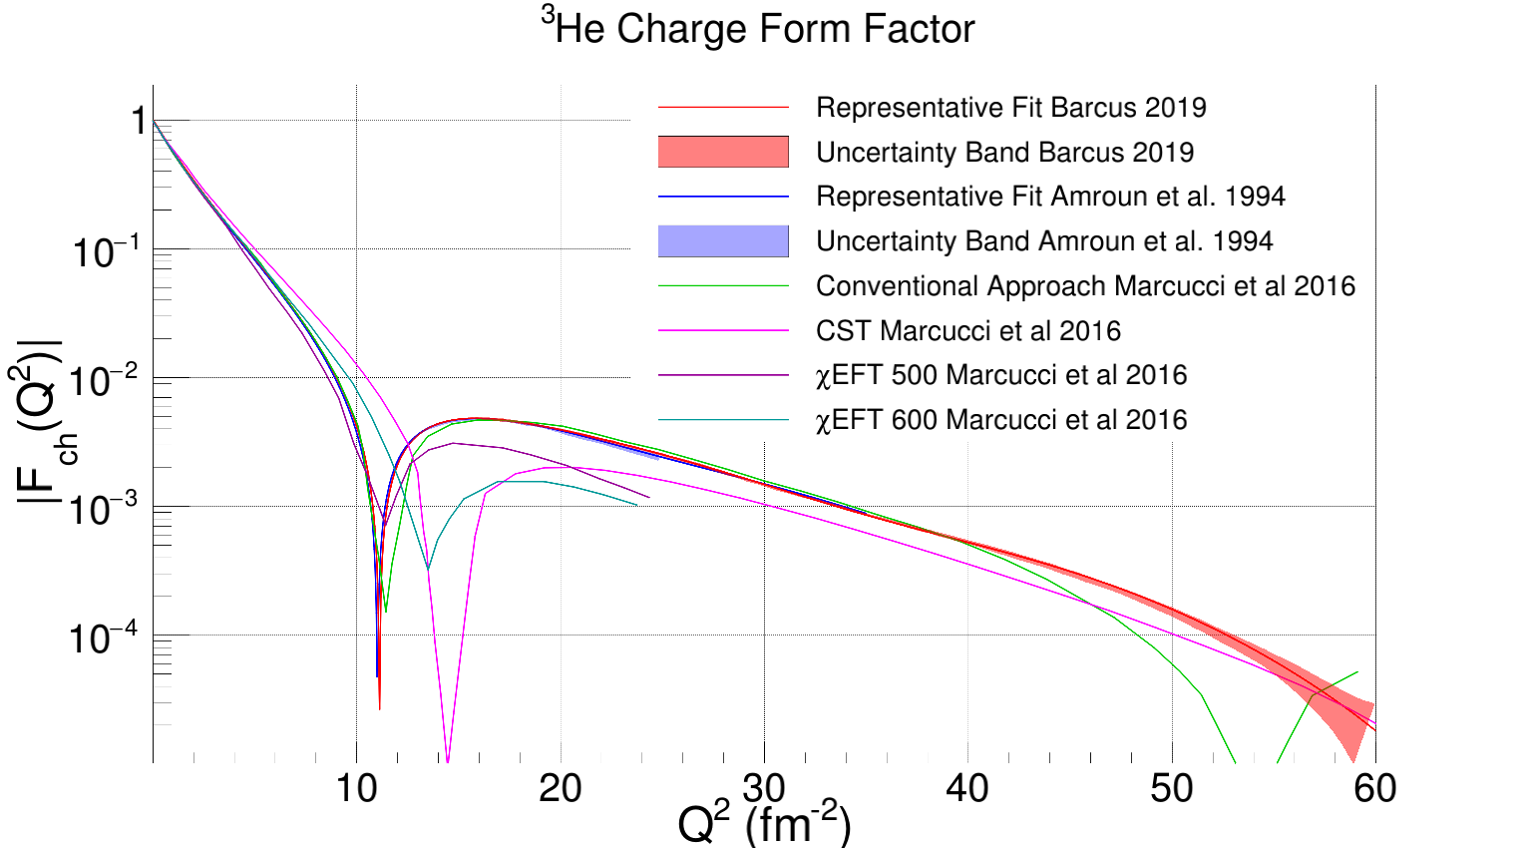

Slide 4
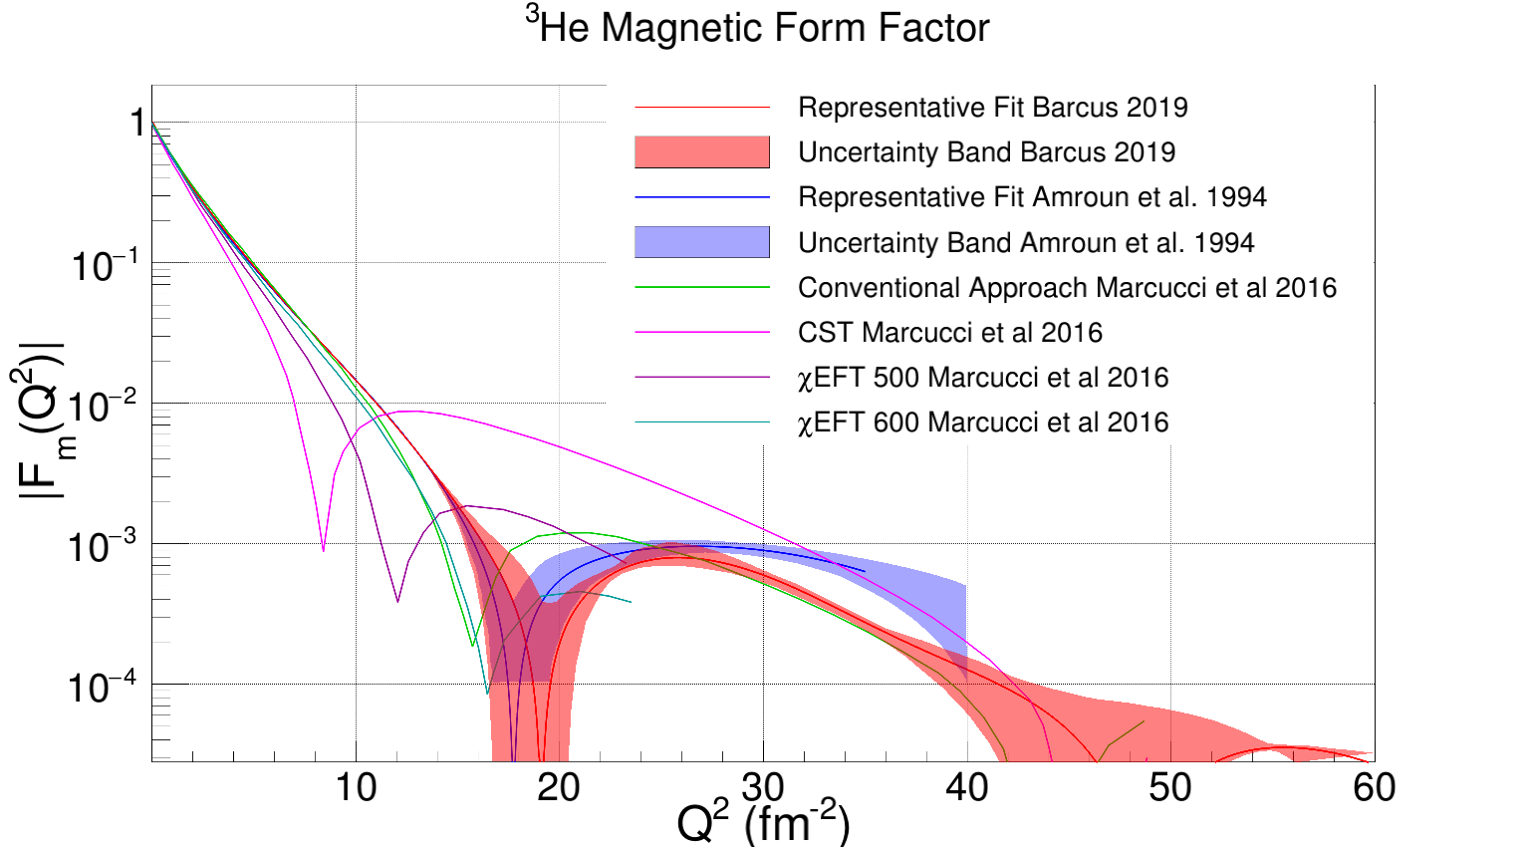

Slide 5
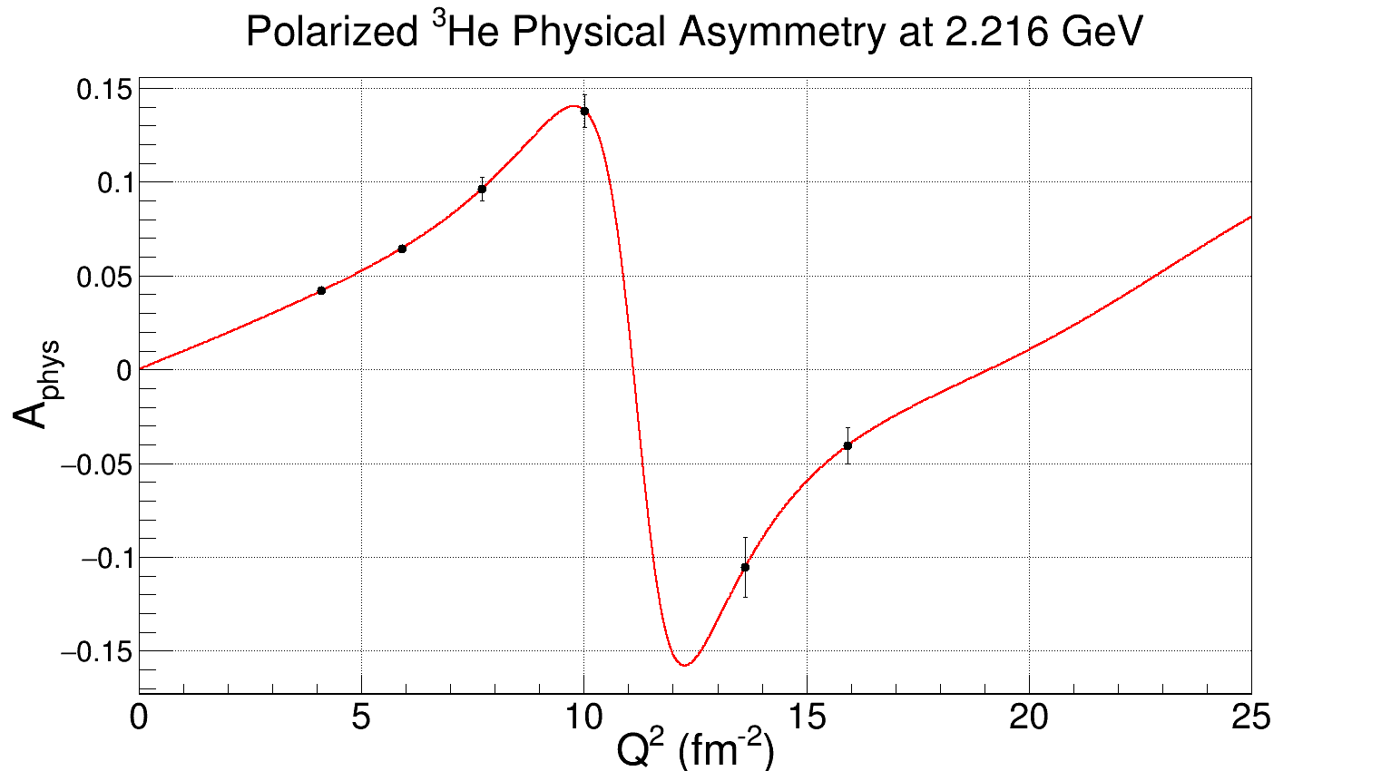

Slide 6
Summary
During the low energy running of the d2n we were already planning to use elastic scattering to determine the product of beam target polarization.
Changing angles (i.e. larger Q²) will allow us to constrain the first minimum of the charge and magnetic form factors.
We will be working with the collaboration to maximize the physics that we can get done while also getting the needed calibrations done.

