Slide 1
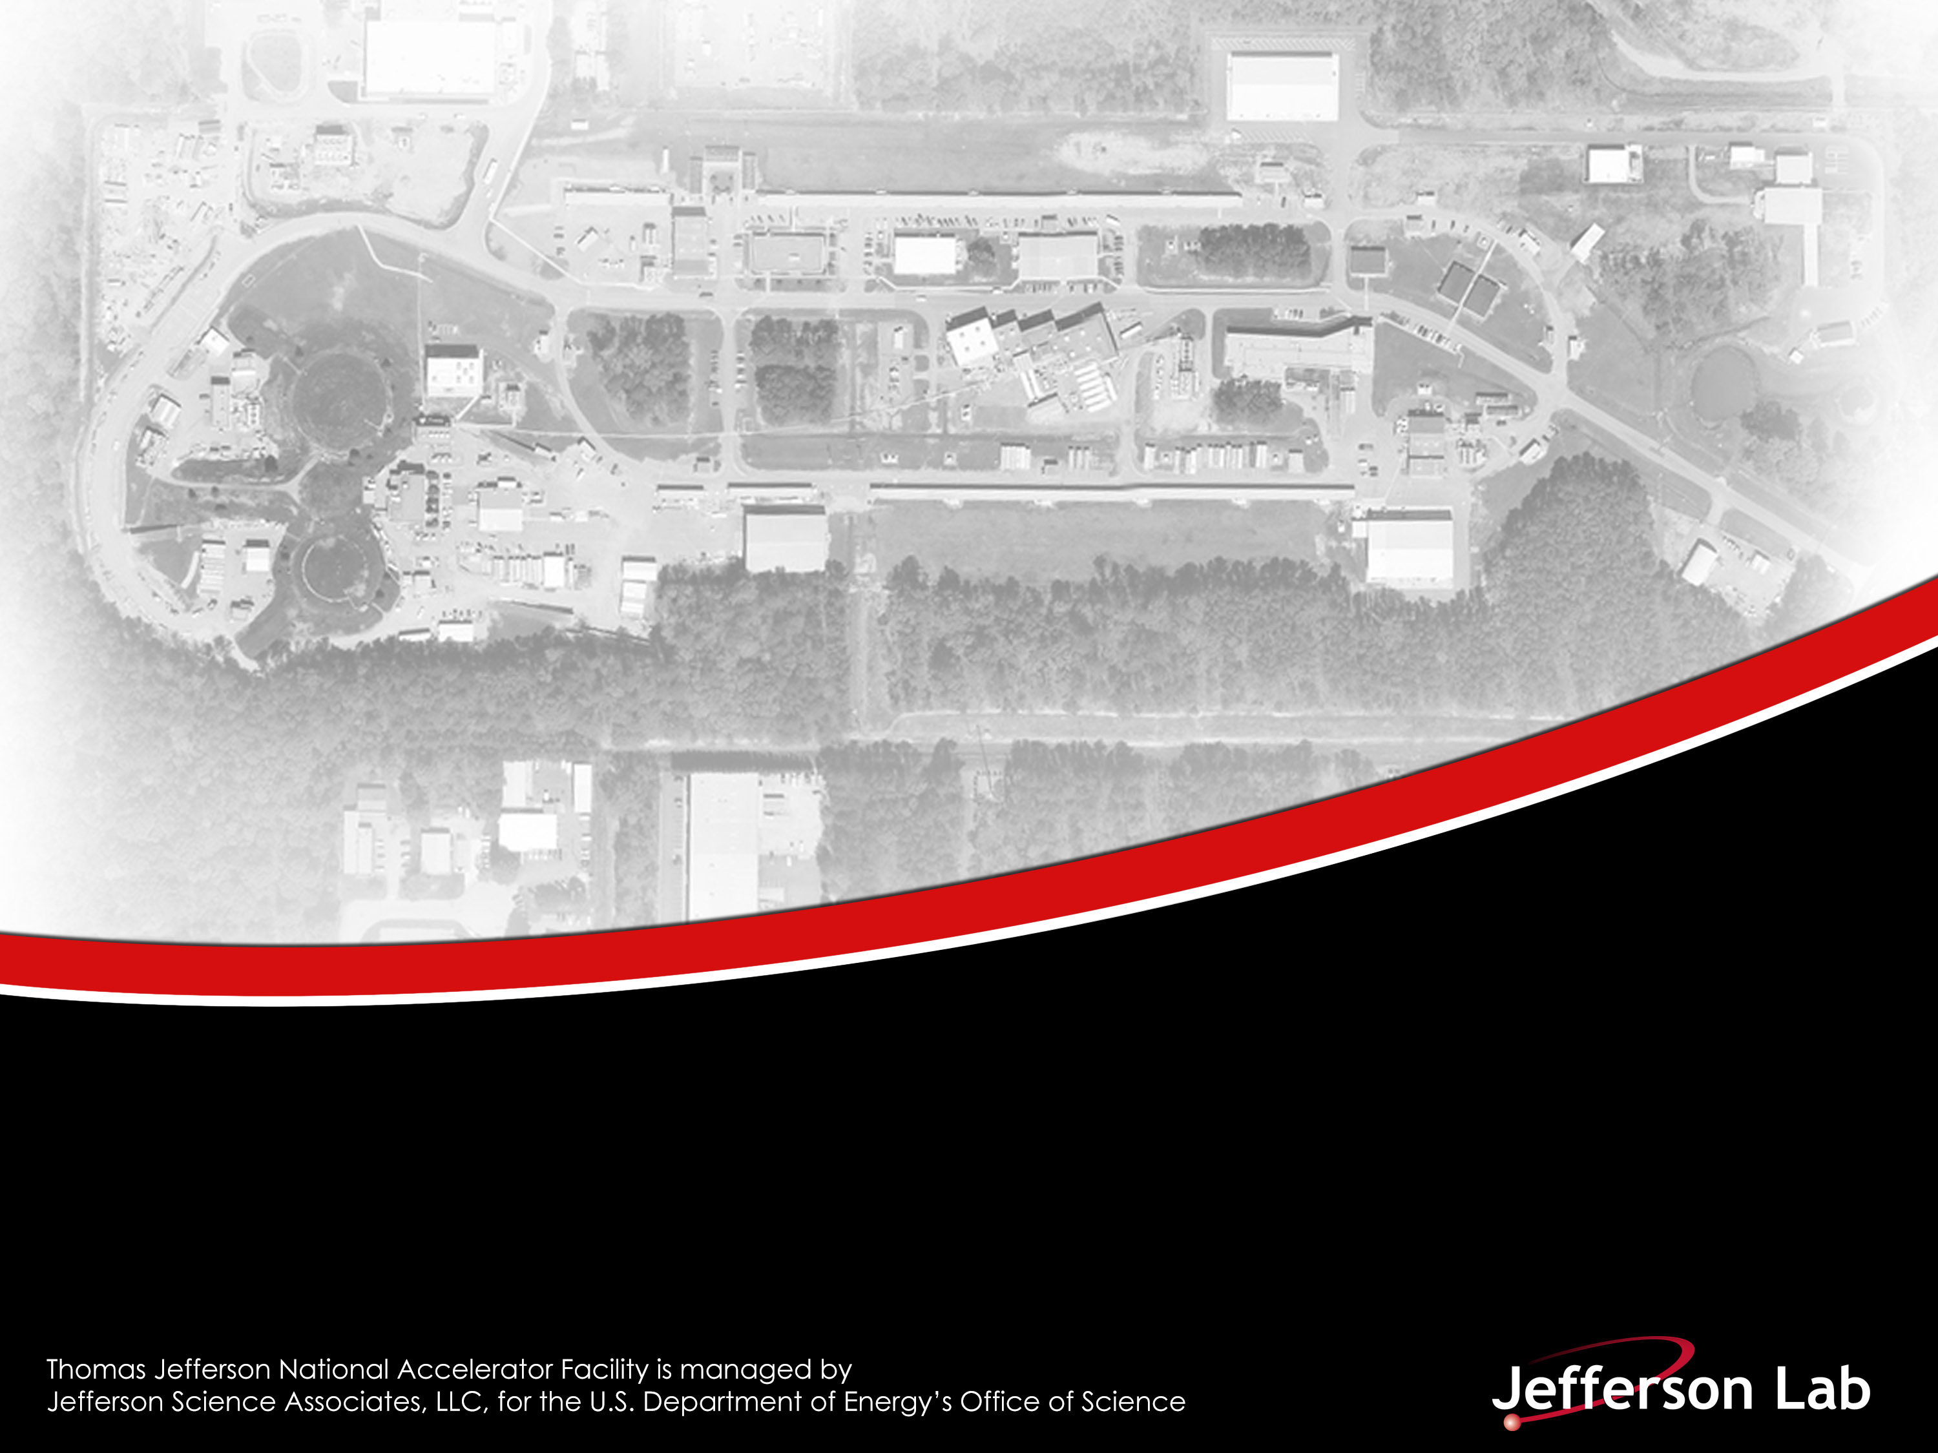





Measurement of Parity-Violation in the N→△ Transition During Q_{weak}
Joint HallA/C Meeting
Jefferson Lab
27 June 2019
Steve Wells for The $Q_{weak}$ Collaboration
Louisiana Tech University
Notes:
Title Page Design 3

Slide 2

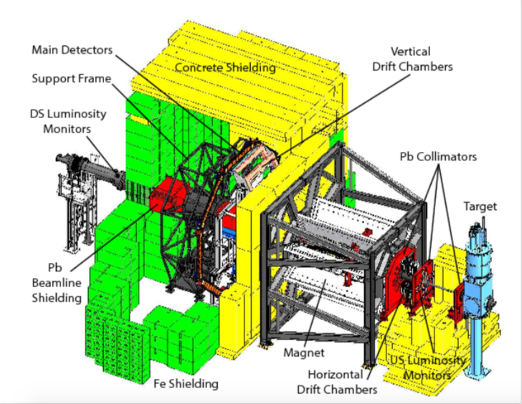

Parity Violating Asymmetries in Q_{weak}
In Q_{weak}, we scattered longitudinally polarized electrons off protons in a unpolarized liquid hydrogen target.
$\vec{\text{e}\text{−}}$ + p → e⁻ + p (Elastic- measures weak chare of the proton)
$\vec{\text{e}\text{−}}$ + p → ∆⁺ + e⁻ → N + π + e⁻ (Inelastic- new physics in the N→ ∆ channel)
Schematic of the Q_{weak} apparatus
Notes:
Interior Page Design 1

Slide 3
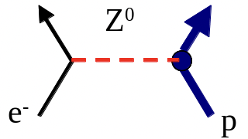
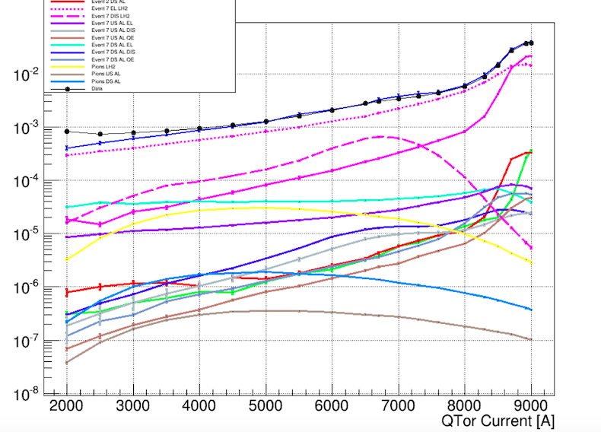
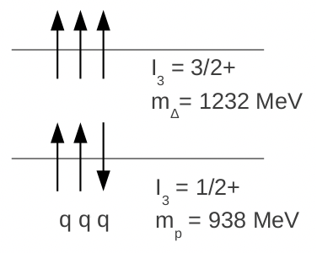




Parity Violating Inelastic measurement
Reasons for measuring the inelastic asymmetries:
To correct the primary measurement for inelastic background asymmetry
Using the N→ ∆ asymmetry to access d∆, a low energy constant in the weak Lagrangian related to hadronic parity violation
The N→∆ transition can be pictured as the Z boson
(neutral current) flipping a single quark spin in a constituent
quark model
e⁻
∆⁺
Total Simulation
$←$Total yield and data
$←$Elastic radiative tail
$←$N→ ∆
Also included:
Al elastic and inelastic,
Pions.
Elastic tail contributes ~ 75% of yield
at Delta peak
$∆$ peak at QTOR= 6700 A
Notes:
Interior Page Design 1

Slide 4

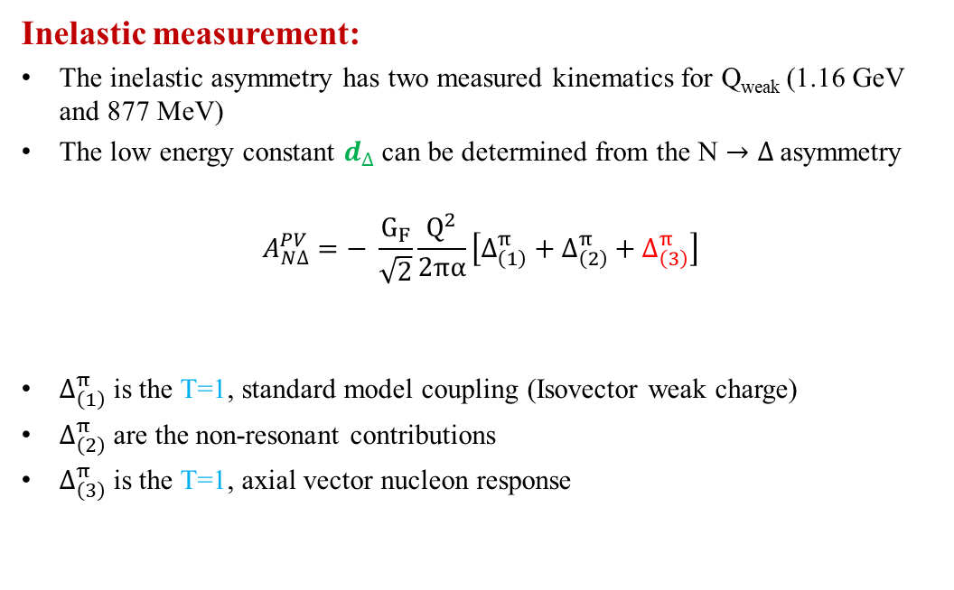
𝒅_{Δ} Extraction
Inelastic measurement:
The inelastic asymmetry has two measured kinematics for Q_{weak} (1.16 GeV and 877 MeV)
The low energy constant $d_{∆}$can be determined from the N $→Δ$asymmetry
$$A_{N∆}^{PV}=− \frac{G_{F}}{\sqrt{2}}\frac{Q^{2}}{2πα}\left[∆_{\left(1\right)}^{π}+∆_{\left(2\right)}^{π}+∆_{\left(3\right)}^{π}\right]$$
$∆_{\left(1\right)}^{π}$ is the T=1, standard model coupling (Isovector weak charge)
$∆_{\left(2\right)}^{π}$ are the non-resonant contributions
$∆_{\left(3\right)}^{π}$ is the T=1, axial vector nucleon response
Contains $d∆$
Notes:
Interior Page Design 1

Slide 5
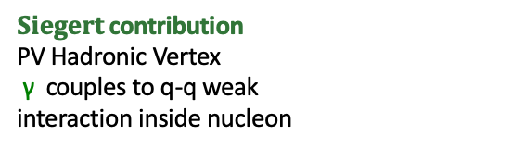


Radiative Corrections
$$∆_{\left(3\right)}^{π} ∝\left(1+ R_{A}^{∆}\right) G_{N∆}^{A}$$
$$R_{A}^{∆}=R_{A}^{ewk}+R_{A}^{Siegert}+R_{A}^{Anapole}+R_{A}^{Box}+…$$
Siegert Contribution
$$A_{N∆}^{PV}=− \frac{G_{F}}{α}Q^{2}\left[a \frac{ω}{Q^{2}}+Anapole\right]$$
PV γNΔ E1 amplitude (Siegert’s Theorem) → d_{Δ} (~ g_{π})
If $d_{∆}$is significantly different from zero,
$${ A}_{N∆}^{PV} (Q^{2}=0)≠0!$$
← PV Hadronic Vertex
γ couples to q-q weak
interaction inside nucleon
g_{π} = 3$×$10⁻⁸ is the natural scale for $d_{∆}$
Same M.E. driving Weak Hyperon Decay (e.g. Σ⁺→pγ)
$Siegert$ contribution
PV Hadronic Vertex
γ couples to q-q weak
interaction inside nucleon
Notes:
Interior Page Design 1

Slide 6
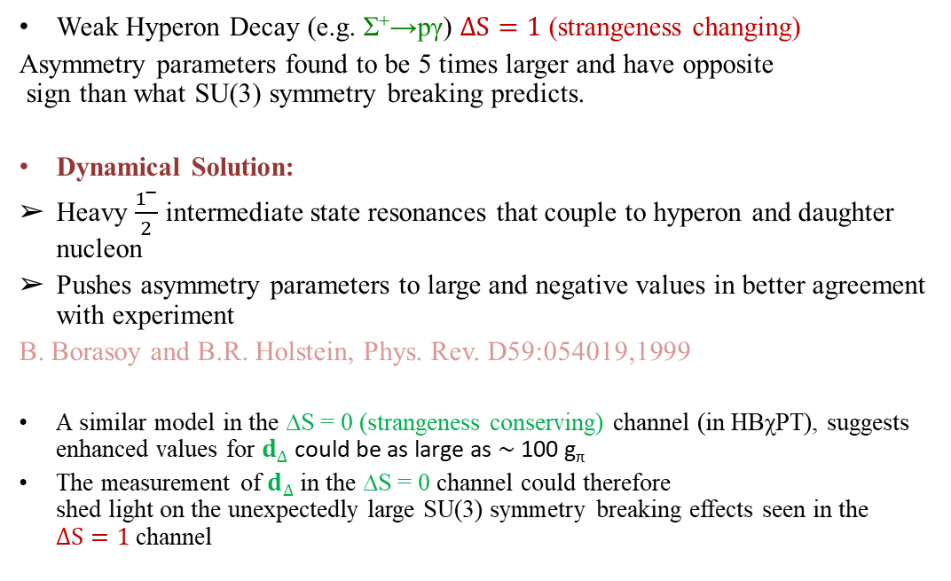
More on 𝒅_{Δ}
Weak Hyperon Decay (e.g. Σ⁺→pγ) $∆S=1$ (strangeness changing)
Asymmetry parameters found to be 5 times larger and have opposite
sign than what SU(3) symmetry breaking predicts.
Dynamical Solution:
Heavy $\frac{1^{−}}{2}$ intermediate state resonances that couple to hyperon and daughter nucleon
Pushes asymmetry parameters to large and negative values in better agreement with experiment
B. Borasoy and B.R. Holstein, Phys. Rev. D59:054019,1999
A similar model in the ∆S = 0 (strangeness conserving) channel (in HBχPT), suggests enhanced values for $d_{∆}$could be as large as ∼ 100 g_{π}
The measurement of $d_{∆}$in the ∆S = 0 channel could therefore
shed light on the unexpectedly large SU(3) symmetry breaking effects seen in the
$∆S=1$ channel
Notes:
Interior Page Design 1

Slide 7
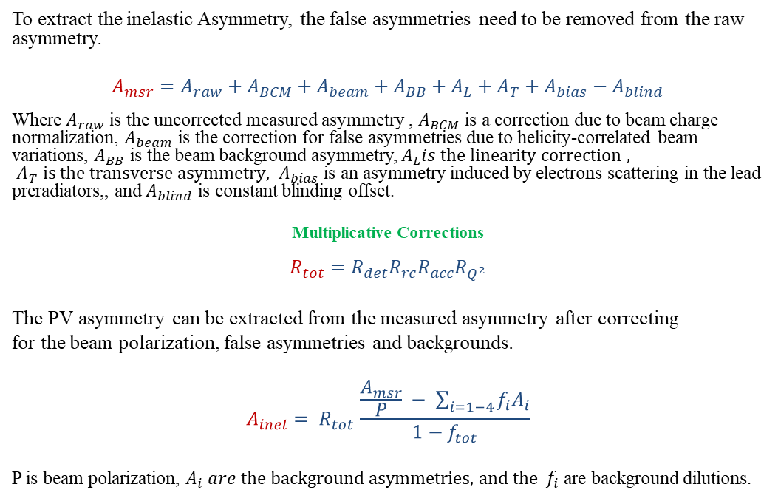
Asymmetry Extraction Formula
To extract the inelastic Asymmetry, the false asymmetries need to be removed from the raw asymmetry.
$$A_{msr}=A_{raw}+A_{BCM}+A_{beam}+A_{BB}+A_{L}+A_{T}+A_{bias}−A_{blind}$$
Where $A_{raw}$ is the uncorrected measured asymmetry , $A_{BCM}$ is a correction due to beam charge normalization, $A_{beam}$ is the correction for false asymmetries due to helicity-correlated beam variations, $A_{BB}$ is the beam background asymmetry, $A_{L}is the linearity correction ,$ ${ A}_{T} is the transverse asymmetry, A_{bias}$is an asymmetry induced by electrons scattering in the lead preradiators,, and $A_{blind}$ is constant blinding offset.
Multiplicative Corrections
$$R_{tot}=R_{det}R_{rc}R_{acc}R_{Q^{2}}$$
The PV asymmetry can be extracted from the measured asymmetry after correcting
for the beam polarization, false asymmetries and backgrounds.
$$A_{inel}= R_{tot }\frac{\frac{A_{msr}}{P} − \sum_{i=1−4}{f_{i}A_{i}}}{1−f_{tot}}$$
P is beam polarization, $A_{i} are the background asymmetries,$ ${and the f}_{i}$ are background dilutions.
Notes:
Interior Page Design 1

Slide 8



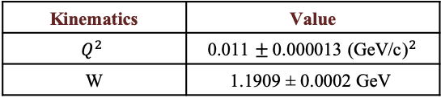
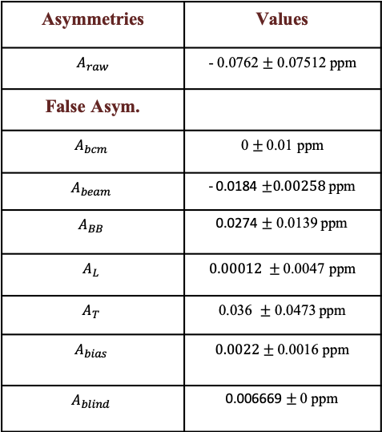
Asymmetries Tables (877 MeV)
Asymmetries | Values
$A_{raw}$ | - 0.0762 $±$ 0.07512 ppm
False Asym.
$$A_{bcm}$$ | 0 $±$0.01 ppm
$$A_{beam}$$ | - 0.0184 $±0.00258$ ppm
$$A_{BB}$$ | 0.0274 $±$ 0.0139 ppm
$$A_{L}$$ | $0.00012 ±$ 0.0047 ppm
$$A_{T}$$ | 0.036 $±$ 0.0473 ppm
$$A_{bias}$$ | $0.0022±$ 0.0016 ppm
$$A_{blind}$$ | 0.006669 $±$ 0 ppm
Kinematics | Value
$$Q^{2}$$ | 0.011 $±$ 0.000013 (${\text{GeV}\text{/}\text{c}\text{)}}^{2}$
W | 1.1909 ± 0.0002 GeV
$f_{ep}$ is a large dilution
Much effort put into simulations vs. Qtor to reduce the uncertainty on f_{ep}
Dilution Factors | Value
$$f_{ep}$$ | 0.790 $±$ 0.0395ppm
 | Value
Polarization | 0.7975 $±$ 0.0159
Notes:
Interior Page Design 1

Slide 9
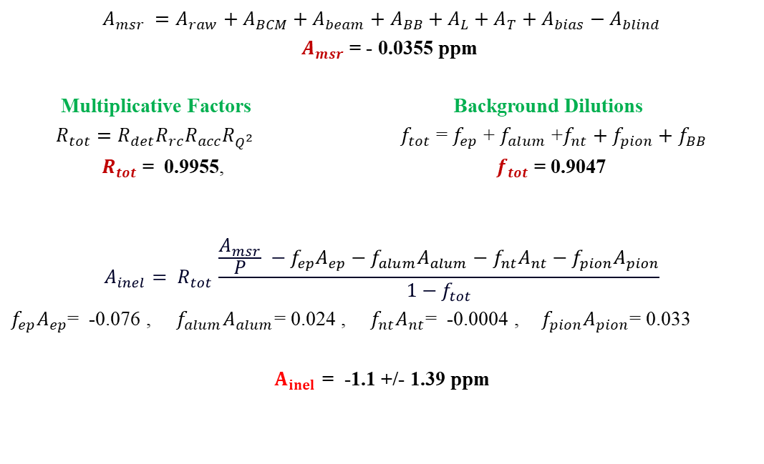
Asymmetry Extraction Formula (877 MeV)
$$A_{msr} =A_{raw}+A_{BCM}+A_{beam}+A_{BB}+A_{L}+A_{T}+A_{bias}−A_{blind}$$
$A_{msr}$ = - 0.0355 ppm
Multiplicative Factors Background Dilutions
$R_{tot}=R_{det}R_{rc}R_{acc}R_{Q^{2}}$ $f_{tot}$ = $f_{ep}$ + $f_{alum}$ +$f_{nt}+$ $f_{pion}+$ $f_{BB}$
$R_{tot}$ = 0.9955, $f_{tot}$ = 0.9047
$$A_{inel}= R_{tot }\frac{\frac{A_{msr}}{P} −f_{ep}A_{ep}−f_{alum}A_{alum}−f_{nt}A_{nt}−f_{pion}A_{pion}}{1−f_{tot}}$$
$f_{ep}A_{ep}$= -0.076 , $f_{alum}A_{alum}$= 0.024 , ${ f}_{nt}A_{nt}$= -0.0004 ,${ f}_{pion}A_{pion}$= 0.033
$A_{inel}$ = -1.1 +/- 1.39 ppm
Notes:
Interior Page Design 1

Slide 10



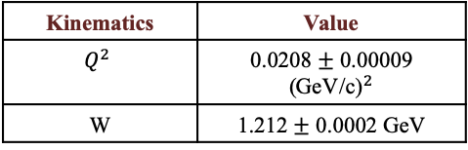
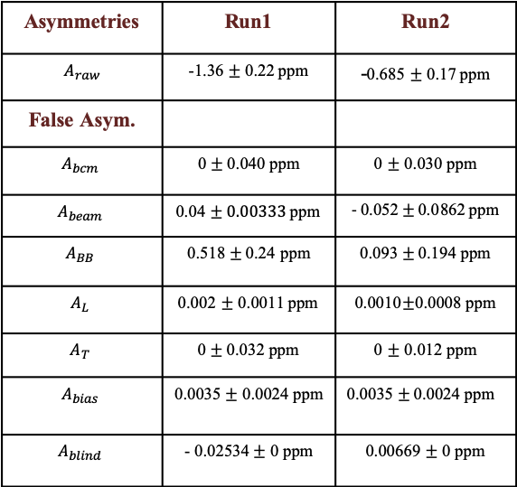
Asymmetries Tables (1.16 GeV)
Asymmetries | Run1 | Run2
$A_{raw}$ | -1.36 $±$ 0.22 ppm | -0.685 $±$ 0.17 ppm
False Asym.
$$A_{bcm}$$ | 0 $±$0.040 ppm | 0 $±$ 0.030 ppm
$$A_{beam}$$ | $\text{0.04}±0.00333$ ppm | - $\text{0.05}\text{2}±\text{0.0}\text{862}$ ppm
$$A_{BB}$$ | 0.518 $±$ 0.24 ppm | 0.093 $±$ 0.194 ppm
$$A_{L}$$ | 0.002 $±$ 0.0011 ppm | 0.0010$±$0.0008 ppm
$$A_{T}$$ | 0 $±$ 0.032 ppm | 0 $±$ 0.012 ppm
$$A_{bias}$$ | 0.0035 $±$ 0.0024 ppm | $$\text{0.0035}±\text{0.0024 }\text{ppm}$$
$$A_{blind}$$ | - 0.02534$±$ 0 ppm | 0.00669$±$ 0 ppm
Kinematics | Value
$$Q^{2}$$ | 0.0208 $±$ 0.00009 (${\text{GeV}\text{/}\text{c}\text{)}}^{2}$
W | 1.212 $±$ 0.0002 GeV
$←$A_{BB} is the largest false asymmetry
for Run1
$f_{ep}$ is a large dilution
Much effort put into simulations vs. Qtor to reduce the uncertainty on f_{ep}
Dilution Factors | Value
$$f_{ep}$$ | 0.7242$±$ 0.03621 ppm
 | Run1 | Run2
Polarization | 0.8585 $±$0.010 | 0.8860 $±$ 0.0055
Notes:
Interior Page Design 1

Slide 11
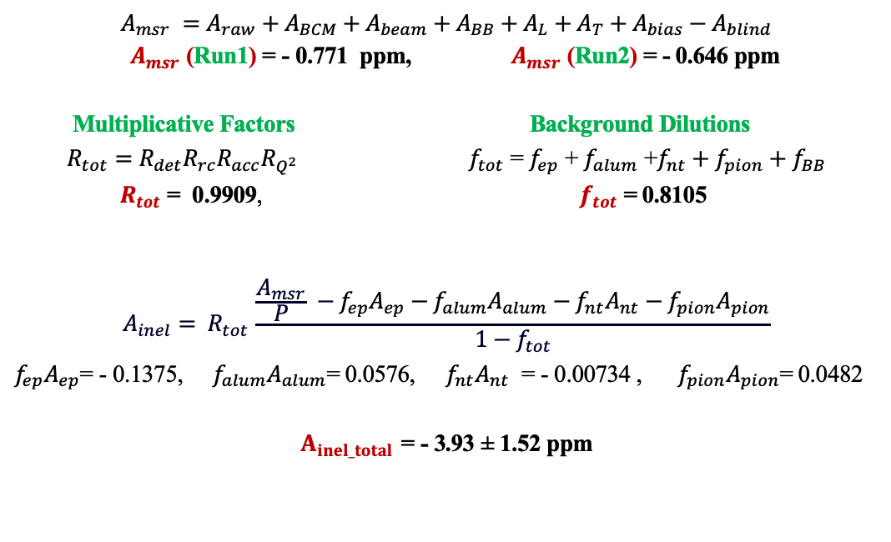
Asymmetry Extraction Formula (1.16 GeV)
$$A_{msr} =A_{raw}+A_{BCM}+A_{beam}+A_{BB}+A_{L}+A_{T}+A_{bias}−A_{blind}$$
$A_{msr}$ (Run1) = - 0.771 ppm, $A_{msr}$ (Run2) = - 0.646 ppm
Multiplicative Factors Background Dilutions
$R_{tot}=R_{det}R_{rc}R_{acc}R_{Q^{2}}$ $f_{tot}$ = $f_{ep}$ + $f_{alum}$ +$f_{nt}+$ $f_{pion}+$ $f_{BB}$
$R_{tot}$ = 0.9909, $f_{tot}$ = 0.8105
$$A_{inel}= R_{tot }\frac{\frac{A_{msr}}{P} −f_{ep}A_{ep}−f_{alum}A_{alum}−f_{nt}A_{nt}−f_{pion}A_{pion}}{1−f_{tot}}$$
$f_{ep}A_{ep}$= - 0.1375, $f_{alum}A_{alum}$= 0.0576, $f_{nt}A_{nt}$ = - 0.00734 , $f_{pion}A_{pion}$= 0.0482
$A_{inel_total}$ = - 3.93 ± 1.52 ppm
Notes:
Interior Page Design 1

Slide 12
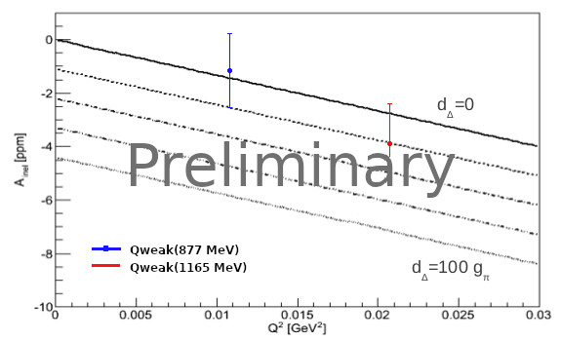
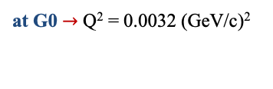
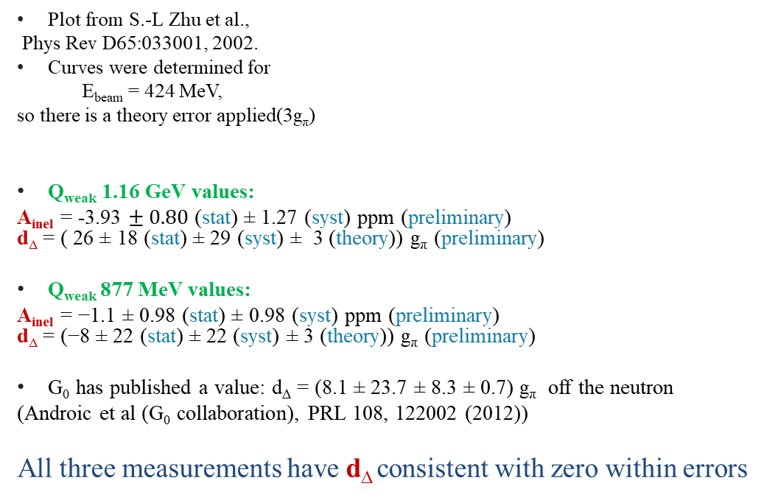
A_{inel} Plotted vs Q²
Plot from S.-L Zhu et al.,
Phys Rev D65:033001, 2002.
Curves were determined for
E_{beam} = 424 MeV,
so there is a theory error applied(3g_{π})
Q_{weak} 1.16 GeV values:
A_{inel} = -3.93 $± 0.80$ (stat) ± 1.27 (syst) ppm (preliminary)
d∆ = ( 26 ± 18 (stat) ± 29 (syst) ± 3 (theory)) g_{π} (preliminary)
Q_{weak} 877 MeV values:
A_{inel} = −1.1 ± 0.98 (stat) ± 0.98 (syst) ppm (preliminary)
d∆ = (−8 ± 22 (stat) ± 22 (syst) ± 3 (theory)) g_{π} (preliminary)
G₀ has published a value: d∆ = (8.1 ± 23.7 ± 8.3 ± 0.7) g_{π} off the neutron
(Androic et al (G₀ collaboration), PRL 108, 122002 (2012))
All three measurements have d∆ consistent with zero within errors
at G0 $→$ Q² = 0.0032 (GeV/c)²
Notes:
Interior Page Design 1

Slide 13

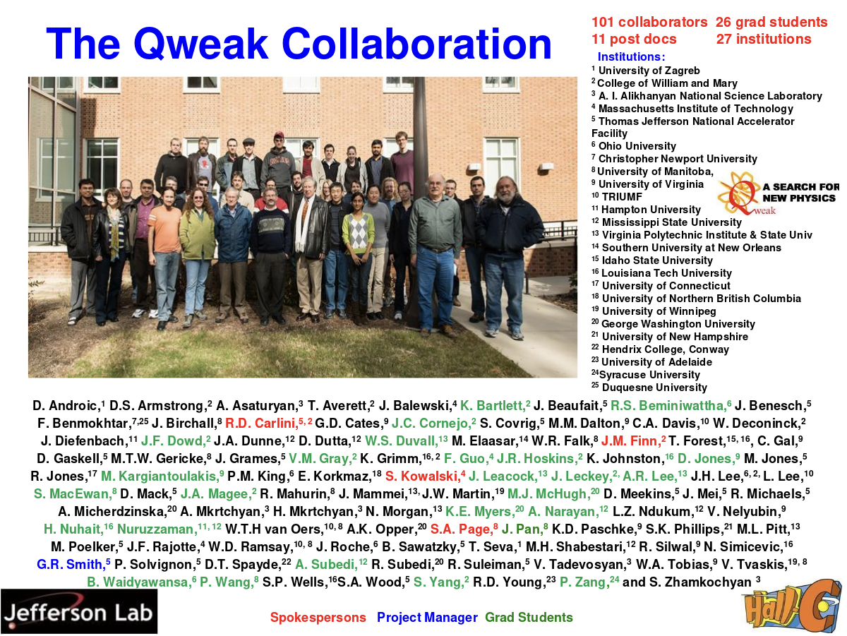
T.AlShayeb ,¹⁶
Notes:
Interior Page Design 2

Slide 14
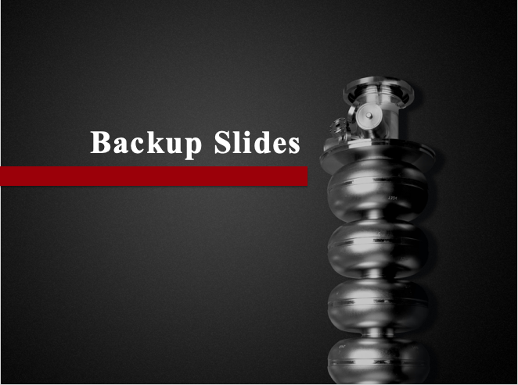
Notes:
Interior Page Design 2

Slide 15
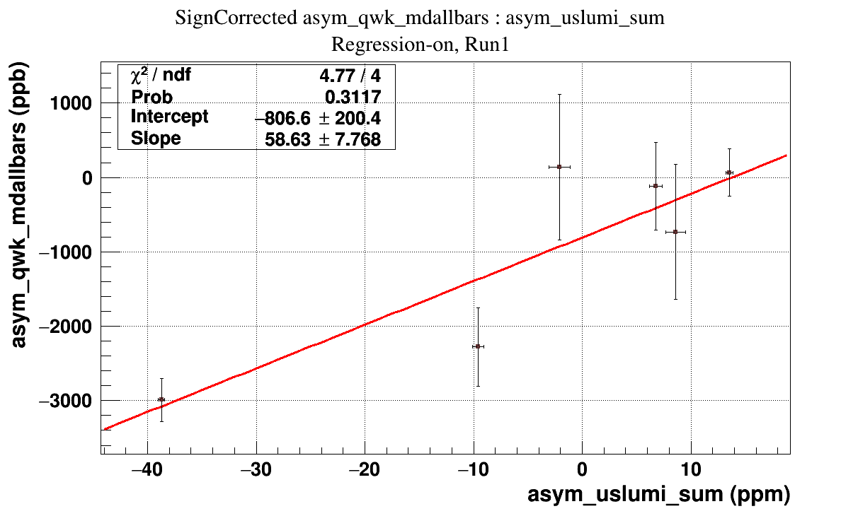
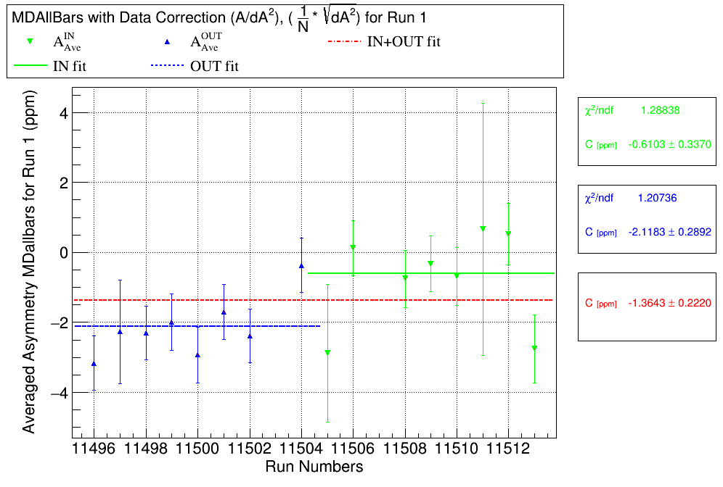

A_{BB} Extraction (1.16 GeV) Run 1
The beamline background asymmetry correction
A_{BB} = 0.518 $±$ 0.24 ppm
Right graph: The sign corrected A_{raw}.
Left graph: Shows the correlation of A_{raw} (ppb) vs. A_{LUMI} (ppm) asymmetries
The slope is 59 $±$ 8 ppb/ppm
Notes:
Interior Page Design 1

Slide 16
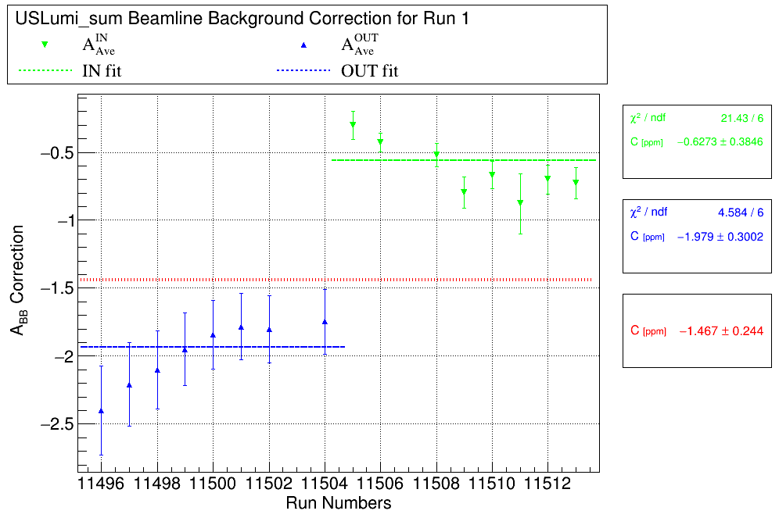
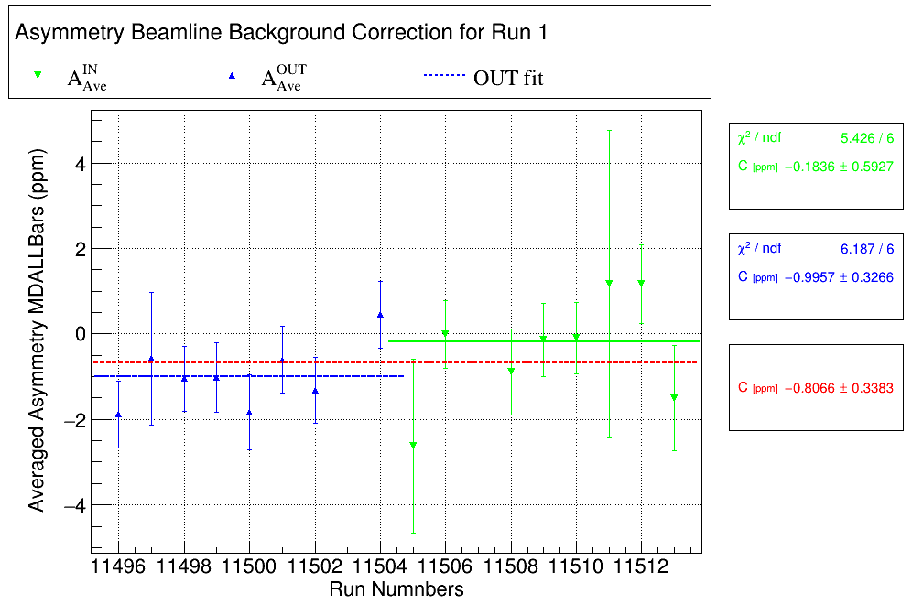
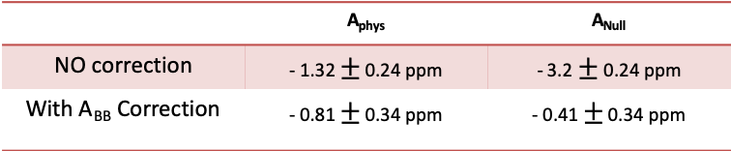

A_{BB} Extraction (1.16 GeV) Run 1
Right graph: A_{raw} with A_{BB} Correction
Left graph: A_{BB} correction (A_{Lumi}$×$ slope of A_{raw} vs A_{Lumi})
about ~13 sigma from 0
about ~ 0.5 sigma from 0
 | A_{phys} | A_{Null}
NO correction | - 1.32 $±$ 0.24 ppm | - 3.2 $±$ 0.24 ppm
With A_{BB} Correction | - 0.81 $±$ 0.34 ppm | - 0.41 $±$ 0.34 ppm
Notes:
Interior Page Design 1

